Slide 1
Engineering Enhanced Vaccine Cell Lines for the
Eradication of Vaccine Preventable Diseases
Ralph A. Tripp
University of Georgia
ratripp@uga.edu
Virology 2014- San Antonio

Slide 2
Outline
RNA interference (RNAi) studies to identify host cellular genes essential for influenza virus replication
Validating gene targets
Gene editing to generate enhanced vaccine cell lines
Confirming stable vaccine cell lines

Slide 3



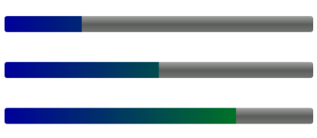
Vaccines providing population-based immunity
Why the need for improved production
Expanding world economies; facilitating vaccine coverage; lower cost of goods
What is the technical solution
Extraordinary yield increases through enhanced vaccine cell line engineering
Partnership
Complimentary skill sets to produce and commercialize innovative technology
Where are we today
Stable gene edited vaccine cell line for poliovirus; expansion to other vaccine platforms & preventable diseases, e.g. EV71

Slide 4
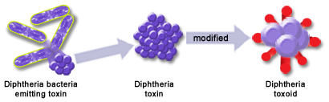
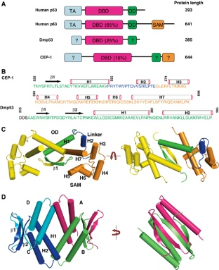

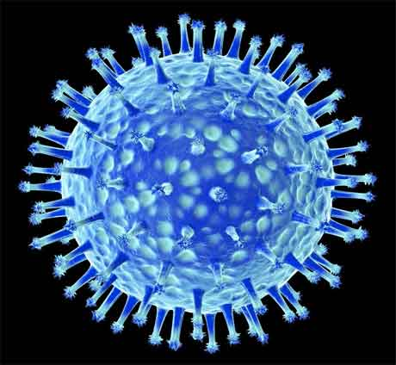
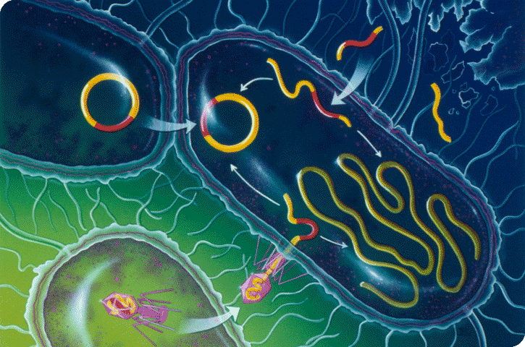
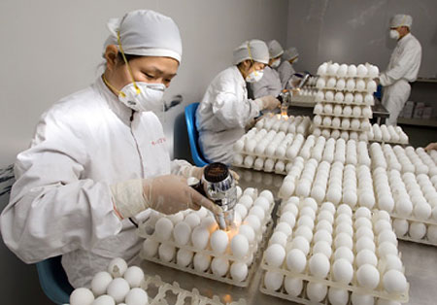
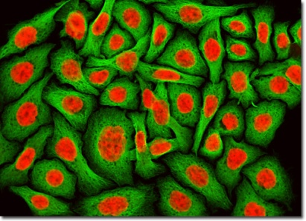

Vaccines: Manufacturing Platforms
Types of Vaccines
Subunit and Toxoid
Inactivated
Attenuated
DNA Vaccine
Production Platforms
Bacterial/Yeast
Fertilized Egg
Mammalian
Mammalian Cell Line Platforms
MRC-5 (Human)
Vero (AGM)
WI-38 (Human)
MDCK (Canine)
Hep-2 (Human)
CHO (Hamster)
HeLa (Human)
Specialized
Use
Diminishing Opportunities
Dominant
Platform
Primarily for subunits and toxins
Influenza vaccines
Inactivated and attenuated vaccines
Inactivated
Live Attenuated
Hepatitis B
HPV
Tetanus
Diphtheria
Yellow fever
Measles
Rubella
OPV /IPV
The majority of the opportunity can be addressed through improvement of a small number of vaccine cell lines

Slide 5
Trends and Vaccine Challenges
Manufacturer desire to improve profitability
Expensive to create & manufacture
Desire to control
process and cost
In-Country Manufacturing Investment
New Market Entrants
Increased need for
validated cell lines
Strong Price Ceilings
Increased Global Demand
Limits set by governments & non-profits
Higher demand for vaccines
Narrow Production Windows
Engineered Vaccine Manufacturing
Cell Lines
Difficulty growing viruses
Short time frame to production
Lack of permissive cells to prepare vaccines
Engineered vaccine manufacturing cell lines are capable of addressing the challenges facing industry

Slide 6



Cell Line Engineering Program
Creation of engineered cell lines/substrates to accelerate vaccine manufacturing

Slide 7
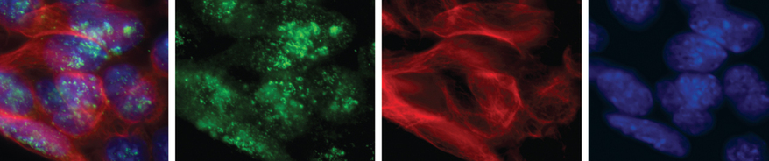
Challenges & Solutions
There are substantial costs and vaccine manufacturing challenges
Recent advances in gene modulation provide a solution for creating a new generation of engineered cell lines with enhanced vaccine manufacturing capabilities.
Increase production of vaccines by silencing non-essential virus resistance genes in a vaccine cell line, thereby reducing costs and increasing vaccine availability

Slide 8
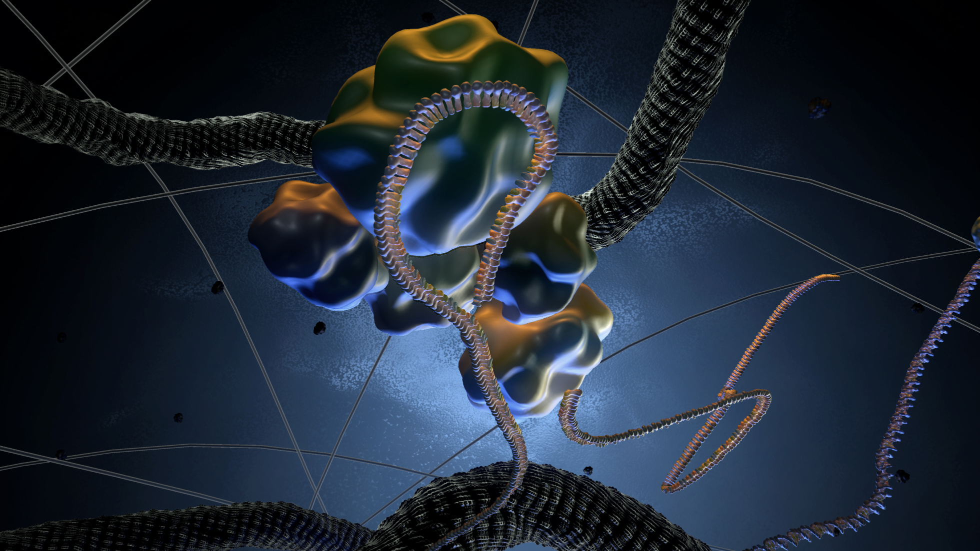
RNA interference (RNAi):
Platform enabling technology for silencing genes

Slide 9
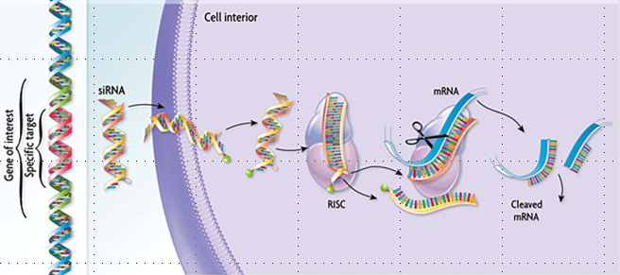
small interfering RNA (siRNA)
1) siRNAs are delivered to cells
2) siRNAs loaded into a RISC complex (Ago2 and other factors)
3) the two strands separate
4) antisense (guide) strand and Ago 2 protein form enzyme complex (RISC) that targets RNA
5) RISC complex base-pairs to target RNA and induces cleavage → effectively silences the gene

Slide 10
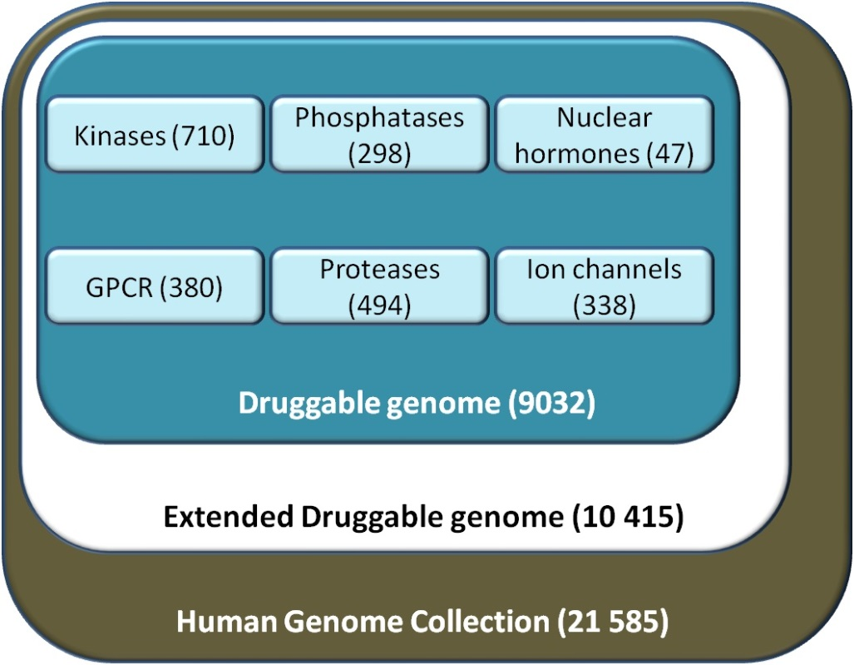
siGENOME Library
Consists of siRNA pools (4 siRNAs) targeting each gene of the human genome
Allows for the identification of all host genes involved in virus replication

Slide 11
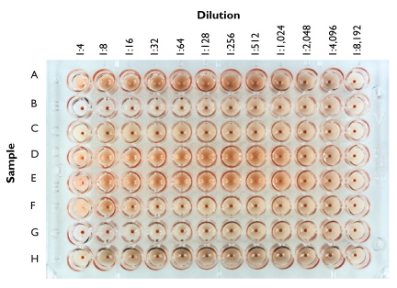
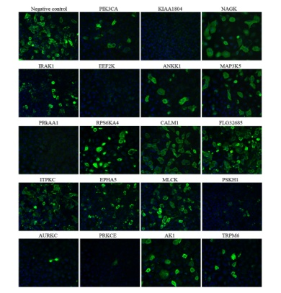
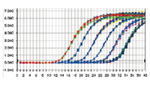
siGENOME HTS: influenza
Influenza screen:
A/WSN/33 (H1N1) used for influenza virus screen
validated gene hits with A/New Caledonia/20/99 (H1N1) & A/New York/55/2004 (H3N2) & A/California/04/09
Host cell line:
A549; human lung epithelial cell line
validated hits in A549 and BEAS2B cells (human bronchial epithelial cells)
Used three endpoints to evaluate affect on virus replication:
Hemagglutination assay (HA)
IFA (high-content analysis) for NP staining in cells
RT-qPCR to confirm M gene amplification
Z-scores were determined from these endpoints (HA titers, PCR, and NP-staining assays) where 2 endpoints needed to match to move screen to validation steps

Slide 12
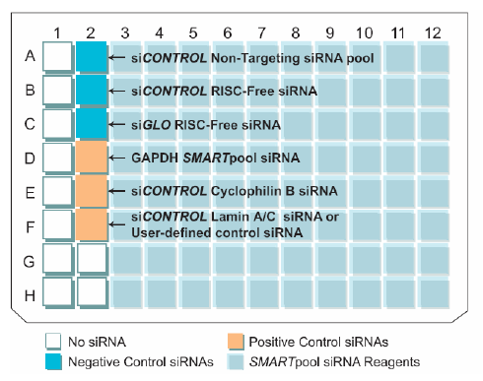
siGENOME screen & Validation
Primary Screen
48 h
Infect with A/WSN/33
(H1N1, MOI 0.001)
48 h
Transfect with siRNAs

Slide 13

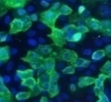
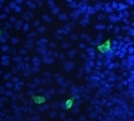
siGENOME screen & Validation
Primary Screen
48 h
Infect with A/WSN/33
(H1N1, MOI 0.001)
Transfect A549 cells with 4 siRNAs targeting gene of interest
48 h
Assay viral replication
TCID₅₀ to measure virus
Influenza NP localization and qRT-PCR to assay viral RNA levels
NEG
MEK
10⁻¹
10⁻²
10⁻³
10⁻⁴
dilution
NEG
MEK

Slide 14
siGENOME screen & Validation
Primary Screen
48 h
Infect with A/WSN/33
(H1N1, MOI 0.001)
Transfect A549 cells with 4 siRNAs targeting gene of interest
48 h
Assay viral replication
TCID₅₀ to measure virus
Influenza NP localization and qRT-PCR to assay viral RNA levels
NEG
MEK
10⁻¹
10⁻²
10⁻³
10⁻⁴
dilution
NEG
MEK
Z score analysis to identify hits
(≥ mean ± 3SD)
consistent phenotype with HA results moves toward validation
validation

Slide 15
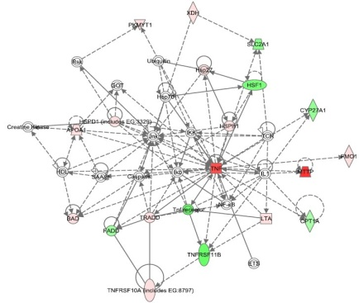
siGENOME screen & Validation
Validation Assays
Infect with A/WSN/33
(H1N1, MOI 0.001)
48 h
Transfect A549 cells with novel siRNA targeting gene hit but at a different seed site
48 h
Assay viral replication
TCID₅₀ to measure virus
Influenza NP localization and qRT-PCR to assay viral RNA levels
NEG
MEK
10⁻¹
10⁻²
10⁻³
10⁻⁴
dilution
NEG
MEK
Pathway Analysis
Z score analysis to identify hits
(≥ mean ± 3SD)
consistent phenotype moves toward validation
validation

Slide 16
siGENOME screen & Validation-
repeated 2x
Primary Screen
Validation Screen
48 h
Infect with A/WSN/33
(H1N1, MOI 0.001)
48 h
Transfect A549 cells with novel siRNA targeting gene of interest – different seed site
Transfect A549 cells with 4 siRNAs targeting gene of interest
48 h
Transfect with siRNAs
Assay viral replication
TCID₅₀ to measure virus
Influenza NP localization and qRT-PCR to assay viral RNA levels
NEG
MEK
10⁻¹
10⁻²
10⁻³
10⁻⁴
dilution
NEG
MEK
Pathway Analysis
Z score analysis to identify hits
(≥ mean ± 3SD)
consistent phenotype moves toward validation
validation

Slide 17
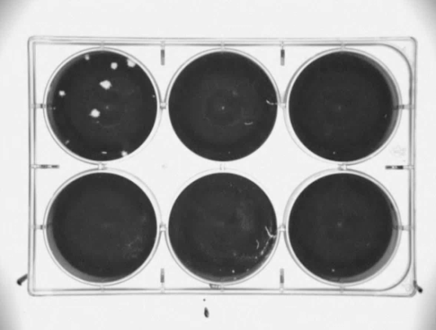
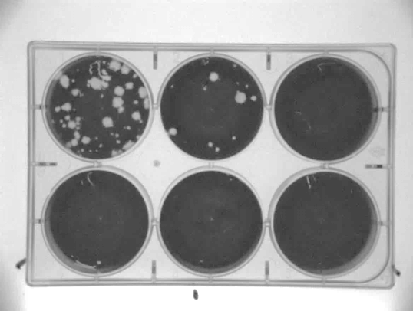
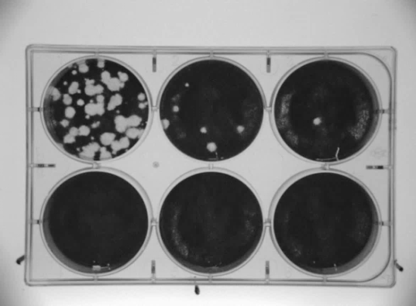
Silencing host genes increases vaccine
NTC
Normalized Z-score
Gene-x
Gene-y
Gene-z
5000
10000
15000
20000
10^4
10^5
10^6
siGENOME screen identifies gene silencing events that enhance virus replication

Slide 18
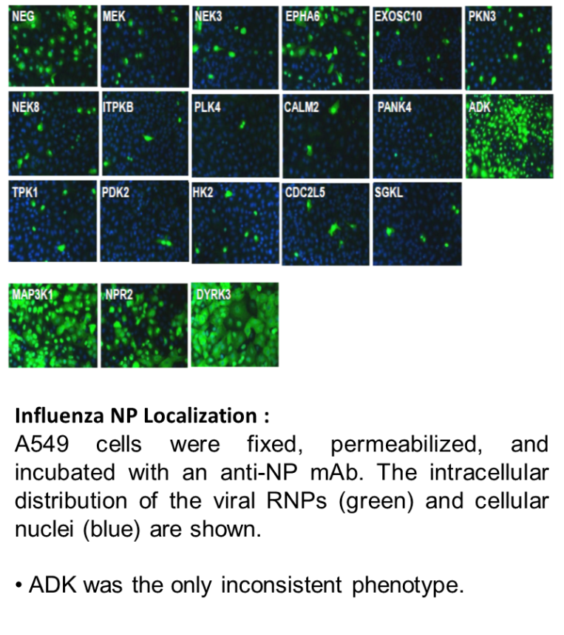
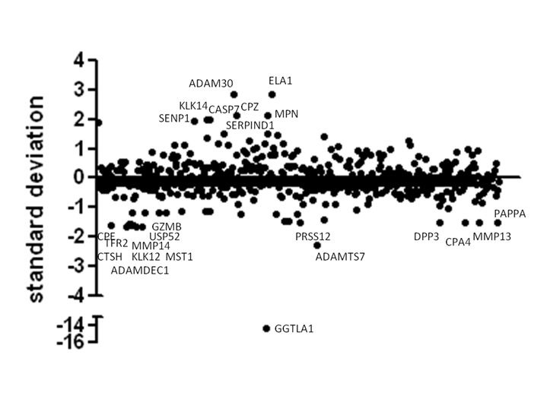
Validation
A secondary screen was performed using novel siRNAs targeting the same gene but at a different seed site.
Endpoint validation included infectious virus production, viral genome replication, and influenza nucleoprotein localization.

Slide 19
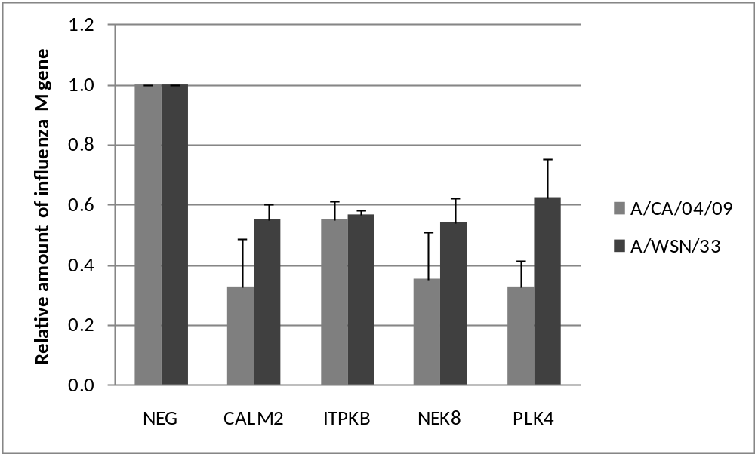
Validated for other viruses
Host cell factors affect replication of H1N1 influenza virus variants. A549 cells transfected with siRNAs were infected (48 h later) with the A/WSN/33 or A/California/04/09 virus strains (MOI=0.5) Influenza M gene levels were determined via qRT-PCR and is expressed as a percentage of the non-targeting transfected control.
M gene levels

Slide 20
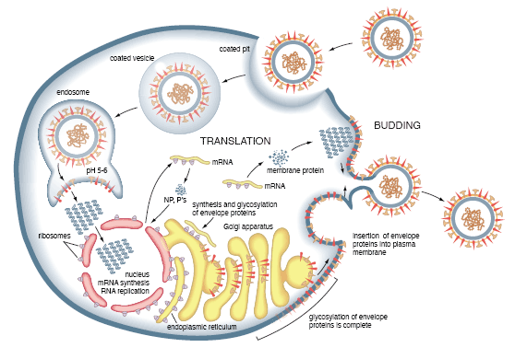
Genes & Cell Pathways
Functional category | Genes | Cellular function | Proposed role | Replication block
Protease hits
NF-κB | CTRC, MST1, CPE, ADAMTS7 | Inflammation | Control of antiviral state | Post-entry, endosome
cAMP-response binding element (CREB) | PRSS12, MST1 | Signaling | Viral entry, apoptosis, transcriptional regulation | Entry, release, trafficking
Cyclin (cell development) | CPZ, MPN | Cell differentiation and growth | Transcriptional regulation | Trafficking of viral proteins, genome replication
Apoptosis | DPP3, CTRC | Programmed cell death | Release of virions | Budding
Kinase hits
p53/DNA damage pathways | EPHA6, NEK8, ADK, CALM2, DYRK3, HK2, ITPKB, MAP3K1, NPR2, PANK4, PDK2, TPK1 | Cell cycle arrest, cellular senescence or apoptosis | Down regulated by the virus to extend host cell survival | Late stages of viral replication
PI3K/AKT signalling | NEK8, CALM2, HK2, ITPKB, MAP3K1, NPR2, PKN3 | Signaling for cell growth, proliferation, differentiation, survival or intracellular trafficking | Important for efficient viral entry, protein yields and nuclear export of vRNPs | Entry
PKC/CA⁺⁺ signaling | EPHA6, NEK8, ADK, CALM2, DYRK3, HK2, ITPKB, MAP3K1, PKN3, PANK4, PDK2, TPK1 | Transport, catabolism, motility, growth, communication or apoptosis | Transcriptional regulation | Post-entry
Not unexpected that many host genes are required for virus replication

Slide 21
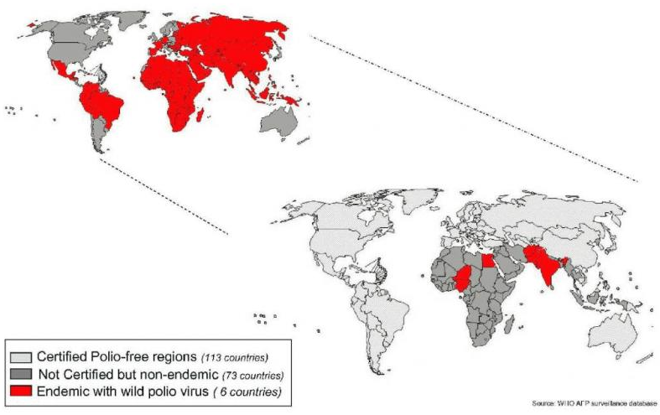
Polio Eradication Program
1988
2014

Slide 22
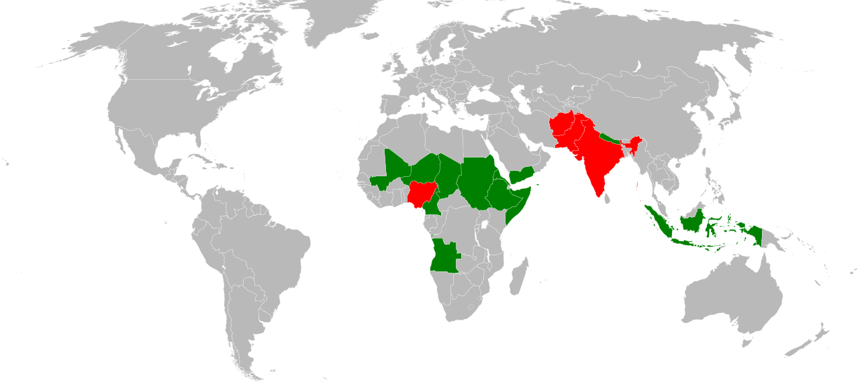
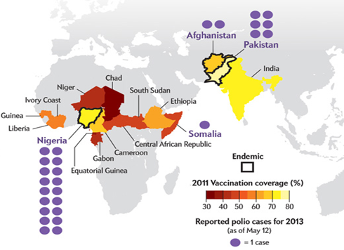
Context : The Polio Belt
Several countries have endemic polio – other previous polio-free countries continue to be ‘seeded’

Slide 23
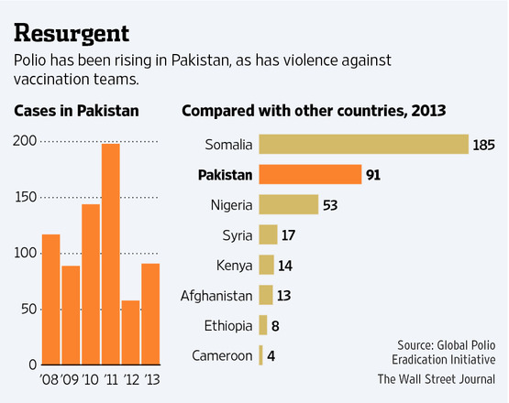
Polio persists
1988: WHO Resolution to Eradicate Polio
Violence and war in countries reduces vaccination coverage leading to resurgence

Slide 24
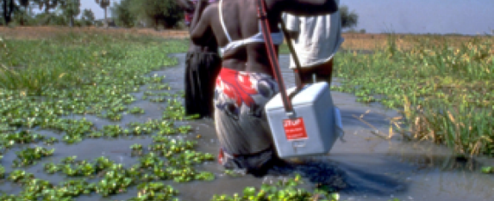

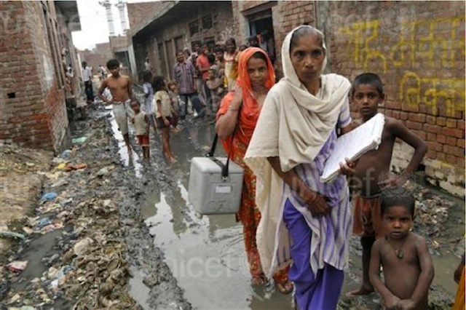
The eradication effort today
  150 million children immunized in 1 day in India
  ~2 billion doses delivered per year worldwide
Large scale immunization campaigns covering remote areas

Slide 25
What is hindering eradication?
Cost of vaccine manufacturing
Insufficient worldwide vaccine supply
Limited vaccine available for supplementary immunization
Need to switch to IPV which costs >5x more than OPV
New technologies that facilitate vaccine manufacturing are needed

Slide 26
Workflow
Primary
Hit
Stable Cell
Translate to
Screen
Validation
Line
Commercial
Development
Value
•
RNAi
gene
•
Eliminate false
•
Targeted gene
•
Licensing of
knockdown
positives
editing
cell lines/
optimized
•
18,000
+
•
Vero
cell
studies
media
targeted genes
•
Antigen
•
Vaccine
equivalency
manufacturers
•
Media
p
roducers
Developing enhanced vaccine cell lines

Slide 27

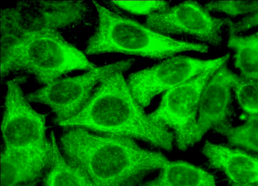
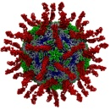

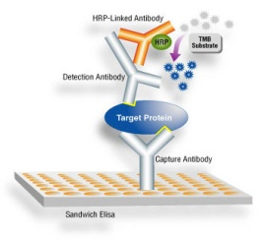
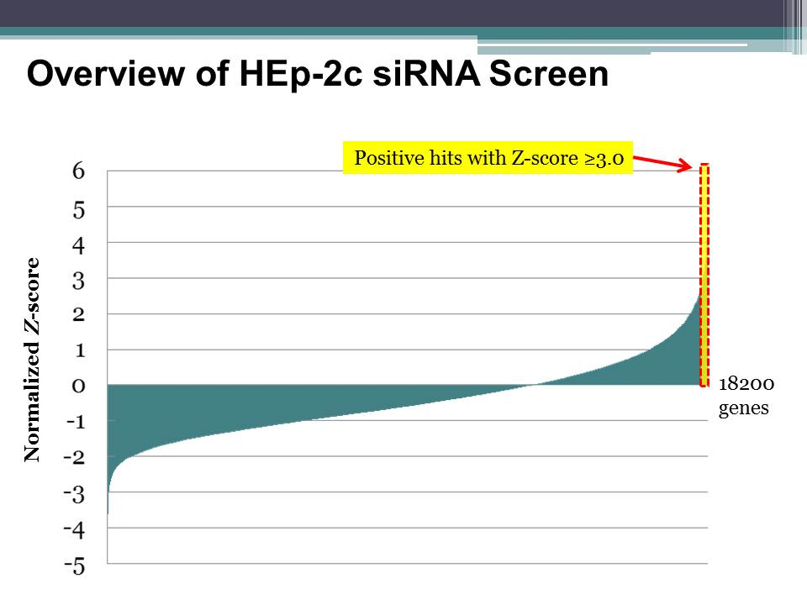
siGenome Outcome
Workflow
Pool of (4) gene-
specific siRNAs
HEp-2C
Sabin 2 Virus
Viral Supernatant
Polio-Specific ELISA
transfect
Results
124 Hits (0.6%) of > 18,000 Genes Screened Enhance Viral Production
Enhance
Virus Production
Future Therapeutics
Suppress
Virus Production
~50 genes
Vaccine Cell Engineering
Screen identifies new opportunities for both therapeutics and
deriving enhanced vaccine cell lines

Slide 28

Validation in Vero Cells
Deconvolution Workflow
Validate top 124 hits in Hep-2c cells with a Z score ≥ 3.0 by decovoluting siRNA pools
Pool
siRNAs targeting validated gene hits are transfected into the Vero cell vaccine line
Singles
Infect silenced genes with Sabin-1, -2, or -3; assay 48h post-transfection
Vero cells
Lyse cells to determine CCID₅₀ (level of poliovirus replication) at 24 post-infection
Identify hits for those genes associated with increased virus titer >5-fold relative to wild-type Vero
siRNA pool deconvolution validates
54% of the primary screen hits
Validation confirms host genes required for enhanced vaccine cell line development

Slide 29
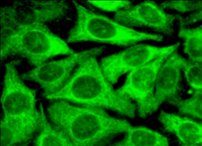
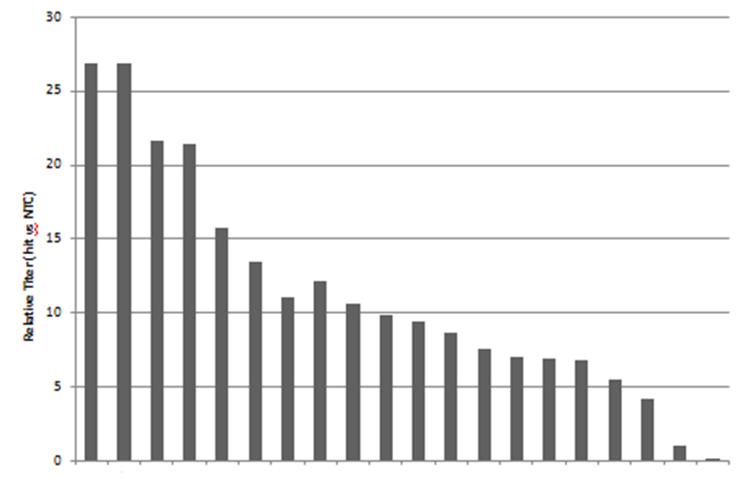
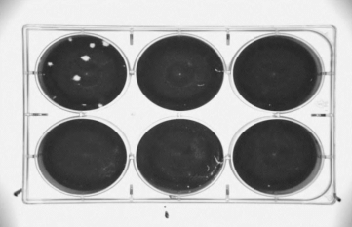
Genes that Increase Replication in Vero Cells
Workflow
Sabin 2
Plaque Assay
Vero Cells
CCID₅₀ Assay
siRNA
Results
CCID₅₀ Assay
Plaque Assay
NTC
Gene 1
Relative Titer to NTC
Gene 2
Gene 3
5x
Dilution
Genes
siPolio
NTC
Single gene modulation events increase poliovirus replication by >30-fold

Slide 30
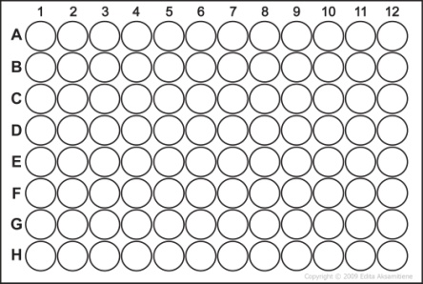

Confirming Viral Antigenicity
Results
Sabin-1 Virus
Workflow
Sample | Dilution of Observed CPE
CONTROL | 1:144
Gene 1 | 1:144
Gene 2 | 1:181
Gene 3 | 1:288
Gene 4 | 1:181
Gene 5 | 1:455
Gene 6 | 1:144
Gene 7 | 1:181
Gene 8 | 1:181
Gene 9 | 1:144
Gene 10 | 1:288
Gene 11 | 1:181
Gene 12 | 1:227
Gene 13 | 1:144
Dilution of Human Sera
(Neutralizing Antibodies)
+/- siRNA
Neutralization Assay
(Hep-2C)
Vero Cells
Sabin 1, 2, or 3
Knockdown of genes does not affect vaccine antigenicity

Slide 31
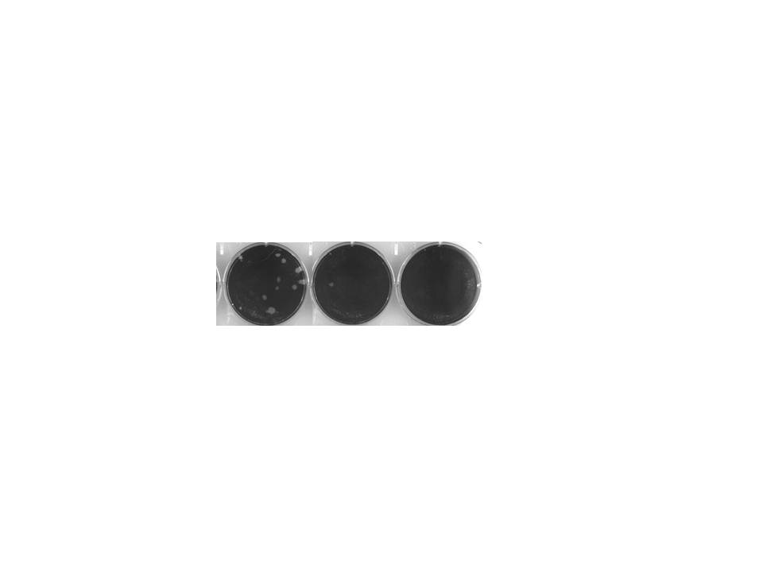
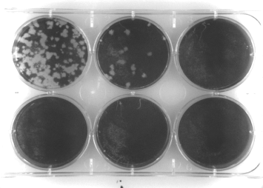
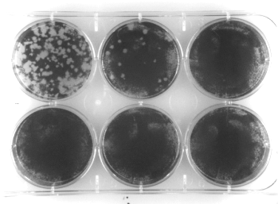
Identified Genes That Act On Multiple Polio Strains
Workflow
Results
Vero Cells
Sabin-3
NTC
10⁴
10⁵
10⁶
siRNA to top hits
Sabin-1, -2, -3, Mahoney, Brunhilde, MEF, or Saukette
Gene 1
Gene 2
Gene 3
Plaque Assay
Hits from Sabin-2 screen increase vaccine titer of multiple poliovirus strains

Slide 32
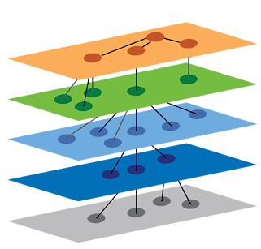
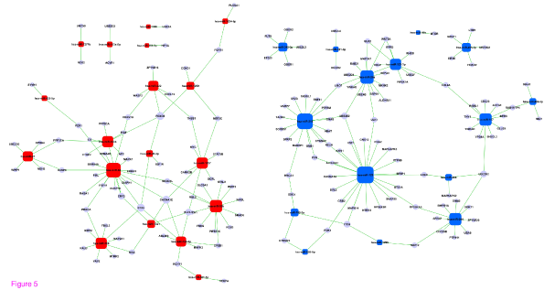

Dual Gene Knockdown Studies
Ingenuity Pathway Analysis
Identify Gene Combinations That Map To Unique Pathways
Target separate pathways
siRNA #1
siRNA #2
Provides insights into how validated hits integrate into known cellular pathways
Negative, Additive or Synergistic effects?
Can we further enhance titer by targeting combinations of genes?

Slide 33
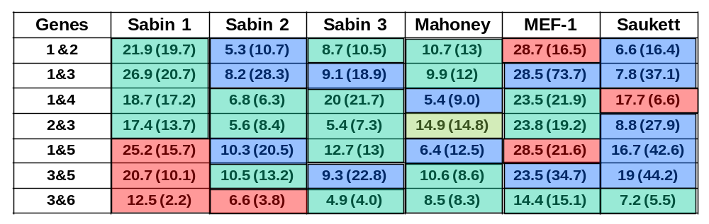
Dual Gene Knockdown: Results
54 Gene Silencing Combinations Tested With 7 Strains
Fold Increase in Poliovirus Titer
~ Additive
Negative
Synergistic
Predicted Additive Effect (Actual Additive Effect)
  Multi-gene knockdown leads to additive and synergistic effects

Slide 34
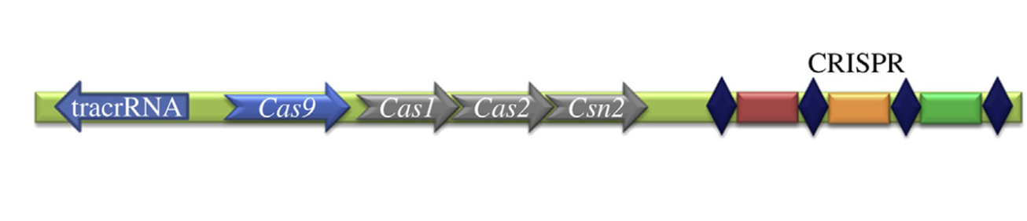

Phase II: Gene Editing: clustered, regularly interspaced, short palindromic repeats
CRISPR-Cas creates double-stranded cuts in DNA, triggering DNA repair mechanisms
that can knock out a gene by breaking its sequence

Slide 35
Gene Editing
Polio replication (vs wt)
Polio replication (vs wt)
Find fold-increases in vaccine production in stable gene edited cell lines

Slide 36
Development Time (~12 mos)
Primary Screen
Hit Validation
Secondary Studies
Stable Cell Line Development
0
4
6
8
10
12
16
months
Primary Screen
Assay Conversion:
Hep-2 to Vero
Rolling Validation
Top single hits from validation studies move directly into CRISPR design
IPA
Dual Gene
KD
Top combinations from dual gene KD studies move into CRISPR design
CRISPR transfection, isolation of clonal KO cell lines

Slide 37
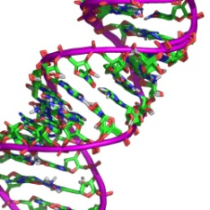

Accomplishments
Screened
Validated
Current
The human genome to identify host genes that when silenced enhance poliovirus replication/production
Several dozen single and dual genes that when silenced enhance poliovirus production between 5-to-60 fold
Created stable genetically modified cell lines that have high yield phenotypes for production use

Slide 38
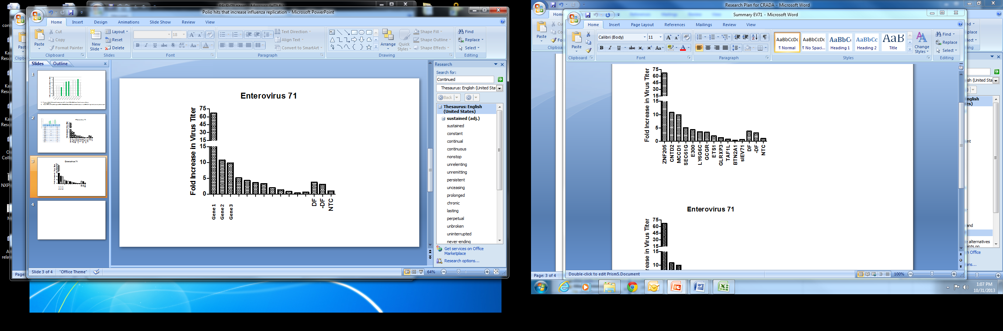
Moving Forward: EV71
>65-fold increase
controls
Silencing genes discovered in poliovirus screen elevate EV71 titers between 10 – 65-fold

Slide 39
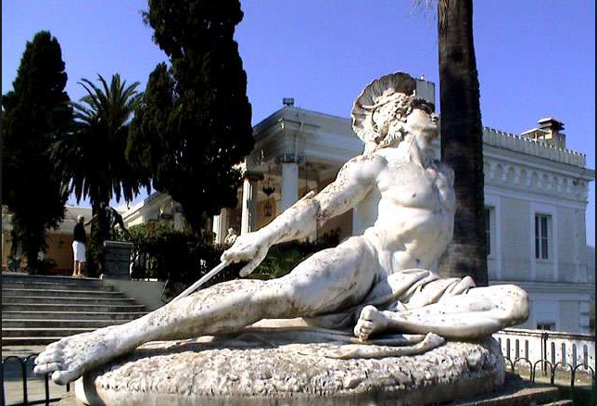
What we are learning…
Polio
Influenza
Subset of hits overlap with those
identified in other studies
11
?
?
17
?
Rotavirus
Measles
The Achilles Heal?

Slide 40




Acknowledgements
University of Georgia
  Mark Tompkins
  Weilin Wu
  Paula Brooks
  Jason O’Donnell
Academia
Translating Basic Research into Opportunities
industry
Non Profit
Centers for Disease Control
  Steve Oberste
  Sabine Van der Sanden
  Naomi Dybdahl-Sissoko
  William Weldon
Government
Thermo Fisher Scientific
  Craig Smith
  Mitch Kennedy
  Jon Karpilow
Bill & Melinda Gates Foundation
  Laura Shackelton
  Graham Snead

