Slide 1

Does Proteogenomics study give answer to the diagnosis of infectious and non-infectious diseases of nervous system?
Dr. R. Ravikumar
Professor of Neuromicrobiology
National Institute of Mental Health and Neurosciences
Bangalore, India

Slide 2
Proteogenomics
Proteogenomics is the intersection of genomics and proteomics
This utilizes the information obtained from proteomics experiments to improve gene annotation
It might help in understanding protein expression, posttranslational modifications

Slide 3
Proteogenomics
The term was originally used to describe studies in which proteomic data are used for improved genome annotation and characterization of the protein-coding potential.

Slide 4
Proteogenomics
In a proteogenomic approach, novel peptides are identified by searching MS/MS spectra against customized protein sequence databases containing predicted novel protein sequences and sequence variants; such databases are generated using genomic and transcriptomic sequence information.

Slide 5
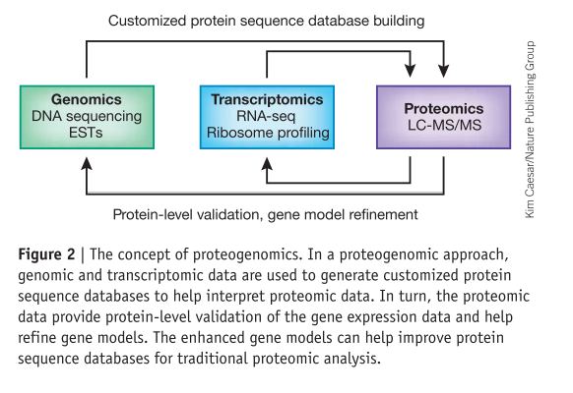
Alexey I Nesvizhskii
DOI:10.1038/NMETH.3144

Slide 6
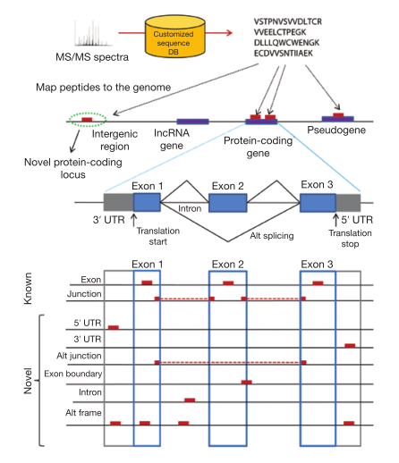
Type of peptides identified in proteogenomics.
Peptides identified by searching customized protein sequence databases (DB) are mapped on the genome. Intergenic peptides map to regions located between annotated gene models, whereas intragenic peptides map to genomic regions contained within or in close proximity to an annotated gene model.
Alexey I Nesvizhskii
DOI:10.1038/NMETH.3144

Slide 7
DOI: 10.1016/j.jprot.2014.01.007

Slide 8
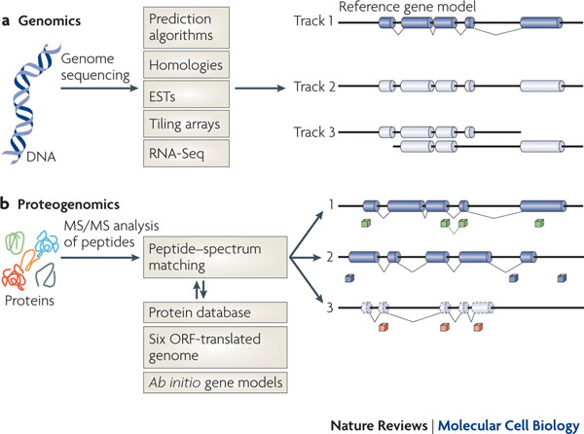
Nature Reviews Molecular Cell Biology 11, 789-801 (November 2010)
doi:10.1038/nrm2973

Slide 9
Diagnosis of Infectious Diseases
Bacterial infections
Fungal Infections
Viral infections
Protozoan Infections
Parasitic Infections

Slide 10
Bacterial Infections
Systemic Infection
Localized Infections
  Central nervous System infection
  Respiratory tract infection
  Gastro-intestinal infection
  Urinary Infection
  Body surface infection

Slide 11
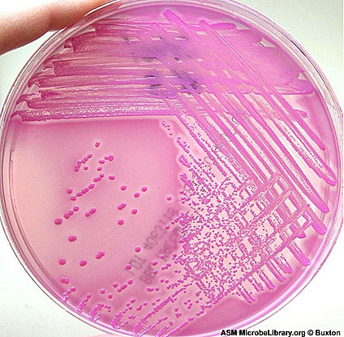
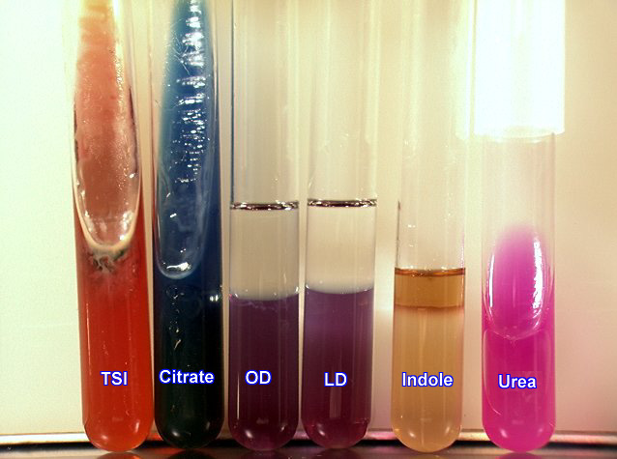
Bacterial Diagnosis
Conventional methods
  Gram’s stain
  Colony Morphology
  Biochemical Reactions

Slide 12
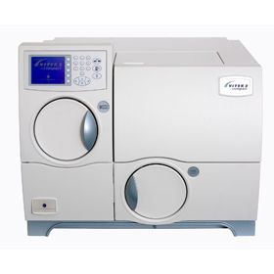
Vitek
Automated system for bacterial identification and antibiotic sensitivity testing

Slide 13
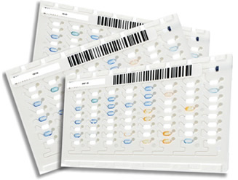
Vitek based Identification
Identification is based on series of biochemical tests done in different wells present in cards
Antibiotic susceptibility testing carried out using AST cards

Slide 14
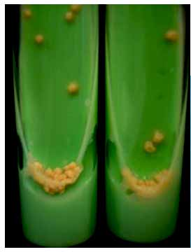
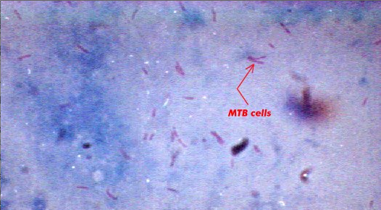
Mycobacterial Diagnosis
Conventional methods
  Zeihl Neelsen staining
  Solid and liquid culture
ZN staining
LJ media

Slide 15
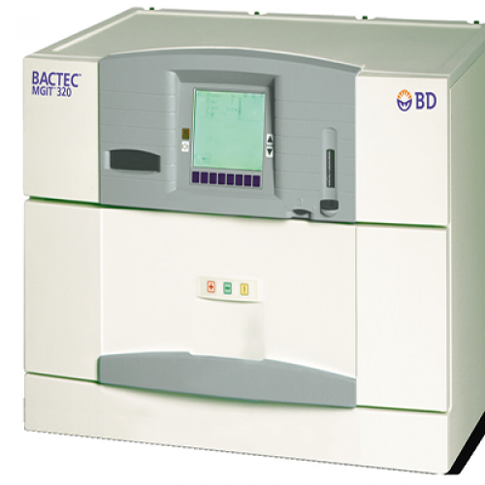
MGIT
Mycobacterium Growth Indicator Tube
Automated system to
promote the growth of
MTB in artificial liquid media

Slide 16
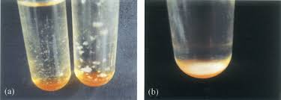
MGIT
Gives comparatively rapid identification of Mycobacterial growth (~ 10 days)
Identification is based on fluorochrome based detection
MGIT tube
Growth No Growth

Slide 17
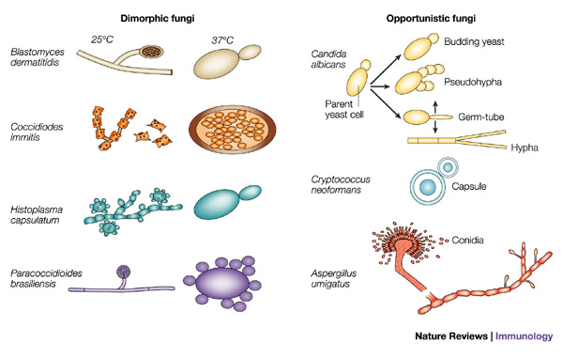
Fungal diagnosis

Slide 18
Fungal diagnosis
A wide range of fungi including saprophytic fungi, melanized fungi, dimorphic fungi, yeast and yeasts-likes can lead to CNS infections which can present as meningitis or space-occupying lesions.

Slide 19
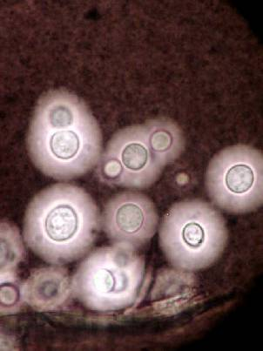
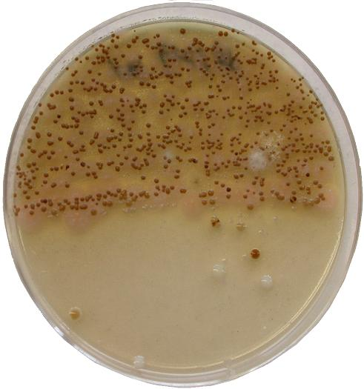
Fungal diagnosis
Conventional methods
  Negative staining
  SDA culture
India Ink
Culture

Slide 20
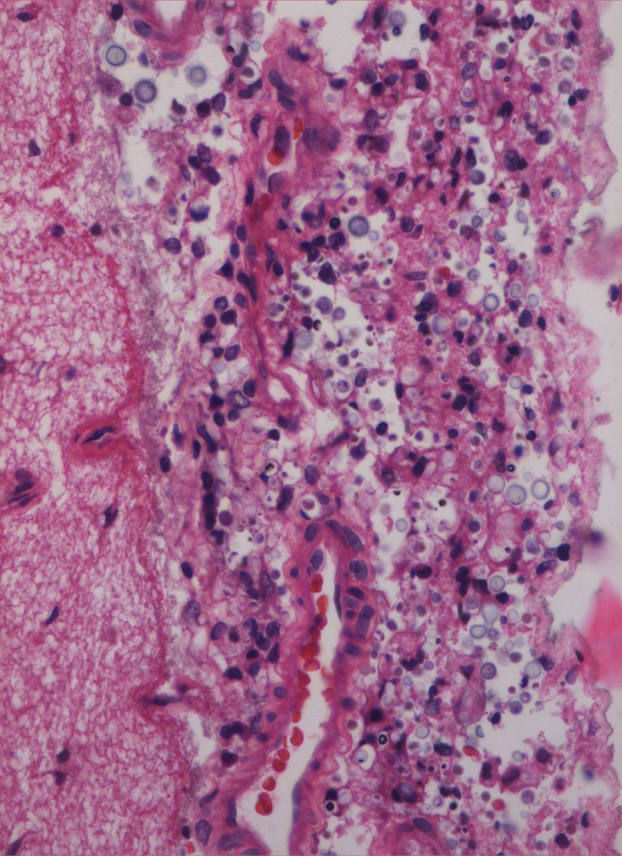
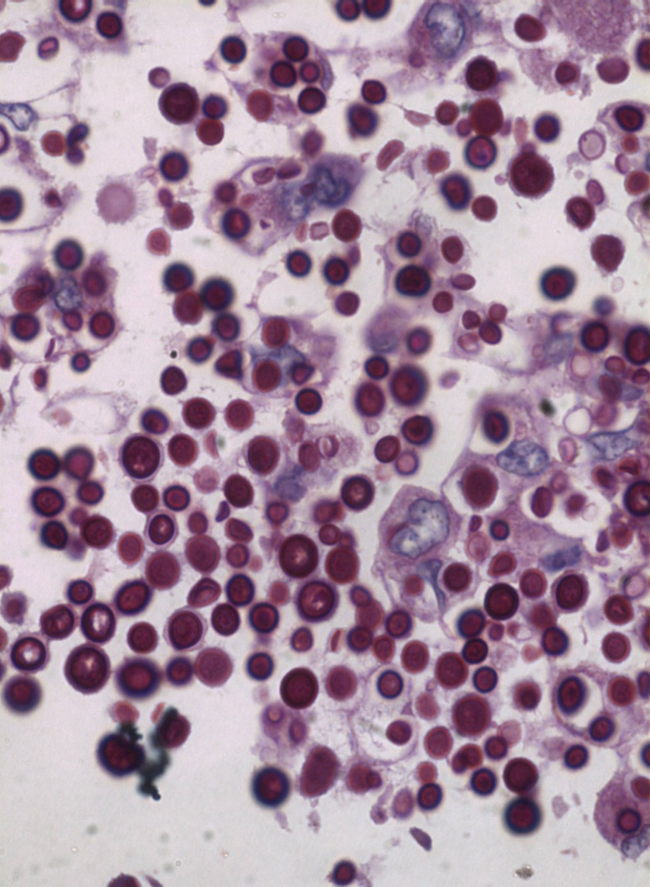
Histopathology based diagnosis
No giant cell response
Extracellular cryptococci
Giant cell response
Engulfed cryptococci
Cryptococcal meningitis with budding yeast forms in subarachnoid space

Slide 21
Other infections
Immunological/ serological assays for diagnosis of infection like Syphilis
Radiological/imaging based diagnosis for infection like Neurocysticercosis
PCR based diagnosis of many diseases like viral infections

Slide 22
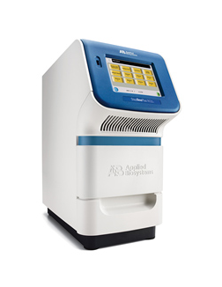
PCR based diagnosis
PCR based diagnosis of infectious diseases like bacterial, fungal, viral has proven to be time saving in comparison to conventional method

Slide 23
PCR based diagnosis
16S rDNA and 18S rDNA sequencing has become the standard for identification of bacterial and eukaryotic organisms for research purpose
However time taken for this experiment doesn’t make it feasible for routine diagnosis
IS6110 is being used for TB identification however sensitivity is less.

Slide 24
PCR based diagnosis
Identification of antibiotic resistance genes have been helpful to know the resistance status of the organisms. For example
  Bla gene, ndm gene etc. in case of Gram negative bacteria
  mecA gene in case of Gram positive bacteria
  rpo, kat g and rif genes in case of Mycobacterium

Slide 25
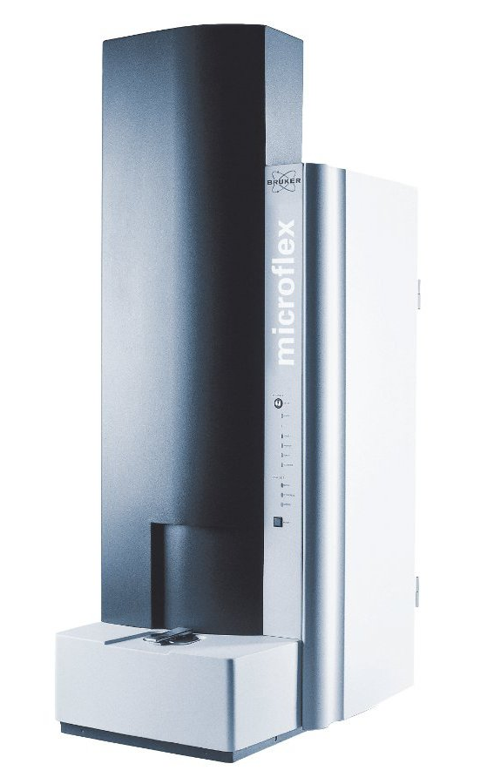
MALDI TOF
Automated system for bacterial identification
Identification based on the signature ribosomal protein

Slide 26
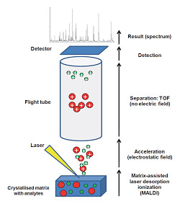
MALDI TOF based Identification
Preferentially requires fresh and isolated colony for identification.
It also allows the identification of bacteria directly from clinical samples

Slide 27
Challenges in diagnosis
Time taken in reporting
Mean turn around time in case of culture negative samples: 1-2 days
Mean turn around time in case of culture positive samples: 2-4 days

Slide 28
Challenges in diagnosis
Processing of samples is the most time consuming job.
Any laboratory takes 12 to 24 hours to cultivate pathogen in appropriate medium and to confirm whether the sample is positive for growth. After that sample is processed for pathogen identification and antibiotic susceptibility testing.

Slide 29
Challenges in diagnosis
Time taken in diagnosis of MTB
  By conventional method is 6-10 weeks
  By MGIT is 10 days
  By PCR is 2 days
PCR though less time consuming but highly unreliable in case of TB meningitis as the sensitivity is very less indicating higher number of false negative.

Slide 30
Challenges in diagnosis
Time taken in diagnosis of Cryptococcal and other fungal infection by culture method is around 72 hours for positive culture.
Culture negative report can be confirmed only after 2-4 weeks of inoculation to rule out the presence of any slow grower pathogen.

Slide 31
Challenges in diagnosis
Sensitivity and Specificity
  As the identification is based on different biochemical reaction the chances of incorrect identification is high
  One wrong biochemical reaction may give different identification

Slide 32
Challenges in diagnosis
MALDI TOF confers the specific identification of organisms but it gives only identification
For complete antibiotic sensitivity testing other methods have to be applied which again increases sample processing time

Slide 33
Challenges in diagnosis
Infections of Central Nervous system
  In case of CNS infections, CSF is the only available fluid for diagnosis.
  Sensitive tests have to be developed to cope with the small amount of CSF samples available for diagnosis
  Quick identification is needed to avoid the complication is case of CNS infections

Slide 34
Lacunae in diagnosis
A platform where pathogens can be identified by directly loading the samples into the system without any processing or culturing in media
Sample turn around time could be reduced to few hours to few minutes

Slide 35
Lacunae in diagnosis
Developments of diagnostic tests that can be done in small volume of samples
Developments of diagnostic tools that can take easily available body fluid especially in case of CNS infections
Single test which can give all required reports

Slide 36
Lacunae in diagnosis
Genome or proteome based identification to increase the accuracy of the diagnosis
A platform which can give drug sensitivity report in less time based on the genome or proteome of the organism to increase the sensitivity of test

Slide 37
Future Aspects
Proteomics Research
  Proteomics or secretome analysis of the pathogen might be helpful in identification of signature protein/proteins which might be used as the diagnostics tool to identify the bacteria without conventional culture techniques

Slide 38
Future Aspects
Genomics Research
  Whole genome sequencing using high throughput Next Genome Sequencing platform may lead to identification of signature sequences in pathogen that can be used for the diagnosis of that particular organism

Slide 39
Future Aspects
Proteogenomics
  Proteogenomics approach might help us identify novel peptide of interest that might have gone undetected while analyzing proteomics data.

Slide 40
Future Aspects
Study related to biomarkers in different body fluids in case of different infections might prove very helpful in development of better diagnostics tool.
Proteomics and genomics approaches for such biomarker related study are the most reliable techniques

Slide 41
Non Infectious diseases
Any clinical condition which for which a cause and effect relationship is not attributed to Pathogens like
  Psychiatric diseases
  Oncological diseases
  Neurodegenerative disorders
  Genetic disorders
  Metabolic disorders

Slide 42
Diagnosis of Non-Infectious diseases
For all such diseases preliminary diagnosis is based upon the symptoms
For most of the psychiatric diseases and neuro degenerative disorders, symptoms are the only parameter for diagnosis

Slide 43
Diagnosis of Non-Infectious diseases
For most of the metabolic disorders diagnosis is based upon symptoms as well as screening of defective gene
For oncological investigations histological and radiological imaging based diagnosis is mostly preferred

Slide 44
Challenges in diagnosis
Most of the clinical conditions, biological complexity and spectrum is not well known
A variety of clinical conditions are multifactorial
Diagnostic support in terms of early biomarker is not available for multiple conditions

Slide 45
Research Aspects
Proteomics
  Proteomic study- For understanding the proteomic expression profile in a given set of clinical condition
  Comparative Proteomics- Study changes in proteome of a tissue of interest with reference to normal controls

Slide 46
Research Aspects
Proteomics
  Phosphoproteomics- Study changes in signaling pathway involving kinases. Especially useful in studying oncological condition
  Chemoproteomics- Study protein chemical interaction. Useful for drug discovery and analysis

Slide 47
Research Aspects
Genomic studies
Comparative Transcriptomics- Study changes in expression level of RNA (especially mRNA), allowing to look at regulatory patterns.
SNP Workup- Study Single nucleotide polymorphism changes for a set of genes or throughout the genome (GWAS; Genome wide association studies)

Slide 48
Research Aspects
Genomic studies- For studying genetic changes in relation to a given condition
Epigenomics- Study methylation pattern in the genome to understand gene expression and silencing patterns.

Slide 49
Acknowledgements
The Director, National Institute of Mental health & Neuro Sciences, Bangalore, Karnataka, India
All Faculty, Students & Other Staff, Department of Neuromicrobiology, National Institute of Mental health & Neuro Sciences, Bangalore, Karnataka, India.

Slide 50
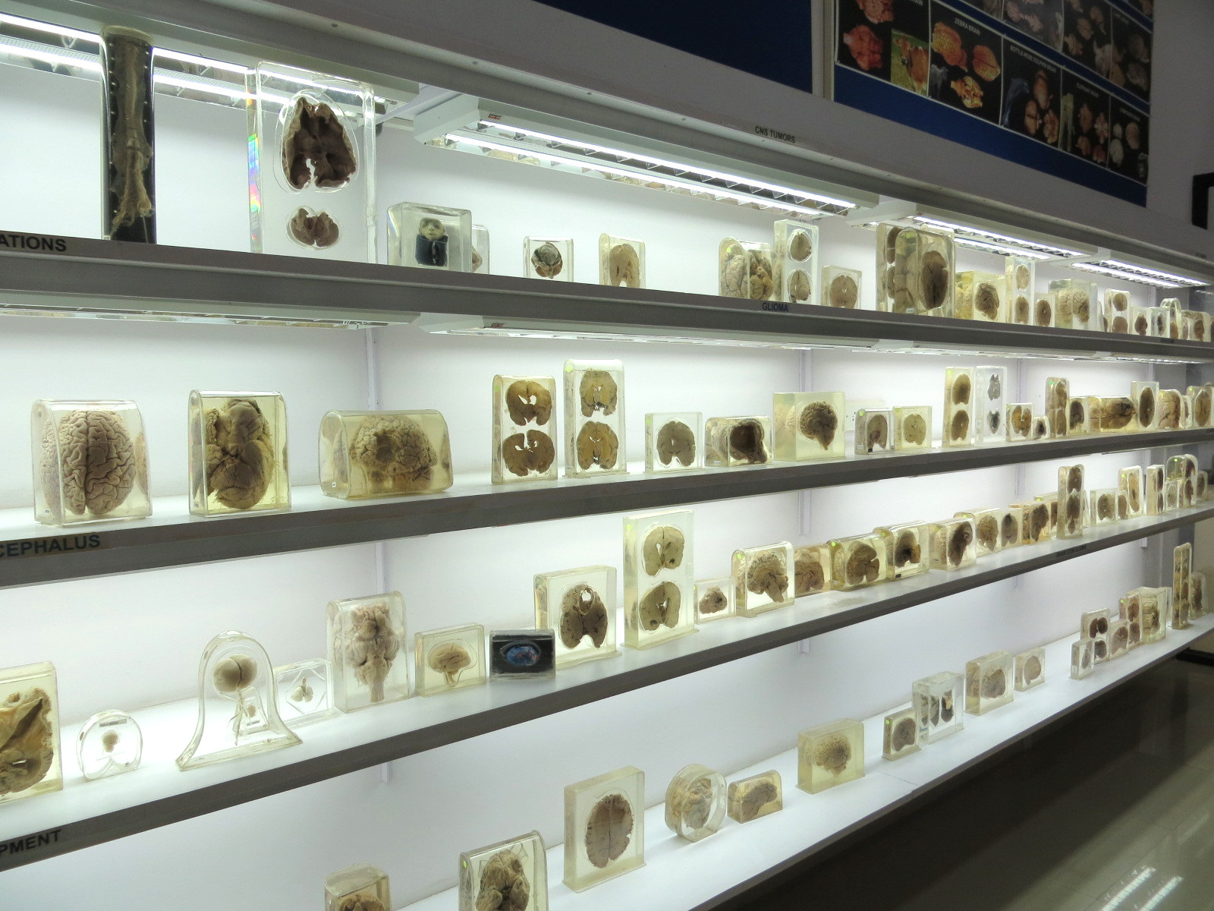

Slide 51


