Slide 1
Extracellular green synthesis of gold nanoparticles by indigenous Bacillus licheniformis GPI-2: a noble biological approach
Rajni Kant Thakur and Poonam Shirkot
Department of Biotechnology
Dr. Y.S PARMAR UNIVERSITY OF HORTICULTURE AND FORESTRY
Email id : rajnithakur136@yahoo.in

Slide 2
Nanotechnology is a group of emerging technologies in which the structure of matter is controlled at the nanometer scale to produce novel materials and devices that have useful and unique properties.
Nanoparticle research is currently an area of intense scientific interest as this plays an important role in a variety of potential applications in fields of biomedicine, in biomedical research like X-ray computed tomography and magnetic resonance imaging , cancer research, drug delivery applications, and its optical properties for cancer diagnosis and photo thermal therapy.
Physical and chemical methods of nanoparticles synthesis are too expensive and toxic with requirements of high temperature and pressure condition.

Slide 3
In contrast to chemical and physical methods, microbial processes for synthesizing nanomaterials can be achieved in aqueous phase under gentle and environmentally benign conditions. Moreover use of microorganisms for synthesis of functional nanoparticles is ecofriendly, comparatively inexpensive and faster.
The ability of microorganisms to change oxidation state of metals and their microbial processes has opened up new opportunity to explore novel applications such as biosynthesis of metal nanomaterials. This approach has become attractive focus in current green biotechnology towards sustainable development.

Slide 4
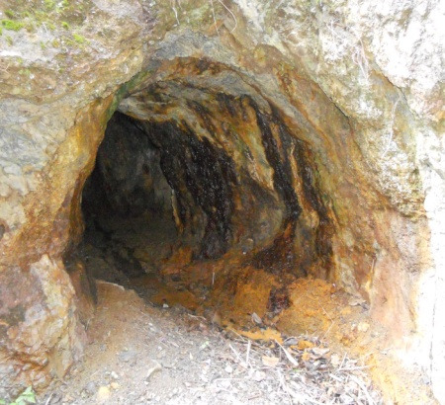
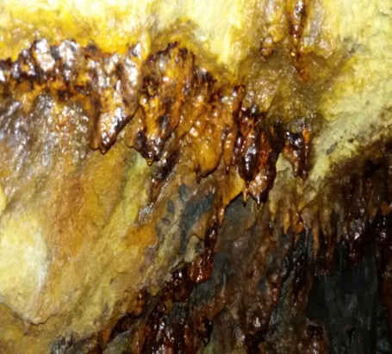
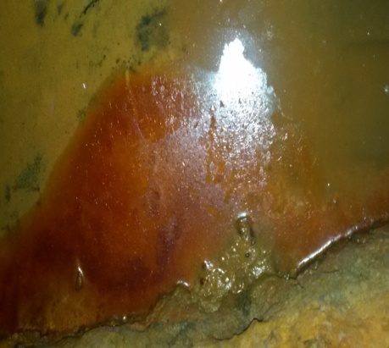
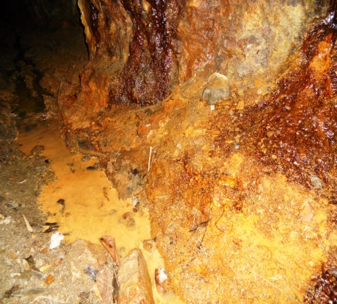
a
b
c
d
Figure 1: Sample collection sites: Khaltunala gold mine from where sample were collected, representing (a) pebble (b) roof topping (c) biofilm (d) yellow soil

Slide 5
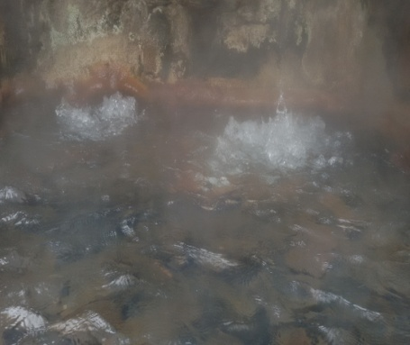
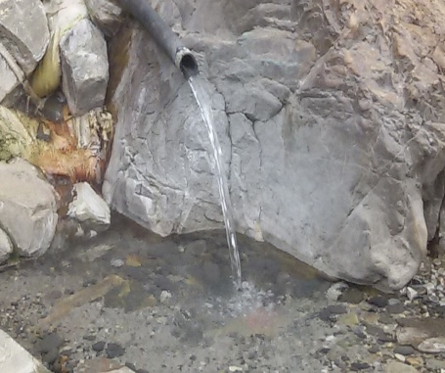
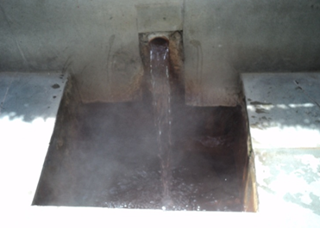
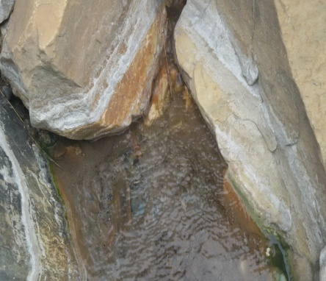
a
b
c
d
Figure 1b: Selected hot water springs of Himachal Pradesh (a) Manikaran (b) Kasol (c) Vashisht (d) Kalath

Slide 6
Isolation of gold nanoparticles synthesizing bacteria was carried out from different samples viz. yellow soil, pebbles, biofilm and stalagmites collected from a local gold mine using nutrient agar medium at 37ºC.
Pure colonies isolated from the pebble sample were characterized for their morphological and physiological characteristics by various biochemical tests using the Bergeys Manual of Determinative Bacteriology.
The screened strain is an aerobic, gram positive, rod shaped with round colonies in shape, 2 mm in diameter with undulated margin, opaque with rough surface. GPI-2 bacterial isolate tested positive for arginine dihydrolase, hydrolysis of esculin, beta galactosidase, phenyl alanine deaminated, degradation of tyrosine acid production from glycerol, salicine, starch, glycogen, lactose, D mannose, maltose, ribose, Sorbitol, sucrose.

Slide 7
Molecular characterization was carried out using 16S r DNA-PCR technology. Total genomic DNA of the GPI-2 bacterial isolate was extracted successfully using genomic DNA extraction Mini kit (Real Genomics) and was selectively amplified with universal primers for 16S rrna gene followed by agarose gel electrophosis leading to a single clear band. This was eluted, purified and sequenced. The sequence was submitted to NCBI with accession number Genbank KP219455. BLASTn analysis depicted homology of GPI-2 bacterial isolate with other Bacillus species. To gain insight of evolutionary pattern, phylogenetic tree was constructed using MEGA 5.0 bioinformatic tool [29]. The bootstrap analysis values identified the bacterial isolate GPI-2 as Bacillus licheniformis GPI-2 Multiple sequence alignment of query nucleotide sequence of maximum gold nanoparticles synthesizing indigenous Bacillus licheniformis strain GPI-2 was performed with that of the selected nucleotide sequences using ClustalW program and pairwise percent similarity score of these selected fifteen nucleotide sequences obtained from NCBI database with test isolate GPI-2 from goldmine, elucidates that sequence of Bacillus licheniformis strain GPI-2 showed maximum similarity score of 99% with Bacillus licheniformis strain NCDO 1772 16S ribosomal RNA gene partial sequence.

Slide 8
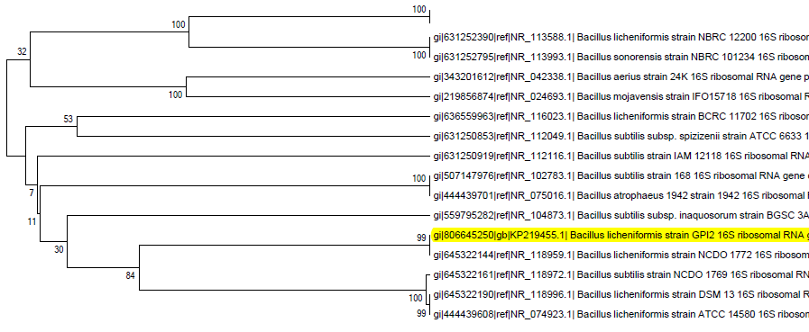
Figure: 2 Phylogenetic tree based on 16S rRNA gene sequences showing the relationship of Bacillus licheniformis GPI-2

Slide 9
In vitro synthesis of gold nanoparticles by indigenous Bacillus licheniformis strain GPI-2
Extracellular biosynthesis of gold nanoparticles was carried out using supernatant of Bacillus licheniformis strain GPI-2, treated with 1mM gold chloride solution and incubated at 37ºC for a time period of 0-240 hrs. Biosynthesis absorption spectra of gold nanoparticles which was indicated by colour change of solution from yellow to red wine and was further confirmed spectrophotometrically. UV-VIS absorption spectra and the time of incubation course and increase in formation of gold nanoparticles took place upto 36 hrs and remained stable upto 48 hrs and than the values declined upto 240 hrs. Gold nanoparticles formation clearly revealed the gold nanoparticles formation initiated after 6 hrs and studies at two different wavelengths of 540 nm and 560 nm. it was observed that optical density values were higher at 560 nm and gold nanoparticles also showed more stability at 36-48 hrs, thus 560 nm wavelength was found superior over 540 nm and was selected for further experiments.

Slide 10
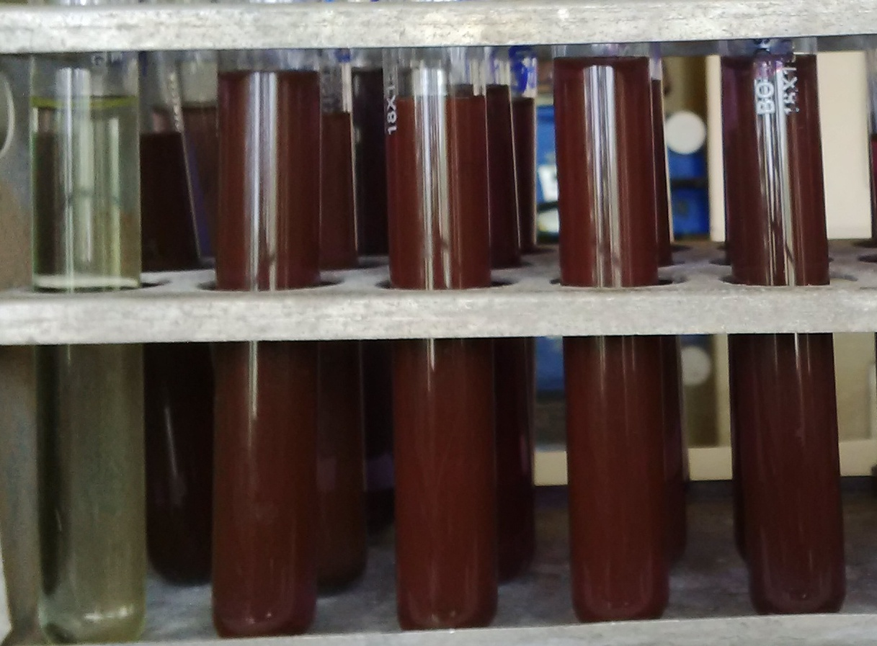
Figure:3 Biosynthesized gold nanoparticles in a colloidal dispersion using the supernatant of Bacillus licheniformis GPI-2

Slide 12
Fig 5a: Optimization of pH for maximum gold nanoparticles synthesis
Figure 5b: Optimization of incubation time for maximum gold nanoparticles synthesis

Slide 13
Optimization of culture conditions for maximum gold nanoparticles synthesis by Bacillus licheniformis strain GPI-2.
The bacterial isolate Bacillus licheniformis GPI-2 depicting maximum gold nanoparticles synthesis activity was further optimized to study the effect of different factors such as incubation time, temperature, pH and wavelength on gold nanoparticles synthesis. Effect of pH on biosynthesis of gold nanoparticles by Bacillus licheniformis GPI-2 bacterial supernatant of was studied for 0-72 hrs using 1mM gold chloride solution at a pH range of 5.0, 6.0, 6.8, 7.5, 8.0 and it was observed that maximum gold nanoparticles took place at pH: 6.8.
Thus pH has been found to be an important parameter affecting gold nanoparticles synthesis. Variation in pH during exposure to gold ions had an impact on the size, shape and number of particles produced per cell. Gold nanoparticles formed at pH 6.8 were predominantly triangles, spherical, hexagons, circular in shape. Whenever pH increases, more competition occurs between protons and metal ions for negatively charged binding sites.

Slide 14
Figure 5c: Optimization of temperature for maximum gold nanoparticles synthesis
Fig 5d: Optimization of wavelength on gold nanoparticles synthesis

Slide 15
Effects of different incubation times for maximum gold nanoparticles synthesis were investigated from 0-72 hrs. The optimum incubation time of 36 hrs, leading to maximum gold nanoparticles production was observed (Figure 5b).
Effect of incubation temperature for maximum gold nanoparticles synthesis was studied at a temperature range of 10-50ºC using nutrient broth and optimum temperature of 37ºC leading to maximum gold nanoparticles synthesis was observed (Figure 5c). It has also been reported that incubation time for maximum gold nanoparticles formation ranges from 30 to 37º C.
Effect of different wavelengths for the maximum optical density values of gold nanoparticles synthesis was investigated in the range of 400-650 nm and an optimum wavelength of 560 nm was found to be leading to maximum values of optical density of gold nanoparticles synthesis (Figure 5d).

Slide 16
Characterization of in vitro synthesis of nanoparticles by Bacillus licheniformis strain GPI-2
FTIR measurements were carried out to identify the possible biomolecules protein responsible for the capping and efficient stabilization of the gold nanoparticles synthesized by Bacillus licheniformis GPI-2. FTIR spectrogram has shown presence of four peaks 3280.18, 2380.99, 2109.12 and 1636.32 (Figure 6).
The FTIR spectra reveal the presence of different functional groups. Wavenumber between 3235 and 3280 cm⁻¹ Indicates for hydrogen bond lengths between 2.69 to 2.85Aº. Alkynes C-C triple bond stretch is found at 2109 cm⁻¹. Peak at 1636 cm⁻¹ coressponds to the N-H bend of primary amines due to carbonyl stretch. Amide 1 is most intensive absorption band in protein. It is primarly governed by the stretching vibration of the C=O (70-80%) and CN stretching groups. (10-20%) frequency 1600-1700 cm⁻¹. In the amide I region (1700−1600 cm⁻¹), each type of secondary structure gives rise to a somewhat different C=O stretching frequency due to unique molecular geometry and hydrogen bonding pattern.
N-H Stretch of primary and secondary amines, amides. Amide A is with more than 95% due to N-H stretching vibration. This mode of vibration does not depends on the backbone conformation but is very sensitive to the strength of a hydrogen bond. Peak maximum around 1650 cm⁻¹ coresponds to proteins alpha helical structure. Half width of alpha helix band depend upon on the stability of the helix. When half width of about 15 cm⁻¹ then we have more stability of helix and transition free energy of more than 300 cal/ml. Amide 1 absorption is primarly determined by the backbone conformation and independent of the amino acid region, Its hydrophilic or hydrophobic properties and charge. Arginine amino acid role was found at 1636 cm⁻¹ in gold nanoparticles synthesis through results of FTIR.

Slide 17
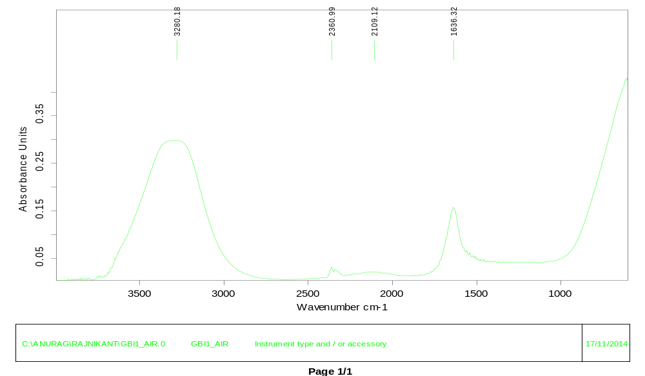
Figure 6: FTIR spectra recorded after 36 hrs of incubation by using supernatant of Bacillus licheniformis GPI-2 with gold chloride.

Slide 18
Figure 7a: Characterization of gold nanoparticles through transmission electron microscope showing the different morphology of gold nanoparticles.

Slide 19
Figure: 7b TEM image of gold nanoparticles showing different sizes of gold nanoparticles

Slide 20
Conclusion
The present work help us develop green route of simple and economic synthesis of gold nanoparticles of 40 –45 nm. The particles synthesized by Bacillus licheniformis GPI-2 were characterized by UV vis spectrophotometer and confirmed by TEM. Extracellular, spherical, small clusters of gold nanoparticles were successfully produced, which were confirmed by Transmission electron. Proteins that serve as biomolecules responsible for the reduction process were confirmed by Fourier Transform Infrared Spectroscopy (FTIR).
The biological function of the gold nanoparticles shown great promise to deliver industry demands. Moreover, this process could be easily scaled up for the industrial applications to increase the yield of the nanoparticles significantly, which undoubtedly would establish its commercial viability. Our research was focused on identification and exploration of gold nanoparticles synthesizing bacteria.

Slide 21
THANKS

