Slide 1

Impact of heavy metal stress on in vitro plant productivity, evaluation of anti-oxidative enzymes, ultra-structural changes and DNA damage in Cassia angustifolia Vahl. a medicinal legume.
By
Rajeshwari
c/o Prof. Veena Agrwal
Department of Botany
University of Delhi
New Delhi
India

Slide 2
Introduction
Plants growing in native environment encounter a variety of biotic and abiotic stresses
Heavy metal stress is one of the major abiotic stress caused by both natural and anthropogenic activities
Their non-biodegradability results in prolonged persistence in the environment
Heavy metals are one of the main yield reducing factor in agriculture
Alter various physiological processes like photosynthesis, cellular homeostasis and plant water relationship
Metal tolerance is exhibited by some plant species which includes exclusion , detoxification and compartmentalization of metal ion inside the plant

Slide 3
Smelting &mining of ores
Fossil fuel combustion
Industrial activities
Sources of Heavy metals
Municipal waste disposal
Metallurgical industries
Fertilizers & pesticides

Slide 4
Essential heavy metals
Non- essential heavy metals
Required in trace amounts but become toxic at elevated concentrations
Not required for normal plant growth, also become toxic at elevated concentrations
E.g. Cu, Fe, Mn, Mo, Ni and Zn
E.g. As, Cd, Pb, Hg and Sn (tin)

Slide 5
Heavy metal induced damage and repair
Heavy metal ions
Non-redox active metals indirectly induce ROS
Redox active metals directly trigger ROS
Compete for the binding site in the target molecules (-SH, COO⁻)
ROS
Redox imbalance
OXIDATIVE DAMAGE
Trigger signalling
molecules
REPAIR MECHANISMS
Image source: modified from Sharma & Dietz, 2008

Slide 6
How plants survive heavy metal stress ?
Antioxidant defence system to counter ROS induced oxidative stress
Sequestration of HM by amino acids, organic acids, glutathione and
metal binding ligand like metallothionein and phytochelation
Accumulation of heavy metals in various plant parts

Slide 7
In the present study , Effect of Zn and Cu have been evaluated in Cassia angustifolia
seedlings with following objectives
Evaluation of phytotoxicity
Accumulation of heavy metals in various plant parts
Antioxidative response
DNA damage and cell death

Slide 8
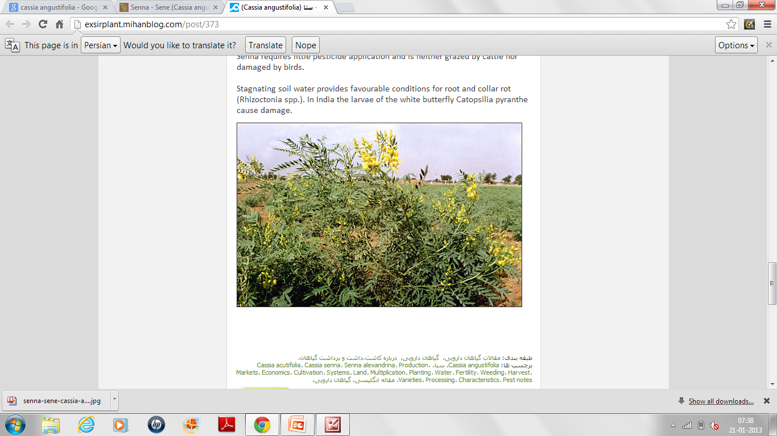
Cassia angustifolia Vahl
Multipurpose medicinal shrub
Widely used for a bioactive compound,
Sennosides
Already reported that Cassia angustifolia
is a drought and salt tolerant plant.

Slide 9
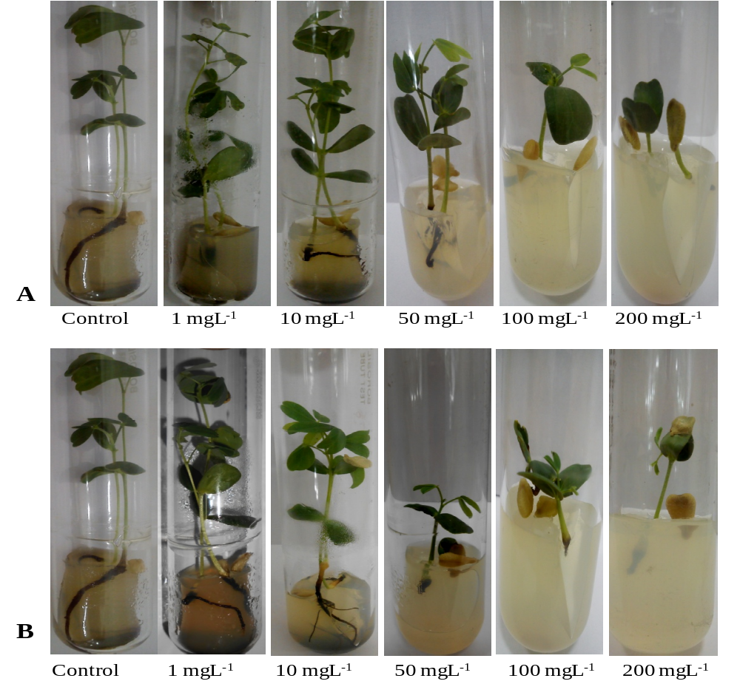
Effect of increasing concentration of Zn (A) and Cu (B) on seedling
growth in 28 days old Cassia angustifolia.

Slide 10
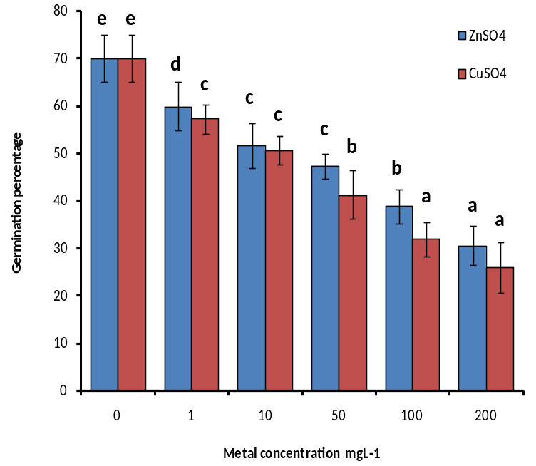
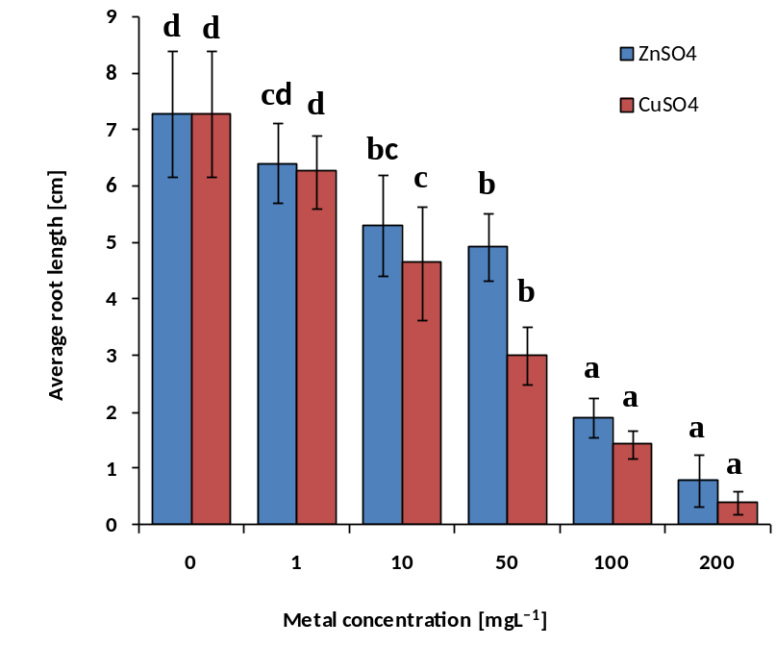
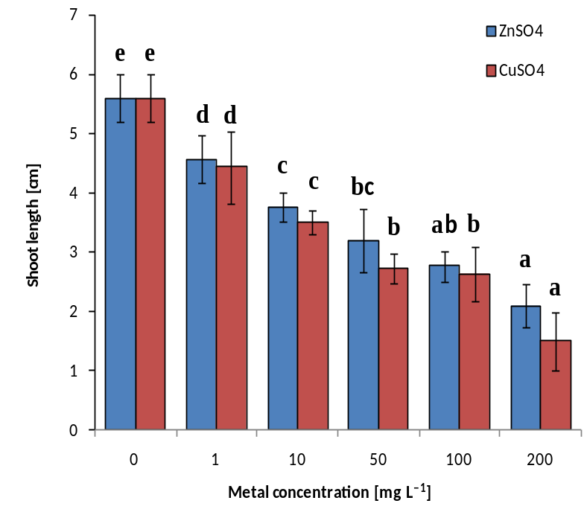
A
B
A. Average germination response
B. Average root length
C. Average shoot length
C

Slide 11
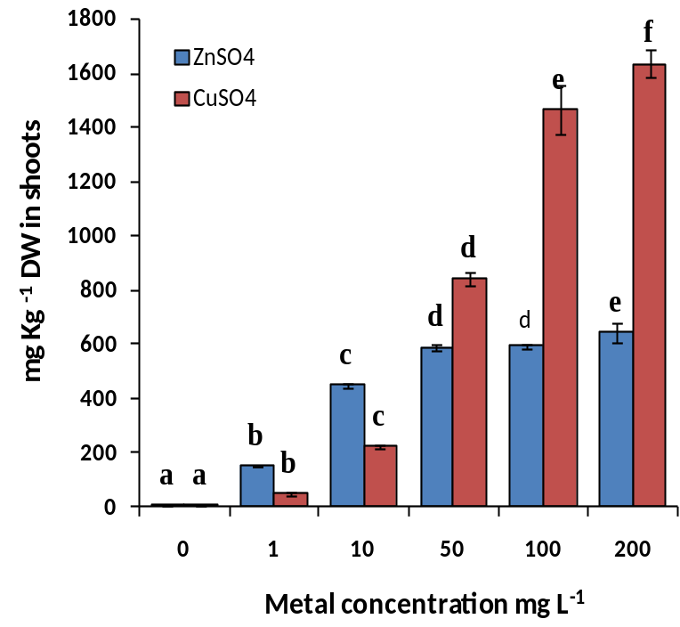
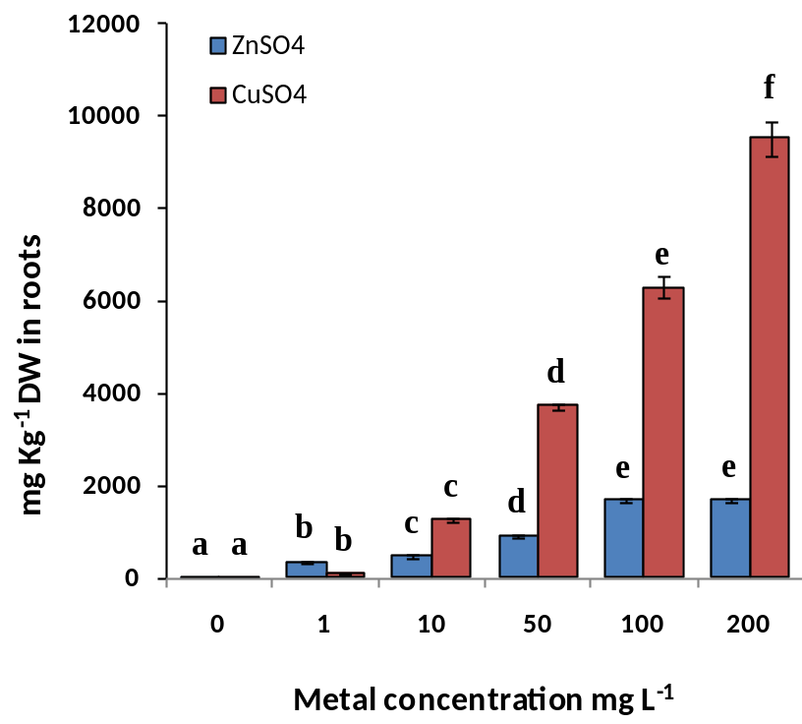
Metal accumulation
A
B
Maximum 1634.23 mg kg^{‒1} and 9516.998 mg kg^{‒1} Cu
accumulated in shoots and roots, respectively

Slide 12
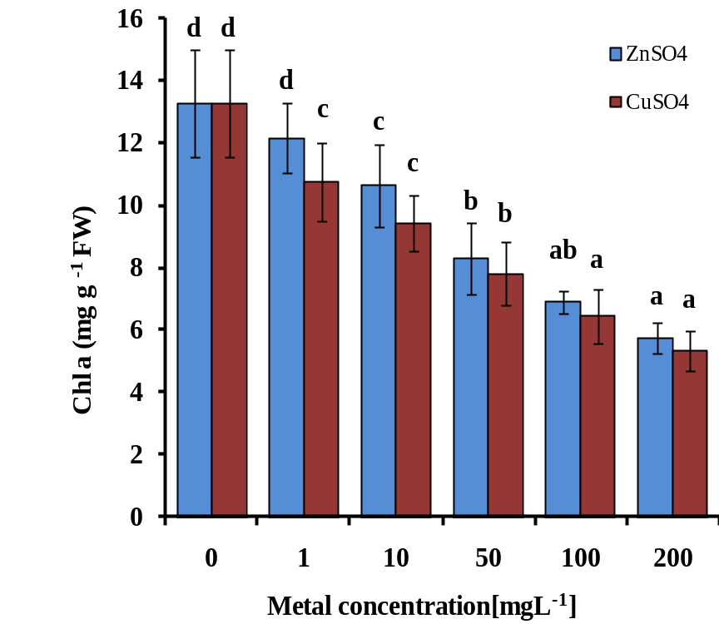
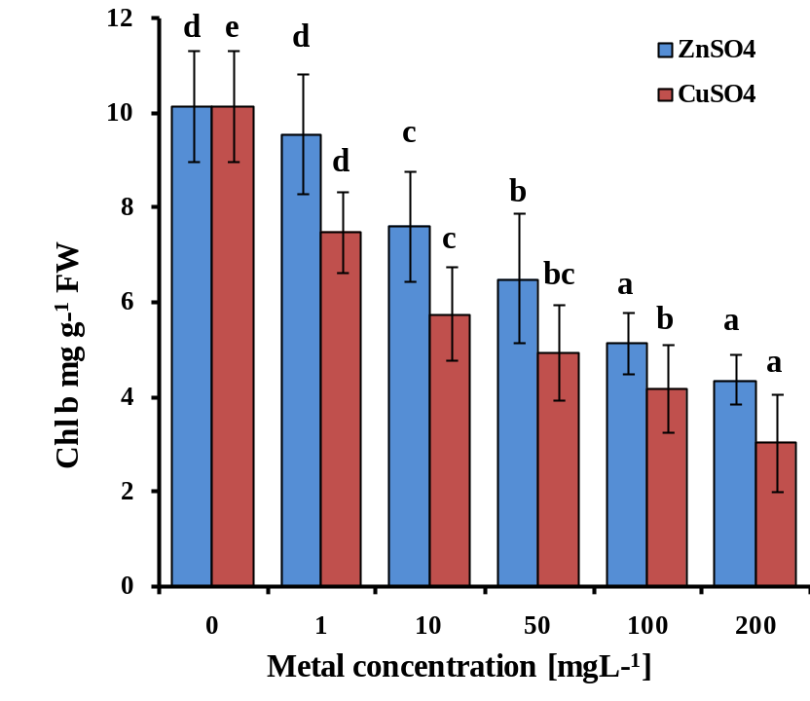
Photosynthetic pigments
A
B

Slide 13
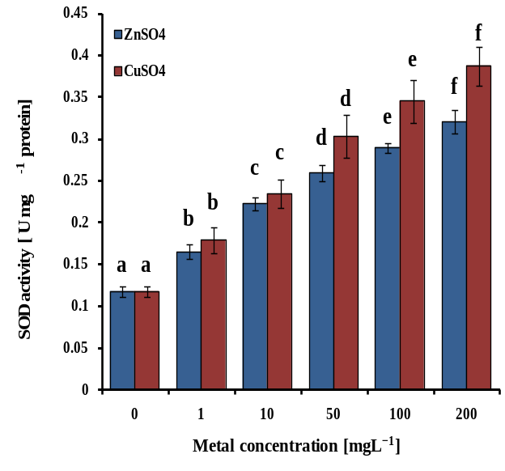
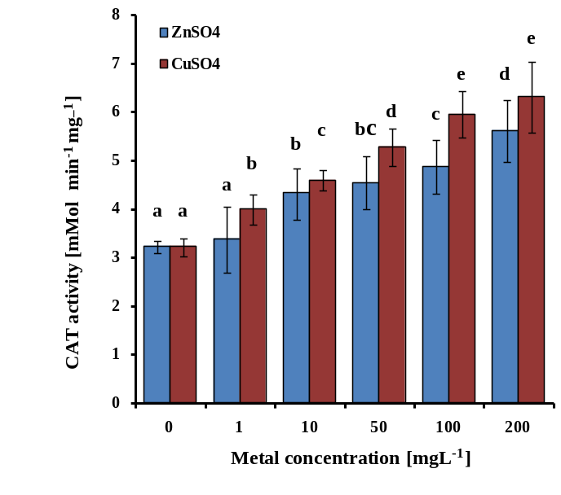
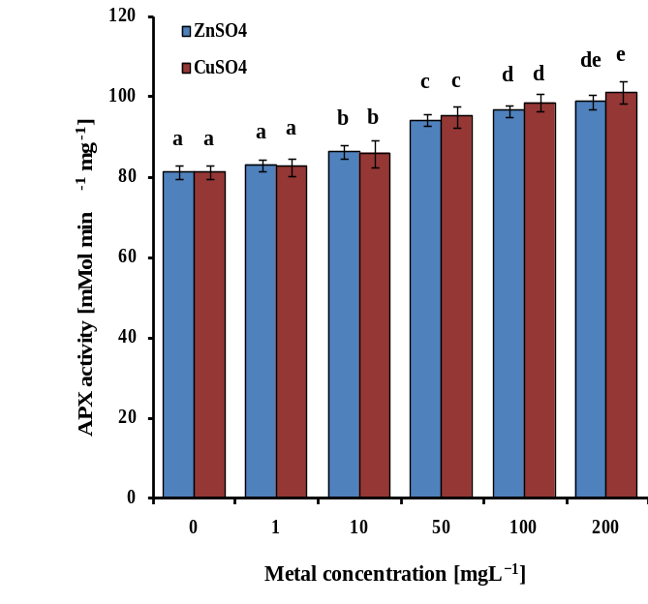
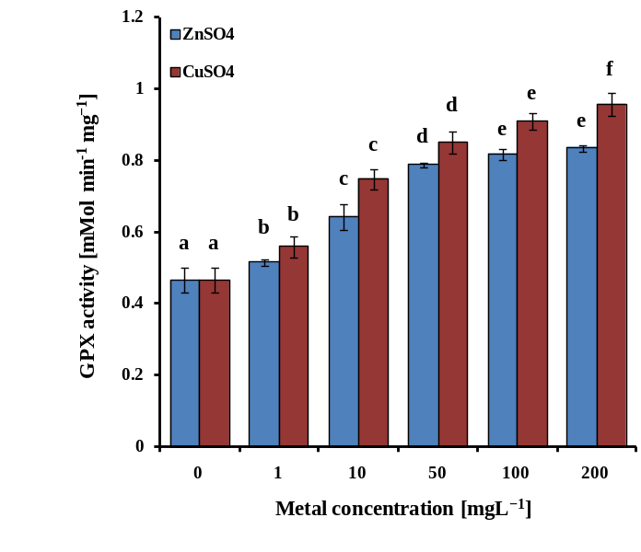
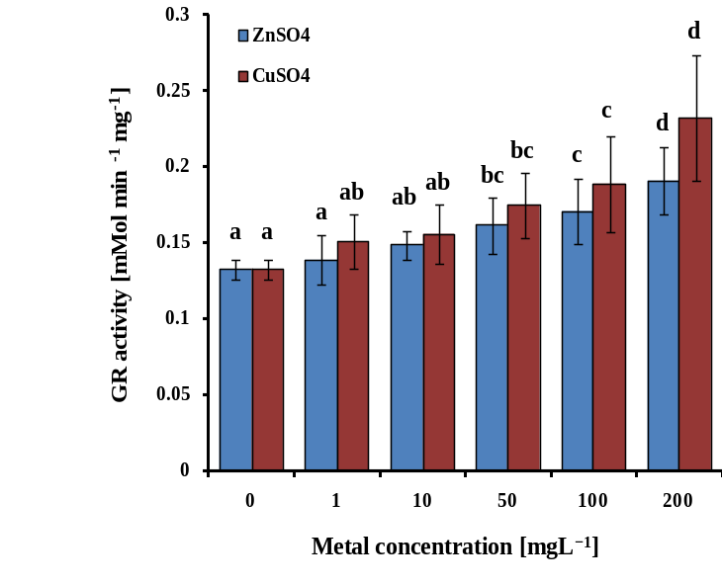
A
B
C
SOD activity
CAT activity
APX activity
GPX activity
GR activity
D
E

Slide 14
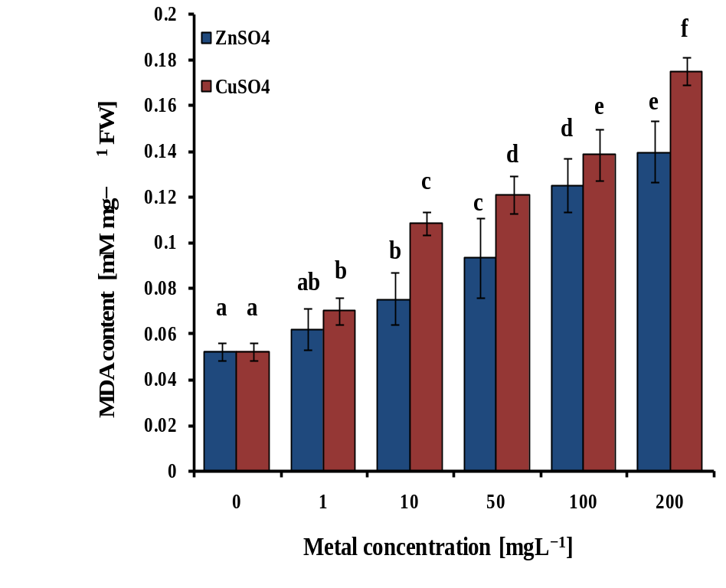
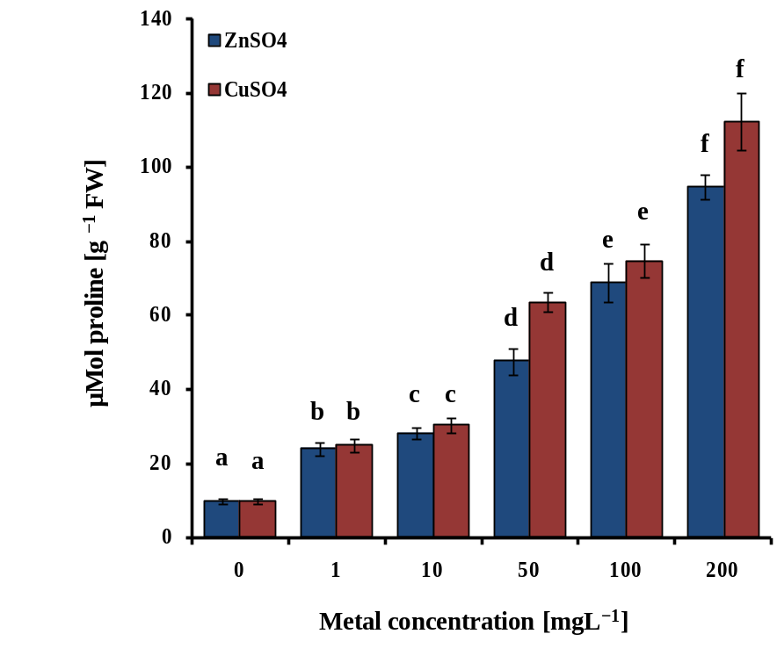
MDA and Proline content
A
B

Slide 15
Scanning Electron Microscope analysis
Control
10 mg L⁻¹ Zn
200 mg L⁻¹ Zn
Control
10 mg L⁻¹ Cu
200 mg L⁻¹ Cu

Slide 16
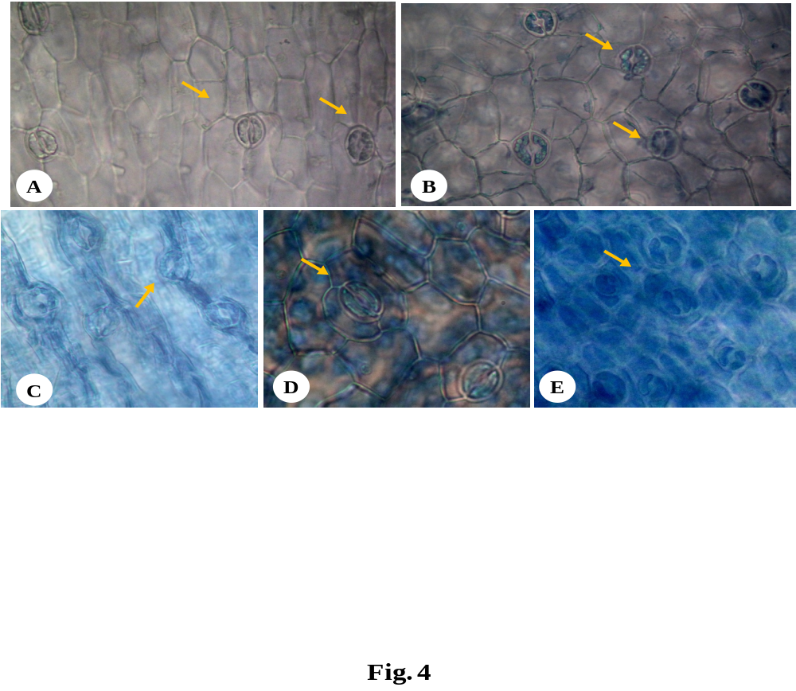
Cell death analysis by Trypan blue assay
Control B. 10 mg L⁻¹ Zn
200 mg L⁻¹ Zn D. 10 mg L⁻¹ Cu
E. 200 mg L⁻¹ Cu

Slide 17
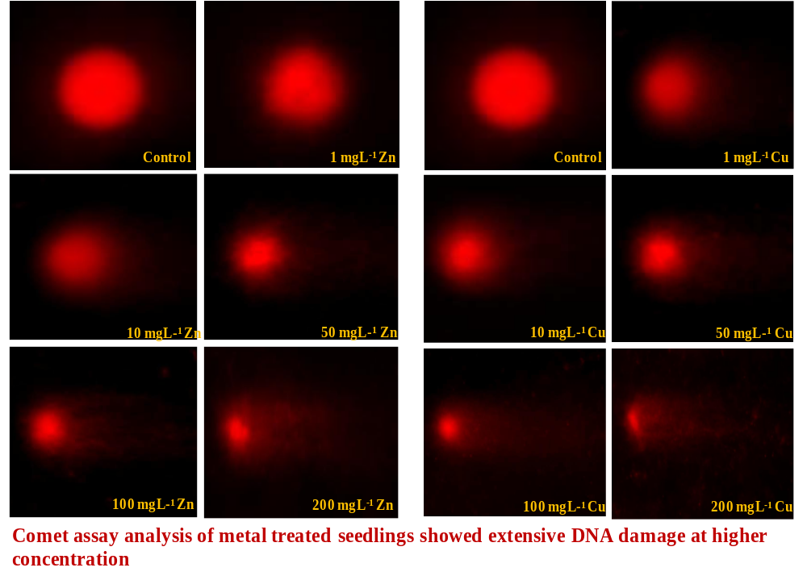
DNA damage analysis by Comet assay

Slide 18
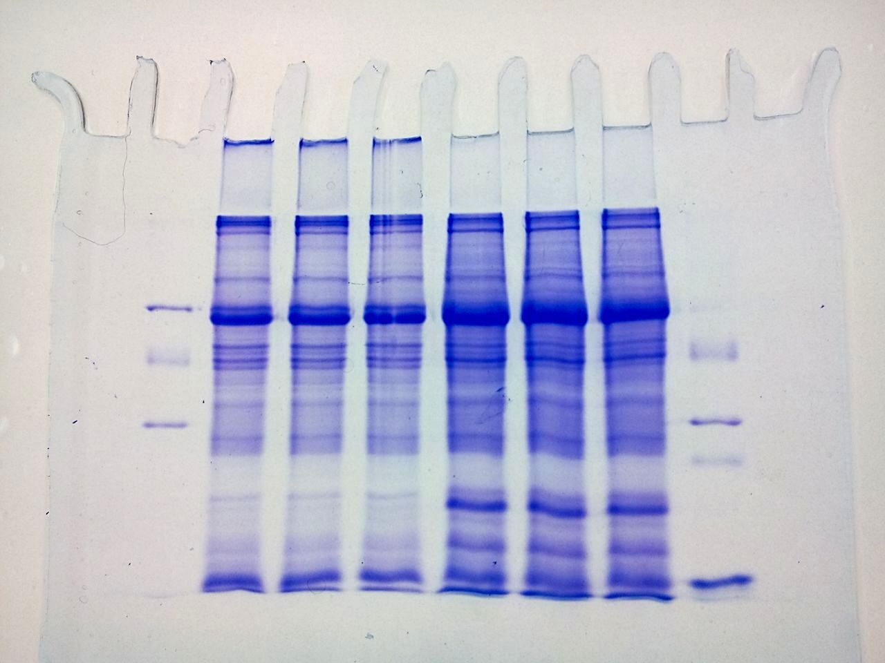
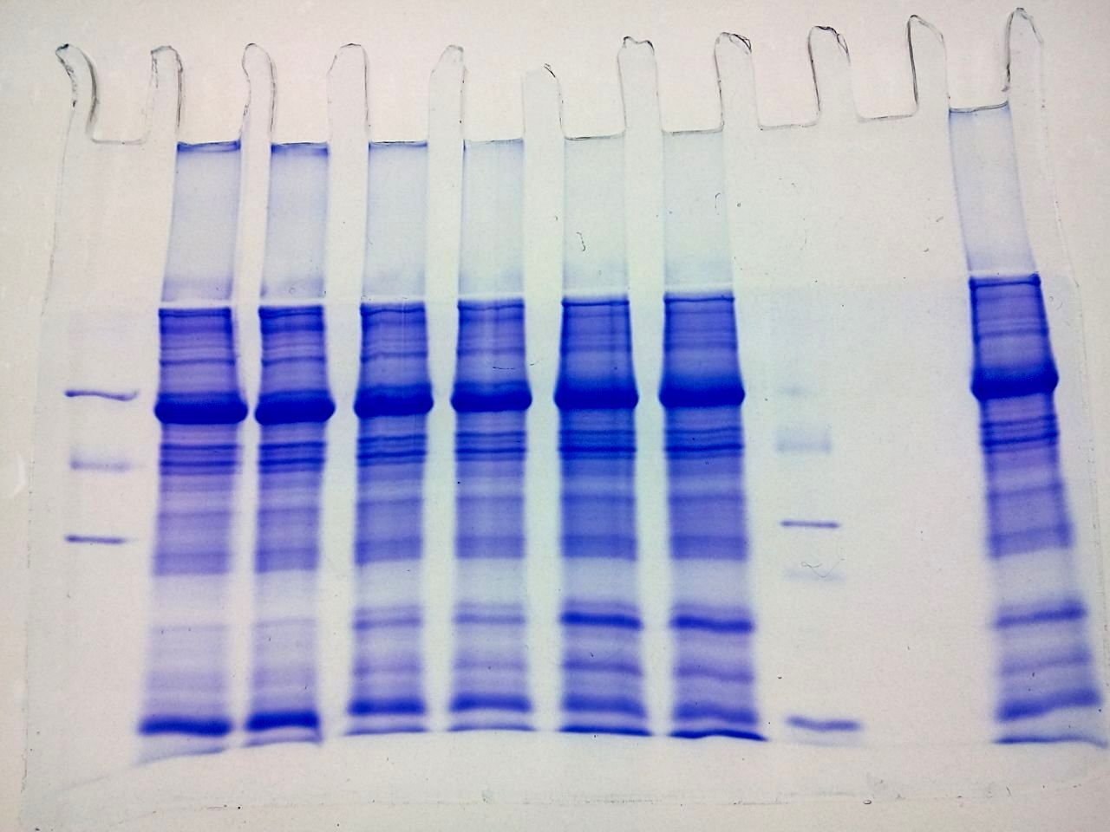
M a b c d e f M
43 kDa
29 kDa
20 kDa
14 kDa
Letters a, b, c, d, e and f represent 0, 1, 10, 50, 100 and 200 mgL⁻¹ Zn and Cu, respectively in (A) and (B).
A
M a b c d e f M
43 kDa
29 kDa
20 kDa
14 kDa
B

Slide 19
Conclusion
Zn and Cu stress reduced seedling growth, photosynthetic pigments
Induced lipid peroxidation, cell death and DNA damage at higher concentration
Caused severe ultra-stuctural changes in leaf morphology
Tolerance mechanisms such as antioxidant defence system and proline accumulation increased
High accumulation of Cu in root part indicates its potential for cleaning metal contaminated lands

Slide 20
Thank you

