Slide 1


2
The application of plant biotechnology in seed industry in the developing countries
Rajeev Taggar
Green World Genetics Sdn Bhd
Plant Science & Physiology
June 26-27, 2017 Bangkok, Thailand

Slide 2
The message
Overview of plant biotechnology
What the seed industry in developing countries actually needs
The quick and easy way to make a difference: prioritization
Gaps in the development of seed industry in developing countries
How to address the gaps

Slide 3
Contents
- Seed industry structure for biotech application
- Importance of localized small and medium scale seed industry in developing countries
- Plant biotech overview: Sections
- Technologies proven in seed industry
- Future biotech in seed industry
- Maximizing gains
- Conclusions
- References
Notes:
Expand the message into content structure of the talk

Slide 4
Seed industry structure & biotech
The indigenous seed industry
Small and medium scale seed industry
Low-investment potential
Low technological power
Large trans-national seed companies
Well established sales and marketing network
Satellite biotech support laboratories
High investment potential
High technological power

Slide 5
Importance of local seed industry
Captures a consumer niche not addressed to by the large trans-national seed companies
Biodiversity conservation
Variety in food, better catering to local tastes and requirements
Self reliance, national economy
Check monopolization in seed industry
Notes:
Okra, pak choy

Slide 6
Plant biotech overview: Sections
Seed industry (Vegetable crops, Cereals, field crops, some fruit crops and ornamentals)
Technologies: Molecular breeding, plant genetic transformation, molecular diagnostics, doubled haploids, embryo rescue
Oil palm/Trees
Technologies: Everything above, special focus micropropagation and somatic embryogenesis
Floriculture
Technologies: Special focus on Somatic embryogenesis, micropropagation, mutation breeding
Public genebanks
Technologies: Special focus on cryopreservation, tissue banking, artificial seeds
Universities and public sector research institutes
Technologies: All the above
Pharmaceuticals
Technologies: Molecular farming

Slide 7
Biotechnology in seed industry
Molecular breeding
Doubled Haploids
Plant genetic transformation
Molecular diagnostics

Slide 8
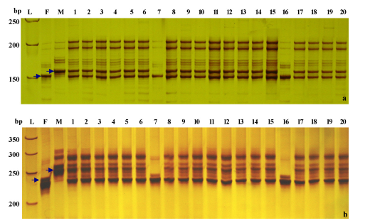
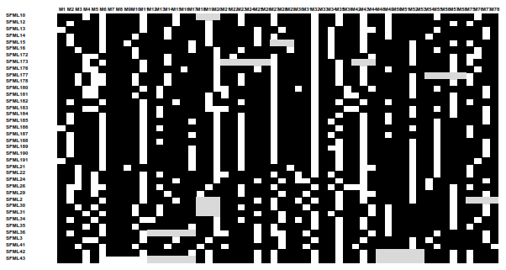
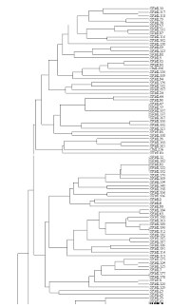
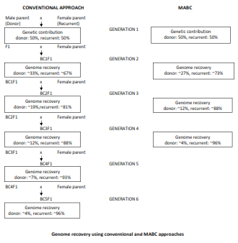
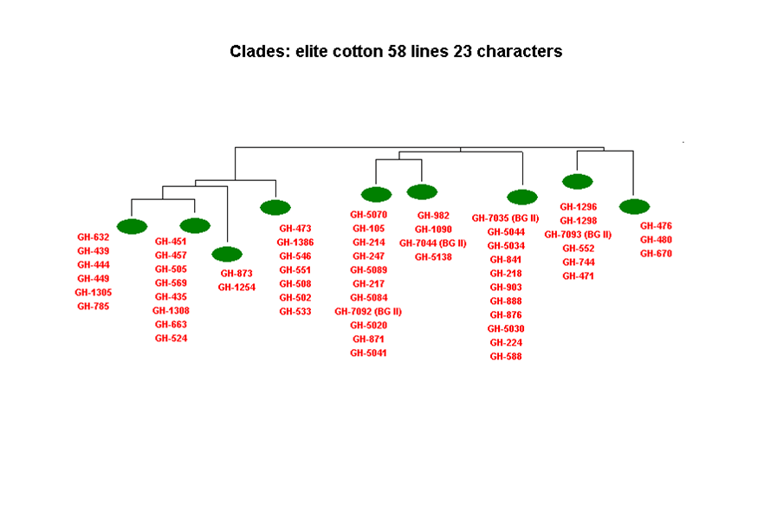
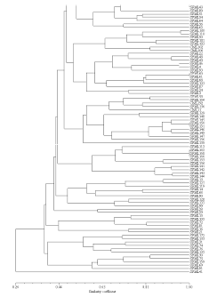

Biotech seed industry: molecular breeding
Hybrid seed purity testing
DNA fingerprinting
Marker-assisted-backcross
Marker assisted selection
Heterotic grouping

Slide 9
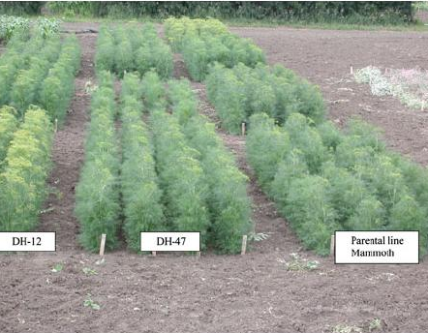
Biotech in seed industry: DH
Doubled Haploids - Uniformity

Slide 10
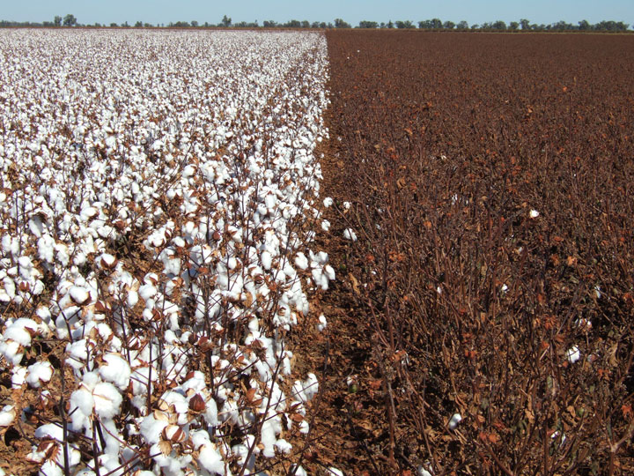
Biotech in seed industry: transgenics
Comparison of unsprayed Bt-cotton and non-Bt cotton

Slide 11
Biotech in seed industry: molecular diagnostics
Activities
Hybrid seed purity testing
Zygosity testing
Pathogen detection
Techniques
PCR-ELISA
Immuno assays / strip-tests
FISH
Microscopy
Microbiological cultures
DNA markers/probes
DNA barcdoing

Slide 12
NGS and Marker technologies
Sequencing/genotyping infrastructure not a constraint anymore
Analytics the challenge now – molecular breeding to information science
Major marker technologies now: GBS, SNPs and SSRs

Slide 13
Future trends
Big data handling – information science – molecular breeding
Cheap sequencers – Oxford Nanopore, Illumina MiniSeq
Use of a wider germplasm base – increased confidence in breaking harmful linkage drag using a dense molecular-markers coverage
Deciphering the molecular basis of heterosis – over a hundred year old riddle – clear role genetics and epigenetics – tools developing – once the mechanism discovered, dramatic improvement in hybrid crop varieties may be expected
Epigenetics – increased application - how
Climate-change-ready crops
Genome editing
DH increased use – inducer lines maize, rice

Slide 14
Maximizing gains – how?
- Time-tested and proven technologies
- Quick delivery: short timelines
- Readily available technologies
- Minimal risk in investment:
Minimal public and environmental concerns
- Minimal financial resources

Slide 15
Maximizing gains – low input industry
Molecular breeding in small & medium seed industry
Marker assisted selection/gene-stacking (MAS)
Marker assisted backcross (MABC)
Heterotic grouping
DNA fingerprinting of inbred lines
DNA fingerprinting of hybrids
Germplasm management
  Germplasm characterization
  Diversity analysis
  Screening for biotic & abiotic stress resistances
  Removal of duplicates
  Purification of germplasm accessions
Line stabilization
Hybrid seed purity testing

Slide 16
Maximizing gains – high input industry
Molecular breeding in large companies and academia
Breeding by design (BBD)
Genomics assisted breeding (GAB)
Fine-level QTL mapping
Association mapping
Genome Wide Association Studies (GWAS)
Nested association mapping (NAM)
Multiparent Advanced Generation inter-Cross (MAGIC)
Mutation breeding (TILLING/Eco-TILLING)
Genomic selection
Genome editing

Slide 17
Maximizing gains: low input v/s high input
Small & medium seed industry
Focus: proven useful technology
Marker assisted selection (MAS)
Heterotic grouping
DNA fingerprinting of inbred lines
DNA fingerprinting of hybrids
Germplasm management
  Germplasm characterization
  Diversity analysis
  Screening for biotic &
  abiotic stress resistances
  Removal of duplicates
  Purification of germplasm accessions
Line stabilization
Hybrid seed purity testing
Academia & large seed industry
Focus: Stay updated with technologies, market leader
Breeding by design (BBD)
Genomics assisted breeding (GAB)
Fine-level QTL mapping
Association mapping
Genome Wide Association Studies
(GWAS)
Nested association mapping (NAM)
Multiparent Advanced Generation Inter-Cross (MAGIC)
TILLING/Eco-TILLING
Genomic selection (GS)
Genome editing

Slide 18
Maximizing gains: low input v/s high input
Comparison
Cheap infrastructure: MiniSeq $49,500, Oxford Nanopore MinIon $1,000 base unit
Less number of markers ~300 v/s ~10,000 markers
Analytical demands relatively low
Returns on investment more assured

Slide 19
Maximizing gains – case of transgenic crops
Transgenic technology (e.g. Bt genes)
Identify, isolate and characterize protein/s of interest Protein chemistry
Make a gene construct .………………………………… Molecular biology
Develop transformation and regeneration protocols .. Cell & microbiology
Transform crop of interest, expression analysis, ……. Cell biology and
copy number analysis, insert size & sequence, molecular biology
elite event selection etc.:
Extensive environmental and biosafety testing ……… Field testing, clinical trials with animals
Regulatory approval by multiple governmental ……… Ministry of
departments Environment/ Health/ Agriculture
Introgression of gene of interest into . ..………………. Plant breeding
elite breeding lines
Develop hybrid varieties for commercialization ……… Plant breeding

Slide 20
Maximizing gains: Transgenics v/s mol breeding
Transgenic crops
Timelines:
~13 years
Commercializing the crop variety
Budget:
Major CapEx – Small companies
Can not afford, medium
companies pay massive royalties
USD 2m-10m (?, personal comm)
Public acceptance:
Difficult
Molecular breeding
Timelines:
Quality control – No time loss
Crop variety development – 3-5 years
Budget:
CapEx affordable for both small and medium biotech/seed business enterprises
Variable but a fraction of the cost incurred for GMOs
Public acceptance:
Guaranteed/ No ethical, biosafety/environmental concern

Slide 21

Maximizing gains: Public-private linkages
Seed industry
Commercial relevance
Customer benefits
Employability
New markets
Academia
Government
Technological innovations
Technical work force
Financial support Regulatory policies
The growth engine for seed industry

Slide 22
Conclusions
The local seed industry in developing country has an important role in society to compliment the large seed companies.
The low-investment-based local seed industry has its own set of biotech requirements different from those of large scale seed industry and academia.
Local seed industry in developing countries requires ear-marked support and not broad-based policy support in the name of plant biotechnology.
There is a need to synchronize government policy making, academia and seed industry.

Slide 23
References
1. Slide 5 (Hybrid seed purity testing)
Li-Wang Liu, Yan Wang, Yi-Qin Gong, Tong-Min, Zhao,Guang Liu, Xiao- Yan Li and Fan-Min Yu (2007) Assessment of genetic purity of tomato (Lycopersicon esculentum L.) hybrid using molecular markers Scientia Horticulturae 115: 7–12
2. Slide 6 (DH)
http://www.usask.ca/agriculture/plantsci/vegetable/med/mdh.htm
3. Slide 7 (Bt cotton)
http://www.learner.org/courses/lens/focus-in/2003/

Slide 24
Acknowledgement:
The German Foundation for International Development (DSE) for the exhaustive training course on plant biotechnology during
Jan 1998-May 1998

Slide 25
Thank you

