Slide 1
Modeling ER Stress and Associated disorders on the onset of Obesity
Rajat K. De
Machine Intelligence Unit
Indian Statistical Institute
Kolkata, India
E-mail: rajat@isical.ac.in

Slide 2
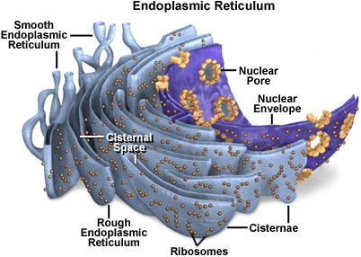
Endoplasmic Reticulum (ER)
The endoplasmic reticulum (ER) is a type of organelle in the eukaryotic cells.
It forms an interconnected network of flattened, membrane-enclosed sacs or tube-like structures known as cisternae.
The membranes of the ER are continuous with the outer nuclear membrane.
Endoplasmic reticulum occurs in most types of eukaryotic cells, including Giardia, but is absent from red blood cells and spermatozoa.
There are two types of endoplasmic reticulum: rough and smooth.
The outer (cytosolic) face of the rough endoplasmic reticulum is studded with ribosomes that are the sites of protein synthesis.
The rough endoplasmic reticulum is especially prominent in cells such as hepatocytes.
The smooth endoplasmic reticulum lacks ribosomes and functions in lipid manufacture and metabolism, the production of steroid hormones, and detoxification.
The smooth ER is especially abundant in mammalian liver and gonad cells.

Slide 3
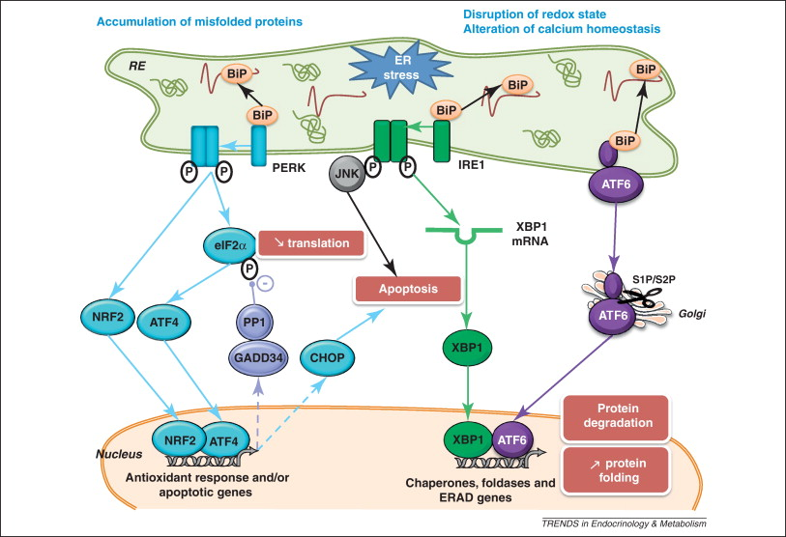
ER Stress
It is the disturbances in the normal functions of the ER.
It leads to an evolutionarily conserved cell stress response, the unfolded protein response.
It can eventually trigger cell death if ER dysfunction is severe or prolonged.
The mechanisms by which ER stress leads to cell death remain unclear.
Important roles for ER-initiated cell death pathways have been recognized for several diseases, including hypoxia, ischemia/reperfusion injury, neuro-degeneration, heart disease, and diabetes.

Slide 4
ER Stress
During the process of protein folding, any intermediate folded protein may get mis-folded.
Chaperons are the molecules that are responsible for proper folding of protein.
Accumulation of mis-folded proteins, induced by externally or internally, leads to ER stress
ER stress signaling pathway involves three main ER transmembrane proteins, viz., PERK1, IRE-12 and ATF63, which together promote expression of genes that are important for increasing protein folding and degradation. This is done by following three ways.
  By increasing the production of molecular chaperones, e.g., BiP.
  By increasing the rate of ERAD system by activating expression of several genes associated with ERAD system. As a result, more misfolded proteins can move from ER to the cytosol where they are degraded by proteosomes.
  By inducing the translational attenuation of proteins via the PERK protein kinase pathway so that ER gets time to remove the load of already synthesized misfolded proteins.

Slide 5
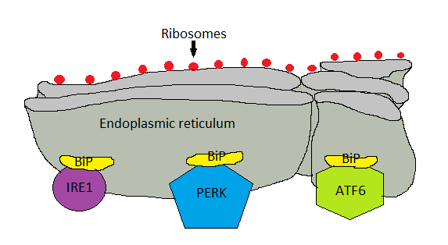
During normal condition i.e. when there is no load of mis-folded proteins I ER, the three pathway of ER stress pathway is inactive due to binding of BiP/GPR78.

Slide 6
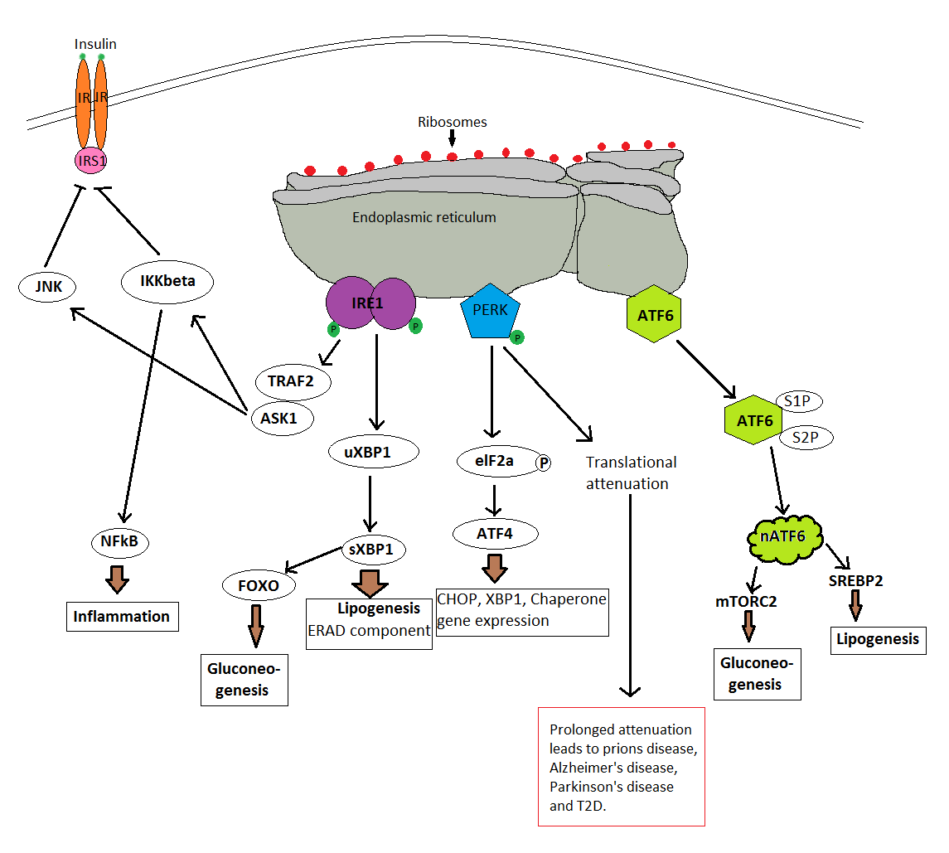

Slide 7
ER stress and Type 2 Diabetes
ER stress develops Type 2 diabetes by several ways:
By inhibiting insulin receptor substrate 1 (IRS-1) by JNK and IKKbeta pathway.
During normal ER stress PERK promotes translational attenuation through phosphorylation of elF-2a. Prolonged attenuation can lead pancreatic beta cell damage.
elF-2a also responsible for synthesis of proteins that are responsible for apoptosis. In normal situation, the apoptosis helps to reduce the burden of cellular defects but prolonged ER stress lead to pancreatic beta cell apoptosis

Slide 8
Obesity
  Obesity is characterized by increased body mass index (BMI) and chronic low level inflammation.
  Obesity associated inflammation affects end organs and results in various diseases, known as obesity associated co-morbid diseases.

Slide 9
Obesity initiates inflammation by many ways
Altering gut-microbiota
Presence of pathogen associated molecular patterns (PAMPs) in junk diet taken
Alteration of adipokine secretion
Increasing free fatty acids in plasma
Activating reactive oxygen species (ROS)
Inducing endoplasmic reticulum stress (ER stress)

Slide 10
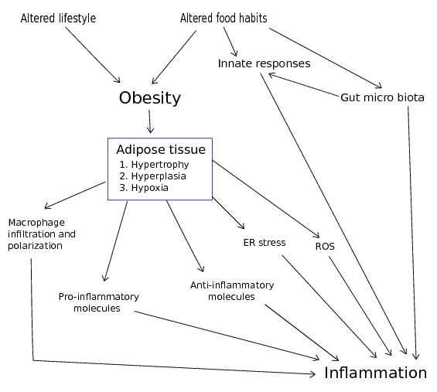

Slide 11
How does ER stress get activated with the onset of obesity?
Obesity increases free fatty acids (FFA) in plasma.
FFA is a factor that causes ER stress.
Increasing evidence points to the ratio of phosphatidylcholine (PC) and phosphatidylethanolamine (PE) in ER membrane composition leads to perturbation in the calcium (Ca+) transport activity of the SERCA pumps resulting in impaired ER calcium retention.
Since calcium is necessary for ER homeostasis and chaperone function, changes in calcium concentrations lead to protein misfolding and ER stress.

Slide 12
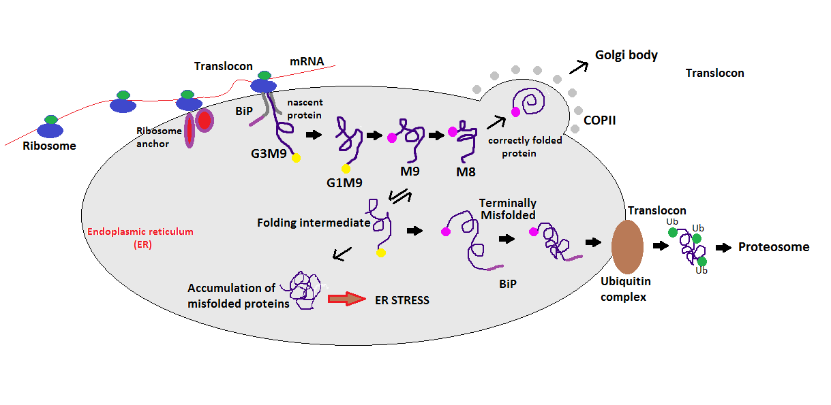
The process of protein folding
Nascent protein enters ER through translocon with the help of ribosome anchor. Nascent
protein gets glycosylated as it matures and gets correctly folded. Any of the folding
intermediates can get misfolded and it gets detected by Ubiquitin-proteosomal complex (UPS) and chaperons.

Slide 13
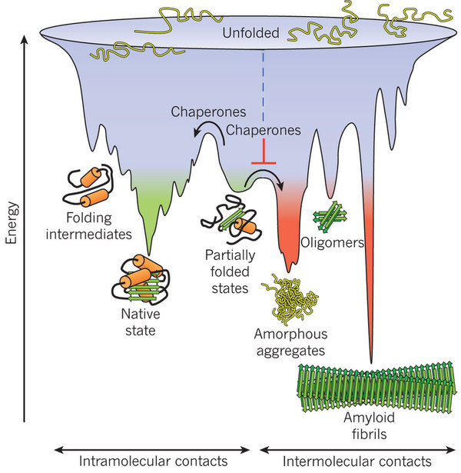
Free energy landscape of protein folding
Hartl FU, Bracher A, Hayer-Hartl M. Molecular chaperones in protein folding and proteostasis. Nature. 2011 Jul 21;475(7356):324-32.

Slide 14
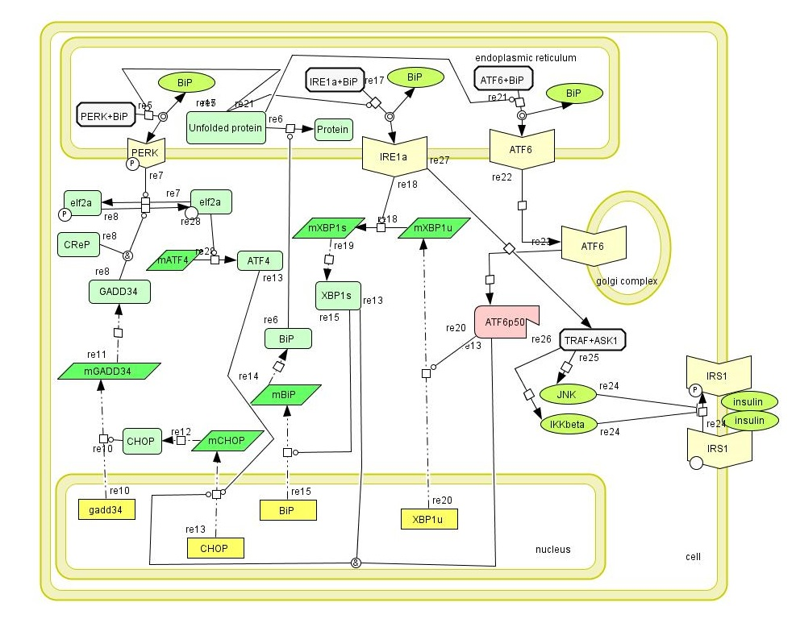
The CellDesigner model for simulation

Slide 15
Definition of Systems Biology
(http://en.wikipedia.org/wiki/Systems_biology)
Interactions between the components of a biological system
ways these interactions give rise to the functions and behavior of that system
Systems biology approach is characterized by a cycle of theory, computational modeling and experiment to quantitatively describe cells or cell processes

Slide 16
Approach for solving a problem in systems biology: Four key parameters
(Kitano (2002), Science)
System structure: networks of gene interactions, biochemical pathways
System dynamics: behavior of a system over time under various conditions, e.g., time series microarray gene expression data for gene regulatory networks
Control method: minimizing malfunctions and providing potential therapeutic targets for treatment of disease
Design method: strategies to modify and construct biological systems having desired properties

Slide 17
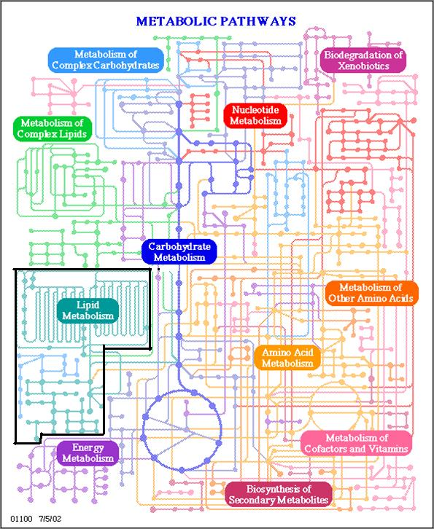
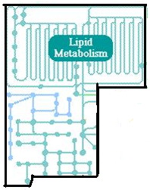
An example

Slide 18
Categorization of methodologies for metabolic pathway analysis
Structural and Stoichiometric modeling
Kinetic Modeling
Network based
Constraints based
Discrete
Continuous
Hybrid modeling
Hypergraph-based
rFBA
Logical-based
ODE-based
Hybrid systems
EM/EP based
srFBA
Petri-Nets (PNs)
Hybrid
Functional PNs
iFBA
idFBA

Slide 19
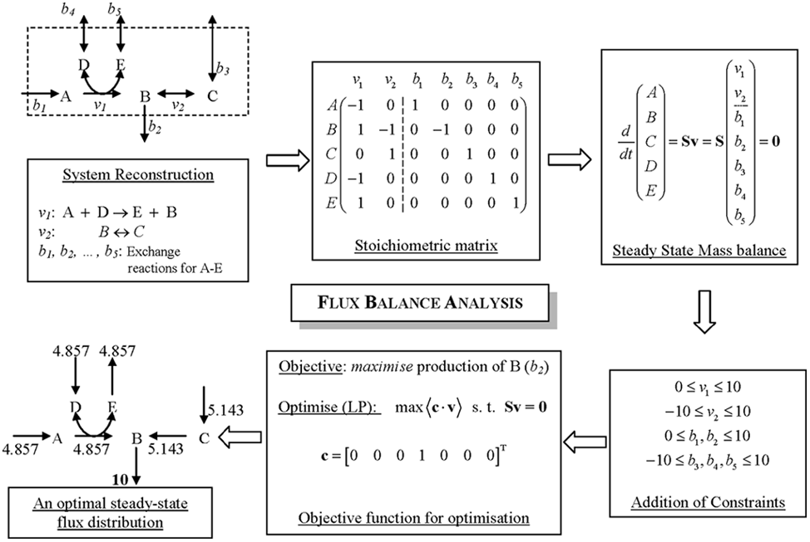
Flux Balance Analysis
(Raman and Nagasuma, Briefings in Bioinformatics (2009))

Slide 20
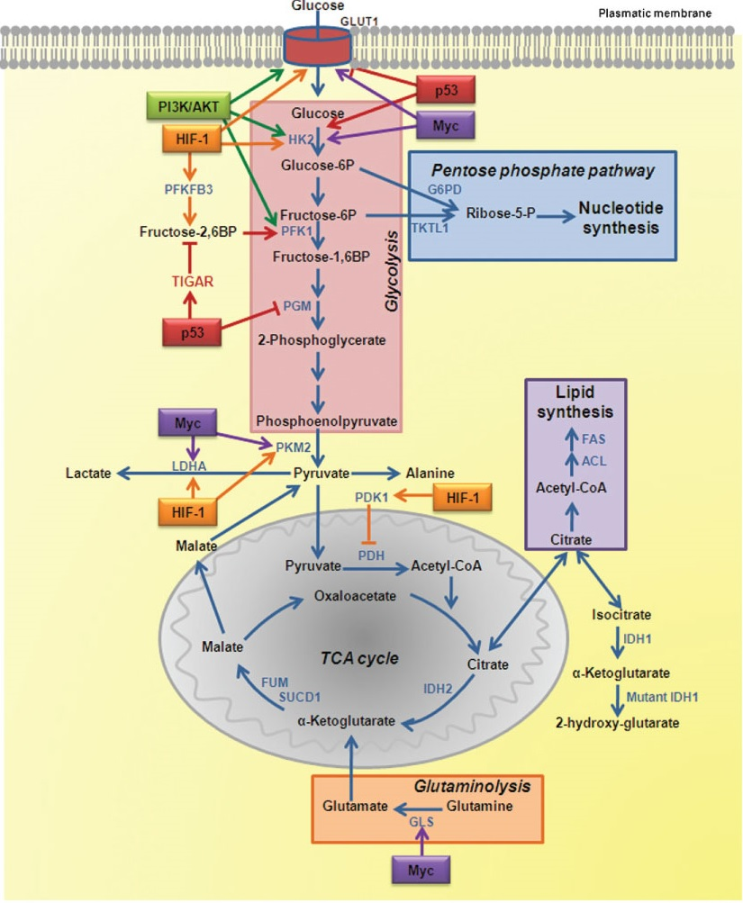
Can type 2 diabetes trigger cancer?

Slide 21
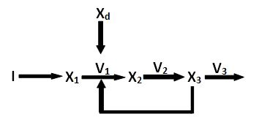
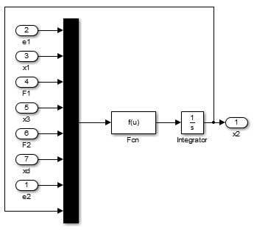

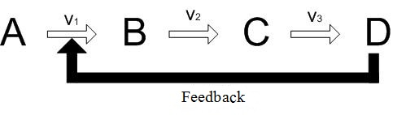
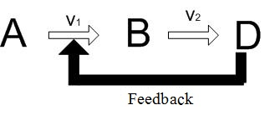


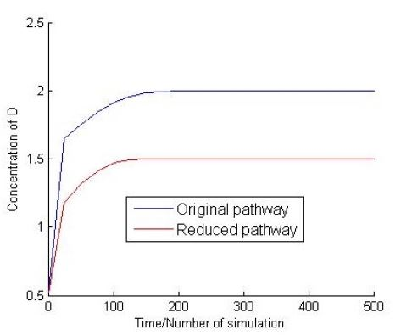

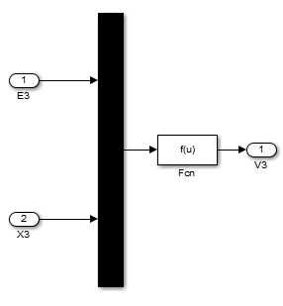
Methodology
(Paul, Dasgupta, De, Plos One, 2015)
Proposed modelling CCM and HIF1α signaling pathway
Order reduction
Stoichiometric matrix
Modifying Michaelis Menten kinetic equation
State vector and output vector
Simulink model
Order reduction
Stoichiometric matrix
Michaelis Menten Kinetics
State vector
State subsystem
Output vector
Modified
Michaelis Menten Kinetics
or
Output subsystem

Slide 22
Order reduction
Stoichiometric matrix
Similarly, We have defined the stoichiometric matrix for CCM pathway.

Slide 23

Modifying Michaelis Menten kinetic equation
Michaelis Menten Kinetics
Modified Michaelis Menten Kinetics
If X₁ is consumed in a reaction which is inhibited by a substrate X₂ then,
Here,
V = initial reaction rate.
[X]= the concentration of a substrate X.
V_{max} (=K.[E])= maximum reaction rate at maximum substrate
concentration.
K_{m}= Michaelis constant.
K= Rate constant.
[E]= concentration of enzyme catalyzing the corresponding reaction.
If X₃ accelerates a reaction that consumes X_{1.}
Here F (feedback constant) determines relative inhibition/acceleration power of a substrate. F lies in (0,1).
State vector and output vector
State space model for a nonlinear system is defined by,
The resultant nonlinear state space representation of a metabolic pathway can be represented by,
x = state.
u = control input.
Let us consider a metabolic pathway comprising m metabolites and n reactions. The metabolic pathway can be represented by,
N = stoichiometric matrix.
V = flux vector ( function of metabolites (x)
(state) and kinetic parameters.

Slide 24
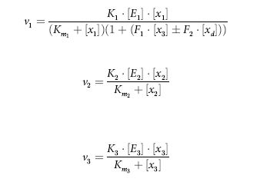
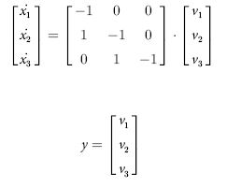
Simulink Model with Example
As depicted in the hypothetical pathway, let the flux vector be v = [v₁ v₂ v₃]^{T} and metabolite concentration vector be x = [x₁ x₂ x₃]^{T}, while I is the input substrate. The term x_{d} is a perturbation which either inhibits the reaction/enzyme or activates it. Each reaction flux of v₁, v₂ and v₃ is modelled using modified Michaelis-Menten kinetic equation.
Finally, the state space model is obtained by
Model of a hypothetical pathway
No perturbation

Slide 25
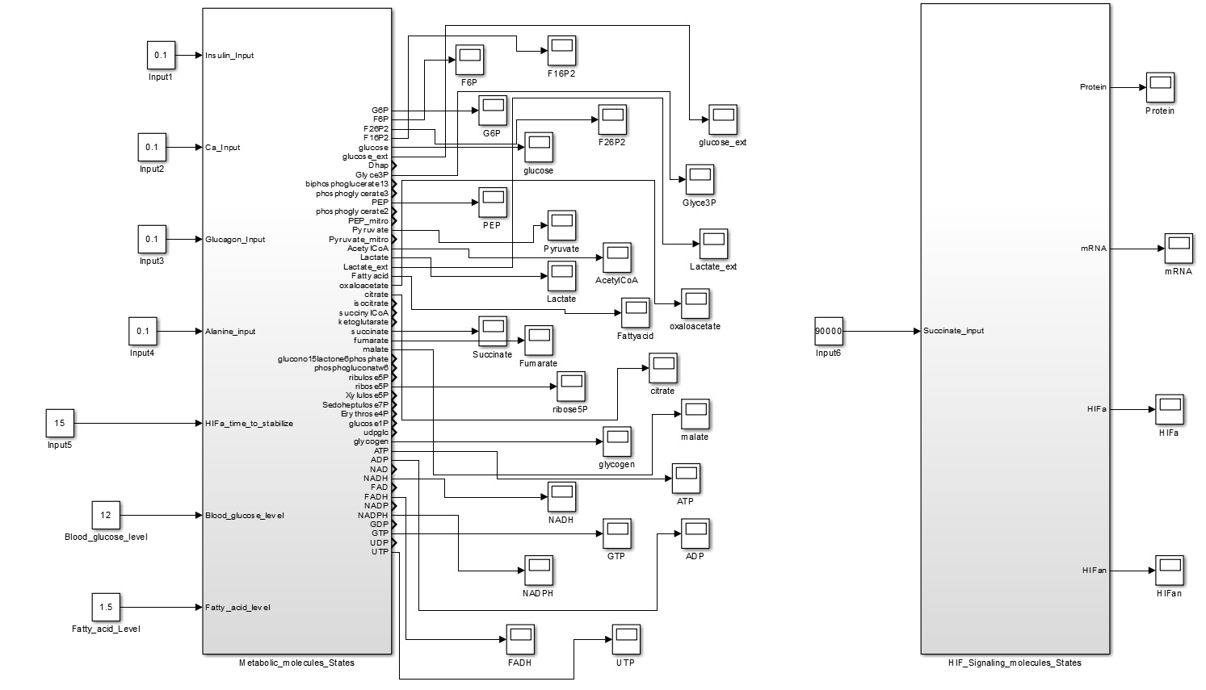
Proposed modelling CCM and HIF1α signaling pathway

Slide 26
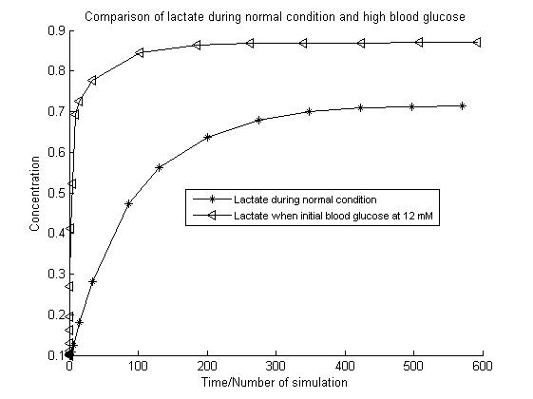
Modelling CCM and HIF1α signaling pathway
Results

Slide 27
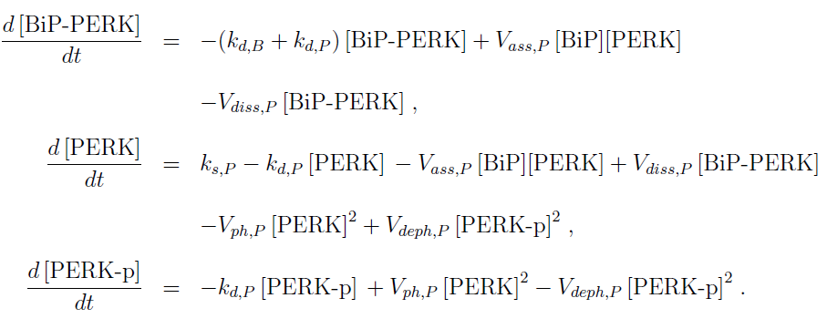
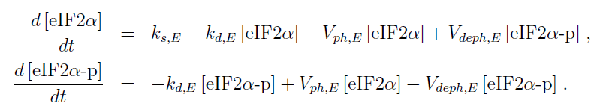
The PERK cascade:
The elF2a cascade :

Slide 28
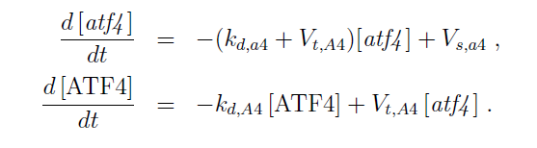
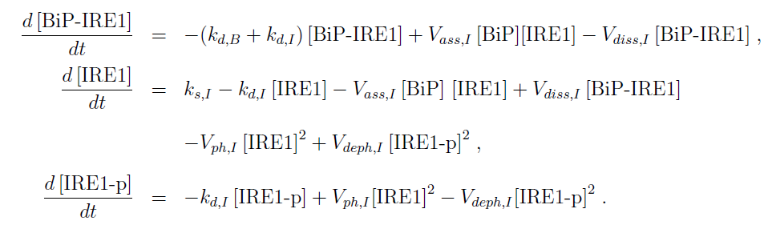
The ATF4 cascade:
The IRE1 cascade:

Slide 29
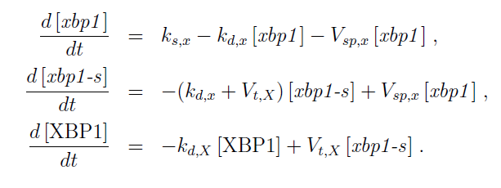
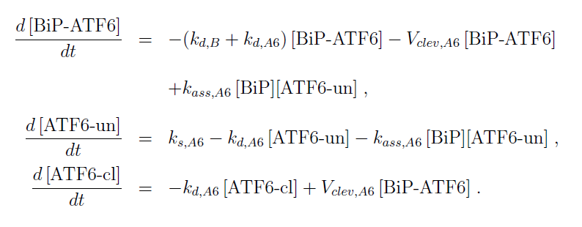
The xbp1 cascade:
The ATF6 cascade:

Slide 30
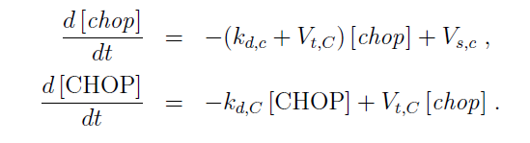
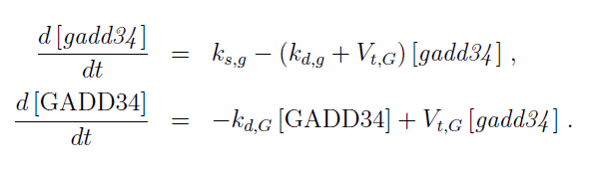
ODE of CHOP and gadd34:

Slide 31
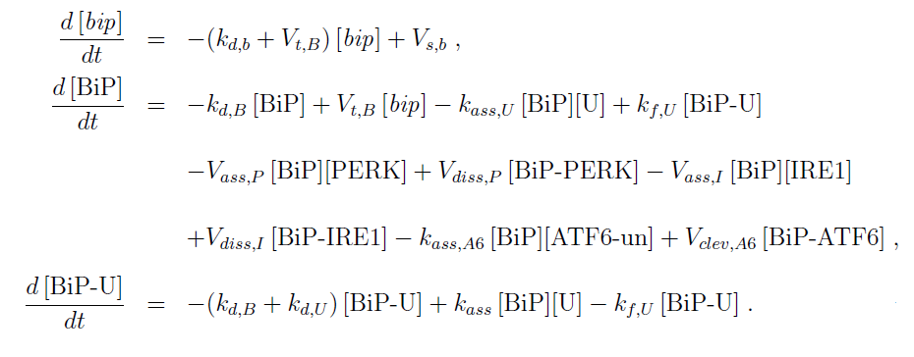

ODE for BiP:
ODE for unfolded protein:

Slide 32
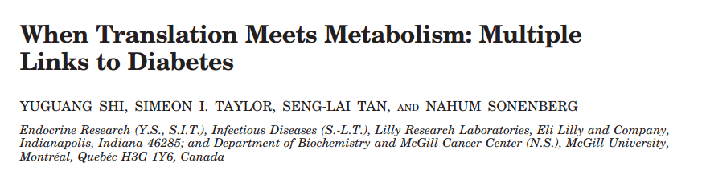
eIF2a Phosphorylation and Hepatic Glucose Output.
eIF4E Binding Protein and Insulin Sensitivity.
S6K1 and Pancreatic -Cell Function.
Translational Control of CD36 Expression and Diabetes-induced Atherosclerosis.

Slide 33
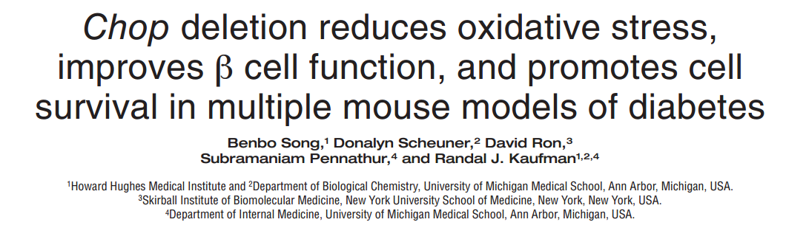
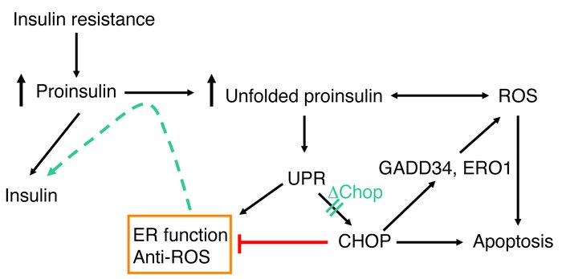

Slide 34
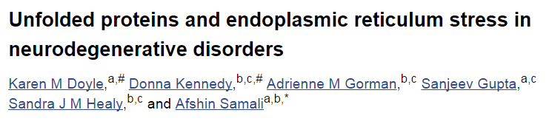
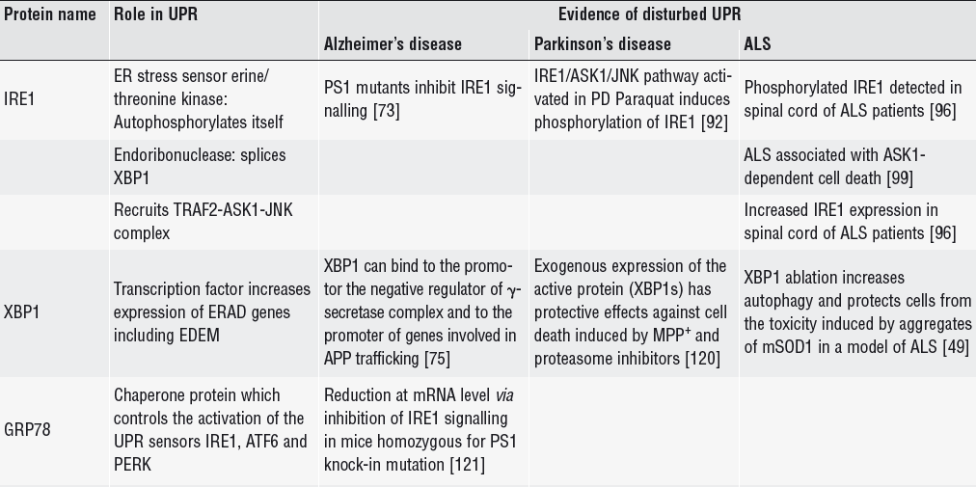

Slide 35
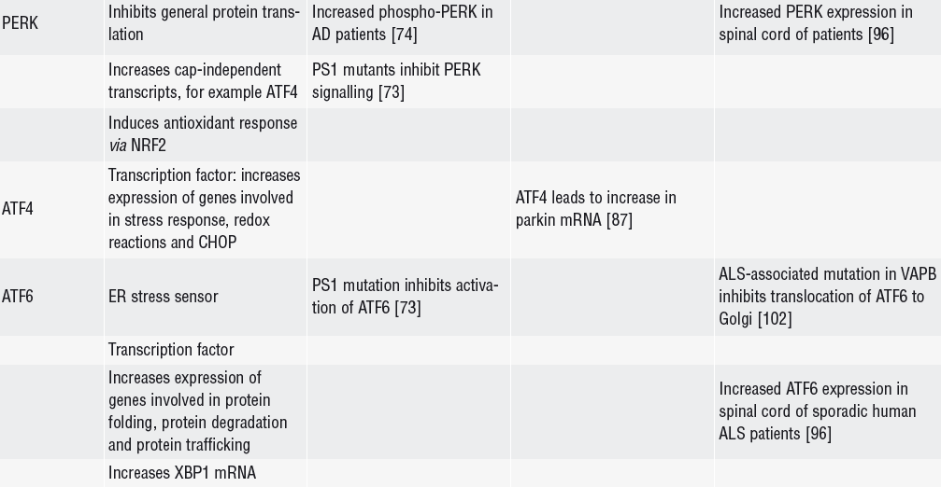
Table contd.

Slide 36
References
Harding, Heather P., et al. "Diabetes mellitus and exocrine pancreatic dysfunction in perk−/− mice reveals a role for translational control in secretory cell survival," Molecular Cell 7.6 (2001): 1153-1163.
Harding, Heather P., et al. "Diabetes mellitus and exocrine pancreatic dysfunction in perk−/− mice reveals a role for translational control in secretory cell survival," Molecular Cell 7.6 (2001): 1153-1163.
Harding, Heather P., et al. "Perk is essential for translational regulation and cell survival during the unfolded protein response," Molecular Cell 5.5 (2000): 897-904.
Smith, Heather L., and Giovanna R. Mallucci. "The unfolded protein response: mechanisms and therapy of neurodegeneration," Brain (2016): aww101.
Liu, Zhong-Wei, et al. "Protein kinase RNA-like endoplasmic reticulum kinase (PERK) signaling pathway plays a major role in reactive oxygen species (ROS)-mediated endoplasmic reticulum stress-induced apoptosis in diabetic cardiomyopathy," Cardiovascular Diabetology 12.1 (2013): 1.
Özcan, Umut, et al. "Endoplasmic reticulum stress links obesity, insulin action, and type 2 diabetes," Science 306.5695 (2004): 457-461.

Slide 37
Thank you !!

