Slide 1



From Simple Chemical Building Blocks to Biological Active Molecules
Raffaella Mancuso
Dipartimento di Chimica e Tecnologie Chimiche, Università della Calabria,
87036 Arcavacata di Rende (Cosenza) Italy
.
raffaella.mancuso@unical.it

Slide 2
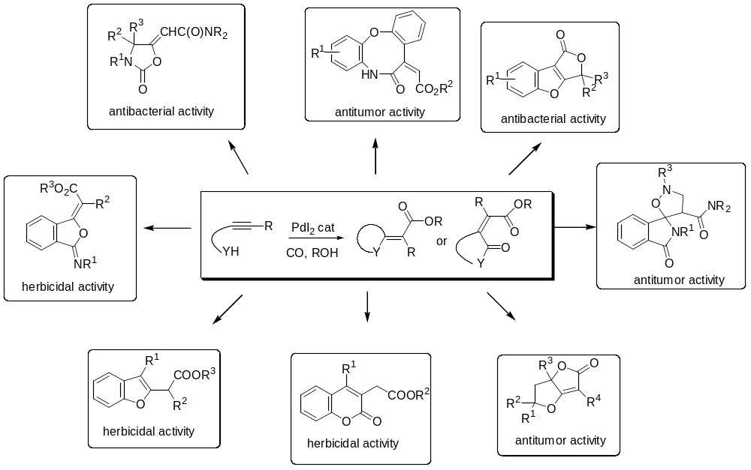

ANTITUMOR MOLECULES
ANTIBACTERIAL MOLECULES
HERBICIDAL MOLECULES

Slide 3

Background: PdI₂-Catalyzed Oxidative Carbonylation for the Synthesis of Heteocyclic Molecules
CARBONYLATION
Carbonylation process is the incorporation of carbon monoxide into an organic substrate.
Carbon monoxide is a relatively inert molecule, so carbonylation usually need to be carried out in the presence of a suitable metal catalyst
-Substitutive Carbonylation
-Additive Carbonylation
-Reductive Carbonylation
-Oxidative Carbonylation

Slide 4
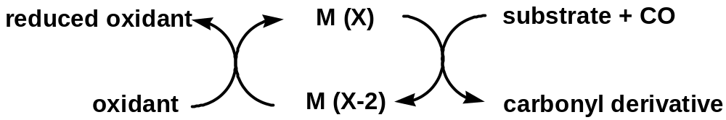
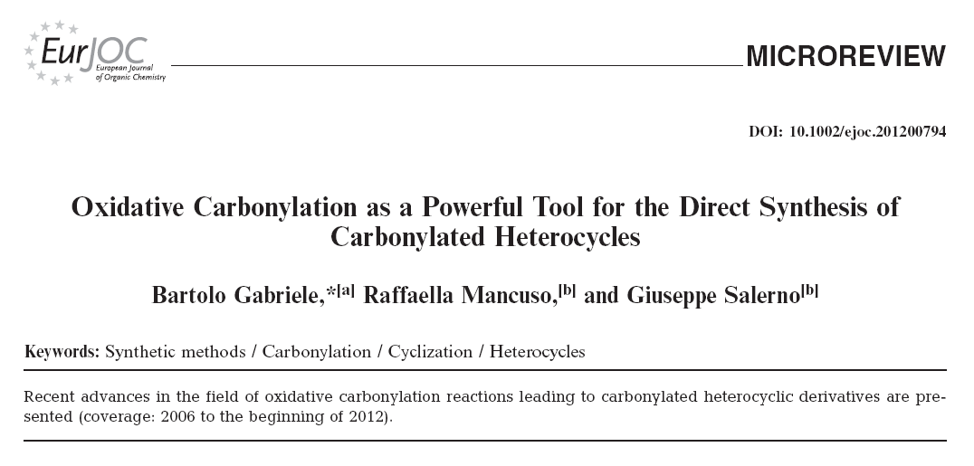
DEFINITION OF OXIDATIVE CARBONYLATION

Slide 5
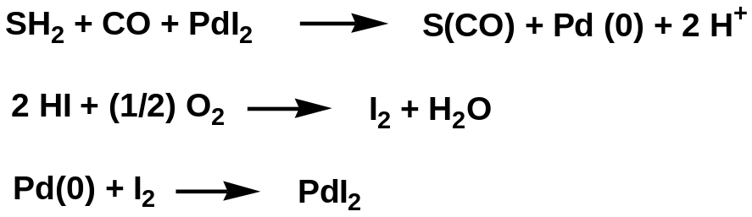


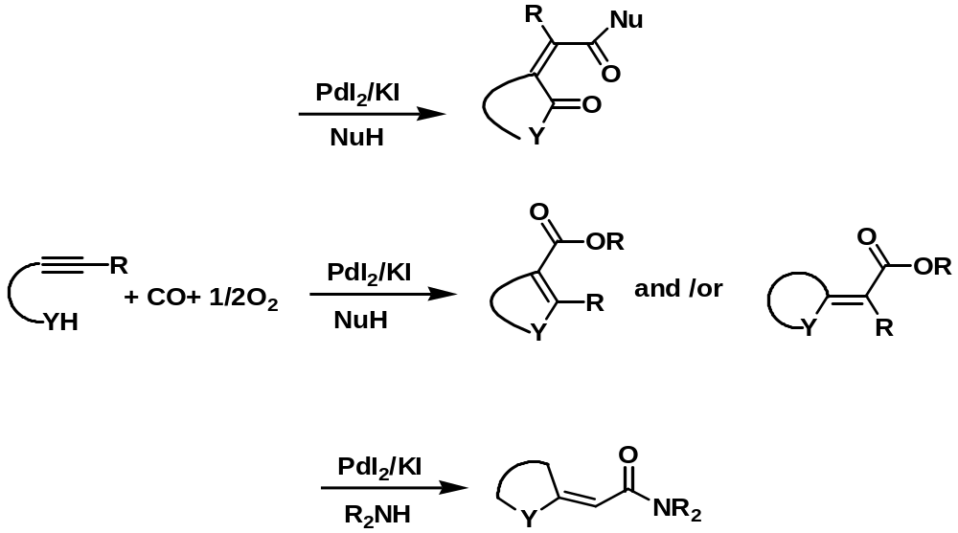
PdI₂-Catalyzed Oxidative Carbonylation of Acetylenic Substrate Leading to Carbonylated Heterocycles
cyclocarbonylation/alkoxycarbonylation
heterocyclization/alkoxycarbonylation
monoaminocarbonylation of terminal triple bond followed by intramolecular conjugate addition

Slide 6
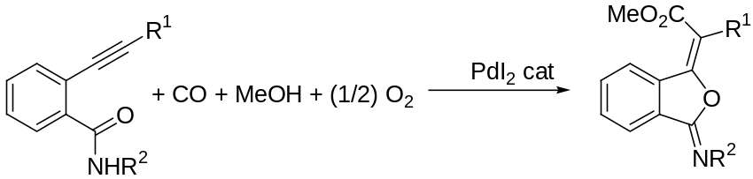
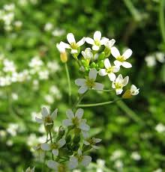
Synthesis of Herbicidal and Antitumor Molecules
by PdI₂-Catalyzed Oxidative Carbonylation
New Natural-Like Erbicides
In modern agriculture the control of weeds is one of the goals to maximize crop yield and quality
Weeds compete with crops for:
-water
-nutrients
-space
-sunlight
Many weeds are the hosts of phatogens:
-viruses
-fungi
-insects
3-(Methoxycarbonylmethylene)-isobenzofuran-1-imines:
a New Class of Synthetic Herbicides
Isobenzofuranimines induce strong phytotoxic effect on both shoot and root systems of Arabidopsis thaliana
Arabidopsis thaliana
R. Mancuso, I. Ziccarelli, D. Armentano, N. Marino, S.V. Giofrè, B. Gabriele, J. Org. Chem., 2014, 79, 3506-3518
F. Araniti, R. Mancuso, I. Ziccarelli, F. Sunseri, M. R. Abenavoli, B. Gabriele, Molecules, 2014, 19, 8261-8275

Slide 7
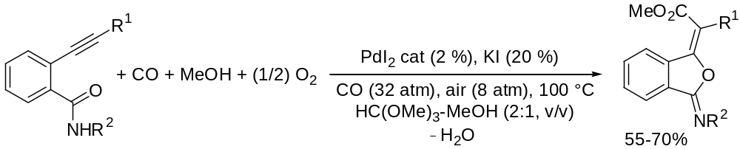
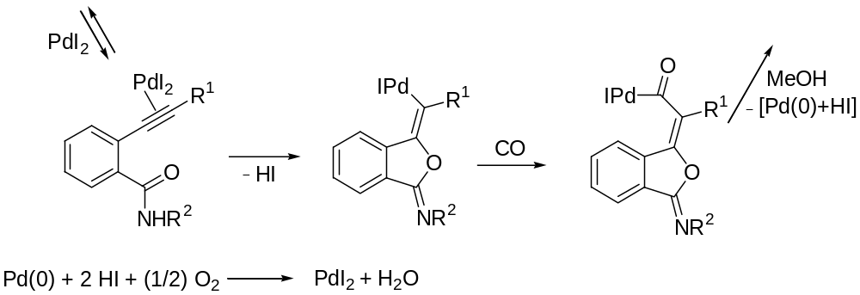
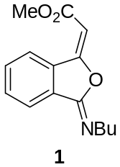
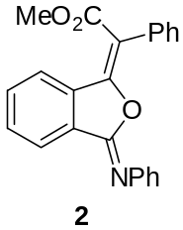
3-(Methoxycarbonylmethylene)-isobenzofuran-1-imines:
a New Class of Synthetic Herbicides
Heterocyclization/
alkoxycarbonylation
R. Mancuso, I. Ziccarelli, D. Armentano, N. Marino, S.V. Giofrè, B. Gabriele, J. Org. Chem., 2014, 79, 3506-3518
F. Araniti, R. Mancuso, I. Ziccarelli, F. Sunseri, M. R. Abenavoli, B. Gabriele, Molecules, 2014, 19, 8261-8275

Slide 8
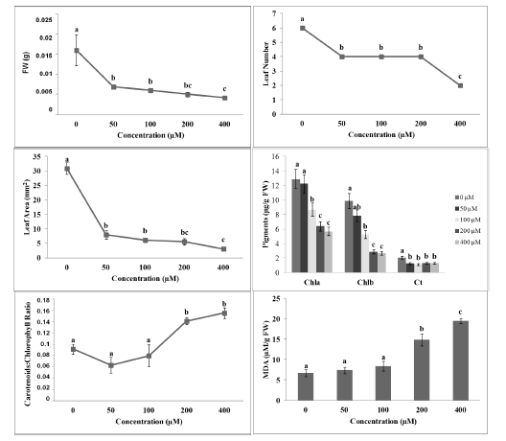
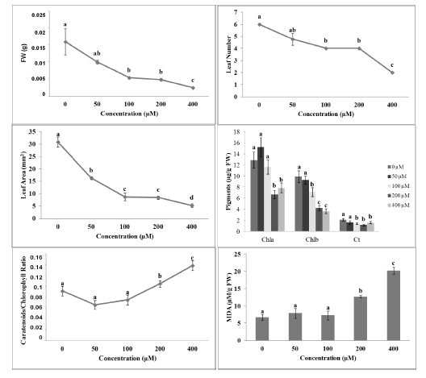
Effects of 3-(Methoxycarbonylmethylene)isobenzofuran-1-imines 1 and 2 on A. thaliana Shoot Morpho-Physiological Parameters
Figure 1. Morpho-physiological parameters of A. thaliana seedlings treated with different concentrations of compound 1: Shoot Fresh Weight (SFW), Leaf Number (LN), Leaf Area (LA), pigments content, Carotenoids: Chlorophyll Ratio and MDA content.
Figure 2. Morpho-physiological parameters of A. thaliana seedlings treated with different concentrations of the compound 2: Shoot Fresh Weight (SFW), Leaf Number (LN), Leaf Area (LA), pigments content, Carotenoids:Chlorophyll Ratio and MDA content.
Simultaneous decrease in:
-shoot fresh weight
-leaf number
-leaf area
Both molecules reduced the pigments contents:
-chlorofyll a and b
-carotenoids
F. Araniti, R. Mancuso, I. Ziccarelli, F. Sunseri, M. R. Abenavoli, B. Gabriele, Molecules, 2014, 19, 8261-8275

Slide 9
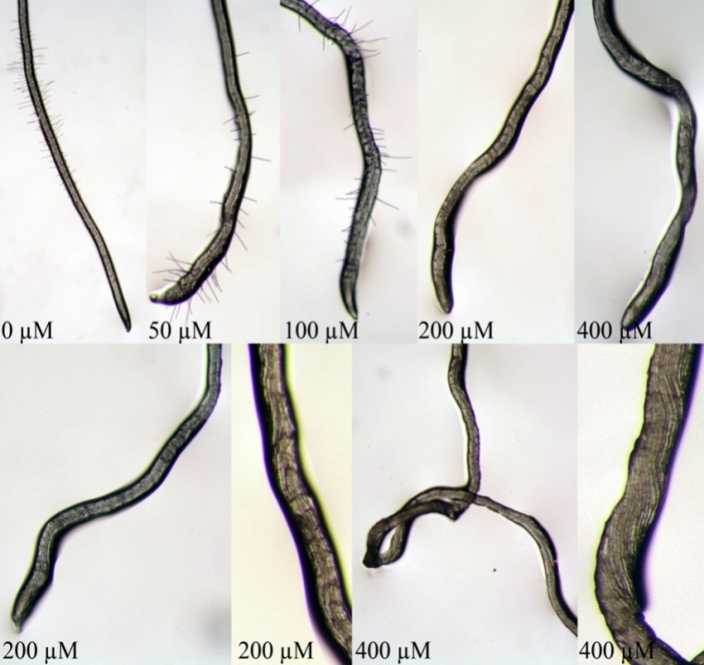
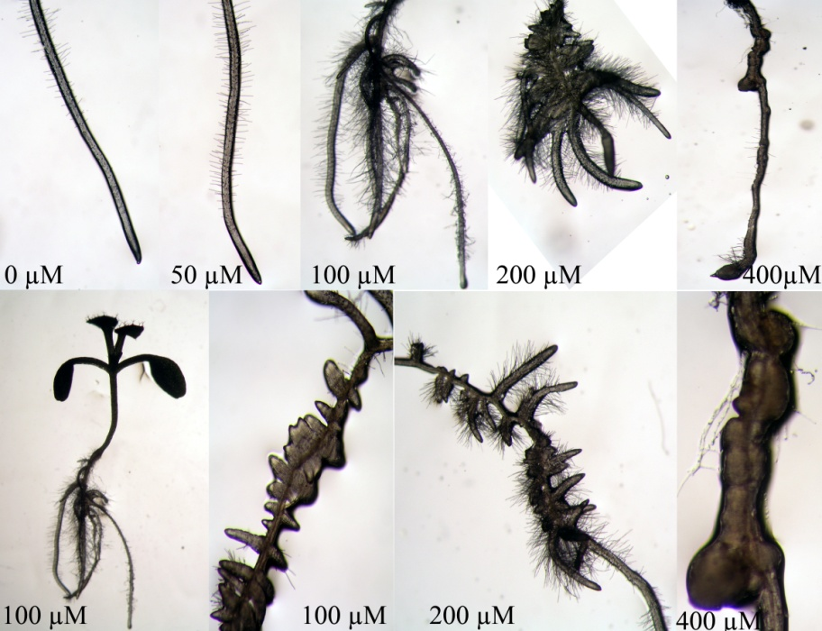
Effects of Isobenzofuranimines 1 and 2 on Root Morphology of A. thaliana
Figure 3. Root tip of A. thaliana grown in vitro and treated with different concentrations of compound 1. Note the lack of root hairs development at the highest concentrations.
Figure 4. Root tip of A. thaliana grown in vitro and treated with different concentrations of compound 2. Note the root malformation and the stimulation of lateral roots and root hairs.
-Strong reduction in root growth
-Lack in lateral roots and root hairs
-Increase of lateral roots number length
-Increase of density of root hairs
-Strong malformation:growing fused and irregularly spaced lateral roots
F. Araniti, R. Mancuso, I. Ziccarelli, F. Sunseri, M. R. Abenavoli, B. Gabriele, Molecules, 2014, 19, 8261-8275

Slide 10
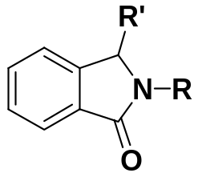
New Antitumor Agents
Spiro[isoindol-isoxazolidinones] as a novel class of inhibitors of MDM2-p53 interaction
The p53 tumor suppressor protein is a transcriptional factor that plays a key role in regulation of several cellular processes:
-Apoptosis
-DNA repair
-Angiogenesis
The murine double minute 2 (MDM2) protein is the primary cellular inhibitor of p53.
Synthesis of a non-peptide, small molecule inhibitors that block the MDM2-p53 interactions
-Found in many natural products
-Posses pharmacological activities such as MDM2-p53 inhibitors
-Structural diversity can represent an important approach in the design of new chemotherapeutics.

Slide 11
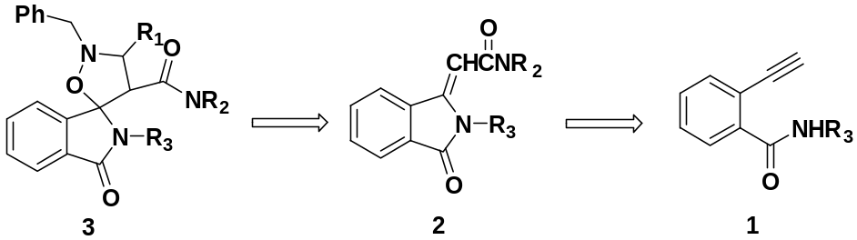
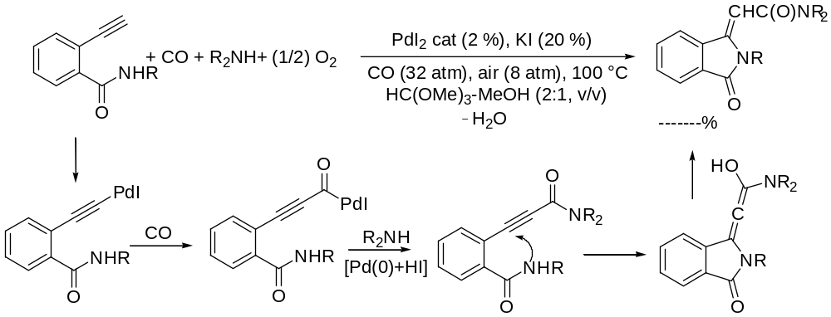
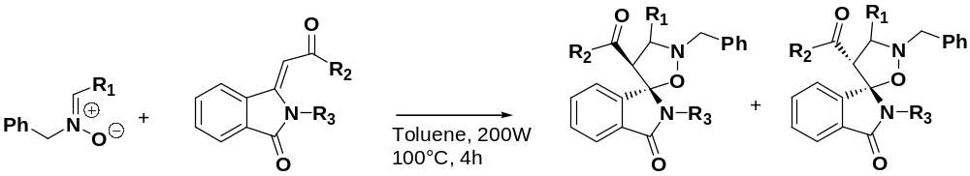
Spiro[isoindol-isoxazolidinones] as a novel class of inhibitors
of MDM2-p53 interaction
Aminocarbonylation/
N-Heterocyclization
R. Mancuso, I. Ziccarelli, D. Armentano, N. Marino, S.V. Giofrè, B. Gabriele, J. Org. Chem., 2014, 79, 3506-3518
S. V. Giofrè, R. Mancuso, F. Nicolò, G. Lanza, L. Legnani, M. A. Chiacchio, M. Navarra, B. Gabriele, R. Romeo, Submitted

Slide 12
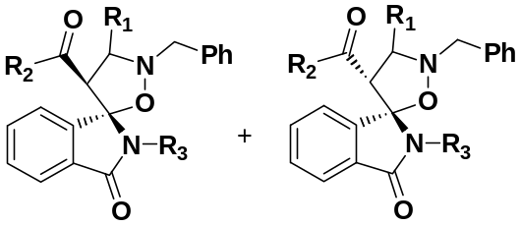
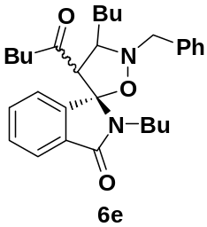
Spiro[isoindol-isoxazolidinones] as a novel class of inhibitors
of MDM2-p53 interaction
Antiproliferative and cytotoxic effect
HUMAN CANCER CELL LINES:
-Neuroblastome SH-SY5Y cells
-Colorectal Adenocarcinoma HT-29 cells
-Hepatocellular carcinoma HepG2 cells
S. V. Giofrè, R. Mancuso, F. Nicolò, Gi. Lanza, L. Legnani, M. A. Chiacchio, M. Navarra, B. Gabriele, R. Romeo, Submitted

Slide 13
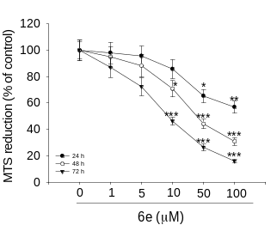
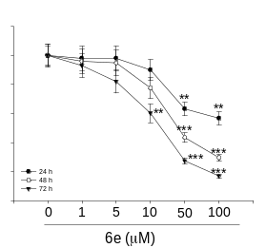
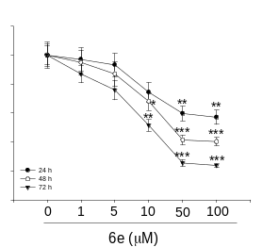
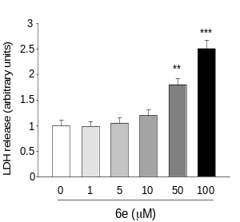
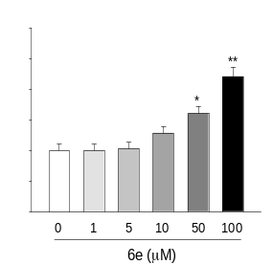
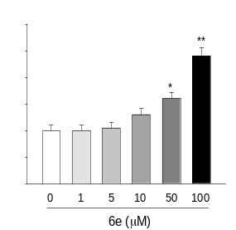
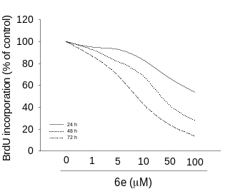
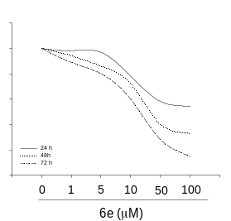
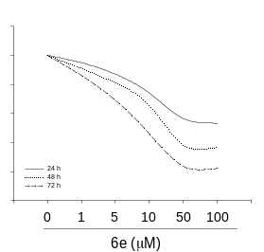
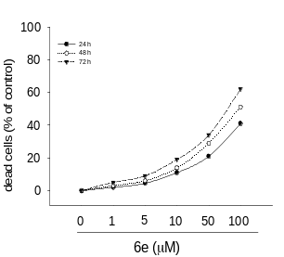
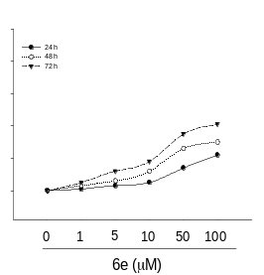
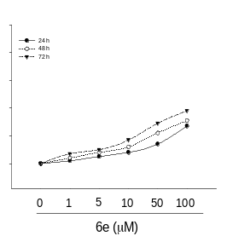
Antiproliferative activity
Cytotoxic effect
SH-SY5Y
HT-29
HepG2
SH-SY5Y
HT-29
HepG2
Figure 5. Compound 6e reduces cancer cell proliferation. Treatment of SH-SY5Y, HT-29 and HepG2 cells with 6e in a range from 1 to 100 µM for 24, 48 and 72 h reduced the growth rate in a time and concentration-dependent manner. The experiments were performed by the MTS assay (a) and BrdU test (b)
Figure 6. Cytotoxic effect of 6e. The cytotoxic activity of 6e was assessed in terms of both LDH release (a) and cell death (b). LDH levels are extrapolated as the values detected in untreated cells, which are arbitrarily expressed as 1. Cell death was reported as the percentage of dead cells vs untreated cultures point to 0
-Neuroblastome SH-SY5Y cells
-Colorectal Adenocarcinoma HT-29 cells
-Hepatocellular carcinoma HepG2 cells
S. V. Giofrè, R. Mancuso, F. Nicolò, Gi. Lanza, L. Legnani, M. A. Chiacchio, M. Navarra, B. Gabriele, R. Romeo, Submitted

Slide 14
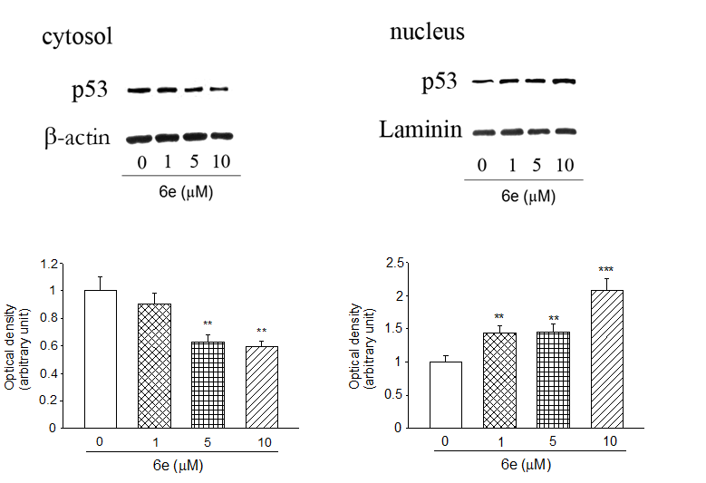
Involvement of p53 in the pharmacological activity
Figure 7. 6e modulate the levels of p53 in SH-SY5Y cells. (a) The SH-SY5Y cells were treated for 24 h with the indicated concentration of 6e compound, and then, both cytosolic and nuclear proteins were analyzed by Western blot for p53 protein. A representative immunoblots of three independent experiment is shown.
S. V. Giofrè, R. Mancuso, F. Nicolò, Gi. Lanza, L. Legnani, M. A. Chiacchio, M. Navarra, B. Gabriele, R. Romeo, Submitted

Slide 15
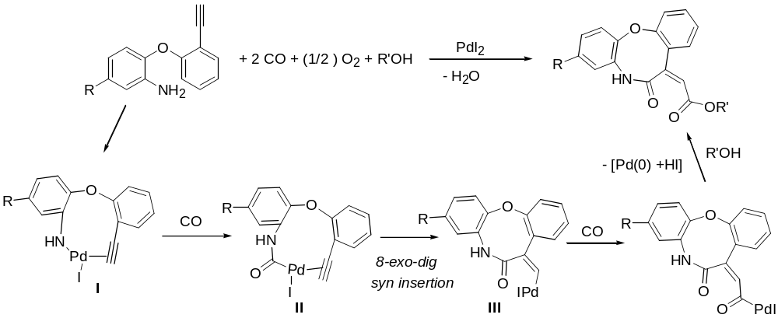
New Antitumor Agents
Eight-Membered Lactam Derivatives with Antitumor Activity
Medium-sized ring are molecular frameworks of particular interest for their biological activity and occurrence in important natural product
Few efficient synthetic methods for their preparation trough cyclization of acyclic precursors are know.
For a combination of unfavorable enthalpic and entropic factor, which tend to raise the cyclization activation energy
Cycloaminocarbonylation/
Alkoxycarbonylation
Considering the bioactivity reported for macro-lactam systems , we tested the new lactams as antitumor agents against human brest cancer cells.
R. Mancuso, D.S. Raut, N. Marino, G. De Luca, C. Giordano, S. Catalano, I. Barone, S. Andò, B. Gabriele, Chem. Eur. J., 2016, 22, 3053-3064.

Slide 16
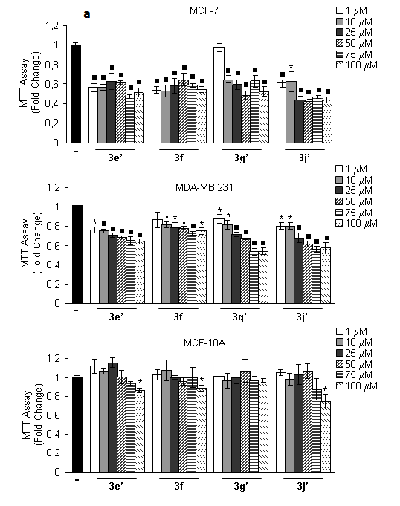
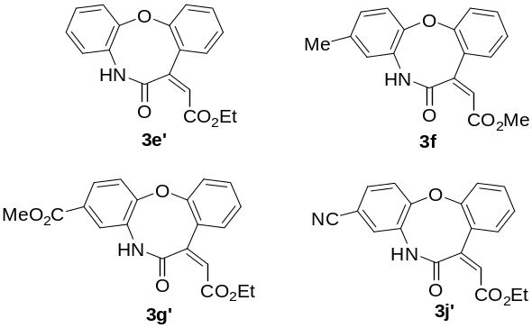
Breast cancer cells viability. Anchorage dependent growth
Human brest cancer cells :
Estrogen Receptor (ER)-positive MCF-7
Estrogen Receptor (ER)-negative MDA-MB-231
Non malignant breast epithelial cell MCF-10A
Lactam 3j’ is the most active in reducing anchorage-dependent growth of brest cancer cells.
1 UM -100 UM, 96 h
R. Mancuso, D.S. Raut, N. Marino, G. De Luca, C. Giordano, S. Catalano, I. Barone, S. Andò, B. Gabriele, Chem. Eur. J., 2016, 22, 3053-3064.

Slide 17
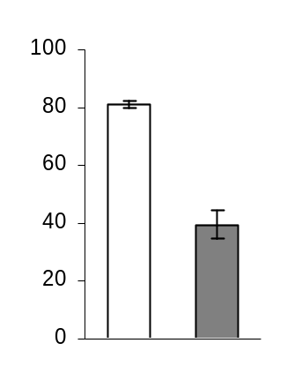
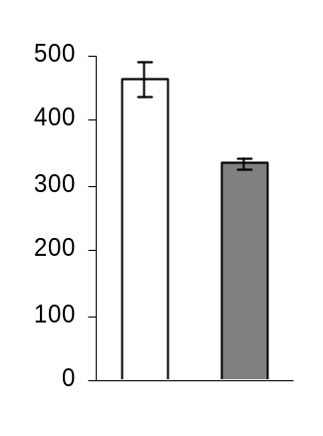
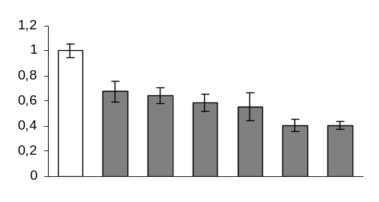
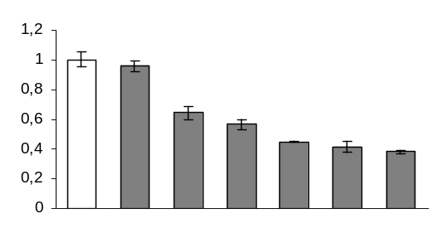
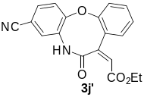
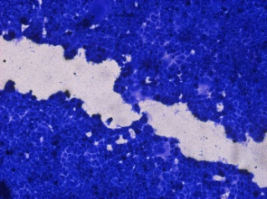
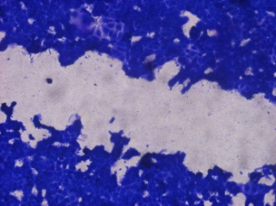

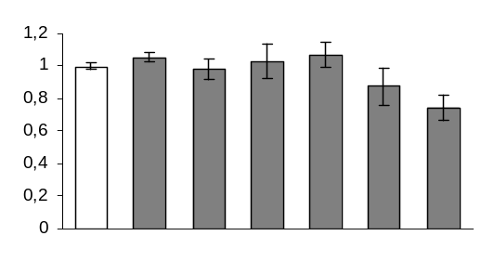
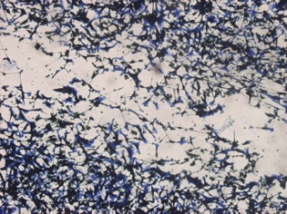
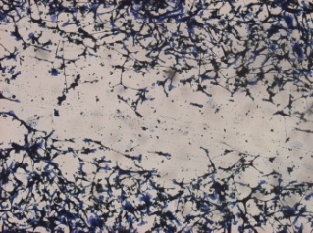

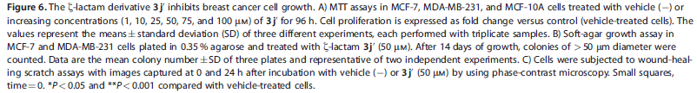
Breast cancer cells viability.
Anchorage dependent growth assays
Anchorage independent growth assays
MCF-7
MDA-MB-231
A
MCF-7
B
*
MTT Assay
(Fold Change)
*
*
*
*
Soft Agar Assay
(# colonies)
*
Soft Agar Assay
(# colonies)
**
**
3j’ (μM)
-
1
10
25
50
75
100
MDA-MB-231
-
3j’
-
3j’
*
Wound-healing scratch assays
MTT Assay
(Fold Change)
**
**
**
C
**
3j’ (μM)
-
1
10
25
50
75
100
MCF-7
MCF-10A
*
MTT Assay
(Fold Change)
MDA-MB 231
3j’ (μM)
-
1
10
25
50
75
100
-
3j’
R. Mancuso, D.S. Raut, N. Marino, G. De Luca, C. Giordano, S. Catalano, I. Barone, S. Andò, B. Gabriele, Chem. Eur. J., 2016, 22, 3053-3064.

Slide 18
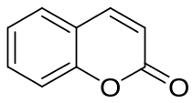
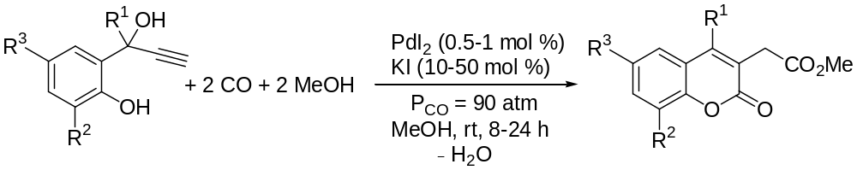
Synthesis of Herbicidal Molecules by PdI₂-Catalyzed Carbonylation
New Natural-Like Erbicides
Coumarin is a natural compound well know for its phytotoxic potential in many plants species .
Coumarin affect:
-photosynthesis
-nutrient uptake and metabolism
-seed germination and root growth
Excellent template for the synthesis of new analogues herbicides
Coumarin as Backbone for the Production of New Natural-Like Herbicides
B. Gabriele, R. Mancuso, G. Salerno, P. Plastina, J. Org. Chem, 2008, 73, 756-759.
F. Araniti, R. Mancuso, A. Lupini, S. V. Giofrè, F. Sunseri, M. R. Abenavoli, B. Gabriele, Molecules, 2015, 20, 17883-17902

Slide 19



Coumarin as Backbone for the Production of New Natural-Like Herbicides
-Germination and rooth growth of noxious weeds
-Seedling growth of weeds model species
Amaranthus retroflexus
Arabidopsis thaliana
Echinochloa crus-galli
Cyclocarbonylation/
Alkoxycarbonylation
B. Gabriele, R. Mancuso, G. Salerno, P. Plastina, J. Org. Chem, 2008, 73, 756-759.
F. Araniti, R. Mancuso, A. Lupini, S. V. Giofrè, F. Sunseri, M. R. Abenavoli, B. Gabriele, Molecules, 2015, 20, 17883-17902

Slide 20
Weeds germination and root growth bioassays in A. retroflexus and E.crusgalli
 | A. retroflexus |  |  | E. crusgalli
G_{T} (%) | 1 | 2 | 3 | 1 | 2 | 3
0 µM | 100ª | 100ª | 100ª | 100ª | 100ª | 100ª
50 µM | 81.8^{b} | 66^{b} | 94a^{b} | 87.8^{b} | 59.5^{b} | 92^{ab}
100 µM | 0^{c} | 8^{c} | 84^{b} | 54^{c} | 46.5^{b} | 54^{b}
200 µM | 0^{c} | 0^{d} | 0^{c} | 0^{d} | 0^{c} | 10.2^{c}
400 µM | 0^{c} | 0^{d} | 0^{c} | 0^{d} | 0^{c} | 0^{d}
800 µM | 0^{c} | 0^{d} | 0^{c} | 0^{d} | 0^{c} | 0^{d}
ED₅₀ (µM) | 53.8ª | 58ª | 115.3^{b} | 104.6^{b} | 72.3ª | 104.9^{b}
TRL (cm)
0 µM | 100ª | 100ª | 100ª | 100ª | 100ª | 100ª
50 µM | 76.9^{b} | 67.1^{b} | 83.9^{b} | 69.5^{b} | 74.9^{b} | 75.3^{b}
100 µM | 63.5^{c} | 47.5^{c} | 51.2^{c} | 56.8^{c} | 47.8^{b} | 49.8^{c}
200 µM | 46.4^{d} | 41.6^{c} | 36.8^{d} | 25.1^{d} | 21.6^{c} | 26.3^{d}
400 µM | 27e | 20.8^{d} | 22.6e | 9.4e | 6.9^{d} | 14.2e
800 µM | 8.7^{f} | 7.1e | 7.7^{f} | 4.2^{f} | 4.7e | 4.7^{f}
ED₅₀ (µM) | 164^{c} | 105.8ª | 126.4^{b} | 104ª | 94.7ª | 101.8ª
-Strong inibhition of all germination parameters and root growth
Data are expressed as percentage of the control. Different letters along the columns, or along the row (ED₅₀ parameter), indicate significant differences at P < 0.05. (N = 5). All the dose response curves pointed out a significance level of P < 0.001.
F. Araniti, R. Mancuso, A. Lupini, S. V. Giofrè, F. Sunseri, M. R. Abenavoli, B. Gabriele, Molecules, 2015, 20, 17883-17902

Slide 21





Bioassays of Arabidopsis thaliana
 | ED₅₀ (µM)
Molecule | SFW | TRL | NLR | RHD
1 | 26.01ª | 111.29^{ab} | 42.49ª | 55.36ª
2 | 53.07^{b} | 74.24ª | 43.56ª | 56.18ª
3 | 59.27^{b} | 173^{b} | 43.34ª | 49.27ª
Different letters along the columns indicate significant differences at P ≤ 0.05. (N = 5). All the dose-response curves pointed out a significance level of P < 0.001.
Pigments content in plants treated with synthetic coumarins 1-3. Data are expressed as percentage of the control. Different letters along the bars indicate significant differences at P ≤ 0.05). N = 5.
F. Araniti, R. Mancuso, A. Lupini, S. V. Giofrè, F. Sunseri, M. R. Abenavoli, B. Gabriele, Molecules, 2015, 20, 17883-17902

Slide 22


Root Growth and Morphology of Arabidopsis thaliana
-Dose-dependent Inibitory effect on primary root growth
-Root structure and organization only modified by 1 and 3
F. Araniti, R. Mancuso, A. Lupini, S. V. Giofrè, F. Sunseri, M. R. Abenavoli, B. Gabriele, Molecules, 2015, 20, 17883-17902

Slide 23
















Conclusions
Herbicidal Molecules
MCF-7
MDA-MB 231
Antitumor Molecules
Antitumor Molecules
Herbicidal Molecules

Slide 24



Acknowledgments
Dipartimento di Chimica e Tecnologie Chimiche Università della Calabria-Italy
Prof. Bartolo Gabriele
Dr. Dnyaneshwar S. Raut
Dr. Ida Ziccarelli
Istituto per la Tecnologia delle Membrane, Consiglio Nazionale delle Ricerche (ITM-CNR)-Italy
Centro Sanitario e Dipartimento di Farmacia e
Scienze della Salute e della Nutrizione
Università della Calabria- Italy
Dott. Giorgio De Luca
Dott. Nadia Marino
Prof. Sebastaino Andò
Prof. Stefania Catalano
Dott. Cinzia Giordano
Dipartimento di Agraria
Università Mediterranea di Reggio Calabria-Italy
Dipartimento di Scienze del Farmaco e dei Prodotti
per la Salute Università di Messina-Italy
Dr. Fabrizio Araniti
Prof. Maria Rosa Abenavoli
Prof. Francesco Sunseri
Dr. Salvatore V. Giofrè
Prof. Roberto Romeo

Slide 25
Thanks

Slide 28

PdI₂-CATALYZED OXIDATIVE CYCLOCARBONYLATION ALKOXYCARBONYLATION MECHANISM

Slide 29

PdI₂-CATALYZED OXIDATIVE HETEROCYCLIZATION-ALKOXYCARBONYLATION MECHANISM

Slide 30

PdI₂-CATALYZED OXIDATIVE MONOAMINOCARBONYLATION-
INTRAMOLECULAR CONJUGATE ADDITION MECHANISM

