Slide 1

The Use of Bone Marrow Stem Cells for Osteoarthritis
Rafael Gonzalez, Ph.D.
Vice President of Research and Development
DaVinci Biosciences, LLC

Slide 2




DaVinci Family of Companies
Cutting-Edge Adult Stem Cell Research
Research Tools for Drug Discovery
Stem Cell Therapy Centers
Adult Stem Cell Storage

Slide 3
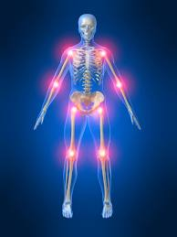
Arthritis
Involves the breakdown of cartilage
Over 100 forms of arthritis
-rheumatoid, osteo, lupus, psoriasis, etc
-Osteo is the most common form
Affects over 37 million people in the US (1 in 7 people)
-Estimated 67 million by 2030
Costs are greater than $128 billion (CDC; 2009)
http://www.cbsnews.com/stories/2007/01/11/health/main2351656.shtml

Slide 4
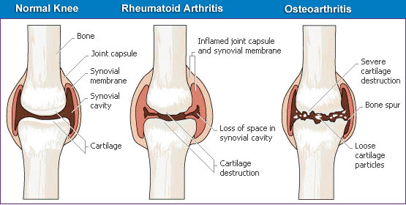
Arthritis
Presently no cure
Standard of care: cortisone therapy, anti-inflammatories, analgesics, small biologics, surgery, physical therapy
- Described as “inadequate as they only treat symptoms of pain and inflammation”
Alternatives: glucosamine, chondroitin, methysulfonylmethane (MSM), hyaluronic acid
Mobasheri et al., 2009

Slide 5
Arthritis
Problem 1: an immune response that causes damage most frequently to the joints
Problem 2: Joints have poor capacity for healing and repair
-Cartilage regeneration is minimal or incorrectly repaired
Mobasheri et al., 2009

Slide 6
Arthritis and Stem Cells
Greater than 1300 peer reviewed publications in the field (pubmed.com -2014)
The most described cell type: Mesenchymal stem cells (MSCs)
- Multipotent
- Immunomodulatory and anti-inflammatory properties
- Trophic support
Described as early as 1991 with therapeutic technology in mind ---Caplan 1991. Mesenchymal Stem Cells. J Orthop Res.

Slide 7
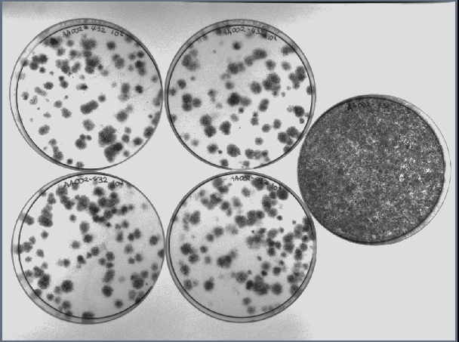
MSCs
Can be isolated from:
bone marrow, adipose tissue, dental pulp
umbilical cord tissue, synovial, testes, etc
Highly expandable-without losing ability to differentiate
-age, disease & culture condition dependent
Should form CFUs

Slide 8
International Guidelines for MSCs
MSCs
Minimum criteria*
- Plastic adherent
- (+) CD105, CD73, CD90
- (-) CD34, CD45, CD14/11, CD19, HLA-DR
- Differentiate to Mesoderm (osteoblast, adipocytes,chondroblasts)
*Dominci et al., 2006. Minimal Criteria for defining multipotent mesenchymal stromal cells. The International Society for Cellular Therapy position statement. Cytotherapy 8(4): 315-317

Slide 9
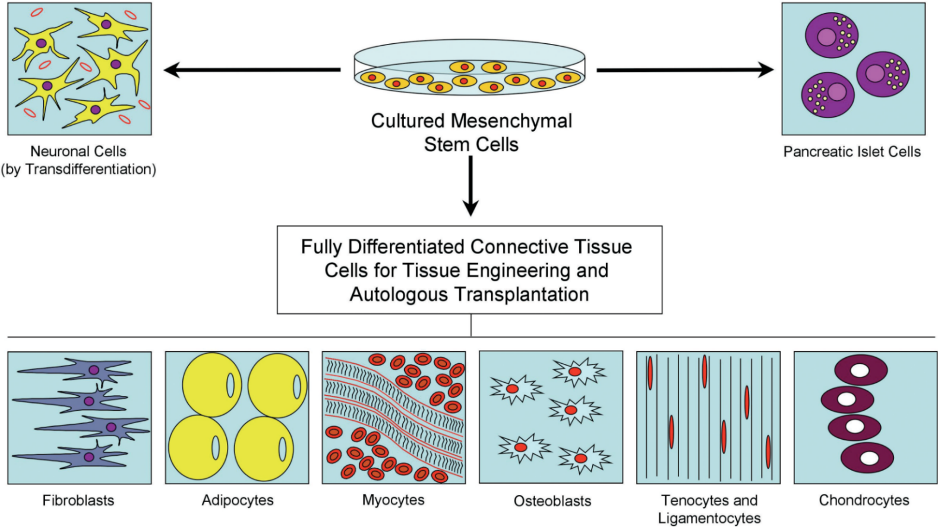
Why Mesenchymal Stem Cells?
Mesoderm
Mesenchyme (connective tissue)
Easily differentiate into fat, cartilage and bone
Mobasheri et al., 2009

Slide 10
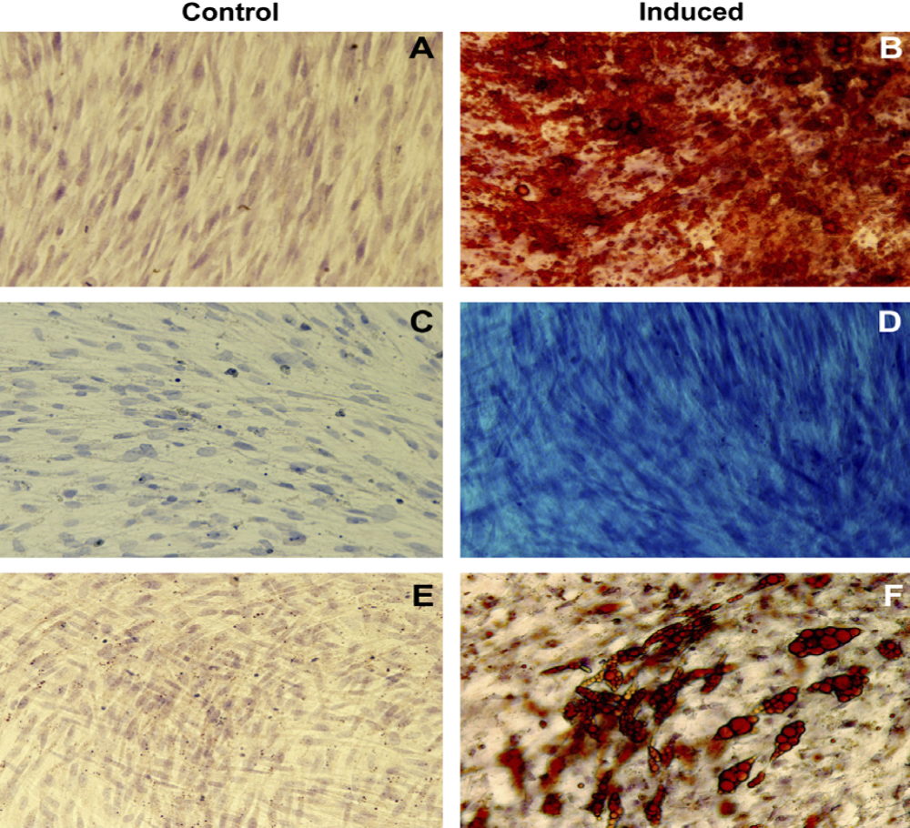
Why Mesenchymal Stem Cells?
Bone
Cartilage
Adipose
Gonzalez et al., 2007

Slide 11
Why Mesenchymal Stem Cells?
Prockop 2007

Slide 12
Why Mesenchymal Stem Cells?
Immunomodulatory and anti-inflammatory properties:
1. prostaglandin E2, TGF-β1, HGF, SDF-1, nitric oxide, IL-4, IL-6, IL-10, indoleamine 2,3-dioxygenase and others
2. prevents function proliferation of inflammatory cells
-both innate and adaptive immune responses
3. Cause transitions of Th1 to Th2 response (balance)
-cartilage regeneration (Tidball et al., 2010)
-autoimmune diseases (Kong et al., 2009)
-anti-diabetic effect (Ezquer et al., 2012)
Murphy et al., 2013

Slide 13
Why Mesenchymal Stem Cells?
Immunomodulatory and anti-inflammatory properties:
4. Express negligible amounts of MHC II; mid levels MHC I
5. Fail to induce activation of adaptive immune responses
6. Used for GVHD
Herrmann and Sturm 2014

Slide 14
Why Mesenchymal Stem Cells?
Trophic Support via release of GFs and chemokines:
- TGF-α, TGF-β, HGF, EGF, FGF-2 and IGF-1 all potent mitogens
- VEGF, IGF-1, EGF and angiopoietin-1 to recruit endothelial lineage cells and initiate vascularization
- Paracrine effect of local cells secreting KGF, SDF-1 and MIP1 α & β
Reduction of scar tissue formation
Burden et al., 2011

Slide 15
Why Mesenchymal Stem Cells?
Trophic support
- TGF-β1 and IGF-1 amongst others cause chondrogenic differentiation
- TGF-β1 most commonly used in vitro
- Endogenous tissue repair or engrafted cells?

Slide 16
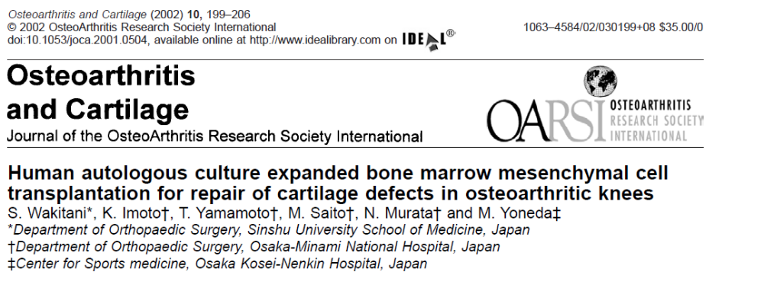
MSCs and Arthritis Case Studies

Slide 17
MSCs and Arthritis Case Studies
Wakitani et al. 2002:
-24 patients diagnosed with OA (12 controls-membrane alone)
-autologous bone marrow derived MSCs (culture expanded)
-MSCs (1.3 x 10⁷; mean) seeded onto collagen type I membrane

Slide 18
MSCs and Arthritis Case Studies
Wakitani et al. 2002 outcomes:
-Significantly higher hyaline cartilage formation in treated
-Clinical improvement not significantly different
-arthroscopic and histological grading score significantly higher
Wilcoxon signed rank tests
Unable to determine if it was the cells or endogenous cartilage growth

Slide 19
MSCs and Arthritis Case Studies
Centeno et al., 2008. Pain Physician 11:3:343-353

Slide 20
MSCs and Arthritis Case Studies
Centeno et al 2008:
-1 case with OA presented
-Autologous bone marrow derived MSCs
-2.4 x 10⁷ cells in PBS intraarticular by 1 ml of nucleated cells from bone marrow (BMC from 50 ml) in 10% platelet lysate
-Patient returned for 2 additional 10% platelet lysate injections
1 & 2 week post transplantation
Centeno et al., 2008. Pain Physician 11:3:343-353

Slide 21
MSCs and Arthritis Case Studies
Centeno et al 2008 results:
-Statistically significant cartilage
and meniscal growth
-increased range of motion
-Decreased modified VAS pain score
Unable to determine if it was the cells or endogenous cartilage growth
Centeno et al., 2008. Pain Physician 11:3:343-353

Slide 22
MSCs and Arthritis Case Studies
Nejadnik et al., 2010.Am J Sports Med 38 (6) 1110-1116

Slide 23
MSCs and Arthritis Case Studies
Nejadnik et al 2010:
-72 patients
-36 patients with Chondrocytes; 36 patients with BMSCs
-Chondrocytes and BMSCs (10-15 million cells) transferred in sheets
-Placed in a periosteal patch and secured with fibrin glue
-Various time points up to 24 months
-ICRS evaluation package to include Short form health survey, knee evaluation form, Lysholm knee scale and Tegner activity level scale
Nejadnik et al., 2010.Am J Sports Med 38 (6) 1110-1116

Slide 24
MSCs and Arthritis Case Studies
Nejadnik et al 2010 results:
-Significant improvement in short form QoL in both groups
-No difference in groups clinical outcomes except in physical role functioning which was better in BMSC group
-No difference in groups for knee evaluation form, Lysholm knee scale and Tegner activity level scale
-Under 45 year old patients did better then older in chondrocyte group
-No difference in benefit with age in BMSC group
BMSC is as effective and less invasive as it requires one less knee surgery
Nejadnik et al., 2010.Am J Sports Med 38 (6) 1110-1116

Slide 25
MSCs and Arthritis Case Studies
The 3 studies all used autologous cells-cultured or not
-many more of these published
All demonstrate clinical improvements
All demonstrate structural changes through MRI based evidence
None are the same
However…….they made a difference

Slide 26
Are MSCs an Ideal Cell Source for Cartilage Repair?
There are several reports of MSCs used for chondrogenic differentiation, however most of these are based on micromass pellet culture or 3-D culture of these cells.
The objective of this study was to develop a condition where monolayer MSCs could be induced towards chondrogenesis, there by these cells could be lifted off the culture dish and directly injected into the injury sites.
MSCs were treated with different conditions (TGF β 3, TGF β3 +IGFI, TGF β3 + TGF β 1, TGF β3 +FGF) for various times and tested for chondrogenic gene and protein expression.

Slide 27
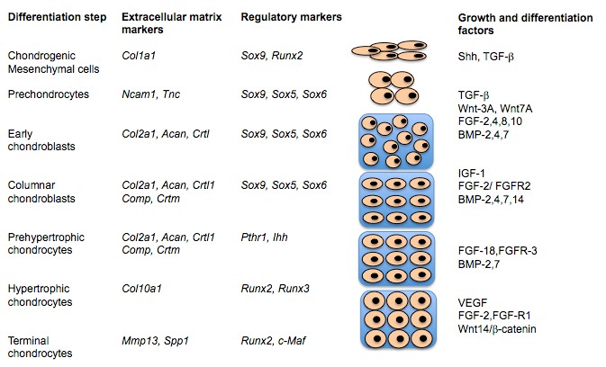
Different Stages of Chondrogenesis
A schematic representation of the different stages of chondrogenesis showing the temporal pattern of extracellular matrix markers, transcription factors, and growth and differentiation factors. Modified from Lefebvre and Smits (2005).

Slide 28
Gene Expression Profile of MSCs post GF Addition
1. Control
2. TGF β 3
3. β3 +IGF-1
4. β3 + β 1
5. β3 +FGF-2

Slide 29
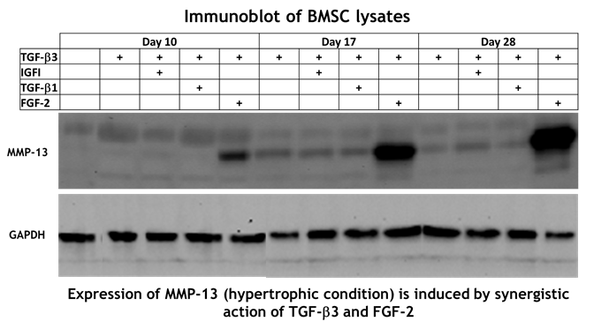
Immuno blot for MMP-13 & GAPDH expression

Slide 30
Effect of Synovial Fluid on in vitro chondrogenesis
To evaluate the effect of different types of human Synovial fluids (AR, OA, RA) mimicking in vivo conditions on chondrogenic differentiation of BMSCs.
Synovial fluids were added to BMSCs and after fixed time intervals cells were stained using Alcian blue dye solution, counter stained by Nuclear Fast Red.

Slide 31
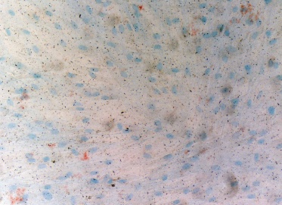
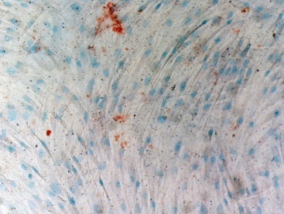
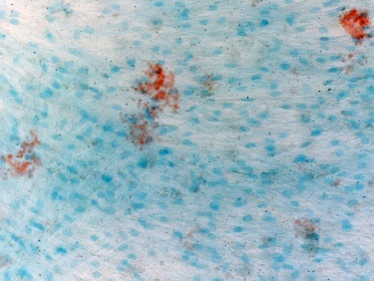
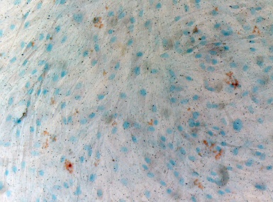
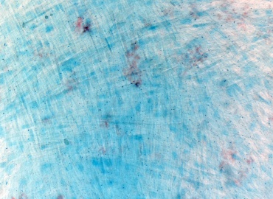
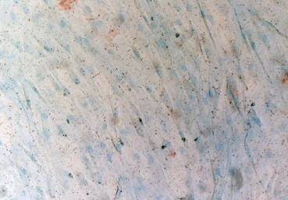
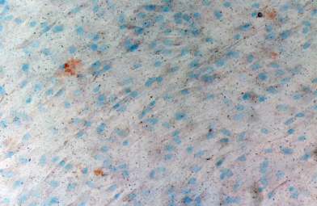
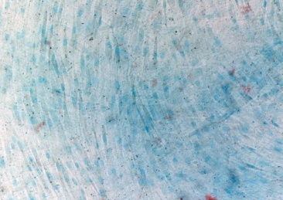
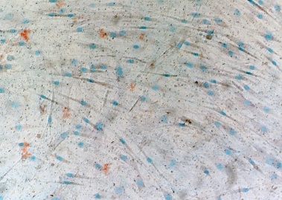
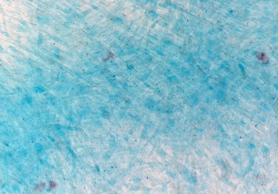
Alcian Blue Staining to visualize proteoglycan content
D10-C
D10-AR
D10-OA
D10-RA
D10-TGFβ3
D28- C
D28- AR
D28- OA
D28- RA
D28-TGFβ3
Cells cultured in synovial fluid from OA or TGFβ3 appear to have more detectable proteoglycans

Slide 32
Conclusions from these set of experiments
Culturing monolayer MSCs with TGFβ3+FGF-2, induced hypertrophic condition of MSCs as seen by very high expression of Collagen10 and MMP-13 genes and proteins.
Alcian blue staining, showed increased proteoglycan content in OA (Osteoarthritis) synovial fluid treated MSCs. Implying monolayer MSCs when exposed to their in vivo condition, may move towards chondrogenesis.
MSCs in monolayer culture did not express Collagen type II, one of the main early differentiation markers of chondrogenesis.

Slide 33
Clinical Application
5 patients with Osteoarthritis
BMC: IV and intraarticular
MSCs: 1.0 x 10^8 cells IV; 5.0 x 10^7 cells intraarticular
Assess:
Blood for safety
WOMAC
Knee evaluation form
Knee Society Clinical Rating System (KSCRS)
MRI using Q Metrics Imaging Software

Slide 34
Clinical Application

Slide 35
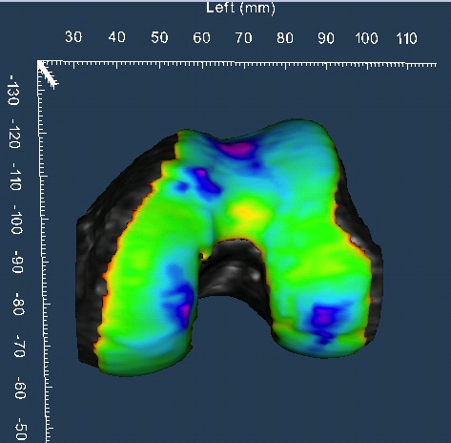
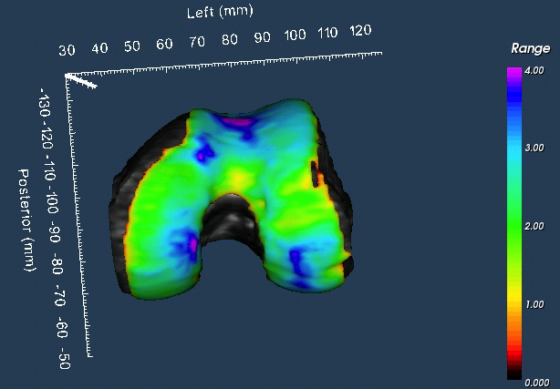

Femur Cartilage Thickness Maps
S3_CAP: 20130925 (Baseline)
S3_CAP: 20140414 (Month 6)

Slide 36
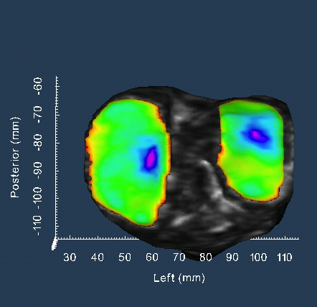
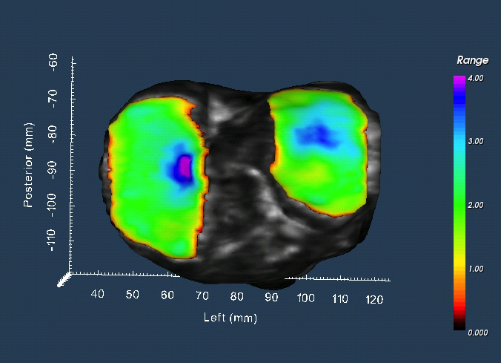
Tibia Cartilage Thickness Maps
S3_CAP: 20130925 (Baseline)
S3_CAP: 20140414 (Month 6)

Slide 37
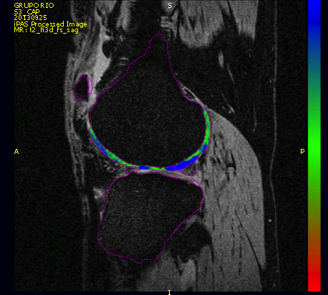
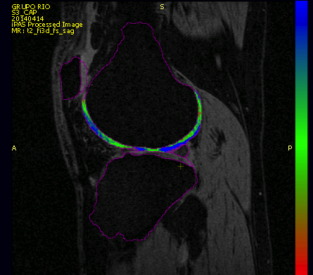
T2 Image
S3_CAP: 20130925 (Baseline)
S3_CAP: 20140414 (Month 6)

Slide 38
Measurements=Data
 |  | Medial Tibia
ID |  | Volume | BCI Area | Thickness |  |  |  | Curvature |  | T2
 | Timepoint |  |  | Mean | Standard Deviation | 95% Percentil | 5% Percentil | Mean | Standard Deviation | Whole T2 Mean | Whole T2 STD | Top T2 Mean | Top T2 STD | Middle T2 Mean | Middle T2 STD | Bottom T2 Mean | Bottom T2 STD
 |  | mm^3 | mm^2 | mm | mm | mm | mm | 1/mm | 1/mm | ms | ms | ms | ms | ms | ms | ms | ms
S1_FAP | 20130925 | 2613.650 | 1044.204 | 2.463 | 0.726 | 3.736 | 0.971 | -0.012 | 0.036 | 49.508 | 6.370 | 52.286 | 9.202 | 48.082 | 7.767 | 51.069 | 9.523
S1_FAP | 20140318 | 2511.275 | 1092.106 | 2.402 | 0.631 | 3.320 | 0.917 | -0.012 | 0.048 | 51.161 | 6.909 | 52.112 | 8.656 | 47.995 | 7.943 | 57.426 | 11.747
S2_MBG | 20130925 | 2000.700 | 1052.812 | 1.965 | 0.660 | 3.369 | 0.789 | -0.014 | 0.050 | 159.779 | 222.217 | 108.142 | 246.119 | 146.522 | 251.666 | 209.062 | 226.164
S2_MBG | 20140319 | 1820.325 | 1066.340 | 1.717 | 0.594 | 3.118 | 0.619 | -0.013 | 0.042 | 142.852 | 190.365 | 103.652 | 208.985 | 130.029 | 212.341 | 188.139 | 193.856
S3_CAP | 20130925 | 2233.075 | 1020.214 | 2.098 | 0.547 | 3.347 | 0.959 | -0.011 | 0.040 | 54.922 | 8.025 | 50.972 | 14.376 | 48.662 | 9.438 | 69.933 | 15.218
S3_CAP | 20140414 | 2305.550 | 1128.551 | 2.156 | 0.662 | 3.864 | 0.910 | -0.012 | 0.042 | 50.516 | 11.319 | 57.117 | 29.849 | 46.668 | 9.739 | 52.303 | 11.747
S4_JCS | 20130925 | 2837.900 | 1007.092 | 2.742 | 0.786 | 4.258 | 1.023 | -0.003 | 0.041 | 54.374 | 8.432 | 60.318 | 19.420 | 51.421 | 9.491 | 57.140 | 13.127
S4_JCS | 20140317 | 3017.300 | 1025.320 | 2.797 | 0.797 | 4.216 | 1.028 | -0.004 | 0.045 | 54.553 | 7.957 | 55.293 | 13.536 | 49.295 | 9.785 | 66.118 | 15.950
S5_MTF | 20130925 | 1733.875 | 853.383 | 1.977 | 0.696 | 3.547 | 0.903 | -0.005 | 0.054 | 53.601 | 9.174 | 59.451 | 23.672 | 50.280 | 9.058 | 55.655 | 12.762
S5_MTF | 20140321 | 1650.025 | 805.863 | 1.985 | 0.656 | 3.461 | 0.866 | -0.006 | 0.047 | 57.648 | 32.384 | 77.692 | 96.961 | 52.659 | 18.626 | 48.835 | 14.386

Slide 39
MSCs and Arthritis
Allogeneic products offer a possible “off the shelf”
Safe with varying improvements in both groups
Hare et al., 2012

Slide 40
MSCs and Arthritis
Patent # 13/668,138

Slide 41
MSCs and Arthritis

Slide 42
MSCs and Arthritis-Summary
MSCs are safe
MSCs decrease symptoms of arthritis
MSCs increase cartilage formation
MSCs may be used as an allogeneic product
Better controlled studies are needed
May need to apply MSCs more than once as shown in many studies
-cryopreservation is ideal for this

Slide 43
Acknowledgements
Science/medical team
Dr Toai Nguyen
Dr Nickolas Chelyapov
Dr Anasua Kusari
Dr Jesus Esparragoza
Dr Luis Geffner
Dr Francisco Arroyo
Dr Manuel Solano
Rami Nasrallah
Kelly Burgee
Catalina Martinez
Marcela Escudero
Quality and supporting staff
Daniel Spurgin
Erin Sairafe
Tony Delamaza
Juan Jose Duran
Marty Killian
Delaney Ware
Slavenska Stockwell
Katrina Fernandez
Gabriela Salgado
Jesus Eduardo Esparragoza
Maria del Carmen Guevara
Raul Plaza
Maria del Carmen Fernandez
The Isaias family

