Slide 1


Photocatalytic reduction of CO₂ by means of TiO₂-based catalysts synthesized with high pressure fluids
Rafael Camarillo Blas
rafael.camarillo@uclm.es

Slide 2
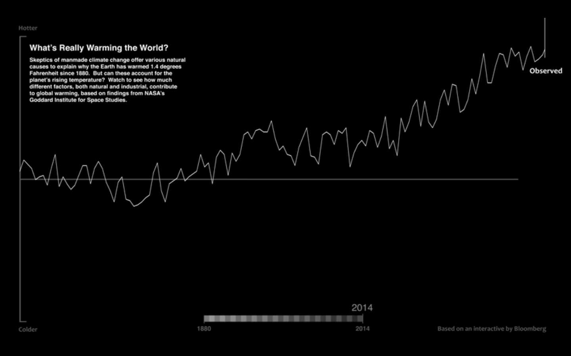

Average anual temperature
Hotter
+0.8 ºC
1880
1950
2014
Colder

Slide 3
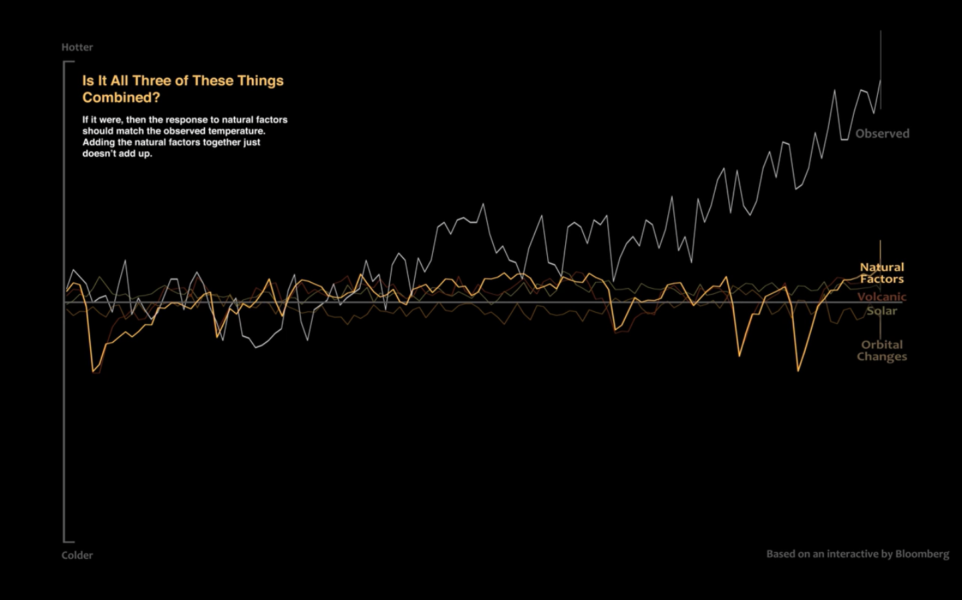
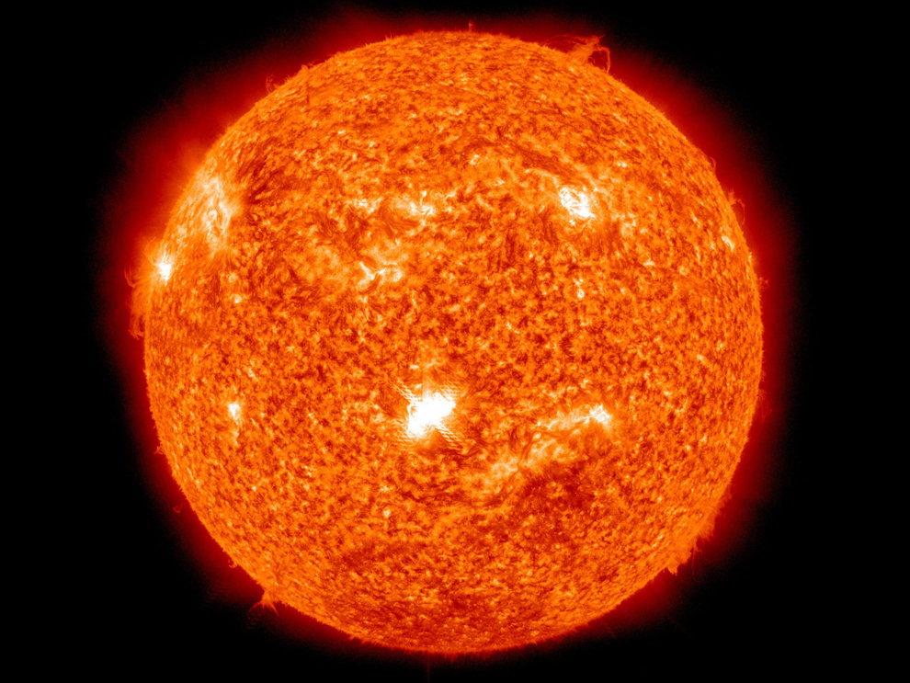
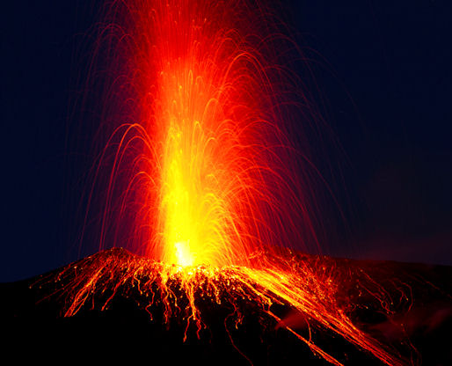
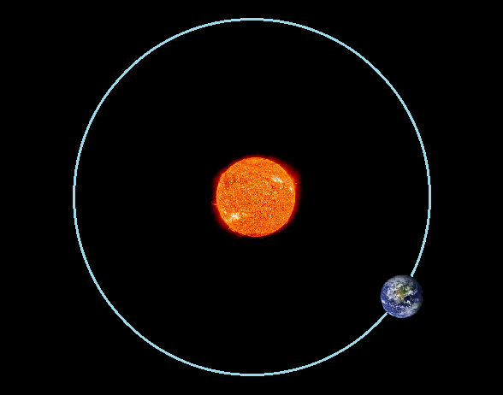
Natural factors
Hotter
1950
1880
2014
Colder

Slide 4
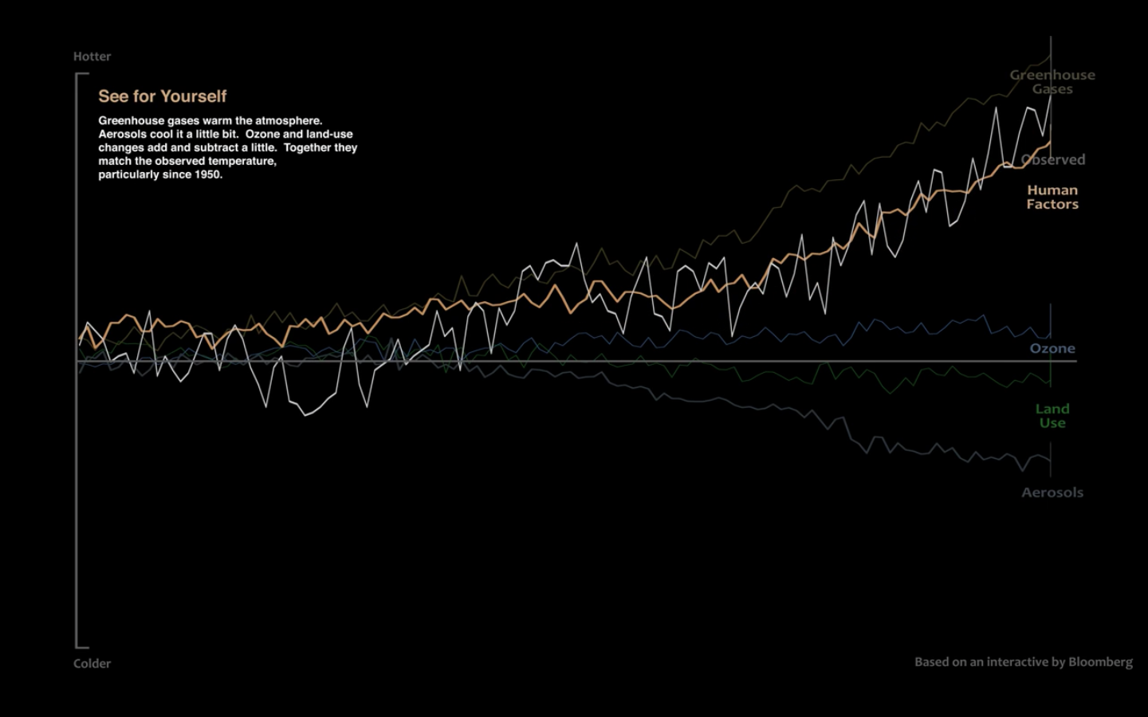
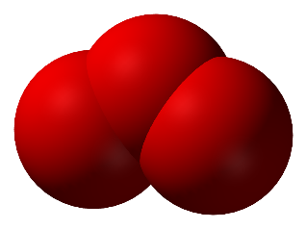
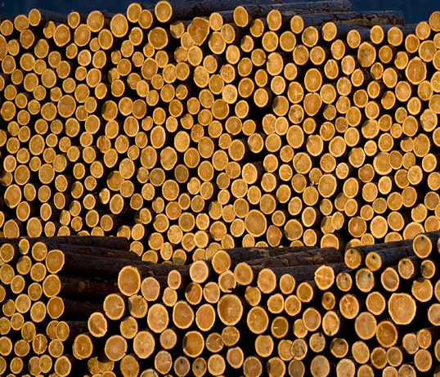
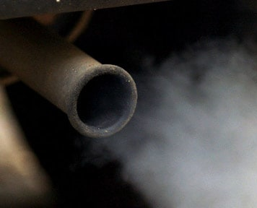
Human factors
Hotter
CO₂
CH₄
O
HFCs
N₂O
O
O
PFCs
SF₆
1950
1880
2014
Colder

Slide 5
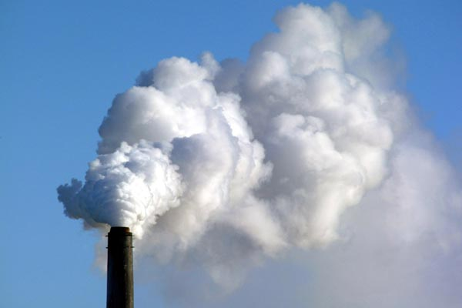
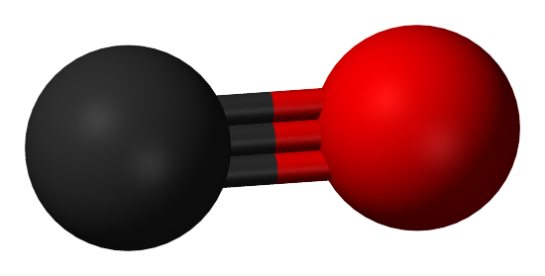
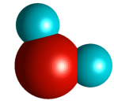
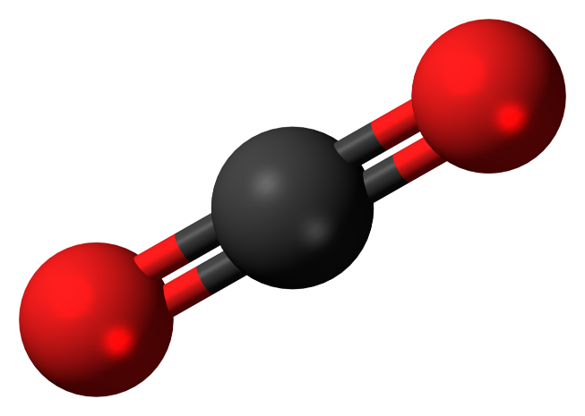
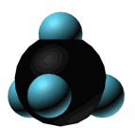
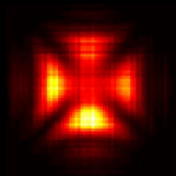
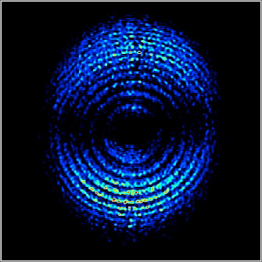
O
H
C
O
O
H
C
H
O
C
H
H
H
Renewable energy sources
light
electricity

Slide 6
1- adsorption
2- light absorption & excitation
Conduction Band
-
4- reduction
3- charge separation
5- desorption & diffusion
+
Valence Band
TiO₂

Slide 7
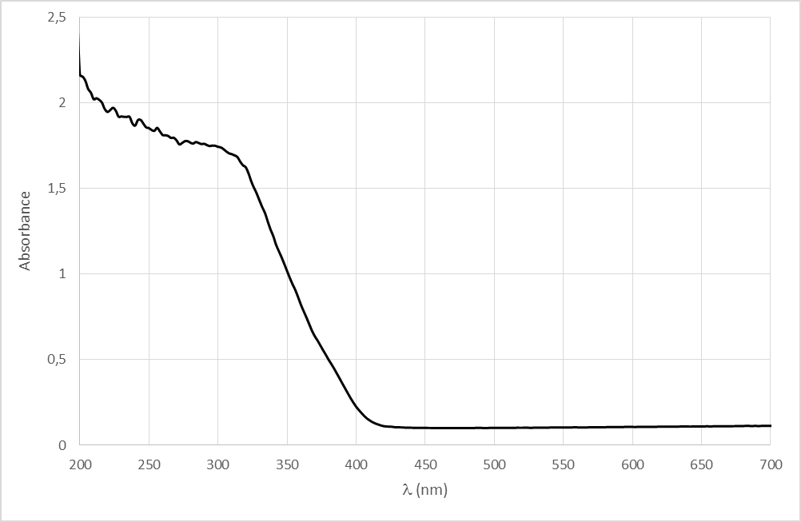
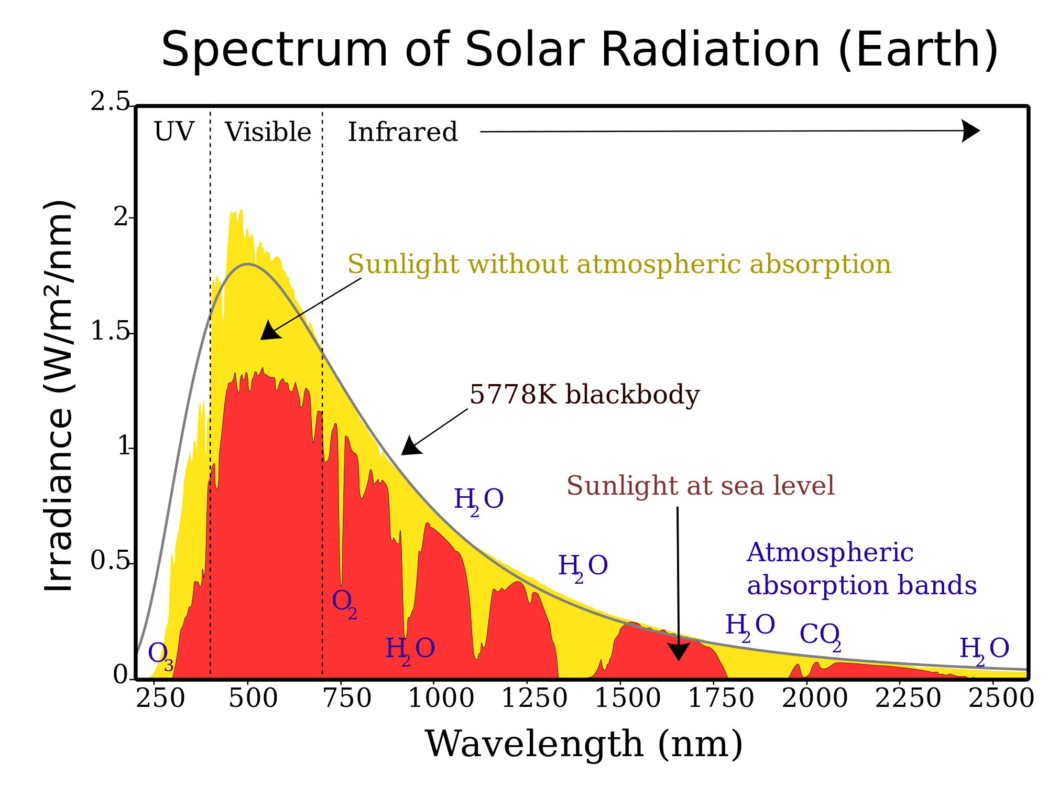
2.5
2
1.5
1
0.5
0
UV
Visible
Band engineering
Absorbance
200 250 300 350 400 450 500 550 600 650 700
Solar radiation
Wavelenght (nm)
P-25

Slide 8
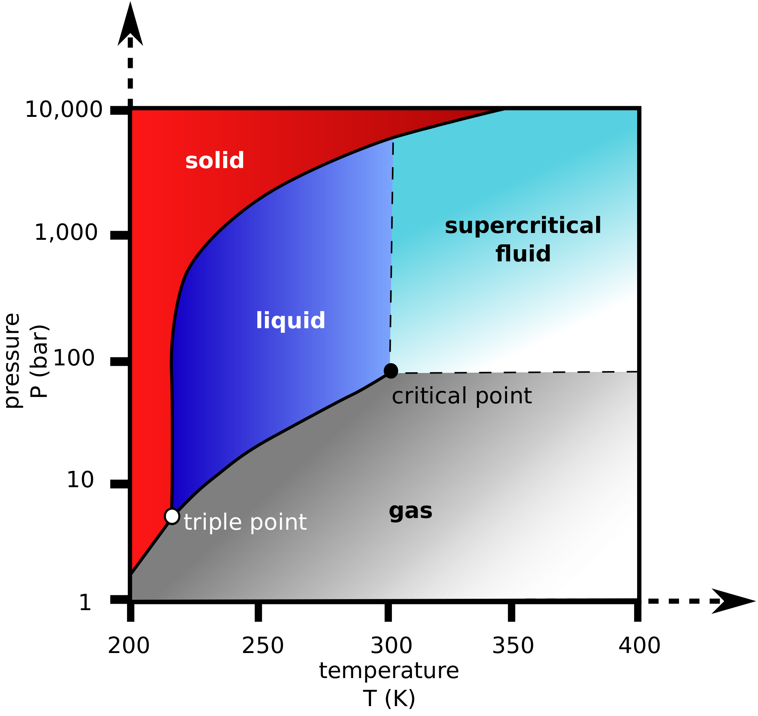

Phase diagram of CO₂
density
solvent power
573 K
200 bar
viscosity
diffusivity

Slide 9
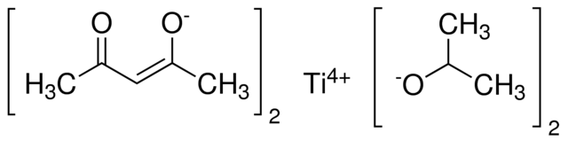

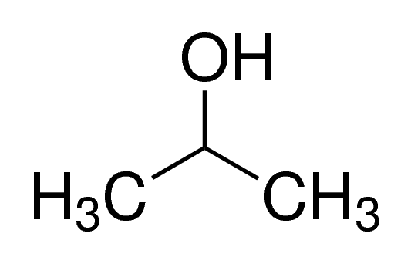
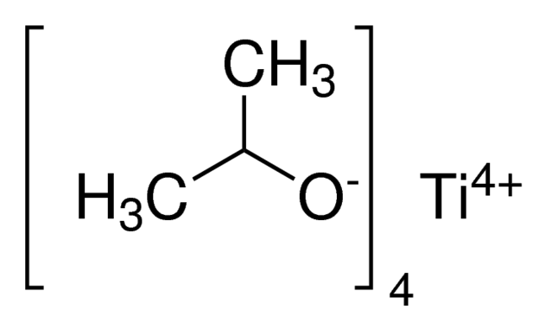
Synthesis of catalysts in high pressure fluids
DIPBAT
SC-CO₂
200 bar
573 K
2 h
TTIP
378 K
673 K
TiO₂
characterization
28 mmol prec./mmol alcohol
12 h
6 h

Slide 10
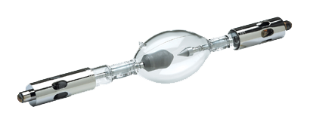

Photocatalytic reaction tests
CH₄ + CO
GC
TiO₂
30-40 mg
1.07 bar
3h
Xe arc lamp
450 W
+ AM 1.5 GF
Photocatalytic reaction test
CO₂ + water vapour (7:2)
solubility

Slide 11
Synthesis yields
75.2 %
Yield (%)
1 mol product : 1 mol precursor

Slide 12
1- adsorption
Surface properties
TiO₂

Slide 13
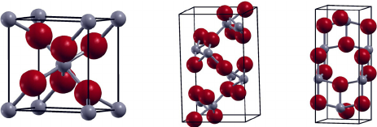
BET areas
+ high porosity
2.5x
S_{BET} (m²/g)
1.6x
Rutile 36-46 m²/g
Anatase 145-163 m²/g
Brookite 76-87 m²/g

Slide 14
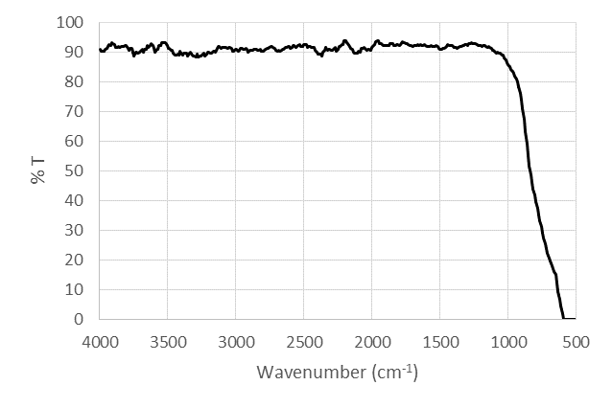
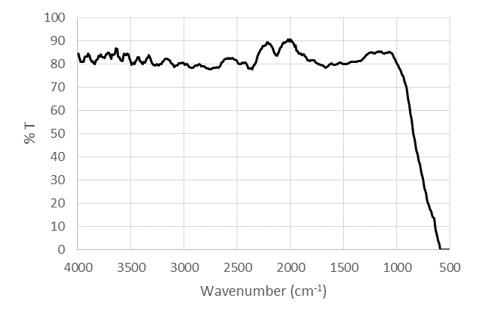
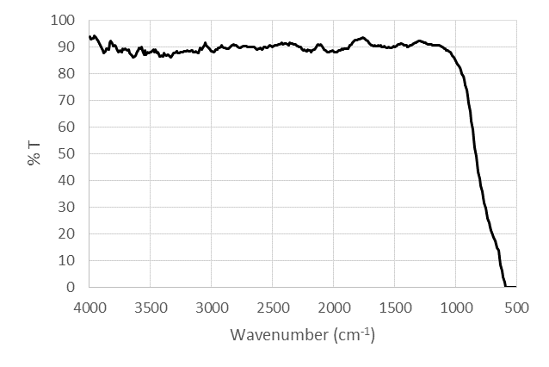
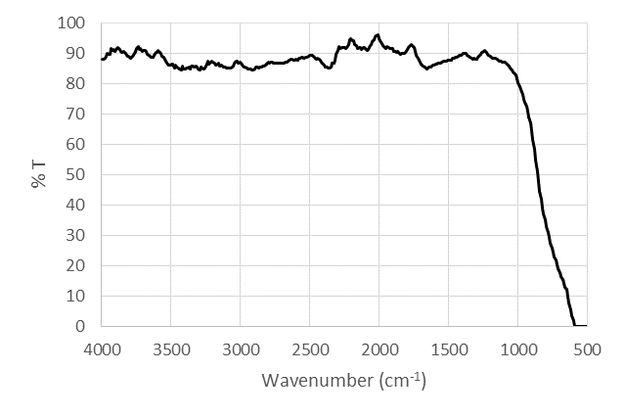
FTIR spectra
TTIP-isopr.
TTIP-ethanol
DIPBAT-isopr.
OH⁻
H₂O
DIPBAT-ethanol
O-Ti-O

Slide 15
2- light absorption & excitation
Conduction Band
-
Band gap energy
+
Valence Band
TiO₂

Slide 16
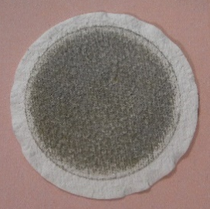
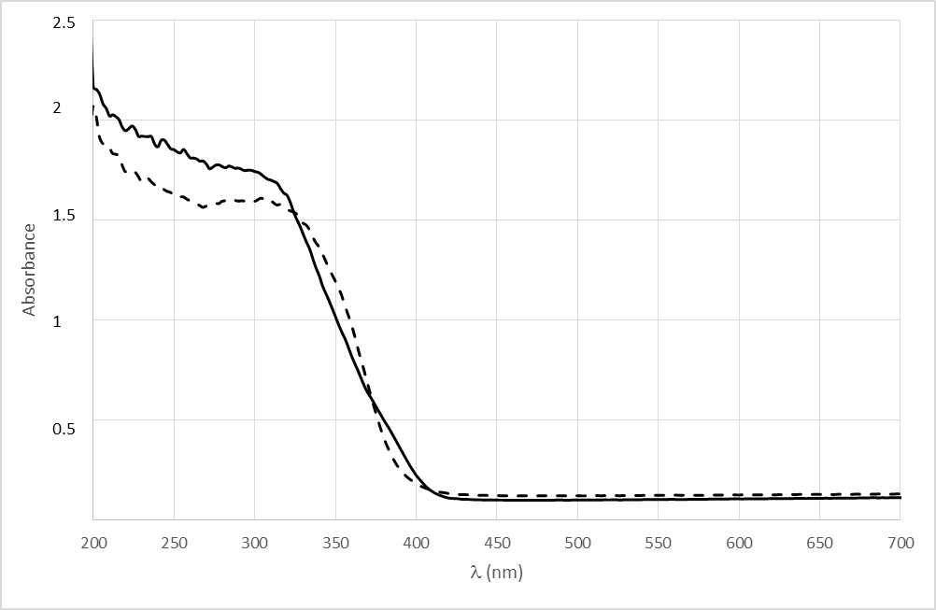
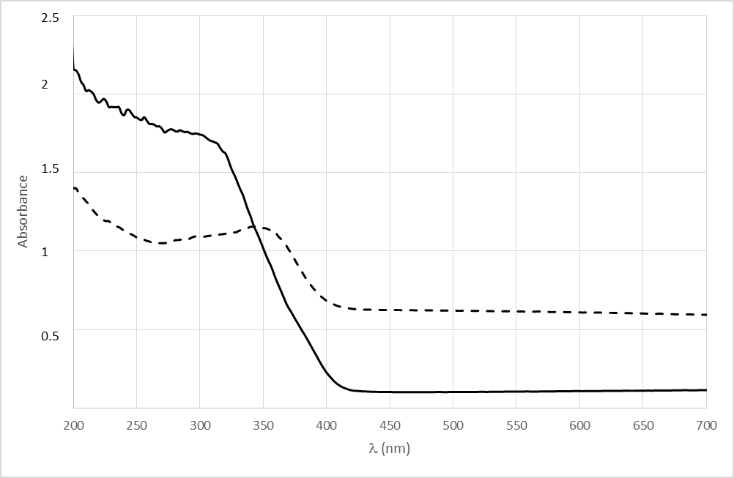
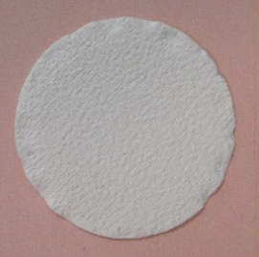
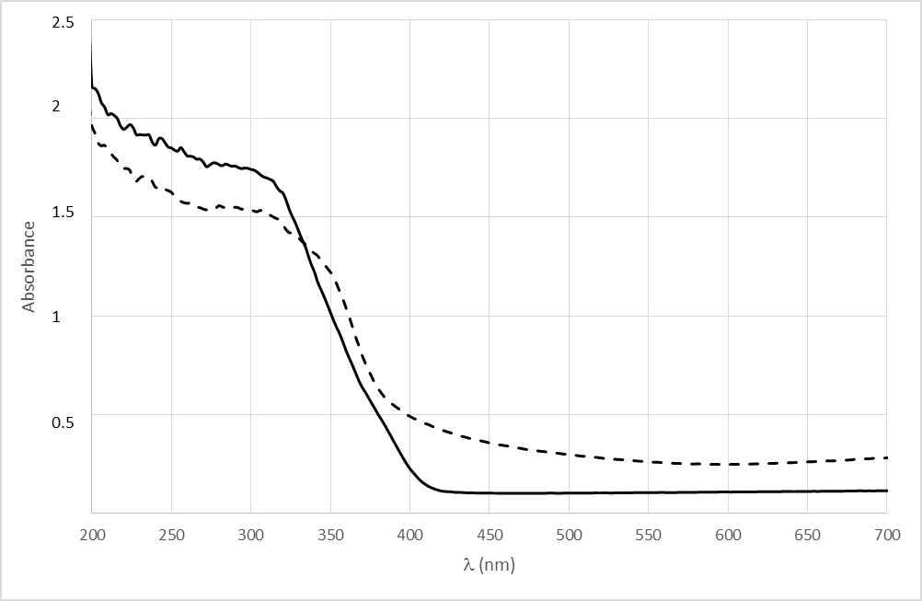
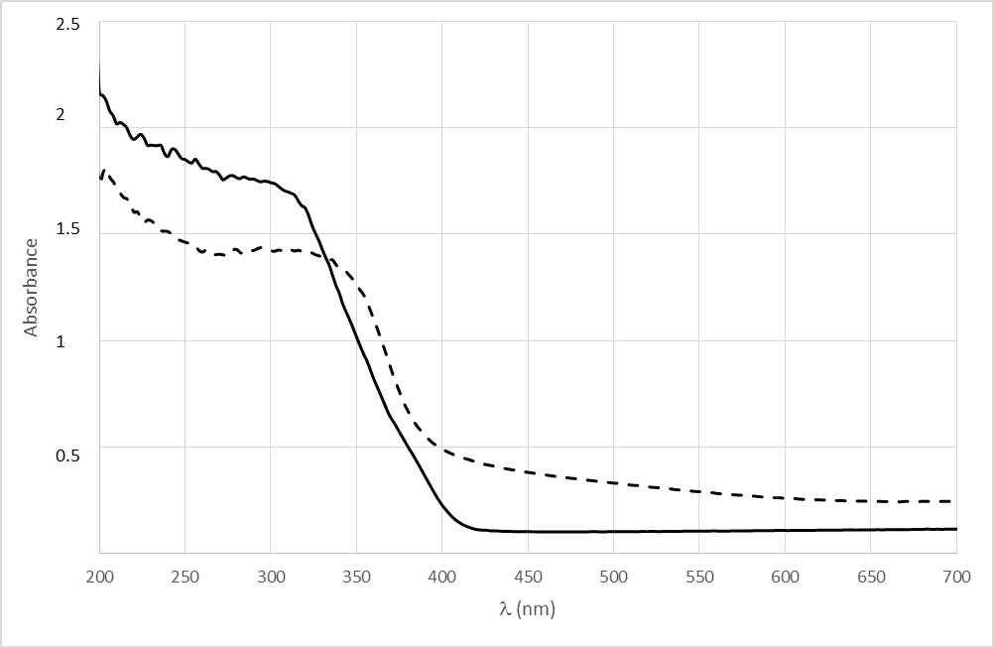
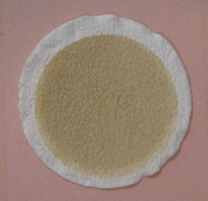
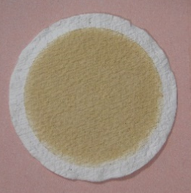
DRS spectra
P-25
3.048 eV (UV light)
TTIP-isopr.
TTIP-ethanol
2.757 eV
surface oxygen vacances
6x
450 nm
DIPBAT-isopr.
DIPBAT-ethanol
3x
3x
413 nm
413 nm
3.004 eV

Slide 17
Conduction Band
-
3- charge separation
+
Valence Band
crystallinity
enhanced morphology
TiO₂

Slide 18
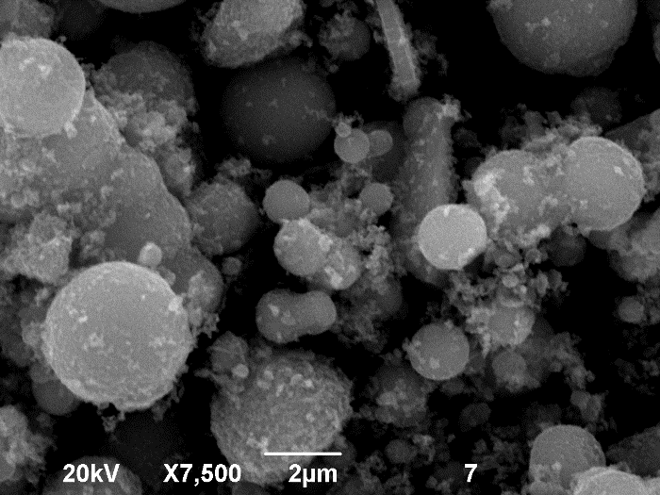
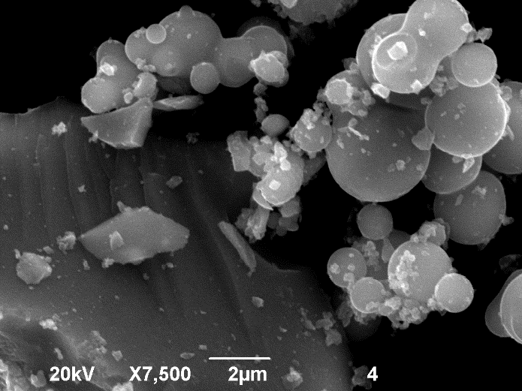
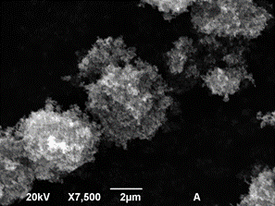
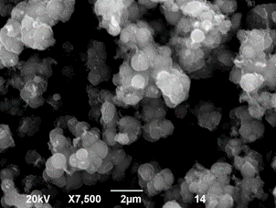
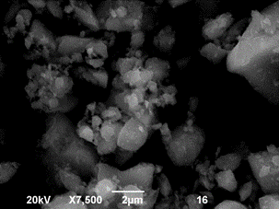
SEM images
TTIP-isopr.
TTIP-ethanol
P-25
DIPBAT-isopr.
DIPBAT-ethanol

Slide 19
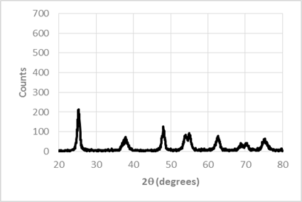
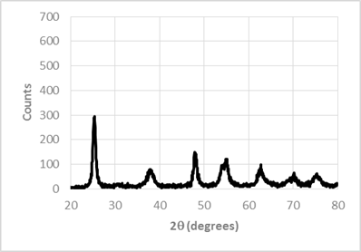
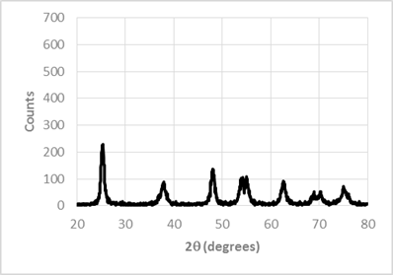
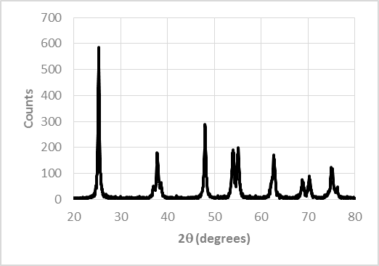
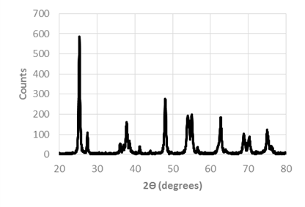
DIPBAT-ethanol
XRD diffractograms
Anatase
DIPBAT-isopr.
10.65 nm
TTIP-ethanol
22.77 nm
19.97 nm
TTIP-isopr.
P-25
R
R
R

Slide 20
Conduction Band
-
4- reduction
+
Valence Band
TiO₂

Slide 21

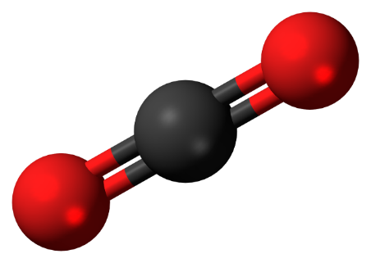
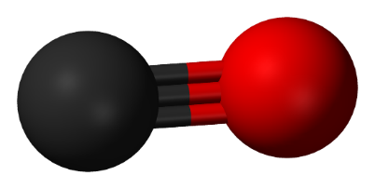
Photocatalytic reduction of CO₂
CH₄, CO (µmol/g/h)
12x
15.7x
H
H
O
O
O
C
C
C
H
H
H
H
O

Slide 22
Conduction Band
-
5- desorption & diffusion
+
Valence Band
TiO₂

Slide 23
Conclusions
Particles with SCFs: large BET areas, good porosity, active surface compositions, narrow band gap, good visible light harvesting properties, high crystallinity and purity, appropriate morphology
Production rates are still far from industrial application
Change in geometry (TNTs) and introduction of dopants (Cu, Pd, Pt)

Slide 24



Acknowledgments
CTM2011-26564
PEII10-0310-5840
Energy & Environment 2010/12

Slide 25

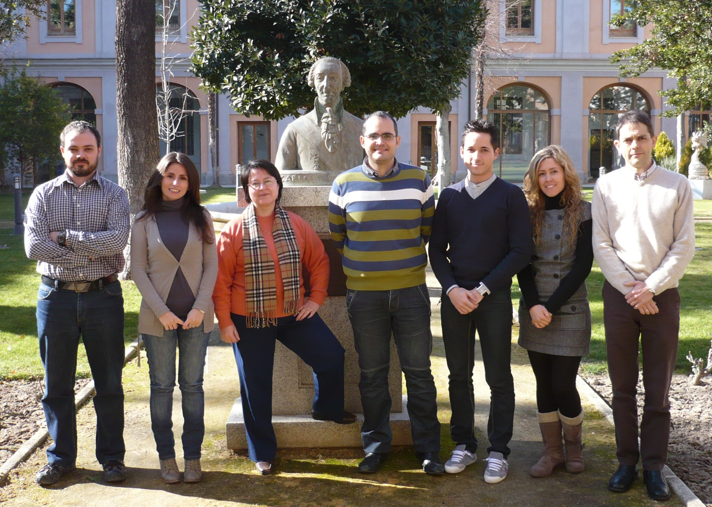
Acknowledgments
INQUIME Group
Carlos
Jiménez
Isaac
Asencio
Jesús
García
Fabiola
Martínez
Jesusa
Rincón
Susana
Tostón

Slide 26
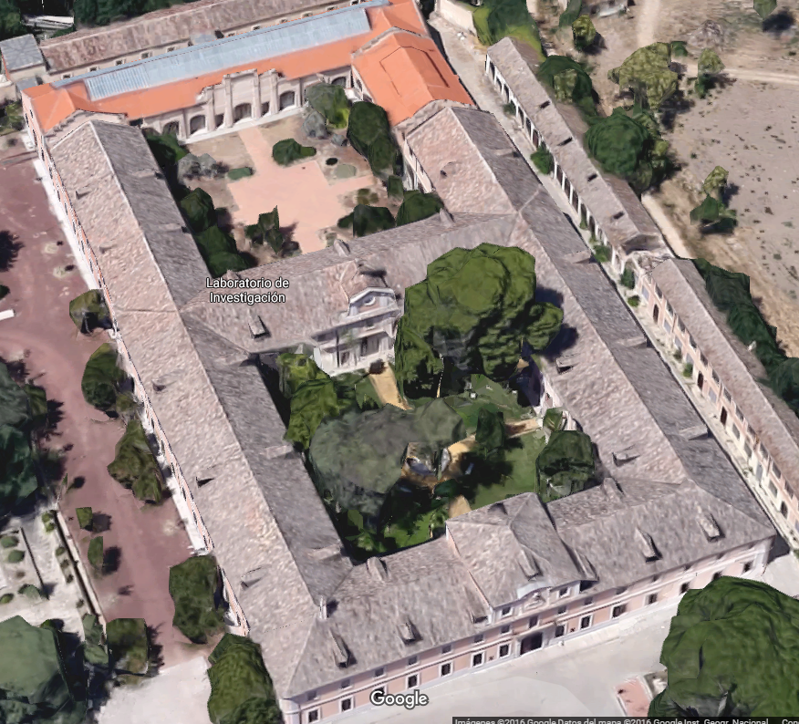



Acknowledgments
Sabatini Building (1780) 10,000 m²
70 km
Toledo
350 km
Former Arms Factory (1780-1996)
> 150,000 m²
River Tagus

Slide 27


Acknowledgments
Alexander Fleming
Albert Einstein
1923
1948

Slide 28




Acknowledgments
1986-2016
طليطلة
טולדות

Slide 29
Photocatalytic reduction of CO₂ by means of TiO₂-based catalysts synthesized with high pressure fluids
Rafael Camarillo Blas
rafael.camarillo@uclm.es

