Slide 1
Impact of Imatinib interruption & duration of prior Hydroxyurea on treatment outcome in CML patients
Raafat R. Abdel-Malek, MD, FRCR
Ass. Prof Clinical Oncology
Cairo University, Egypt

Slide 2
Introduction
CML is a myeloproliferative neoplasm characterized by presence of BCR-ABL fusion gene resulting in uncontrolled proliferation of mature and maturing granulocytes.
CML accounts for 15-20% of leukemias in adults.
It has an annual incidence of 1-2 cases per 100,000, with a slight male predominance.

Slide 3
Introduction
The management of CML has undergone a profound evolution over a relatively short period of time, with the introduction of Imatinib in 1998.
Imatinib produced significantly higher hematologic and cytogenetic response rates with deeper, more durable responses, and much less toxicity than interferon therapy, which had been standard of care prior to availability of Imatinib.
Optimal response requires that patients should be maintained on the drug continuously.

Slide 4
Aim of work
Evaluation the impact of Imatinib interruption and prior Hydroxyurea use on response and progression free survival of patients with CML in chronic phase.

Slide 5
Patients and Methods
Between January 2010 and December 2013, all patients with chronic phase CML who received Imatinib at our department were included in a retrospective analysis.
The patients were analyzed with respect to the demographic profile, EUTOS score, molecular response and survival.
Patients were divided into 2 groups according to prior Hydroxyurea administration or Imatinib interruption.

Slide 6
Patients and Methods
The 2009 European Leukemia Net (ELN) response criteria was adopted to define chronic, accelerated, blastic phases and to assess the response.
PFS was defined as time from start of Imatinib to onset of an accelerated or blastic phase, discontinuation of Imatinib due to failure, sub-optimal response or death.

Slide 7
Results
During study period, 60 patients were included. 33 patients (55%) received Imatinib upfront, while 27 (45%) received Imatinib post Hydroxyurea.
On the other hand, half of patients (30 patients) received the drug regularly without interruption while the other half had interruption of more than 7 days over 3 months period.

Slide 8
Baseline characteristics
Number (%)
60 (100) |  | Total number
46 (18 – 86) | Median (range) | Age
30 (50) | Male | Gender
30 (50) | Female
45 (75) | low | EUTOS score
15 (25) | high
150 (29.8 – 500) | Median (range) | TLC
10 (6.4 – 12.6) | Median (range) | Hgb
271 (93 – 797) | Median (range) | Plt

Slide 9
Response evaluation according to prior Hydroxyurea use
P value | Prior Hydroxyurea | Upfront Imatinib
 | N= 27 | N= 33
0.234 | 24 (89%) | 31 (94%) | CHR at 3 mo
0.757 | 15 (55.5%) | 19 (57.5%) | MMR at 6 mo
0.462 | 6 (22%) | 9 (27%) | CMR at 12 mo

Slide 10
Response evaluation according to Drug Interruption
P value | Interruption | No interruption
 | N= 30 | N= 30
0.234 | 27 (90%) | 28 (93%) | CHR at 3 mo
<0.001 | 9 (30%) | 21 (70%) | MMR at 6 mo
<0.001 | 0 (0%) | 13 (43.3%) | CMR at 12 mo

Slide 11
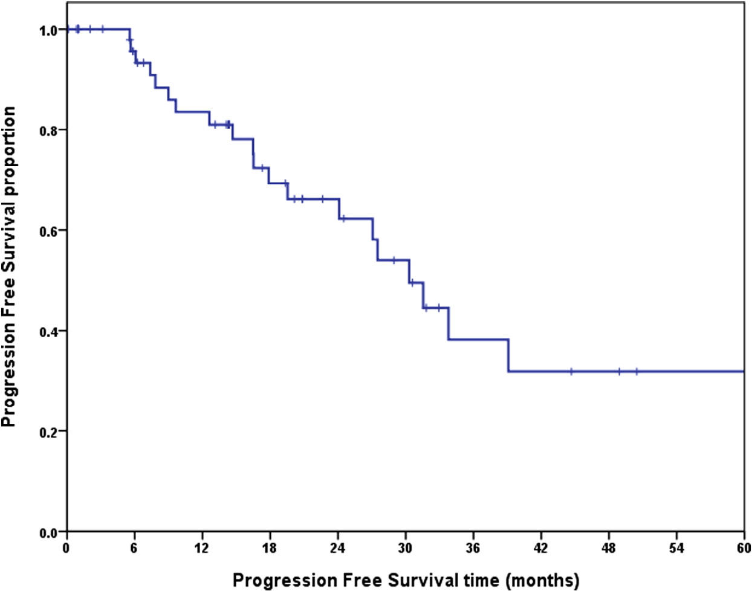
Survival analysis
median PFS was 30.3 months (95% CI 24.3–36.3)

Slide 12
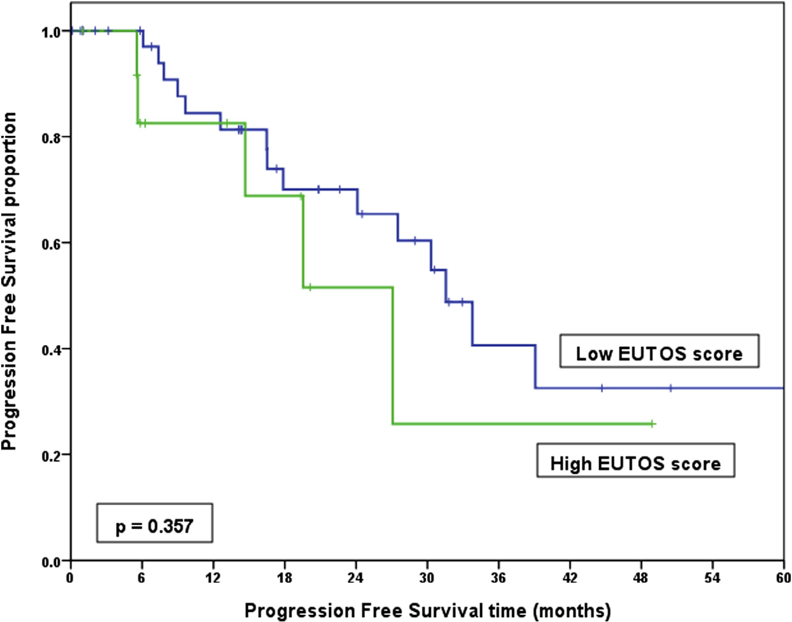
PFS according to EUTOS score

Slide 13
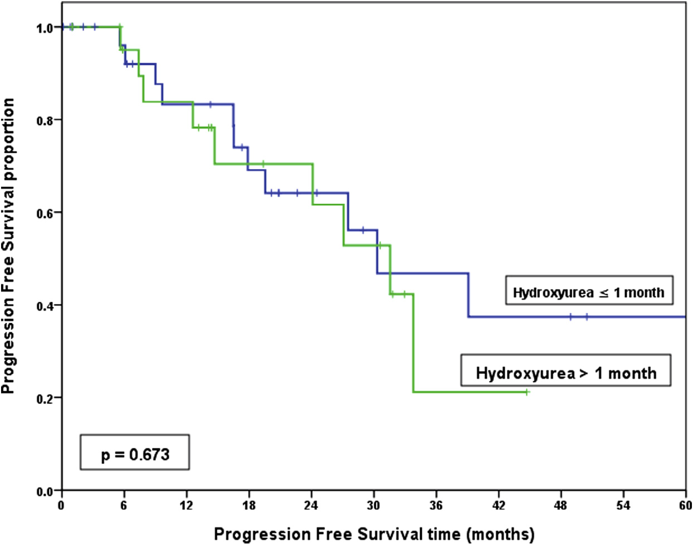
PFS acc to prior Hydroxyurea use

Slide 14
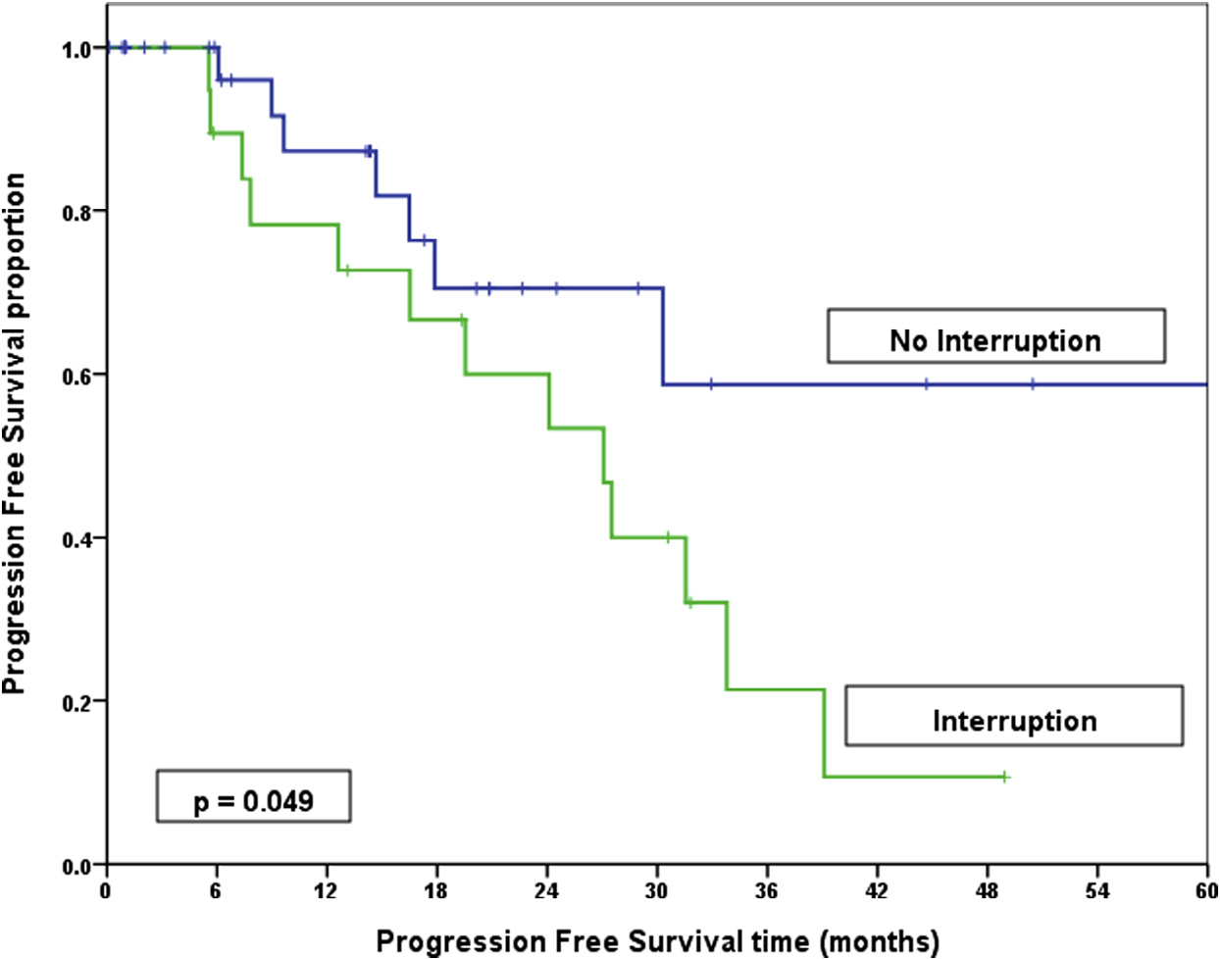
PFS according to Drug Interruption

Slide 15
Conclusions
In conclusion, duration of prior Hydroxyurea had no impact on response or PFS.
Patients regular on Imatinib had statistically significant higher MMR, CMR and PFS, compared to those who had periods of drug interruption.
Thus, we need more governmental support to supply the drug without interruption to improve treatment outcome for our CML patients.

Slide 16
Thank You
for your attention

Slide 17
95% CI | HR | P value
0.49 – 2.96 | 1.21 | 0.673 | Imatinib (prior Hydroxyurea vs. no)
1.01 – 5.99 | 2.38 | 0.049 | Drug administration (Interruption vs. No)
0.58 – 4.48 | 1.61 | 0.360 | EUTOS score (High vs. Low)

