Slide 1
Efficacy & Toxicity of Sunitinib in mRCC patients in Egypt
Raafat R. Abdel-Malek, MD, FRCR
Ass. Prof Clinical Oncology
Cairo University, Egypt

Slide 2
Introduction
Renal cell carcinoma (RCC) accounts for 2–3% of all adult cancers.
At diagnosis, a third of the patients present with locally advanced or metastatic disease and a third of patients undergoing nephrectomy will eventually develop metastasis.
Understanding the molecular pathogenesis of RCC has identified many targets for therapeutic intervention.

Slide 3
Introduction
The rapid development of agents blocking the vascular endothelial growth factor (VEGF) pathway (eg, Sunitinib, Sorafenib, Bevacizumab, Pazopanib, Axitinib) or the mTOR pathway (Temsirolimus, Everolimus) has established molecularly-targeted therapy as the preferred treatment approach for most patients with advanced clear cell renal cell carcinoma.
Here we present our data regarding the efficacy and toxicity of Sunitinib among Egyptian patients with metastatic RCC.

Slide 4
Patients and methods
Between January 2010 and December 2013, patients with metastatic RCC presented to Clinical Oncology department, Cairo University who received Sunitinib as 1st line treatment were enrolled in this retrospective analysis.
The medical records were reviewed, and data on both the patient and tumor characteristics were collected.
The patients were analyzed with respect to the demographic profile, MSKCC risk scoring, dose of Sunitinib, response rate, adverse events, and survival.

Slide 5
Patients and methods
PFS was calculated from date of diagnosis of metastatic disease till date of progression or death from any cause.
OS was calculated from the date of diagnosis of metastatic disease till date of last follow-up or death from any cause.

Slide 6
Results
% | Number | Baseline characteristics
100 | 44 | Total number of included patients
53 years (19 – 78) |  | Median (range) | Age
73 | 32 | male | Gender
27 | 12 | Female
91 | 40 | Clear cell | Pathological subtype
2 | 1 | papillary
7 | 3 | sarcomatoid
93 | 41 | 0-1 | ECOG P.S
7 | 3 | 2
84 | 37 |  | Nephrectomy
50 | 22 | Metastatic at 1st presentation

Slide 7
Results
% | Number | Baseline characteristics
25 | 11 | Favorable | MSKCC scoring
66 | 29 | Intermediate
9 | 4 | Poor
66 | 29 | Lung | Site of metastasis
36 | 16 | Lymph nodes
32 | 14 | Bone
25 | 11 | Liver
7 | 3 | Brain
7 | 3 | Local recurrence

Slide 8
Results
At median follow up of 19 months:
    9 patients (21%) achieved PR
    20 patients (45%) had SD
    7 patients (16%) had DP,
    4 patients (9%) had discontinued therapy due to repeated G3 toxicity (Fatigue or Hand & Foot syndrome)
    4 (9%) lost follow up

Slide 9
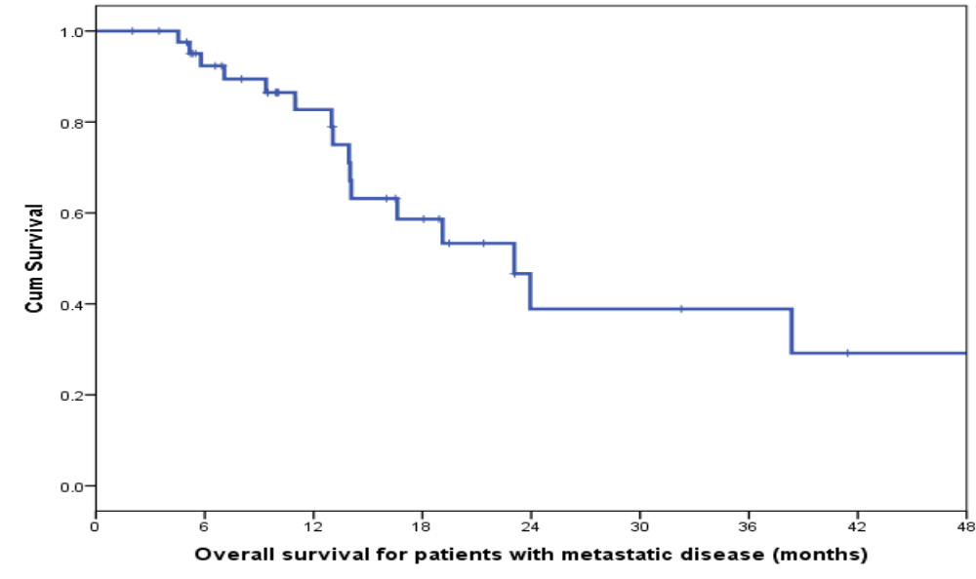
Results
Median OS: 23 months (95% CI 15.2 – 30.9)

Slide 10
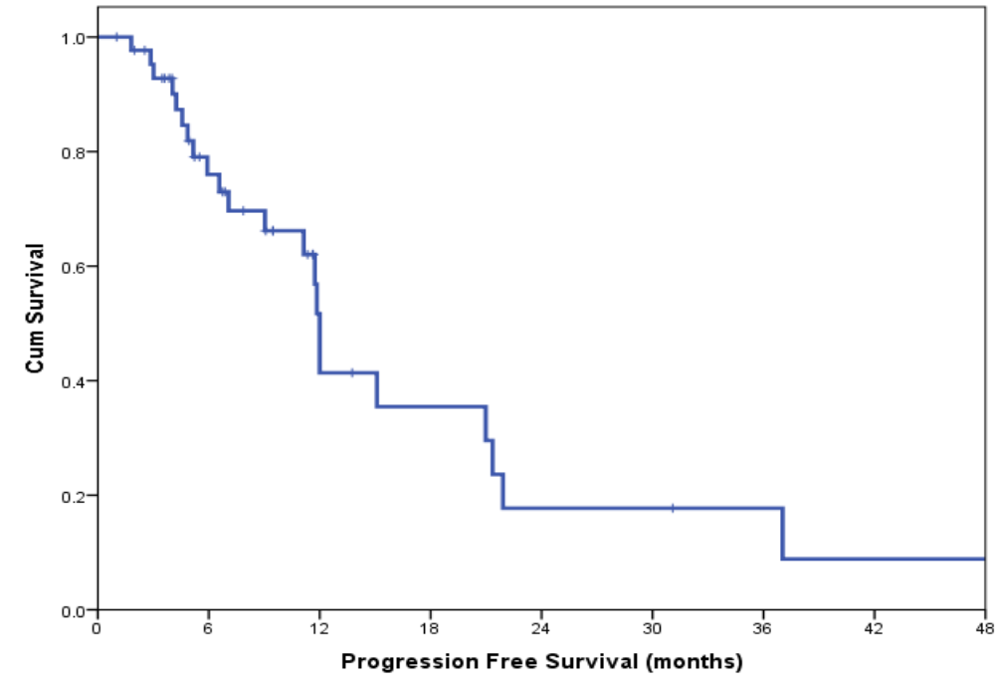
Results
Median PFS: 12 months (95% CI 11.6 – 12.3)

Slide 11
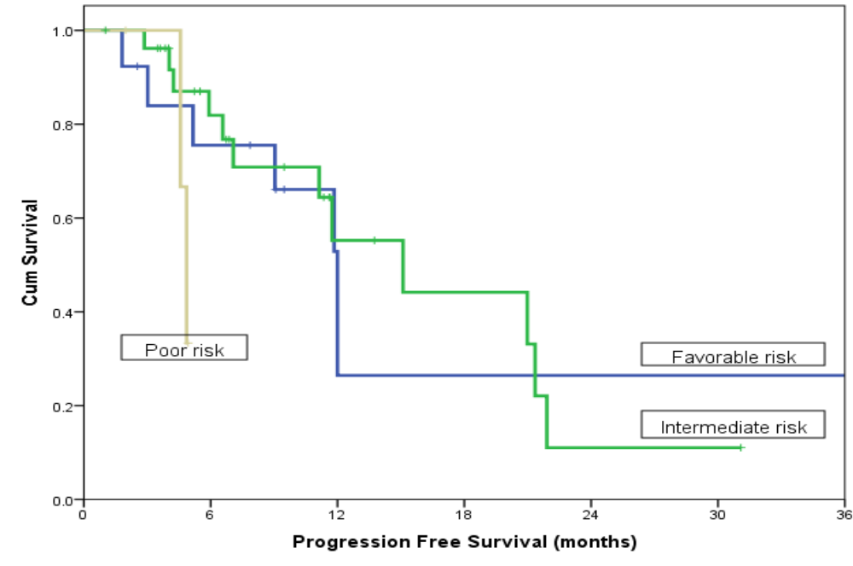
Results
PFS according to Memorial Sloan Kettering Cancer Center risk score

Slide 12
Adverse events
All patients started Sunitinib at the standard dose 50 mg orally once daily on a 4 weeks on, 2 weeks off dosing schedule.
The median treatment duration was 8.75 months,
dose reduction was necessary in 21 (47.7%) patients.
The dose was decreased to 37.5 mg/day in 18 (86%) patients and to 25 mg/day in 3 (14%) patients.
Sunitinib was interrupted in 4 patients due to grade 3 toxicity.
Most of the patients had their dose reduction at the second cycle (70%) followed by the third one (20%).

Slide 13
Adverse events
Grade 3-4 (%) | All gardes (%) | Adverse events
4 (9) | 25 (65.8) | Fatigue
3 (6.8) | 22 (50) | Vomiting
7 (15.9) | 21 (47.7 ) | Mucositis
6 (13.6) | 20 (45.4) | Hand and foot syndrome
1 (2.2) | 17 (38.6) | Hypertension
3 (6.8) | 16 (36.3) | Diarrhea
0 | 11(25) | Heart burn
0 | 10 (22.7) | Skin rash
0 | 4 (9) | Hypothyroidism
0 | 3 (6.8) | Bleeding
0 | 2 (4.5) | Decline in EF

Slide 14
Adverse events
Grade 3-4 (%) | All gardes (%) | Lab abnormalities
2(4.5) | 22 (50) | Anemia
1(2.2) | 21(47.7) | Leucopenia
3(6.8) | 12(27.2) | Neutropenia
1(2.2) | 7(15.9) | Thrombocytopenia
1(2.2) | 4 (9) | Liver enzymes elevation

Slide 15
Conclusions
In our study, median PFS of 12 months & median OS was 23 months coincide with published literature.
The most common non hematological adverse events in our Egyptian patients were fatigue, vomiting while most frequent G3 toxicity were mucositis and hand & foot.
Our toxicity profile is quite different from the western literature, where diarrhea was the dominant adverse event (61%), while hypertension (12%) and fatigue (11%) were the most frequent grade 3 non hematological toxicity.

Slide 16
Conclusions
Different toxicity profile were seen in Asian population where the most common adverse events were fatigue (81%), stomatitis (60%), thrombocytopenia (56%), anemia (55%) and hand–foot syndrome (48%) . Grade 3 or 4 events were for hand–foot syndrome (16%), thrombocytopenia (16%) and stomatitis (10%).
In conclusion, it seems that the toxicity profile in our Egyptian patients is more close to the Asian people rather than the western countries, a phenomenon that obviously needs further validation by a large prospective trial.

Slide 17
Thank You
for your attention

Slide 18
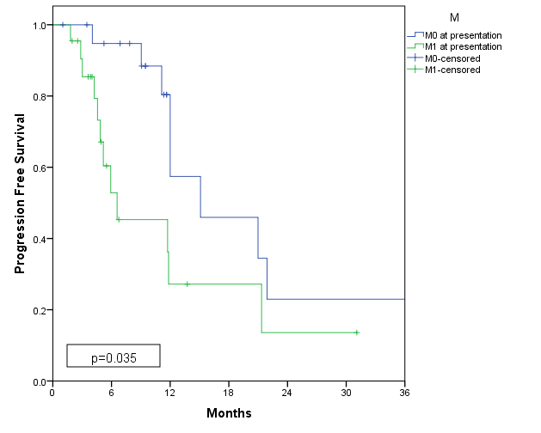
Results
PFS according to status at presentation

