Slide 1

Biomonitoring of selected freshwater bodies using diatoms as ecological indicators
R. U. Sawaiker * and B. F. Rodrigues
Department of Botany, Goa University,
Goa 403 206, India.
E-mail: ranjitasawaikar@gmail.com

Slide 2
INTRODUCTION
Water - one of the vital issues of the 21st century - life of people will depend on the wise management of the water resources.
Precious aquatic environment is getting polluted - warrants urgent action to prevent further degradation.
Anthropogenic activities degrade freshwater ecosystems - affecting ecological integrity, functioning and subsequently their use for domestic, industrial and agricultural purposes.

Slide 3
INTRODUCTION
Freshwater communities - very sensitive to environmental variables.
Monitoring of water quality with regards to physical and chemical parameters reflects instantaneous measurements - biotic parameters developed during the recent years - serve as an excellent tools in water pollution studies - provides better evaluation of environmental changes.
Biological monitoring - fast and cost-effective approach for assessing the effects of environmental stressors.
Phytoplanktons - used as indicators of water quality mainly due to their sensitivity and strong response to physical and chemical changes in waters.

Slide 4
INTRODUCTION
Diatoms - potential indicators of water quality due to their sensitivity and strong response to physico- chemical and biological changes.
Ubiquitous in distribution - their cells remain unchanged for years under varied environmental conditions – hence used as water quality indicators.
Various indices - developed for monitoring pollution in water bodies.

Slide 5
INTRODUCTION
IDSE/5 - simplest and effective water quality index, utilizing diatom population - indicates the quality of water in terms of organic pollution as well as anthropogenic eutrophication.
The design of OMNIDA Software for computation of diatom indices has facilitated the use of diatom based biomonitoring (Leconite et al., 1993).
This software - a comprehensive database having an inbuilt ecological data for 13,000 diatom species.

Slide 6
AIMS AND OBJECTIVES
To ascertain the level of degradation in the selected water bodies due to organic and anthropogenic pollution,
To identify the diatom species indicating organic and anthropogenic pollution in the selected water bodies, and
To derive Louis Leclercq index of Saprobity- Eutrophication (IDSE/5) using OMNIDIA GB 5.3 software and know the trophic state of the selected water bodies.

Slide 7
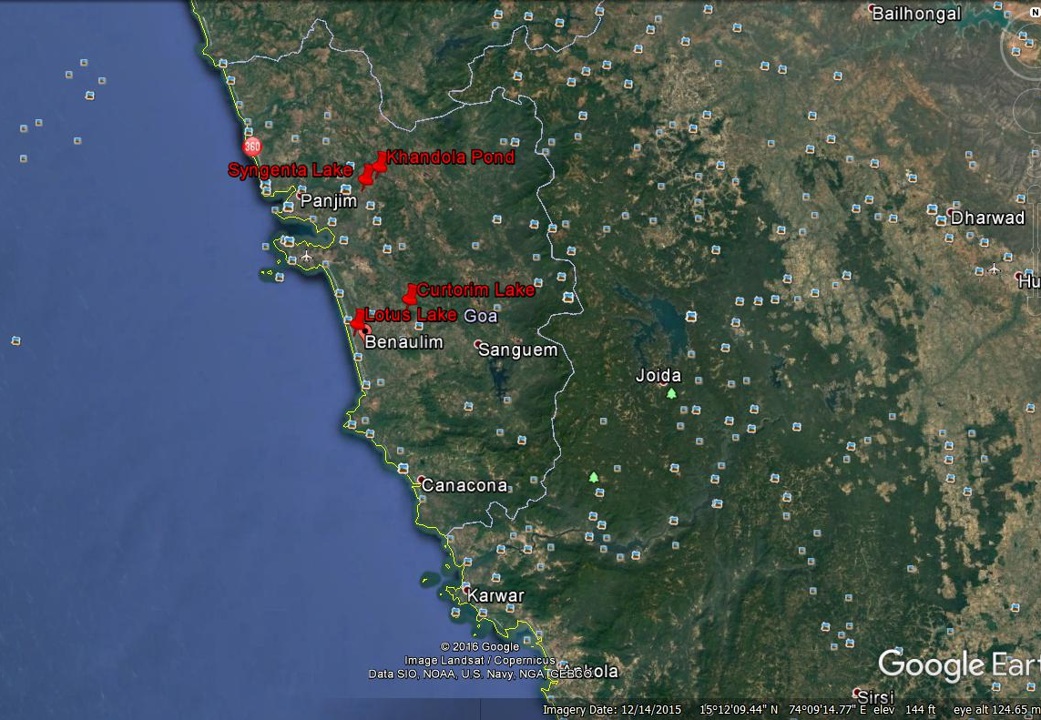
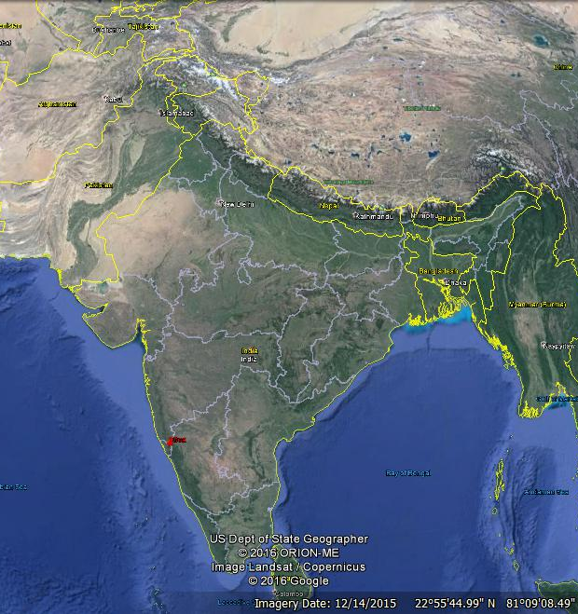
MATERIALS AND METHODS
Two water bodies each from North Goa (Syngenta Lake and Khandola Pond) and South Goa (Lotus Lake and Curtorim Lake) were selected for the study from January 2014 to December 2015 on monthly basis.
Location of study sites

Slide 8
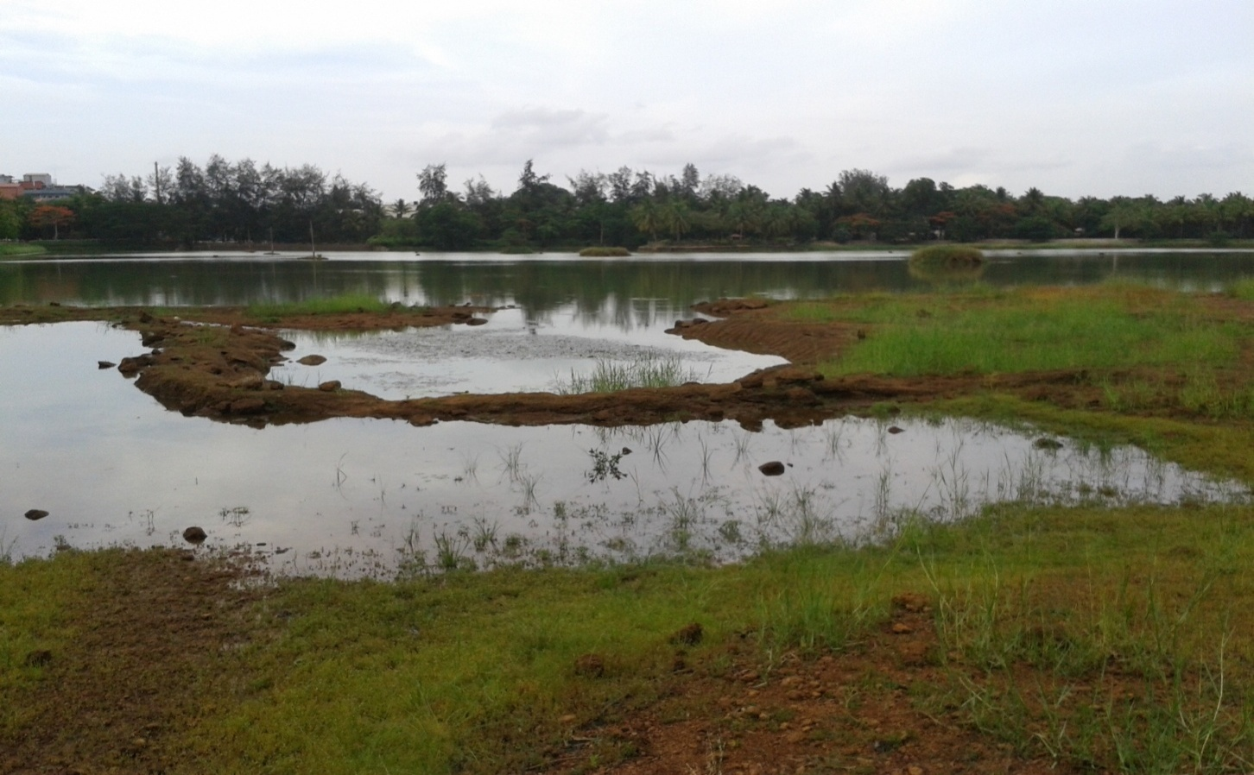
VIEW OF SYNGENTA LAKE
Syngenta Lake is in the premises of M/s Syngenta Agro Chemicals
(15.5º N Lat. 73.94ºE Long.)

Slide 9
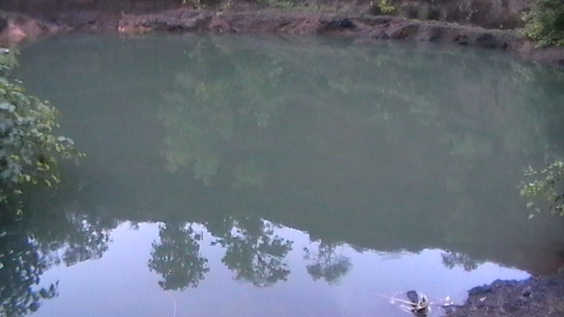
VIEW OF KHANDOLA POND
Khandola Pond is in Marcela village - source of irrigation to areca nut plantation.
(15.51º N Lat. 73.95ºE Long.)

Slide 10
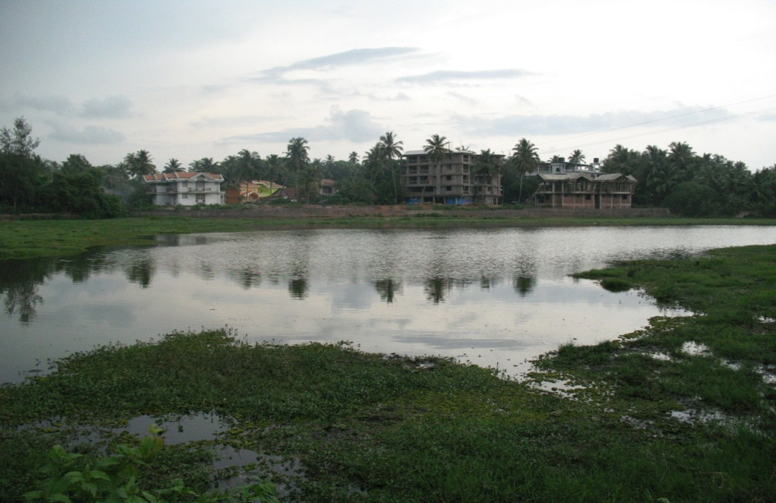
VIEW OF LOTUS LAKE
Lotus Lake is in Benaulim village - source of irrigation for paddy crop.
(15.24⁰N Lat. and 73.92⁰E Long.)

Slide 11
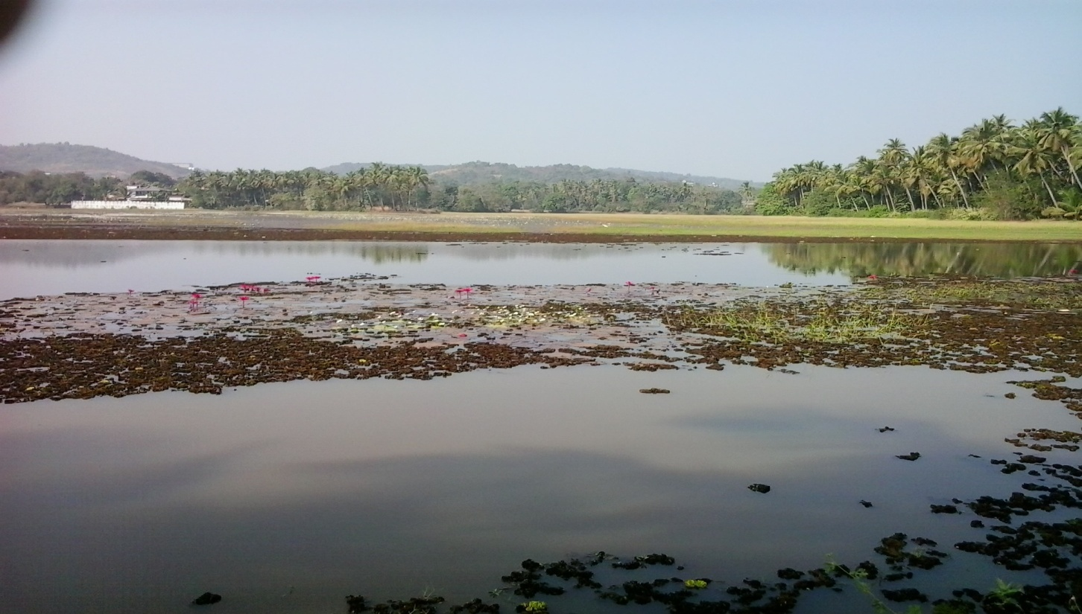
VIEW OF CURTORIM LAKE
Curtorim Lake is situated in Curtorim village - source of irrigation for paddy crop
(15.28⁰N Lat. and 74.01⁰E Long.)

Slide 12
MATERIALS AND METHODS
Water samples were collected in the early hours as daily vertical migrations of organisms occur in response to sunlight and nutrient concentrations from the surface near the landward margins. Physico-chemical parameters -pH, temperature, nitrates and phosphates were analyzed using standard procedures (APHA, 2012).
For diatom study 1l of water sample - collected in sterile plastic bottles (in triplicate) and Lugol’s solution (0.7ml/100 ml of sample) added immediately for sedimentation.

Slide 13
MATERIALS AND METHODS
The bottles were subsequently left undisturbed for 24 h. The diatoms fixed and settled at the bottom of the containers after decanting the supernatant fluid were collected and preserved in bottles containing 4% formaldehyde.
Enumeration of diatoms - modified Lackey’s drop method (Suxena, 1987). Dimensions measured using micrometry technique and photomicrographs were taken using Nikon DS Fi 2 camera.

Slide 14
MATERIALS AND METHODS
Various taxonomic guides consulted (Gandhi, 1998; Sarode and Kamath, 1984; Kramer and Lange - Bertalot, 2003; Karthick et al., 2010).
Each taxon was coded with acronyms as per the rules of OMNIDA GB 5.3 software. Diatom species counts were entered index calculation tool, OMNIDIA version 5.3 (Lecointe et al., 1993).
The output of the software provides various metrics of water quality through the indices and ecological characteristics. The Louis Leclercq IDSE/5 index was calculated using this software (Leclerq and Maquet, 1987).

Slide 15
MATERIALS AND METHODS
Seven ecological indicator values (that indicate the conditions required for growth and survival of diatoms and also determines the water quality ) given by Van Dam et al., (1994) were derived for selected water bodies using the OMNIDIA GB 5.3 software and were used for interpretation of results.
These include pH, salinity (S), nitrogen uptake (NU), oxygen requirements (OR), saprobity (SP), trophic state (TS) and moisture (M). Each parameter is measured on a scale of 1-7. OMNIDIA is also used to compute degradation (D) using IDSE/5 Louis Leclercq index for organic pollution (OP) and anthropogenic eutrophication (AE).

Slide 16
RESULTS
Sr. No. | Species | Acronym
1 | Pinnularia graciloids Huste | PGRA
2 | Pinnularia dolosa H.P. Gandhi | PDOL
3 | Navicula halophila( Gurnow)Cleve | NHAL
4 | Cocconeis placentula (Gurnow) Cleve | CPLA
5 | Navicula mutica Kutzing | NMUT
6 | Gomphonema parabolum Kutzing | GPAR
7 | Ahninthes exigua Grunow. | AEXI
8 | Cymbella chandolensis Gandhi. | CCHA
9 | Synedra ulna (Nitzsch) Ehrenberg. | SULN
10 | Pinnularia gibba Ehrenberg | PGIB
11 | Melosira islandica O. Muller | MISL
12 | Amphora ovalis (Kutzing) Kutzing | AOVA
13 | Stauroneis phoenicenteron (Nitzsch) Ehrenberg | SPHO
14 | Navicula microcephala Grunov | NMIC
15 | Diploneis elliptica (Kutzing) Cleve | DELL
16 | Stauroneis anceps Ehrenberg | SANC
17 | Navicula sphaerophora Kutzing | NSPH
18 | Navicula radiosa Kutzing | NRAD
19 | Gomphonema subtiles Ehrenberg | GSUB
20 | Navicula rhynococephala Kutzing | NRHY
21 | Eunotia tumida Gandhi | ETUM
Diatom species with their acronyms.
During the study period 21 species of diatoms belonging to 12 genera were recorded.

Slide 17
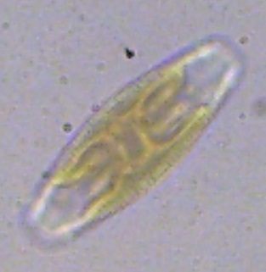
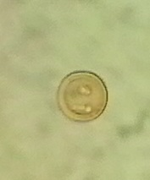
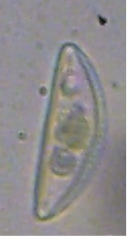
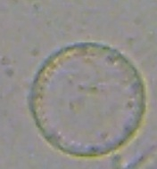
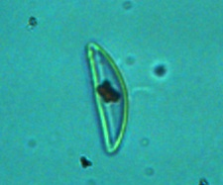
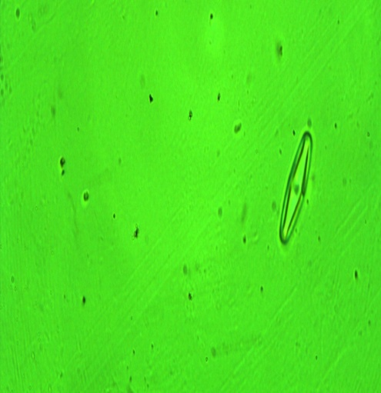
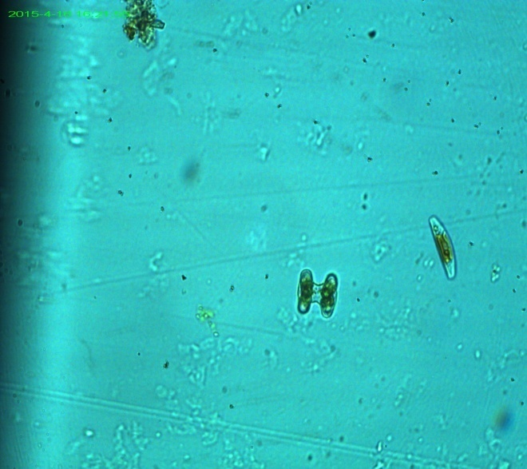
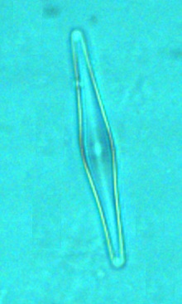
Diatoms species
Ahninthes exigua
Cocconeis placentula
Cymbella chandolensis
Cocconies placentula
Cymbella turgidula
Diploneis elliptica
Eunotia tumida
Gomphonema subtiles

Slide 18
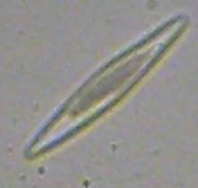
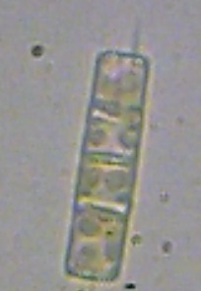
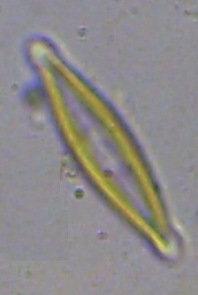
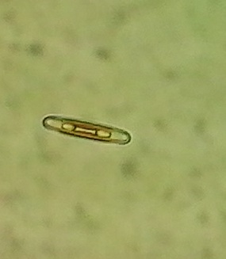
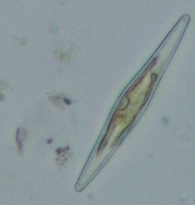
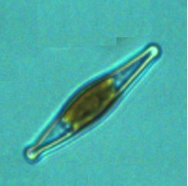
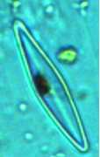
Diatoms species
Gomphonema parabolum
Melosira indica
Navicula halophila
Navicula mutica
Navicula radiosa
Navicula rhynococephala
Navicula microcephala

Slide 19
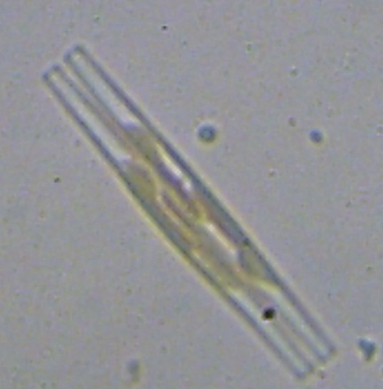
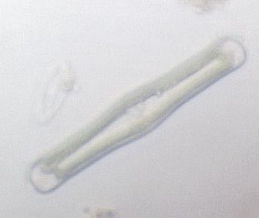
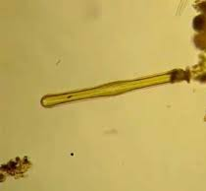
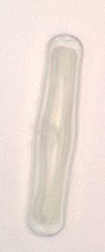
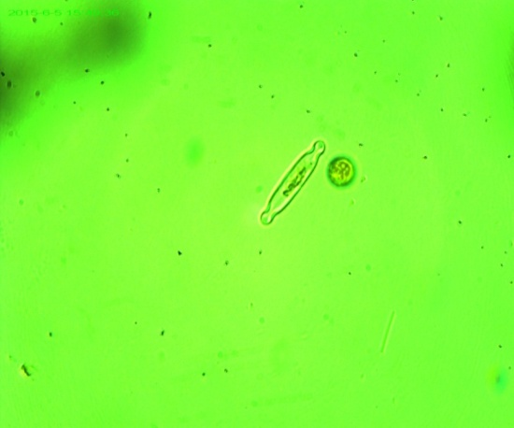
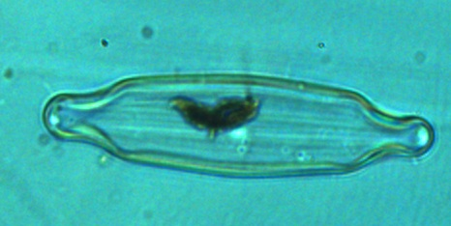
Diatoms species
Synedra ulna
Pinnularia dolosa
Pinnularia gibba
Pinnularia graciloids
Stauroneis anceps
Stauroneis phoenicenteron

Slide 20
Classification of Ecological Indicator values (VanDam, Martens and Sinkeldam (1994)
(R) pH (1-6)
1 | Acidobiontic | Optional occurrence at pH <5.5
2 | Acidophilous | Mainly occurring at pH <7
3 | Circumneutral | Mainly occurring at pH – values about 7
4 | Alkaliphilous | Mainly occurring at pH >7
5 | Alkalibiontic | Exclusively occurring at pH >7
6 | Indifferent | No apparent optimum
(H) Salinity (1-4)
 | Water Quality | Cl- (mg/L) | Salinity
1 | Fresh | <100 | <0.2
2 | Fresh brackish | <500 | <0.9
3 | Brackish fresh | 500-1000 | 0.9-1.8
4 | Brackish | 1000-5000 | 1.8-9.0
(N) Nitrogen Uptake (1-4)
1 | Nitrogen-autotrophic taxa tolerating very small concentrations of orgaically bound nitrogen
2 | Nitrogen-autotrophic taxa tolerating elevated concentrations of organically bound nitrogen
3 | Facultatively bound nitrogen-heterotrophic taxa needing periodically elevated concentrations of organically bound nitrogen
4 | Obligately nitrogen-heterotrophic taxa needing continuously elevated concentrations of organically bound nitrogen
Saprobity (1-5)
1 | Oligosaprobous
2 | β-mesosaprobous
3 | α-mesosaprobous
4 | α-meso- /polysaprobous
5 | Polysaprobous
(M) Moisture (1-5)
1 | Never or only very rarely occurring outside water bodies
2 | Mainly occurring in water bodies, sometimes on wet places
3 | Mainly occurring in water bodies also rather regularly on wet and moist places
4 | Mainly occurring on wet and moist or temporarily dry places
5 | Nearly exclusively occurring outside water bodies
Trophic State (1-7)
1 | Oligotrophentic
2 | Oligo-mesotrophentic
3 | Mesotrophentic
4 | Meso-eutrophentic
5 | Eutrophentic
6 | Hypereutrophentic
7 | Oligo-to eutrophentic (hypoeutrophentic)
(O) Oxygen requirements (1-5 )
1 | Continuously high (about 100% saturation)
2 | Fairly high (above 75% saturation)
3 | Moderate (above 50% saturation)
4 | Low (above 30% saturation)
5 | Very low (about 10% saturation)

Slide 21
Ecological indicator values for selected water bodies (As per Van Dam et al., 1994)
(Data derived from OMNIDA GB5.3 Software)
January to December 2014
Sr.No. | Parameter /criteria | SL | KP | LL | CL
1 | Number of genera | 10 | 2 | 12 | 12
2 | population | 78862 | 96925 | 14155 | 10763
3 | Diversity | 3.64 | 2.07 | 3.65 | 3.7
4 | Evenness | 0.98 | 0.89 | 0.98 | 0.97
5 | Number of species | 13 | 5 | 14 | 14
6 | pH (R) | 4-Alkaliphilous mainly occurring at pH >7 | 3-Circumneutral mainly occurring at pH 7 | 3- Circumneutral mainly occurring at pH 7 | 3- Circumneutral mainly occurring at pH 7
7 | Salinity (H) | Fresh to brackish | 2-Fresh to br brackish | 2-Fresh to brackish | 2-Fresh to brackish
8 | Nitrogen Uptake metabolism (N) | 2- Nitrogen autotrophic taxa tolerating elevated levels of organically bound nitrogen | 2- Nitrogen autotrophic taxa tolerating elevated levels of organically bound nitrogen | 2- Nitrogen autotrophic taxa tolerating elevated levels of organically bound nitrogen | 2-Nitrogen autotrophic taxa tolerating elevated levels of organically bound nitrogen
9 | Oxygen Requirement (O) | 3-Moderate (above 50% saturation) | 2- Fairly high(above 75% saturation) | 3- Moderate (above 50% saturation) | 3- Moderate (above 50% saturation)
10 | Saprobity (S) | 3-Alfa mesosaprobous | 2- B mesosaprobus | 3-Alpha mesosaprobous | 3- Alpha mesosaprobous
11 | Trophic state | 5-Eutrophantic | 4-Mesoeutrophantic | 5- Eutrophentic | 5- Eutrophentic
12 | Moisture retention (M) | 2- Mainly occurring in water bodies | 2-Mainly occurring in water bodies | 2- Mainly occurring in water bodies | 2- Mainly occurring in water bodies
13 | IDSE/5(Louis Leclercq Index) | 3.31 | 3.52 | 3.53 | 3.46
14 | % Indicators of organic pollution | 30.65% | 22.12% | 21.23% | 20.87%
15 | Indicator organisms | GPAR, NHAL, NMIC, NMUT | NMUT | GPAR, NHAL, NMUT | GPAR, NHAL, NMUT
16 | % indicators of anthropogenic eutrophications | 27.19% | 27.19% | 15.28% | 23.48%
17 | Indicator organisms | AOVA,SPHO,SULN | NRHY | AOVA,SPHO,SULN | AOVA,SPHO,SULN

Slide 22
Ecological indicator values for selected water bodies (As per Van Dam et al., 1994)
(Data derived from OMNIDA GB5.3 Software)
January to December 2015
Sr. No. | Parameter /criteria | SL | KP | LL | CL
1 | Number of genera | 10 | 2 | 11 | 10
2 | population | 11124 | 95525 | 99119 | 13000
3 | Diversity | 3.65 | 2.05 | 3.72 | 3.62
4 | Evenness | 0.96 | 0.88 | 0.98 | 0.95
5 | Number of species | 14 | 5 | 14 | 14
6 | pH (R) | 3- Circumneutral mainly occurring at pH 7 | 3-Circumneutral mainly occurring at pH 7 | 3-Circumneutral mainly occurring at pH 7 | 3-Circumneutral mainly occurring at pH 7
7 | Salinity (H) | 2- Fresh to brackish | 2, Fresh to brackish | 2-Fresh to brackish | 2-Fresh to brackish
8 | Nitrogen Uptake metabolism (N) | 2-Nitrogen autotrophic taxa tolerating elevated levels of organically bound nitrogen | 2-Nitrogen autotrophic taxa tolerating elevated levels of organically bound nitrogen | 2-Nitrogen autotrophic taxa tolerating elevated levels of organically bound nitrogen | 2- Nitrogen autotrophic taxa tolerating elevated levels of organically bound nitrogen
9 | Oxygen Requirement (O) | 2- Fairly high(above 75% saturation) | 2- Fairly high(above 75% saturation) | 3- Moderate (above 50% saturation) | 3- Moderate (above 50% saturation)
10 | Saprobity (S) | 3- Alfa mesosaprobous | 2- B mesosaprobus | 3-Alpha mesosaprobous | 3-Alpha mesosaprobous
11 | Trophic state | 5- Eutrophantic | 4-Mesoeutrophantic | 5- Eutrophentic | 5- Eutrophentic
12 | Moisture retention (M) | 2- Mainly occurring in water bodies | 2- Mainly occurring in water bodies | 2- Mainly occurring in water bodies | 2- Mainly occurring in water bodies
13 | IDSE/5(Louis Leclercq Index) | 3.47 | 3.52 | 3.16 | 3.47
14 | % Indicators of organic pollution | 19.63% | 15.29% | 32.59% | 19.63%
15 | Indicator organisms | GPAR, NHAL, NMUT | NMUT | GPAR, NHAL, NMUT | GPAR, NHAL, NMUT
16 | % indicators of anthropogenic eutrophications | 15.32% | 20.98% | 18.71% | 15.32%
17 | Indicator organisms | AOVA,SPHO,SULN | NRHY | AOVA,SPHO,SULN | AOVA,SPHO, SULN

Slide 23
Variations in pH of selected water bodies
Months of study | Syngenta Lake | Khandola Pond | Lotus Lake | Curtorim Lake
Jan’14 | 6.1 | 7.1 | 7.8 | 6.8
Feb’14 | 5.9 | 6.1 | 6.6 | 6.9
Mar’14 | 6.2 | 6.0 | 6.4 | 6.7
Apr’14 | 6.2 | 6.1 | 6.0 | 6.9
May’14 | 6.3 | 6.0 | 5.9 | 6.7
June’14 | 6.4 | 6.8 | 6.0 | 7.6
July’14 | 6.8 | 6.4 | 6.7 | 7.6
Aug’14 | 6.4 | 6.2 | 6.0 | 7.6
Sept’14 | 6.2 | 6.4 | 6.5 | 7.5
Oct’14 | 6.0 | 6.4 | 6.0 | 7.6
Nov’14 | 6.5 | 6.4 | 6.6 | 6.4
Dec’14 | 6.7 | 6.4 | 6.0 | 6.9
Jan’15 | 6.1 | 7.1 | 6.8 | 6.6
Feb’15 | 6.0 | 6.1 | 6.6 | 6.7
Mar’15 | 6.2 | 6.1 | 6.4 | 7.1
Apr’15 | 6.2 | 6.1 | 6.0 | 6.7
May’15 | 5.9 | 6.0 | 5.8 | 6.8
June’15 | 6.2 | 6.1 | 6.0 | 6.7
July’15 | 6.2 | 6.3 | 6.7 | 6.6
Aug’15 | 6.4 | 6.2 | 6.7 | 6.6
Sept’15 | 6.4 | 6.4 | 6.0 | 6.5
Oct’15 | 6.3 | 6.3 | 5.4 | 6.1
Nov’15 | 6.1 | 6.4 | 6.2 | 5.4
Dec’15 | 6.3 | 6.4 | 6.5 | 6.3
In the present study, the pH of water was ranging from acidic to alkaline; varied in different water bodies viz., Syngenta Lake (5.9 - 6.8), Khandola Pond (6.0 - 7.1), Lotus Lake (5.4 - 7.8) and Curtorim Lake (5.4 - 7.6).
Diatom population also showed variations which may be attributed to the change in pH values.
Robert et al., (1974) suggested that pH range from 5 to 8.5 - ideal for phytoplankton growth.

Slide 24
Variations in temperature of selected water bodies
Months of study | Syngenta Lake | Khandola Pond | Lotus Lake | Curtorim Lake
Jan’14 | 25 | 25 | 25 | 25
Feb’14 | 28 | 28 | 29 | 29
Mar’14 | 28 | 28 | 29 | 29
Apr’14 | 30 | 30 | 30 | 30
May’14 | 31 | 31 | 31 | 31
June’14 | 30 | 30 | 30 | 30
July’14 | 28 | 30 | 30 | 30
Aug’14 | 27 | 28 | 26 | 26
Sept’14 | 28 | 27 | 28 | 28
Oct’14 | 29 | 28 | 29 | 29
Nov’14 | 29 | 29 | 29 | 29
Dec’14 | 28 | 28 | 28 | 28
Jan’15 | 23 | 23 | 25 | 25
Feb’15 | 25 | 25 | 29 | 29
Mar’15 | 29 | 29 | 29 | 29
Apr’15 | 30 | 30 | 30 | 30
May’15 | 32 | 32 | 32 | 32
June’15 | 31 | 31 | 31 | 31
July’15 | 28 | 28 | 30 | 30
Aug’15 | 27 | 27 | 26 | 26
Sept’15 | 28 | 28 | 28 | 28
Oct’15 | 29 | 29 | 29 | 29
Nov’15 | 29 | 29 | 29 | 29
Dec’15 | 28 | 28 | 28 | 31
The water temperature ranged from 25 to 32ºC, with maximum in May (summer) and minimum in January (winter).
Water temperature plays an important role in controlling occurrence and abundance of phytoplanktons (Nazneen, 1980).

Slide 25
Variations in nitrates of selected water bodies
Months of study | Syngenta Lake | Khandola Pond | Lotus Lake | Curtorim Lake
Jan’14 | 0.20 | 0.27 | 1.43 | 0.80
Feb’14 | 0.72 | 0.23 | 1.58 | 1.27
Mar’14 | 0.82 | 0.56 | 1.66 | 1.50
Apr’14 | 0.31 | 0.47 | 1.76 | 1.78
May’14 | 0.54 | 0.36 | 1.81 | 2.57
June’14 | 0.33 | 0.50 | 2.16 | 1.32
July’14 | 0.41 | 0.58 | 4.55 | 2.27
Aug’14 | 0.50 | 0.34 | 3.16 | 2.76
Sept’14 | 0.53 | 0.38 | 3.38 | 1.43
Oct’14 | 0.48 | 0.31 | 4.45 | 1.27
Nov’14 | 0.31 | 0.30 | 3.06 | 1.19
Dec’14 | 0.29 | 0.29 | 2.38 | 1.27
Jan’15 | 0.21 | 0.21 | 1.76 | 0.93
Feb’15 | 0.34 | 0.23 | 1.65 | 1.43
Mar’15 | 0.73 | 0.50 | 1.75 | 1.67
Apr’15 | 0.24 | 0.49 | 1.70 | 1.51
May’15 | 0.32 | 0.32 | 1.81 | 1.55
June’15 | 0.37 | 0.35 | 2.24 | 2.30
July’15 | 0.43 | 0.28 | 2.95 | 2.45
Aug’15 | 0.59 | 0.33 | 3.19 | 2.64
Sept’15 | 0.57 | 0.38 | 3.38 | 2.40
Oct’15 | 0.53 | 0.32 | 2.55 | 1.73
Nov’15 | 0.45 | 0.29 | 2.17 | 1.65
Dec’15 | 0.37 | 0.27 | 2.02 | 2.57
Legend: Values expressed in mg/L
Nitrate levels in the selected water bodies varied; ranged from 0.20 to 0.73 mg/ L in Syngenta Lake, 0.20 to 0.73 mg /L in Khandola Pond, 1.43 to 4.55 mg /L in Lotus Lake and, 0.80 to 2.76mg /L in Curtorim Lake.

Slide 26
Variations in nitrates of selected water bodies

Slide 27
Variations in phosphates of selected water bodies
Months of study | Syngenta Lake | Khandola Pond | Lotus Lake | Curtorim Lake
Jan’14 | 0.10 | 0.01 | 0.01 | 0.01
Feb’14 | 0.12 | 0.02 | 0.03 | 0.02
Mar’14 | 0.23 | 0.01 | 0.10 | 0.01
Apr’14 | 0.10 | 0.04 | 0.25 | 0.04
May’14 | 0.24 | 0.02 | 0.25 | 0.12
June’14 | 0.27 | 0.02 | 0.30 | 0.15
July’14 | 0.25 | 0.30 | 2.41 | 1.72
Aug’14 | 0.19 | 0.25 | 1.92 | 0.49
Sept’14 | 0.20 | 0.15 | 0.78 | 0.55
Oct’14 | 0.15 | 0.15 | 0.60 | 0.30
Nov’14 | 0.19 | 0.10 | 0.19 | 0.19
Dec’14 | 0.10 | 0.02 | 0.10 | 0.10
Jan’15 | 0.11 | 0.01 | 0.27 | 0.19
Feb’15 | 0.07 | 0.02 | 0.20 | 0.30
Mar’15 | 0.09 | 0.01 | 0.21 | 0.48
Apr’15 | 0.10 | 0.04 | 0.18 | 0.40
May’15 | 0.20 | 0.02 | 0.25 | 0.47
June’15 | 0.25 | 0.02 | 0.39 | 1.15
July’15 | 0.29 | 0.01 | 1.01 | 1.22
Aug’15 | 0.31 | 0.02 | 1.62 | 1.54
Sept’15 | 0.28 | 0.04 | 1.70 | 0.95
Oct’15 | 0.22 | 0.03 | 1.03 | 0.40
Nov’15 | 0.17 | 0.02 | 0.17 | 0.20
Dec’15 | 0.12 | 0.01 | 0.11 | 0.12
Legend: Values expressed in mg/L
Phosphate concentrations showed variations and ranged from 0.07 to 0.31 mg /L in Syngenta Lake, 0.01 to 0.30 mg/L in Khandola Pond, 0.01 to 2. 41 mg/L in Lotus Lake and 0.01 to 1.72 mg/ L in Curtorim Lake.
During monsoon season, nutrients like nitrates and phosphates enter the water bodies from the surrounding area, especially from farmlands and sewage, resulting in their elevation (Sawaiker and Rodrigues, 2016).

Slide 28
Variations in phosphates of selected water bodies

Slide 29
RESULTS AND DISCUSSION
α - mesosaprobous form were found to be occurring in Syngenta, Lotus and Curtorim Lakes while β- mesosaprobous forms were recorded from Khandola Pond.
Both α and β mesosaprobous organisms indicate presence of moderately polluted water.
Nautiyal and Mishra (2013) reported alkaliphilic, fresh-brackish, β-mesosaprobic and eutraphentic condition in water body that was under anthropogenic influence.

Slide 30
RESULTS AND DISCUSSION
IDSE/5 index ranged from 3.31-3.47 in Syngenta Lake, 3.52 in Khandola Pond during both years of study, 3.16-3.53 in Lotus Lake and 3.46-3.47 in Curtorim Lake indicating low to moderate degradation of all water bodies. (IDSE index range is between 1- 5 {1 - worse and 5 - best}).
Trophic state was eutrophentic in Syngenta, Lotus and Curtorim Lakes and mesotrophantic in Khandola Pond indicating the deteriorating water quality.

Slide 31
RESULTS AND DISCUSSION
Indicator species of diatoms for organic pollution viz., Gomphonema parabolum, Navicula halophila, N. microcephala, N. mutica and anthropogenic pollution viz., Amphora ovalis, Stauroneis phoenicenteron, Synedra ulna were recorded from Syngenta, Lotus and Curtorim Lakes.
Indicator species for organic pollution viz., Navicula mutica and anthropogenic pollution viz., Navicula microcephala were recorded from Khandola Pond.

Slide 32
CONCLUSION
There is deterioration of water quality in selected water bodies.
The deterioration of water quality is due to organic and anthropogenic pollution - due to human activities such as cattle washing, fishing, unrestricted entry of huge quantity of sewage and effluents from the surrounding residential areas and industries.
Diatoms encountered during study are most powerful ecological indicators of degradation levels and are proper tools for biomonitoring.

Slide 33
ACKNOWLEDGEMENT
We acknowledge with thanks financial support provided by Deccan Fine Chemicals India Ltd. Goa, India.

Slide 34
THANK YOU

