Slide 1

BHealth Management
Helping Your Organization Help Others
Healthcare Knowledge and Decision Support

Slide 2

What is it?
How do we collect the data necessary for healthcare decisions?
How do we extract the data to make healthcare decisions?
How do we analyze the data to make it useful for healthcare decisions?

Slide 3
What does “Meaningful Use” say about healthcare knowledge management?
HITECH Act of 2009 required “meaningful use” of interoperable EHR adoption
Three phases through 2015
Key areas addressed by standards:
  The use of a certified EHR in a meaningful manner, such as e-prescribing.
  The use of certified EHR technology for electronic exchange of health information to improve quality of health care.
  The use of certified EHR technology to submit clinical quality and other measures.

Slide 4
Requirements Stage I
Eligible EMR vendors (and hospitals), in order to be certified have to meet a set of 25 standards, including:
  Implement one clinical decision support rule.
  Report ambulatory quality measures to CMS or the States.
Clinical decision support? HIT functionality that builds upon the foundation of an EHR to provide persons involved in care processes with general and person-specific information, intelligently filtered and organized, at appropriate times, to enhance health and health care.

Slide 5
Meaningful Use
Those are the only two references to the use of data in all three sets of meaningful use standards.
WHY?
I would suggest that being able to get data out of an EHR system is one of the greatest aspects of those systems.
Unfortunately, there are a lot of systems out there that don’t allow practitioners to extract meaningful data.

Slide 6
Model of Outcomes Management
CARF (The Rehabilitation Accreditation Commission) requires that there be at least one of the following outcome measures for each program being accredited:
  Effectiveness
  Efficiency
  Access
  Satisfaction
These measures are very similar to Medicaid/Medicare outcome measure expectations for MCO’s.
An EHR system must be able to collect and report on these measures for the purpose of continuous quality improvement.

Slide 7
EHR’s and Outcome Management
EHR’s should not only be able to collect the data necessary to report on the outcome measures, systems should make it easy to extract the data to report on the measures.
This is a significant weakness of a lot of systems.
Examples:
  A behavioral health provider in NC
  Maryland’s substance abuse administration
  The Veterans Administration

Slide 8
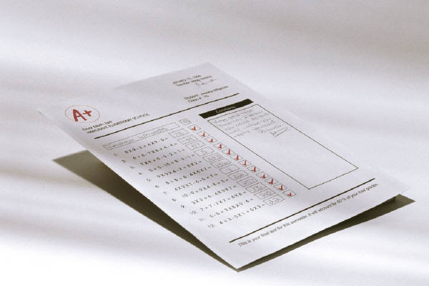
What you need in EHR report writing
If you believe that a vendor’s set of canned reports is going to meet your reporting needs, you are deluded.
You need a system that has a good report writer.
What is a good report writer?
  One that can manipulate every single bit of data in the system.
  One that is “user friendly”.
  One that you aren’t required to have an IT trained staff member to manage.
  One that spits out reports that are intellectually accessible to all providers.

Slide 9
Are there products out there?
Yes.
I was the implementation leader of an EHR system at a small residential substance abuse provider a few years back.
In the first week after go-live I built a report in about ten minutes that saved the organization over 125 man-hours a year.
I went through a demo for a client to test whether a potential vendor’s report writer passed my smell test. I wouldn’t say that the report writer was necessarily “user-friendly” but I believed that someone on my client’s staff could be trained to use the system.
So, the products are out there and they are getting better.

Slide 10

What does the future hold?
I think that artificial intelligence will ultimately become financially accessible to community healthcare providers.
When that happens, report writers will become obsolete.
Providers will, hopefully, decide what questions they need to ask and subsequently talk to the computer and ask the question.
Think Star Trek.

Slide 11

Thank You!
Scott Graham, MBA
BHealth Management, LLC
bhealth1@Verizon.net

