Slide 1
Nanoparticulate Drug Delivery Systems for Modified Tissue Distribution and Better Cancer Chemotherapy
R N Saha, Shri BK Birla & Smt Sarala Birla Chair Professor and Director, BITS Pilani Dubai Campus
5th Int. Conference and Exhibition on Pharmaceutics & Novel Drug Delivery Systems 16th March 2015

Slide 2
New insight of diseases and advancement in pharmacokinetics made drug deliver totally different
Selective delivery can make better efficacy
Nanotechnology has helped in improved drug delivery

Slide 3
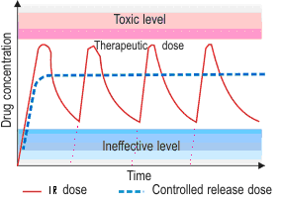
Fate of Drug - Oral Administration
Drug
(In Formulation)
Site of Action
Other Sites
Site of Administration
Drug Distribution
Drug Absorption
Systemic Circulation
Drug
(In Solution)
Drug Metabolism
Drug Elimination

Slide 4
Nanotechnology: Potential in Therapeutics
Drug stabilization in vivo
Facilitation of the absorption, better availability, enhanced PK
Controlled drug release for increased therapeutic effectiveness
Drug targeting – Organ / tissue
Modulation of the spatial drug distribution or selective distribution
More efficient utilization of drug – cost reduction
Improved patient compliance – better Quality of Life
Saha R.N, Vasanthakumar S, Snehalatha M and Girish B (2010). Nanoparticulate drug delivery systems for chemotheraphy. Mol Membr Biol, 27 (7), 215-223 (Invited Review Article in Special Thematic Issue).

Slide 5
Cancer Chemotherapy
Cancer - leading causes of death, all over the world
The cancer chemotherapy began in the early 1940s and efforts are continuing to provide better drugs and therapy
Presently, efforts are being made to enhance the therapeutic effectiveness by modified delivery systems or formulations
Challenges in Cancer Treatment
>90 % of the administered drug distributed to unwanted places (normal cell) and only 2-5 % of the dose reaches the cancer cells
Under-dosing undermines effective therapy and over-dosing results in excessive toxicity

Slide 6
Challenges in Delivering Anticancer Drugs
Poor solubility
Poor bioavailability
Substrate for p-glycoproteins
Non-selective distribution
Fast elimination or metabolism
Life threatening side effects
Patients noncompliance
Saha R.N. and Vasanthakumar S. (2011). Nanoparticulate Drug delivery System, Nanotechnology in health care, Jaipur, India, S.P. Publication

Slide 7
Benefit of NPs in Cancer
Selective biodistribution
Controlled drug delivery
Maintain optimal and effective concentration at site of action
Reduction in untoward effects
Cross biological barriers (BBB, BCB etc.)
Enhanced permeation and retention effect
Overcome drug efflux system
Better stability, Better PK and bioavailability

Slide 8
Nanoparticulate Delivery Systems for Selective Delivery and Better Efficacy
NPDDS for Anti-cancer Drugs
Paclitaxel
Etoposide
Imatinib Mesylate

Slide 9
Challenges in Delivering Paclitaxel
Poor aqueous solubility (<1 µg/mL )
pH independent solubility
Several adverse effects at therapeutic concentration due to non-selective distribution
High molecular weight drug
High hydrophobicity
Substrate for enzymes and p-gp
Oral bioavailability <10 %

Slide 10
Nanoparticulate Paclitaxel Delivery
NPDDS for Anti-cancer Drug
Paclitaxel
Preparation and optimization of nanoparticles
Characterization of nanoparticles
In vitro drug release
Stability of prepared formulations
Biodistribution and pharmacokinetic studies
Invitro Cytotoxicity Study
Pharmacodynamic Study

Slide 11
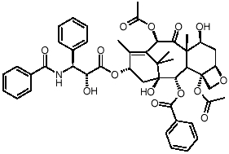
Drug Profile
Paclitaxel
Category: Anti-cancer drug
Therapeutic class: Promoting the formation of
microtubules and stabilizing the microtubules
Molecular weight: 853.9
Solubility profile: Highly lipophilic, insoluble in water
Therapeutic application:
Paclitaxel has been found to be highly useful against breast, ovarian, lung, liver and several other tumor types. Paclitaxel shows antitumor activity on various tumor cell lines, MCF-7, BT4C rat glioma, C6 glioma, 4T1 murine epithelial breast cancer, human epithelial colorectal adenocarcinoma and human hepatocellular carcinoma, HepG2 and HuH-7

Slide 12
Formulation Design and Development
Preparation of Nanoparticles
Characterization of Nanoparticles
In-vitro Release
Pharmacokinetic Study
Stabilizer
1) Polyvinyl alcohol
2) Poloxamer 188
Preparation of nanoparticles
Polymers
Poly (D,L Lactide-co-glycolide) (PLGA 50/50) ⁽¹³⁾
Poly Caprolactone (PCL)
Poly Lactic Acid (PLA)
Method of Preparation
Nanoprecipitation
Emulsion solvent evaporation
Sivacharan K, Bende G, Snehalatha M, Saha R.N. (2010). Application of rotatable central composite design in the preparation and optimization of poly (lactic-co-glycolic acid) nanoparticles for controlled delivery of paclitaxel. Drug Dev Ind Pharm, 36 (11), 1377-1387.

Slide 13

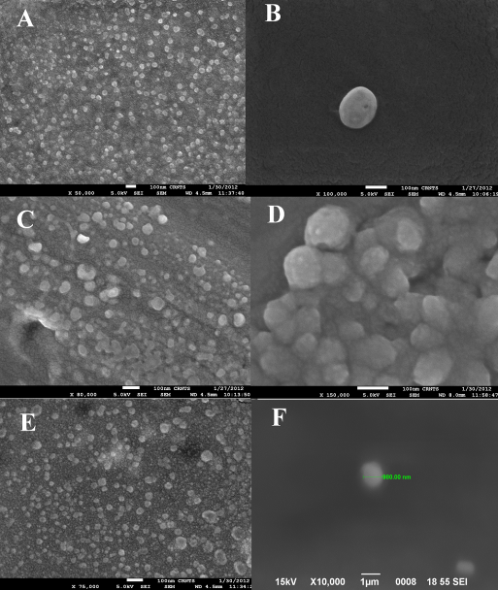
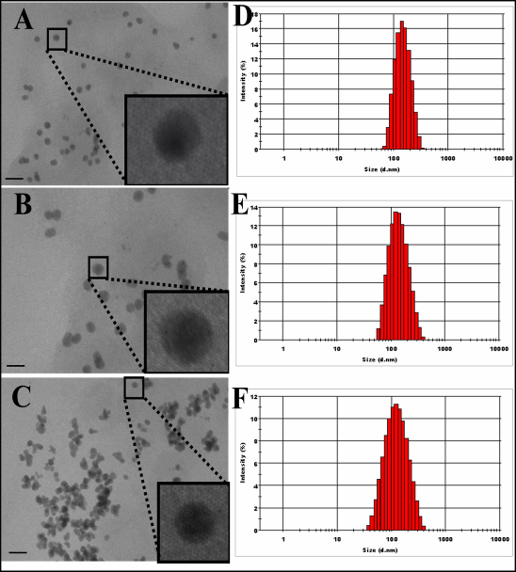
Result and Discussion Characterization of NPs-SEM and TEM
Fig. 5.1 Characterization of Paclitaxel loaded PNPs by SEM, cluster and single PCL NPs (A and B), cluster PLGA NPs (C and D) and cluster and single PLA NPs (E and F)
Fig. 5.2 Characterization of Paclitaxel loaded PNPs by TEM, PCL NPs (A), PLGA NPs (B) PLA NPs (C), particle size distribution of PCL NPs (D), PLGA NPs (E) and PLA NPs (F), bar represents 100 nm

Slide 14
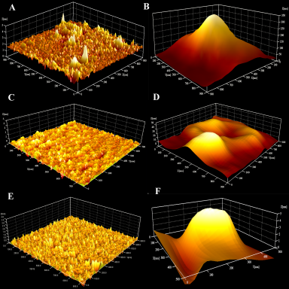
Formulation Design and Development
Characterization of nanoparticles by AFM
A---- PCL NPs Cluster View
B---- PCL NPs Single Particle
C---- PLGA NPs Cluster View
D---- PLGA NPs Single Particle
E---- PLA NPs Cluster View
F---- PLA NPs Single Particle

Slide 15
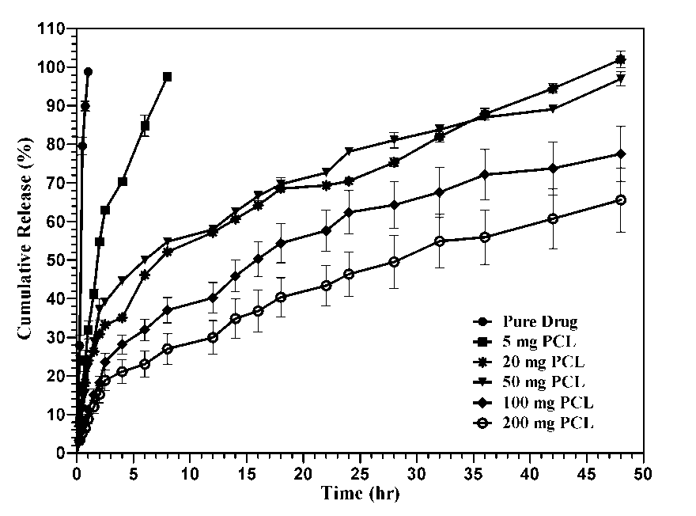
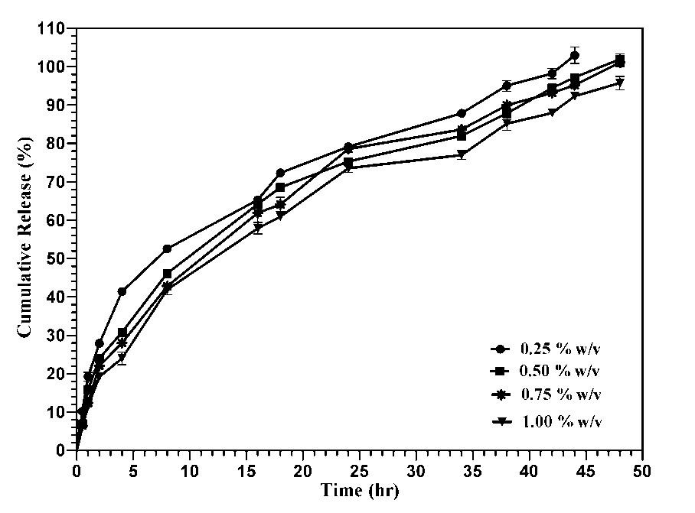
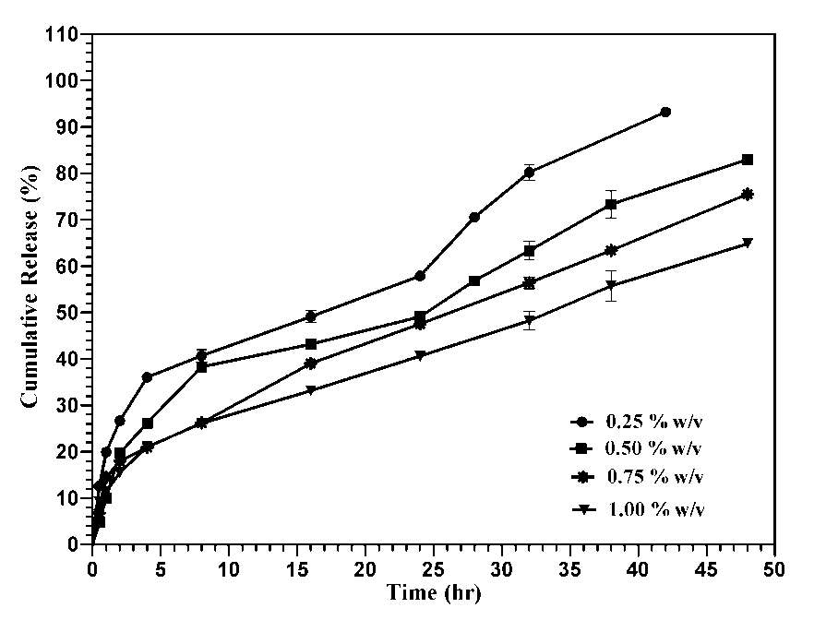
Formulation Design and Development
In-vitro drug release profile of PCL NPs
Cumulative drug release from Paclitaxel-loaded PCL NPs with PF 68 as stabilizer
Cumulative drug release from Paclitaxel-loaded PCL NPs with PVA as stabilizer

Slide 16
In-vivo pharmacokinetic study of NPs
Route: Intravenous dose of 10 mg/kg
Formulations: Pure drug, PCL, PLGA and PLA Nanoparticles
Animals: Healthy male Wistar rats (225 ± 25 g)
Time Point: 0.5,1.00,1.50,2.00,2.50,3.00,6.00,9.00,12.00,18.00 and 24.00
Analysis*: By the developed 3D view LC-diode array UV method
Data analysis: Noncompartment model by WinNonlin (Scientific Consultants, Mountian View, CA)
*Vasanthakumar S, Srinath S.T, R.N Saha. 2012. A Simple and Rapid 3D View Method for Selective and Sensitive Determination of Paclitaxel in Micro Volume Rat Plasma by LC-Diode Array UV and Its Pharmacokinetic Application. J. Chro. Sci, 50 (3), 259-270.
*Vasanthakumar S, Srinath S.T, R.N Saha. 2009. A New, Simple HPLC Method for Estimation of Paclitaxel in Micro- Volume Rat Plasma. AAPS Journal, 11 (S2), 1953.

Slide 17
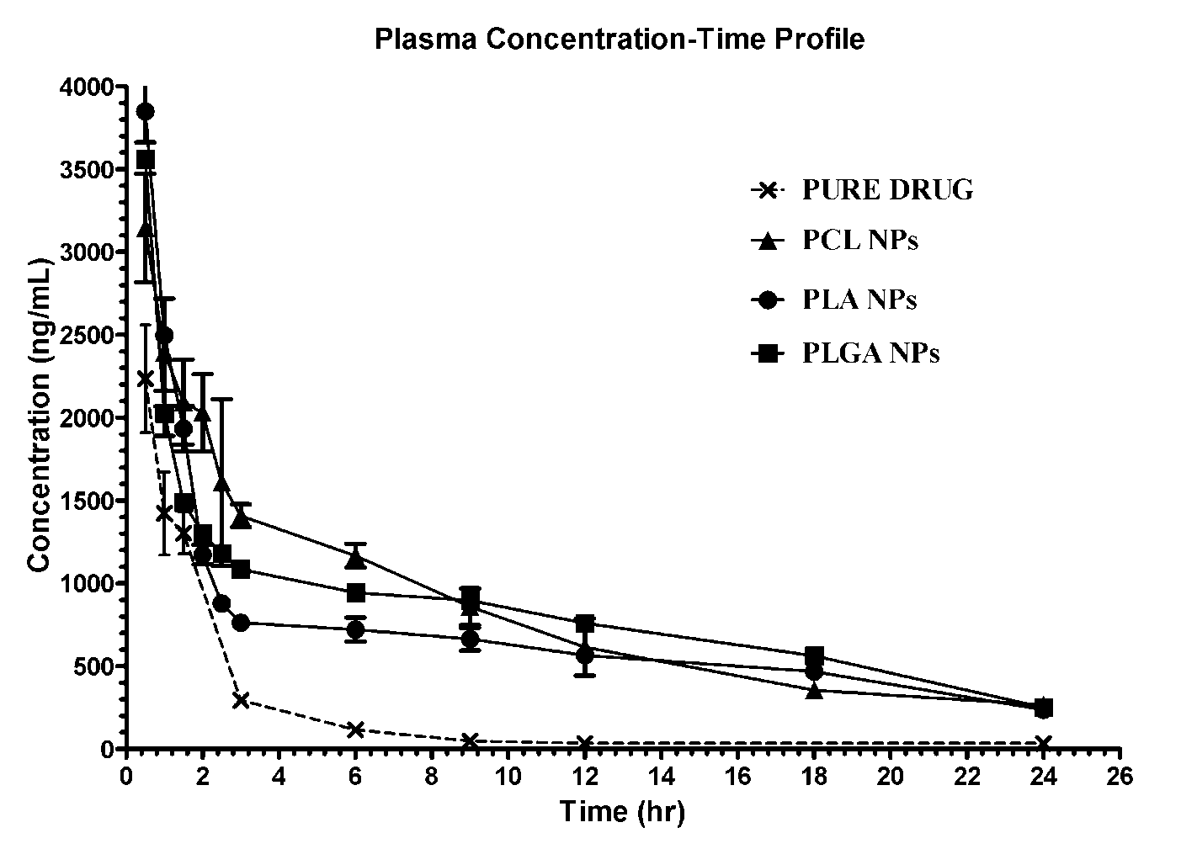
In-vivo pharmacokinetic study of NPs
Comparative plasma concentration time profile of paclitaxel after 10 mg/kg of i.v. administration of different polymeric nanoparticles in rat (data is mean of n=3, × Pure Drug; • PLGA NPs; ■ PLA NPs;▲PCL NPs

Slide 18
Pharmacokinetic study of NPs
Non-compartment-Pharmacokinetic Parameters of Paclitaxel
S.No | Parameters | TAX Sol | PCL NPs | PLGA NPs | PLA NPs
1 | AUC_{0-inf} (ng.h)/mL | 5787 | 25304.48 | 24517.26 | 20070.01
2 | AUMC_{0-inf} (ng.h²)/mL | 21484 | 262731.55 | 297425.32 | 232132.67
3 | C_{max} (ng/mL ) | 3511 | 6144.41 | 6900.36 | 5268.00
5 | MRT (h) | 3.71 | 10.38 | 12.13 | 11.57
6 | Cl (L/h/kg) | 1.8 | 0.4 | 0.4 | 0.5

Slide 19
In-vitro Cytotoxicity
The cytotoxicity of the prepared Paclitaxel loaded PNPs were measured in MCF-7 cancer cell line using MTT assay
Samples of cytotoxicity study
Negative control (NC) sample-High density polyethylene
Positive control (PC) sample-Phenol
Paclitaxel Loaded PCL, PLGA and PLA PNPs
Commercial Formulation
MTT assay procedure
Concentration tested-10, 20 and 40 µg/mL
Plate incubated for 24, 48 and 72 hr
Morphological changes observed through microscope

Slide 20
Results of Cytotoxic Study
By micro plate reader
Estimated by micro plate reader at 430 and 485 nm excitation wavelength and emission wavelength
IC₅₀ (µg/mL) of MCF-7 cells after 24, 48 and 72 hr of incubation with 10 µg/mL concentration of Paclitaxel
loaded PNPs and commercial Paclitaxel formulation
S.NO | NPs Formulation | IC₅₀ (µg/mL) at different incubation time (hr)
1 |  | 24 | 48 | 72
 | CRE-MR (Commercial product) | 19.51 | 12.27 | 8.74
2 | Paclitaxel PCL NPs | 14.30 | 10.28 | 7.63
3 | Paclitaxel PLGA NPs | 13.32 | 9.88 | 7.21
4 | Paclitaxel PLA NPs | 9.79 | 8.18 | 6.80

Slide 21
Pharmacodynamic Study
In-vivo anti-tumor activity in rat
Groups (n=6)
Hepatocellular carcinoma (HCC) model in rats
HCC model was chemically induced to wistar rats by intraperitoneal (i.p) administration of N-Nitrosodiethylamine (DEN, Isopac® Sigma, USA) 180 mg/kg for three days
HCC is the 5th most common neoplasm in the world, 6th most common cancer in male and the 3rd most common cause of cancer-related death
1 3 5 7 Normal Saline Daily
G1
1 3 5 7 Paclitaxel Pure Daily
G2
1 3 5 7 TAXOL Formulation Daily
G3
1 3 5 7 PLGA NPs Alternate Days
G4
1 3 5 7 PCL NPs Alternate Days
G5
1 3 5 7 PLA NPs Alternate Days
G6
Each group (G1-6) contains 8 animals

Slide 22
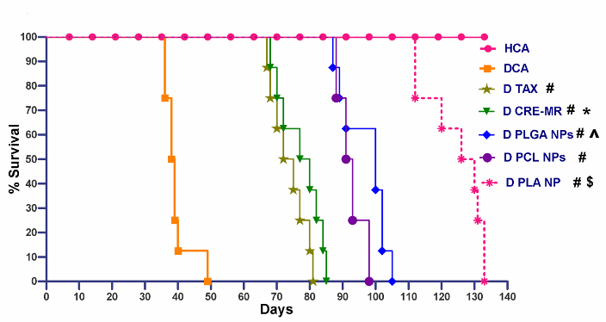
Survival Curve
Survival curves of rats in hepatocellular carcinoma model
# represents that there is no significant (P<0.05) differences in the survival of rats with respect to DEN control group, * represents that there is no significant differences (P<0.05) in the survival of rats with respect to pure Paclitaxel treated group, ^ represents that there is no significant differences (P<0.05) in the survival of rats with respect to PLA NPs treated group, $ represents that there is no significant differences (P<0.05) in the survival of rats with respect to control group
Statistical data of survival study of Hepatocellular carcinoma rats
S. NO | Treatment groups ^{c} | MST ^{b} (days) | 95 % CI for MST | LTS (Nos) | MXST (days)
1 | DCA | 39.38 ± 4.14 | 35.92-42.83 | 2 | 40
2 | D TAX | 73.75 ± 5.34 | 69.29-78.21 | 2 | 80
3 | D CRE-MR | 77.25 ± 6.56 | 71.76-82.74 | 2 | 84
4 | D PCL NPs | 97.00 ± 6.89 | 91.24-102.8 | 3 | 102
5 | D PLGA NPs | 92.50 ± 3.89 | 89.25-95.75 | 2 | 98
6 | D PLA NPs | 124.60 ± 8.88 | 117.2-132.0 | 3 | 131
22

Slide 23
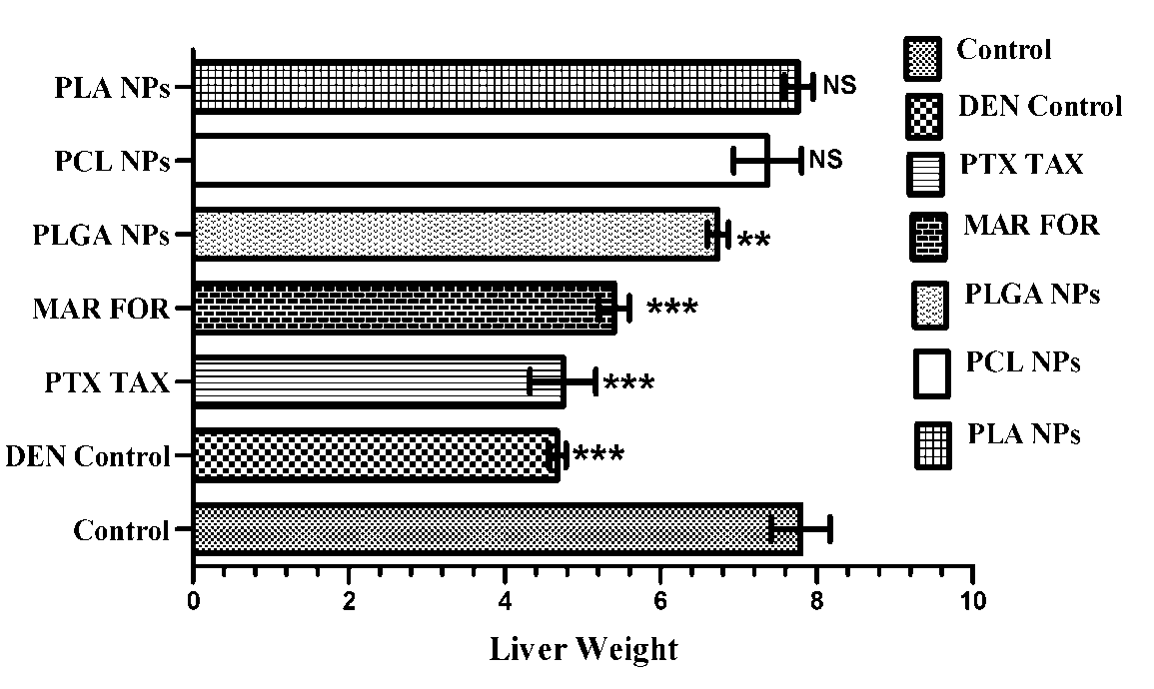
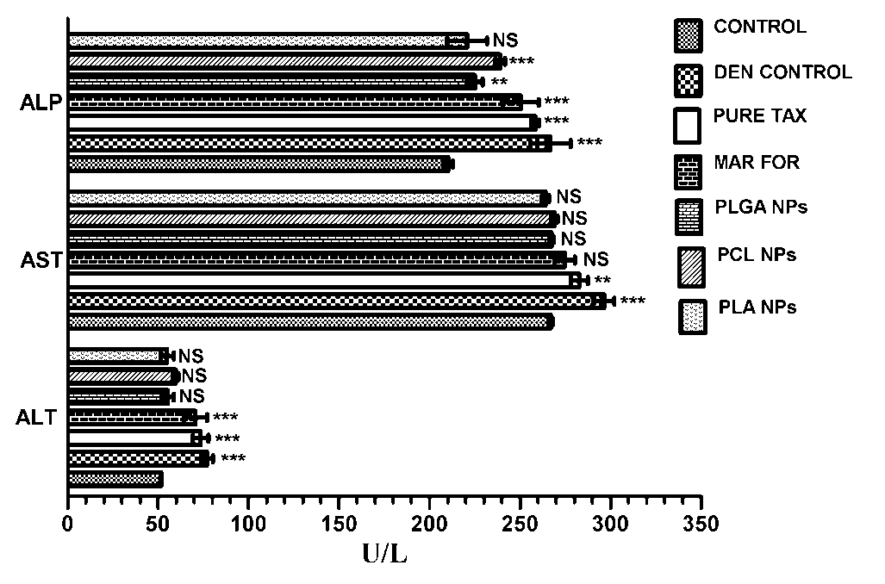
Pharmacodynamic Study
Liver weight foot note
One way ANOVA was performed to the liver weight and the significances (P<0.05) of the data was represented, extremely significant *** (P< 0.001), very significant ** (P between 0.001 to 0.01) and not significant NS (P> 0.05)
LFT foot note
Two way ANOVA was performed to the liver function test and the significances (P<0.05) of the data was represented, extremely significant *** (P< 0.001), very significant ** (P between 0.001 to 0.01 or <0.01) and not significant NS (P> 0.05)

Slide 24
Pharmacodynamic Study
Survival Curve Construction
The PNPs treated animals showed the most significant [Log-rank (Mantel-Cox) test P<0.0001] increased median survival times compared to the non-treated control group (38.5 days), pure TAX (73.5 days) and market formulation (78.5 days)
The order of increased median survival times of the prepared PNPs were, PCL (92 days) < PLGA (100 days) < PLA (128 days) respectively
The mean survival time of all the groups were, 39.98 ± 4.14 days (DEN Control), 73.75 ± 5.34 days (PURE TAX), 77.25 ± 6.57 days (MAR FOR), 97.00 ± 6.89 days (PLGA NPs), 92.50 ± 3.89 days (PCL NPs) and 124.6 ± 8.88 days (PLA NPs) respectively
The IST median and IST mean % of the five treatment groups, Pure TAX, MAR FOR, PLGA NPs, PCL NPs and PLA NPs were, 91, 104, 160, 139, 233 and 87, 96, 146, 135 and 216 days respectively, this clearly says that the NPs increases the survival of the animals more significantly

Slide 25
Selective Biodistribution and Pharmacokinetics Studies of NPDDS of Etoposide

Slide 26
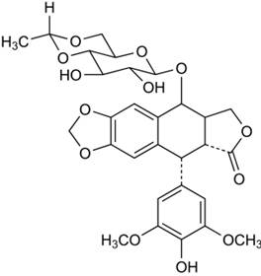
Drug Profile
Etoposide
Category: Anti-neoplastic
Therapeutic class:Topoisomerase II inhibitor
Molecular weight: 588.6
Solubility profile: Highly unstable in lower pH, Poor aqueous solubility

Slide 27
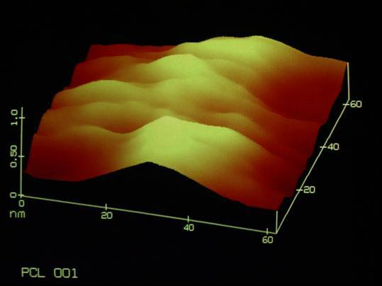
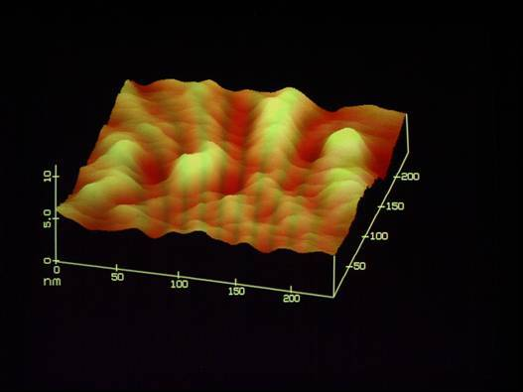
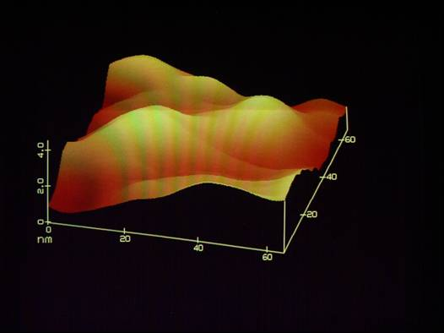
Formulation Design and Development
Characterization of nanoparticles by AFM
ETNP/PCL/F68/03
ETNP1/F68
ETNP2/F68

Slide 28
Formulation Design and Development
Tumor Uptake Studies
Tumor Implantation and Development
Dalton’s Lymphoma Solid Tumor
­ Maintained in the peritoneum of Balb/C mice
Tumor cells of 5 × 10⁶ per mouse - injected subcutaneously
Tumor volume after 10 days of implantation ­ 1.0 ± 0.2 cm³
Preparations were injected intravenously through tail vein
(100 µl of preparation with 200 µCi activity)
Biodistribution Study
Organs and tissues were extracted
Measured Radioactivity ­ %A/g versus Time (h)

Slide 29
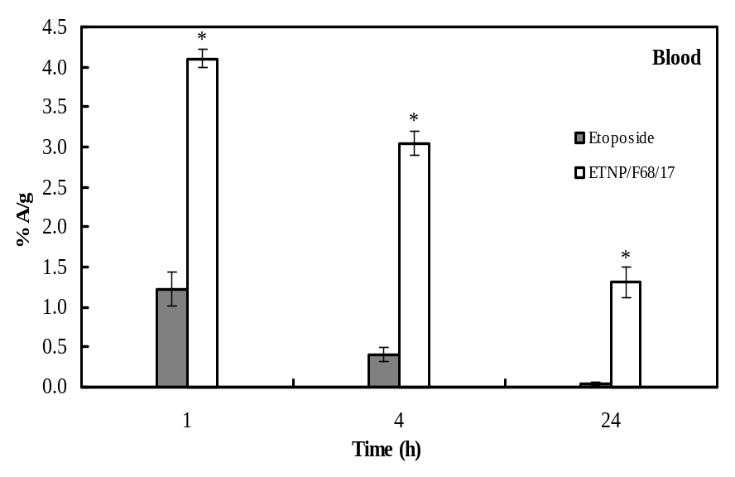
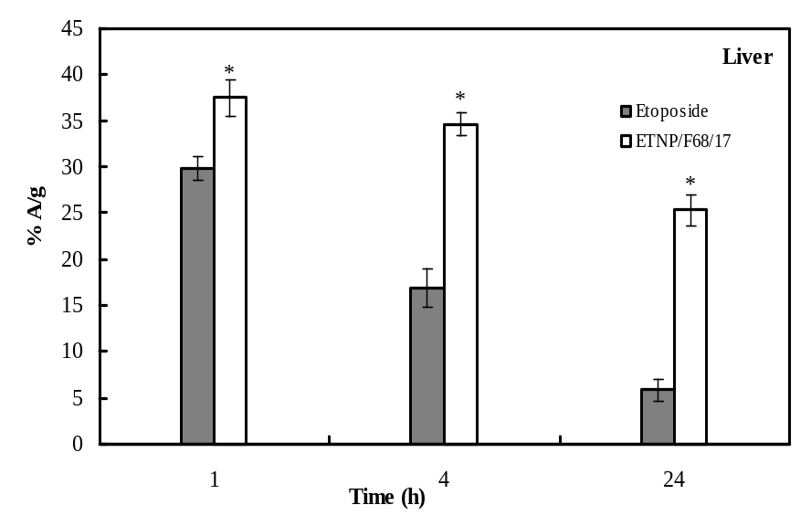
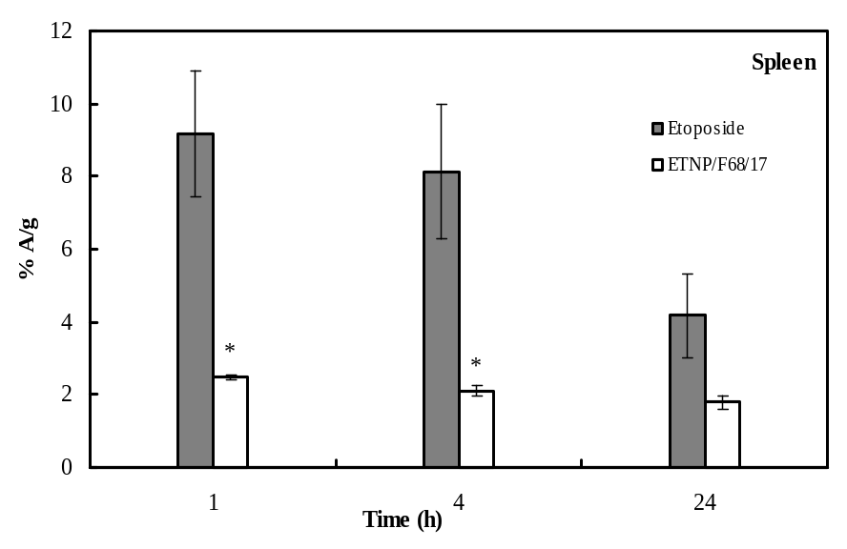
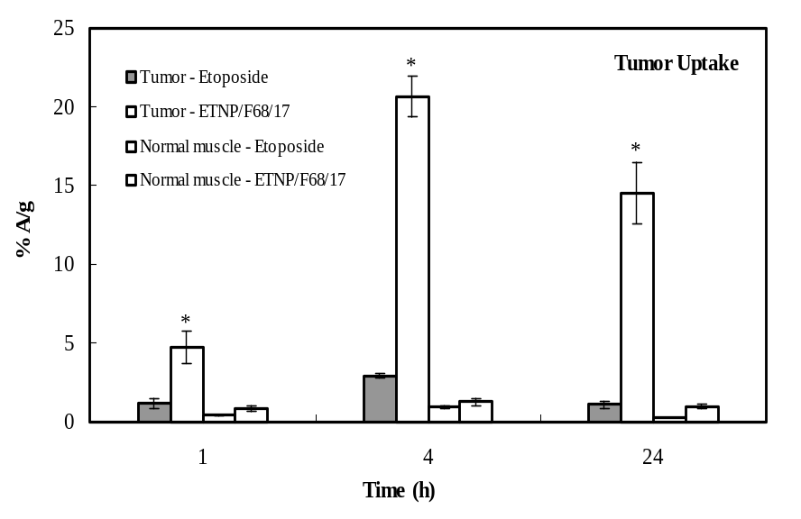
Formulation Design and Development
Biodistribution studies in DLS tumor bearing mice

Slide 30
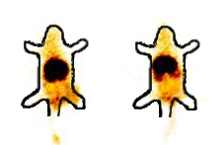
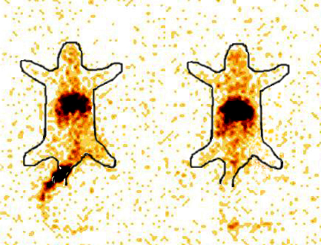
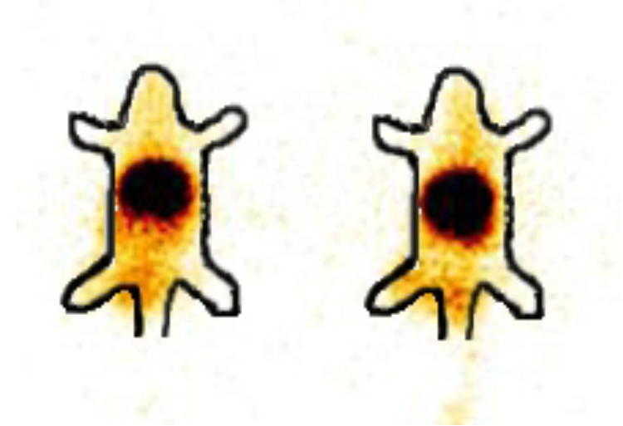
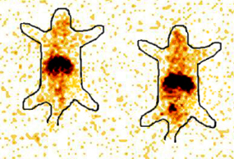
Gamma Scintigraphic image of DLS tumor induced and normal mice
4 h
24 h
A
B
A
B
C
D
C
D
A: Nanoparticle formulation (ETNP/F68/17) in DLS tumor induced mice
B: Etoposide in DLS tumor induced mice
C: Nanoparticle formulation (ETNP/F68/17) in normal mice
D: Etoposide in normal mice
Circled portions indicate radioactivity present in tumor and normal muscle/tissue. Darker the colour more the radio activity present at that part

Slide 31
Further Opportunities
Selective Distribution
Different distribution by using different polymers or mixture of polymers
Better targeting
Reduced dose
No or reduced side effects
Better therapy and patient compliance
Enhanced permeation to brain for anticancer or CNS active drugs

Slide 32


Slide 33
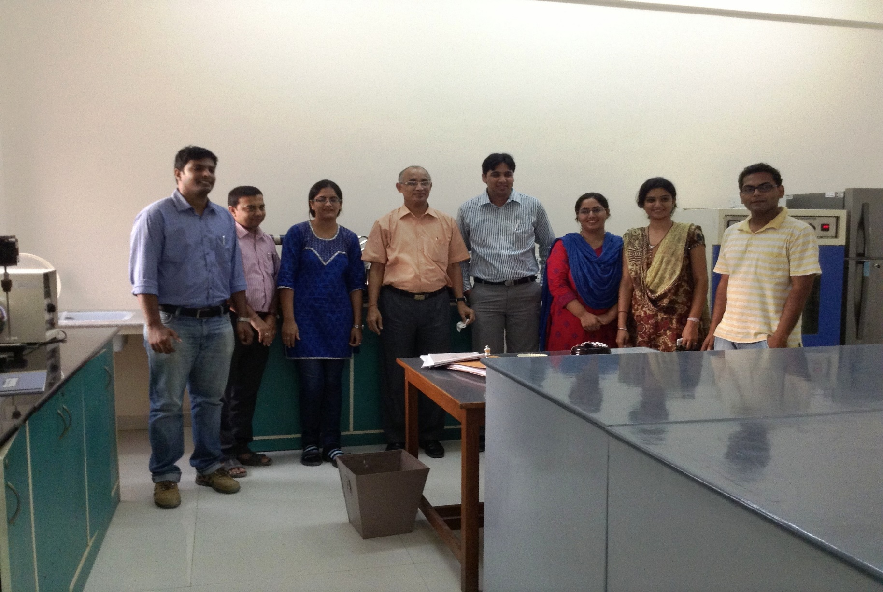
My Doctoral Students

Slide 34
Acknowledgement
My Doctoral Students: Vasanth Sekar, Girish Bende, Snehalatha M, Vibhu
BITS Pilani, Pilani campus
Getwel Pharmaceuticals, Gurgaon
CSIR for Fellowship support
Collaborating Industries
Graduate Students

Slide 35

Thank You
Sharda Peeth- Temple of Goddess of Learning
rnsaha@pilani.bits-pilani.ac.in
http://www.bits-pilani.ac.in

Slide 36
Pharmacokinetic Consideration of Site- Specific Drug Delivery Systems
In pharmacokinetic terms, it aims to maximize the ratio of drug concentration at its site of action to that at site of potential toxicity.
The evaluation can be done by:
- Steady state analysis
- Pharmacodynamic aspects
- Temporal aspects

Slide 37
Steady state analysis
S
Q_{r}
R
T
Q_{t}
Drug targeting index (DTI)
AUC_{R}/AUC_{T} (drug carrier admin.)
DTI = ------------------
AUC_{R}/AUC_{T} (drug admin.)
AUC is area under the concentration time profile

Slide 38
Pharmacodynamic aspects:
AUI_{R} (drug administration)
Target Index, TI = -----------------
AUI_{R} (drug carrier admins.)
AUI stands for area under the intensity-time profile
Temporal aspects: MI_{R}/MI_{T}(drug carrier adm)
MI (Max. Intensity) = -----------------------
MI_{R}/MI_{T}(drug adm)

Slide 39
Challenges for NPDDS
Large scale production
Reproducibility
High drug content
Biocompatible and Biodegradable polymer
Selection of proper carrier
Highly sensitive analytical process
Safety study of nanoparticulate systems
In vitro study design and protocol

Slide 40
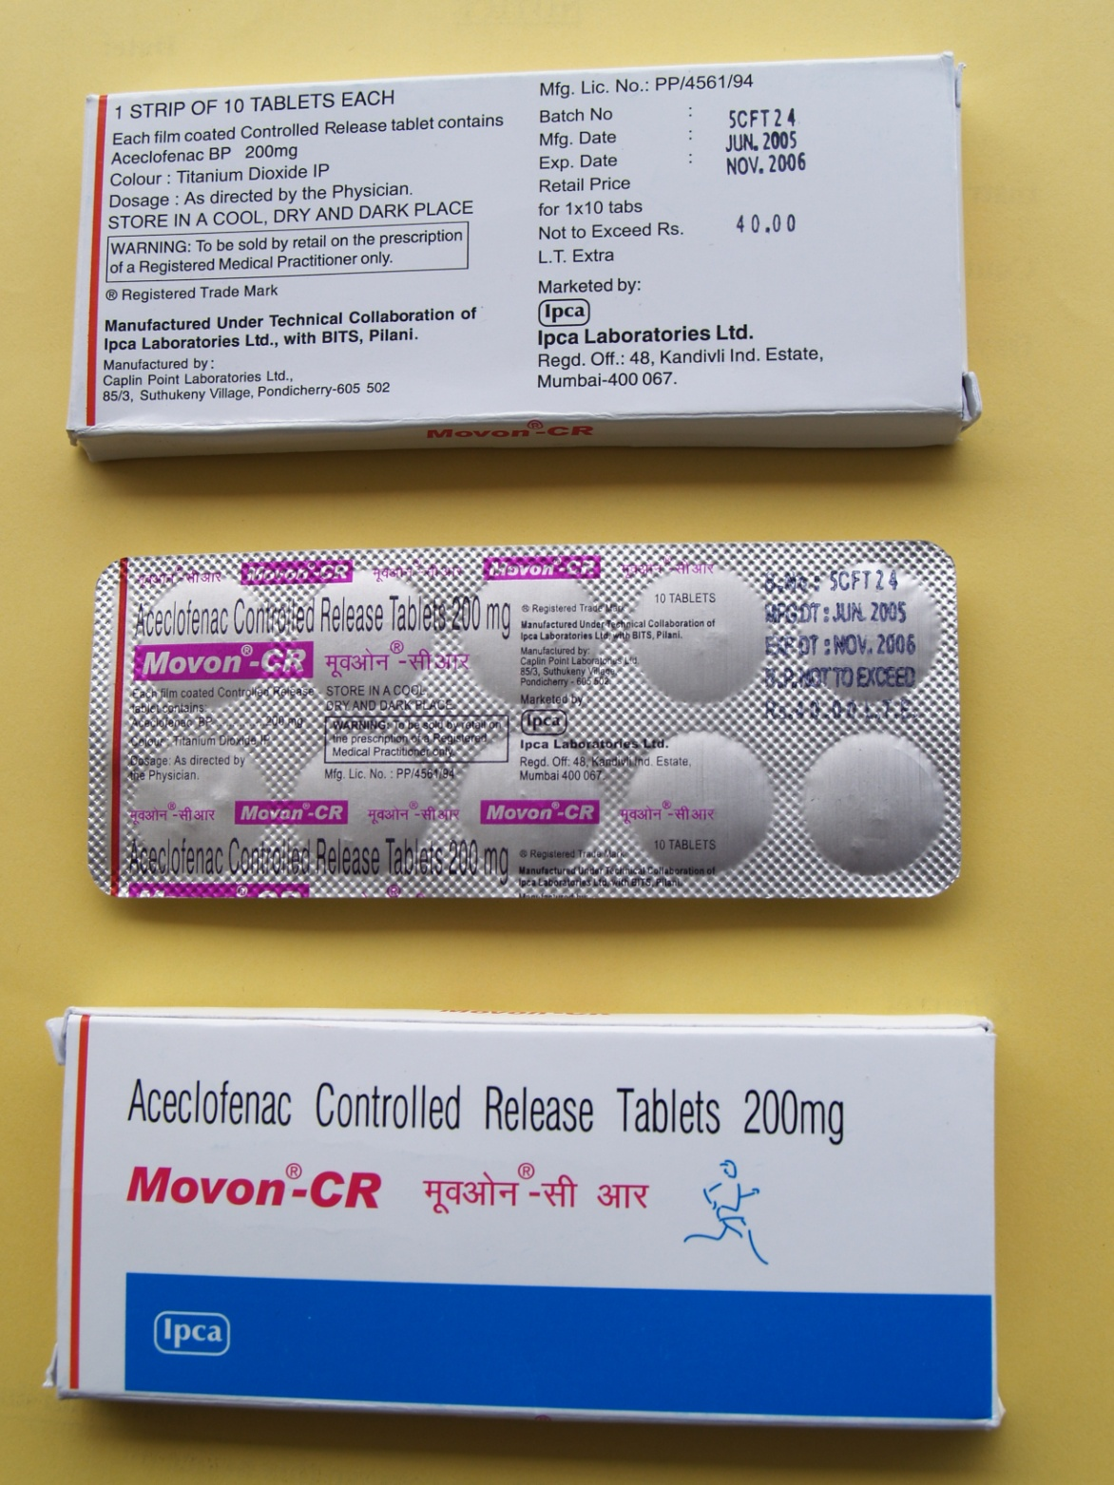
IPCA Lab Ltd, Mumbai have generic market for ACECLOFENAC (non-steroidal anti-inflammatory drug) IR tablet
IPCA partnered with Pharmacy Group, BITS-Pilani to develop and commercialize
ONCE DAILY
ACECLOFENAC Tablet
Indian Patent obtained
Substantial gain of oral NSAID market in India in the last 4 yr
ZERODOL CR & MOVON CR

