Slide 1


Fabrication of Nano Structured PGPR Mediated SRF System and its Influence on Germination of
Arachis hypogaea
R.Mala and A.S.Ruby Celsia
Department of Biotechnology
Mepco Schlenk Engineering College,
Sivakasi-626005,Tamil Nadu
India

Slide 2
INTRODUCTION
Agriculture is the backbone of our Country serving millions of people.
India ranks 2nd in the world’s agricultural production.

Slide 3
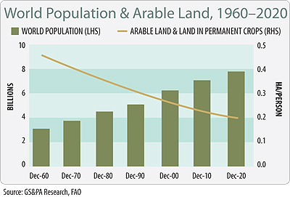
POPULATION AND FOOD DEMAND
To feed the estimated population of 1.36 billion by 2025, it is necessary to increase the productivity by 100% from present level .
By 2000, about 163 million hectares of land was considered as arable land and it was reduced to 157 million hectares in 2011.

Slide 4
AGRICULTURE PRODUCTIVITY
Main issues regarding reduction in the productivity are
  Extensive use of chemical fertilizers .
  Intensive farming and agricultural practices.
  Urbanization and Industrialization.

Slide 5
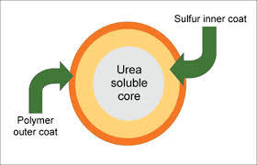
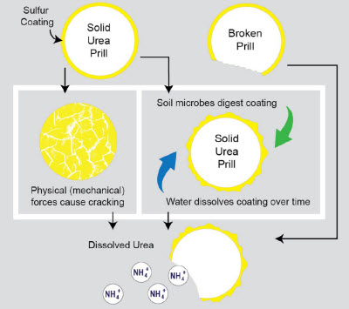
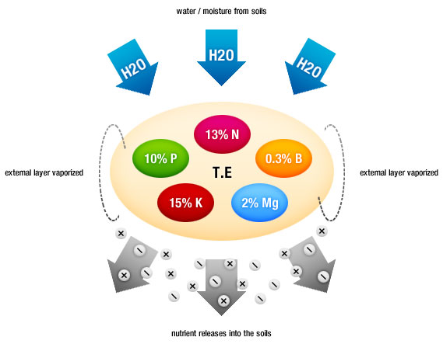
CURRENTLY AVAILABLE SRFS & THEIR LIMITATIONS
Urea – Formaldehyde
Sulphur – coated
Polymer – coated
Bio inhibitors
LIMITATIONS
Environmental concerns
Affects PGPR population
Limited availability

Slide 6
OBJECTIVES
To develop a Slow Release Fertilizer System (SRFS) with
Nano structured Rock phosphate and Phosphate Solubilizing bacteria
Nano structured Rock Potash and Potash Activa
and examine their effect on germination of Arachis hypogaea

Slide 7
MATERIALS AND METHODS

Slide 8
FABRICATION OF NANO STRUCTURED SRFS
NEEM CAKE
NANO ROCK PHOSPHATE
(O.05%)
SRFS ROCK PHOSPHATE
PSB
NEEM
CAKE
NANO ROCK
POTASH
(O.05%)
SRFS ROCK POTASH
KSB
Sonication -30 minutes ,
0.5 cycles ,
80 amplitude

Slide 9
T1
T2
T3
T4
T5
T6
T7
T8
T9
T10
T11
T12
T13
TREATMENT
Water
Neem cake
Neem cake pellet
Phosphate solubilising bacteria control-PSB
Potash solubilizing bacteria control –KSB
Rock Phosphate
Rock Potash
Neem cake and phosphate solubilizing bacteria
Neem cake and potash solubilizing bacteria
Neem cake and Rock Phosphate
Neem cake and Rock Potash
SRFS – Rock Phosphate
SRFS – Rock Potash

Slide 10
GERMINATION CHARACTERISTICS
Seed germination (%)
Number of seeds germinated
Total number of seeds
Mean Germination Time
MGT= Σn.D / Σn
Where
n= number of seeds newly germinated at time D;
D= days from the beginning of the germination test,
Σn= final germination
X 100

Slide 11
RESULTS AND DISCUSSION

Slide 12
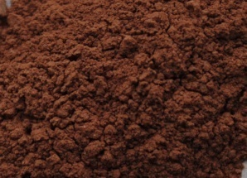
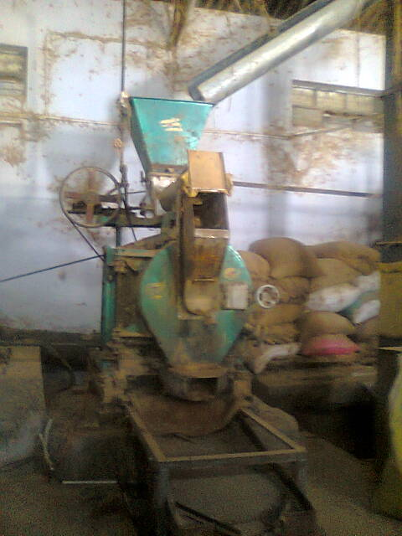
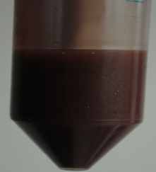
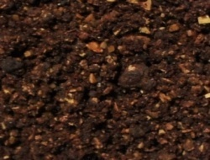
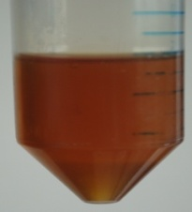
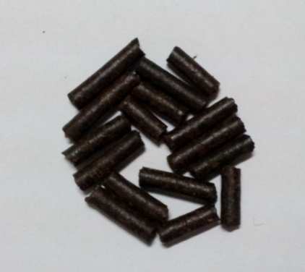
SRFS PELLET
RP/Rpot
Sonication
Neem cake
Pelletizer
Nano RP/Rpot
Neem Oil
SRFS Pellet

Slide 13
NANO STRUCTURED SRFS
Neem cake
NC NRP
NC NRPot
SRFS RP
SRFS RPot

Slide 14
Influence of SRFS on Germination of Arachis hypogaea

Slide 15
Influence of SRFS on MGT of Arachis hypogaea

Slide 16
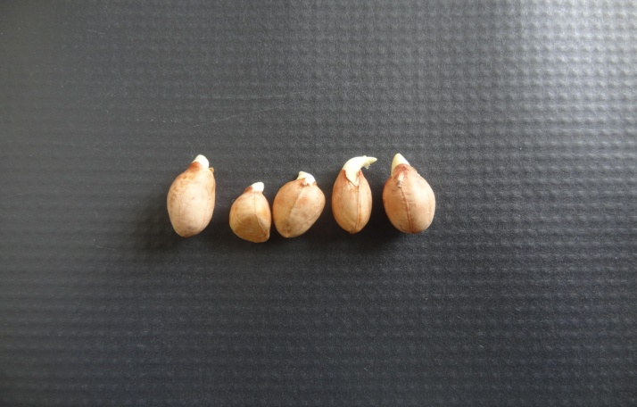
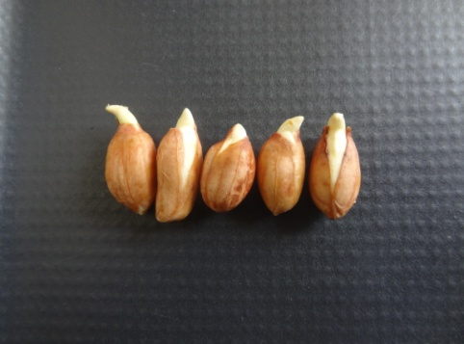
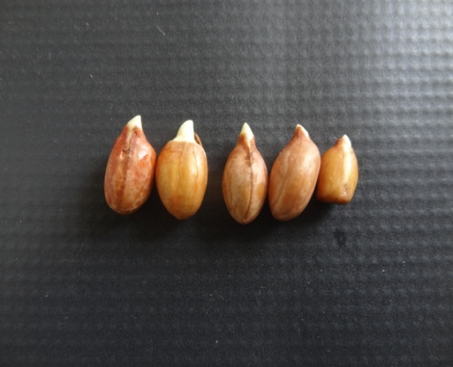
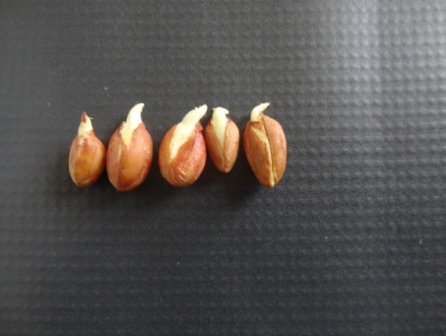
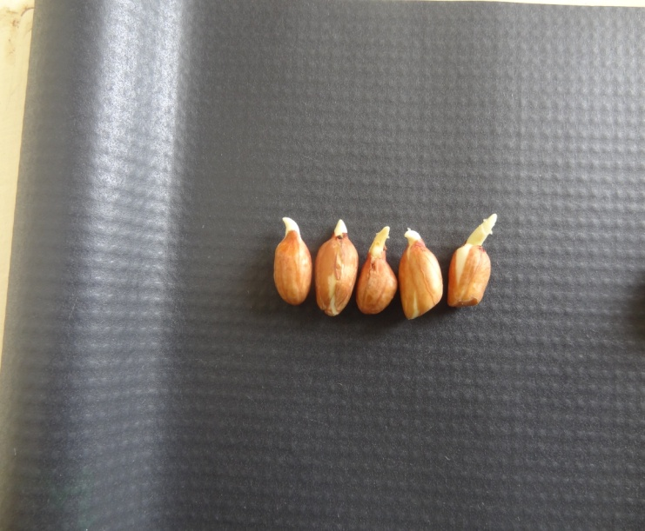
Influence of SRFS on Germination of Arachis hypogaea
BIOLOGICAL CONTROL
CHEMICAL CONTROL
WATER
SRFS ROCK PHOSPHATE
SRFS ROCK POTASH

Slide 17
REFERENCES

Slide 18
Guertal EA. Slow Release Nitrogen Fertilizers in Vegetable Production : A review. HortTechnology 2009; 19(1) : 16 – 19.
Krishnan G, Saha SK. Integrated Plant Nutrition System (IPNS) – A Practice for Sustainable Agriculture resources management. Indian J. Environ. & Ecoplan. 2008; 15(1-2) : 15 - 28.
Kumar P and Mittal S. Agricultural Productivity Trends in India: Sustainability Issues. Agricultural Economics Research Review. 2006; 19 : 71-88.
Pandey MM. Indian Agriculture – An Introduction. Fourth Session of the Technical Committee of APCAEM, Thailand 2009.
Parmar DK, Sharma A, Chaddha S et al. Increasing Potato Productivity and Profitability through Integrated Plant Nutrient System in the North – Western Himalayas. Potato J. 2007; 34(3-4) : 209 – 215.
Santhi R, Saranya S, Appavu K, et al. Soil test crop response based integrated plant nutrition system for Ashwagandha (Withania somnifera L. Dunal) on Inceptisols. 19th World Congress of Soil Science, Soil Solutions for a Changing World, Australia 2010.

Slide 19
Trenkel EM. Controlled Release and Stabilized Fertilizers in Agriculture. International Fertilizer Industry Association 2009; 1-156.
http://apfm.net.au
http://blogs.welingkar.org/index.php/faculty-talk/wto-challenges-and-opportunities-for-indian-agriculture
http://www.cymax.com
http://www.fao.org
http://www.fertilizer.org
http://www.tradingeconomics.com
(http://blogs.welingkar.org)
(http://www.tradingeconomics.com

Slide 20

THANK YOU

