Slide 1


Invertebrate community composition enables to predict compliance to microbial pathogen related standards of rivers
Rubén Jerves-Cobo, I. Nopens, P. Goethals
Ruben.JervesCobo@UGent.Be
Laboratory of Environmental Toxicology and Aquatic Ecology
BIG DATA AND DATA MINING 2016, London, England, Date (26/09/2016)
Laboratory of Environmental Toxicology and Aquatic Ecology, Research Group Aquatic Ecology (AECO) Ruben.JervesCobo@UGent.be

Slide 2
Materials and methods
Results
Conclusion
Background and objective
OUTLINE
BIG DATA AND DATA MINING 2016, London, England, Date (26/09/2016)
Laboratory of Environmental Toxicology and Aquatic Ecology, Research Group Aquatic Ecology (AECO) Ruben.JervesCobo@UGent.be

Slide 3
1-BACKGROUND AND OBJECTIVE (I)
total coliforms and fecal coliforms and/or Escherichia coli
The indicators used to verify microbial contamination of water are:
drinking water, recreational purpose, Irrigation
The quality of the water must accomplish standards.
BIG DATA AND DATA MINING 2016, London, England, Date (26/09/2016)
Laboratory of Environmental Toxicology and Aquatic Ecology, Research Group Aquatic Ecology (AECO) Ruben.JervesCobo@UGent.be

Slide 4
1-BACKGROUND AND OBJECTIVE (II)
Checking the fulfillment requires expensive and highly trained personnel in laboratories
Biota works as a permanent monitor of water
biological samples can :
predict average values of chemical parameters
reflect an increase in pollution.
BIG DATA AND DATA MINING 2016, London, England, Date (26/09/2016)
Laboratory of Environmental Toxicology and Aquatic Ecology, Research Group Aquatic Ecology (AECO) Ruben.JervesCobo@UGent.be

Slide 5
Objective
Introduce a quick way of checking the fulfillment of fecal coliforms standards using macro-benthos.
Analyzes the requirement to include biology and hydro-morphology aspects in Ecuadorian regulations to assess river ecosystem health.
BIG DATA AND DATA MINING 2016, London, England, Date (26/09/2016)
Laboratory of Environmental Toxicology and Aquatic Ecology, Research Group Aquatic Ecology (AECO) Ruben.JervesCobo@UGent.be

Slide 6
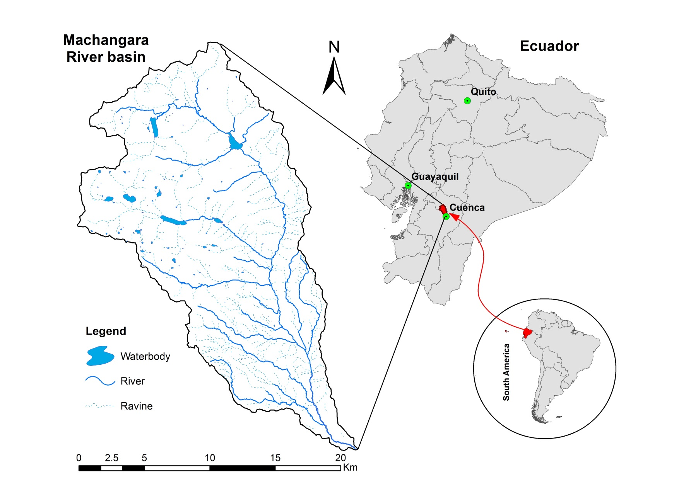
2- MATERIALS AND METHODS
LOCATION

Slide 7
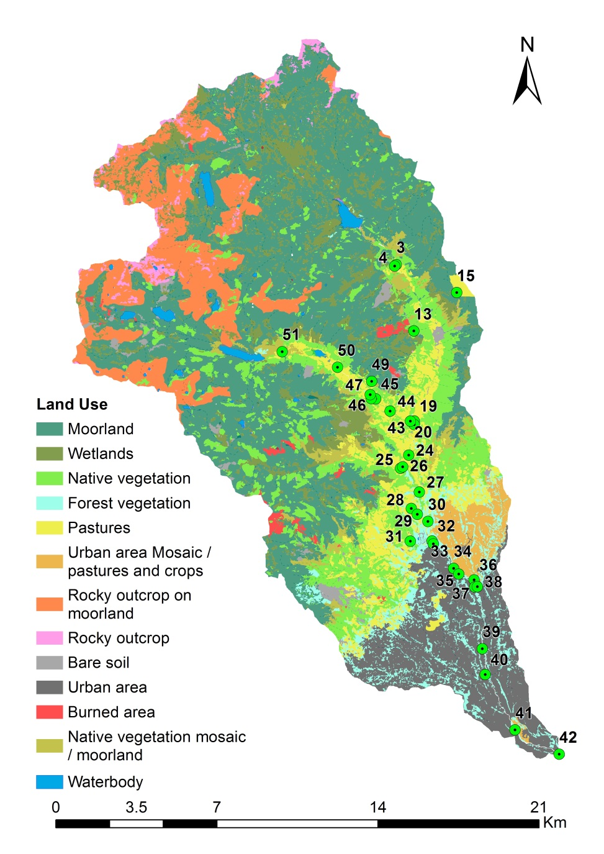
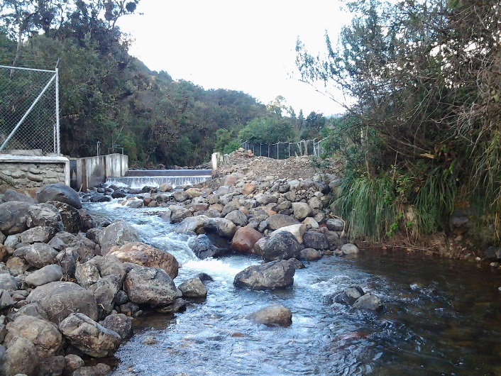
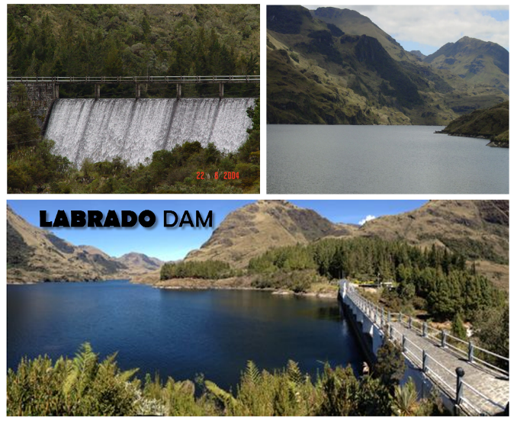
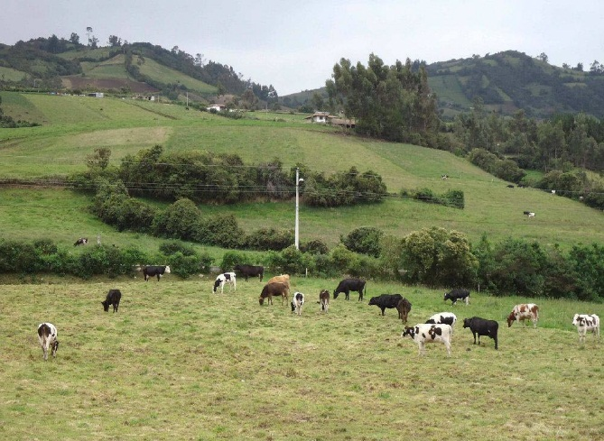
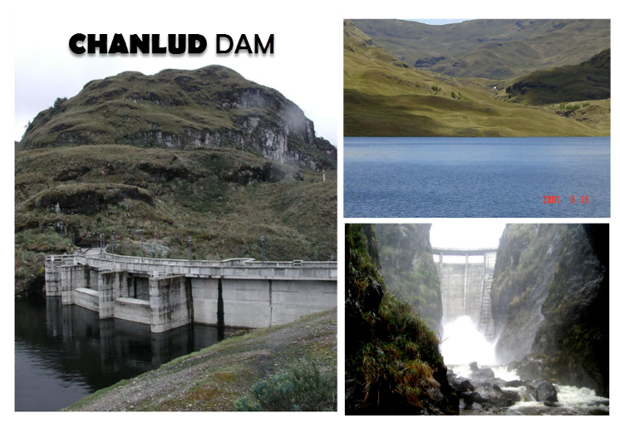
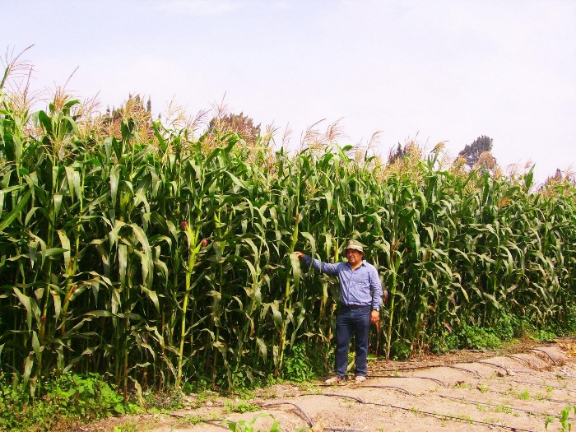
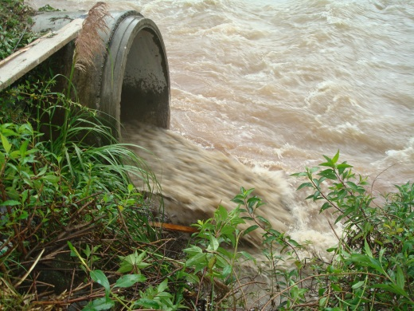
LAND USE

Slide 8
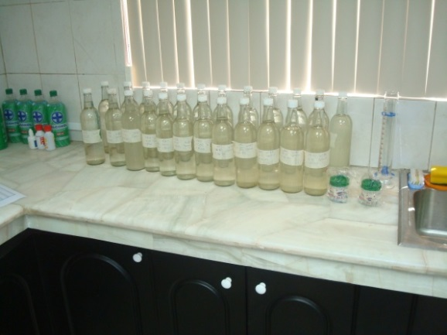
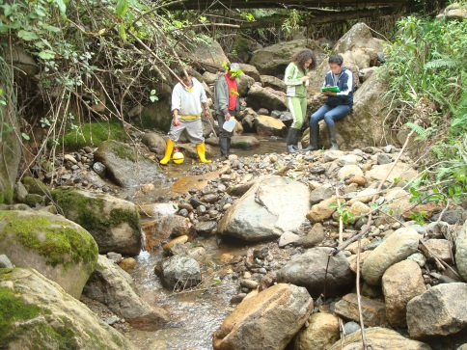
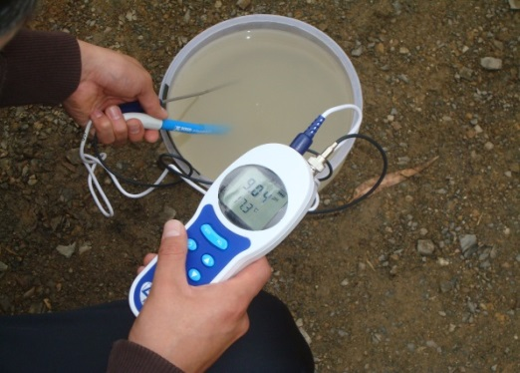
DATA COLLECTION:
Completed information on 33 locations
Physicochemical, hydraulic, microbiological
Laboratory
  BOD_{5,} COD, Nitrate + Nitrite, Ammonia, Organic Nitrogen, Phosphates, Total Phosphorus, Fecal and Total Coliforms, Real Color, Turbidity, Total Solids
Field: Flow Velocity, Ph, Conductivity, Temperature, Dissolved Oxygen
Macro-benthos
39 families (taxa) found

Slide 9
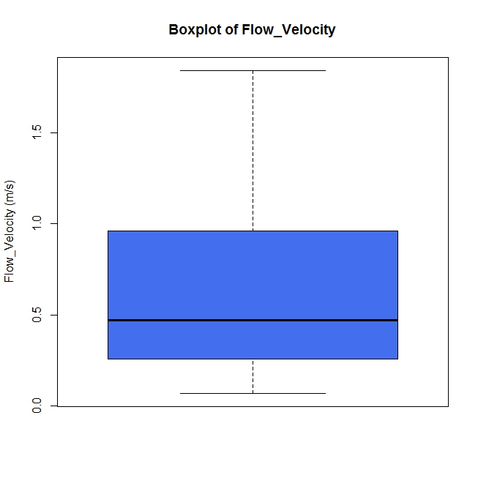
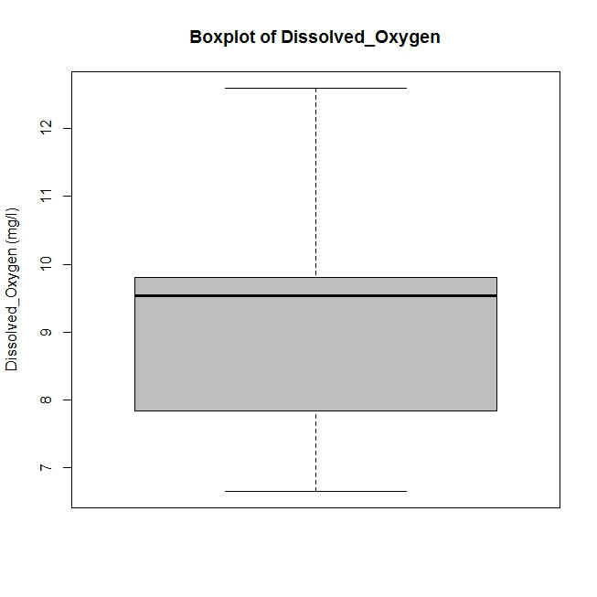
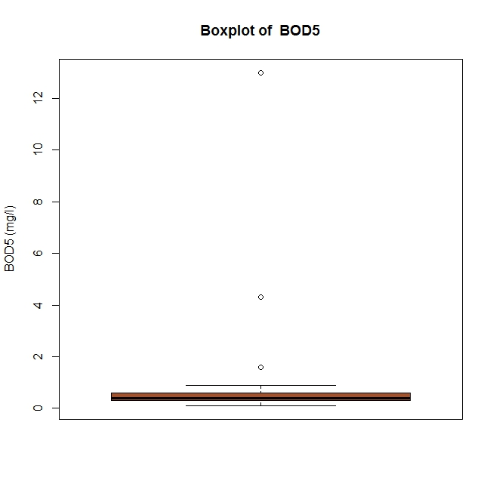
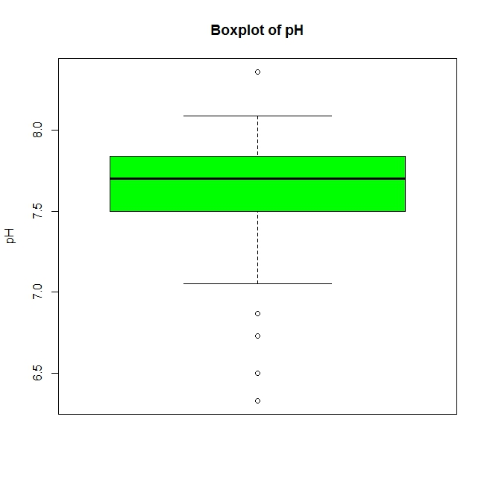
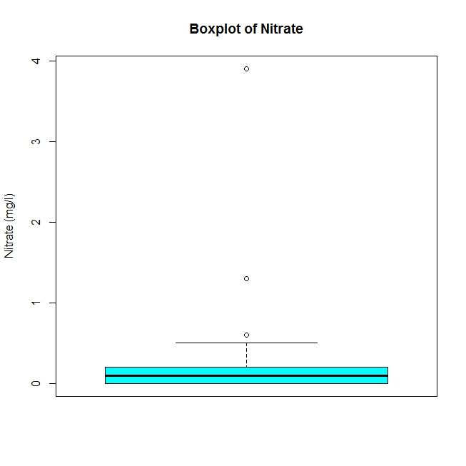
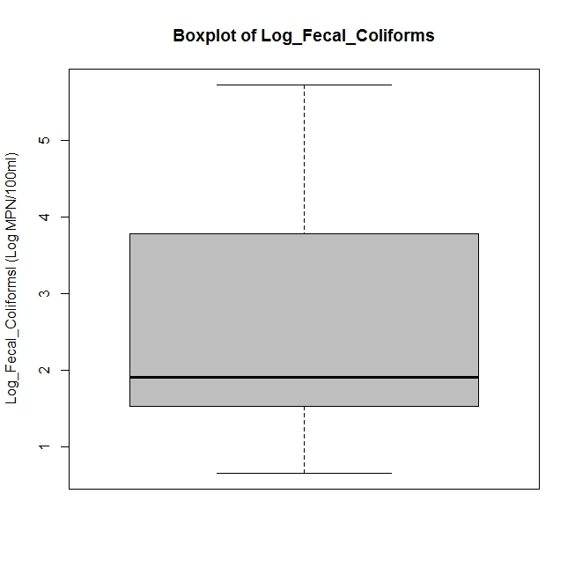
Variables Variation

Slide 10
Ecuadorian Water Quality Regulation for Fecal Coliforms
Regulations | Water used to | Fecal Coliforms Limited Value MPN/100 ml
First | Recreational with primary contact | ≤200
Second | Agriculture and Livestock | ≤1,000
Third | raw water previous to non-conventional treatment* | ≤2,000
* Conventional treatment refers to chemical addition, rapid mixing, flocculation and sedimentation
BIG DATA AND DATA MINING 2016, London, England, Date (26/09/2016)
Laboratory of Environmental Toxicology and Aquatic Ecology, Research Group Aquatic Ecology (AECO) Ruben.JervesCobo@UGent.be

Slide 11
ECOLOGICAL WATER QUALITY
Biological Monitoring Working Party Index - Col
BMWP-Col = f(Sensitivity of Macrobenthos)
Sensitivity -> 1-10 (Low – High Sensitivity)
Class | Quality | BMWP | Color
I | Very Good | > 100
II | Good | 61 - 100
III | Moderate | 36 - 60
IV | Deficient | 16 - 35
V | Bad | ≤ 15
BIG DATA AND DATA MINING 2016, London, England, Date (26/09/2016)
Laboratory of Environmental Toxicology and Aquatic Ecology, Research Group Aquatic Ecology (AECO) Ruben.JervesCobo@UGent.be

Slide 12
Model development
Ecosystem
Training dataset
Validation dataset
1
2
Measurement set

Slide 13
Methodology
Pruned Multi-target Clustering Trees (PMCT)
Classification trees: searching for if-then rules (threshold values): 100% reliable and ‘safe’ models
O
a
Absence
Presence
c
b
O<=c
O<c
O>b
O<=b
B<a
B>=a

Slide 14
Model Performance
Models must be evaluated based on statistical and ecological criteria.
Models must be as clear and simple as possible.
Settings
Machine learning software: Waikato Environment for Knowledge Analysis (WEKA)
Three, five, ten-fold cross validation (k fcv)
Pruning process
  Pruning confidence factors (PCF): 0.25, 0.10
BIG DATA AND DATA MINING 2016, London, England, Date (26/09/2016)
Laboratory of Environmental Toxicology and Aquatic Ecology, Research Group Aquatic Ecology (AECO) Ruben.JervesCobo@UGent.be

Slide 15
Model Performance
Confusion matrix from Decision Tree Models:
Correctly Classified Instances (CCI):> 0.70
Cohen´s Kappa Statistic: > 0.40
Lowest value for the false negative (FN) will increase sensitivity
 |  | Predicted Class
 |  | Yes | No
Observed Class | Yes | TP | FN
 | No | FP | TN
BIG DATA AND DATA MINING 2016, London, England, Date (26/09/2016)
Laboratory of Environmental Toxicology and Aquatic Ecology, Research Group Aquatic Ecology (AECO) Ruben.JervesCobo@UGent.be

Slide 16
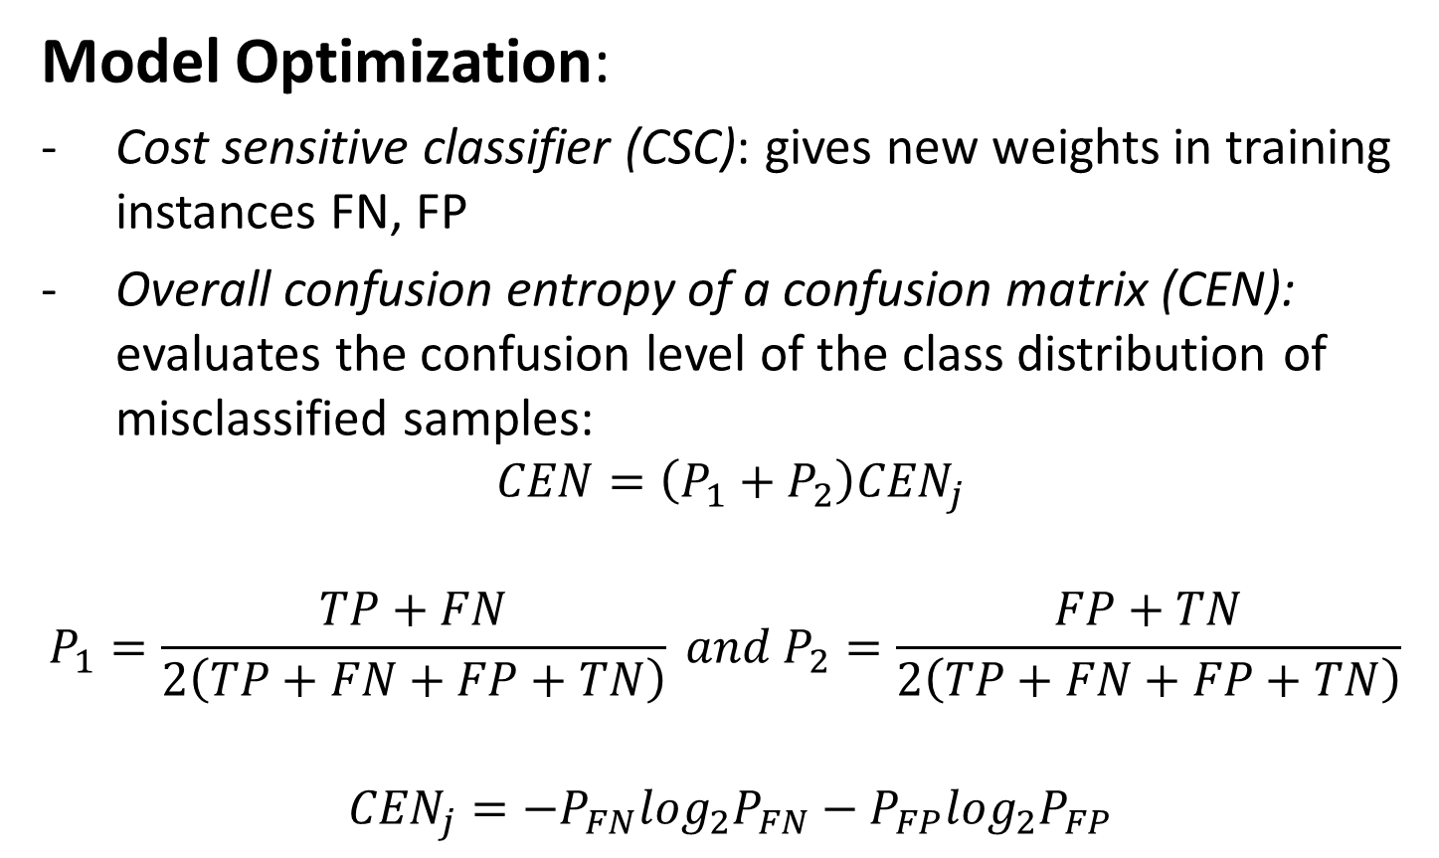
Model Optimization:
Cost sensitive classifier (CSC): gives new weights in training instances FN, FP
Overall confusion entropy of a confusion matrix (CEN): evaluates the confusion level of the class distribution of misclassified samples:
$$CEN=\left(P_{1}+P_{2}\right){CEN}_{j}$$
$$P_{1}=\frac{TP+FN}{2\left(TP+FN+FP+TN\right)} and P_{2}=\frac{FP+TN}{2\left(TP+FN+FP+TN\right)}$$
  $${CEN}_{j}=−P_{FN}\log_{2}P_{FN}−P_{FP}\log_{2}P_{FP}$$
BIG DATA AND DATA MINING 2016, London, England, Date (26/09/2016)
Laboratory of Environmental Toxicology and Aquatic Ecology, Research Group Aquatic Ecology (AECO) Ruben.JervesCobo@UGent.be

Slide 17
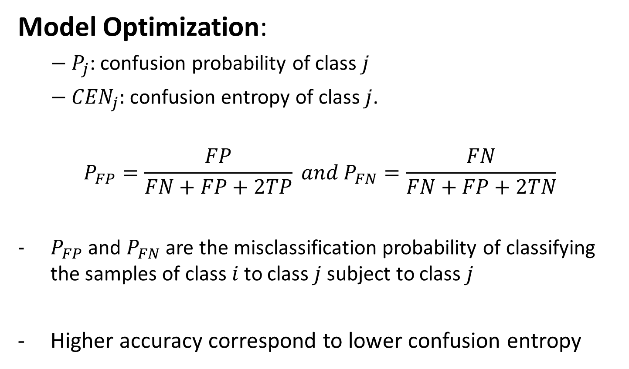
Model Optimization:
  ${− P}_{j}$: confusion probability of class $j$
  ${− CEN}_{j}:$confusion entropy of class $j$.
  $$P_{FP}=\frac{FP}{FN+FP+2TP} and P_{FN}=\frac{FN}{FN+FP+2TN}$$
  $P_{FP}$ and $P_{FN}$ are the misclassification probability of classifying the samples of class $i$ to class $j$ subject to class$j$
  Higher accuracy correspond to lower confusion entropy
BIG DATA AND DATA MINING 2016, London, England, Date (26/09/2016)
Laboratory of Environmental Toxicology and Aquatic Ecology, Research Group Aquatic Ecology (AECO) Ruben.JervesCobo@UGent.be

Slide 18
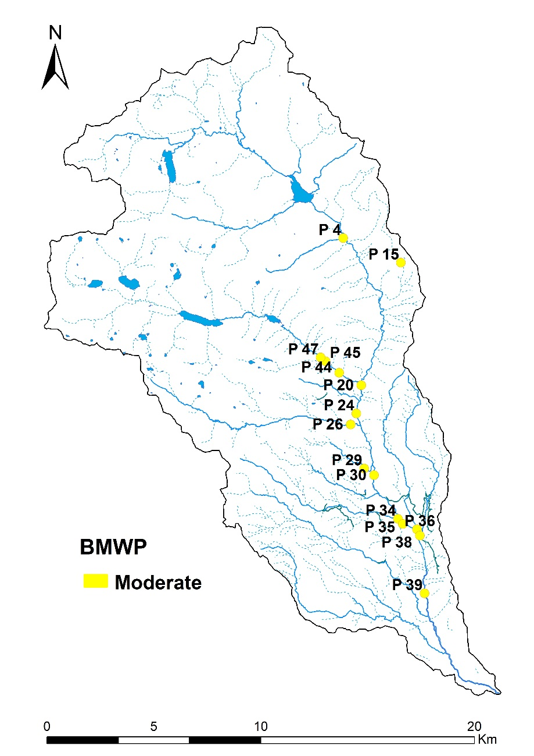
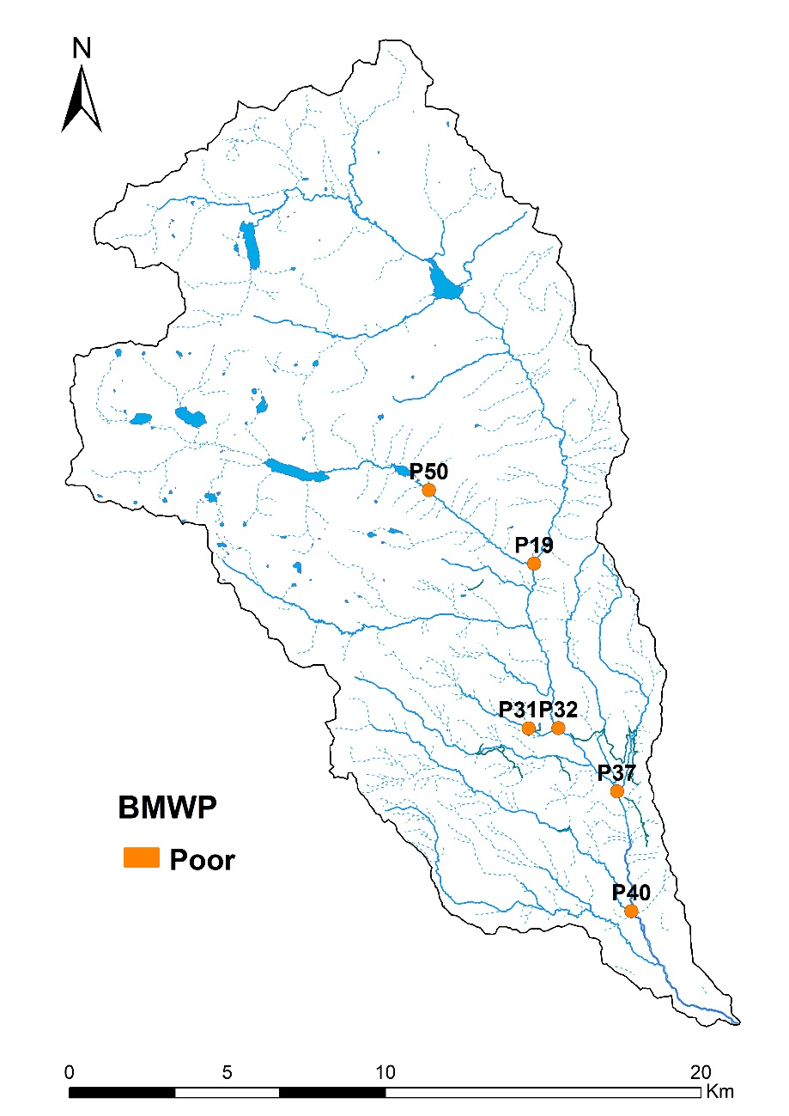
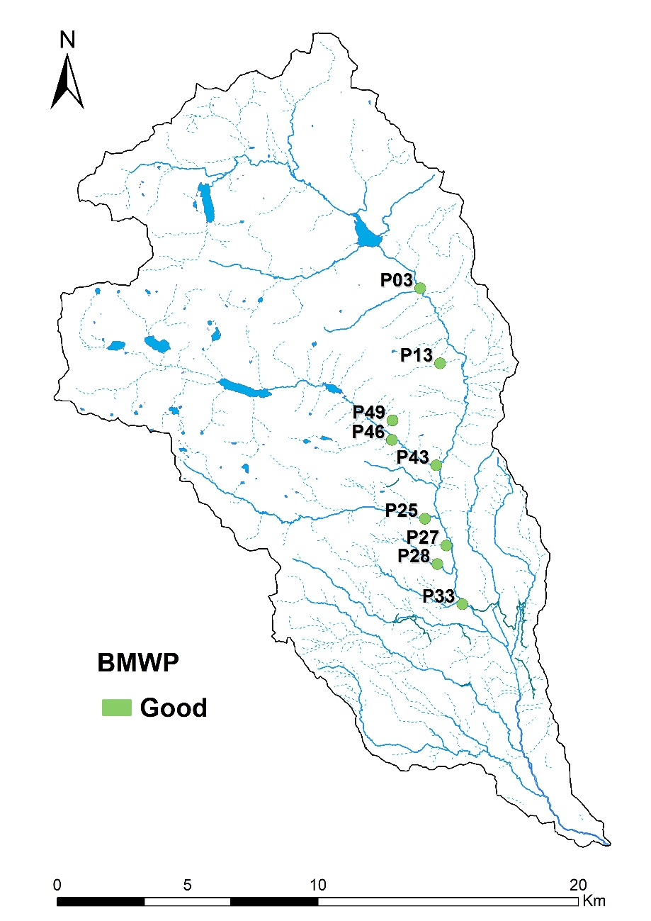
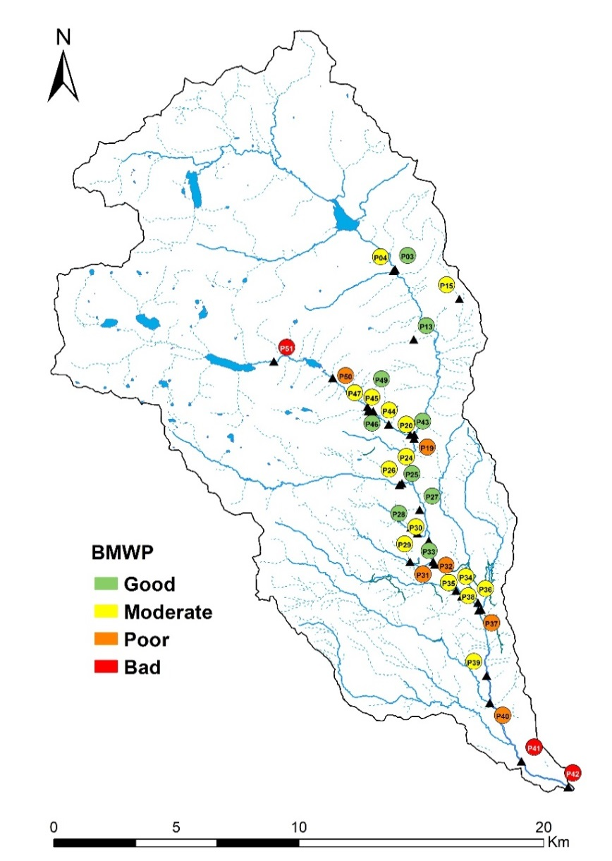
3- RESULTS
ECOLOGICAL WATER
QUALITY
BMWP-Col:
- 9 good
- 15 moderate
- 6 poor
- 3 bad

Slide 19
Analysis of Ecuadorian Water Quality Regulation for Fecal Coliforms in relationship BMWP-Col
BMWP-Col | First Preservation Regulation | Second Preservation Regulation | Third Preservation Regulation
Bad | 2 | 2 | 2
Deficient | 2 | 2 | 2
Moderate | 8 | 5 | 5
God or very god | 2 | - | -
TOTAL non Fulfillment | 14 | 9 | 9
BIG DATA AND DATA MINING 2016, London, England, Date (26/09/2016)
Laboratory of Environmental Toxicology and Aquatic Ecology, Research Group Aquatic Ecology (AECO) Ruben.JervesCobo@UGent.be

Slide 20
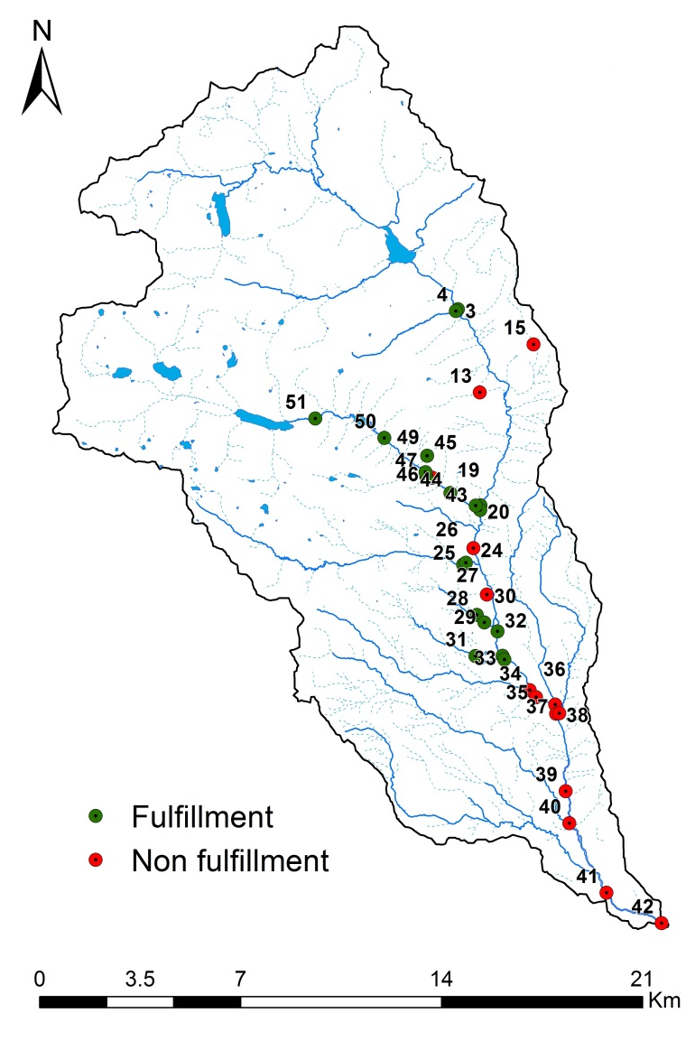

Fulfillment of Fecal Coliforms limits in relationship to water use
(a) Recreational with primary contact | (b) Agricultural - Livestock use and (c) raw water

Slide 21
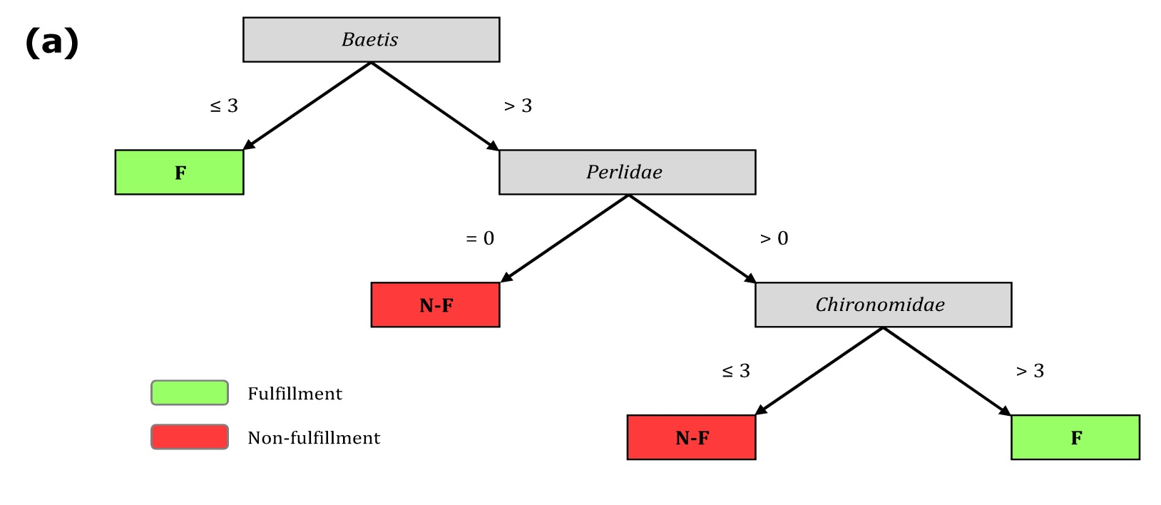
Model Performance (1)
First Model: Primary Contact – Fecal Coliforms Regulation.
CCI = 73%
Kappa = 0.46
FN = 2
CEN = 0.762
Chironomidae families include species with large differences in tolerance to pollutants

Slide 22
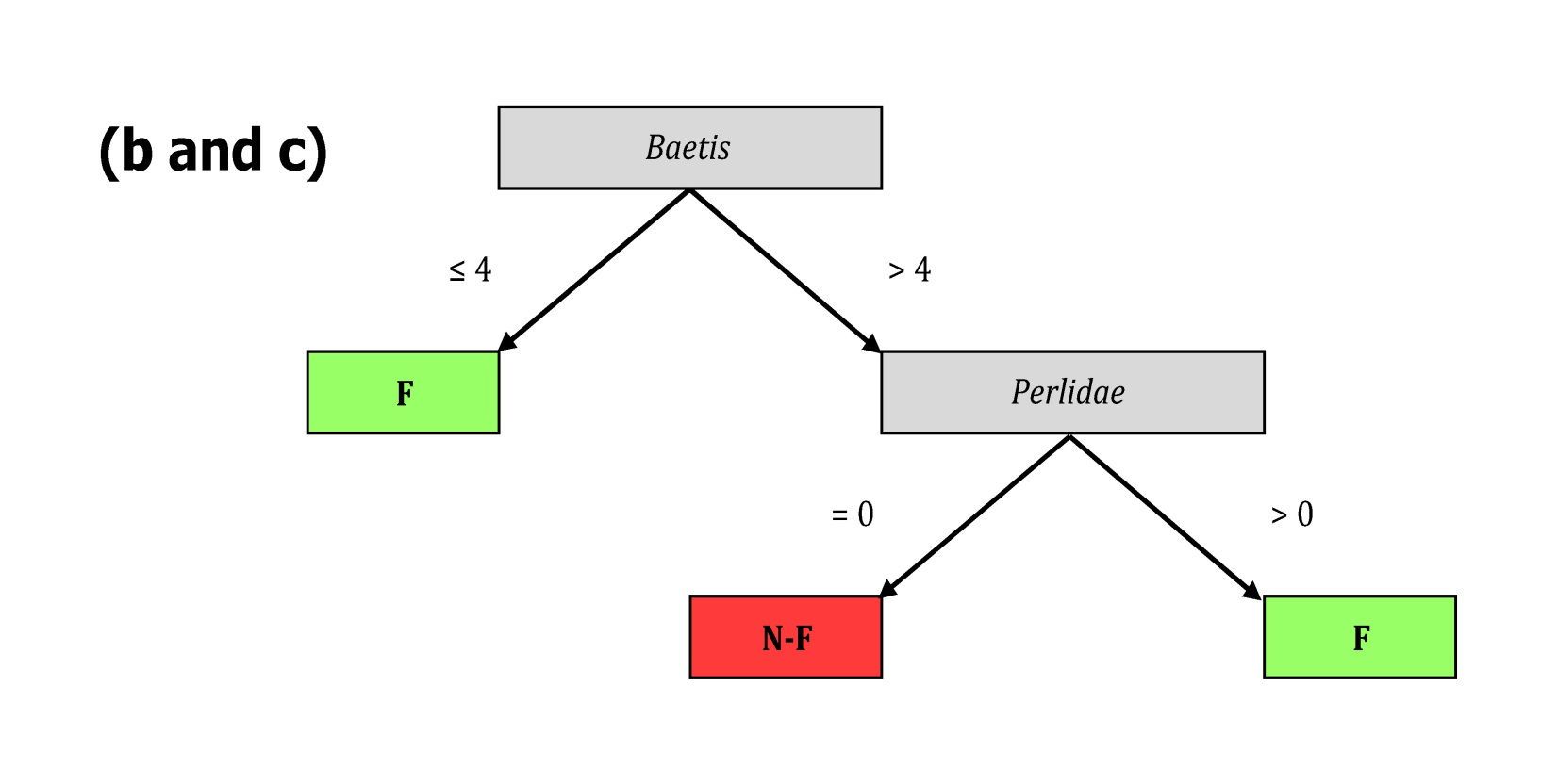
Model Performance (2)
Second model: Agriculture - Livestock Irrigation and raw water previous to non-conventional treatment
CCI = 94%
Kappa = 0.85
FN = 1
CEN = 0.348

Slide 23
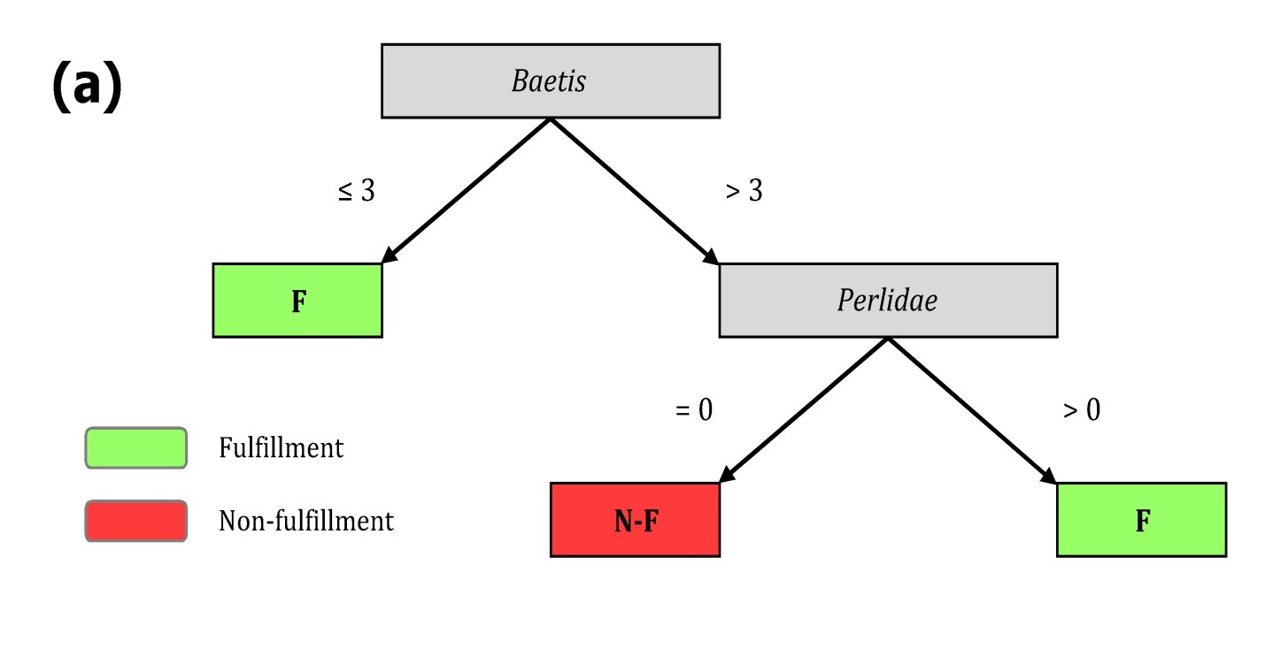
Model Optimization (2)
First Model: Primary Contact – Fecal Coliforms Regulation.
CCI = 91%
Kappa = 0.81
FN = 0
CEN = 0.285

Slide 24
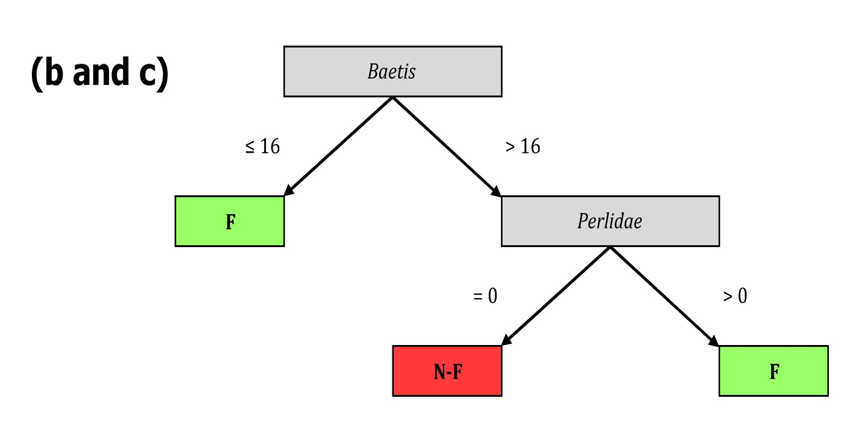
Model Optimization (3)
Second model: Agriculture - Livestock Irrigation and raw water previous to non-conventional treatment
CCI = 100%
Kappa = 1.0
FN = 0
CEN = 0

Slide 25
4- CONCLUSION
Four models were selected.
  Two Models: fecal coliforms threshold in recreational with primary contact water use.
  Two Models: fecal coliforms limits in agricultural - livestock water use, or raw water for drinking water treated with non-conventional processes.
The cost-sensitive classifier (CSC) in the Weka can reduce false negatives (FN) in the confusion matrix, improved the reliability of the resulting models.
Confusion entropy of a confusion matrix (CEN) was lower when the confusion matrix had lower FN values.

Slide 26
Acknowledgement
VLIR-UOS IUC Programme - University of Cuenca
VLIR Ecuador Biodiversity Network Project
Council of the Machangara River Basin
BIG DATA AND DATA MINING 2016, London, England, Date (26/09/2016)
Laboratory of Environmental Toxicology and Aquatic Ecology, Research Group Aquatic Ecology (AECO) Ruben.JervesCobo@UGent.be

Slide 27
Thank you
?
BIG DATA AND DATA MINING 2016, London, England, Date (26/09/2016)
Laboratory of Environmental Toxicology and Aquatic Ecology, Research Group Aquatic Ecology (AECO) Ruben.JervesCobo@UGent.be

Slide 28
Bibliography:
D'Heygere, T., P. L. M. Goethals, and N. De Pauw. 2003. Use of Genetic Algorithms to Select Input Variables in Decision Tree Models for the Prediction of Benthic Macroinvertebrates. Ecological Modelling 160:291-300
Maimon, O., and L. Rokach. 2005. Data Mining and Knowledge Discovery Handbook. Springer.
Roldán Pérez, G. 1999. Los Macroinvertebrados y Su Valor Como Indicadores de la Calidad del Agua. Academia Colombiana de Ciencia 23:375-387.
Ting, K. M. 2002. An instance-weighting method to induce cost-sensitive trees. Ieee Transactions on Knowledge and Data Engineering 14:659-665.
Wei, J.-M., X.-J. Yuan, Q.-H. Hu, and S.-Q. Wang. 2010. A novel measure for evaluating classifiers. Expert Systems with Applications 37:3799-3809
BIG DATA AND DATA MINING 2016, London, England, Date (26/09/2016)
Laboratory of Environmental Toxicology and Aquatic Ecology, Research Group Aquatic Ecology (AECO) Ruben.JervesCobo@UGent.be

