Slide 1
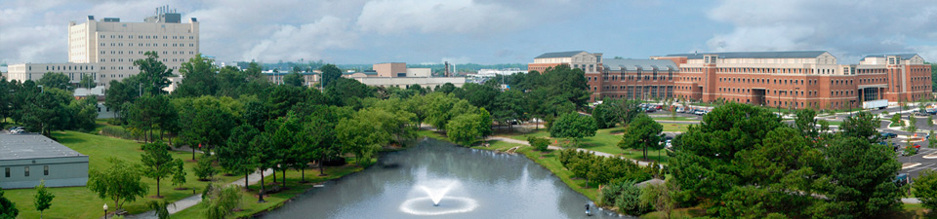
Urine Biomarkers for Prostate Cancer Detection
Dr. Qun Lu
Professor of Anatomy and Cell Biology
Director, The Wooten Laboratory
Brody School of Medicine

Slide 2
Acknowledgement of Support
Funding
US National Institutes of Health (NCI CA111891; CA165202)
US Department of Defense (PC040569)
US North Carolina Biotechnology Center (MRG-1101)
US Golfers Against Cancer Foundation
Patents
US 7,445,906 (Prostate Cancer)
US 8,058,020 (Lung Cancer)
US 8,932,824 (Esophageal Cancer)
PCT/CN2012/000708 (ZCL278)
US #20140051081 (Prostate Cancer-pending)

Slide 3
Urine Biomarkers for Prostate Cancer Detection
- Significances of cancer biomarkers
- Biomarker sources
- Potential urine biomarkers for prostate cancer detection
- Challenges and opportunities

Slide 4
Cancer Biomarker Applications as An Industry
Biomarker Market
- An active world market
20 billion
- International
conferences
- Publications
PubMed: 264,855
4,700 (2015)
27,180 (Prostate)
761 (Urine)
- Merger and
acquisition
Biomarkers improve and save life
- EGFR mutations and Iressa (Gefitinib)
- Prostate specific antigen (PSA)
Precision and personalized medicine on the horizon
- NGS and genome diagnosis
- Omics in all categories
- Point-of-care technologies (POCT) and
mobile technologies

Slide 5
Enriched Biomarker Sources
Tissues
Pathology meets
molecular biology
Pathology meets
immunology
Cells and their presence in body fluids
Circulating tumor cells (CTCs)
Cell debris and/or exosomes (prostasomes)
Fluids (serum and urine)
Nucleic acids
Proteins
Metabolic products
MDxHealth Test:
DNA hyper-methylation
GSTP1-DNA detoxification
APC-apoptosis
RASSF1-cell cycle regulation
Hologic Gen-Probe Test:
1. Progensa PCA3 assay

Slide 6

Urine Biomarker Characteristics
- Simple and non-invasive
- Cost effective
- Early detection and screening
- Variable and unstable
Urine biomarkers are attractive because they may offer a simple, non-invasive approach for early detection of prostate cancer and can allow broader population access to the screening. However, their reliability is subject to changes by diet, behavior, ways of collection and storage.
Lu et al., 2012. Cancer Biomarkers

Slide 7
Urine Biomarkers for Prostate Cancer Detection
Prostate cancer biomarkers in commercial applications
PSA: Paradoxes (USPSTF)
PCA3: Paradoxes (FDA approval and market acceptance)
MDxHealth Test: (Epigenetics)
Urine biomarkers under development
Non-coding RNA (miRNA; TMPRSS2:ERG; SchLAP1; TTTY15-USP9Y)
Engrailed 2 (EN2)
δ-Catenin/NPRAP/Neurojungin
Minichromosome maintenance 5 protein
Anterior gradient 2 (ARG2)
Sarcosine
PSMA
Notes:
PCA3: First urine-based molecular diagnostic assay approved as a decision aid for possible prostate cancer. 2012.
PCA3 is a protein produced only in the prostate gland, a walnut-shaped structure in men that is below the bladder. This test, which has been available in Europe for several years, measures the urine level of PCA3 messenger RNA (m-RNA), a signal from genes that tells the prostate to produce the PCA3 protein. Increased amounts of the m-RNA (over-expressed) are produced by 95% of prostate cancer cells.
The PCA3 test does not provide a definitive answer as to whether a man has a cancer or not. A positive biopsy remains the gold standard in diagnosing prostate cancer. Rather, the test is intended for use in men 50 years of age or older who have high prostate-specific antigen (PSA) values and one or more previous negative prostate biopsies for whom repeat biopsies would usually be recommended. Prostate biopsies can sometimes have false-negative results, leading to the need for repeat procedures.
The recently approved test compares the amount of PCA3 messenger RNA (m-RNA) to the the level of PSA RNA in the first urine sample collected after a digital-rectal examination (DRE). Labs report a score based on the ratio of PCA3 RNA to PSA RNA called the PCA3 score. Doctors consider the test results in conjunction with other laboratory and clinical data to determine the likelihood that a repeat biopsy will be positive.
In a multicenter study of the test's performance, 49.6% of 466 subjects had PCA3 scores less than 25. Of these men, 90% subsequently had a negative biopsy result, while 10% had a biopsy positive for prostate cancer. Of the 235 men with PCA3 scores over 25, 34% had positive biopsies and 66% had negative biopsies. The results suggest that scores less than 25 indicate decreased likelihood of a positive repeat biopsy result, so patients with such scores might consider delaying repeat biopsies.
The PCA3 test may help doctors and their patients with elevated PSA levels make decisions about care related to possible prostate cancer. These choices are often difficult and confusing. Although PSA can help detect cancer, there are sometimes false-positive results, and major health organizations disagree on the usefulness of PSA for prostate cancer screening. Biopsies used in follow-up to positive PSA results to diagnose cancer can cause discomfort, anxiety, and sometimes complications. Their accuracy depends on the number of tissue samples and the sites from which they are taken. Concerns over missing clinically significant cancer may prompt additional biopsies. As the PCA3 test gains wider acceptance, it may aid some men and their doctors in decisions about their future care.
TMPRSS2:ERG
SchLAP1
TTTY15-USP9Y
Minichromosome maintenance 5 protein: structurally very similar to the CDC46 protein from S. cerevisiae, a protein involved in the initiation of DNA replication
Anterior gradient 2: AGR2, ER isomerase family protein involved in ER stress modulation.
Sarcosine: Sarcosine, also known as N-methylglycine, is an intermediate and byproduct in glycine synthesis and degradation.
PMSA

Slide 8
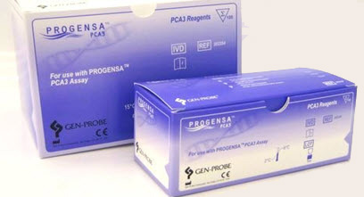
PCA3
Urine sediments following DRE or post-biopsy
Urine collection following DRE with push.
First void urine following biopsy
Brown et al., 2014. Urology (2000 patient tests )
Acceptable sensitivity and specificity
Sensitivity: 0.62 (0.59-0.65). CI: 95%
Specificity: 0.75 (0.73-0.76). CI: 95%
AUC: 0.75 (0.71-0.78). CI: 95%
Xue et al., 2014. J Cancer Res Ther (Meta analysis of 13 trials)
Obstacles in clinical applications
Market acceptance
Medical insurance reimbursement
Moul J, 2014 Urology (Editorial comments)
PROGENSA® PCA3 Assay - FDA

Slide 9


TMPRSS2:ERG Fusion
-TMPRSS2:ERG, PCA3 and PSA-
From the three groups based upon the levels of TMPRSS2:ERG and PCA3 in their urine: low, intermediate and high levels, cancer was diagnosed in each of the groups respectively: 21%, 43%, and 69%. High-grade prostate cancer, defined as a Gleason score greater than 6, also occurred at different frequencies in the three groups with 7%, 20%, and 40% diagnosed in each group respectively

Slide 10
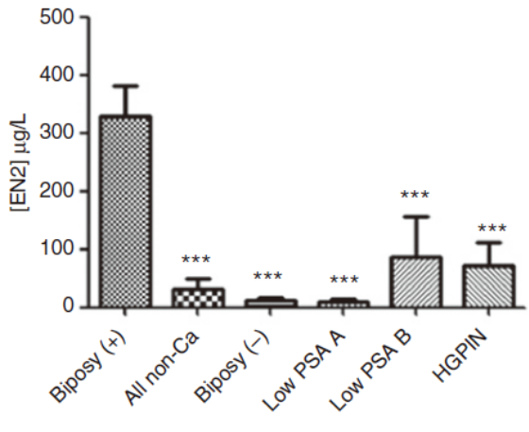
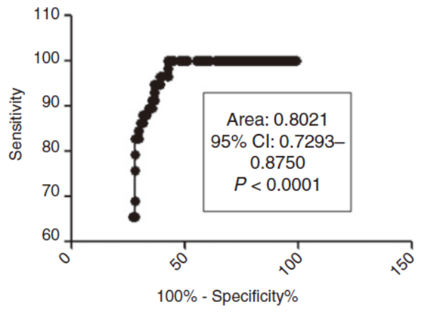
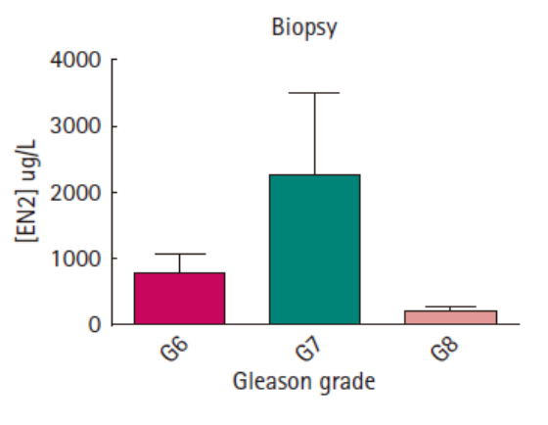
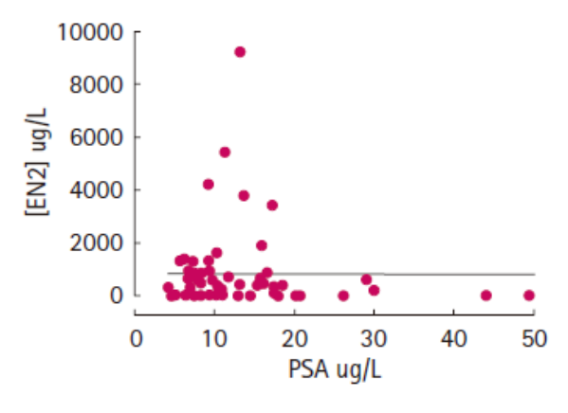
Engrailed 2 (EN2)
A Hox family protein overexpressed in PCa urine
Morgan et al., 2011. Clin Can Res
Pandha et al., 2012. BJUI

Slide 11
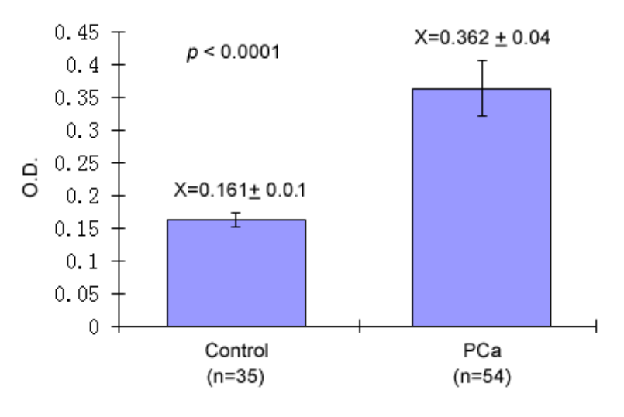
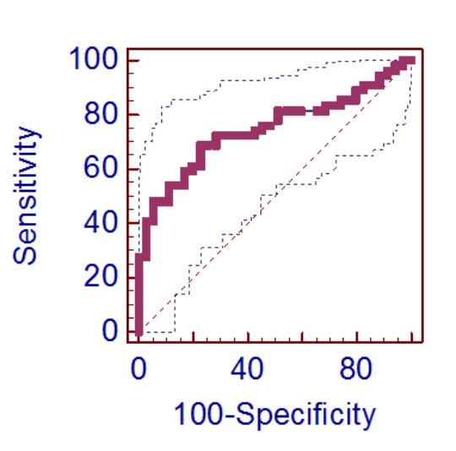
δ-Catenin/NPRAP/Neurojungin
A B
Sensitivity: 68.52%
Specificity: 77.14%
ROC curve
Variable Control/PCa
Sample size 89
Positive group : diag = 1 PCa 54
Negative group : diag = 0 Control 35
Area under the ROC curve (AUC) 0.744
Standard Error a 0.0519
95% CI 0.640 to 0.830
Significance level P (Area=0.5) <0.0001
a DeLong et al., 1988
b Binomial exact
ECU-UNC Epidemiology Study
(Unpublished)

Slide 12
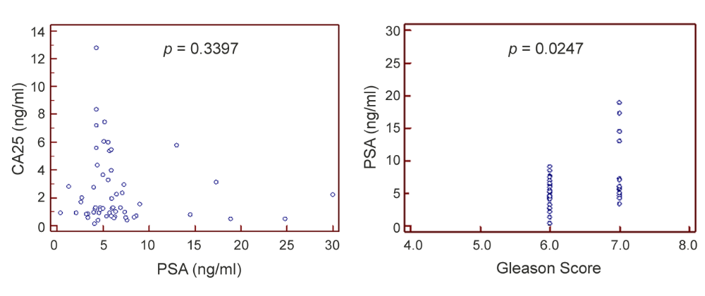
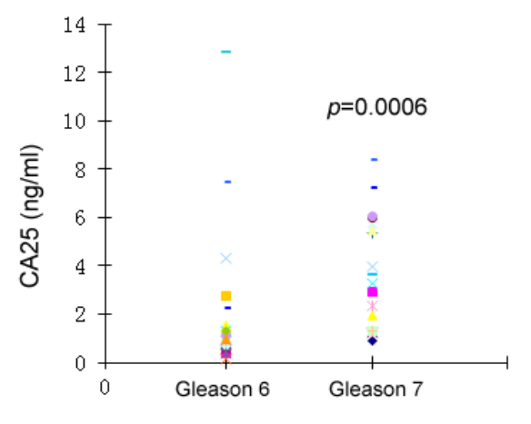
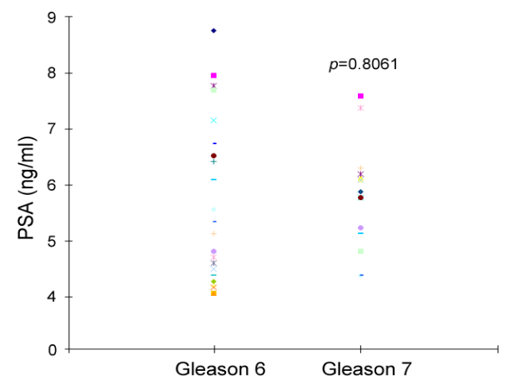
Comparison betweeb δ-Catenin and PSA
δ-catenin PSA
A B
C D
ECU-UNC Epidemiology Study
(Unpublished)

Slide 13
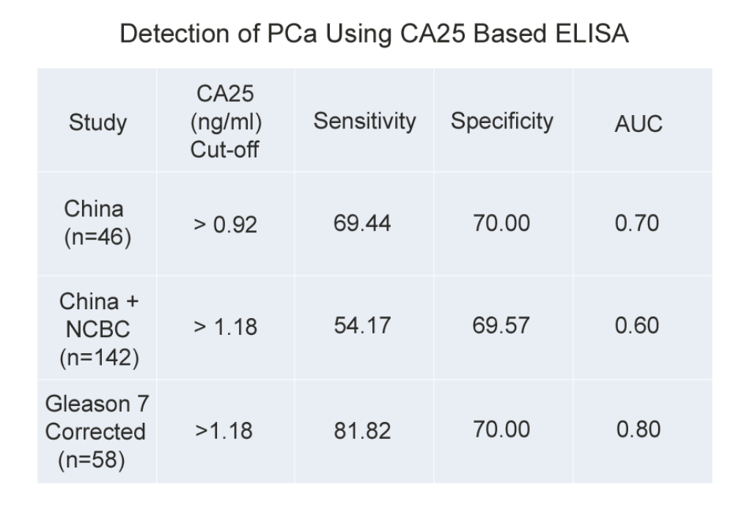
δ-Catenin/NPRAP/Neurojungin
ECU-UNC Epidemiology Study: PCa Case Analysis
(Unpublished)

Slide 14
Urine Biomarkers for Monitoring PCa Recurrence
- Biochemical recurrence: PSA (0.2~0.4 ng/ml)
- Urine biomarkers
DNA methylation in urine
RASSF1, GSTP1 and RARB genes were methylated in the urine of 60% of patients with prostate cancer. RASSF1 was methylated in 45% of prostate cancer urine samples.
In a univariate model RASSF1 methylation and the total number of methylated genes were predictive of time to biochemical recurrence. On multivariate analysis RASSF1 methylation together with pathological stage was the most significant predictor of biochemical recurrence in patients with Gleason score 6 tumors when analyzed in tissue and urine.
Daniunaite et al., J. Urol 2014
Protein levels independent of DNA/RNA alterations
YB-1 and MTA-1 protein levels predict prostate cancer recurrence. High
protein levels of YB-1 and MTA1 are associated with a 3-fold increased risk
for requiring future hormone therapy or radiation therapy.
Ruggero et al. Oncotarget, 2015
Notes:
YB-1: Y-box protein
MTA-1: Metastasis-associated protein-1. Chromotin remodeling

Slide 15

The Rise of Theragnostics
Advanced Accelerator Applications (AAA):
Lutathera, a theragnostic somatostatin analogue, emits two types of radiation---gamma radiation used to make SPECT images and beta radiation, energetic electrons that destroy the DNA of tumor cells.
FDA Fast Track Designation for Lutathera for the treatment of midgut neuroendocrine tumors.
Molecular theragnostics targeting urine components?
Prostate-Specific Membrane Antigen (PMSA)
- Radiopharmaceutics;
- Vaccine therapy
Notes:
PMSA-imaging of PCa and therapeutics.
1. Drawbacks of 111In-capromab is that it recognizes an intracellular epitope and cannot bind living cells;
2. Antibody–based imaging is the long time required for the antibody to clear from non-target tissues, thus necessitating several days between antibody
injection and imaging
Reviewed in Urol Onco in 2014 by Benjamin T. Ristau, M.D., Denise S. O’Keefe, Ph.D., and Dean J. Bacich, Ph.D.
Department of Urology, University of Pittsburgh School of Medicine, Pittsburgh, PA
PSMA remains an attractive target for the detection, diagnosis, and treatment of prostate
cancer 20 years from the date of its cloning. Therapeutics based on it biological role in the
nervous system where it functions as a NAALADase are promising in preclinical models.
There has yet to be a clinically important impact on survival in as a result of PSMA-based
therapeutics in prostate cancer. However, several recent new approaches to target PSMA
including the use of small molecule inhibitors, improved radioactive antibodies/antibodydrug
conjugates, PSMA-based immunotherapy, RNA aptamer conjugates, and PSMAtargeted
prodrug therapy have reinvigorated research in the field. Future study in PSMA and
prostate cancer might focus on its intracellular functions and its possible role in tumor
neurogenesis. As our understanding of tumor biology advances and molecular techniques
become more refined, PSMA-based therapeutics will likely play a role in the developing
armamentarium of treatment for CRPC.

Slide 16



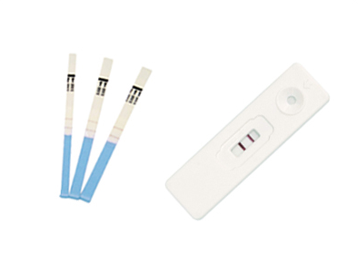




Challenges and Opportunities
Improved sensitivity/specificity (Differential priority)
New categories of biomarkers
Diversified platforms (Hospital, third party, Theranos, retail consumer)
Clinical laboratory and market acceptance (Commercialization and medical reimbursement)
Accessibility and portability (internet and mobile technology)
Global health strategy
Omics to big data and big health
POCT and global accessibility

Slide 17


