Slide 1


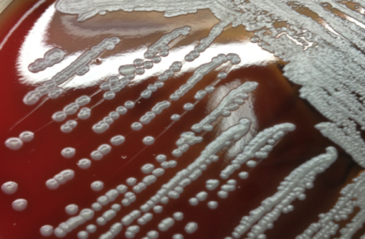
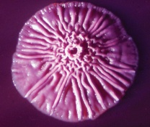
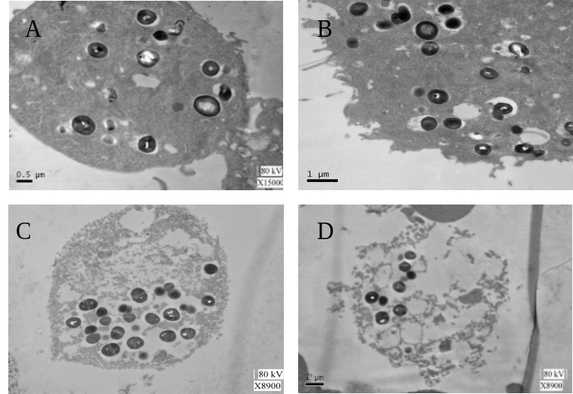
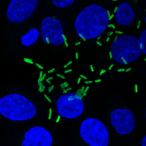
Burkholderia pseudomallei inhibits autophagy to benefit its intracellular survival in lung epithelial cells by suppressing ATG10
Third Military Medical University
Qian Li
Graduate student
May 17th, 2016
Notes:
Hi, everyone. It’s my great honor to be here, and share my research project with all of you.
I am coming from China, and now I am a 5th year PhD student in the TMMU in Chongqing province.
Today I will introduce a bacteria, which is called Burkholderia pseudomallei.

Slide 2
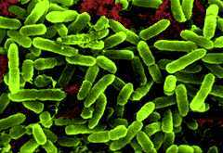
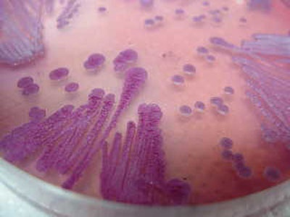
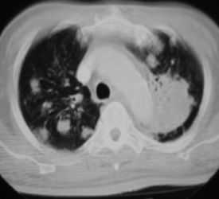
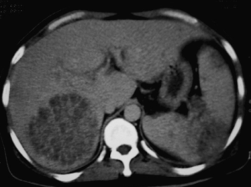
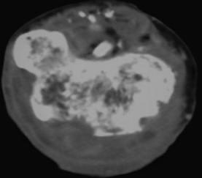
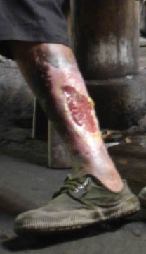
Background
Burkholderia pseudomallei，Bp
Melioidosis
liver abscess
pulmonary abscess
(multiple abscesses)
brain abscess
gangrene
Notes:
Firstly, let me introduce some background about the pathogen.
Burkholderia pseudomallei is a gram-negative pathogen. When human beings are infected with Bp through inoculation, inhalation, or ingestion, it can cause a disease, we call it melioidosis.
Melioidosis is classically characterized by pneumonia and multiple abscesses, with a mortality rate of up to 40%.
So Bp is classified as category B potential bioterrorism agent by the CDC.

Slide 3

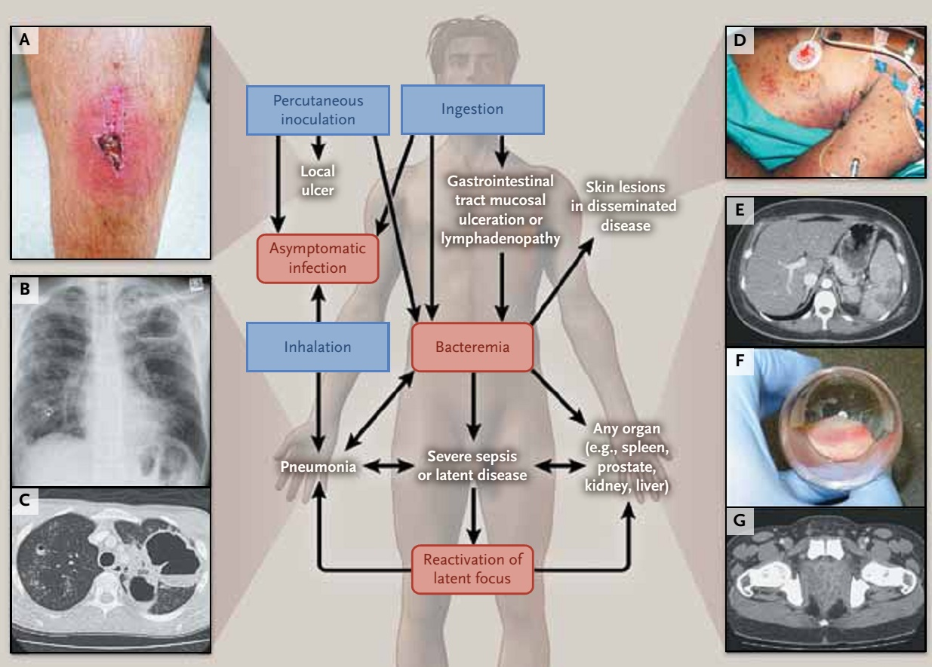
Background
prevalent in tropical regions of the world
high pathogenicity
difficult to diagnose
high mortality
a long latency period inside host
easy to obtain (water, soil)
easy to spread (aerosol)
Wiersinga WJ, Currie BJ, Peacock SJ. N Engl J Med. 2012, 367(11):1035-44.
Notes:
Melioidosis is epidemic in Southeast Asia, Northern Australia and other tropical regions. In China, the regional distribution of melioidosis is asymmetrical, with most cases in recent decades being found in local hospitals in Hainan province.
Hainan, as an international tourist destination, its recent rapid growth in popularity has been focused additional governmental and epidemiological attention on the risk of Bp infection within the province.
So, it’s high time to understand the detailed pathogenesis of Bp.

Slide 4
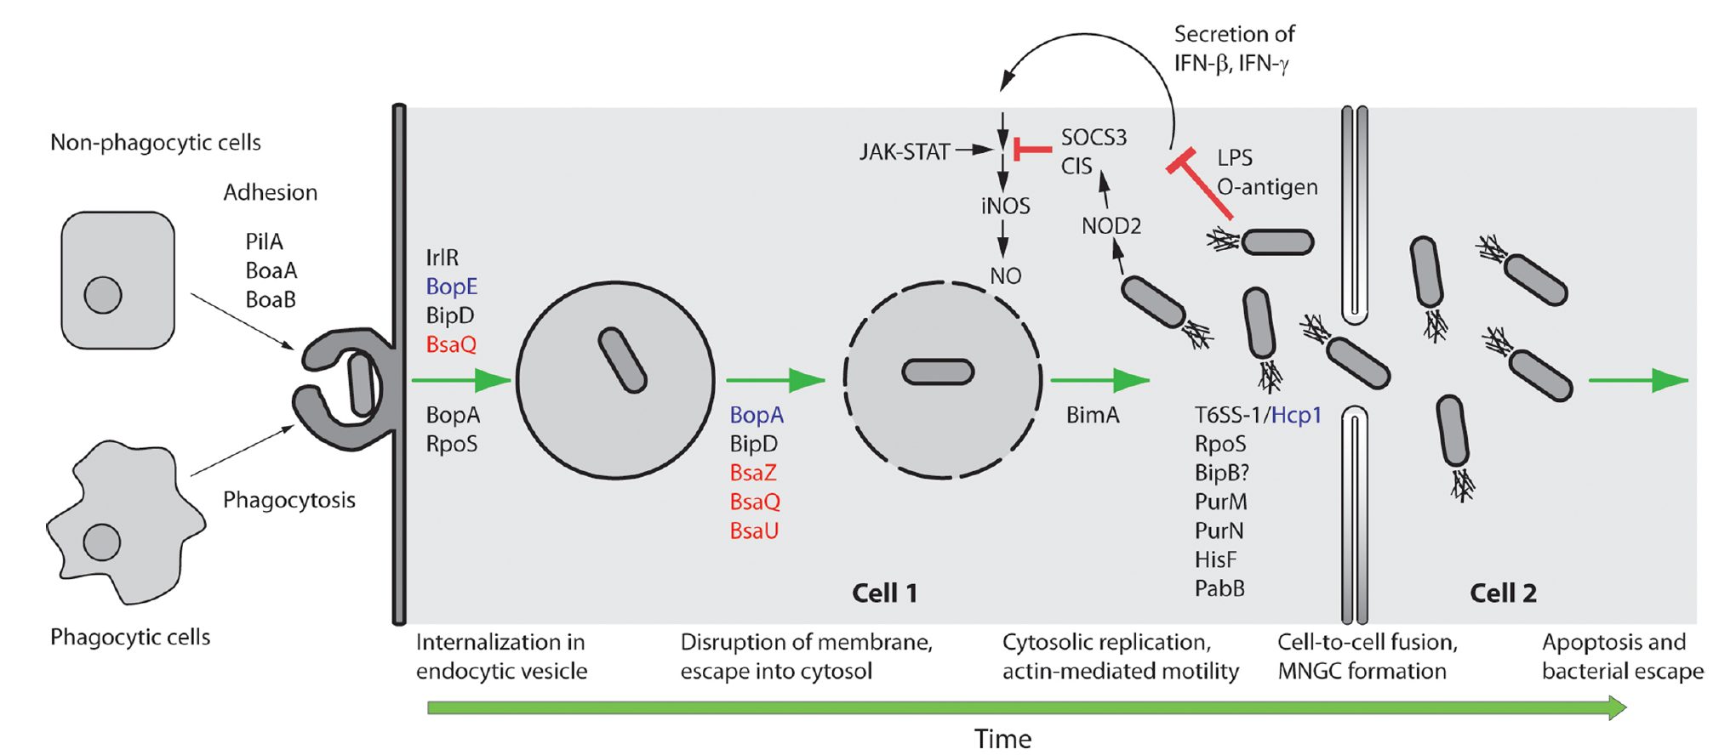
Background
Schematic representation of selected steps in the intracellular life style of Bp
Elizabeth MA, Rodney JD, John DB. Front Microbiol. 2011, 8(2):37-56.
Notes:
Bp is an intracelluar pathogen, after entry, Bp can make good use of numerous strategies that enable it to survive in such a specialized niche as the intracellular environment.
So far, some evidence has shown that Bp can escape from the immune recognition, and also can disrupt the immune clearance.
So it can invade, survive and replicate in a range of phagocytic and non-phagocytic cell lines, and its intracellular behavior is considered to be crucial for disease pathogenesis.
But how does host defense against Bp infection?

Slide 5
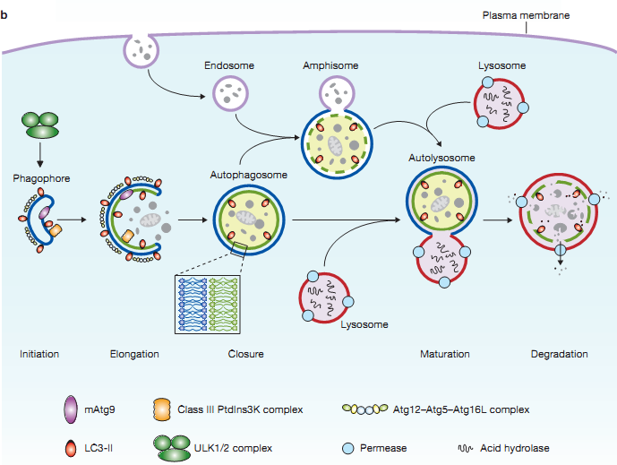
Background
Autophagy pathway:
Yang Z, Klionsky DJ. Nat Cell Biol. 2010, 12(9):814-822.
Notes:
Autophagy, as an important part of innate immunity, is one of the earliest defense responses encountered by intracellular pathogens, and it is also a process that engulfs and delivers intracellular bacteria for lysosomal degradation.
Autophagy in principle involves three morphologic stages:
1. initiation (formation of crescent membranes termed phagophores);
2. elongation and closure (increase in the size of the phagophore and its closure into a completed autophagosome containing the sequestered cargo);
3. maturation (conversion of autophagosomes into degradative organelles termed autolysosomes by fusion with late endosomal and lysosomal organelles or trafficking carriers);

Slide 6
Background
Methods for Monitoring Autophagy:
Transmission electron microscopy (TEM)
LC3 detection and quantification
Western blotting and ubiquitin-like protein conjugation systems
Turnover of LC3II–PE
GFP-LC3 lysosomal delivery and proteolysis
GFP-LC3 fluorescence microscopy
Tandem mRFP/mCherry-GFP fluorescence microscopy
Autophagic flux determination
Immunohistochemistry
SQSTM1/p62 and related LC3 binding protein turnover assays
……
Daniel JK, Fabio CA, Hagai A, et al. Autophagy. 2016, 12(1):1-222.
Notes:
There are many methods to detect the autophagy process.
Like, TEM can be used to monitor morphological autophagic structures.
And LC3-II, as the most important autophagy marker, can be detected by WB, fluorescent assay,immunohistochemistry and so on.
For example, by TEM image analysis, we observe an accumulation of autophagosomes; or by fluorescence microscopy assay, we also see the increased number of GFP-LC3 puncta; or by western blot, we viewed the changes in the amount of lipidated LC3, all of these results could reflect a reduction in autophagosome turnover, or the inability of turnover to keep pace with increased autophagosome formation.

Slide 7
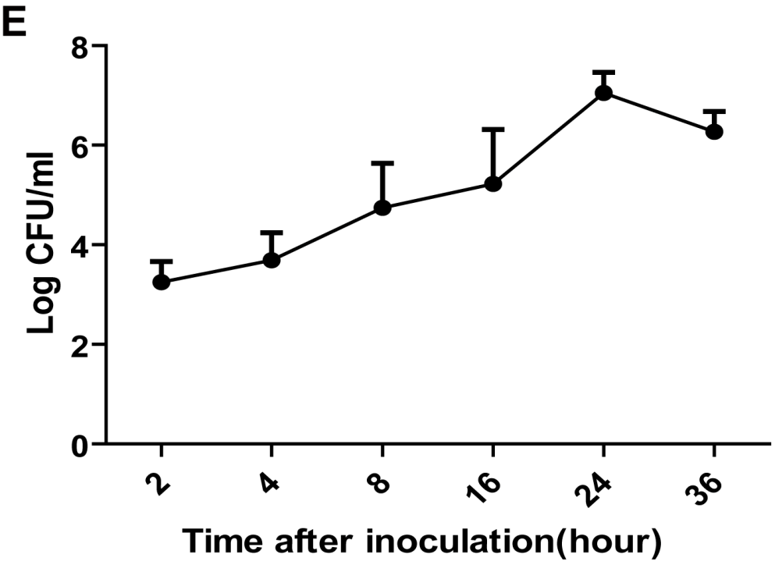
1. Intracellular survival and replication of B. pseudomallei in human lung epithelium cells.
A549 cells
uninfected
2 h p.i. (postinfection)
12 h p.i.
24 h p.i.
Notes:
In this project, we used A549 lung epithelial cell line as the research model. To investigate the replication of Bp in A549 cells, we observed the cells using TEM. As shown in the Figures, we can see Bp can invade into the host cell, and then replicate in the intracellular environment.
And over the infection time, Bp can cause the formation of MNGC (multi-nucleated giant cells), which contains 3 or more nuclei per giant cell.
Furthermore, the number of CFU (colony forming units) assay of Bp was gradually increased after infection, indicating that internalized Bp underwent intracellular replication.

Slide 8
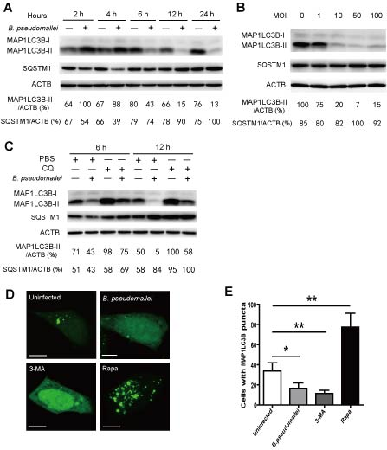
2. Autophagy is induced in early response to B. pseudomallei infection, but then decreased in the later infection phase.
Autophagic response detection
(1) Western blot
CQ：Chloroquine,
block autophagic flux;
(2) GFP-LC3 puncta assay
Notes:
Then we want to determine whether Bp modulates autophagy, we performed the Western Blot and GFP-LC3 puncta assay.
According to the Western Blot results, compared to the uninfected controls, the ratio of LC3-II to Actin clearly decreased and SQSTM1 protein level also showed a delayed accumulation after 6 hours with Bp infection.
Then we used a drug, CQ, to block the autophagic flux, we can see the decline of LC3-II generation was more obvious when infected with Bp.
Furthermore, we also did the GFP-LC3 puncta assay, cells were scored as positive for LC3 puncta if they contained more than 5 puncta. And the images showed that GFP-LC3-positive autophagosomes were absent in most cells when infected with Bp.
So we found that autophagy was inhibited in response to Bp infection.

Slide 9
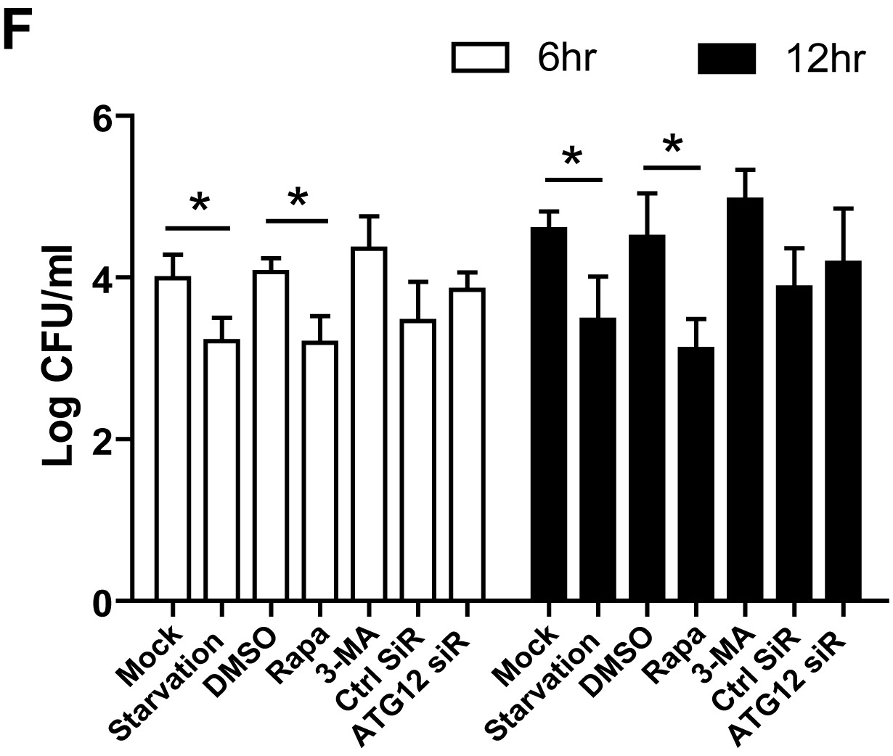
2. Autophagy is induced in early response to B. pseudomallei infection, but then decreased in the later infection phase.
(3) Intracellular survival of bacteria
Rapa：autophagy enhancer;
3-MA：autophagy inhibitor；
Notes:
To evaluate the effect of autophagy on intracellular multiplication, we added some drugs or siRNA to enhance or inhibit host autophagy response before Bp infection.
As a result, stimulation of autophagy resulted in an enhanced ability of the cell to control infection. In contrast, no significant increases were observed in the presence of 3-MA and ATG12 siRNA compared to the controls.
So we reason that Bp may evolve mechanisms to escape intracellular clearance by subverting autophagy.

Slide 10
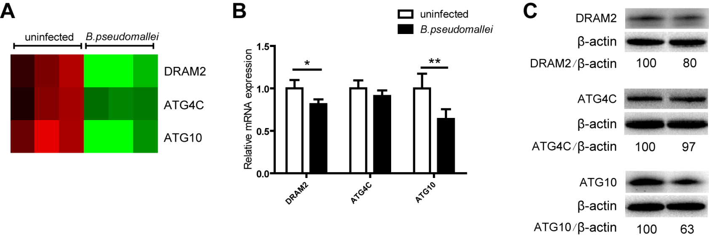
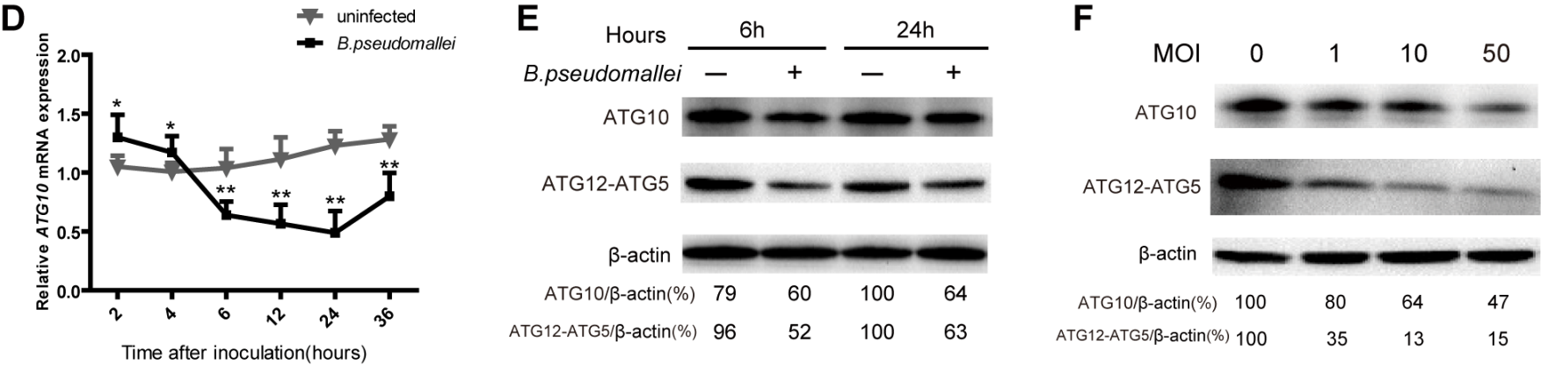
3. Down-regulation of ATG10 expression in response to B. pseudomallei infection.
6 h p.i.
GeneChips
qRT-PCR, WB
ATG10
ATG10：qRT-PCR, WB
Notes:
In order to investigate the underlying mechanisms that Bp inhibits the autophagy pathway to avoid clearance by the host cells, we used Human GeneChips to determine the gene expression profile of A549 cells.
Analysis of the GeneChips data revealed that there were three autophagy related genes were expressed at decreased levels in response to Bp infection compared to controls. They are DRAM2, ATG4C and ATG10.
To confirm the validity of microarray, we performed qRT-PCR and western blot.
According to the results, we found ATG10 was the most significant down-regulation among the genes.
So we choose ATG10 as our target gene for further study.

Slide 11
3. Down-regulation of ATG10 expression in response to B. pseudomallei infection.
overexpressed ATG10
WB, immunofluorescence, intracellular survival assay
Notes:
We found that when we enforced the expression of ATG10, it can enhance the co-localization of intracellular Bp with autophagosomes, and significantly decreased the bacterial load of intracellular Bp compared to the control vector.
So, the above data indicated that Bp inhibits autophagy and autophagy-mediated intracellular bacterial elimination by suppressing ATG10 expression.
Okay, let me draw a short conclusion. Firstly, we found Bp can inhibit host autophagy response, and then we found this inhibition is mediated by suppressing ATG10 expression.
So, next we also want to know how does Bp inhibit ATG10 expression?

Slide 12
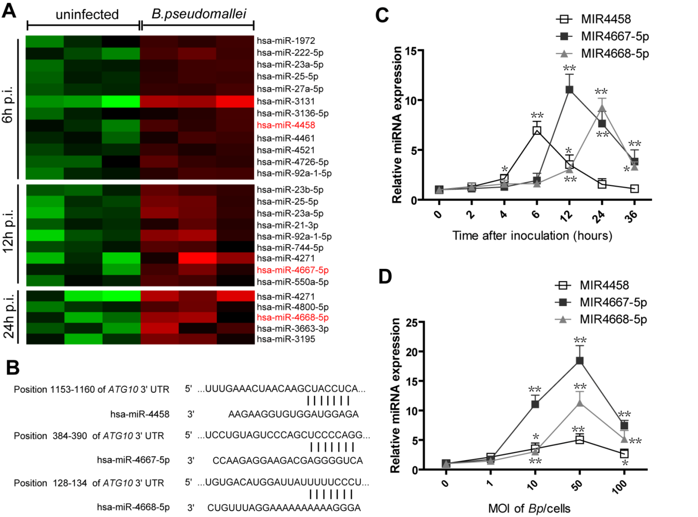
4. MIR4458, MIR4667-5p and MIR4668-5p are upregulated after B.pseudomallei infection.
miRNA microarrays
bioinformatics tools
qRT-PCR
Notes:
So far, mounting evidence indicates that the post-transcriptional and translational controls mediated by miRNAs contribute significantly to autophagy.
So, in order to find the remained mechanisms, we performed miRNA microarrays.
To analyze the data, we used bioinformatics tools, like TargetScan and miRDB, to predict its targets, ATG10, and then we focused on three novel miRNAs, MIR4458, MIR4667-5p and MIR4668-5p. All of the three miRNAs are predicted to target different 3’UTR regions of ATG10. So we choose the three miRNAs for our further study targets.
Firstly, we also need to confirm the validity of the miRNA data, so we performed the qRT-PCR analysis. The results of qRT-PCR showed that MIR4458, MIR4667-5p and MIR4668-5p were upregulated after Bp infection. Consistent with time-course experiments, similar results were also observed when dose-dependency was tested.

Slide 13
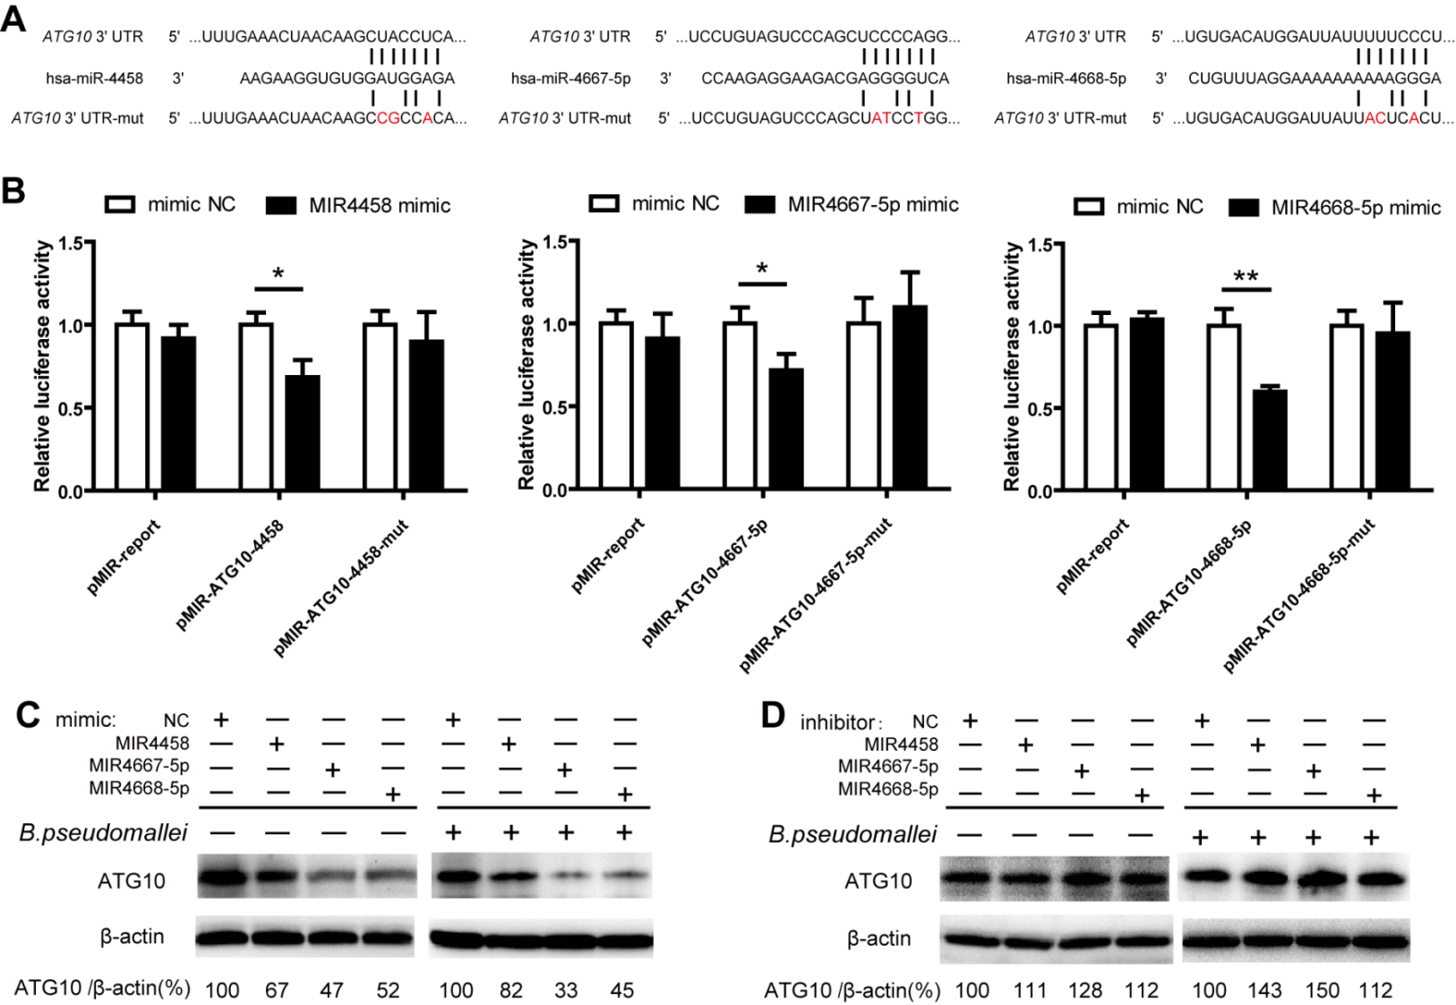
5. MIR4458, MIR4667-5p and MIR4668-5p suppresse expression of ATG10 by binding with its 3’UTR.
miRNA target validation methods ：
1. Luciferase assay
2. WB
3. qRT-PCR
HEK293 cells
A549 cells
Notes:
Then I need to verify if ATG10 is the target of the three miRNAs.
We used 3 different methods. For the luciferase assay, the relative luciferase activity of wild-type vectors was effectively suppressed by the 3 miRNA mimics, while that of mutant vectors was not significantly changed, so these results suggested that MIR4458, MIR4667-5p and MIR4668-5p could bind to the 3’UTR of ATG10.
For western blot results, we observed that the protein levels of ATG10 were decreased by the 3 miRNAs with different inhibition rates, especially for MIR4667-5p.

Slide 14
5. MIR4458, MIR4667-5p and MIR4668-5p suppresse expression of ATG10 by binding with its 3’UTR.
miRNA target validation methods ：
1. Luciferase assay
2. WB
3. qRT-PCR
HEK293 cells
Notes:
Next, we constructed a ATG10 cDNA vector containing all the three miRNAs binding sites in the 3’UTR. Interestingly, at the mRNA level, expression of ATG10 was reduced by MIR4458 and MIR4668-5p, but no significant change was observed with MIR4667-5p.
In contrast to qRT-PCR analysis, at the protein level, ATG10 expression was repressed by the 3 miRNAs.
So what’s the reason? I think the possible reason might be that miRNAs may downregulate their target genes through mRNA degradation or translation inhibition, the above results suggest that MIR4458 and MIR4668-5p may downregulate ATG10 expression through mRNA degradation, while MIR4667-5p does it through translation inhibition.
Taken together, we can draw the conclusion MIR4458, MIR4667-5p and MIR4668-5p can target and suppress ATG10.

Slide 15
6. MIR4458, MIR4667-5p and MIR4668-5p inhibit autophagy and promote the intracellular survival of B.pseudomallei.
1. Autophagy response
（WB, GFP-LC3 puncta assay）
2. intracellular survival assay
(1) WB
CQ：Chloroquine, block autophagic flux;
Notes:
Next, we need direct evidence that MIR4458, MIR4667-5p and MIR4668-5p have role in the negative regulation of autophagy during Bp infection.
We examined the autophagy process. According to the WB results, transfection with the 3 miRNA mimics decreased LC3-II conversion in uninfected and Bp infected A549 cells, while transfection with the inhibitors increased the amount of LC3-II.
Then, in the presence of CQ, MIR4458, MIR4667-5p and MIR4668-5p mimics also decreased the amount of LC3-II, respectively, while the inhibitors for the 3 miRNAs increased it.

Slide 16
6. MIR4458, MIR4667-5p and MIR4668-5p inhibit autophagy and promote the intracellular survival of B.pseudomallei.
1. Autophagy response
（WB, GFP-LC3 puncta assay）
2. intracellular survival assay
(2) GFP-LC3 puncta assay
Notes:
Furthermore, we co-transfected the GFP-LC3 vector and the 3 miRNA mimics, through these images, we can clearly see that the number of GFP-LC3 puncta declined compared to the control, which means the three miRNA mimics significantly decreased autophagy in A549 cells.
So combined western blot and puncta assay data, these results suggested that MIR4458, MIR4667-5p and MIR4668-5p inhibit autophagy.

Slide 17
6. MIR4458, MIR4667-5p and MIR4668-5p inhibit autophagy and promote the intracellular survival of B.pseudomallei.
1. Autophagy response
（WB, GFP-LC3 puncta assay）
2. intracellular survival assay
Notes:
Nest, we need to investigate whether MIR4458, MIR4667-5p and MIR4668-5p modulate the intracellular survival of Bp through autophagy.
So we detected the effect of the 3 miRNAs on bacterial survival. According to the data, transfection with MIR4458, MIR4667-5p and MIR4668-5p mimics increased intracellular survival of Bp in A549 cells, but when we used the drug, 3-MA, to inhibit autophagy, no significant changes were observed.
Moreover, to further determine whether MIR4458, MIR4667-5p and MIR4668-5p enhance the intracellular survival of Bp by targeting ATG10, we cotransfected the 3 miRNA mimics with the ATG10 expression-plasmid into A549 cells before Bp infection. Overexpression of MIR4458, MIR4667-5p and MIR4668-5p significantly increased the bacterial load of intracellular Bp, whereas ATG10 overexpression attenuated miRNA-mediated intracellular survival of Bp in A549 cells.
So taken all the data together, these results suggested that MIR4458, MIR4667-5p and MIR4668-5p inhibit autophagy-mediated elimination of intracellular Bp by targeting ATG10.

Slide 18
Schematic figure：
Notes:
This is a schematic picture of the whole story.
When Bp infected the host cells, firstly, Bp can induce the upregulation of MIR4458, MIR4667-5p and MIR4668-5p. Then, these three novel miRNAs target to ATG10, which reduce the expression level of ATG10, to inhibit autophagy and autophagy-mediated elimination of Bp. In turn, Bp can survive and replicate inside host cells.

Slide 19
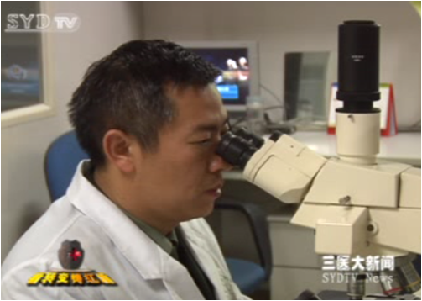


Acknowledgments
Prof. Xuhu Mao
Dr. Bing Tang
Dr. Yao Fang
Pan Zhu
Chunyan Ren
Kun Wang
Yinping Jia
Notes:
This study was supported by grants from National Natural Science Foundation of China.
And I would like to express my special appreciation to my Ph.D. advisor Prof. Xuhu Mao for his great guidance and valuable advice throughout my PhD and professional development.
And I am also grateful to Dr. Bing Tang and Dr. Yao Fang for their great and constructive advice on my research projects. And I would like to thank all the group members for their help.
Thanks for your attention!

Slide 20
Thanks for your attention!

