Slide 1

June 26, 2017
Self-multimerization of transglutaminase-2 mediated by the calcium binding C1 domain
Qamar Bashir
University of Oslo Norway

Slide 2
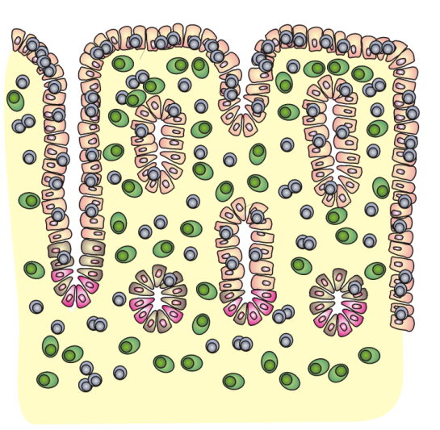

Celiac disease (CD)
aberrant autoimmune response to dietry gluten
Enterocyte killing, damaging small intestine, affecting nutrient absorption
CD4+ T-cell response towards gluten derived peptides
Genetically susceptible individuals carrying HLA-DQ2.5, HLA-DQ2.2 and HLA-DQ8
Deamidated gluten
disease specific, gluten dependent antibody production
Transglutaminase 2
+ gluten
- gluten
Healthy
Celiac

Slide 3
Trasglutaminase 2 (TG2) in CD
Catalyzes highly specific deamidation of gluten peptides
Generates immunogenic CD4+ T-cell epitopes
Transamidation: covalent cross linking of glutamine with lysine or primary amine
Autoantigen
  gluten dependent
  TG2 has dual role, and is central to CD
  Poorly understood

Slide 4
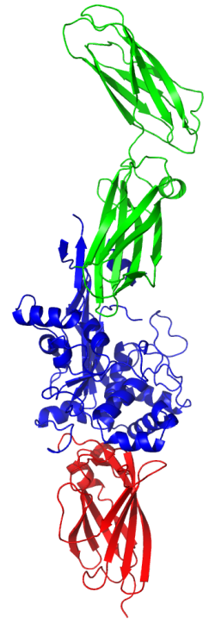
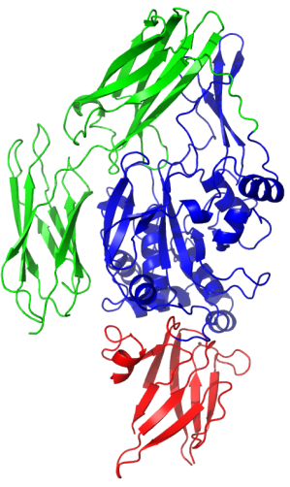
Transglutaminase 2
Wound healing enzyme
Ca⁺⁺ dependent enzyme
Expressed in cytosol but present extracellular as well
Intracellularly works as GTPase
C2 domain
C1 domain
Catalytic core
N terminal
Closed
Open

Slide 5
TG2 multimerization
TG2 full length (1-687)
TG2 1-586 (missing C1 domain)
TG2 1-465 (missing C1C2 domain)
TG2 C1 domain (466-586)
TG2 C2 domain (586-687)
TG2 C1C2 domain (466-687)
C2 domain
C1 domain
Catalytic core
N terminal

Slide 6
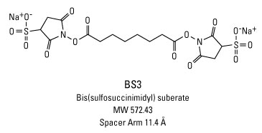
BS3 cross linker
Amine-to-amine cross linker
Capture non-covalent interactions
Forms amide bond with primary amines
Release of N-hydroxysulfosuccinimide

Slide 7
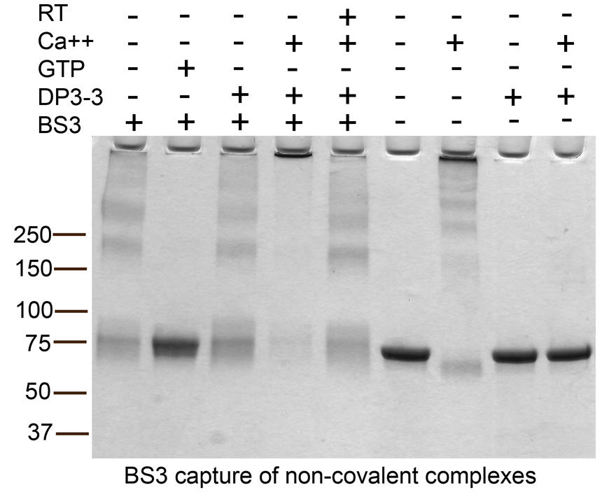
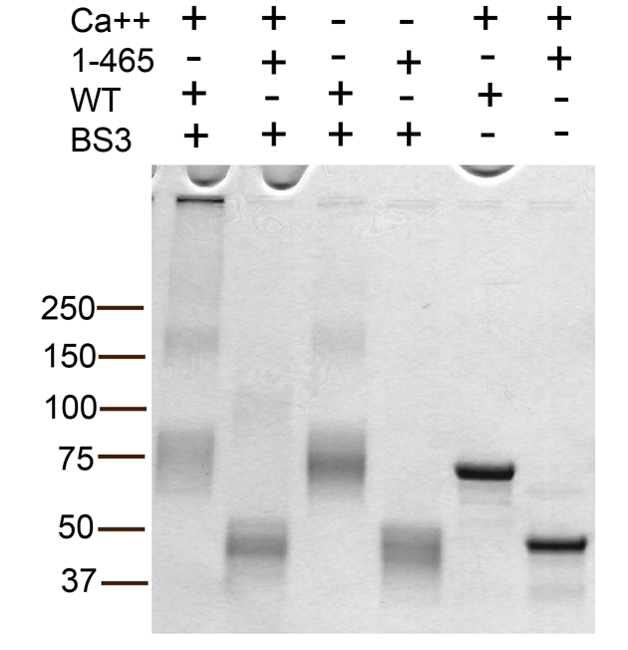
TG2 multimerization

Slide 8
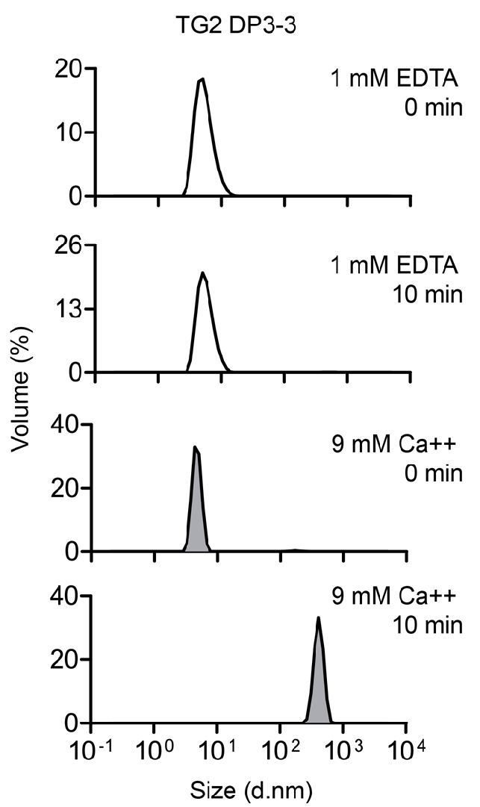
Dynamic Light Scattering
Characterize particle size
Fluctuations in scattered light intensity
Diffusion coefficient of particles
Particle population
Stamnaes J et al. (2015) PloS One 10:e0134922

Slide 9
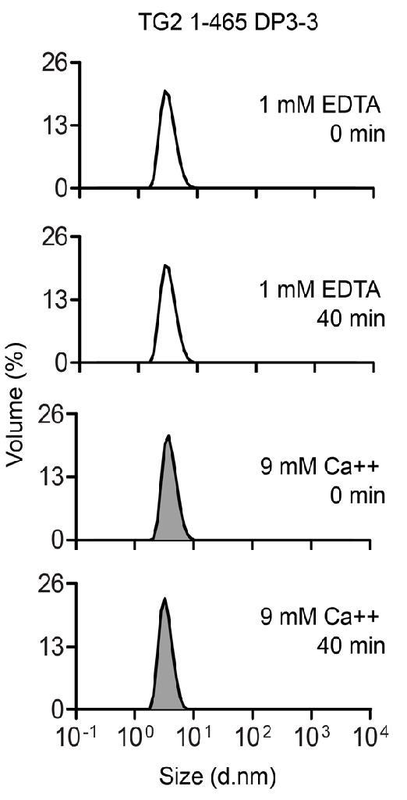
Dynamic Light Scattering
Stamnaes J et al. (2015) PloS One 10:e0134922

Slide 10
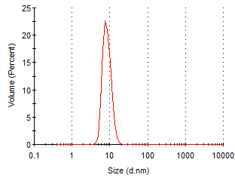
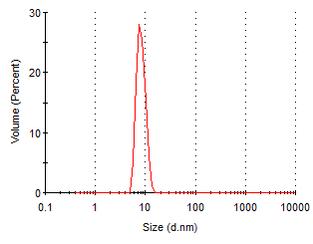
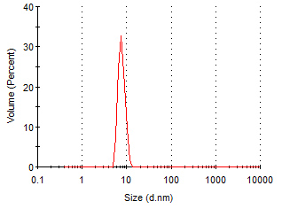
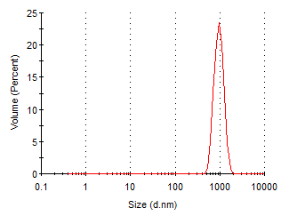
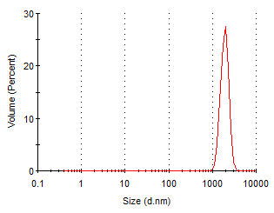
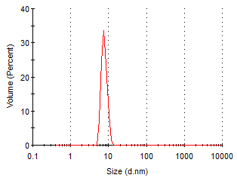
TG2 1-687
TG2 1-586
TG2 1-465
1mM EDTA
1mM EDTA
1mM EDTA
5mM
calcium chloride
5mM
calcium chloride
5mM
calcium chloride

Slide 11
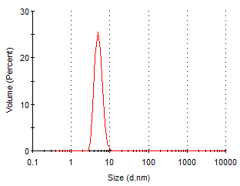
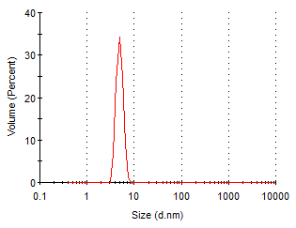
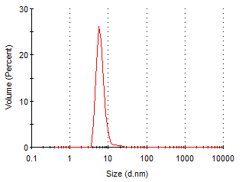
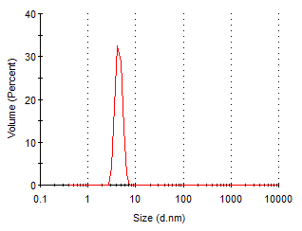
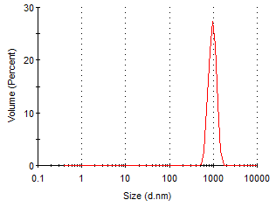
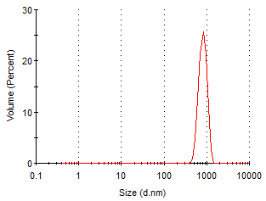
TG2-C1 (466-586)
TG2-C2 (586-687)
TG2-C1C2 (466-687)
1mM EDTA
1mM EDTA
1mM EDTA
5mM
calcium chloride
5mM
calcium chloride
5mM
calcium chloride

Slide 12

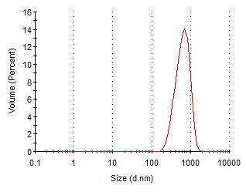
Effect of salt on aggregation
TG2 1-687
150mM NaCl
300mM NaCl
5mM
calcium chloride
5mM
calcium chloride
10mM
calcium chloride

Slide 13
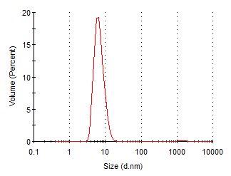
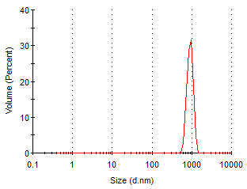
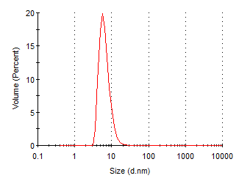
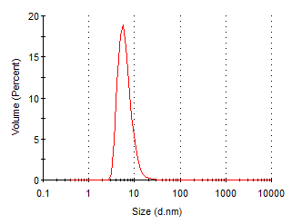
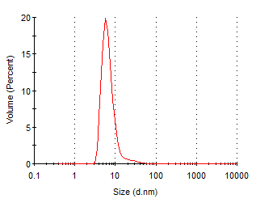
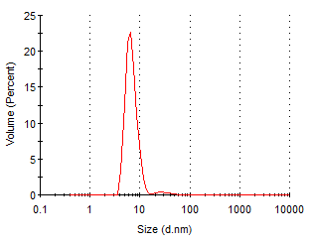
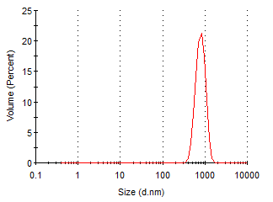
Effect of salt on aggregation
150mM NaCl
400mM NaCl
700mM NaCl
5 mM
calcium chloride
5 mM
calcium chloride
5 mM
calcium chloride
10 mM
calcium chloride
10 mM
calcium chloride
TG2-C1C2 (466-687)
20 mM
calcium chloride
20 mM
calcium chloride

Slide 14
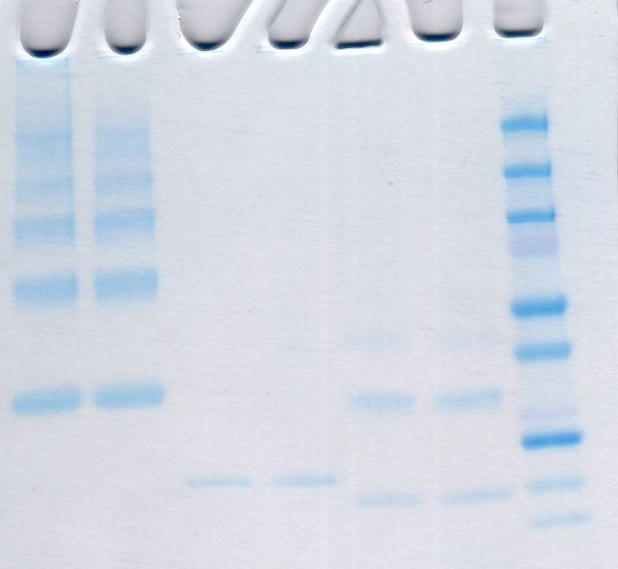
BS3 cross linking
+ - + - + - CaCl₂
C1C2 C1C2 C2 C2 C1 C1 M

Slide 15
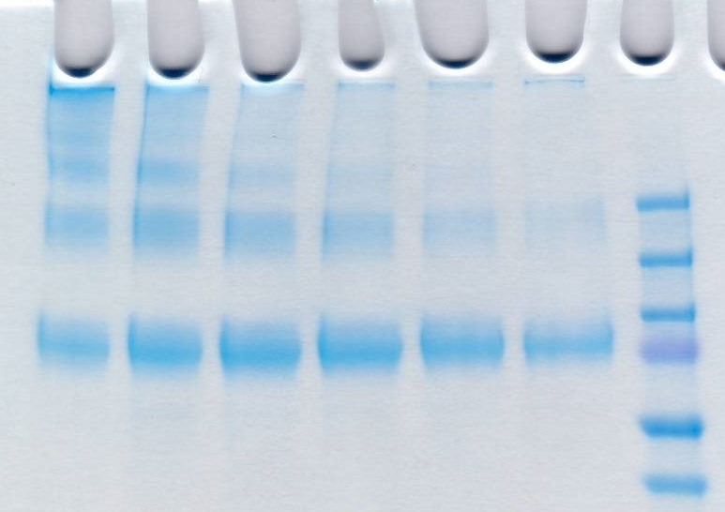
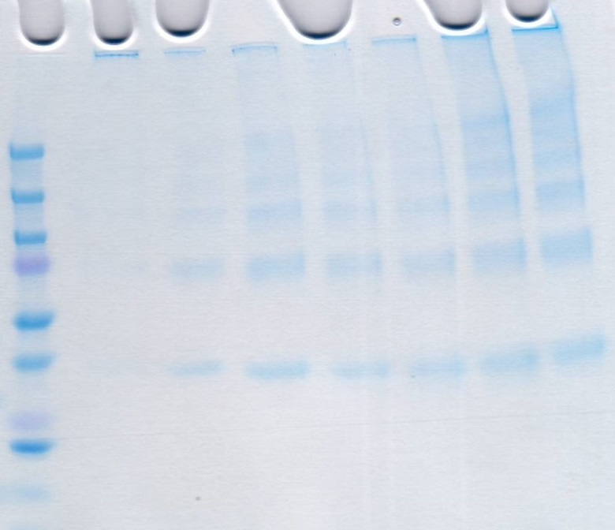
Effect of salt concentration
TG2 1-687
C1C2 (466-687)
NaCl (M) 0.15 0.25 0.5 0.75 1 1.5
NaCl (M) 2.5 1.5 1.0 0.75 0.5 0.25 0.15

Slide 16
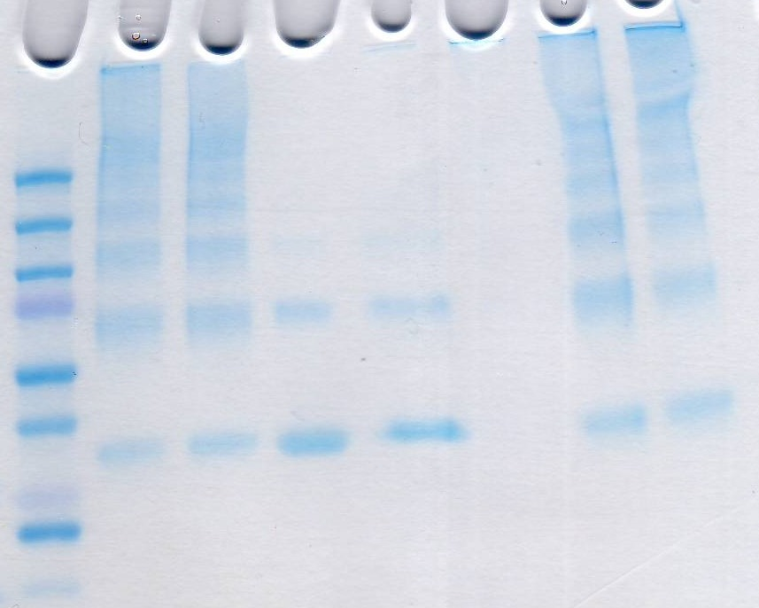
Effect of additives
C1C2 (466-687)
Triton Tween SDS (NH4)₂SO₄ GdHCl Urea Control
X-100 20
0.01% 0.005% 0.1% 1M 1M 1M

Slide 17
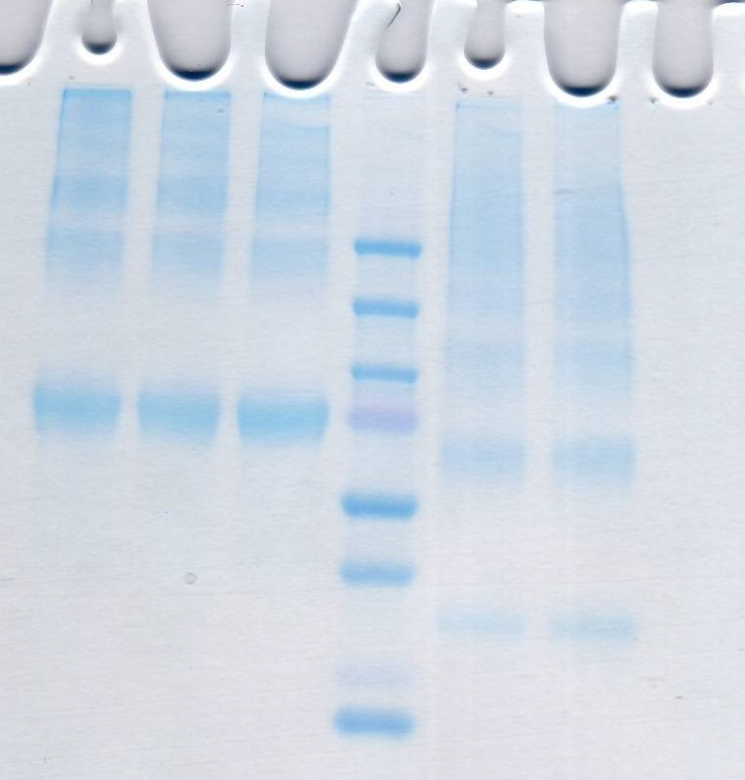
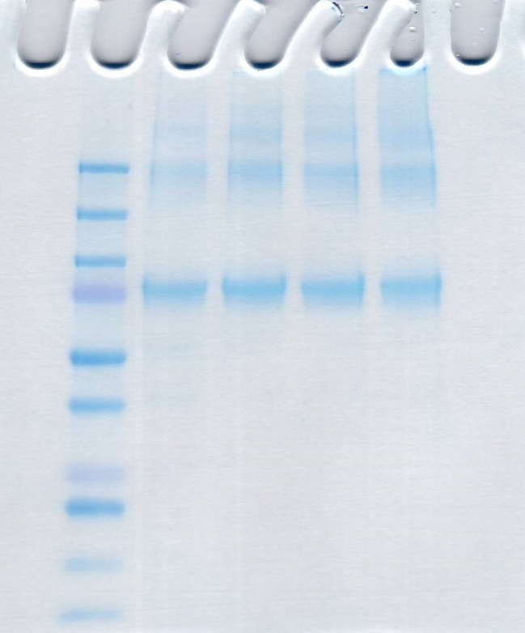
Effect of EDTA and GDP
TG2 with 1 mM GDP
TG2 TG2 TG2 C1C2 C1C2
GDP EDTA Control Control EDTA
TG2 (mg/ml) 0.15 0.2 0.3 0.6

Slide 18
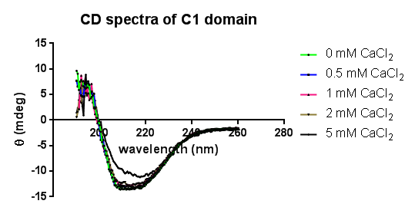
Effect calcium on secondary structure

Slide 19
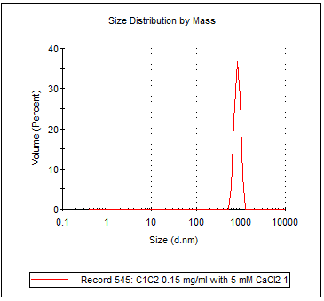
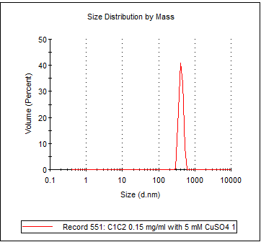
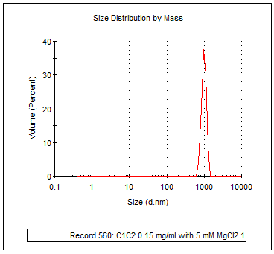
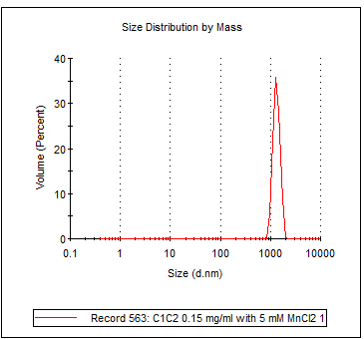
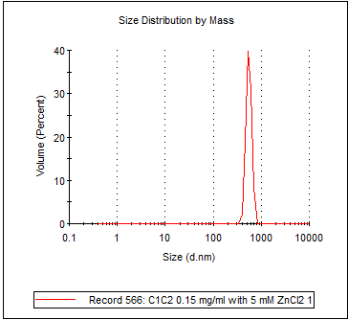
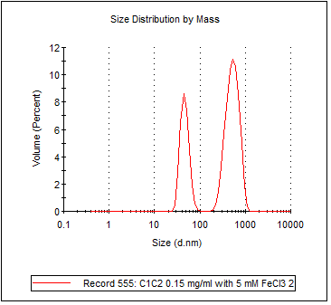
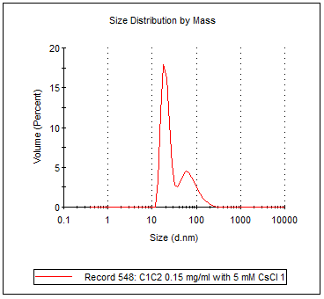
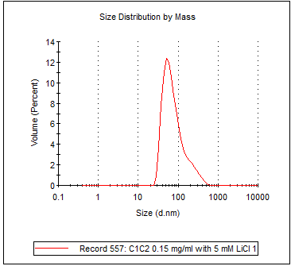
Effect of metals on aggregation
CaCl₂
CuSO₄
MgCl₂
MnCl₂
ZnCl₂
FeCl₃
CsCl
LiCl

Slide 20
Summary
TG2-C1 (466-586) domain is involved in TG2 self association
It appears to be C1 – C1 interaction
The aggregation is affected by multivalent metals (Ca⁺², Cu⁺², Mg⁺², Mn⁺², Zn⁺², Fe⁺³)
TG2 multimerization is affected by salt concentration
Calcium affects multimerization and not the secondary structure
C1 appears to have calcium binding site

Slide 21
Aknowledgements
Ludvig Sollid
Jorunn Stamnæs
?

