Slide 1

“6thAsia-Pacific Pharma Congress”
11-13, July 2016, Kuala Lumpur, Malaysia
Sensitive and Selective Polyaniline Nanofibre Based Voltammetric Sensor for the Quantification of Tinidazole
Presented By
Dr. PRIYANKA KAROLIA
SCHOOL OF STUDIES IN CHEMISTRY
Jiwaji University, Gwalior, INDIA

Slide 2
Need for the Analysis of Pharmaceuticals
Qualitative and quantitative analysis of drug is one of the major requirements for the medical research.
The action of a drug is not only determined by its chemical structure, but also by its physico-chemical properties.
The knowledge of the mechanism of electrode reaction of pharmaceutical compounds can give a useful clue into the elucidation of the mechanism of their interaction with living cells.
Thus, in order to have better technique for the analysis of drugs, electrochemical methods have been applied.

Slide 3
Techniques for Analysis of Pharmaceuticals
Spectrometric Techniques
Chromatographic Techniques
Electrochemical Techniques

Slide 4
Electrochemical Methods
Monitoring drug level and absorption, reliable analytical methods are required.
Expensive
HPLC, GC, LCMS
Time consuming
Complicated

Slide 5
Advantages of Electrochemical Techniques
To demonstrates applicability in studies of electrodic reactional mechanisms of pharmaceuticals in biological medium.
It offers high sensitivity, low limit of determination, easy operation and use of simple instrumentation.
An alternative substitute to other sophisticated methods.

Slide 6
Classification of Electrochemical Sensors
Electrochemical sensors
Amperometric Sensors
Conductometric Sensors
Potentiometric Sensors
Voltammetric
Sensors

Slide 7
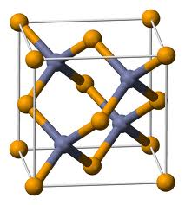
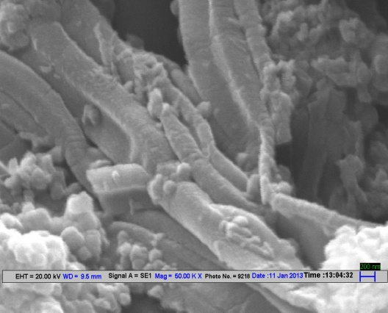
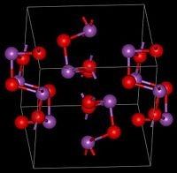
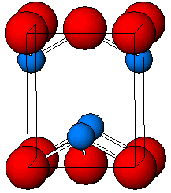
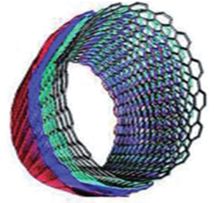
Modern Electrochemical Sensors
Polyaniline nanofibers
Zinc oxide (ZnO)
Advanced
Nanomaterias
Tin Oxide
Multi-walled carbon
nanotubes
Bismuth oxide

Slide 8
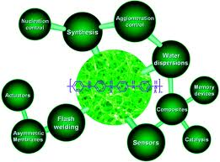
Polyaniline Nanofibers
Conducting polymers are one of the interesting mediators in chemically modified electrodes.
Nanostructure materials have attracted much interest because they show physical properties that are significantly different from their bulk materials.
Polyaniline (PANI) nanofibers is one of the most extensively studied polymers due to its environmental stability, interesting redox properties, high electrocatalytic activity and facile synthesis.

Slide 9
Significance of Polyaniline Nanofibers
High Electrical- Conductivity
Large Surface-Area
Low Charge- Transfer Resistance
Electrochemical- Impedance Spectroscopy
Randles-Sevcik equation
Cyclic-Voltammetric studies

Slide 10
Objective of the Study
To develop the voltammetric methods for the determination of the selected model drugs.
Polyaniline nanofibers are expected to be promising material for sensing applications because of the ease of fabrication, excellent electrochemical performance, and high electroactive surface area.
To standardize electrochemical procedures for the qualitative and quantitative analysis.
The modified electrode has good operating characteristics like sensitivity, low detection limit, with fast response .

Slide 11
Instrumentation
potentiostat
reference
N₂
inlet
counter
Electrode
Material
Insulator
PolyanilineFilm
Working Electrode
Electrochemical Cell

Slide 12
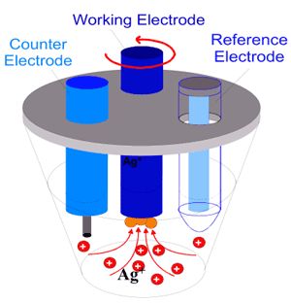
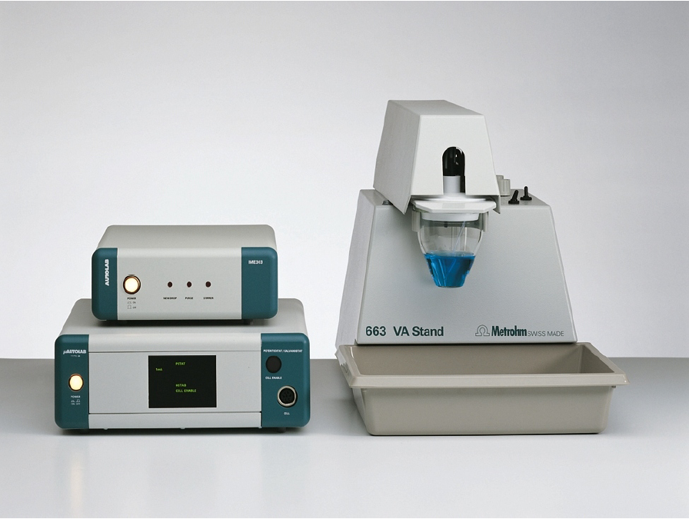
Instrumentation
µ-Autolab type III (Eco-Chemie B.V.) potentiostat–galvanostat
Electrochemical cell

Slide 13
Methodology
SEM
Synthesis of Polyaniline Nanofibers
EIS
Polyaniline Nanofibers Dispersion in DMF
IR
TGA
Sensor Fabrication
Effect of Scan
Rates
Characterization of Sensor
Effective Area
Analysis of Results
Results Recorded
Calibration curve
Drug
(Tablet dosage form)
LOD and LOQ
Optimization of pH
Reproducibility
Optimization of Solvent
Recovery

Slide 14
Drug of Interest Tinidazole
1‐(2‐ Ethyl sulfonyl ethyl) –2 – methyl – 5‐ nitroimidozole
  A novel antiparasitic drug.
  Used against protozoan infection.

Slide 15
Chemicals and Reagents
Polyaniline was procured from RFCL limited. Camphor sulphonic acid used as a doping agent was obtained from Ranbaxy, India.
Tinidazole standard (98% purity) was obtained from Cipla Clinical Research Pvt. Ltd., Ahmedabad, India.
Tablets containing Tinidazole (VIROVIR) labeled 300 mg were obtained from commercial sources.
A stock solution of tinidazole (1 mg/mL) was prepared in N, N-dimethylformamide (DMF).
BR buffers (2.5 to 12.0) and Potassium chloride (1.0 M).

Slide 16
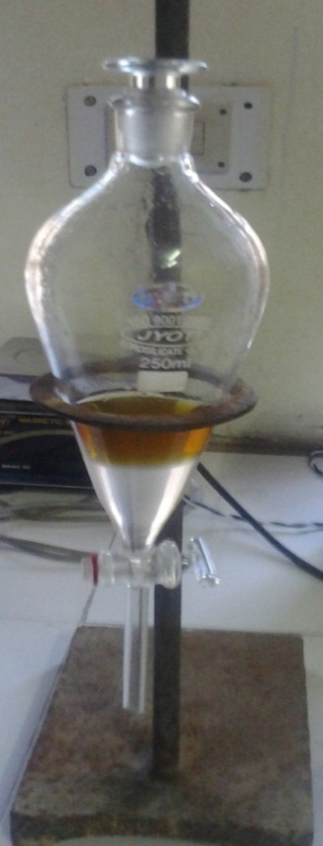
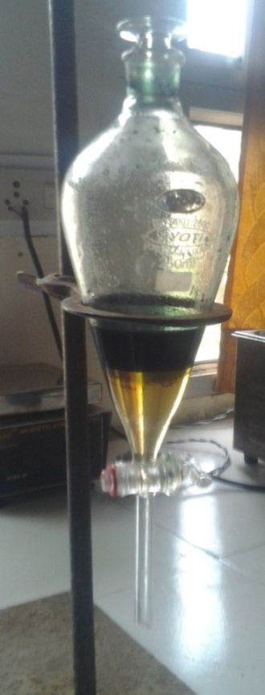
Synthesis of Polyaniline
Polyaniline nanopowder was synthesized by Interfacial polymerization method.
Typical synthesis consists the following steps
(i) 0.36 mL predistilled aniline was dissolved in 40 mL carbon tetrachloride (solution A).
A
B
(ii) 0.456 g ammonium persulphate was dissolved in 0.1 M camphor sulphonic acid and stirred until a homogenous solution is obtained (solution B).
(iii) And then solution A was added into the mixture B with vigorous stirring for 10 min, solution so obtained was kept at 4^{ο}C for overnight, polymerization reaction occurred at interface of two immiscible solvents.
Synthesis of PANI Nanopowder
Before Polymerization
After Polymerization
(iv) Thus obtained PANI precipitate was centrifuged for 5 min, washed with deionized water and ethyl alcohol for several times and left at room temperature overnight for drying.

Slide 17
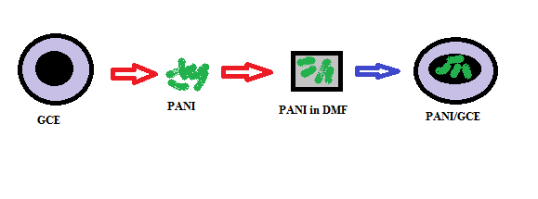
Fabrication of Modified Electrode

Slide 18
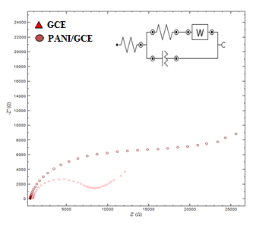
Characterization of Fabricated Sensor
b
a
SEM image of PANI/GCE
GCE = 9.79 kΩ
PANI/GCE = 6.17 kΩ
Nyquist plots of 5 mM Fe(CN)6 ^{3-/4−} of GCE (a) and PANI/GCE (b)

Slide 19
Fourier Transforms Infrared Spectroscopy
The modification of glassy carbon electrode with polyaniline (PANI) nanofibre was analyzed by FTIR spectroscopy. FTIR adsorption spectra of PANI polymer nanofibre displayed of peak (C=N) stretching vibration of quinoid ring at 1578 cm⁻¹, C=C stretching vibration of benzenoid ring at 1490 cm⁻¹ , C-C and C-H bonding mode of aromatic ring at 598 and 695 cm⁻¹, C-N stretching of benzenoid ring at 1246 and 1305 cm⁻¹. The peaks at 1039 and 1146 cm⁻¹ can be assigned to the asymmetric and symmetric O=S=O stretching vibrations, respectively, indicating the existence of SO₃⁻ groups. The absorption peaks at 1039 and 1146 cm⁻¹ in the FTIR spectra of the CSA doped PANI nanofibers are consistent with the presence of the SO₃⁻ group attached to the aromatic rings.

Slide 20
Thermo Gravimetric Analysis
TGA curves of the polymer nanofibre shows a nearly continuous weight loss with respect to temperature. However, three distinct weight losses could be detected. The first weight loss occurs at a temperature of 90–100 ◦C due to loss of moisture. The second loss around 100–260 ◦C is due to the loss of the counter anion of the dopant acid. The third weight loss around 260–670 ◦C is due to the degradation of the polymer backbone. Thus, good thermal stability coupled with high electrical conductivity is the most significant advantage of organic dopant acids for the synthesis of polymer nanofibre.

Slide 21
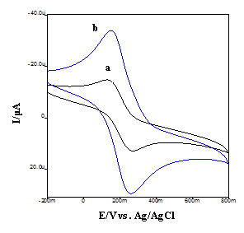
Effective Surface Area
Cyclic Voltammetric Studies
The electroactive surface areas of different electrodes were obtained by cyclic voltammetry using 1.0 mM K₃ Fe (CN)₆ as a redox probe at different scan rates based on Randles-Sevcik equation :
i_{p} = (2.69 × 10⁵) n^{3/2} AC D₀^{1/2} ν^{1/2}
PANI/GCE = 0.16 cm²
GCE = 0.07 cm²
Comparison of the cyclic voltammetric behaviour at modified electrode in 1.0 mM K₃Fe(CN)₆ (a) GCE (b) PANI/GCE

Slide 22
Characterization Parameters
Working electrode | Rct (kΩ) A(cm²) (1 mM K₃Fe(CN)₆)
Bare GCE | 9.79 kΩ 0.07cm²
PANI/GCE | 6.17 kΩ 0.16 cm²
Characterization and performance parameters of the fabricated PANI/GCE
sensor.

Slide 23
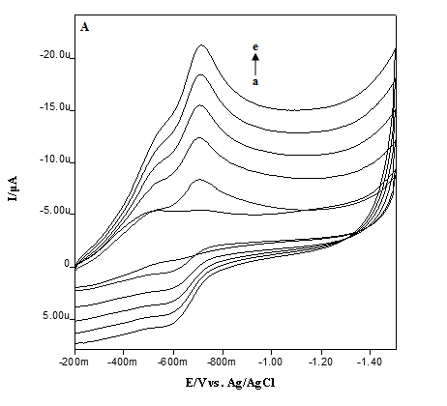
Effect of Scan Rate
A linear Randles-Sevcik plot is a straight line with good linear regression equation, indicating that diffusion is the means of mass transport. Linear regression equation can be expressed as follows.
ip/μA = 0.0212 (mV s⁻¹) + 2.8320; r² = 0.996
The finding was further confirmed by plotting log i_{p} vs. log υ where a straight line was observed which can be expressed by the following equation.
log ip (μA) = 0.5336 log ν + 0.0080 ; r²=0.9995
The obtained slope is close to 0.5, also confirms diffusion controlled nature of the electrode process.
Cyclic voltammetric behaviour of TNZ at PANI/GCE in BR buffer 9.5 at different scan rates (a-e): 25, 50, 75, 100 and 125 mVs⁻¹, (B) Inset: plot of log I vs. log ν

Slide 24
Optimization of Experimental Parameters
A
B
C
Optimization of experimental conditions for reduction of tinidazole at PANI/GCE (A) Effect of pH (B) Effect of solvents (C) Effect of varying PANI dosage

Slide 25
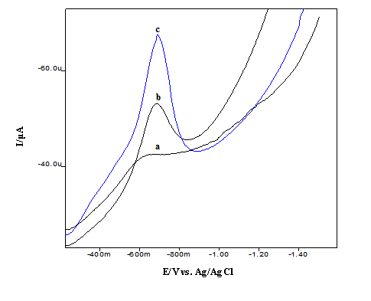
Electrochemical Performance of
PANI/GCE Sensor for Tinidazole Reduction
Square Wave Voltammetry
Electrocatalytic effect of fabricated sensor towards the tinidazole reduction. Square wave voltammograms, blank (curve a), at bare GCE (curve b), and at PANI/GCE (curve c)

Slide 26
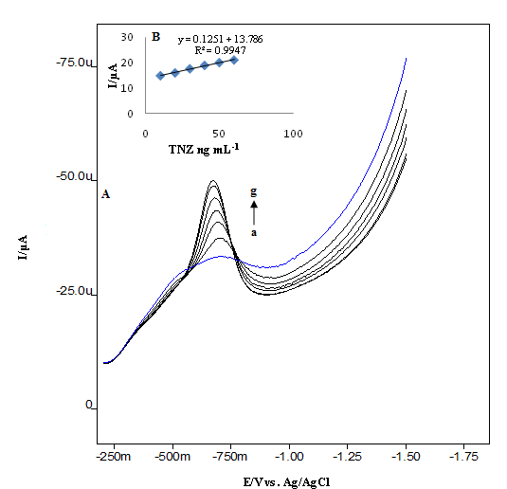
Validation of the Proposed Method
Linearity, Detection and Quantification Limit
A linear calibration curve is obtained for tinidazole and may be expressed by equation:
Ip/μA= 0.1251 (ng mL⁻¹) + 13.786, r² = 0.9947
The detection limit,
LOD (3s/m) = 4.71 ng mL⁻¹
The quantification limit,
LOQ (10s/m) = 14.26 ng mL⁻¹
Square wave voltammograms of TNZ at PANI/GCE sensor at different concentrations (a-g), (a) blank, (b) 10 ng mL⁻¹, (c) 20 ng mL⁻¹ (d) 30 ng mL⁻¹, (e) 40 ng mL⁻¹, (f) 50 ng mL⁻¹, (g) 60 ng mL⁻¹, (B) Inset: plot of peak current, I vs. TNZ concentration.

Slide 27
Reproducibility of Fabricated Sensor
Time | Inter-day repeatability Average current % CV (Ip/μA) |  | Intra-day repeatability Average current % CV (Ip/μA)
Day 1 | 26.7ª | 0.64 | 26.7ª | 0.64
Day 2 | 24.5ª | 0.88
Day 3 | 23.6ª | 0.89
Average | 24.9^{b} | 0.80^{b}
ª Average of six replicate readings
^{b} Average of three consecutive days readings
The repeatability of the modified electrode was investigated by replicate recordings of voltammograms at a fixed tinidazole concentration of 50 ng mL⁻¹. The intra-day precision of the method was evaluated by repeating six experiments in the same solution containing 50 ng mL⁻¹ of the analyte using the same PANI modified glassy carbon electrode. The R.S.D. was found to be 0.64% indicating excellent reproducibility of the modified electrode.
Further, inter-day precision was investigated by measuring the current response of the modified electrode for 6 consecutive days for the same concentration of tinidazole (50 ng mL⁻¹) taken separately and the relative standard deviation was found to be 0.80%. Thus, it demonstrated the good reproducibility of the method at the PANI modified glassy carbon electrode.

Slide 28

Applications to Commercial Formulation
Table : Recovery study of TNZ in pharmaceutical formulation
.
Added (ng mL⁻¹) | Found (ng mL⁻¹) | RSD (%) | Recovery (%)
10 | 9.40 | 1.78 | 94.00
20 | 19.61 | 1.48 | 98.05
30 | 29.40 | 0.95 | 98.00
The results show that the recoveries vary in the range from 94.00 to 98.00% and the relative standard deviation is ±0.40%.

Slide 29
Superiority of Developed Method
Reference method | Detection Limit | Reference
Spectrophotometric I | 0.47 μg/mL | 1
Spectrophotometric II | 0.36 μg/mL | 2
RP-HPLC I | 10-80 μg/mL | 3
RP-HPLC II | 5-125 μg/mL | 4
DPV I | 0.03 μg/mL | 5
DPV II | 0.24 μg cm⁻³ | 6
DPV III | 0.3 μg/mL | 7
SWNTs/GCE | .01 μg/mL | 8
Poly (carmine) film | .01 μg/mL | 9
Ion-Selective Membrane Sensors | 2.5 μg/mL | 10
AuNP/L-Cys/GCE | 63 ng/mL | 11
Polyanilne (PANI/GCE) | 4.71 ng/mL | Present work
Comparison of detection limit of the proposed method with the other reported methods.

Slide 30
Conclusion
An ultrasensitive electrochemical sensor based on polyaniline nanofibers was fabricated and characterized.
Fabricated sensor shows better electrochemical performance and excellent electrocatalytic activity with low detection limits.
The excellent electrocatalytic activity, high sensitivity, good reproducibility, and stability are the main advantages of developed procedures for routine analysis.
This fabricated sensor was successfully applied for the determination of tinidazole in commercially available tablet dosage form.

Slide 31
References
[1] Nagaraja, P.; Sunitha, K.R.; Vasantha, R.A.; Yathirajan, H.S. J Pharm Biomed Anal 2002, 28, 527.
[2] Abou-Taleb, N.H.; El-Sherbiny, D.T.; El-Wasseef, D.R.; Abu El-Enin, M.A.; El-Ashry, S.M. Int J Biomed Sci 2011, 7, 137.
[3] Pasha, K.; Ali, A.; Bana, S.; Humair, S. J Pharm Sci 2010, 2, 46.
[4] Darwish, K.M.; Salama, I.; Mostafa, S.; El-Sadek, M. J Chromatogr Sci 2013, 51, 566.
[5] Abu Zuhri, A.Z.; Al-Khalil, S.; Shubietah, R.M.; El-Hroub I. J Pharm Biomed Anal 1999, 21, 881.
[6] Salvi, V.S.; Sathe, P.A.; Rege, P.V. J Anal Bioanal Techniques 2010, 1, 1.
[7] Rege, P.V.; Sathe, P.A.; Salvi, V.S.; Int J Chem Tech Res Sci 2011, 3, 1213.
[8] Yang, C. Anal Sci 2004, 20, 821.
[9] Wang, C.; Wang, F.; Li, C.; Xu, X.; Li, T.; Wang, C.; J Pharm Biomed Anal 2006, 41, 1396.
[10] Riad, S.M.; Rezk, M.R.; Ahmed, K.; Salem, H. Anal Bioanal Electrochem 2014, 6, 688.
[11] Y. Wu, Y. Lin, F. Wei, M. Lu, L. Liu, J Nanosci Nanotech 2014, 14, 3976

Slide 32
Publications
Rajeev Jain, D.C. Tiwari, Priyanka Karolia, Highly sensitive and selective polyaniline–zinc oxide nanocomposite sensor for betahistine hydrochloride in solubilized system, J. Mol. Liq., 196 (2014) 308-313.
Rajeev Jain, D.C. Tiwari, Priyanka Karolia, Electrocatalytic detection and quantification of nitazoxanide based on graphene-polyaniline (Grp-Pani) nanocomposite sensor, J. Electrochem. Soc., 161 (2014) H839-H844.
Priyanka Karolia, Rajeev Jain, D.C. Tiwari, Electrocatalytic sensing of proton pump inhibitor omeprazole, Ionics (2015) 21 2355-2362.
Rajeev Jain, Ab Lateef Khan, Priyanka Karolia, Electrocatalytic Quantification of Pantaprazole, J. Electrochem. Soc., (Accepted).

Slide 33
Acknowledgement
Dr. Rajeev Jain : Professor, S.O.S. in Chemistry.
Dr. D.C. Tiwari: Professor & Head S.O.S. in Physics'.
Department of Science and Technology (DST) New Delhi: For Junior Research Fellowship.

Slide 34


