Slide 1


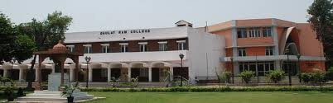
DAULAT RAM COLLEGE,
University of Delhi, India
SYNTHESIS OF ZEROVALENT IRON NANOPARTICLES (Fe NP) EMPLOYING GREEN METHODOLOGY USING NATURAL EXTRACTS
Dr. Priti Malhotra
Associate Professor, Department of Chemistry,
Daulat Ram College University of Delhi, Delhi-110007

Slide 2
Different nano-synthesis methods
Physical
•Ball milling
•Thermal evaporation
•Lithography
Chemical
•Sol-gel processing(films)
•Solution-based synthesis
Biological
•In bacteria
•In fungi
•Using plant extracts
In water
(At the air-water interface and in foams)
In non-polar organic solvents

Slide 3
Making the connection between nanomaterials and biologicals
Inorganic nanoparticles as scaffolds for immobilization of :
1) Amino acids (stabilization of nanoparticles; assembly of nano- particles; amino acid-stabilized nanoparticles as templates for mineral growth)
2) Proteins/enzymes (reusable biocatalysts)
3) Drugs (insulin etc.)
4) DNA/RNA (structural interconnects; nanoparticle assembly; application in biodiagnostics); imaging
Biological methods for the synthesis of inorganic nanoparticles

Slide 4
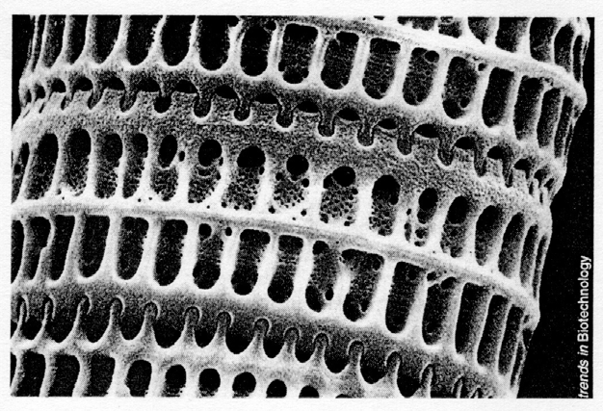
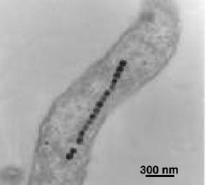
Exquisite nanoscale/mesoscalestructures in nature
Diatoms (marine organisms, amorphous silica)
Magnetotacticbacteria (magnetite nanoparticles)
Biomimetic approach to advanced materials, particularly nanomaterials

Slide 5
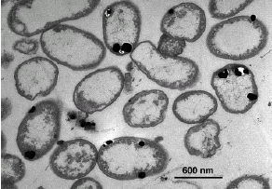
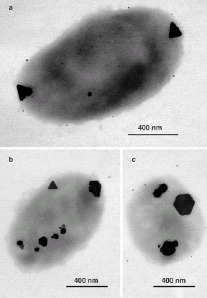
Biosynthesis of nano-silver using bacteria
Pseudomonas stutzeri extracted from
silver mines
If bacteria can synthesize metal nanoparticles, plant extracts can do so

Slide 6
Applications of Fe NPs
Fe NP prepared from plant extracts can further be utilized as Fenton-like catalysis for decolorization of aqueous solutions containing dyes e.g. methylene blue and methyl orange.
Fe nanoparticles used in the remediation of waste ground water e.g. for removal of Ni(II), Cd(II), Pb(II) etc.
In the treatment of industrial wastes containing metal complexed cyanides.
Catalytic elimination of various environmental pollutants using bimetallic Fe NPs. Their strong reducing ability can be used to remove numerous pollutants (e.g. heavy metals, halogenated organic compounds, nitro and azo compounds and oxyanions.

Slide 7
Applications of Fe NPs contd….
Unique surface properties can emerge when iron particles reach nanodimensions (<100nm)
Iron nanoparticles (Fe NP) have the capability to not only degrade organic materials but aslo adsorb inorganic contaminants
Fe NP have potential to become one of the most effective technologies for soil and groundwater remediation owing to its strong reducing power and reactivity.

Slide 8
Applications of Fe NPs contd….
Wastewater from electroplating and some metallurgical factories can be an important source of Cd pollution (at typical conc. of 40 mg/L). Fe NP have proved to be efficient material for Cd immobilization.
Zerovalent Fe NP can efficiently act as reductant i.e. can readily donate electron to inorganic species and can make surface mediated complexes which can lead to the immobilization of inorganic contaminants.
Due to small size of zerovalent Fe NP and its tendency to remain in a suspended state, Fe Np can be easily used for remediation of trace metals as well as metalloid like As(III), (V) and Sb(III) contaminants in ground water.

Slide 9
Fe NP
Owing to the high intrinsic reactivity on their surface sites, Iron nanoparticles (Fe NP) have received ample attention by researchers and have been successfully employed for:
remediation of heavy metals from soil
efficient and selective reduction of H₂O₂ in the presence of oxygen.
However, the classical synthesis of Fe NP is based on using sodium borohydride as the reducing agent which incurred
high cost
toxic to the environment
Therefore, there is an urgent need of green synthesis of Fe NP from biorenewable natural sources

Slide 10
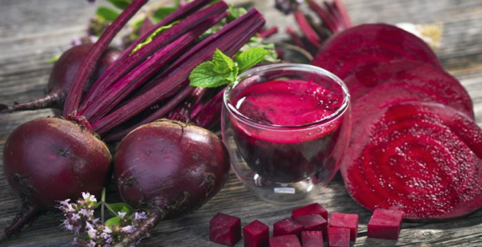
Plant Extracts
Beta vulgaris (beet): plant in the Amaranthaceae family
It has numerous cultivated varieties, the most well known of which is the root vegetable known as the beetroot or garden beet.
Excellent source of folate and a good source of manganese, and contains betaines which may function to reduce the concentration of homocysteine, a homolog of the naturally occurring amino acid cysteine.
therapeutic use of beetroot includes its antitumor, hemostatic and renal protective properties
potential herb used in cardiovascular conditions. Beetroot is known to be a powerful antioxidant.
Because of the sugar-rich content, it has great reductive capability, which can be utilized in the synthesis of nanomaterials

Slide 11
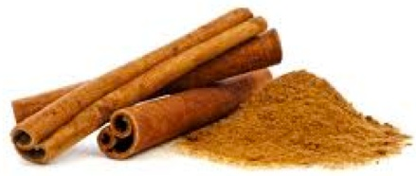
Plant Extracts
Cinnamon (Cinnamomum zeylanicum, and Cinnamon cassia)
the eternal tree of tropical medicine, belongs to the Lauraceae family.
primarily contains vital oils and other derivatives, such as cinnamaldehyde, cinnamic acid, and cinnamate.
a good antioxidant, anti-inflammatory, antidiabetic, antimicrobial, anticancer, lipid-lowering, and cardiovascular-disease-lowering compound,
possess activities against neurological disorders, such as Parkinson's and Alzheimer's diseases.
The phytoconstituents embedded within cinnamon contain functional groups such as aldehyde and hydroxyl units within the molecular framework, in combination with carbohydrates (starch and polysaccharides). These functional groups provide synergistic chemical reduction power for the production and stabilization of nanoparticles in a singular green process

Slide 12
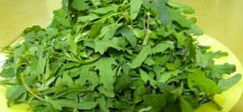
Plant Extracts
Chenopodium album (B athua)
widely distributed in Asia, North America and Europe.
Is a woody annual competitor troublesome weeds for many crops viz. wheat and capable of producing crop losses.
A wide variety of chemical constituent’s viz. aldehyde, alkaloids, apocarotenoids, flavonoids, and various bioactivities, including antifungal and antioxidant properties have been reported in phytochemical studies from this plant.
Chemical constituents found in Chenopodium album leaf extract may act as biological reductant.
The plant leaf has high level of oxalic acid, its oxalate, the di-anion which can be acts as reducing agent as well as a ligand.
Because of the sugar-rich content, it has great reductive capability, which can be utilized in the synthesis of nanomaterials.

Slide 13
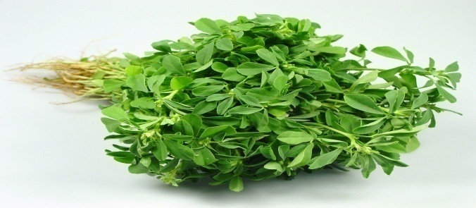
Plant Extracts
Trigonella foenum–graecum L. (fenugreek)
an important medicinal plant and its leaves and seeds have been used in various illnesses and as a health tonic since very long time.
known to have hypoglycemic, hypocholesterolaemic, antioxidant potency, digestive stimulant action, and hepatoprotective effect.
Fenugreek leaf extract contains oxalic acid and ascorbic acid which are strong reducing agents.
the extract contains steroidal saponins, e.g., furostnol glycosides and spirostanol glycosides, phytosterols, alkaloids, e.g. choline, and amino acids like isolucine, tryptophane, methionine etc

Slide 14
Preparation of Plant Extracts
About 20 g of fresh beetroot/ Bathua leaves/ Fenugreek leaves/ Cinnamon powder was collected.
Leaves and beetroot was washed thoroughly with MilliQ water.
They were blended into fine pieces and boiled with 200 mL MilliQ water in Erlenmeyer flask at 80 °C for 20-30 min. The extract was cooled at room temperature and filtered using Whatman.

Slide 15
Synthesis of Iron Nanoparticles
During the synthesis of Iron nanoparticles both the precursor and the reducing agent were mixed in a clean sterilized flask in 1:1 proportion.
For the reduction of Fe ions, 5ml of extract was mixed to 5 ml of 0.001 M aqueous of FeCl3 solution with constant stirring at room temperature. After the addition of leaf extract to the salt solution, color change was observed.
In another set the extract and FeCl₃ solution were mixed at 50-60 °C, with immediate change of color.
The reaction mixture was centrifuged at 10,000 rpm for 15 min. The supernatant was kept separately and the pellets were repeatedly washed with MilliQ water and dried.

Slide 16
Table 1. Indication of change in pH during green synthesis of Iron nanoparticles
S.No. | Nanoparticle Solution | pH change before reduction | pH change after reduction
1. | Beta vulgaris (Beetroot) | 5.02 | 3.45
2. | Cinnamomum zeylanicum (Cinnamon) | 6.18 | 2.24
3. | Chenopodium album (Bathua) | 7.59 | 2.18
4. | Trigonella foenum–graecum L. (Fenugreek) | 6.87 | 1.85

Slide 17
Table 2. Indication of color change in green synthesis of Iron nanoparticles
S.No. | Nanoparticle Solution | Colour change before reduction | Colour change after reduction | Time (minutes)ª
1. | Beta vulgaris (Beetroot) | Dark Red | Dark Brown | 30
2. | Cinnamomum zeylanicum (Cinnamon) | Yellow | Light Brown | 30
3. | Chenopodium album (Bathua) | Dark Green | Light Yellow | 60
4. | Trigonella foenum–graecum L. (Fenugreek) | Light Green | Orange | 90
ª Immediate change of color was observed when the extract and FeCl3 solution were mixed at 50-60 °C with constant stirring

Slide 18
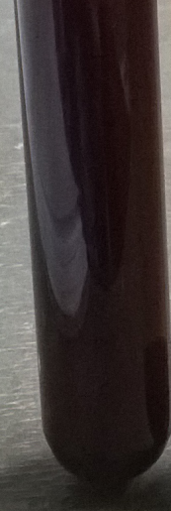
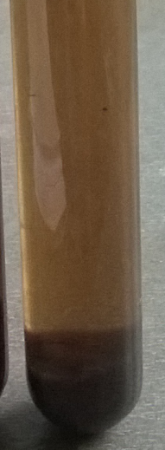
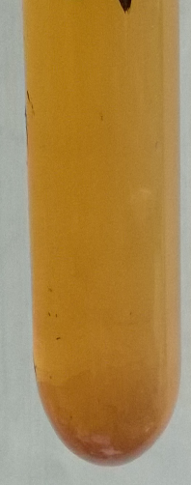

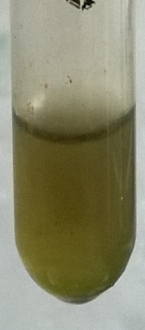
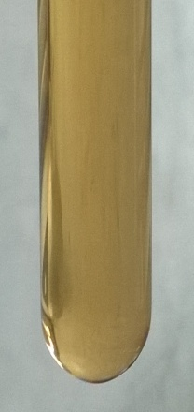
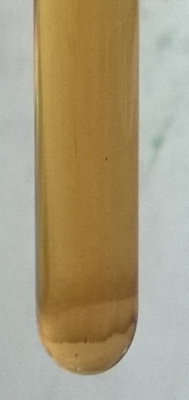
Figure 1. Color change during green synthesis of Iron nanoparticles
Color change from Beta Vulgaris (Beetroot)
Color change from Cinnamomum zeylanicum (Cinnamon)
Color change from Chenopodium album (Bathua)
Color change from Trigonella foenum–graecum L. (Fenugreek)

Slide 19
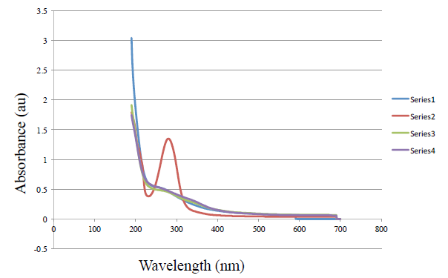
UV-Vis Spectroscopy
Figure 2. UV-vis adsorption spectra of iron nanoparticles after bioreduction kinetics of the reaction of aqueous iron ions with a) Series 1: Beta Vulgaris (Beetroot) extract; b) Series 2: Cinnamomum zeylanicum (Cinnamon) extract; c) Series 3: Chenopodium album (Bathua) extract; d) Series 4: Trigonella foenum–graecum L. (Fenugreek) extract

Slide 20
Separation procedures
pH Analysis
The pH was determined by using Digital pH meter Systronics. The pH of the reduced solution with Nanoparticle synthesized was found to be acidic. After reduction the pH of every sample was found to decrease and move towards the acidic range.
FTIR Analysis
The FTIR spectrum of iron nanoparticles showed major absorption bands. The peaks 3369 and 1096 cm⁻¹ represented the characteristic band of O-H group and sulphate groups respectively. The band 617 cm⁻¹ represented the Fe-O stretching.
UV-Vis Spectral Analysis
The bioreduction of Fe⁺³ in aqueous solutions was monitored by periodic sampling of aliquots of the mixture and subsequently measuring UV–Vis spectra. UV-Vis spectral analysis was done by using UV-Vis spectrophotometer Systronics 118 at the range of 200-700 nm and the absorption peaks at 216-265 nm regions due to the excitation of surface plasmon vibrations in the iron nanoparticles were observed, which are identical to the characteristics UV visible spectrum of metallic iron. FAAS.

Slide 21
Concluding Remarks
The extracts of plants and spice selected for this study were found to be capable of producing Iron nanoparticle.
Under the UV-Visible wavelength, Nanoparticles showed quiet good surface plasmon resonance behavior.
The color change was also remarkable when Ferric chloride was mixed with reducing agent i.e plants and spice extract.
As and when reduction occurred the color changed with concerned change in pH of solution.
Success of such a rapid time scale for synthesis of metallic nanoparticles is an alternative to chemical synthesis protocols and low cost reductant for synthesizing iron nanoparticles.
For more confirmation we plan to conduct further studies using higher characterization techniques such as XRD, SEM, TEM, FTRI, etc.

Slide 22
Concluding Remarks
The extracts of plants and spice selected for this study were found to be capable of producing Iron nanoparticle.
Under the UV-Visible wavelength, Nanoparticles showed quiet good surface plasmon resonance behavior.
The color change was also remarkable when Ferric chloride was mixed with reducing agent i.e plants and spice extract.
As and when reduction occurred the color changed with concerned change in pH of solution.
Success of such a rapid time scale for synthesis of metallic nanoparticles is an alternative to chemical synthesis protocols and low cost reductant for synthesizing iron nanoparticles.
For more confirmation we plan to conduct further studies using higher characterization techniques such as XRD, SEM, TEM, FTRI, etc.

Slide 23
References
B. Z. Zhan, M. A. White, T. K. Sham, J. A. Pincock, R. J. Doucet, K. V. R. Rao, K. N. Robertson, and T. S. Cameron, 2003. J. Am. Chem. Soc. 125, 2195.
A. L. Linsebigler,G. Lu, and J. T.Yates, 1995. Chem. Rev. 95, 735.
H. Zhang, R. L. Penn, R. J. Hamers, and J. F. Banfield, 1999. J. Phys. Chem. B 103, 4656.
R. F. Service, 1998. Science 281, 940.
N. L. Rosi, D. A. Giljohann, C. S. Thaxton, A. K. R. Lytton-Jean, M. S. Han, and C. A. Mirkin, 2006. Science 312, 1027.

Slide 24
THANK YOU

