Slide 1


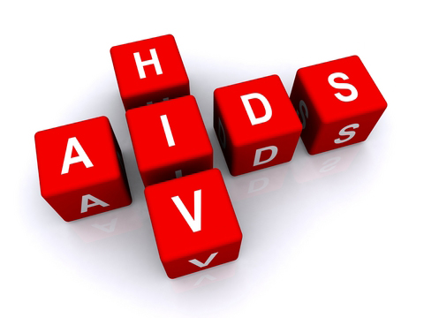

Mathematical models on the dogmas of HIV contagions
Dr. Priti Kumar Roy
Centre for Mathematical Biology and Ecology
Department of Mathematics
Jadavpur University
Kolkata, India.
E-mail: pritiju@gmail.com

Slide 2
Contents of My Talk
Basics of HIV
HIV transmission
Mathematical Models in HIV
Therapeutic use of IL-2
Awareness Campaign in HIV

Slide 3

What is AIDS?
HIV is the virus that causes AIDS
Not everyone who is infected with HIV has AIDS
Everyone with AIDS is infected with HIV
AIDS is result of the progression of HIV Infection
Anyone infected with HIV, although healthy, can still transmit the virus to another person
Acquired: To come into possession of something new
Immune Deficiency: Decrease or weakness in the body’s ability to fight off infections and illnesses
Syndrome: A group of signs and symptoms that occur together and characterize a particular abnormality
AIDS is the final stage of the disease caused by infection with a type of virus called HIV.
Notes:
HIV infection leads to a weakened immune system. This makes a person with HIV vulnerable to a group of illness, e.g., opportunistic infections, that would not as easily affect a healthy person
AIDS results when HIV infection progresses to an advanced stage, damaging the immune system to a point at which the body can no longer fight illness.
AIDS is a syndrome because it is characterized by a group of illnesses
Drugs are available which can treat HIV and AIDS.
These drugs are called antiretrovirals (ARVs). They prevent the virus from replicating and slow the progress of the disease, but there is still no cure for AIDS or vaccine to prevent HIV transmission.

Slide 4
Historical background of HIV/AIDS
In 1981 AIDS was first recognized in young previously healthy homosexual men in New York City, Los Angeles and San Francisco.
In 1983 a cytopathic retrovirus was isolated from persons with AIDS and associated condition such as chronic lymphadenopathy.
In 1985 serological tests had been developed and licensed to make aware of verification of infectivity with HIV.
In 1987 alteration incorporated HIV encephalopathy, wasting syndrome, and other AIDS indicator diseases were diagnosed presumptively.
The first AIDS case in India was detected in 1986 and since then HIV infection has been reported in all states and union territories.

Slide 5
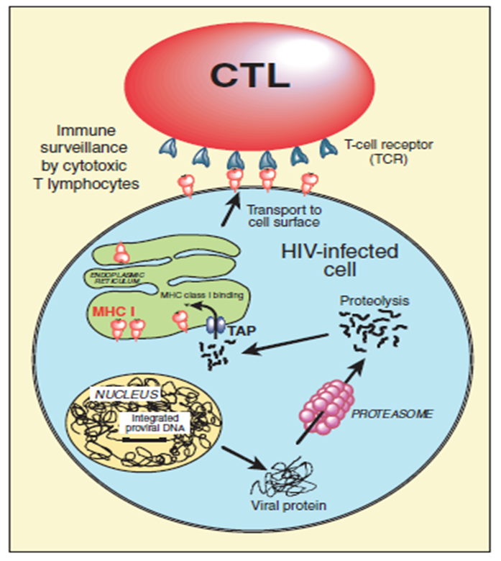
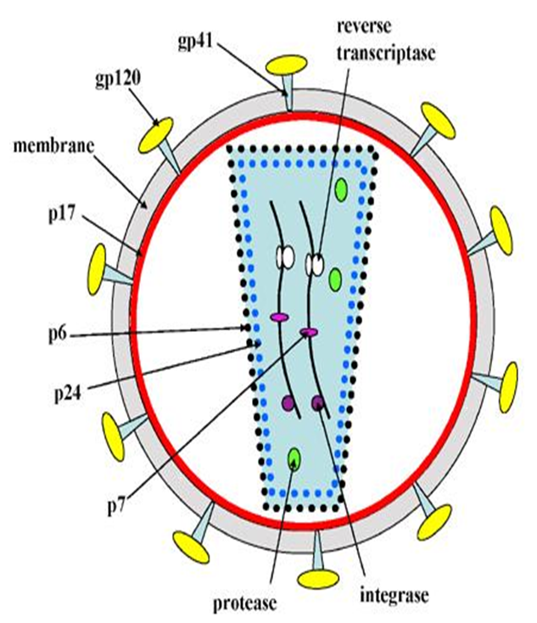
Structure & Manifestation of HIV Virion
Notes:
This is the structure of the HIV virus. It looks like a spherical particle of 80 to 100 mm in diameter. Like all viruses, it is made up of 2 main elements: the external envelope, and the internal core.
HIV is a retrovirus
Viruses in general are made up of a core with RNA or DNA and sometimes an external envelope

Slide 6
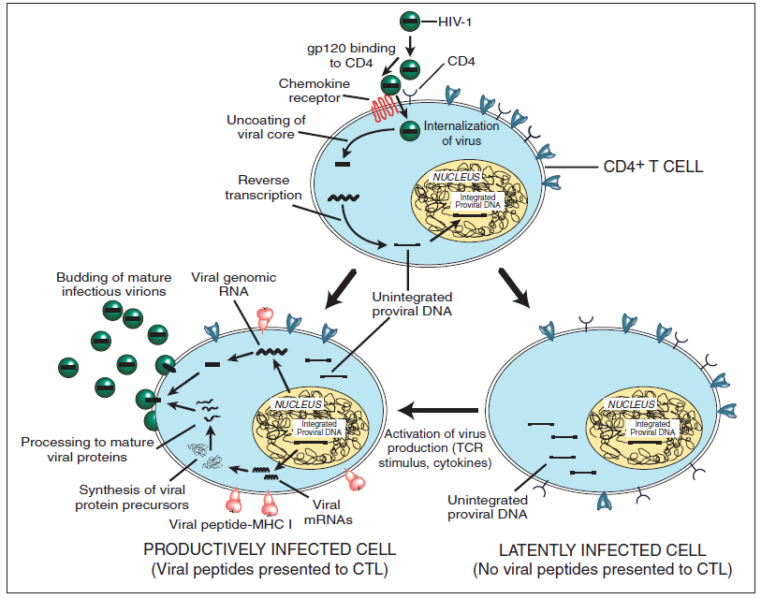
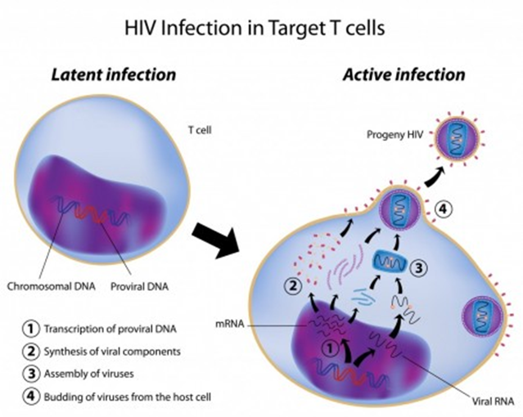

Slide 7
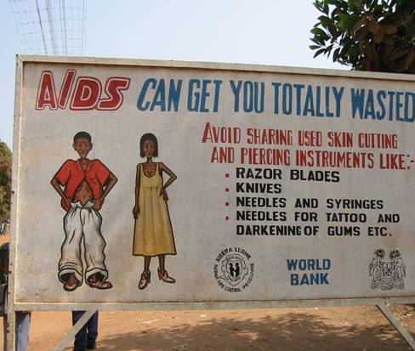
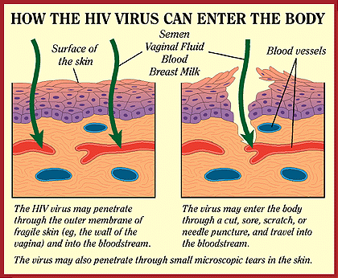
How is HIV Transmitted?
Unprotected sexual contact with an infected partner
Exposure of broken skin or wound to infected blood or body fluids
Transfusion with HIV-infected blood
Injection with contaminated objects
Mother to child during pregnancy, birth or breastfeeding

Slide 8


HIV: A Global Pandemic
Eastern Europe
& Central Asia
1.2 – 1.8 million
Western Europe
520 000 – 680 000
North America
790 000 – 1.2 million
East Asia & Pacific
700 000 – 1.3 million
North Africa & Middle East
470 000 – 730 000
South
& South-East Asia
4.6 – 8.2 million
Caribbean
350 000 – 590 000
Sub-Saharan Africa
25.0 – 28.2 million
Latin America
1.3 – 1.9 million
Australia
& New Zealand
12 000 – 18 000
Adults and children estimated to be living with HIV/AIDS (2003): 34 – 46 million total
Notes:
This slide produced by UNAIDS is familiar to many of you and provides estimates for the numbers of persons living with HIV in different continents. A total of between 34 and 46 million persons live with HIV; most of these in Africa.
HIV infection is a worldwide epidemic – a pandemic – affecting people everywhere.

Slide 9
Clinical Latency Period
HIV continues to reproduce, CD4 count gradually declines from its normal value of 500-1200.
Once CD4 count drops below 500, HIV infected person at risk for opportunistic infections.
CD4 count drops below 200 person is considered to have advanced HIV disease
If preventative medications not started the HIV infected person is now at risk for infesting secondary infections and achieving death -Most deaths occur with CD4 counts below 50.
The median incubation period from HIV infection until development of AIDS is estimated at approximately 10 years for young adults.
Without treatment, people with AIDS typically survive about 3 years.

Slide 10
Modeling the HIV System
Our Approach

Slide 11
Published papers in this field
1.. Roy Priti Kumar; Chattopadhyay B: Mathematical Modelling on the dynamics of CD4+T cell infection by HIV that includes a time delay, International Journal of Evolution Equation, Vol.4, No.2, pp. 227-239, 2009.
2. Roy Priti Kumar, Bairagi N, Chattopadhyay J and Chattopadhyay B: HIV model with intracellular delay -a mathematical study, published in 5th Annual IEEE Conference proceedings on Automation Science and Engineering Bangalore, pp 373-378, 2009
3. Roy Priti Kumar, Chatterjee A N, Chattopadhyay B: “ HIV Infection in T-Lymphocytes and Drug Induced CTL Response of a Time Delayed Model”, Lecture Notes in Engineering and Computer Science, WCE, UK, Vol. 1, pp. 533-538, 2010.
4. Roy Priti Kumar, Chatterjee A N: “T-cell Proliferation in a Mathematical Model of CTL Activity Through HIV-1 Infection”, Lecture Notes in Engineering and Computer Science, WCE, UK, Vol. 1, pp. 615-620, 2010.
5. Roy Priti Kumar, Chatterjee A N: “Delay effect in a Mathematical model of HIV infected T-cell against killing by CTL”, Bull. Cal. Math. Soc.,Vol. 102(6), pp. 513-524, 2010.
6. Roy Priti Kumar, Chatterjee A N: “Effect of HAART on CTL Mediated Immune Cells: An Optimal Control Theoretic Approach”, Electrical Engineering and Applied Computing, Springer, Vol. 90, pp.595-607, 2011.
7. Roy Priti Kumar, Chatterjee A N: “Reduction of HIV Infection that Includes a Delay of HIV with Cure Rate During Long Term Treatment: A Mathematical Study”, Electrical Engineering and Applied Computing”, Springer, Vol. 90, pp. 699-713, 2011.

Slide 12
8. Roy Priti Kumar, Sil N, Bhattacharya S: “On the Estimation of Expected Time to Extinction in a Dynamical Model of HIV”, International Journal on Mathematical Sciences and Applications, Volume 2, No. 1, pp. 213- 221, 2012.
9. Chatterjee A N, Roy Priti Kumar: “Anti-viral drug treatment along with immune activator IL-2: A control based mathematical approach for HIV infection”, International Journal of Control, Volume 85, No. 2, pp. 220- 237, 2012.
10. Roy Priti Kumar, Chowdhury S, Chatterjee A N, Biswas Majee S: “Mathematical Modeling of IL-2 Based Immune Therapy on T Cell Homeostasis in HIV”, Insight and Control of Infectious Disease in Global Scenario, InTech Publisher, Chapter 5, pp.79-96, 2012.
11. Chowdhury S, Roy Priti Kumar, “CTL Response Suppression in Chronic Phase of Infection: A Mathematical Study”, Acta Analysis Functionalis Applicata, Vol.14, No.1, pp. 46- 54, 2012.
12. Roy Priti Kumar, Chatterjee_A N, Biswas Majee S: “Effect of Chemokine Analog through Perfect Adherence in HIV Treatment: A Model Based Study”, International Journal of Applied Mathematics and Applications, Vol. 4, No. 2, pp. 121-145, 2012.
13. Roy Priti Kumar, Nandi S, Sil N, Bhattacharya S: “Insight of T Cell Proliferation in the Estimation of Expected Time to Extinction of the Disease HIV/AIDS”, International Journal of Applied Mathematics, Volume 25, No. 6, pp.779-792, 2012.
14. Mondal J, Roy Priti Kumar, Biswas Majee S, Bhattacharya R.: “MATHEMATICAL MODELING OF IMPACT FOR ANTIGENIC STIMULATION ON T-CELL HOMEOSTASIS DURING PRIMARY HIV INFECTION”, Bulletin of Calcutta Mathematical Society, Volume 104, No. 5, pp. 393- 408, 2012.

Slide 13
15. Roy Priti Kumar, Chowdhury S: “Mathematical Modeling of Enfuvirtide - IL-2 Administration in Impulsive Mode for HIV-1 Treatment, American Journal of Mathematics and Sciences, Vol.2, No.1, pp. 93- 103, 2013.
16. Roy Priti Kumar, Chatterjee A. N., Greenhalgh D., Khan Q. J. A., “Long term dynamics in a mathematical model of HIV-1 infection with delay in different variants of the basic drug therapy model”, Nonlinear Analysis: Real World Applications, Vol.14, Issue 3, pp. 1621-1633, 2013.
17. Roy Priti Kumar, Chatterjee A. N., Biswas Majee S, “Immune Cell Response to Negative Feedback Effect on HIV”, Biomedical Engineering Research, Vol.2, Issue 1, pp. 37-47, 2013.
18. Roy Priti Kumar, Chowdhury S, Xue-Zhi Li: “Saturation Effects for CTL Mediated Control of HIV-1 Infection: A Mathematical Study”, International Journal of Biomathematics, Vol. 6, No. 3, pp 1350013-1-19, 2013.
Roy Priti Kumar, Chowdhury S, Chatterjee A, Chattopadhyay J, Rachel Norman: “A Mathematical Model on CTL Mediated Control of HIV Infection in a Long Term Drug Therapy”, Journal of Biological Systems, Vol. 21, No. 3 (2013) 1350019 (25 pages), 2013.
Chatterjee A N, Roy Priti Kumar, Biswas Majee S: Negative Feedback Effect in HIV Progression: An Optimal Control Therapeutic Approach. Journal of Algorithms and Optimization (Accepted), 2013.
Chatterjee A N, Roy Priti Kumar: The Effect of Perfect Drug Adherence to Dendritic Cell and Immune Cell Interaction in HIV-1 Disease Progression. International Journal of Biomathematics. Vol. 9, No. 1 (2016) 1650005 (20 pages)

Slide 14
Anti-viral drug treatment along with immune activator IL-2: a control based mathematical approach for HIV infection
The effect of combination of drug therapy (Reverse Transcriptase Inhibitors (RTI) and Interleukin -2 (IL-2).
How the drugs act to reduce the cellular infection and simultaneously to activate the immune system?
The effect of latently infected CD4+T cell population and the effect of IL-2 therapy.
The control effectiveness of RTI and IL-2 in different approaches.
The effectiveness of the drugs to make an impact on the immune system.
The effect of perfect adherence to antiretroviral therapy as studied in respect of our basic mathematical model.

Slide 15
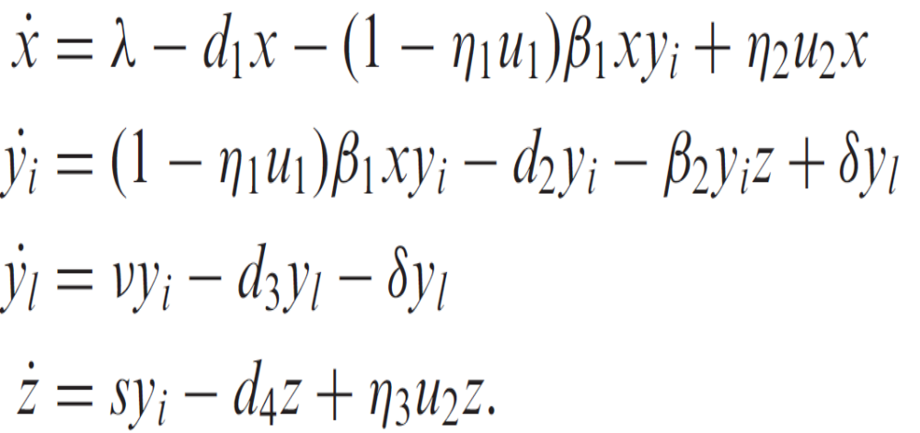


Formulation of the basic model as implicit form
The work has been published in “International Journal of Control, Vol. 85, No. 2, February 2012, 220-237”

Slide 16
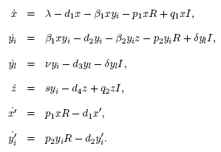


Drug therapy with perfect adherence in explicit form
Here R(t) and I(t) denotes the drug concentration in the plasma of RTIs and IL-2 respectively. The dynamics of the drugs are given by:

Slide 17
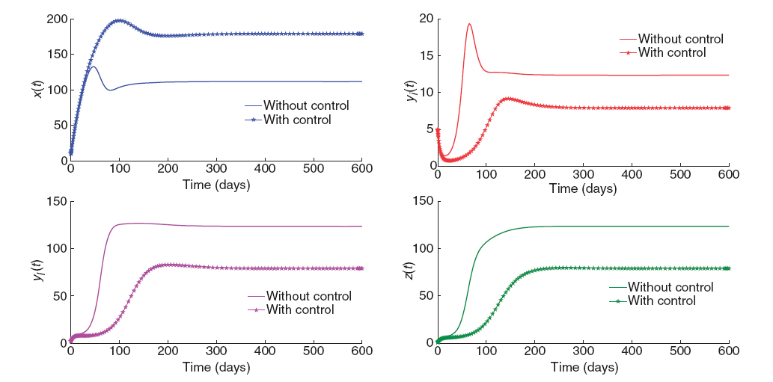
Numerical Simulation of both explicit and implicit model

Slide 18
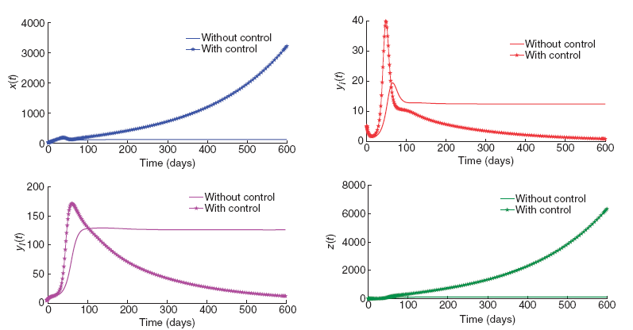
Numerical Simulation of both explicit and implicit model

Slide 19
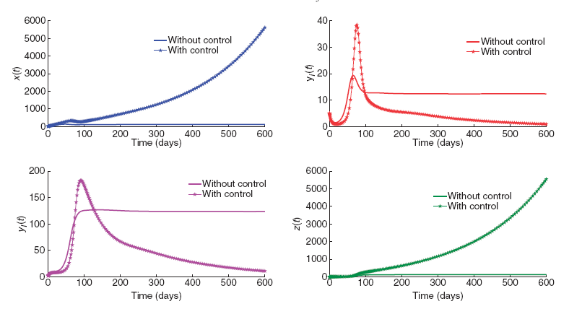

Slide 20
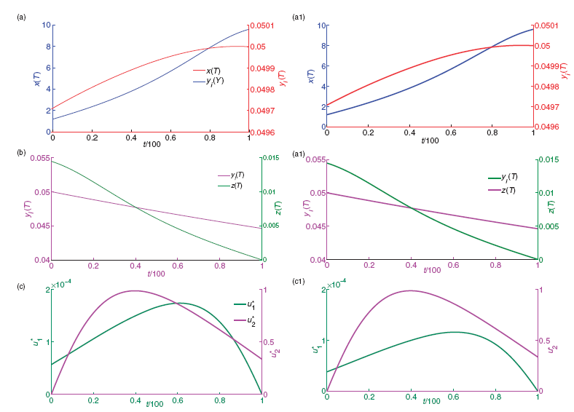

Slide 21
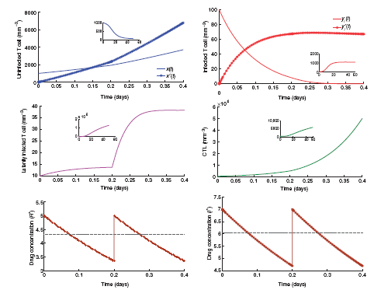
Figure 6.6: The impulsive system behaviour for the perfect adherence with Rd = 5, Id = 7 and
τ =σ= 0.2. Inset: Trajectories for the system in absence of therapy.

Slide 22
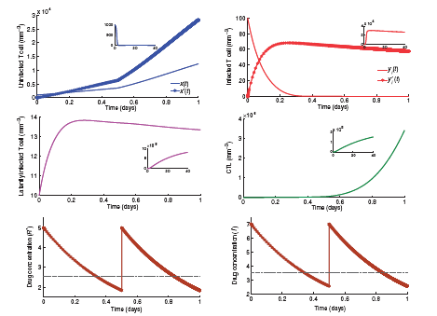
Figure 6.7: The impulsive system behaviour for the perfect adherence with Rd = 5, Id = 7 and τ =σ= 0.5. Inset: Trajectories for the system in absence of therapy.

Slide 23
Discussions
During the disease progression the antigenic response of the body is totally collapsed. Thus, only RTIs can not totally control the disease.
Far better results will appear using immune activator IL-2, compared to only using of RTIs, because IL-2 stimulate the immune system to act properly.
Fixed dosing interval (dosage interval for IL-2) if RTIs are taken with sufficient frequency. The infected CD4T cell population approaches towards extinction.
If the drug dosage are taken with perfect adherence on considering the derived condition of drug doses interval and drug dosage, then cellular infection can be controlled and immune system acts properly.

Slide 24




Effect of awareness programs in
controlling the disease HIV/AIDS: an optimal
control theoretic approach
Human awareness results in the reduction of susceptibility to infection, naturally, in the epidemiological study this factor should be included
Research reveals that most HIV infections come from undiagnosed people and untreated people, but principally from unaware people.
Broadcast media have tremendous reach and influence, particularly with young people, so in this study, we incorporate the influence of media and investigate the effect of awareness program in disease outbreaks.
In this present study, we have analyzed a simple SI network epidemic model to study the impact of awareness programs conducted through media campaigning on the spread of HIV/AIDS in a variable population with immigration. However, these results will fall into the non-network epidemic models category

Slide 25
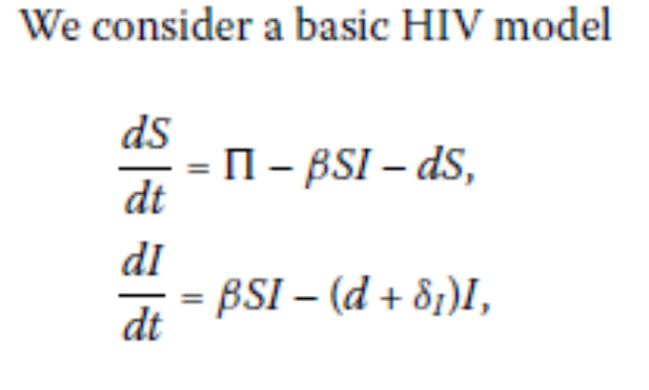
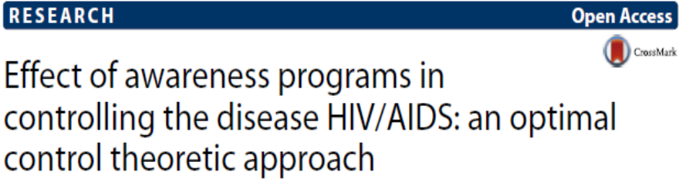


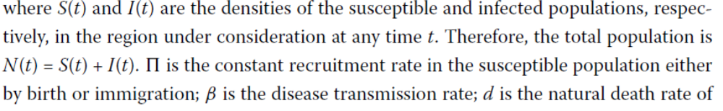
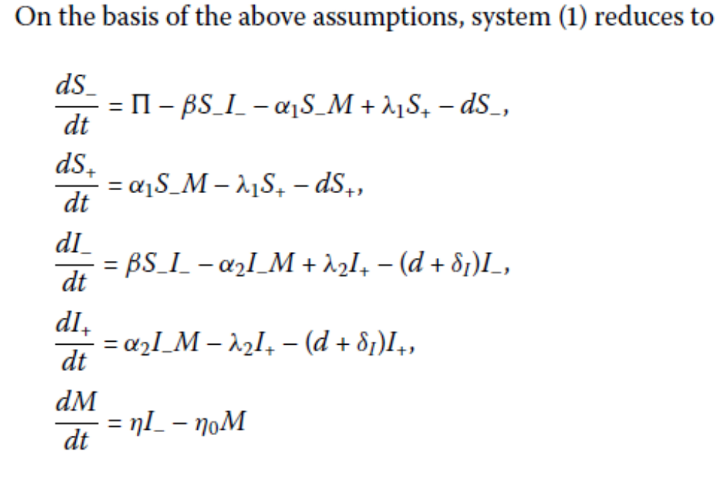
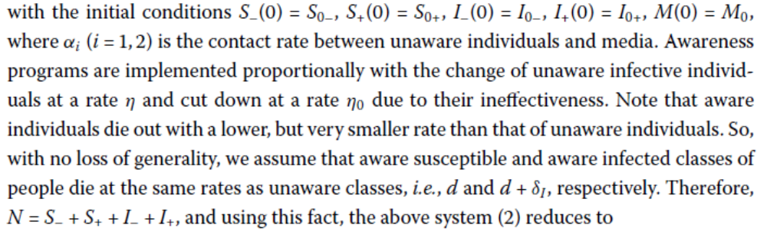

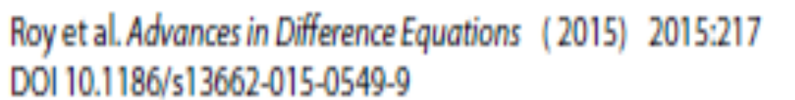

Slide 26
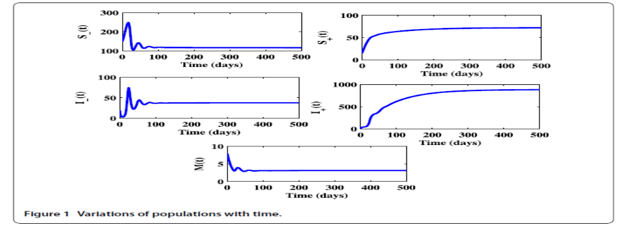
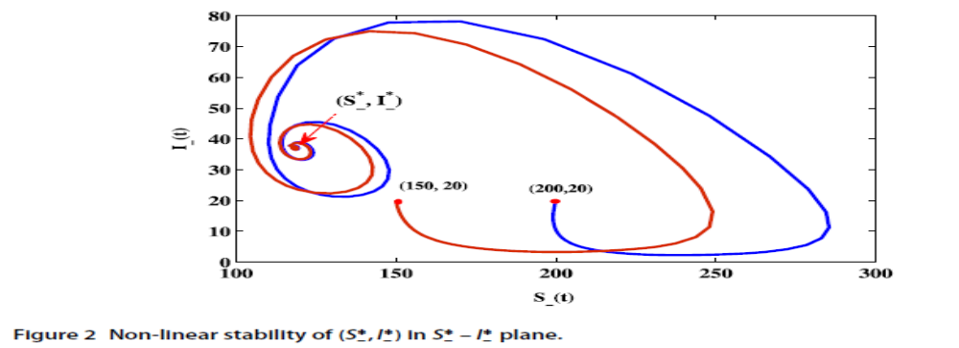

Slide 27
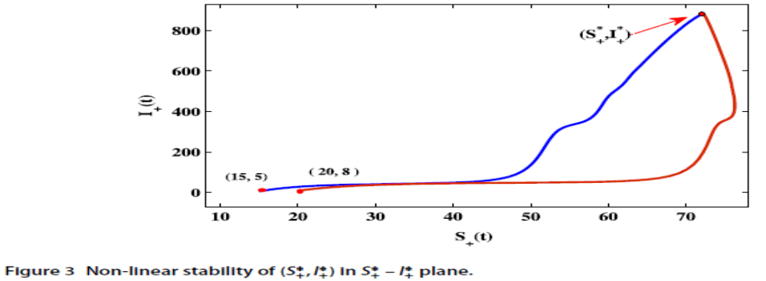
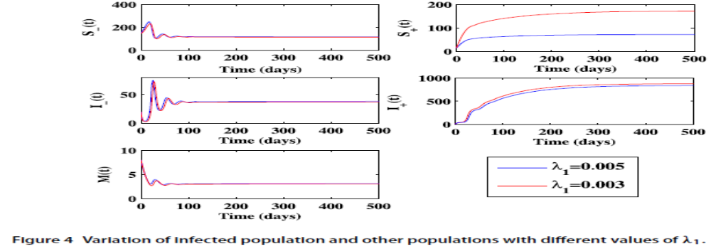

Slide 28
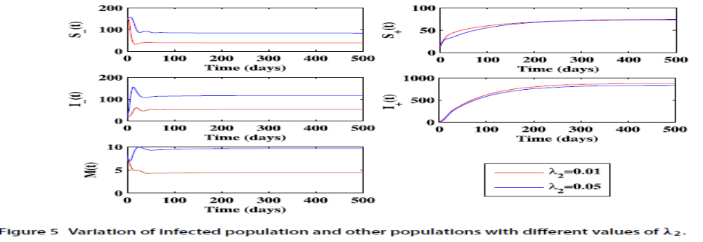
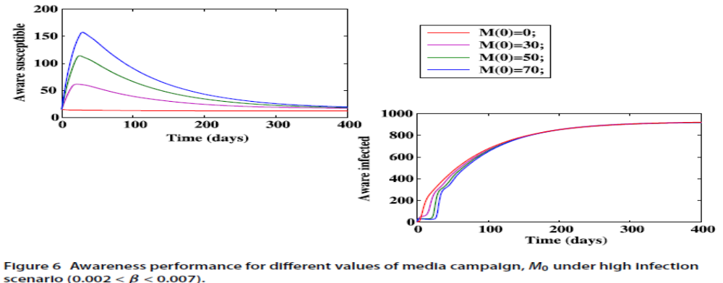

Slide 29
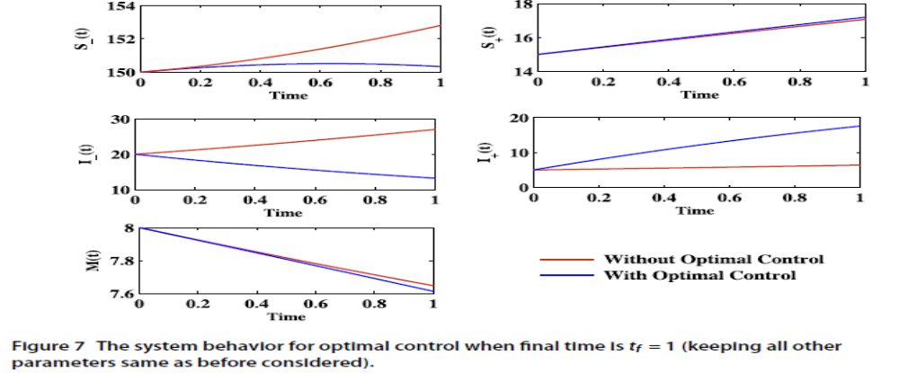
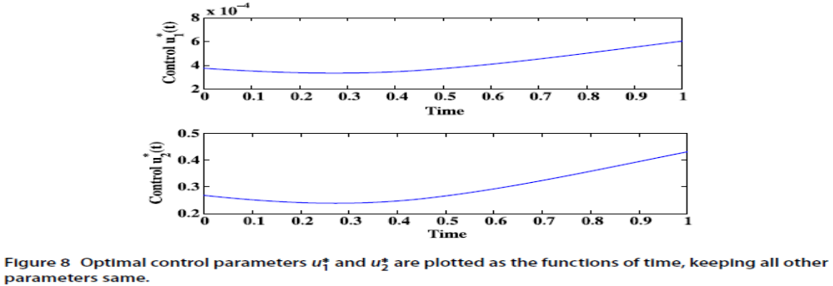

Slide 30



Discussions
In the modeling process, it is assumed that media campaigns create awareness regarding personal protection as well as control AIDS.
Individuals of this class not only protect themselves from the infection, but being aware they also take part in reducing AIDS by taking precautions.
Awareness programs reduce the infection rate, shorten the rate of disease transmission and cut down the size of the disease.

Slide 31
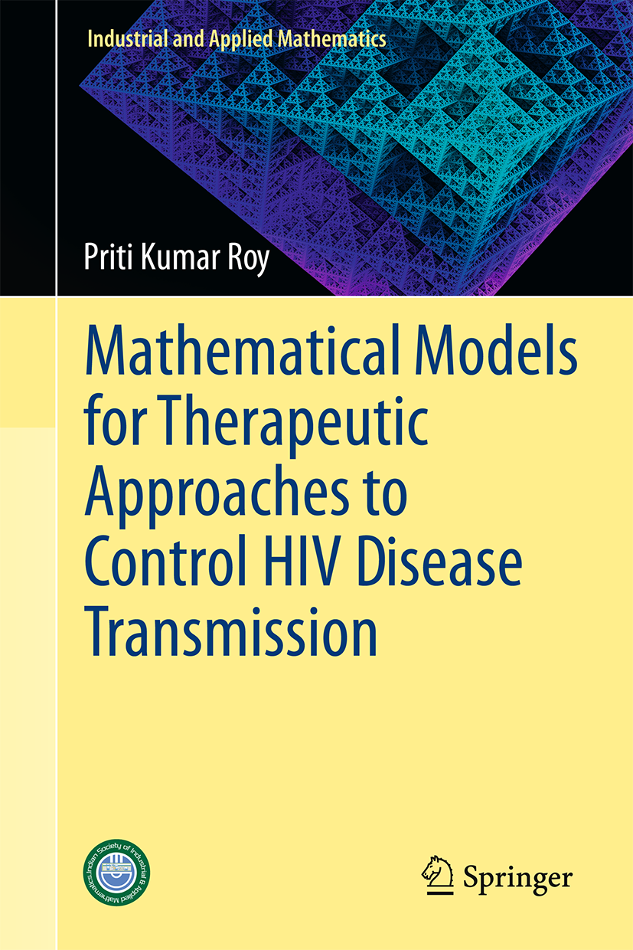
The book discusses different therapeutic approaches based on different mathematical models to control the HIV/AIDS disease transmission. It uses clinical data, collected from different cited sources, to formulate the deterministic as well as stochastic mathematical models of HIV/AIDS. It provides complementary approaches, from deterministic and stochastic points of view, to optimal control strategy with perfect drug adherence and also tries to seek viewpoints of the same issue from different angles with various mathematical models to computer simulations. The book presents essential methods and techniques for students who are interested in designing epidemiological models on HIV/AIDS. It also guides research scientists, working in the periphery of mathematical modeling, and helps them to explore a hypothetical method by examining its consequences in the form of a mathematical modeling and making some scientific predictions.
The model equations, mathematical analysis and several numerical simulations that are presented in the book would serve to reveal the consequences of the logical structure of the disease transmission, quantitatively as well as qualitatively. One of the chapters introduces the optimal control approach towards the mathematical models, describing the optimal drug dosage process that is discussed with the basic deterministic models dealing with stability analysis. Another one chapter deals with the mathematical analysis for the perfect drug adherence for different drug dynamics during the treatment management. The last chapter of the book consists the stochastic approach to the disease dynamics on HIV/AIDS. This method helps to move the disease HIV/AIDS to extinction as the time to increase. This book will appeal to undergraduate and postgraduate students, as well as researchers, who are studying and working in the field of bio-mathematical modeling on infectious diseases, applied mathematics, health informatics, applied statistics and qualitative public health, etc. Social workers, who are working in the field of HIV, will also find the book useful for complements.

Slide 32


