Slide 1
DIAGNOSTIC DILEMAS IN TESTICULAR TUMOURS
DR PRITI JOSHI MBBS, MD, FRCPath
CONSULTANT ANATOMIC PATHOLOGIST
CLEVELAND CLINIC ABU DHABI
&
CLINICAL ASSOCIATE PROFESSOR
CLEVELAND CLINIC LERNER COLLEGE OF MEDICINE OHIO

Slide 2
INTRODUCTION
CLASSIFICATION
HISTOGENESIS
CHALLENGES IN DIAGNOSIS
- Seminoma vs Embryonal carcinoma
- Seminoma vs Yolk sac tumour
- Seminoma vs Sex cord stromal tumour
- Regressed GCT vs Scar
UPDATE IN STAGING
INTERESTING CASE PRESENTATION
Notes:
In my 17-18 year career in histopathology so far, I have found testicular tumours most intriguing and it is also very fascinating to see how every case of testicular tumour is so different and yet so similar to the one earlier. I have divided my talk into a quick introduction, followed by classification and brief histogenesis. The focus of the talk will then be on addressing challenges that one may encounter in the diagnosis of some of the common testicular tumours, followed by an update in tumour staging and finally, I will conclude with a very interesting case presentation.

Slide 3
Most common cancer in males under 45 yrs
95% tumours are germ cell tumours
White more than non-White population
Highest incidence in Denmark & Switzerland - 9/100,000 males/year (USA - 6/100,000/year and Asia and Africa – 1/100,000/year)
Higher incidence in professional workers and high socioeconomic status
Notes:
Testicular tumours are the most common cancers in males under the age of 45 yrs with 95% of the tumours being germ cell tumours. They are more common in White males in comparison to non-White males. The highest incidence of testicular cancer is found in Denmark and Switzerland, where the incidence is 9 per 100,000 males/year (while the incidence in USA is 6/100,000/year and in Asia and Africa the incidence is low - 1/100,000/year). The incidence is also high in professional workers and in high socioeconomic status.

Slide 4
PREDISPOSING CONDITIONS FOR GERM CELL TUMOURS
Cryptorchidism = 3.5-5X
Prior history of testicular GCT = 5-10X
Family history (1st degree male) = 3-10X
Disorders of sex development = 15-50X
Notes:
There are four known predisposing conditions for developing germ cell tumours of the testis. The first is
Cryptorchidism or undescended testis in which the risk of developing GCT is 3.5-5X and the risk persists even after surgery.
The second is Prior history of testicular GCT in which the risk is 5-10X in the contralateral testis
The third is Family history (1st degree male) in which the overall risk is 3-10X . The risk is highest if the affected person is the brother. The risk is low if the affected person is the father and least if it is the son.
And finally, certain disorders of sex development have the highest risk of 15-50X

Slide 5
WHO CLASSIFICATION OF TESTICULAR TUMOURS
Germ Cell Tumours
Sex Cord Stromal Tumours
Mixed Germ Cell Sex Cord Stromal Tumours
Ovarian-type Tumours
Tumours of Rete Testis
Haematopoietic origin
Miscellaneous (mesenchymal and metastatic)
Notes:
The WHO classifies testicular tumours into Germ cell tumours, Sex cord stromal tumours, Mixed germ cell sex cord stromal tumours, Ovarian-type tumours, Tumours of rete, Haematopoietic, Misc (mesenchymal & mets)

Slide 6
WHO CLASSIFICATION OF GERM CELL TUMOURS
Precursor – IGCN (unclassified and specific)
Tumours of one histologic type
- Seminoma
- Spermatocytic seminoma
- Embryonal carcinoma
- Yolk sac tumour
- Teratoma
- Choriocarcinoma
Tumours of more than 1 histologic type
- Mixed GCT
- Polyembryoma
- Diffuse embryoma
Regressed (burnt out) germ cell tumour
Notes:
GCT are further classified into:
Precursor – IGCN (unclassified and specific)
Tumours of one histologic type – {Seminoma, Spermatocytic seminoma, Embryonal carcinoma, Yolk sac tumour, Teratoma, Choriocarcinoma}
Tumours of more than 1 histologic type – {Mixed GCT, Polyembryoma , Diffuse embryoma}
Regressed (burnt out) germ cell tumour

Slide 7
Fundamentally different, each with unique pattern of gene activation & genomic imprinting
Paediatric (prepubertal) GCT - YST & dermoid
POSTPUBERTAL GCT
Spermatocytic seminoma
Dermoid cyst
Gestational choriocarcinoma
Notes:
Another way to look at germ cell tumours is on the basis of histogenesis. Accordingly, there are 5 fundamentally different forms of GCT and each has a unique pattern of gene activation & genomic imprinting.
The first is Paediatric (prepubertal) GCT {eg. YST & dermoid}. Histogenesis of paediatric GCT in prepubertal children is different from postpubertal patients. They lack association with IGCNU, paediatric YST lacks chromosome 12p abnormality and paediatric teratoma have diploid DNA content and normal karyotype.
- POSTPUBERTAL GCT – This evolves from IGCN and only this catergory will be discussed further
- Spermatocytic seminoma
- Dermoid cyst
- Gestational choriocarcinoma

Slide 8
INTRATUBULAR GERM CELL NEOPLASIA UNCLASSIFIED (IGCNU)
Precursor of testicular germ cell tumour
~50% cases progress to invasive GCT in 5 yrs
No spontaneous regression
Basilar proliferation of seminoma-like cells
IHC – PLAP, OCT 3/4, D2-40, NANOG, SOX17
DD – Intratubular seminoma
Rx ablative:
- Unilateral IGCNU - Unilateral orchiectomy
- Bilateral IGCNU- Bilateral orchiectomy or radiation
Notes:
The precursor of TGCT is IGCNU. In ~50% cases IGCNU progresses to invasive GCT within 5 years of identification. Furthermore, no case of spontaneous regression of IGCNU has been documented. IGCNU is composed of basilar proliferation of seminoma-like cells with clear cytoplasm and enlarged, hyperchromatic nuclei having one or two prominent nucleoli. Not only does it have morphological similarities with seminoma, but it also shares many features including ultrastructure and immunohistochemical reactions of seminoma. It should be distinguished from specific forms of IGCN i.e intratubular seminoma that fills and distends the tubules, whereas IGCNU is restricted to basilar cells, although the cells are histologically identical to seminoma. Treatment of IGCNU is ablative. Unilateral IGCNU is usually managed by unilateral orchiectomy and bilateral orchiectomy may be treated by bilateral orchiectomy or radiation.

Slide 9
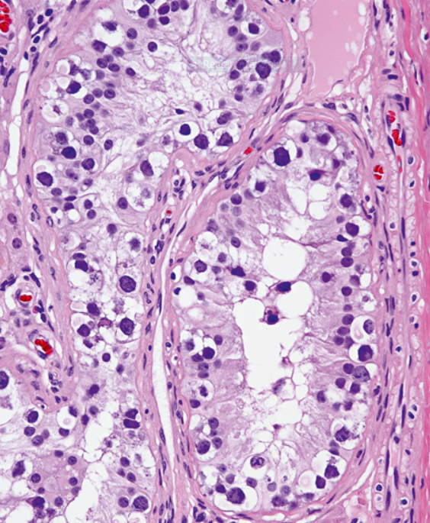
Notes:
IMAGE - Basilar proliferation of seminoma-like cells with clear cytoplasm and enlarged, hyperchromatic nuclei having one or two prominent nucleoli.

Slide 10
Additional 12p sequences are essential for invasive growth of IGCNU
IGCNU adjacent to nonseminomatous tumours or seminoma shares certain chromosomal abnormalities with the invasive tumour
Strong similarities between IGCNU and seminoma imply that seminoma is also a precursor for other germ cell tumours, (supported by morphological, IHC and molecular observations)
Notes:
It is believed that additional 12p sequences are essential for invasive growth in IGCNU by inhibiting apoptosis and thereby permitting survival of invasive tumours outside of the microenvironment of seminiferous tubules.
IGCNU adjacent to seminoma or nonseminomatous tumours shares certain chromosomal abnormalities with the invasive tumour and these abnormalities differ depending on whether the adjacent tumour is seminoma or nonseminomatous germ cell tumour.
There are also strong similarities between IGCNU and seminoma which imply that seminoma is also a precursor for other germ cell tumours. This interpretation is supported by morphological, IHC and molecular observations.

Slide 11
SIMILARITY B/W IGCNU & SEMINOMA
Pure seminoma can subsequently develop nonseminomatous elements, as evidenced by histology or rise in serum AFP level
Seminoma may undergo subtle transition to either embryonal carcinoma or yolk sac tumour or choriocarcinoma
DNA content of seminoma is consistently higher than nonseminomatous tumours
Notes:
Pure seminoma can subsequently develop nonseminomatous elements, as evidenced by histology or rise in serum AFP level. Autopsy studies of patients who died of metastatic GCT post-orchiectomy with pure seminoma demonstrated nonseminomatous elements in 30-40% cases.
Seminoma may undergo subtle transition to either embryonal carcinoma or yolk sac tumour or choriocarcinoma.
DNA content of seminoma is consistently higher than nonseminomatous tumours, suggesting that nonseminomatous tumours evolve from seminoma as a result of gene loss.
{Karyotypic analyses have shown striking tendency for certain chromosomes to be in parallel excess or deficiency in seminoma and nonseminomatous tumours and loss of heterozygosity studies have also shown similar patterns of allelic imbalance between coexisiting seminoma and nonseminomatous tumours in the testis}.

Slide 12
CHALLENGES IN DIAGNOSIS
Seminoma vs Embryonal Carcinoma
Seminoma vs Yolk Sac Tumour
Seminoma vs Sex Cord Stromal Tumour
Regressed GCT vs Scar
Notes:
With this background, I will now try to address some of the challenges one may encounter in differentiating seminoma from nonseminomatous germ cell tumours and from sex cord stromal tumours; identify regressed or burnt out GCT from scar tissue.
The reason why is it so important to accurately diagnose and type testicular germ cell tumour is because it is a highly curable tumour from the current available treatment, especially in early stages. It is also important to differentiate seminoma from nonseminomatous germ cell tumour, and germ cell tumour from sex cord tumours, because treatment is different for each group of tumours.

Slide 13
TREATMENT PRINCIPLES
Seminoma - Radiosensitive & Chemosensitive
Embryonal Carcinoma and Yolk Sac Tumour
- Chemosensitive and Radioresistant
Benign Sex Cord Stromal Tumour - Orchiectomy only
Malignant Sex Cord Stromal Tumour
- Radioresistant and Chemoresistant
- Rx is orchiectomy and RPLND
Notes:
Seminoma is both radiosensitive & chemosensitive. Stage I and non-bulky stage II seminoma are treated by orchiectomy and radiotherapy; and cisplatinum based chemotherapy is given for advanced stage tumours or with bulky retroperitoneal lymphadenopathy. So if patients with embryonal carcinoma receive radiation treatment, because of initial misinterpretation as seminoma, it may limit the amount of chemotherapy that they can subsequently receive because of cumulative effects of radiation and chemotherapy-related bone marrow toxicity.
Both, embryonal carcinoma and YST are chemosensitive and radioresistant. They are often part of mixed GCT and stage I cases are treated by orchiectomy +/-ipsilateral RPLND. Relapse occurs in 10% cases and these are almost all salvaged by combination chemotherapy, {although patients with metastatic YST do not respond as well to chemotherapy as patients with other forms of metastatic nonteratomatous GCT and therefore seem to have a worse prognosis}.
Orchiectomy alone suffices for treating benign sex cord stromal tumours. On the other hand, malignant sex cord stromal tumours are radioresistant as well as chemoresistant and are treated by orchiectomy and RPLND.

Slide 14
SEMINOMA
Solid sheets divided by lymphocyte-bearing fibrovascular septae
Uniform round to polygonal cells
Uniform round to oval nuclei
Distinct cell membranes
Abundant pale to clear cytoplasm
Mitotic figures prominent
+/- admixed granuloma
Syncytiotrophoblast cells in 10-20% cases
Notes:
The architecture of a classical seminoma is of solid sheets of tumour cells which are divided by lymphocyte-bearing fibrovascular septae. The tumour cells are uniform round to polygonal cells with distinct cell membranes, uniform round to oval nuclei that are often described as squared off, lending the nuclei a boxy appearance and the nuclear membranes are irregularly thickened. There is abundant pale to clear cytoplasm and there may be admixed granuloma and in 10-20% cases there are syncytiotrophoblasts. Mitoses are present.

Slide 15
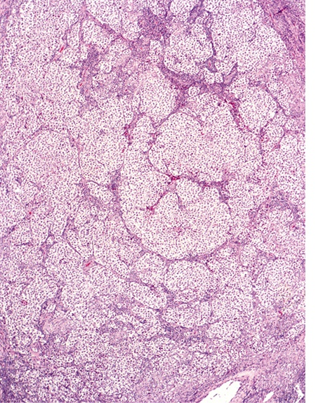
Notes:
IMAGE - Sheetlike pattern of seminoma and intervening thin fibrous septae bearing lymphocytes

Slide 16
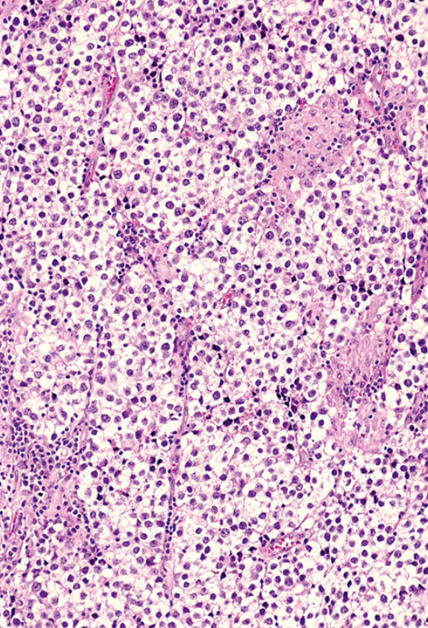
Notes:
HP of the same

Slide 17
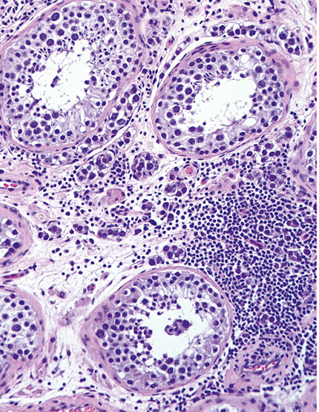
Notes:
Intertubular growth of seminoma with intervening lymphocytes

Slide 18
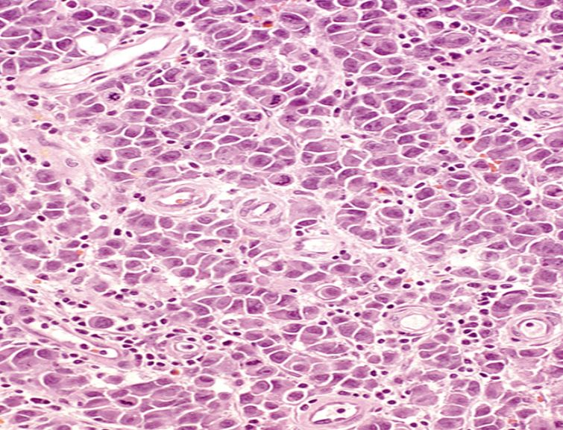
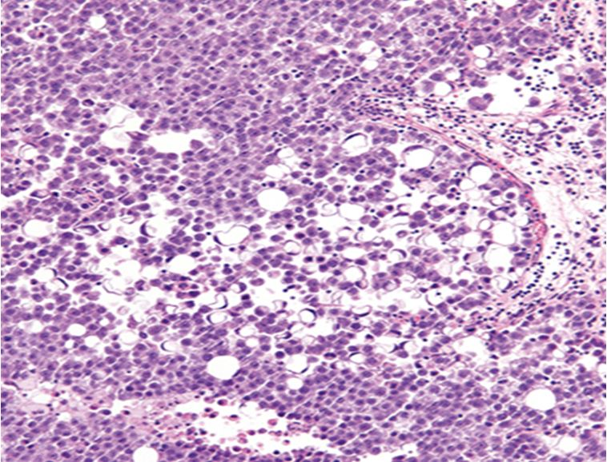
Notes:
Sometimes, the seminoma cells have a plasmacytoid appearance and rarely have intracytoplasmic vacuoles that cause a signet ring cell morphology which may be a focal finding in an otherwise classical seminoma.

Slide 19
EMBRYONAL CARCINOMA
Solid, trabecular, glandular and papillary patterns
Tumour cells are more cohesive
Less distinct cell membranes
Large pleomorphic cells with irregular, smudged, crowded, HC/vesicular nuclei with macronucleoli
High mitotic rate
Dense amphophilic cytoplasm
Coagulative necrosis, karyorrhectic debris - dystrophic calcification – excellent evidence of regressed GCT
Notes:
Embryonal carcinoma on the other hand shows solid, trabecular, glandular and papillary patterns and the cells are more cohesive than seminoma. The tumour cells have less distinct cell membranes and show large pleomorphic cells with irregular, smudged, crowded, hyperchromatic/vesicular nuclei with prominent macronucleoli. Mitotic rate is high. The cytoplasm is dense amphophilic. There is prominent coagulative necrosis and karyorrhectic debris is frequent in the background. Necrotic foci may undergo dystrophic calcification which may serve as an excellent evidence of regressed GCT. This will be discussed later.

Slide 20
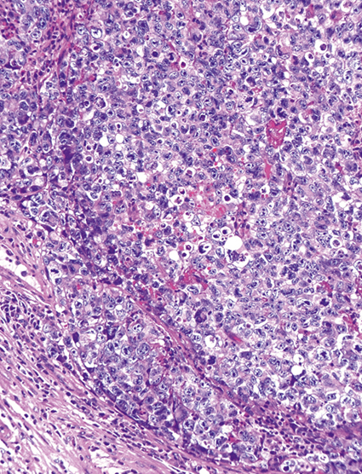
Notes:
IMAGE - Solid pattern of embryonal carcinoma with cohesive and pleomorphic nuclei

Slide 21
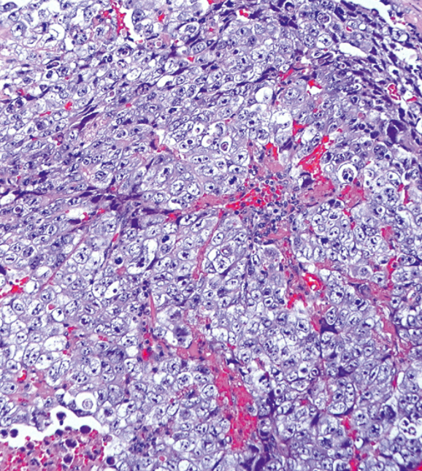
Notes:
Embryonal carcinoma showing degenerate, smudged cells and focal necrosis

Slide 22
SEMINOMA vs EMBRYONAL CA

Slide 23
SEMINOMA vs EMBRYONAL CA
Cytological atypia in seminoma
Tubular variant of seminoma
Notes:
Although the morphology of seminoma and embryonal carcinoma is very distinctive, problem occurs when seminoma is difficult to differentiate from embryonal carcinoma, either when the degree of cytological atypia is comparable to embryonal carcinoma, or when the seminoma architecture is glandular or tubular again having resemblance to embryonal carcinoma.

Slide 24
CYTOLOGICAL ATYPIA IN SEMINOMA
Diffusely present or occurs focally within separate nodules of the tumour
Increased nuclear atypia, darker cytoplasm and increased cell crowding
Retention of typical architecture and lymphocytic reaction
Atypia surrounding small foci of necrosis in typical seminoma - ?ischaemic change
Notes:
When seminoma shows cytological atypia, it can be seen either diffusely or may occur focally within separate nodules of tumour. There is increased nuclear atypia, darker cytoplasm and increased cell crowding. Clue to diagnosis of seminoma is retention of the typical architecture and presence of lymphocytic reaction. The atypia can be found in areas surrounding small punctate foci of tumour necrosis in typical seminoma and in that circumstance, these findings are likely reflective of ischaemia-induced changes.

Slide 25
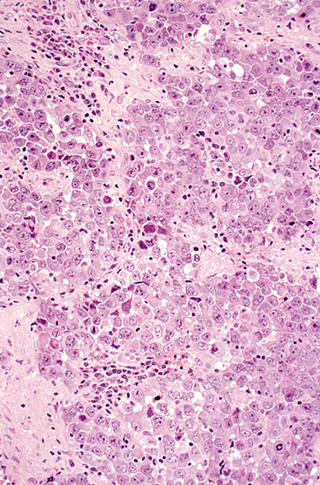
Notes:
IMAGE - Seminoma with increased nuclear pleomorphism and crowding and dense cytoplasm

Slide 26
TUBULAR VARIANT OF SEMINOMA
Architecture – Resembles gland forming embryonal carcinoma
Pseudoglandular arrangements in solid sheets with no true glandular lumens
Cytological features of seminoma retained
Notes:
In the tubular variant of seminoma, the architecture resembles gland forming embryonal carcinoma or there may be pseudoglandular arrangements in solid sheets with no true glandular lumens. The cytological features of seminoma are retained in such scenarios.

Slide 27
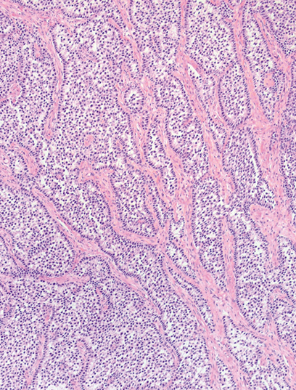
Notes:
IMAGE - Tubular pattern in seminoma

Slide 28
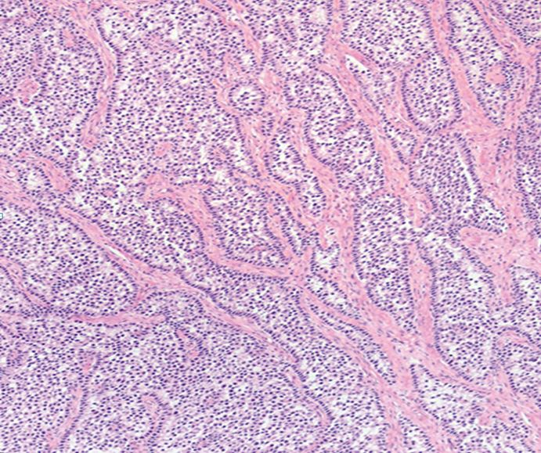
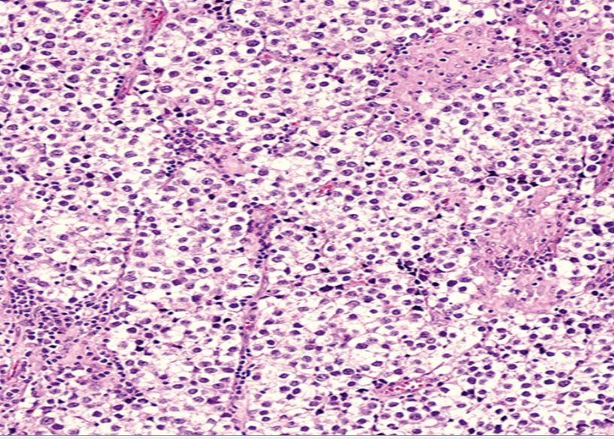
Notes:
So we see that in the atypical variant of seminoma there is cytological atypia, but the typical architecture is retained, and in the tubular variant of seminoma, the tumour architecture is pseudoglandular but the cytological features of seminoma are retained.

Slide 29
IMMUNOHISTOCHEMISTRY
 | SEMINOMA | EMBRYONAL CARCINOMA
CD117 and D2-40 | Diffusely positive | Negative or focally positive
AE1/AE3 and CD30 | Negative or focally positive | Diffusely positive (CD30 loss frequent postchemoTx)
Transcription factors (may be not available) | SOX 2 Negative SOX17 Nuclear positive | SOX2 Nuclear positive SOX17 Negative
PLAP and OCT 4 | Both positive (PLAP more intense) | Both positive (OCT 4 more intense)
Notes:
However, when the typical architectural or cytological features are lacking or leave the pathologist uneasy regarding the possibility of embryonal carcinoma, IHC is very useful. Seminoma shows diffuse positive staining with CD117 and D2-40; and embryonal carcinoma shows diffuse positive staining with AE1/AE3 and CD30. Transcription factors SOX17 and SOX2 are not readily available, but if used, SOX17 stains seminoma and SOX 2 stains embryonal carcinoma. PLAP and Oct4 stains are not discriminatory between the 2 tumours, although PLAP staining intensity is greater in seminoma and the staining intensity of oct 4 is greater in embryonal carcinoma.

Slide 30
SEMINOMA vs YOLK SAC TUMOUR

Slide 31
SEMINOMA VS YOLK SAC TUMOUR
YST shows many architectural patterns – microcystic, endodermal sinus, papillary, solid, glandular, myxomatous, sarcomatoid, macrocystic, polyvesicular vitelline, hepatoid and parietal
Glypican 3 – positive and more sensitive than AFP, staining nearly 100% of YST (focal staining in embryonal CA, teratoma and spermatocytic seminoma)
Notes:
YST can show many architectural patterns {– microcystic (honeycomb, reticular, vacuolated), endodermal sinus (perivascular or festoon), papillary, solid, glandular (alveolar), myxomatous, sarcomatoid, macrocystic, polyvesicular vitelline, hepatoid and parietal}.
Glypican 3, a proteoglycan that plays a role in embryonic growth is more sensitive than AFP which stains only 58% cases of YST whereas GP3 stains positive in nearly 100% YST (exception being solid YST). Focal staining with GP3 is seen in some cases of embryonal CA, teratoma and spermatocytic seminoma and can also be seen in nontesticular visceral epithelial tumours such as HCC, cholangioCa, etc.

Slide 32
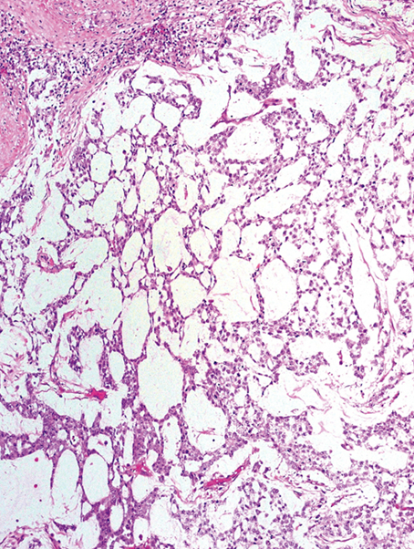
Notes:
IMAGE - Microcystic pattern of yolk sac tumor created by cords of cells surrounding extracellular space (also referred to as reticular pattern).

Slide 33
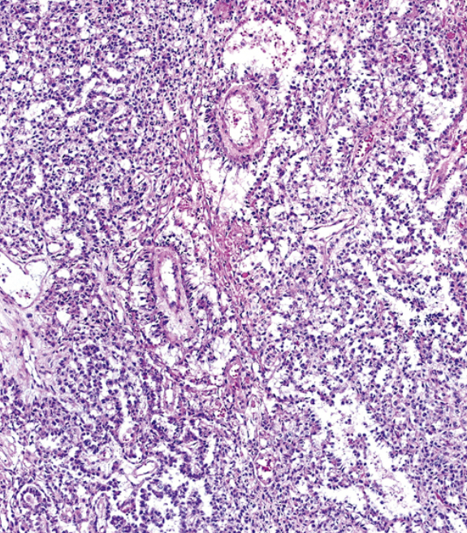
Notes:
Endodermal sinus pattern shows a central vessel rimmed by fibrous tissue that is in turn surrounded by malignant epithelium and this structure is contained within a cystic space that is lined by flattened tumour cells.

Slide 34
TUBULAR PATTERN
Seminoma in tubular or pseudoglandular pattern
YST grows in separated or merged true glands with well defined lumens and sharp, luminal borders
Notes:
Seminoma may resemble YST by forming tubular and microcystic patterns. Tubular structures in seminoma are pseudoglands formed by discohesion of tumour cells in a nested arrangement. In contrast, YST grows in separated or merged true glands with well defined lumens and sharp, luminal borders.

Slide 35
Notes:
IMAGE - Tubular pattern in seminoma

Slide 36
MICROCYSTIC STRUCTURES
Microcystic structures in seminoma are formed by oedema, frequently with tumour cells floating in oedema fluid. The spaces usually have irregular luminal outlines and, most importantly, are lined by typical cells characteristic of seminoma
Microcystic structures in YST are formed either by myxoid stroma or empty vacuoles, and the cells bordering spaces are characteristically flattened
Notes:
Microcystic structures in seminoma are typically formed by oedema, frequently with attached tumour cells floating in oedema fluid, {although on occasion, they may appear empty}. The spaces usually have irregular luminal outlines and, most importantly, are lined by typical polygonal cells characteristic of seminoma.
On the other hand, microcystic structures in YST are formed either by myxoid stroma or empty vacuoles, and the tumour cells bordering microcystic spaces are
characteristically flattened, in contrast to polygonal lining cells of microcystic seminoma.

Slide 37
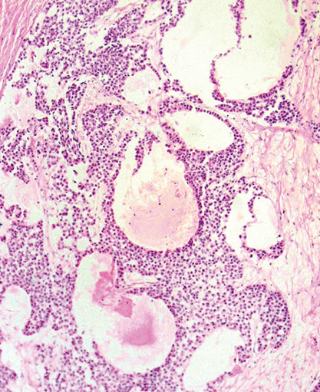
Notes:
IMAGE - Oedema in seminoma creating an irregular microcystic pattern

Slide 38
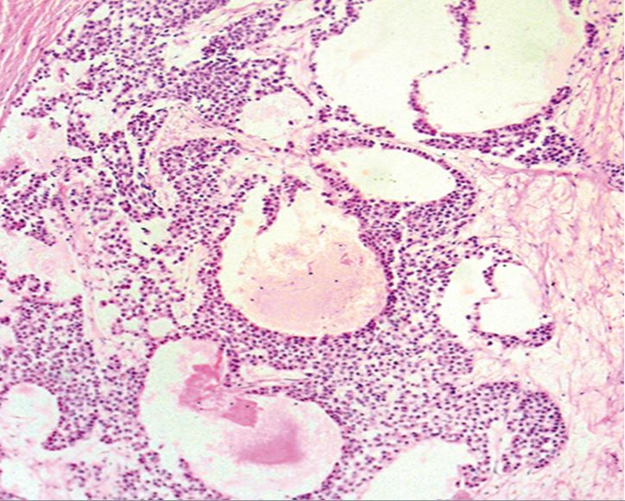
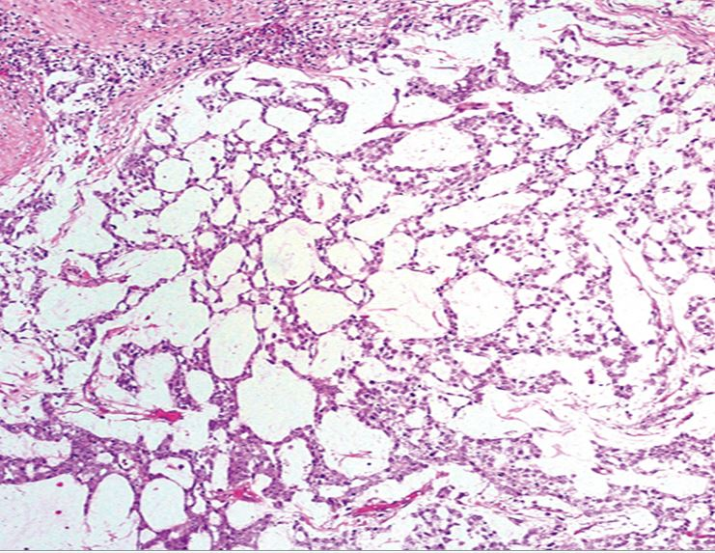
Notes:
Microcystic structures in seminoma are typically formed by oedema, frequently with attached tumour cells floating in oedema fluid, {although on occasion, they may appear empty}. The spaces usually have irregular luminal outlines and, most importantly, are lined by typical polygonal cells characteristic of seminoma.
On the other hand, microcystic structures in YST are formed either by myxoid stroma or empty vacuoles, and the tumour cells bordering microcystic spaces are characteristically flattened, in contrast to polygonal lining cells of microcystic seminoma.
So, like we saw earlier in seminoma vs embryonal carcinoma, when it comes to differentiating seminoma from yolk sac tumour, when there is an overlap in architecture, the cytological features of seminoma and yolk sac are maintained.

Slide 39
SOLID GROWTH PATTERN
YST may mimic seminoma by growing in solid sheets with clear cytoplasm and distinct cell membranes, similar to seminoma
Lymphocytic infiltrates occur in 17% solid YSTs
YST cells are more pleomorphic than seminoma cells but, almost always associated with other more distinctive YST architecture patterns
Frequent intra-cytoplasmic hyaline globules and extracellular basement membrane deposits
Granulomas are rare
Notes:
Conversely, YST may mimic seminoma by growing in solid sheets of cells, with clear cytoplasm and distinct cell membranes similar to seminoma. Lymphocytic infiltrates occur in 17% solid YSTs.
However, YST cells are more pleomorphic than seminoma and the solid YST is almost always associated with other more distinctive YST patterns. Also, solid-pattern YST frequently contains intra-cytoplasmic hyaline globules and extracellular basement membrane deposits, features rarely found in seminomas. Granulomas are rare.

Slide 40
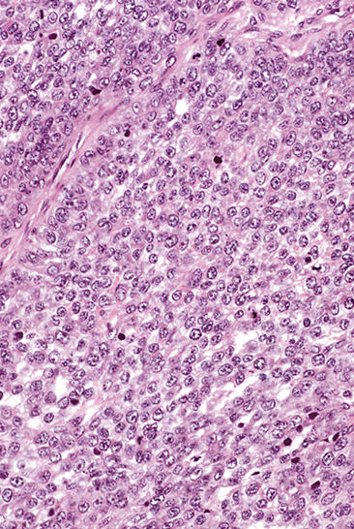
Notes:
IMAGE - Solid pattern YST

Slide 41
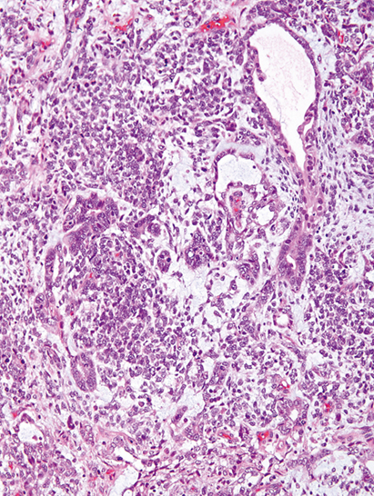
Notes:
Solid areas in yolk sac tumor, composed of small, blastema-like cells, mixed with microcystic and glandular patterns.

Slide 42
IMMUNOHISTOCHEMISTRY
 | SEMINOMA | SOLID YST
OCT 3/4 | Positive | Negative
AE1/AE3 and GLYPICAN 3 (AFP is less sensitive) | Negative | Positive
CD117 (not useful) | Diffusely positive | Positive in 59% cases
Notes:
Immunohistochemistry is very useful to differentiate between the two entities. Oct ¾ is positive in seminoma and negative in YST including solid YST. Although AFP is less sensitive than GP3, both AFP and GP3 are 100% specific in DD versus seminoma. Even though GP3 is more sensitive than AFP for solid YST, the intensity of staining in solid YST is less than it is in other yolk sac tumour patterns. CD117 may not be helpful since it is positive in a large number about 59% cases of solid YST.

Slide 43
SEMINOMA VS CLEAR CELL SEX CORD-STROMAL TUMOUR

Slide 44
SEMINOMA VS CLEAR CELL SEX CORD-STROMAL TUMOUR
Clear cell change (lipid accumulation – micro/macrovesicular) in Sertoli cell tumour and Leydig cell tumour with solid growth pattern
Lack fibrous septae and granulomatous reaction, but may show a prominent lymphocytic reaction
Cytological features are distinctive - SCST have smaller, round/oval to irregular nuclei, and vary more than of seminoma, +/- intracyto inclusions
MOST IMPORTANT – ABSENT IGCNU IN SCST
Notes:
Treatment of seminoma and sex cord stromal tumour is very different. Benign SCST needs orchiectomy and malignant SCST also get RPLND. Seminoma is both radio and chemosensitive whereas SCST is resistant to both. So differentiating between the two is very important.
Clear cell change in sex cord tumours can resemble seminoma. It can be caused by lipid accumulation in Sertoli or Leydig cells imparting a microvesicular to macrovesicular appearance. In contrast the clear cytoplasm in seminoma is due to glycogen accumulation which gives the a water-clear appearance. {SCST lack thin fibrous septae and granulomatous reaction, but may show a prominent lymphocytic reaction leading to serious confusion with seminoma. However, cytological features are very helpful in making the distinction between the two. SCST have smaller nuclei which are round to oval to irregular, and vary more than those of seminoma, sometimes having intracytoplasmic inclusions. Seminoma cells have polygonal nuclei with prominent nucleoli and frequent mitotic figures}.
Most important of all, is the absence of IGCNU in SCST while it is seen adjacent to most cases of seminoma.

Slide 45
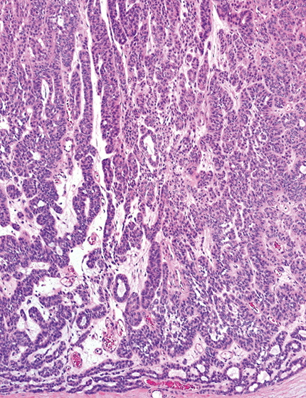
Notes:
IMAGE - Sertoli cell tumor composed of mostly solid tubules

Slide 46
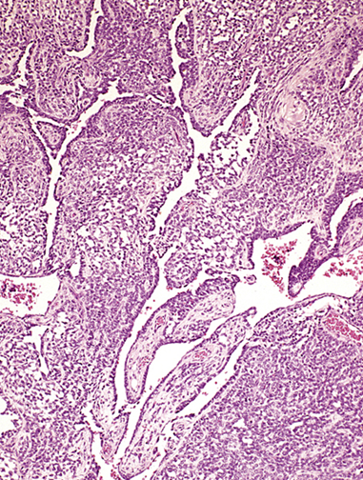
Notes:
Retiform pattern in a Sertoli cell tumour

Slide 47
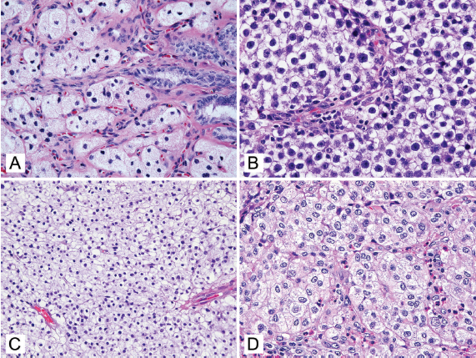
Notes:
A. Sertoli cell tumor forms cords of cells with foamy cytoplasm, reflecting lipid droplets.
B. When clear cytoplasm occurs in a seminoma it usually has an ‘‘empty’’ quality.
C. A solid growth pattern of pale to clear cells in this unclassified sex cord-stromal tumor is reminiscent of seminoma.
D. In contrast to seminoma, the nuclei of this clear cell Sertoli cell tumor are relatively small and lack prominent nucleoli and conspicuous mitotic figures.

Slide 48
SEX CORD STROMAL TUMOUR WITH CLEAR CELL CHANGE | SEMINOMA
Lipid accumulation = micro/macrovesicular | Glycogen
No fibrous septae or granuloma Prominent lymphocytic reaction present | All present
Small nuclei with round-oval-irregular nuclei, with more variation, +/-intracytoplasmic inclusions | Polygonal nuclei with prominent nucleoli and frequent mitotic figures
Absent IGCNU | IGCNU present
MelanA, calretinin and inhibin positive | PLAP, OCT3/4, SALL4, CD117 and D2-40 positive
Notes:
To quickly summarize the difference between sex cord stromal tumour and seminoma in a tabular form. Clear cell change in sex cord tumours is caused by lipid accumulation imparting a microvesicular to macrovesicular appearance. In seminoma the clear cytoplasm is due to glycogen accumulation giving a water-clear appearance.
SCST lack thin fibrous septae and granulomatous reaction, but may show a prominent lymphocytic reaction leading to serious confusion with seminoma. But here come in the cytological features which are very helpful in making the distinction between the two. SCST have smaller nuclei which are round to oval to irregular, and vary more than do those of seminoma, sometimes having intracytoplasmic inclusions. Seminoma cells have polygonal nuclei with prominent nucleoli and frequent mitotic figures.
Most important of all, is the absence of IGCNU in SCST while it is seen adjacent to most cases of seminoma. And also IHC is very discriminatory. SCST stain positive with MelanA, calretinin and inhibin and stain negative with germ cell markers such as PLAP, OCT 3/4, SALL4, CD117 and D2-40.

Slide 49
SCAR VS REGRESSED GERM CELL TUMOUR

Slide 50
SCAR VS REGRESSED GERM CELL TUMOUR
Spontaneous regression is a known phenomenon
All types of germ cell tumours (most cases are of seminoma) are susceptible to regression
Many cases of pure adult testicular teratoma represent mixed GCT with regressed nonteratomatous components
10% of patients who die of metastatic germ cell tumour show “burnt out” primary testicular tumours
Notes:
Testicular GCT is unique for this phenomenon of spontaneous regression. This is a well recognized phenomenon and essentially, all types of GCT are susceptible to it. Seminoma being the most common GCT has shown the highest incidence of regression. There are also many cases of pure testicular teratoma in the adult population and these actually represent mixed GCT in which the nonteratomatous components have regressed. Autopsy studies have shown that nearly 10% of patients who die of metastatic testicular germ cell tumour show burnt out primary tumours

Slide 51
Nodule or stellate scar in testis – ? regressed GCT
Dysgenetic features (impaired spermatogenesis, tubular atrophy and microliths) in background testis
Leydig cell hyperplasia common
Fibrotic nodule - clusters of haemosiderin, hyalinised ghost tubules, many curvilinear small vessels and lymphoplasmacytic infiltrates
TWO DIAGNOSTIC FEATURES – LARGE COARSE INTRATUBULAR CALCIFICATIONS AND IGCNU
Diagnostic features in ~50% cases, hence the constellation of other findings must be relied upon
Notes:
In patients who present with a scarred nodule in the testis in the absence of metastasis, one must distinguish a completely regressed GCT which has metastatic potential, from nonspecific scars that result from injuries or vascular lesions. Grossly it may look like a nodule or a stellate scar within the testicular parenchyma.
Microscopically, the background testicular tissue often shows dysgenetic features, including impaired spermatogenesis, tubular atrophy, and microliths.
Leydig cell hyperplasia is frequently present. {This may occur in response to elevated conc of LH or because of its LH-like activity, hCG and may partly reflect hCG production by tumour prior to regression}. Within the fibrotic nodule, it is common to see clusters of haemosiderin within macrophages, hyalinised ghost tubules, many small vessels (which are likely to reflect prior tumour angiogenesis) and lymphoplasmcytic infiltrates (may suggest that immune reaction may play a role in tumour regression).
There are two diagnostic features of regressed GCT. The first is large and coarse calcifications with an intratubular configuration which are are pathognomic of regressed GCT. They represent dystrophic calcification in the necrotic debris that commonly occurs in the comedocarcinoma-like pattern of intratubular embryonal carcinoma. The second diagnostic feature is the presence of IGCNU associated with a scar.
These two diagnostic findings of coarse intratubular calcifications and IGCNU occur in approx 50% cases, and therefore the constellation of other findings must be relied on to support or detract from the possibility of regressed GCT.

Slide 52
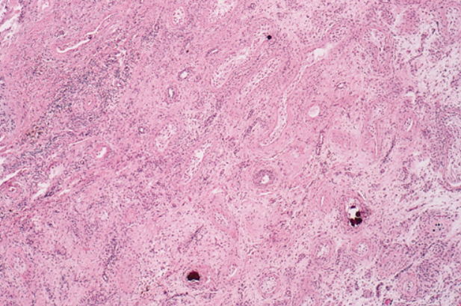
Notes:
IMAGE - Within the fibrotic nodule, it is common to see clusters of haemosiderin within macrophages, hyalinised ghost tubules, many small vessels (which are likely to reflect prior tumour angiogenesis) and lymphoplasmcytic infiltrates (may suggest that immune reaction may play a role in tumour regression).

Slide 53
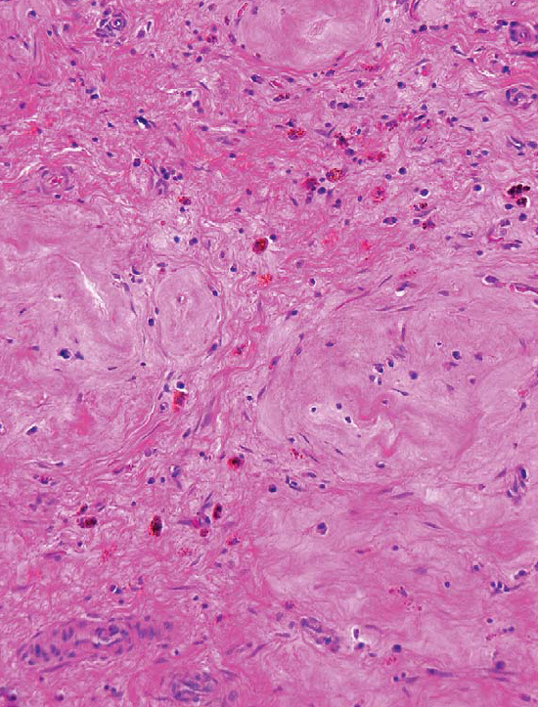
Notes:
Outlines of hyalinized, ghost tubules in the scar, with scattered siderophages

Slide 54
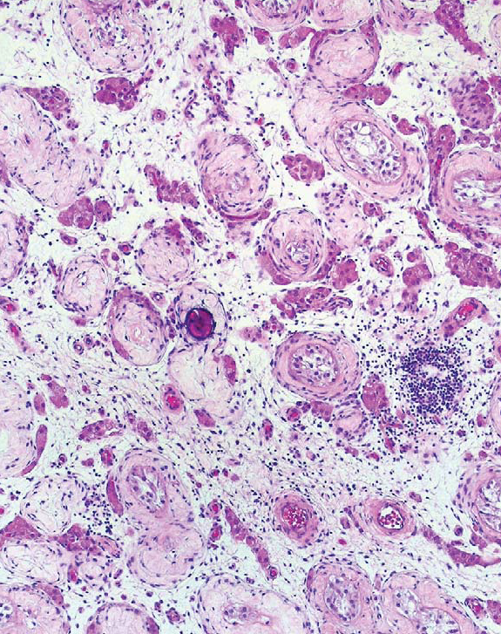
Notes:
Testicular atrophy showing shrunken and hyalinized seminiferous tubule and a central microlith

Slide 55
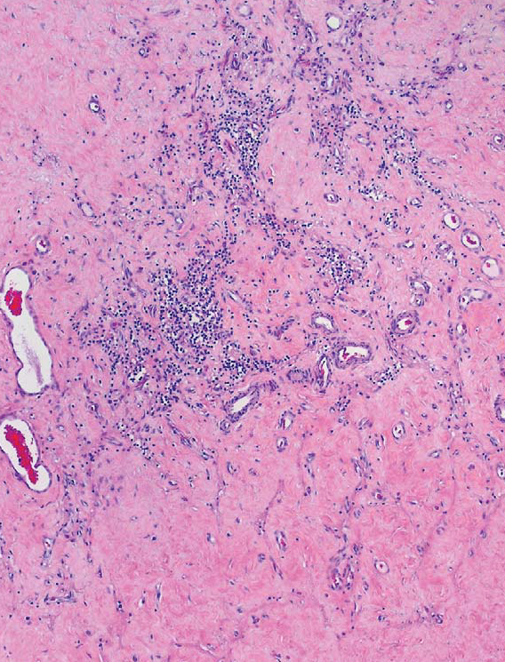
Notes:
Lymphoplasmacytic infiltrate within the scarred zone, which also contains numerous round and arcuate vessels.

Slide 56
Subtyping of regressed GCT – not realistic
Ghost tubules & intratubular calcifications
Ghost tubules - likely from regression of intertubular tumour, common in seminoma
Coarse irregularly-shaped intratubular calcifications - regression of intratubular embryonal carcinoma. Calcifications represent a dystrophic phenomenon in comedotype necrosis of intratubular embryonal carcinoma and often exceed the diameter of normal seminiferous tubules
Notes:
Subtyping of regressed GCT is not a realistic objective. Having said that there are 2 findings that may suggest its nature, namely ghost tubules and intratubular coarse calcifications. The presence of ghost tubules in many scars is likely secondary to regression of intertubular tumour which is a common finding in seminoma. The presence of coarse, often irregularly-shaped intratubular calcifications, correspond to regression of intratubular embryonal carcinoma, as such foci are commonly seen adjacent to cases of embryonal carcinoma with an intratubular component. The calcifications represent a dystrophic phenomenon in the foci of comedo-type necrosis that are seen in intratubular embryonal carcinoma; they often exceed the diameter of normal seminiferous tubules since they develop in tubules that are expanded by intratubular tumour.

Slide 57
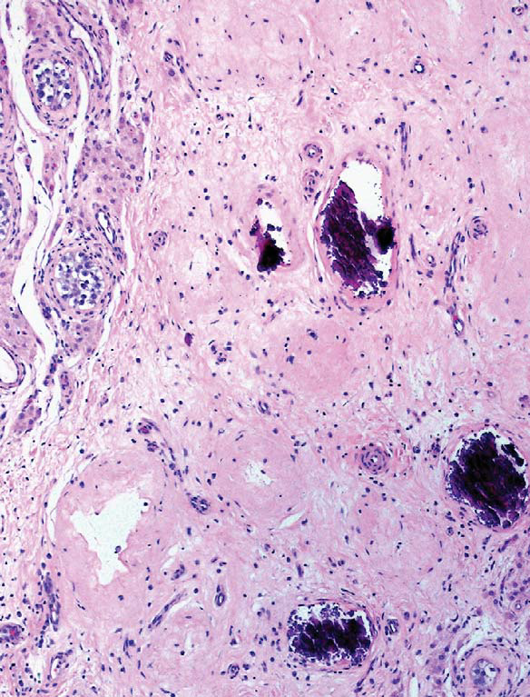
Notes:
IMAGE - Coarse intratubular calcification within a scar indicating regressed embryonal carcinoma.

Slide 58
Reference: Balzer BL, Ulbright TM. Spontaneous regression of testicular germ cell tumors: an analysis of 42 cases. Am J Surg Pathol. 2006;30(7):858-865.
Notes:
And this is an excellent reference from 2008 in the Am J S Path elaborating on their experience of regressed testicular germ cell tumours.

Slide 59
UPDATE IN STAGING TESTICULAR TUMOURS

Slide 60
Primary Tumour 7th edition AJCC TNM
pTX: Cannot be assessed
pT0: No evidence of primary tumour
pTis: Intratubular germ cell neoplasia (carcinoma in situ)
pT1: Tumour limited to the testis and epididymis without LVI; tumour may invade tunica albuginea but not tunica vaginalis
pT2: Tumour limited to the testis and epididymis with vascular/lymphatic invasion, or tumour extending through the tunica albuginea with involvement of the tunica vaginalis
pT3: Invades the spermatic cord with or without LVI
pT4: Invades the scrotum with or without LVI
Notes:
According to the 7th edition of American Joint Committee on Cancer (AJCC) TNM staging system, {primary testicular tumours can be staged into these categories pTX when the primary tumour cannot be assessd, pT0 when there is no evidence of primary tumour such as in regressed tumour and pTis when there is IGCN only}
tumours with lymphovacsular invasion or tumours invading the tunica vaginalis (perforating the mesothelial layer) are consideed pT2.
It was also recognized that rete testis invasion can be associated with higher risk of relapse in clinical stage I seminoma and also, hilar soft tissue invasion is the predominant pathway of extratesticular extension. However, invasion of rete testis or epididymis was not assigned a higher pT stage than that for a tumour limited to the testis.

Slide 61
Rete testis invasion - invasive tumour involves the rete testis stroma, with or without luminal involvement
Pagetoid extension of IGCNU into the rete testis should not be considered rete testis invasion
Rete testis and hilar soft tissue invasion have predictive value for metastatic disease in patients with nonseminomatous GCTs
8th edition of AJCC TNM - invasion of epididymis and hilar soft tissue staged pT2 from Jan 2018
Notes:
In the Feb 2017 release of the 7th edition of AJCC TNM, more description was provided as to what constitutes rete testis invasion. {Rete testis invasion is when the invasive tumour involves the rete testis stroma, with or without luminal involvement. Pagetoid extension of IGCNU into the rete testis should not be considered rete testis invasion}.
It was recognized that there is evidence beginning to accumulate that rete testis and hilar soft tissue invasion have predictive value for metastatic disease in patients with nonseminomatous GCTs. Consequently, from 1st Jan 2018, in the 8th edition of AJCC TNM staging system, invasion of epididymis and invasion of hilar soft tissue is staged as pT2.

Slide 62
Primary Tumour 8th edition AJCC TNM
pT1: Tumour limited to testis (including rete testis invasion) without LVI
- pT1a: Tumour smaller than 3 cm (for seminoma only)
- pT1b: Tumour 3 cm or larger(for seminoma only)
pT2: Tumour limited to testis (including rete testis invasion) with LVI
OR
Tumour invading hilar soft tissue +/- LVI
OR
Tumour invading the epididymis +/- LVI
OR
Tumour penetrating visceral mesothelial layer covering the external surface of tunica albuginea, +/- LVI
pT3: Tumour directly invades spermatic cord soft tissue +/- LVSI
pT4: Tumour invades scrotum with or without lymphovascular invasion

Slide 63
Distant Metastases
7th EDITION AJCC TNM
pM1a: Nonregional nodal or pulmonary mets
pM1b: Distant metastasis other than to nonregional lymph nodes and lung
8th EDITION AJCC TNM
pM1a: Nonretroperitoneal LN or pulmonary mets
pM1b: Nonpulmonary visceral metastases
Discontinuous involvement of the spermatic cord soft tissue via a vascular thrombus is better regarded as a metastatic deposit (pM1). Presence of only an intravascular tumour in the spermatic cord in the absence of parenchymal invasion is considered pT2
Notes:
The 7th edition of AJCC TNM staging system does not specifically address the issue of vascular invasion in the spermatic cord. While invasion of the cord is considered a pT3 stage, it is logical to regard vascular invasion in the cord as pT2 stage, unless the tumor penetrates through the vessel wall into perivascular soft tissues of the cord.
But according to the 8th edition AJCC TNM staging system, discontinuous involvement of the spermatic cord soft tissue via a vascular thrombus is better regarded as a metastatic deposit (pM1). Presence of only an intravascular tumor in the spermatic cord in the absence of parenchymal invasion is considered pT2.

Slide 64
Regional nodes (pN) 7th and 8th edition AJCC TNM
pNX: Cannot be assessed
pN0: No regional lymph node metastasis
pN1: Metastasis with a lymph node mass 2 cm or less in greatest dimension and less than or equal to 5 nodes positive, none more than 2 cm in greatest dimension
pN2: Metastasis with a lymph node mass more than 2 cm but not more than 5 cm in greatest dimension; or more than 5 nodes positive, none more than 5 cm; or evidence of extranodal extension of tumour
pN3: Metastasis in a lymph node more than 5 cm in greatest dimension
Notes:
There is no change in the regional node staging between the 7th and 8th editions. In several studies, the presence of vascular space invasion (usually lymphatic but possibly also capillary or venous invasion) has been correlated with a significantly elevated risk for distant metastasis. This observation, therefore, is most pertinent for patients who have clinical stage I disease, ie, those who have no evidence of spread beyond the testis by clinical examination (including radiographic and serum marker studies). Some clinicians manage the patients with clinical stage I disease who lack evidence of lymphatic or vascular invasion in their orchiectomy specimens (with possibly other favorable prognostic features, such as relatively small amounts of embryonal carcinoma) by close follow-up examinations rather than intervention.

Slide 65
References on hilar fat invasion:
Dry SM, Renshaw AA. Extratesticular extension of germ cell tumors preferentially occurs at the hilum. Am J Clin Pathol. 1999;111:534-538.
Yilmaz A, Cheng T, Zhang J, Trpkov K. Mod Pathol. 2013;26(4):579-586. Testicular hilum and vascular invasion predict advanced clinical stage in nonseminomatous germ cell tumors.
Notes:
And these are some useful references from 1999 Am J Clin Path and from 2013 Mod Pathol sharing their experience on testicular hilar involvement by germ cell tumours.

Slide 66
CASE PRESENTATION

Slide 67
INTERESTING CASE
50/M - right testicular pain
Known case of infertility and azospermia
Infertility investigations were done in the past and was known to have bilateral testicular atrophy - ? cause
USG - Both testis were atrophic, right epididymitis and a small nodule (<10mm) in the left testis
Tumour markers - normal
Bilateral descended testis since birth
Notes:
50 year old male presented with right testicular pain. Both testis were atrophic on USG and he was found to have right epididymitis which was the cause for his pain. Antibiotics were given and his pain resolved. He was a known case of infertility and azospermia. Infertility investigations were done in the past and was detected to have bilateral testicular atrophy, but the cause for this was not found. There was no history of cryptorchidism. However, the USG also showed an incidental <10mm nodule in the left testis. Tumour markers were normal. CT showed no distant metastases. The decision was made to do a unilateral left orchiectomy for the nodule.

Slide 68
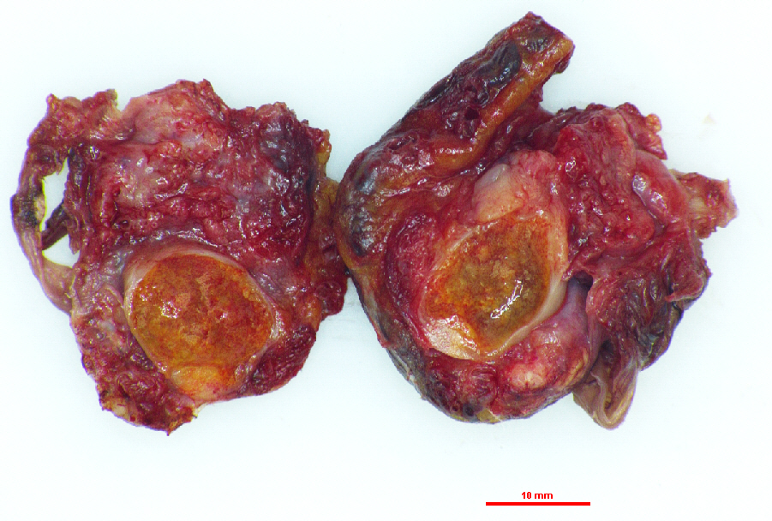

Slide 69
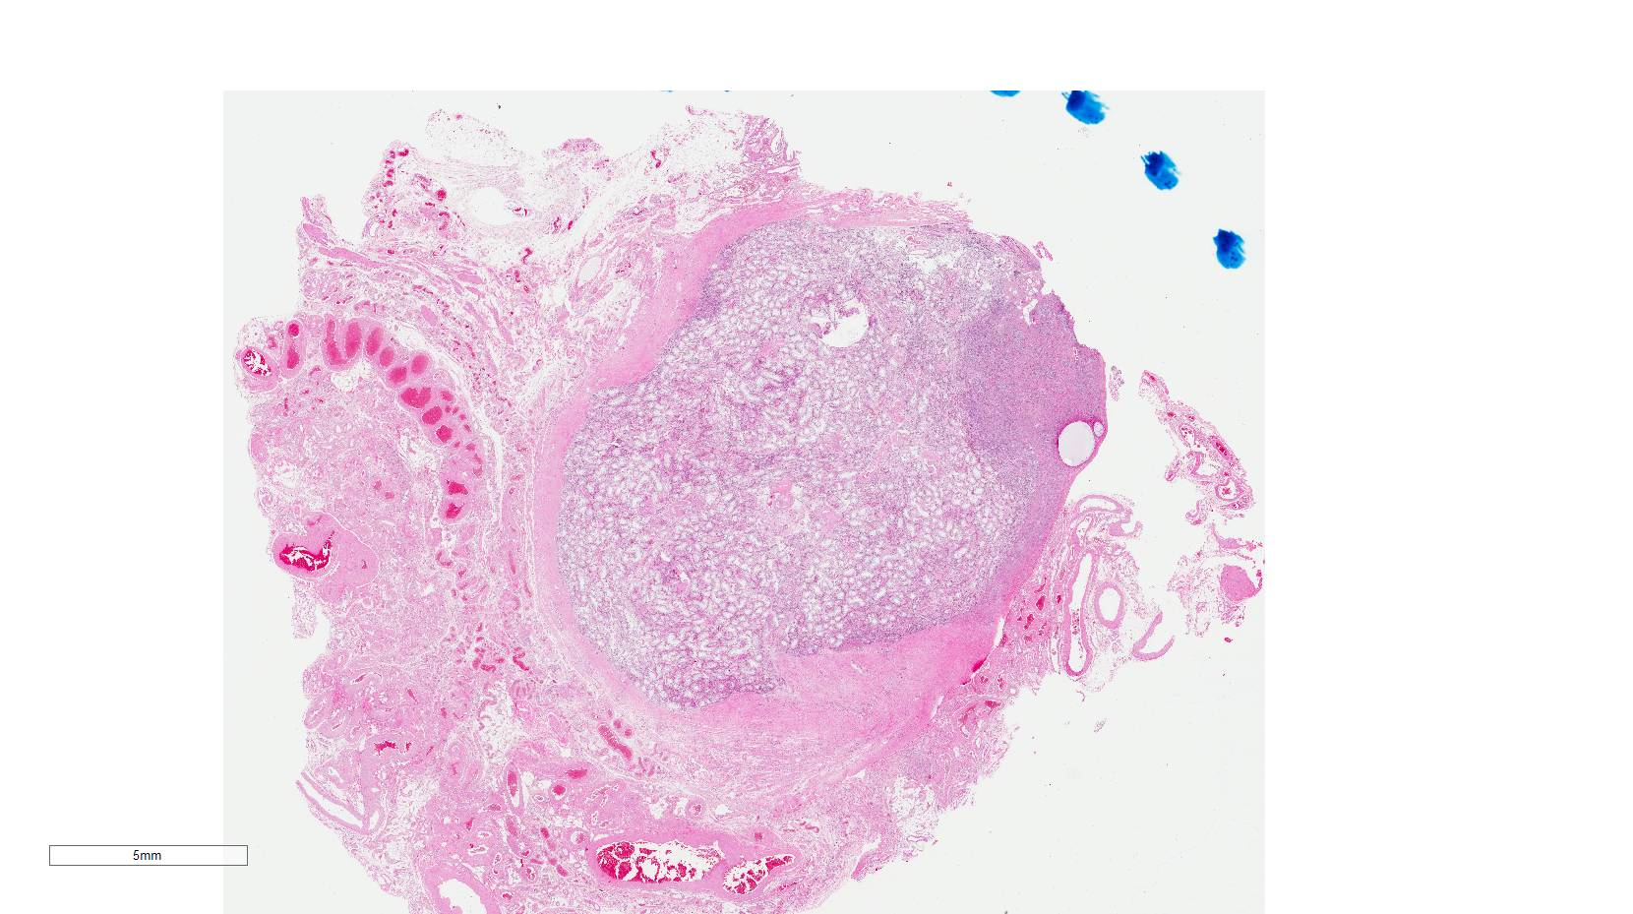
Notes:
Whole slice image to show a small nodule close to the head of the epididymis opposite to the spermatic cord

Slide 70
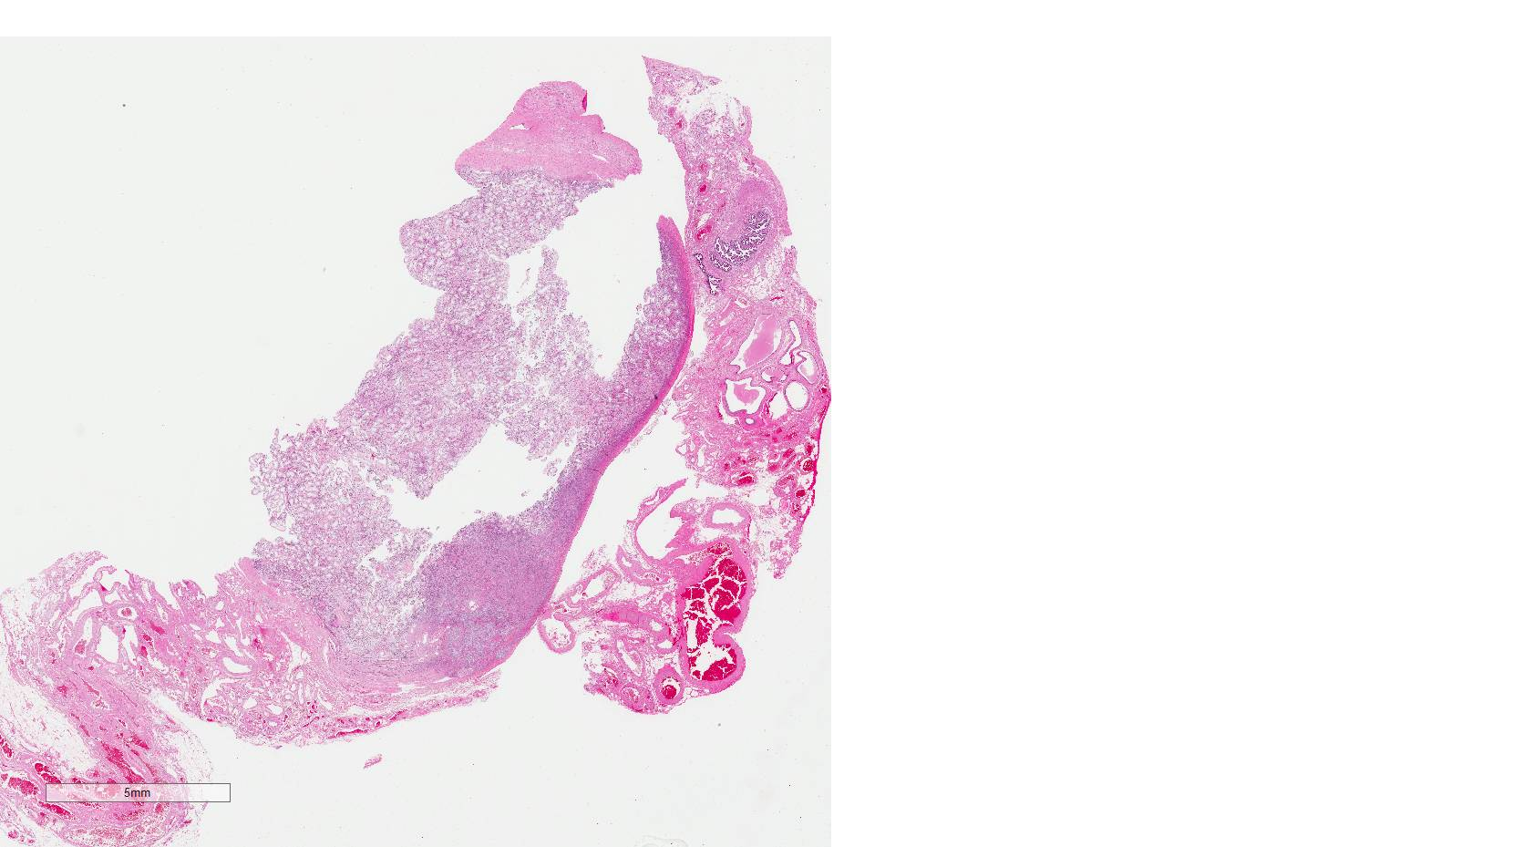

Slide 71
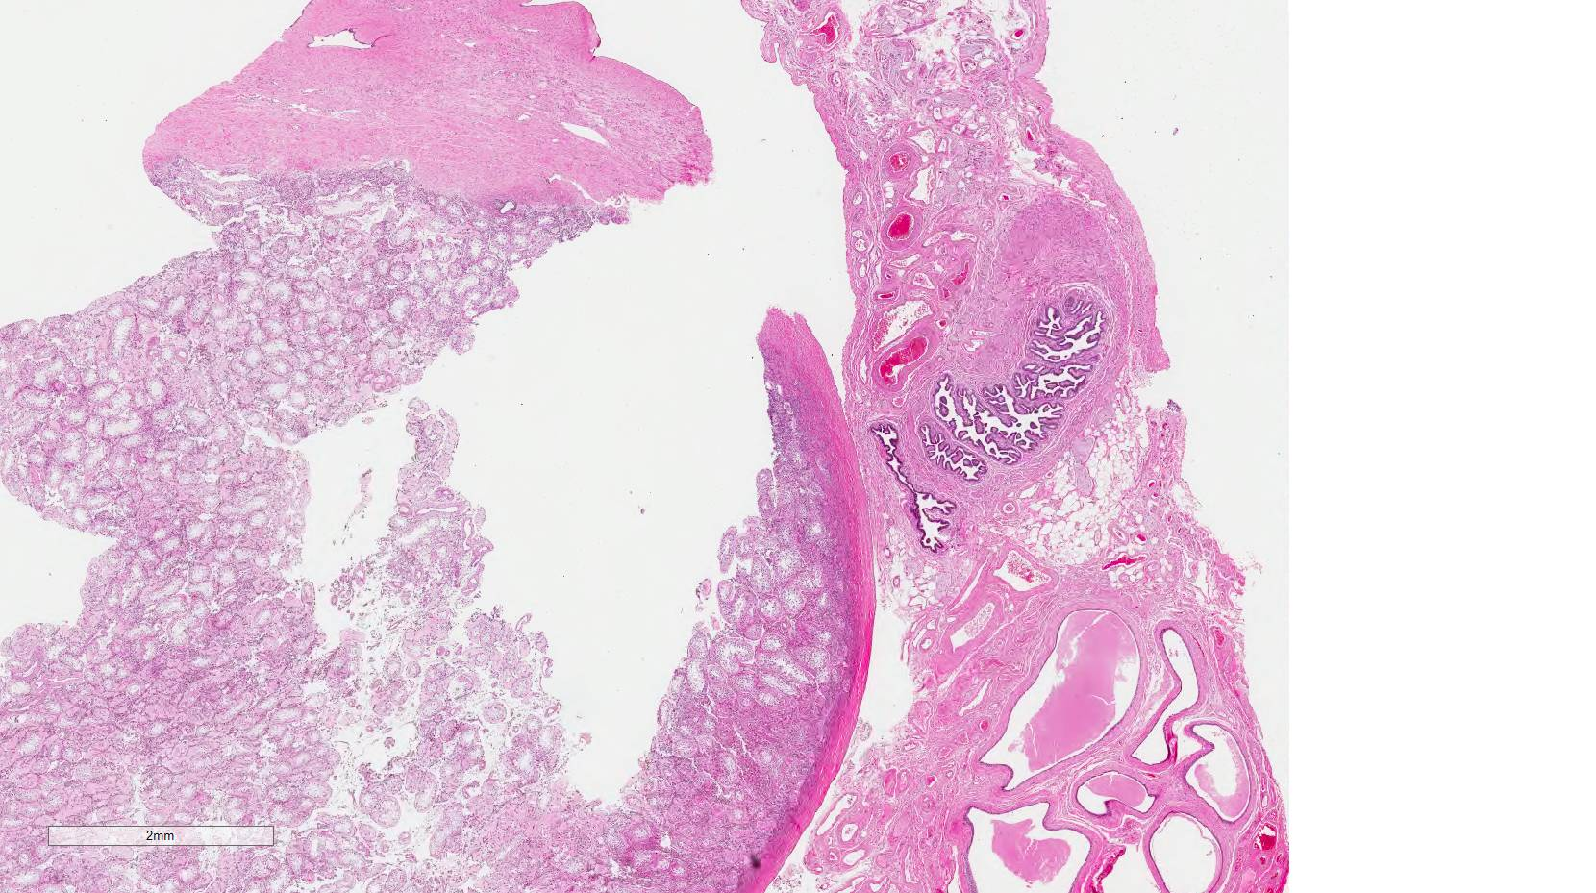

Slide 72
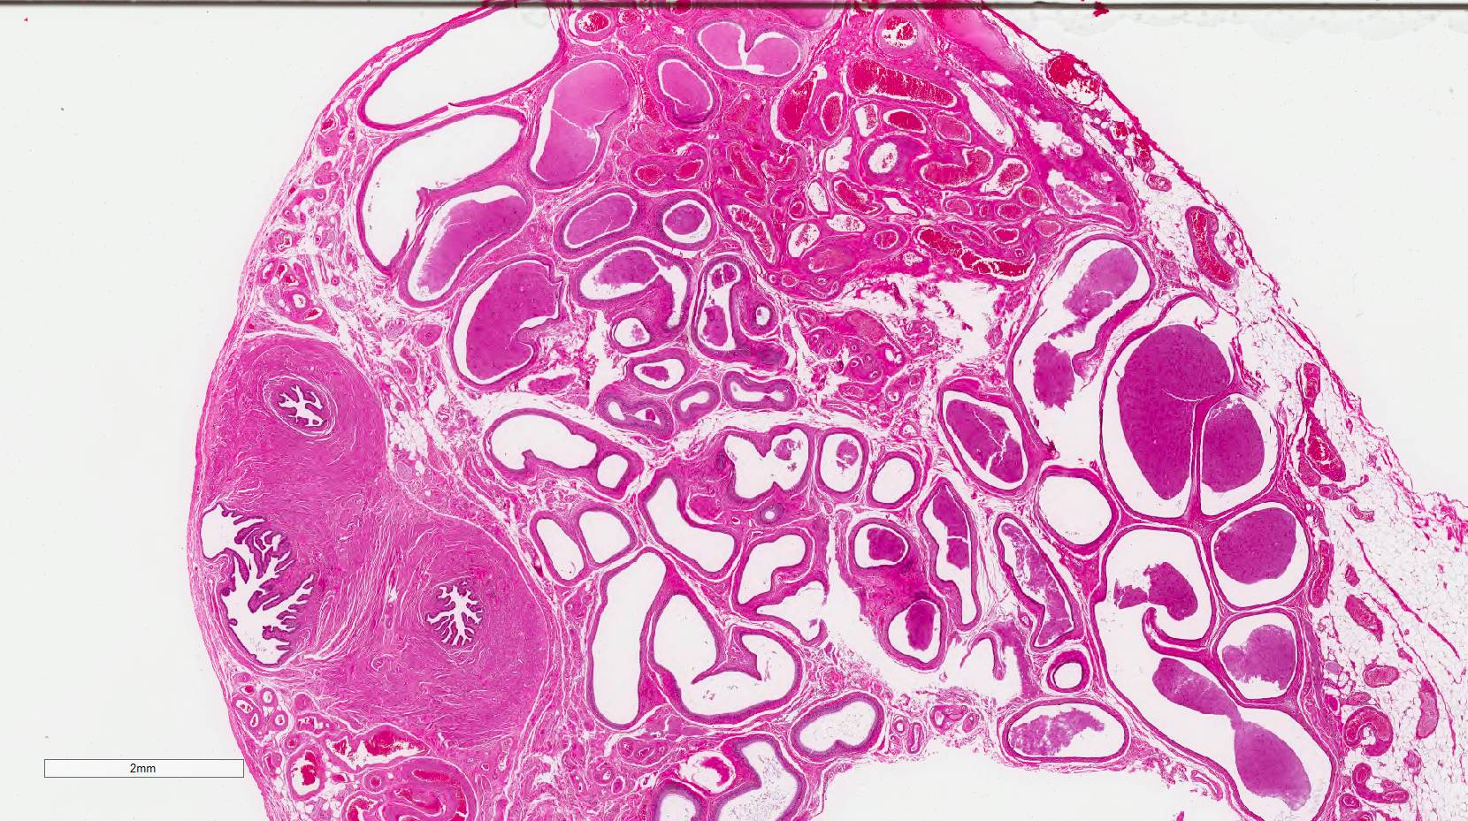

Slide 73
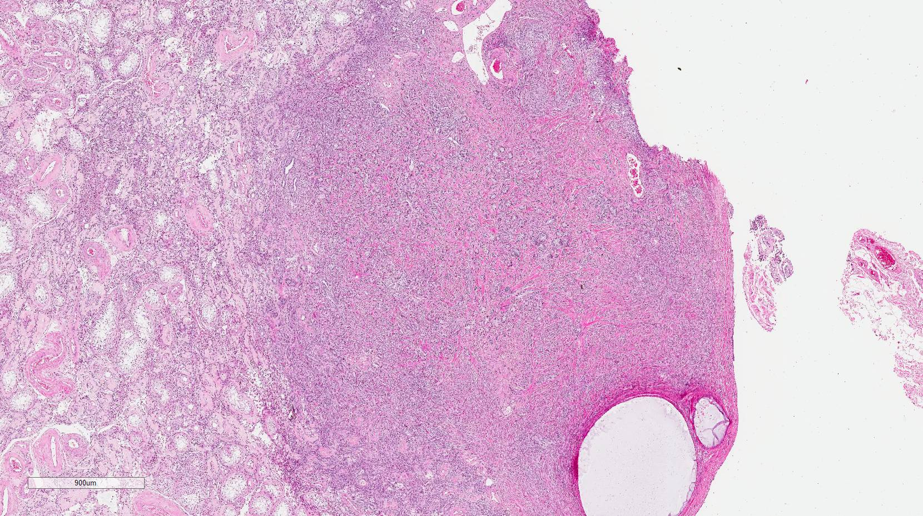
Notes:
Closer look shows the nodule to be composed of tubules in a very fibromatous stroma

Slide 74
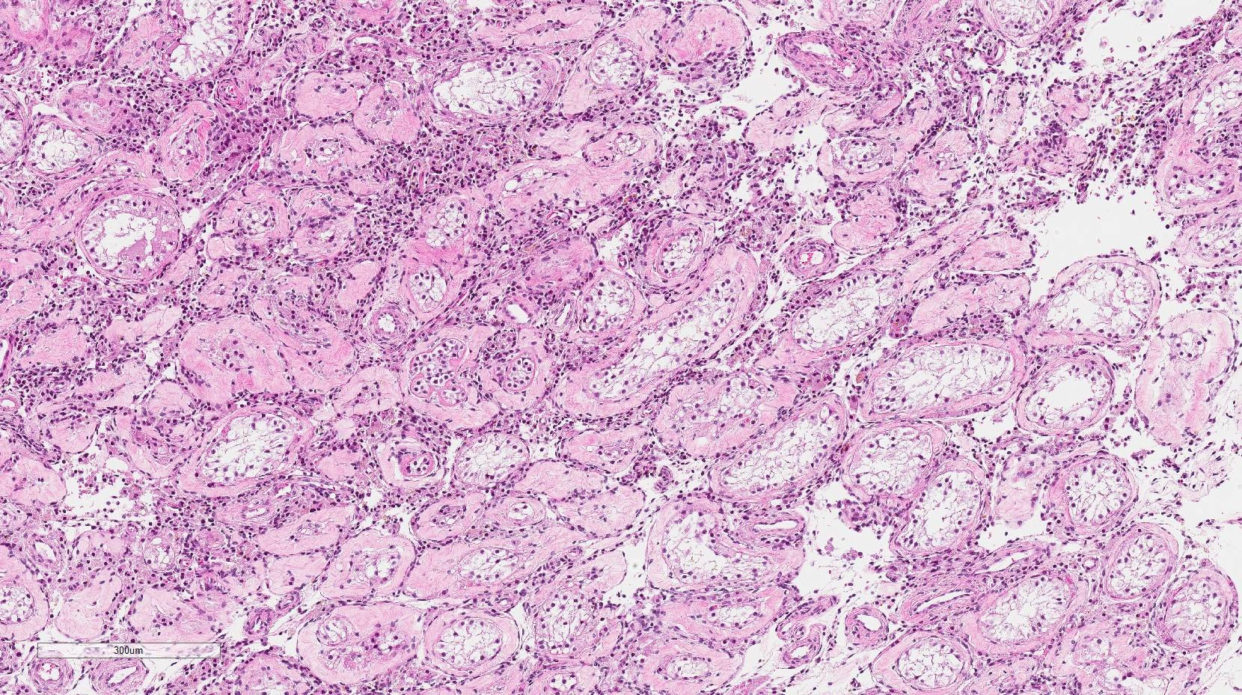
Notes:
Background testis was atrophic showing hyalinisation of seminiferous tubes and Leydig cell hyperplasia in the interstitium

Slide 75
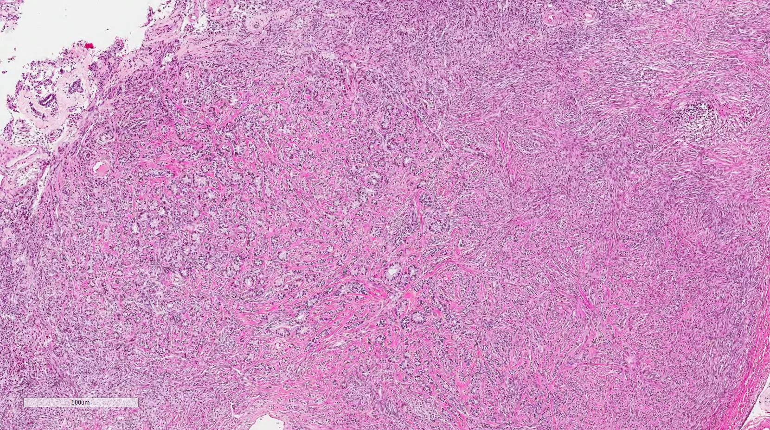
Notes:
Small tubules in stroma

Slide 76
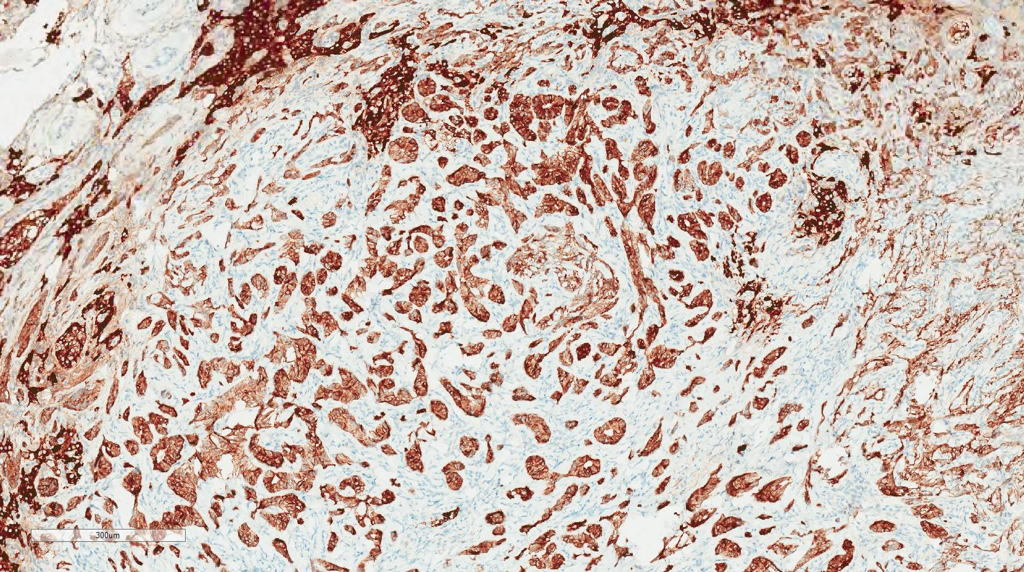
Notes:
Inhibin immunostain which showed the tubules to be very strongly positive
Other stains were also done …………..

Slide 77
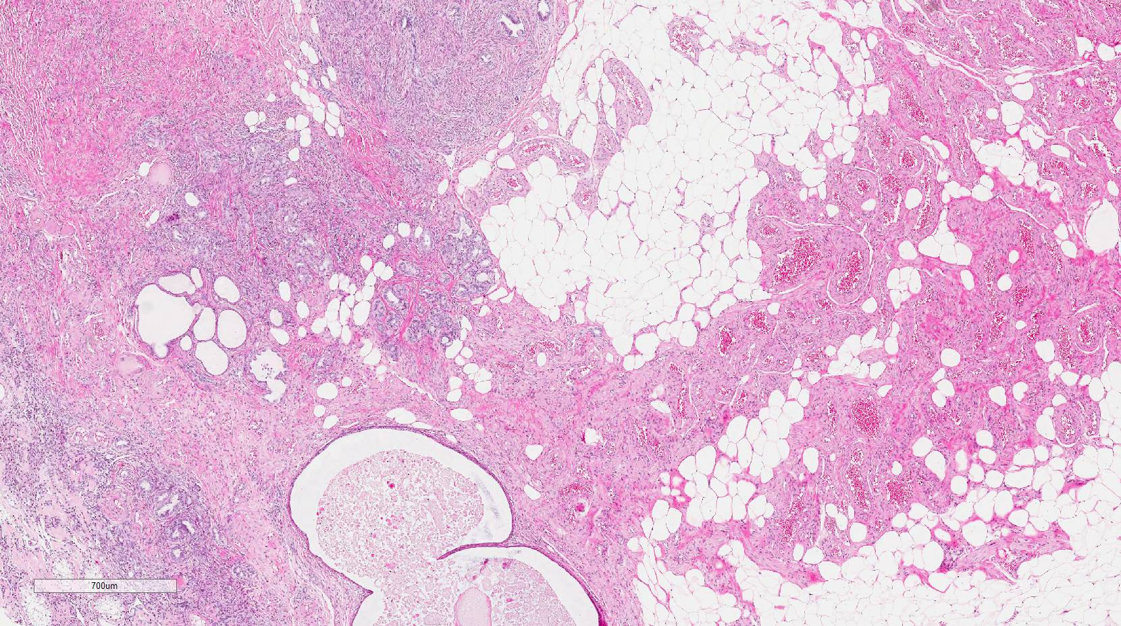
Notes:
Very focal invasion of the hilar fat was seen and hence this Sertoli cell lesion was classified as tumour and not Sertoli cell nodule or Pick’s adenoma

Slide 78
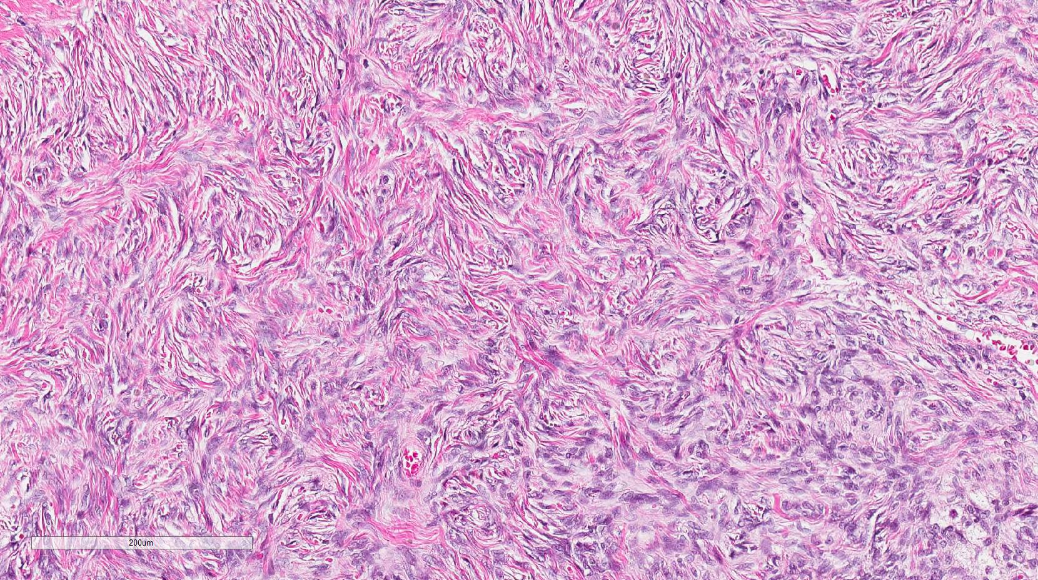
Notes:
Very fibromatous stroma in which the tubules were embedded.
Storiform architecture and reminiscent of ovarian stroma

Slide 79
Notes:
Another similar smaller lesion was seen against the tunica albuginea
Odd convulated tubal structure next to the epididymis

Slide 80
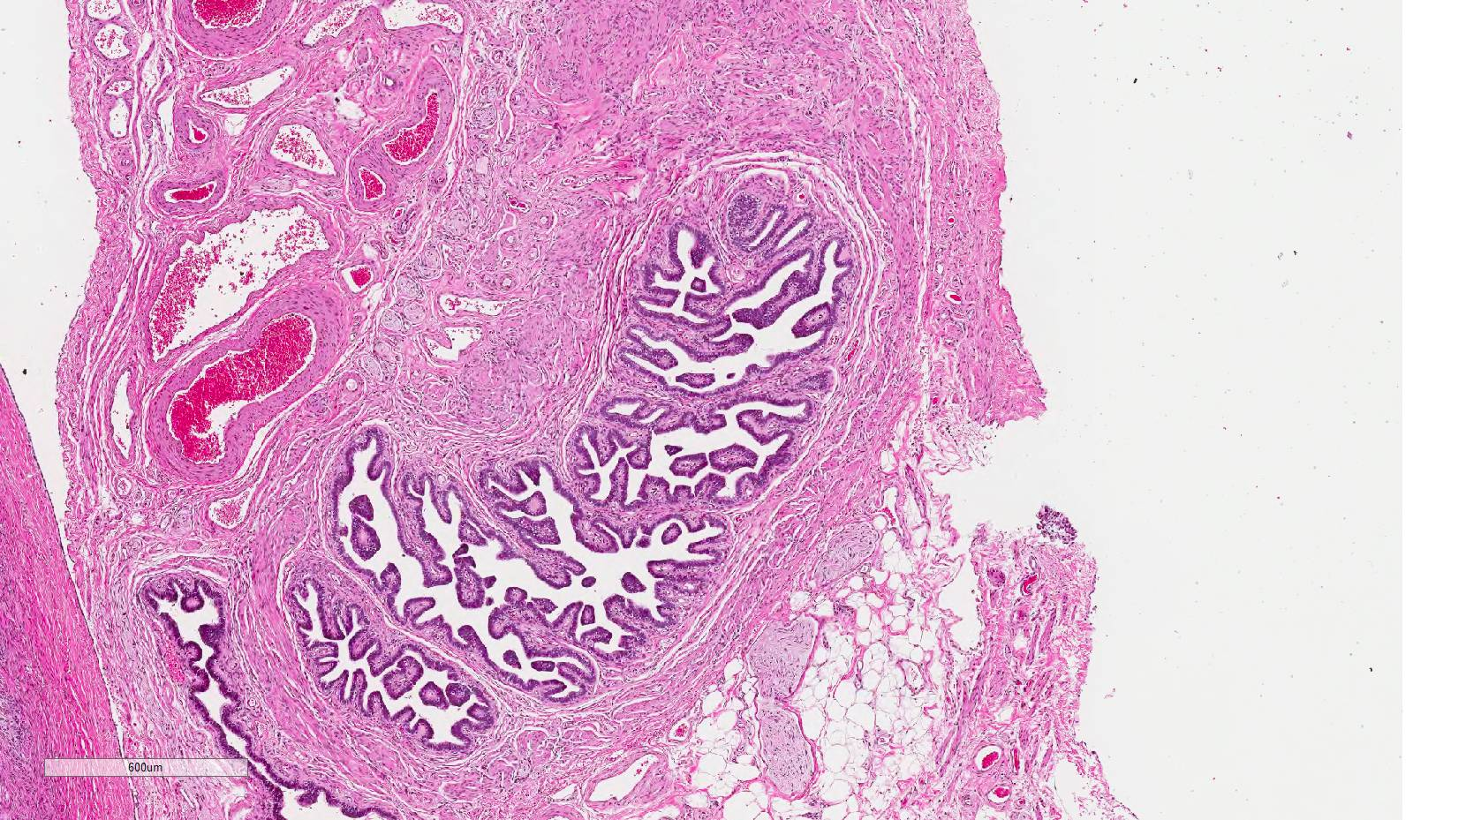
Notes:
Muscle wall and convulated epithelial lining

Slide 81
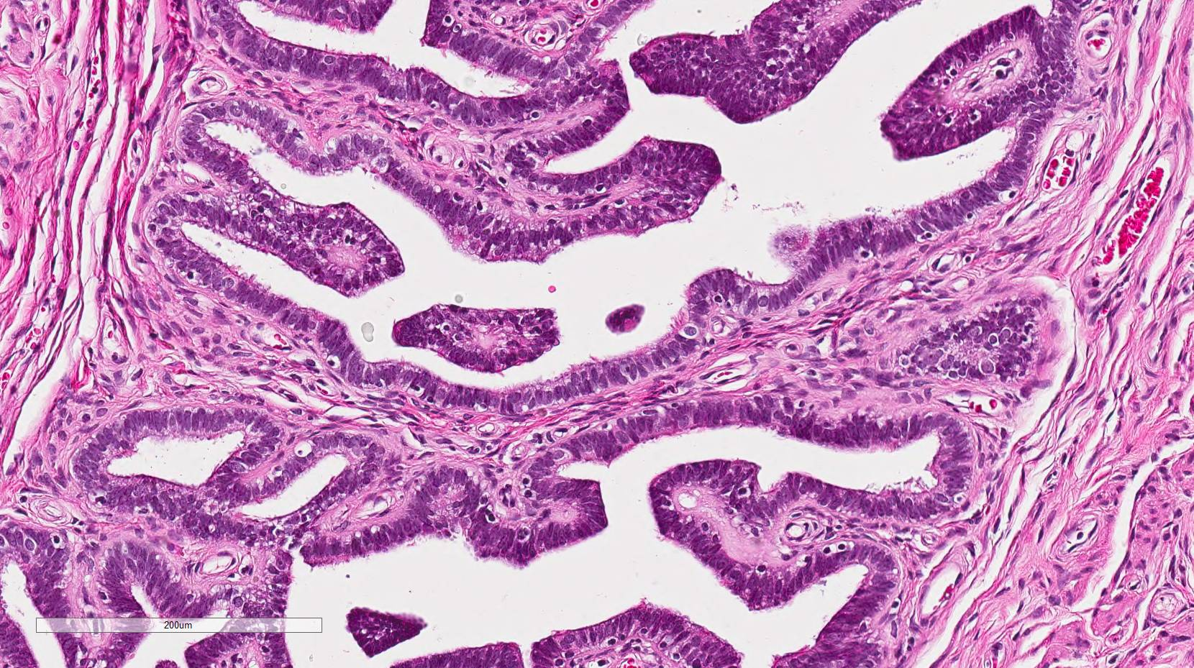
Notes:
Tubal type epithelium with intercalated cells and also cilia

Slide 82
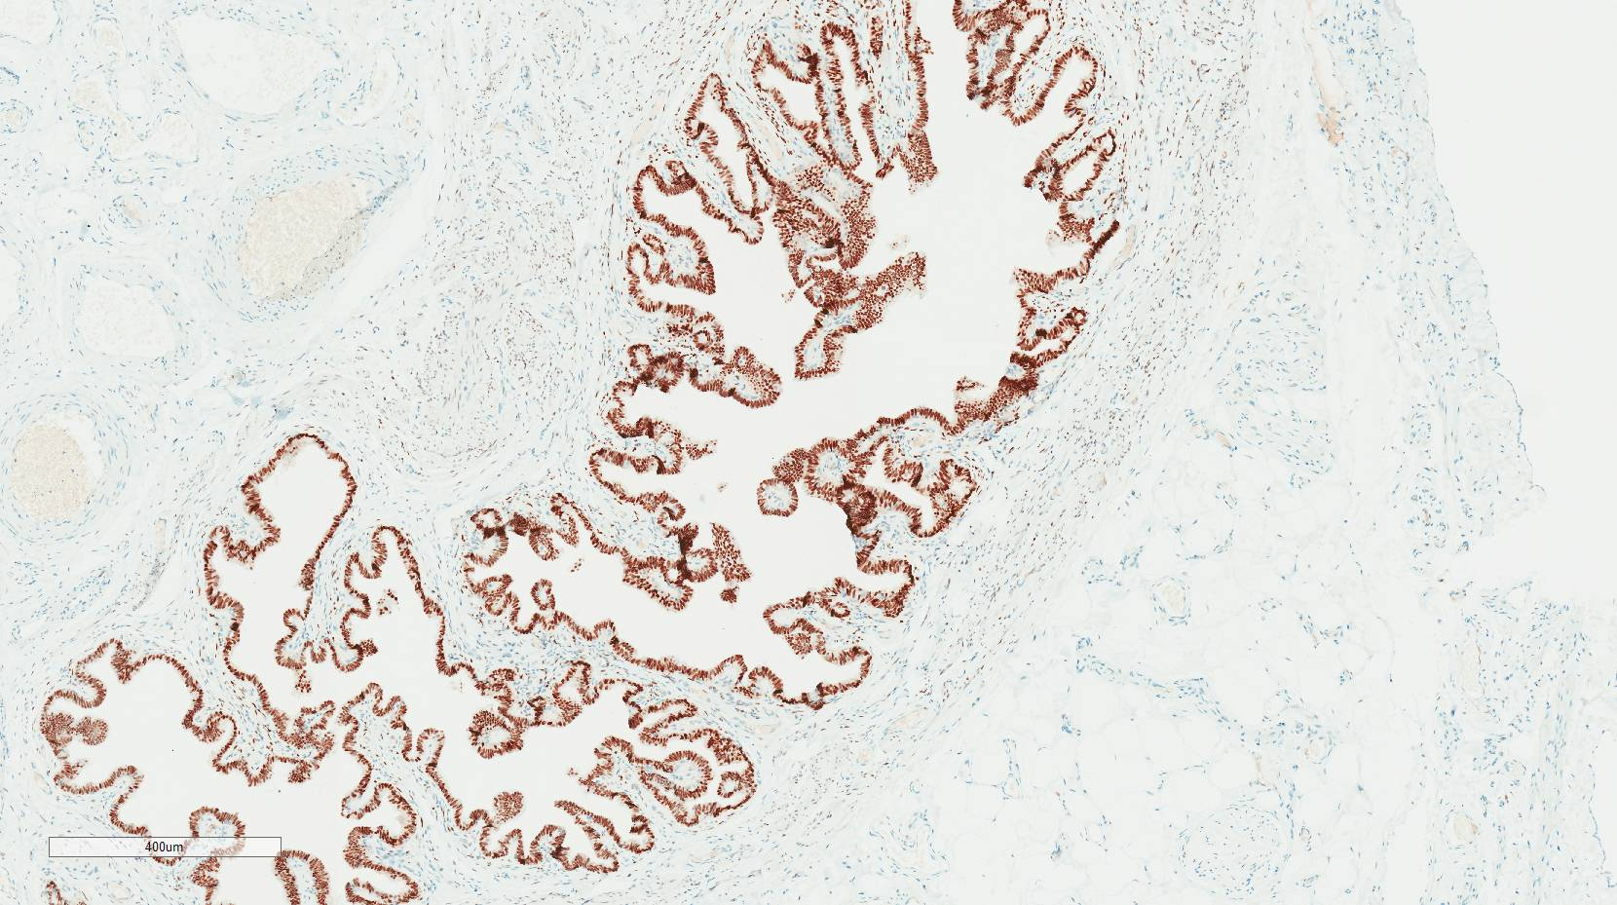
Notes:
ER positive

Slide 83
DIAGNOSIS
SERTOLI CELL TUMOUR IN OVOTESTIS
TRUE HERMAPHRODITE WITH MALE PHENOTYPE
Hilar fat invasion present so pT2
10% chance of malignant behaviour
Notes:
Sertoli cell tumour not nodule even though small and in atrophic testis and hence 10% chance of malignant behaviour.

Slide 84
FOLLOW UP
True hermophrodite status not discussed with patient
Karyotyping not done
No evidence of tumour spread on CT abdomen and pelvis – 6 months post surgery
Normal tumour markers

Slide 85
TAKE HOME MESSAGES
Seminoma is the most common testicular GCT
Evidence to suggest that nonseminomatous GCT evolve from seminoma, therefore scrutinize all cases of seminoma very carefully to look for other components
Crucial to differentiate pure seminoma from mixed GCT as treatment is different
Important to differentiate GCT from sex cord stromal tumours as treatment is different
Notes:
With this I conclude my presentation with a few take home messages. Seminoma is the most common testicular GCT and there is now good evidence to suggest that nonseminomatous GCT evolve from seminoma and therefore it is important that all cases of seminoma very carefully scrutinized to look for other GCT elements. It is absolutely crucial to differentiate between pure seminoma and mixed GCT as treatment is different. Similarly, it is very important to differentiate GCT from sex cord stromal tumours as treatment is different.

Slide 86
Use IHC to accurately subtype testicular tumours as cure rate is very high even in metastatic tumours
Regressed GCT have metastatic potential, hence important to differentiate from nonspecific scar
Dysgenetic gonads and certain syndromes have unique associations and very high incidence of testicular tumours
Notes:
IHC should be used, and I would say quite judiciously if need be to accurately subtype testicular tumours as cure rate is very high even in metastatic tumours and we know that treatment is different for different tumour subtypes. Regressed GCT have metastatic potential, hence important to differentiate from nonspecific scar. Dysgenetic gonads and certain syndromes have unique associations and very high incidence of testicular tumours, so it is worth looking for clues of gonadal dysgenesis and syndromic associations while evaluating testicular tumours.

Slide 87
THANK YOU

