Slide 1

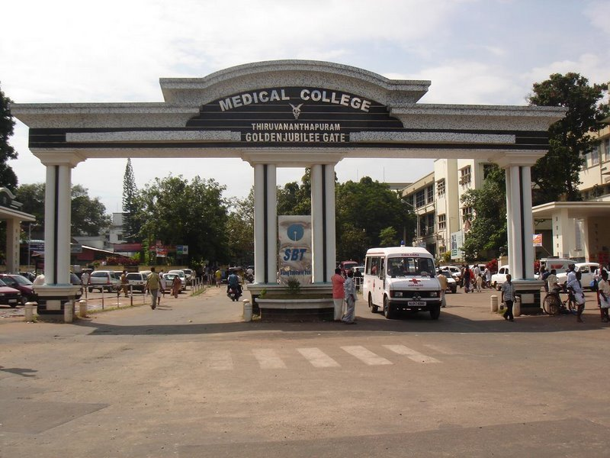

Slide 2
Anti microbial Photodynamic Therapy in Periodontitis
Presented by:
Dr. Presanthila Janam
Principal
Govt. Dental College
Trivandrum
Kerala
INDIA

Slide 3
Outline
Background
  Mechanism of action
  Materials and methods
Efficacy in terms of clinical parameters
  Perception of patients
  Antimicrobial effect
Conclusions and future perspectives

Slide 4
Question of the day
Is photodynamic therapy effective in the management of periodontitis?

Slide 5
Chronic Periodontitis
Current treatment approaches
  SRP- Gold standard
  Adjunctive treatments (Systemic & Local delivery)
  Drawbacks of antimicrobials
    low concentrations in the periodontal pocket
    microbial resistance (Meisel, P., & Kocher, T. (2005)
    allergies, gastro-intestinal disorders(Quirynen et al., 2003; )
    reduced patient compliance (Rodrigues et al., 2004).

Slide 6
Rationale
Need to develop new antimicrobial concepts as alternatives to conventional chemotherapy.
Novel site specific treatment option in controlling the subgingival microorganisms
killing microbes in localized topical infections (Katie et al., 2005).
In-vitro Wilson et al., 1996; Soukos et al., 2003. Pfitzner et al., 2004
Animal studies Komerik et al., 2003; Sigusch et al., 2005
Katie, et al (2005) The potential for photodynamic therapy in the treatment of localized infections. Photodiagnosis and Photodynamic Therapy 2, 247–262.

Slide 7
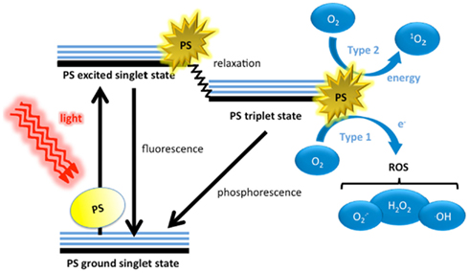
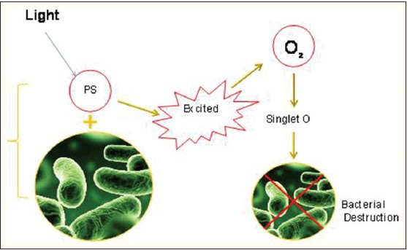
aPDT-mechanism of action
Transfer of energy causes the formation of free radicals of singlet oxygen exerting a
destructive action on bacteria and their products (Dobson & Wilson 1992, Komerik et al 2003).
Komerik, et al (2003) In vivo killing of Porphyromonas gingivalis by toluidine blue-mediated photosensitization in an animal model. Antimicrobial Agents and Chemotherapy 47, 932–940.

Slide 8
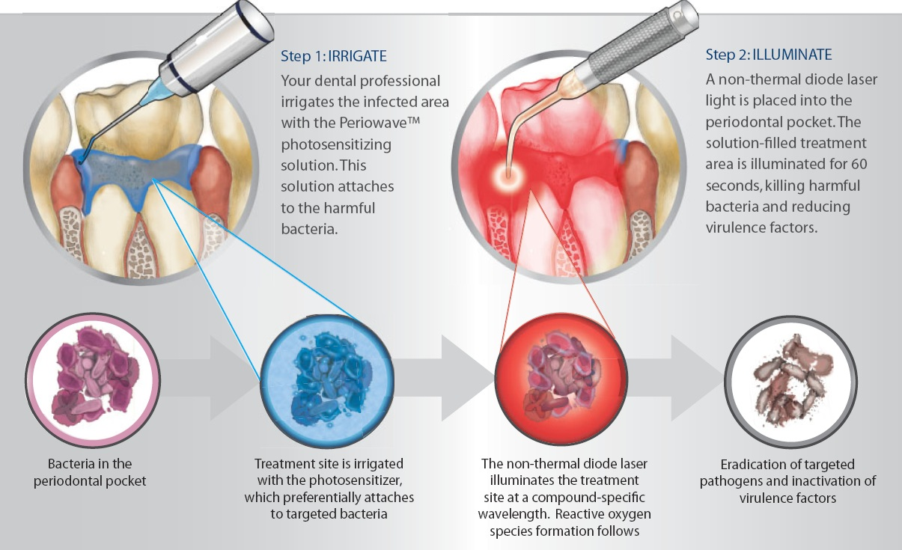

Slide 9
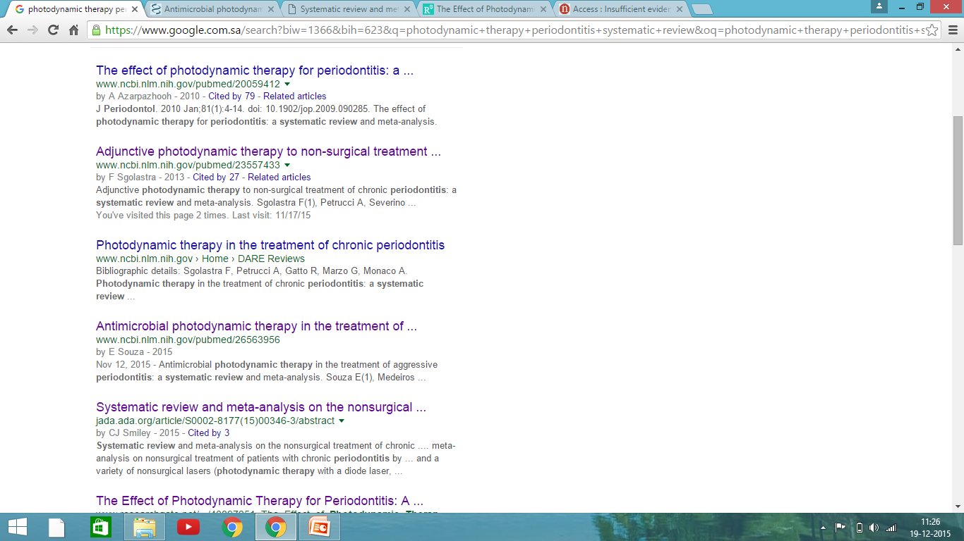

Slide 10
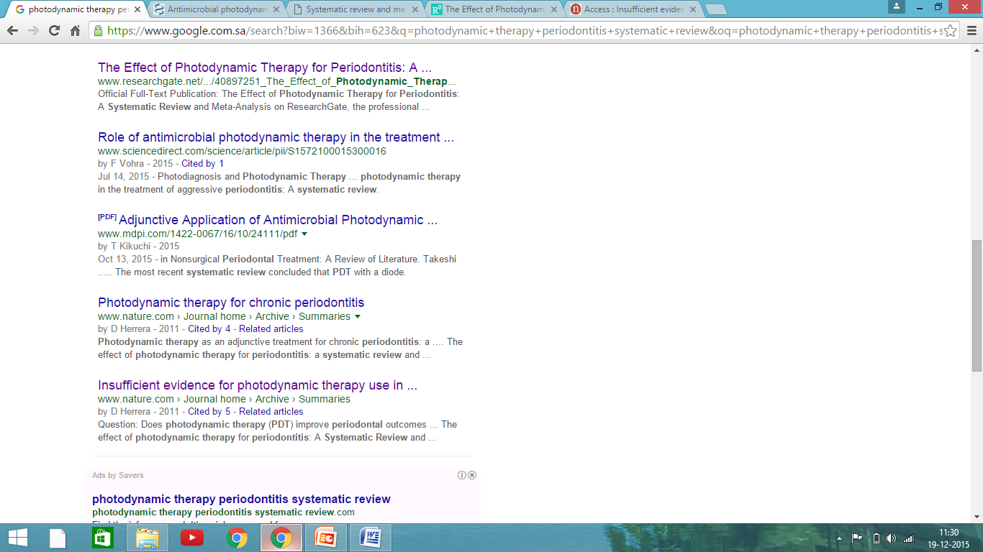

Slide 11
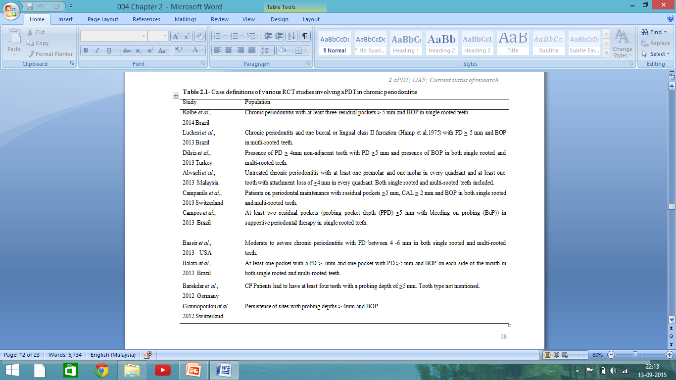

Slide 12
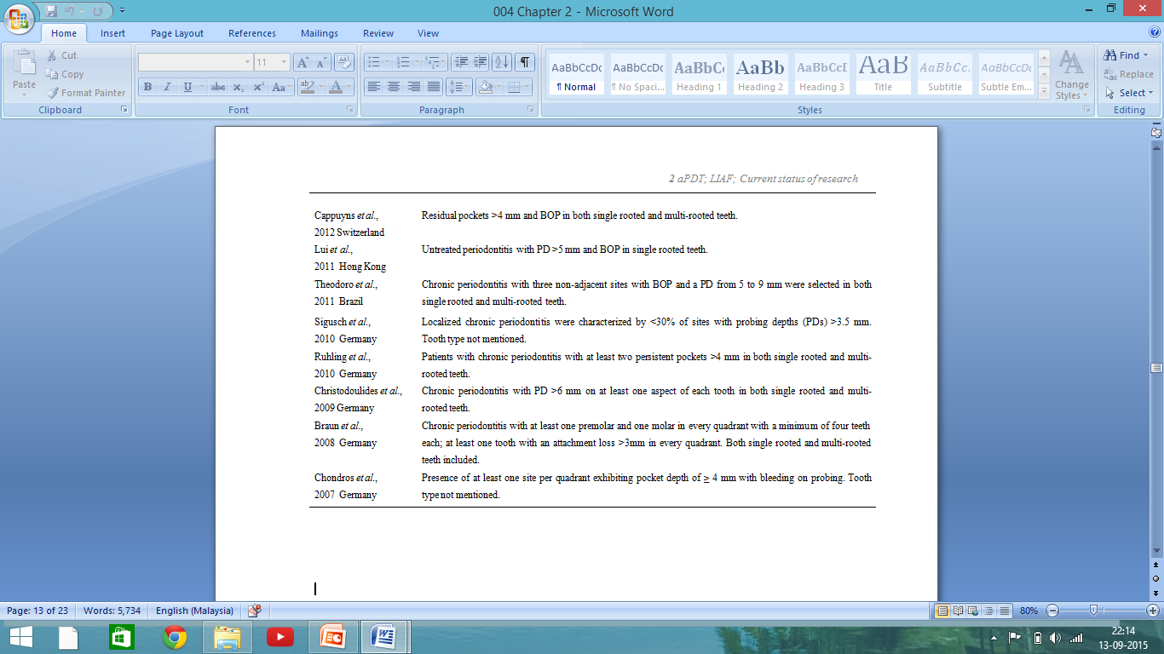

Slide 13
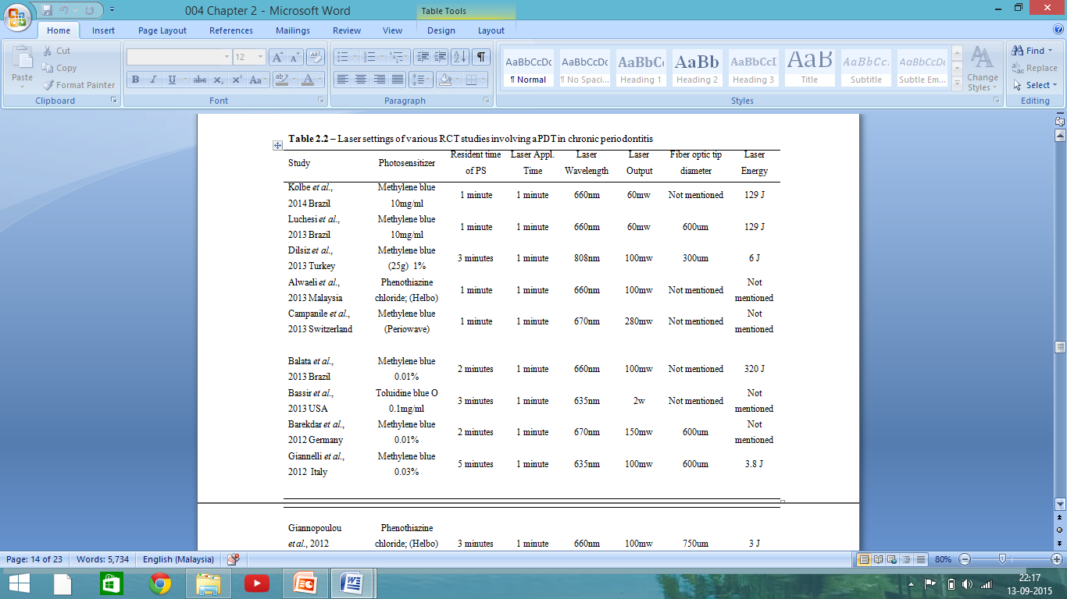

Slide 14
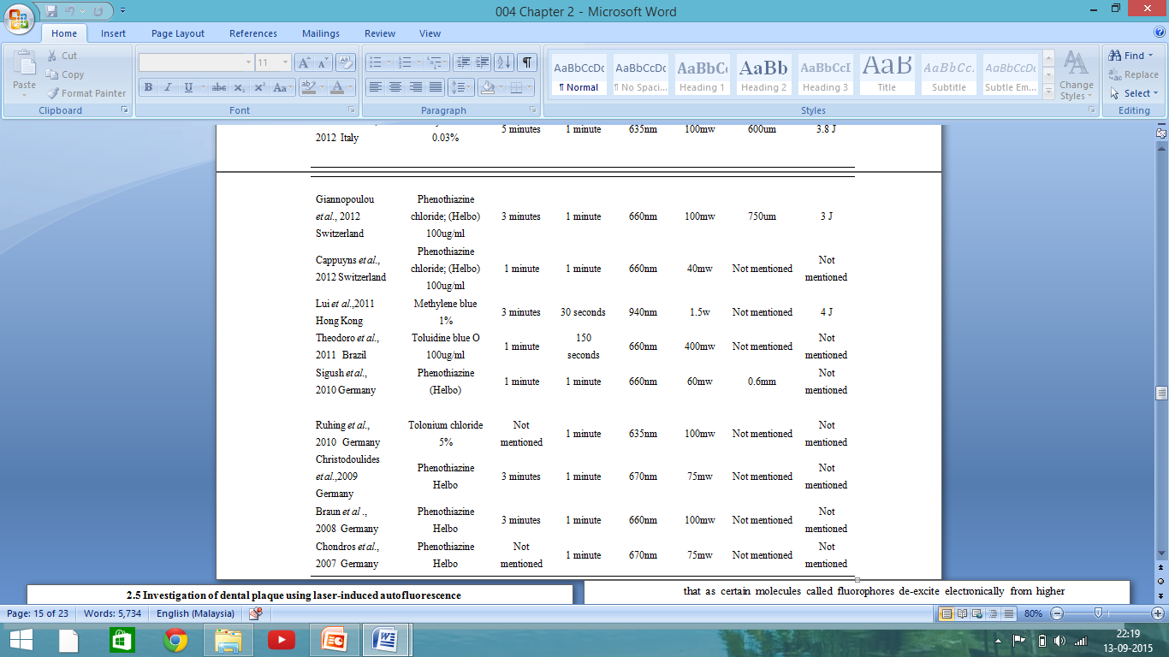

Slide 15
Efficacy Of Photodynamic Therapy In The Management Of Chronic Periodontitis In Terms Of Clinical Parameters

Slide 16
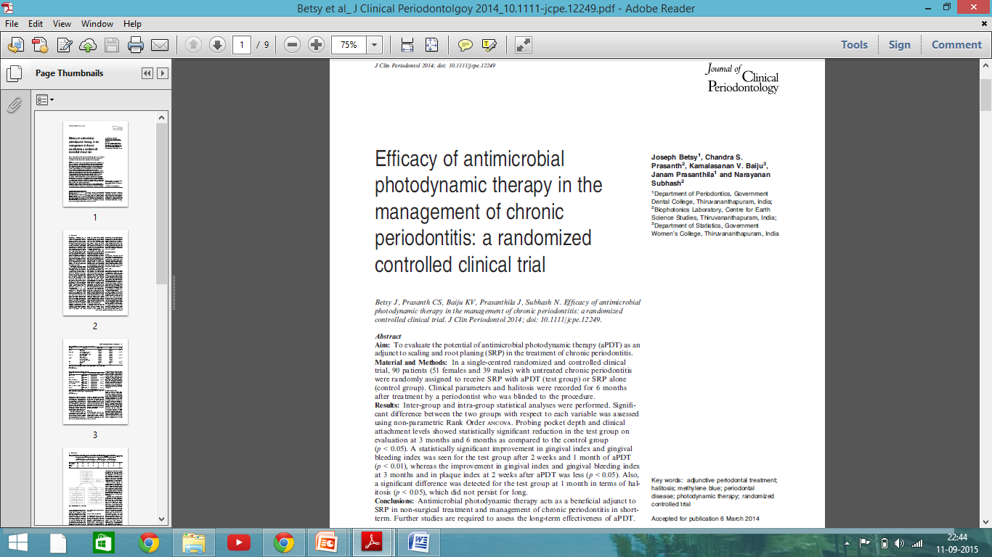

Slide 17
Study Protocol and Ethical clearance
Institutional Ethics committee of GDC
IEC no. IEC/C/42-A/2011/DCT/dtd18/1/2011.
Clinical trial registry of India:
CTRI no-CTRI/2014/05/004636
Informed consent from patients diagnosed with chronic localized periodontitis
Study centre
Department of Periodontics GDC, Trivandrum
Centre for Earth Science Studies, Trivandrum
Development of aPDT and LIAF unit (Biophotonics laboratory of CESS )

Slide 18
Inclusion criteria
PPD between 4 and 6 mm at least in two different quadrants of the mouth
age between 18 and 65 years (both males and females)
single rooted teeth, good general health without any signs of systemic disease
no use of antibiotics for the past 6 months
female patients were not pregnant or lactating
non-smoking and
non-allergic to methylene/toludine blue.

Slide 19
Exclusion criteria
Teeth other than incisors and canines
Teeth presenting unsatisfactory restorations
Caries lesions
Fractures
Teeth where the CEJ is difficult to determine

Slide 20

Study design
Double blinded randomized controlled trial
Sample size calculation
Oral hygiene program
Effect size = 0.5
Standard deviation =0.6
(Zα+Zβ)²=13).
At least 37 subjects in each group
20% was added to compensate for loss
Therefore, a total of 90 patients
SRP
44
Test
SRP+aPDT
44
Control

Slide 21
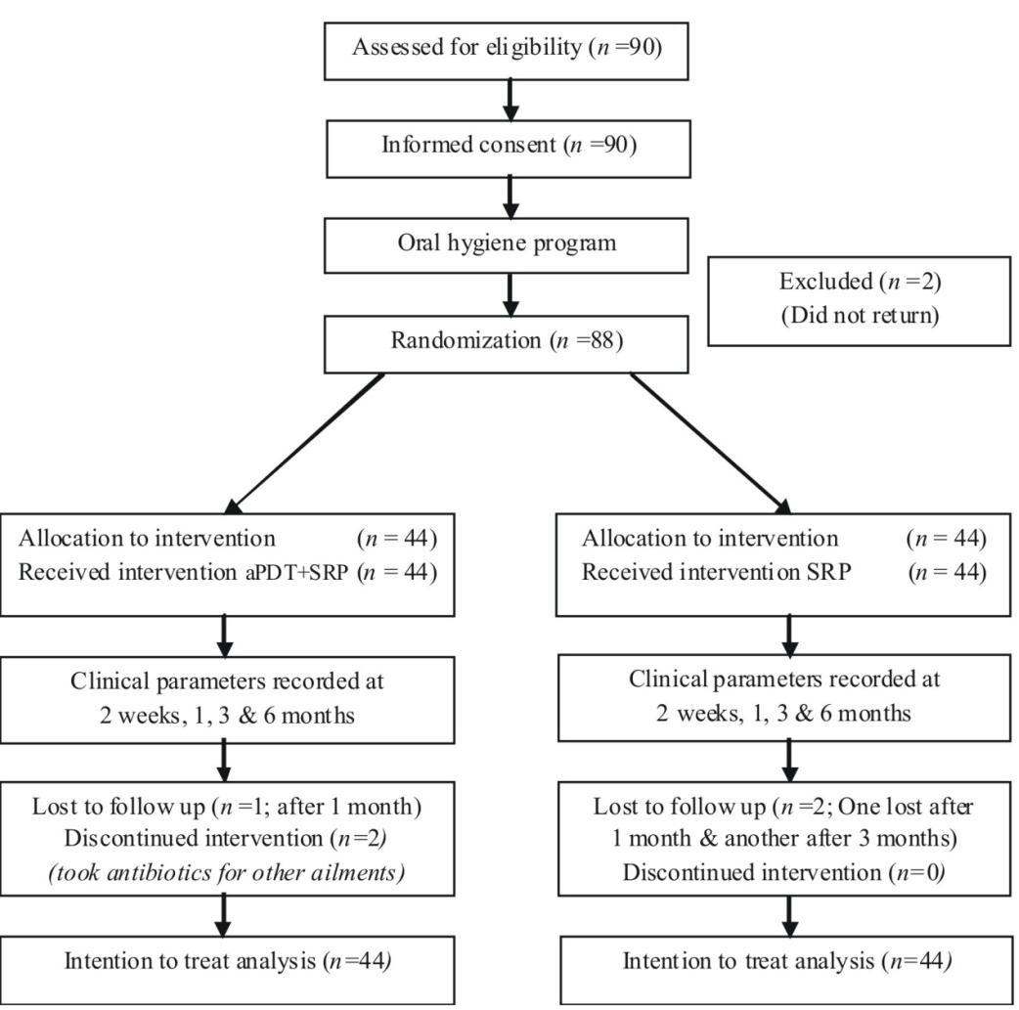
CONSORT Flow chart

Slide 22
Treatment protocol
Control group (Group 1)
SRP
Full-mouth supragingival and subgingival scaling
No other treatment was given to this group.
All sites within 24 hours until the operator felt that tooth and root surfaces were adequately debrided and planed.
Test group (Group 2)
aPDT in addition to SRP.
Methylene blue (MB) was the photosensitizer used

Slide 23
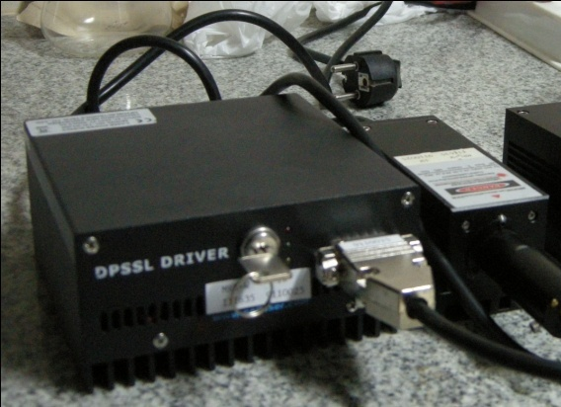
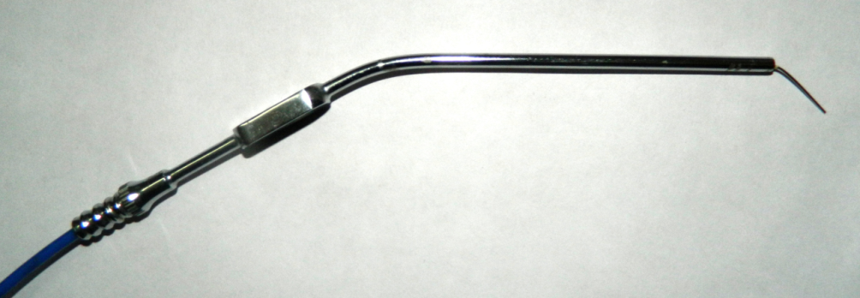
Diode laser (CNI Opto-electronics Tech. Co. Ltd, Changchun, China)
655 nm
Continuous laser
60mW/cm²
60 s per site
The laser beam was guided through a flexible fibre-optic cable (200 um dia.)
The outer diameter of the SS probe tip was 0.5 mm, which facilitated easy access to periodontal pockets.
Top-hat energy distribution
Freshly prepared methylene blue (MB) [M9140; Sigma-Aldrich, St. Louis, MO, USA]
Crystals suspended in double distilled water 10 mg/ml.

Slide 24
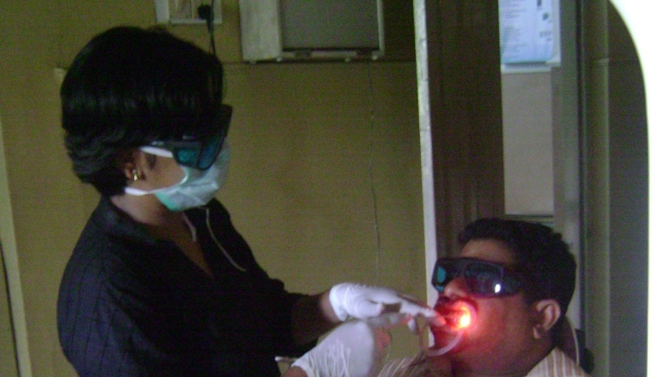
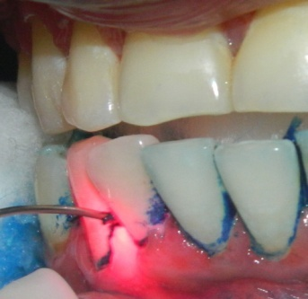
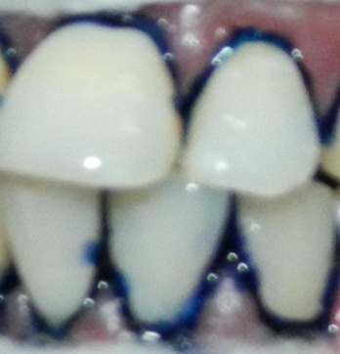
SRP
2ml MB 60 sec
Resident time
Irrigate with distilled water
LASER 60 sec per site
The aPDT treatment was performed at a continuous laser power density of 60 mW/cm²,
Mesiobuccal, distobuccal, mesiolingual or distolingual site with 4–6 mm pockets on selected teeth.

Slide 25
Results

Slide 26
Table. Socio-demographic characteristics of patients at baseline
Variable | Category | aPDT+SRP | SRP | p-value
Gender | Male | 22(50%) | 15(34.1%) | 0.101^{ns} $
 | Female | 22(50%) | 29(65.9%)
Occupation | Agriculture/Laborer | 30(68.2%) | 31(70.5%) | 0.113^{ns} $
 | Private Employees | 9(20.4%) | 10(22.7%)
 | Govt.Employees | 5(11.4%) | 3(6.8%)
Education | Middle school | 17(38.6%) | 18(40.9%) | 0.176^{ns} $
 | High school | 13(29.6%) | 16(36.4%)
 | College | 14(31.8) | 10(22.7%)
Income | Rs. 2000-6000 | 16(36.4%) | 19(43.2%) | 0.881^{ns} $
 | Rs. 6000-10000 | 20(45.4%) | 17(38.6%)
 | Rs. 10000 and above | 8(18.2%) | 8(18.2%)
SES | Average | 28(63.6%) | 30(68.2%) | 0.464^{ns} $
 | High | 16(33.4%) | 14(31.8%)
Age | Mean | 40.66 | 38.62 | 0.180^{ns} #
 | SD | 7.98 | 9.35

Slide 27
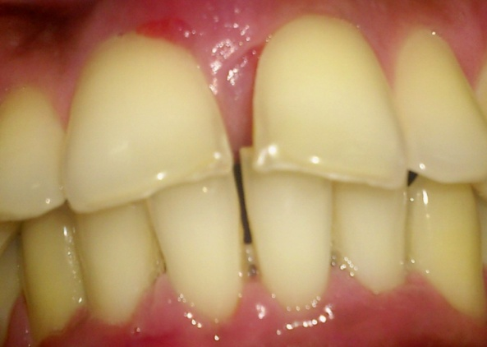
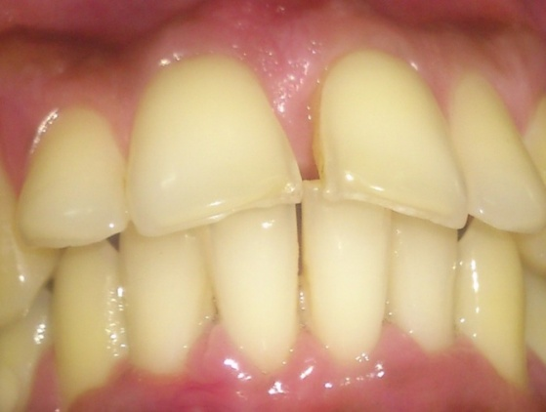
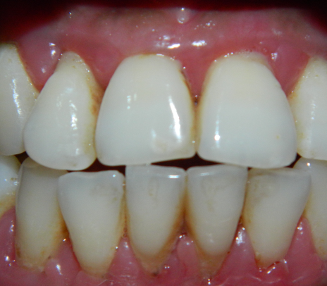
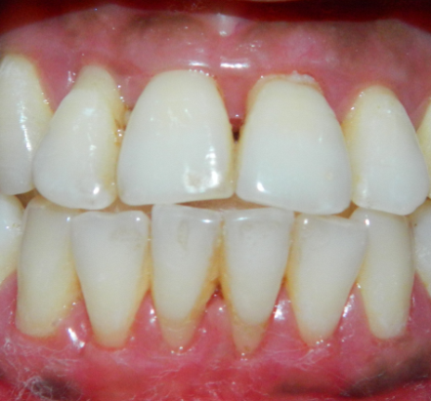
Table - Demographic data of teeth in enrolled patients in test and control group: number of all evaluated teeth
 | Test |  |  |  | Control
 | Female(n=22) |  | Male(n=22) |  | Female(n=29) |  | Male(n=15) |  | Total(n=88)
 | maxillary | mandibular | maxillary | mandibular | maxillary | mandibular | maxillary | mandibular
Central incisors | 16 | 10 | 20 | 10 | 12 | 15 | 13 | 14 | 110
Lateral incisors | 12 | 8 | 6 | 4 | 14 | 9 | 11 | 5 | 69
Canines | 9 | 4 | 7 | 3 | 6 | 11 | 3 | 7 | 50
 | (37) | (22) | (33) | (17) | (32) | (35) | (27) | (26) | (229)
Total | 109 |  |  |  | 120 |  |  |  | 229

Slide 28
Table .Characteristics of clinical parameters at baseline
Baseline | Group | n | Median (Min-Max;IQR) | p-value
Gingival Score | aPDT+SRP | 44 | 2 (1.5-3;0.52) | 0.904 ^{ns} #
 | SRP | 44 | 2.2 (1.2-2.8;0.5)
Plaque score | aPDT+SRP | 44 | 2 (0.5- 3;0.97) | 0.301 ^{ns} #
 | SRP | 44 | 1.25 (0.5-3;1)
GBI | aPDT+SRP | 44 | 100 (50-100;25) | 0.232 ^{ns} #
 | SRP | 44 | 75 (50-100;25)
Probing Pocket Depth | aPDT+SRP | 44 | 5.7mm (5-6;1) | 0.363^{ns} #
 | SRP | 44 | 5.5 mm (4.25-6;1)
Recession | aPDT+SRP | 44 | 1mm (0-2;1) | 0.760 ^{ns} #
 | SRP | 44 | 1 mm (0-2;1)
Clinical Attachment Level | aPDT+SRP | 44 | 6.5 mm (5-8;1.42) | 0.455 ^{ns} #
 | SRP | 44 | 6 mm (4.25-8;1.73)

Slide 29
Table : Difference in PPD and CAL at baseline, 1, 3 and 6 months of treatment
Parameter | Baseline | At 1 mo | At 3 mo | At 6 mo | p- values
PPD | Median (Min-Max;IQR) | Median (Min-Max;IQR) | Median (Min-Max;IQR) | Median (Min-Max;IQR) | 0-1 mo | 0–3 mo | 0–6 mo
Test | 5.7mm (5-6;1) | 4mm (2-5.6;1) | 3.12mm (2-4.75;1) | 3mm (2-4.5;1) | <0.0005 | <0.0005 | <0.0005
Control | 5.5 mm (4.25-6;1) | 4.3 mm (3-5.25;1) | 3.42 mm (2-5;1) | 3.5mm (2-5;1) | <0.0005 | <0.0005 | <0.0005
p- values |  |  |  |  | 0.575^{ns} | 0.041* | 0.028*
R
Test | 1mm (0-2;1) | 1 mm (0-2;1) | 1 mm (0-2;1) | 1 mm (0-2;1) | 0.046 | 0.366 ^{n s} | 0.354^{ns}
Control | 1 mm (0-2;1) | 1 mm (0-3;1) | 1 mm (0-2;1) | 1 mm (0-3;1) | 0.014 | 0.48 ^{ns} | 0.019^{ns}
p- values |  |  |  |  | 0.881 ^{ns} | 0.518^{ns} | 0.363^{ns}
CAL
Test | 6.5 mm (5-8;1.42) | 5.25 mm (3-7.2;2.05) | 4mm (2-5.75;1.43) | 4mm (2.6-5.5;2) | <0.0005 | <0.0005 | <0.0005
Control | 6 mm (4.25-8;1.73) | 5mm (4-8;1.23) | 4.1mm (2-6;2) | 4mm (2-7;1.85) | <0.0005 | <0.0005 | <0.0005
p- values |  |  |  |  | 0.932^{ns} | 0.445* | 0.027*

Slide 30
Table : Difference in GI,PI and GBI at baseline,2 wks, 1mo, 3 mo and 6 months treatment
Parameter | Baseline | 2 wks | 1 month | 3 months | 6 months | p- values
 | Median (Min-Max;IQR) | Median (Min-Max;IQR) | Median (Min-Max;IQR) | Median (Min-Max;IQR) | Median (Min-Max;IQR) | 0–2 wks | 0–1 month | 0-3 months | 0-6 months
GI
Test | 2 (1.5-3;0.52) | 1 (0-2.1;0.42) | 0.75 (0-2;0.76) | 0.8 (0-2.2;0.76) | 1 (0.5-2;1) | <0.0005 | <0.0005 | <0.0005 | <0.0005
Control | 2.2 (1.2-2.8;0.5) | 1.45 (0.50-2.50;0.67) | 1 (0-2.7;0.6) | 1 (0-2.1;0.55) | 1.4 (0.2-2.4;1) | <0.0005 | <0.0005 | <0.0005 | <0.0005
p- values |  |  |  |  |  | 0.001** | 0.004* | 0.016* | 0.27^{ns}
PI
Test |  | 0.75 (0-2.5;0.5) | 0.5 (0-2.5;1) | 0.5 (0-2.5;1) | 1 (0-2.5;0.81) | <0.0005 | .034* | <0.0005 | <0.0005
Control | 1.25 (0.5-3;1) | 1 (0-2;0.5) | 0.5 (0-1.5;0.75) | 0.5 (0-1.5;0.75) | 0.5 (0-2;0.5) | <0.0005 | <0.0005 | <0.0005 | <0.0005
p- values |  |  |  |  |  | 0.035* | 0.384 ^{ns} | 0.631^{ns} | 0.553^{ns}
GBI
Test | 100 (50-100;25) | 25 (0-100;50) | 25 (0-75;25) | 25 (0-75;6.25) | 25 (0-75;50) | <0.0005 | <0.0005 | <0.0005 | <0.0005
Control | 75 (50-100;25) | 37.5 (0-100;75) | 25 (0-100;50) | 25 (0-100;25) | 25 (0-100;50) | <0.0005 | <0.0005 | <0.0005 | <0.0005
p- values |  |  |  |  |  | 0.033* | 0.026* | 0.025* | 0.40^{ns}

Slide 31
Reduction in PPD Gain in CAL
3 & 6 months(p<0.05).
Comparable results Braun et al. (2008),
Pinheiro et al. (2010), Ge et al.
(2011), Berakdar et al. (2012) and
Alwaeli et al. (2013) heterogenous studies
Reduction in GI and GBI 2 weeks (p<0.01)
Reduction in GI and GBI
1 month and 3 months (p<0.05)
Multiple mechanism
increasing bacterial killing
inactivating bacterial virulence factors
inactivating host cytokines
a more favorable healing environment
(Braham et al 2009)
The reduction in GBI –correlated (de Oliveira et al.2007);Yilmaz et al. 2002)
BOP data- reported differently
In aggressive and chronic periodontitis de Oliveira et al. 2007,
Braun et al. 2008, Ge et al. 2011).
.
Braham, et al (2009) Antimicrobial photodynamic therapy may promote periodontal healing through multiple mechanisms. Journal of Periodontology 80, 1790–1798.

Slide 32
Single application of MB-mediated aPDT,
evaluated over a period of 6 months was found
to be effective in reducing gingival inflammation
and probing pocket depth.

Slide 33
Perceptions Of Patient About
Antimicrobial Photodynamic Therapy
In Chronic Periodontitis

Slide 34
Bleeding gums and pain inside the gums while chewing -reduction in the test group at 2 weeks and 1 month (p<0.05).
Halitosis - reduction in the test group at 1 month (p<0.05).
Acceptance same as control
Pain not more than control
Author | Sample | Parameter
Kolbe et al 2014 Brazil | 22 | Pain perception (VAS)
Betsy et al 2014 India | 90 | Halitosis as perceived by patient
Campanile et al 2013 Switzerland | 27 | Pain perception (VAS)
Cappuyns et al 2012 Switzerland | 32 | Pain perception (VAS)

Slide 35
Antimicrobial effects of Periodontal
Pathogens After aPDT

Slide 36
Novel treatment option in controlling the subgingival microorganisms-aPDT
Killing microbes in localized topical infections
(Katie et al.,2005,Cappynus et al 2011,Campanile et al 2013).

Slide 37
Dzink et al 1988
Detection of Actinomyces sp., decreased the likelihood of a site being disease active.
P.gingivalis was not seen after treatment in both groups. Griffen et al. 1998 and Moore and Moore 1994
This organism is rarely detected in healthy individuals.
Repopulation of periodontal pocket by 2 months
Magnuson et al 2002

Slide 38
Author | Sample size | Organisms evaluated | Conclusions
Kolbe et al 2014 Brazil | 22 | A.a, P.g and T.f (PCR) | PDT protocol presented inferior frequency of P. g at 3 months when compared with the other therapies.
Luchesi et al 2013 Brazil | 37 | A.a, P.g and T.f (PCR) | At 6 months, real-time PCR evaluation showed a decrease in P.g and T.f only in the PDT group with no inter-group differences.
Campanile et al 2013 Switzerland | 27 | P.g, A.a, T.f, T.d, P.i and P.micra (PCR) | Detection frequencies of the studied microorganisms at >1,000 and >100.000 cells/ml did not change significantly from baseline to months 3 or 6 in any group.
Cappuyns et al 2012 Switzerland | 32 | P. g, T. f, and T. d (RNA probe) | Frequencies of three microorganisms were significantly lower in aPDT- than in Diode soft laser-treated quadrants after 14 days, but not at months 2 and 6.
Theodoro et al 2011 Brazil | 33 | A.a, P.g, P.i, T.f and P.n (PCR) | All treatment groups showed a significant reduction in the proportion of sites positive for periodontopathogens at 60,90 and 180 days compared to baseline. At 180 days, PDT treatment led to a significant reduction in the percentage of sites positive for all bacteria compared to SRP alone.
Sigusch et al 2010 Germany | 24 | F.n (PCR) | Appropriate to reduce periodontal inflammation and to successfully treat infection with F. n.
Polansky et al 2009 Austria | 58 | P. g, T.f and T.d (PCR) | P. g was significantly reduced in both. No significant reductions of T. f and T. d were observed in either group.
Chondros et al 2007 Germany | 24 | A.a, P.g, P.i, T.d, T.f, P.m,F.n,C.r,E.n,E.c (PCR) | At 3 months after therapy, the microbiological analysis showed a statistically significant reduction of F.n and E.n in the test group.

Slide 39
Multiple mechanism
Increasing bacterial killing
Inactivating bacterial virulence factors
Inactivating host cytokines
A more favorable healing environment
(Braham et al 2009)
Adjuvant application of aPDT is appropriate to reduce successfully reduce many periodontal pathogens in chronic periodontitis.
Aggressive periodontitis and periodontal abscess should be evaluated in future studies.
Multiple sessions of aPDT recommended

Slide 40
Future Perspective

Slide 41
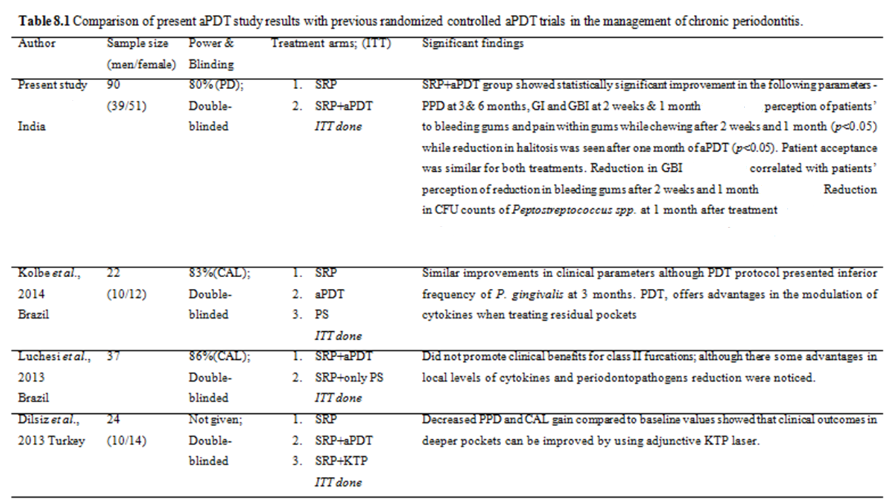

Slide 42
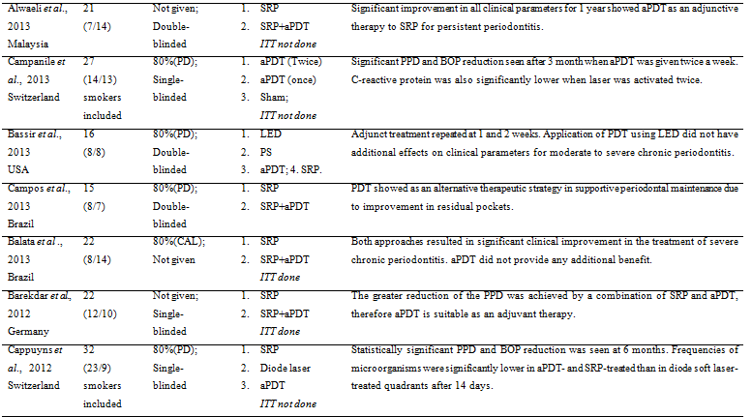

Slide 43
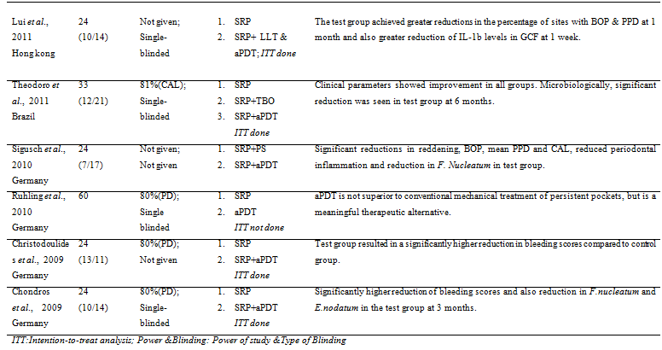

Slide 44
Application of single session of aPDT to sites with chronic periodontitis proves to be a valuable adjunct to mechanical debridement.
Significant changes in clinical parameters (GI,GBI and PPD), patient based outcome(Bleeding from gingiva, pain inside gingiva while chewing and halitosis) and microbiological parameters (reduction in CFU counts of periodontal pathogens)
No adverse effects reported by patients during 6 months reevaluation and equally preferred by patients as compared to SRP
As aPDT gives better clinical, patient- based outcomes and microbial results as compared to conventional SRP, this can definitely be proposed as an adjunct to improve treatment results.

Slide 45
Encouraging results obtained, it would be worthwhile to repeat aPDT at frequent intervals to obtain a more definitive cure.
Further, long term multi-centric aPDT studies are needed with newer photosensitizers and in different group of patients such as diabetic and patients on immunosuppresants to improve its generalizability in our population.

Slide 46


