Slide 1
XYLITOL PRODUCTION FROM WATER HYACINTH BIOMASS USING ACID CATALYST AND OPTIMISATION OF PROCESS PARAMETERS FOR INCREASING XYLOSE YIELD
AUTHOR’S
AMIT GANGULY,PREMSUNDER GHOSH,APURBA DEY,PRADIP KUMAR CHATTERJEE
Presented by
PREMSUNDER GHOSH
4th year student, Department of Biotechnology
NIT Durgapur
Under the guidance of
Dr. PRADIP KUMAR CHATTERJEE & Dr. AMIT GANGULY
THERMAL ENGG. DIVISION
CSIR-CMERI,DURGAPUR
Dr. APURBA DEY
Dept. of Biotechnology
NIT DURGAPUR

Slide 2
INTRODUCTION
XYLITOL
First discovered in 1891 by German chemist, Emil Fischer.
A five carbon sugar poly-alcohol
It is found in low content as a natural constituent of various fruits and vegetables
It is as sweet as sucrose with 33% fewer calories. As a result it can replace sucrose in low calorie products.
Xylitol is actively beneficial to mankind. It is a safe sweetener that doesn’t affect insulin levels of people with diabetes.
It has anticariogenic properties i.e effective in suppressing caries production thereby protecting the enamel of the teeth. Colgate Total with 10% xylitol.
It is relatively expensive by about $7/kg
Value added product which can be efficiently obtained from lignocellulosic biomass ( Lignin + Cellulose + Hemicellulose = Bio waste) such as sugarcane baggase, wheatstraw, soyabean stalks, corncobs etc., where hemicellulose is the main source for Xylitol obtained from Xylose sugar .

Slide 3
STRUCTURE OF XYLITOL
HO H OH
HOH₂C C C C CH₂OH
H OH H
Xylitol chemical structure
(Beutler, 1984)

Slide 4
Physical properties :
(Counsell-1978, Jaffe-1978, Bar-1991)
Formula : C₅H₁₂O₆
Mol. Wt. : 152.15
Appearance : White, crystalline powder
Odor : None
pH : 5-7
(1g/10ml)
Melting point : 93 – 94.5 ºC
Boiling point : 216 ºC
Density : 1.50 g/l
(15 ºC)
Caloric value : 4.06 cal/g [16.88 J/g]
Heat of Solution : 36.61 Cal/g ( 153.76 J/g)
Endothermic
Relative sweetness : Equal to sucrose, greater than sorbitol and mannitol
Specific Rotation : Optically Inactive

Slide 5
Commercial production of XYLITOL
This commercial production of xylitol is performed in the presence of a catalyst like Ni/Al₂O₃. However, high temperature and pressure requirements, and a low yield make such an important and useful product relatively expensive, as it costs about $7 per kg.

Slide 6
Alternative for Xylitol Production
Lignocellulosic Materials
Lignocellulosic is considered a future alternative for the agricultural products.
It is more abundant and less expensive than food crops, especially when waste streams are used.
Furthermore, the use of lignocellulosic biomass is more attractive as it is eco-friendly approach.
Lignocellulosic biomass is a plentiful and renewable resource for fuels and chemicals. It is composed of cellulose, hemicellulose, and lignin. The carbohydrate polymers (cellulose and hemicelluloses) are tightly bound to the lignin, by hydrogen and covalent bonds.

Slide 7
Rice straw(~220 million ton/year)
Ricinus communis (~1.6 million ton/year)
Lantana camara (0.2 million ton/year)
Maize straw (~16million tons/year)
Jatropha curcas (200 thousand metric ton/year)
Wheat straw (~ 70 million ton/year)
Water hyacinth (Eichhornia crassipes) growth rate of 17.5 metric tonnes per hectare per day
Rice husk (~12 million ton/year)
Jute waste (1.44 million ton/year)
Parthenium hysterophorous
Oil seed waste
Pomgamia

Slide 8

Agricultural waste | Cellulose | Hemicellulose | Lignin
Oilseed | 36 | 24 | 7
Maize straw | 25.6 | 28.11 | 34.87
Rice straw | 38.6 | 19.7 | 13.6
Wheat straw | 24 | 47 | 7.5
Rice husk | 28.6 | 28.6 | 24.4
Water Hyacinth | 25 35 | 35 33.5 | 10 15.50
Jute waste | 61 | 7 | 12

Slide 9
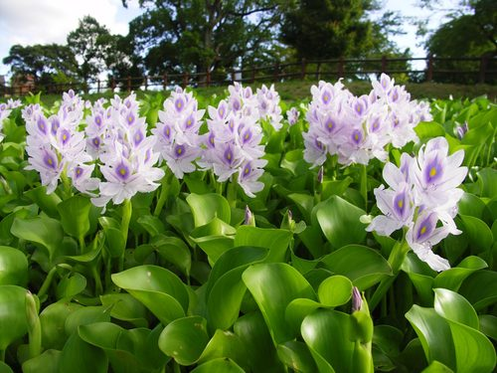
Selection of Lignocellulosic Material?
Water Hyacinth (Eichhornia crassipes) has high percentage of hemi-cellulose (33.5 to 35%) content in comparison to other available lignocellulosic biomass.
The only source of xylose, a pentose sugar is Hemicellulose, on fermentation of which yields our desired product Xylitol.
fast growing noxious weed, a cheap substrate, abundantly available, non edible, can be considered for conversion to a value added product Xylitol first by acid hydrolysis and then fermentation.
Very few research work is recorded on the conversion of Xylitol
from water hyacinth biomass till date.

Slide 10
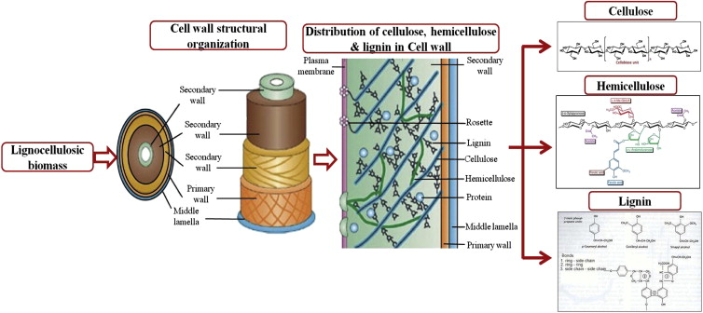
Generalized view of a Plant Cell Wall composition

Slide 11
FLOW DIAGRAM
XYLAN CONTAINING LIGNOCELLULOSICS
Pretreatment
WASHING & DRYING OF
BIOMASS
CATALYST (Acid)
HYDROLYSIS
FILTRATION
XYLOSE CONTAAINING
HYDROLYSATE
Enzyme or Micro organism
XYLITOL

Slide 12
Xylitol production from Water Hyacinth
Cellulose
Recalcitrant Lignin
Recalcitrant Lignin
Lignin
Delignification
Swelling
Hemi-cellulose
Hemi-cellulose
Cellulose
Water Hyacinth Biomass
Lignin
Xylitol
Fermentation
Yeasts
Pentoses
Bottom Residue

Slide 13
Objectives and Scope of work
Pretreatment of substrate(water hyacinth) by using acid catalyst( sulphuric acid)
Fermentation by microorganisms
Optimization to get maximum yield of xylose from hydrolysates

Slide 14
XYLITOL PRODUCTION FROM WATER HYACINTH BIOMASS USING ACID CATALYST AND OPTIMISATION OF PROCESS PARAMETERS FOR INCREASING XYLOSE YIELD
MATERIALS AND METHODS

Slide 15
METHODOLOGY
Pretreatment of biomass
Sizing
Crushing
Acid pretreatment
Fermentation
    Pichia stipitis
Measurement /ANALYSIS
UV-Spectrophotometric method
HPLC

Slide 16
ANALYTICAL METHODS
Estimation of xylose: Phloroglucinol method
OPTIMIZATION
Response surface methodology (RSM) is the most preferred method for optimization in recent time. RSM is an empirical based statistical approach, which helps us to construct a proper experimental design and simultaneously use that design to solve multivariate equations.

Slide 17
RESULTS AND DISCUSSION

Slide 18
Chemical concentration of water hyacinth reported by other researchers

Slide 19
RESPONSE SURFACE METHODOLOGY
The limitations of the classical method can be eliminated by optimizing all the process parameters collectively by statistical experimental design such as Response Surface Methodology (RSM).The classical method is time consuming. Moreover, it seldom guarantees the determination of optimal condition
The method was introduced by G.E.P. Box and K. B. Wilson in 1951. The main idea of RSM is to use a sequence of designed experiments to obtain an optimal response.
Hence, the combined effects of various parameters for the Amount of xylose by acid hydrolysis from water hyacinth, viz. soaking time, concentration of acid, agitation speed and treatment time was done using Central Composite Design in Response Surface Methodology (RSM) by Design Expert Version 9.0.3 (Stat Ease, USA).
RSM offers certain advantages like higher percentage yield, reduced process variability, closer confirmation of output response to nominal and target achievement (Kincl et. al. 2005).

Slide 20
The variables studied were soaking time, concentration of acid, agitation speed and treatment time.
The number of independent variables are four hence for each categorical variable, a 2⁴ full factorial CCRD, consisting of 16 factorial points, 8 axial points and 6 replicates at the centre points were employed, which indicates the need of 30 experiments, as calculated from Eq. (1).
N=2^{k}+2k+n₀=2⁴+2×4+6=30 ---- (1)
Where N is the total number of experiments required and k is the number of factors.

Slide 21
Building Empirical Model
Generally the behavior of the system is explained by the following quadratic equation
Where Y is response (dependent variable), β_{o} is constant coefficient, β_{i}, β_{ii}, β_{ij} are coefficients for the linear, quadratic and interaction effect, x_{i,} x_{j} are factors (independent variables), the error is represented by ε.
Regression analysis and estimation of the coefficients were performed using Design Expert®9.0.3 trial version. The contributions of individual parameters and their quadratic and interaction effects on xylose production were determined.
The best combination of parameters for obtaining maximal xylose yield was determined by using the numerical optimization function in Design Expert®9.0.3 trial version.

Slide 22
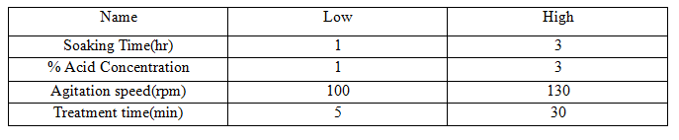
Experimental range and levels of independent process variables for Acid hydrolysis

Slide 23
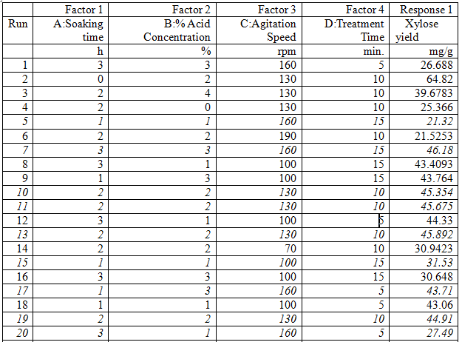
RSM model, for finding out average values using xylose yield as a response under different conditions

Slide 24
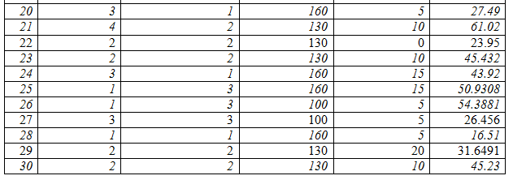
Contd.

Slide 25
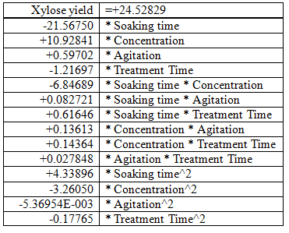
The corresponding second order model obtained after ANOVA study:

Slide 26
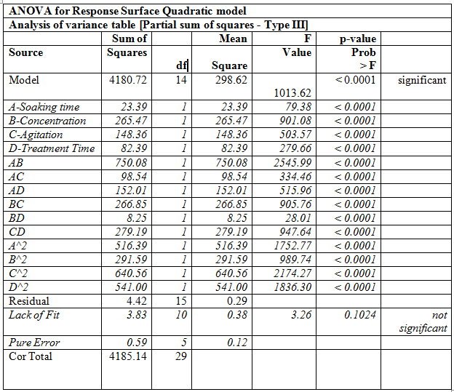
Analysis of Variance of the quadratic model for xylose content of acid pre-treated WHB
*SD- 0.54; Mean-19.04; R-Squared, 0.9980; C.V.%= 1.40;

Slide 27
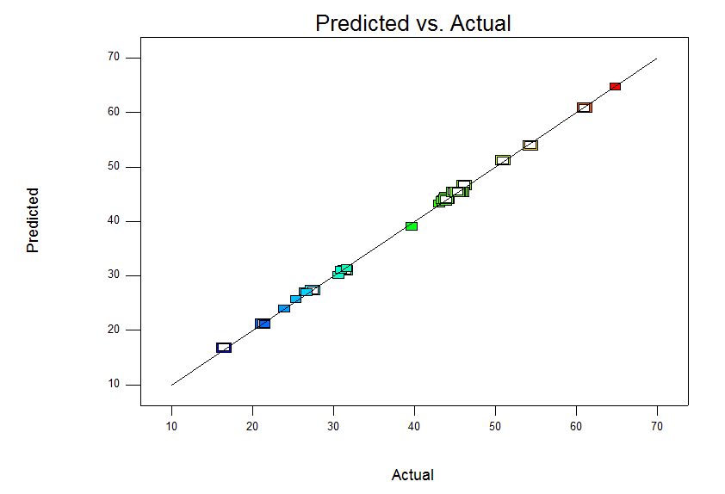
Experimental data plotted against RSM model predicted data for acid hydrolysis of WHB using xylose yield as a response
This figure gives clear evidence that model predicted results are very close to agreement with the experimental ones. As most experimental results lie on the 45 degree line implying the model had fitted the experimental data with an excellent accuracy resulting in lesser deviation from the predicted values.

Slide 28
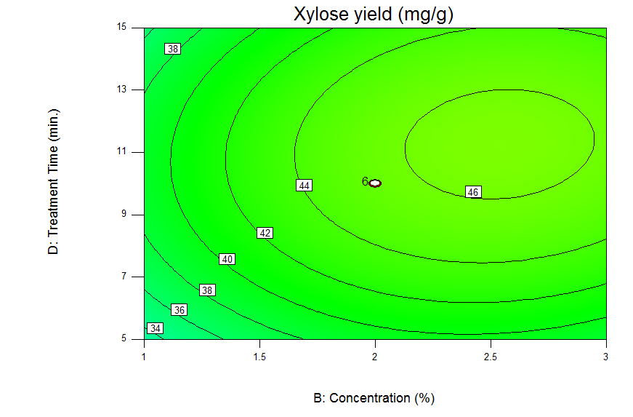
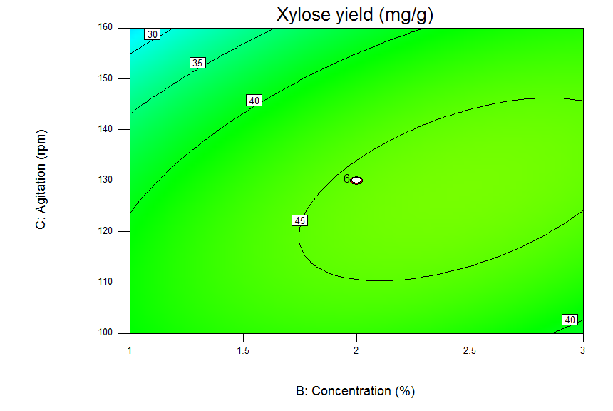
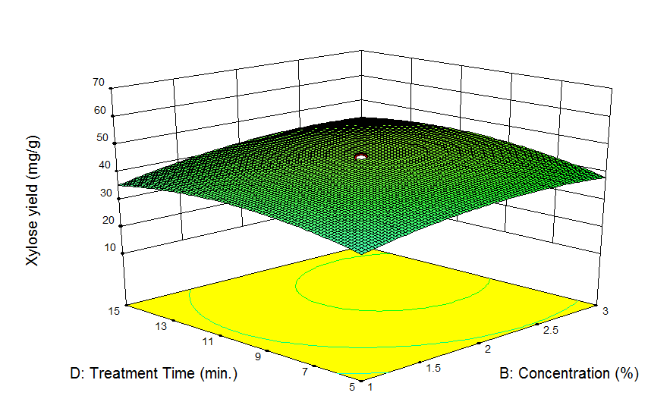
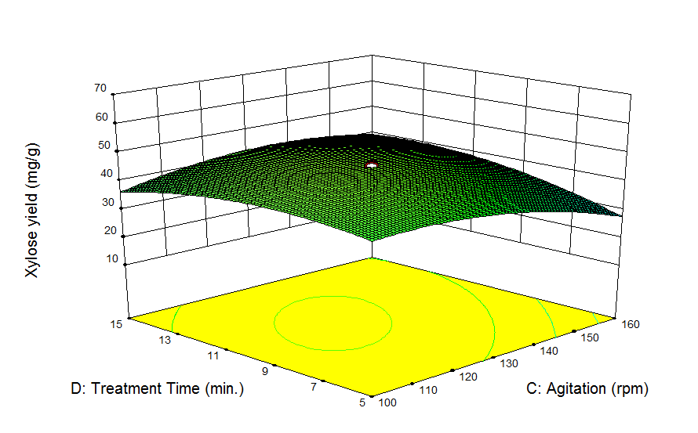
Contour Plots and 3D plots
The contour plots and 3D plots determine the mutual interaction of the components

Slide 29
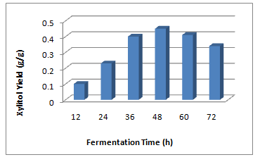
Effect of the application of yeast on the generation of xylitol
The filtered hydrolysate after fermentation yielded 22.5g/l of xylitol using Pichia stipitis when treated for 48h at 30^{O} C with a yield of 0.45g xylitol /g xylose.

Slide 30
CONCLUSION
Water hyacinth can be used act as an eco-friendly alternative for production of xylitol
P. stipitis is efficient for fermentation of C-6 &C-5 sugars.
Bioconversion of lignocelluloses to highly value added product Xylitol , opens the prospective of further studies on biodegradation kinetics of lignin, hemicelluloses hydrolysis kinetics and optimization of xylitol yield.

Slide 31


Slide 33
BACKUP SLIDES

Slide 35
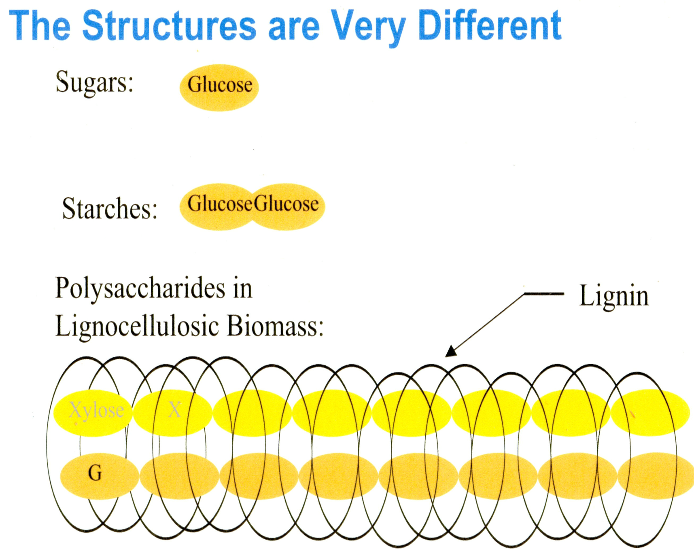

Slide 36
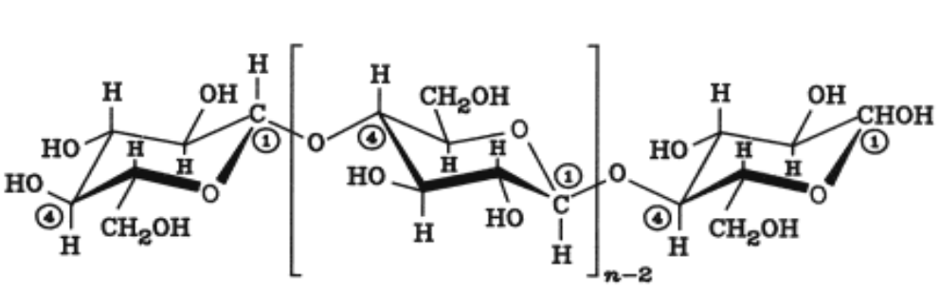
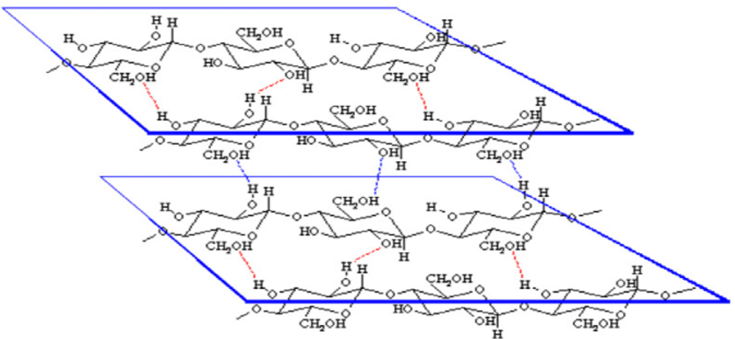
Cellulose is a homopolysaccharide composed of β-D-glucopyranose units which are linked together by β−(1→4) glycosidic linkages.Two adjacent glucose units are linked by elimination of one molecule of water between their hydroxylic groups at carbon 1 and carbon 4

Slide 37
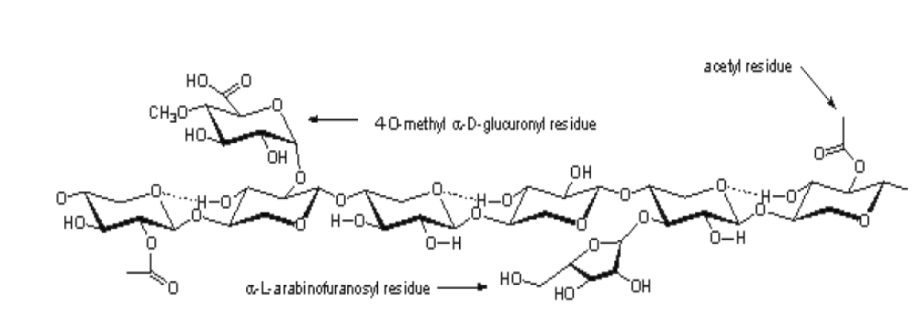
A schematic representation of the hemicellulose backbone in plants
Hemicelluloses are heterogeneous polymers of pentoses (xylose, arabinose), hexoses (mannose, glucose, galactose ), and sugar ,acids. Unlike cellulose, hemicelluloses are not chemically homogeneous. Hardwood hemicelluloses contain mostly xylans, whereas softwood hemicelluloses contain mostly glucomannans .

Slide 38
OH
The lignin molecule is a polymer with a DP (degree of polymerization) of 450 to 550, formed by the free radical, oxidative condensation of the three monomers, coniferyl alcohol, sinapyl alcohol and coumaryl alcohol (Wayman, M et al)[25].
Lignin is a complex polymer of phenylpropane units, which are cross-linked to each other with a variety of different chemical bonds .Lignin resists attack by most microorganisms. Lignin is nature's cement, along with hemicellulose, which exploits the strength of cellulose while conferring flexibility.
R
C
C
C
R’
R’
R’
OH
Lignin
“monomer”
R’
4 - alkylcatechol
H,
OH,
or
O
R

Slide 39
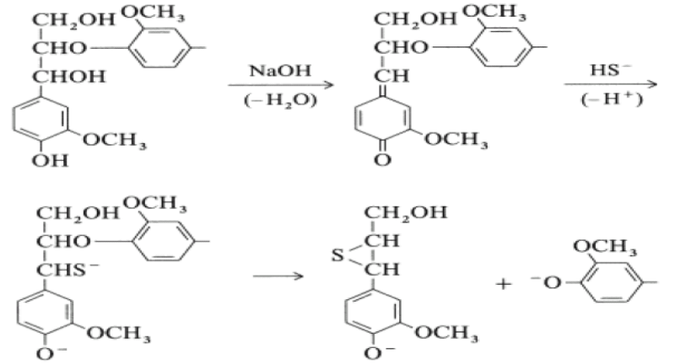
Stoichiometry
Cleavage of ether bond of lignin in alkaline solution (Lin and Lin, 2002)
The cleavage of the ether bond occurs though solvolytic reactions. It can take place under acidic or alkaline conditions via different mechanisms. In the case of lignin, under acidic conditions the ether bond is converted into hydroxyl and then converted to carbonyl or carboxyl before it is finally fragmented into C3 or C2 molecules. Under alkaline conditions the mechanism is different and the end result is not fragmentation of the side chain, but separation of the aromatic rings

Slide 40
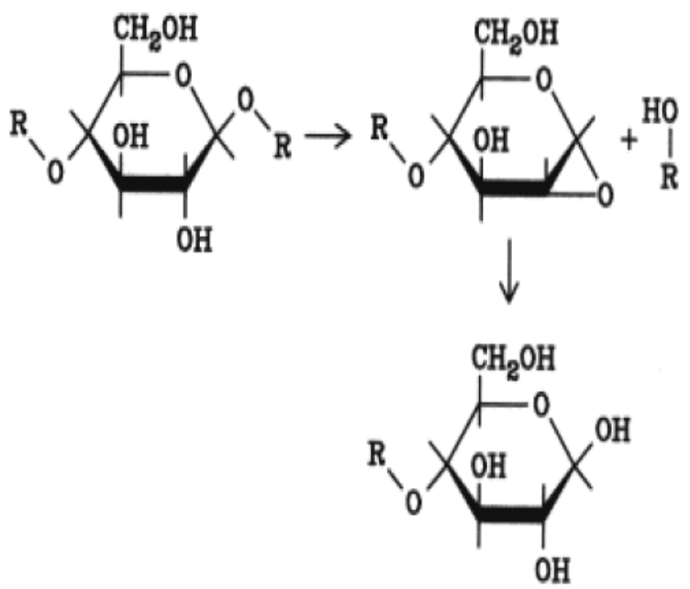
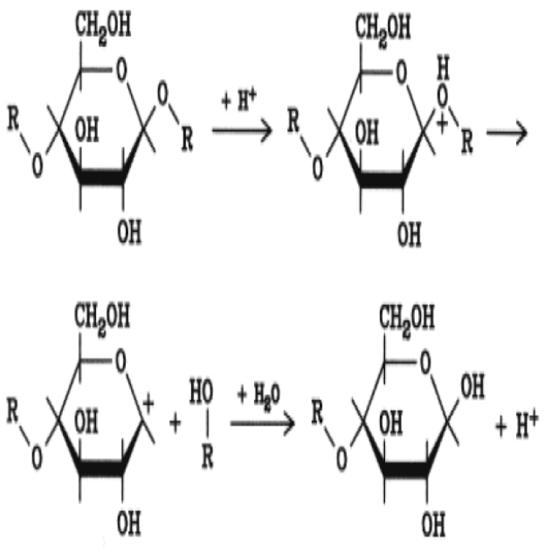
Stoichiometry Contd.
Cellulose hydrolysis in alkaline media (Krassig and Schurz, 2002)
The mechanism most probably involves the intermediate formation of 1,2-anhydro configuration which is a type of epoxide that, due to the ring that is formed between the two carbon atoms and oxygen, allows via the S_{N}2 mechanism the nucleophilic substitution of hydrogen (Solomon, 1988). Where S_{N}2 indicates substitution, nucleophilic, bimolecular reaction,
Hydrolysis of cellulose in acidic media (Krassig and Schurz, 2002)
When acidic media are used, the acid acts as a catalyst protonating the oxygen atom. The charged group leaves the polymer chain and is replaced by the hydroxyl group of water.

Slide 41
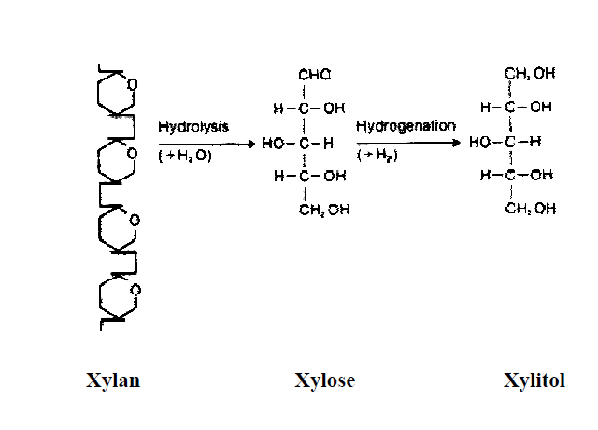
Xylitol From Xylan present in the Complex heteropolymer Hemicellulose
Hemicellulose can be hydrolysed by addition of water in suitable condition to obtain different sugars present in polymer.
(C₅H₈O₄)_{n} + nH₂O nC₅H₁₀O₅

Slide 42
Xylitol from Pentose
Xylitol reductase
D-Xylose
Yeast, Fungi
Xylose isomerase
Xylitol
D-Xylulose
Xylitol dehydrogenase
Bacteria,
Actinomycetes

