Slide 1
mMAP: mouse Metabolomics Analysis Platform
Preeti Bais
09/09/2014

Slide 2
Outline
Introduction: What is Metabolomics ?
Problem: Need for Bioinformatics Infrastructure
Solution: mMap Database and Pipeline

Slide 3
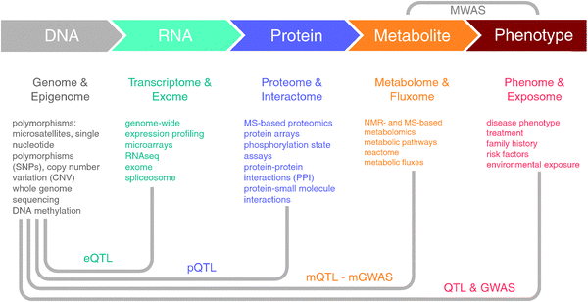
What is Metabolomics?
Mol. BioSyst., 2012,8, 2494-2502

Slide 4

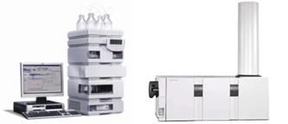



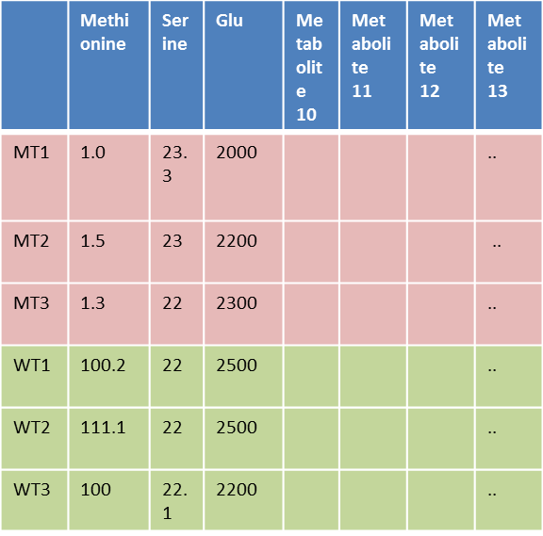
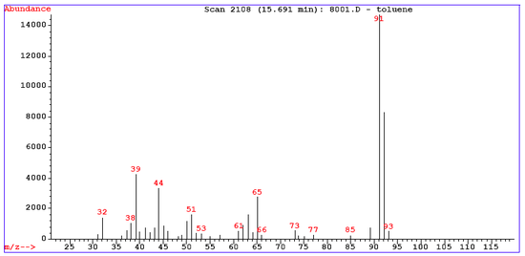

Metabolomics Workflow
Vs.

Slide 5
Project Goals
To identify metabolic pathways related to pathogenesis in mouse models of 3 neuromuscular degeneration mutants
To develop informatics tools to assign metabolomics data to curated biochemical pathways and functional annotations for mouse genes and proteins
Data Generation -> Data Analysis -> Data Interpretation
Metabolites->Biochemical Pathways->Genes->Annotations

Slide 6
Bioinformatics infrastructure is lacking for metabolomics data analysis and interpretation
Metabolite names are variable and are used inconsistently (e.g. B-Alanine, Beta-Alanine)
Very few metabolomics data analysis pipelines are designed for the biologists (e.g HMDB, plantmetabolomics.org)
Need to combine the metabolomics data with genomics data and biological annotations for interpretation

Slide 7
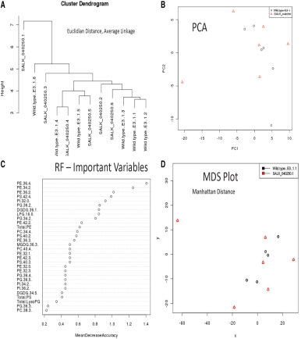
mMAP Features: Data Base and Data Analysis Pipeline
Metabolomics Data Reporting Standards
Metabolomics
Data Base
Data Mining
Pipeline
Vs.

Slide 8
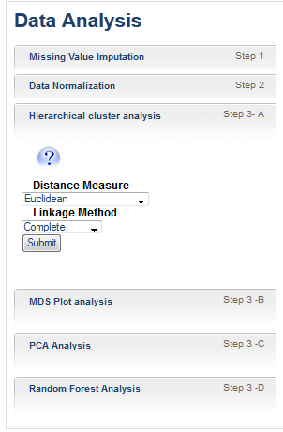
mMap Features: Advanced Data Analysis Tools
Menu Driven automated data analysis pipeline
Best practices in metabolomics data analysis
Connected to genomics information
Interactive plots : Download/Print
Flexible pipeline
Help in interpretation of plots with examples

Slide 9
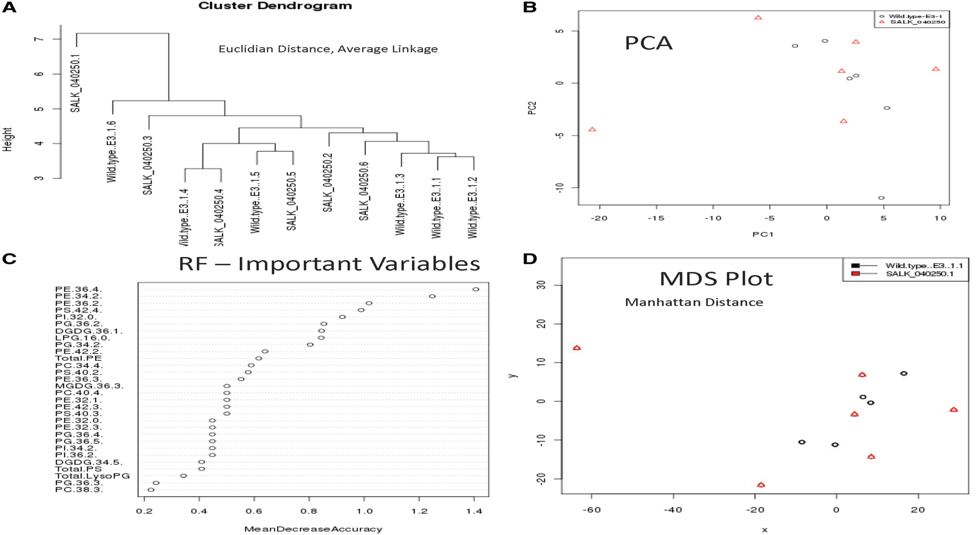
mMap Features: Data Analysis Plots

Slide 10
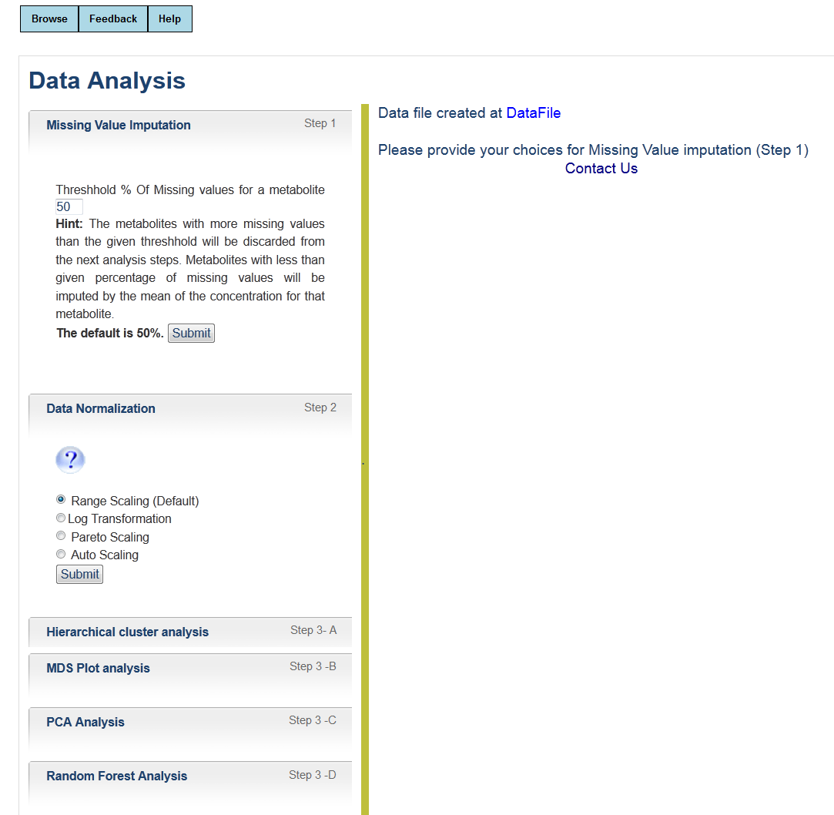
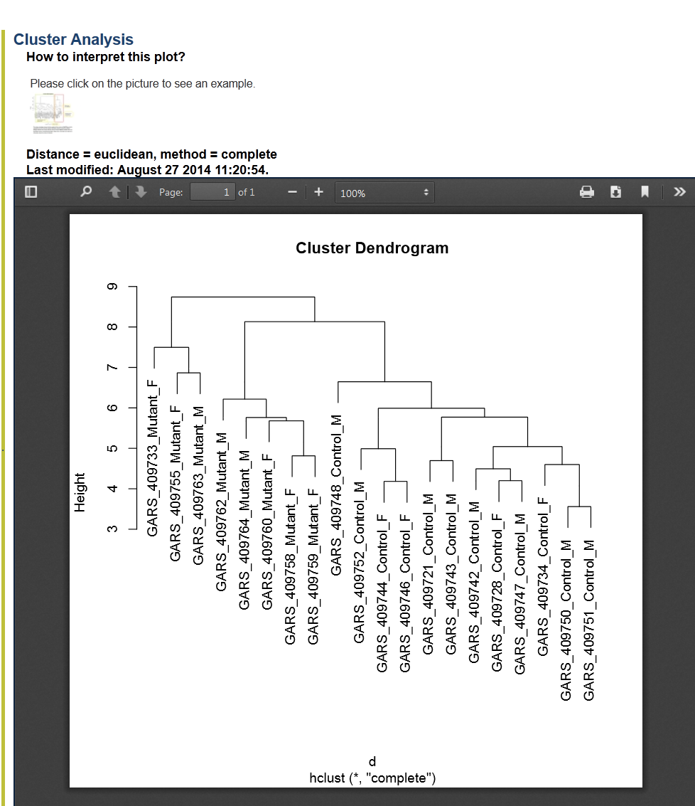
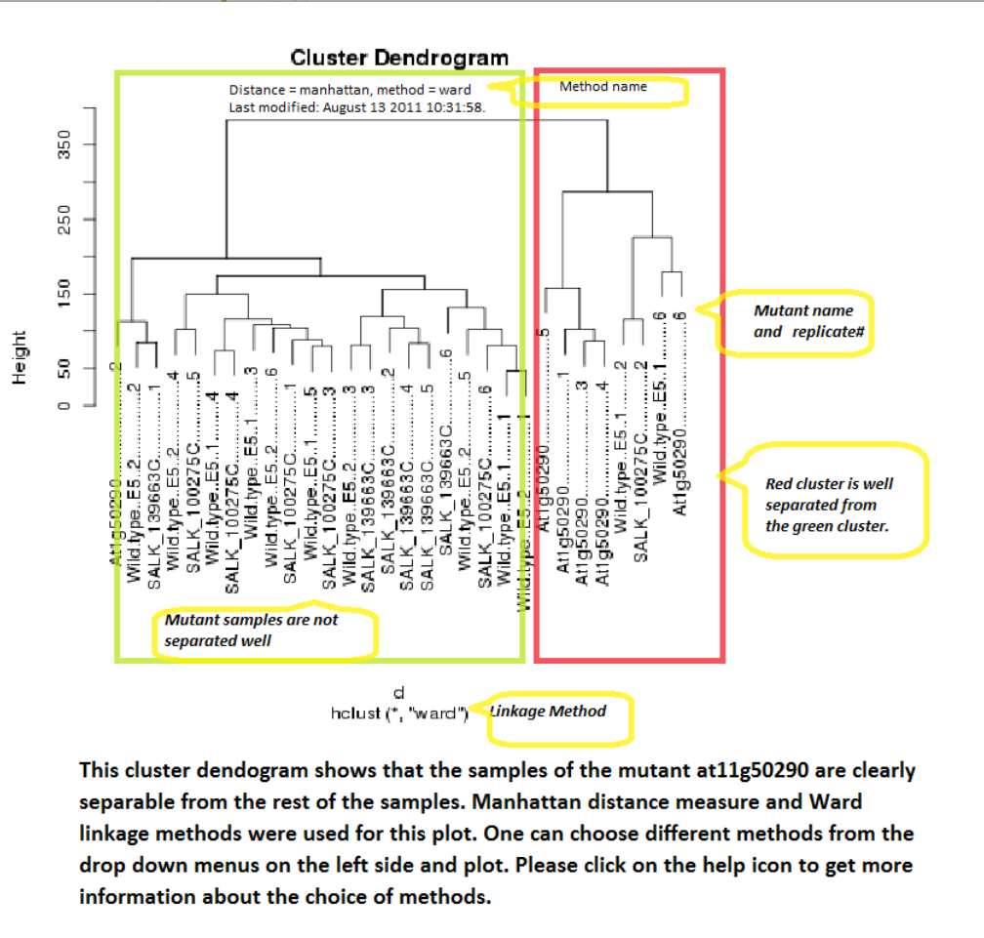
mMap Features : Help in Interpreting the Plots

Slide 11
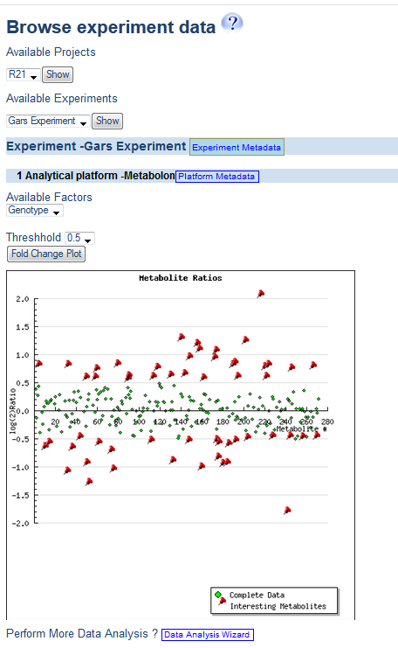
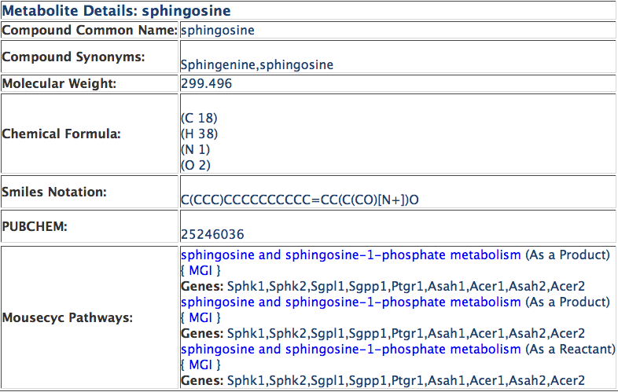
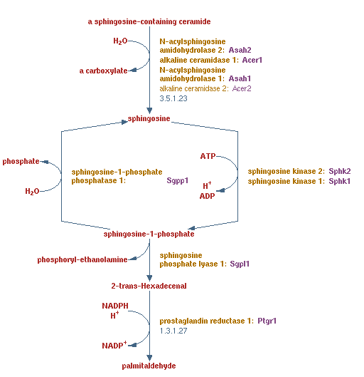
mMAP Features : Interactive Plots
mMAP Metabolite Details
MouseCyc Pathway
mMAP Data Analysis Results

Slide 12
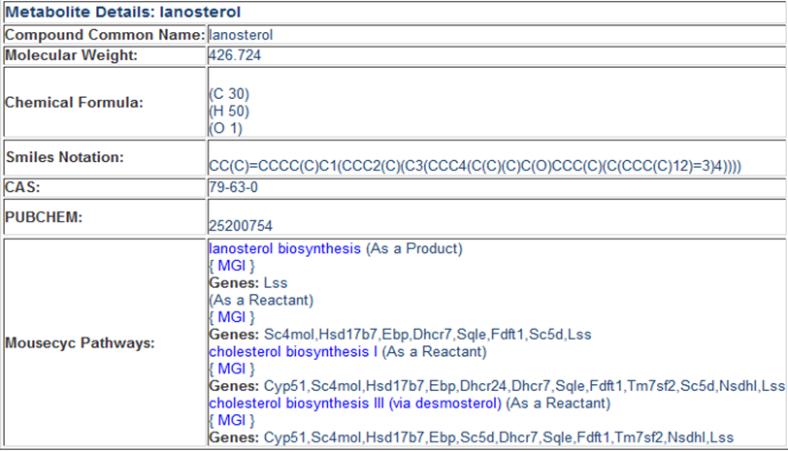
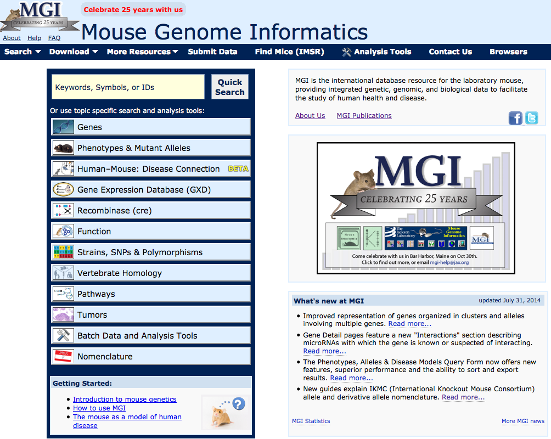
mMAP Features: Links to curated pathways, genes, and proteins
mMAP Metabolite Details
MouseCyc@MGI
MouseMine@MGI
http://www.informatics.jax.org/

Slide 13
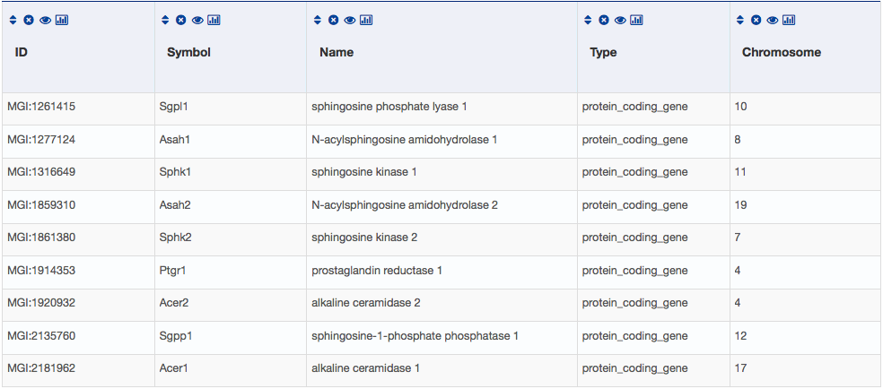

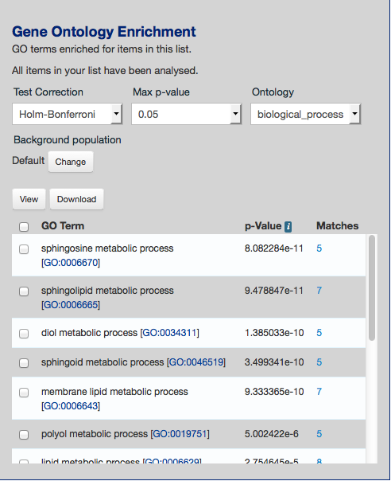
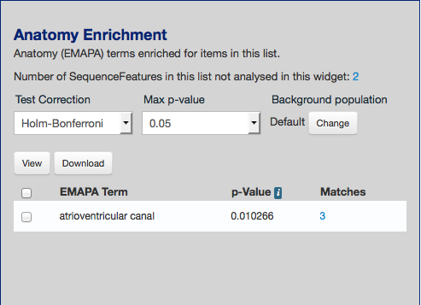
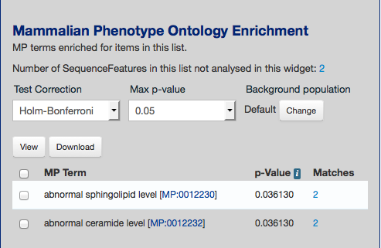
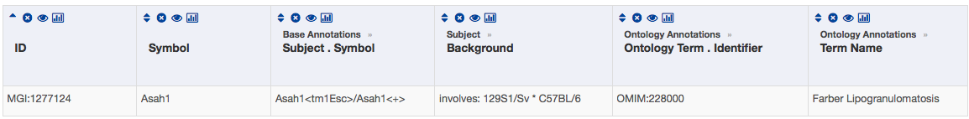
mMAP Features: Links to curated pathways, genes, and proteins
mMAP Metabolite Details
Genes list in MouseMine@MGI
MouseMine@MGI
Term Enrichment Analysis and Associated Disease Phenotypes

Slide 14
Summary and Future Goals
Provides a computational metabolomics platform for JAX researchers to incorporate metabolomics data in their research. Will be available to the community as well
The automated pipeline is modular and can easily be extended to experiments to include different factors (e.g. Mutation, Drug, Disease etc.)
Currently the genomic annotations for mice are available but it can be easily extended to other organisms with Biocyc Pathways (e.g. Worm, Fly, Yeast)

Slide 15





Metabolomics of Peripheral Neuropathy Team
PI: Gregory A. Cox
PI: Robert W. Burgess
PI: Carol J. Bult
Lauren Kuffler
Preeti Bais
Funding – NIH R21NS082666

