Slide 1
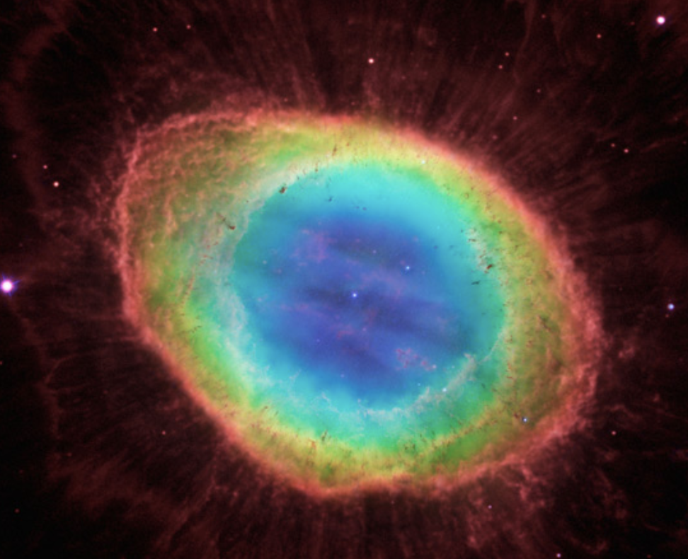
Fourfold Composite Quantum, The Emergence of Space, Time, Energy, and Gravity, and Some Implications
Dr Pravir MALIK
Deep Order Technologies, USA
pravir.malik@deepordertechnologies.com

Slide 2
Overview
Light
Quantum Theory – A Light-Centered Interpretation
  Emergence of Space, Time, Energy, Gravity
  Space
  Time
  Energy/Matter
  Gravity
  Fourfold Quantum
  Organization of Matter
  Effect of Four Simultaneous Components of Light
Cosmic Scenarios
  Composite Quantum at Atomic-Particle Level
  Quanta at Unit-Space Level
  Quanta at Level of Big-Planet
  Quanta in Expanding Universe
  Quanta of Particle Approaching Speed of Light
  Quanta at Black Hole Level
  Quanta of Cosmic Bounce
Summary & Further Exploration

Slide 3
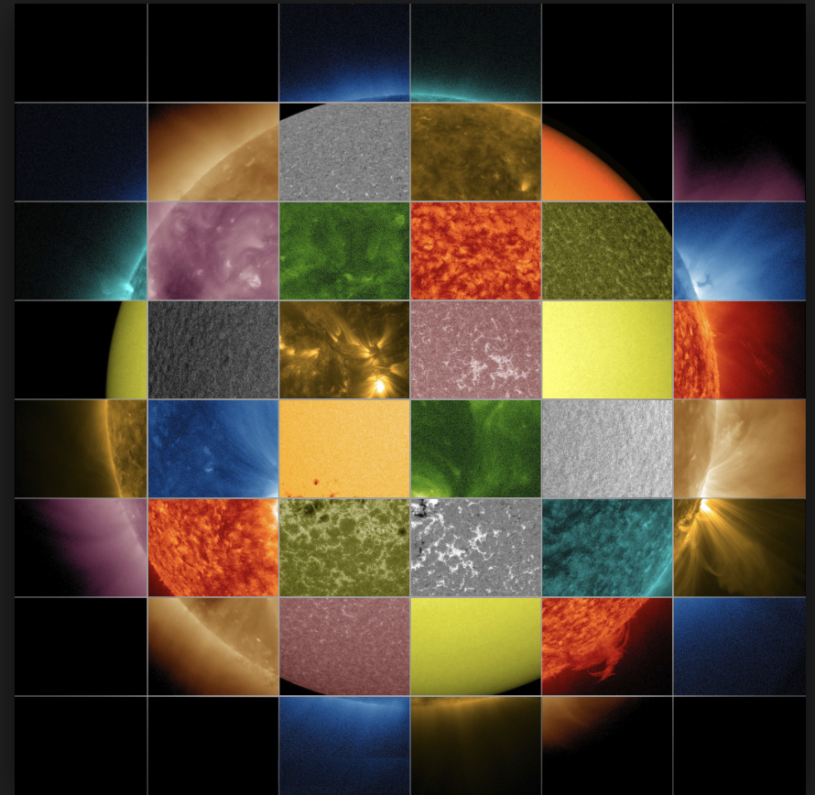
Light

Slide 4
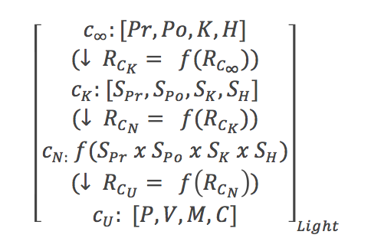
Light

Slide 5
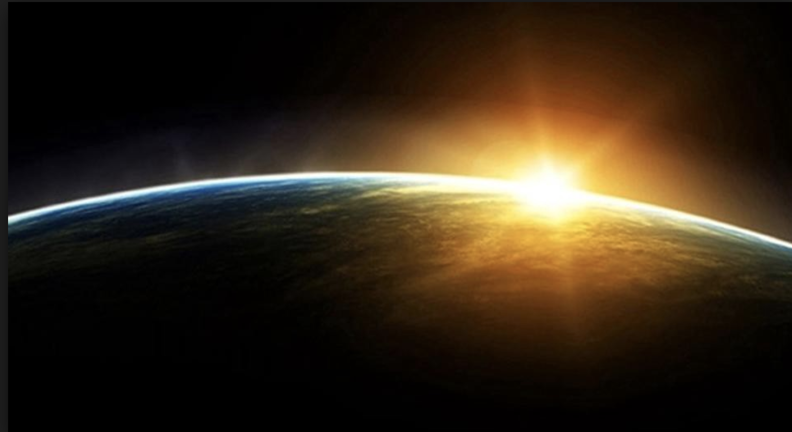

Light@c
Past, Present, Future, Matter

Slide 6
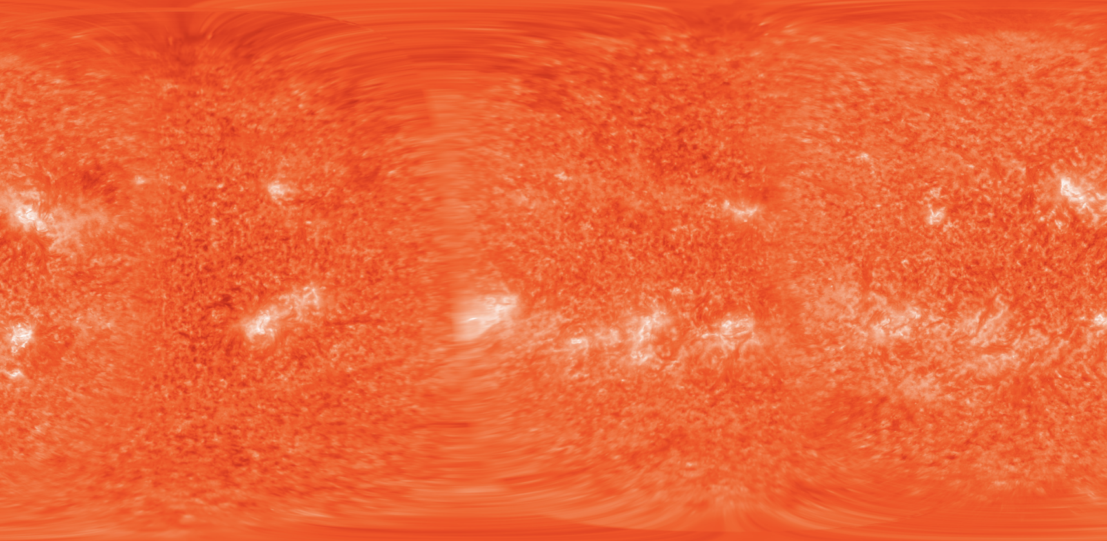

Light@Infinity
Omnipresent, Omnipotent, Omniscient, Omniloving

Slide 7
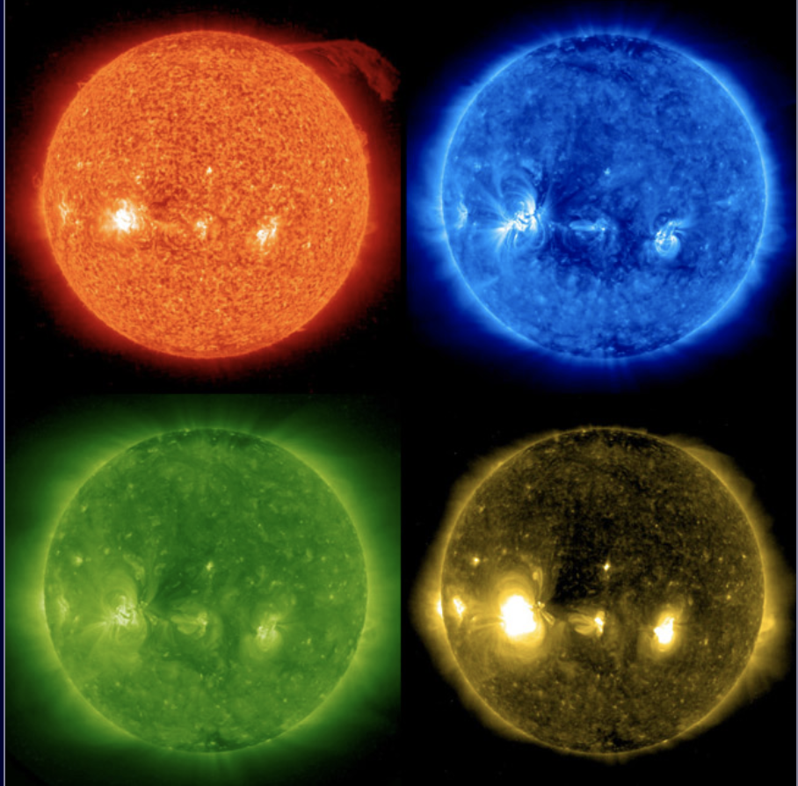

Light Master Sets

Slide 8
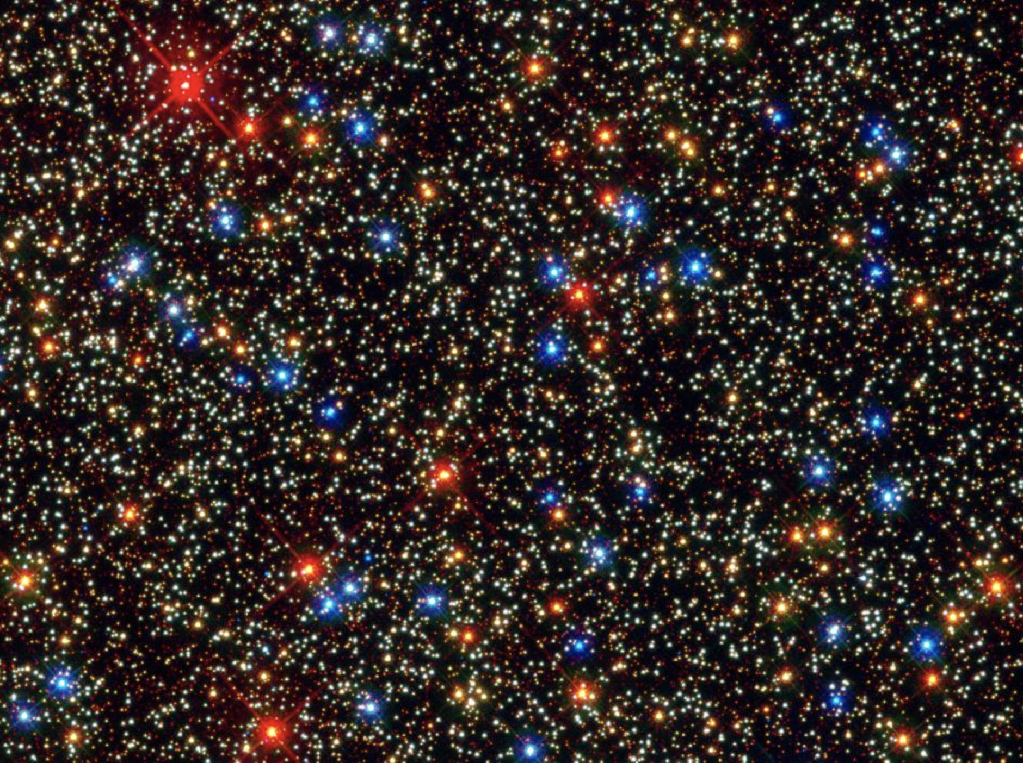

Light Diversification

Slide 9
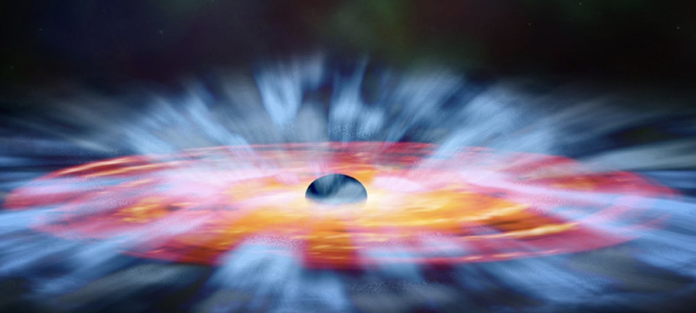
Quantum Theory: A Light-Centered Interpretation

Slide 10
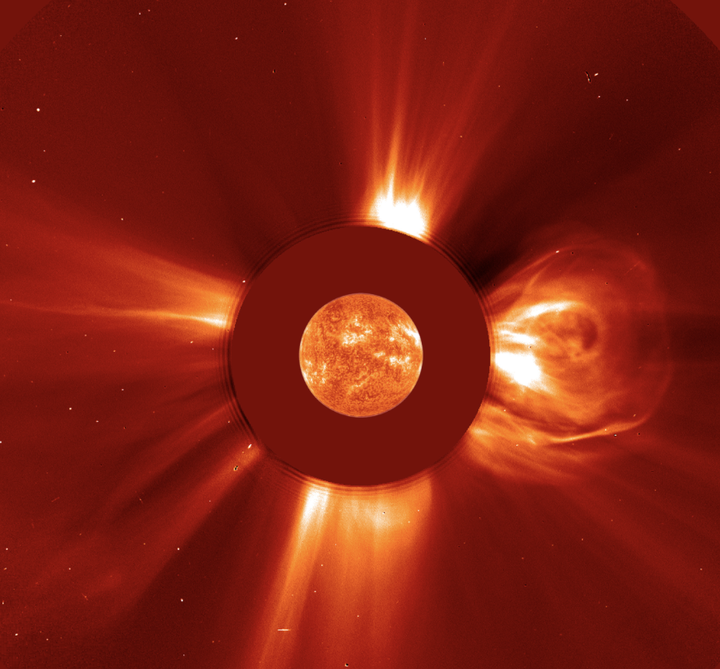
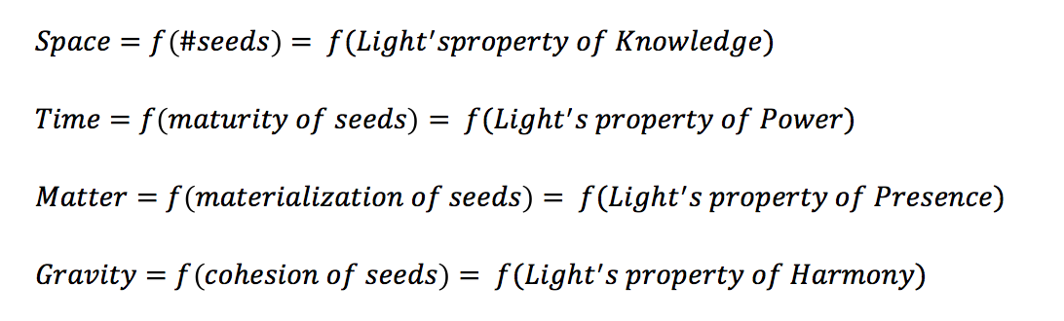
Emergence of Space, Time, Matter, Gravity

Slide 11
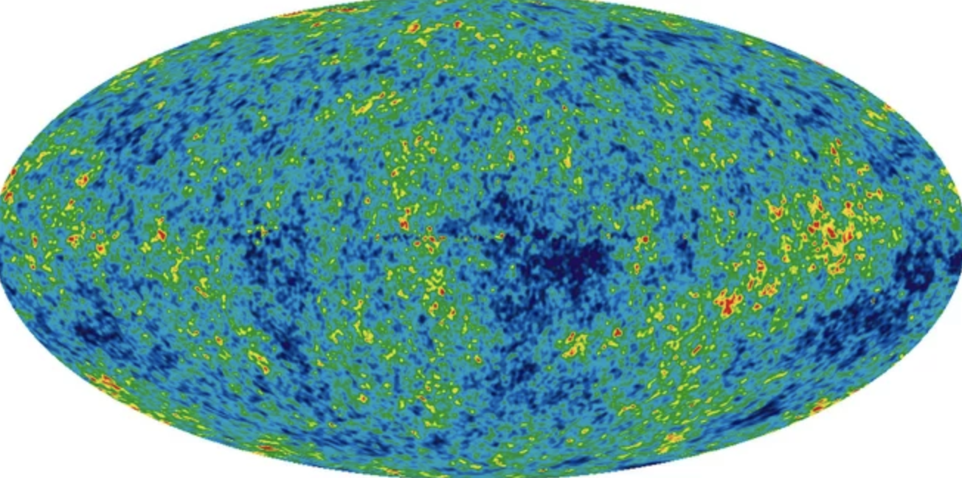
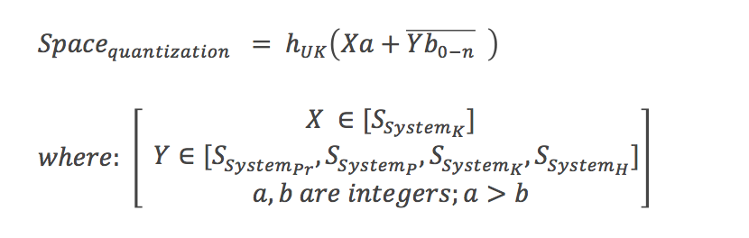
Space
In this model ‘space’ as an emergent property of Light, is structured by infinite seeds of knowledge
But because the emergence is taking place in a layer of reality generally itself structured by a finite speed of light, c, it has to be quantized
The quantization assures that the knowledge is not dissipated, but can accumulate to create seeds, and therefore, the structure of space itself
It is assumed that there is some kind of ‘Planck’s constant’ in effect, that is modeled as being specific to the way knowledge or space may be quantized – hence, h_{UK}

Slide 12
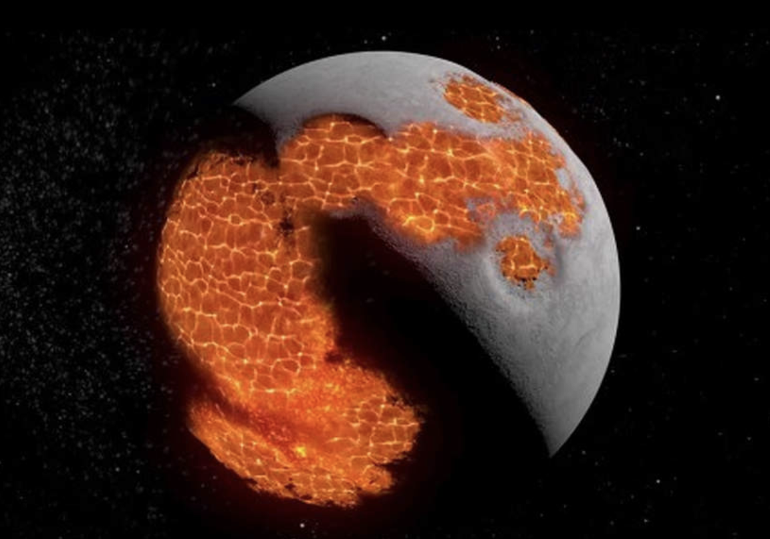
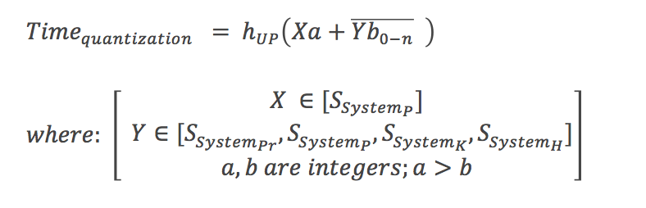
Time
In this model ‘time’ as an emergent property of Light, is structured by an inevitable process of maturity, which due to its inevitability, is related to power
But because the emergence is taking place in a layer of reality generally itself structured by a finite speed of light, c, it has to be quantized
The quantization assures that the power is not dissipated, but can accumulate to express phased maturity, and therefore, the structure of time itself
It is assumed that there is some kind of ‘Planck’s constant’ in effect, that is modeled as being specific to the way power or time may be quantized – hence, h_{UP}

Slide 13
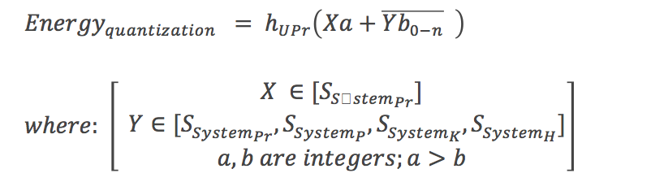
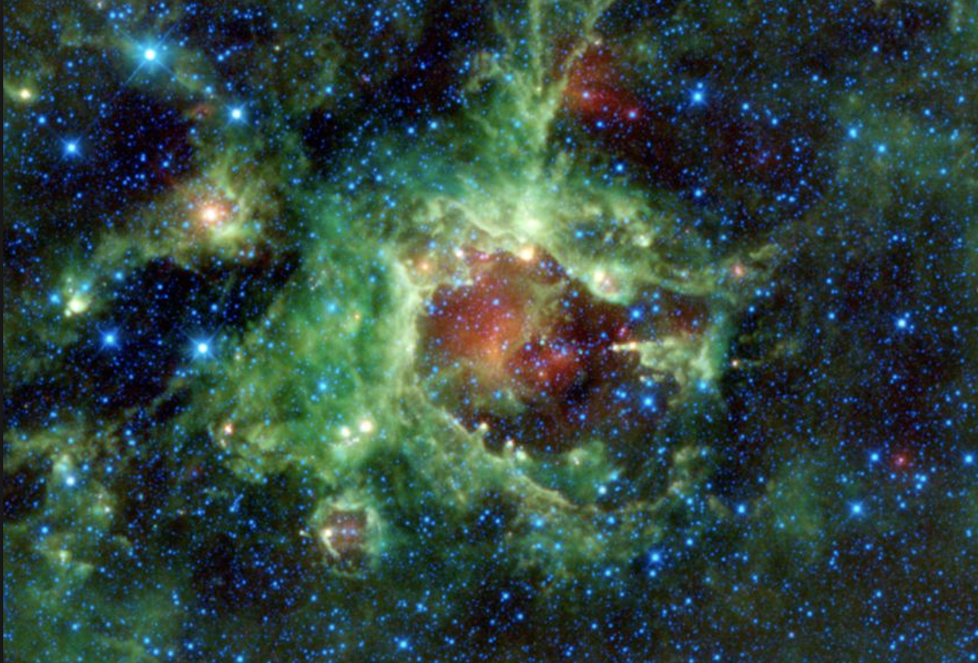
Energy/Matter
In this model ‘energy’ as an emergent property of Light, results in the reality of matter
But because the emergence is taking place in a layer of reality generally itself structured by a finite speed of light, c, it has to be quantized
The quantization assures that the energy is not dissipated, but can accumulate to create matter
Planck’s constant is referred to as - h_{UPr}

Slide 14
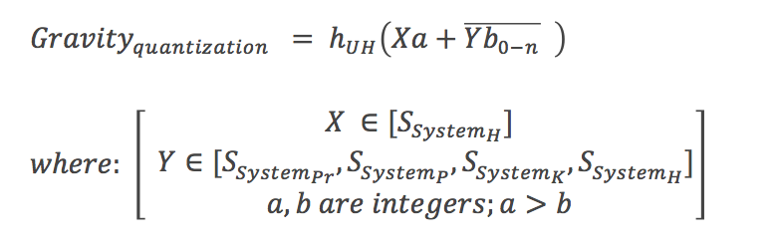
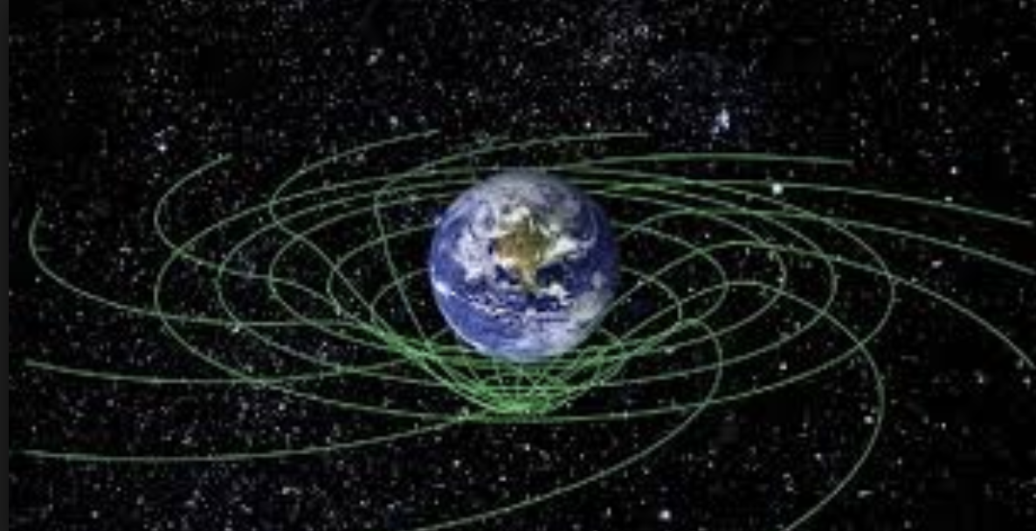
Gravity
In this model ‘gravity’ as an emergent property of Light, results in a harmonious collectivity of seemingly independent objects
But because the emergence is taking place in a layer of reality generally itself structured by a finite speed of light, c, it has to be quantized
The quantization assures that the harmony is not dissipated, but can accumulate to express more and more complex collectivities on large-scale
It is assumed that there is some kind of ‘Planck’s constant’ in effect, that is modeled as being specific to the way harmony or gravity may be quantized – hence, h_{UH}

Slide 15
Fourfold Quantum
Quanta hold within themselves the essence of what must be projected from properties or function in higher-velocity light to lower-velocity more-material light
Four-fold properties are a representation of the inherent oneness of Light
Four-foldness will continue to have a bias to uphold that oneness in its more material manifestation
Therefore space-quanta, time-quanta, energy-quanta, and gravity-quanta related to a single particle will operate as a composite fourfold quantum
Four quantum fields operate together or as one composite field in the emergence and possibilities represented by a particle
Allows explanation of phenomena at different levels of complexity, as well as providing a possible basis for the integration of relativity with quantum theory

Slide 16
Fourfold Organization of Matter*
Light’s Property | Cosmic Fundamentals | Quantum Level | Boson Level | Atomic Level | Cellular Level
Knowledge | Space | Quarks | Gluon | p-Shell | Nucleic Acids
Presence | Energy | Higgs-Boson | Photon | d-Shell | Proteins
Power | Time | Leptons | W and Z Bosons | s-Shell | Polysaccharides
Harmony | Gravity | Bosons | “Graviton” | f-Shell | Lipids
Newton – “An Alchemist through and through: wondered about whether solid bodies and light are interconnected and whether light is the source and activity of solid bodies” (source: Quantum Astrologer’s Handbook, page 55)
Light does not need a carrier. Range of bosons are generated from Light as are all other layers of matter
  Gluons bond quarks together to ensure integrity of nucleus so that knowledge is propagated in behavior of atoms
  W and Z bosons allow neutrons to change to protons thereby releasing power or energy
  Photons allow matter to be present by device of electromagnetic field
  Gravitons allow collectivities of matter to form thereby expressing harmony
*Cosmology of Light Book Series, Malik, 2017-18

Slide 17
Effect of Four Simultaneous Components of Light (1)
Block + field + wave + particle (similar to Pilot Wave Interpretation of QM proposed by De Broglie – Bohm)
Wave-particle duality
  Particles guided to regions of constructive interference of waves traveling greater than c
  Photoelectric effect due to light particles traveling at c
Apparent randomness
  Because light travels as a whole, “instantiation” is only a variable bi-product
  Randomness appears to exist only because “wholeness” is behind
  Statistical disaggregation should be used to explain “randomness” rather than randomness converted to “classical determinism” through statistical aggregation (which is what appears to be done in Copenhagen and Ensemble Interpretations of QM)
Functional-View
  Quantum levels open a window into wholeness and “Qualified Determinism” rather than divide the world into smaller and smaller bits
  Democritus’ suggestion of ‘atoms of salt – sharp; atoms of water – smooth etc’, gets to functionality as expressed in this model of Light

Slide 18
Effect of Four Simultaneous Components of Light (2)
Entanglement
  Something of the oneness as higher meta-levels are approached becoming real
  Model of Light consistent with Nobel Laureate Gerard Hooft’s observation: “Hidden threads controlling properties of atoms”. Correlations between atoms / particles derived from Big Bang (Superdeterminism Interpretation of QM)
Time travel
  Time travel impossible at U since time measures maturity of seeds
  Entry into meta-levels will allow time to be experienced differently so that travel into origin or completeness of ideas may be possible
  Wave-function of a quantum system is by definition tapping into metal-levels and therefore some knowledge of future and past can be simultaneously present
Superposition
  Function of four simultaneous components of Light rather than myriad simultaneous possibilities as suggested by Copenhagen and Many Worlds Interpretation of QM
  Universe alive with activity: Particles come in and out of existence constantly (Casimir effect - where there is slight pressure between metal plates due to short wave-length virtual particles)
  Side-note: Implications for Quantum Computing

Slide 19
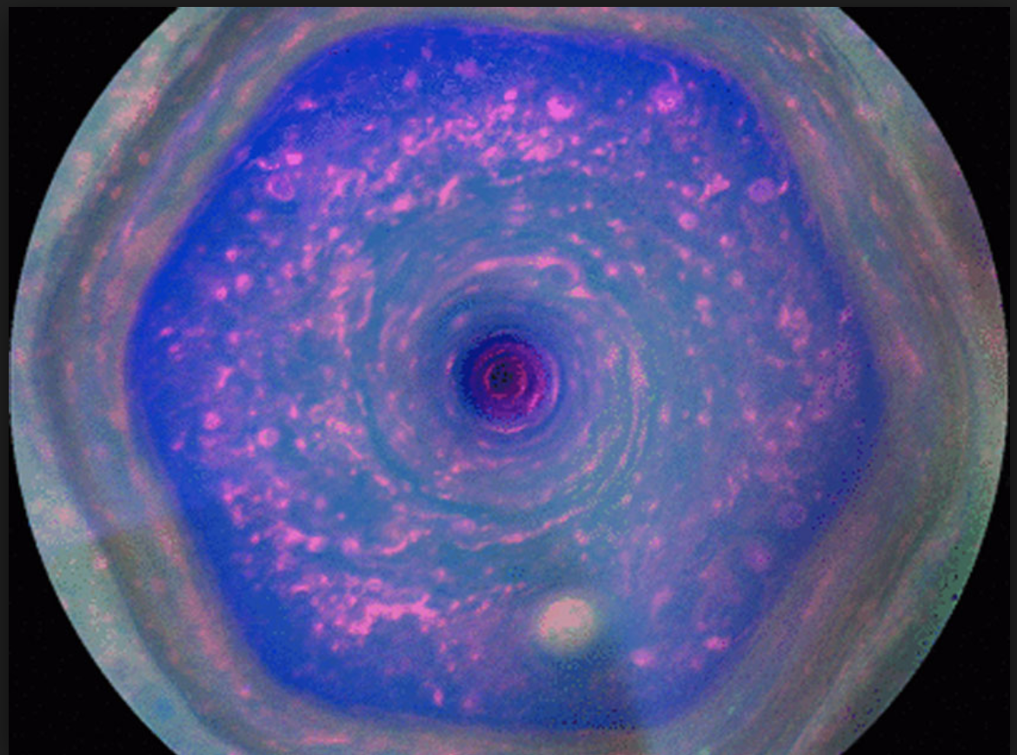
Cosmic Scenarios

Slide 20
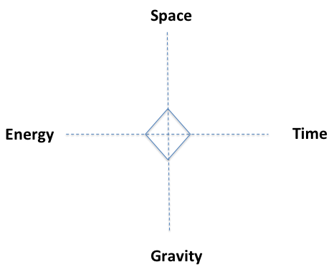
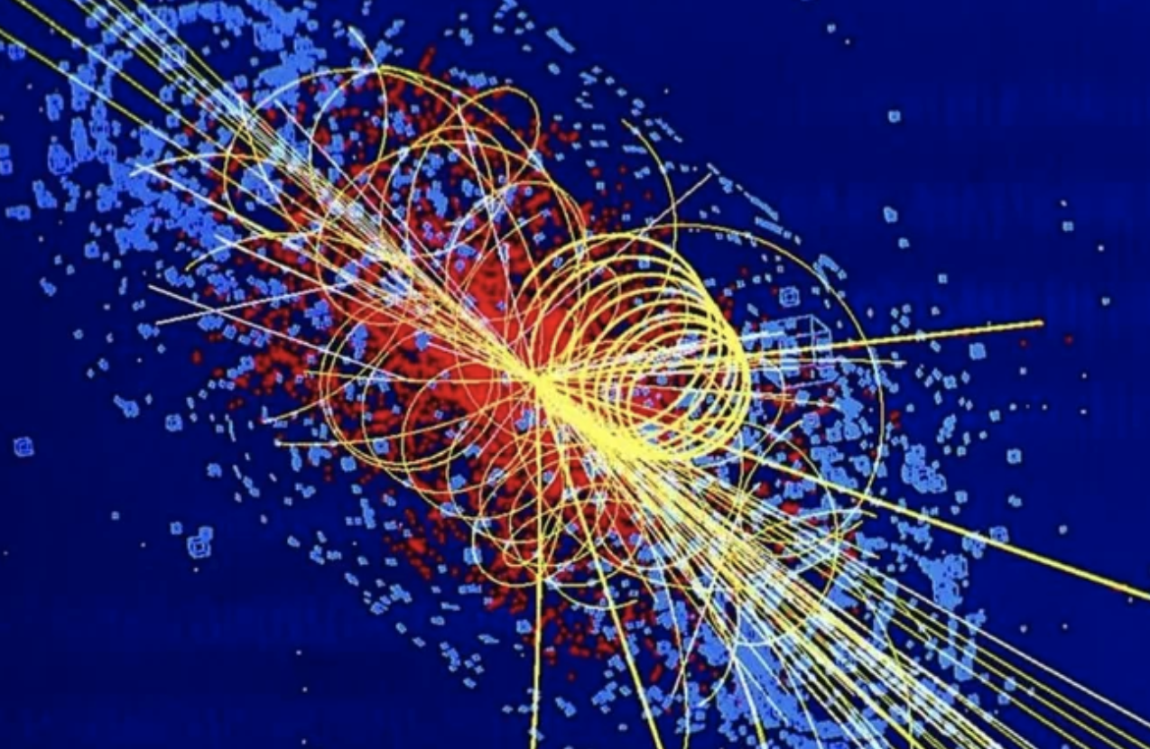
Composite-Quantum at Atomic-Particle Level
The graphic is illustrating that all things being equal there is a balanced accumulation of anterior possibility or information along the space, time, gravity, and energy dimensions
This accumulation plays a primary role in orchestrating the possibility contained in the atomic-particle
Space dimension contains information to do with unique seeds
Time dimension information to do with the maturity of seeds
Gravity dimension information to do with collectivities of seeds
Energy dimension information to do with the materialization of seeds.

Slide 21
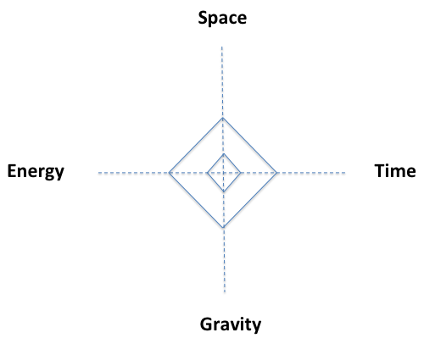


Composite-Quantum at Unit-Space Level
Small rhombus represents a quantum at the atomic-particle level
Larger rhombus is an extrapolation of that in some unit space
All things being equal it is the same fourfold accumulation of anterior possibility or information captured by the quantum that will govern particle behavior at the unit-space level.

Slide 22
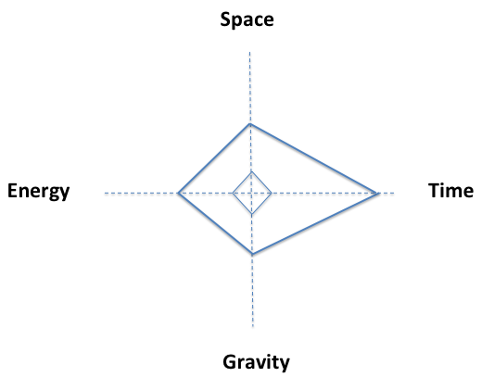
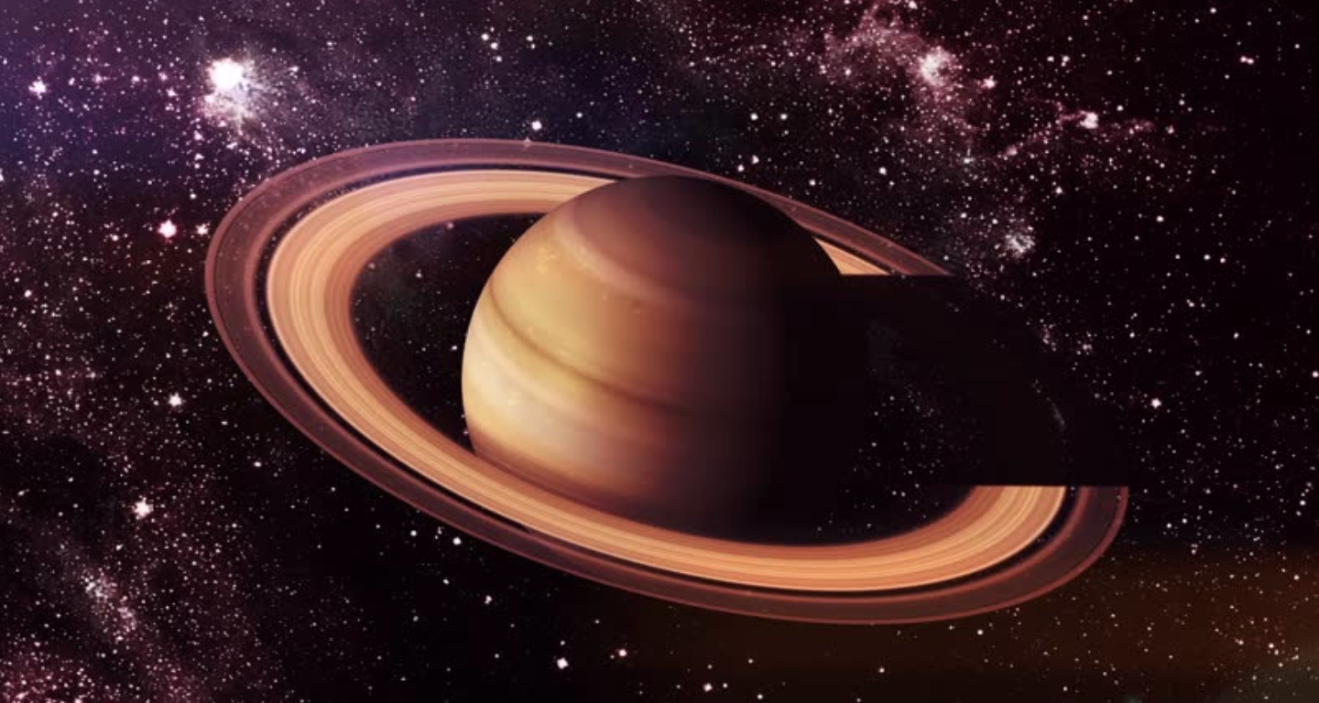

Composite-Quantum at Level of Big-Planet
Smaller rhombus represents a quantum at the unit-space level, while the larger kite-quadrilateral represents a quantum at the Big-Planet level
The kite-quadrilateral is elongated along the time dimension implying that the larger collectivity of seeds represented by a space such as a Big-Planet will take longer to reach maturity, relative to a seed contained in a unit-space
Represents a counter-effect to General Relativity and illustrates the tight integration between ‘mathematical spaces’ or adjacent layers of reality
There is the possibility of the unit-quantum being changed by circumstance

Slide 23
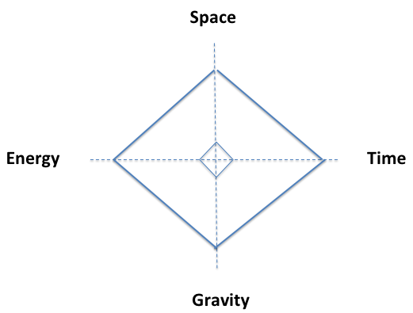
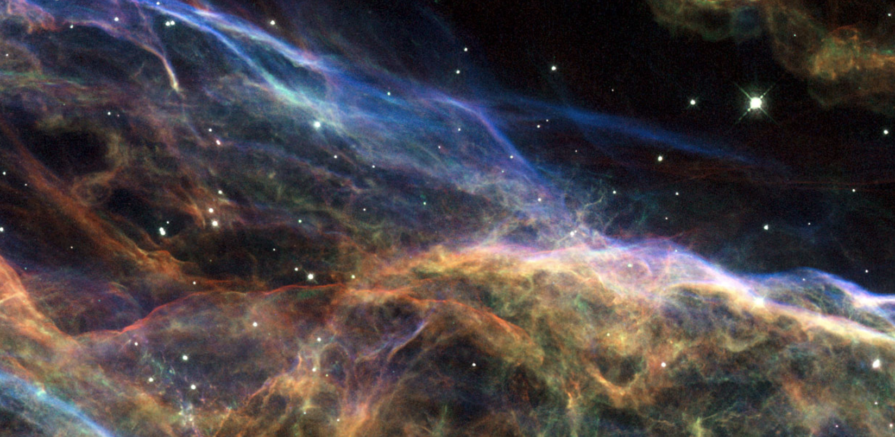

Quanta in Expanding Universe
Depicts the relative relationship between the smaller unit-space composite-quantum rhombus and the scaled up expanding-universe composite-quantum rhombus
It is estimated that the space, time, gravity, and energy components all go through some related increase

Slide 24
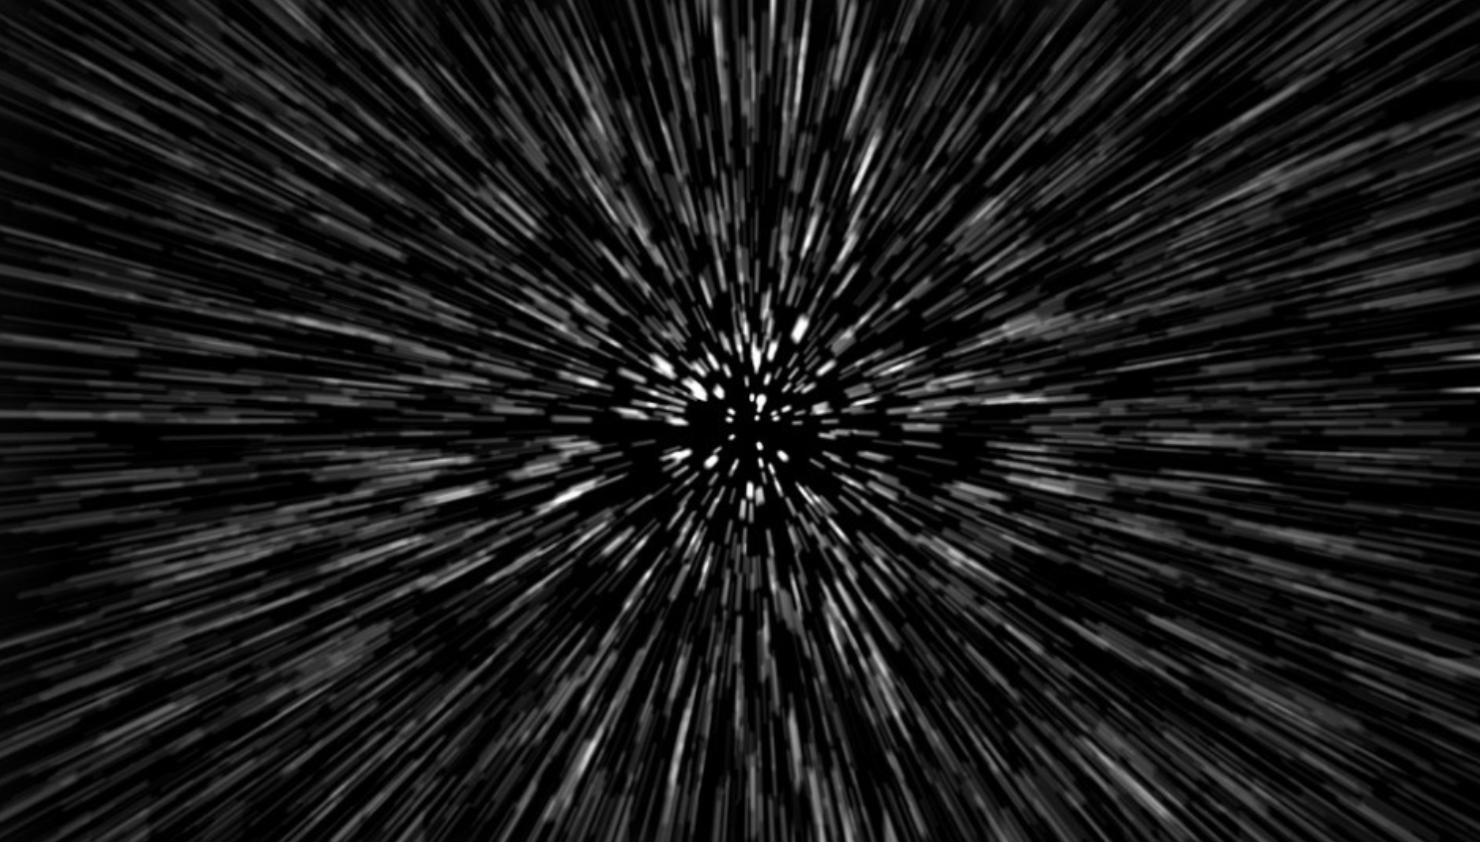

Composite-Quantum of Particle Approaching the Speed of Light
As a particle approaches the speed of light it is in effect approaching the boundary between U and the reality set up by c_{N}
Since space, time, gravity, and energy are emergent and there is a single particle only, the relative structure of these four dimensions should remain unchanged since each dimension will equally be influenced by proximity to the boundary

Slide 25
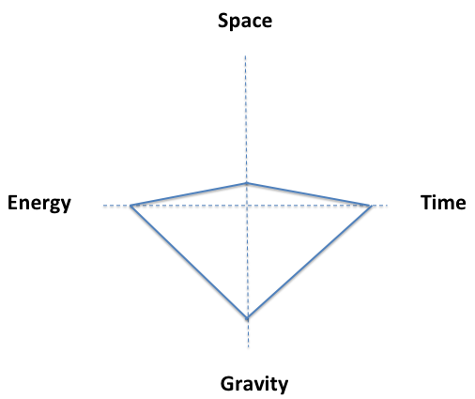
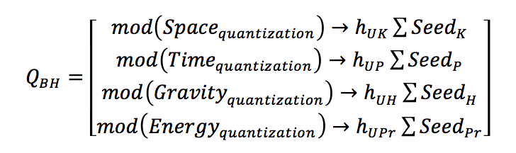
Composite-Quantum at Black Hole Level
This composite-quantum is hypothesized as being the result of a large number of seeds previously spread in space, coming together to be reformulated as a smaller set or a new seed
The new seed(s) have a different intent than the spread out un-mashed seeds, will have a very different and relatively elongated maturity-dynamic as depicted along the time-dimension, will have a very different collectivity-relationship between other seeds as represented by the gravity-dimension, and will similarly also have a very different energy-materialization dynamic as represented by the energy-dimension
Note that consistent with General Relativity, the dynamic of gravity intensifies, space is compressed, time slows down, and energy-potential increases.

Slide 26
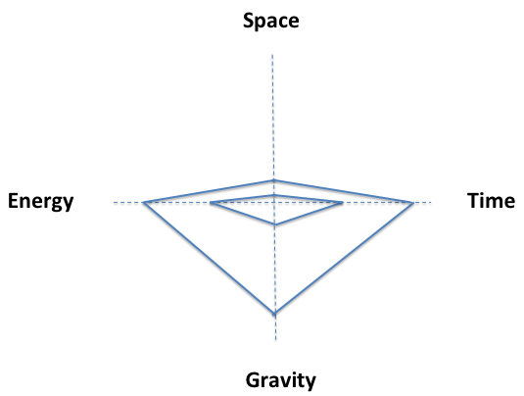
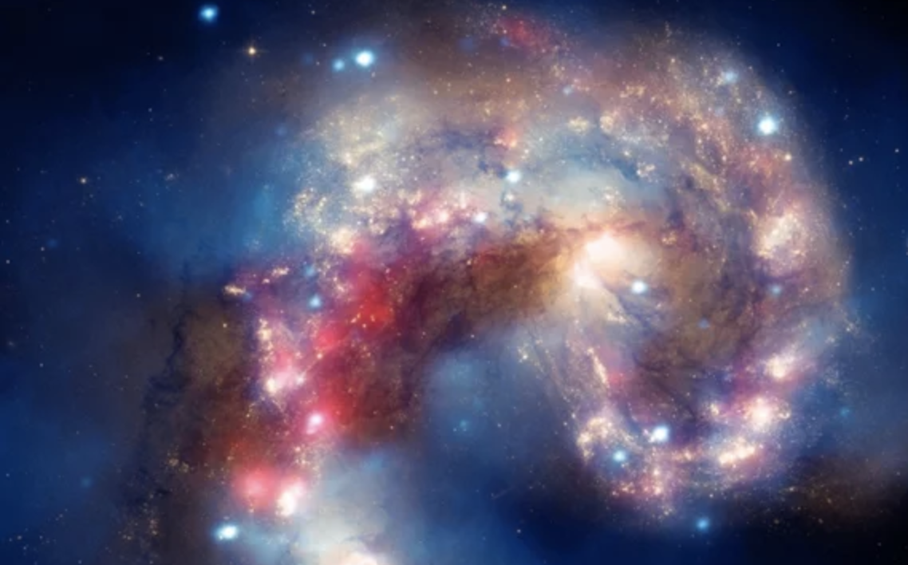

Composite-Quantum at Cosmic-Bounce
Composite-Quantum at Cosmic Bounce, depicts the composite-quantum at a possible Cosmic Bounce event
The smaller quadrilateral represents the black hole composite-quantum, while the larger quadrilateral is a scaled up Cosmic Bounce version of Q_{BH}
The notion of scaling up, is captured by e^{M} where M is some very large number, in the Cosmic Bounce composite-quantum equation

Slide 27
Summary & Further Exploration

Slide 28
Summary
Quanta are a result of light slowing down from some native speed to c
This allows the materialization of properties inherent to Light
Further, space, time, gravity, and energy are themselves seen as emergent from Light and as being constructs related to the seeds so created to materialize the immense possibility and information inherent in Light
Fourfold Light provides a different QM interpretation and allows popularized characteristics at the quantum-level to be thought of differently
It is proposed that there is a composite space-time-gravity-energy quantum that may alter in certain circumstances
Such circumstances that alter the relative proportions of the four dimensions are a Big Planet scenario, a Black Hole scenario, and a Cosmic Bounce scenario
It is further proposed that the Big Planet scenario has a different effect on time than General Relativity, and finding different situations which involve higher planet mass with a different range of seeds may provide a possible proof for a part of the thesis presented here
Similarly the Particle Approaching c scenario predicts contrary effects on the energy associated with a particle and may also provide grounds for a proof for part of the thesis presented here

Slide 29
Further Exploration
Light’s Property | Cosmic Fundamentals | Quantum Level | Boson Level | Atomic Level | Cellular Level
Knowledge | Space | Quarks | Gluon | p-Shell | Nucleic Acids
Presence | Energy | Higgs-Boson | Photon | d-Shell | Proteins
Power | Time | Leptons | W and Z Bosons | s-Shell | Polysaccharides
Harmony | Gravity | Bosons | “Graviton” | f-Shell | Lipids
May be possible to see a variation in the relative percentages of the four properties in the various scenarios suggested in the section on the composite quantum
Specifically, in a Big Planet scenario where it is proposed that time is elongated, perhaps manifestations of the property related to Power may increase
Similarly at the level of a Black Hole manifestations of the property related to Knowledge may decrease relative to other possible manifestations

Slide 30
Acknowledgment
Note that all images taken from NASA

