Slide 1
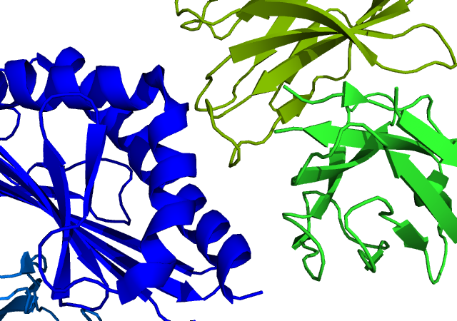
Structural and Molecular Investigations into Natural killer T-cell (NKT) and CD1d glycolipid recognition
Praveena Thirunavukkarasu
Jamie Rossjohn lab
Monash University
Australia
Notes:
1

Slide 2
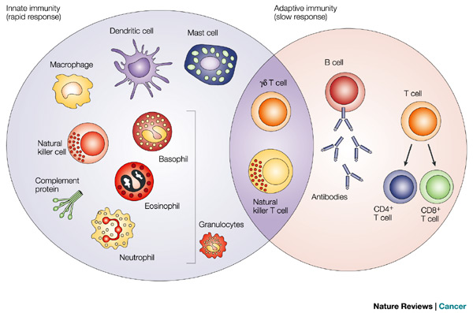
Human Immune System
Pathogens
Innate Immunity
Adaptive Immunity
From Dranoff G. , Nature Review Cancer, 2004
Bridge the gap between innate and adaptive immunity
Function as `Innate-adaptive hybrids’
Possess immunomodulatory potential

Slide 3
Natural Killer T (NKT) cells
αβ TCR
αβ TCR
NK1.1
NK1.1
T
cells
NKT
cells
NK
cells
Share properties of both conventional T cells and Natural Killer (NK) cells
Express a T cell receptor (TCR) that allows them to recognize antigens
Constitute ~ 0.1% of all peripheral blood T cells
Notes:
3

Slide 4
NKT cells recognize lipid antigens
IL13
IFN-γ
NKT
cells
CD8+
T cells
CD4+
T cells
NKT
cells
IL-21
Cytokines
GMCSF
IL-4
TGF-β
IL-17
TNF-α
Non Vα24
TCR
Non Vα24
TCR
Non Vα24
TCR
Non Vα24
TCR
α
β
α
β
α
β
α
β
CD1d
CD1d
Peptides
CD1d
Lipids
CD1d
CD1d
MHC - I
MHC - II
CD1d
β2M
Human APC
β2M
β2M
β2M
Human APC
Human APC
Human APC

Slide 5
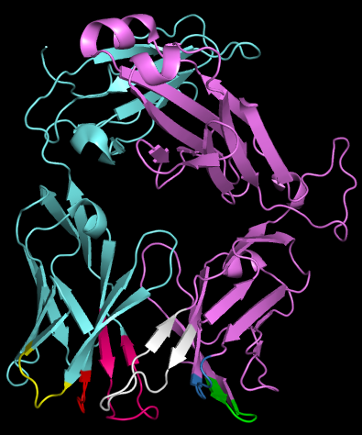
T cell receptor (TCR)
α-chain
Cα
Cβ
Vα
Jα
Cα
CDR1α
CDR2α
CDR3α
β-chain
α
β
Vβ
D
Jβ
Cβ
Vα
Vβ
CDR1β
CDR2β
CDR3β
CDR2α
CDR3β
CDR1β
CDR1α
CDR3α
CDR2β
CDR1α
CDR2α
CDR3α
CDR1β
CDR2β
CDR3β
α
β
TCR

Slide 6
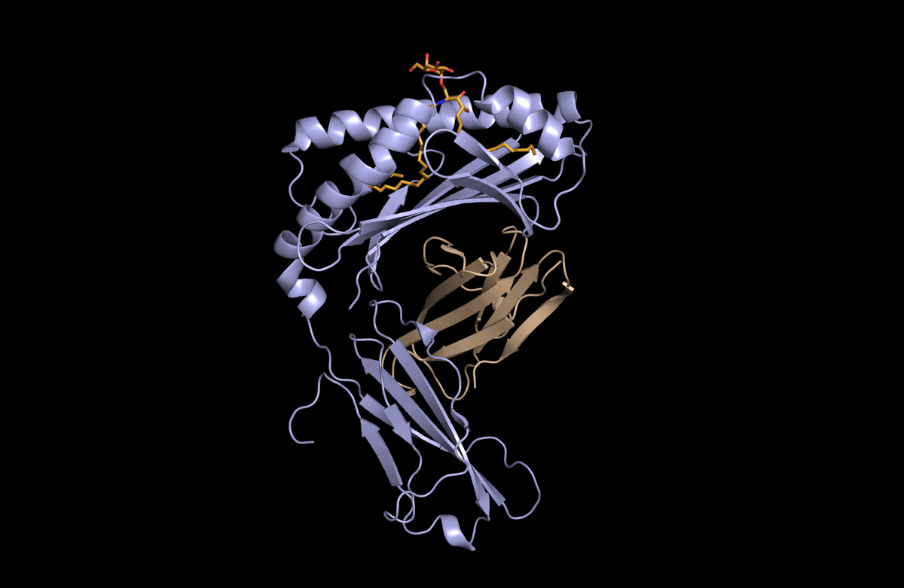
Structure of CD1d
α1
F’
Non-polymorphic antigen presenting molecule
Heavy chain non-covalently associated with β₂m
Heavy chain is composed of three domains α1, α2 and α3
Antigen-binding cavity is formed from α1 and α2 domains
The cleft is hydrophobic and has two pockets namely A’ and F’
A’
α1
α2
F’
A’
β₂m
α3
α2

Slide 7
Why do we care about NKT cells?
NKT cells
°
°
°
°
°
°
°
°
°
°
°
°
°
°
Direct activation
°
°
°
°
°
°
IFN-γ
°
°
GMCSF
Indirect activation
Direct activation
IL-13
IL-17
TNF-α
NKT cell
NK cell
IL-4
IL-21
NKT cell
NK cell
Activation
Activation
Infection
Allergy
Autoimmunity
Microbial immunity
Cancer
TCR
Killing
Non Vα24
TCR
Non Vα24
α
β
α
β
CD1d
Killing
Killing
CD1d
hCD1d
hCD1d
β2M
β2M
Tumor cell
Tumor cell
Human APC

Slide 8
Types of NKT cells
Type I
NKT
Type II
NKT
Non Vα24
TCR
Non Vα24
TCR
Vα24Jα18
α
β
Vβ11
Vα3.2Jα9
α
β
Vβ8
CD1d
₂M
CD1d
₂M
hCD1d
hCD1d
β2M
β2M
Human APC
Human APC

Slide 9
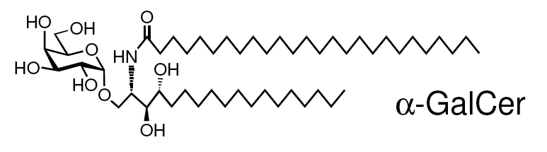
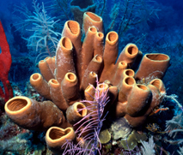
Lipid antigen - α-Galactosylceramide
α-Galactosylceramide (α-GalCer)
Prototypic type I NKT cell antigen
Marine sponge-derived glycolipid (non-mammalian, bacterial)
Lipid portion interacts with the hydrophobic pocket of CD1d
Carbohydrate head group interacts with TCR
Currently in human phase I/II trials as anti-cancer agent

Slide 10
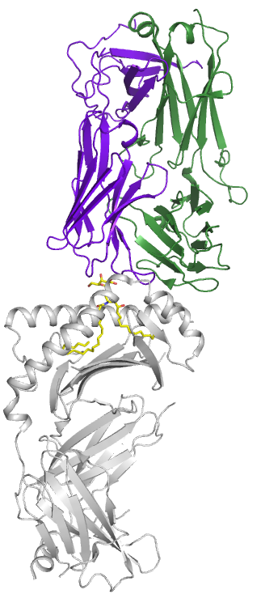
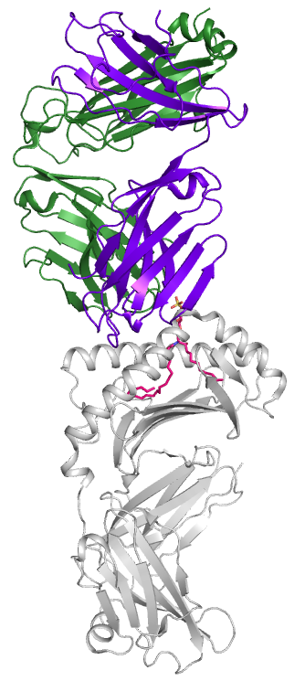
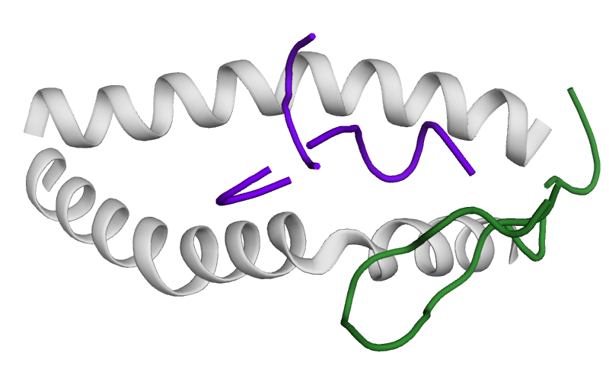
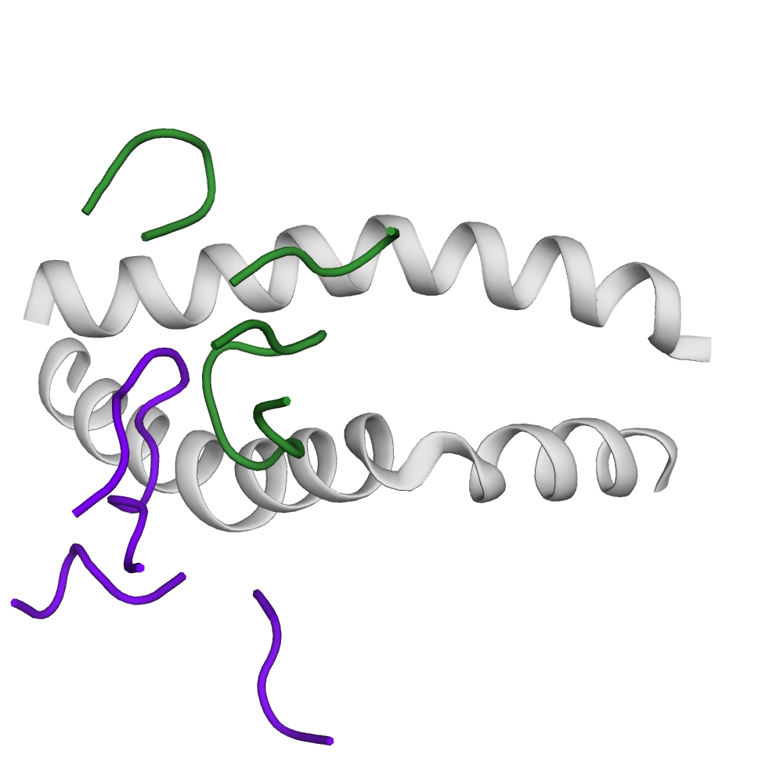
Type I and Type II NKT TCRs docking modes
Type I
Type II
αβ TCR
αβ TCR
Vα
Vα
Vβ
Vβ
α-GalCer
Sulfatide
CD1d
β2M
CD1d
β2M
Borg et al., Nature, 2007
Patel et al., Nature Immun., 2012

Slide 11
What does docking orientation signify?
Type I
NKT
Type I
NKT
Type I
Type II
TCRs dock on to peptide/MHC or lipid/CD1d in a conserved orientation
key aminoacids encoded by TCR and CD1d have been selected and maintained through evolution
Are there any other CD1d-restricted α-Galcer reactive NKT subsets in humans and do they dock in a conserved manner?
TCR
TCR
α
β
α
β
hCD1d
hCD1d
β2M
β2M
Human APC
Human APC

Slide 12
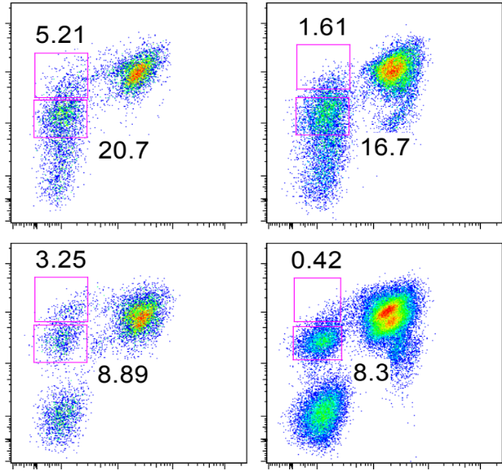
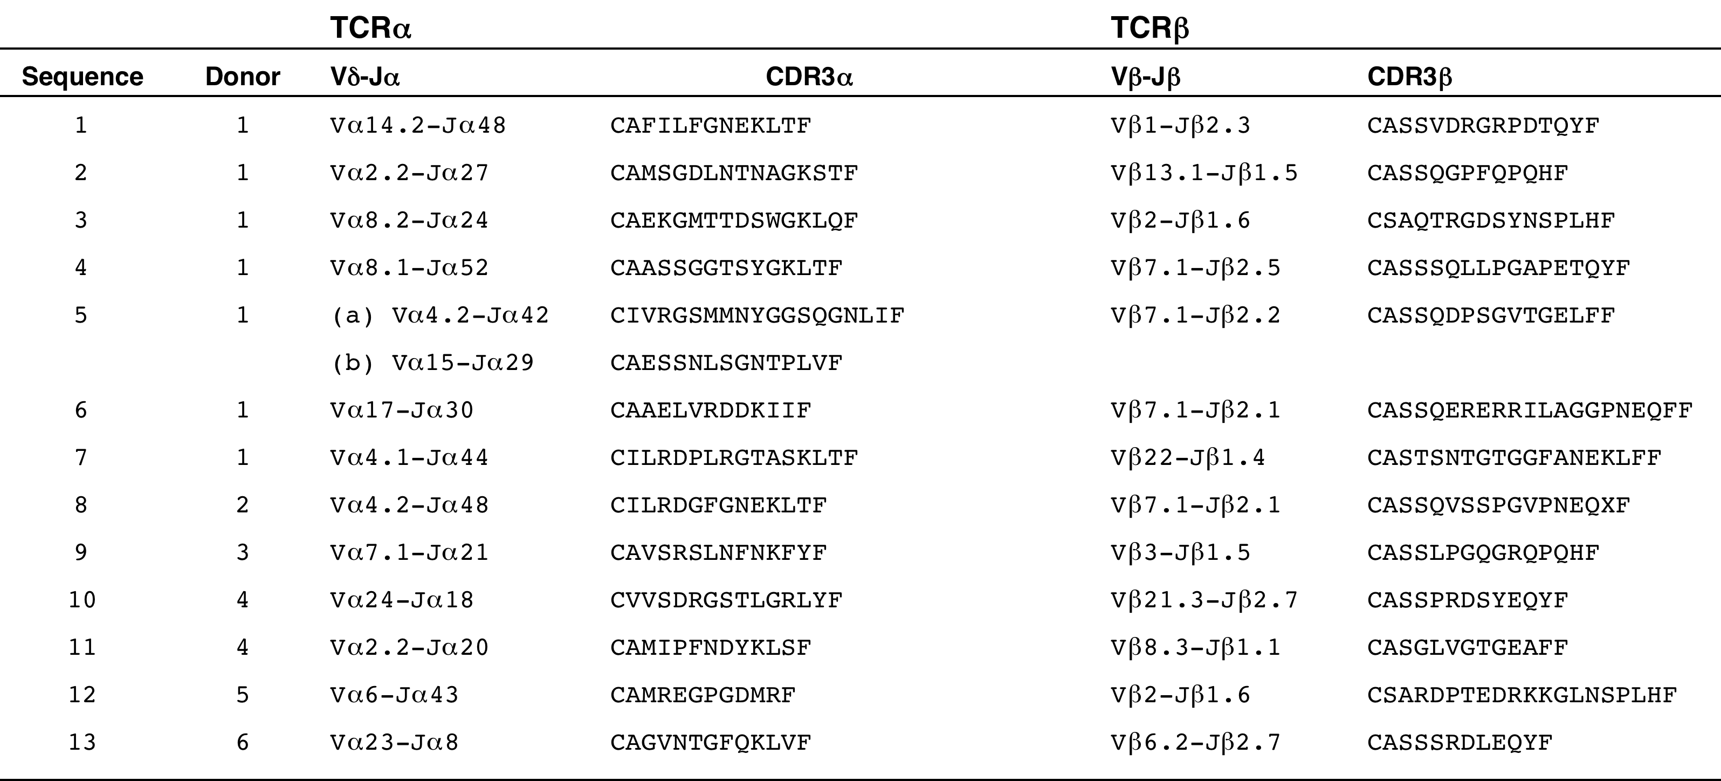
New subset of NKT cells exist in humans
NKT
cells
Donor 1
Streptavidin
PE
FACS
CD1d
Single cell sorting
hCD1d-aGalCer tetramer
α−GalCer
Single cell sequencing
Donor 2
Clones identified
Vα24
Vβ11
9B1
9B2
9B3
9B6
9B7
9B10
9B12
Collaboration with University of Melbourne

Slide 13
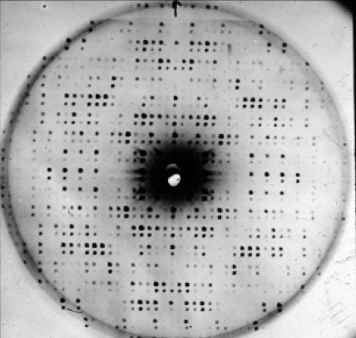
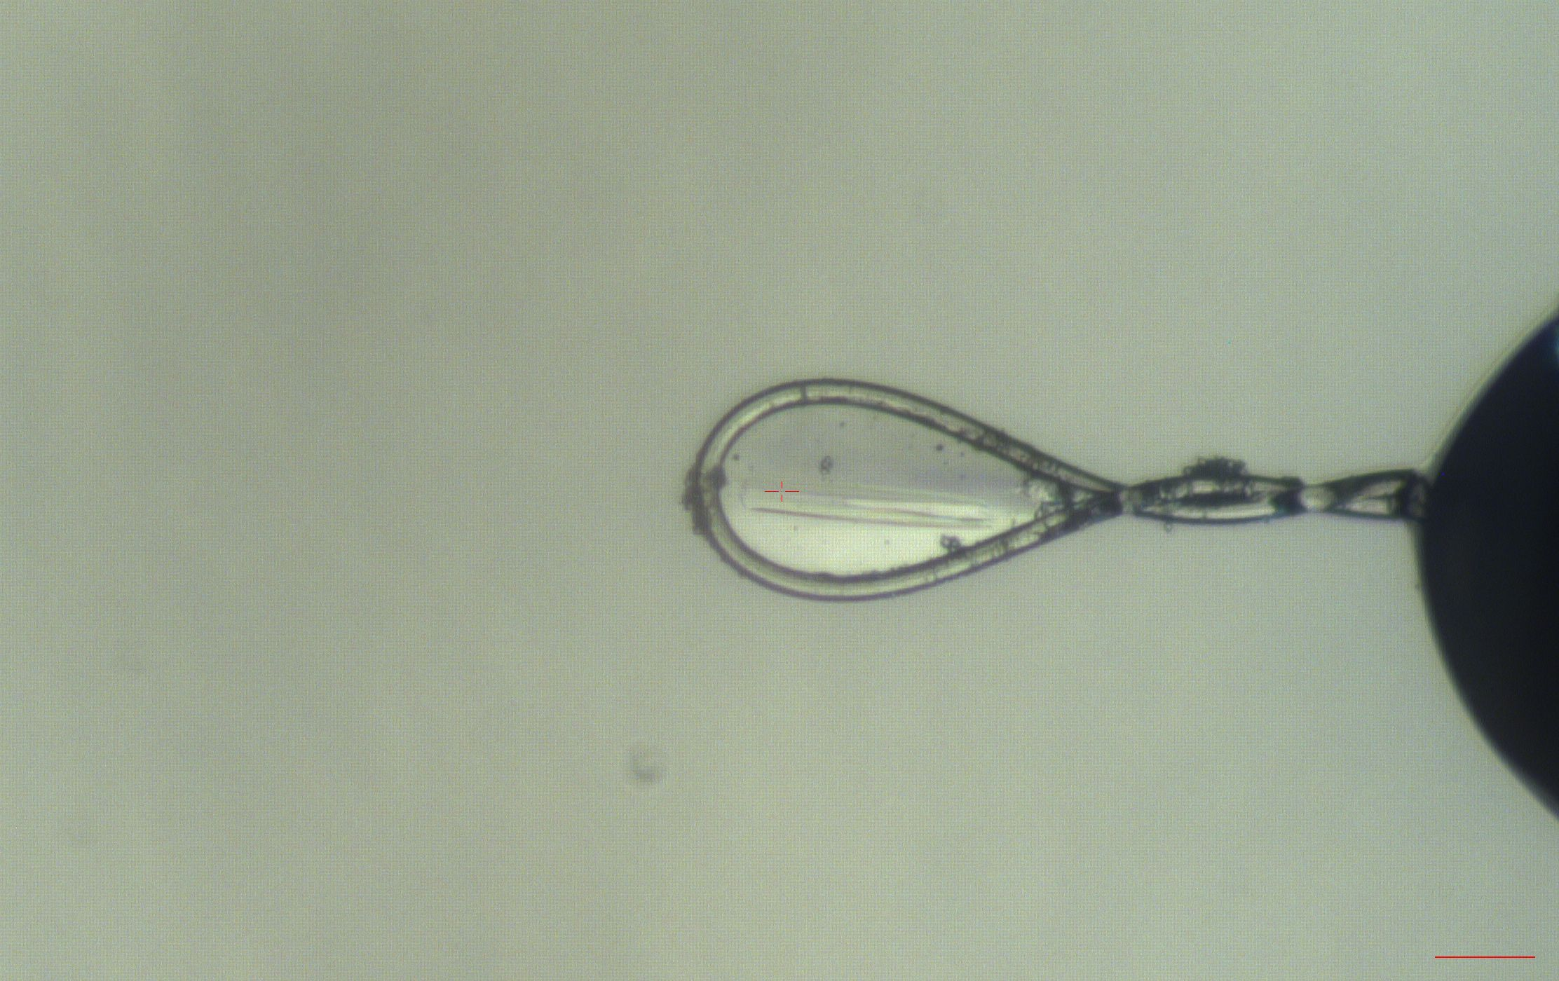
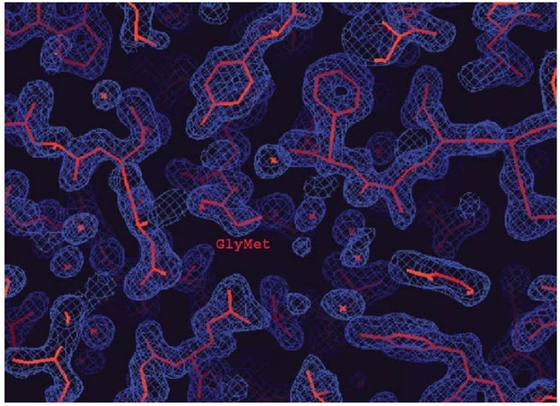
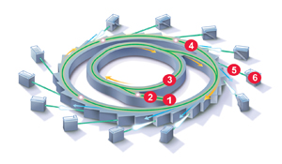
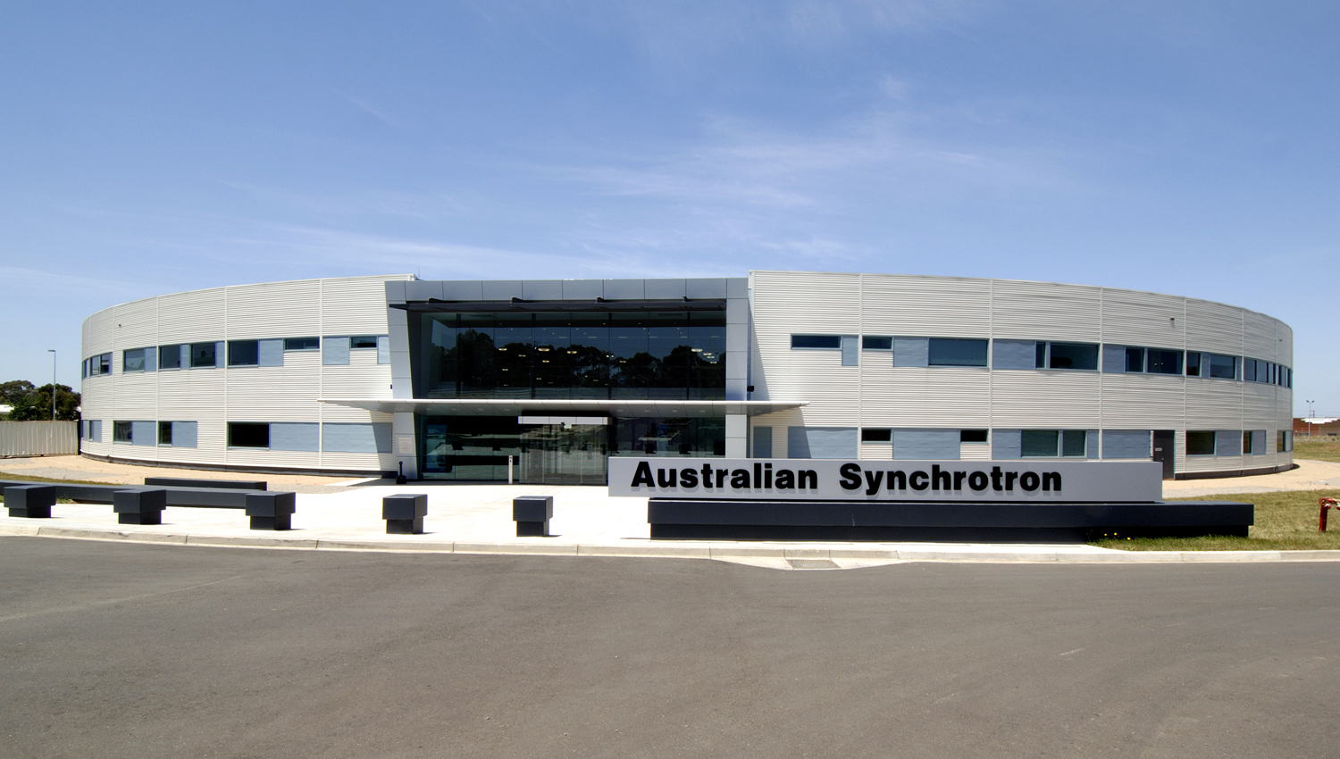
Experimental Flow
Clone and express protein
(Bacterial system)
Protein Purification
Protein Crystallization
Crystals
Electron density map
Diffraction pattern
Protein Structure

Slide 14
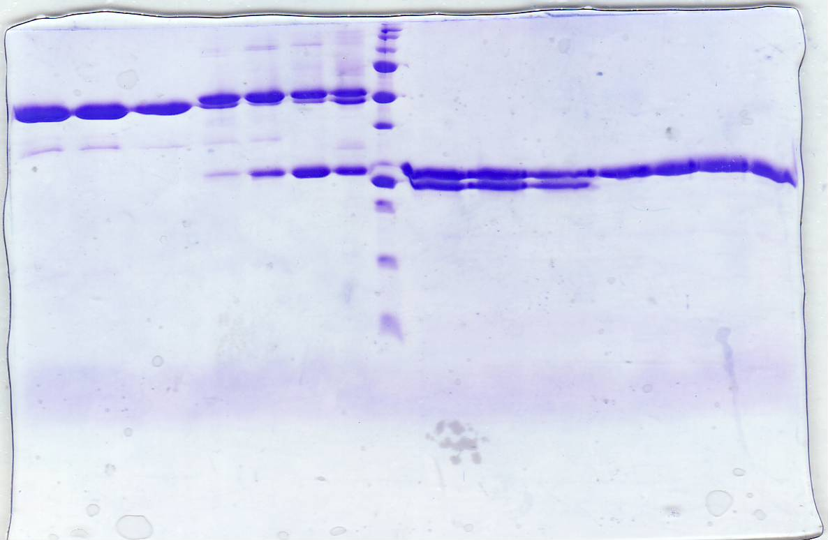
Expression and Purification of TCR
Cloned into pET-30 vector
Expressed in BL21 E.coli cells
Inclusion body preparations were performed
Variable Domain
Constant domain
N-terminal
C-terminal
Refolding
Two injections of α and β chain
Dialysed 3 days
Purification
β
Ion exchange chromatography (DEAE)
α
Size exclusion chromatography
Non-Reducing
Reducing
Anion exchange chromatography (Hitrap Q)
Hydrophobic interaction chromatography (HIC)

Slide 15
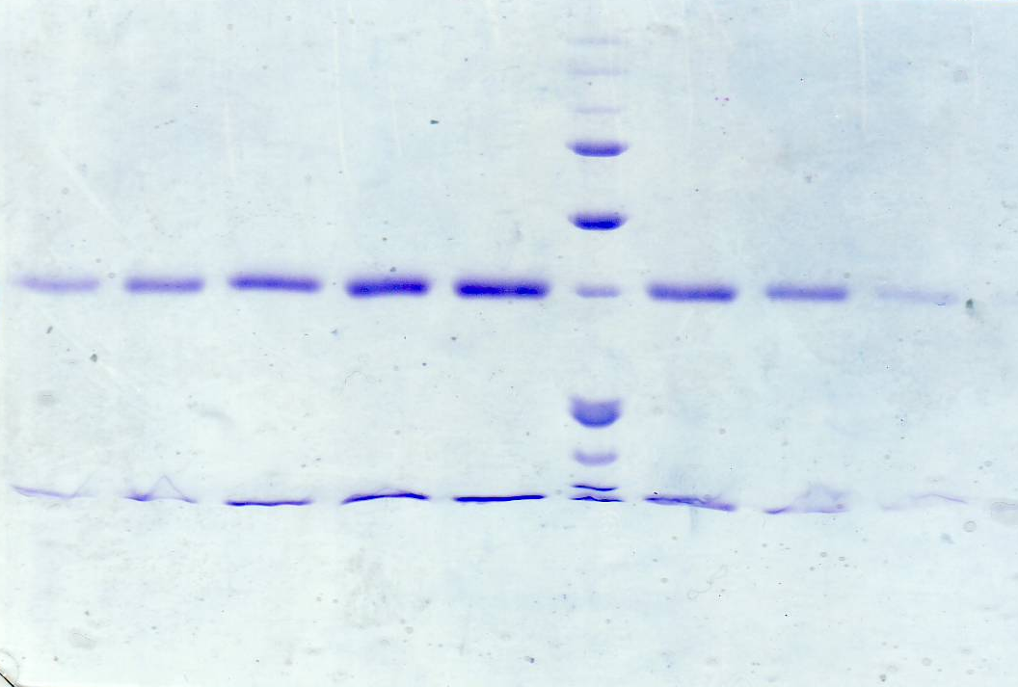
Expression and purification of Human CD1d
Cloned into a dual promoter baculovirus transfer vector pBacp10pH.
Expressed in Hi5 insect cells.
Heavy chain
32kDa
β2M
12kDa
Lipid loading
Reducing
Endogenous lipid
α-Galcer
hCD1d
Displacement
hCD1d
hCD1d
β2M
β2M

Slide 16
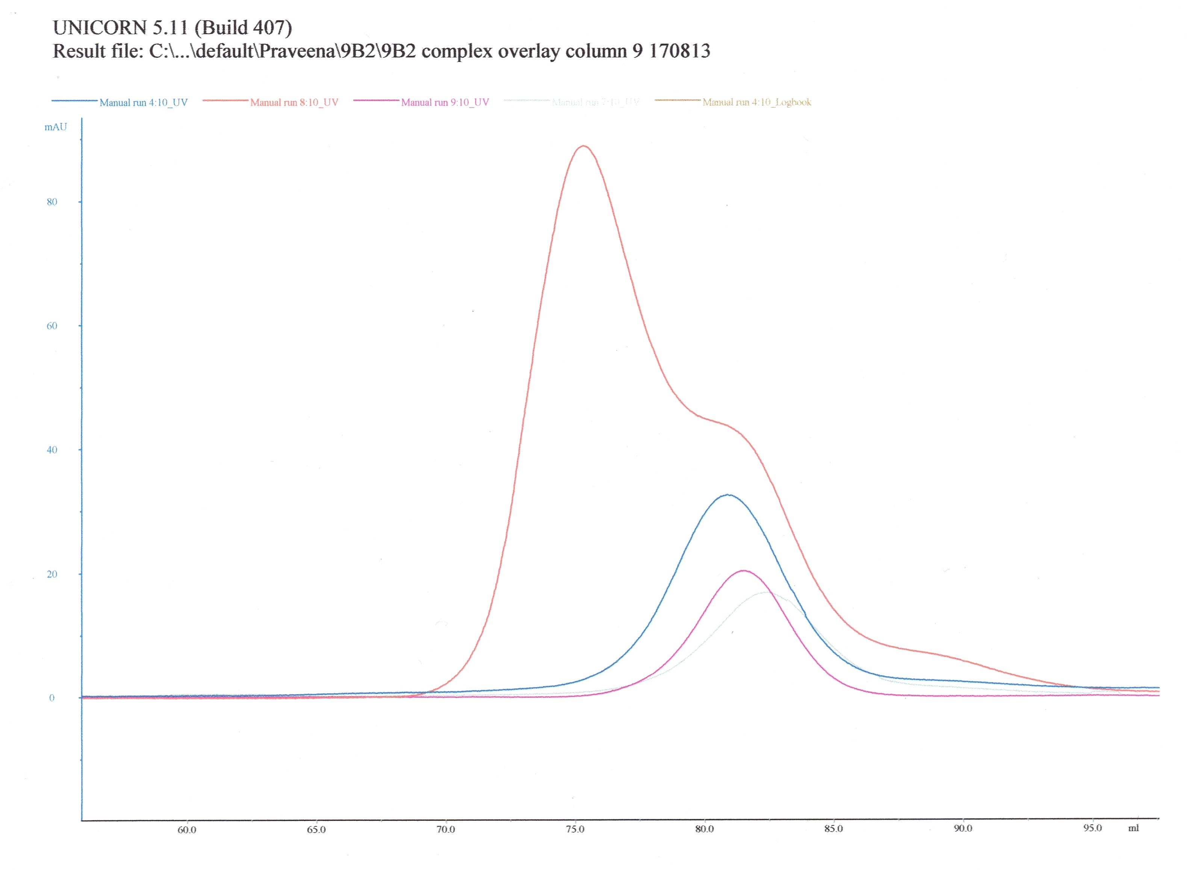
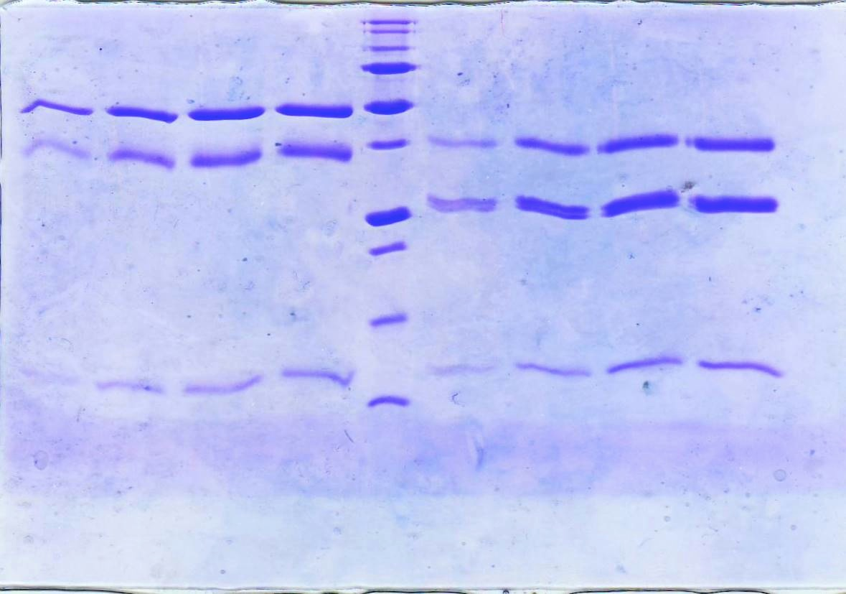
9B2 TCR-hCD1d/α-Galcer co-complexation
Size exclusion chromatography
S200 16/60
hCD1d + α-Galcer+ TCR
TCR
hCD1d + α-Galcer
hCD1d endo + TCR
A Shift in peak of 5ml indicated complex formation
TCR
CD1d
hCD1d
β
α
β2m
Non-Reducing
Reducing

Slide 17
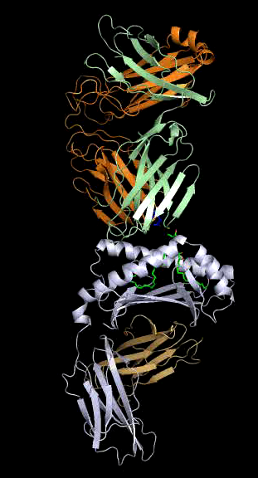
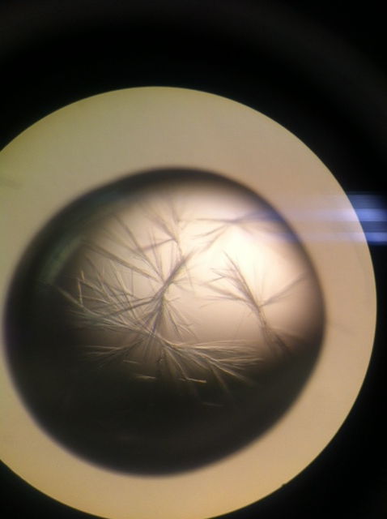
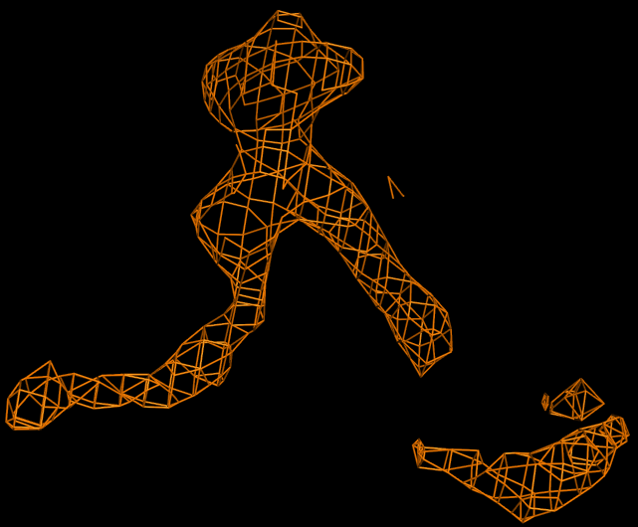
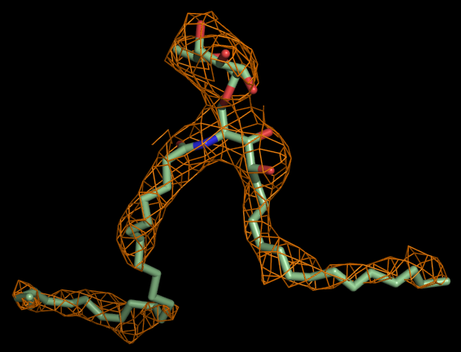
Structure of 9B2 ternary complex
Novel docking mode
Docking angle ~110°
α - chain
β - chain
α - Galcer
CD1d
β2M
α-GalCer (Fo-Fc electron
density map)
20% PEG 8000
0.1M CHES pH 9.5
α-GalCer (2Fo-Fc electron
density map @ 0.8σ level)

Slide 18
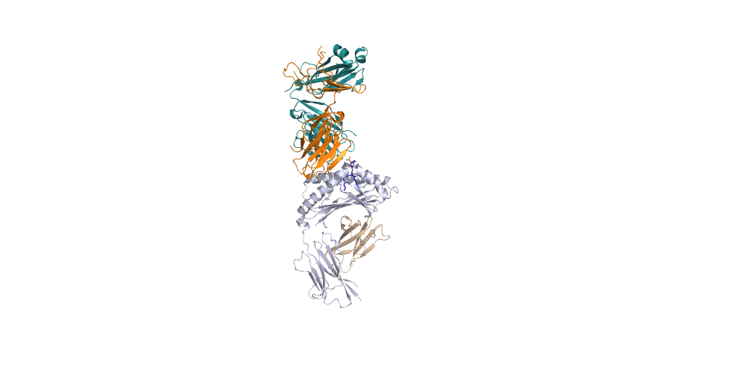
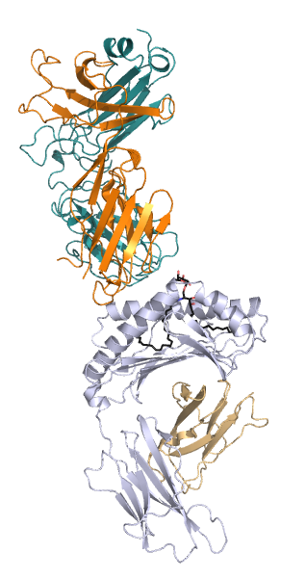
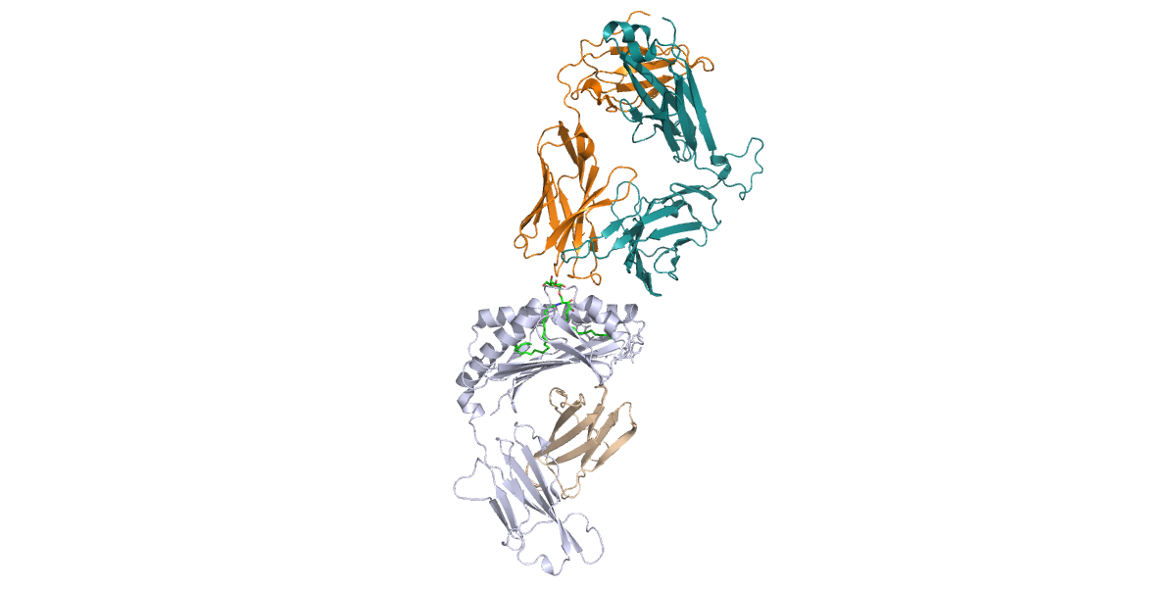
Comparison of docking modes of different types of NKT TCRs
Cα
Cβ
Cβ
Cα
Cβ
Cα
Cα
Cβ
Vβ
Vβ
Vβ
Vα
Vα
Vα
Vβ
Vα
β2m
β2m
β2m
β2m
hCD1d
hCD1d
hCD1d
Type II
9B2
Type I
hCD1d
Patel et al., 2012 Nat.Immunology
Borg et al., 2007 Nature

Slide 19
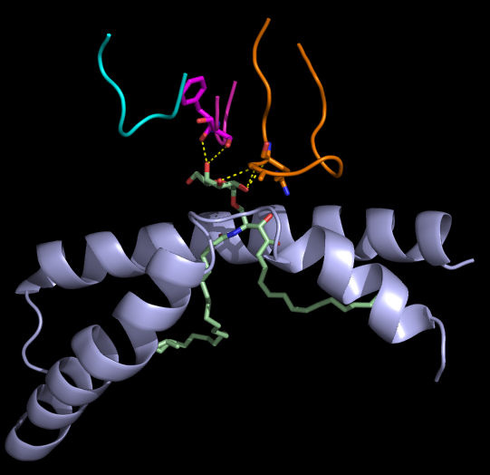
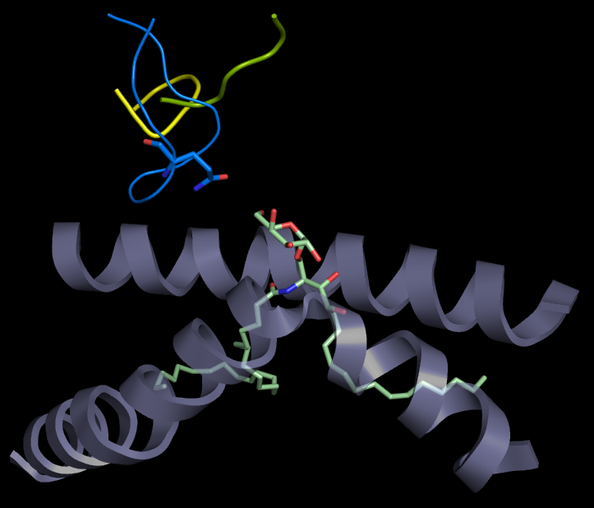
Interactions of 9B2 TCR with α-Galcer
Dominated by CDR3β loop
Q99 interacts with O6 of galactose moiety by
Van der waals interaction.
Dominated by CDR1α and CDR3α loops.
G96, F29 and S30 are H-bonded to O2, O4 and O3
respectively.
9B2 TCR
Type I
CDR1β
CDR1α
CDR2β
CDR2α
CDR3β
CDR3α
4’
6’
2’
6’
3’
α1
α1
A’
F’
A’
F’
α2
α2

Slide 20
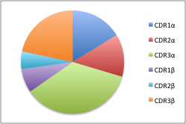
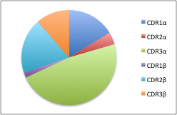
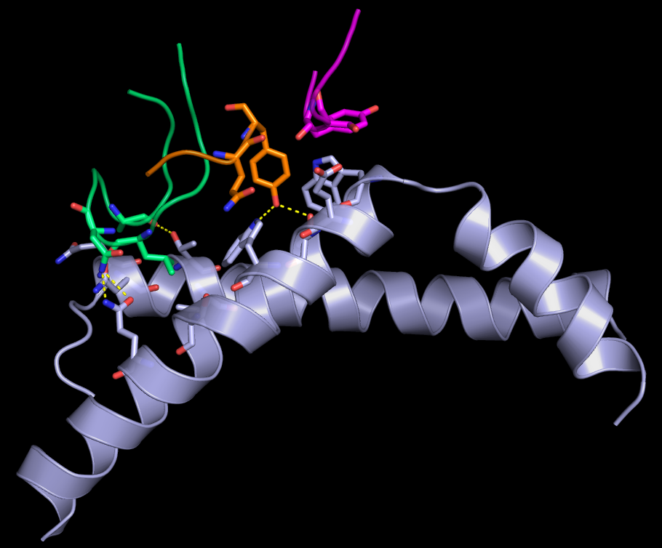
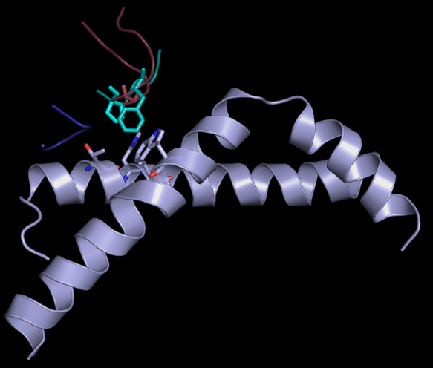
9B2 TCR-CD1d interactions
Buried surface area
9B2 TCR
Type I TCR
19.6%
14.7%
9.5%
13.5%
15.5%
3.5%
5%
12.1%
6.8%
1.5%
32.3%
39.5%
Dominated by α-chain
CDR1β
CDR1α
CDR2α
CDR3α
CDR3β
CDR2β
α1
α1
A’
F’
A’
F’
α2
CD1d/α-Chain
α2
CD1d/β-Chain

Slide 21
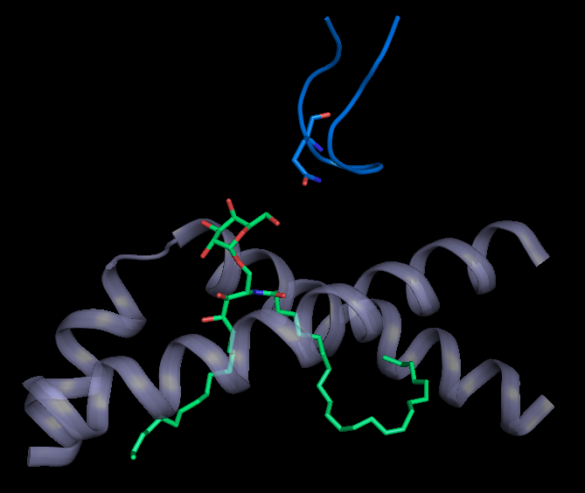
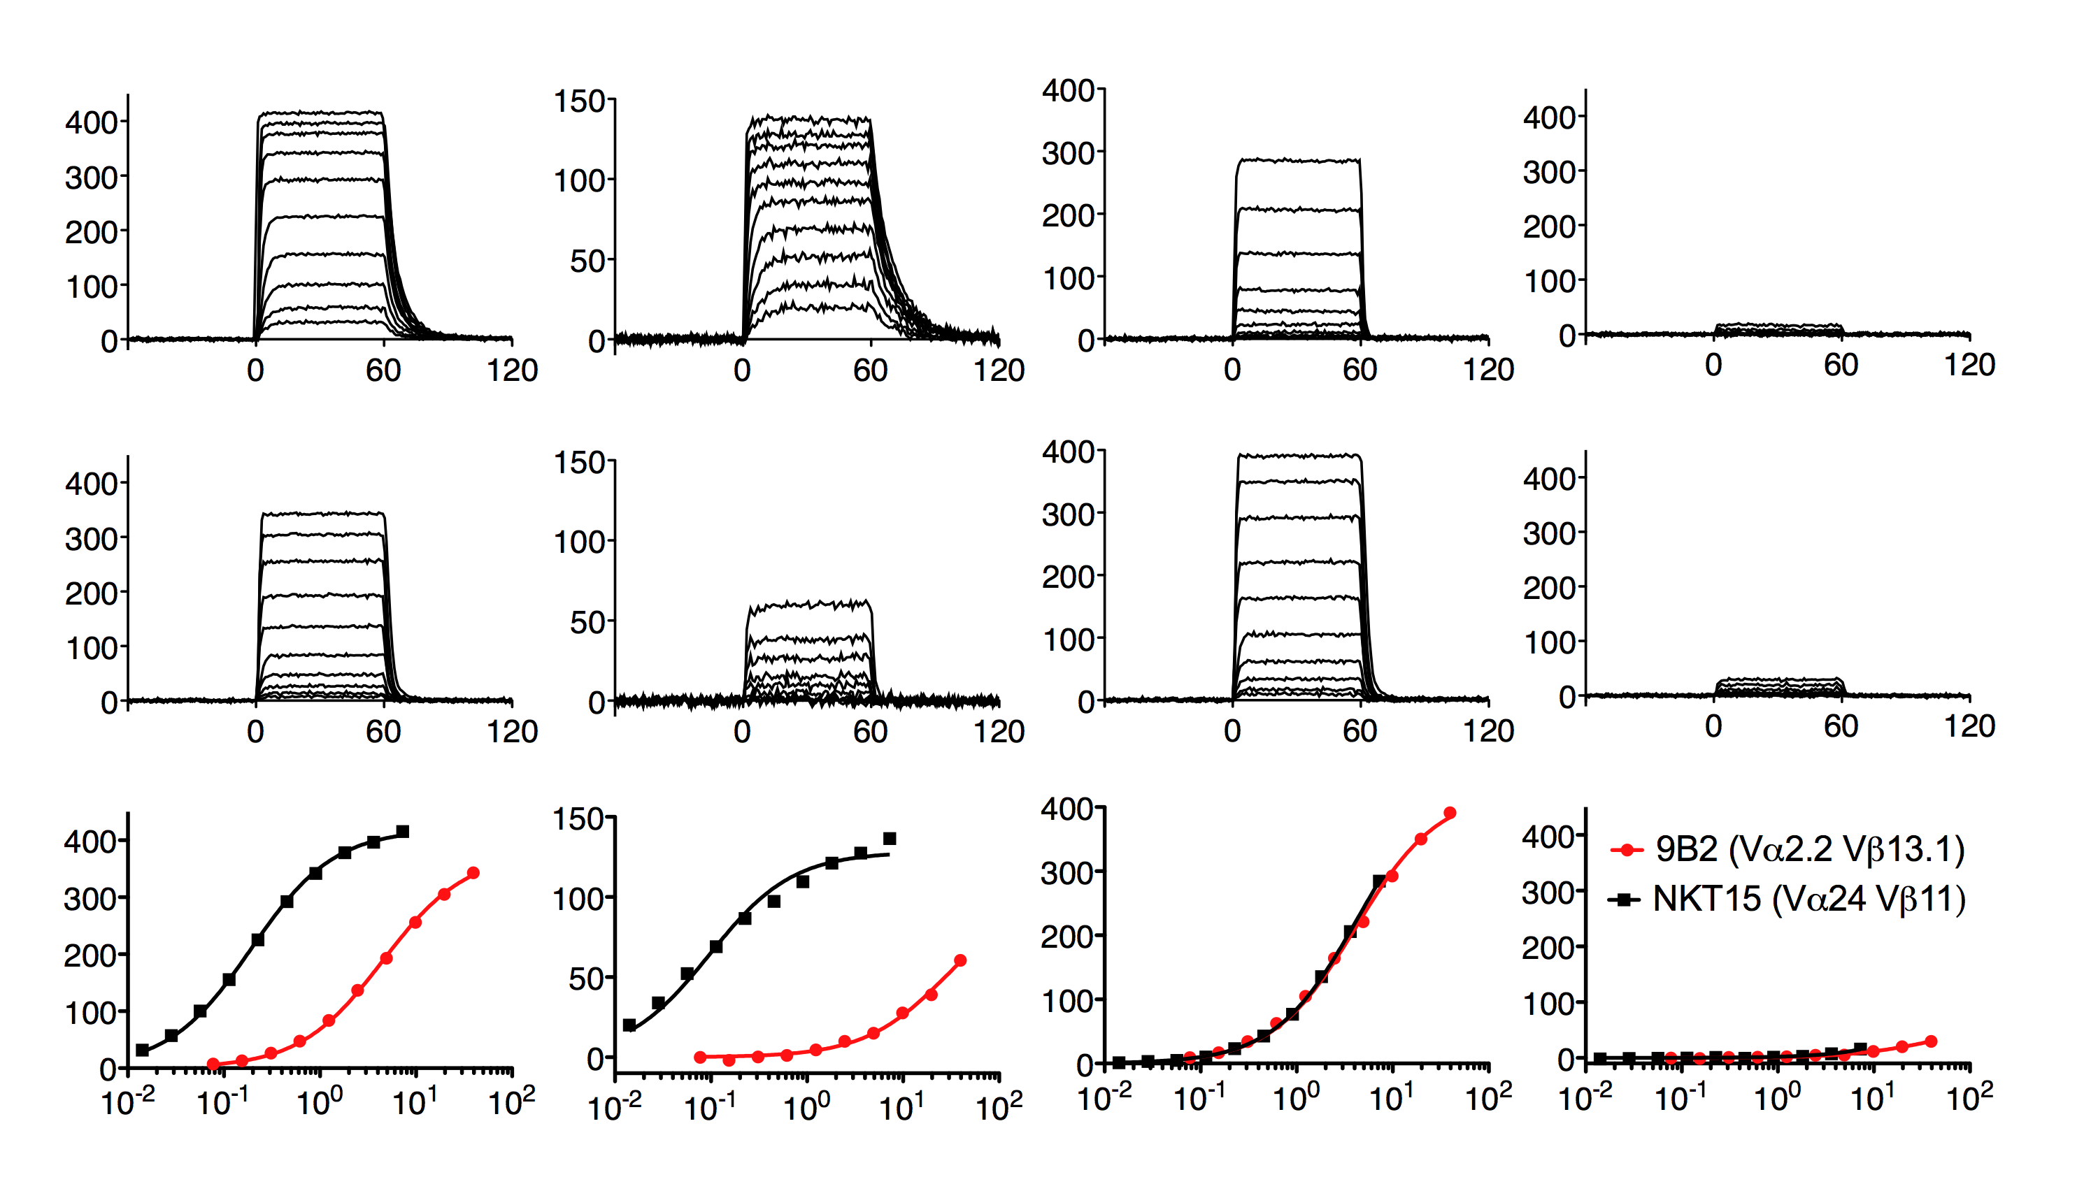
Affinity measurements of 9B2 TCR with CD1d-α-Galcer
Surface plasmon resonance (SPR)
α-GalCer
‘Unloaded’
Q99β
K_{D}: 190 nM
4’
NKT15
(Type I)
6
3’
6’
Binding (RU)
2’
K_{D}: 4.0 μM
9B2 TCR
Binding (RU)
Q99A TCR mutant showed 2-fold reduction in affinity compared with wild type
Collaboration with University of Melbourne

Slide 22
Summary
A new subset of CD1d-restricted NKT TCRs were identified in humans and termed as ‘Atypical NKT cells’
The ternary structure of 9B2 TCR revealed a novel docking mode (orthogonal) in clear contrast to Type I but comparable with Type II TCR
6’-OH of galactose moiety interacted merely with Q99 residue of TCRβ chain
SPR studies showed the affinity of interaction of 9B2 TCR (wild type) with hCD1d- α-Galcer is 4.0μM and 2-fold reduction in affinity for Q99 mutant
Diverse TCR repertoire broadens the spectrum of glycolipids recognised and thus leading to stimulation of NKT cells

Slide 23






Acknowledgements
Monash University
University of Melbourne
Jamie Rossjohn
Jérôme Le Nours
Onisha Patel
Maria Sandoval
Srinivasan Sundararaj
Dale Godfrey
Adam Uldrich
Daniel Pellicci

