Slide 1

Topical delivery of hybrid antimicrobial peptide for managing Acinetobacter baumannii infected wounds:
A novel therapeutic option
Prof. Praveen Rishi
DEPARTMENT OF MICROBIOLOGY
PANJAB UNIVERSITY
CHANDIGARH
INDIA

Slide 2
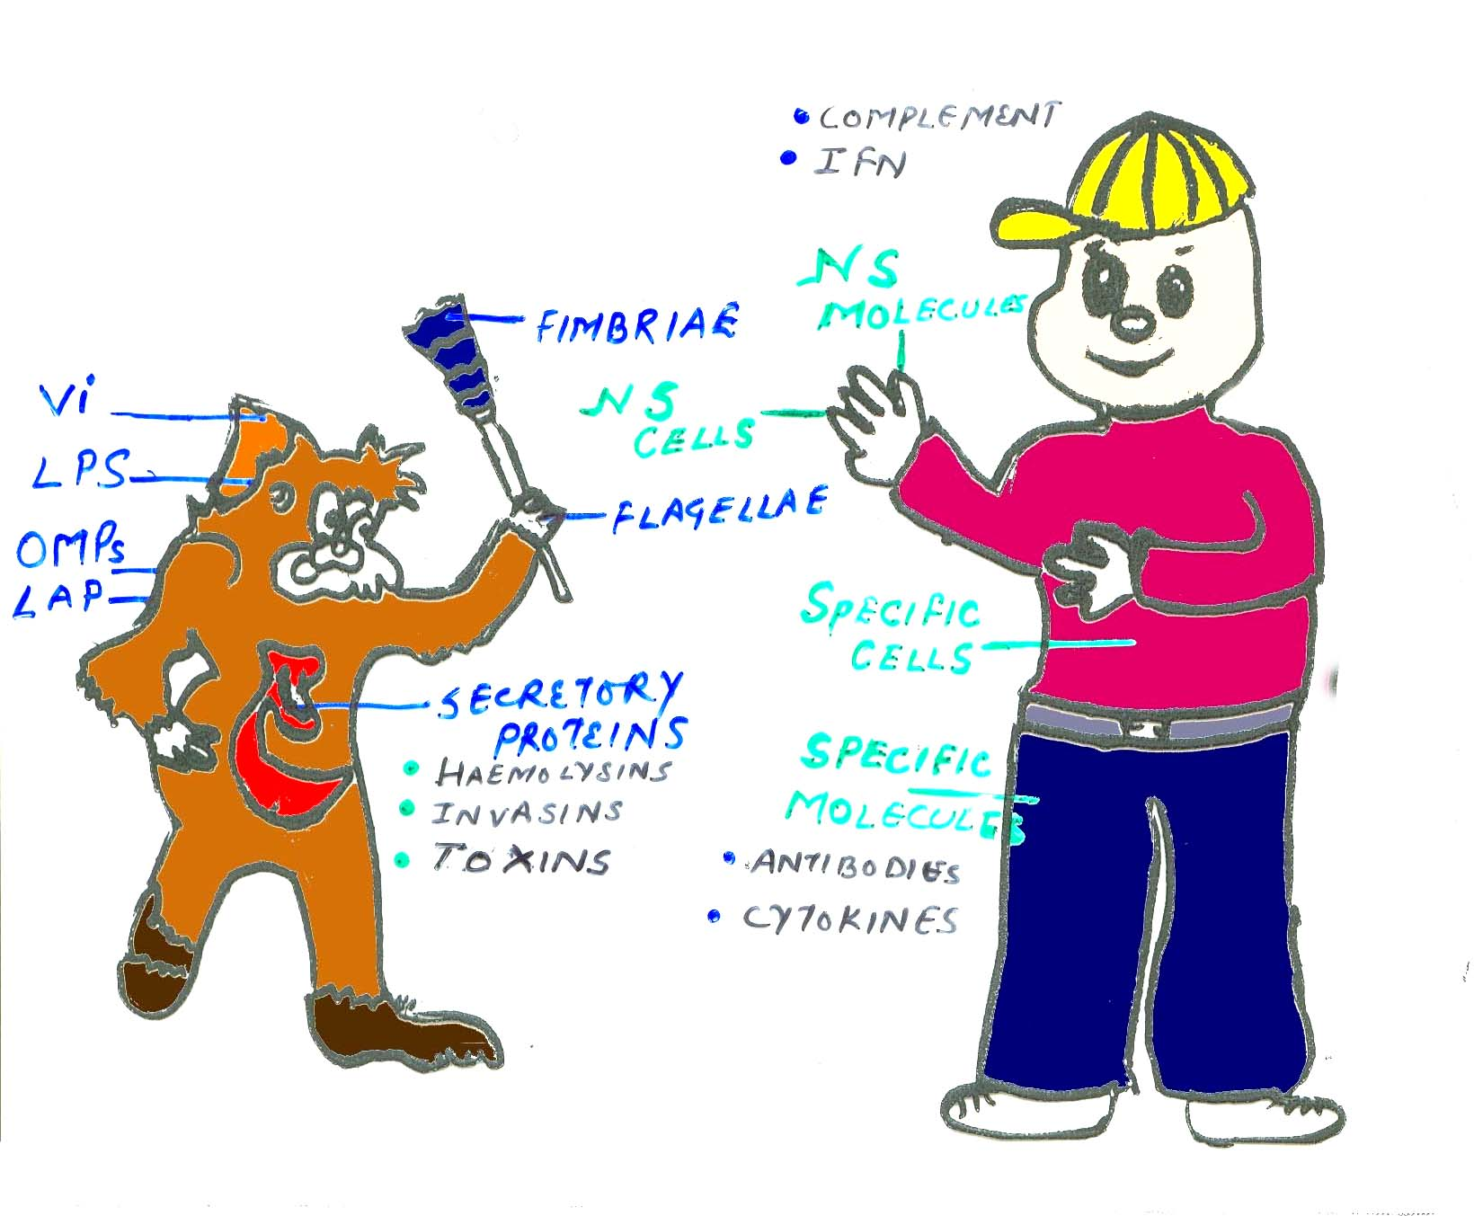
HOST-PARASITE INTERACTION
Battle between microbe and host

Slide 3

Balance between the host defense and microbial virulence determines the outcome
i.e. HEALTH OR DISEASE ?
Host-defense
mechanisms
Microbial
virulence

Slide 4
MICROBIAL WONDERS
Every now and then, changing their hats and coats according to the changing environment of the host.
Display a remarkable degree of adaptation to exploit a variety of host immune responses.

Slide 5
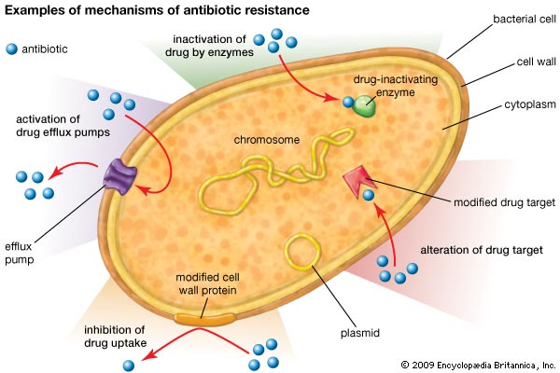
Multiple Drug Resistance

Slide 6
Revisiting anti-infective biotherapeutics
Pre-antibiotic era
Antibiotic era
Bio-antibiotic era
1st, 2nd and 3rd gen antibiotics
Native Biotherapeutic + Antibiotic
Designer biotherapeutics + Antibiotic
Prokaryotic 0rigin
Eukaryotic origin
Drug resistant pathogens
Toxicity
Disruption of gut microbiota
Cost
Expected outcomes-
Improved activity
Reduced toxicity
Lowered incidence of drug resistance
Cost reduction
Immunomodulation: General health benefits
Probiotics
Bacteriocins
Herbal products
Antimicrobial peptides
Mixed therapeutic results
Poor understanding of Phys, Pharma
and Physico-chemical nature
Lack of validation
Rishi et al., 2013. Critical reviews in Microbiology (IF- 6.2)

Slide 7
Antibiotic Resistance
Multi Drug Resistant (MDR) /‘superbugs’
Acinetobacter baumanii, “Iraquibacter”
Alternate Therapy
Antimicrobial Peptides (AMPs)

Slide 8
In this context, antimicrobial peptides (AMPs) from prokaryotic and eukaryotic origin are finding a strategic place in the therapeutic armamentarium against infectious diseases
Properties of AMPs
Small size (generally less than 100 amino acid residues)
Overall positive charge
Components of host innate immune defense
Advantages of AMPs over Antibiotics
Broad spectrum of activity
Fast killing
Immunomodulatory properties (linkers of natural and acquired immunity)
There is a lot of commercial interest in developing them as potential antimicrobial therapeutics.

Slide 9
Antimicrobial peptides
CRYPTDINS
One of the most well-characterized and highly expressed antimicrobial peptide families is that of the α-defensins.
Mouse enteric α-defensins called cryptdins are expressed in the granules of Paneth cells and are secreted into the lumen of intestinal crypts in response to bacterial stimuli
Cationic peptides of 3–5 kDa.
(Preet et al., 2010, JAC; Preet et al.,2011 PLoS NTD; Rishi et al.,2011,AAC)
From Amoebas to Humans (incl. Bacteria),
  Magainin (Frog)
  Protegrin (Porcine)
  Indolicidin (Bovine/ mammalian)
  Defensins (Humans)
  Cryptdin (Paneth cells)
  Nisin (Lactococcus lactis )
Nisin
Lactococcus lactis subsp. lactis.
Effective against Gram-positive organisms
34 amino acid polypeptide of 3-5 kDa
“Generally Regarded As Safe” (GRAS) compound
Efficacy against Gram-negative organisms using EDTA and other antibiotics have been evaluated
(Singh and Rishi et al., 2013, Plos One; Singh and Rishi et al.,2014., JAC)
Notes:
A-defensins: neutrophils and paneth
B defensins epithelial cells
Competition for nutrients by bacteria

Slide 10
ANTI-A. baumannii PEPTIDES USED IN THIS STUDY
 |  |  | No. of | Molecular
 |  |  | amino
Name | Code | Peptide Sequence |  | weight | Source | Reference
 |  |  | acid
 |  |  |  | (Daltons)
 |  |  | residues
CA |  |  |  |  | Hybrid [Cecropin A | Rodrigues-
 | P-1 | KWKLFKKVLKVL | 12 | 1530.9 |  | Hernandez et al.^{[17]}
(1-7)M(5-9) |  |  |  |  | (1-7)- Melittin(5-9)]
Magainin-II | P-2 | GIGKFLHSAKKFGK | 23 | 2466.8 | African frog | Giacometti et al.^{[8]}
 |  | AFVGEIMNS
K-11 | P-3 | KWKSFIKKLTKKFL | 20 | 2494 | Hybrid [CP26 (1-11)- | Jin-Jiang et al.^{[12]}
 |  | HSAKKF |  |  | P18 (10-18)*]
[D4K]B2RP# | P-4 | GIWKTIKSMGKVFA | 20 | 2177.4 | Secretion of mink frog | Conlon et al.^{[4]}
 |  | GAIKQN
Mastoparan | P-5 | INLKALAALAKKIL | 14 | 1479.9 | Vespula lewisii | Vila-Farres et al.^{[27]}
 |  |  |  |  | (Wasp)
Histatin 8 | P-6 | KFHEKHHSHRGY | 12 | 1562.7 | Homo sapiens | Vila-Farres et al. ^{[27]}
Bactenicin | P-7 | RLCRIVVIRVCR | 12 | 1485 | Bovine neutrophils | Vila-Farres et al. ^{[27]}
*CP26 : N- terminal 8 amino acid residue of Cecropin A + N terminal 18 amino acid residues of Melittin
*P18 : 8 amino acid residues of N terminus of Cecropin A + N terminal 12 amino acid residue of Magainin 2
#Brevinin-2 related peptide

Slide 11
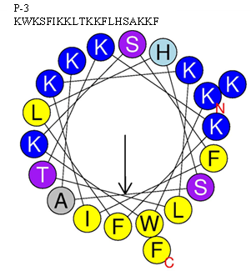
In-vitro and In-silico COMPARATIVE EVALUATION OF ANTI- A. baumannii PEPTIDES
7 peptides (P1-P7) including 2 Hybrid peptides selected on the basis of sequence
Synthesis
P1
P2
P3
P4
P5
P6
P7
Activity checked against MDR A. baumannii strains
Maximum activity
P3
P6
No activity
Prediction of AMPs using in silico tools
P3
CAMP (Seq. based similarity-3D structure
DBAASP (Physico-chemical )
orientation of cationic and hydrophobic residues

Slide 12
In-vitro Evaluation
A) Antibiogram of various clinical isolates of A. baumannii
Forty-nine clinical isolates of A. baumannii were collected from PGIMER, Chandigarh, India.
All the isolates were resistant to at least two or more antibiotics.
Maximum resistance was observed with ciprofloxacin (46, 92%), followed by cefotaxime (45, 90%),
cefepime (43, 86%), ceftazidime (43, 86%), cefoperazone/sulbactum (SBX, 42, 84%),
piperacillin/tazobactum (piptaz, 39, 78%), amikacin (38, 76%) and imipenem (16, 32%).
Fourteen isolates (58, 4961, 5759, 6730, 6823, 6824, 6934, 7055, 7080, 7690, 7696, 8331, 11617, 24909)
exhibited resistance to all the eight antibiotics.

Slide 13
In-vitro Evaluation
B) Screening of the synthetic AMP’s gainst various clinical isolates of A. baumannii
In vitro activity of the AMPs against
clinical isolates of A. baumannii
Peptide | MICrange
code | (µg/ml)
P-1 | 8-32
P-2 | 16-64
P-3 | 2-4
P-4 | 8-32
P-5 | 32-64
P-6 | >64
P-7 | 32-64
The most potent AMP was found
to be P-3, a hybrid of cecropin,
melittin and magainin 2, and
showed MIC range of 2-4µg/ml
Forty nine isolates of A. baumannii were used in this study.

Slide 14
CP 26
KWKSFIKKLTSAAKKVVTTAKPLISS-NH2
N Terminus 8 aa residues of Cecropin A1 and N Terminal 18 aa residues of Melittin
P18
KWKLFKKIPKFLHLAKKF-NH2
8 aa residues of the N-terminus of Cecropin A1 and the N terminal 12 aa residues of Magainin 2
CP-P
1-11 aa at N terminus of CP26
10-18 aa at C-terminus of P18
High antimicrobial activity
Low eukaryotic cell toxicity
Satisfactory antimicrobial activity
No eukaryotic cell toxicity
Maximum antimicrobial activity
KWKSFIKKLTSAAKKVVTTAKPLISS-NH2
No eukaryotic cell toxicity
K11
KWKSFIKKLTKKFLHSAKKF-NH2
Serine(S) To Lysine(K) at position 11
Lower MIC than other designed peptides
Maximum antimicrobial activity
Best biological properties among tested peptides

Slide 15
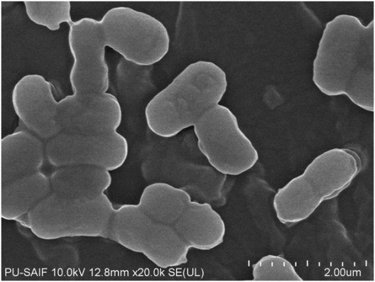
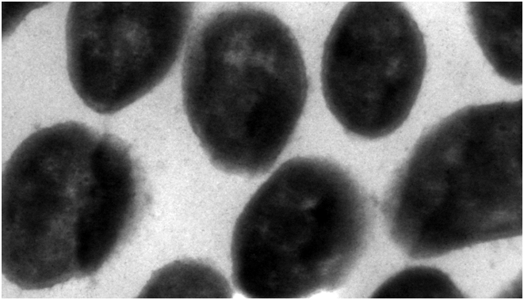
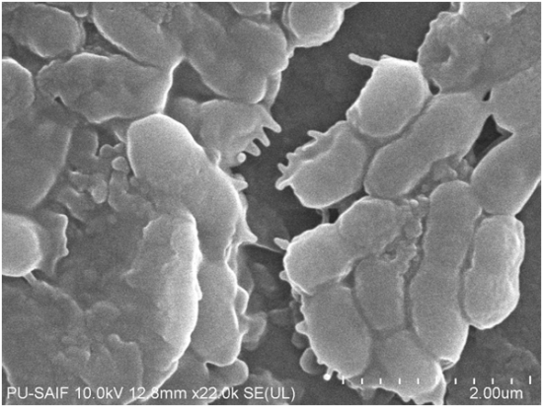
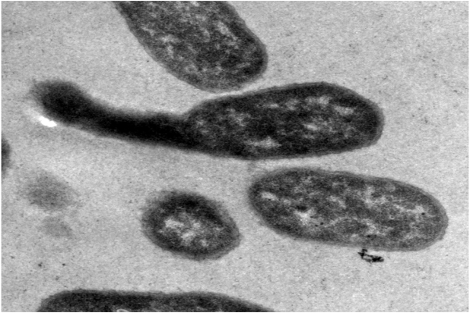
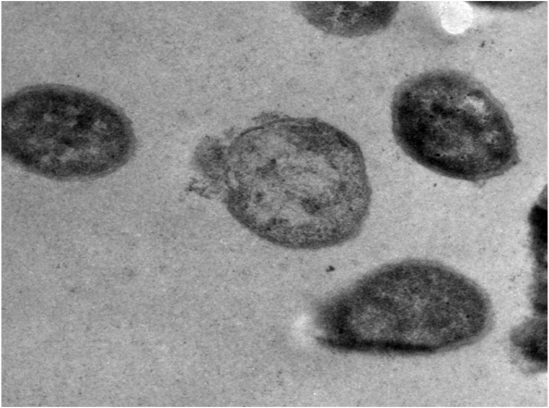
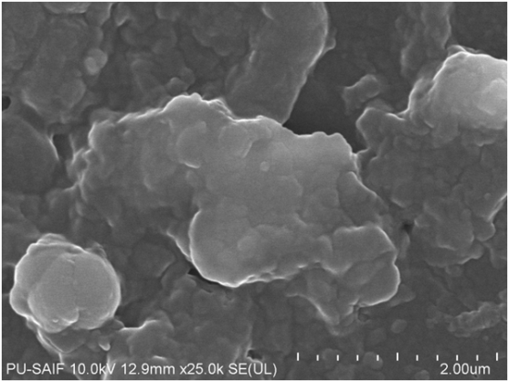
A
A
Smooth and intact surface
A. baumannii envelope were found to be smooth
B
Wrinkling of the cell surface
B
Breakage in the cell wall
Damaged cell membrane with leaked cytoplasmic content
Surface disruption
Blebs on the cell surface
C
C
Debris of the cell lysate
Displaced and distended
membrane
Fig.Scanning electron micrographs showing Acinetobacter baumannii (ATCC 19606)
cell wall damage. A: Untreated cells used as control, B: Cells treated for 30min,
C: Cells treated for 90min.
Fig. Ultrastructural damages in A. baumannii ATCC 19606 treated with
peptide P-3. Bacteria were (a) untreated cells (b) & (c) cells treated
with peptide P-3 at a concentration of 2 𝜇g/mL.

Slide 16
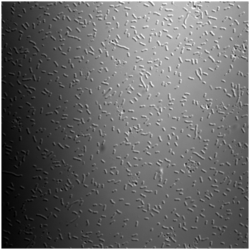
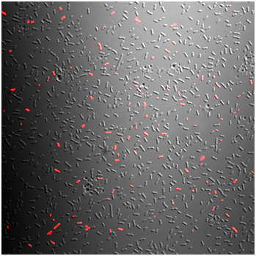
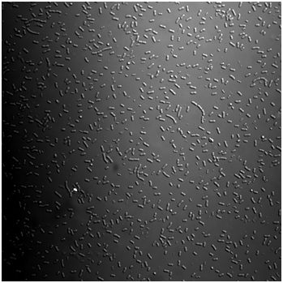
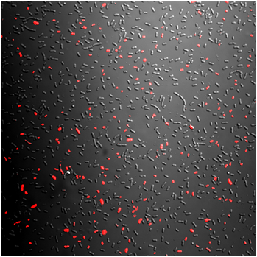
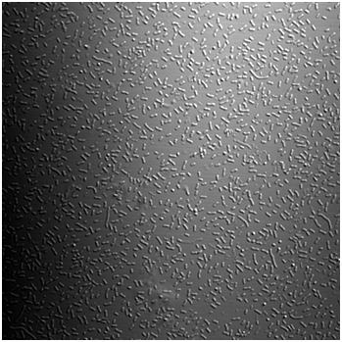
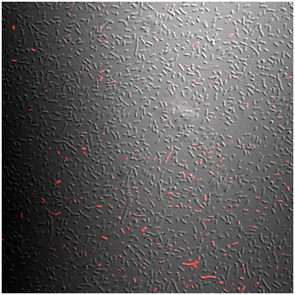
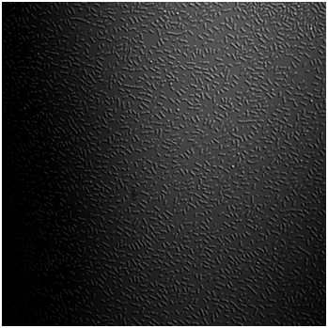
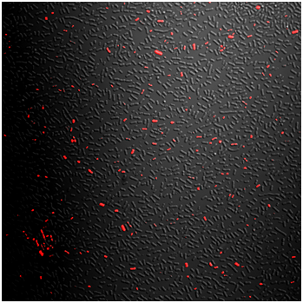
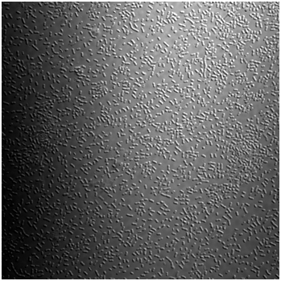
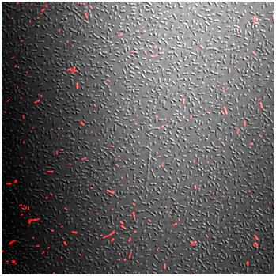
20 mins
5 Mins
30 Mins
10 Mins
60 Mins
Fig : Confocal microscopy analysis of membrane permeabilization assay by PI uptake.
Acinetobacter baumannii (ATCC 19606) was incubated (5 to 60 min) with peptide P-3
(2 µg/ml) at 37ºC in MHB medium. Panel on the left side is the control group and on the right side, the treated cells at varied time intervals.

Slide 17
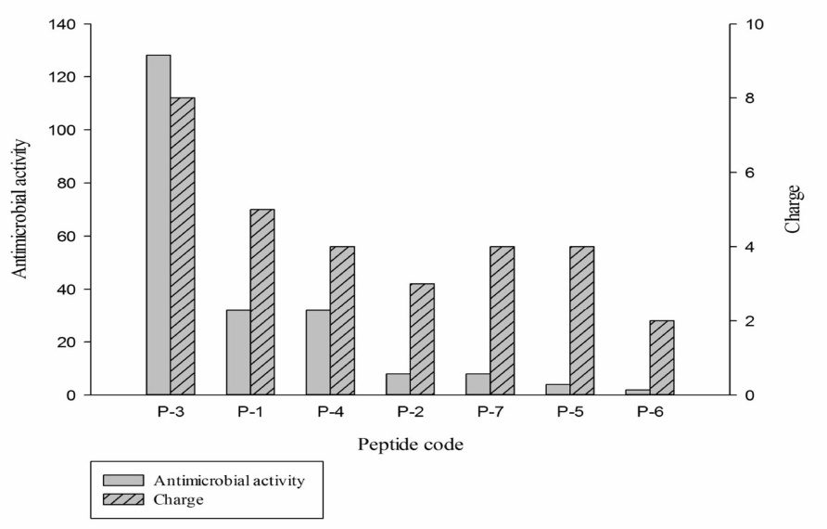
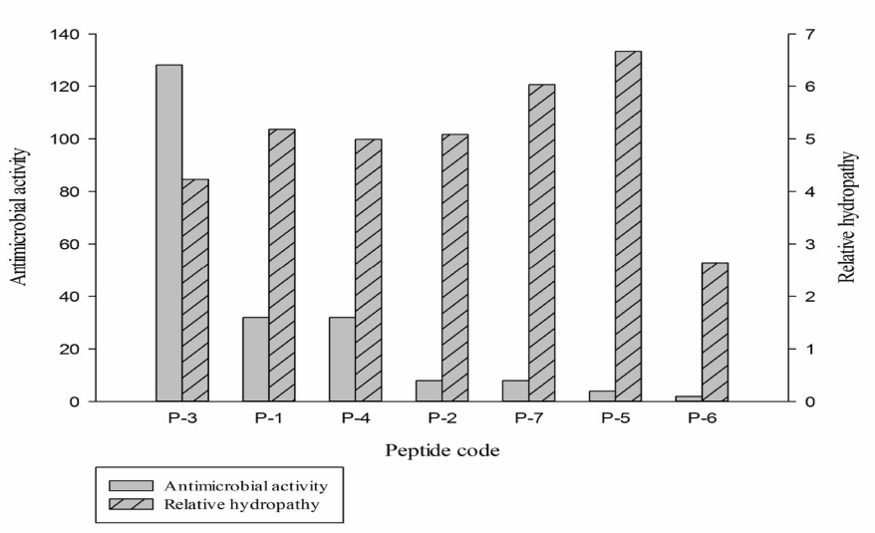
In-silico Studies
Prediction of biophysical properties of AMPS using in-silico tools
 |  |  | Antimicrobial |  | Antimicrobial |  | AMP |  | Hydrophobic
Peptide | MICrange | MIC₅₀ | Prediction/ |  | Prediction/ |  | prediction
 |  |  |  |  |  |  |  | Hydropathy | moment | Charge
code | (µg/ml) | (µg/ml) | Probability |  | Probability |  | tool
 |  |  |  |  |  |  |  |  | (HM index)
 |  |  | (CAMP: RF) |  | (CAMP: SVM) |  | (DBAASP)
 |  |  | Old | Updated | Old | Updated
 |  |  | 2010 | 2014 | 2010 | 2014
P-1 | 8-32 | 8 | AMP/ | AMP/ | AMP/ | AMP/ | AMP | 0.18 | 0.658 | +5
 |  |  | 0.99 | 0.94 | 0.95 | 0.97
P-2 | 16-64 | 32 | AMP/ | AMP/ | AMP/ | AMP/ | AMP | 0.08 | 0.475 | +3
 |  |  | 1 | 0.99 | 0.86 | 0.94
P-3 | 2-4 | 2 | AMP/ | AMP/ | AMP/ | AMP/ | AMP | -0.77 | 0.642 | +8
 |  |  | 0.95 | 0.97 | 1 | 0.99
P-4 | 8-32 | 8 | AMP/ | AMP/ | AMP/ | AMP/ | AMP | -0.01 | 0.529 | +4
 |  |  | 0.93 | 0.99 | 0.93 | 0.99
P-5 | 32-64 | 64 | AMP/ | AMP/ | AMP/ | AMP/ | AMP | 1.16 | 0.398 | +4
 |  |  | 0.99 | 1 | 0.97 | 0.98
 |  |  | AMP/ | Non- | AMP/ | Non-
P-6 | >64 | >64 |  | AMP/ |  | AMP/ | non- AMP | -2.36 | 0.185 | +2
 |  |  | 0.55 |  | 0.93
 |  |  |  | 0.37 |  | 0.43
P-7 | 32-64 | 32 | AMP/ | AMP/ | AMP/ | AMP/ | AMP | 1.03 | 0.321 | +4
 |  |  | 1 | 0.97 | 0.83 | 0.98
Fig- Correlation of antimicrobial activity and charge of
antimicrobial peptides
Fig- Correlation of antimicrobial activity and relative hydropathy
of antimicrobial peptides.

Slide 18
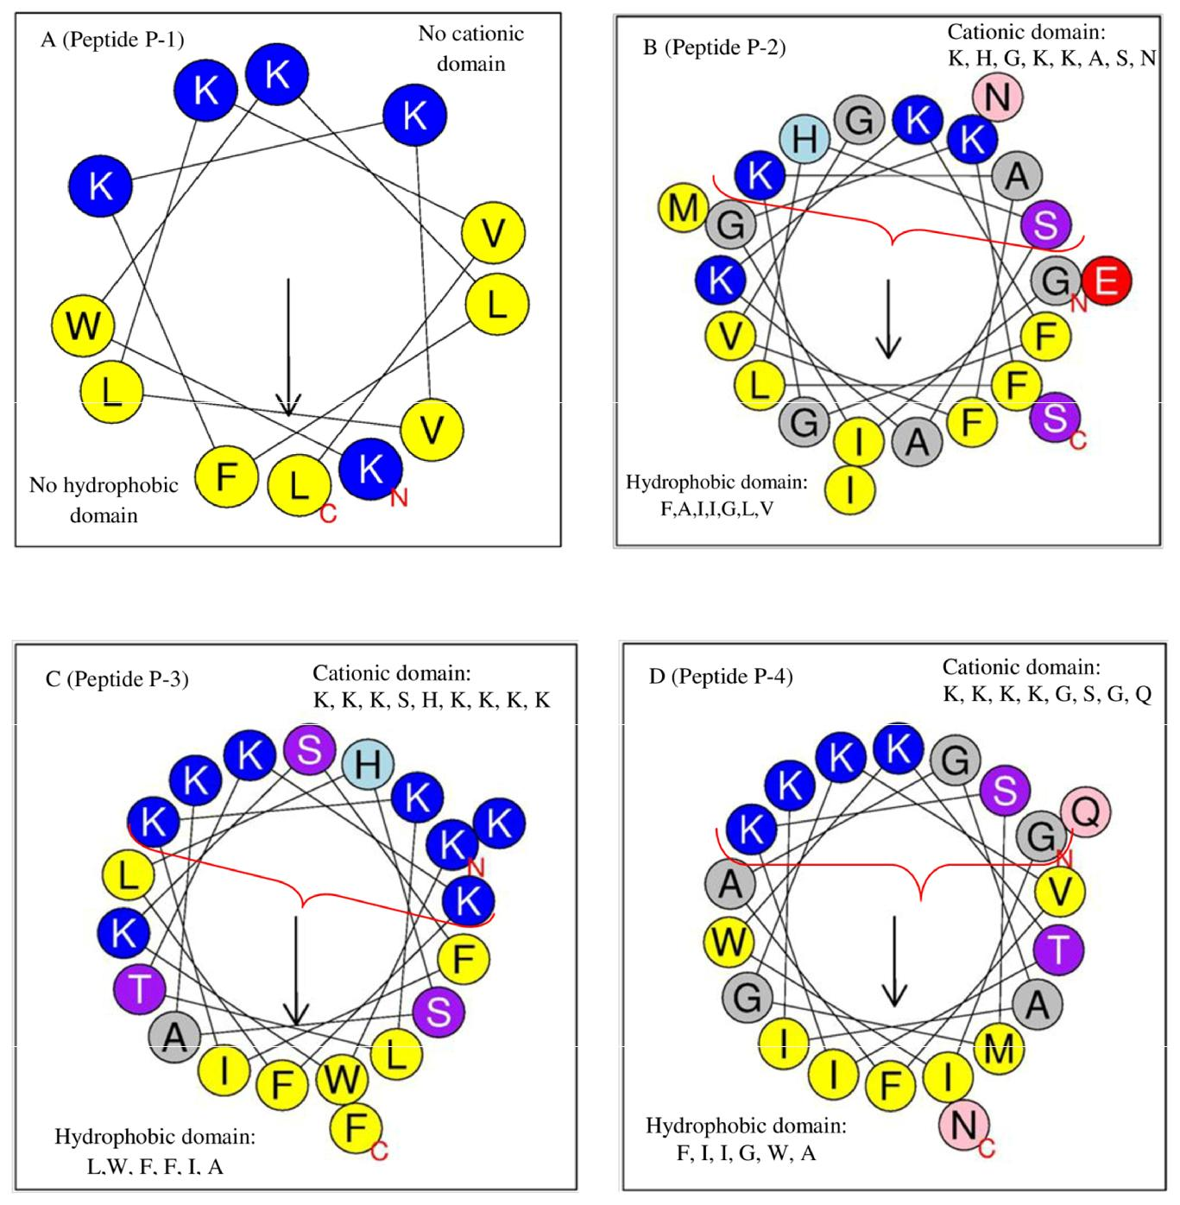
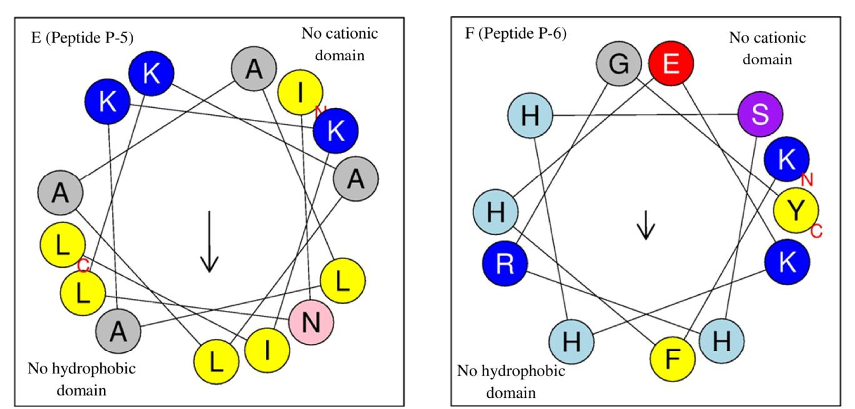
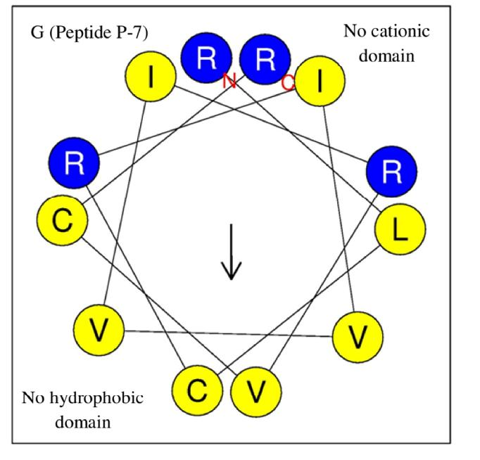
In-silico Studies
Helical wheel projection of the
anti-Acinetobacter peptides depicting
the spatial arrangement of the amino acids.
Helical wheel projection was determined
by Heliquest software.
Color code:
Yellow: non polar residues;
Dark blue: polar charged residues;
Grey: polar uncharged residues;
E, Q, N: polar residues, found rarely in peptides.
N: amino terminal of peptide;
C: carboxy terminal of peptide.

Slide 19
Significance
In spite of the encouraging results obtained from in vitro studies there is a dearth of literature pertaining to in vivo efficacy.
Lacunae
There are few in vivo reports on applications of AMPs, but the efficacy is limited due to stability and bioavailability issues.
In the present study, efficacy of using a hybrid peptide (encapsulated in a suitable matrix to improve its stability) against A. baumannii infection was studied.
Difficulty in obtaining adequate amount of native peptide
High cost of synthetic peptide.

Slide 20
Topical Therapeutic efficacy????
K11 hybrid peptide for managing A. baumannii infected wound in a murine model

Slide 21
In-vitro Evaluation
PREPARATION OF PEPTIDE HYDROGEL FORMULATION

Slide 22
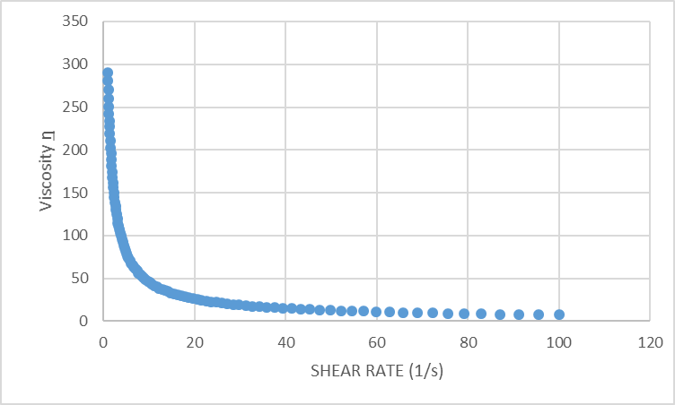
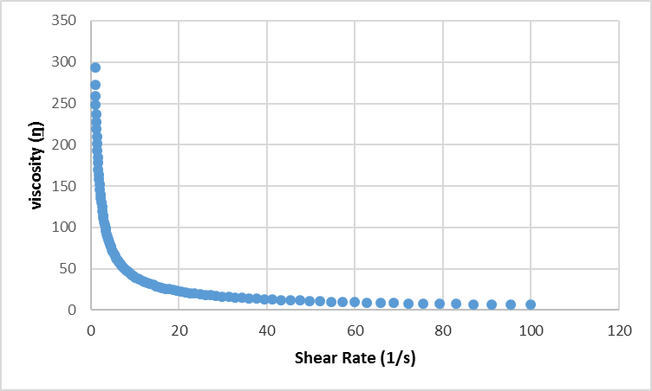
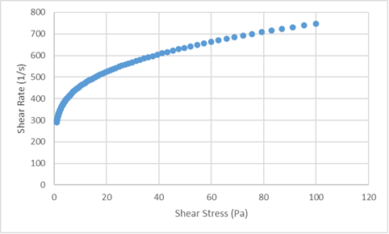
Rheological properties of Carbopol
a
b
Graph showing the shear rate vs viscosity of the gel used in the per se group(a), formulation for treatment group(b).
The graph on the left depicting the viscosity vs shear rate of the formulation used for the treatment.
NON NEWTONIAN FLUID

Slide 23
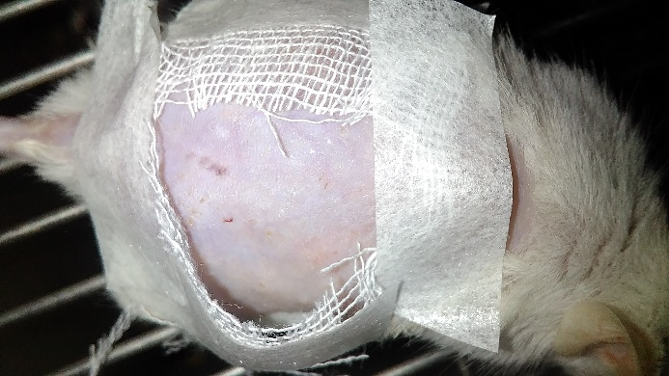
TOXICITY STUDIES OF THE PEPTIDE
NON TOXIC TO MURINE MODEL
Fig: The patch studied showed no sign of irritation or inflammation when observed for a period of 2 weeks.

Slide 24
ESTABLISHMENT OF EXCISION WOUND INFECTION WITH
baumannii IN MURINE MODEL
Excision wound was created by pinching and lifting the shaved skin on the dorsal side of mouse by
using a 6mm biopsy punch after which the wound was challenged with infection of
A. baumannii. (Thompson et al., 2014).

Slide 25
EVALUATION OF THERAPEUTIC EFFICACY OF THE PEPTIDE HYDROGEL FORMULATION
GROUP 1 (CONTROL)
Uninfected wound
GROUP 2 (INFECTED)
Infected wound
GROUP 3 (PER SE)
Infected wound with
hydrogel (without AMP)
GROUP 4 (Treatment)
Infected wound
hydrogel (with AMP)

Slide 26
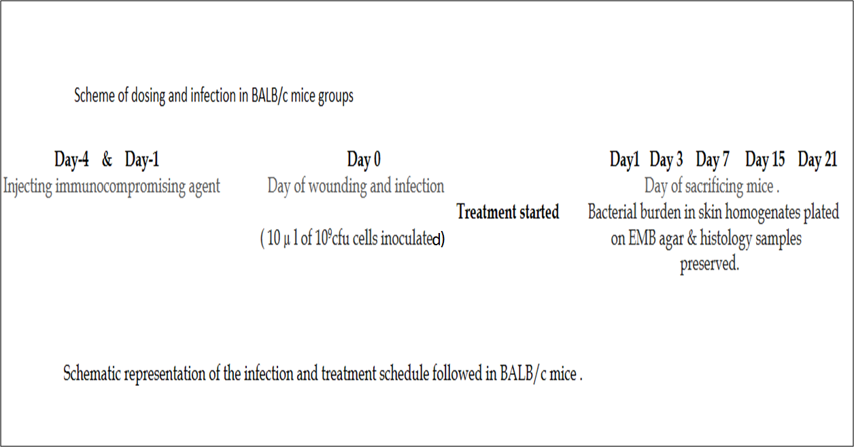

Slide 27
Figure: Showing systemic representation of mice excision wound model (A) Showing removal of the hair with hair removing cream. (B) Wound infliction with a punch of 6mm which is challenged with infection of A. baumannii and is allowed to get absorbed. (C) Wound after the infection.

Slide 28
Weight of the mice recorded
Fig: Weight recorded during the course of the experiment with initial weights being 23±2, 25±2, 24±2 and 25±2 for control, infected, per se and treatment respectively.

Slide 29
Quantification of Wound Bioburden
Day | Infected | Per se | Treatment
Day1 | 6.92±0.5 | 6.79±0.4 | 6.76±0.5
Day3 | 7.85±0.47 | 5.83±0.4 | 5.4±0.2
Day7 | 6.72±0.5 | 4.36±0.51 | 0
Day15 | 3.86±0.5 | 3.06±0.2 | 0
Day21 | 2±0.2 | 0 | 0

Slide 30
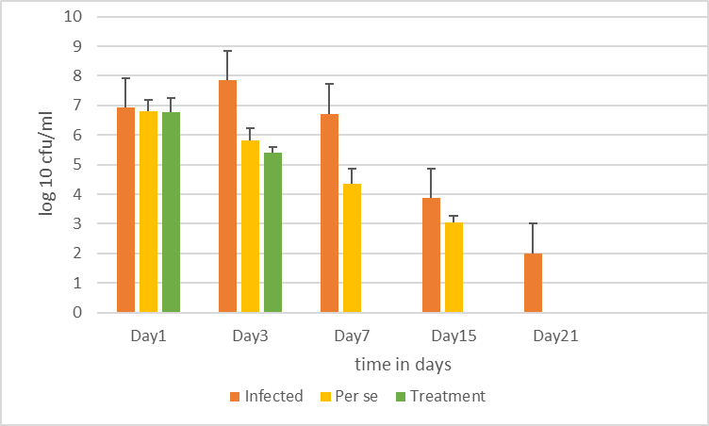
Quantification of Wound Bioburden
*
Figure: Bacterial burdens (Log₁₀CFU/ml) of A. baumannii on different days in infected, per se and treatment groups.

Slide 31
Macroscopic assessment of the wound enclosure and healing.
Quantitative assessment of wound (Wound contraction rate in %)
 | DAY 1 | DAY 3 | DAY 7 | DAY 15 | DAY 21
CONTROL (Uninfected Wound) | 16.6 | 23.3 | 46.6 | 62.7 | 78.1
INFECTED | 6.0 | 8.3 | 36.6 | 53.3 | 70.8
PER SE | 13.3 | 25 | 59.1 | 83.3 | 91.6
TREATMENT | 16.6 | 33.3 | 79.1 | 95 | 99.1
Table: Percentage enclosure of wound over a period of 21 days

Slide 32

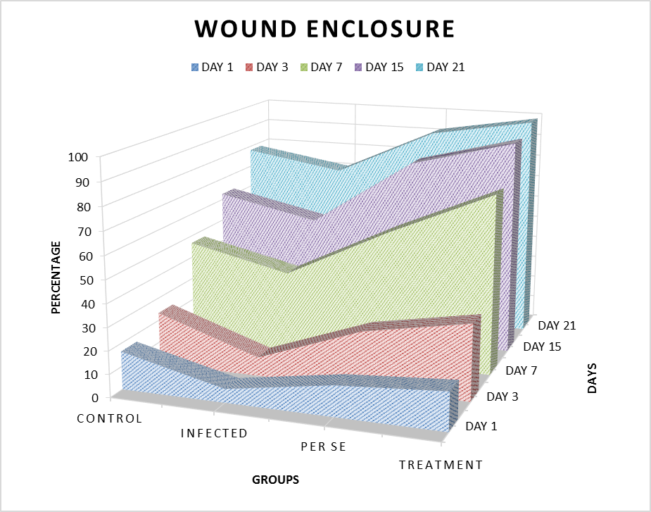
Qualitative assessment of the wound
Fig: Percentage wound enclosure in various study groups

Slide 33
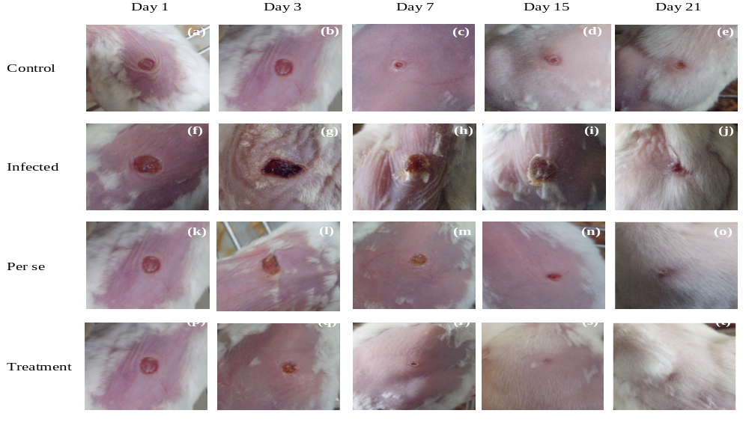
Punched Uninfected
Punched Infected
Punched Infected + hydrogel
Punched Infected + formulation
Figure: Pictorial representation of the wound contraction at various time intervals

Slide 34
Histopathological studies

Slide 35
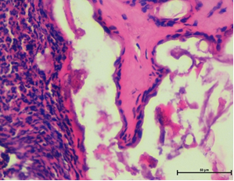
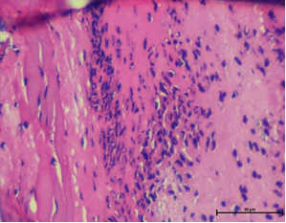
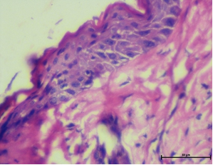
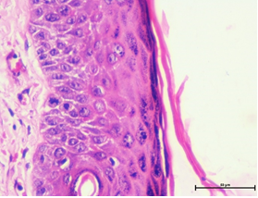
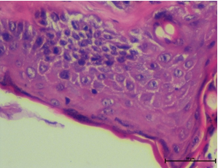
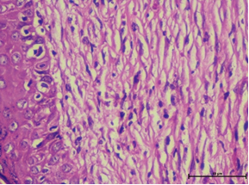
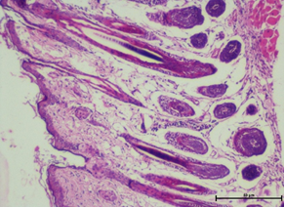
Photomicrographs of H-E stained dorsal wound sections UNDER 400X
1
2
3
Infected, day 3 (Eschar on left, surface ulceration on right)
Infected, day 7 (Thick band of
infilterating PMNLs)
Infected, day 15 (epithelial cells and
necrotic tissue of damaged sample)
4
5
6
7
Treated, day 3 (wound remodelling
& keratin producing keratinocytes)
Treated, day 7 (formation of
Epithelial cells and basal cells
layer)
Treated, day 7 (granulation
tissue at periphery with healed
area, removal of necrotic tissue)
Treated, day 15 (hair follicles
present, significant healing
and regeneration)

Slide 36
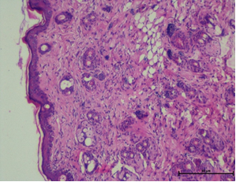
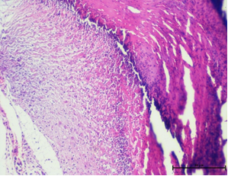
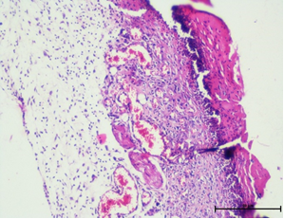
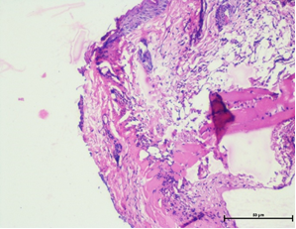
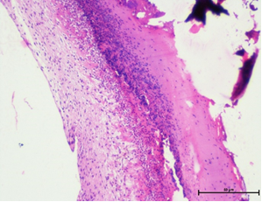
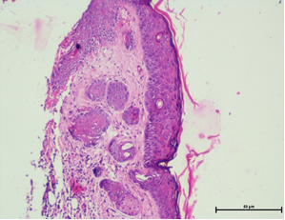
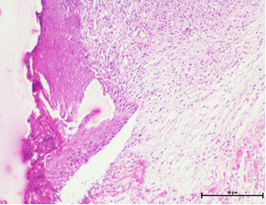
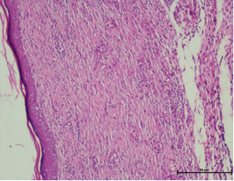
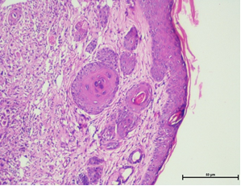
Photomicrographs of H-E stained dorsal wound sections UNDER 100X
1
2
3
4
Control , Day3 (Neutrophil infiltration & granular tissue formation)
Control , Day 7 (Healing & necrosis going on simultaneously)
Infected , Day 3 (Damaged ulcer beds & monocytes )
Infected, Day 7 (Granulation tissue with blood vessels & inflammatory cells)
Treatment on day 3
Day3
Day 7
Day 7
Day 15
5
6
7
8
9
Treatment, Day 3 (Tissue remodelling with infiltrating pus cells)
Day 3, (Active cell division & apoptotic cell bodies)
Day 7, (Tissue healing, no blood vessels seen)
Day 7, (Gap filling in epithelium with debriding, Hyperplasia seen)
Day 15, (Regeneration with
angiogenesis & epithelization)

Slide 37
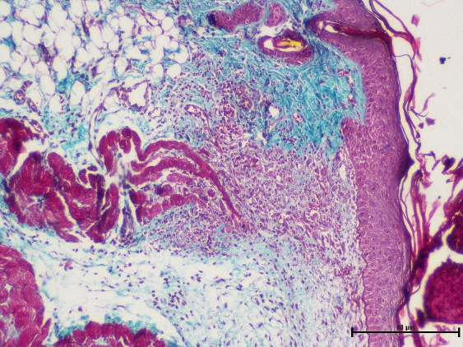
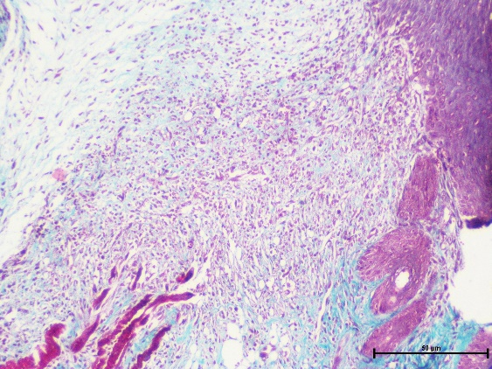


Collagen - Masson's Trichrome stain
A
B
C
D
Control, day 3 (collagen in healing tissue)
Infected, day 3 (extensive expanded network of collagen)
Treated, day 7 (blue green collagen fibres closely packed; nucleated fibroblasts between fibres, more collagen and less granulation tissue)
Treated, day21 (normal collagen with
hair follicles and reduced vascularity)
Fig: Photomicrographs of Masson’s Trichrome staining of wound sections (A to D) under 100X

Slide 38




Elastic tissue fibres - Verhoeff's van Gieson (EVG)
A
B
C
D
Control, day 3 (normal collagen, fibres not seen)
Treatment, day 3 (dense collagen, elastic fibres in black)
Treatment, day 7 (individual elastic fibres , more widely spread than in control)
Treatment, day 7 (dense elastic fibres between rose pink collagen, showing small vessels formed from elastin fibres)
Fig: Photomicrographs via Elastic Van Geison staining of wound sections under 100X

Slide 39

Estimation of lipid peroxidation
TO DETERMINE THE LEVEL OF OXIDATIVE STRESS
Fig: Effect of formulation on Lipid Peroxidase level in various study groups. Values represented as nanomoles of MDA/mg protein. Values are expressed as mean ± S.D. of three different observations. *p<0.001 vs control. #p<0.001 vs infected.

Slide 40


Estimation of Catalase activity:
Figure: Effect of formulation on the various study group in terms of catalase activity in a murine model infected with A. baumannii. Values represented as nmoles of catalase/mg protein. Values are expressed as mean ± S.D. of three different observations. **p<0.01 vs control, * p<0.05 vs control. #p<0.01 vs infected, ##p<0.05 vs infected.

Slide 41
80%
0%
To assess the survivability of animals
Figure: Pictorial representation of percentage survival of mice in various study groups.

Slide 42
Outcome of the studies
Low and effective MIC of the peptide
Effective and rapid clearance of the pathogen from the wound
Synergistic action of peptide along with gel restores normal tissue architecture in the wounded area
Excellent survival rate
The outcome of this study being that the peptide in a hydrogel formulation has better efficacy as well as good host compliance.
K11 shows antibacterial as well as immuno-modulatory potential in vivo

Slide 43


Marketable Product
Performance Effective
Cost Effective
Bio-therapeutics
Evolutionary Ancient weapons

Slide 44

















Research Team
AMP group
Biosensor group
Molecular studies on drug resistance
Probiotic group
New joinees
Combating Biofilms

