Slide 1
About OMICS Group
OMICS Group is an amalgamation of Open Access Publications and worldwide international science conferences and events. Established in the year 2007 with the sole aim of making the information on Sciences and technology ‘Open Access’, OMICS Group publishes 500 online open access scholarly journals in all aspects of Science, Engineering, Management and Technology journals. OMICS Group has been instrumental in taking the knowledge on Science & technology to the doorsteps of ordinary men and women. Research Scholars, Students, Libraries, Educational Institutions, Research centers and the industry are main stakeholders that benefitted greatly from this knowledge dissemination. OMICS Group also organizes 500 International conferences annually across the globe, where knowledge transfer takes place through debates, round table discussions, poster presentations, workshops, symposia and exhibitions.

Slide 2
OMICS International Conferences
OMICS International is a pioneer and leading science event organizer, which publishes around 500 open access journals and conducts over 500 Medical, Clinical, Engineering, Life Sciences, Pharma scientific conferences all over the globe annually with the support of more than 1000 scientific associations and 30,000 editorial board members and 3.5 million followers to its credit.
OMICS Group has organized 500 conferences, workshops and national symposiums across the major cities including San Francisco, Las Vegas, San Antonio, Omaha, Orlando, Raleigh, Santa Clara, Chicago, Philadelphia, Baltimore, United Kingdom, Valencia, Dubai, Beijing, Hyderabad, Bengaluru and Mumbai.

Slide 3


Slide 4
Lean, six sigma and ISO and their applications in clinical trials/research
4th International Conference and Exhibition on Pharmacovigilance and Clinical Trials
Pramod Wable, Manager QA GCP_GLP, Daiichi Sankyo Development, UK
11 August 2015

Slide 5



Lean Six Sigma and Its Applications in Clinical Research
Objective
Feel confident about using Lean Six Sigma

Slide 6
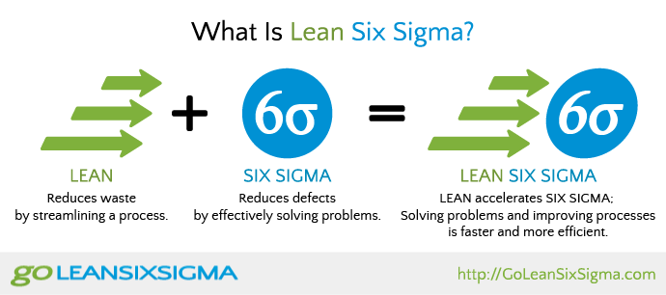




Let's discuss today!

Slide 7
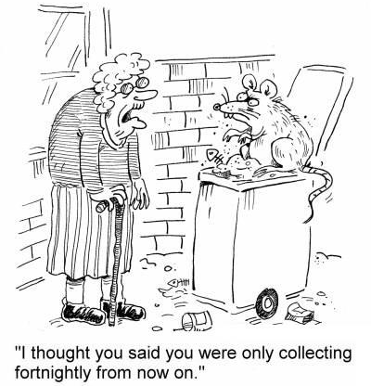
What is Lean?
“Continuous removal of the waste from process, product and service”

Slide 8
Five Principles of Lean
Identify Value
Create Flow
Map Value Stream
Waste
Pursue Perfection
Establish Pull
People
Motion
Transportation
Processing
Defects
Waiting
Over-production
Inventory

Slide 9
Lean Methodology - How
Value Added Activities
Waste – actions with no value
High Quality &
Defect-Free Process, Product and Service
Non-Value Added but Essential Activities

Slide 10


Six Sigma -
“Simply it is a set of techniques and tools for process improvement”
99.9997%
3.4 defective parts/million
How to
improve
swimming

Slide 11

Design For Six Sigma
DMAIC
Process and define factors of improvement
Problem and objectives
Maintain the improvements
DEFINE
MEASURE
ANALYSE
IMPROVE
CONTROL
Problem – what do to improve?
Implement
Improved Process

Slide 12
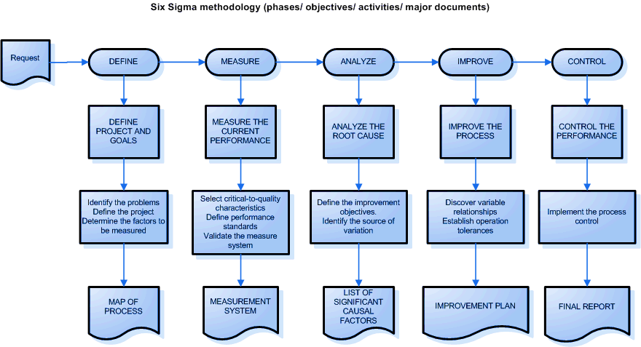
Six Sigma Methodology

Slide 13
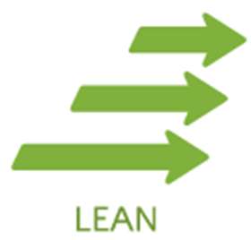

Lean Six Sigma
What is it?

Slide 14









Benefits
Employee, Customer and Stakeholder Satisfaction
Cost Reduction
Time Management
Cycle Time Reduction
Enhanced Organizational Capability
Accelerated Problem Solving
Strategic Planning
Improved Performance

Slide 15

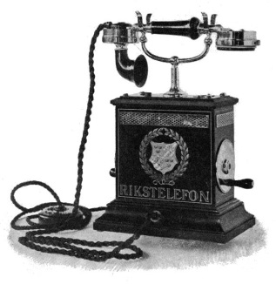

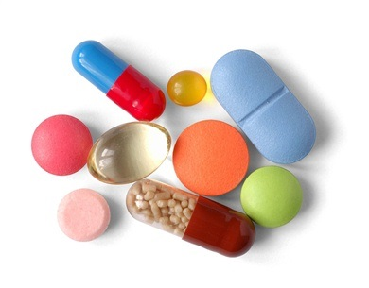




Applications
“Industry Independent”
  Manufacturing
  Industry
  Service Industry
Process Driven Industry

Slide 16
In Clinical Research
Who is Lean Six Sigma Candidate in Clinical Research?
High performing companies
Benchmark others
Empower employees
Continuously improve
Ultimate Aim = Customer Satisfaction
Who is Customer in Clinical Research?
Patients
Doctors
For clinical operations
  Biostatistics, Quality Assurance etc. (internal customer)
  Regulatory Agencies such as FDA, MHRA, EMA (customer by proxy)
  Insurance companies (intermediate)

Slide 17

Applications
Clinical Operations
Study Monitoring Activities
Phase I studies
Supply Chain Management
Clinical Quality Assurance
Project Planning
Clinical Trial Management
Clinical Trial Process
Enhancement
Metrics & Benchmarking
Development
Strategic Development
Key – “Focusing on Output Measures” (The ‘X’ factor)

Slide 18
Key Potential Difficulties in Application
Poor understanding
Improper application of statistics/methodology
“Going through the motions”
Lack of time and clarity about project
Resistance to change
Negative perceptions
Lack of effective system of communication

Slide 19


















Case Study - Shopping…!
No
Yes

Slide 20

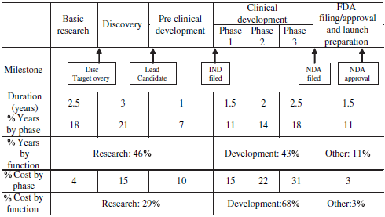

Case Study
“Highly Regulated and Expensive Industry”
Development
Research and
Source of Table/Information: DOI: 10.1016/j.jala.2005.10.003
Approx. Years
Ultimate Challenge = Quality with Cost

Slide 21
Case Study
Elliott Liu - Clinical Research during 2006
  Objectivity - reduction of a cycle time and improvement in the process
  Process tested – Paper Case Report Form (CRF)
  Sample – 32 patients and 21 CRF pages for each patient
  Method – Two methods of CRFs data entry were compared
  In-house/organization’s current method of CRFs data entry
  Improved/enhanced CRF data entry process developed by using Lean Six Sigma
Measures –
  First data entry step
  Second data entry step
  Isolated time consuming steps affecting process cycle time and error rate
  Time with respect to complete entry of CRFs into database

Slide 22
Experimental Observations
    For In-house/organization’s current method of CRFs data entry:
    Labour intensive workflow
    Error prone
    Multiple QC cycles
    Manual query handling
    Weeks in data entry and transfer
  Improved/enhanced CRF data entry process developed by using Lean Six Sigma
    Dedicated project team involved
    Almost error free within 0.2% acceptance margin of SOP
    Less QC activity with more accuracy
    Less cycle time

Slide 23


Outcome and Conclusion
Reduction of greater than 70% in cycle time and errors while CRF Data Entry
Eliminating waste and duplication + Improve and redesign workflow/processes
=
Better and efficient workflow/processes

Slide 24


The ‘X’ Factor
Focusing on Output Measures is something to look in a rear view mirror.

Slide 25
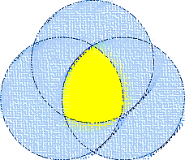

Cocktail…!
ISO
Quality
Management
System
Six
Sigma
LEAN
Can you handle this cocktail?

Slide 26
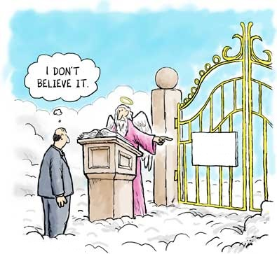

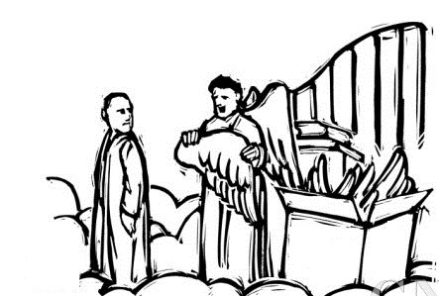
I hope this presentation helped you to strengthen your faith on Lean Six Sigma…!
Welcome to Heaven
If you QUALIFY;
then you will get
a BONUS
Lean Six
Sigma
Followers
Only
Lean Six
Sigma
WINGS
Be
the
Perfection

Slide 27




Thank you!
Contact –
Pramod Wable
+44 (0) 7872442090
pjwable@gmail.com

Slide 28
Useful Reading –
The Lean Six Sigma Pocket Toolbook: A Quick Reference
Guide to 70 Tools for Improving Quality and Speed
by Michael L. George, John Maxey, David T. Rowlands,
Malcolm Upton
The Lean Six Sigma Black Belt Handbook: Tools and
Methods for Process Acceleration
by Frank Voehl, H. James Harrington, Chuck Mignosa,
Rich Charron
Velocity: Combining Lean, Six Sigma and the Theory of
Constraints to Achieve Breakthrough Performance-
A Business Novel
by Dee Jacob, Suzan Bergland, Jeff Cox
Lean Six Sigma and Its Applications in Clinical Research
CONFIDENTIAL

Slide 29
Let us meet again..
We welcome you all to our future conferences of OMICS International
5th International Conference & Exhibition on Pharmacovigilance & Clinical Trials
On
September 19 - 21, 2016 at Vienna, Austria http://pharmacovigilance.pharmaceuticalconferences.com/

