Slide 1
HEALTH INSURANCE AND THIRD PARTY ADMINISTRATORS IN INDIA:
AWARENESS AND PERCEPTION OF POLICY HOLDERS
COMPILED AND COLLATED BY:
DR. PRABHJOT KAUR DILAWARI
BDS., MHA.
ASSISTANT PROFESSOR
GURU NANAK DEV UNIVERSITY, AMRITSAR

Slide 2

INTRODUCTION
The ILO defines Health Insurance as “the reduction or elimination of the uncertain risk of loss for the individual or household by combining a larger number of similarly exposed individuals or households who are included in a common fund that makes good the loss caused to any one member” (ILO, 1996).
Third party administrators was introduced through the notification on TPA Health Services Regulation 2001 by IRDA (Insurance Regulatory and Development Authority of India )

Slide 3


Slide 4
NEED FOR HEALTH INSURANCE IN INDIA
Increase in communicable and non communicable diseases,
Low public spending on health care,
High out of pocket expenses,
Poor public health institutes infrastructure,
Shortage of drugs and equipment supply in public healthcare setup,
Advent of corporate hospitals,
Costly line of treatment in private hospitals due to highly qualified and highly paid doctors

Slide 5
Most of the population cannot afford spending a ransom on getting themselves treated in case of an accident or disease, in one go.
Hence the concept of health insurance offers relief to community at large by pooling in risks and funds among similarly exposed people , thereby protecting them from severe indebtation at the time of illness or accident.

Slide 6
government SPENDING ON HEALTH
The World Health Organisation has recommended that governments must spend at least 5 per cent of GDP on the health sector.
India spends 6 per cent of its GDP on health. Out of that the share of government is less than 2 percent.
Government allocations in health sector have been declining over the years from 1.3 per cent of GDP in 1990 to 0.9 per cent in 1999 according to National Health Policy, 2001.
Current health expenditure in India is estimated to be around Rs 1,030 billion.
Though the demand for healthcare is increasing owing to population pressure, the government is finding it very difficult to maintain its health facilities.

Slide 7

THIRD PARTY ADMINISTRATOR
The Insurance Regulatory and Development Authority of India (IRDA) defines TPA as a Third Party Administrator who, for the time being, is licensed by the Authority, and is engaged, for a fee or remuneration, in the agreement with an insurance company, for the provision of health services.
A Third Party Administrator is an organization which processes claims or provides cashless facilities as a separate entity. It is seen as an outsourcing of claim processing.
Their basic role is to function as an intermediary between insured and insurer and facilitate the cashless service of the insurance.
For this service they are paid a fixed 5.5 % of insurance premiums.

Slide 8

An insurance company hires TPA to manage its claims processing.
While some TPA operates as units of insurance companies, most are often independent.
Handling healthcare or employee benefit claims requires using a specialized set of manpower and technology, therefore hiring a TPA for the same is a more cost effective method.
It has the expertise and capability to administer all or a portion of the claims process.
The services include claims processing, premium collection, enrollment and cashless processing, handling employee benefit plans such as processing retirement plans.

Slide 9
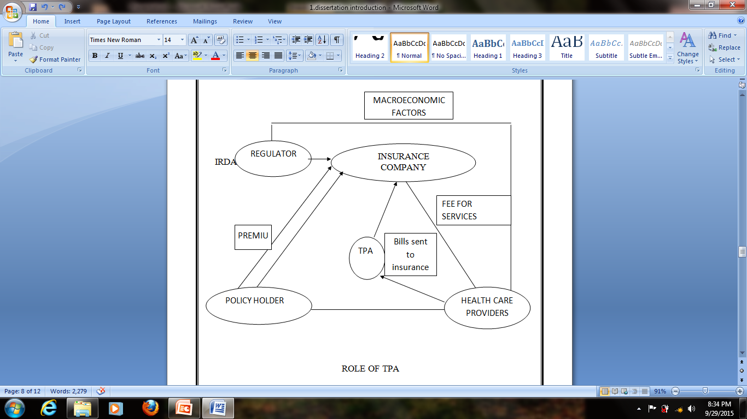
PREMIUM
<
Services to policy holders

Slide 10
ROLE PLAYED BY TPA’S
Records of medical insurance policies of an insurer will be transferred to the TPA once the insurance company has given the business to a TPA.
The TPA will issue identity cards to all policyholders, which they have to show to the hospital authorities before availing any hospitalization services
In case of a claim, policy holder has to inform the TPA on a 24-hour toll-free line provided by the latter.
On informing the TPA, policyholder will be directed to a hospital where the TPA has a tied up arrangement (cashless) or join any other hospital of their choice (reimbursement)
TPA issues an authorization letter to the hospital for treatment, and will pay for the treatment.

Slide 11
ROLE PLAYED BY TPA’S (contd…)
TPA makes the payment to the hospital
TPA sends all the documents necessary for consideration of claims, along with bills to the insurer.
Insurer reimburses the TPA
TPA will track the case of the insured at the hospital and at the point of discharge; all the bills will be sent to TPA

Slide 12
BENEFITS OF TPA
TPAs are kind of single window service for all planes of pre and post hospitalization
Admission to network hospital is beneficial because one gets cashless insurance and chances of overcharging by hospital gets diminished.
TPAs verify treatment ensuring that patient don’t receive any unnecessary services and that the hospital charges are correct and at negotiated rates
TPAs are advantageous to the health insurance companies because they manage down the claims as a result of vigilant administration.
TPAs scrutinize all claims before settlement and can guide the patient for availing a particular treatment as there are a number of doctors among the employees of TPA.

Slide 13
CONDITIONS DEFINED BY IRDA FOR TPAs
Share capital 1 crore and registered under the Companies Act, 1956
At least one of the directors of company should be a qualified doctor, registered under MCI.
License from the Authority in Form TPA-1 and accompanied with a fees of Rs. 20000.
The Authority may issue a license, if satisfied, in Form TPA-2 for 3 years unless the Authority decides, either to revoke or cancel it earlier.
TPA approved by the Authority shall pay a further sum of Rs. 30,000 as license fee before the license is granted to it.

Slide 14
CONDITIONS DEFINED BY IRDA FOR TPAs
Once the application is rejected, it can be entertained only after two years gap
A copy of the agreement between the TPA and the insurance company, shall be filed, within 15 days of its execution.
Every TPA shall appoint from its directors or senior employees, a Chief Administrative Officer (CAO)/Chief Executive Officer (CEO) who shall be responsible for the proper day to day administration
A license granted to a TPA may be renewed for a further period of three years on submission of the prescribed renewal application in Form TPA-3 along with a renewal fee of Rs. 30,000/- at least thirty days prior to the date of expiry of the license.

Slide 15
PARITY BETWEEN ROLE DEFINED BY IRDA AND ROLE IN PRACTICE PLAYED BY TPAs
EXPECTED BENEFITS OF TPAs
DEVIATION FROM EXPECTATIONS
Providers of services as and when needed
Streamline and simplifies the claim process
Automatic development of information system
Ensured services of qualified registered medical professional
Value added services
No extra burden on insured
Failure to meet the service responsibility
Lack of knowledge about coverage and exclusion in policies
Failure to meet the expectations of parties involved
Delay in settlement of claims
Indirect cost to consumer
Cost of healthcare increase
Cost of management increases

Slide 16


PURPOSE OF THIS STUDY
This study focuses on analyzing whether policy holders find health insurance beneficial.
The aim of the study is to check the level of awareness among health insurance policy holders and their perception about the services provided by the TPAs in claim settling and facilitation of the utilization of health insurance services(CASHLESS) by the hospital when they visit the hospital for treatment.
Thus, in short, it determines which areas of health insurance and TPAs require attention and improvement.

Slide 17

METHODOLOGY
STUDY DESIGN
SURVEY TYPE
SAMPLE SIZE
N= 100
AREA OF SAMPLE COLLECTION
FORTIS ESCORTS HOSPITAL, AMRITSAR

Slide 18

TOOLS FOR EVALUATION:
CONSENT FORM
WELL STRUCTURED CLOSE ENDED QUESTIONNAIRE
SAMPLING TECHNIQUE:
RANDOMLY SELECTED PATIENTS

Slide 19
PROCEDURE FOR DATA COLLECTION
Explanation of questionnaire and purpose of the study to subjects
Filling of consent form
Recording feedback
Analysis of questionnaires filled

Slide 20
INCLUSION CRITERIA
1. Patients visiting Fortis Escorts Hospital Amritsar.
2. Health insurance Policy holders empanelled with Fortis Escorts Hospital Amritsar
3. Age more than 18 years

Slide 21
EXCLUSION CRITERIA
  Policy holders age less than 18 years
  Policy holders suffering from neurological disorders or mental retardation are totally excluded from the survey.

Slide 22

RESULTS

Slide 23
GENDER DISTRIBUTION
AGE DISTRIBUTION

Slide 24
100% patients had to pay security at the time of admission of charges even though the treatment is claimed to be cashless.

Slide 25
Overall 63% patients felt that health insurance is beneficial to them.

Slide 26
Benefits of health insurance were felt more in the age groups more than 45 years which can be due to increased illness episodes, future risk coverage, etc.

Slide 27
Maximum number of sample from higher education levels found health insurance to be beneficial.
Here, sample with lesser education or the ones having bad experience in claim settling, found it to be an additional financial burden.

Slide 28
Majority of sample had insurance from public company owing to perception that private companies have more hidden clauses or terms and conditions

Slide 29
A major chunk of sample were covered under health insurance due to employers contribution as a compulsory insurance or the others had it done for future risk coverage.
Reason for enrolling in health insurance

Slide 30
Around 80% sample knew about the existence of TPAs out of
which 63% is male sample and a meager 17% of females knew the same.

Slide 31
Knowledge about existence of TPAs on the basis of education- maximum in graduates

Slide 32
Around 93% of patients denied having knowledge of hidden clauses.

Slide 33
81% of sample did not know the included and excluded illnesses. Only a 19% population read the document of insurance that enumerated diseases

Slide 34
Are you aware of the list of hospitals empanelled with your insurance company?

Slide 35
Even after 14 years of introduction of TPAs, there is a percentage of people who confuse TPAs for insurance agents.

Slide 36
Problems faced sample when TPA is contacted on toll free number at the time of emergency

Slide 37
52% sample population considered TPA services to be good where still 45% population were not highly satisfied with their services.

Slide 38
DO YOU THINK TPA FACILITATES THE DELIVERY OF CASHLESS INSURANCE SERVICE WELL?

Slide 39

DISCUSSION

Slide 40
The present study was undertaken with the objective of assessing the level of awareness and perception of policy holders with respect to TPAs and health insurance in India.

Slide 41
SAMPLE HAVING POSITIVE PERCEPTION ABOUT HEALTH INSURANCE
Educated sample
Sample having facilitated claim settlement
Less educated and financially weaker subjects whose health insurance claim prevented them from severe indebtation in times of health emergency.

Slide 42
SAMPLE HAVING NEGATIVE PERCEPTION ABOUT HEALTH INSURANCE
Major uneducated sample .
Financially weaker samples for whom it is just an additional financial burden
Samples who had a troubled claim settlement.

Slide 43
ANOTHER MAJOR FINDINGS
The majority gave the reason to be enrolled in health insurance as employer’s contribution, tax planning measure and future coverage against potential illness and old age, etc.
Generally policy holders avoid dealing with the insurance company directly due to procedural hassles and it has been seen that they tend to rely more on insurance agents than insurance company or TPAs.

Slide 44
The fault in acknowledgement of TPAs lies in both policy holders and insurance agents. Companies provide information booklet to policy holders who are required to read the same to have full knowledge about hospitals empanelled and diseases included or excluded.
Another major issue is payment of hefty amount of security at the time of admission in a hospital even though the treatment is claimed to be cashless.

Slide 45

Thanks for your attention ☺ ☺ ☺
Have a nice day

