Slide 1
Clinical Research in Diabetes
Diabetes, Insulin And The Brain
Diabetologists 2016
Dallas
Pnina Vardi

Slide 2


Combined Clinical And Basic Research Studies
Haifa
Diabetes clinic
Tel Aviv University
Basic research

Slide 3

The Central Unit For Childhood Endocrinology and Diabetes
Haifa & Galilee
Advantageous setting to study diabetes in multiple ethnic population of children and adults

Slide 4
International Diabetes Federation 2014
Diabetes = 387 million people were estimated In 2014 to be living with diabetes, estimated to rise to 592 million within the next twenty years.
Prediabetes =316 million with impaired glucose tolerance are at high risk for diabetes, projecting that over 1 billion people will be living with or at high risk of diabetes in 2035

Slide 5

Standards of Medical Care in Diabetes — 2016
Notes:
This purpose of this talk is to overview the 2016 American Diabetes Association Standards of Medical Care in Diabetes. These Standards comprise all of the current and key clinical practice recommendations of the American Diabetes Association.
[SLIDE]
5
Reference
American Diabetes Association. Standards of medical care in diabetes—2014. Diabetes Care 2014;37(suppl 1):S1

Slide 6
Fasting Plasma Glucose & 2 hr OGTT
Fasting plasma glucose (FPG) *
≥126 mg/dL (7.0 mmol/L)
OR
2-h plasma glucose ≥200 mg/dL *
(11.1 mmol/L) during an OGTT
* In the absence of unequivocal hyperglycemia,
result should be confirmed by repeat testing.
American Diabetes Association Standards of Medical Care in Diabetes.
Classification and diagnosis of diabetes. Diabetes Care 2016; 39 (Suppl. 1): S13-S22
Notes:
Either the Fasting Plasma Glucose (FPG) or the 2 hour Oral Glucose Tolerance Test may be used to screen for or diagnose diabetes. Diagnostic cutpoints are listed on this slide.
It’s worth noting that the concordance between these two tests is imperfect, as is the concordance between A1C and either glucose-based test. Numerous studies have confirmed that, compared with FPG cut points and A1C, the 2-h PG value diagnoses more people with diabetes.
For the fasting plasma glucose, fasting is defined as no caloric intake for at least 8 hours prior. This sometimes can be hard to achieve; patients don’t count the cup of coffee they had on the way to the lab, and forget about the two tablespoons of sugar that are in it.
The 2-hour oral glucose tolerance test is conducted after a 75g load. This is slightly more achievable, but many patients object to sitting around the office, waiting.
[SLIDE]
6
References
American Diabetes Association. Standards of medical care in diabetes—2014. Diabetes Care 2014;37(suppl 1):S15; Table 2
Cowie CC, Rust KF, Byrd-Holt DD, et al. Prevalence of diabetes and high risk for diabetes using A1C criteria in the U.S. population in 1988-2006. Diabetes Care 2010;33:562–568
Picón MJ, Murri M, Muňoz A, Fernández-Garcia JC, Gomez-Huelgas R, Tinahones FJ. Hemoglobin A1c versus oral glucose tolerance test in postpartum diabetes screening. Diabetes Care 2012;35:1648–1653

Slide 7
Prediabetes*
FPG 100–125 mg/dL (5.6–6.9 mmol/L): IFG OR
2-h plasma glucose 140–199 mg/dL (7.8–11.0 mmol/L): IGT OR
A1C 5.7–6.4%
* For all three tests, risk is continuous, extending below the lower limit of a range and becoming disproportionately greater at higher ends of the range.
American Diabetes Association Standards of Medical Care in Diabetes.
Classification and diagnosis of diabetes. Diabetes Care 2016; 39 (Suppl. 1): S13-S22
Notes:
Here are the diagnostic cutpoints for prediabetes across the three tests. Note that risk is continuous, extending below the lower limit of a range and becoming disproportionately greater at higher ends of the range.
[SLIDE]
7
References
Expert Committee on the Diagnosis and Classification of Diabetes Mellitus. Report of the Expert Committee on the Diagnosis and Classification of Diabetes Mellitus. Diabetes Care 1997;20:1183–1197
Genuth S, Alberti KG, Bennett P, et al., for the Expert Committee on the Diagnosis and Classification of Diabetes Mellitus. Follow-up report on the diagnosis of diabetes mellitus. Diabetes Care 2003;26:3160–3167
American Diabetes Association. Standards of medical care in diabetes—2014. Diabetes Care 2014;37suppl 1):S16; Table 3

Slide 8
Do We Need A Different Strategy
Diabetes does not seem to slow down and it is
Supplemented by prediabetes threat, despite huge pharma investment and medical progress
What is really wrong ?
Are we intervening too late ?
How can we make a change ?
Shouldn’t we define a different primarily target for therapy other then BG level ?

Slide 9
Where To Search:
Performing A Local Re-search
Clinical observation
Published information
Clinical and Laboratory data

Slide 10
Clinical observation
Ethnicity And Diabetes In Israel
High frequency of pre-diabetes, undiagnosed diabetes and metabolic syndrome among overweight Arabs in Israel.
Increased prevalence of microvascular complications in type 2 diabetes patients with the metabolic syndrome. Abdul-Ghani MA…..Vardi P, et al., 2006

Slide 11
Published Information
Diabetes Prevalence In Israel (2010)
The prevalence of diabetes increased in Israel
From
20/1000 in 1995
↓
63/1000 in 2007

Slide 12
Published information
Arab Ethnicity Is A Very High Risk Factor For T2DM
High prevalence of T2DM in the Middle East has been observed in areas undergoing rapid economic development and in developed countries
High rate of undiagnosed diabetes was observed in some Arab populations
In Israel Higher prevalence rate of T2DM among Arab women (13.5% ) compared with Jewish (4.9%) and among Arab men (9.4%) compared with Jewish (5.7%).

Slide 13
Higher Prevalence Of T2DM In Arab Population
Why ?
Genetic background ?
Higher consanguinity rates ?
Lower socioeconomic status in villages ?

Slide 14
Clinical observation
Family History Of T2DM In Childhood Diabetes Clinic
From relatively rare to rising family history of T2DM in I and II degree relatives of children with T1DM

Slide 15
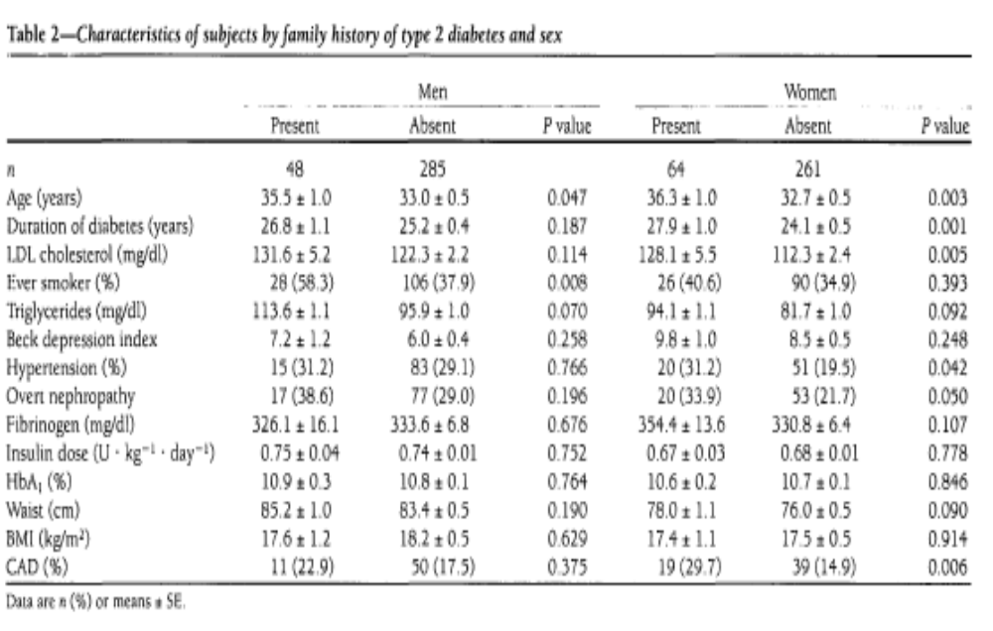
Published information
History of type 2 and CAD in type 1 diabetes, Diabetes Care 1998

Slide 16
History Of Type 2 And CAD In Type 1 Diabetes
Diabetes Care 1998
SUMMARY
Men with T1DM have 17% family history of T2DM
Women with T1DM have 24.5% family history of T2DM
A family history of T2DM increases significantly the risk to develop nephropathy, HTN and CAD

Slide 17
Diagnosis Of Children In The Diabetes Clinic
Overweight only | Overweight Metabolic syndrome | IFG/IGT Non insulin deficient | T2DM | T1DM
10 | 10 | 4 | 4 | 23 | T=51

Slide 18
Family Ethnicity Of Children In The Diabetes Clinic
(n=51 families)
Arab=14 (27.5%)
Non-Ashkenazi Jews=12
Ashkenazi Jews=22
Mix=3

Slide 19
Adults Relation To Individual Diabetic Child
80 =parents
5=Sibs
6=Related to II˚ relatives
2=Spouse/family friend

Slide 20
Rate Of Consanguinity
Arabs= 26%
Non-Ashkenazi Jews = 0%
Ashkenazi Jews=0%

Slide 21
Disease Classification Of Children In Diabetes Clinic
DM1/DM2 IFG/IGT (prediabetes) Metabolic synd (MS) Obesity | Age (yrs) | F/M | Number (T=51) | Ethnicity
DM1 (6) DM2/pred. (3) MS. (3) OB ( 2) | 6-17 | 5/9 | 14 | Arabs
DM1 (2) DM2/pred. (3) Met. (5) OB (2) | 9-14 | 7/4 | 12 | Non -Ashkenazi Jews
DM1 (14) DM2/pred. (2) Met. (2) OB (5) | 3-29 | 12/9 | 22 | Ashkenazi Jews
DM1 (2) OB (1) | 11-16 | 1/2 | 3 | Mixed Ash/non-Ash

Slide 22
Medical History Of Adult I˚ Family Relatives
Early familial CVD Morbidity mortality | Metabolic Syndrome | Hypoglycemia | T2DM | IFG/IGT | Subjects (N-79)
4 (15%) | 8 (30%) | - | 6(22%) | 5 (19%) | Arabs (27 )
9 (45%) | 17 (85%) | - | 8 (40%) | 1(5%) | Non-Ashkenazi Jews (20)
13 (41%) | 17 (53%) | 2 | 9 (28%) | 6 (19%) | Ashkenazi Jews (32)

Slide 23
Blood Glucose And Insulin Response In Obese Adolescents
Vardi et al., Metabolic Syndrome: Clinical Research & Reviews 2007
Mean
BG Insulin Iinsulin C-pep C-pep
fasting fasting AUC fasting AUC
(mg/dl) (pmol/l) U x hr (pmol/l) (U x hr)
Obese 84±8 125±78 1290 ±545 1200 ±445 5734 ±1493
IGT 90±14 184 ±129 1793 ± 863 1643 ± 482 6831 ±2165
& DM
ESMTS 145 ±22 217±132 ND 1429 ± 568 ND
Normal 84 ± 9 84 ± 22 734 ± 88 617 ±249 ND
P <0.0001 0.0001 <0.0001 <0.0001 0.06

Slide 24
Do We Need A Different Strategy
What is really wrong ?
Is it high BG level or high insulin secretion or both ?
Can we stop it ? Reverse it ? Normalize it ?
How can we increase the success rate of diabetes treatment

Slide 25
Laboratory Data And Islet Pathogenesis
Normalization ? | Fasting Insulin (pmol) | FBG Mg%
yes | 180 | 110 | Patient 1
no | 30 | 110 | Patient 2

Slide 26
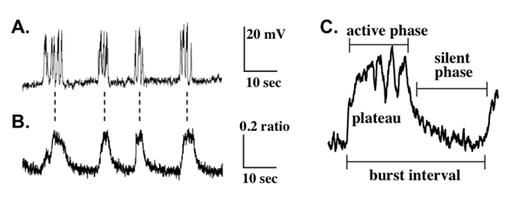

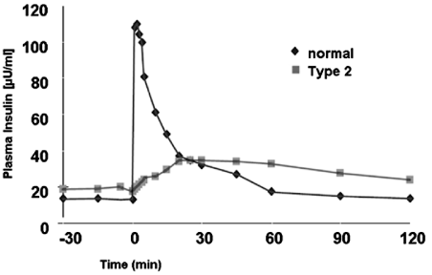
Insulin
Not an innocent bystander
Loss of proinsulin cleavage to insulin
Loss of islet bursts, and insulin pulsatility
Loss of regulated insulin secretion

Slide 27
Proinsulin insulin and CVD
Proinsulin levels predict the development of NIDDM in Japanese-American men.
Proinsulin is an independent predictor of coronary heart disease: Report from a 27-year follow-up study.
Homeostasis model assessment of insulin resistance in relation to the incidence of cardiovascular disease: the San Antonio Heart Study.
Fasting insulin is a stronger cardiovascular risk factor in women than in men.

Slide 28







The Metabolic Syndrome And Its Components
Central/abdominal
obesity
Hyperinsulinemia
Type 2 diabetes
Coronary
heart
disease
Insulin
resistance
syndrome
Hypertension
Dyslipidemia
Microalbuminuria
25% disease frequency .
Notes:
While insulin resistance is fundamental to the development of type 2 diabetes, it is also central to the insulin resistance syndrome, often known as the metabolic syndrome or syndrome X. First described by Reaven in 1988, this comprises a cluster of metabolic disorders associated with insulin resistance, including coronary heart disease, central obesity, hypertension and dyslipidemia.
Slide 13

Slide 29
Alzheimer Disease, Type 3 Diabetes
Insulin Action in Brain Regulates Systemic Metabolism and Brain Function. C. Ronald Kahn, Diabetes 2014
(non relevant BG level)

Slide 30
Targeting Insulin And Proinsulin In Diabetes Treatment
United States Patent | 6,197,765
Vardi , et al. | March 6, 2001
Use of diazoxide for the treatment of metabolic syndrome and diabetes complications
Abstract
The present invention discloses a treatment for syndrome-X, and resulting complications, that include hyperlipidemia, hypertension, central obesity, hyperinsulinemia and impaired glucose intolerance. Diabetic complications include excess proinsulin levels.

Slide 31
Insulin action in brain regulates systemic metabolism and brain function.
Kahn CR, Diabetes. 2014.
Insulin acts on brain receptors to modulate peripheral metabolism, including regulation of appetite, reproductive function, body temperature, white fat mass, hepatic glucose output, and response to hypoglycemia.
Insulin signaling also modulates neurotransmitter channel activity, brain cholesterol synthesis, and mitochondrial function.
Disruption of insulin action in the brain leads to impairment of neuronal function and synaptogenesis.
…insulin signaling modulates phosphorylation of tau protein, an early component in the development of Alzheimer disease.
Thus, alterations in insulin action in the brain can contribute to metabolic syndrome, and the development of mood disorders and neurodegenerative diseases.

Slide 32
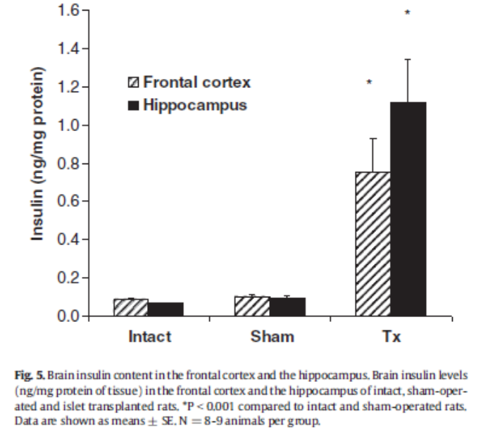
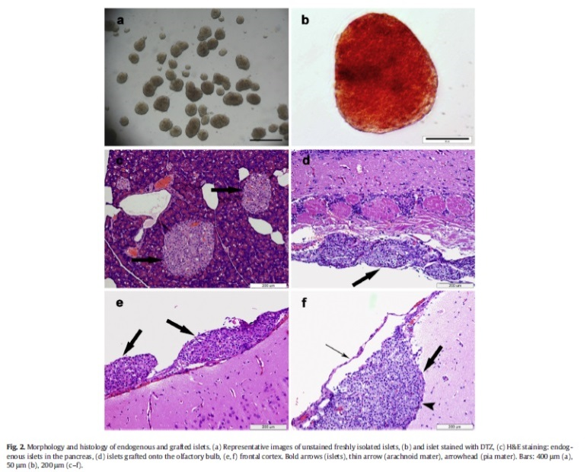
Insulin Delivery Into The Brain
Anti-diabetic and neuroprotective effects of pancreatic islet transplantation into the central nervous system.
Diabetes Metab Res Rev. 2016
Intracranial pancreatic islet transplantation increases islet hormone expression in the rat brain and attenuates behavioral dysfunctions induced by MK-801 (dizocilpine).
Horm Behav. 2015
Comment on Gray et al. Insulin regulates brain function, but how does it get there? Diabetes 2014;63:3992-3997.
Diabetes. 2015

Slide 33
The Epidemics Of Obesity & Diabetes
The current explanation
Sedentary life style
Higher food consumption
Lower energy expenditure
Is it all ?

Slide 34


Westernization – Clinical Observation
Disruption of enlarged family structure
Appearance of small “isolated” family units
Loss of daily communication with enlarged family and neighbors
Replacement of communication by virtual reality (TV, Internet)
Growing loneliness and depression compensated by food consumption
Exposure to aggressive marketing of junk food
Loss of children ability to dream desire and improvise
Induces chronic stress, over eating, overweight, over secretion of insulin, which lead to DM and CVD

Slide 35


The 21th Century
“The Virtual life”
Under expression of
Body signals
Sleepiness
Hunger
Desire & curiosity
>
The Era Of Brain Dominance Over Body Signals

Slide 36
Partial Reversibility of Hypothalamic Dysfunction and Changes in Brain Activity After Body Mass Reduction in Obese Subjects Diabetes 2011
fMRI were used to explore changes in brain activity after body mass reduction.
Obese patients present distinct functional activity patterns compared with lean subjects
On massive loss of body mass, after bariatric surgery, increases in the CSF concentrations of interleukin (IL)-10 and IL-6 are accompanied by changes in fMRI patterns, particularly in the hypothalamus.
CONCLUSIONS Massive reduction of body mass promotes a partial reversal of hypothalamic dysfunction and increases anti-inflammatory activity in the CSF.

Slide 37
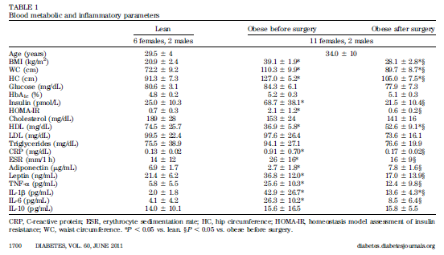

Slide 38
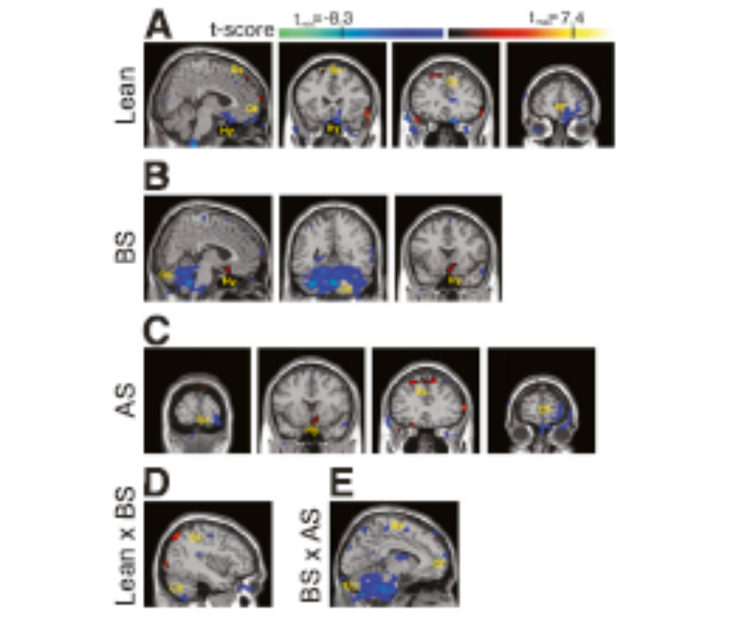
FIG. 3. Functional connectivity maps.
Brain Involvement In Overweight

Slide 39
Accelerated Telomere Shortening In Response To Life Stress PNAS 2004
Background: association reported between chronic stress and indices of poor health, including risk factors for cardiovascular disease and poorer immune function.
Hypothesis: stress impacts health by modulating the rate of cellular aging.
Results: provide evidence that perceived stress and chronicity of stress is significantly associated with higher oxidative stress, lower telomerase activity, and shorter telomere length, which are known determinants of cell senescence and longevity.
Conclusions: Women with the highest levels of perceived stress have telomeres shorter on average by the equivalent of at least one decade of additional aging compared to low stress women

Slide 40
Accelerated telomere shortening in response to life stress PNAS 2004
Western life style
Chronic stress
Overweight, hyperinsulinemia
Brain dysfunction, Accelerated cellular aging
(Diabetes, CVD)

Slide 41
Prevention or Delay
of Type 2 Diabetes
Notes:
Now we are going to move on to section four, on the prevention or delay of type 2 diabetes.
[SLIDE]
41

Slide 42
Recommendations: Prediabetes
Testing should begin at age 45 for all patients, particularly those who are overweight or obese. B
Consider testing for prediabetes in asymptomatic adults of any age w/ BMI ≥25 kg/m2 or ≥23 kg/m2 (in Asian Americans) who have 1 or more add’l risk factors for diabetes. B
If tests are normal, repeat at a minimum of 3-year intervals. C
American Diabetes Association Standards of Medical Care in Diabetes.
Classification and diagnosis of diabetes. Diabetes Care 2016; 39 (Suppl. 1): S13-S22
Notes:
This is new this year– in order to clarify the relationship between age, BMI, and risk for type 2 diabetes and prediabetes, the Association revised the screening recommendations to now recommend testing all adults beginning at age 45 years, regardless of weight. [CLICK]
Testing is also recommended for asymptomatic adults of any age who are overweight or obese and who have one or more additional risk factors for diabetes. [CLICK] If tests are normal, the Association recommends repeat testing at least every 3 years.
[SLIDE]
42

Slide 43
Predictor of T2DM and MTS
Adolescents
BMI > 38
Females
Family history of T2DM
Fasting hyperinsulinemia
Insulin resistance (HOMA) > 4.6

Slide 44
Methods
Family involvement in individual diabetic management
Education & Information
Evaluate the change in nuclear and enlarged family
life style
Cultural consideration

Slide 45
Treatment Concept
Higher compliance is achieved with better understanding of the disease
Patients should be involved in their treatment and follow end- points
Adults are also concerned about their own health and appearance

Slide 46


Different Treatment Attitude In Families With Diabetic Individuals
Empower the diabetic child in directing family life style
Deviate the treatment focus from the child to the whole family
Offer different disease interpretation such as Aging instead of Diabetes

Slide 47
Information II
Overweight is bad
Over secretion of insulin leads to atherosclerosis (death, CVA)
Hyperglycemia and hyperinsulinemia accelerate aging processes

Slide 48
Our Concept
ADA and WHO criteria for normal BG are not good enough to prevent T2DM development
We focus on
Weight reduction
Reduce FBG ≤80mg%
Reduce fasting insulin ≤80pmol/l

Slide 49


A Healthy Community
Reduce food consumption
Eliminate in-house junk food
Keep early supper and early bed time
Exit house and encourage extra-house encounters

Slide 50
Cultural Consideration In Traditional Societies
Do not recommend Western diet
Establish common TV club
Establish women club
Encourage out-door children activity

Slide 51
Be Your Doctor
Encourage family/community leadership to take responsibility for healthy life style

Slide 52
Aim
To propagate an individual diabetic management toward the enlarged family, focusing on subjects
at high risk to develop
Diabetes, Metabolic syndrome and Complications
(initiated January 2010)
“The Tsunami project”
.

Slide 53

  The Central Unit For Family Diabetes, The Galilee

Slide 54

Thank You For Listening
Notes:
54

