Slide 1


Epibrassinolide Induced Apoptosis via Endoplasmic Reticulum Stress Regardless of p53 Expression in Prostate Cancer Cells
Pinar Obakan-Yerlikaya, PhD.
Istanbul Kultur University
Department of Molecular Biology and Genetics
p.obakan@iku.edu.tr

Slide 2
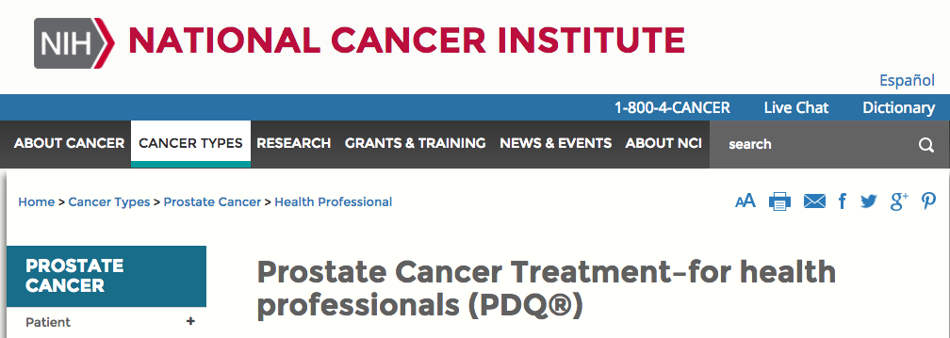

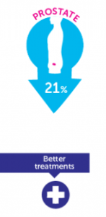
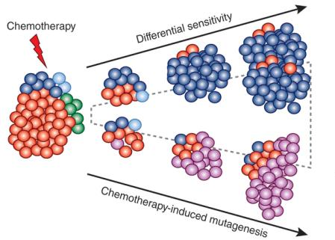
http://www.cancer.gov/types/prostate/hp/prostate-treatment-pdq#link/_1679_toc

Slide 3
ROLE OF ANDROGEN RECEPTOR (AR)
testosterone
5 α-reductase
testosterone
DHT
HSP
AR
DHT
DHT
HSP
DHT
P
AR
AR
P
AR
PSA
DHT
DHT
P
AR
AR
Target gene
Proliferation
ARE
Survival
DHT: Dihydrotestosterone
PSA: Prostate spesific antigen

Slide 4
OTHER FACTORS
Growth factors
Estrogen
Glicocorticoid
Flutamide
Hipersensitivity
testosterone
P
P
P
AR
AR
P
AKT
MAPK
P
AR
AR
P
AR
AR
P
P
P
AR
AR
P
PSA
Bcl-2
DHT
DHT
kalikreins
P
AR
AR
Survival
Growth
ARE

Slide 5
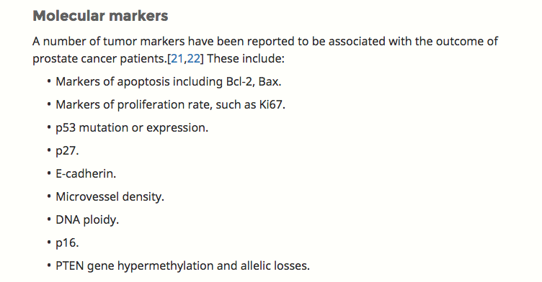
Related to APOPTOSIS
http://www.cancer.gov/types/prostate/hp/prostate-treatment-pdq#link/_1679_toc

Slide 6
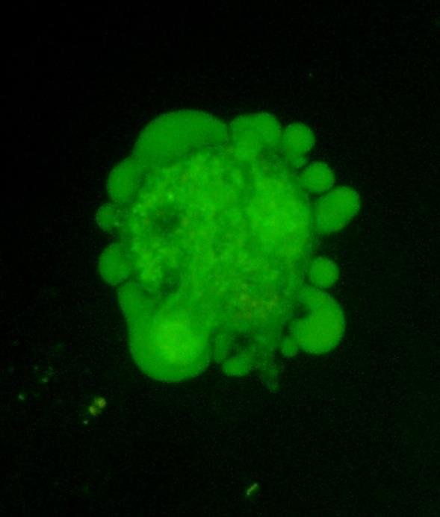
APOPTOSIS
Cell shrinkage
Chromatin condensation
Normal Cell
Membrane blebbing
Mitochondrial membrane potential loss
Activation of caspases
Protein degradation
DNA fragmentation
Nuclear collapse
Apoptotic bodies

Slide 7
p53 ROLE DURING APOPTOSIS
p53
Bcl-2
Bax
Bcl-xL
BiD
Bax
Bax
p53 transcriptional
targets
Puma
MDM-2
p21
Cytochrome c

Slide 8
p53
Bax
Bcl-2

Slide 9

p53
Bcl-2
Bax
APOPTOSIS

Slide 10
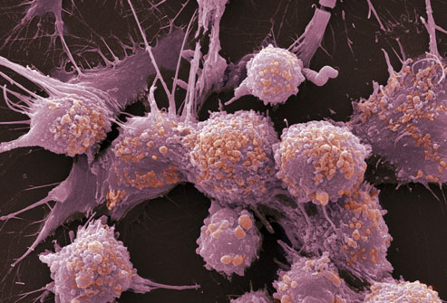
p53
Bax
Bcl-2
CANCER CELL SURVIVAL
CHEMO-RESISTANCE

Slide 11
The search for a compound for the cure of
advanced prostate cancer:
- without toxic effect on normal epithelial cells
- effective on both androgen receptor (+) and (-) cells
- miminum side effects
- easy to deliver
A HUMAN STEROID-LİKE NATURAL AGENT
EPIBRASSINOLIDE

Slide 12
Epibrassinolide (EBR):
A member of brassinosteroids (plant growth factor family)
Anti-proliferative activity in cancer cells (MCF-7) (Malikova et al., Phytochemistry 2008)
Cell cycle arrest, mitotic arrest
(Steigerova et al., Steroids, 2013)
Nuclear hormone
receptor blocker?
EBR induces apoptosis regardless of AR expression in prostate
cancer cells without affecting normal prostate epithelial cells
(Obakan et. al, Aminoacids, 2014)
EBR induces p53-independent apoptosis in prostate
cancer cells
(Obakan et. al, The Prostate, 2014)

Slide 13
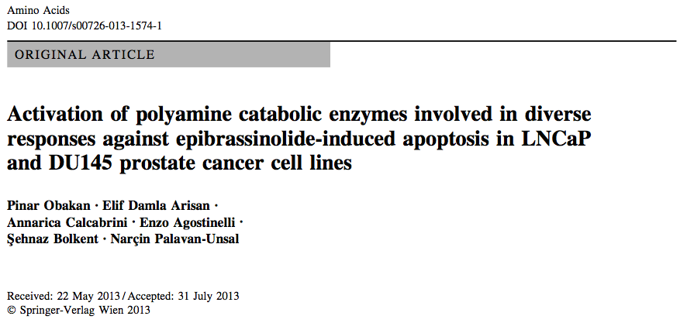
EPIBRASSİNOLİDE AS AN APOPTOTIC INDUCER IN
BOTH AR+ AND AR- PROSTATE CANCER CELLS
W/O AFFECTING NORMAL PROSTATE EPITHELIAL CELLS
AR +
p53 +
AR –
p53 -

Slide 14
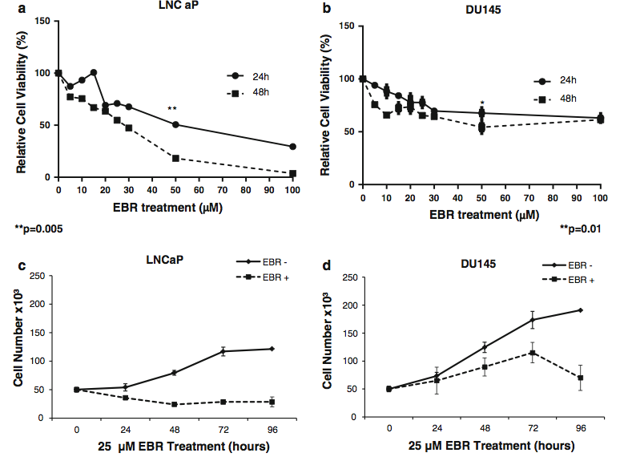

Decrease
in cell viability
Cytotoxic
Obakan et. al, Amino acids, 2013

Slide 15
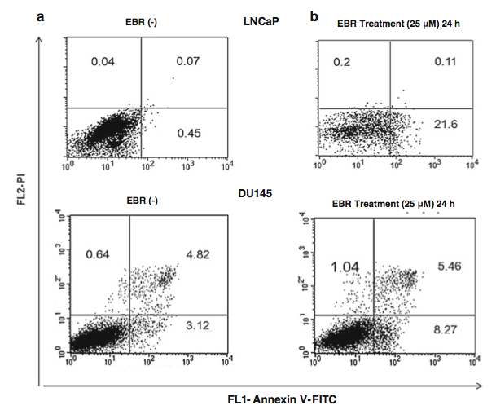
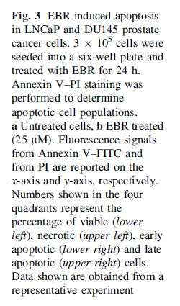
Increase in apoptotic population
Obakan et. al, Amino acids, 2013

Slide 16
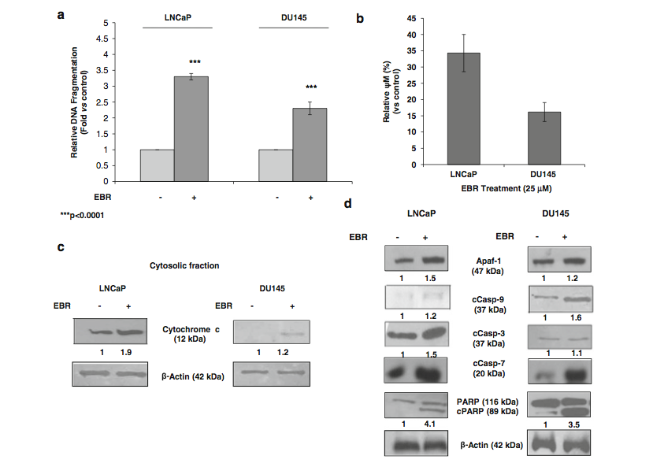
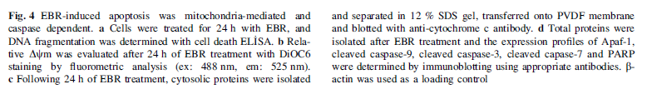
Apoptosis induction
Obakan et. al, Amino acids, 2013

Slide 17
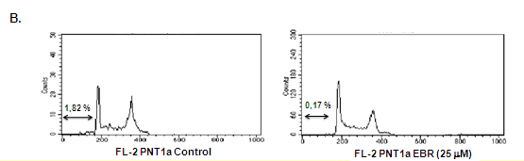



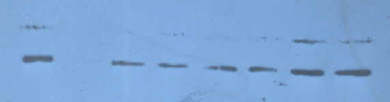
No apoptotic effect in normal prostatic epithelial cells
PNT1a
EBR (-)
EBR Treatment (25 μM) 24 h
FL2- PI
PNT1a
25 μM EBR Treatment (hours)
PNT1a
EBR - +
0 24 48 72
Apaf-1 (47 kDa)
PARP (116 kDa)
cCasp-9 (37 kDa)
β-Actin (42 kDa)
β-Actin (42 kDa)
Obakan et. al, Amino acids, 2013

Slide 18
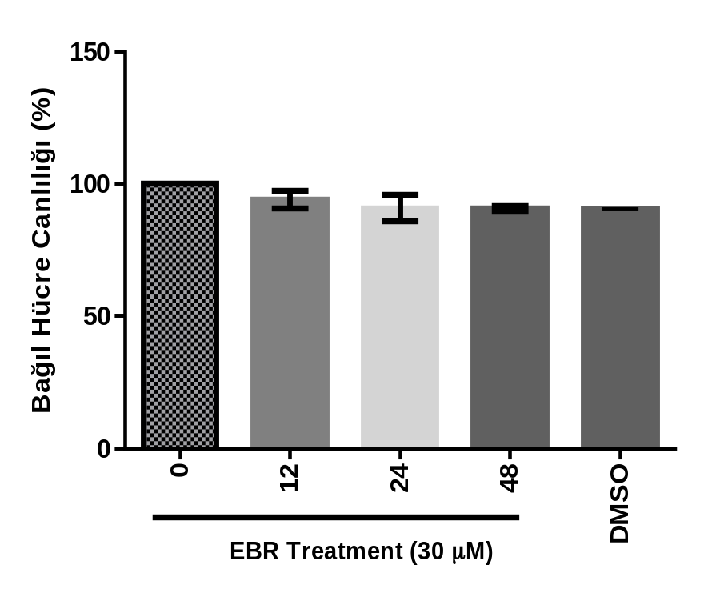
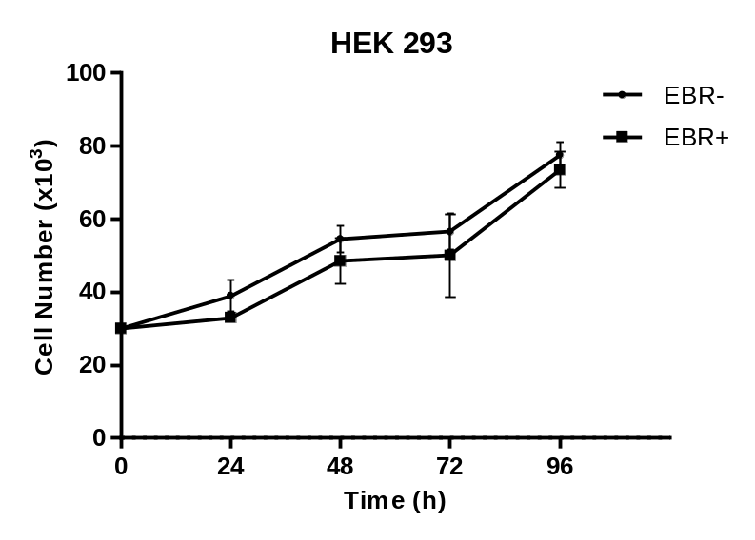
Normal epithelial cells are not affected by EBR treatment
FHC

Slide 19
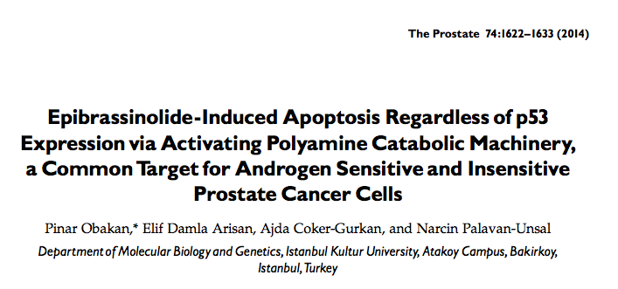
PC3 prostate cancer cells and PC3 p53+
AR –
p53 -

Slide 20
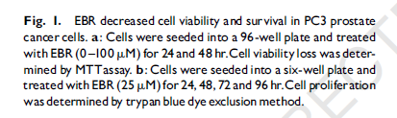
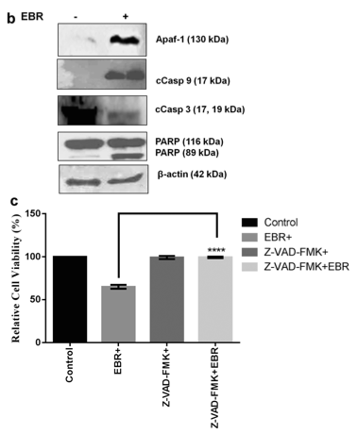
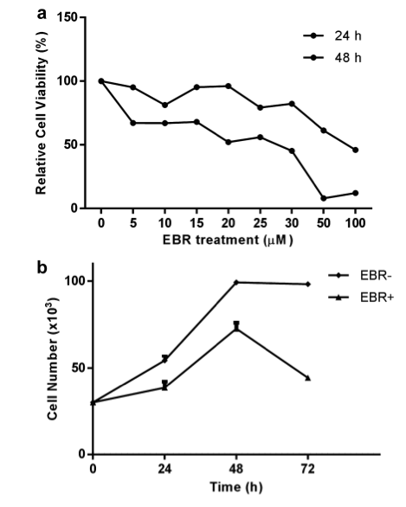
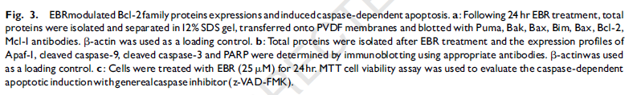
Decrease
in cell viability
Apoptosis induction
Obakan et. al, The Prostate, 2014

Slide 21
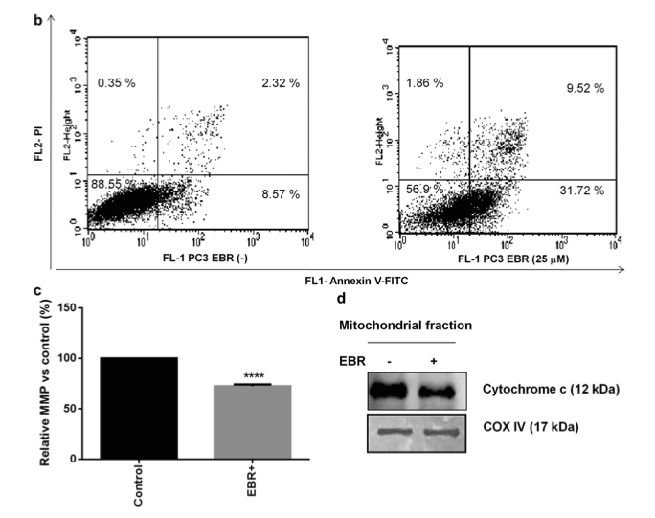
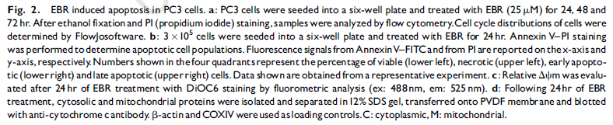
Obakan et. al, The Prostate, 2014
Apoptosis induction

Slide 22
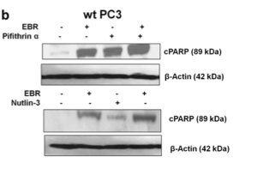
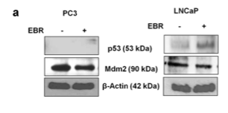
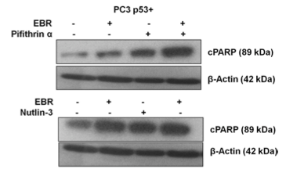
No p53 effect in EBR-induced apoptosis
Obakan et. al, The Prostate, 2014

Slide 23
RESULTS:
EBR induces apoptosis in AR expressing or non expressing prostate cancer cells.
EBR induces p53-independent apoptosis
WHAT IS THE EXACT MECHANISM OF EBR?

Slide 24


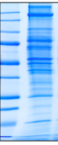
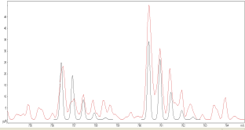
Stable isotope labelling by aminoacids in cell culture
(SILAC)
Non-radioactive isotopes containing aminoacids
are incorporated in newly synthesized proteins
EBR (-)
EBR (+)
LIGHT Media
Protein Labelling
HEAVY Media
ER Stress
Protein
Mix
1D-SDS PAGE in gel digestion
Validation by immunoblotting
Protein quantification by LC-MS/MS

Slide 26
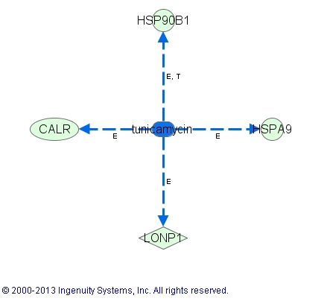
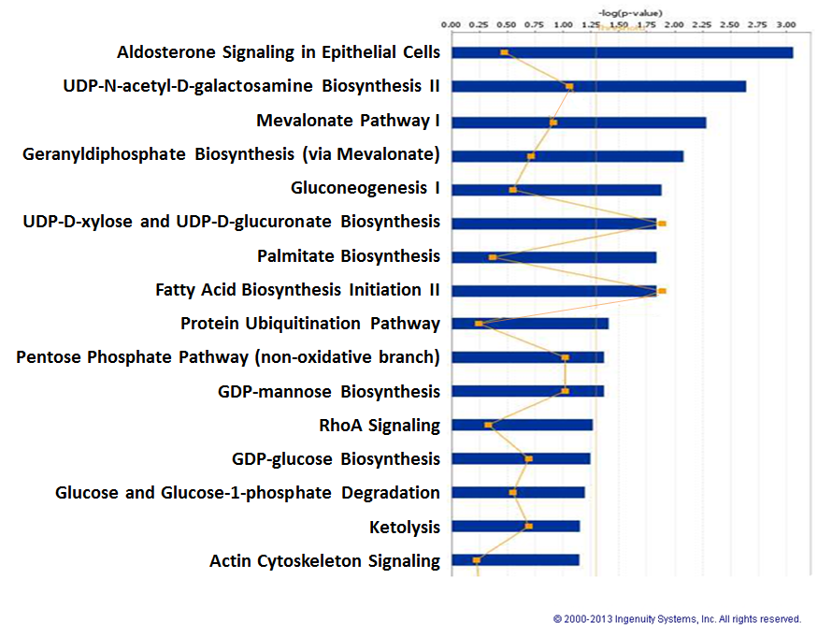

Slide 27
Table. Fold changes in the molecules associated with the SILAC analysis
Symbol | Entrez Gene Name | Accession number GenPept/UniProt/Swiss-Prot | Fold Change
SCN11A | sodium channel, voltage-gated, type XI, alpha subunit | Q9UI33 | 7.059
PTDSS1 | phosphatidylserine synthase 1 | P48651 | 3.950
CACNA1S | calcium channel, voltage-dependent, L type, alpha 1S subunit | Q13698 | 3.395
HSPD1 | heat shock 60kDa protein 1 (chaperonin) | P10809 | 2.855
RNASEL | ribonuclease L (2',5'-oligoisoadenylate synthetase-dependent) | Q05823 | 2.329
HIST3H2BB | histone cluster 3, H2bb | Q8N257 | -2.017
HSP90B1 | heat shock protein 90kDa beta (Grp94), member 1 | P14625 | -2.113
EIF5B | eukaryotic translation initiation factor 5B | O60841 | -2.235
CALR | calreticulin Score: 150 Match: 11 # Peptides: 4 | P27797 | -2.287
TUBB | tubulin, beta class I | P07437 | -2.295
HSPA9 | heat shock 70kDa protein 9 (mortalin) | P38646 | -2.300
GANAB | glucosidase, alpha; neutral AB | Q14697 | -2.316
AMPD3 | adenosine monophosphate deaminase 3 | Q01432 | -2.350
KCNA5 | potassium voltage-gated channel, shaker-related subfamily, member 5 | P22460 | -2.353
VDAC1 | voltage-dependent anion channel 1 | P21796 | -2.478
ACADVL | acyl-CoA dehydrogenase, very long chain | P49748 | -2.511
PSME1 | proteasome (prosome, macropain) activator subunit 1 (PA28 alpha) | Q06323 | -2.662
RASAL1 | RAS protein activator like 1 (GAP1 like) | O95294 | -2.766
PPARD | peroxisome proliferator-activated receptor delta | Q03181 | -3.176
HSD17B2 | hydroxysteroid (17-beta) dehydrogenase 2 | P37059 | -3.311

Slide 28
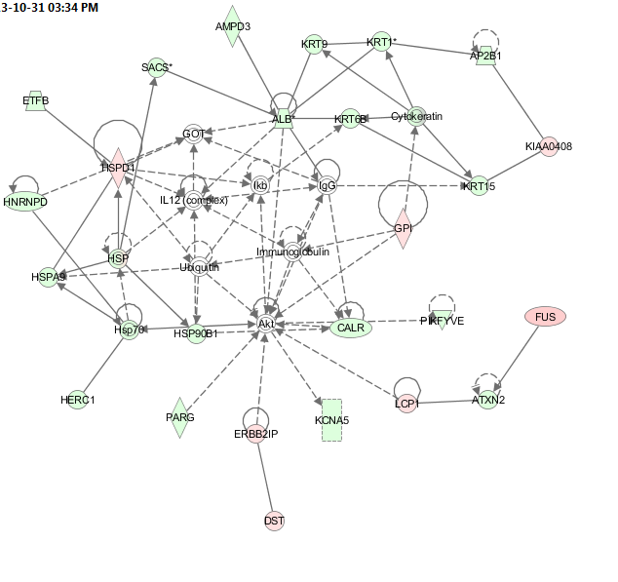


Slide 29
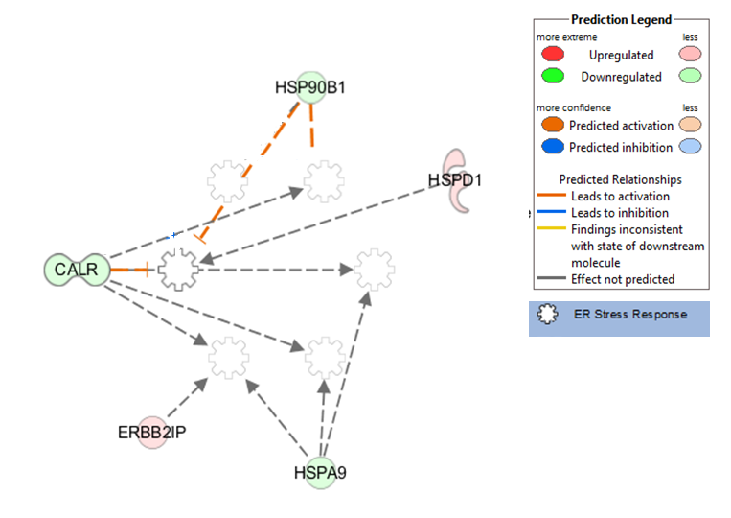
CALR-ER stress network

Slide 30
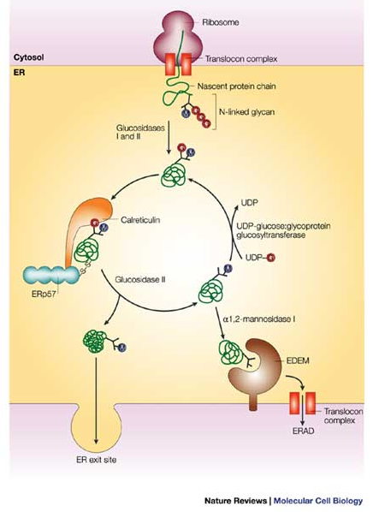
Protein folding
in ER lumen
Ellgaard and Helenius, 2003

Slide 31
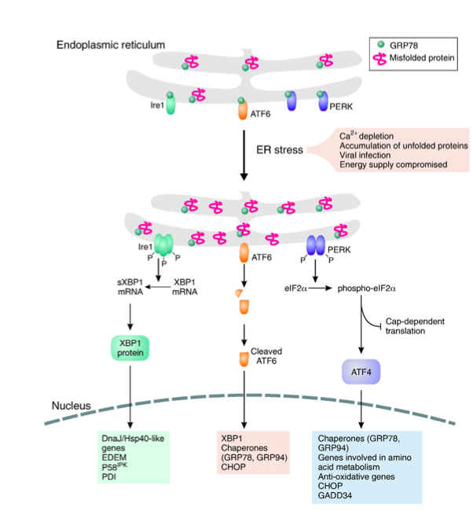
Healy et al., European Journal of Pharmacology, 2009

Slide 32

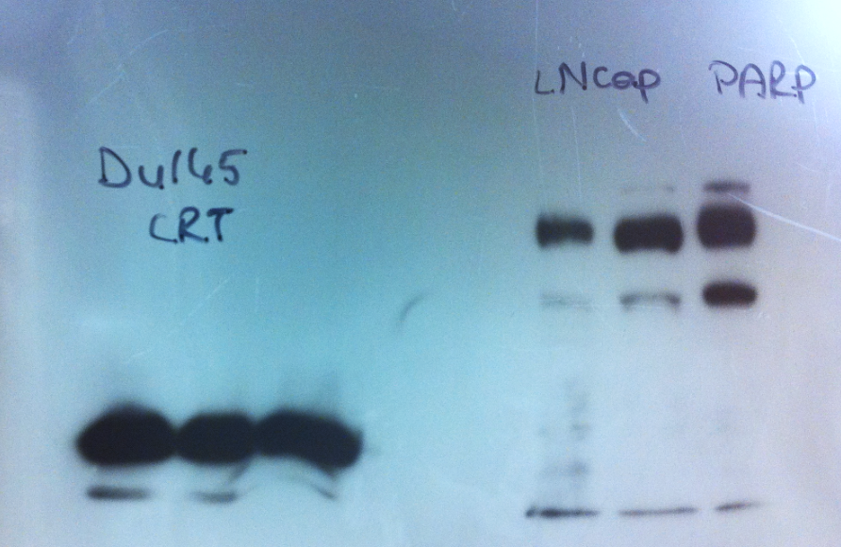




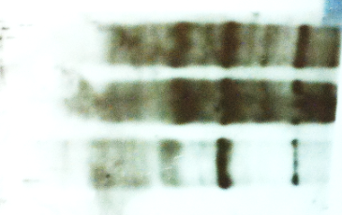
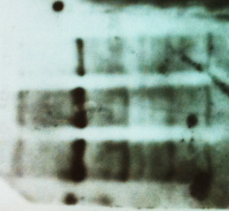










LNCaP
DU145
EBR Treatment (hours)
EBR Treatment (hours)
0 12 24
0 12 24
CALR (55 kDa)
1.4 0.1 0.4
6.1 3.2 0.4
CALNX (67 kDa)
1.8 0.5 0.6
6 4.8 3.8
BiP (78 kDa)
ER stress is induced
after EBR treatment
0.5 1.7 2.2
0.6 2 2.3
IRE1α (130 kDa)
0.5 0.4 1
0.5 4.6 2.7
CHOP (27kDa)
0.6 5.2 3.9
0.5 6.1 4.8
PDI (57 kDa)
1.1 0.9 0.9
6.5 8.6 8.7
Casp 12 (55 kDa)
1 0.7 0,3
0.8 0.9 0.3
PERK (140 kDa)
0.7 1.2 2.9
0.5 1.5 1.1
ATF6 (75 kDa)
0.5 1 2.4
0.7 0.6 1.5
β-Actin (42 kDa)
1 1 1
1 1 1

Slide 33


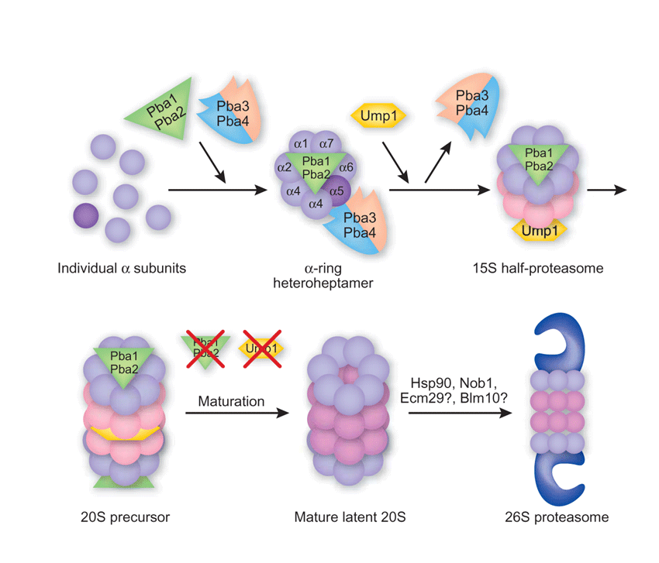
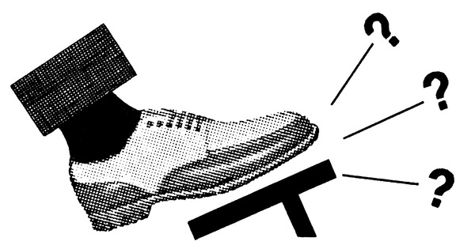
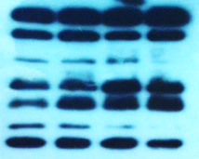



EBR -
EBR +
**
Rapamycin
Unfolded/misfolded
protein
MG132
***
26S proteasome
Rapamycin - + - - + -
MG132 - - + - - +
EBR - + - +
Rapamycin - - + +
EBR - + - +
MG132 - - + +
PARP (116 kDa)
cPARP (89 kDa)
β-Actin (42 kDa)
ER stress is responsible from EBR-induced apoptosis

Slide 34

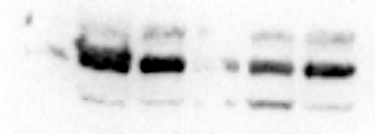


CALR is an important molecule in EBR-induced ER stress
-CALR
+CALR
**
EBR - + - - +
Tunicamycin - - + - -
CALR (55 kDa)
CALNX (67 kDa)
BiP (78 kDa)
PARP (116 kDa)
cPARP (89kDa)
EBR - + -
Tunicamycin - - +
β-Actin (42 kDa)

Slide 35




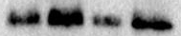
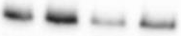




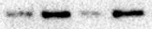






CALR is an important molecule in EBR-induced ER stress
HCT 116
HT 29
EBR - + -
CALR siRNA - - +
EBR - + -
CALR siRNA - - +
CALR (55 kDa)
β-actin (42 kDa)
HCT-116
HT 29
EBR - + - +
CALR siRNA - - + +
EBR - + - +
CALR siRNA - - + +
CALR (55 kDa)
PDI (57 kDa)
BİP (78kDa)
IRE1α (130 kDa)
PARP (116, 89 kDa)
cCasp12 (xxkDa)
β-actin (42 kDa)

Slide 36
RESULTS
EBR treatment induced apoptosis in prostate cancer cells
as well as colon cancer cells
CALR is a key molecule in EBR-induced apoptosis.
EBR-induced apoptosis is due to ER stress induction.
APOPTOSIS
CHOP
ER
CALR
EBR
ER stress
EBR+Rapamycin

Slide 37
FUTURE WORK
Molecular targets of EBR in animal models ?
(COST project: 115Z037)
The role of EBR in autophagy induction ?

Slide 38


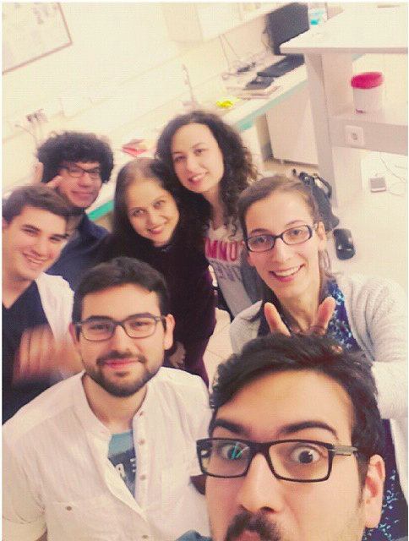




Thank you...
Narçın Palavan-Ünsal
Damla Arısan
Ajda Çoker-Gürkan
Pelin Özfiliz
Özge Berrak
Cagri Gumuskaptan
Utku Ozbey
Didem Baran
Berna Somuncu
Kaan Adacan
Project ♯: 113Z845
Open positions for PhD.
Salim Merali
Carlos Barrero
Oscar Perez
GENIE BM1408
Project ♯: 115Z037

Slide 39
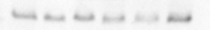
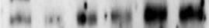




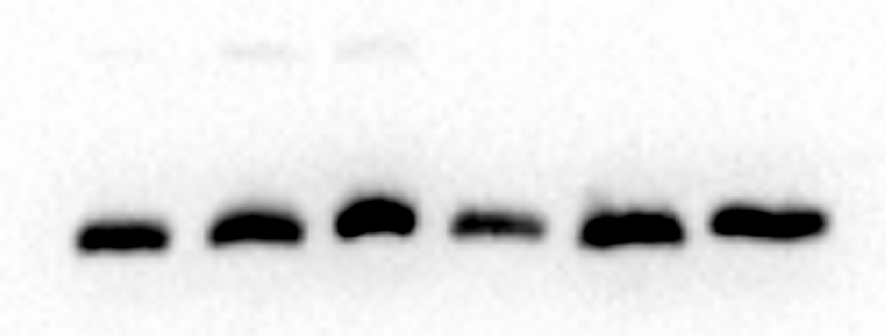

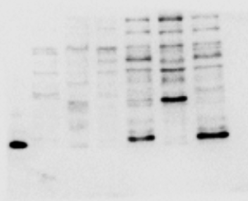
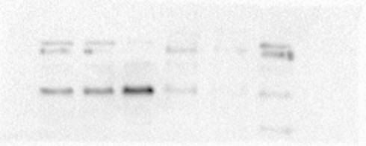






ER stress is induced in response to EBR treatment in colon cancer cells
HCT 116
HT 29
Cytoplasmic Nuclear
Cytoplasmic Nuclear
EBR 0 24 48 0 24 48
EBR 0 24 48 0 24 48
ATF6 (49 kDa)
ATF4 (49 kDa)
CHOP (27 kDa)
XBPI (U) (54 kDa)
GAPDH (37 kDa)
DLD-1
SW480
Cytoplasmic Nuclear
Cytoplasmic Nuclear
EBR 0 24 48 0 24 48
EBR 0 24 48 0 24 48
ATF6 (50 kDa)
ATF4 (49 kDa)
CHOP (27 kDa)
XBPI (U) (54 kDa)
GAPDH (37 kDa)

Slide 40








Control
1:6
CALR is an important
molecule in EBR-induced
ER stress
1:7
pmEmerald-Calreticulin-N-16
2:6
SW480 cells

