Slide 1
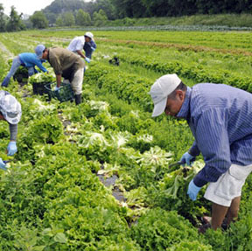
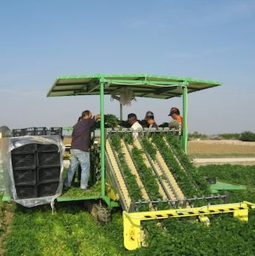
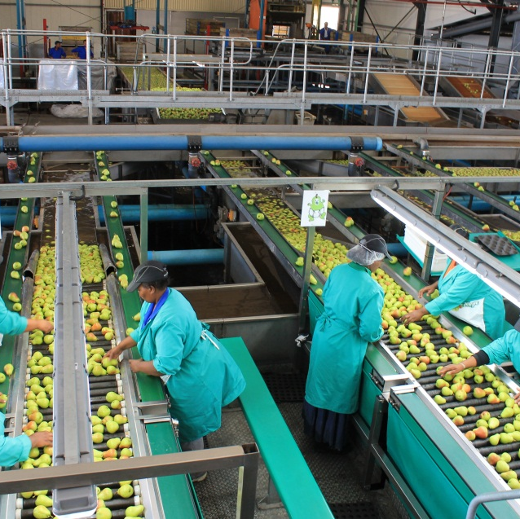
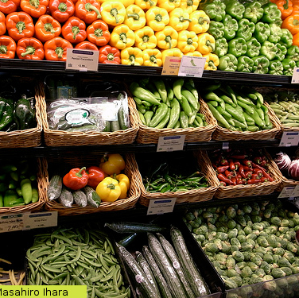
Factors explaining differences in FSMS performance in fresh produce supply chains:
in Europe and beyond
August, 2015: Pieternel Luning, K. Kirezieva & L. Jacxsens

Slide 2

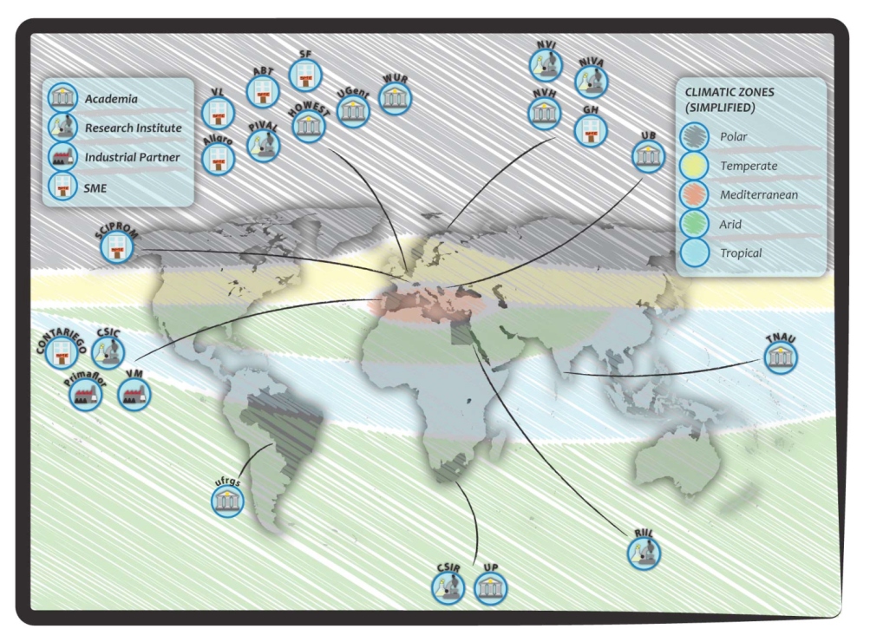
Veg-i-trade project
“Impact of climate change and globalisation on safety of fresh produce – governing a supply chain of uncompromised food sovereignty”
Veg-i-Trade unifies 23 international partners from - universities, research institutes, SMEs & large industrial partners

Slide 3
Topics of presentation
Challenges hampering food safety management systems
Diagnostic instrument for FSMS assessment from systems perspective
Study on FSMS status in Europe and beyond
Conclusions

Slide 4
Challenges managing fresh produce safety
Increase global trade
multiple sources, year round supply
Raising consumption of ready-to-eat / fresh produce
Cultivation dominated by micro, small
and medium sized producers
food safety management
system
Re-emerging pathogens, unknown pesticides, mycotoxins
Different legal requirements, standards, guidelines
Climate change,
heavy rainfalls, flooding, higher temperatures
Complexity of international supply chain networks
transparency, many transactions, crossing borders
Understanding food safety management systems performance
Notes:
In the last few decades a lot of attention was paid to control and assurance of the safety of animal-derived food products. More recently, the scope has broadened and nowadays also management of safety of fresh produce in international supply chains gained attention worldwide, with the EHEC disaster in 2010 with one of the most obvious outbreaks.
Management of food safety is subjected to many different challenges, as shown

Slide 5
Food safety management from systems’ perspective
Setting assurance requirements
Stakeholders
e.g. Government,
retail, branch
organisations
Quality assurance standards, guidelines, legal requirements
FSMS context characteristics:
Various
Imply different initial risks
Can affect system output
Entail different demands on safety mitigation measures in FSMS
Translation assurance requirements
Assurance activities
Ensuring and providing evidence that system functions properly
Setting system requirements
Collecting data & verifying system performance
Control activities
Keeping products, processes & people actions within acceptable tolerances
Safe
produce
Food production chain
Luning et al, 2008, 2009, 2011
Notes:
Specific context refers to the characteristics of the products they produce, the food production systems characteristics, like the irrigation systems etc.
Basic model to illustrate systems perspective

Slide 6


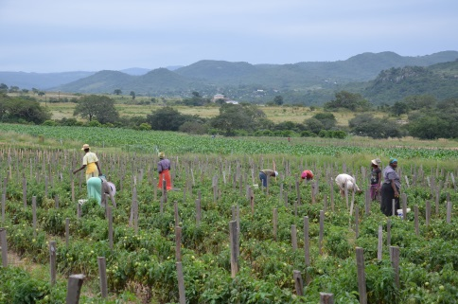

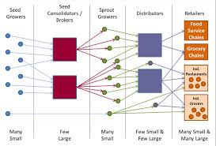
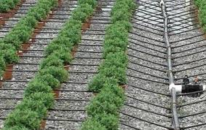
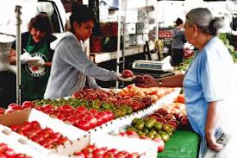
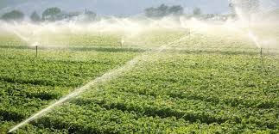
Specific context
Product characteristics
Organisational characteristics
COMPANY specific FSMS
Production system characteristics
Supply chain characteristics

Slide 7

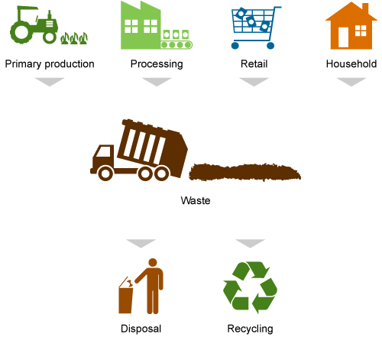
Elements the diagnostic instrument
Context riskiness
Performance of activities
System output
External &
Internal
evaluation
Product characteristics
Core control activities
Core assurance activities
Preventive measures design
Defining system set-up
Process characteristics
Intervention processes design
Validation
Organisational characteristics
Monitoring systems design
Verification
Chain characteristics
Documentation
Actual operation control strategies
Safe
produce
Trade
Notes:
The instrument for fresh produce consists of indicators and corresponding grids to assess the FSMS activities (control and assurance).
Assessment of the food safety output of the system are included, based on several key performance indicators based on internal (company data) and external (audits, complaints) information.
Core control activities aim at keeping products and processes and people actions within acceptable tolerances, by measuring, comparing measurement results with target values/ tolerances and taking corrective actions if needed. Assurance activities, on the other hand, aim at ensuring and providing evidence/confidence that processes function well by setting requirements on internal quality management system, validating its effectiveness and verifying its actual performance. Core control activities are defined as: preventive measures, intervention processes, and monitoring. In the tool we include assessment of both design and actual everyday operation of these. The assurance activities are: defining the system, validation, verification and documentation.
the tool include assessment of the context in which companies operate. Characteristics of context which cannot be (easily) changed or modified on short term but which affect food safety
It includes assessment of the product and process characteristics, organisational and chain environment characteristics.

Slide 8
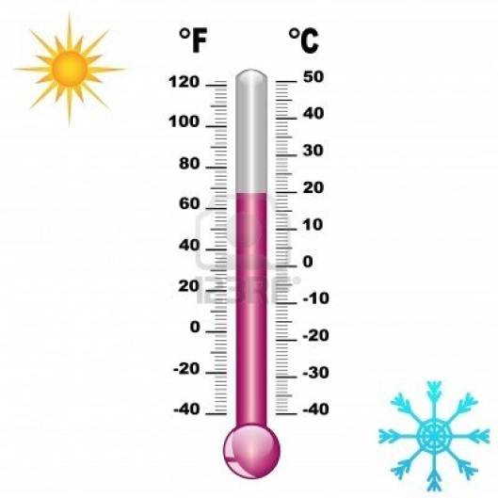
How did we measure these elements?
For each context factor, core control and core assurance activity → sets of indicators and judgement grids were defined
Indicator → essential aspect of a factor/activity that gives an indication about its situation; it is a way to get an overall idea based on restricted but crucial information
Grid → for each indicator sets of descriptions have been made that represent typical situations; grids support in judging the actual situation
(Pictures from Google pictures)
Notes:
The set of indicators together represent the context factor or core control or assurance activity (e.g. preventive measures)

Slide 9
Indicators to measure preventive measures in FSMS
Preventive measures design
Sophistication hygienic design equipment & facilities
Specificity of maintenance program
Adequacy of storage facilities
Specificity of sanitation program
Extent of personal hygiene requirements
Sophistication of initial material control
Adequacy of packaging
Sophistication of supplier control
Sophistication of water control
Specificity of fertilizer program
Specificity of pesticide program
Adequacy of irrigation method
Kirezieva et al, 2013a

Slide 10
Indicators to measure context riskiness
Organisational characteristics
Presence of technical person
Variability of workforce composition
Sufficiency of operators’ competence
Extent of management commitment
Degree of employee involvement
Level of formalisation
Sufficiency of supporting info system
Kirezieva et al, 2013b

Slide 11
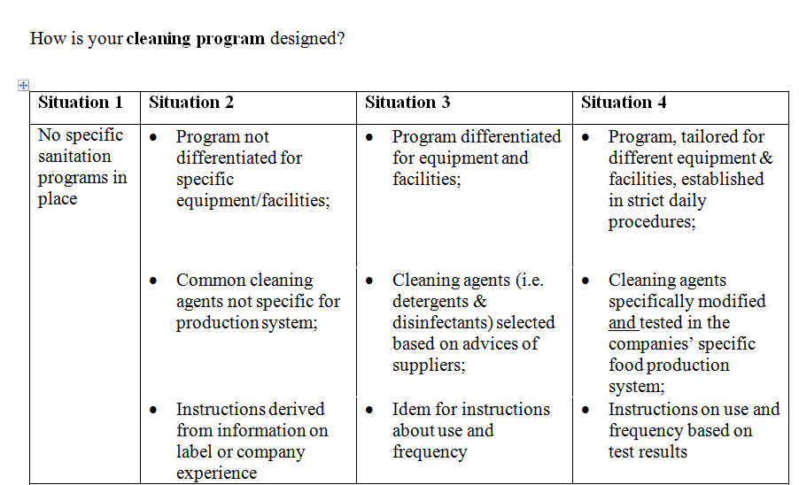




Judgement design cleaning program
Notes:
Situations correspond with similar characteristics. This is what companies see and fill in, without knowing which level is advanced and which basic

Slide 12
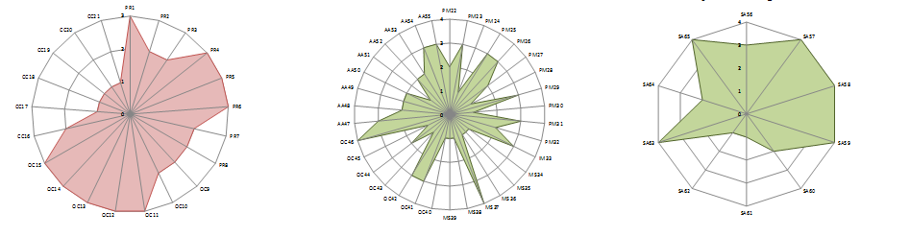
Company FSMS profile
Status of activities
Context riskiness
Output

Slide 13
Topics of presentation
Challenges hampering food safety management systems
Diagnostic instrument for FSMS assessment from systems perspective
Study on FSMS status in Europe and beyond
Conclusions

Slide 14
Study design
European Union (n=69)
Belgium |  | Norway |  | Spain |  | Netherlands
Lettuce | Berries | Lettuce | Berries | Lettuce | Berries | Mixed
6 | 11 | 6 | 4 | 13 | 4 | 25
Non-EU (n=89)
Kenya | Uganda | South Africa | Egyptª | Indiaª | Chinaª | Brazil | Serbia
French beans | Hot pepper | Fruits & lettuce | Berries | Mango | Apples | Lettuce | Berries
30 | 30 | 10 | 1 | 1 | 2 | 6 | 9
ª Interview with expert in the sector

Slide 15
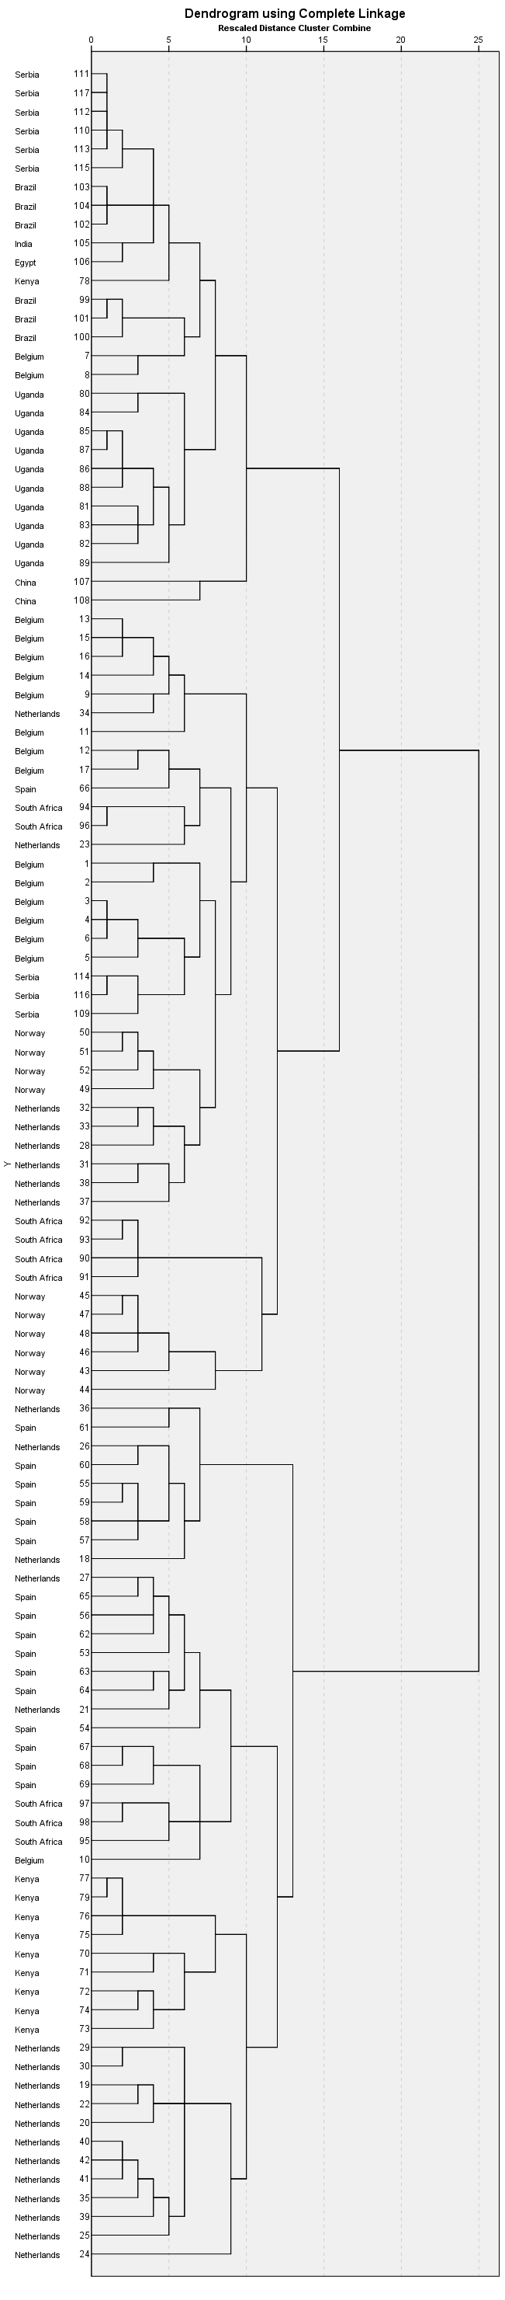
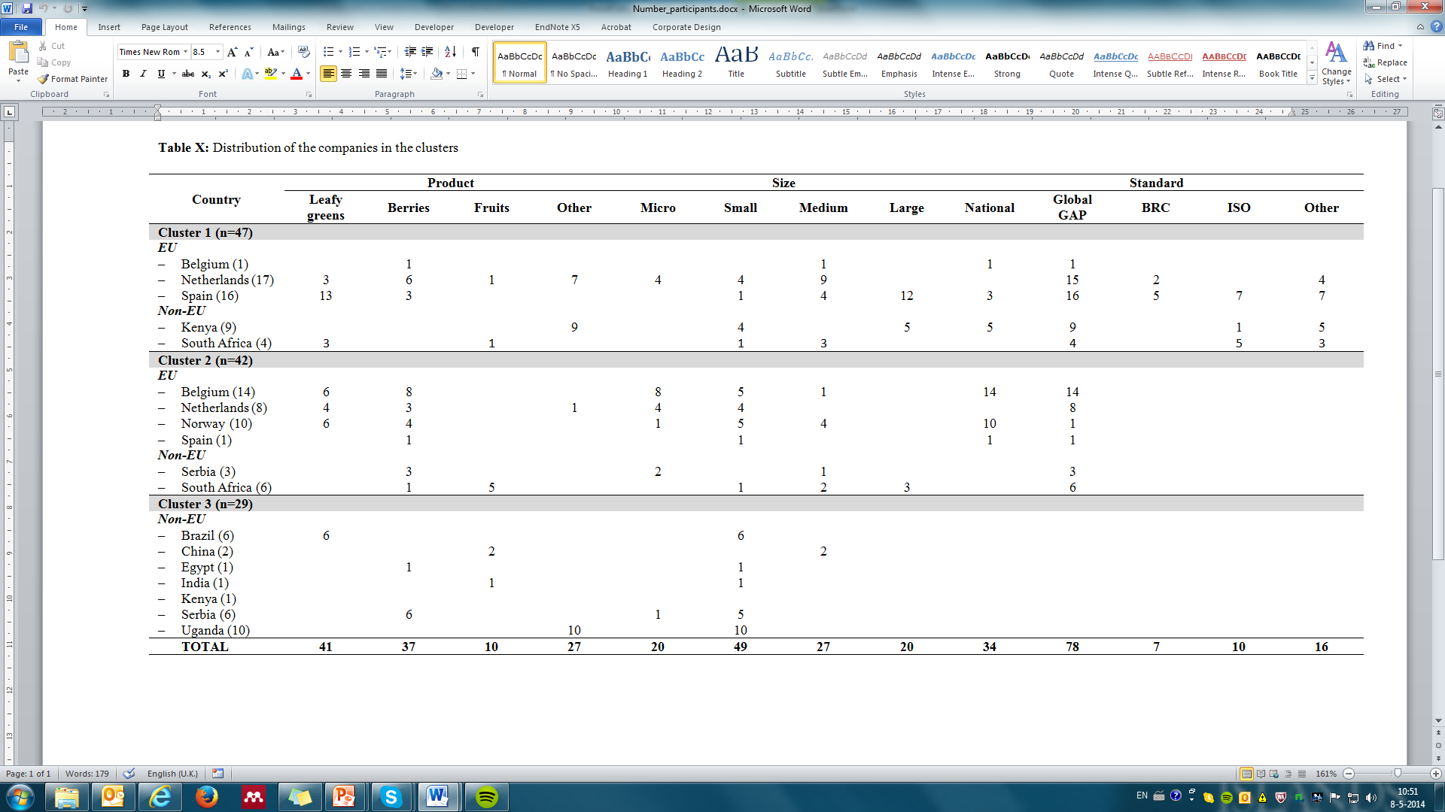
Cluster 3
Cluster 2
NONE
Cluster 1

Slide 16
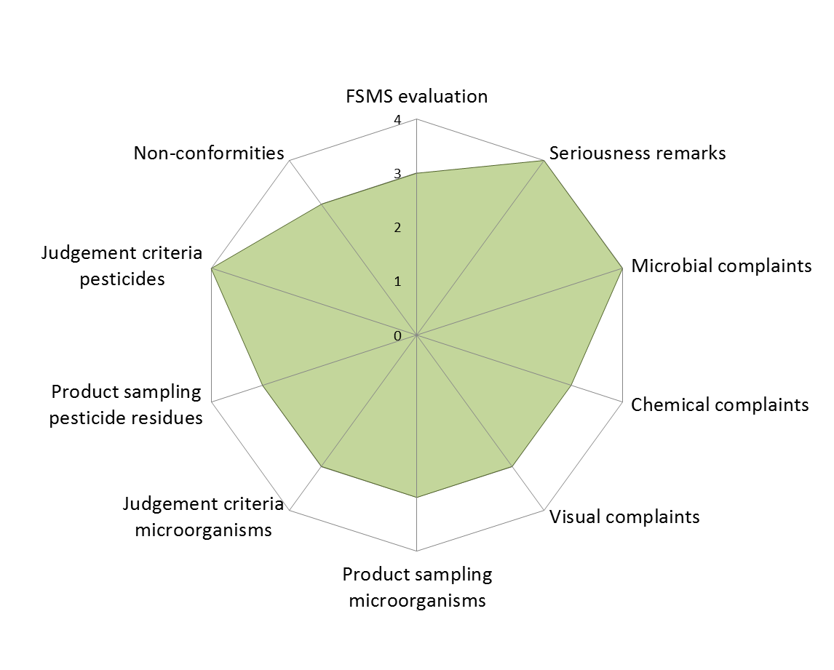
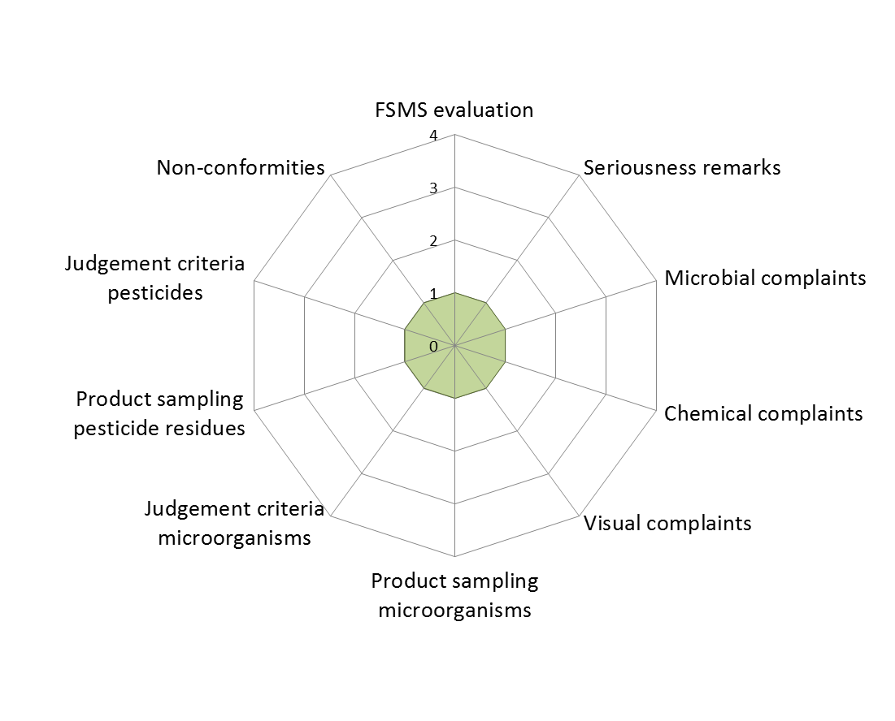
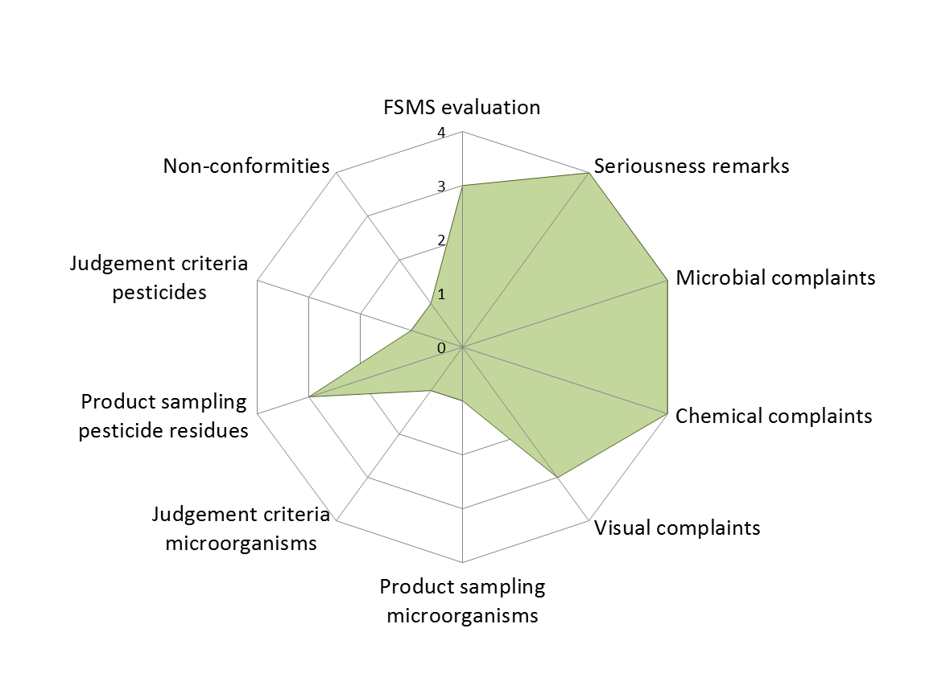
Output of FSMS
Cluster 1
Cluster 3
Cluster 2
More green spider-web → more information and better output of FSMS
Kirezieva et al, 2015, Food Control

Slide 17
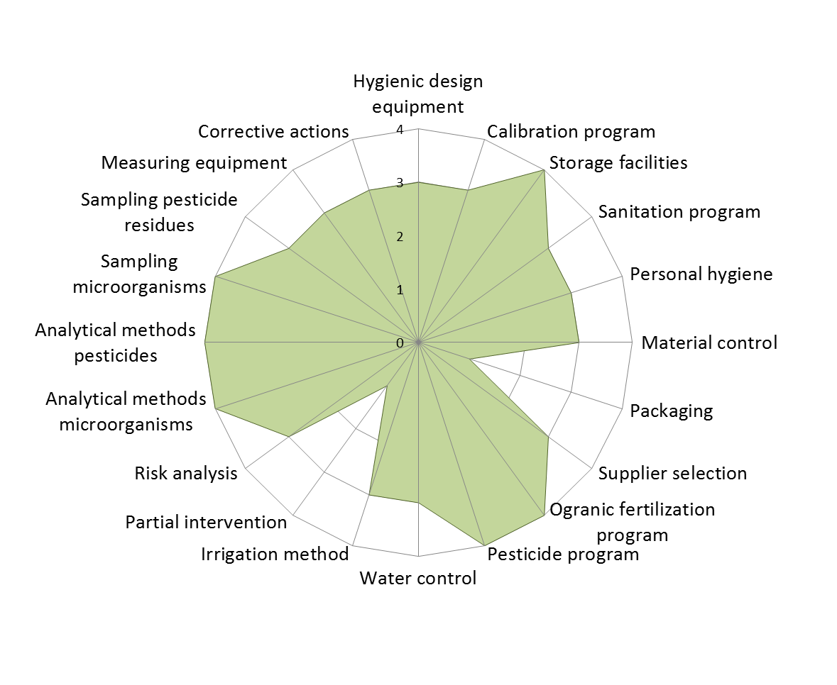
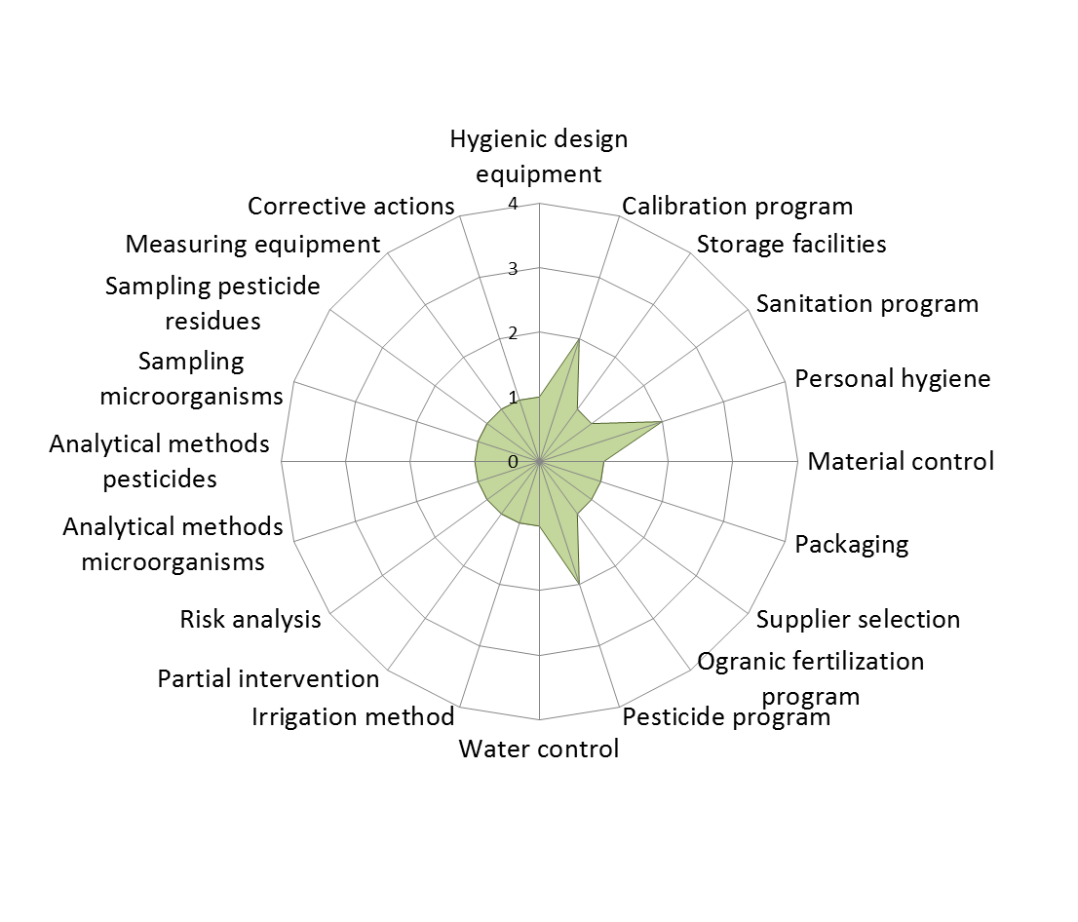
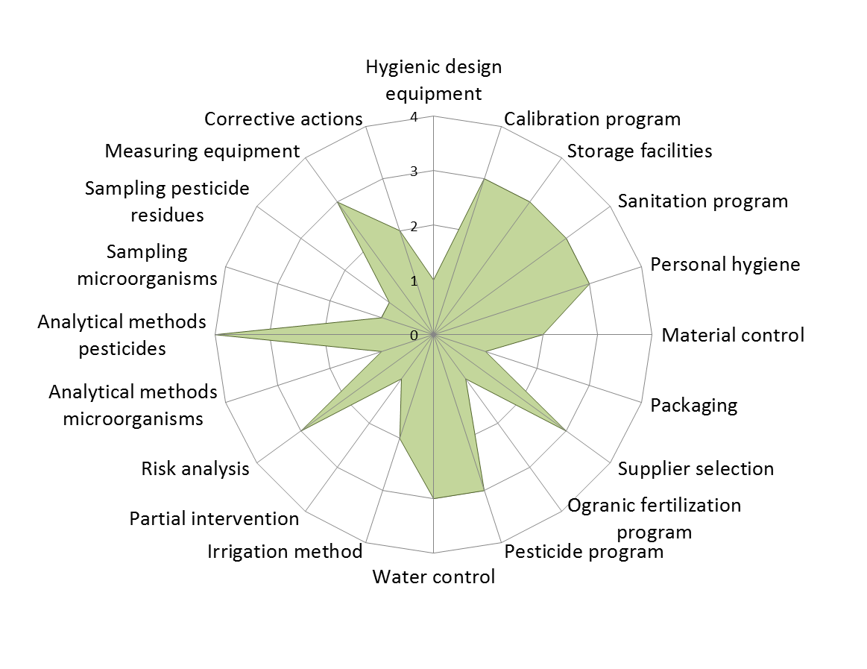
Design control strategies
Cluster 1
Cluster 3
Cluster 2
More green spider-web → more advanced control activities
Kirezieva et al, 2015, Food Control

Slide 18
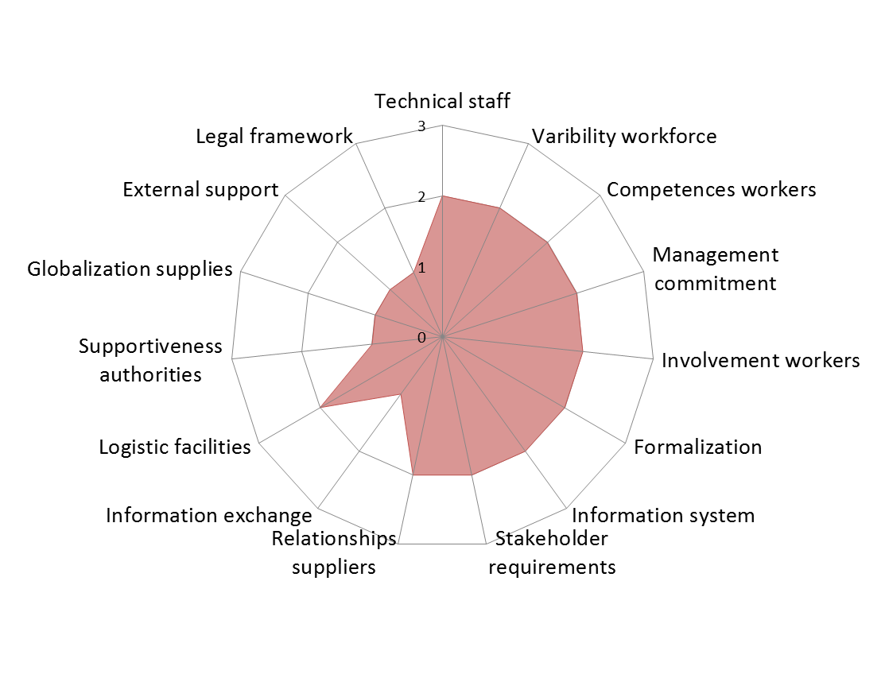
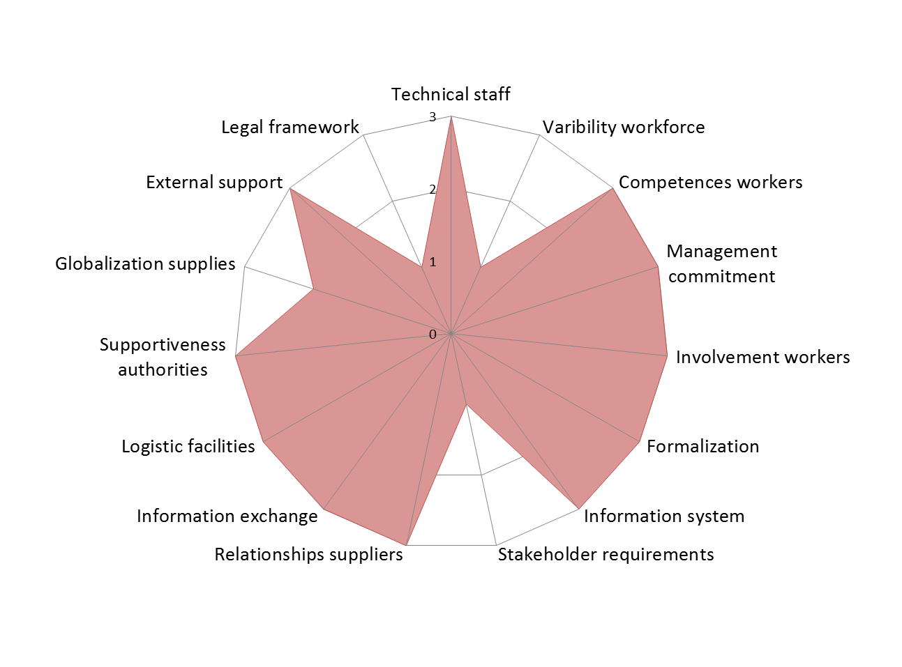
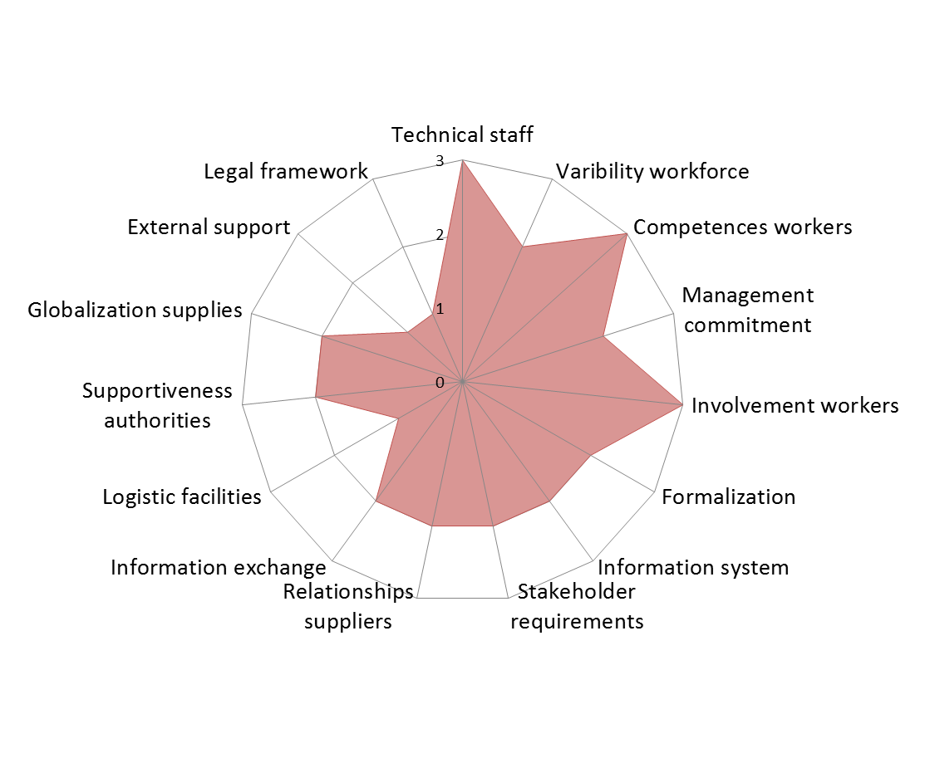
Context riskiness?
Organizational characteristics
Cluster 1
Cluster 3
Cluster 2
More red spider-web => more risky FSMS context
Kirezieva et al, 2015, Food Control

Slide 19
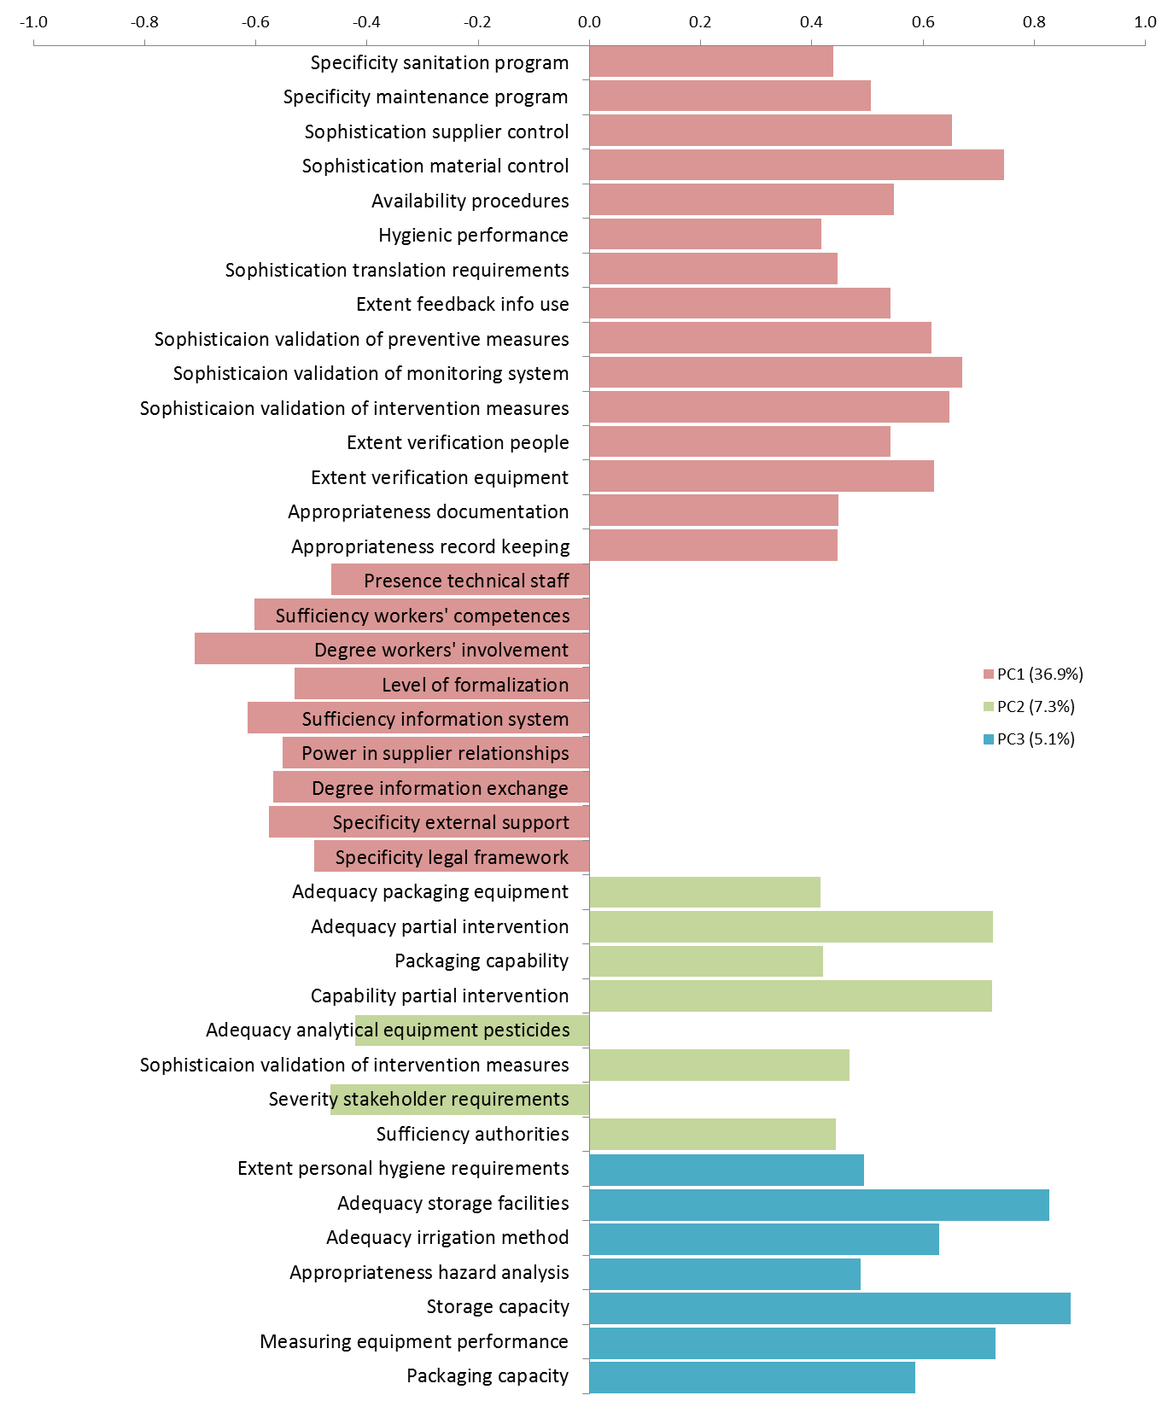
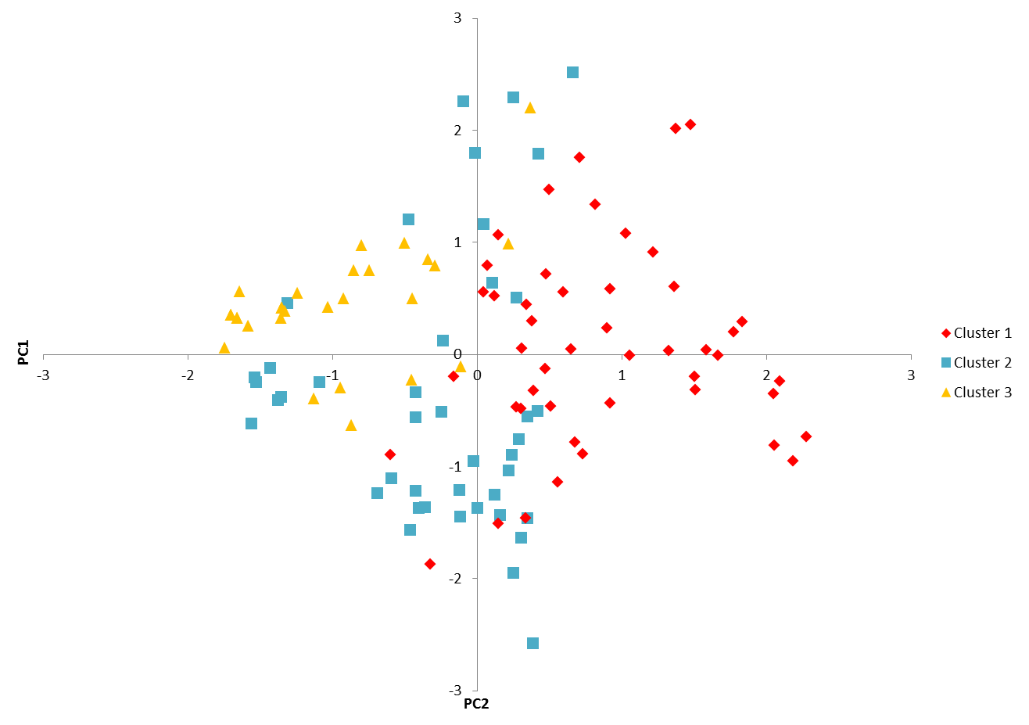
Main Factors
PC1 36.9%
Supportive organisation and chain characteristics (low risk context) → advanced assurance activities and supplies control
Kirezieva et al, 2015, Food Control
Notes:
Results PCA analysis

Slide 20
Conclusions
+
Stringent private standards
Supportive supply chain
Advanced activities (adapted and tested for own production)
+
Baseline (public or private) standards
Lack of support from supply chain
Average activities (based on best available knowledge and equipment)
+
Lack of support from supply chain
Few basic activities
(based on own knowledge and experience)
Lack of standards

Slide 21
Conclusions
Stringent private standards and supportive supply chains led to advanced food safety management activities
SMEs in both industrialised and developing countries face challenges with tailoring the requirements into their specific production and organisation when supportive chain is lacking
Companies in local market in developing countries operate in high risk context due to lack of chain support and they lack even basic activities
Need for stratified measures and policies according to the supply chain in which companies operate

Slide 22
Acknowledgements
This research would not be possible without the kind assistance of:
Allende, A. (CEBAS-CSIC, Spain)
Bender, R.J. (UFRGS, Brazil)
El Tahan, F. (RIIL, Egypt)
Gil, M.I. (CEBAS-CSIC, Spain)
Heiberg, N. (Gartnerhallen SA, Norway)
Holvoet, K. (Ghent University, Belgium)
Johannessen, G. (NVI, Norway)
Nottebaere, E. (Vegaplan, Belgium)
Quaedvlieg, N. (Productschap Tuinbouw, the Netherlands)
Rajkovic, A. (UB, Serbia)
Smigic, N. (UB, Serbia)
Tondo, E. (UFRGS, Brazil)
Uyttendaele, M. (UGhent, Belgium)
Van der Sypt, V. (Fresh Trade, Belgium)
All the companies and researches involved in the regional studies

Slide 23

Questions?
Thank you for your attention!

