Slide 1
STEM CELLS N’ ARTHRITIS
A Review on topical research regarding stem cells’ vast potential in treating Arthritis
Pierre Luc Pace & Nicole Pace
University of Malta

Slide 2
Plan of presentation
Focal Cartilage Lesions & Osteoarthritis
Repair vs. Regeneration
The Possibilities
iPSCs: Cell Therapies & Tools for further study
Rheumatoid Arthritis (RA) & Systemic Juvenile Idiopathic Arthritis (sJIA)
Challenges
Clinical Warnings
Coming Soon to a Clinic Near You

Slide 3
The Promise
Stem cells are currently undergoing many clinical trials for OA treatment
Together with other disciplines such as gene therapy, stem cell therapy may well hold the fabled cure.
Much still needs to be understood, for now the discussion rests on the possibilities

Slide 4
Focal Cartilage Lesions & Osteoarthritis:
Intrinsically Related but different
FCLs are classified as acute defects occurring after localised trauma to the hyaline cartilage.
Usually these are resolved by slow repair mechanisms due to cartilage being an avascular, aneural organ with no lymphatic drainage (Orth et al. 2014)
Osteoarthritis is a chronic phase condition occurring when FCLs accumulate after repetitive injury
Repair mechanisms fail to compensate sufficiently and chondrocyte senescence and apoptosis follows.

Slide 5
Repair vs Regeneration
Repair
‘repair cartilage’ laid down lacks the hyaline-arcade morphology
chondrocyte-ECM laminae do not align adequately to those of adjacent, native cartilage
chondrocytes from native cartilage do not migrate into the defect
Regeneration
instigates a commitment to restore the lesion back to its exact, original architecture
new cartilage laid down should integrate well with and be indistinguishable from native cartilage histologically, morphologically and biomechanically
regeneration occurs only in embryos

Slide 6
Possibilities
1
For SC therapy to be truly worth-while, the selected SC population should be:
easily obtainable
easily cultured and expanded
have a high potency and can be specifically committed to chondrogenesis,
be ideally autologous to avoid undesirable immune responses.
risks of teratomas and tumorigenesis must be minimal.

Slide 7
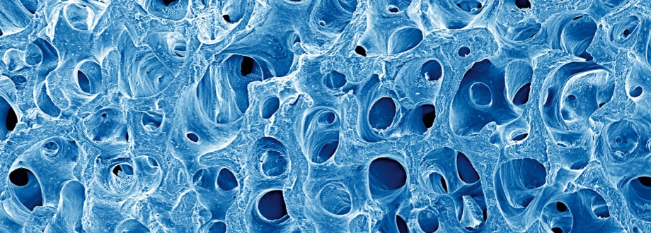
Possibilities
2
Biomaterials
Scaffolds may be useful media for SC delivery
Biocompatible gels or glues have been widely used
Surgical vs. Non-Surgical SC Delivery
SC injection is less invasive, carries minimal risk of infection with a very short post-op recovery time but cannot be delivered accurately to a chosen lesion
Open surgery poses a higher risk of infection and neurovascular complications, with several days of recovery but it gains in accuracy

Slide 8
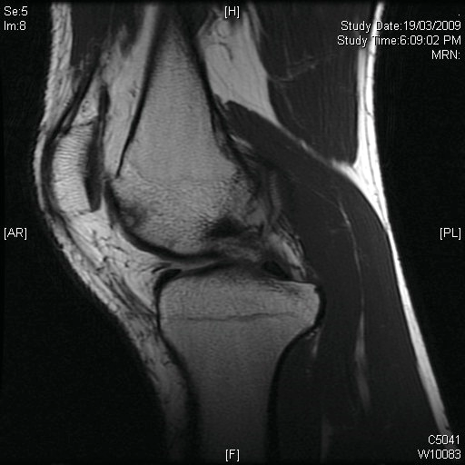
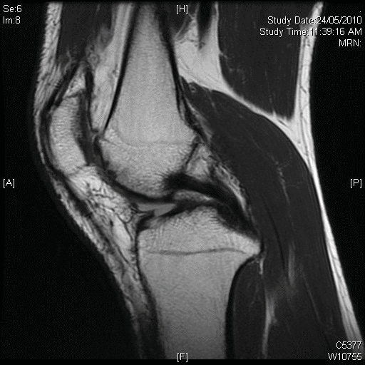
Intra-Articular Injections for Focal Lesions
So far focal lesions have been treated by injection of bm-MSCs and pb-MSCs, only together with marrow stimulation procedures.
injectable method yielded similar improvements to the control whilst proving better in the IKDC and Lysholm knee scale. 1 year a post-op MRI showed significant defect filling and integration of repair scaffold
Repeated injections of pb-MSCs in other studies yielded similarly significant improvements in the Lysholm and KOOS pain scale

Slide 9
Intra-Articular Injections for OA
In a pilot study on autologous bm-MSCs injections for chronic knee OA: “Patients exhibited rapid and progressive improvement.”(Orozco et al. 2013)
Augmentation in cartilage quality was observed in 11 of 12 patients tested, with a mean of 27% reduction of feeble cartilage regions.
Knee OA can be further complicated with meniscal deterioration, and arthroscopy often helps little.
Evidence suggests, both repeated and single-shot MSC injections post-knee surgery, have been fruitful in meniscal recovery. (Brandt S. & Debi. 2014)

Slide 10
Surgical Delivery in Focal Lesions
Bm-MSCs have been transplanted into chondral knee defects
Irrespective of medium type, marked enhancement in Lysholm, ICRS, IKDC, and KOOS, in both functional and pain knee scores, was reported. (Orth et al. 2014)
Formation of hyaline-like repair tissue comparable to 1st-generation autologous chondrocyte grafting was observed, with good continuation with native cartilage laminae
In another study bm-MSCs were embedded via a porous hydroxyapatite ceramic vehicle with both cartilage and bone demonstrated significant restoration. (Orth et al. 2014)

Slide 11
Surgical Delivery in OA
As open surgery is reported more feasible for FCLs, only Wakitani et al. attempted this approach for knee OA (Orth et al. 2014).
After undergoing a high tibial osteotomy, patients received bm-MSCs delivered within a collagen gel.
SC-treated subjects did show some improvement according to arthroscopic and histological examinations, after 7 weeks and 42 weeks.
Nevertheless clinical evaluation pre-and post-op, using the Hospital for Special Surgery knee scale, discovered no difference between SC-treated and control groups.

Slide 12
Adipose-Derived MSCs
Intra-articular injections of Adipose Derived SCs (ADSCs) have reported significant improvements in OA knee function and pain between 16 months and 2 years post-op, according to WOMAC and Lysholm indices. (Orth et al. 2014)
However evidence suggests that ADSCs from obese patients are of poorer quality compared to healthy people. Thus further study is required on how obesity affects SC potency and proliferation, if one hopes to boost reparative chondrogenesis in obese OA patients as well. (Diekman & Guilak. 2013)

Slide 13
Synovial-Derived MSCs
MSCs from the synovial membrane (sd-MSCs) are harder to extract, yet show high chondrogenic and proliferative capacities, especially when cultured with Bone-morphogenetic Protein 3 (BMP3). (Orth et al. 2014) In vivo experiments have shown augmented cartilage repair.
However fibroblastic and hypertrophic features frequently arise among cells derived from chondrogenically-committed sd-MSCs. To raise the feasibility of sd-MSCs, such complications should be overcome.

Slide 14
OA in other joints
Studies seem to concentrate more on knee OA.
However Regenerixx are already using autologous bm-MSC harvested from the iliac crest (less painful than bone marrow biopsy), to treat hip, hand and vertebral OA via local injection with promising outcomes.
They claim to have “helped 73% of patients (with hip OA) return to sporting activities”. (Wagner, Dade & Friedlis 2013

Slide 15
iPSCs: Cell therapies & Tools for further study
strong evidence that bm-MSCs and ADSCs show decreased differentiation potential in elderly and obese individuals. If autologous source is a problem, allogeneic MSC sources may be a safe alternative. (Diekman & Guilak. 2013)
IPSCs permit efficient autologous tissue-engineering even for elderly and/or obese OA patients.(Diekman et al. 2012)
persistent challenge is to commit all the iPSCs in a single culture to chondrogenesis, without resulting in teratoma formation
iPSC-engineered cartilage may be used as an important model for conducting new pathophysiological or pharmacological research on defect repair. This is an advantage over using animal models, which allow a limited number of tests each.

Slide 16
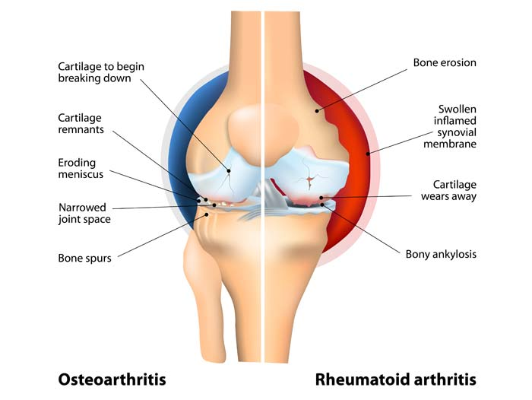
Rheumatoid Arthritis (RA) & Systemic Juvenile Idiopathic Arthritis (sJIA)
potential use of BM-MSC for RA therapy is emerging
ADSCs from RA patients have similar chondrogenic potential to ADSCs from OA patients
Inflammation plays a major role in RA pathogenesis, unlike in OA and RA requires systemic management of pain and inflammation
MSCs transplanted into RA and sJIA joints have not only demonstrated cartilage repair, but also suppression of WBC joint attack
autologous MSCs is a viable treatment option for sJIA

Slide 17
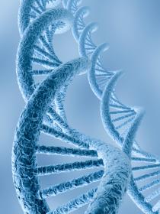
Challenges
Inflammatory Environment
Genome Integrity
Stability of Chondrocytic Phenotype
Integration with Native Cartilage
Changes in Differentiation Potential
Teratoma formation
Tumorigenesis risk
long-term effects

Slide 18
Coming Soon to a Clinic Near You
stem cells is regeneration rather than repair of cartilage defects
Personalised Treatment for OA
Gene therapy, combined with stem cells aided by optimal chondrogenic chemical boosters, may become the gold-standard treatment in the foreseeable future
SC treatment might soon become cost-effective enough to be part of standard protocol

Slide 19
Thanks a lot for your attention and patience
Pierre Luc Pace
Nicole Pace

