Slide 1


Two
applications of Variable Neighborhood
Search in Data Mining
Pierre Hansen
GERAD and HEC Montreal, Canada
Joint work with
Mustapha Aouchiche & Gilles Caporossi
GERAD and HEC Montreal, Canada
Nenad Mladenović
LAMIH, University of Valenciennes FRANCE
Claire Lucas
Saint Gobain Research Laboratories Paris, FRANCE
Two applications of VNS in Data Mining
Pierre Hansen
Paris, September 7–8, 2017
1 / 34

Slide 2












Two applications of VNS in Data Mining
Outline
1
Heuristics and metaheuristics
Variable Neighborhood Search
Principles
Some applications
Heuristic resolution of the p-median problem Finding conjecture with an automated system The AutoGraphiX (AGX) system
Some of the uses of AGX
Systematic study of relations of AGX Form 1
Conclusions
2
3
4
5
Two applications of VNS in Data Mining
Pierre Hansen
Paris, September 7–8, 2017
2 / 34

Slide 3



Heuristics and metaheuristics
Metaheuristic
An optimization problem can be solved :
by a heuristic, which provides quickly an unproved optimal or a near optimal solution;
by an exact algorithm, which provides, hopefully quickly, a proved optimal solution.
Thousands of heuristics are proposed each year
A metaheuristic is a general framework for building heuristics
(e.g. genetic algorithms, simulated annealing, tabu search, GRASP, VNS, ant colonies)
Two applications of VNS in Data Mining
Pierre Hansen
Paris, September 7–8, 2017
3 / 34

Slide 4







Heuristics and metaheuristics
Desirable properties of a metaheuristic
Simplicity : simple and clear principle, widely applicable;
Precision : precise formulation, independent of source of inspiration; Coherence : particular cases follow naturally the metaheuristic principle; Efficiency : provide (near) optimal solutions for at least most realistic
instances in particular cases;
Effectiveness : moderate computing time in to solve particular problems; Robustness : consistent performance over a variety of instances; User–friendliness : clearly expressed, easy to understand and easy to use; Innovation : lead to new types of application.
Two applications of VNS in Data Mining
Pierre Hansen
Paris, September 7–8, 2017
4 / 34

Slide 5

Variable Neighborhood Search: Principles
Principles
A metaheuristic is a general framework for building heuristics applied in various combinatorial or global optimization problems
The variable neighborhood search metaheuristic is due to N. Mladenović and P. H.
(1997)
It exploits a systematic change in the neighborhood in descent step towards a local
optimum as well as in a perturbation step in order to get out of the corresponding valley
This metaheuristic has been widely used in Operations Research, in artificial
intelligence and in data mining
(See the Science Citation Index and Google Scholar for several thousands references
and citations)
Two applications of VNS in Data Mining
Pierre Hansen
Paris, September 7–8, 2017
5 / 34

Slide 6

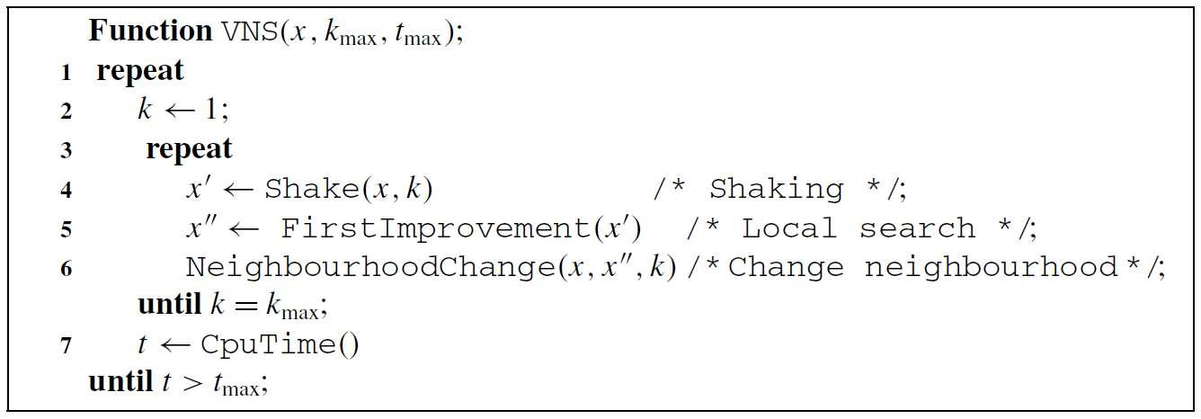
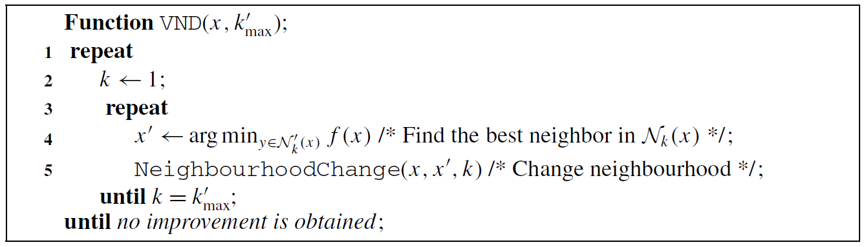
Variable Neighborhood Search:
Principles
General scheme
Steps of the basic VNS
Steps of the basic VND
Two applications of VNS in Data Mining
Pierre Hansen
Paris, September 7–8, 2017
6 / 34

Slide 7

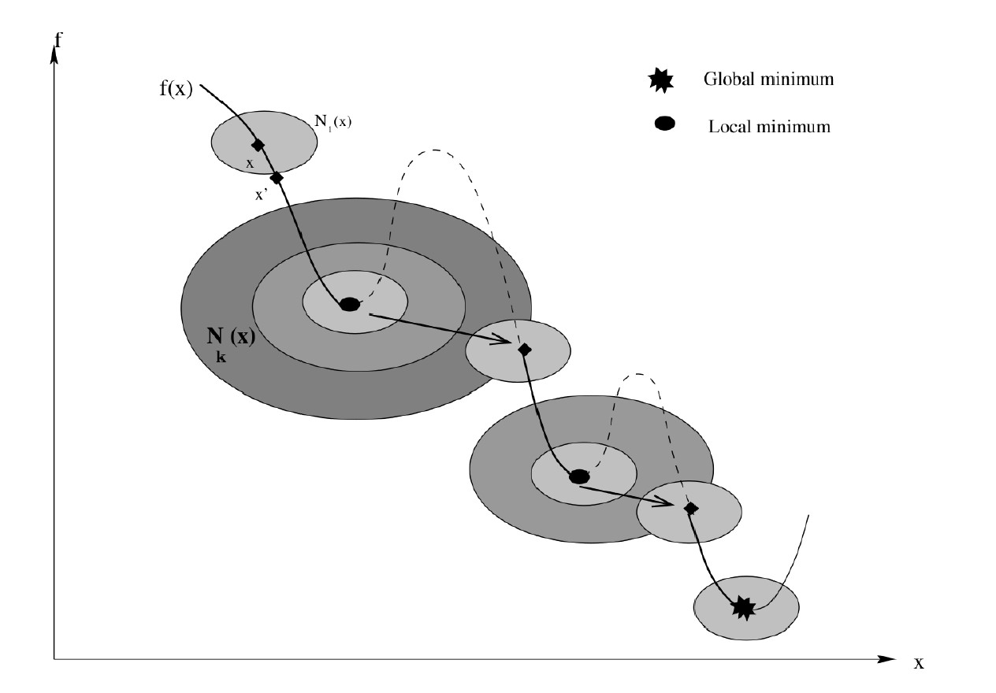
Variable Neighborhood Search:
Principles
General scheme
Two applications of VNS in Data Mining
Pierre Hansen
Paris, September 7–8, 2017
7 / 34

Slide 8






Variable Neighborhood Search: p-median problem
The p-median problem
The p-median problem is one of the most studied in OR and more precisely in
location science.
It can be formulated in graph theoretical terms as follows: given a complete graph with n vertices and weighted edges, find among the n vertices of a graph p vertices associated with facilities and assign the remaining vertices to the closest facilities.
In algebraic terms, the p-median problem is to find p columns such that the sum for all lines of the distances of the coefficients in those columns be the smallest possible.
Reese provided a detailed annotated bibliography of works on the p-median problem which includes over 100 references.
Early heuristics are based on elementary improvement of an initial solution such as substitution of a median to a non-median. Such movements can be combined following the rules of genetic algorithms as shown by Alba and Dominguez.
Two applications of VNS in Data Mining
Pierre Hansen
Paris, September 7–8, 2017
8 / 34

Slide 9






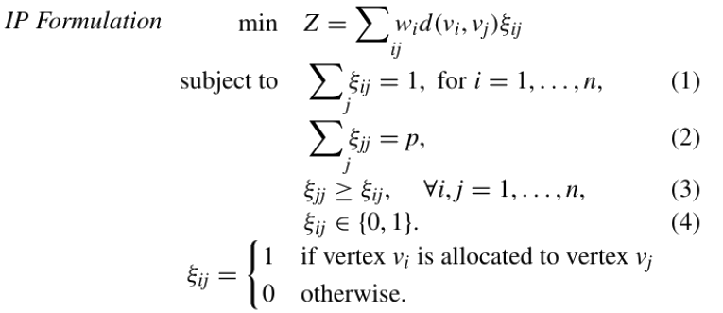
Variable Neighborhood Search:
p-median problem
The p-median problem
VNS algorithm is based on using
reduced VNS;
relaxation of the primal and dual (gave rise to a primal–dual heuristic);
A data structure due to Whitaker and to Resende and Vernecke;
a variable neighborhood decomposition search;
the sliding simplex algorithm which focuses on the dual resolution in a dynamic way with all these tools problems with up to n = 89 600, with an average error less than 1%.
Two applications of VNS in Data Mining
Pierre Hansen
Paris, September 7–8, 2017
9 / 34

Slide 10

Variable Neighborhood Search: Applications
Applications of VNS, or of hybrids of VNS combined with other metaheuristics, are diverse and
numerous. In this section, we review some of them.
Industrial applications
Regarding the first industrial applications, the oil industry has provided many problems. These include the design of an offshore pipeline network (Brimberg et al. 2003), the pooling problem (Audet et al.
2004) and the scheduling of walkover rigs for Petrobras (Aloise et al. 2006).
Parallel machine scheduling
Anghinolfi and Paolucci (2007) propose a hybrid metaheuristic approach which integrates several
features from tabu search, simulated annealing and VNS for a parallel machine total tardiness scheduling problem. De Paula et al. (2007) apply VNS for solving parallel machines scheduling problems with sequence-dependent setups.
Car sequencing
Prandtstetter and Raidl (2008) use a hybrid VNS for the car sequencing problem and Gavranović (2008) applies VNS to car-sequencing problems with colours. Ribeiro et al. (2008a) propose a set of heuristics based on the paradigms of the VNS and ILS metaheuristics for a multi-objective real-life car sequencing problem with painting and assembly line constraints and Ribeiro et al. (2008b) provide an efficient implementation of the VNS/ILS heuristic for this real-life car sequencing problem. Joly and Frein (2008) use VNS to tackle an industrial car sequencing problem considering paint and assembly shop objectives. Good results were obtained in Estellon et al. (2006, 2008) by applying VNS-related heuristics for real
life car sequencing problems.
Two applications of VNS in Data Mining
Pierre Hansen
Paris, September 7–8, 2017
10 / 34

Slide 11

Variable Neighborhood Search: Applications
Resource-constrained project scheduling
Fleszar and Hindi (2004) propose a solution for the resource-constrained project scheduling problem by a VNS and Kolisch and Hartmann (2006) include VNS in an experimental investigation of heuristics for resource-constrained project scheduling. Bouffard and Ferland (2007) improve simulated annealing with VNS to solve the resource-constrained scheduling problem.
Problems in biosciences and chemistry VNS has been useful in recently emerging areas in Bioscience and
Chemistry such as Bioinformatics. Andreatta and Ribeiro (2002) propose VNS heuristics for the phylogeny problem and Ribeiro and Vianna (2005) use a GRASP with a VND heuristic for this problem with a new neighbourhood structure. Kawashimo et al. (2006) apply VNS to DNA Sequence Design and Liberti et al. (2009) propose a double VNS with smoothing for the molecular distance geometry
problem. Santana et al. (2008) illustrate another example of hybridization of metaheuristics through the combination of VNS and Estimation Distribution Algorithms (EDAs). They present the first attempt to combine these two methods testing it on the protein side chain placement problem. Belacel et al. (2004b) use VNS for Fuzzy Clustering.
Arc routing and waste collection Hertz and Mittaz (2001) use a variable neighbourhood descent
algorithm for the undirected capacitated arc routing problem. Polacek et al. (2008) develop a basic VNS algorithm to solve the capacitated arc routing problem with intermediate facilities. Nuortio et al. (2006) use VNS in an improved route planning and scheduling of waste collection and transport and Del Pia
and Filippi (2006) use a variable neighbourhood descent algorithm for a real waste collection problem with mobile depots.
Two applications of VNS in Data Mining
Pierre Hansen
Paris, September 7–8, 2017
11 / 34

Slide 12






Finding conjecture with an automated system
AutoGraphiX system (AGX)
Developed by Caporossi & Hansen since 1997 at GERAD & HEC
Montreal, AGX (Available at http://www.gerad.ca/∼gillesc/) is designed
for
Search for graphs subject to constraints
(based on VNS metaheuristic, Mladenović & Hansen 1997, 2001)
Search for extremal graphs
(based on VNS metaheuristic, Mladenović & Hansen 1997, 2001)
Corroborate, strengthen, refute or find conjectures in graph theory
(numerical, geometric and algebraic methods to find conjectures)
Find ideas of proof
Find automated proof of (simple) results
Two applications of VNS in Data Mining
Pierre Hansen
Paris, September 7–8, 2017
12 / 34

Slide 13



Finding conjecture with an automated system
AutoGraphiX system (AGX)
The research program that led to AutoGraphiX (G. Caporossi, P. H.
1998, 1999, 2000,...) is based on the following two observations:
Many problems in extremal graph theory can be formulated as parametric combinatorial optimization problem on an infinite family of graphs (of which only those of moderate size are considered in practice).
These problems can be solved approximately using a generic heuristic (instead of requiring, as in Operations Research, specific algorithms for each problem)
Two applications of VNS in Data Mining
Pierre Hansen
Paris, September 7–8, 2017
13 / 34

Slide 14




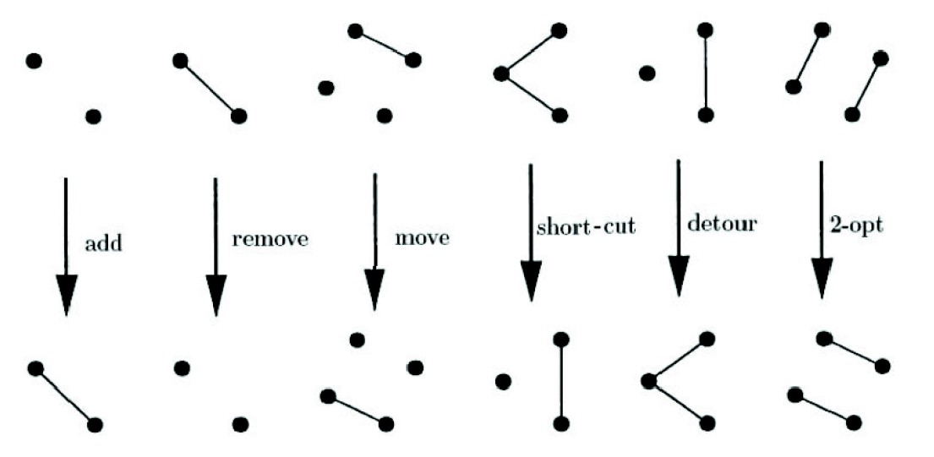
Finding conjecture with an automated system
VNS for extremal graphs
Neighborhoods in the VNS metaheuristic use basic moves (operations) on a graph
In a subsequent version, AGX also uses all the possible moves on 2, 3 or 4
vertices simultaneously
Recent experiments show a great interest in using large moves such as increasing or decreasing maximum degree, diameter, maximum clique,. . .
Two applications of VNS in Data Mining
Pierre Hansen
Paris, September 7–8, 2017
14 / 34

Slide 15

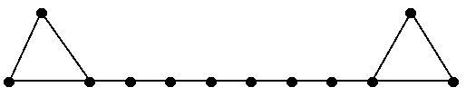
Finding conjecture with an automated system
Some of the uses of AGX: Refutations
Conjecture 834 of Graffiti: Fog any connected graph, (1 + δ)l ≤ n.
Refuted by AGX [Caporossi & Hansen, 2000]
Several neighborhoods and VNS were necessary : an edge addition, 15 edge deletions,
a split, two mergings, 6 moves, 3 2-Opts, another merging and split after VNS with neighborhoods of size up to 7, and a final edge deletion after another application of VNS with neighborhoods of size up to 7
Two applications of VNS in Data Mining
Pierre Hansen
Paris, September 7–8, 2017
15 / 34

Slide 16

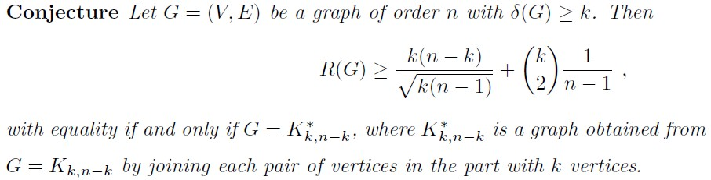
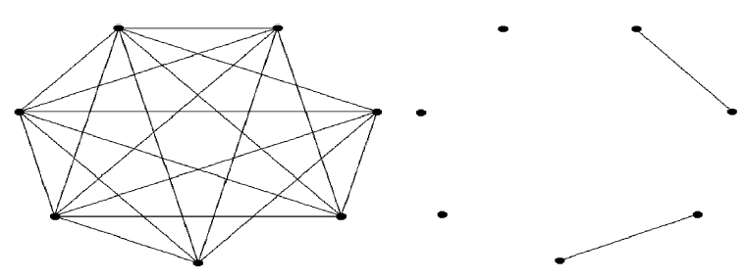
Finding conjecture with an automated system
Some of the uses of AGX: Refutations
The Randić index R introduced by M. Randić (1975, a paper cited 2593 times) is
widely used in Chemical Graph Theory: R = Puv E ^{√ 1}
du dv
In 2002, Delorme, Favaron and Rautenbach suggested
The smallest counter-example
Two applications of VNS in Data Mining
Pierre Hansen
Paris, September 7–8, 2017
16 / 34

Slide 17
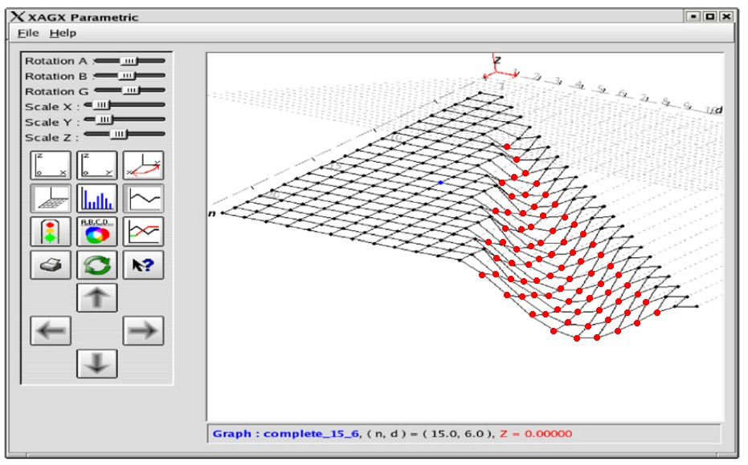
Finding conjecture with an automated system
Some of the uses of AGX: Refutations
The curve of the results given by AGX
Two applications of VNS in Data Mining
Pierre Hansen
Paris, September 7–8, 2017
17 / 34

Slide 18

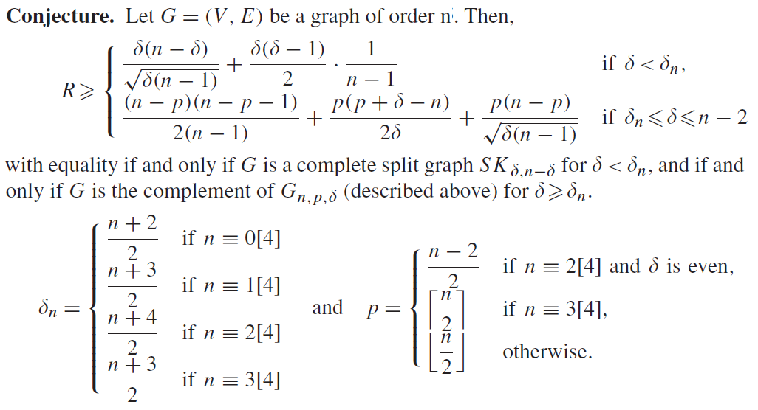
Finding conjecture with an automated system
Some of the uses of AGX: Refutations
The new conjecture
Partial results about the above conjecture can be found in [Pavlović, 2007], [Divnić,
Pavlović, 2013], [Liu, 2013], and [Liu, Pavlović, Divnić, Liu, Stojanović, 2013]
Two applications of VNS in Data Mining
Pierre Hansen
Paris, September 7–8, 2017
18 / 34

Slide 19





Finding conjecture with an automated system
Some of the uses of AGX: Bounding invariants
Apply VNS to find graphs that minimize an invariant function Inv
Apply data mining techniques to find the formula of the bound Inv
State the so obtained conjecture : Inv ≥ Inv
Similar process for maximization : Inv ≤ Inv
Two applications of VNS in Data Mining
Pierre Hansen
Paris, September 7–8, 2017
19 / 34

Slide 20
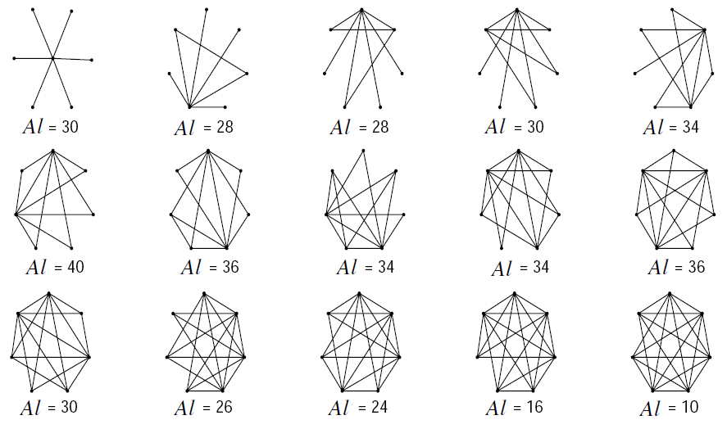
Finding conjecture with an automated system
Some of the uses of AGX: Bounding Albertson irregularity
Albertson (1997) suggested a concept of graph irregularity:
irr (G ) = ^{X} |di − dj |
ij ∈E
Using AGX, a best possible upper bound was found as a function of the order n and the size m. In addition, AGX provided the basic idea to prove its validity
The extremal graphs for n = 7: fanned complete split graphs.
Two applications of VNS in Data Mining
Pierre Hansen
Paris, September 7–8, 2017
20 / 34

Slide 21

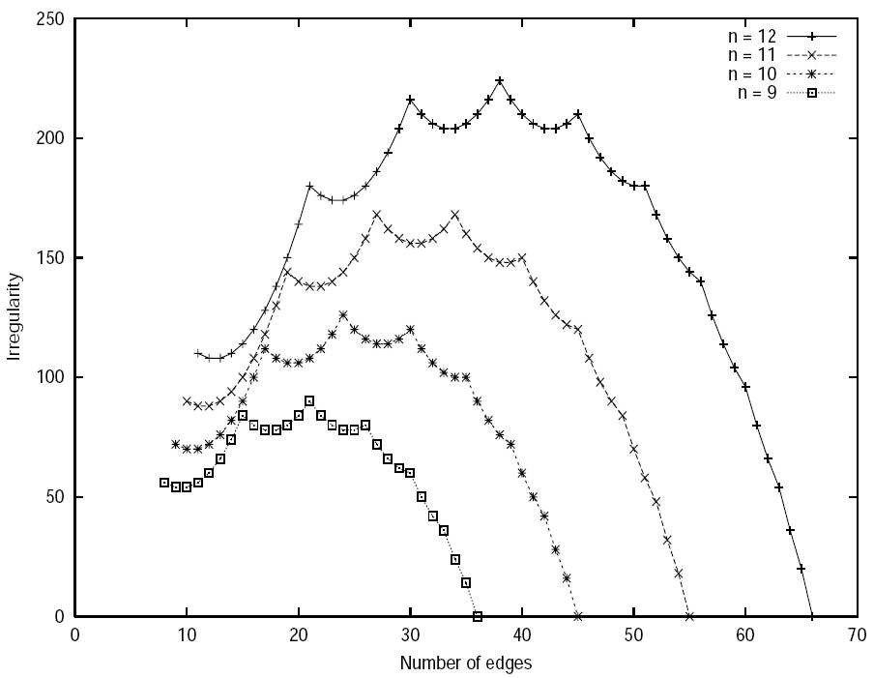
Finding conjecture with an automated system
Some of the uses of AGX: Bounding Albertson irregularity
The curves of the irregularity for different values of n:
Two applications of VNS in Data Mining
Pierre Hansen
Paris, September 7–8, 2017
21 / 34

Slide 22

Finding conjecture with an automated system
Some of the uses of AGX: Bounding Albertson irregularity
AGX obtained the same graphs using only one type of move: an edge rotation. From where the proof idea: show that for any non-optimal graph, there exists an edge rotation that increases the irregularity. This proof works and the result is the following:
Theorem : (proved in [Hansen and Mélot, 2005])
If G is a graph on n vertices and m edges, then
irr (G ) ≤ s (n − s )(n − s + 1) + t (t − 2s − 1)
q
where
s = n − ¹ − n − ¹ ² − 2m
2
2
and
t = m − s (n − s ) − ^{s (s −1)} .
2
Moreover, the bound is attained if and only if G is fanned split graph.
Two applications of VNS in Data Mining
Pierre Hansen
Paris, September 7–8, 2017
22 / 34

Slide 23

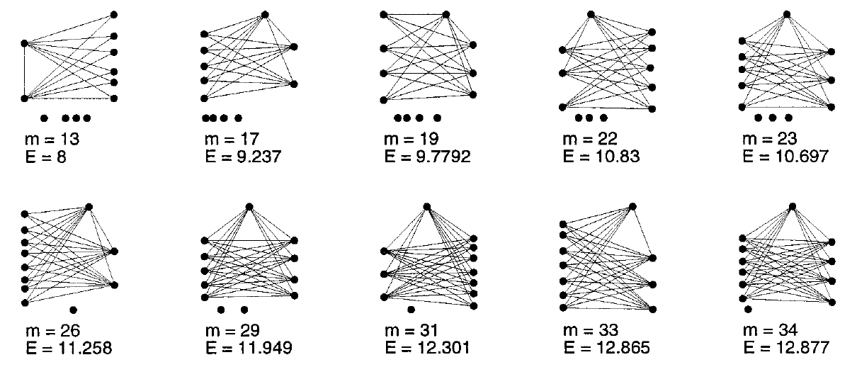
Finding conjecture with an automated system
Some of the uses of AGX: Bounding the Energy
The energy of a graph G is defined by
n
E = ^{X} |λi |
i =1
where λi are the eigenvalues of G
Graphs minimizing E with n = 12
Two applications of VNS in Data Mining
Pierre Hansen
Paris, September 7–8, 2017
23 / 34

Slide 24

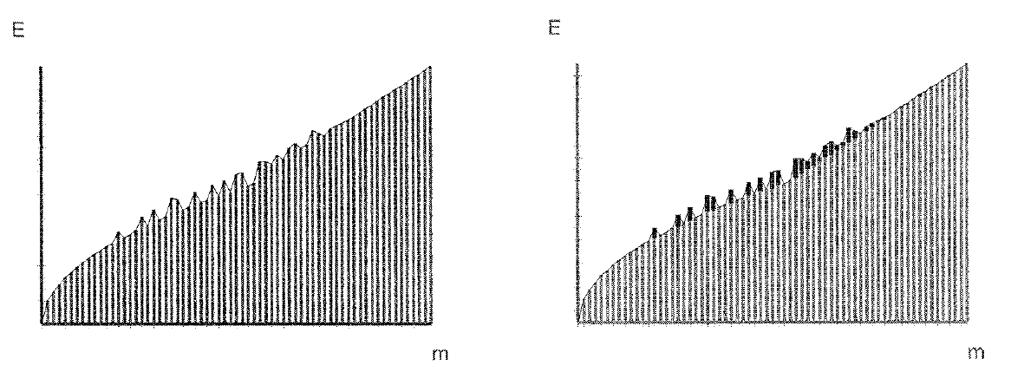
Finding conjecture with an automated system
Some of the uses of AGX: Bounding the Energy
Curve of E (n = 12) obtained by AGX Same curve compared with the conjecture
Conjecture : (proved in [Caporossi e t al., 1999])
If G is a graph of order n and size m, then E ≥ max{2√_{m, 4m/n}.}
Two applications of VNS in Data Mining
Pierre Hansen
Paris, September 7–8, 2017
24 / 34

Slide 25

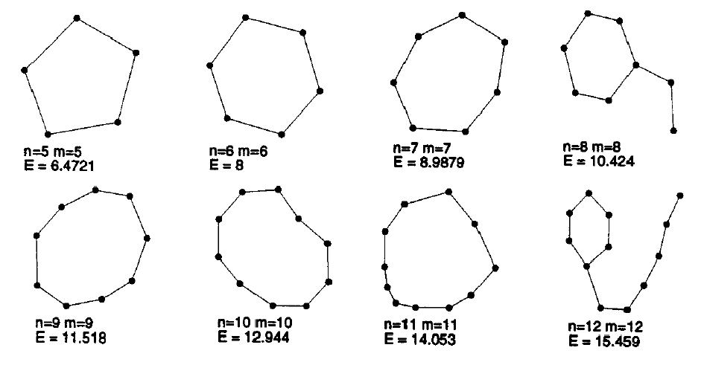
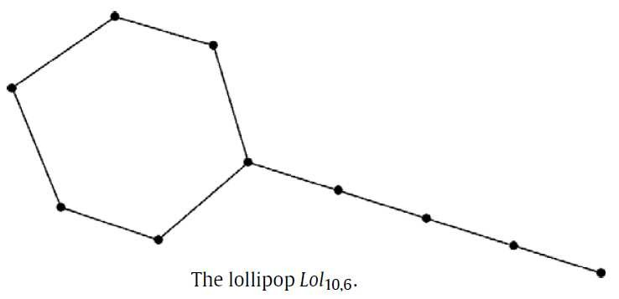
Finding conjecture with an automated system
Some of the uses of AGX: Bounding the Energy
Unicyclic graphs with maximum energy
Conjecture : (proved in [Hou et al., 2002])
If G is a connected, unicyclic and bipartite graph with n ≥
E (G ) ≤ E (Loln,6 ).
7, then
Two applications of VNS in Data Mining
Pierre Hansen
Paris, September 7–8, 2017
25 / 34

Slide 26

Finding conjecture with an automated system
Systematic study of AGX Form 1
To evaluate the AGX performances, we carried out a systematic comparison of
20 usual graph invariants (or sometimes less known ones).
In addition, we chose a relation of a particular form to be studied.
This form generalizes the well-known form of Nordhaus-Gaddum relations (1956), by considering two invariants instead of the values of the same invariant in a graph and its complement, and also by adding to the sum and the product operations the difference and the ratio.
(Finf )
Ln ≤ i1 ⊗ i2 ≤ Un (Fsup )
i1 and i2 :
two graph invariants
⊗: −, +, / or ×
lower and upper bounds as functions of n, and the best possible
Ln , Un :
Finf and Fsup :
families of extremal graphs associated to the bounds
Two applications of VNS in Data Mining
Pierre Hansen
Paris, September 7–8, 2017
26 / 34

Slide 27

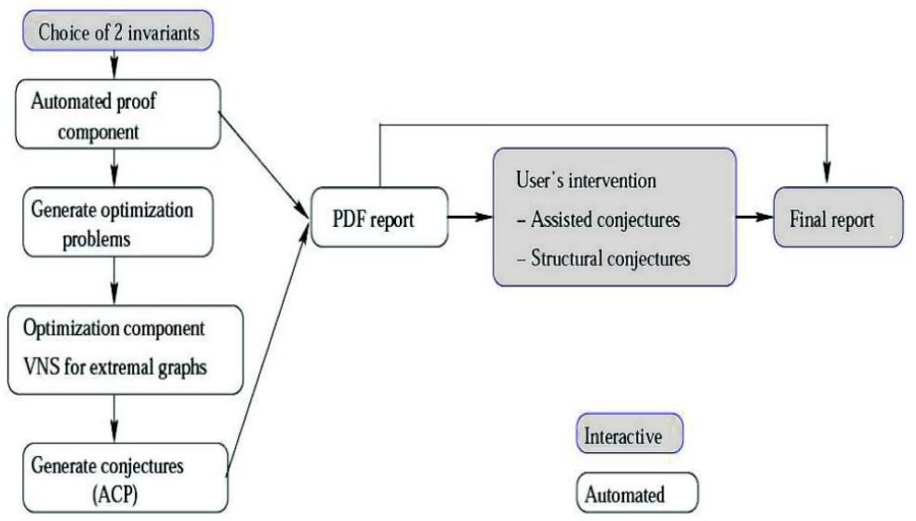
Finding conjecture with an automated system
AGX Form 1: automated process
Two applications of VNS in Data Mining
Pierre Hansen
Paris, September 7–8, 2017
27 / 34

Slide 28

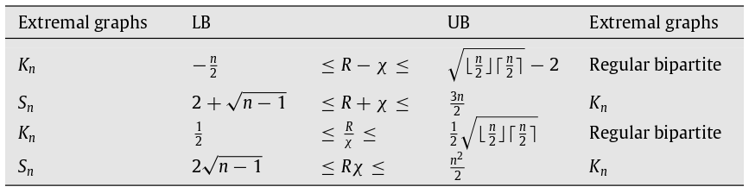
Finding conjecture with an automated system
AGX Form 1: examples
The AGX conjectures related to the comparison between the chromatic number χ and the Randić index R were proved in [Hansen, Vukicević, 2009]
Two applications of VNS in Data Mining
Pierre Hansen
Paris, September 7–8, 2017
28 / 34

Slide 29
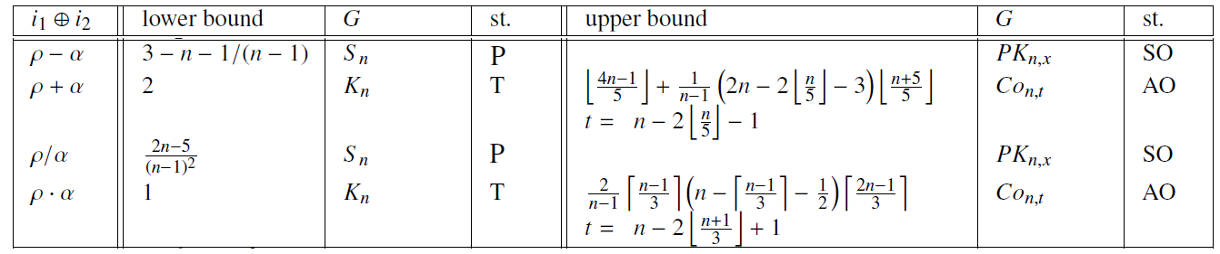
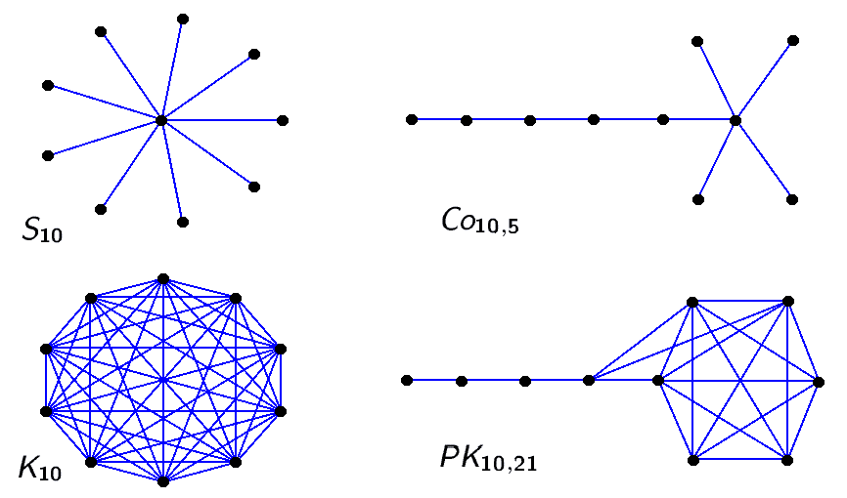
Finding conjecture with an automated system
AGX Form 1: Remoteness ρ and independence number α
Two applications of VNS in Data Mining
Pierre Hansen
Paris, September 7–8, 2017
29 / 34

Slide 30
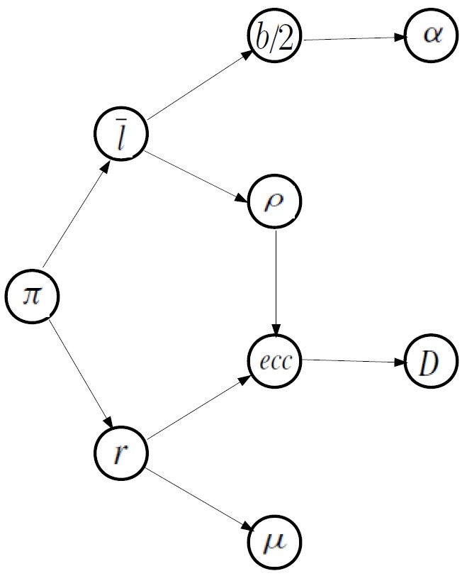
Finding conjecture with an automated system
AGX Form 1: a network of invariants
π = min
v
1 ^{X}
d (u, v ) : proximity
n − 1
u
l
r b
: average distance
: radius
: order of the maximum induced bipartite subgraph
ρ = max
v
1 ^{X}
d (u, v ) : remoteness
n − 1
u
ecc : eccentricity ( e (v ) = max d (u, v ) )
u
µ : matching number
α : indpendence number
D : diameter
l ≤ α [Chung, 1988];
r ≤ µ [Fajtlowicz, 1998];
l ≤ b/2 [Hansen et al., 2009]; ρ ≤ ecc [Aouchiche & Hansen, 2011].
Two applications of VNS in Data Mining
Pierre Hansen
Paris, September 7–8, 2017
30 / 34

Slide 31

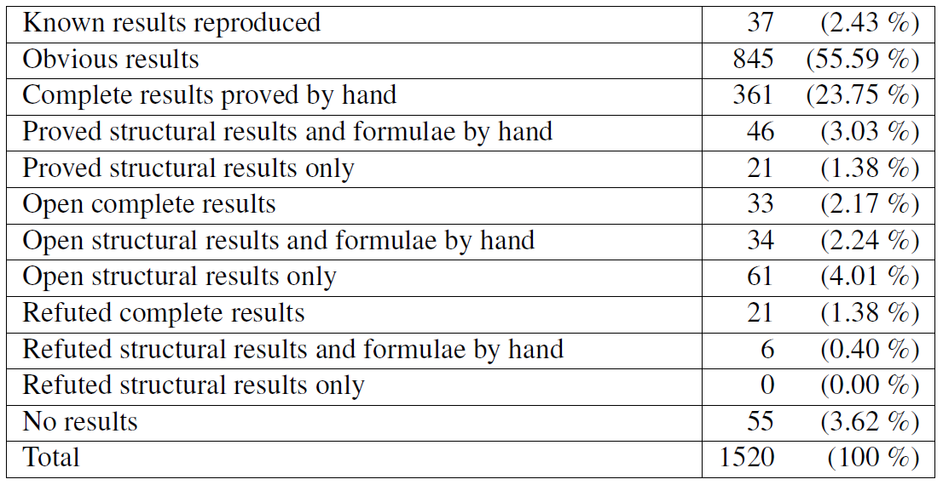
Finding conjecture with an automated system
AGX Form 1: statistics
Two applications of VNS in Data Mining
Pierre Hansen
Paris, September 7–8, 2017
31 / 34

Slide 32
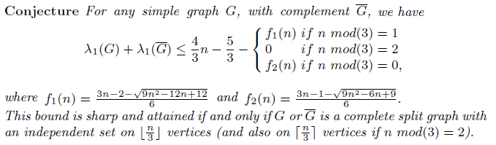
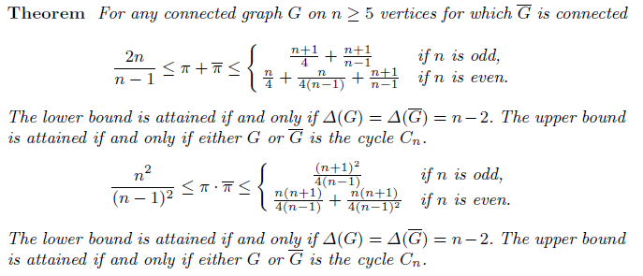
Finding conjecture with an automated system
Other forms : Norhaus-Gaddum inequalities
Two applications of VNS in Data Mining
Pierre Hansen
Paris, September 7–8, 2017
32 / 34

Slide 33

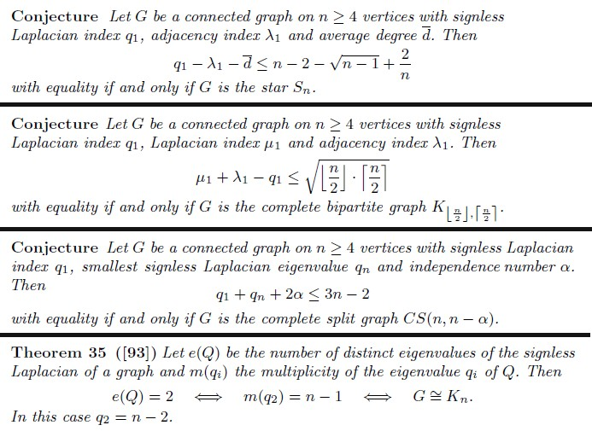
Finding conjecture with an automated system
Other forms : miscellaneous
Two applications of VNS in Data Mining
Pierre Hansen
Paris, September 7–8, 2017
33 / 34

Slide 34




Conclusions
VNS metaheuristic leads to many heuristics for a variety of combinatorial
optimization problems from data mining, operations research, location science and other fields.
Development and use of AGX by many researchers showed that this system can generate many conjectures in graph theory which range from the obvious to the very difficult.
Mostly relations of AGX Form 1 have been studied up to now. There are
many other possibilities.
Forbiden subgraphs characterizations of graphs are used in a way similar
to AGX [Desrosiers et al. 2014].
Two applications of VNS in Data Mining
Pierre Hansen
Paris, September 7–8, 2017
34 / 34

