Slide 1

Calcium Folate (ImmunoPterin)
Dietary Supplement – An Update
Phillip B. Berkey Moheno, Ph.D.
SanRx Pharmaceuticals, Inc.
NCI Summary
November 1, 2016

Slide 2

Calcium Folate (ImmunoPterin)
Dietary Supplement – An Update
Phillip B. Berkey Moheno, Ph.D.
SanRx Pharmaceuticals, Inc.
Moheno PBB. Observational Study of Calcium Folate.
Open Science Journal of Pharmacy and Pharmacology. 2014; 2: 14-8.
Ad libitum 25-76 mg of CaFolate (300-900 µg folic acid equivalent) orally per day,
Reported and determined efficacies:
no flu/colds (>20/20 reporting none during the cold and flu season);
greater energy/stamina (8/8 reporting increased);
less osteoarthritis pain (10/11 reporting improvement);
diminished mouth sores due to chemotherapy (2/2 reporting significant clearance), and
cancer remissions (4/5 reported plus 1 transient improvement in a terminal case).
These observational findings identify certain clinical endpoints for future matched group, randomized, double-blind, placebo-controlled clinical trials. One such clinical trial is underway in osteoarthritis.

Slide 3
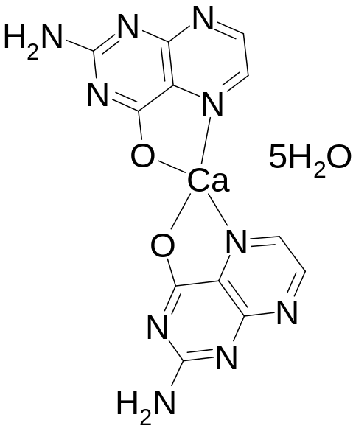
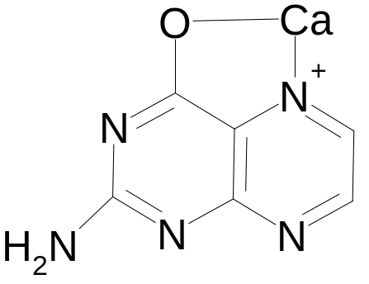

First Calcium Pterin Oral Immunotherapies
CaPterin™
Dipterinyl Calcium
Pentahydrate (DCP™)

Slide 4
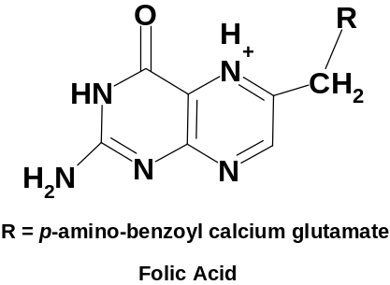
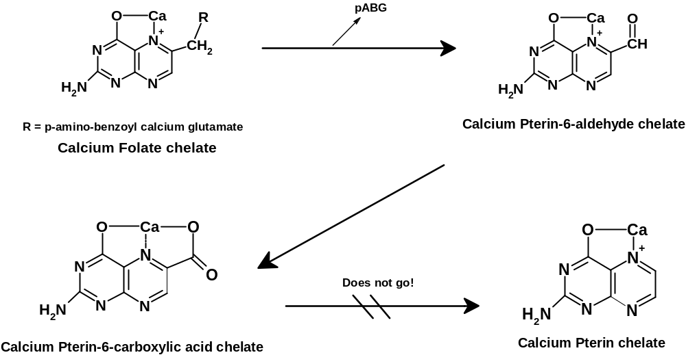
Calcium folate chemistry
+ 250 mol excess
CaCl₂.2H₂O
aqueous

Slide 5
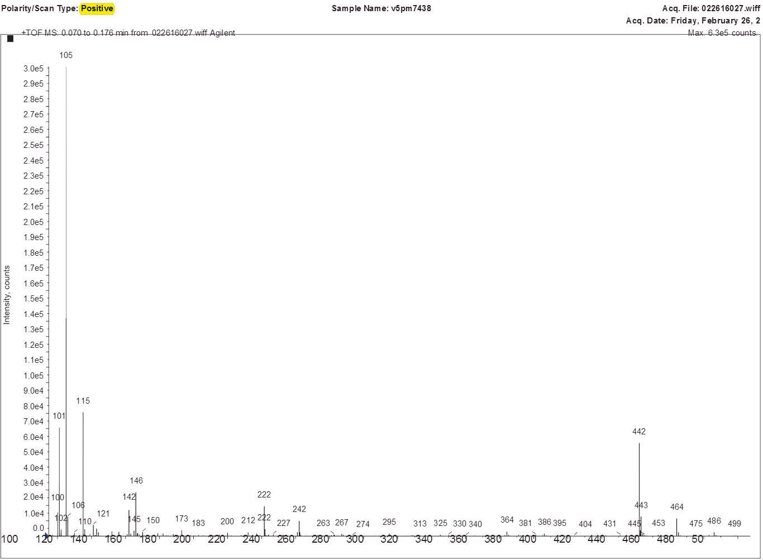
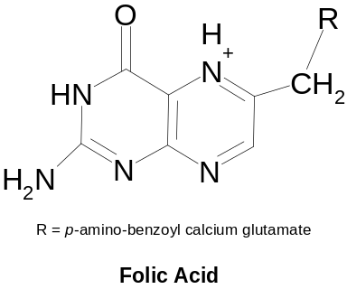
Mass Spec of folic acid (aq)

Slide 6
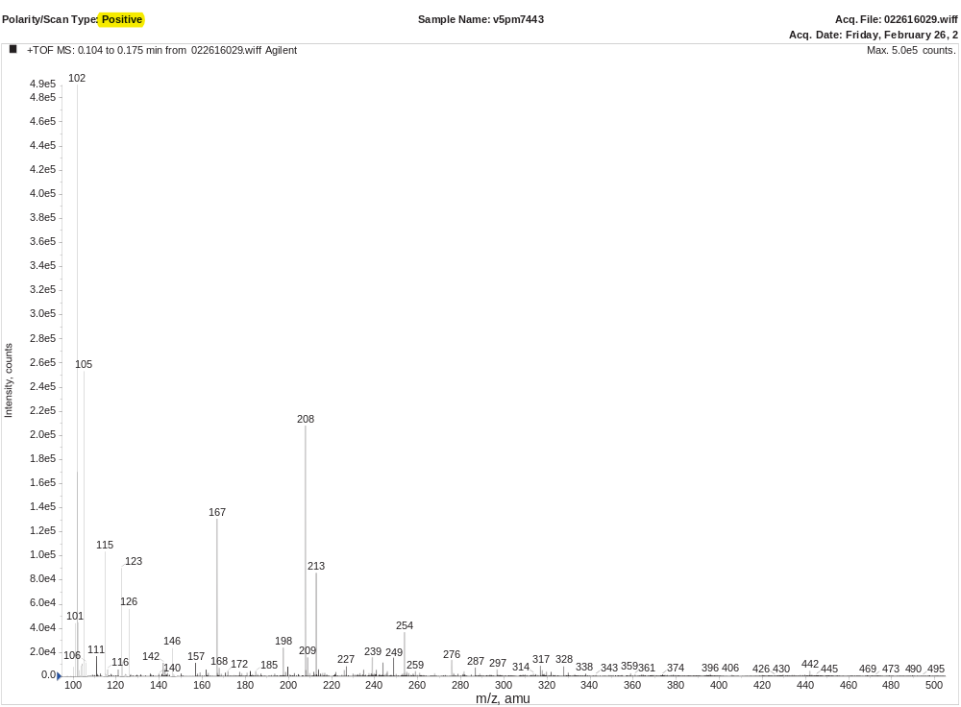
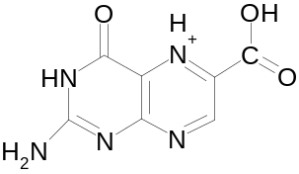
Mass Spec of Folic Acid + excess CaCl₂·2H₂O (aq)
C-18 reverse-phase HPLC with dual phase elution of 1) 0.1% formic acid, and
2) acetonitrile + 0.1% formic acid

Slide 7
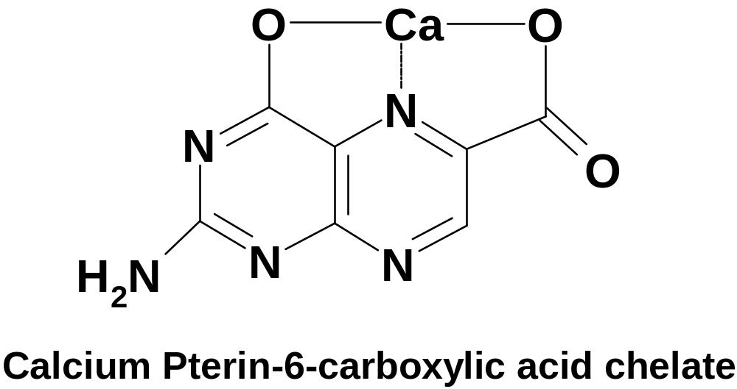
Calcium Folate Active Ingredient

Slide 8
Summary of calcium folate (ImmunoPterin) clinical evidence
Number of CaFolate Users Reporting (N) | Condition | Reported Positive Efficacy with CaFolate
>20 | Flu/colds (during cold/flu season) | 100%
8 | Energy/Stamina | 100%
11 | Arthritis | 91%
2 | Chemo Mouth Sores | 100%
1 | Lupus erythematosus | 100%
1 | Leg Pain | 100%
1 | Hepatitis C | Remission
2 | Type 2 diabetes | Stabilized
1 | Bladder CA (tumor) | Remission
1 | Skin CA lesions | Remission
1 | Brain CA (terminal) | Increased apatite
1 | Kidney CA (tumor) | Remission
1 | Breast CA with bone metastasis | Remission
1 | Mononucleosis/Lyme Disease | Inconclusive
1 | Lyme Disease | Induced inflammatory response
1 | Gastroenteritis | Mitigated

Slide 9
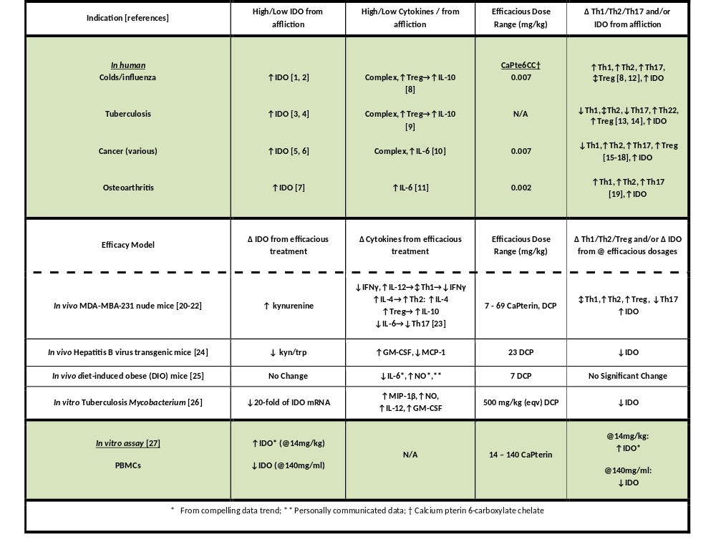

Slide 10
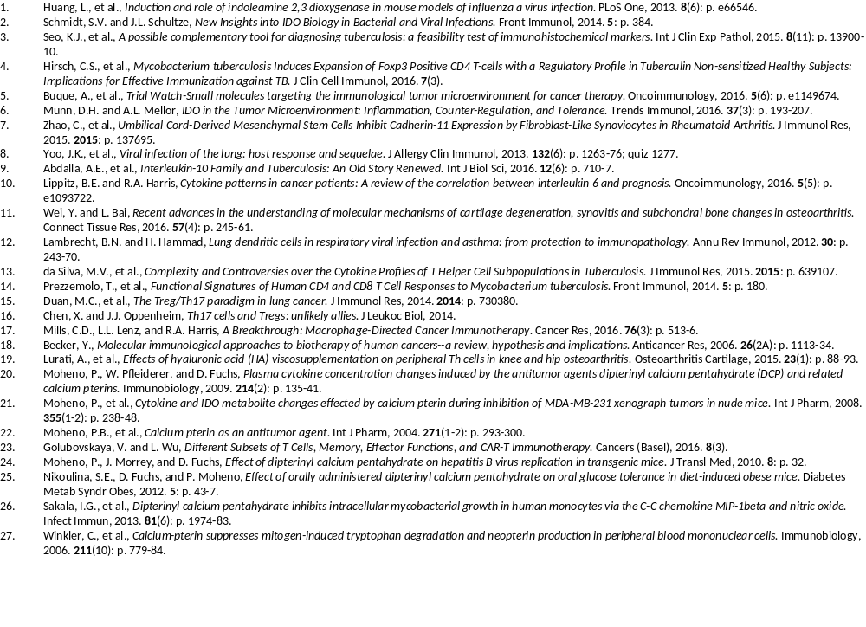

Slide 11
Hypothesized Efficacious Mechanism of Action (Nude Mouse Tumor Model)
CaPterins
(CaPterin 6-carboxylate chelate)
↕IDO↔↕Th1→↑Th2,↓Th17,↑Treg
Plasticity?

Slide 12


SanRx Team
Highly experienced Scientific Team
  100+ combined years experience in biochemistry, applied research, IP
Scientific Advisory Board
  United States, Austria, Germany
Business Advisory Board
  Business development, finance, marketing, nutraceutical
Edgar Berkey
Phillip B. Berkey Moheno

Slide 13
Scientific Advisors
Dietmar Fuchs Ph.D. – Medical Chemistry, Innsbruck Medical University, Austria
Stephen Chang, Ph.D. – SanRx Consultant
Boris Minev MD – Director of Tumor Immunology, UCSD Moores Cancer Center
James C. Ryan Ph.D. - UC San Francisco, Immunology
Wolfgang Pfleiderer Ph.D. – Prof. of Chemistry, Univ. of Stuttgart and Konstanz in Germany
Arnold L. Rheingold Ph.D. - UC San Diego, Chemistry & Biochemistry
Antonio G. DiPasquale Ph.D. - UC Berkeley, Chemistry & Biochemistry
John D. Morrey Ph.D. - Institute for Antiviral Research, Utah State University
Daniel F. Hoft MD Ph.D. – Saint Louis Univ., Immunobiology, Internal Medicine, & Microbiology
Svetlana Nikoulina Ph.D. – Director of Preclinical Research & Development, SanRx
For further details visit www.sanrx.com and www.immunopterin.com .

