Slide 1
About Omics Group
OMICS Group International through its Open Access Initiative is committed to make genuine and reliable contributions to the scientific community. OMICS Group hosts over 400 leading-edge peer reviewed Open Access Journals and organize over 300 International Conferences annually all over the world. OMICS Publishing Group journals have over 3 million readers and the fame and success of the same can be attributed to the strong editorial board which contains over 30000 eminent personalities that ensure a rapid, quality and quick review process.

Slide 2
About Omics Group conferences
OMICS Group signed an agreement with more than 1000 International Societies to make healthcare information Open Access. OMICS Group Conferences make the perfect platform for global networking as it brings together renowned speakers and scientists across the globe to a most exciting and memorable scientific event filled with much enlightening interactive sessions, world class exhibitions and poster presentations
Omics group has organised 500 conferences, workshops and national symposium across the major cities including SanFrancisco,Omaha,Orlado,Rayleigh,SantaClara,Chicago,Philadelphia,Unitedkingdom,Baltimore,SanAntanio,Dubai,Hyderabad,Bangaluru and Mumbai.

Slide 3



Quantum interference effects and molecular electronics
Philippe Lafarge
Université Paris Diderot, CNRS, Paris, France
philippe.lafarge@univ-paris-diderot.fr
Optics 2014 - sept. 10, 2014

Slide 4
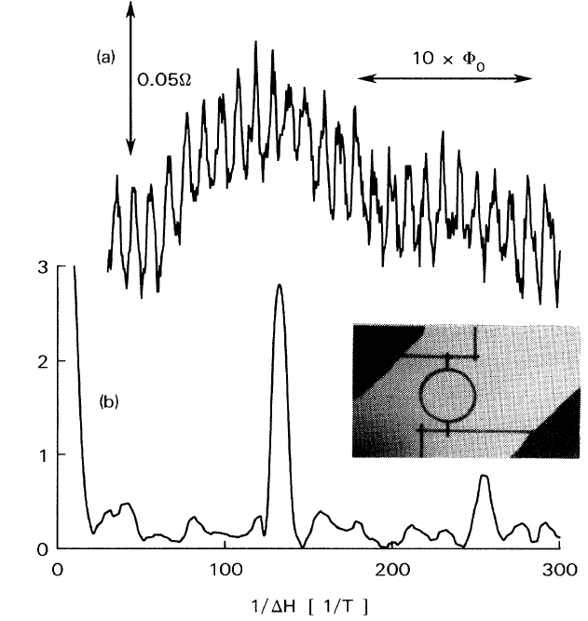
Quantum interference in mesoscopic systems
Aharonov-Bohm effect in a metal ring
phase coherent transport
P_{QM} = |A₁ + A₂|²
quantum interference
phase shift controlled by magnetic flux
= π Φ/Φ₀
R. A. Webb et al., Phys. Rev. Lett. 54, 2696 (1985)

Slide 5
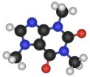
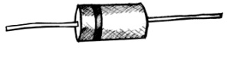


Molecular electronics
Molecular junctions
Quantum interference
Simulations
Experimental results
Conclusions and perspectives
MOLECULES
Nanoscale structures
chemically active
Cost-effective
Electronic components made with molecules ?
Need to probe the electronic properties of molecules !
Molecular junctions
D. Fracasso et al. J. Am. Chem. Soc. 2011,133, 9556-9563
M. L. Perrin et al. Nat Nano
2013, 8, 282-287
R. McCreery et al. Phys. Chem. Chem. Phys. 2013, 15, 1065
Monolayer molecular junctions
Based on self assembled monolayers (SAMs)
Mechanically controlled break-junctions
One or a few molecules connected
Solid state planar junction
Millions of molecules are connected thanks to electrografting

Slide 6
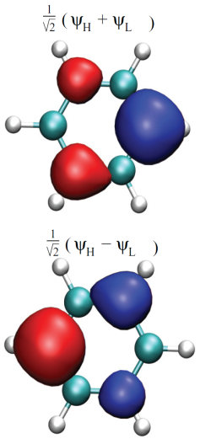
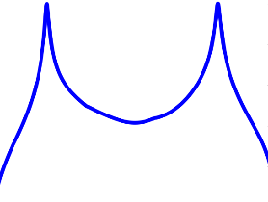
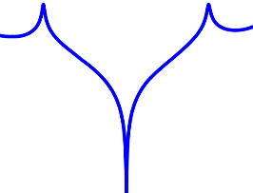
Quantum interference
Molecular junctions
Quantum interference
Simulations
Experimental results
Conclusions and perspectives
The connection between the molecule and the electrodes influences the
electronic properties described by the electronic transmission probability T_{LR}(E)
Electron transport through a single benzene molecule connected in
ortho, para or meta.
L
L
R
L
R
R
ortho
para
meta
T_{LR} (E_{F}) ≠ 0
T_{LR} (E_{F}) = 0
No QI
Destructive QI
P. Sautet, C. Joachim, Chem. Phys. Lett., 153, 511 (1988)
T. Markussen et al. Nano Lett. 10, 4260-4265 (2010)
C. R. Arroyo et al. Ang.Chem., 125, 3234-3237 (2013)

Slide 7
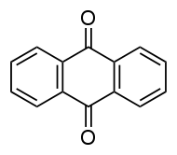
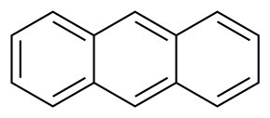
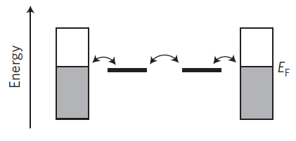
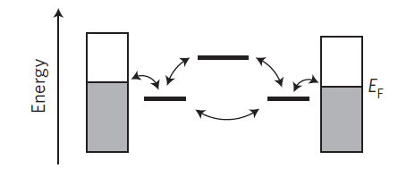
QI and molecular structure
Molecular junctions
Quantum interference
Simulations
Experimental results
Conclusions and perspectives
para
MOLECULE
para
linearly conjugated
cross conjugated
Anthracene (AC)
Anthraquinone (AQ)
R
L
L
R
Molecular junctions
Energy diagrams
(Localized Molecular Orbitals)
Only 1 path allowed
2 phase-opposed electronic paths
Constant transmission function at E_{f}
Antiresonance in the transmission function
T(E_{f}) = 0
No QI
Destructive QI
G. Solomon et al. ChemPhysChem, 10, 257-264 (2009)
C.M.Guédon et al. Nat Nano. 7, 305-309 (2012)

Slide 8
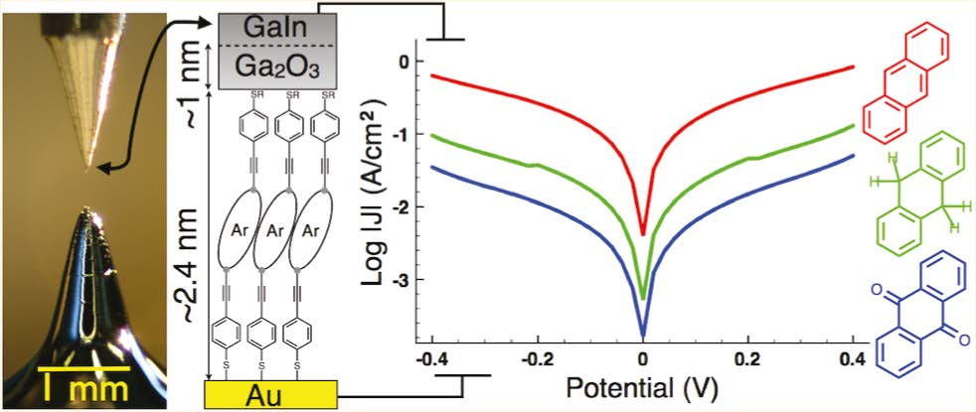
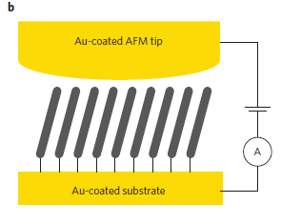

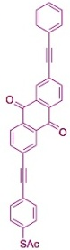
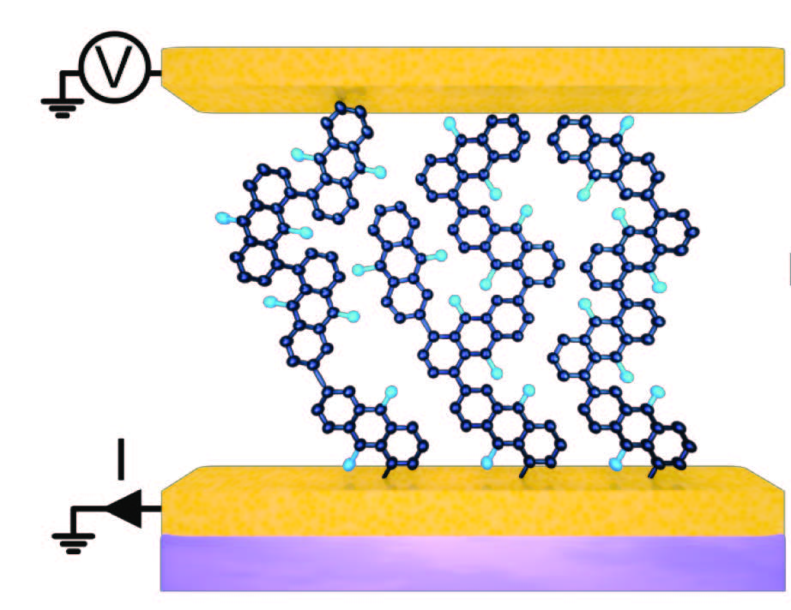
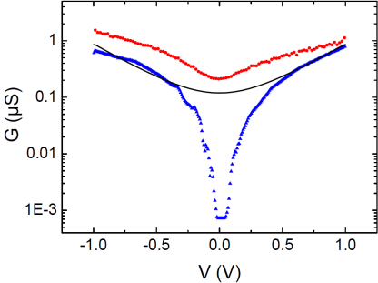
First experimental evidences
Molecular junctions
Quantum interference
Simulations
Experimental results
Conclusions and perspectives
In SAMs of AC and AQ arylethynylene thiolates with eutectic Ga-In top contacts
D. Fracasso et al., JACS 133, 9556 (2011)
I_{AQ}(V) < I_{AC}(V)
From an indirect measurement of AQ and AC based SAMs, statistical analysis
C.M.Guédon et al. Nat Nano. 7, 305-309 (2012)
C-AFM
two-dimensional histograms
AC-DT
AQ-MT
dI/dV vs V
In AQ based molecular junctions from a direct measurement of the conductance curves
Rabache et al., JACS 135, 10218 (2013)
300 K
tunneling barrier model
4 K
30 x 30 μm²

Slide 9
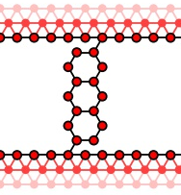
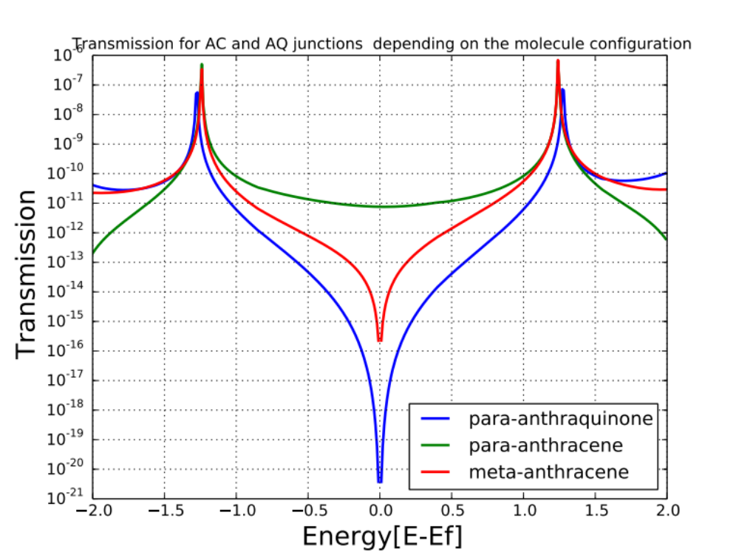


Transmission function calculation
Molecular junctions
Quantum interferences
Simulations
Experimental results
Conclusions and perspectives
Tight binding approach applied to charge transport (KWANT)
Key role played by the way the molecules are connected to the electrodes.
Para - anthracene
Meta-anthracene
Para-anthraquinone
Parameters
On site energies = 0eV / Coupling energies = -3eV / Coupling to the electrodes = -1eV
C.W. Groth et al. a software package for quantum transport, arXiv: 1309.2926

Slide 10
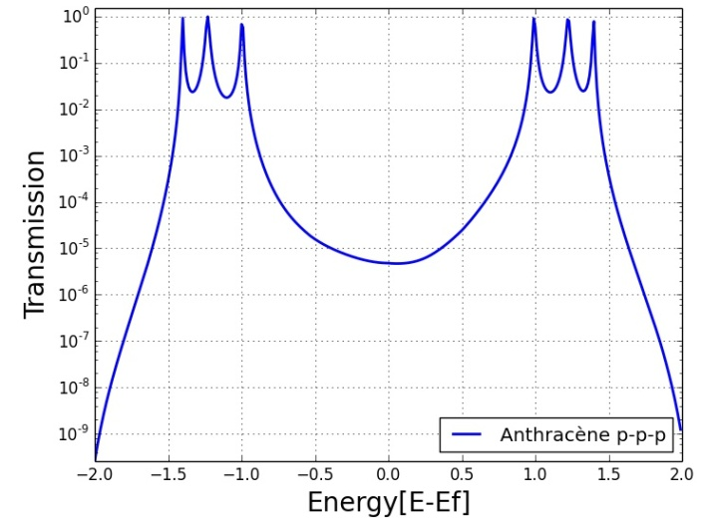
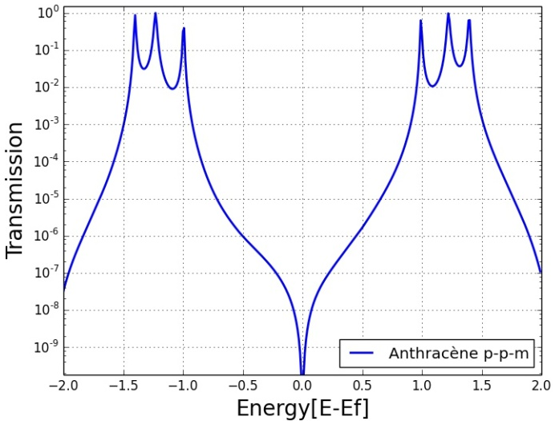
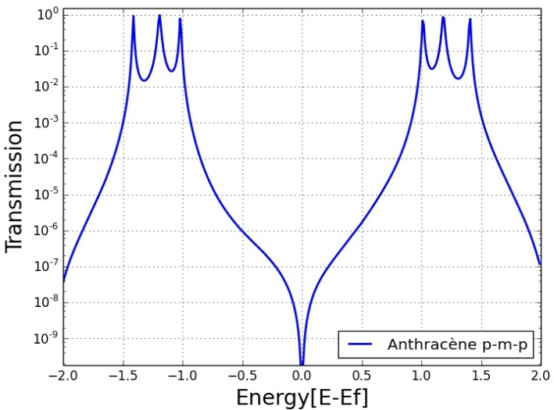
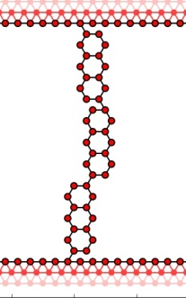
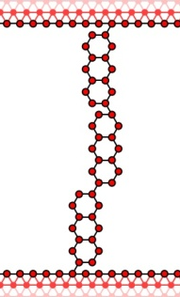
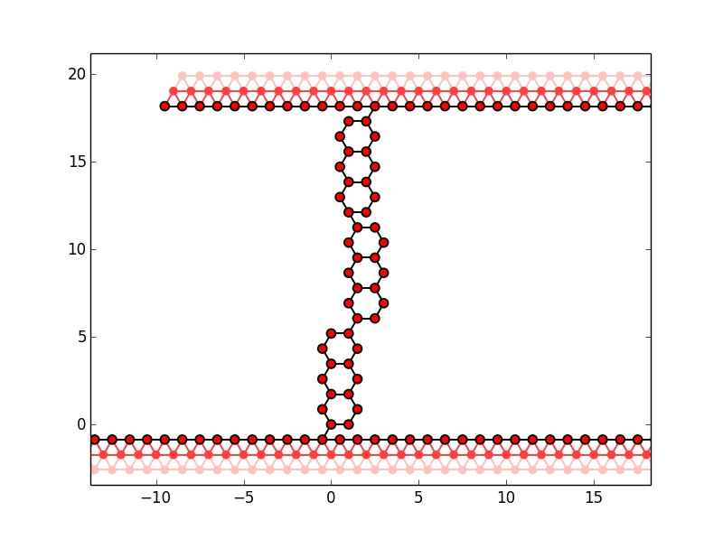
Simulations for anthracene
Molecular junctions
Quantum interferences
Simulations
Experimental results
Conclusions and perspectives
One meta connection in a chain is enough to make QI occur
para-para-para
para-para-meta
para-meta-para
no QI
QI
QI
para
meta
para
para
para
meta
para
para
para
C.W. Groth et al. a software package for quantum transport, arXiv: 1309.2926

Slide 11
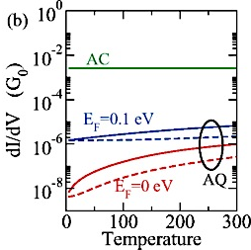
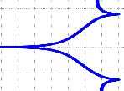
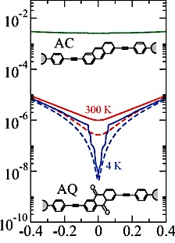
Recent theoretical predictions
Molecular junctions
Quantum interferences
Simulations
Experimental results
Conclusions and perspectives
Influence of the temperature on QI effects
No thermal activation
Dependence on the alignment of the transmission node and the Fermi level (blue and red lines)
el-ph interactions (solid lines)
LUMO
T(E)
E
ΔE_{F}
HOMO
Structures in the dI/dV curves
Steps visible a low T with el-ph interactions (solid blue line), not visible at RT (solid red line)
dI/dV (G₀)
T. Markussen et al. Phys.Rev.B, 89, 085420 (2014)
Bias voltage (V)

Slide 12

Fabrication of the junctions
Molecular junctions
Quantum interferences
Simulations
Experimental results
Conclusions and perspectives
Bottom electrode
UV light
Au
resist
Ti
SiO2
Si
Optical mask
Optical lithography
Development
Metallic deposition
Lift off
Postive resist with a positive mask
To carve the design of the electrode
Au ~ 50nm
Ti ~ 2-3nm
Aceton bath
Top electrode
electrografting
Metallic deposition
+ lift off
Development
Optical lithography

Slide 13
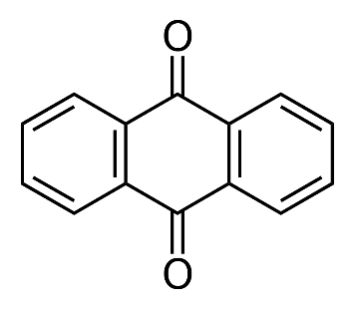
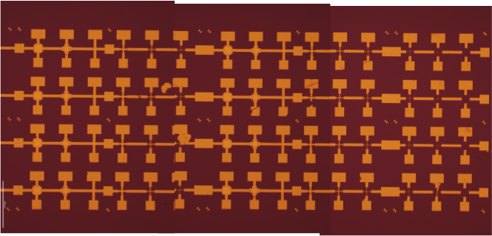
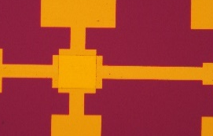
Fabrication of the junctions
Molecular junctions
Quantum interferences
Simulations
Experimental results
Conclusions and perspectives
Formation of organic film by reduction of diazonium salt
AQ
precursor
AQ
diazonium salt
ACN
NBu₄BF₄
+e⁻
Au
NH₂
N₂⁺
9,10-dioxo-1-anthracenediazonium (AQD)
P. Martin, J.-C. Lacroix, ITODYS lab, Paris Diderot University
Final solid state planar junctions (cross bar geometry)
Au
Molecular layer
junction
Au
Profile view (schematic)
Crossed bar geometry junctions (optical image x 20)
Samples made with 24 junctions of 20x20μm²

Slide 14
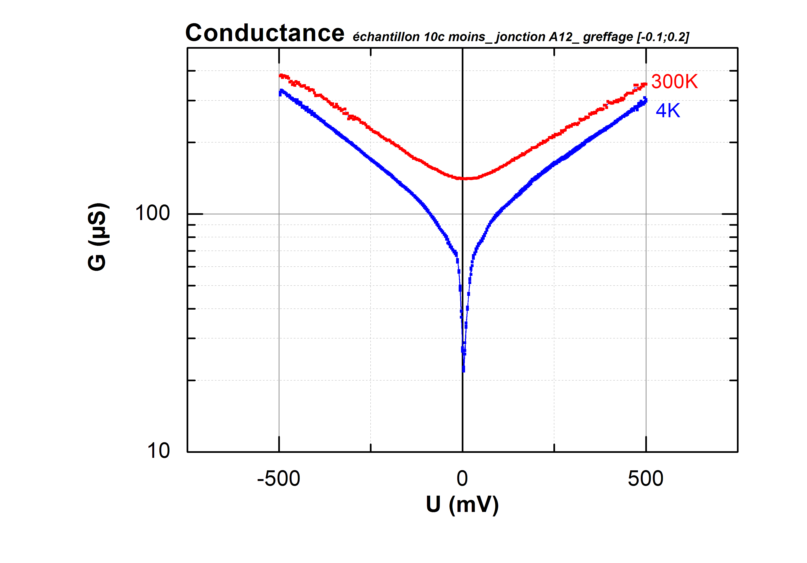
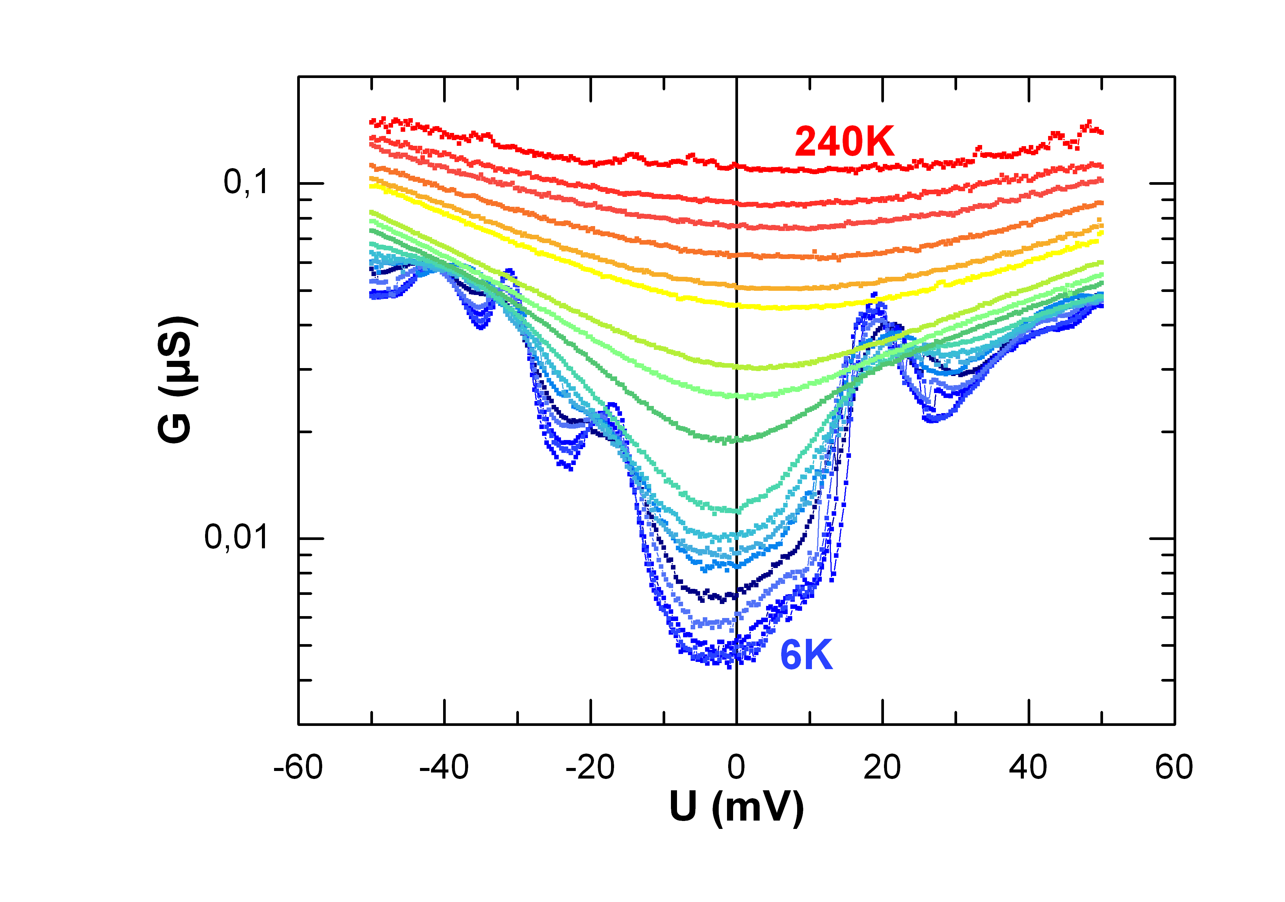
Conductance measurements
Molecular junctions
Quantum interferences
Simulations
Experimental results
Conclusions and perspectives
Au/ AQ /Au junctions
G (V) vs bias voltage
G (V = 0) vs bias voltage
Junction 1
20x20μm²
Junction 2
20x20μm²
Antiresonance dip at 4K, lower visibility at 300K
Temperature dependent structures at low T

Slide 15
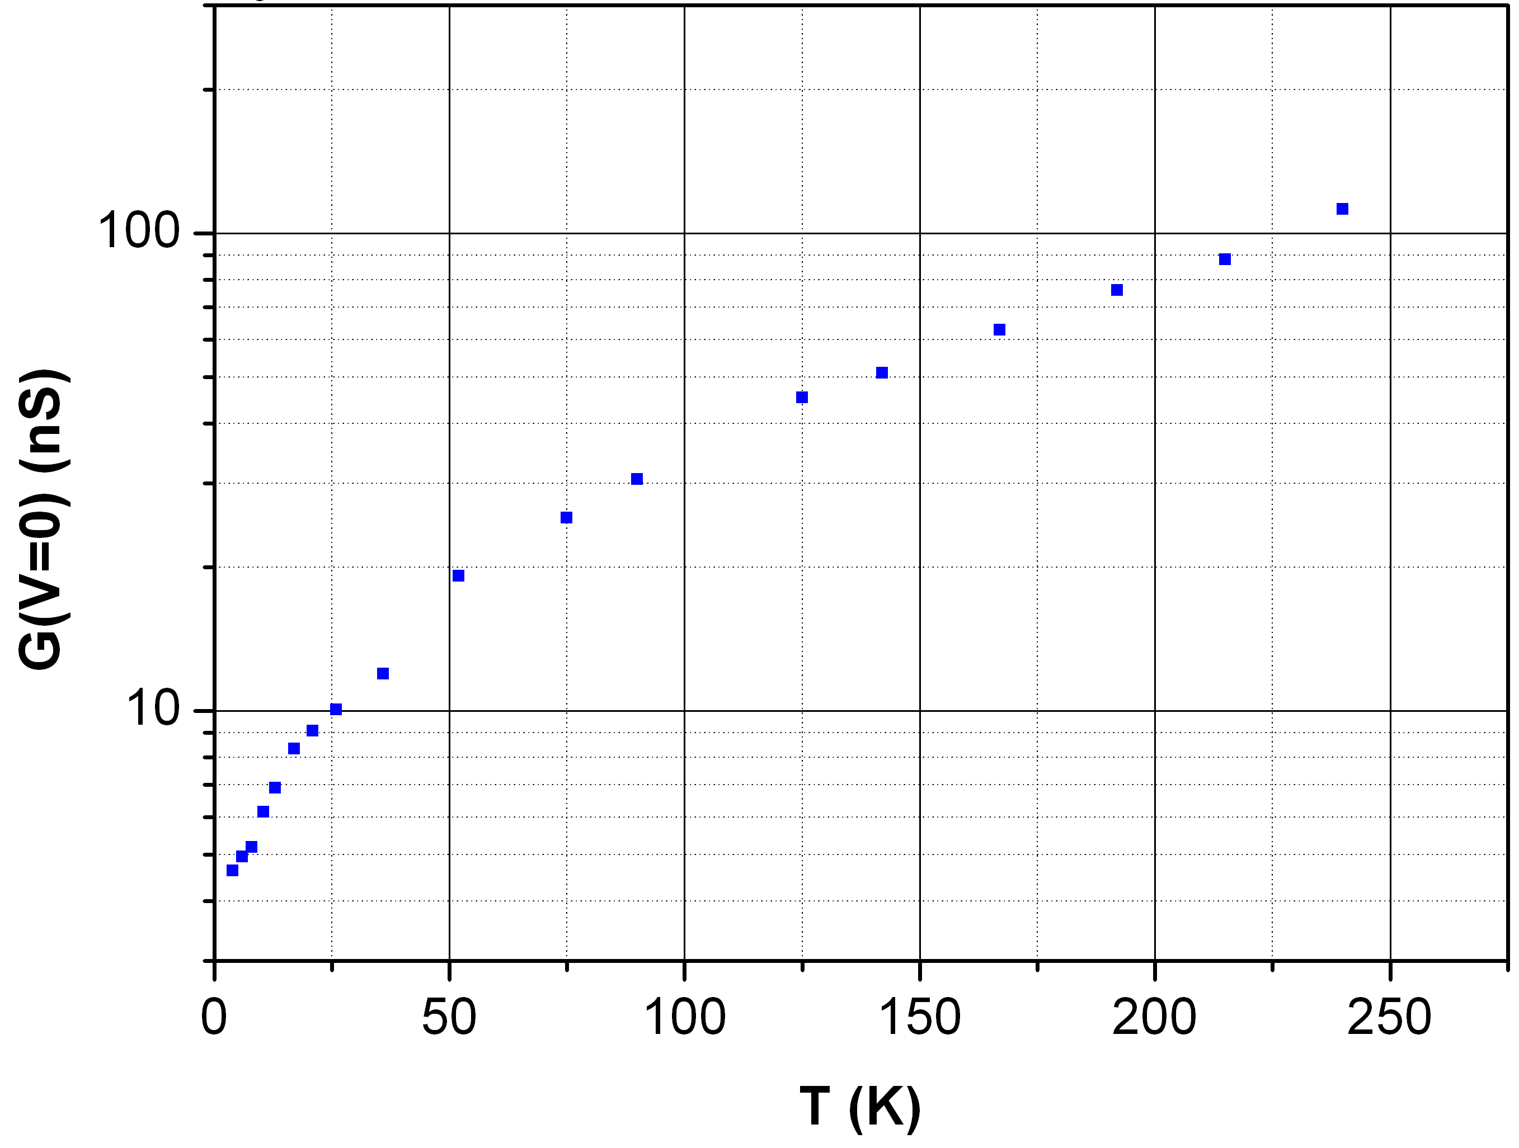
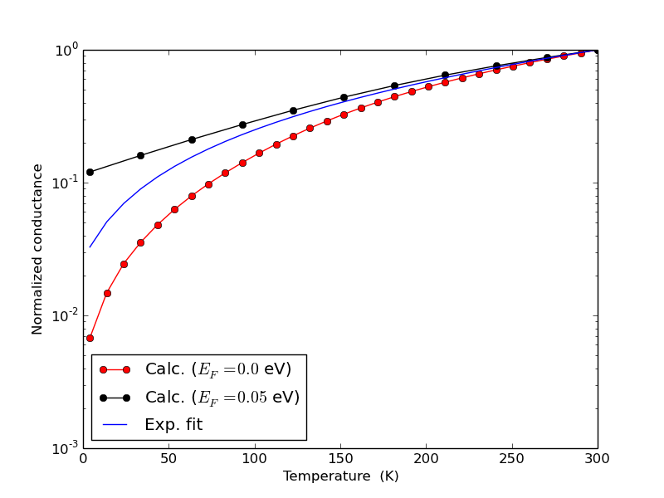
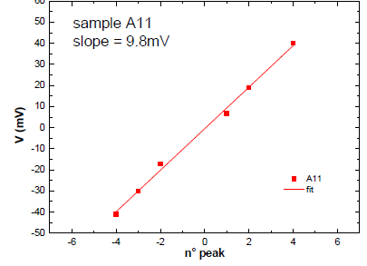
Conductance vs temperature
Molecular junctions
Quantum interferences
Simulations
Experimental results
Conclusions and perspectives
G (V= 0) vs temperature
Experimental fit !
T. Markussen, 2014 private communication
Energy of the structures vs the position
Experimental behaviour (blue line) similar to the one predicted for single molecule junctions with el-ph interactions (red line)
Decoherence by electron phonon coupling ?
V_{n} = 2(ε + nhν)

Slide 16
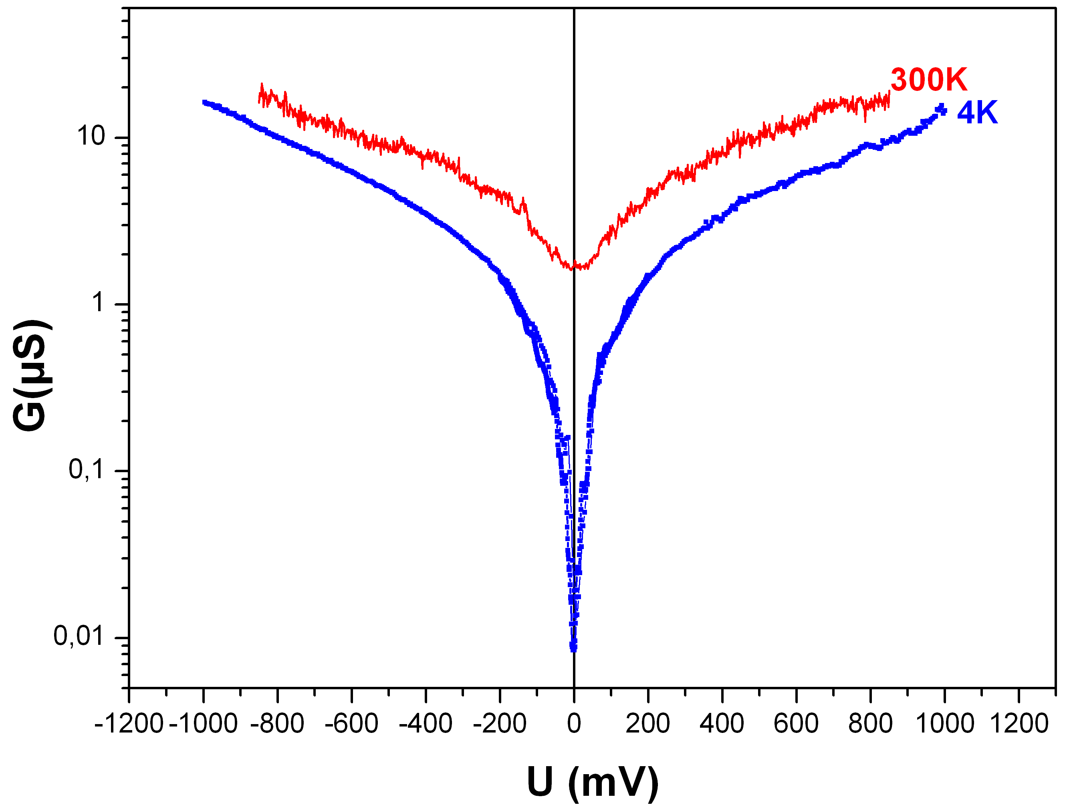
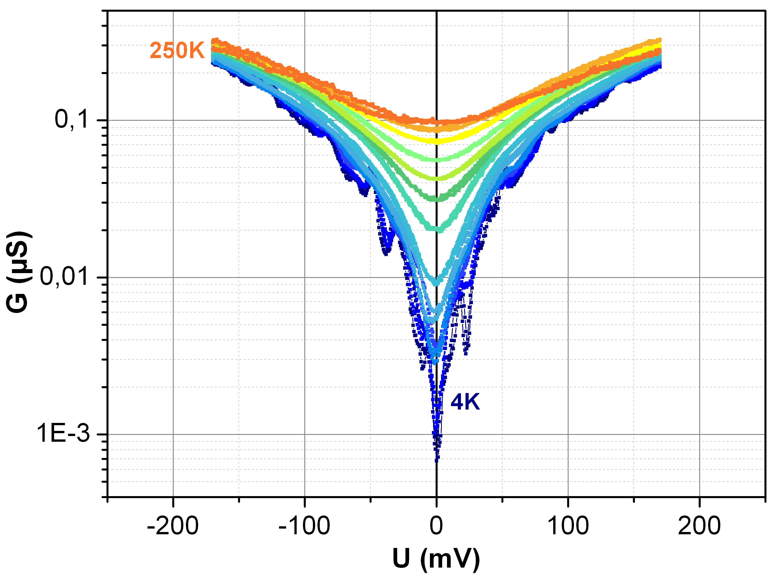
Anthracene based junctions
Molecular junctions
Quantum interferences
Simulations
Experimental results
Conclusions and perspectives
Au / AC /Au based junctions
G (V) vs bias voltage
G (V = 0) vs bias voltage
Junction 3
20x20μm²
Junction 4
20x20μm²
Antiresonance dip at 4K, lower visibility at 300K as for the AQ-based junctions
Temperature dependent structures at low T

Slide 17
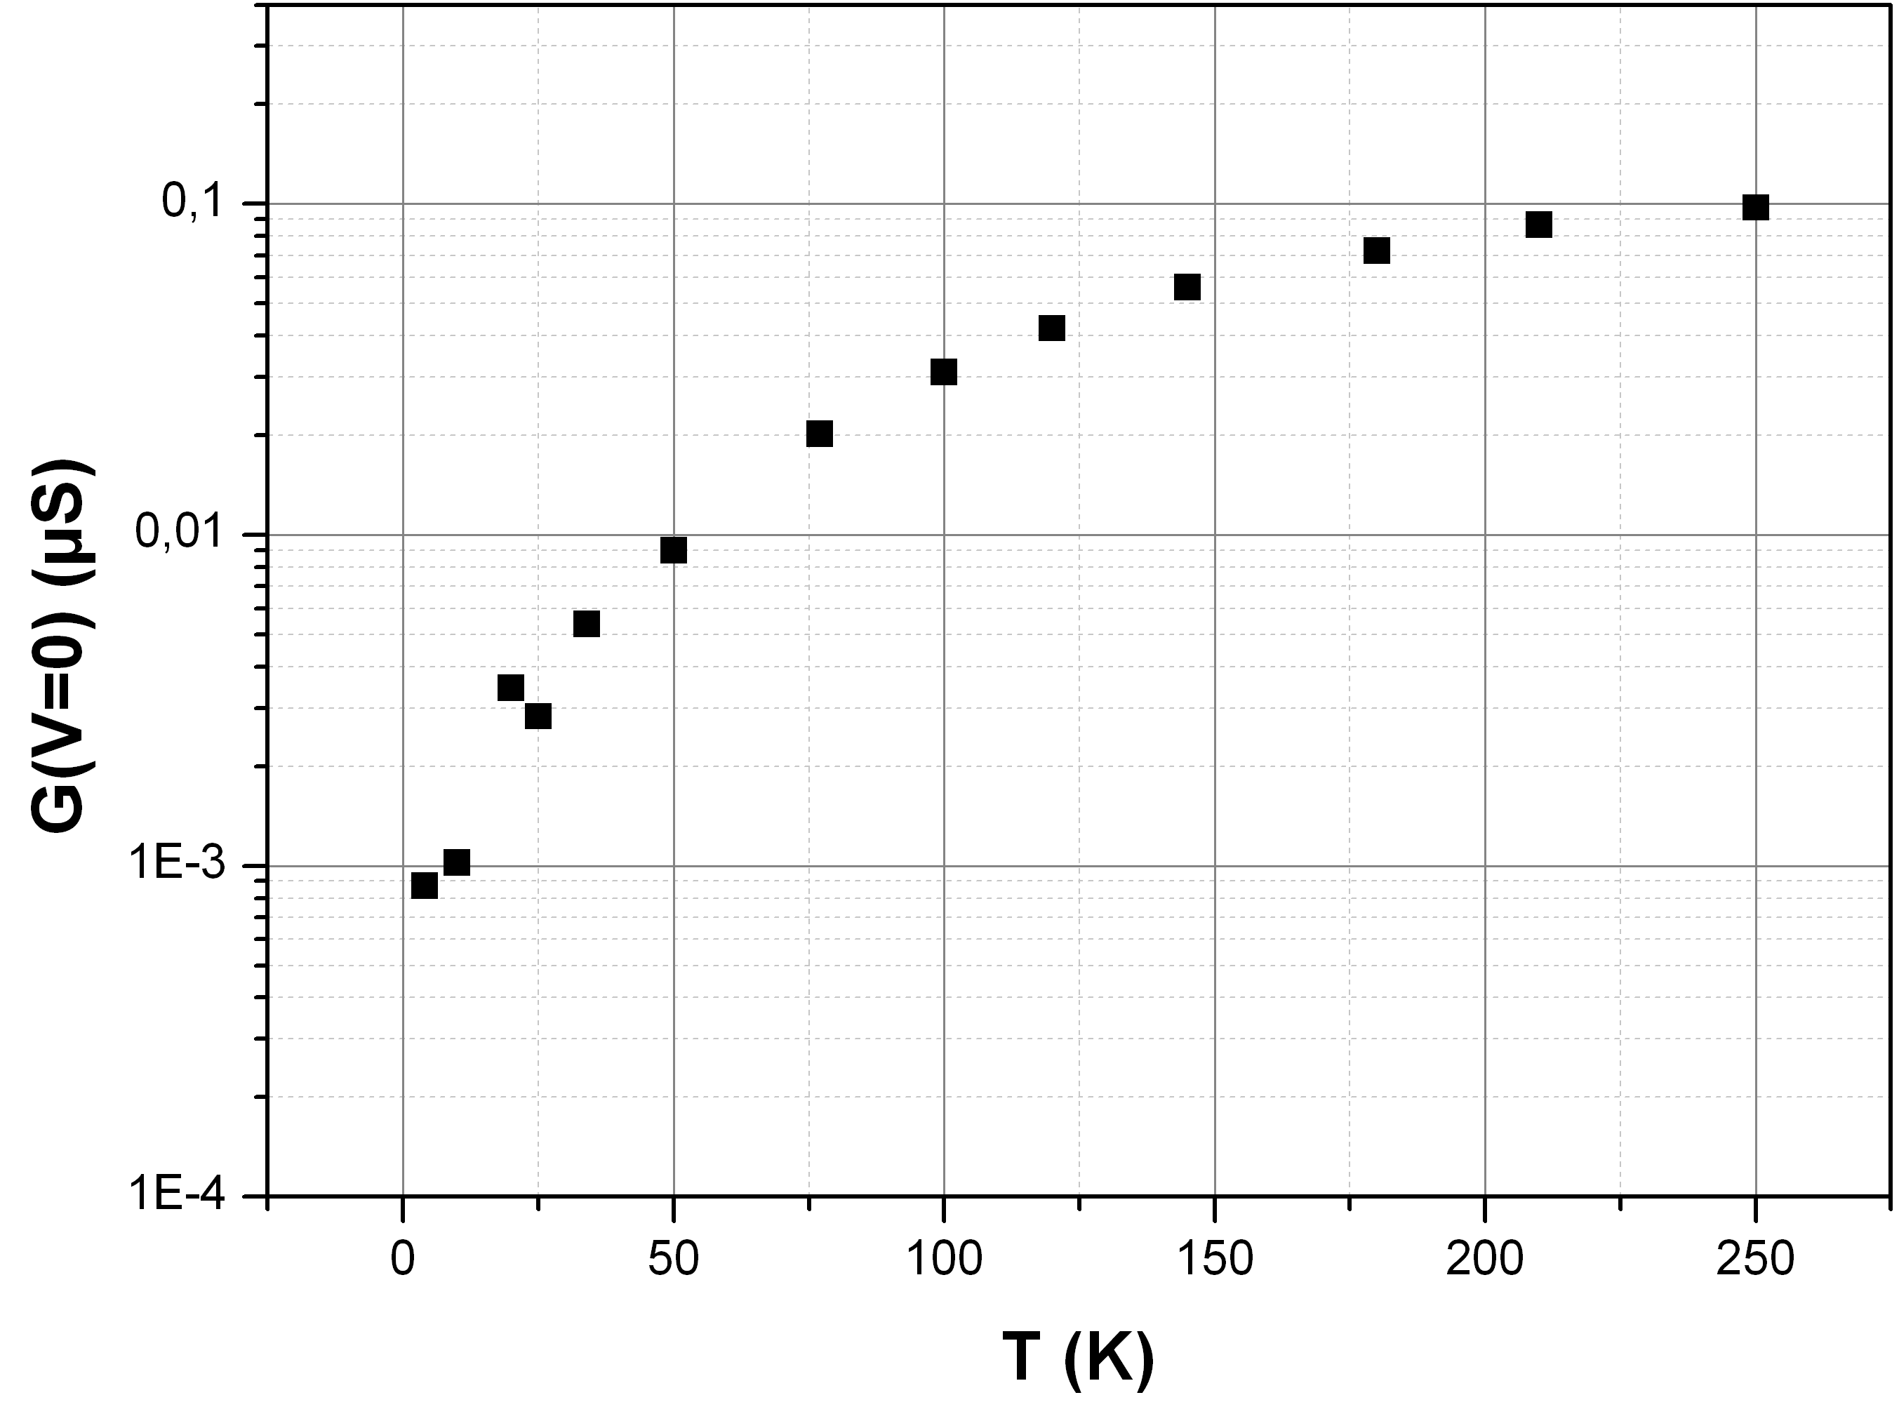
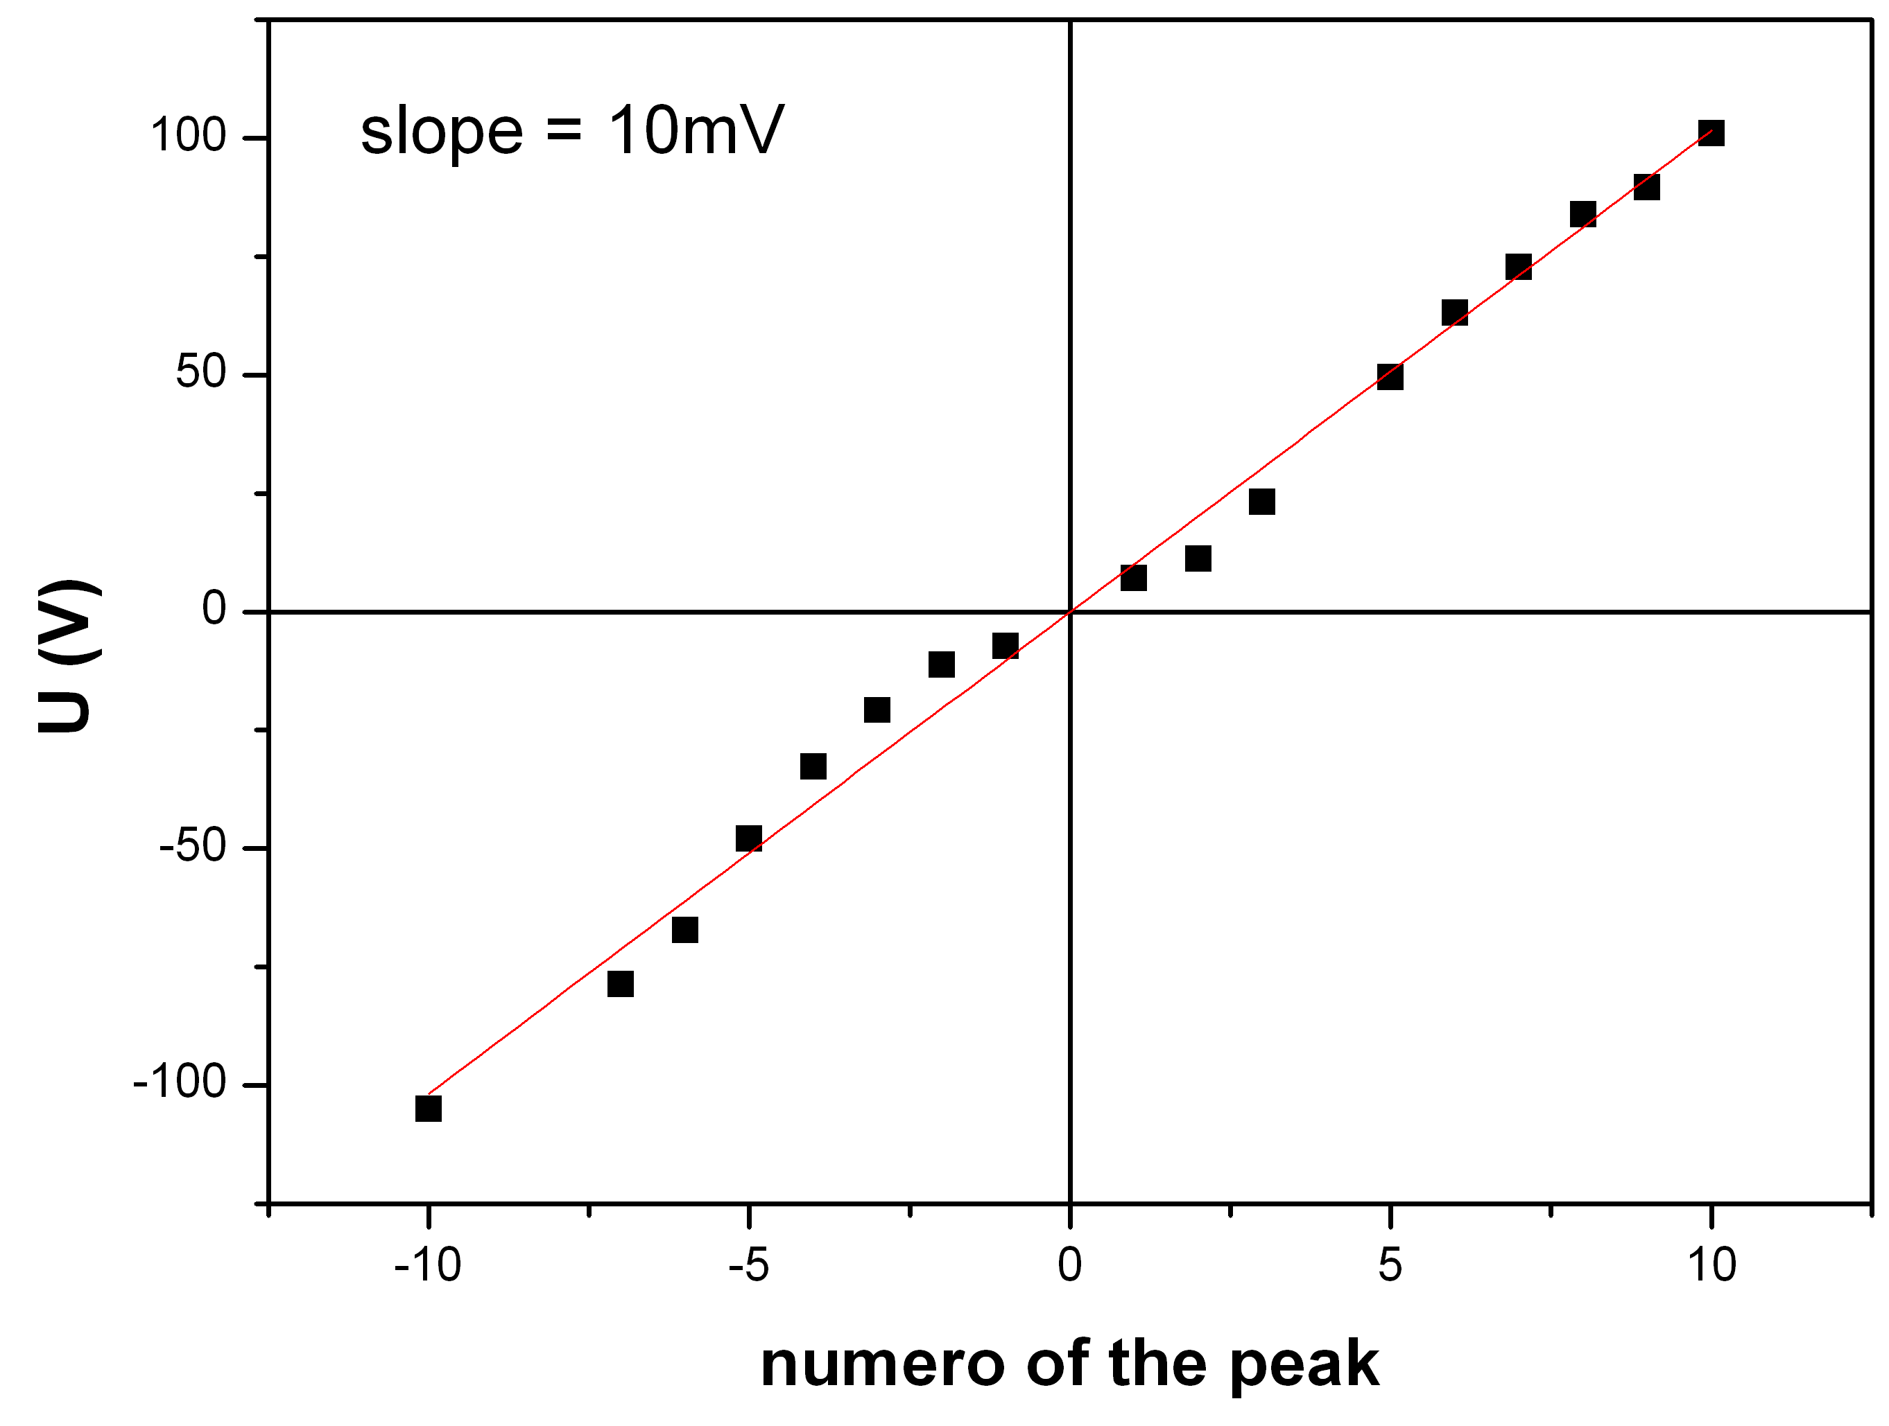
Temperature dependence
Molecular junctions
Quantum interferences
Simulations
Experimental results
Conclusions and perspectives
G (V= 0) vs temperature
Energy of the structures vs the position
U (mV)
V_{n} = 2(ε + nhν)
n° peak
Experimental behaviour similar to the one predicted for single and AQ based junctions
Decoherence by electron phonon coupling ?
Same vibrational modes as for the AQ excited

Slide 18
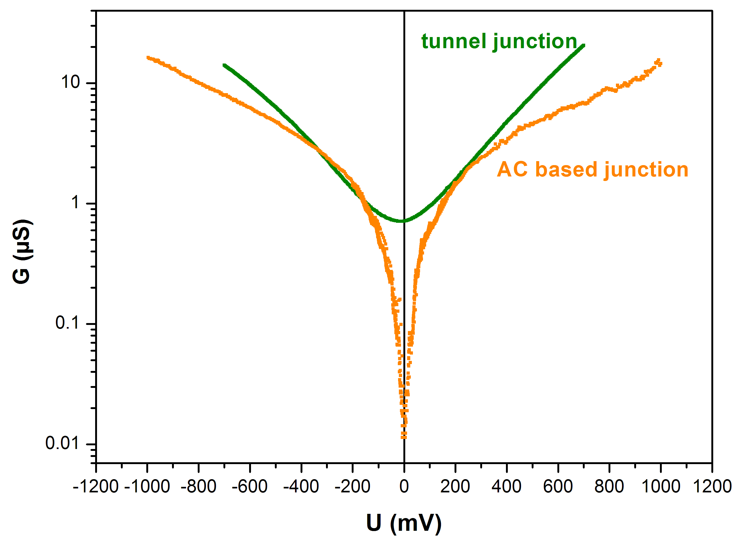
Molecular junction and tunneling
Molecular junctions
Quantum interferences
Simulations
Experimental results
Conclusions and perspectives
QI vs tunnel behaviour
Metallic tunnel junctions
Al / Al₂O₃ /Al
Al (50nm)
Al₂O₃ (~ nm)
Al (50nm)
Different shapes at low T
4K

Slide 19
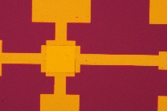
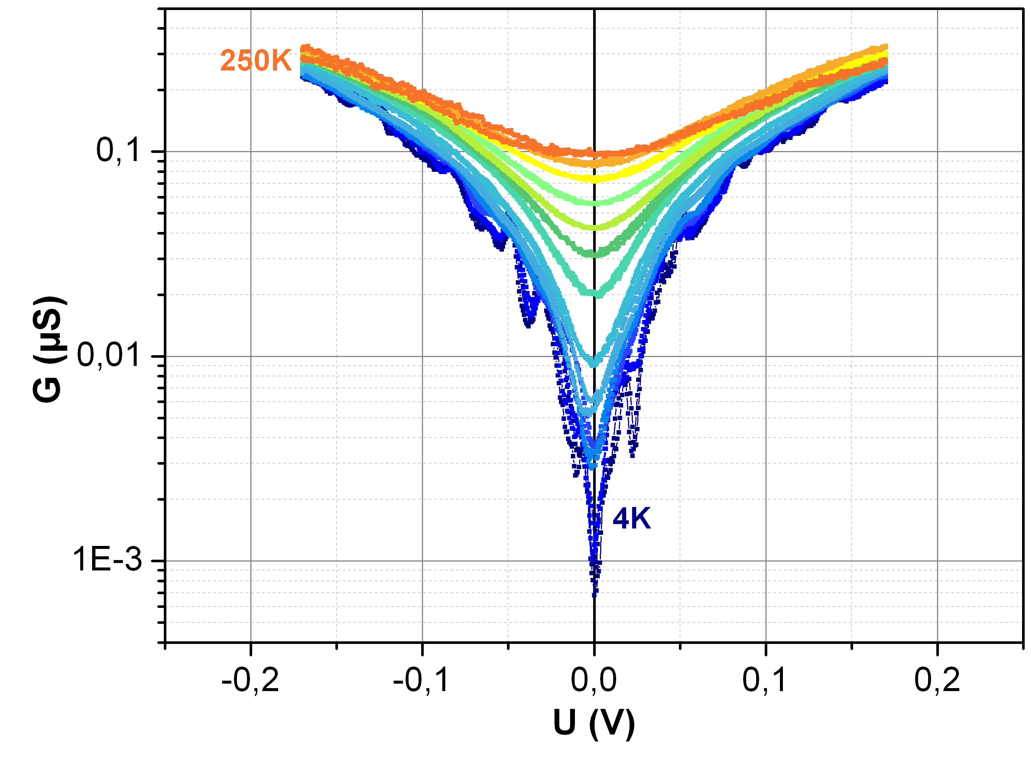
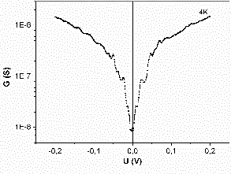
Conclusions and perspectives
Molecular junctions
Quantum interferences
Simulations
Experimental results
Conclusions and perspectives
Large area solid state molecules based junctions (with AQ, AC, oxides…)
Direct measurement of large antiresonance dip in dI/dV curves with a strong temperature dependence.
Additional structures at low T that could be the signatures of vibrational modes of the organic layer.
Giant thermoelectric effect predicted in molecular junctions where QI occur…
J.P. Bergfield and C.A. Stafford, NanoLett. 9, 3072 (2009)
J.P. Bergfield, M.A. Solis and C.A. Stafford, ACS Nano 4, 5314 (2010)
μ-μ_{node}(eV)

Slide 20
Thank you
MPQ Lab, Paris Diderot University
Maria Luisa Della Rocca, Clément Barraud, Charlotte Bessis, Julien Chaste, Philippe Petit
ITODYS, Paris Diderot University
Pascal Martin, Jean-Christophe Lacroix
University of Alberta
Richard L. McCreery
Copenhagen, Quantum Wise
Troels Markussen

Slide 21
Let Us Meet Again
We welcome all to our future group conferences of Omics group international
Please visit:
www.omicsgroup.com
www.Conferenceseries.com
http://optics.conferenceseries.com/

