Slide 1

2015 OPTICS Conference
Valencia, September 2015
Influence of the InAs/GaSb superlattice period composition on the electro-optical performances of T2SL infrared photodiode
P. Christol, M. Delmas, R. Rossignol, J.B. Rodriguez
Institut d'Electronique et des Systèmes (IES)
UMR-CNRS, Université de Montpellier, FRANCE.
Université de Montpellier
Work supported by the French DGA

Slide 2
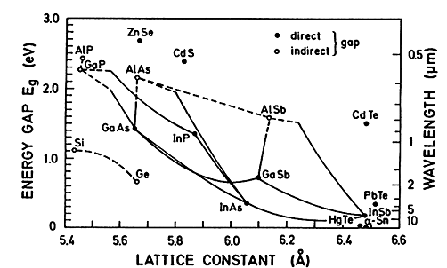
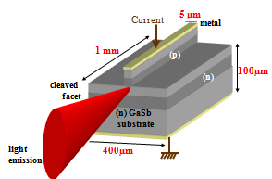
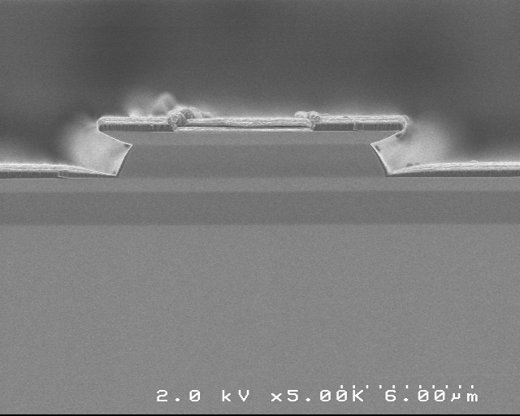
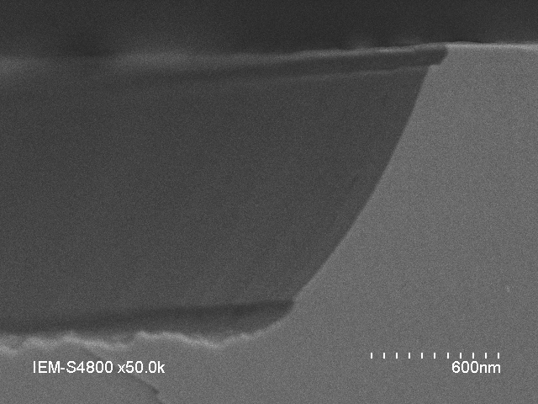
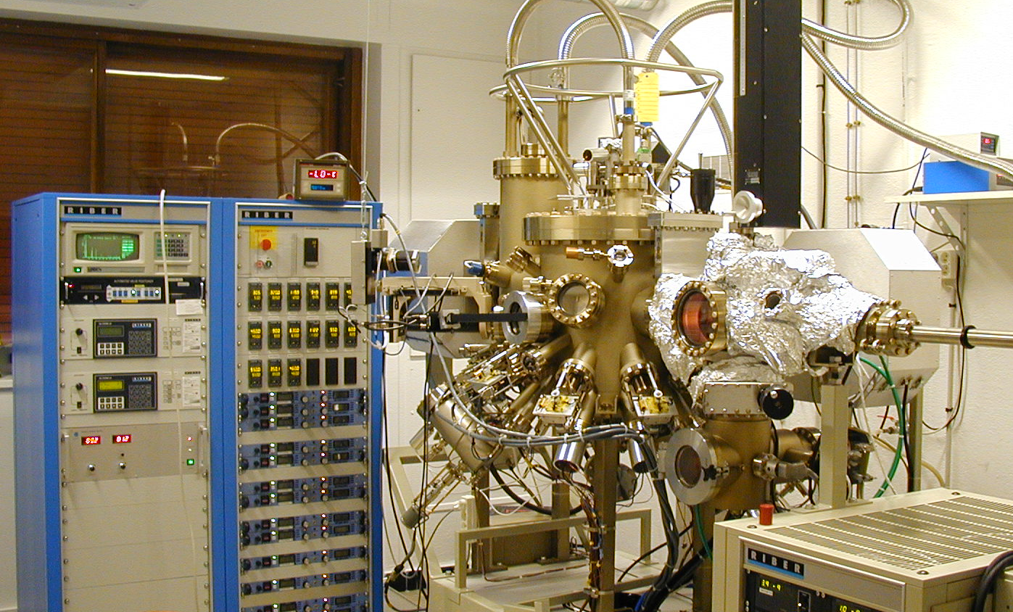
Photonic research group of IES
University of Montpellier (France)
Antimonide (Sb)-based materials
GaSb, InAs, AlSb, InSb, (Ga,In,Al,As,Sb)
MWIR Laser diodes MWIR detectors
hν
III-Sb (p)
active zone
nid (~3µm)
III-Sb (n)
GaSb or InSb substrate
30µm
Laser diode
Pixel pin Photodiode
a (Å)
metal
contact layer
oxyde
( p)
MBE machine
RIBER compact 21E
( n)
active
zone
GaSb Substrate
0.6µm
substrate
SEM image of IR Laser diode
SEM image of IR mesa photodiode
InAs/AlSb QCL
GaInAsSb EELs & VCSELs
InSb & InAsSb photodiodes
InAs/GaSb Superlattice (T2SL) photodiodes

Slide 3
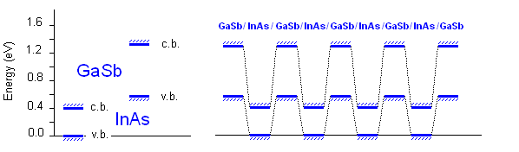
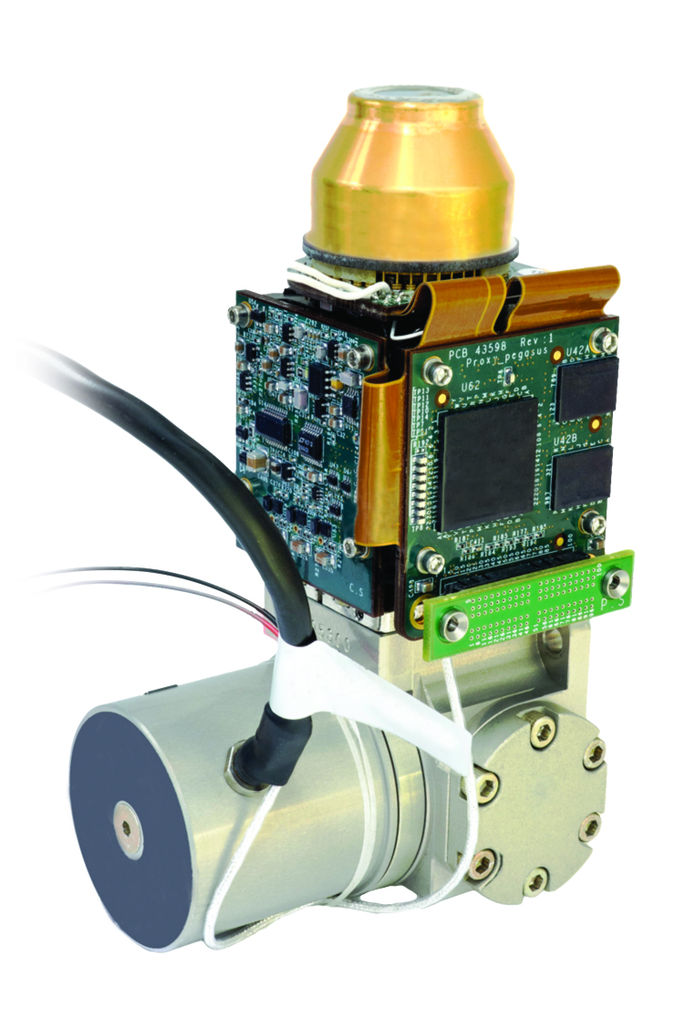
Type-II Superlattice (T2SL) photodiode
*
InAs/GaSb heterostructure :
Type-III or type-II broken gap
band alignment
(InAs CB lower than GaSb VB)
GaSb
Electron minband
*
absorption
InAs
Hole minbands
d
InAs/GaSb type-II superlattice (SL)
SL = a periodic stacking of InAs and GaSb layers with a period d of a few nm thick
SL = coupled MQW ➔ energy minibands ➔ Fundamental absorption between V1C1
suitable for Infrared detection (3-30µm)
hν
I_{ph}
SL : active zone of a pin junction
➔ T2SL Photodiode to compete
InSb and MCT high performance IR detectors
InAs (n)
A
InAs/GaSb
SL
GaSb (p)
T2SL FPA commercially available (2015) :
IRNOVA, SCD, IRcamera
BUT works have to be done
to improve performances…
Buffer GaSb (p)

Slide 4
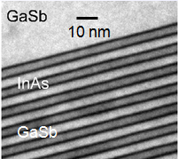
Outline
Our motivation : study the influence of SL period composition (flexibility) on the performances of MWIR T2SL photodetector
InAs (n)
SL period
composition
InAs/GaSb
SL
GaSb (p)
GaSb (p) substrate
Pixel pin Photodiode
Influence of SL period composition
on material-rich structure
on dimensionality
on residual type of doping
on electrical & electro-optical
performances

Slide 5
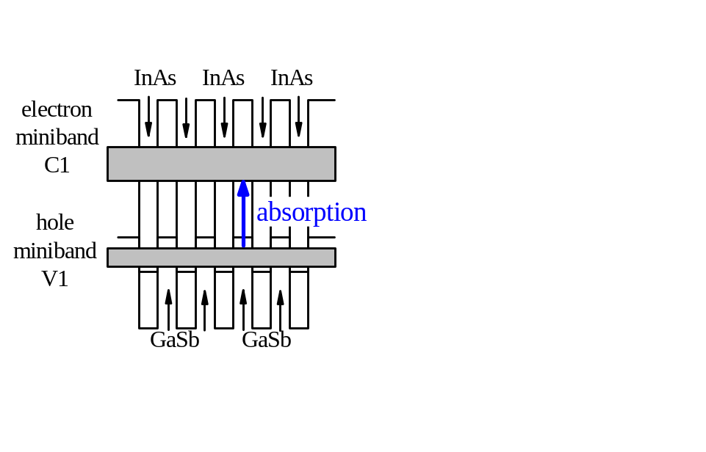
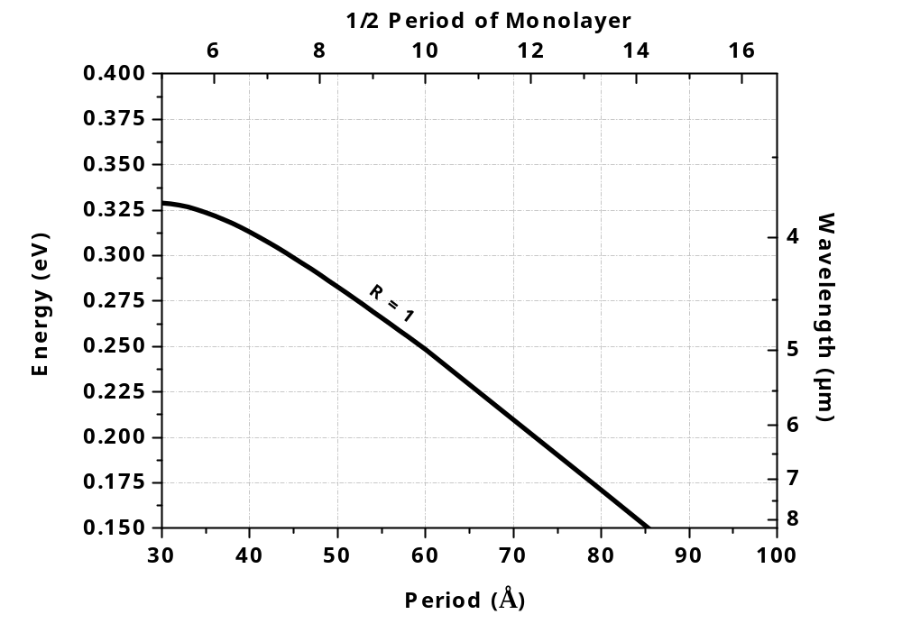
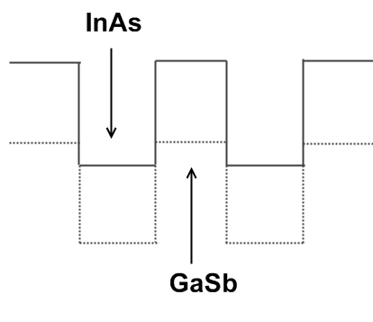
Choice of SL period for MWIR domain
P
BC
BV
InAs(ML)
R=
GaSb(ML)
Symmetrical
period
Fundamental C1V1 energy
T=77K
(3Å=1ML)
5

Slide 6
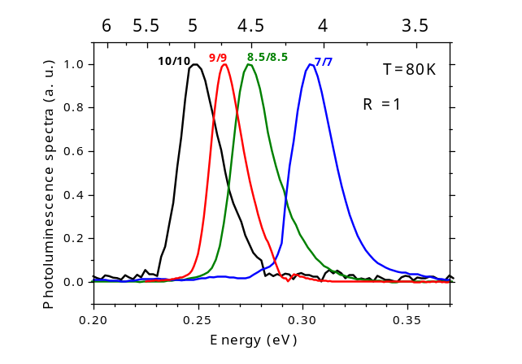
Choice of SL period for MWIR domain
☞ MWIR spectral domain addressed by the same SL thickness ratio R
P
BC
BV
InAs(ML)
R=
GaSb(ML)
Symmetrical
period
Fundamental C1V1 energy
7/7
T=77K
10/10
(3Å=1ML)
Photoluminescence spectra
6

Slide 7

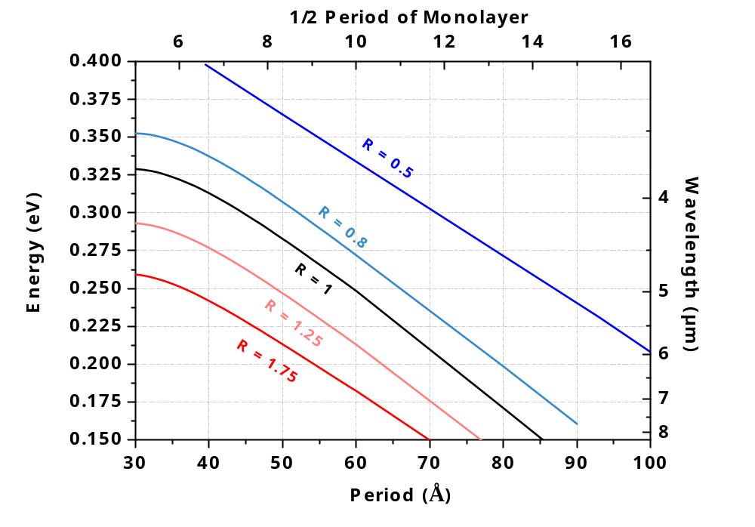
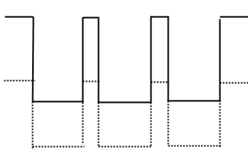
Choice of SL period for MWIR domain
P
BC
InAs
T=77K
BV
InAs(ML)
R=
GaSb(ML)
GaSb
GaSb-rich
Asymmetrical
period
Fundamental C1V1 energy
T=77K
InAs-rich
7

Slide 8
Choice of SL period for MWIR domain
☞ Same bandgap energy addressed by different SL thickness ratio R
P
BC
InAs
T=77K
BV
InAs(ML)
R=
GaSb(ML)
GaSb
GaSb-rich
Asymmetrical
period
Fundamental C1V1 energy
T=77K
InAs-rich
For a given band gap ➔ different material-rich structures
8

Slide 9
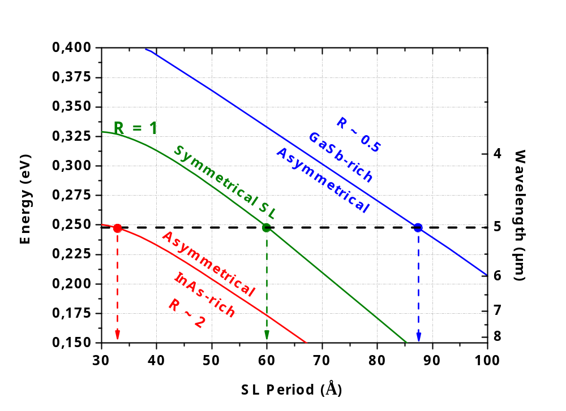
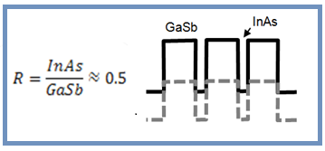
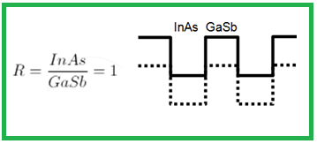
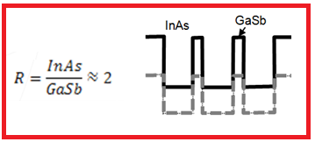
Choice of SL period for MWIR domain
☞ Same bandgap energy addressed by different SL thickness ratio R
InAs(ML)
R=
10/19 SL
GaSb(ML)
10/10 SL
7/4 SL
7/4
InAs/GaSb SL
10/10
InAs/GaSb SL
10/19
InAs/GaSb SL
➔ for cut-off wavelength around 5µm (@77K)

Slide 10
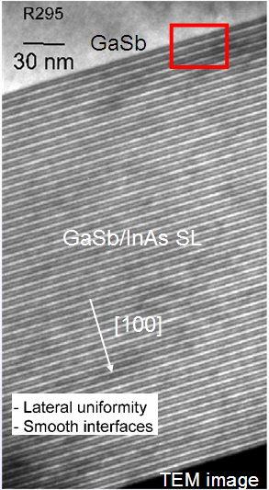
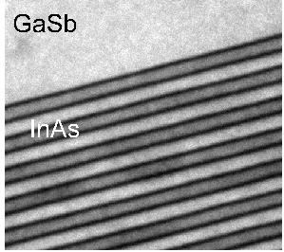
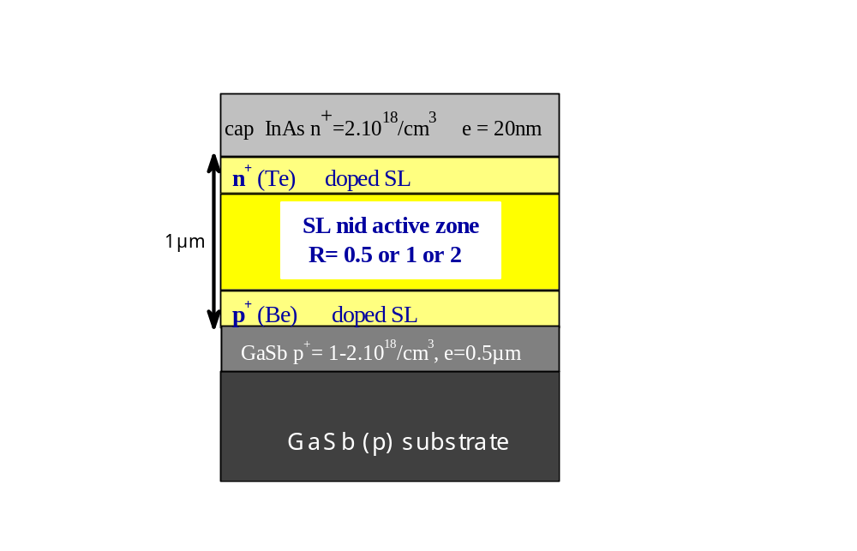
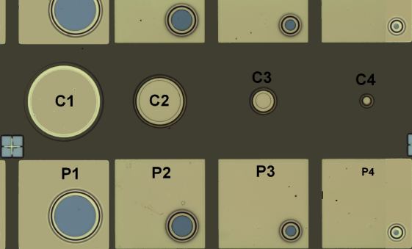
Choice of SL period for MWIR domain
☞ Same bandgap energy addressed by different SL thickness ratio R
SL pin photodiodes have been fabricated by MBE
with active zone thickness of 1µm
10/19 SL
10 nm
GaSb
10/10 SL
MBE growth control of InAs/GaSb superlattice on GaSb substrate
7/4 SL
Mesa diodes & photodiodes

Slide 11
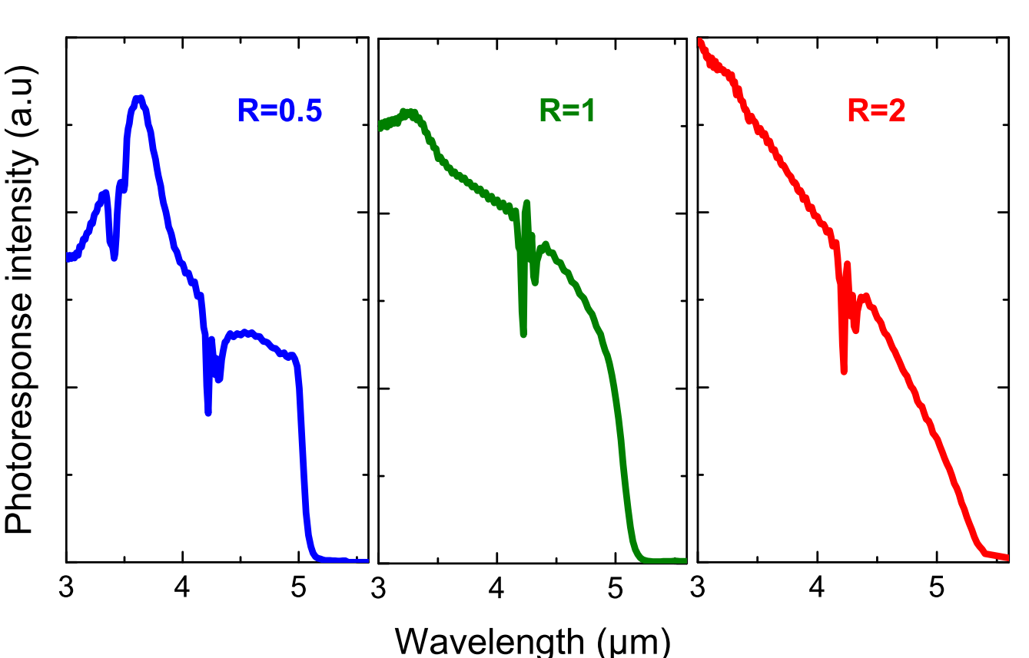
Photoresponse spectra
GaSb-rich
Symmetric
InAs-rich
☞ Influence of SL period composition on PR spectra
Same cut-off (5µm @ 77K) but photoresponse spectra strongly different !

Slide 12
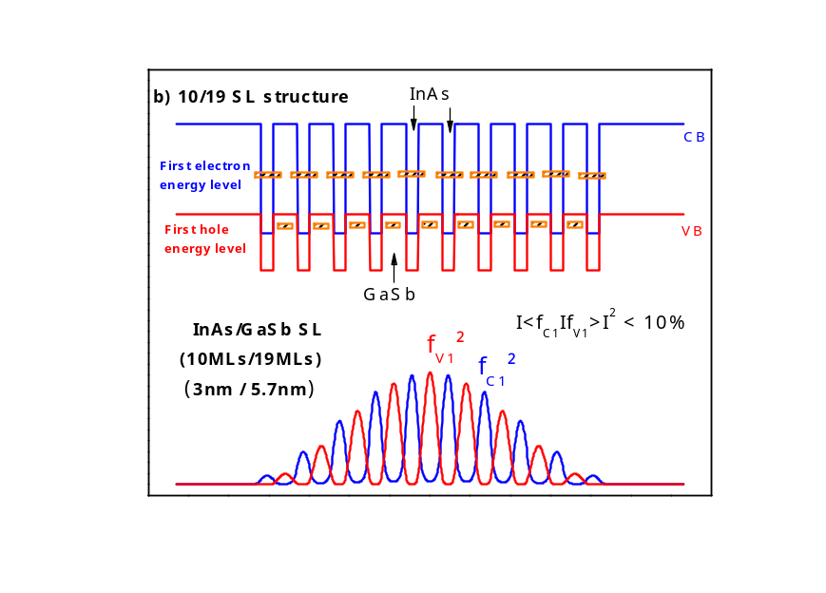
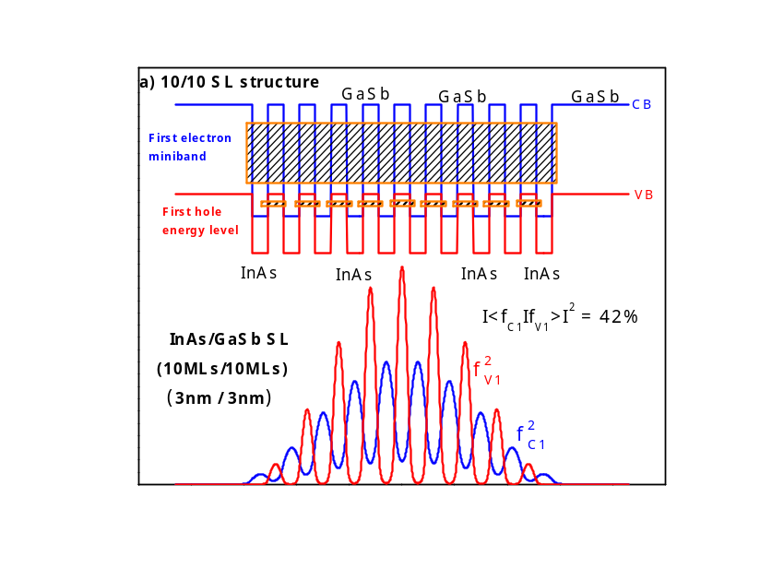
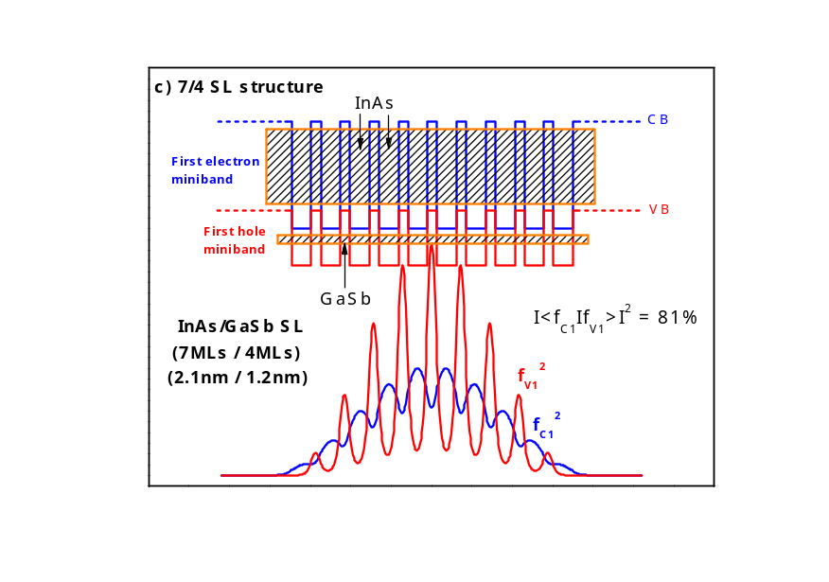
Photoresponse spectra
GaSb-rich
Symmetric
InAs-rich
Same cut-off but MQW versus SL behavior
GaSb-rich
MQW behavior
Symmetric
InAs-rich
SL behavior

Slide 13
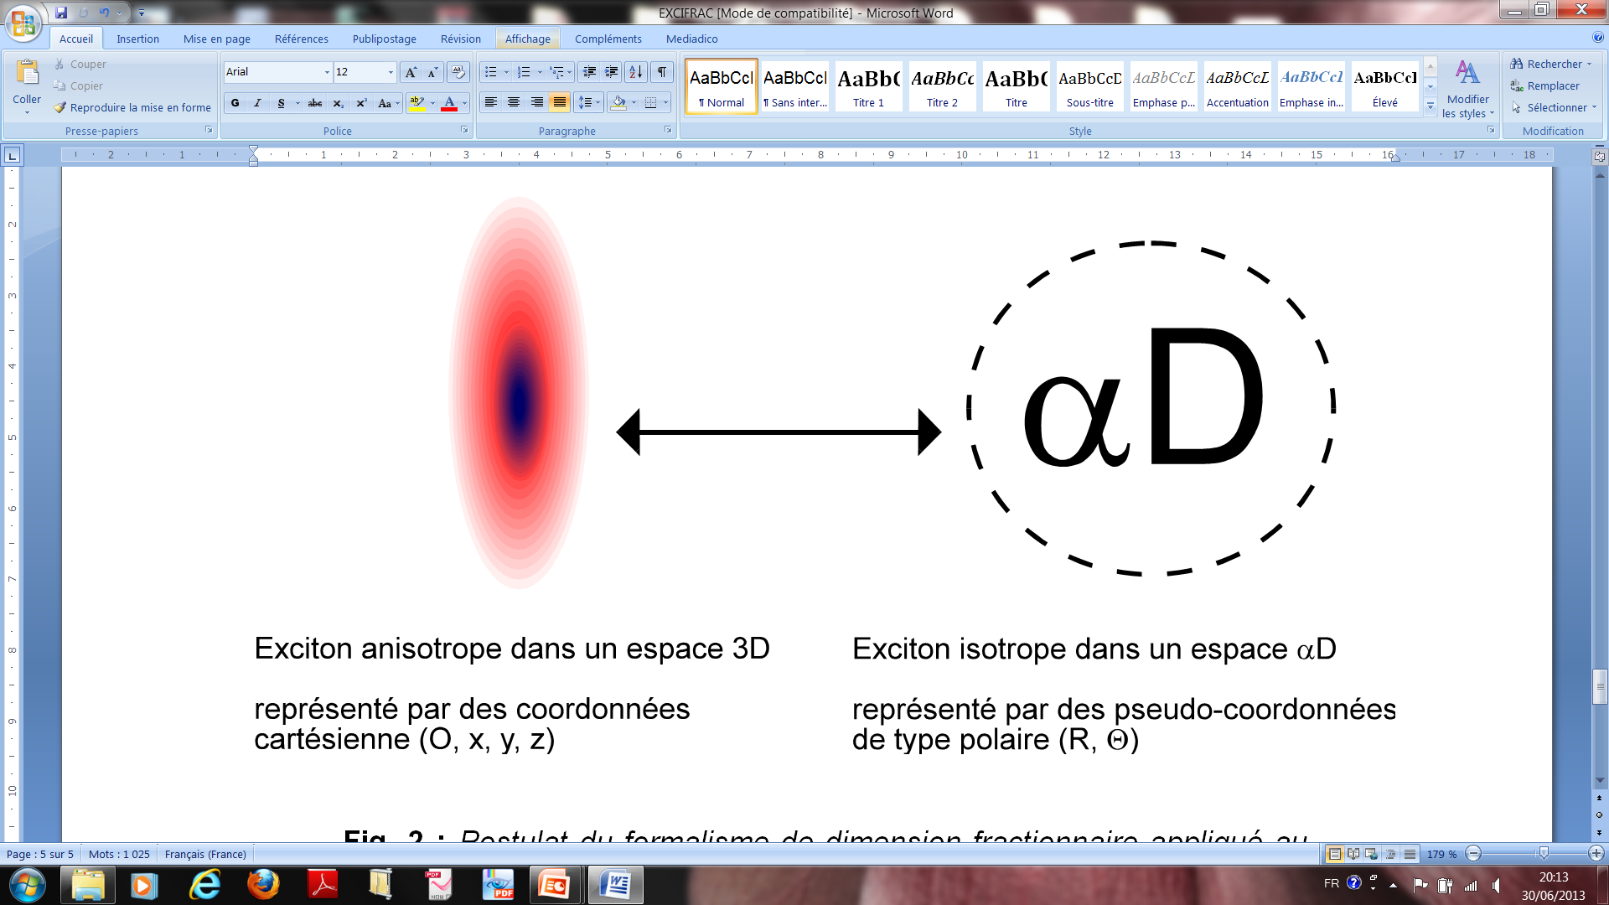
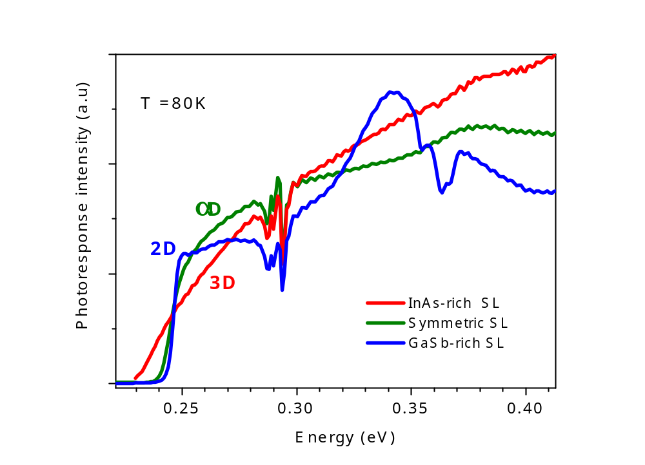
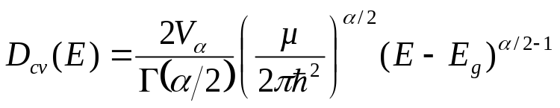
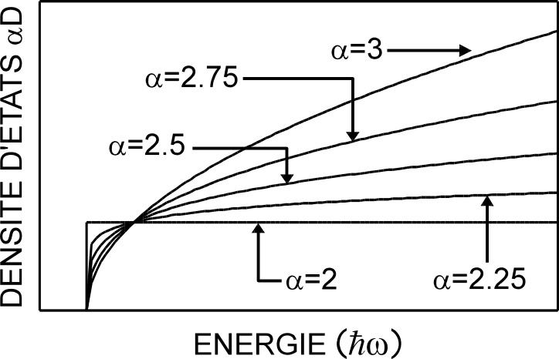
Photoresponse spectra
- Photoresponse spectrum is proportional to the excitonic absorption
In the framework of
fractional dimensional space
- Spectral absorption shape is relative to the joined density of states
Anisotropic situation
in 3D space
Isotropic situation
in a αD space
Joined density of states
Density of states αD
☞ Influence on dimensionality
Energy (ω)

Slide 14
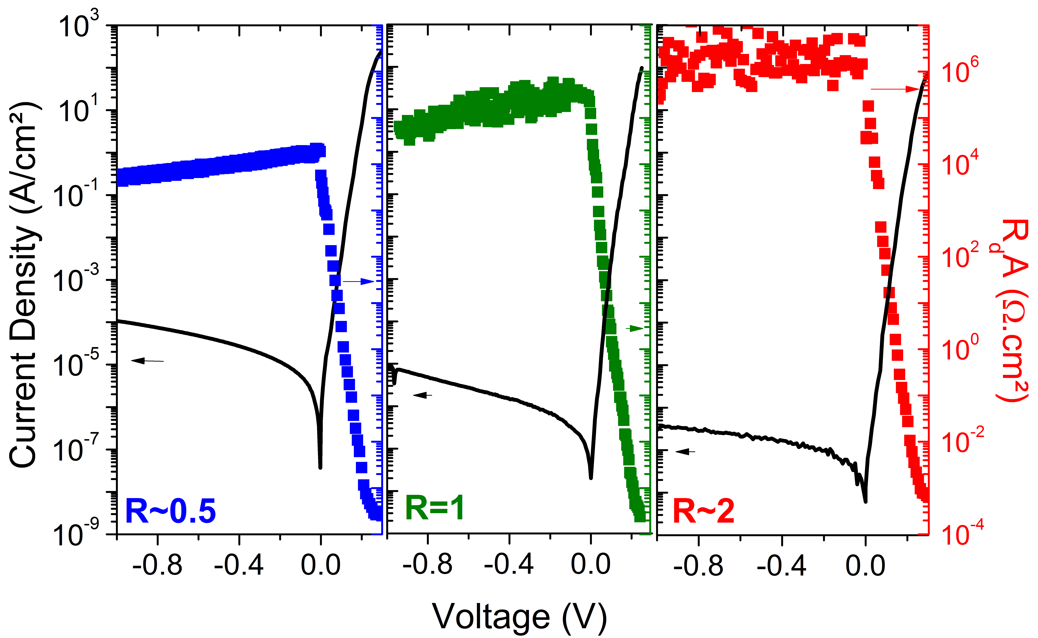
Electrical measurements
J(V) results
77 K
GaSb-rich
InAs-rich
J(-50mV)= 3µA/cm²
R₀A = 2x10⁴ Ω.cm²
J(-50mV)= 0.04µA/cm²
R₀A = 2x10⁶ Ω.cm²
J(-50mV)= 0.2µA/cm²
R₀A = 3x10⁵ Ω.cm²
10/19 SL
(~110 periods)
7/4 SL
(~300 periods)
10/10 SL
(~170 periods)
Same cut-off but electrical performances strongly different !

Slide 15
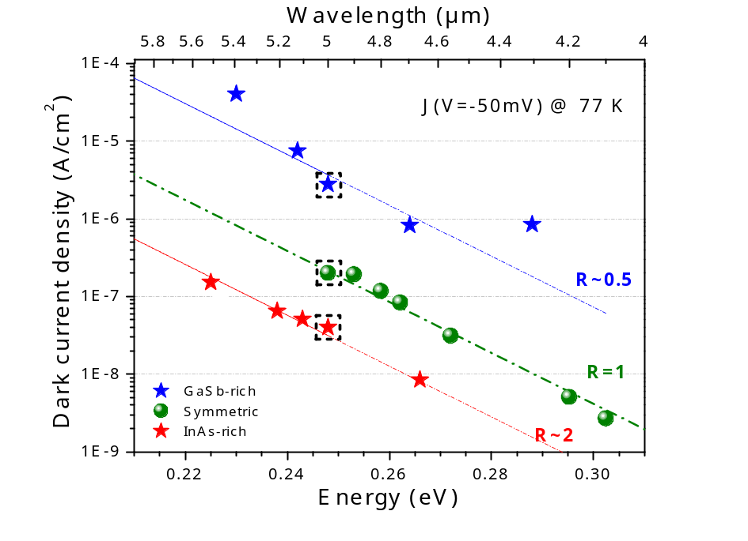

Electrical measurements
J(V) results
Different cut-off but same electrical behavior for each kind of structure
15

Slide 16
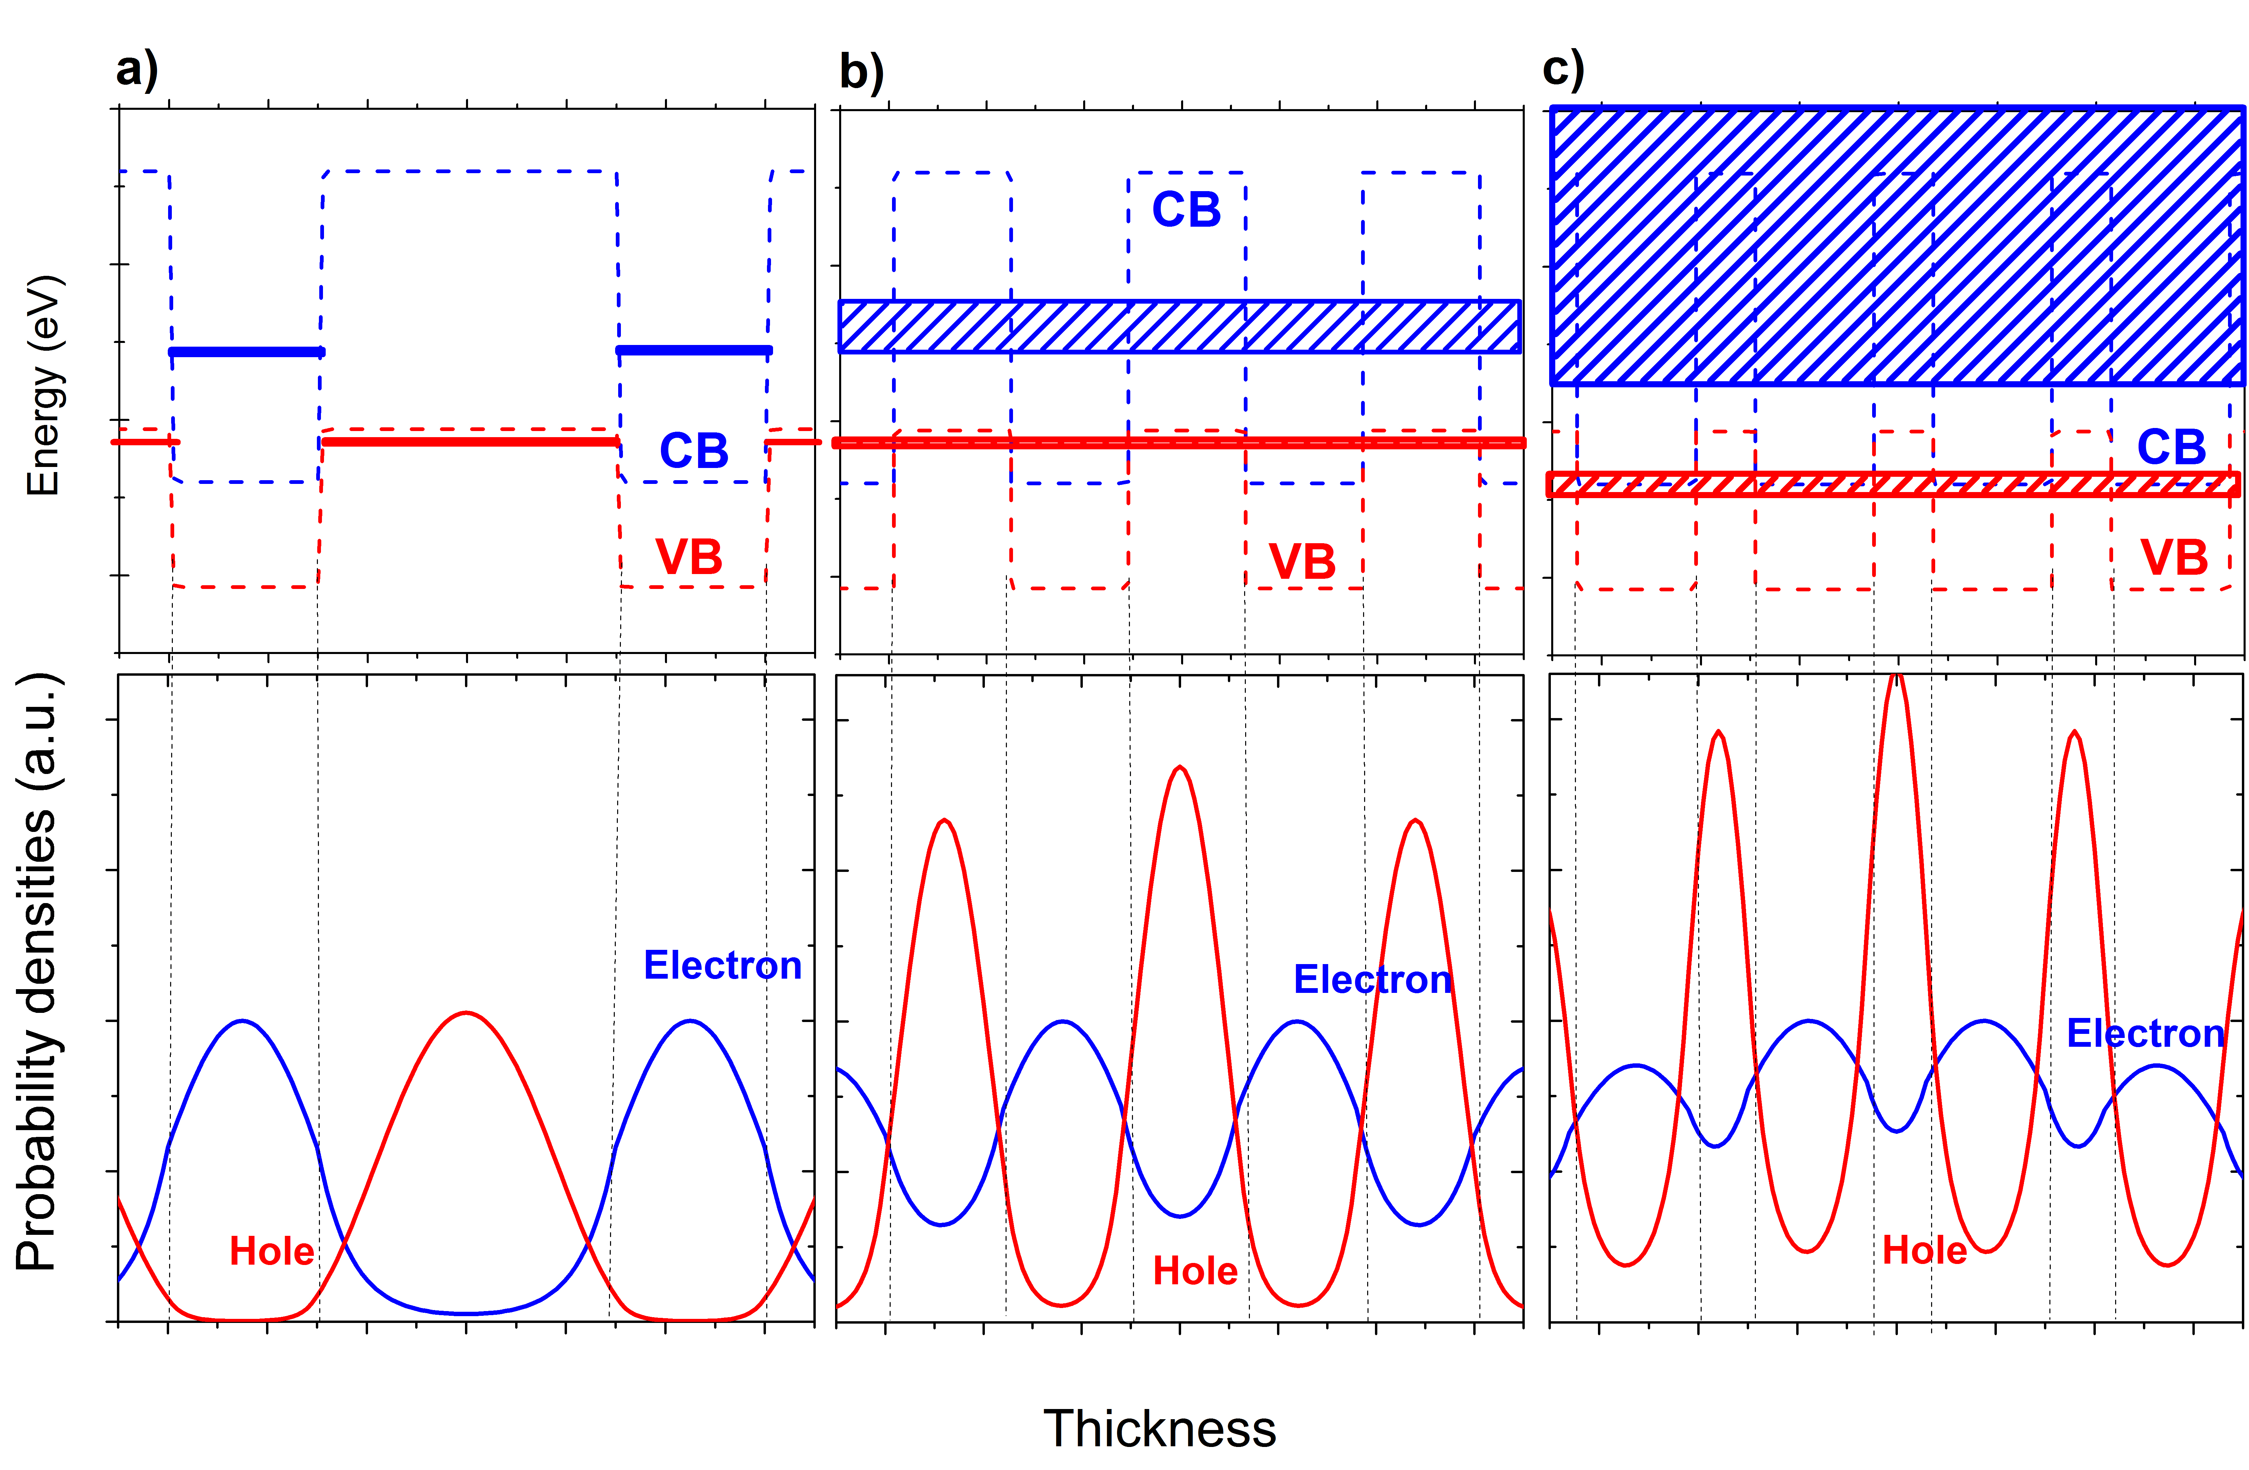
Electrical measurements
J(V) results
Intrinsic carrier concentration n_{i}
n_{i} = f (E_{g}, T, m*_{eff} )
R=0.5
« GaSb-rich »
R=1
Symmetric
R=2
« InAs-rich »
Different cut-off but same electrical behavior for each kind of structure
High coupling
⇒ small masses
⇒ n_{i} ↓
⇒ J_{GR} ↓
⇒ Low J_{dark} value of InAs-rich SL
16

Slide 17
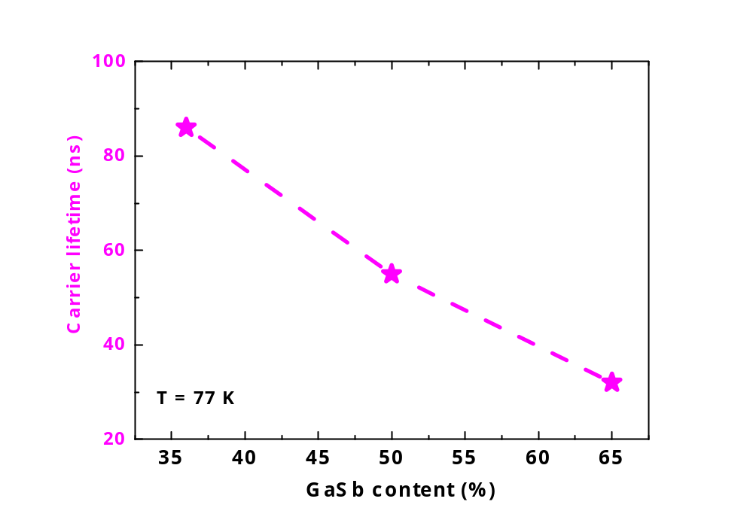
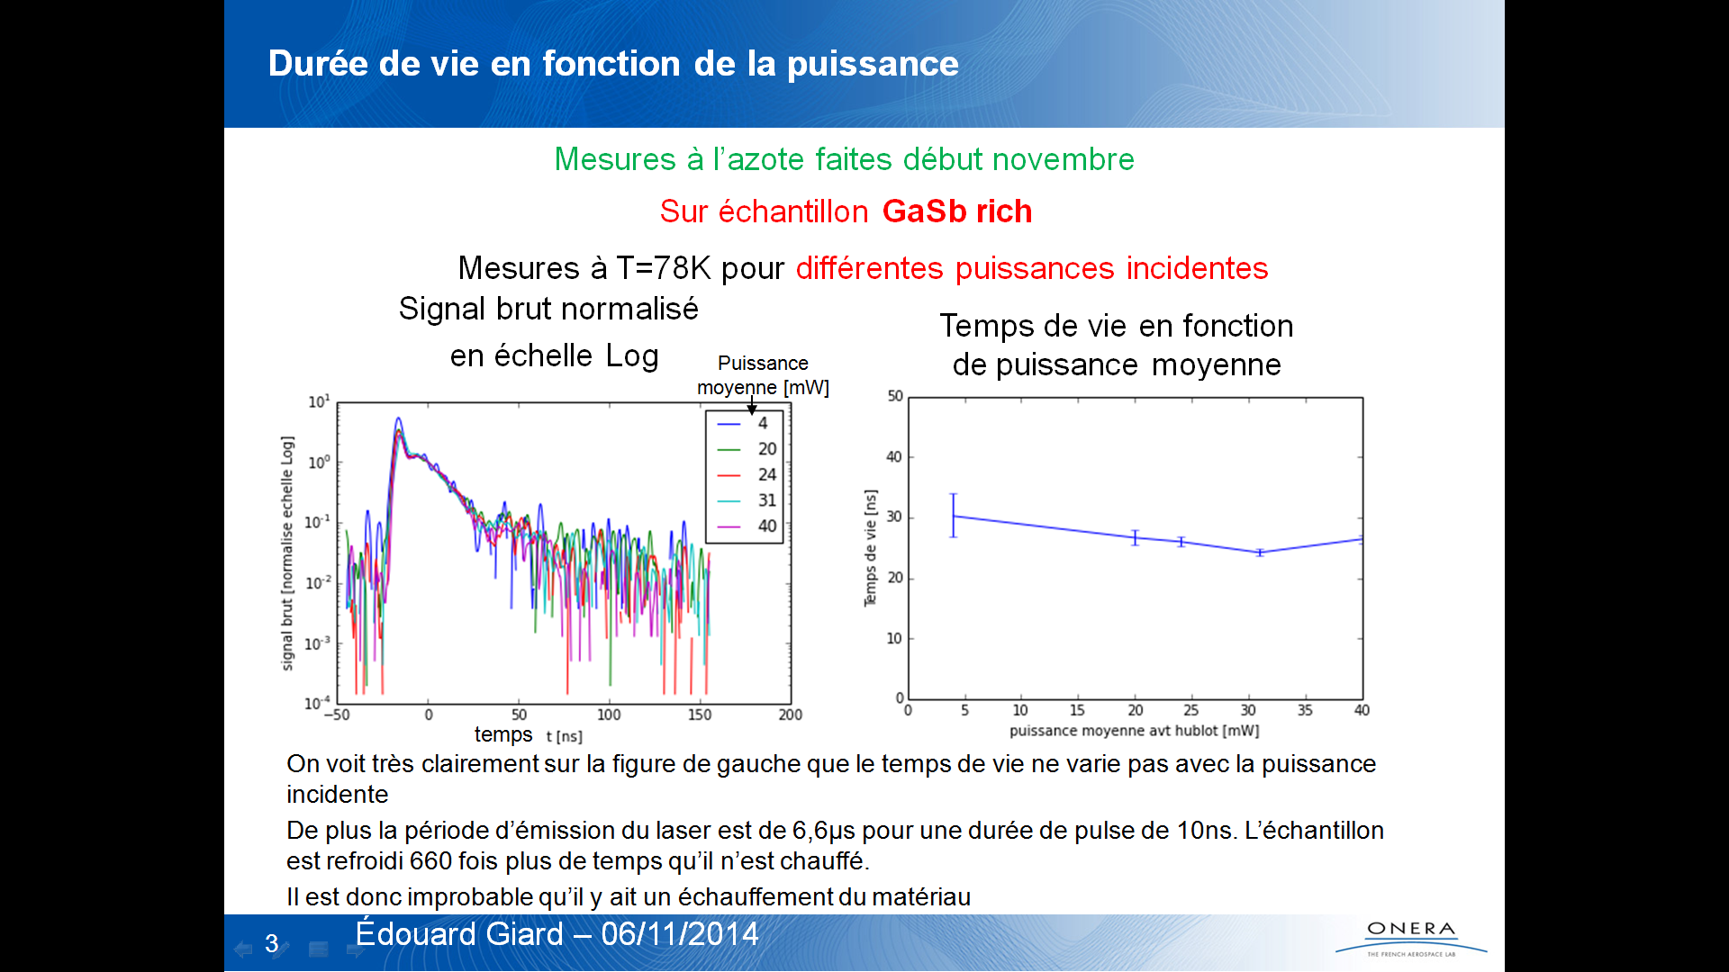
Electrical measurements
J(V) results
Carrier lifetime τ_{GR}
InAs-rich
ONERA
77K
Symmetric
GaSb-rich
Different cut-off but same electrical behavior for each kind of structure
%GaSb  ➔ τ_{GR} 
⇒ high J_{dark} value of GaSb-rich SL
17

Slide 18
Electrical measurements
J(V) results
Carrier lifetime τ_{GR}
InAs-rich
ONERA
77K
Symmetric
GaSb-rich
Different cut-off but same electrical behavior for each kind of structure
%GaSb  ➔ τ_{GR} 
⇒ high J_{dark} value of GaSb-rich SL
Electrical performances of InAs/GaSb SL diode are strongly dependant on GaSb-content
➔ Ga-free InAs/InAsSb SL diode
18

Slide 19
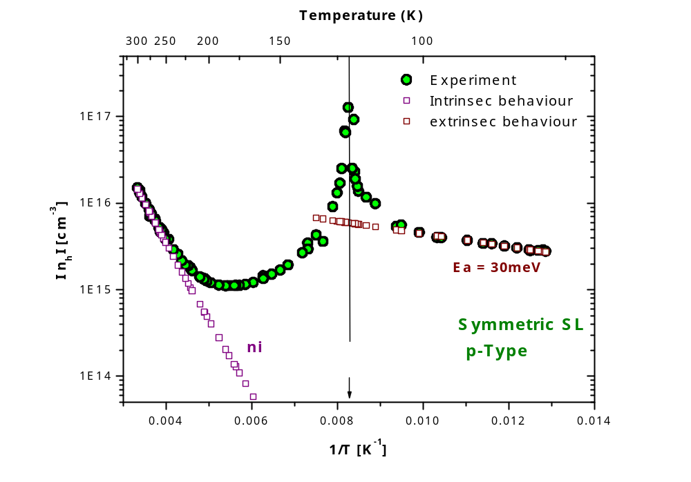
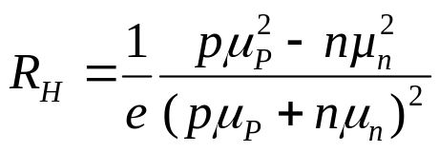
Electrical measurements
Transport ➔ type of SL material
Change in type of apparent conductivity
µ_{n} >> µ_{P}
Symmetric SL is p-type !!

Slide 20
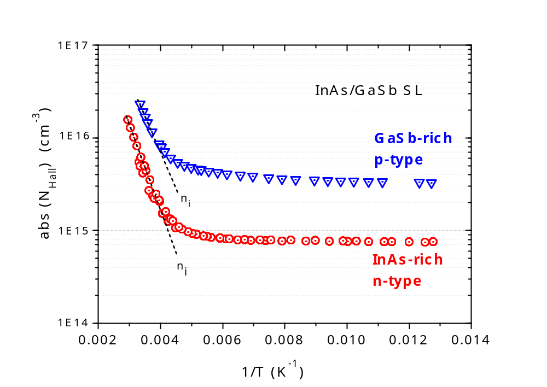
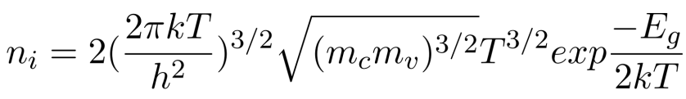
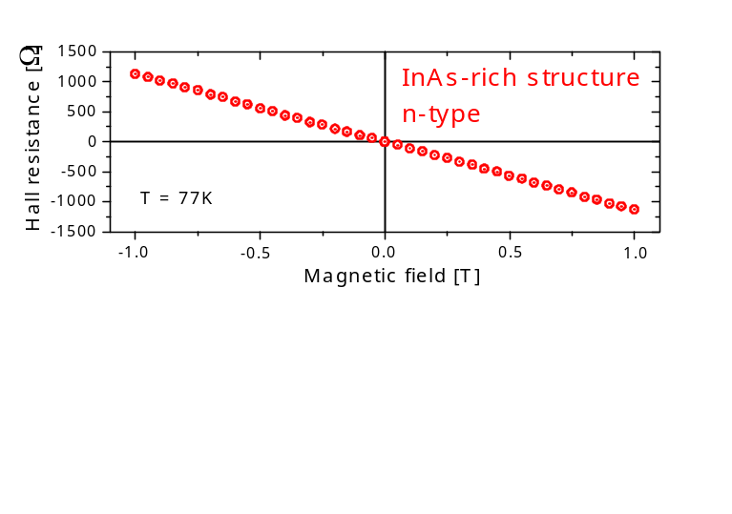
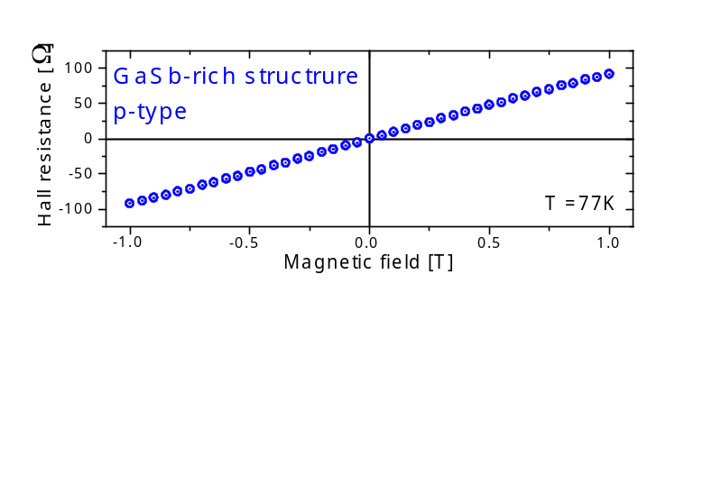
Electrical measurements
Transport ➔ type of SL material
 | GaSb-rich (R=0.5) | Symmetric (R=1) | InAs-rich (R=2)
Residual carrier concentration (cm⁻³) | 3.5x10¹⁵ P-type | 2.5x10¹⁵ P-type | 8x10¹⁴ N-type
T = 77K
☞ Influence on type of doping

Slide 21
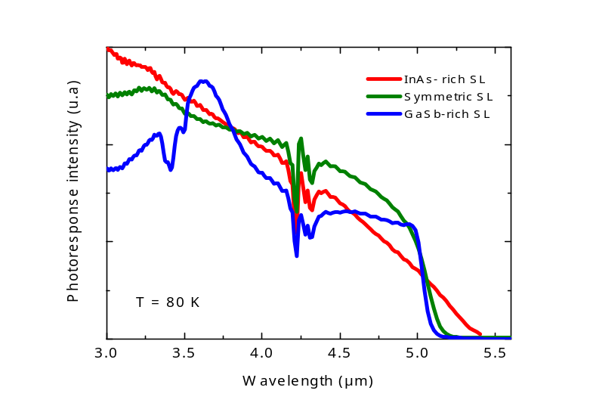
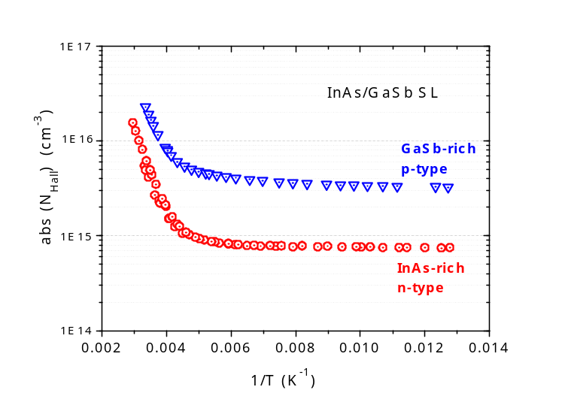
Summary of results ➔ Conclusion
InAs-rich SL
N-type structure
GaSb-rich SL
P-type structure
Minority carriers : holes
Very low dark current
3D spectral shape
Minority carriers : electrons (high QE)
High dark current
2D spectral shape
2D
3D
Influence of SL period composition
- same cut-off for different SL periods with different properties/performances
- same cut-off with n-type or p-type residual SL doping
21

Slide 22
Conclusion ➔ Combined structure
InAs-rich SL
N-type structure
GaSb-rich SL
P-type structure
Minority carriers : holes
Very low dark current
3D spectral shape
Minority carriers : electrons (high QE)
High dark current
2D spectral shape
Combine the advantages of each structure
N+ contact
InAs-rich
Residual N-type
N-side of the junction
GaSb-rich
Residual P-type
➔ pn junction without doping the junction !
Active zone
P-side of the junction
P+ contact
22

Slide 23
Conclusion ➔ Combined structure
MWIR T2SL photodiode combining SL properties
Cap InAs n⁺=5.10¹⁷cm⁻³ 20nm
SL 7ML InAs/4ML GaSb n⁺=5.10¹⁷cm⁻³ 100nm
N+ contact
SL 7ML InAs/4ML GaSb N.i.D 200nm
N-side
InAs-rich
Residual N-type
SL 9ML InAs/8ML GaSb N.i.D 50nm
Gradual periods
(%GaSb ↘)
SL 10ML InAs/12ML GaSb N.i.D 50nm
GaSb-rich
Residual P-type
SL 11ML InAs/16ML GaSb N.i.D 50nm
SL 11ML InAs/20ML GaSb N.i.D 1.5μm
Active zone P-side
P+ contact
SL 11ML InAs/20ML GaSb p⁺=5.10¹⁷cm⁻³ 130nm
GaSb (P) Substrate

Slide 24
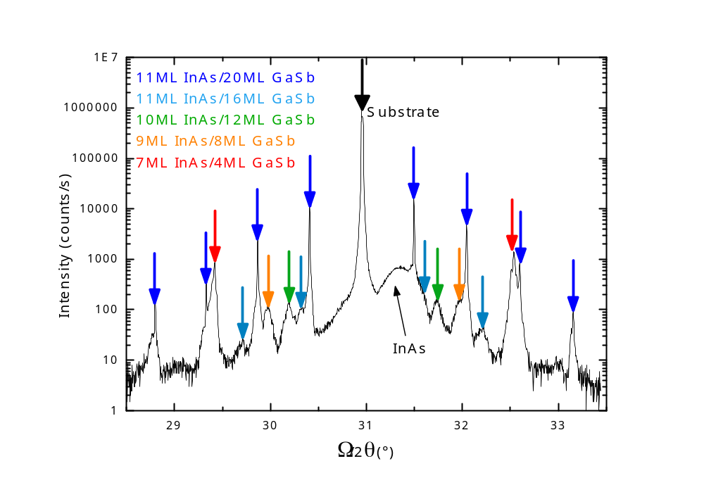
Conclusion ➔ Combined structure
MWIR T2SL photodiode combining SL properties
Cap InAs n⁺=5.10¹⁷cm⁻³ 20nm
SL 7ML InAs/4ML GaSb n⁺=5.10¹⁷cm⁻³ 100nm
HR-XRD spectrum
SL 7ML InAs/4ML GaSb N.i.D 200nm
SL 9ML InAs/8ML GaSb N.i.D 50nm
SL 10ML InAs/12ML GaSb N.i.D 50nm
SL 11ML InAs/16ML GaSb N.i.D 50nm
SL 11ML InAs/20ML GaSb N.i.D 1.5μm
SL 11ML InAs/20ML GaSb p⁺=5.10¹⁷cm⁻³ 130nm
GaSb (P) Substrate

Slide 25
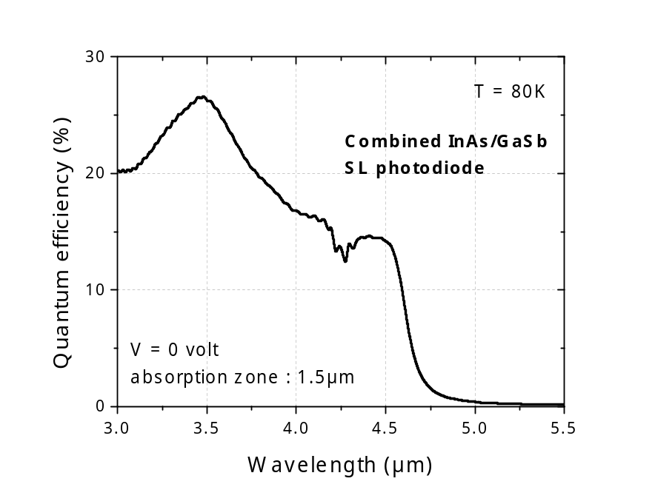
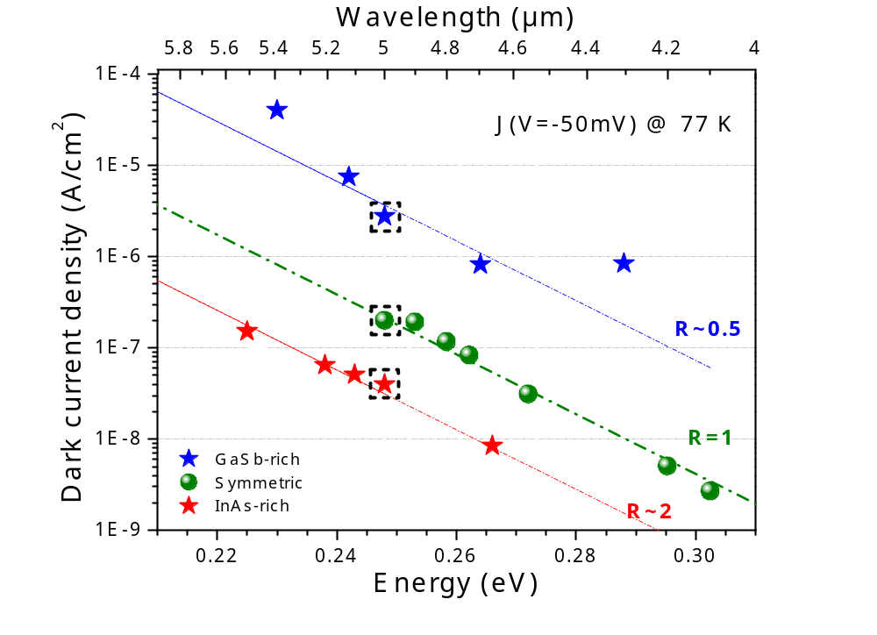
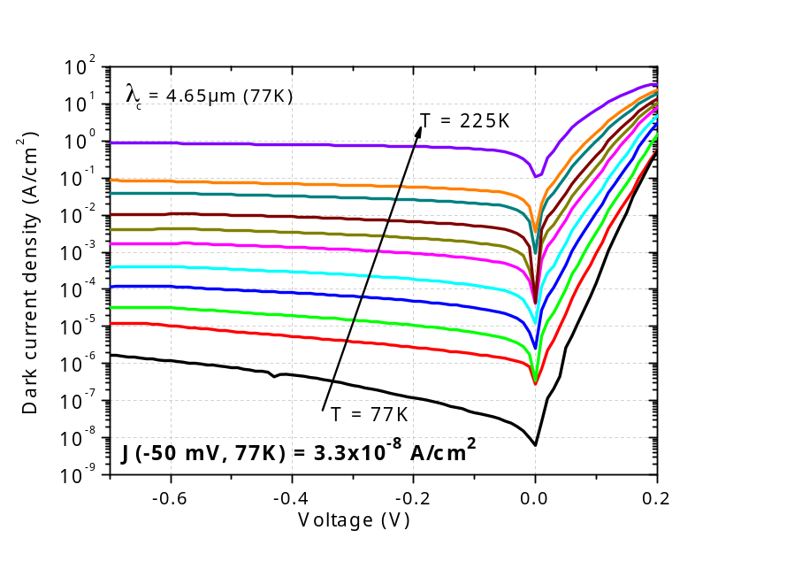
Conclusion ➔ Combined structure
MWIR T2SL photodiode combining SL properties
- 2D spectral shape (as GaSb-rich SL)
- Dark current is lower than the GaSb-rich period but slightly higher than the InAs-rich period
        … in progress

Slide 26
Thank you for your attention
Our recent publications on T2SL photodiodes
M. Delmas et al “Midwave infrared InAs/GaSb superIattice photodiode with a dopant-free p-n junction”
Infrared Physics & Technology, 70, 76 (2015)
E. Giard, et al “ Influence of the p-type doping on the radiometric performances of MWIR T2SL photodiodes”
Infrared Physics & Technology, 70, 103 (2015)
M. Delmas et al “Electrical modeling of InAs/GaSb superlattice mid-wavelength infrared pin photodiode to analyze experimental dark current characteristics”
Journal of Applied Physics 116, 113101-7 (2014)
E. Giard, et al “Quantum efficiency investigations of type-II InAs/GaSb MWIR superlattice photodetectors”
Journal of Applied Physics 116, 043101-6 (2014)
R. Taalat et al “Influence of the period thickness and composition on the electro-optical properties of type-II InAs/GaSb midwave infrared superlattice photodetector”.
Journal of Physics D : Applied Physics 47, 015101-7 (2014)

