Slide 1

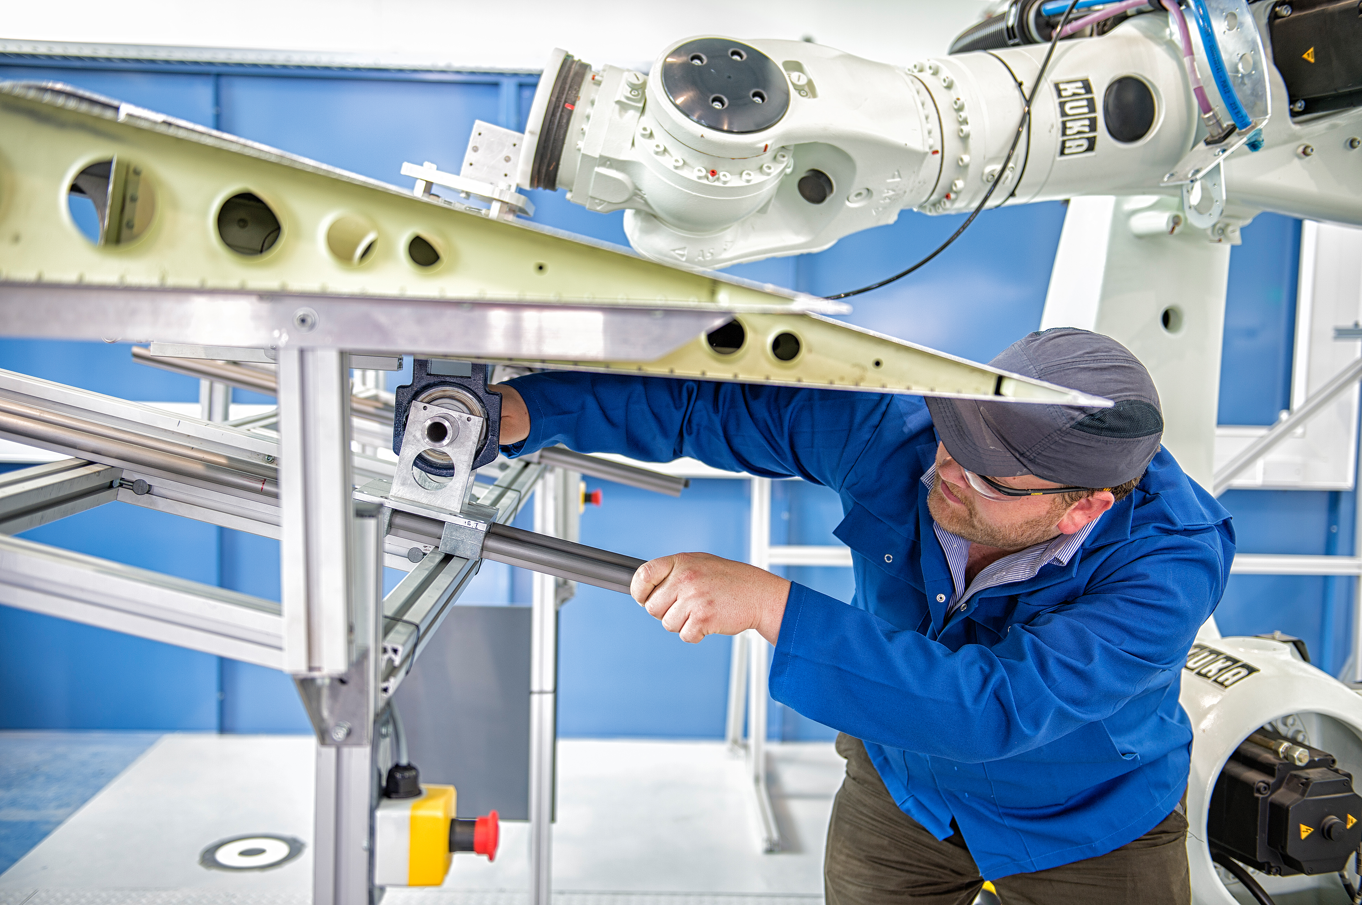
Understanding Human Robot Collaboration in Flexible and Reconfigurable Industrial Environments
Professor Phil Webb
Head of Centre for Structures, Assembly and Intelligent Automation

Slide 2
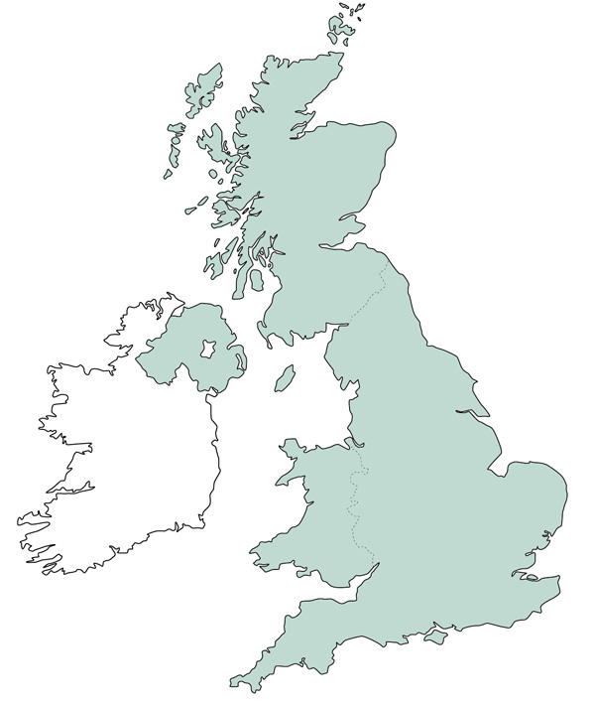
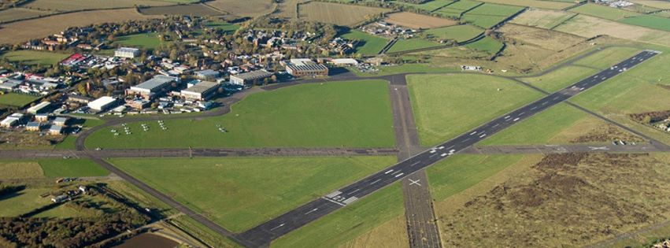
Cranfield University
50 Miles North of London

Slide 3
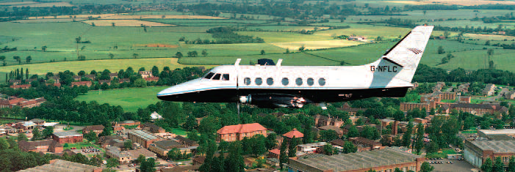
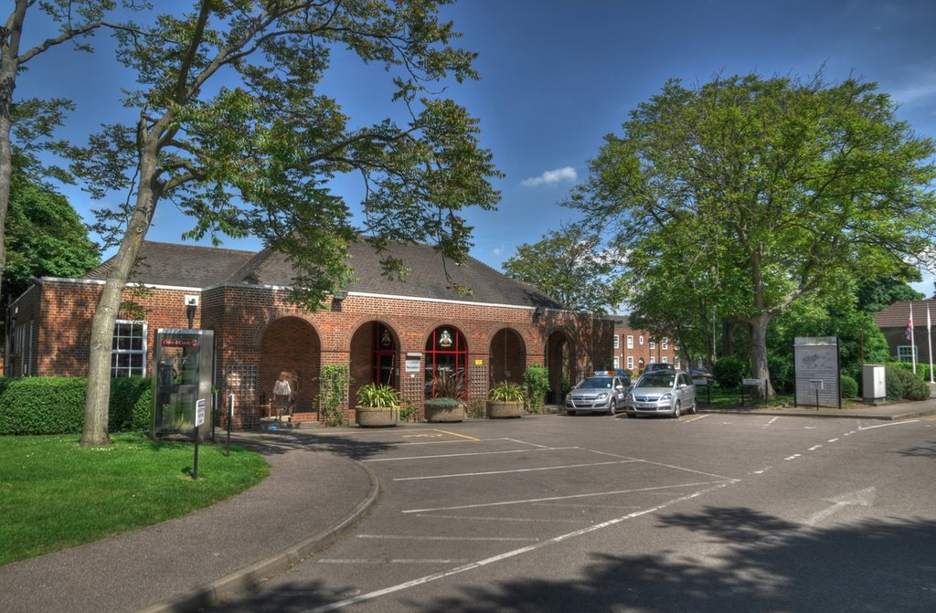
Cranfield University
Wholly Postgraduate University
Specialises in Technology and Management
  4500 Students
  > 800 Doctoral students
  > 20,000 Exec & Professional
  > 100 countries
450 Academic staff

Slide 4
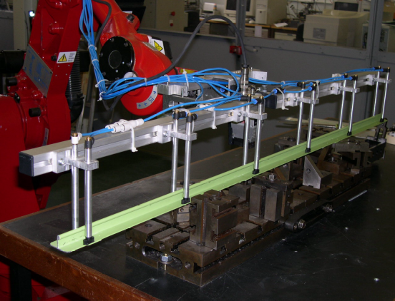
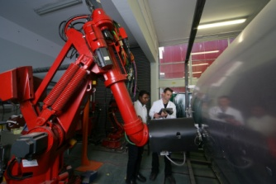
Assembly of Aerospace Components
Large variation in size and weight
Low volume
Complex shapes
Not always to tolerance
Located using using complex jigs and fixtures
Large structures difficult to guard using conventional physical means

Slide 5
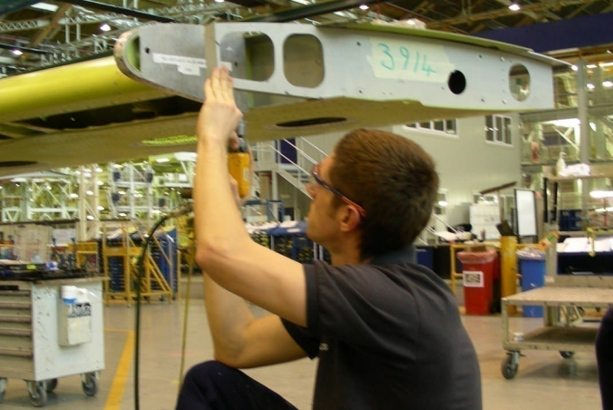
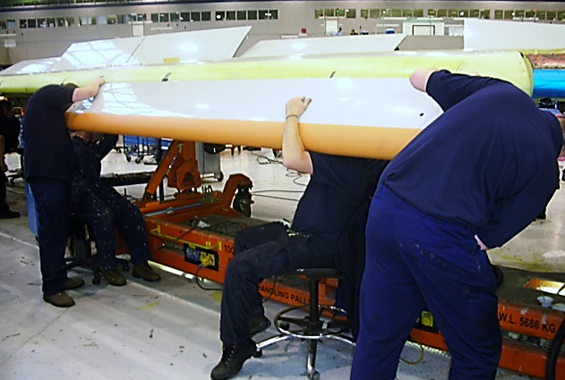
Degrees of Automation
Which tasks can we automate and by how much to realise a business case?

Slide 6
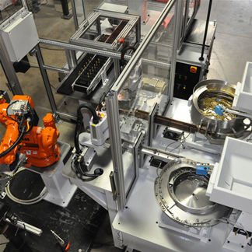
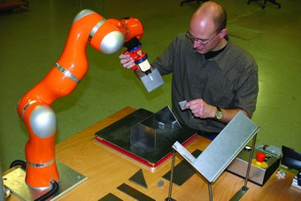
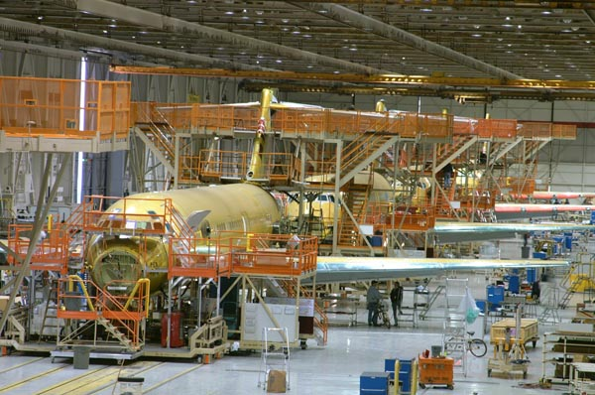
Degrees of Automation
By acquiring tacit knowledge and applying technical measurement we can determine what we can automate and what is best left to people.
Where does a process lie?
Full Automation
Collaborative Automation ?
‘Craft’ Work

Slide 7
Understanding the Task
Principal starting point: Hierarchical Task Analysis (HTA) – the decomposition of a task into discrete elements
  Much deeper than process map / work standards: repeated / reiterative examination via interview and observation
HTA will decompose tasks into discrete elements to an increasingly deeper level until sufficient for further analysis
Further analysis depends on what we want to know about the task e.g.
  Human error identification (HEI)
  Distinction of ‘skill’ type: procedural (implicit ) vs declarative (tacit)
  Function allocation
  Analysis of situational variables and dependencies.

Slide 8
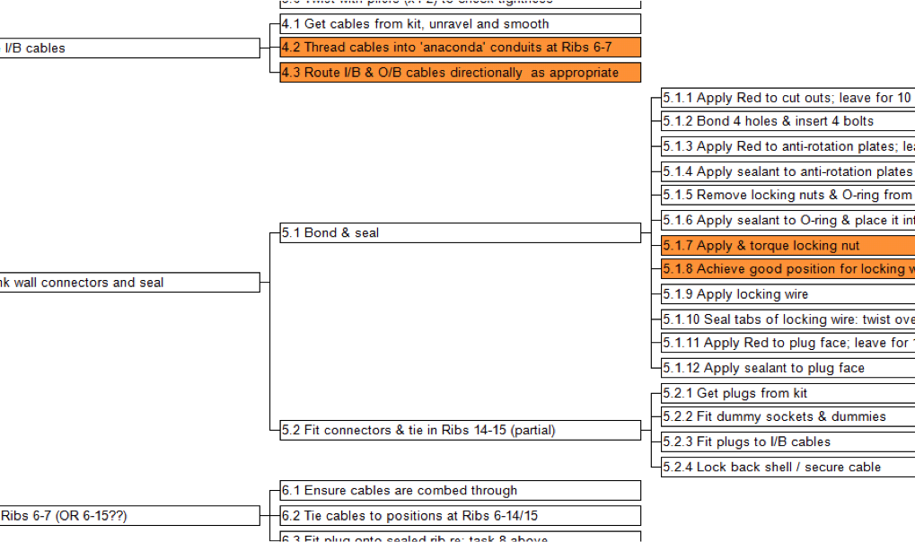
Understanding the Task

Slide 9
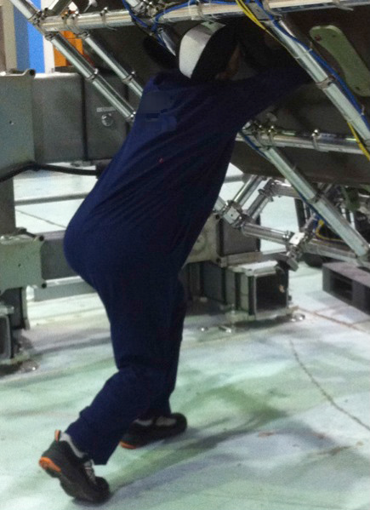
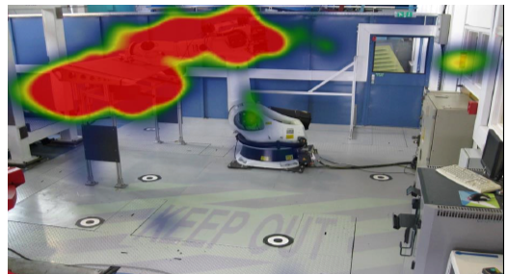
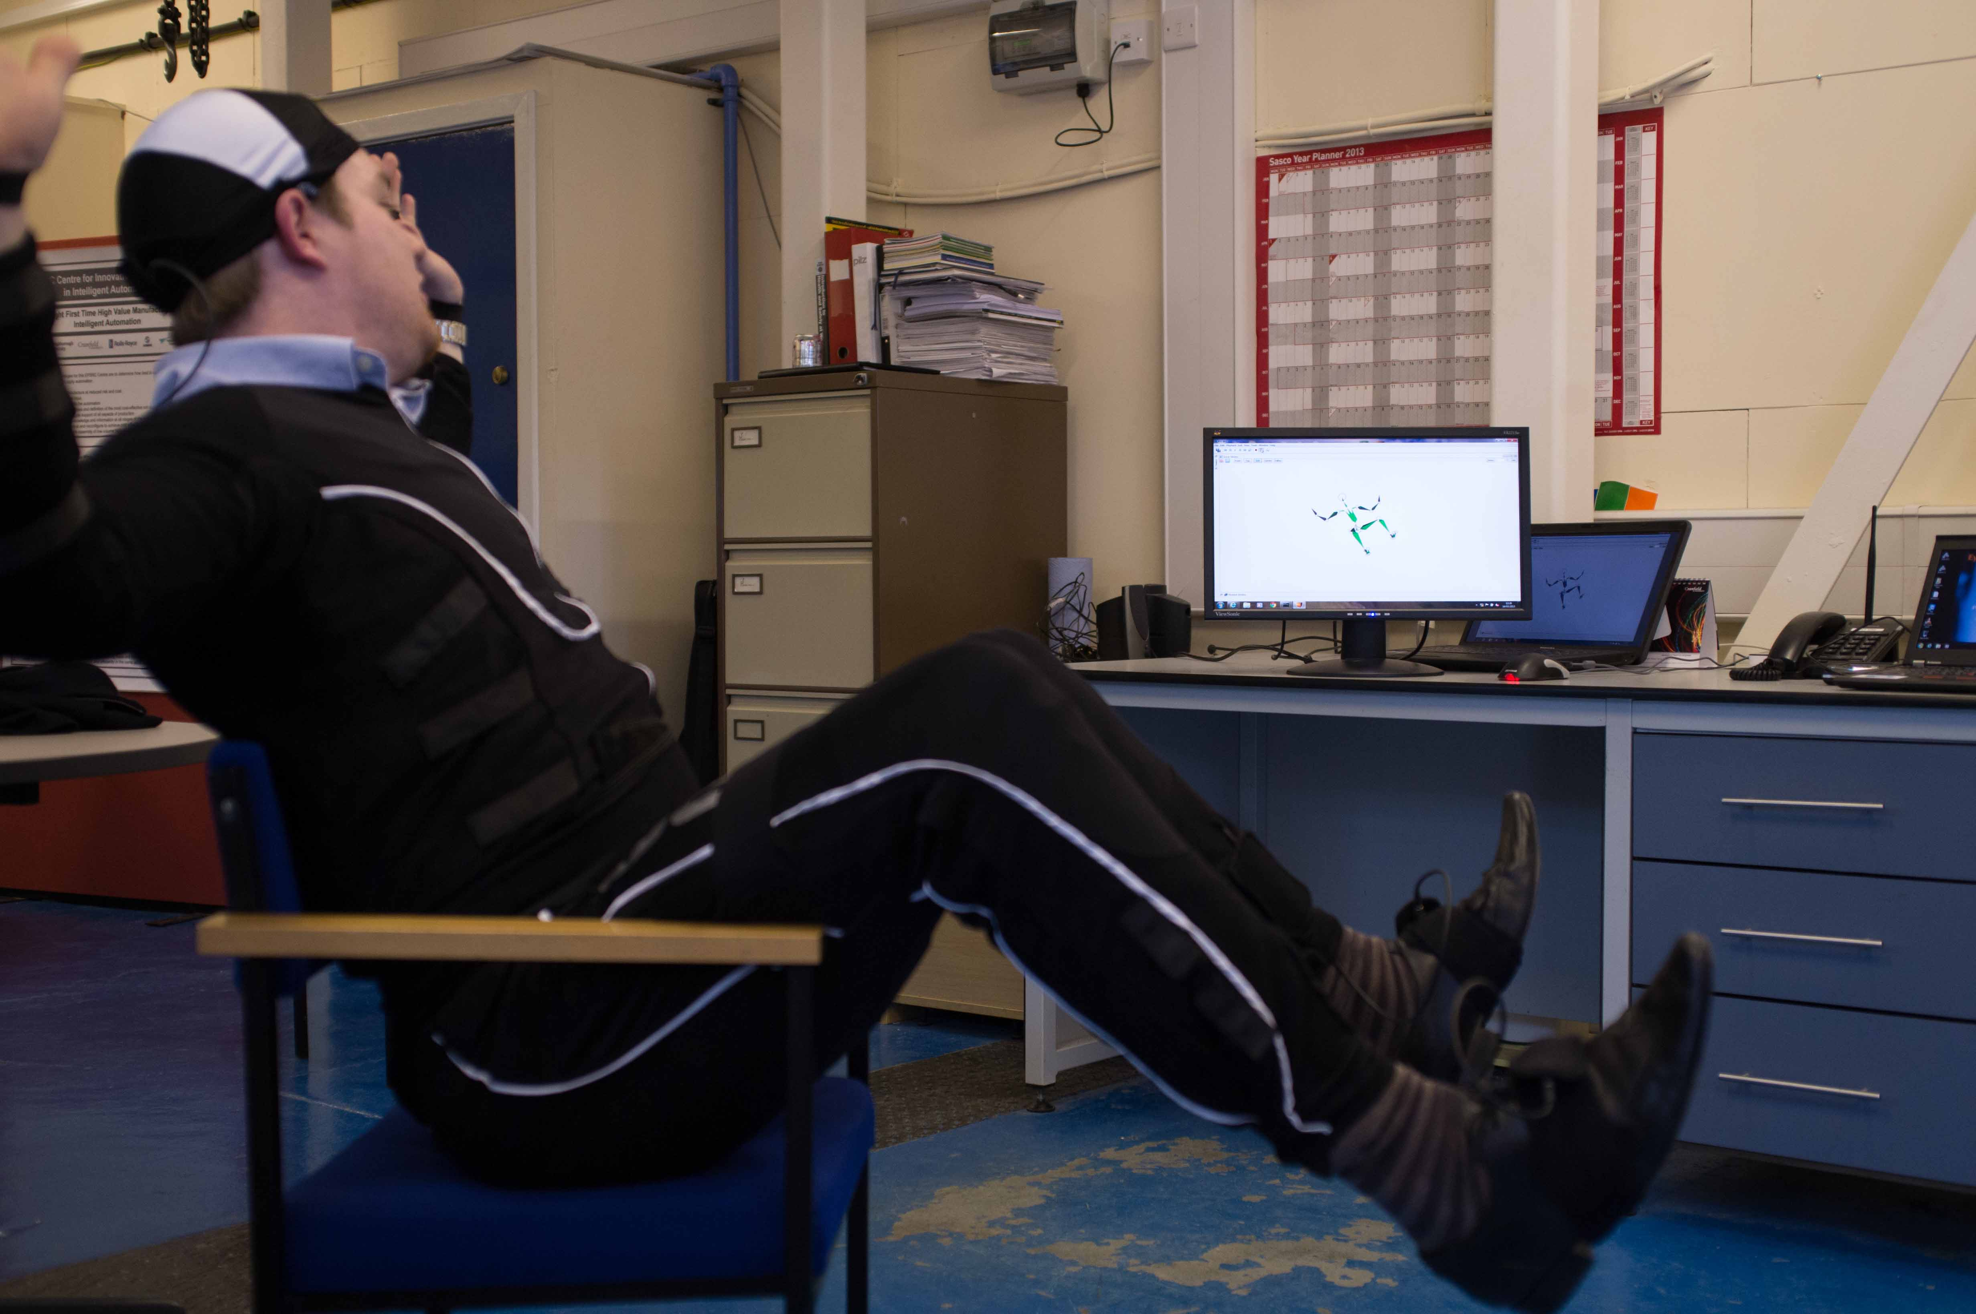
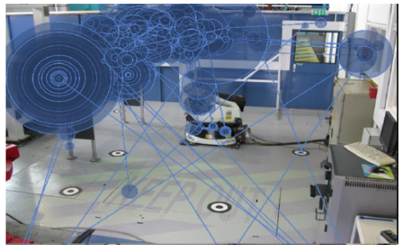
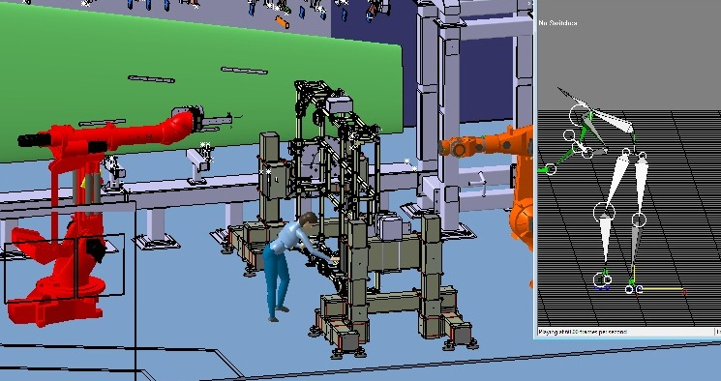
Understanding the Task
Use Motion Capture and
Eye Tracking to augment
data gathering providing
real physical attributes

Slide 10
Degrees of Automation
Where does a process lie?
Full Automation
Collaborative Automation ?
‘Craft’ Work

Slide 11
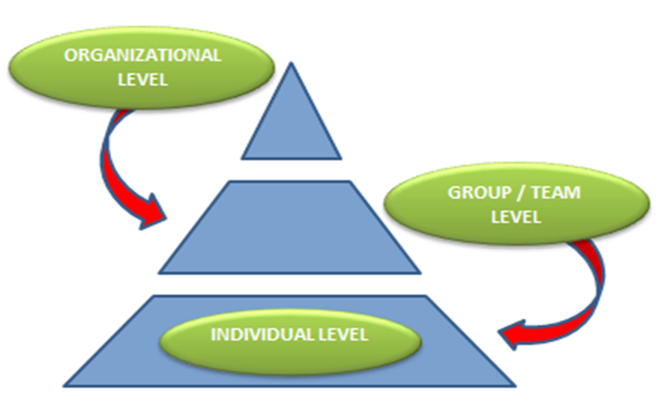
Understanding the
Industrial Context
External
Unions
Health & Safety (H&S)
Government legislation
Overall environmental uncertainty
Organisational
Mechanistic structure
Management commitment and control
Individual
Automation effects on work characteristics
Employee resistance
Fear and Trust
Group / Team
Technology champions
Lack of team approach and functional integration

Slide 12
Understanding Trust
How do people react to working next to Industrial Robots?
  Development of a trust scale for industrial human robot collaboration
Factors include:
  Types of movement (smooth / jerky)
  Control (Who leads the task?)
  Speed (does the operator have control?)
  Does the operator feel inherently safe? – initial results with over 100 experienced and naive operators suggest that they do and there is little difference based on experience.

Slide 13
Risk Assessment and Management
  Hazard Identification
  Method was based on Risk Priority Number.
  Assessment of risk quantitatively using Fault Tree Analysis and Event Tree Analysis
    FTA model based on top level hazard of ‘failure of safety-rated integrated robotic device’ ETA model for the initiating event
    eg: ‘inadvertent movement of robot arm’ (leading to death) to or (non-permanent injury).
    Damage to asset depending on accident sequence path.
However this does not take into account human error! Further work in progress to produce a more representative risk analysis too

Slide 14
Risk Assessment and Acceptability
  An assessment of the residual risk of large scale collaborative automation in context needs to carried out. Quantitative and qualitative methodologies can be used as follows:
  Reliability-based methodology using functional failure analysis and fault / event trees;
  Systems-Theoretic Accident Model and Processes (STAMP).
  The risk acceptability methodology involves capturing individual’s understanding of safety and risk to identify the key factors that will most likely influence decision-makers to accept the residual risk and agree deployment of collaborative automation in the light of the significant business benefits that it could provide.

Slide 15
Key Factors
Task understanding and division
Trust – operator comfort and acceptance
Perceived safety – not the same as actual safety

Slide 16
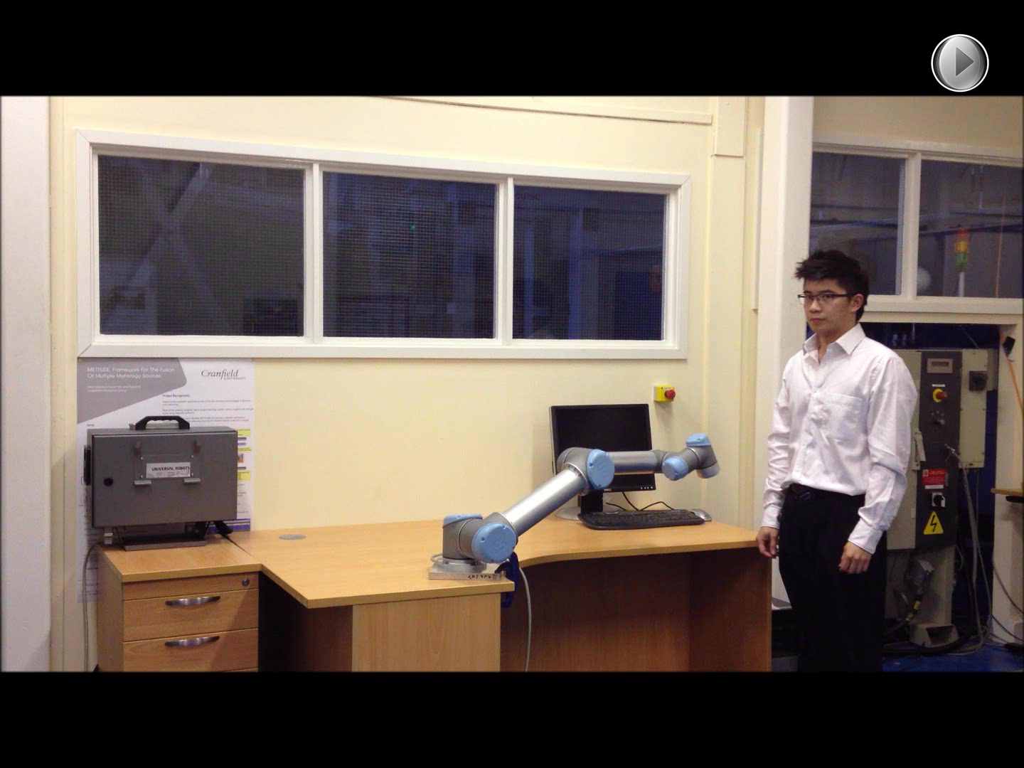
Collaborative Automation
Force / Torque limited robots
Payload limited to about 10Kg max
No guarding required but hazard usually from process or end-effector.

Slide 17
Collaborative Working
Combining all the above should facilitate true collaborative working.
Current research and developing standards suggests that contact may be permissible if it does not cause injury – is this really acceptable?

Slide 18
Large Scale
Airbus A320 Flap Installation
Labour intensive
Significant number of operator hours
Ergonomic issues
What can we automate?

Slide 19
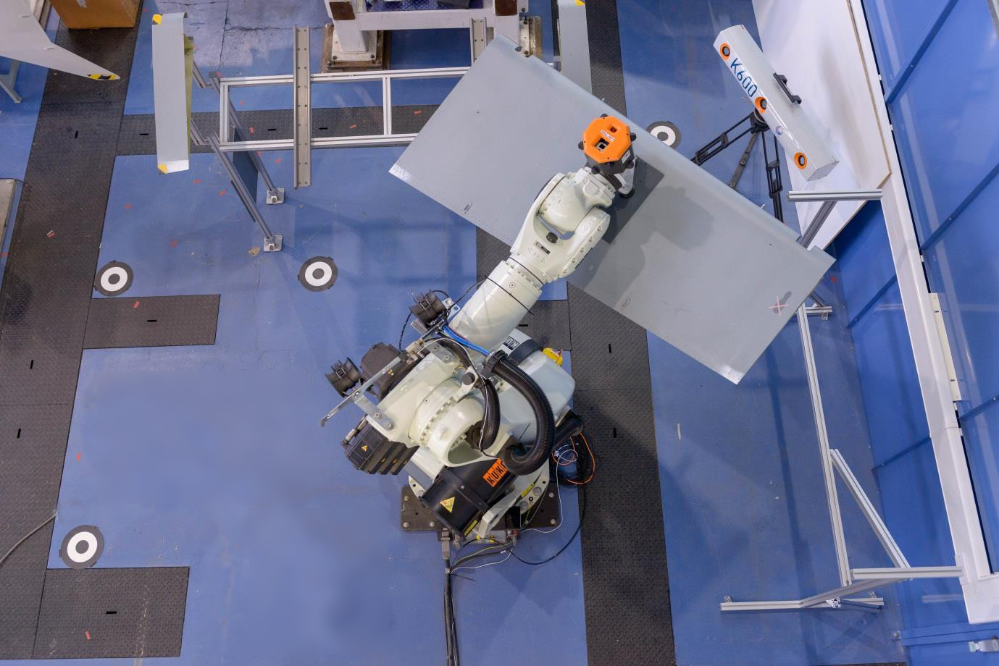
H/R Cooperative
System
Robot scans and positions flap
Once the flap is in correct position, operator enters working area to perform installation of the flap on to the wing

Slide 20
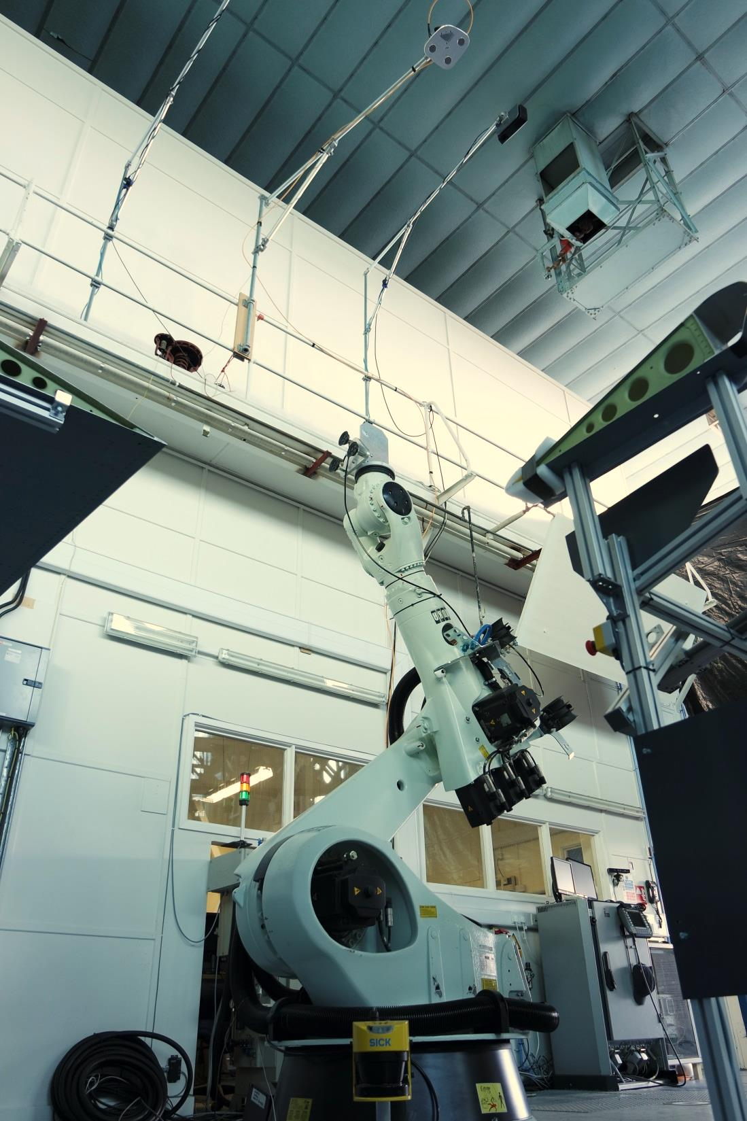
System Safety
Overhead 3D monitoring camera
Safety laser scanner for under wing monitoring

Slide 21
Fixed guarding ensures safety?
24.07.2006 Fatality – crushed between a robotic arm and frame of one of the robot's work stations - Reaching to remove scrap dropped by robot, or reaching to activate a "reset" button. No robot malfunction
25.05.2007 Fatality – struck by robot - Robot cycled and struck employee during troubleshooting.
21.07.2009 Fatality – crushed torso - Failed to de-energise equipment before entering cage.
02.08.2011 Fatality – pinched between robot arm and conveyer belt - Cause unspecified but employee was freeing a jam.

Slide 22
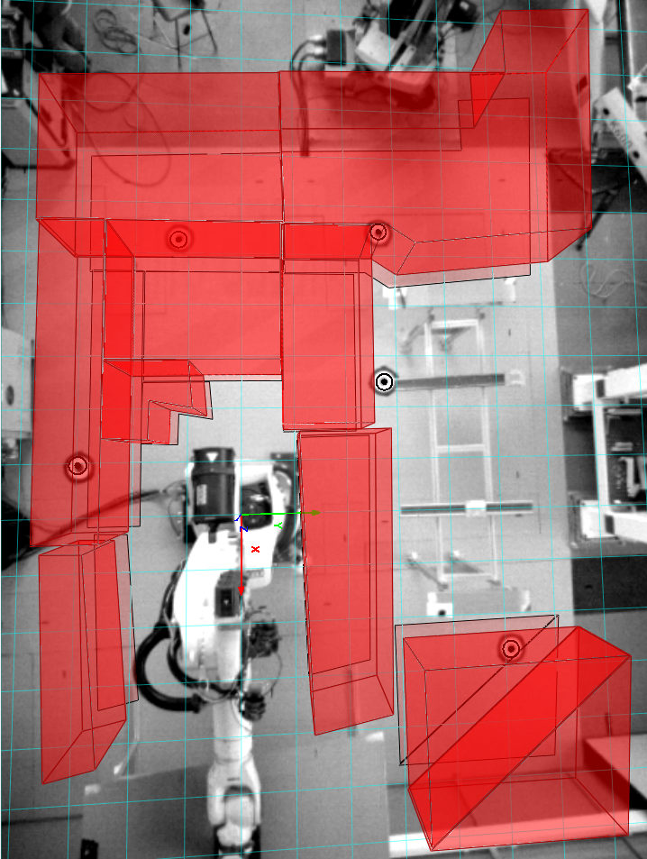
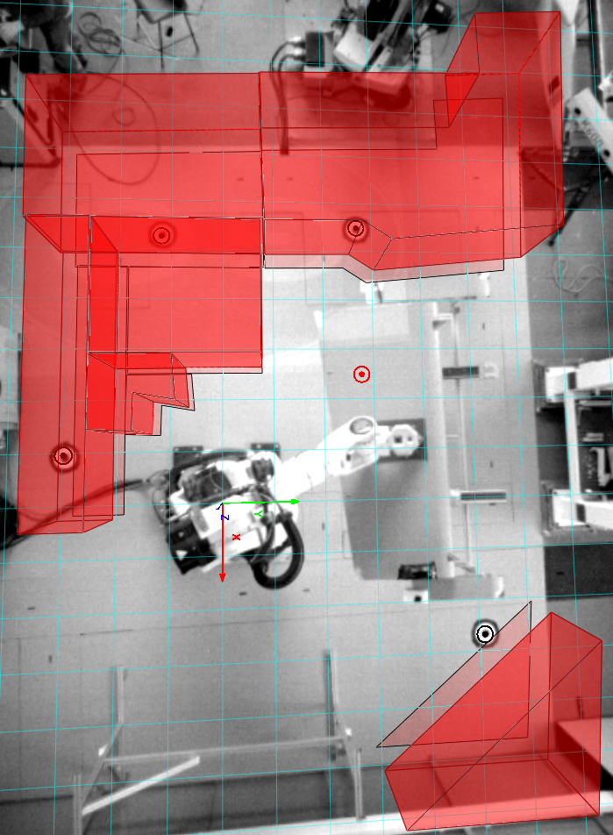
Flexible safety monitoring
Monitoring profile changes according to robot movement

Slide 23
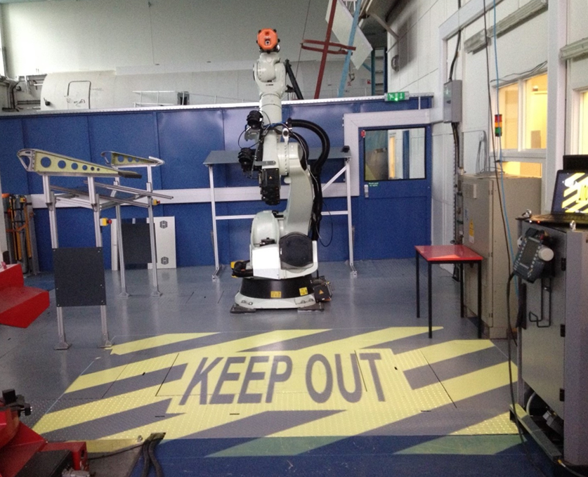
Dynamic work area labelling
Projected floor labels to indicate system status
Traffic lights and audible alerts for active warning
Business case can be made!

Slide 24
Flap Installation
Movie

Slide 25
Thank You

