Slide 1
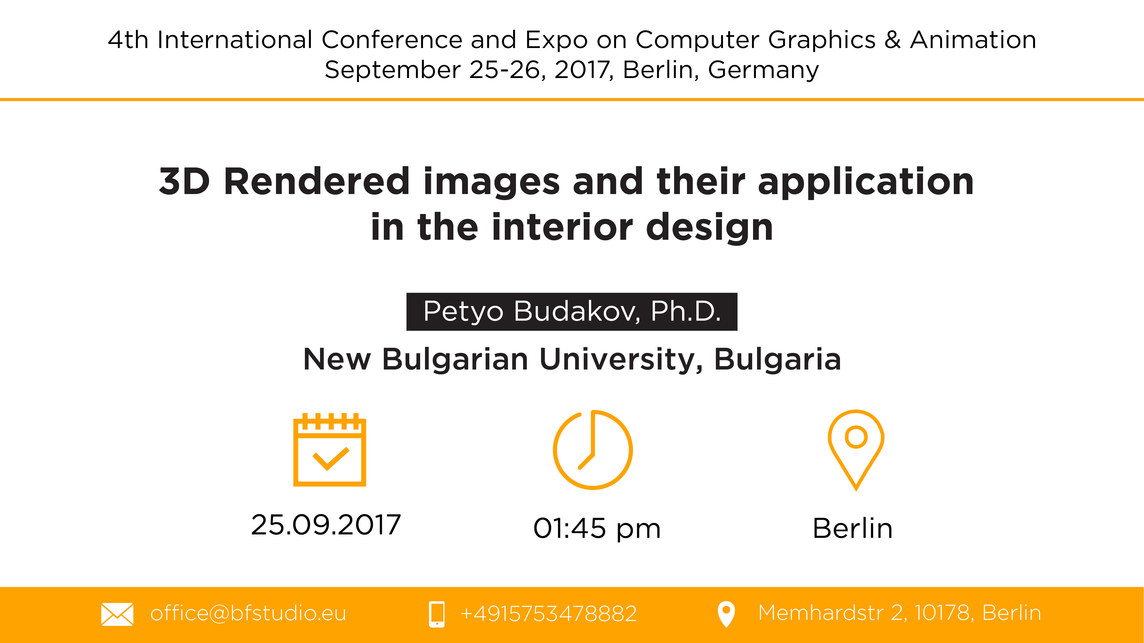

Slide 2


Slide 3


Slide 4
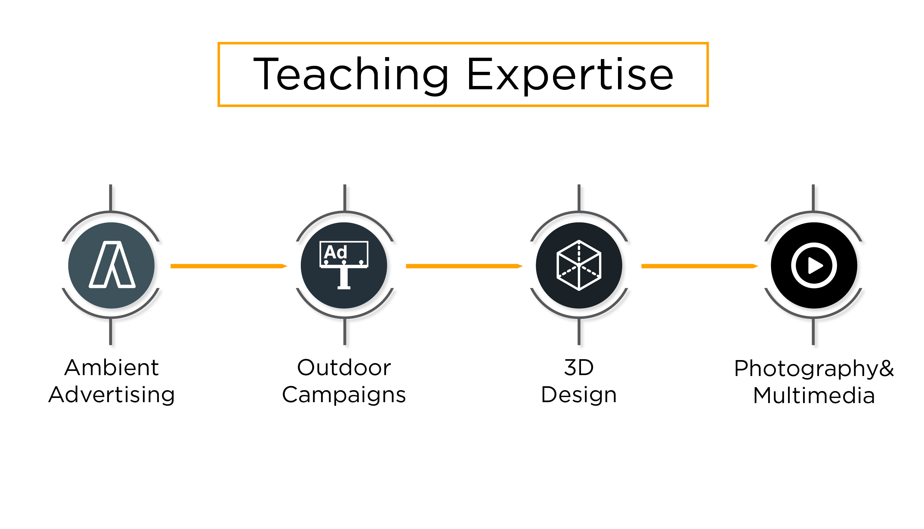

Slide 5
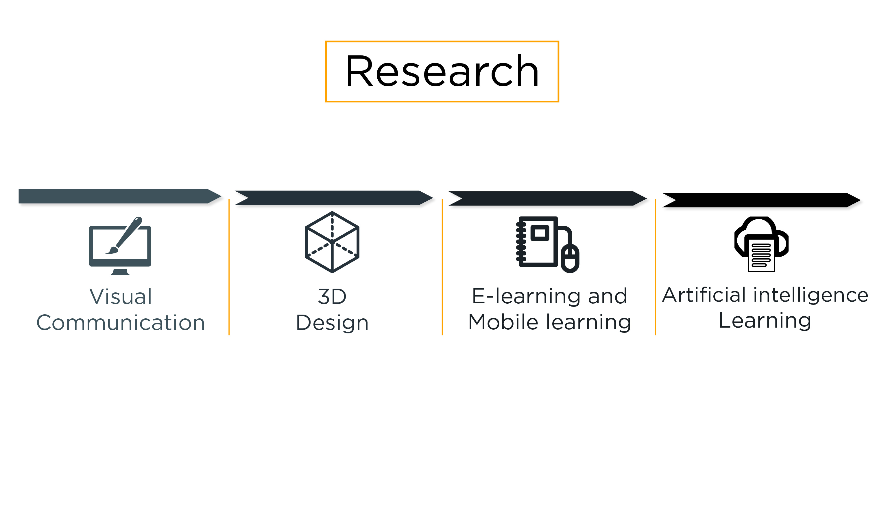

Slide 6
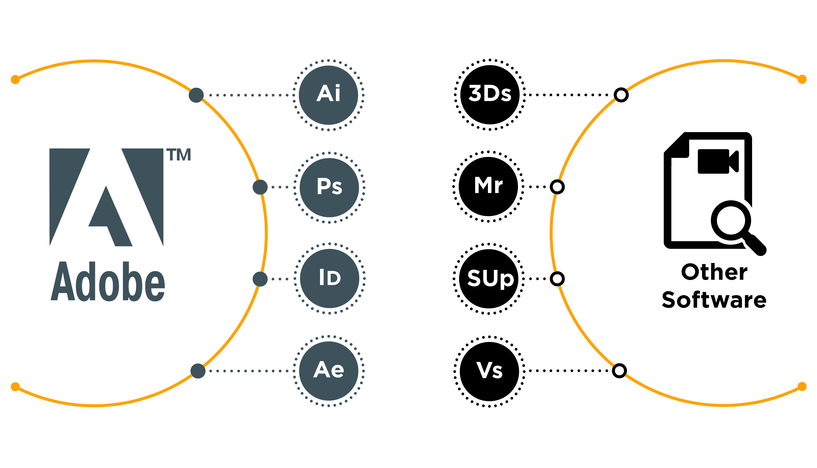

Slide 7


Slide 8
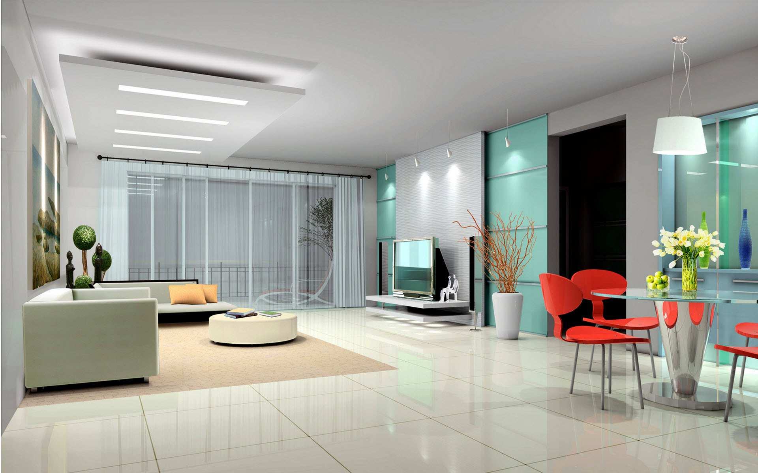
Source: http://cdn.homedit.com/wp-content/uploads/2011/01/modern-home-interior-design.jpg

Slide 9
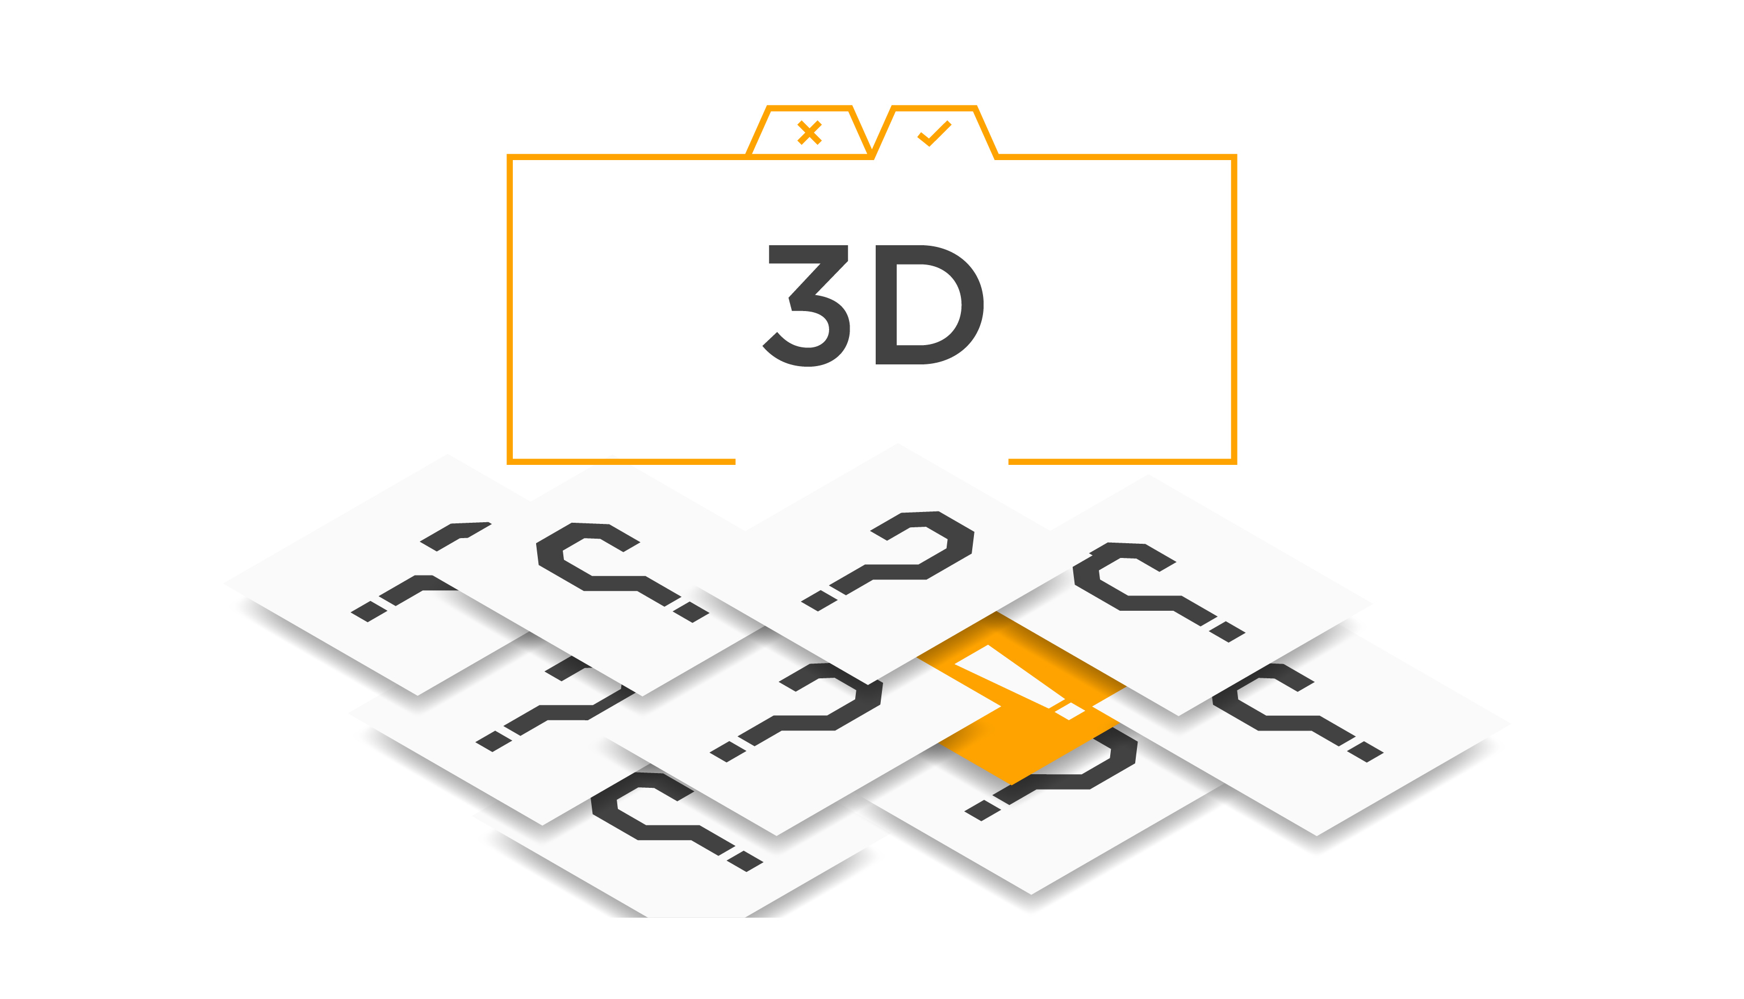

Slide 10
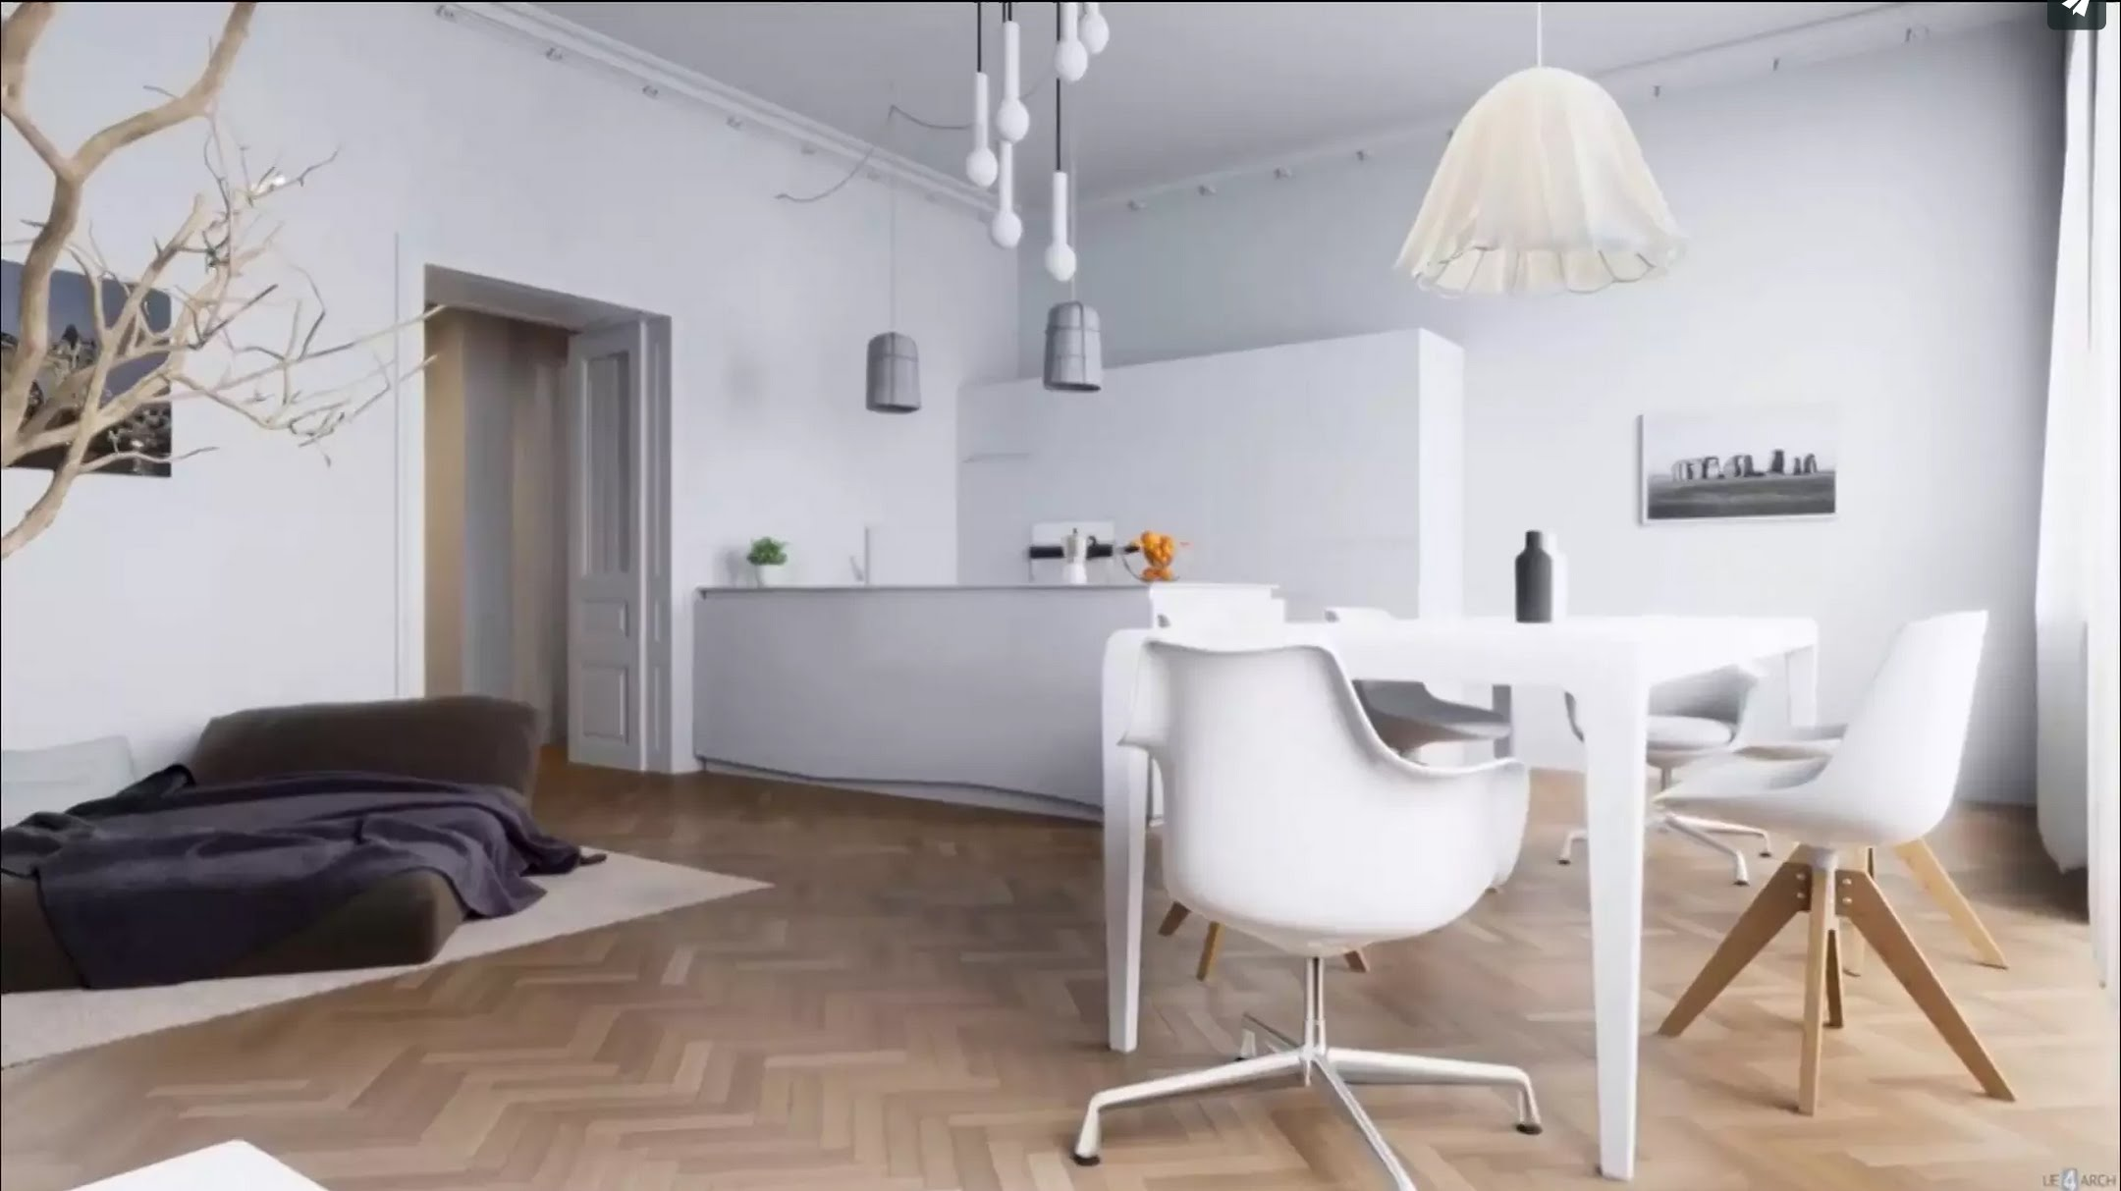
Source: https://i.ytimg.com/vi/JOMRxZUQ-nI/maxresdefault.jpg

Slide 12

Source: https://i.pinimg.com/originals/b3/b3/0c/b3b30c7616df1120825eaec11a5a9899.jpg

Slide 13


Slide 14
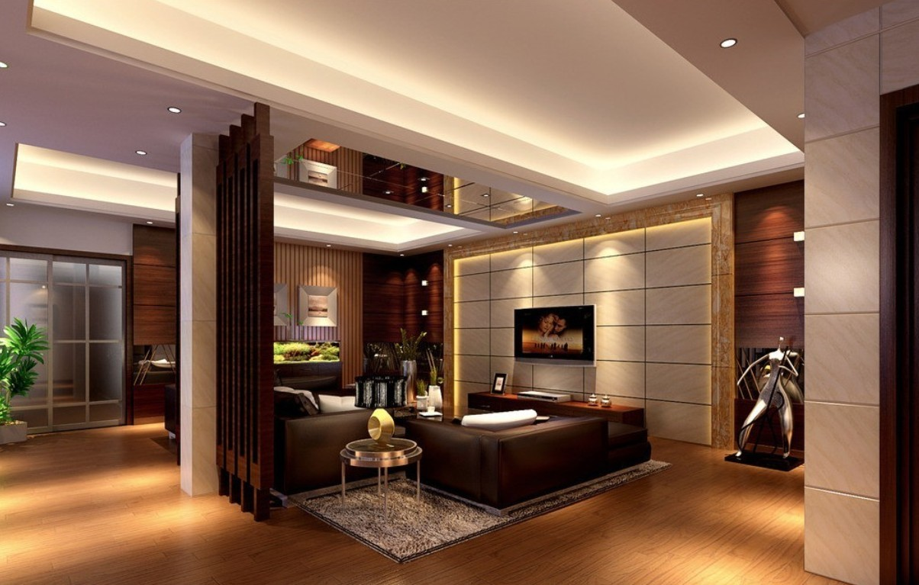
Source: https://i.pinimg.com/originals/07/83/5b/07835b77f71c057a9aa809e0db4449a4.jpg

Slide 16
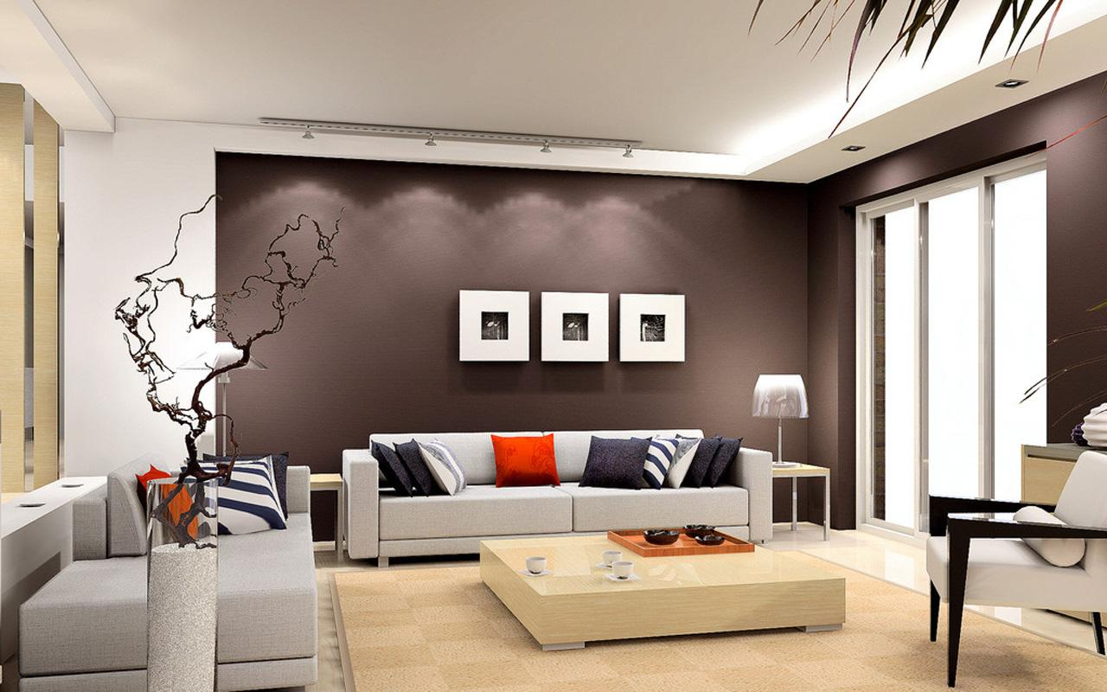
Source: http://essentialhome.eu/inspirations/wp-content/uploads/2017/01/The-Importance-Of-Interior-Design-4.jpg

Slide 18

Source: http://www.zastavki.com/pictures/1920x1200/2009/Interior_Design_of_rooms_with_a_fireplace_012365_.jpg

Slide 20
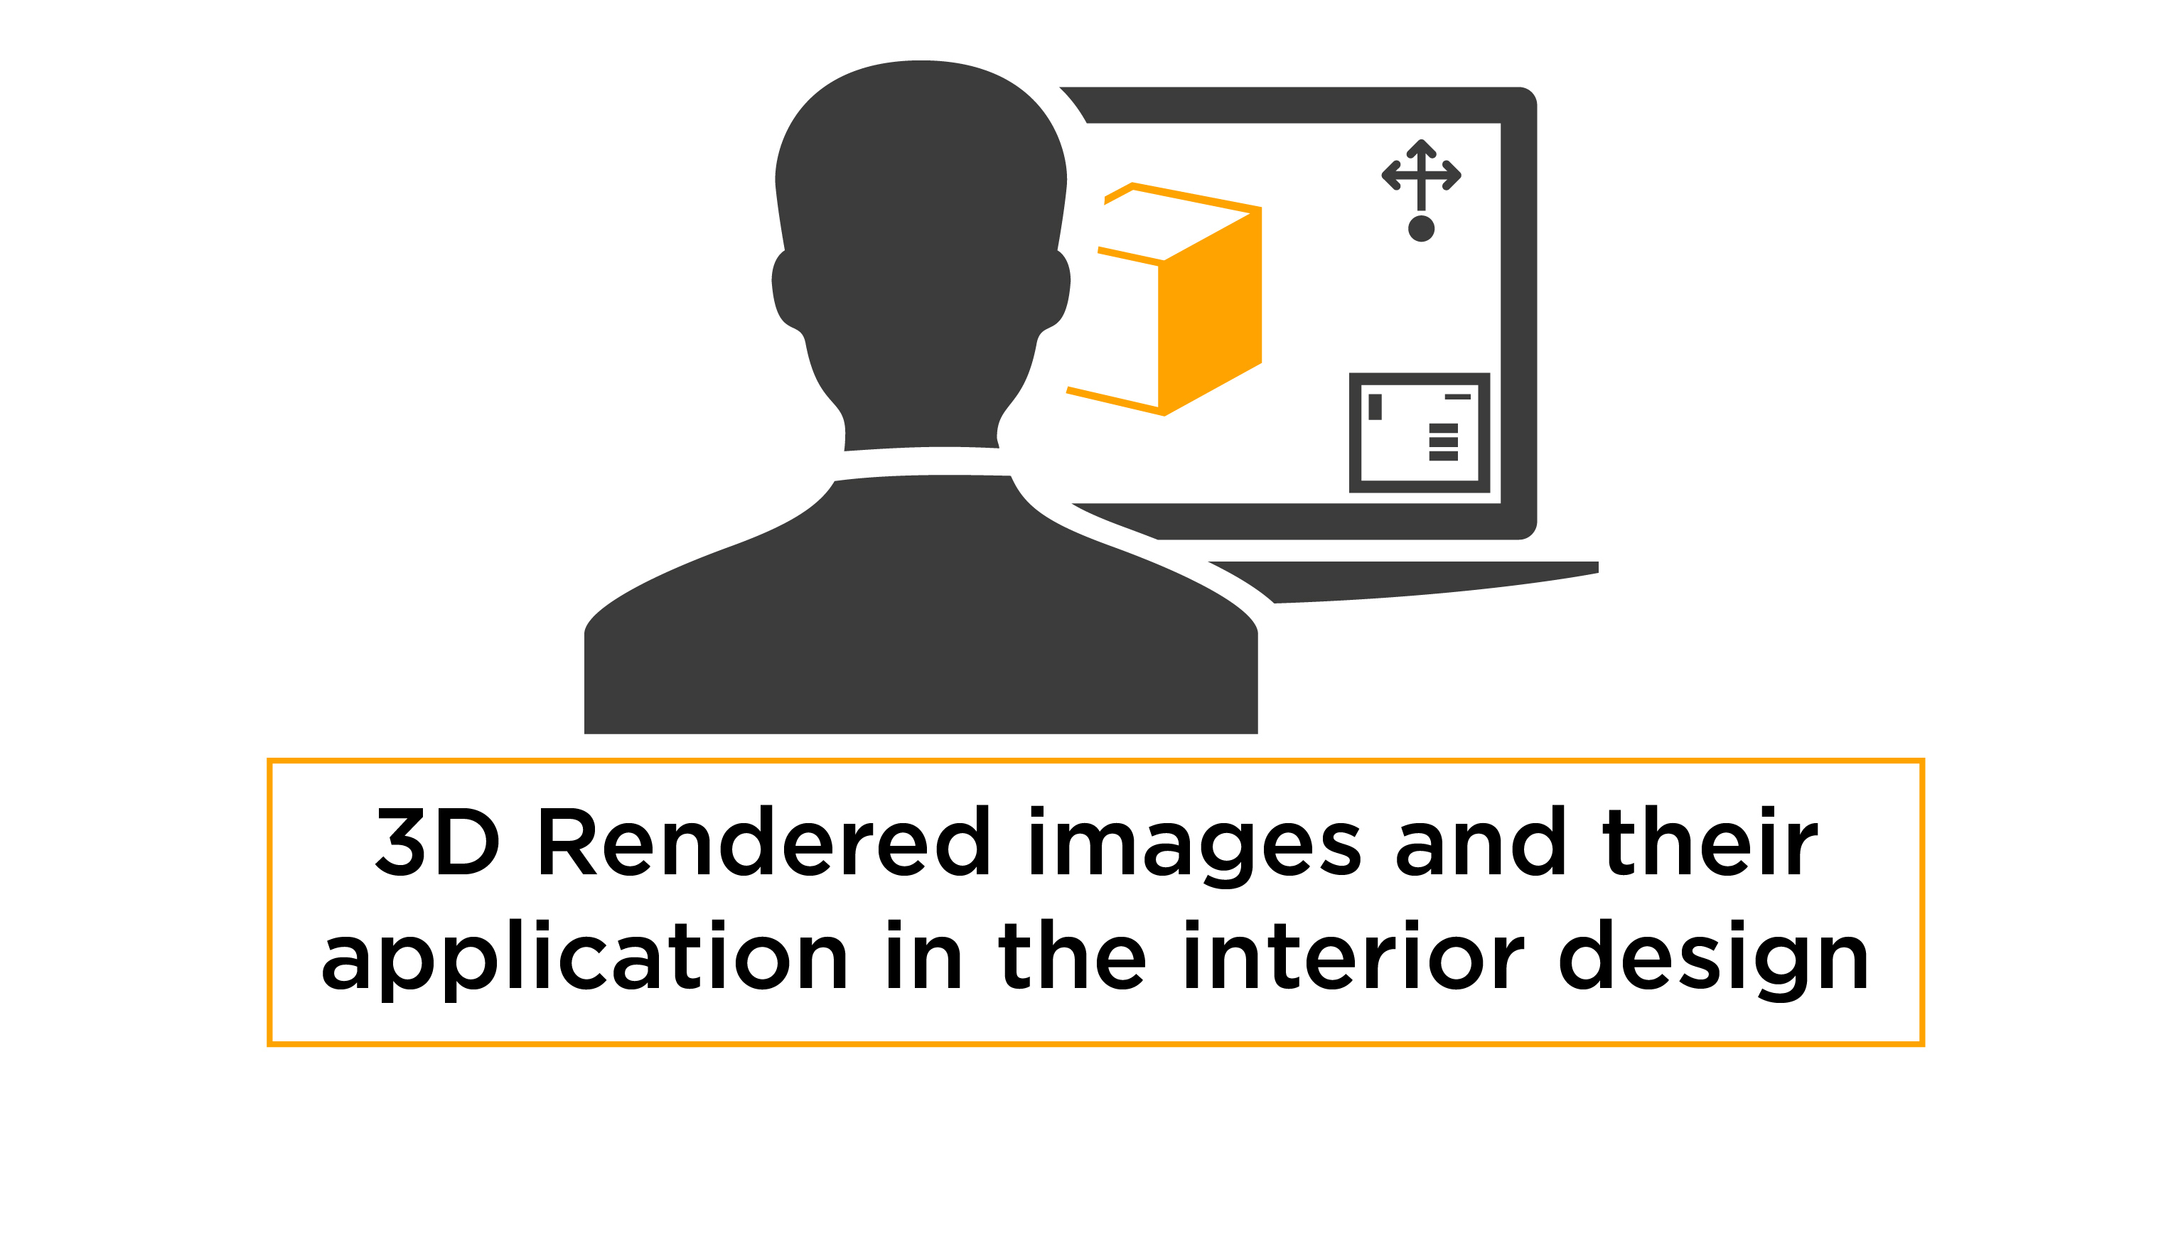

Slide 21
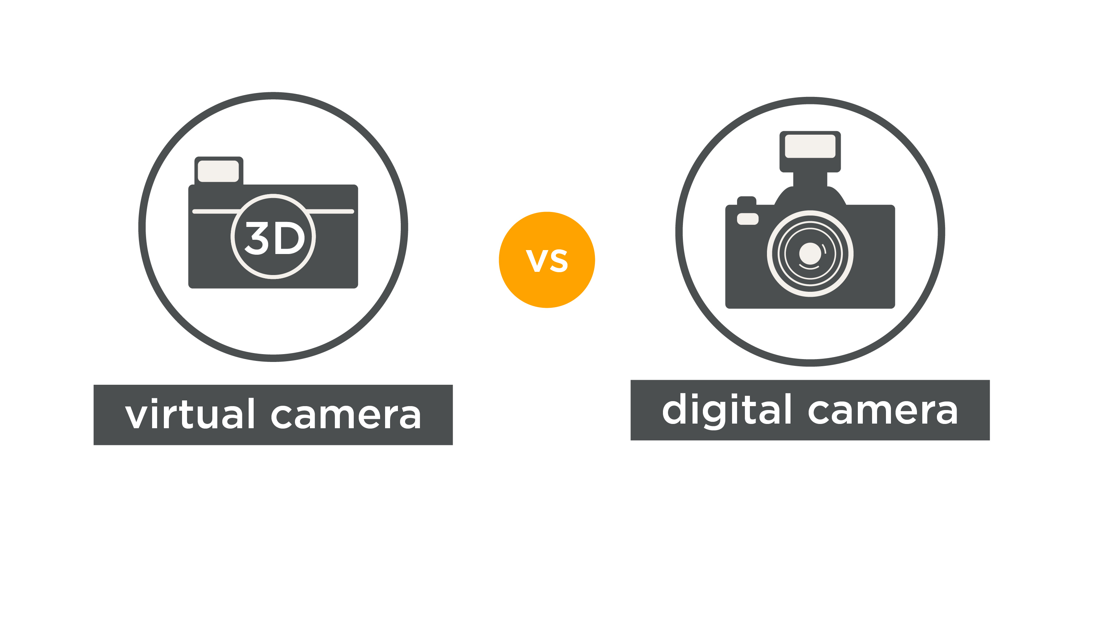

Slide 22


Slide 23
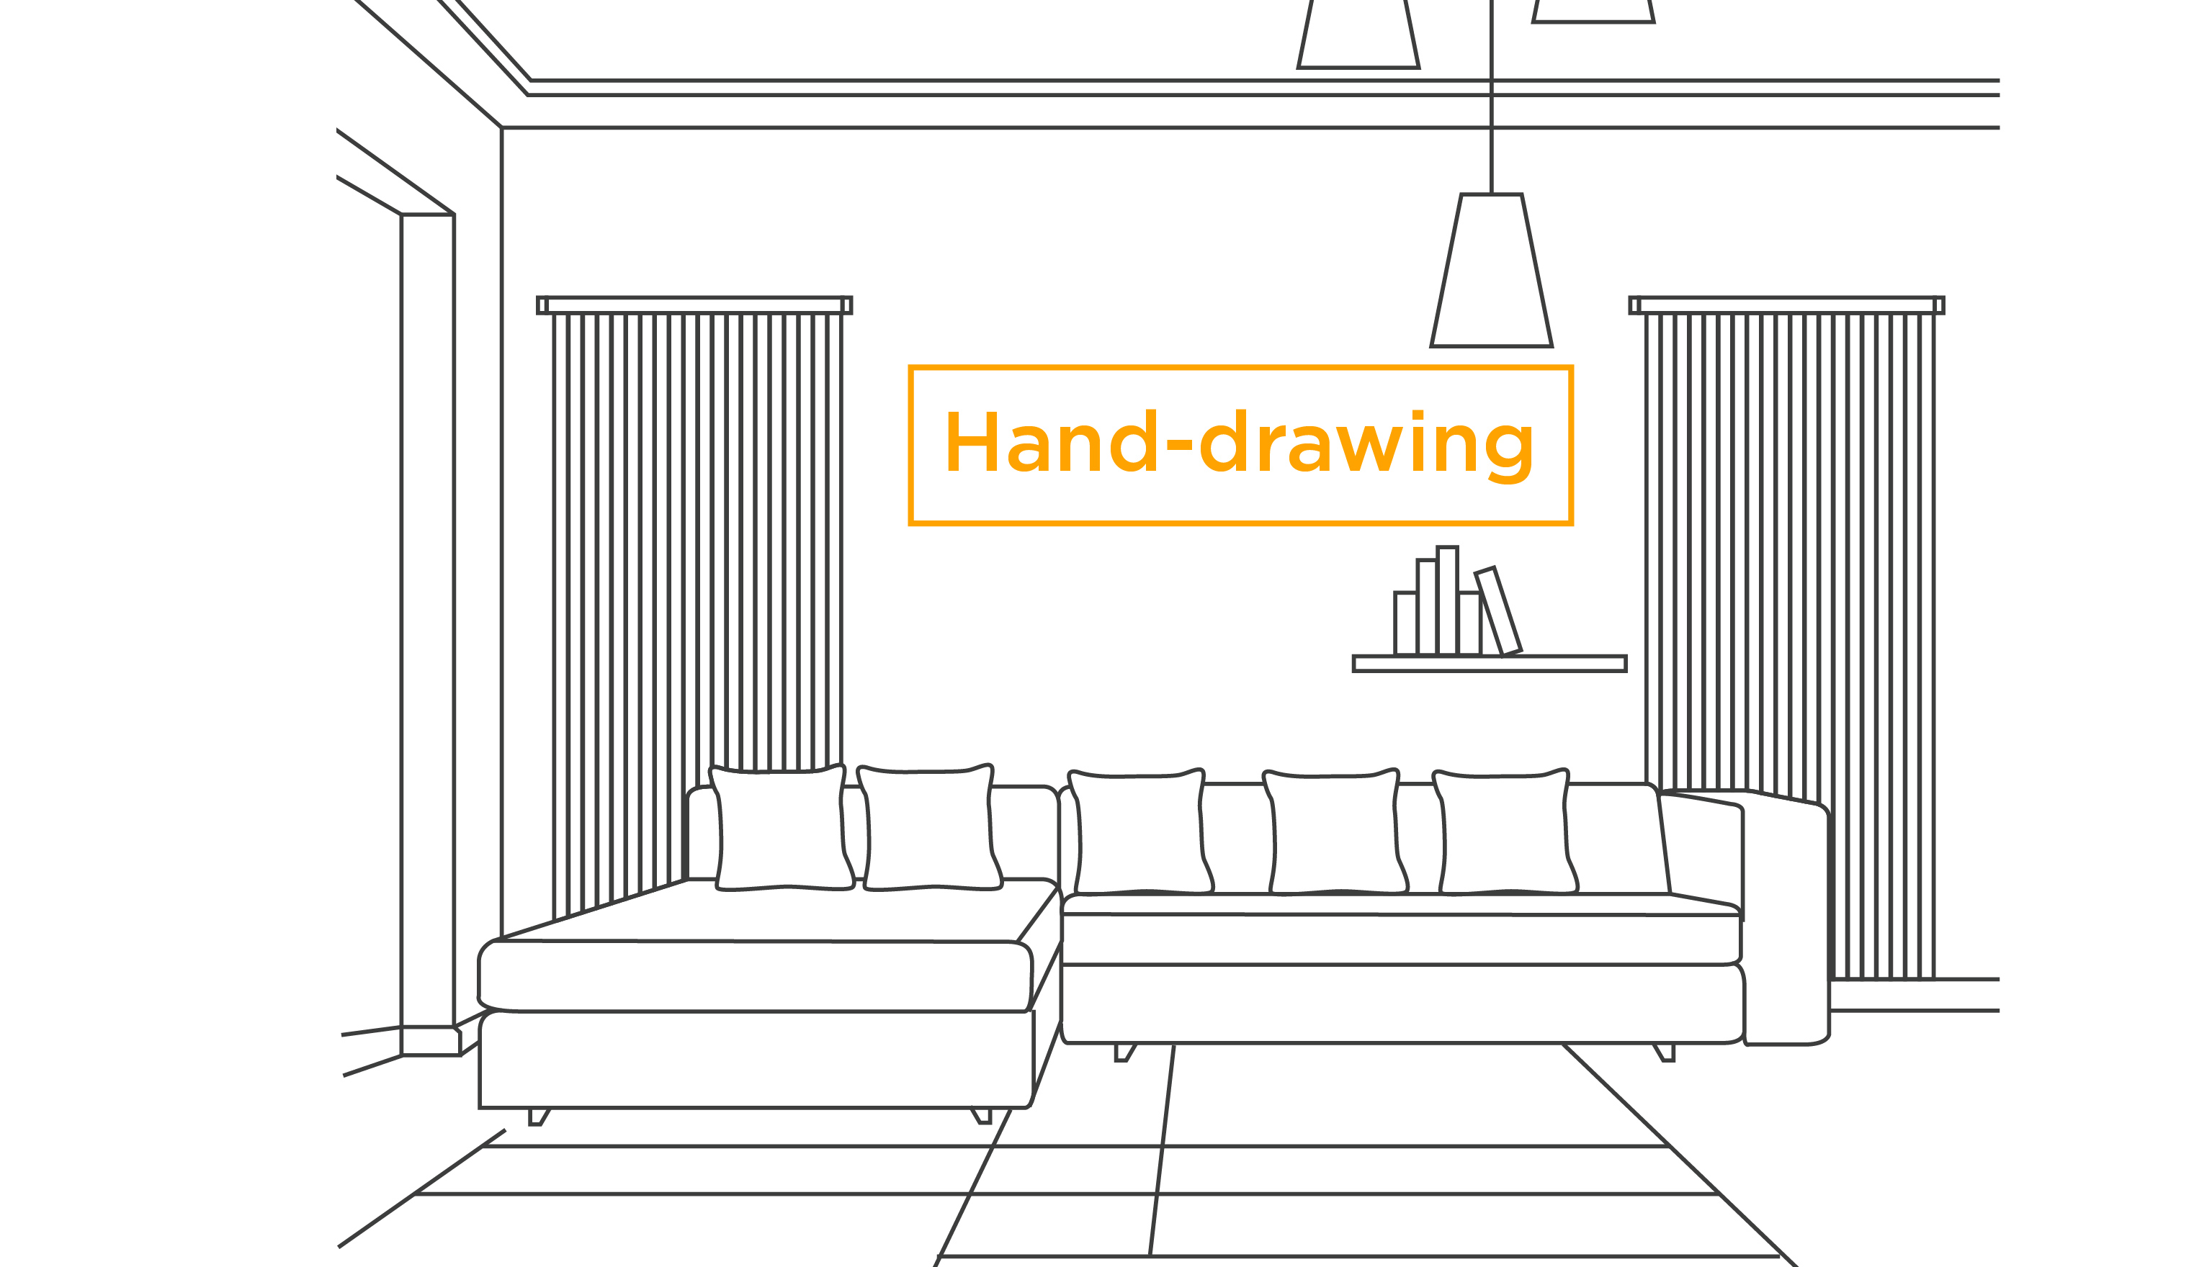

Slide 24
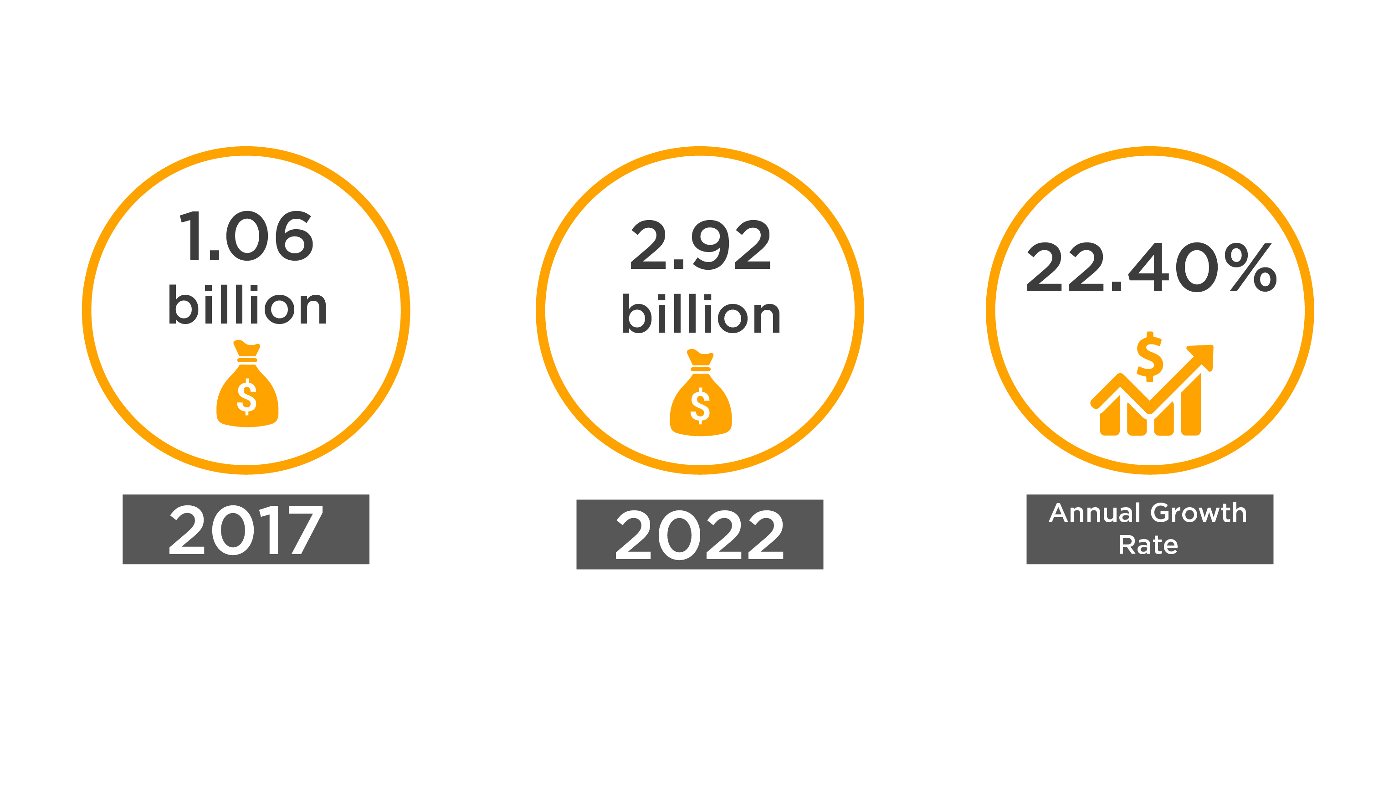
Source: marketsandmarkets.com

Slide 25
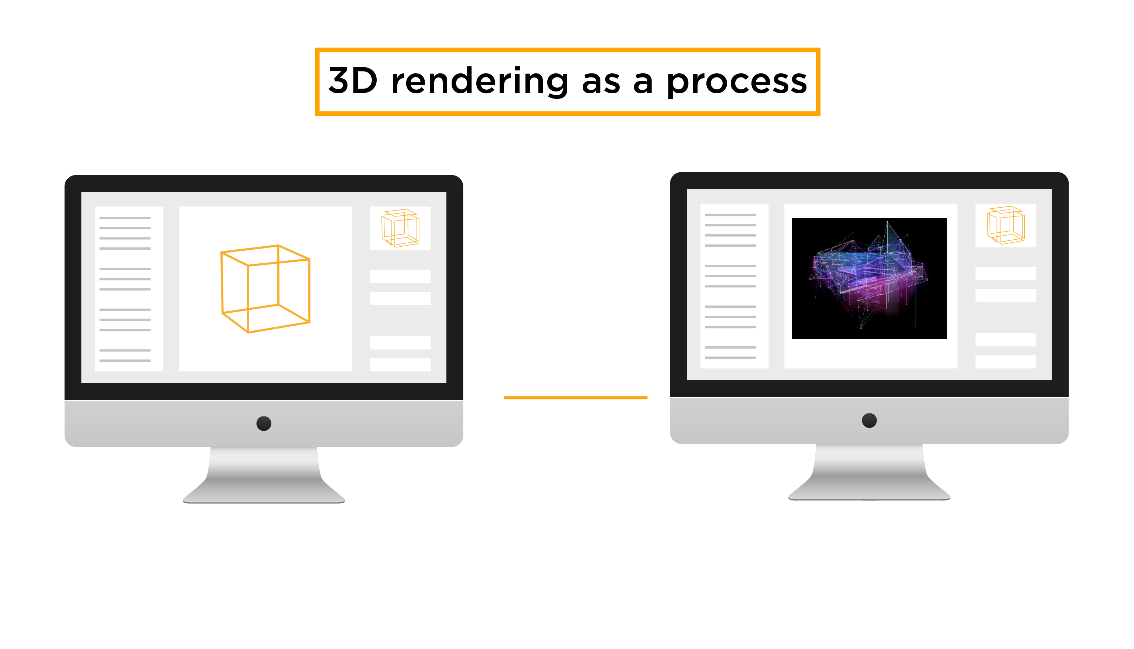

Slide 26
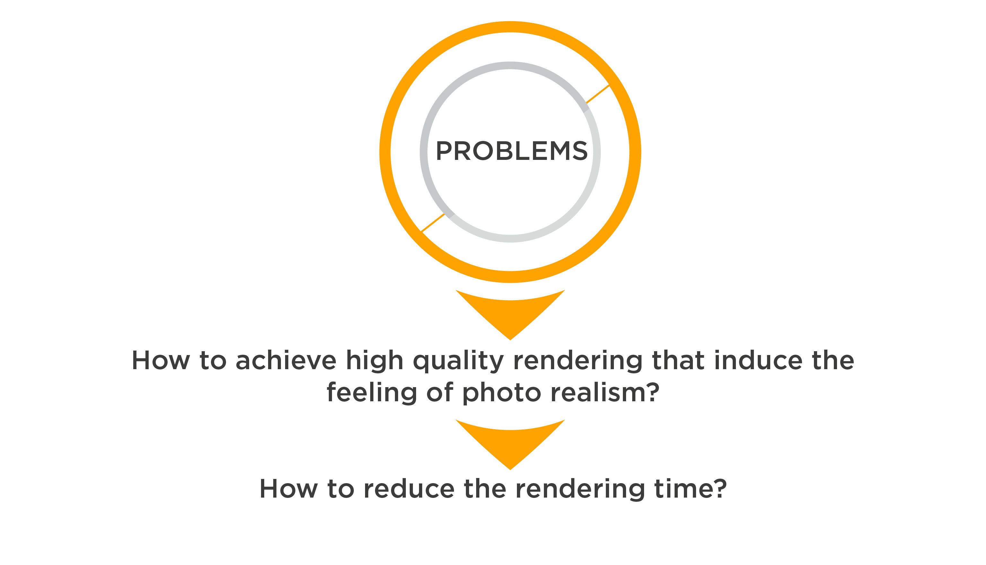

Slide 27
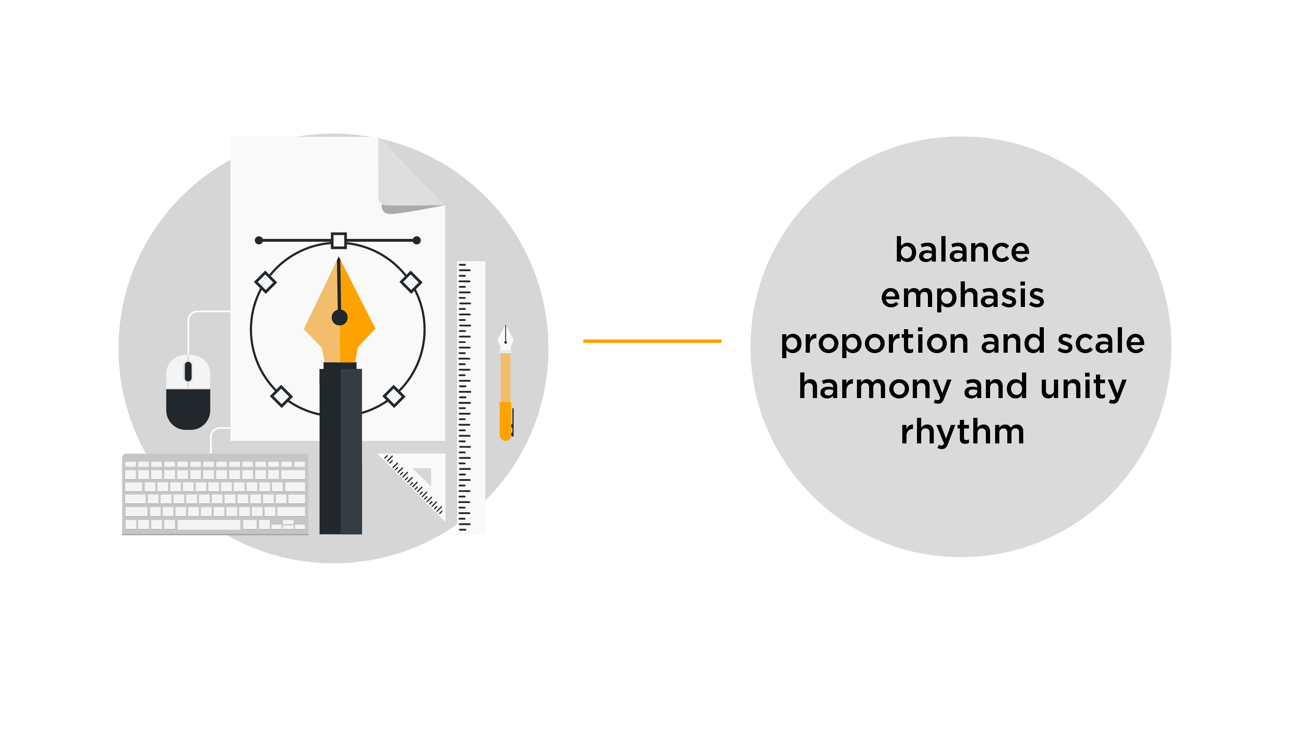

Slide 28


Slide 29
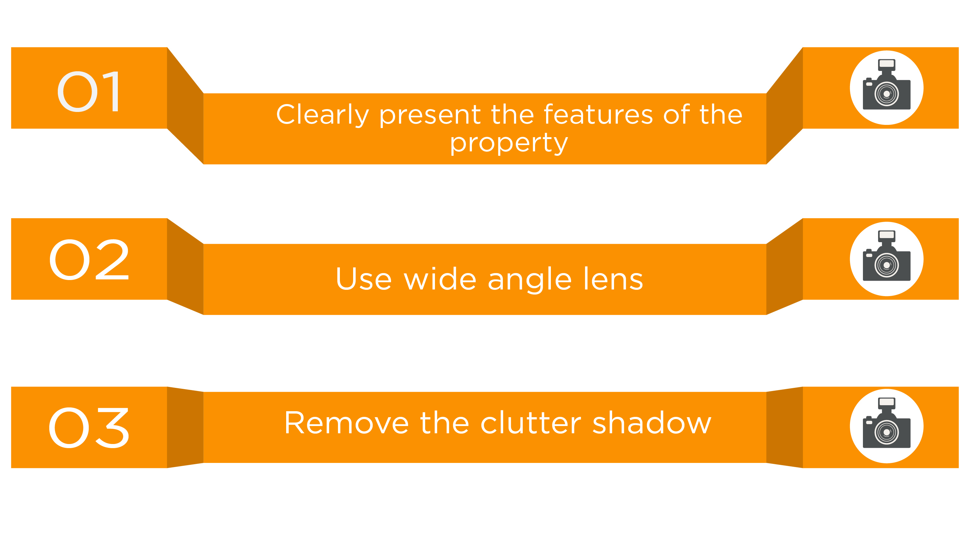

Slide 30
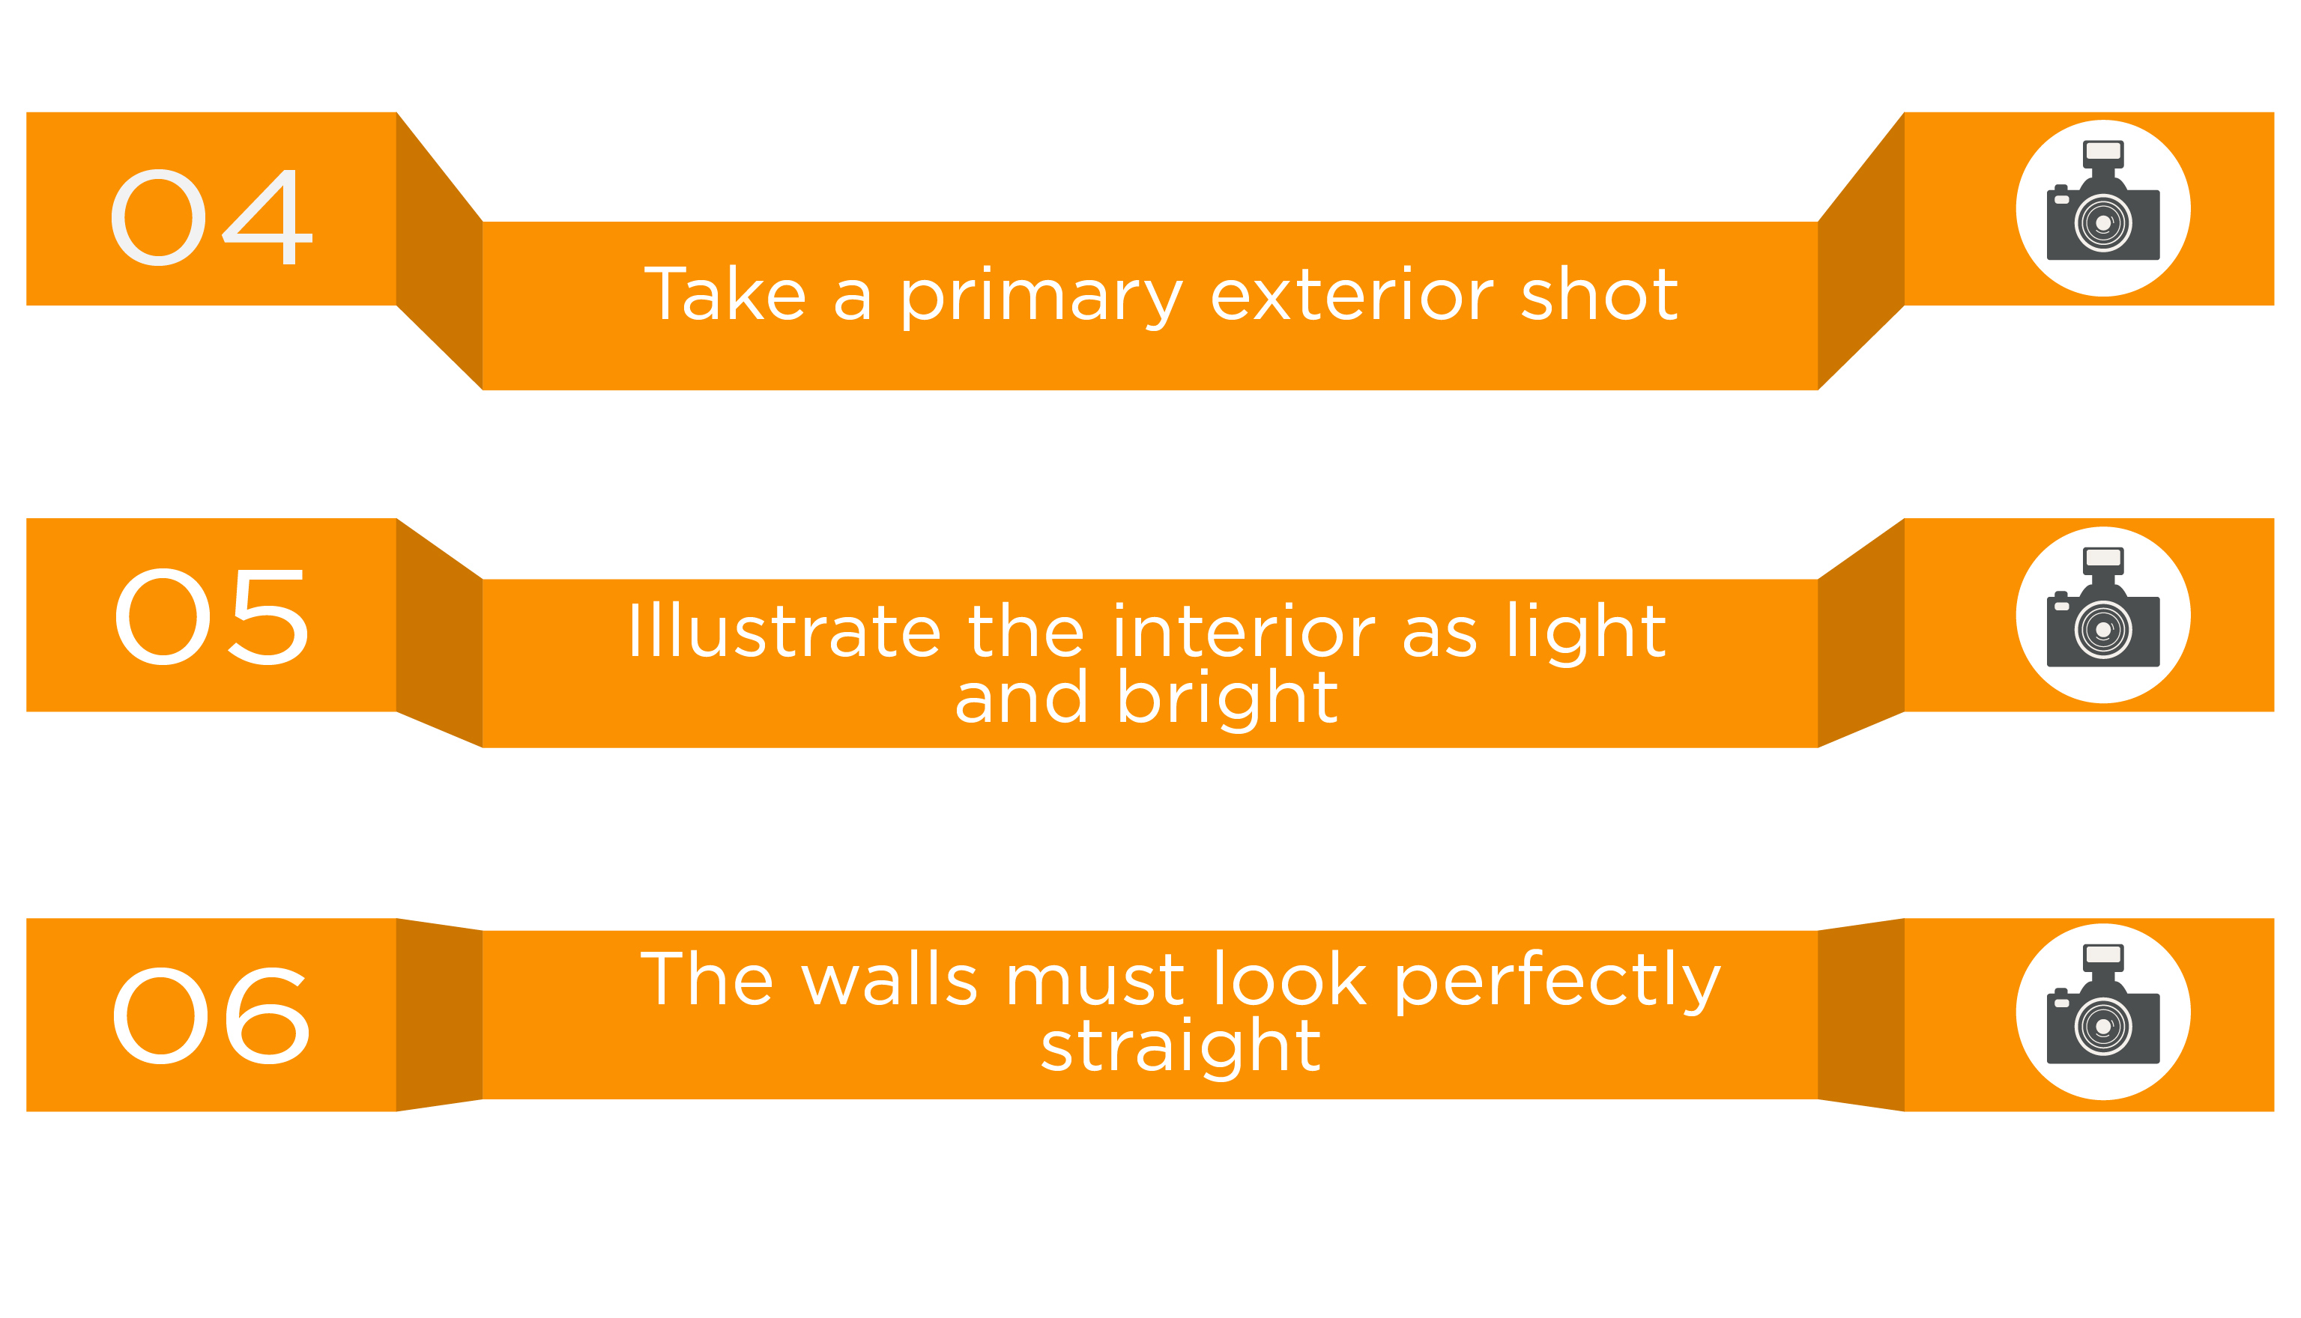

Slide 31
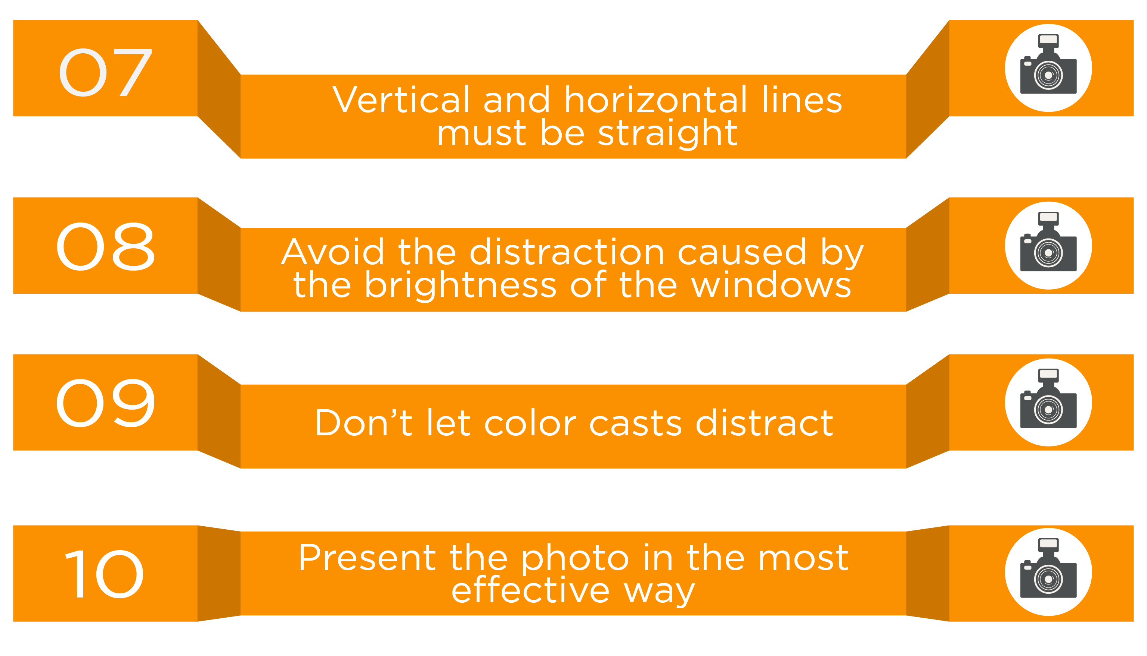

Slide 32
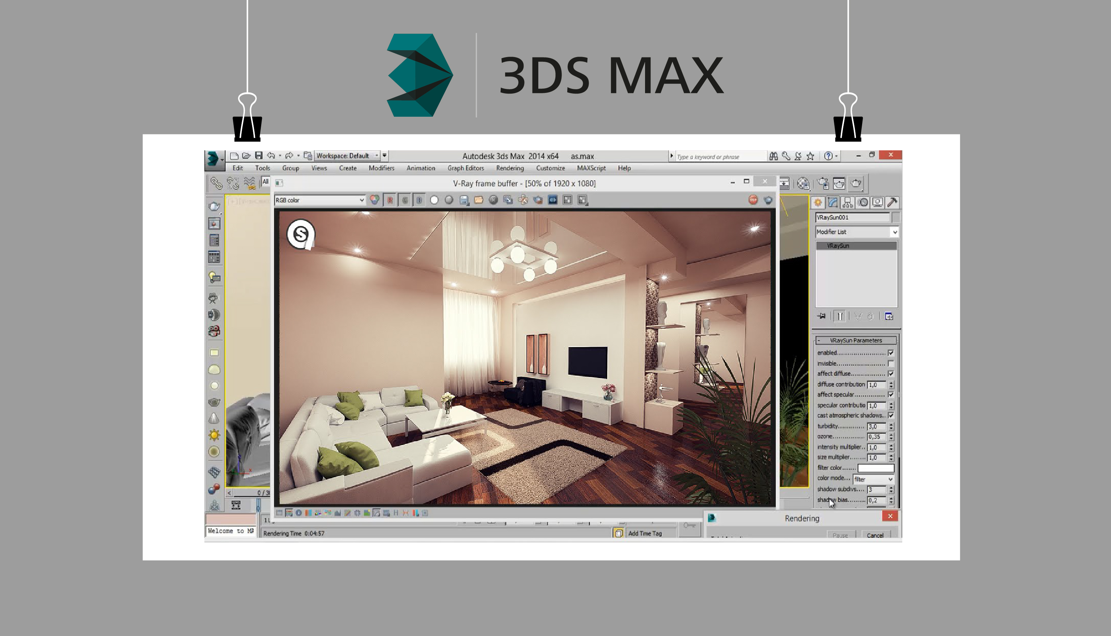

Slide 33


Slide 35
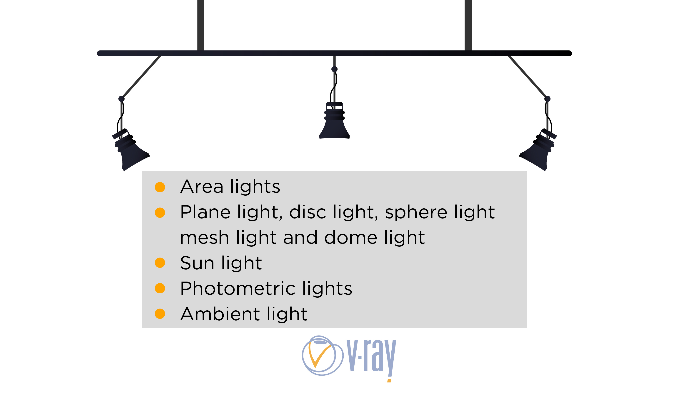

Slide 36
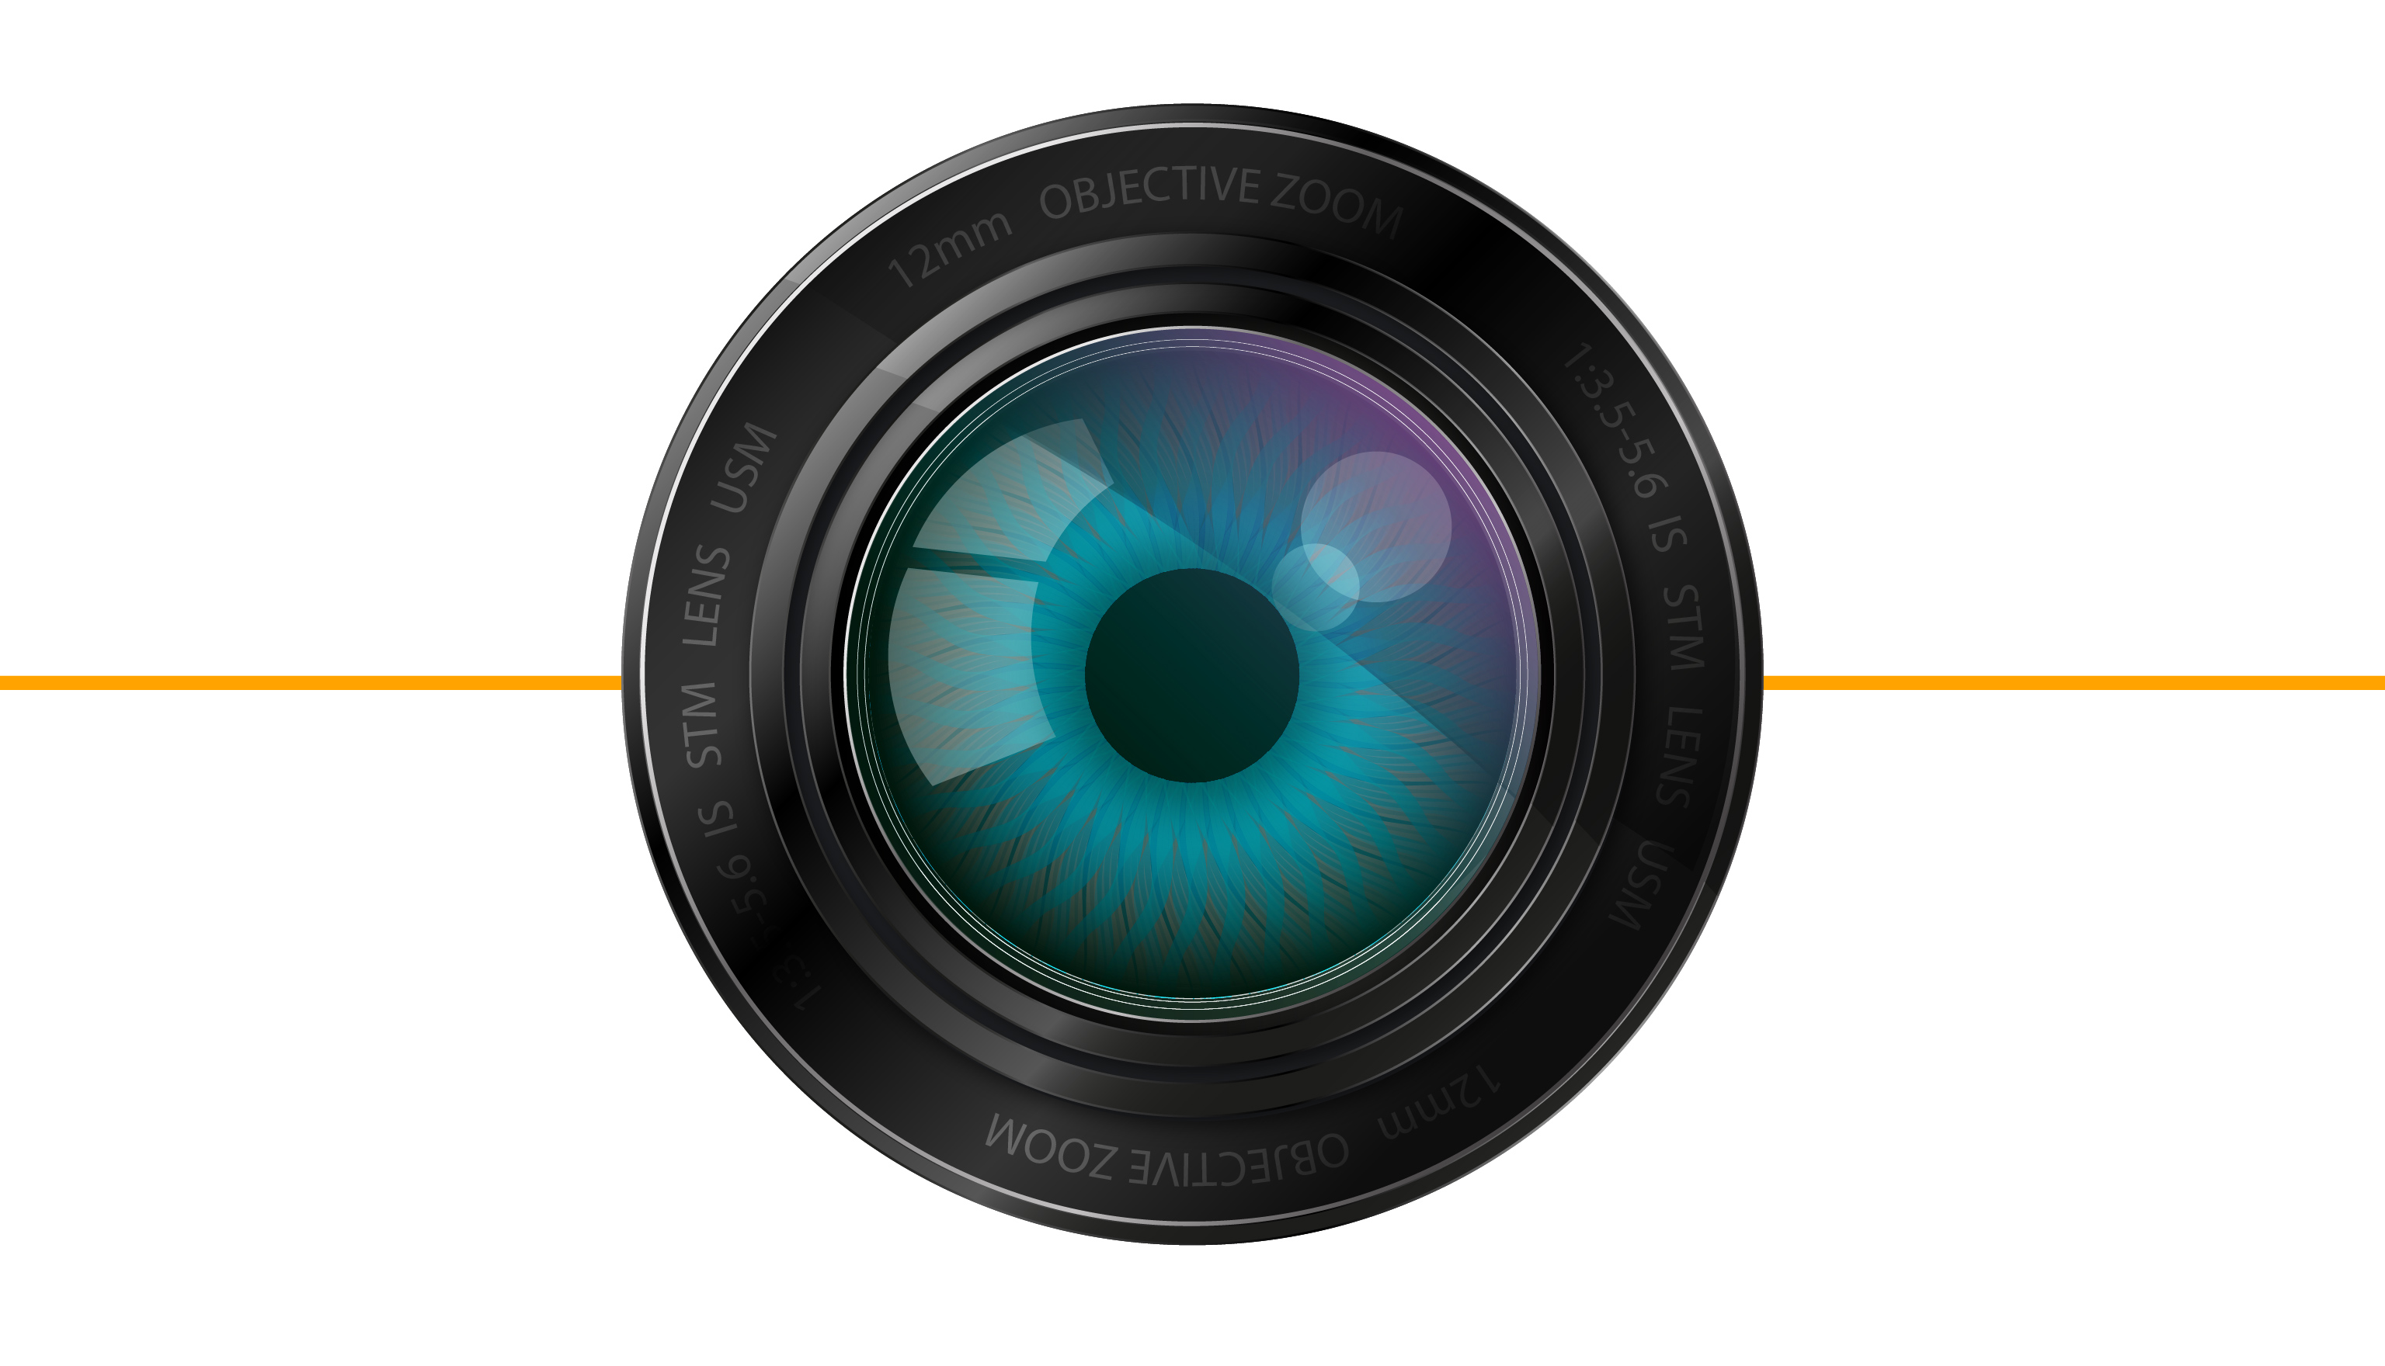

Slide 37


Slide 41
V-ray Physical Camera menu

Slide 42
V-ray Physical Camera menu
Field of View | Real-world Camera | V-ray Physical Camera
Depth of Field | Yes | Yes (The users can specify the DOF depending on the which Film/Sensor Preset has been chosen).
Focal length | Yes | Yes (Default is 40 mm and could be customized)
The camera’s format size | Yes | Yes (Default is 35 mm and could be customized)
Lens breathing | Yes | Yes (Default is 1.0 and could be adjusted)

Slide 44


Slide 46
V-ray Exposure Control Menu
Mode | Allows to choose between different modes, e.g. photographic
Camera Node | Specifies certain node from which the camera settings could be taken.
Exposure Value (EV) | Controls the exposure with a single parameter – it enables to make the image brighter or darker.
Shutter speed | The same function as the shutter has in the digital photography. The value is illustrated on numbers, e.g. 1/200 in V-ray is 200.
f-number | Controls the aperture with the same step as they are designated in the photography (1.4, 2, 2.8, 5.6, 8, 11, 16, 22)
ISO | It determines the film sensitivity. Smaller value makes the render image darker, and larger value – brighter. Unlike the digital photography, the large amount of ISO does not increase the noise in the picture.

Slide 47
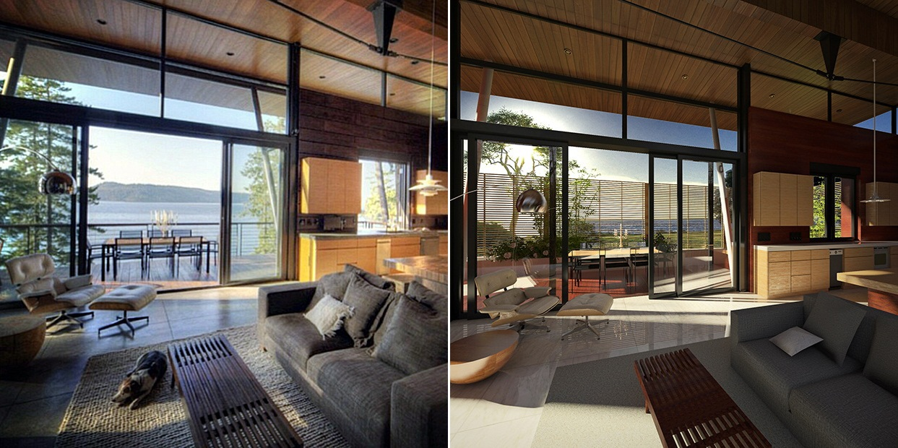
Fig.3. Comparison between photo and V-ray render.
Source: https://nayeemasif.files.wordpress.com/2014/02/comparison.jpg

Slide 48
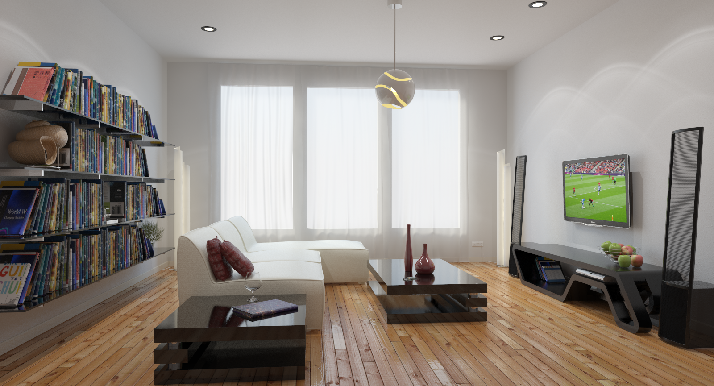
The image bellow illustrates an interior which is rendered with V-ray Adv.3.03
V-ray Physical Camera, ISO: 400
Shutter Speed: 1/60, f 8, Vignetting – off. Lens: 28 mm.
Resolution: 1600 x 859

Slide 49
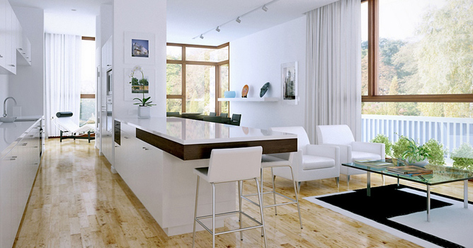
Fig.5. V-ray rendered image
Source: http://4.bp.blogspot.com/-F7ONDCB9lA4/U2iwZpQltQI/AAAAAAAAALs/CGu1gp-p7Qo/s1600/making-interior-scene_0_832.jpg

Slide 50


Slide 51
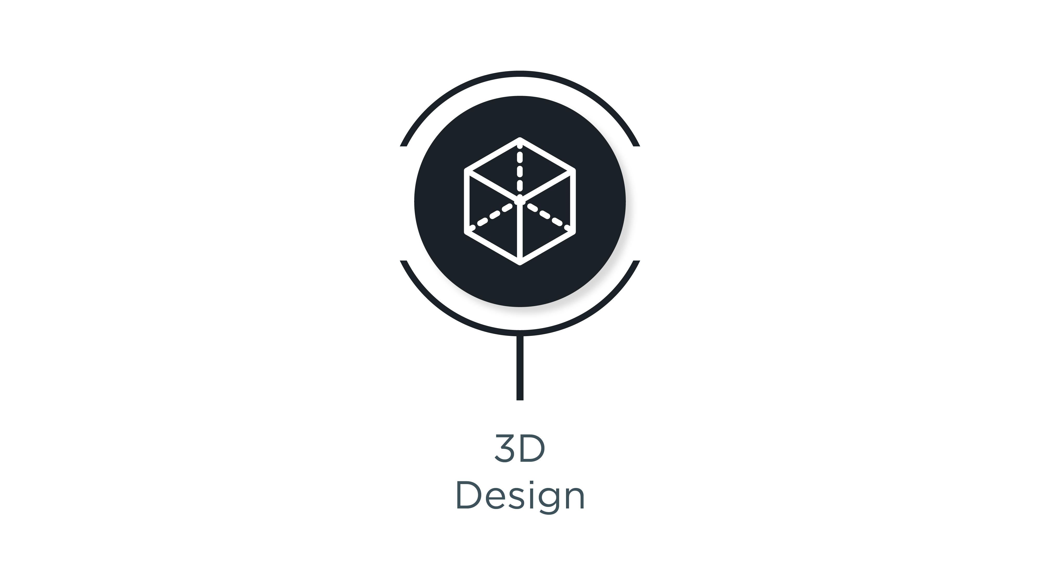

Slide 52
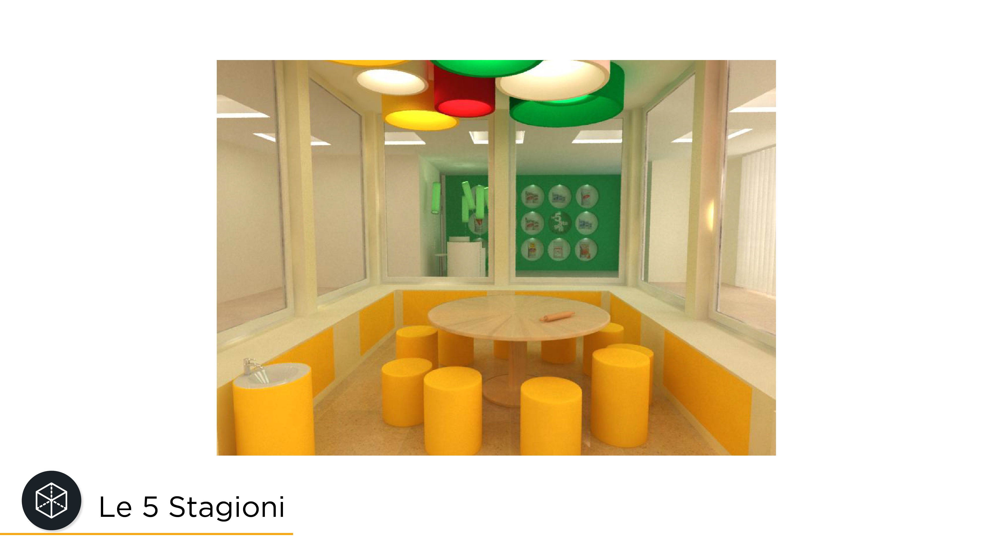

Slide 53
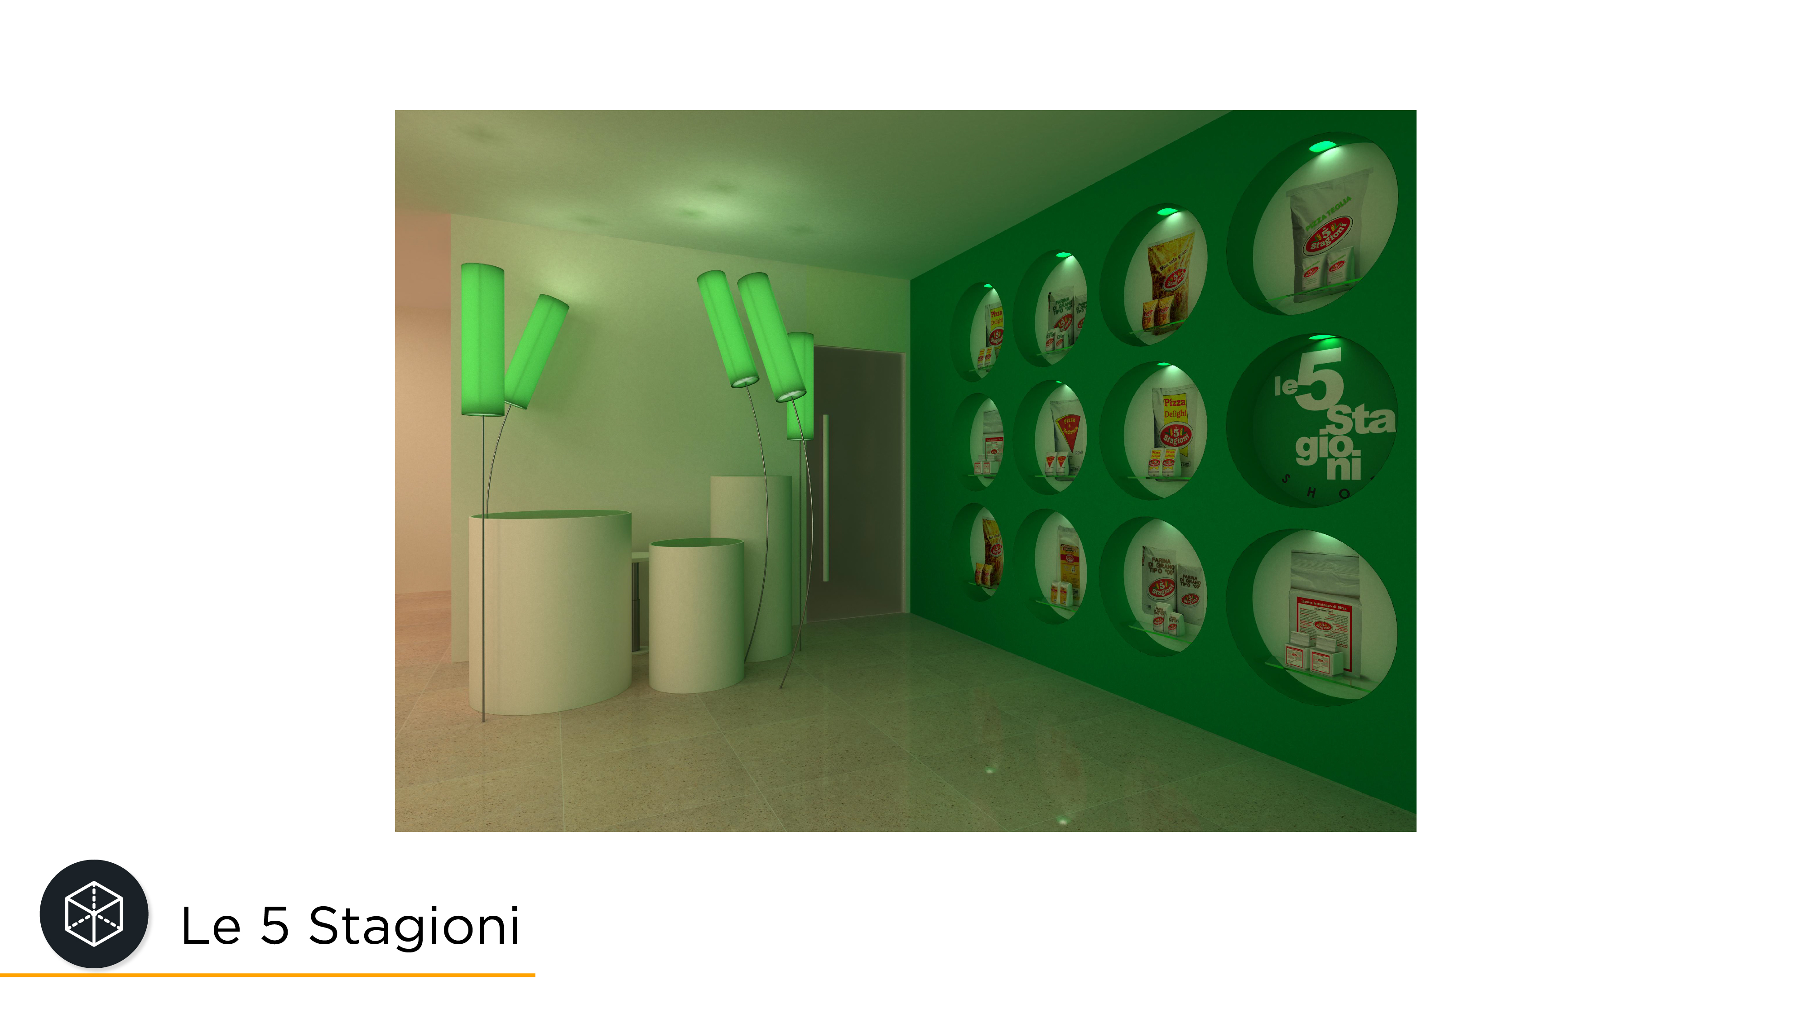

Slide 54
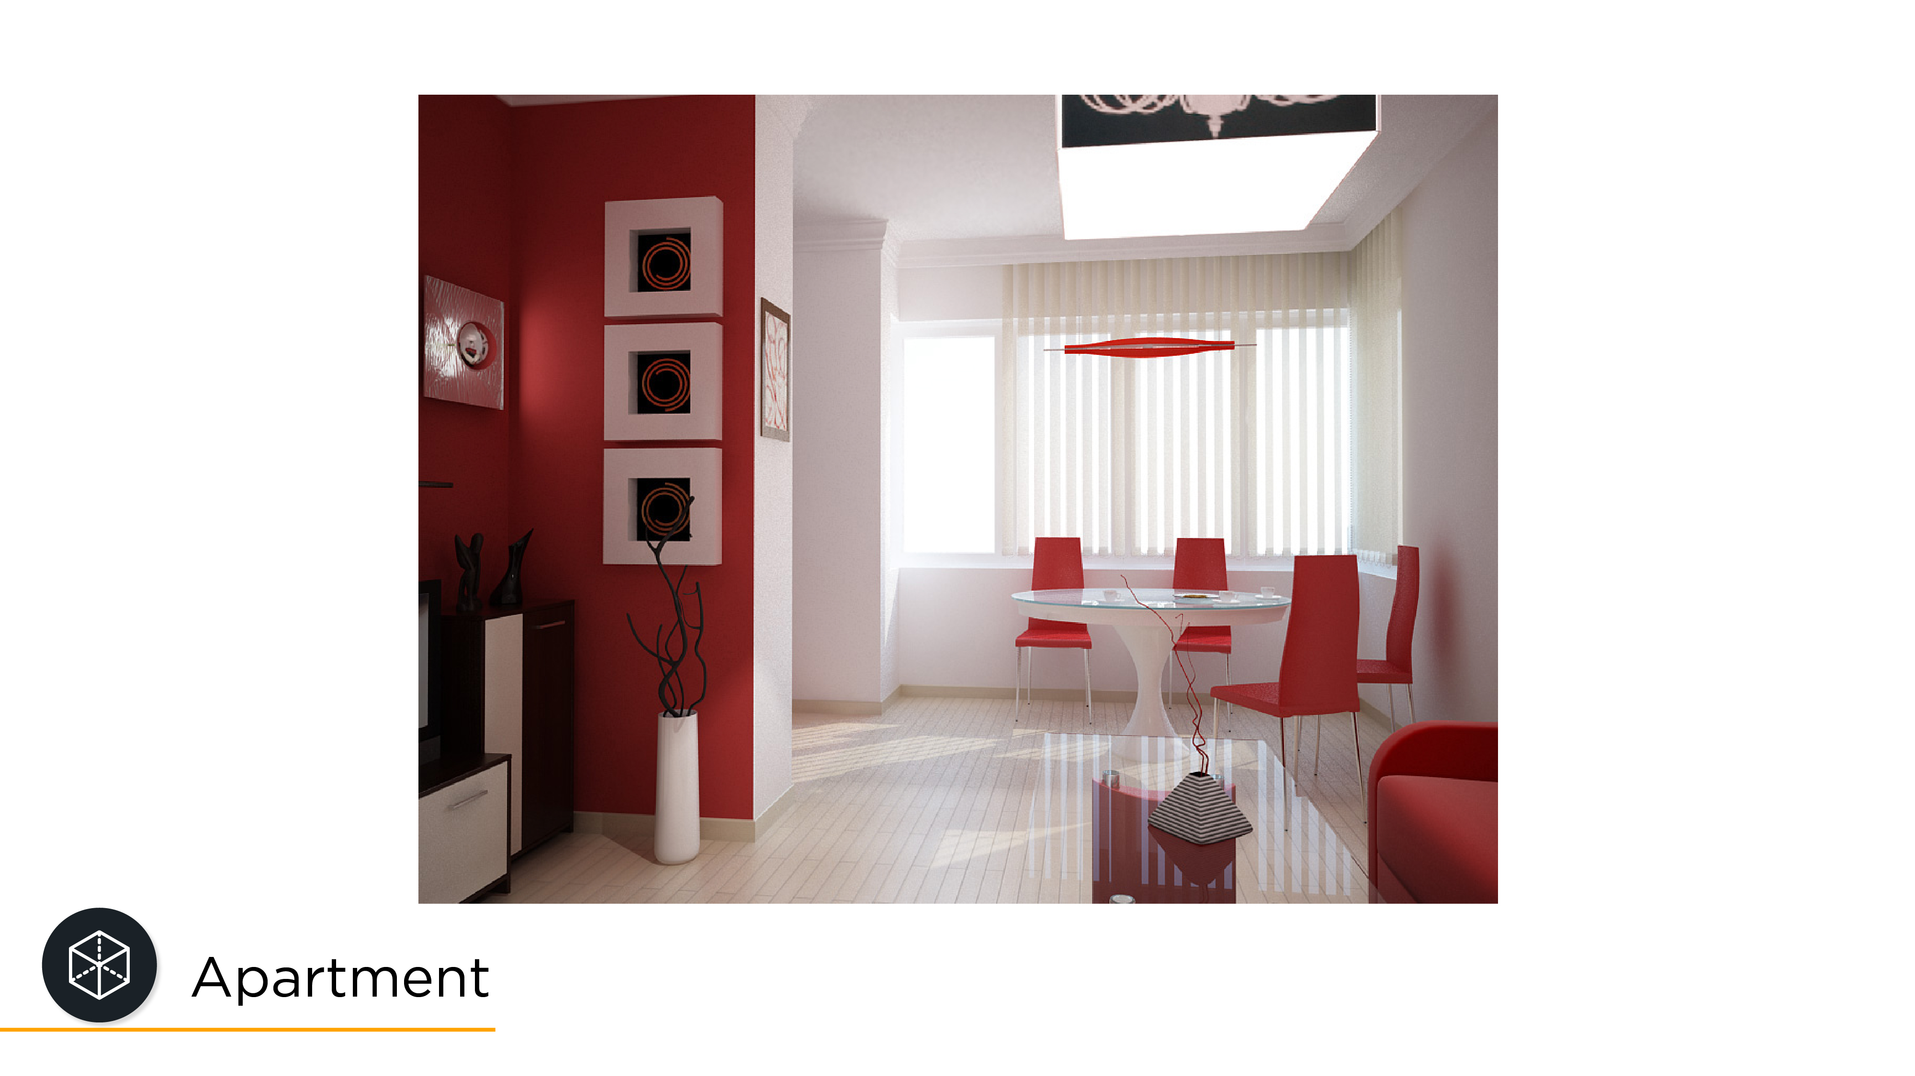

Slide 55
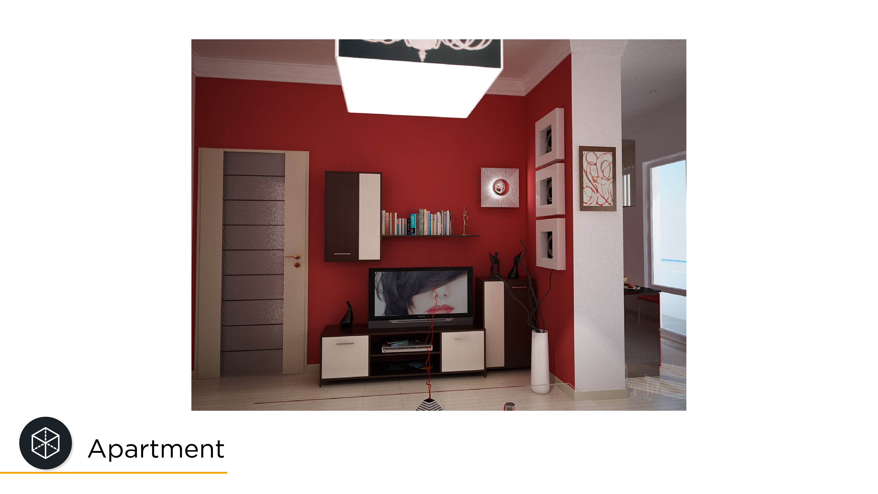

Slide 56
Reference
Books
Lohrman L (2014), What real estate agents need to know about photography, Edition 4, Media LLC
Wang T. (2002), Pencil Sketching, Wiley; 2 edition
E-books
Douglass K, (2009), Equivalent Focal Length, Issue 1:
http://dougkerr.net/Pumpkin/articles/Equiv_Focal_Length.pdf
Nagahara H, Kuthirummal S, Zhou C, Nayar S., (2008), Flexible Depth of Field Photography, European Conference on Computer Vision, pp. 60–73. Retrieved from: http://www.cs.columbia.edu/~sujit/PAMI.pdf
Swanson E., (2010), Interior Design 101, Retrieved from: http://ericaswansondesign.com/wordpress/wp-content/uploads/2010/05/E-Book-Final.pdf
Verma V, Walia E, (2010), 3D Rendering - Techniques and Challenges, International Journal of Engineering and Technology Vol.2(2), 2010, 29-33. Retrieved from: http://www.enggjournals.com/ijet/docs/IJET10-02-02-01.pdf
Reports
Obeo, (2017) Introduction to Real Estate Photography, Retrieved from: http://www.obeo.com/wp-content/themes/obeo/assets/media/obeo-photography-ebook.pdf
Real Estate in a Digital Age (2017), National Association of Realtors. Retrieved from: https://www.nar.realtor/sites/default/files/reports/2017/2017-real-estate-in-a-digital-age-03-10-2017.pdf
Websites
Barry O Carroll (www.bocphotography.com)
CHAOSGROUP, https://docs.chaosgroup.com/display/VRAY3MAX/Area+Lights+%7C+VRayLight
Visualization and 3D Rendering Software Market by Application (High-End Video Games, Architectural and Product Visualization, Training Simulation, Marketing and Advertisement), Deployment Type, End-User, and Region- Global forecast to 2022, Published by: marketsandmarkets.com, publishing Date: June 2017, Report Code: TC 4168

Slide 57


