Slide 1
How Did Things Get So Bad?
The Past, Present and Future of Diabetes Type Two
Dr Peter Mansfield
mansfield.pj@gmail.com
Retired Aeromedical Examiner, UK
Independent Health Investigator
Notes:
My thanks to the Organising Committee for the opportunity to give this paper.
I am not an Ayurvedic practitioner, and my experience of herbal medicines is not expert. However, any system of medicine needs to understand what it is dealing with, to be able to set about management appropriately. This is perticularly rewarding in the case of Diabetes Type Two.
I will relate the history of diabetes Type Two, from the beginning of settled farming, and explains why there has from the 1950s until recently been so little emphasis on the prevention and reversal of the disease.

Slide 2
Pandemic
WHO GLOBAL REPORT ON DIABETES 2016
Globally, an estimated 422 million adults were living with diabetes in 2014, compared to 108 million in 1980.
The global prevalence (age-standardized) of diabetes has nearly doubled since 1980, rising from 4.7% to 8.5% in the adult population.
This reflects an increase in associated risk factors such as being overweight or obese.
Over the past decade, diabetes prevalence has risen faster in low- and middle-income countries than in high-income countries.
Notes:
These are last year’s figures, which will only have got worse since.

Slide 3

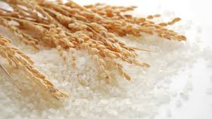
Pre-History
Hunter-gatherers
until 12000 BC
Settled Farming
in Middle East
from 8000 BC
Notes:
So how did we get this bad? To understand that we need to delve back 20000 years into the past.
The advent of cereal farming was a major step. It meant far greater food security, releasing effort that could be devoted to other things.
It is no accident that written culture and monumental construction began about this time.

Slide 4
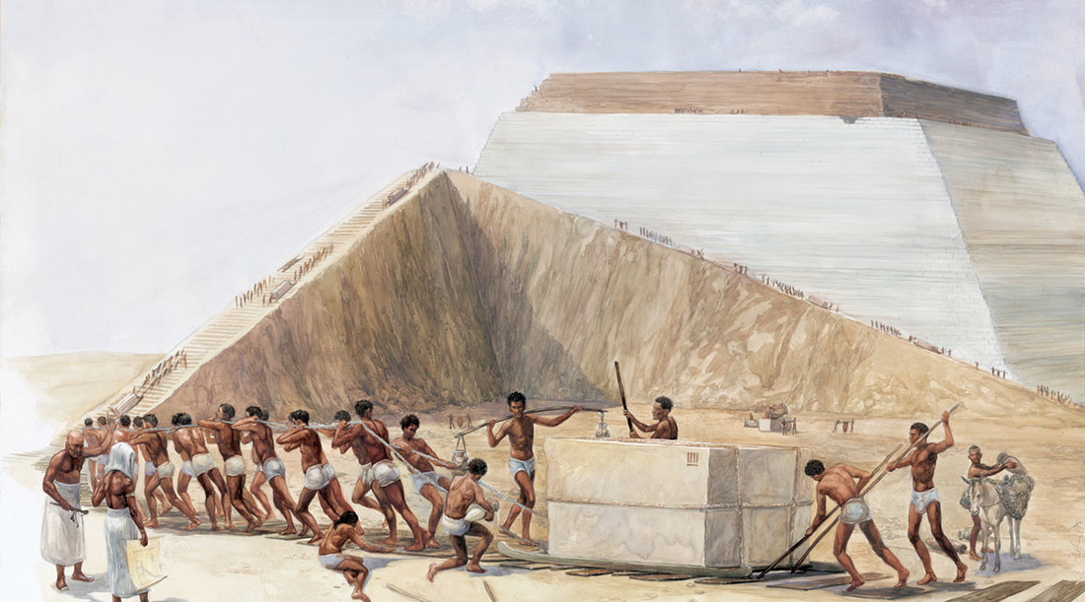
Hard Labour
Notes:
It made greater energy available to the slaves who actually built those monuments

Slide 5

Going Soft
Notes:
Now fast forward 7000 years, and we had found ways to work less hard

Slide 6
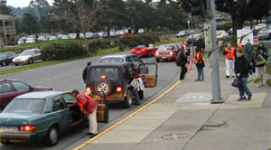

. . . And Softer Still
Notes:
. . . Until the present century, when few of us work at all. At least the gardener has to push his mower – most don’t even do that.

Slide 7

. . . But Just as Hungry
Notes:
Yet we go on producing carbohydrates in unprecedented quantities.

Slide 8

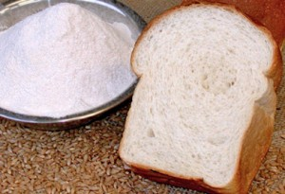
Pure, White and . . .?
Notes:
And taking the best part out, leaving almost empty calories.
Note the name on the packet, by the way.

Slide 9
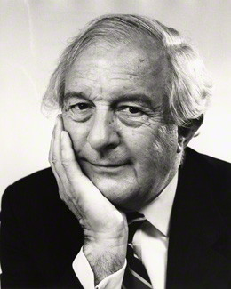
Enter John Butterfield
Proc R Soc Med. 1964 Mar; 57(3): 196–200. Diabetes Survey in Bedford 1962
Butterfield, W J H
Notes:
At this point meet an illustrious man, whose brilliant career began in Cambridge in the 1950s.

Slide 10
Personal Communication by Lord Butterfield to the Author, 1985
An important paper funded by the MRC and published by Professor John Butterfield in 1964, identified for the first time the hidden prevalence of early non-insulin-dependent diabetes, coined by him Type 2. A ten-year follow-up study in Bedford ensued, but the MRC declined on political grounds to fund further diabetes research proposals put forward by Butterfield – still early in a brilliant and distinguished career.
Notes:
He was the first to identify and name Diabetes Type Two, in the population of Bedford.

Slide 11
Personal Communication by Lord Butterfield to the Author, 1985 . . . continued
Rather than abandon his ideas, Butterfield broke another piece of new ground. He went to industry in search of funding. And the most favourable response he received was from Tate and Lyle, the largest sugar company in Britain. They offered generous funding for research into diabetes, provided only that no link with sugar consumption were ever mentioned or pursued.
Notes:
Frustrated by a political unwillingness to extend his research, he approached industry for the funding he needed.

Slide 12
Personal Communication by Lord Butterfield to the Author, 1985 . . . continued
Butterfield accepted these terms, keenly aware of the commercial and political constraints imposed by the world he was entering, and determined to make the best of them. He turned his attention to the genetic and immunological aspects of diabetes, and the development of human-identical insulin.
He was faithful to the terms of his original funders throughout his years directing research at Guy’s Hospital, and as WHO Principal Adviser in Diabetes. But he disclosed them to me without hesitation in 1985 when, during a private conversation at his rooms in Downing College, Cambridge, I asked him why diabetes prevention had received so little research attention.
Notes:
He made a Faustian pact, well aware of the implications. It set him off in the directions for which he became famous. But we had no research in prevention or the cause of diabetes for the next 60 years.

Slide 13
Personal Communication by Lord Butterfield to the Author, 1985 . . . continued
I in turn respected his confidence until the advent in 2015 of “Action On Sugar”, a consensus campaign by leading academics to highlight the dangers of sugar consumption – including diabetes.
Baron Butterfield of Stechford – otherwise Professor Sir William John Hughes Butterfield Kt OBE FRCP - died in 2000 aged 80, deservedly honoured for his wisdom, integrity and scientific distinction.
Peter Mansfield 11th September 2017
http://www.actiononsugar.org/ accessed on 11th September 2017.
Notes:
Meanwhile in 1985 I had an opportunity to question him about this. He was candid, and I respected his confidence until 2015.
By which time Butterfield had been dead 15 years.

Slide 14
Diabetes Doctrine to 2015
(Type One) Diabetics are normal people except they have to inject themselves every day
We don’t know why there are so many diabetics, but it doesn’t matter – we know how to treat them
Eat as much good food as you like, and we will give you enough treatment to cover it.
Notes:
These are examples of the prevailing philosophical stance in medicine for the past century, that Harris Coulter described as Rational.

Slide 15
Rational versus Empirical
Rational:
The diabetic is sick because the patient’s pancreas produces too little insulin
- so give hypoglycaemic medication
Empirical:
The pancreas under-secretes insulin because the patient is diabetic
- so adjust the diet
After Harris Coulter, “Divided Legacy” IV p 225
Notes:
Our academic establishment is not used to thinking empirically, and that has infected all the practitioners they train.
However general medical practice in the British NHS, and public health practice using that model, work much better when rooted in empirical thinking.
Here’s an example.

Slide 16
Air Pilots – a Special Case
They love to fly
The professionals are well paid
Diabetes was until recently a bar to flying
It still imposes severe limitations on the pilot
Pilots will work hard to get rid of the hassle

Slide 17
Suitable Diets
Palaeolithic - Based on diet presumed to prevail before the advent of settlement and agriculture. Excludes cereal crops and dairy produce.
See http://thepaleodiet.com/, accessed on 11th Sept 2017
Atkins – severely restricted carbohydrate intake, devised by Dr Robert Atkins chiefly for weight reduction. Less severe than the Palaelithic diet
http://www.atkins.com/, accessed on 11th Sept 2017
Montignac – devised by Michel Montignac to control his own weight. Does not exclude carbs but separates them from fats.
www.montignac.com/ accessed on 11th Sept 2017

Slide 18
Results in Pilots
These are approximations
1100 pilots registered
Officially obese (BMI >35) ±5
Overweight ±200
Successful weight reduction ±100
Reversal of Type Two Diabetes ±10
Reduction of medication and/or weight loss ±20 more

Slide 19
Implications?
Obesity and Type Two Diabetes Preventable
Type Two Diabetes Curable if detected early
Major Effort required
Incentives?
  Medical Insurance Premiums
  No Claims Discounts
  “Honours”?

Slide 20
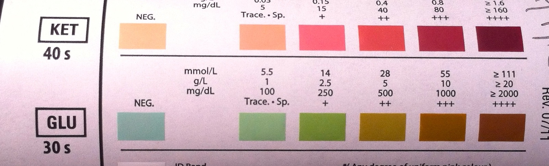
Towards Zero Tolerance
Thank you for your attention

