Slide 1
Libraries in the Big Data Era Strategies and Challenges in Archiving and Sharing Research Data
Peter Löwe
September 27 2016
BigData 2016

Slide 2
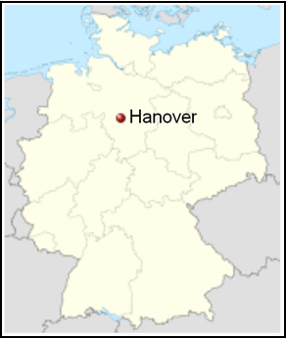

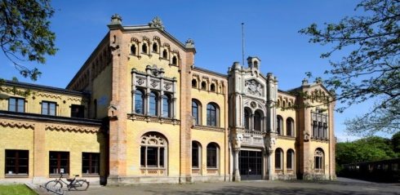
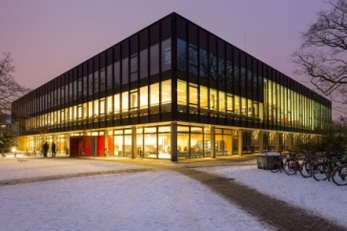
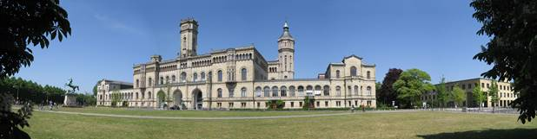
German National Library of Science and Technology Technische Informationsbibliothek (TIB)
  National library of Germany for
    engineering, technology, and the physical sciences
  Largest science and technology library globally
    over 9 Mio. items
    180 Mio. Documents (TIB Portal)
    125 km of shelving
  Infrastructure provider for the scientific work process
  Global customer base
Notes:
Engineering, architecture, chemistry, information technology, mathematics and physics
The German National Library of Science and Technology (TIB) ranks as one of the largest specialized libraries worldwide:
Its mission is to comprehensively acquire and archive literature from around the world pertaining to all areas of engineering, architecture, chemistry, information technology, mathematics and physics.
Tools and infrastructure are developed to support users in scientific work processes, enabling the easy publication, discoverability and long-term availability of scientific-technical information.

Slide 3
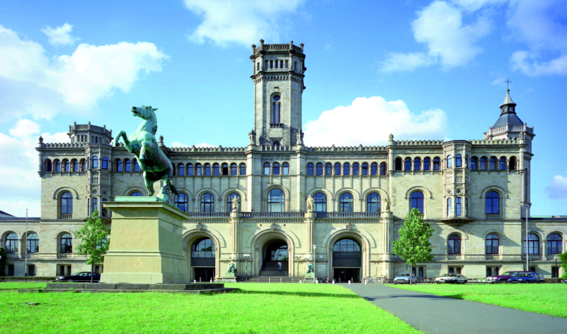
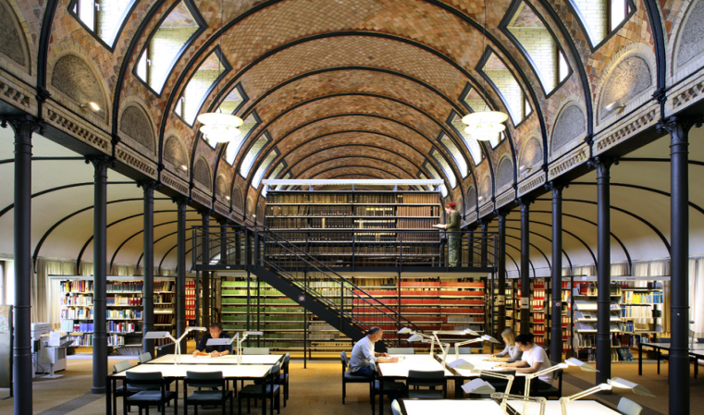

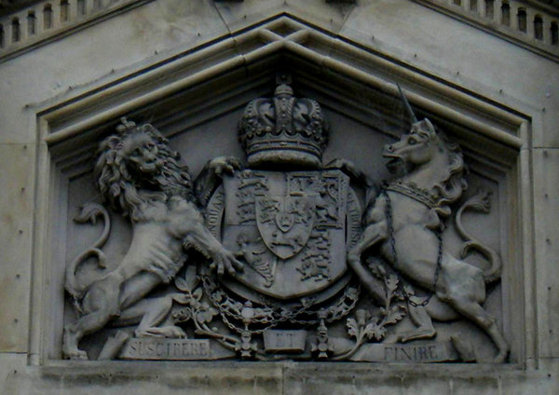
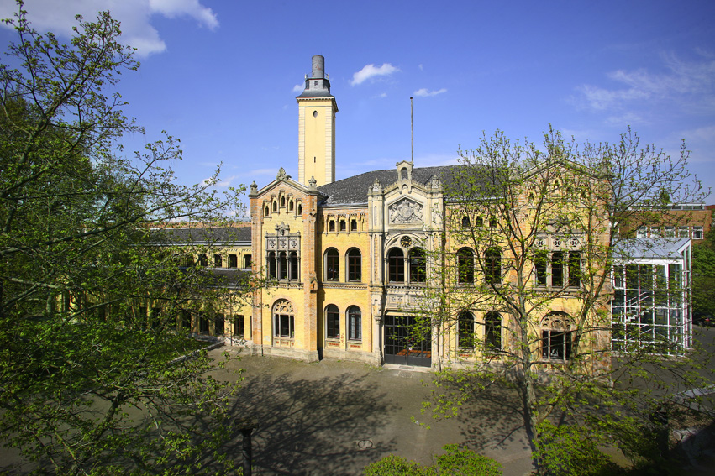
TIB – Hannover – Great Britain
Guelph Castle (main campus)
Source: TIB
Stables of the Royal Guelph Lancers
Source: TIB
SUSCIPERE ET FINIRE
Undertake and accomplish
Source: TIB
Britisch-Hannoverian
coat of arms (1714–1801)
Stables of the Royal Guelph Lancers
Source: Wikipedia
Source: TIB
Notes:
SUSCIPERE ET FINIRE (unternehmen und zu Ende führen)
Ulanen: Cavalry/Lancers
British succession[edit]
Religion-driven politics brought about Ernest Augustus' wife Sophia of Hanover being in the line of succession to the British crown by theSettlement Act of 1701, written to ensure a Protestant succession to the thrones of Scotland and England at a time when anti-Catholic sentiment ran high in much of Northern Europe and Great Britain. But Sophia died shortly before her first cousin once removed, Anne, Queen of Great Britain, the last sovereign of the House of Stuart. Sophia's son George I succeeded queen Anne and formed a personal union from 1714 between the British crown and the Electorate of Hanover, which lasted until well after the end of the Napoleonic Warsmore than a century later, through the dissolution of the Holy Roman Empire and the rise of a new successor kingdom. The British royal family became known as the House of Hanover.
Kingdom of Hanover[edit]
The "Electorate of Hanover" (the core duchy) was enlarged with the addition of other lands and became the Kingdom of Hanover in 1814 at the Congress of Vienna. During the first half of the nineteenth century, the Kingdom was ruled as personal union by the British crown from its creation under George III of the United Kingdom, the last elector of Hanover until the death of William IV in 1837. At that point, the crown of Hanover went to William's younger brother, Ernest Augustus, Duke of Cumberland and Teviotdale under the Salic law requiring the next male heir to inherit, whereas the British throne was inherited by an elder brother's only daughter, Queen Victoria. Her offspring belong to the House of Saxe-Coburg and Gotha: in 1917 the name was changed to the House of Windsor.
The Kingdom of Hanover was lost in 1866 by Ernest Augustus' son George V of Hanover, Austria's ally during the Austro-Prussian War, when it was annexed byPrussia after Austria's defeat, and became the Prussian province of Hanover. The Welfs went into exile at Gmunden, Austria, where they built Cumberland Castle.
Edward VII and, in turn, his son, George V, were members of the German ducal House of Saxe-Coburg and Gotha by virtue of their descent fromAlbert, Prince Consort, husband of Queen Victoria. High anti-German sentiment amongst the people of the British Empire during World War I reached a peak in March 1917, when the Gotha G.IV, a heavy aircraft capable of crossing the English Channel, began bombing London directly and became a household name. In the same year, on 15 March, King George's first cousin, Nicholas II, the Emperor of Russia, was forced toabdicate, which raised the spectre of the eventual abolition of all the monarchies in Europe. The King and his family were finally convinced to abandon all titles held under the German Crown and to change German titles and house names to anglicised versions. Hence, on 17 July 1917, a royal proclamation issued by George V declared:
Now, therefore, We, out of Our Royal Will and Authority, do hereby declare and announce that as from the date of this Our Royal Proclamation Our House and Family shall be styled and known as the House and Family of Windsor, and that all the descendants in the male line of Our said Grandmother Queen Victoria who are subjects of these Realms, other than female descendants who may marry or may have married, shall bear the said Name of Windsor....^{[2]}
The name had a long association with monarchy in Britain, through the town of Windsor, Berkshire, and Windsor Castle; the link is alluded to in the Round Tower of Windsor Castle being the basis of the badge of the House of Windsor. From 1917 to 1919, George V also stripped 15 of his German relations—most of whom belonged to the House of Hanover—of their British titles and styles of prince and princess.
Upon hearing that his cousin had changed the name of the British royal house to Windsor and in reference to Shakespeare's The Merry Wives of Windsor,German Emperor Wilhelm II remarked jokingly that he planned to see "The Merry Wives of Saxe-Coburg-Gotha".^{[3]}

Slide 4
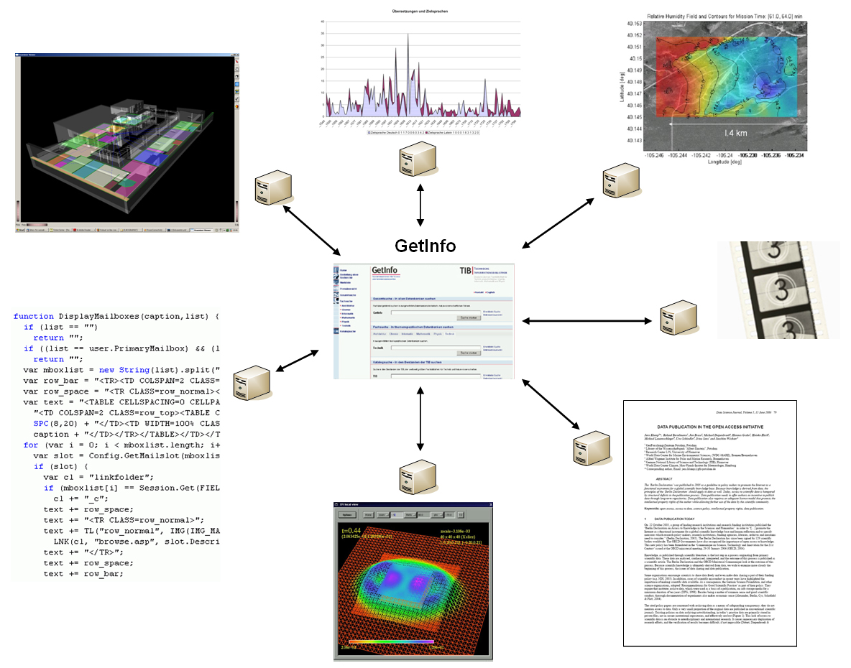
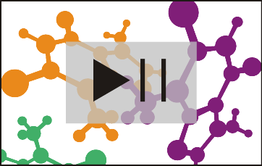
TIB-Strategy:
Move beyond text
3D-objects
scientific films
software
TIB
research data
simulation
text

Slide 5
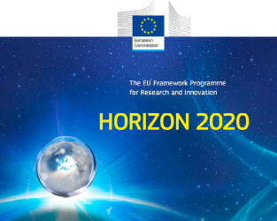



Main services
Provision & retrieval of scientific content
Full texts, document delivery, interlibrary loan
Long-term preservation of scientific media
DOI service for referencing digital objects
Research and development, bibliometrics
Libraries as preservers of knowledge &
multipliers for reproducible science:
→ New policies to publish results & underlying data
→ Re-usability of publicly funded research

Slide 6
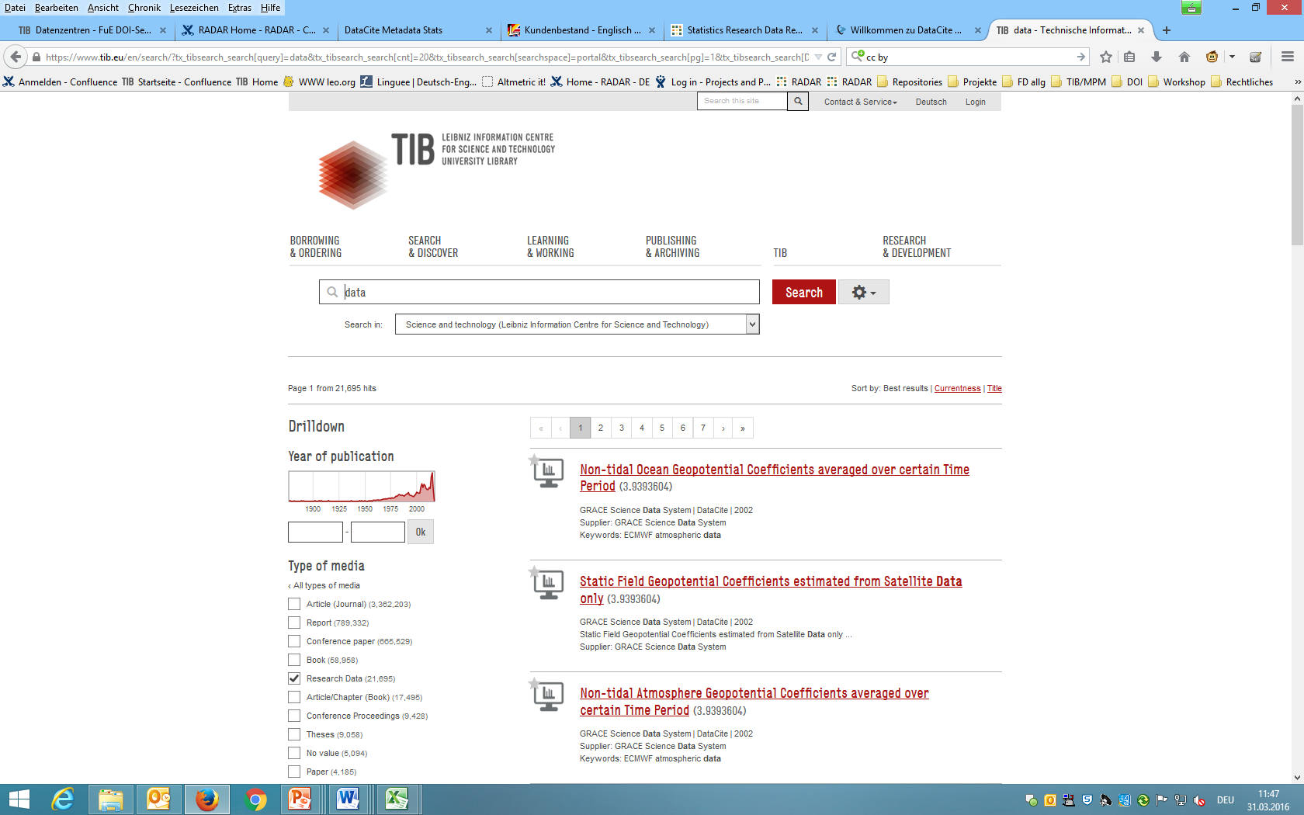
Accessing digital resources
Example: Research Data at tib.eu

Slide 7
The TIB as a Service Provider:
Digital Preservation
e-books and
e-journals
research
reports
digitized
books
TIB Digital
Preservation System
ETDs
LUH
Open Access
Repository
TIB
AV-Portal
proceedings
3D
Notes:
ETD: Electronic theses and dissertations

Slide 8
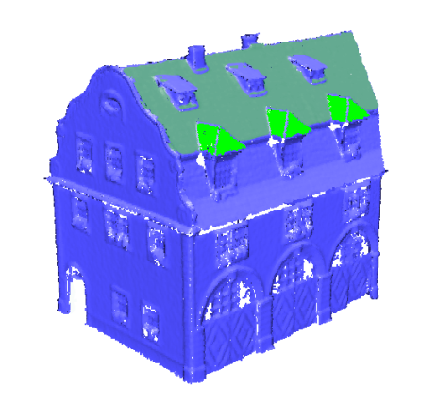
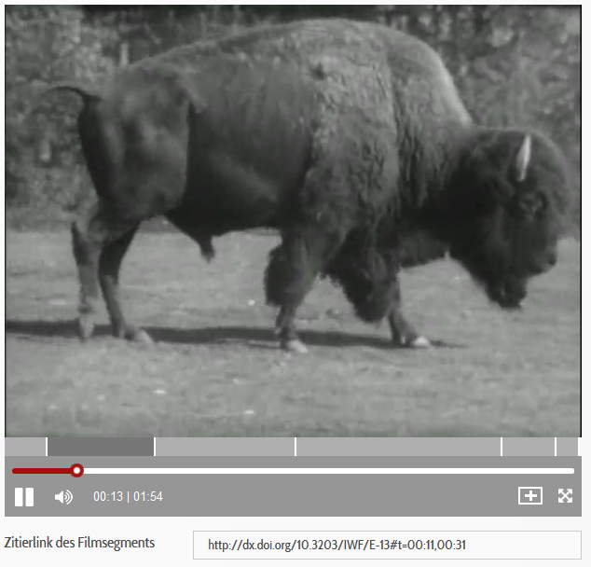

The TIB as a Service Provider:
Digital Preservation
Digital Preservation of 3D and AV
TIB is tailoring workflows to meet the needs
of 3D and AV material:
Integration of tools for format analysis
development of metadata schemas and mappings
structuring representations for collections
TIB is involved in applied research and integrates the results into the digital preservation process:
EU FP-7 DURAARK (3D)
DFG LaZAR (multimedia, AV)

Slide 9
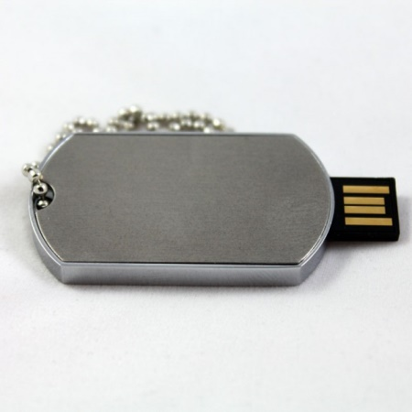
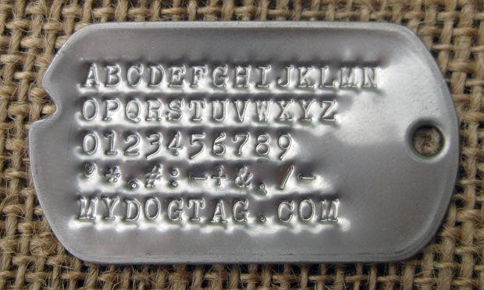
Introducing DOI and ORCID:
Digital Object Identifiers (DOI): Identifiers for publications and data
ORCID: Identifiers for researchers
TIB uses DOI and ORCID to provide
  a baseline infrastructure for Open Science,
  making scientific technical information public, citable and traceable

Slide 10


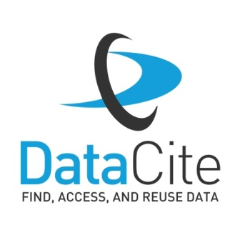

Digital Object Identifiers at TIB:
The Facts
  DOIs registered via TIB
  Total 1,370,798 DOIs (31st March, 2016)
      62 % Research data
      37 % Grey literature
      1 % AV media
  Registering data centers
  Total 112 data centers
        Major research centers i.e. Pangaea, WDCC and ESO
        43 universities/university libraries

Slide 11
DOI at TIB: Figures
  Since 2014: Accelerated increase of both,
  DOIs &
  datacenters

Slide 12
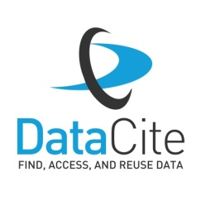

More on DataCite, Gravitational waves, DOI and Open Science …
  DataCite DOIs have been assigned to millions of research datasets
  - making them public, citable, traceable.
Total DataCite DOI count: 7,369,025 DOIs (31st March, 2016)
Steps towards open science – some small, some bigger;
and some deserve a little bit more attention:
Like this! →
What‘s that?
Source:
Benger, W: When black holes collide
https://commons.wikimedia.org/wiki/File:
When_Black_Holes_Collide.jpg
CC-BY 2.0

Slide 13

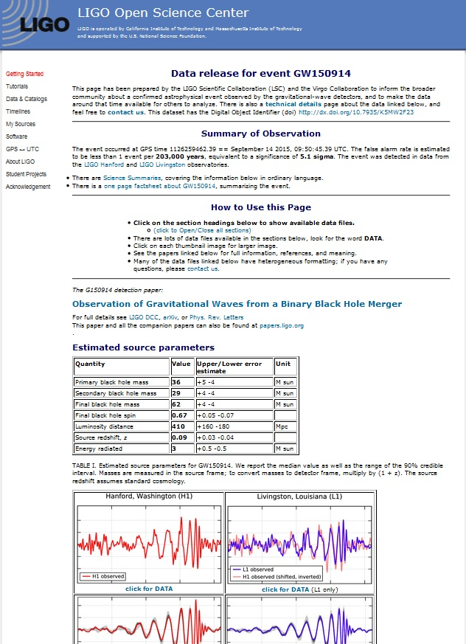
It’s about Open Data!
  Explore: GW150914
  View: http://doi.org/10.7935/K5MW2F23
  The data behind the collision of two
  black holes
  collected by LIGO's twin detectors,
  citable via a DataCite DOI, and
  open for everyone!
  Made available by LIGO Open Science Center at the California Institute of Technology and Massachusetts Institute of Technology –
  including technical reports, graphs, calibration data & even audio files!
Source: Screenshot GW150914 Landing Page: http://doi.org/10.7935/K5MW2F23

Slide 14
The Research Data Management Challenge
What is the general problem with research data?

Slide 15
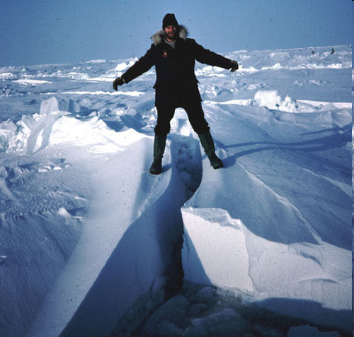
A Gap
A widening gap in the scientific record between published research in a text document and the data that underlies it
As a result, datasets are
      Difficult to discover
      Difficult to access
Scientific information gets lost

Slide 16


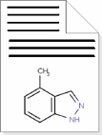
The Research Trajectory
Data
… is lost!
analysed
interpreted
Information
… is traceable
published
Knowledge
… is accessible
Publication

Slide 17
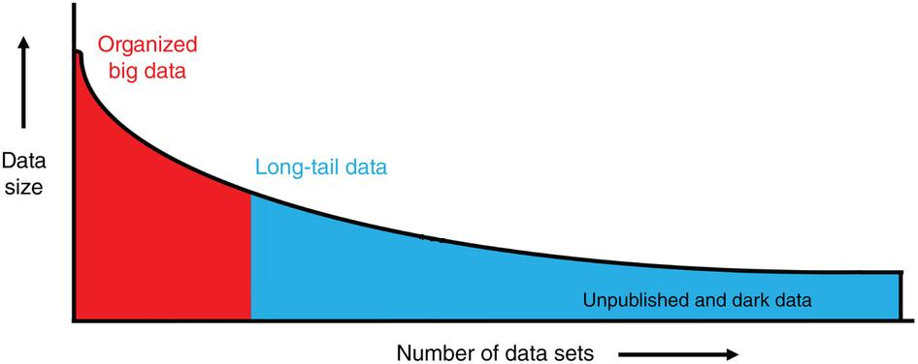
Research Data Management:
Where does my data go?
Long-tail data
Challenge of ‘long-tailed’ data:
  Heterogeneous
  Lack of recognition concept for the scientific service of data generation & publication
  Costs of setting up infrastructure and sustainable! operation
  Ensure the ability to find and reuse research data
  → Subject-specific data repository
  → Overview: www.re3data.org
  or
  →Cross-disciplinary repository
  Here:
  →Generic repository RADAR (De)
  → www.radar-projekt.org
Source: Ferguson et al. (2014): Big data from small data: data-sharing in the 'long tail' of neuroscience. DOI: 10.1038/nn.3838
“The majority of datasets produced through research are part of the
‘Long Tail of Research Data’”
Source: Humphrey C (2014): OpenAIRE-COAR Conference, Athens

Slide 18
Solution
Creation of new and strengthening of existing data centres
Global access to data sets and their metadata through existing catalogues
By the use of persistent identifiers for data
Monitoring of new technology trends in science

Slide 19


Research Data Repository - RADAR
RADAR: Research Data Repository – the project
Objective:
Establish a digital data repository (RADAR) as a basic service for scientific institutions for archiving & publishing research data
Goal:
Preservation & reuse of research data
  Focus:
  Repository for specialized research disciplines (‚Long Tail‘), addition to big data archives → for customers without own computing centers/capacities, dedicated to open research data standards
Duration: September 2013 – August 2016
Further information: www.radar-projekt.org
Service (June 2016): www.radar-service.eu
Findable
Accessible
Interoperable
Reuseable
= promoting FAIR Research Data https://www.force11.org

Slide 20


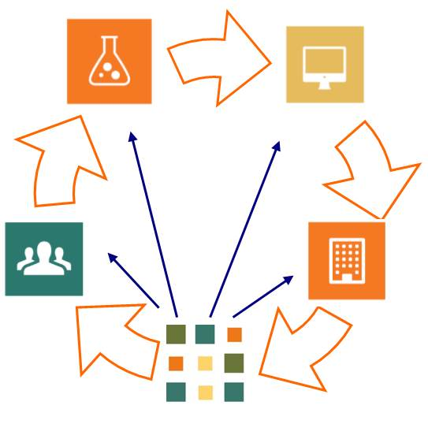

RADAR: Service & Business Model
Services:
Basic service: Archival Storage
Extended service: Data Publication
Features:
Data Life Cycle support
REST API for clients (customizable)
Interoperability & cross-linking of
published datasets via API: DataCite,
ORCID & others
Optional Peer-Review Support
Statistics on downstream data use
  Prices:
  500 € annual fee + 0,39 € per GB data volume per year (net price)
Generic end-point
repository with services for
scientists/institutions

Slide 21
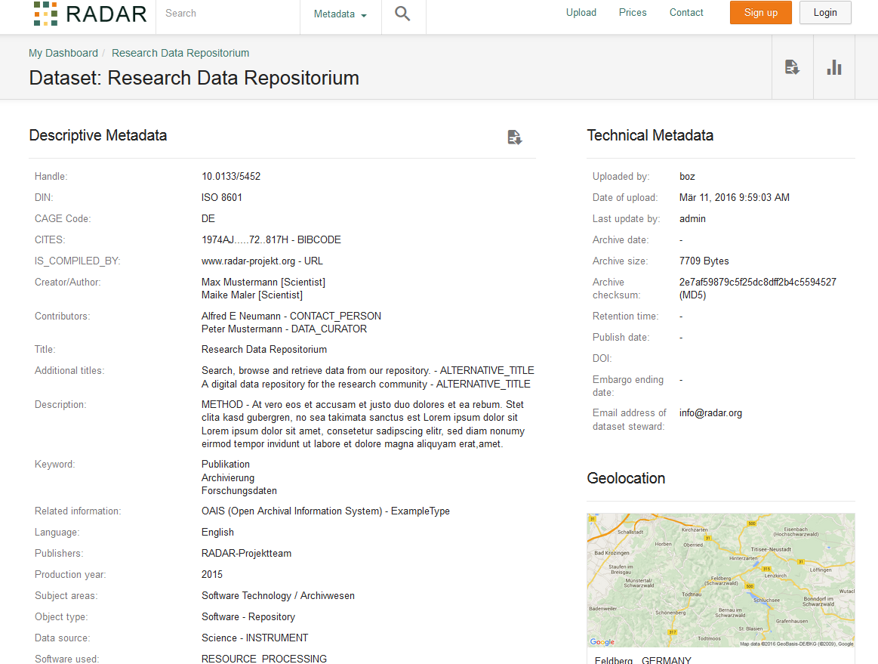
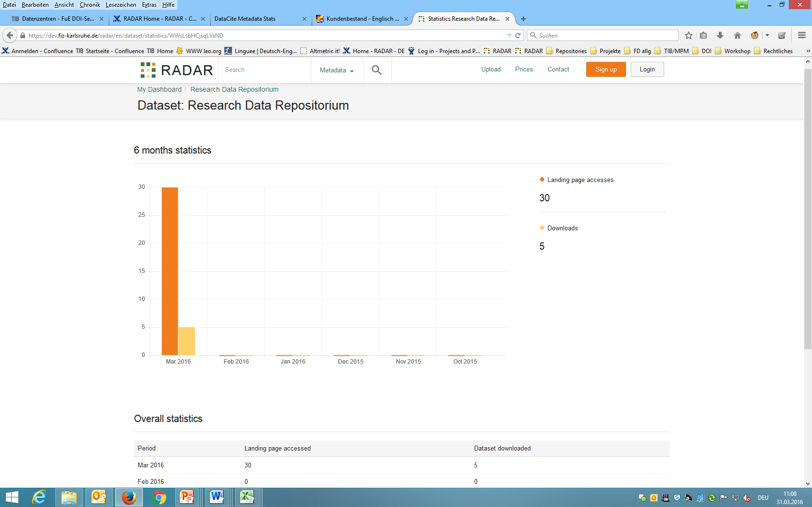
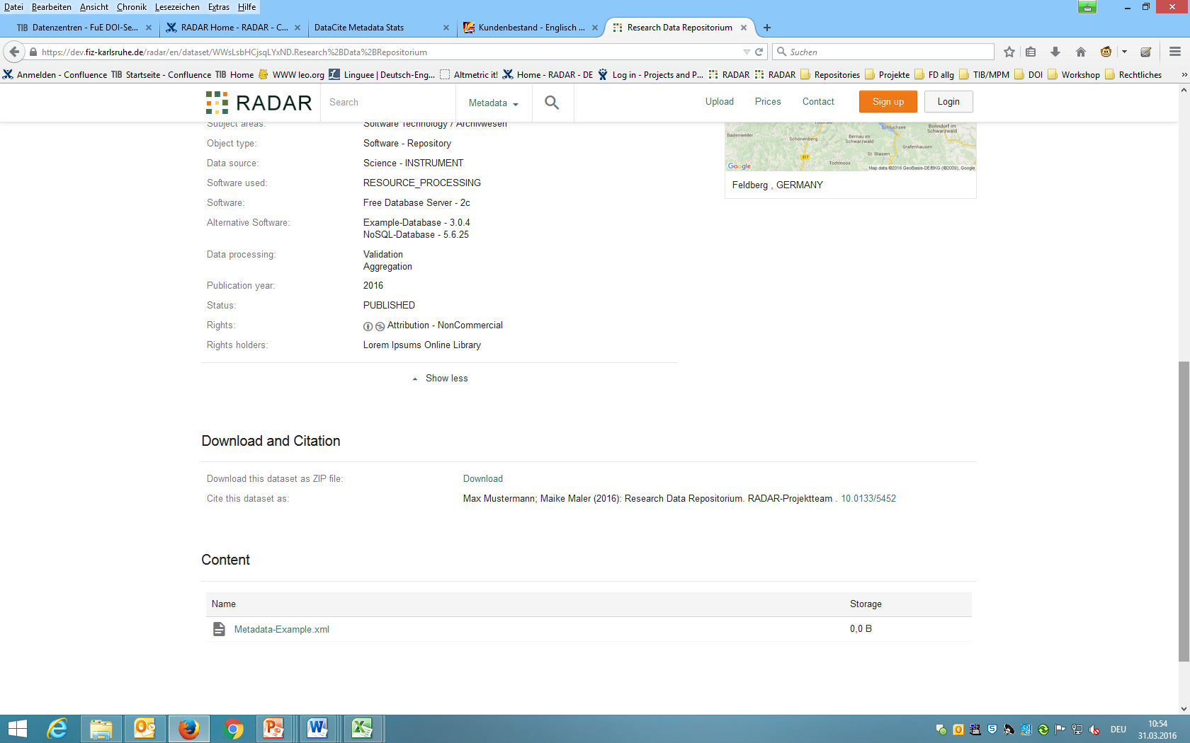

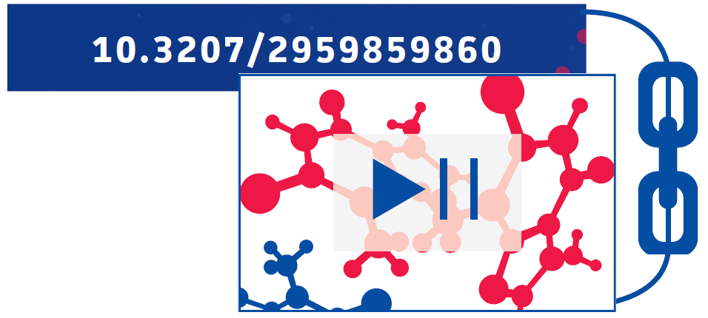
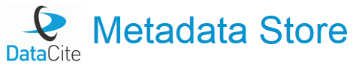


Example: PUBLISHED Data
Downstream data use
DOI-based services …

Slide 22
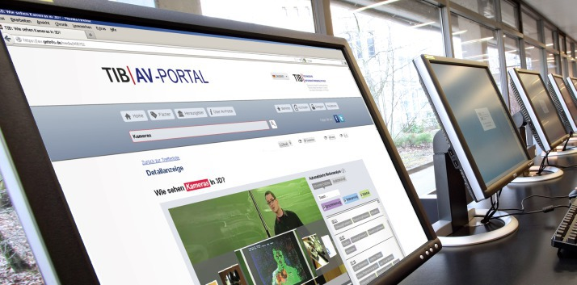
TIB AV-Portal
Scientific Audio-Visual Information
Provides access to high grade scientific films from the fields of engineering, architecture, chemistry, computer science, mathematics and physics in German and English.
http://av.tib.eu/

Slide 23
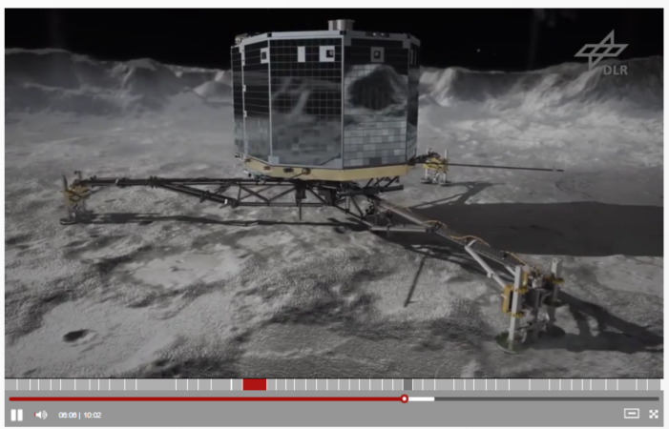
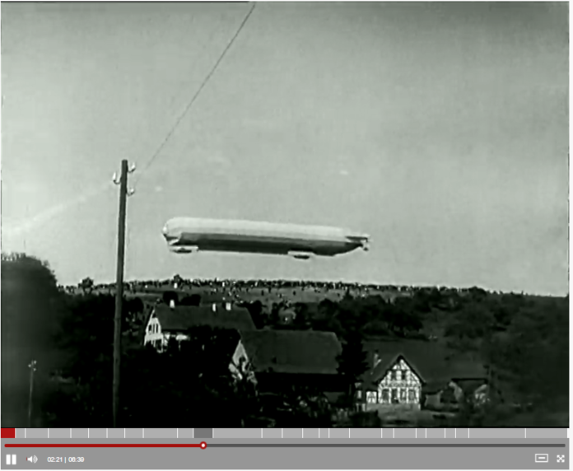
TIB AV-Portal: Content
Focus
Videos from the realms of
  Technology
  Architecture
  Chemistry
  Informatics
  Mathematics, and
  Physics
Historic scientific technical film (1911 - ..)
Content Status
4,500 videos / 2,300 external links (June 2016)
Mostly licensed under Open Access
av.tib.eu

Slide 24
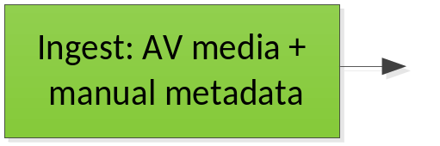
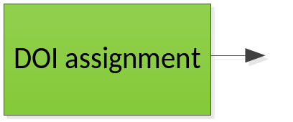
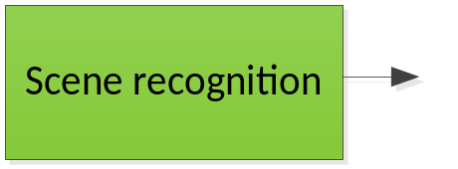
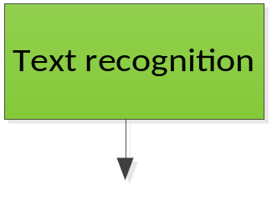
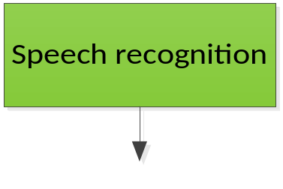
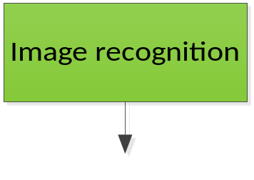
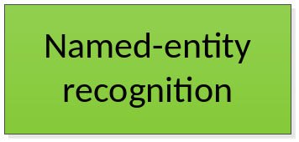
TIB AV-Portal: Workflow
Permanent linking / citability
Visual table of contents / pinpoint access
Search in written content of the video
Search in spoken content of the video
Search for image motifs
Ontology-based semantic search
resolver
DOI
MFID
http://dx.doi.org/10.5446/12717#t=00:27,00:38

Slide 25



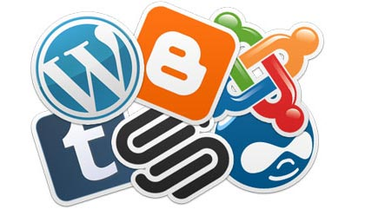
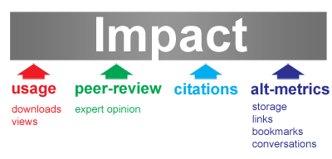
Value adding for for Video Authors:
The AV-Portal helps to..
Videos are long time preserved
Video quotes for wiki blogging
Web 2.0 crowdsourced thematic content mining
The road ahead: Linked Open Data
Alternative metrics

Slide 26
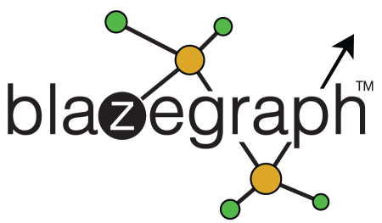
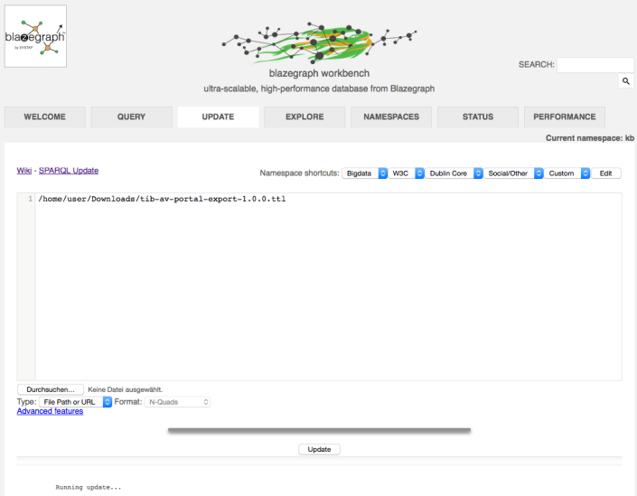
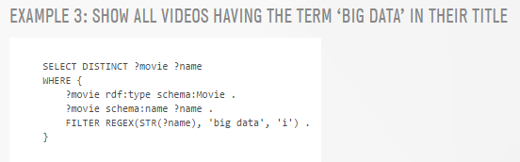
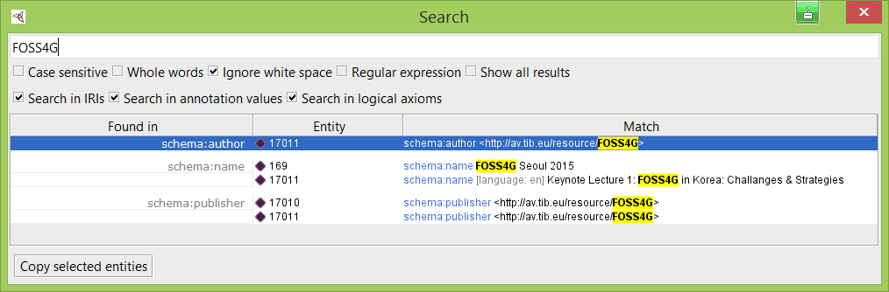

TIB AV-Portal: Linked Open Data
https://av.tib.eu/opendata
https://www.blazegraph.com/
Notes:
Graph databases
„How GIS-friendly are Graph Databases today“ – Felix Kunde, Wednesday afternoon
In GIS
Here we talk ABOUT GIS
-> missed it ? You can watch the video soon on the TIB AV-Portal. And you can use and cite it in your work so Felix gets some credit for his effort!

Slide 27
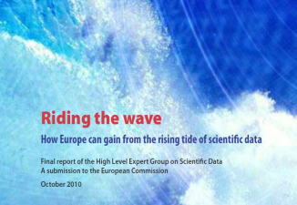

Libraries in the "Big Data“ era:
Strategies and Challenges in Archiving and Sharing Research Data
EU-Level: „Riding the Wave“ EC-Report
Germany: „Radieschen“ Research Project

Slide 28
Approach: Future Scenarios
Scenarios are used in Innovation Management:
  Thinking ahead, to
  describe upcoming chances and threats,
  instead trying to predict a likely future

Slide 29
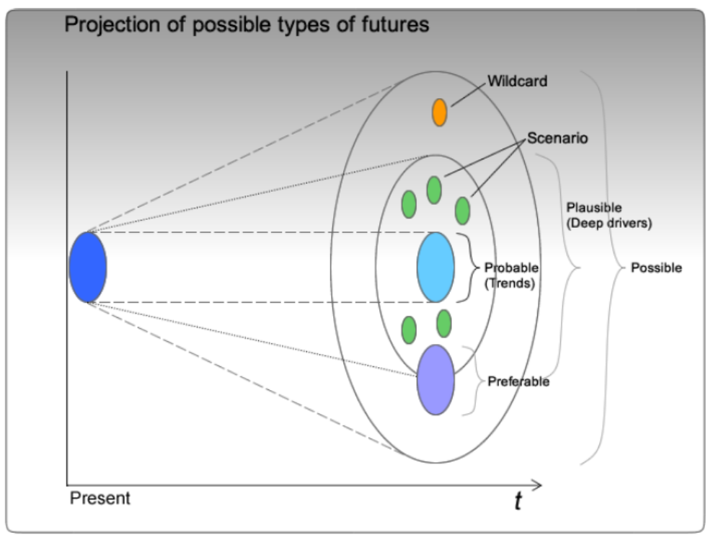
Projecting Future Scenarios
Now
Source: http://www.quesucede.com/page/show/id/scenario_planning

Slide 30


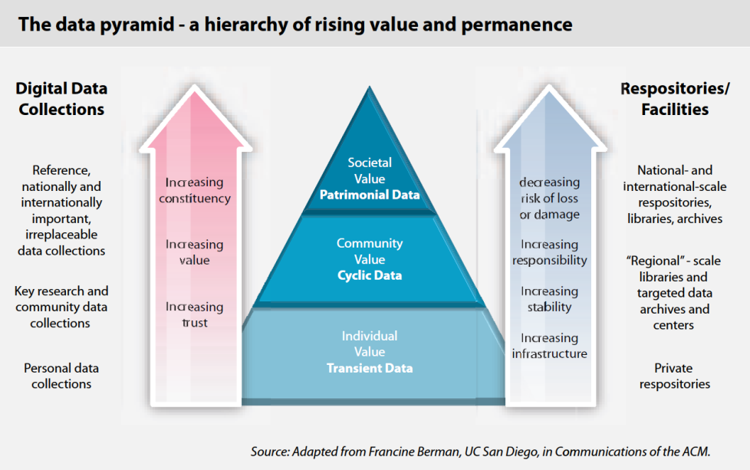
Libraries in the "Big Data" era:
The European Perspective
Knowledge is power:
Europe must manage the digital assets its researchers create!

Slide 31
Scenarios for Europe
I: Science and data management
II: Science and the citizen
III: Science and the data set
IV: Science and the student
V: Science and data sharing incentives

Slide 32
Milestones for Europe towards 2030 (1)
All stakeholders (…) are aware of the critical importance of conserving and sharing reliable data produced during the scientific process.
Researchers (…) are able to find, access and process the data they need. They can be confident in their ability to use and understand data, they can evaluate the degree to which that data can be trusted.
Producers of data benefit from opening it to broad access, and prefer to deposit their data with confidence in reliable repositories. A framework of repositiories is guided by international standards, to ensure they are trustworthy.
Public funding rises (…) through increased use and re-use of publicly generated data.

Slide 33
Milestones for Europe towards 2030 (2)
The innovative power of industry and enterprise is harnessed by clear and efficient arrangements for exchange of data between private and public sectors, allowing appropriate returns for both.
The public has access to and make creative use of the huge amount of data available; it can also contribute to the data store and enrich it. Citizens can be adequately educated and prepared to benefit from this abundance of information.
Policy makers are able to make decisions based on solid evidence, and can monitor the impact of these decisions. Government becomes more trustworthy.
Global governance promotes international trust and interoperability.

Slide 34


Libraries in the "Big Data“ era: Germany
Insights from the Radieschen Project
Radieschen: Requirements for a multi-disciplinary research data infrastructure
  „Rahmenbedingungen einer disziplinübergreifenden Forschungsdateninfrastruktur“
  Acronym: Radieschen („little radish“)
  Future Scenarios for Science in Germany in 2020
  Based on community polls in Germany and the EC
  Conducted by GFZ Potsdam (2012-2013)

Slide 35
Open questions –the library perspective
Libraries provide access to digital media, support the publication of research data and enable their long term preservation.
How will the library of the future be like?
      Libraries as interfaces to Computation Centers?
      Will Libraries and Computation Centers merge into new service units?
      What will become of scientific publishers?

Slide 36
Possible Future Scenarios for Science in Germany in 2020
Five future scenarios describe possible developments of Science in Germany by 2020 (or later).
The scenarios are over-simplified and describe extreme cases.
This is to emphasize trends and to allow to infer development steps.

Slide 37
Scenario I:
New performance indicators for Science
The simple tallying of publications and quotes to judge academic performance is replaced by a combination of publications of articles, research data and software.
An international scoring system becomes established and provides access to research ressources.

Slide 38
Scenario II:
Libraries are the Future
Libraries evolve into innovative, interlinked centers for information and competence.
Data Scientists, highly qualified experts in the use of data, work in libraries in fields like curation, quality assurance or archiving.
Libraries replace the scientific publishers of today.

Slide 39
Scenario III:
The Rise of the Data Scientists
The profession „Data Scientist“ becomes established in Academia.
Data Scientists work for modern information providers for Academia, which have evolved from the former Science Libraries.
The tasks of Data Scientists include ingest and archiving, but also research regarding Data Analysis.

Slide 40
Scenario IV:
Data Centres take on new roles
Computation Centres evolve into Data Centres.
They are the primary points of access for researchers both for data management, software services and all kinds of publications.
Data Scientists work in the new Data Centers to provide a range of services to the communities.

Slide 41
Scenario V:
Steady State
The striving for innovation is blocked for various reasons.
Scientists in Germany are cut off from the international community.

Slide 42
Guidelines for Action
Science is dynamic and continuously changing.
The stakeholders need to take the necessary steps to enable a mutually positive way ahead.
For an optimal result the involved parties must interact while being willing to reevaluate and change their current positions.

Slide 43
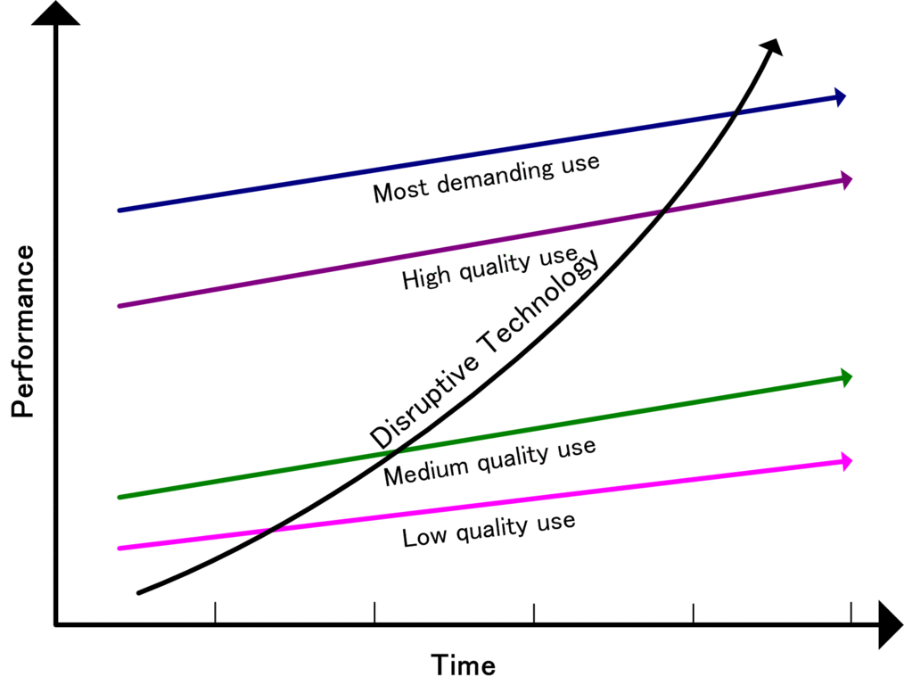
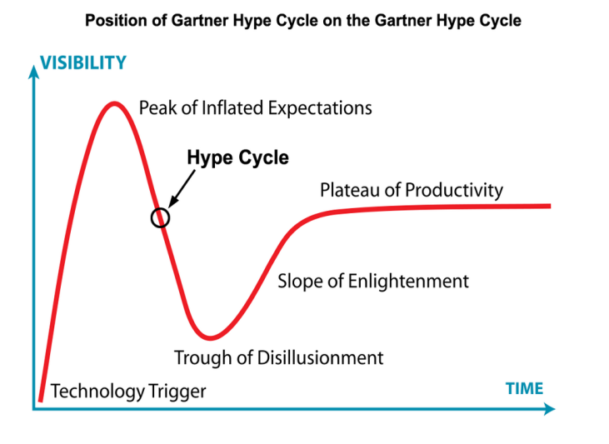
Consequences for the handling of research data
It is impossible to predict which technological solutions will become available or reach maturity.
Trends can only be identified on a limited scale:
disruptive innovation patterns affect the development, which by itself is a new trend.

Slide 44

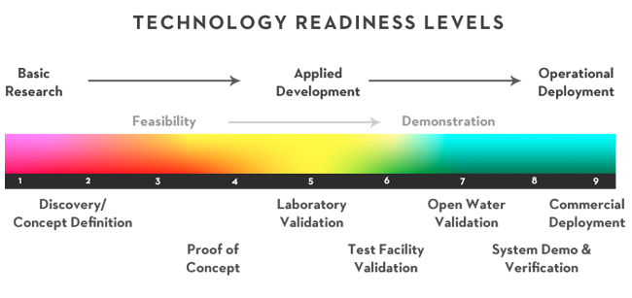
Conclusion
Future-proof service portfolios for flexibility and stability
A likely success strategy for the provision of research infrastructures could be to develop a modularized service portfolio, based on a common platform.
This would enable the stakeholders to adapt the services flexibly according to the changing requirements of Science, while allowing for the long term evolving of the underlying platform.
This will bridge the gap between infrastructure‘s need for stability while allowing for the required flexible, yet potentially short-lived, applications for science.

Slide 45
Thanks for listening.
Questions ?
Contact
Peter Löwe (ORCID: 0000-0003-2257-0517)
T +49 511 762-3428, peter.loewe@tib.eu

