Slide 1





Alkali-Activated Concrete from Plasmarok®
Peter Keeley^{1,2}, Neil Rowson²
¹Tetronics International, ²University of Birmingham
World Recycling Congress, Berlin 2016
27th July 2016

Slide 2
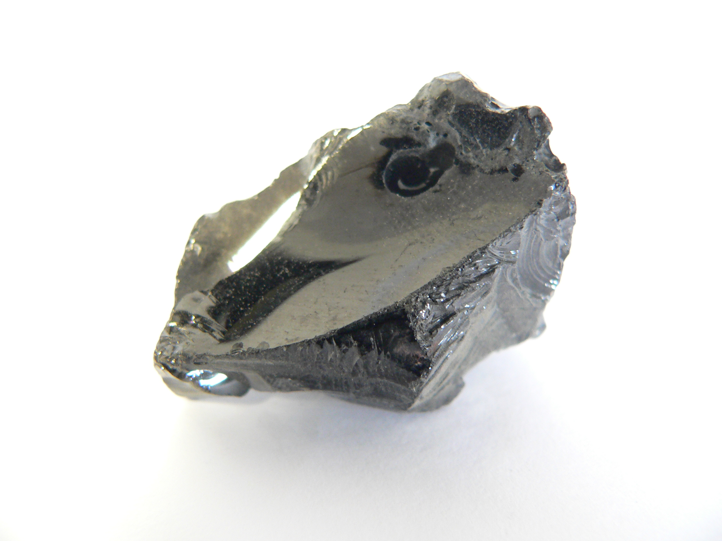
Air Pollution Control Residue (APCr)
Mixture of fly ash, organic pollutants, carbon and alkaline salts produced during gaseous emissions cleaning from incineration activities.
The UK is approaching the production of 500,000 tonnes of APCr per year.
Thermal plasma can be used to transform the APCr into a non-hazardous material know as Plasmarok® via a vitrification process.
Plasmarok® can be re-used as an aggregate in construction applications but Tetronics have currently been researching its application as a cement replacement.

Slide 3
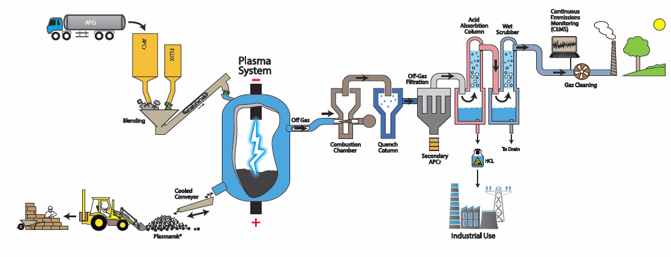
The Plasma Vitrification Process

Slide 4
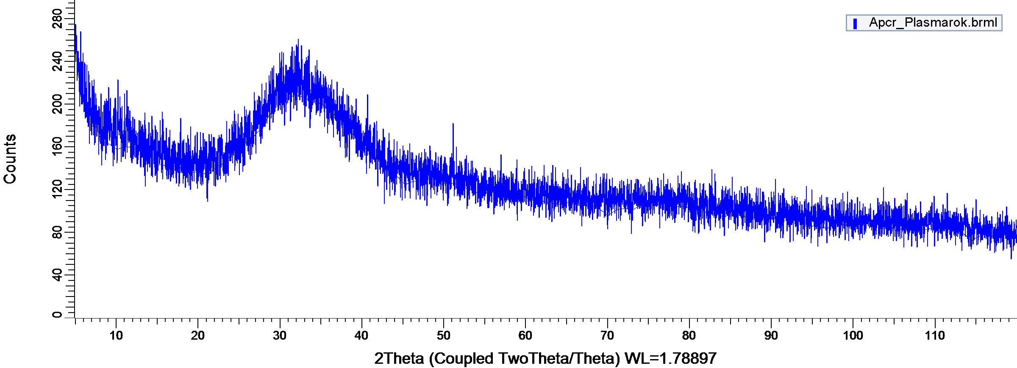
Cement Replacements
Oxide | wt%
Al₂O₃ | 16
SiO₂ | 39
CaO | 35
Fe₂O₃ | 4
MgO | 1.3
TiO₂ | 1.3
P₂O₅ | 0.7
Na₂O | 0.2
Fly ashes, calcined clays, volcanic ashes and blast furnace slags are examples of successful commercial cement replacement materials.
Materials with high SiO₂ and Al₂O₃ content, glassy phases and small particle sizes are good cement replacements.
Alkali-activated concretes derived from Plasmarok can have very high compressive strengths (90 Mpa)
Alkali-activated concretes require the material to be mixed with an alkaline solution such as NaOH to initiate their production.

Slide 5
Factors effecting the material properties
There a number of stages which occur as alkali-activated concretes are produced. These stages are affected by:
  Particle size of the Plasmarok.
  Chemical composition of the formulation.
  Mix design.
  Processing route.
Dissolution
Speciation equilibrium
Gelation
Polymerisation and hardening

Slide 6
Particle size
The particle size distribution of the Plasmarok has a significant effect on the strength of the concrete.
As the particle size is reduced the strength of the final alkali activated concrete is increased.
Reducing the particle size increase the available surface area for the dissolution of the species from the Plasmarok into solution.
As more species can dissolve into the solution, the stronger the material can become.

Slide 7
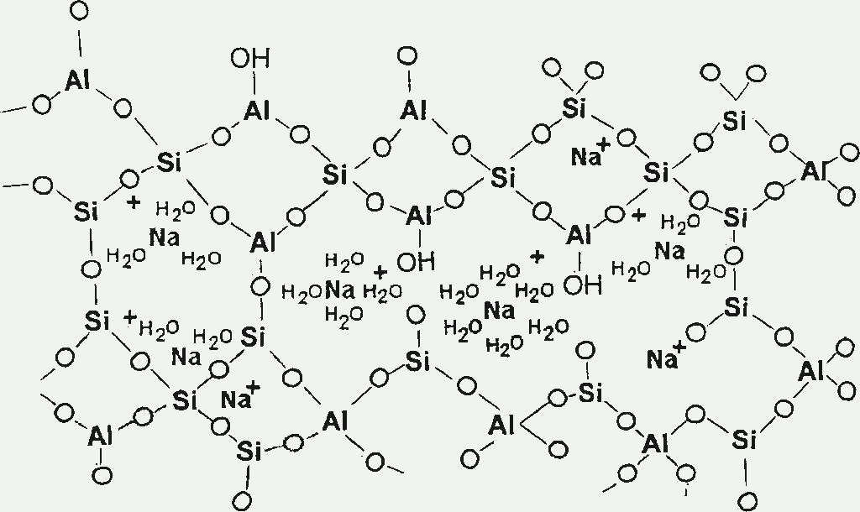
SiO₂ – Al₂O₃ Ratio
Increasing the Si/Al ratio in the formulation can increase the compressive strength of the alkali-activated concrete.
The species form alumino-silicate chains during polymerisation, but the Si-O bond is much stronger than the Al-O bond.
The more Al in these chains the weaker they would be.
Aluminium ions are more readily dissolved from the Plasmarok in alkaline environments than silicon ions.

Slide 8
Oxide | A1 | B3 | B5 | C2 | 580
SiO₂ | 34 | 35 | 30 | 40 | 42
Al₂O₃ | 17 | 22 | 25 | 16 | 10
CaO | 36 | 36 | 36 | 36 | 40
Na₂O | 5 | 0.3 | 1.2 | 0.7 | 0.2
Fe₂O₃ | 2.6 | 1.7 | 1.5 | 2.3 | 1.2
MgO | 1.4 | 1.5 | 1.4 | 2.1 | 1.4
TiO₂ | 1.1 | 1.2 | 1.2 | 1.4 | 1.1

Slide 9
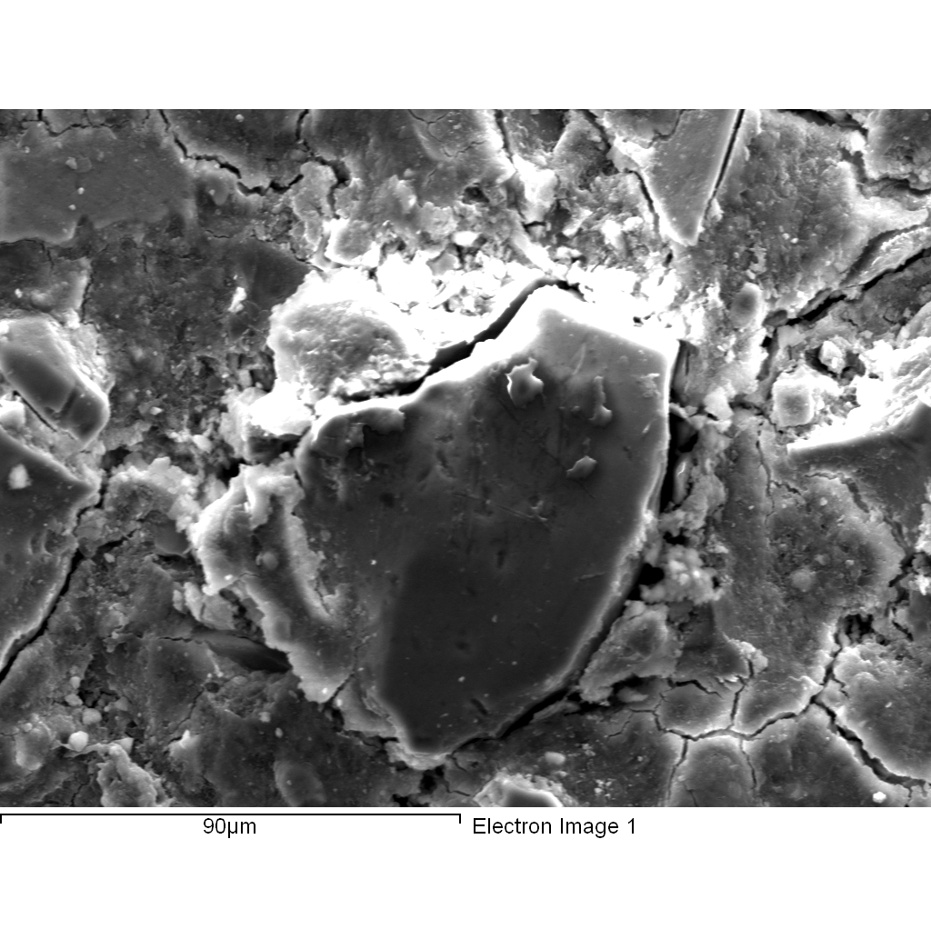
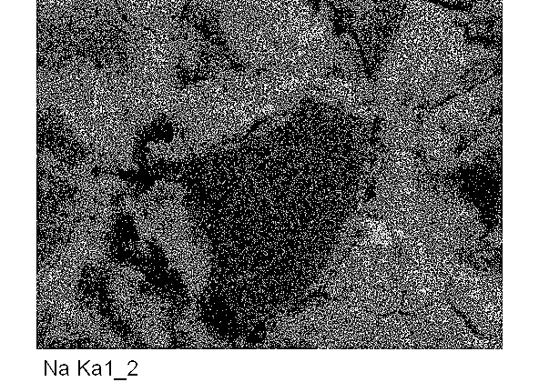
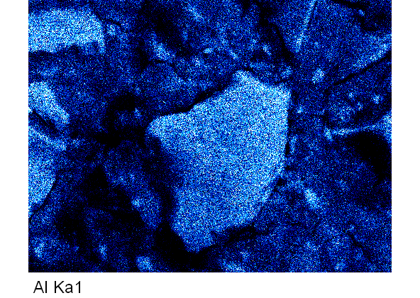
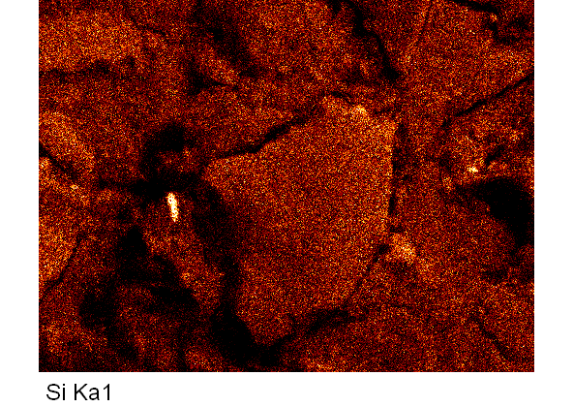
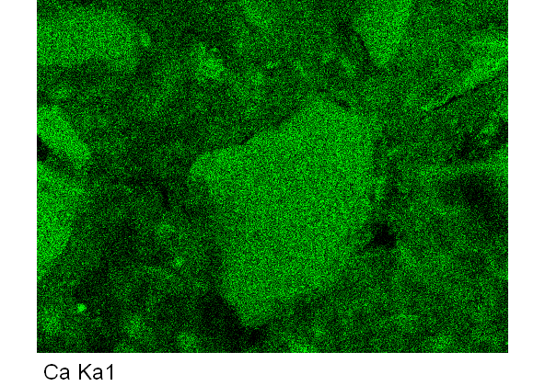
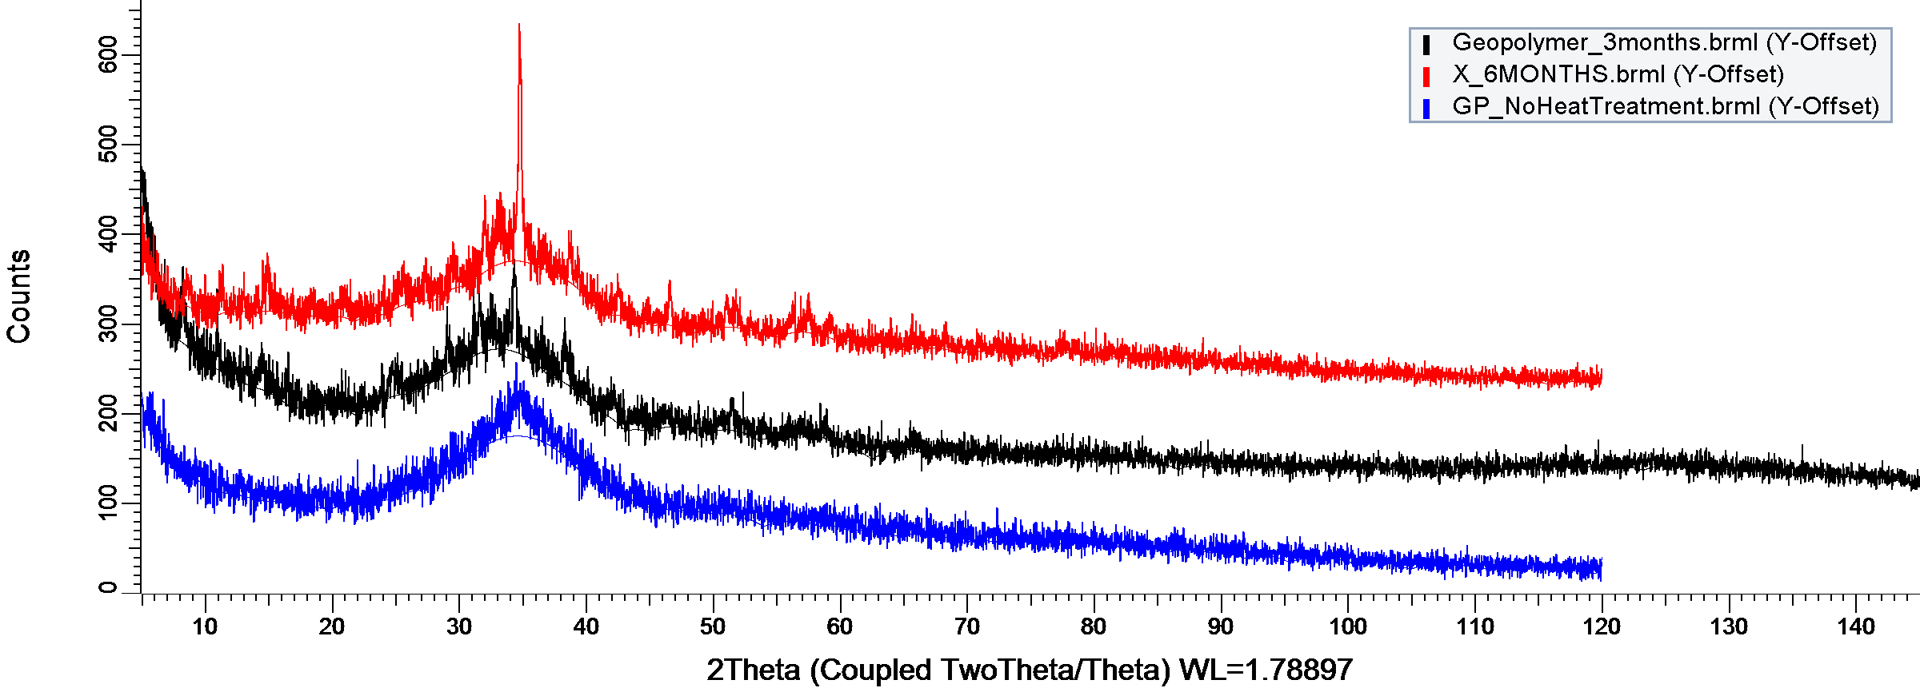
The binding phase is composed of sodium, aluminium, silicon and calcium oxides and so can be represented as a C-(N)-A-S-H binding phase.
The binding phase is at first amorphous but gradually develops a semi-crystalline structure over time.
6 months
3 months
1 month

Slide 10
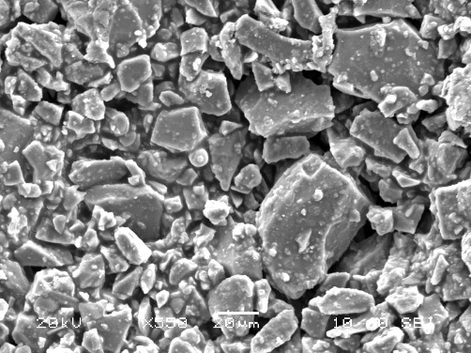
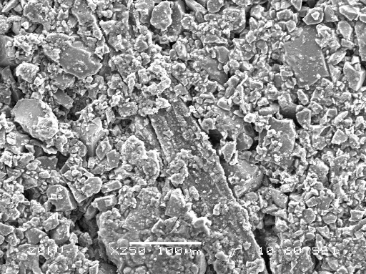
Increasing binding phase content
Unreacted particles
Binding phase
Solid : liquid ratio 10
Solid : liquid ratio 6
Solid : liquid ratio 3.75
Increasing characteristic strength

Slide 11
Process Route
The strength of the material can be variable.
Compaction of the mixture in the mould reduces the variability of the strength of the material.
The compaction of the raw materials reduces residual stress in the final material derived from large pores.

Slide 12

Summary
Hazardous wastes such as air pollution control residue can be transformed into a non-hazardous glass via plasma technology
The non-hazardous glass can be recycled as a cement replacement and used to make high strength alkali-activated concretes.
The properties of the alkali-activated concretes are dependant on a number of factors including intrinsic properties of the material and extrinsic influences such as the processing route or mix design.
Understanding the influences of these factors helps us to be able to develop consistent materials which desirable properties.

Slide 13
Acknowledgments and thanks:
Dr. David Deegan and Dr. Tim Johnson – Tetronics International
Professor Neil Rowson and Dr. Richard Greenwood – University of Birmingham
Engineering and Physical Science Research Council (EPRSC)

