Slide 1
Maintain the effectiveness of a QMS by using Lean Six Sigma approach
« Nobody is perfect, but a team can be »
Peter Jehander
3rd International Summit on GMP, GCP and Quality Control
Valencia 25th of September 2014
Notes:
We would like the presentation to cover your full proposal for the start-up phase of the project with an outline of how you propose to approach the project, the resources that will be needed from you and from GE and a cost outline. We would also like some broad outline of the challenges you foresee for this project and where you see the biggest problems to be overcome and how you feel you can do this.

Slide 2
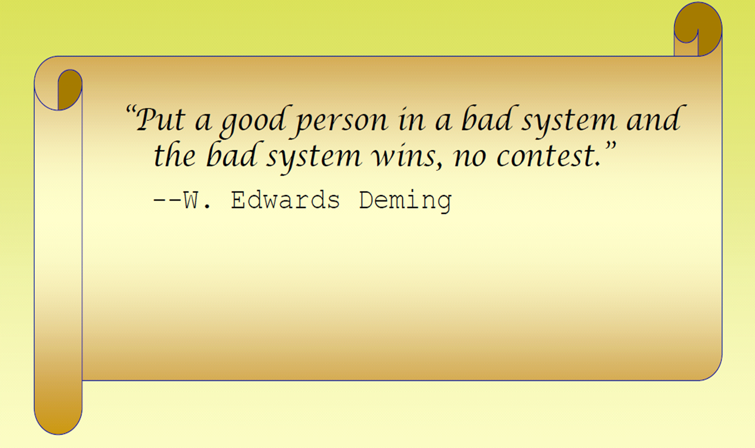
LEAN - System approach
Source: PLAN organization, SWEDEN

Slide 3
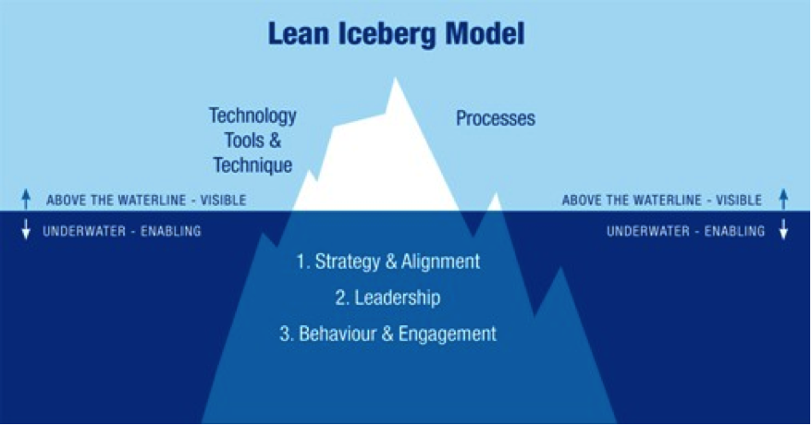
Sustainable Lean
Source: Lean Iceberg Model © 2008 P. Hines, P. Found, G. Griffiths, & R Harrison

Slide 4
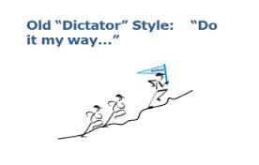
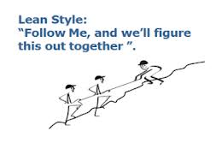
Lean management
Traditional leadership – Taylorism; Command and control
Focus on results - management by objectives
Lean Leadership – Coaching leadership
Process approach and focus on results

Slide 5
Key Performance Indicators
(Taylorism)
Source: Bernard Marr; Key Performance Indicators

Slide 6
Key Performance Indicators
(Lean)
Source: Bernard Marr; Key Performance Indicators

Slide 7
Key Performance Indicators
(Taylorism)
Source: Bernard Marr; Key Performance Indicators

Slide 8
Key Performance Indicators
(Lean/Taylorism)
Source: Bernard Marr; Key Performance Indicators

Slide 9
Key Performance Indicators
(Lean)
Source: Bernard Marr; Key Performance Indicators

Slide 10
Key Performance Indicators
(Lean)
Source: Bernard Marr; Key Performance Indicators

Slide 11
Key Performance Indicators
Source: Bernard Marr; Key Performance Indicators

Slide 12
QMS Effectiveness
Management responsibilities
Main process
Clause 5.1 Management commitment
Subprocesses
Clause 4.4.2 System processes
Clause 6 Resource management
Clause 5.5.3 Internal communication
Clause 8.4 Analysis of data
Clause 8.5 Improvement
Source: ISO EN 13485:2003

Slide 13
BMS instead of QMS
System processes/Resource management
The QMS (Quality Management System) is not integrated with the governance structure on top level, which traditionally focuses on the Financial together with Marketing and sales perspective KPIs.
Top Management should align its KPIs to match the QMS process objectives,
and accept this system as a BMS (Business Management System).
Internal communication/Improvement
This is the most efficient way for employees on different levels to contribute and
understand their role when adjusting system parameters in organizations.
Performance management needs to adapt to a more flexible approach.

Slide 14


We have a burning passion for consulting and engineering
Thank You!
Questions?

