Slide 1




Towards end-user centered outcome measurement:
An example from Parkinson’s disease
Peter Hagell, RN PhD
Professor of Neurological Caring Science
The PRO-CARE Group
School of Health and Society
Kristianstad University, Kristianstad, Sweden

Slide 2
Acknowledgements
Sweden
Markus Idavall, PhD
Maria H. Nilsson, PT PhD
Per Nyberg, PhD
Jan Reimer, RN
Catharina Sjödahl-Hammarlund, PT PhD
Albert Westergren, RN PhD
UK
Jeremy Hobart, MRCP PhD
Stephen P. McKenna, PhD
USA
Scott R. Rosas, PhD
A. Jackson Stenner, PhD
Funding
Swedish Research Council
Swedish Parkinson Foundation
Swedish Parkinson Academy
Skåne County Research & Development Foundation

Slide 3
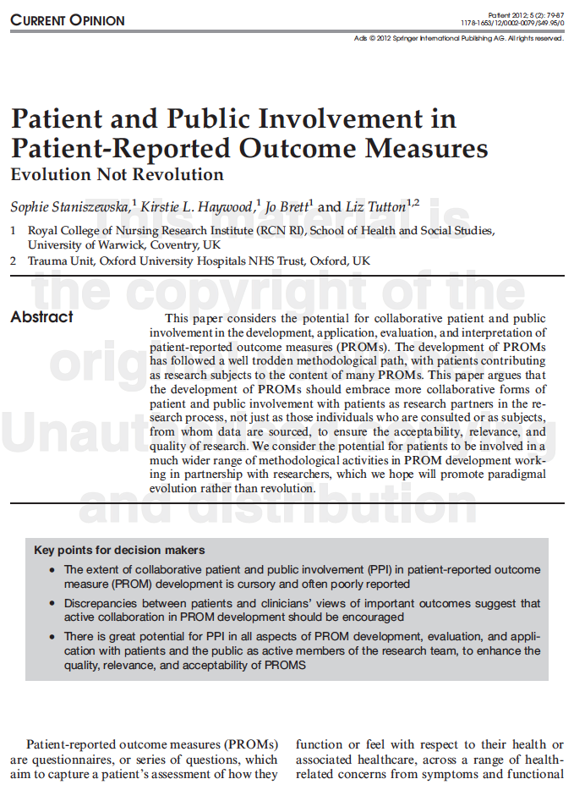
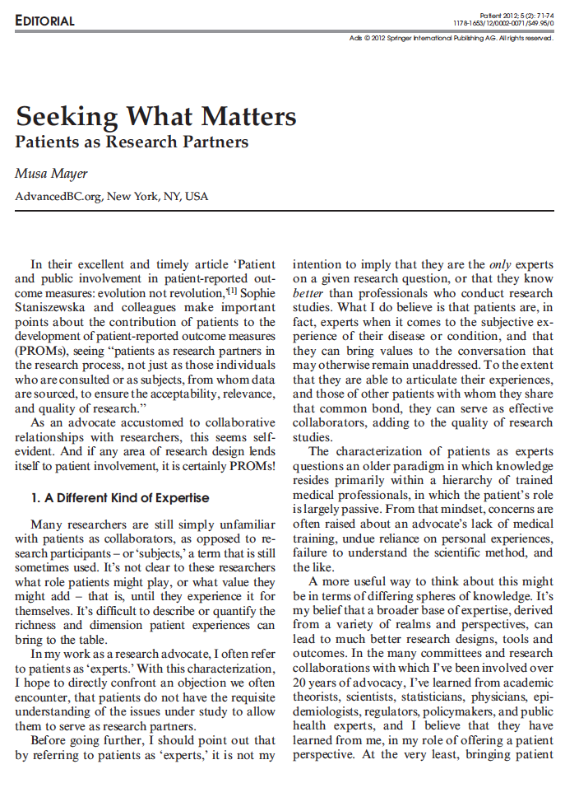
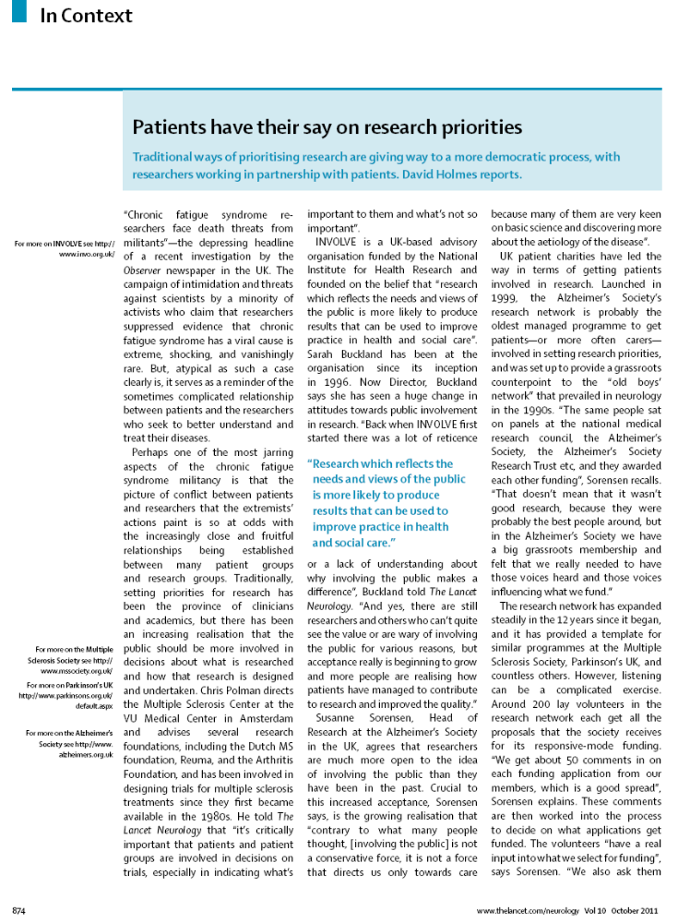
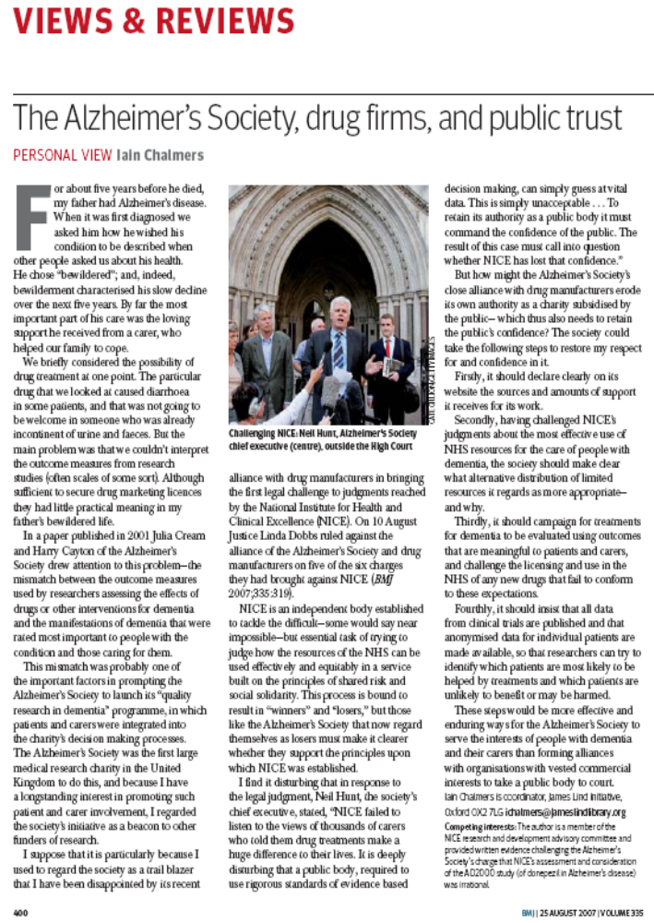
A broader base of expertise, derived from a variety of realms and perspectives, can lead to better research designs, tools and outcomes

Slide 4
”…the main problem was that we couldn’t interpret the outcome measures from research studies (often scales of some sort). Although sufficient to secure drug marketing licenses, they had little practical meaning.”
Iain Chalmers
National Institute of Clinical Exellence (NICE)
R&D Advisory Committee
BMJ 2007; 335: 400

Slide 5
Rating Scale Requirements in Interventional Studies
To be meaningful and meet the purpose of their use in clinical trials, rating scales need to represent
  rigorous measures of the variables they intend to quantify
  the variables that therapies are intended to target
  the variables that are important to people with PD

Slide 6
Patient-Reported Outcome Measures
Rating scales completed by patients themselves
Often intended to provide patients with a voice in the decision making regarding effectiveness of therapies by assessing the impact of illness and therapy from their perspective
→ Need to be relevant to those who respond to them
If not, they…
  …are unlikely to be valid representations of patients’ perspectives
  …may discriminate against those to whom they are less relevant
  …may threat scientific validity and basic bioethical principles

Slide 7
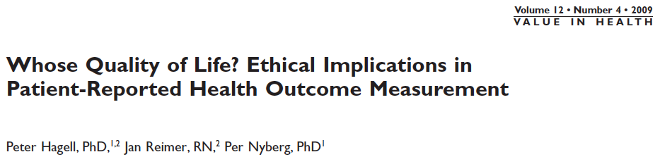
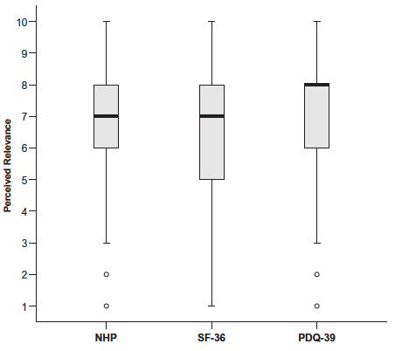
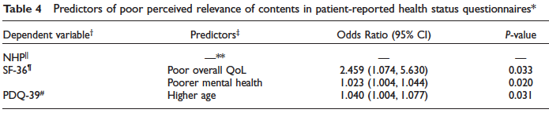
P=0.142 (Kruskal-Wallis test)
202 people with Parkinson’s disease (PD)
3 health status/HRQL rating scales:
  NHP (38 items; generic)
  SF-36 (36 items; generic)
  PDQ-39 (39 items; PD-specific)
Rating of overall content relevance (1-10; 1=worst possible, 10=best possible)
IVs: Gender, Age, PD duration, Clinical and Perceived PD severity, Dyskinesias, Overall QoL, Respective summary scores

Slide 8
What outcomes are important to assess in Parkinson’s disease from an end-user perspective?

Slide 9
Qualitative Literature Review
PD impact from the patients' perspective
  Independence in daily life
  Walking/mobility
  Lack of energy/fatigue
  Unpredictability (due to fluctuating drug responses and dyskinesias)
  Communication

Slide 10
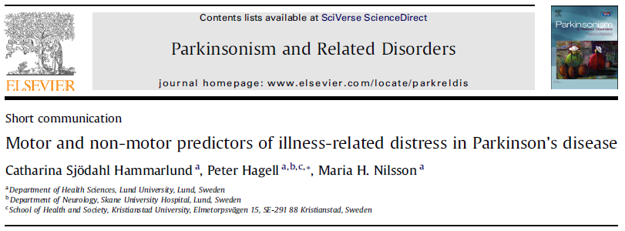
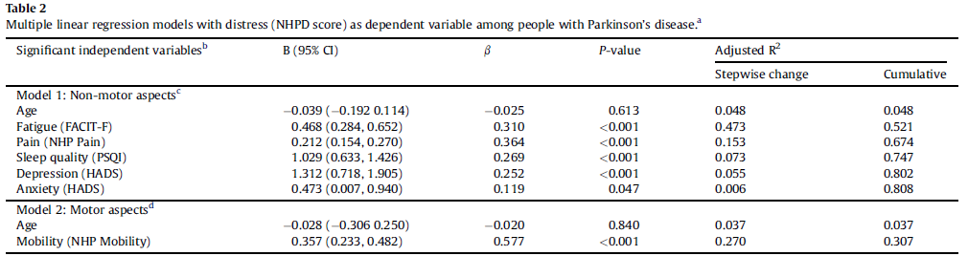
ª All models controlled for age.
^{b} Listed by order of entry into the models (forward method).
^{c} IVs: PD duration (years), Cognition, Fatigue, Daytime sleepiness, Depression, Anxiety, Pain, Sleep quality, Motivation,
Psychiatric complications.
^{d} IVs: Parkinsonism, Mobility, Dyskinesias, Motor fluctuations, Falls and/or balance problems.

Slide 11
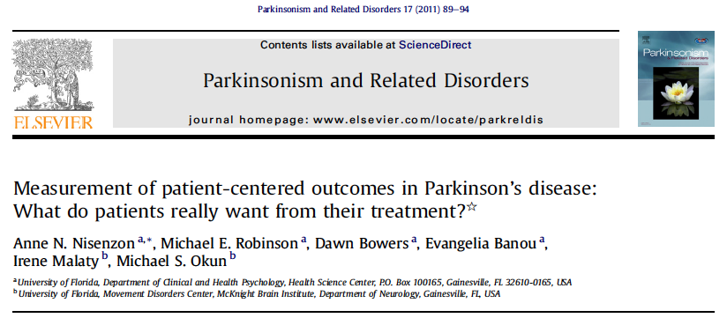
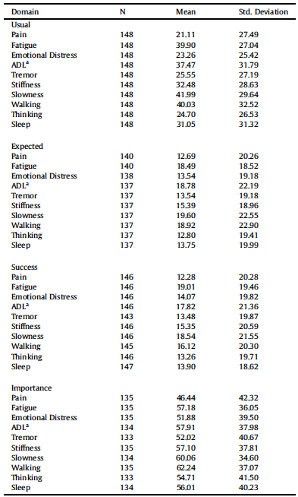
10
4
9
3
8
5
2
1
7
6

Slide 12
Limited by pre-defined areas/independent variables…

Slide 13
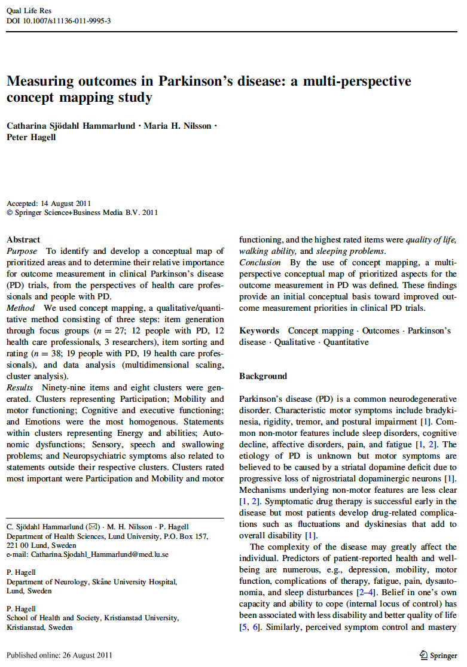
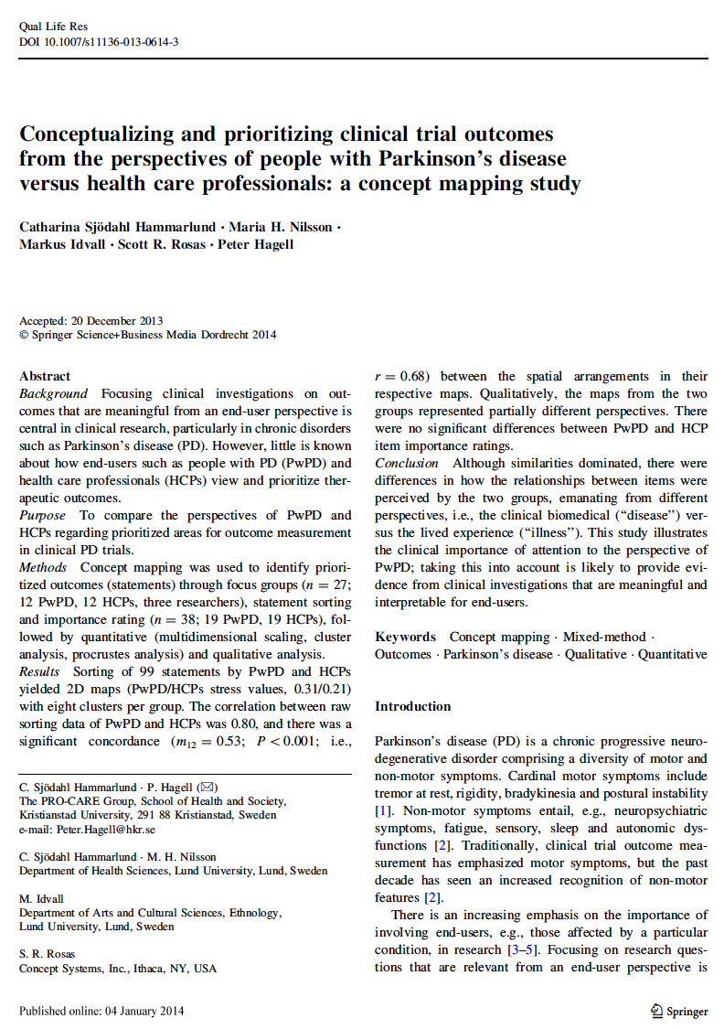
AIMS:
Identify important outcomes
Develop conceptual maps of prioritized outcomes
Determine the relative importance of identified outcomes for assessment in clinical PD trials
… from the perspectives of people with PD and
health care professionals

Slide 14



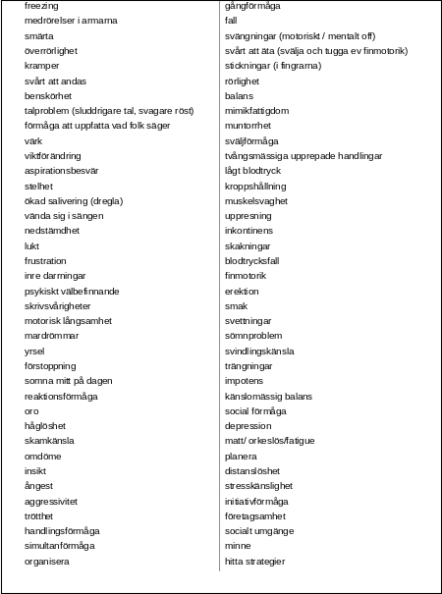


Group Concept Mapping
Qualitative
Quantitative
Patients – Clinicians – Researchers
“A concrete example of what is most important
to assess when treating PD, regardless of whether
there is such a treatment available or not, is…”
→ 99 statements (outcomes)

Slide 15
People with PD vs. Health Care Professionals
People with PD
Health Care Professionals
Heterogeneous and unidimensional
Homogeneous and multidimensional

Slide 16
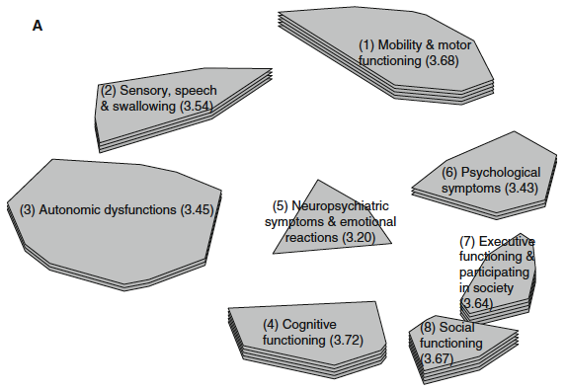
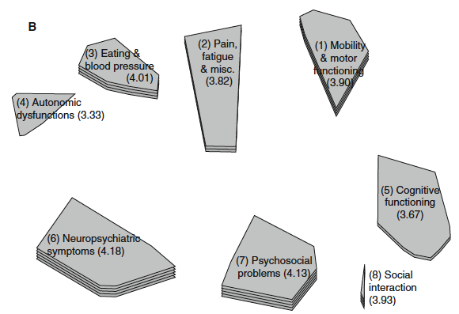
People with PD vs. Health Care Professionals
People with PD
Health Care Professionals
Highest Importance-Rated Statements
People with PD | Clinicians
Quality of life | Quality of life
Walking | Depression
Mobility | Fluctuations
Psychological well-being | Walking
Sleep problems | Sleep problems
Control over disease process | Falling

Slide 17
Despite overall similarities, patient perspectives differ from that of clinicans’
  Lived experience vs. scholarly/biomedical perspective
End-user prioritized outcomes
  Quality of life, walking/mobility, sleep, fatigue, perceived disease control; fluctuations, depression, falls
  Evidence from clinical trials that are more meaningful
  and interpretable for end-users
Implications
  Needs for new and refined outcome measures
  Priorities for therapeutic research

