Slide 1


Sleep and Media Habits in School-age Children
Pernilla Garmy,
School Nurse, PhD student
San Francisco, August 11, 2015

Slide 2

Sweden: a country in Europe with 9 million inhabitants

Slide 3
Sleep habits in schoolchildren
How do they sleep?
How should they sleep?
3. Should we do something about it?

Slide 4


Slide 5
Sleep length of schoolchildren in Lund
6-7 y: 10 h (20:00)
10y: 9½ h (21:00)
14y: 8 h (22:30)
16y: 7½ h (23:00)
n=3011
Garmy P, Nyberg P, Jakobsson U. Sleep and Television and Computer Habits of Swedish School-Age Children The Journal of School Nursing, 2012 Dec;28(6): 469-76

Slide 6
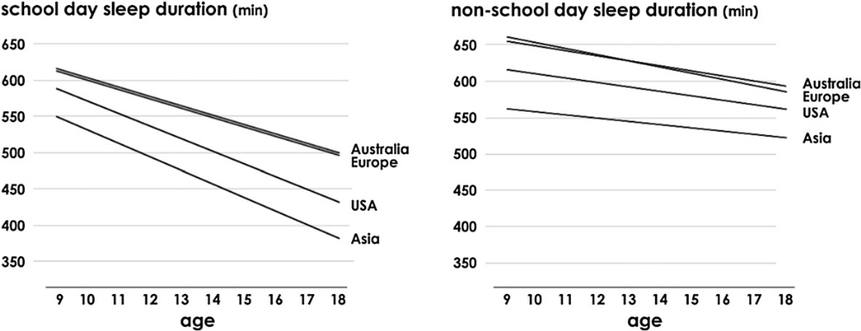
International diversity
10 h = 600 min; 9 h = 540 min; 8 h = 480 min; 7 h = 420 min; 6 h = 360 min
Olds et al. (2010) The relationships between sex, age, geography and time in bed in adolescents:
A meta-analysis of data from 23 countries. Sleep Medicine Reviews

Slide 7
Declining sleep length?
30-40 min shorter sleep compared with 50 years earlier Klackenberg (1982)
1 h shorter sleep / 100 years
Matricciani et al. 2012

Slide 8
What has happened?
Later bedtimes
Unchanged waking-up times

Slide 9

24/7 – night-time on earth
National Geographic

Slide 10
How much sleep do they need?
Schoolchildren 6-12 y: 10-11 h
Adolescents 13-18 y: 9 h
Sömnstörningar hos barn – kunskapsdokument.
Information från läkemedelsverket 2: 2015

Slide 11


Sleep length of schoolchildren in Lund
6-7 y: 10 h (20:00)
10y: 9½ h (21:00)
14y: 8 h (22:30)
16y: 7½ h (23:00)
n=3011
Garmy P, Nyberg P, Jakobsson U. Sleep and Television and Computer Habits of Swedish School-Age Children The Journal of School Nursing, 2012 Dec;28(6): 469-76

Slide 12
Short sleep length is associated with
Bedroom TV
TV time more than 2 h
Computer time more than 2 h
Sleep problems
Being tired at school
Difficulties waking up
Less enjoyment in school
Garmy P, Nyberg P, Jakobsson U. Sleep and Television and Computer Habits of Swedish School-Age Children
Journal of School Nursing, 2012 Dec;28(6): 469-76

Slide 13
Short term sleep deprivation influences
Short-term memory
Problem-solving skills
Concentration ability
Stress sensitivity
Alcohol sensitivity
Kryger et al. 2011 Principles and Practice of Sleep Medicine

Slide 14
Long-term sleep deprivation influences
Stress hormones
Insulin resistance
Regulation of leptin / ghrelin (hunger/ satiety)
Immune system
Learning ability
Risk of overweight, cardiovascular diseases, and diabetes
Kryger et al. (2011) Principles and Practice of Sleep Medicine

Slide 15
Mental health
Sleep deprivation in childhood and adolescence increases the risk for mental disorders in adults (Smedje 2008)
Disturbed sleep is present in almost all mental disorders (Mallon 2009)

Slide 16
Snoring
Schoolchildren should not snore!

Slide 17
  n=286
  Garmy (2015). Survey among adolescents 16 years (1st year at secondary school). Unpublished data

Slide 18
Irregular wake times
Rising time weekends: 10:00
Rising time school days: 6:30
… 3½ h diskrepancy…
n=204, 16y
Garmy (2014) Sleep, television, texting and computer habits and overweightness in schoolchildren and adolescents. Chapter in Psychology of Habits

Slide 19
Social jet lag
Late bedtime
Less sleep
Tired during school week
Weekend sleep-in
Adolescent sleep misalignment and chronic jet lag: a matter of public health (Touitou 2013)

Slide 20
Social jet lag symptoms
Indigestion
Sluggishness
Struggling to wake up and/or fall asleep
Feeling sleepy during the day
Loss of appetite
Difficulties concentrating
Clumsiness
Feeling generally unwell

Slide 21
General advice
Outdoor 1h a day
Regular waking-up times (school day and weekends – breakfast at 9 am on weekends!)
Go to bed before 10 p.m.
Avoid screentime before bedtime

Slide 22
Finally…
Ask about sleep and nightmares!
Be optimistic!
Have patience!
Thanks for your attention
pernilla.garmy@hkr.se

