Slide 1
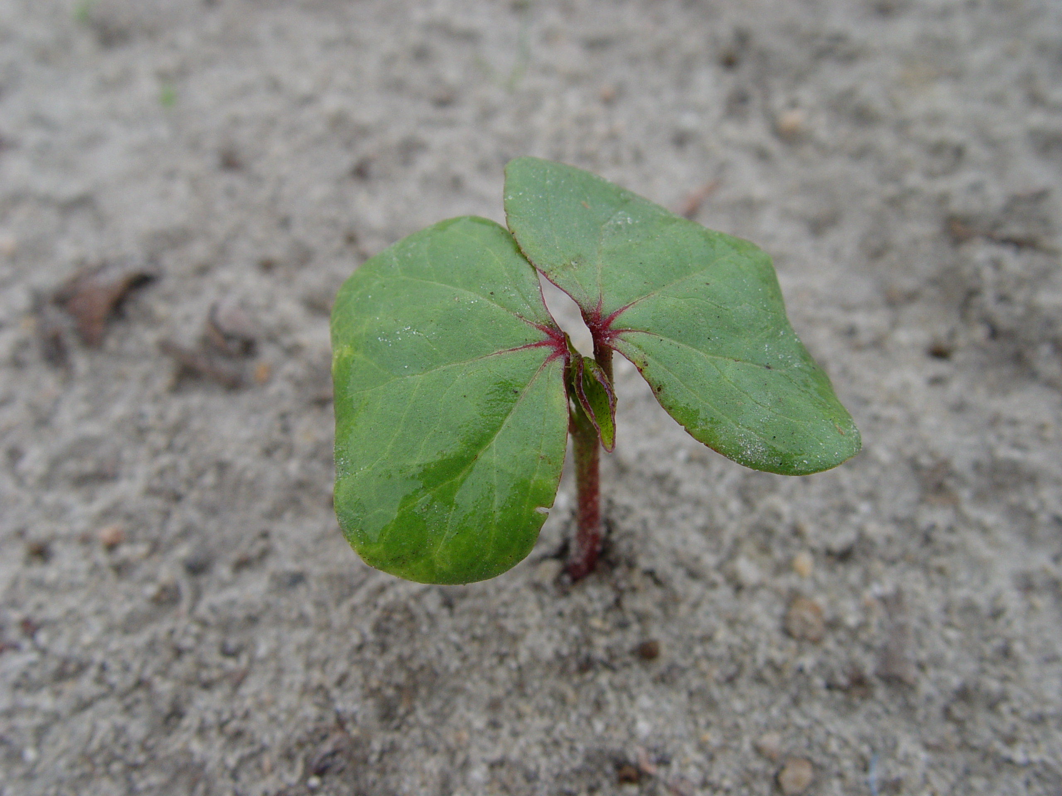
Towards cloning the root-knot nematode resistance genes in Upland cotton
Peng W. Chee
Institute of Plant Breeding, Genetics and Genomics
University of Georgia
Bangkok, July 3, 2017
Notes:
I would like to thank the organizing committee for inviting me to give this presentation.
Im a cotton breeder and geneticists at the university of Georgia in US.
Today Im sharing with you our work on trying to understand the genetics of root-knot nematode resistance

Slide 2
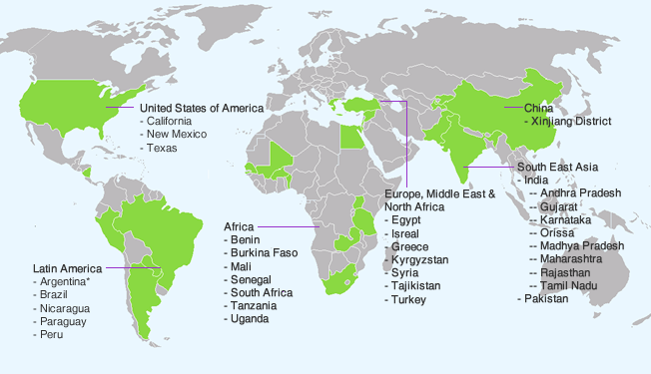
World cotton production 2009-13
Source:textileexchange.org
Notes:
Let me start by giving you a little background on cotton production.
Cotton is a global crop, grown in more than 30 countries as a cash crop for its fiber to supply the textile industry.
The largest producer is China, and is also the largest consumer. Follow by India and the United states ranked 3rd in total production
The biggest challenge face by cotton growers is low cotton prices, which hovers around 70 cents a pound or around $1.50 per kilo. The low price in recent years has to do with competition with synthetic fiber or polyester. It would be nice if we can see the price go back to $2 per kilo. But with low crude oil prices I suspect the current price will stay this way for a while.
From production stand point, the biggest challenge is managing diseases and pests. A few nasty ones are endemic to certain regions, such as boll weevil in Brazil, curly leaf virus in India and Pakistan, verticilium wilt in China. In the US, the major pest faced by cotton growers is paracitic nematodes.

Slide 3
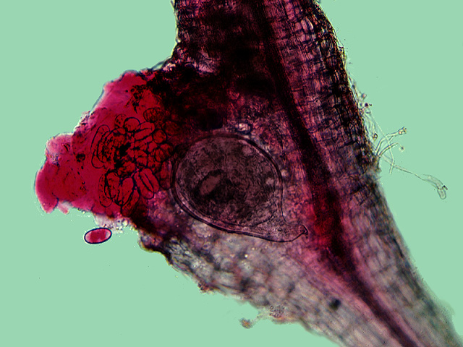
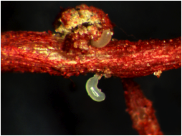
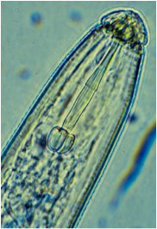
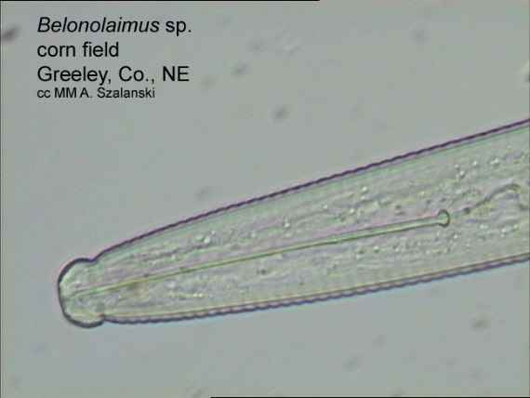
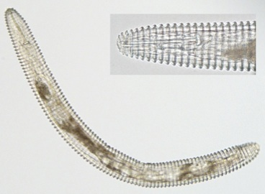
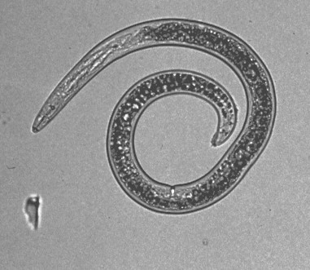
Parasitic nematodes of cotton
Southern root-knot
(M. incognita)
Reniform
(R. reniformis)
Lance
(N. galeatus)
Sting
Ring
Spiral
(B. longicaudatus)
(C. ornata)
(H. pseudorobustus)
Notes:
Quite a few parasitic nematode species can cause damage to cotton but by far the most severe one is melodoygne incognita, the southern root knot

Slide 4
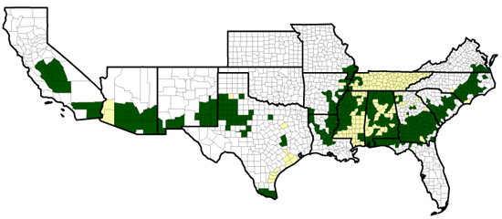
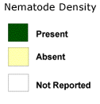
Population distributions and densities of root-knot nematodes in the US cotton belt
Source: National Cotton Council, 2009
Notes:
Its distributed across the US entire cotton belt, particularly prevalent in Georgia, Texas, and Mississippi where most of the cotton are being grown.
Has a wide host range and a short life cycle so can multiply quickly, plus the eggs can stay dormant in the soil, so once you have it in your farm, its there.

Slide 5
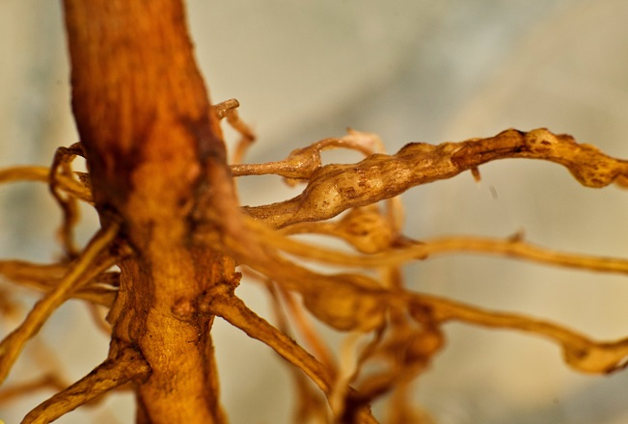
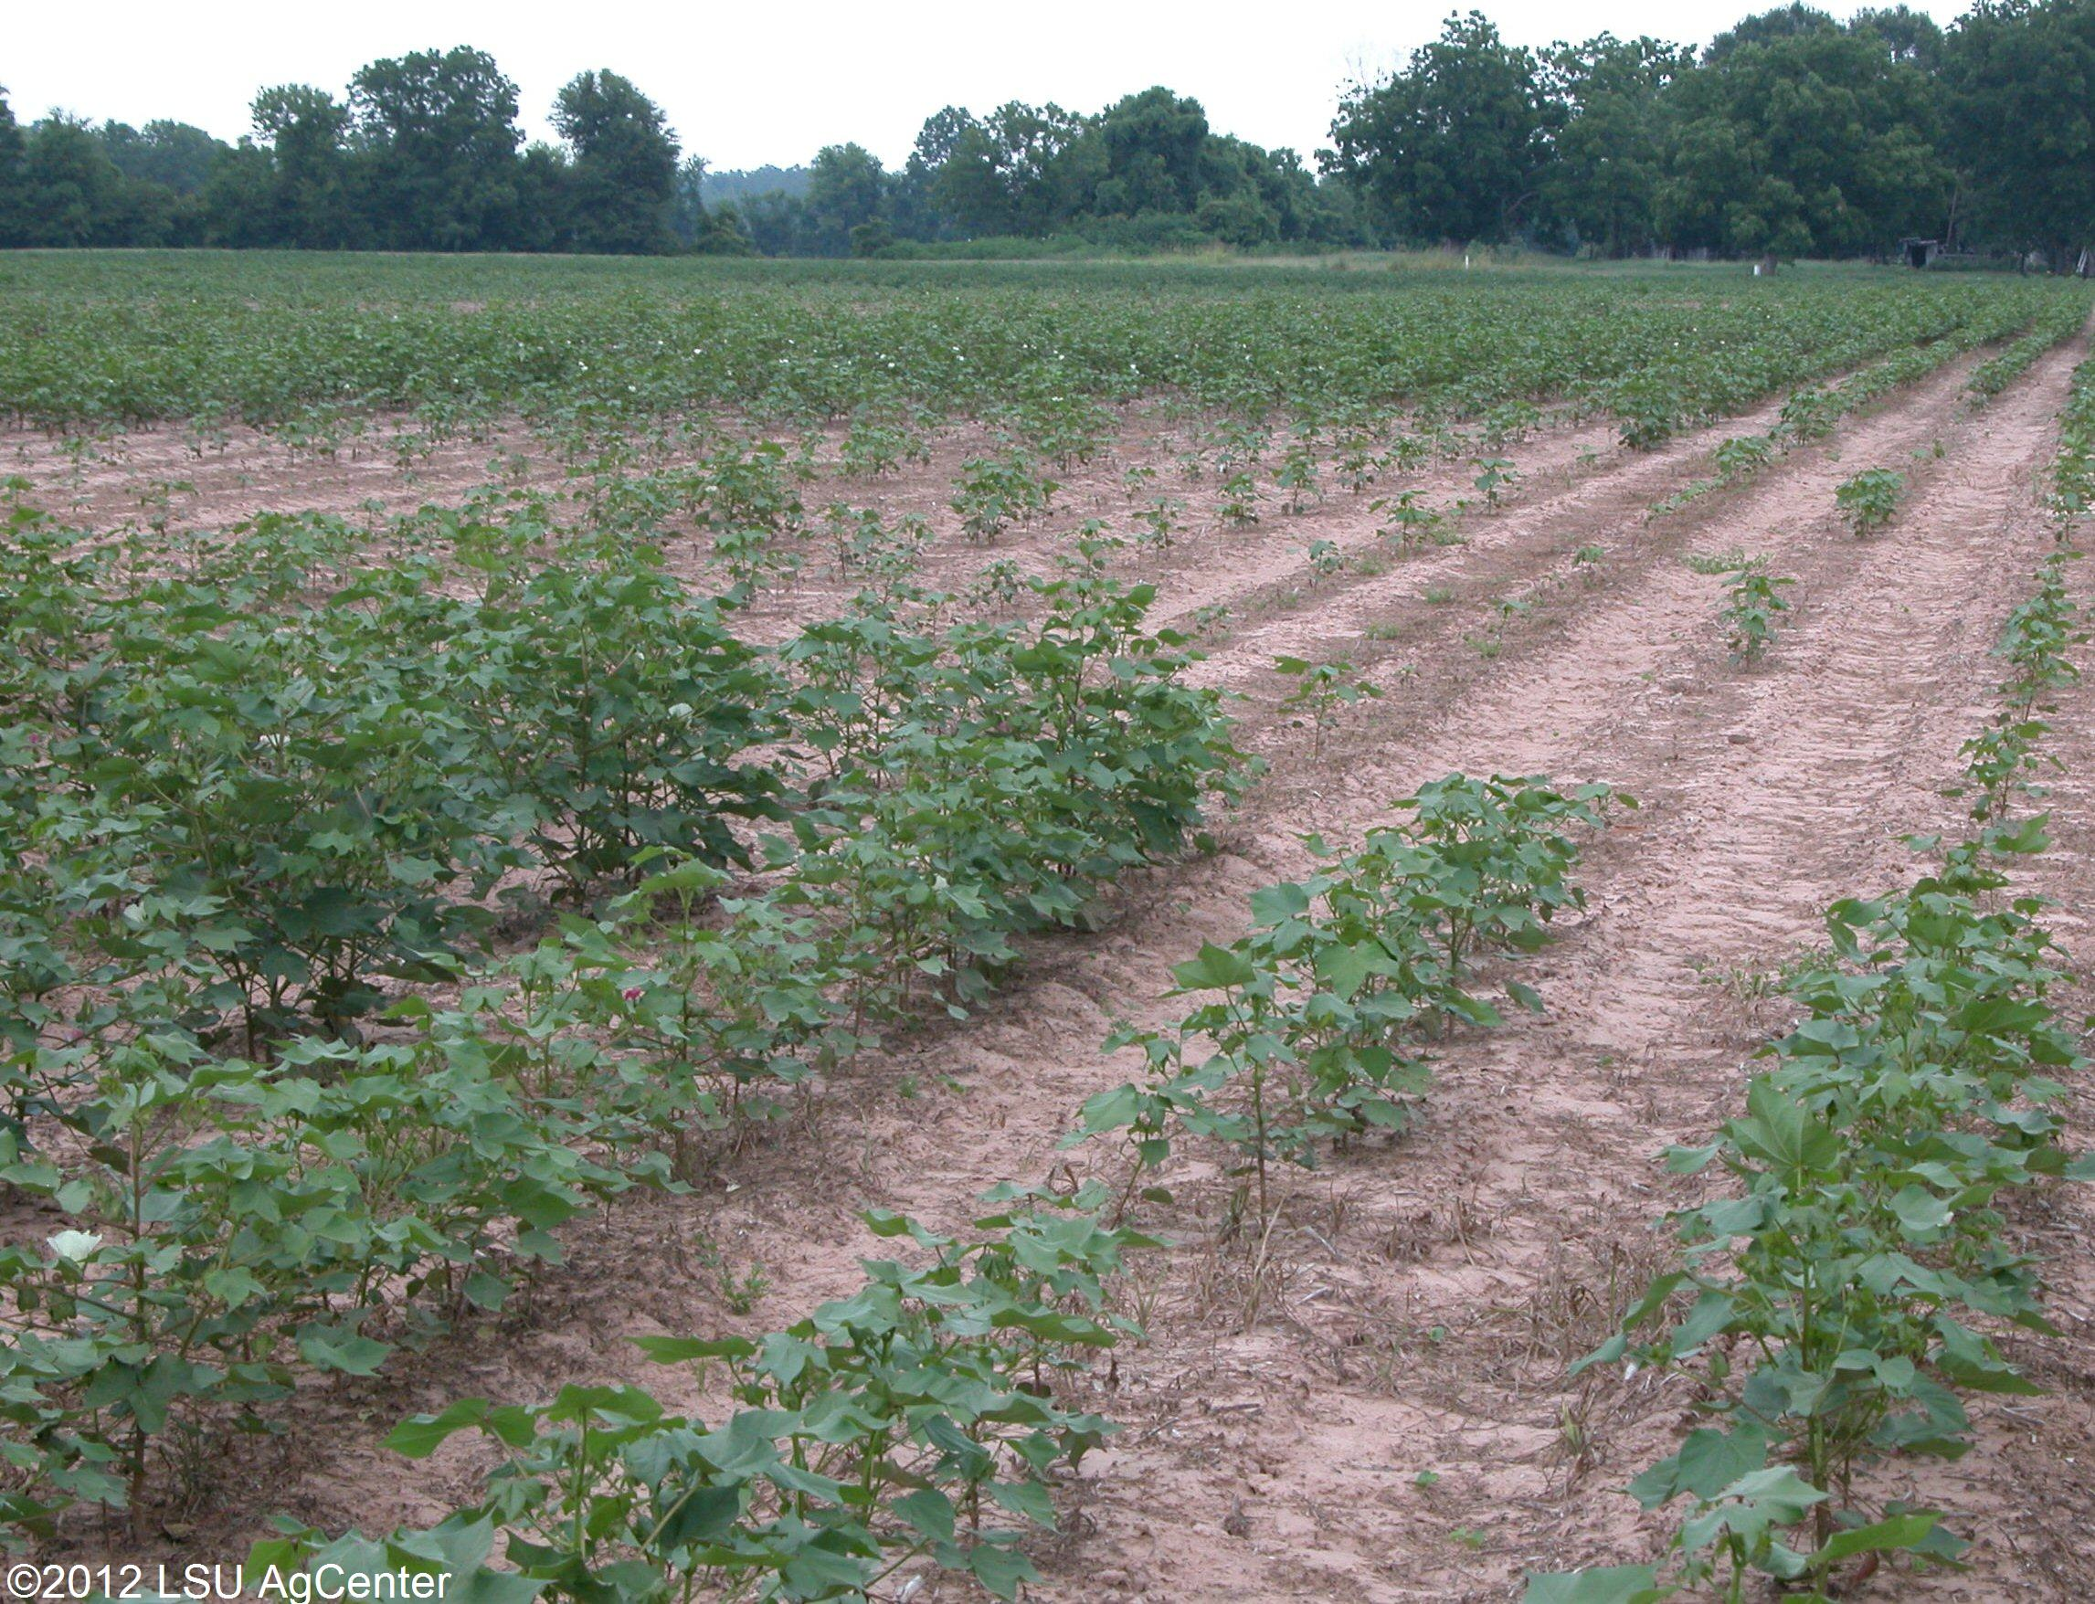
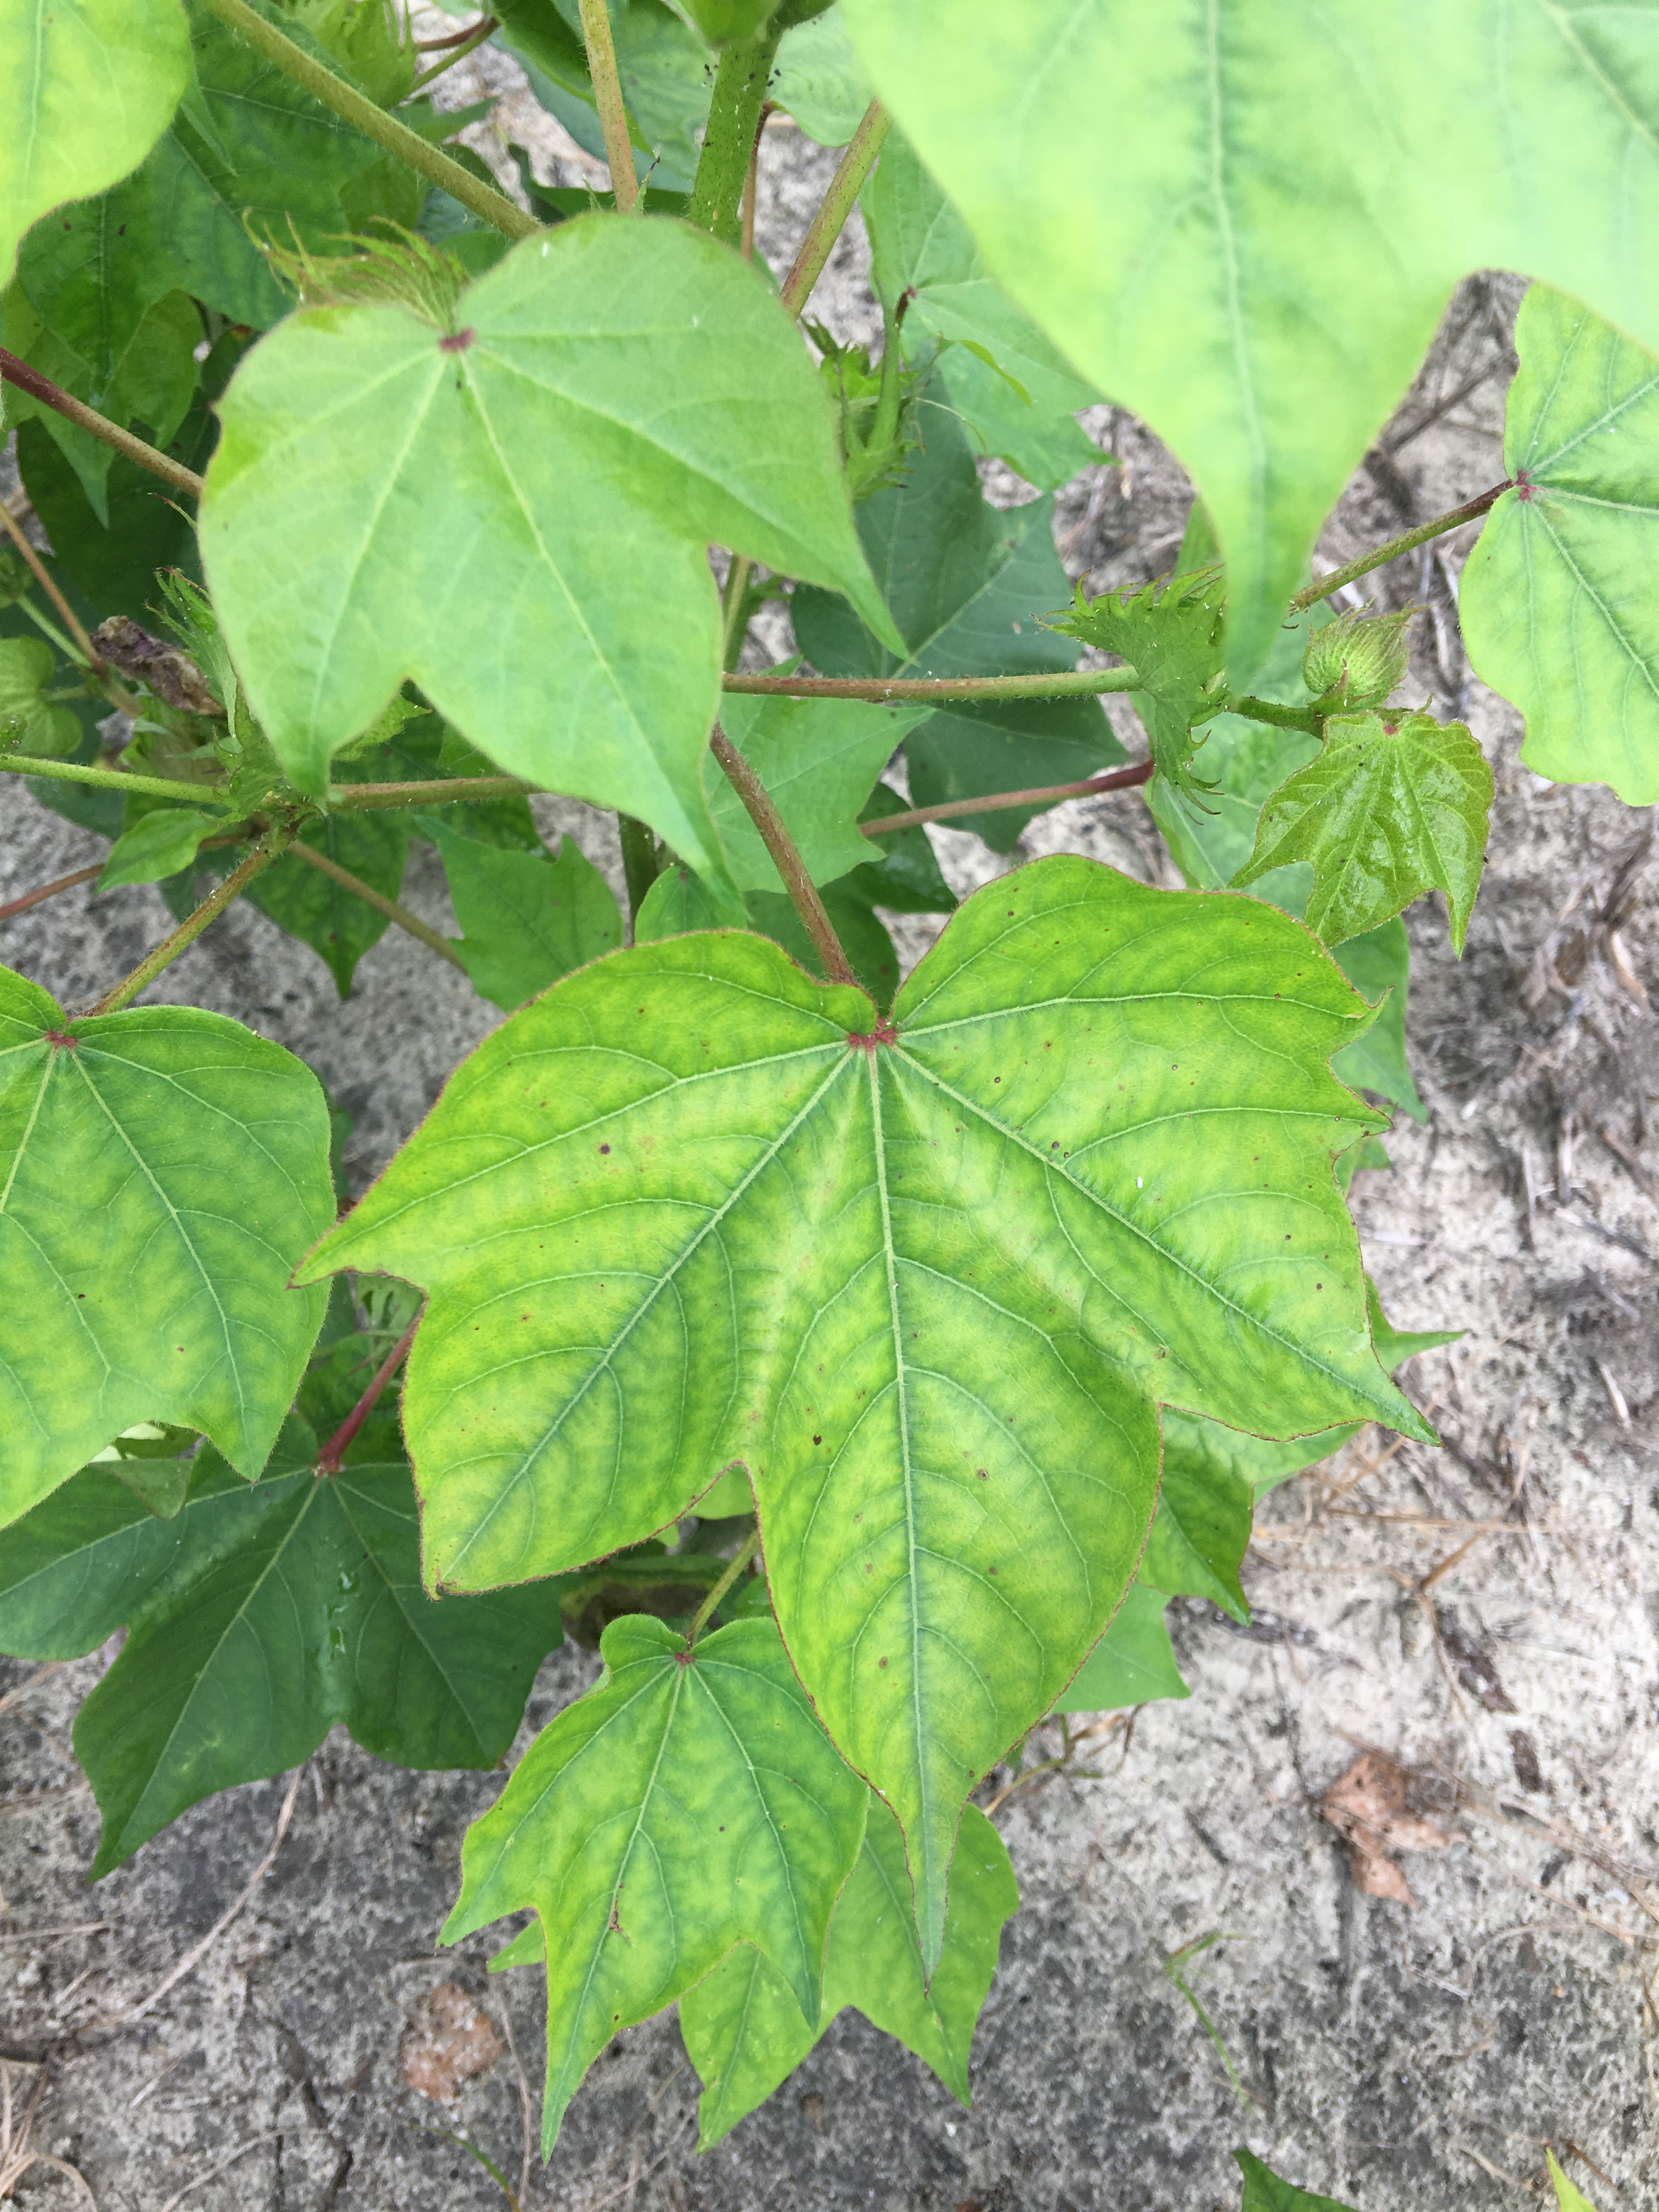
Southern Root-knot Nematode
Notes:
The root-knot life cycle start from eggs. After hatching, the root-knot juvenile will find a suitable host. infects the roots, it will form a feeding site and the female will becomes sedantry until she lay its eggs and die.
The feeding site usually forms galls which give its name root-knot nematodes.
Infected plants will have yellowing leaves from water and nutrients deficiencies and are stunted, producing very little cotton fibers.

Slide 6
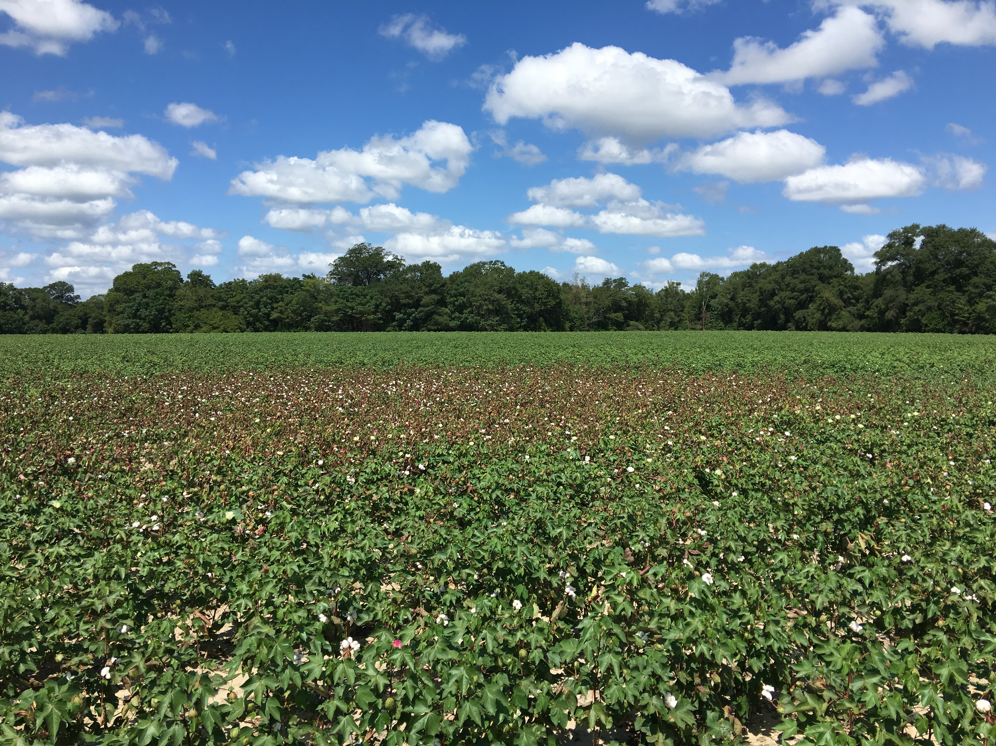
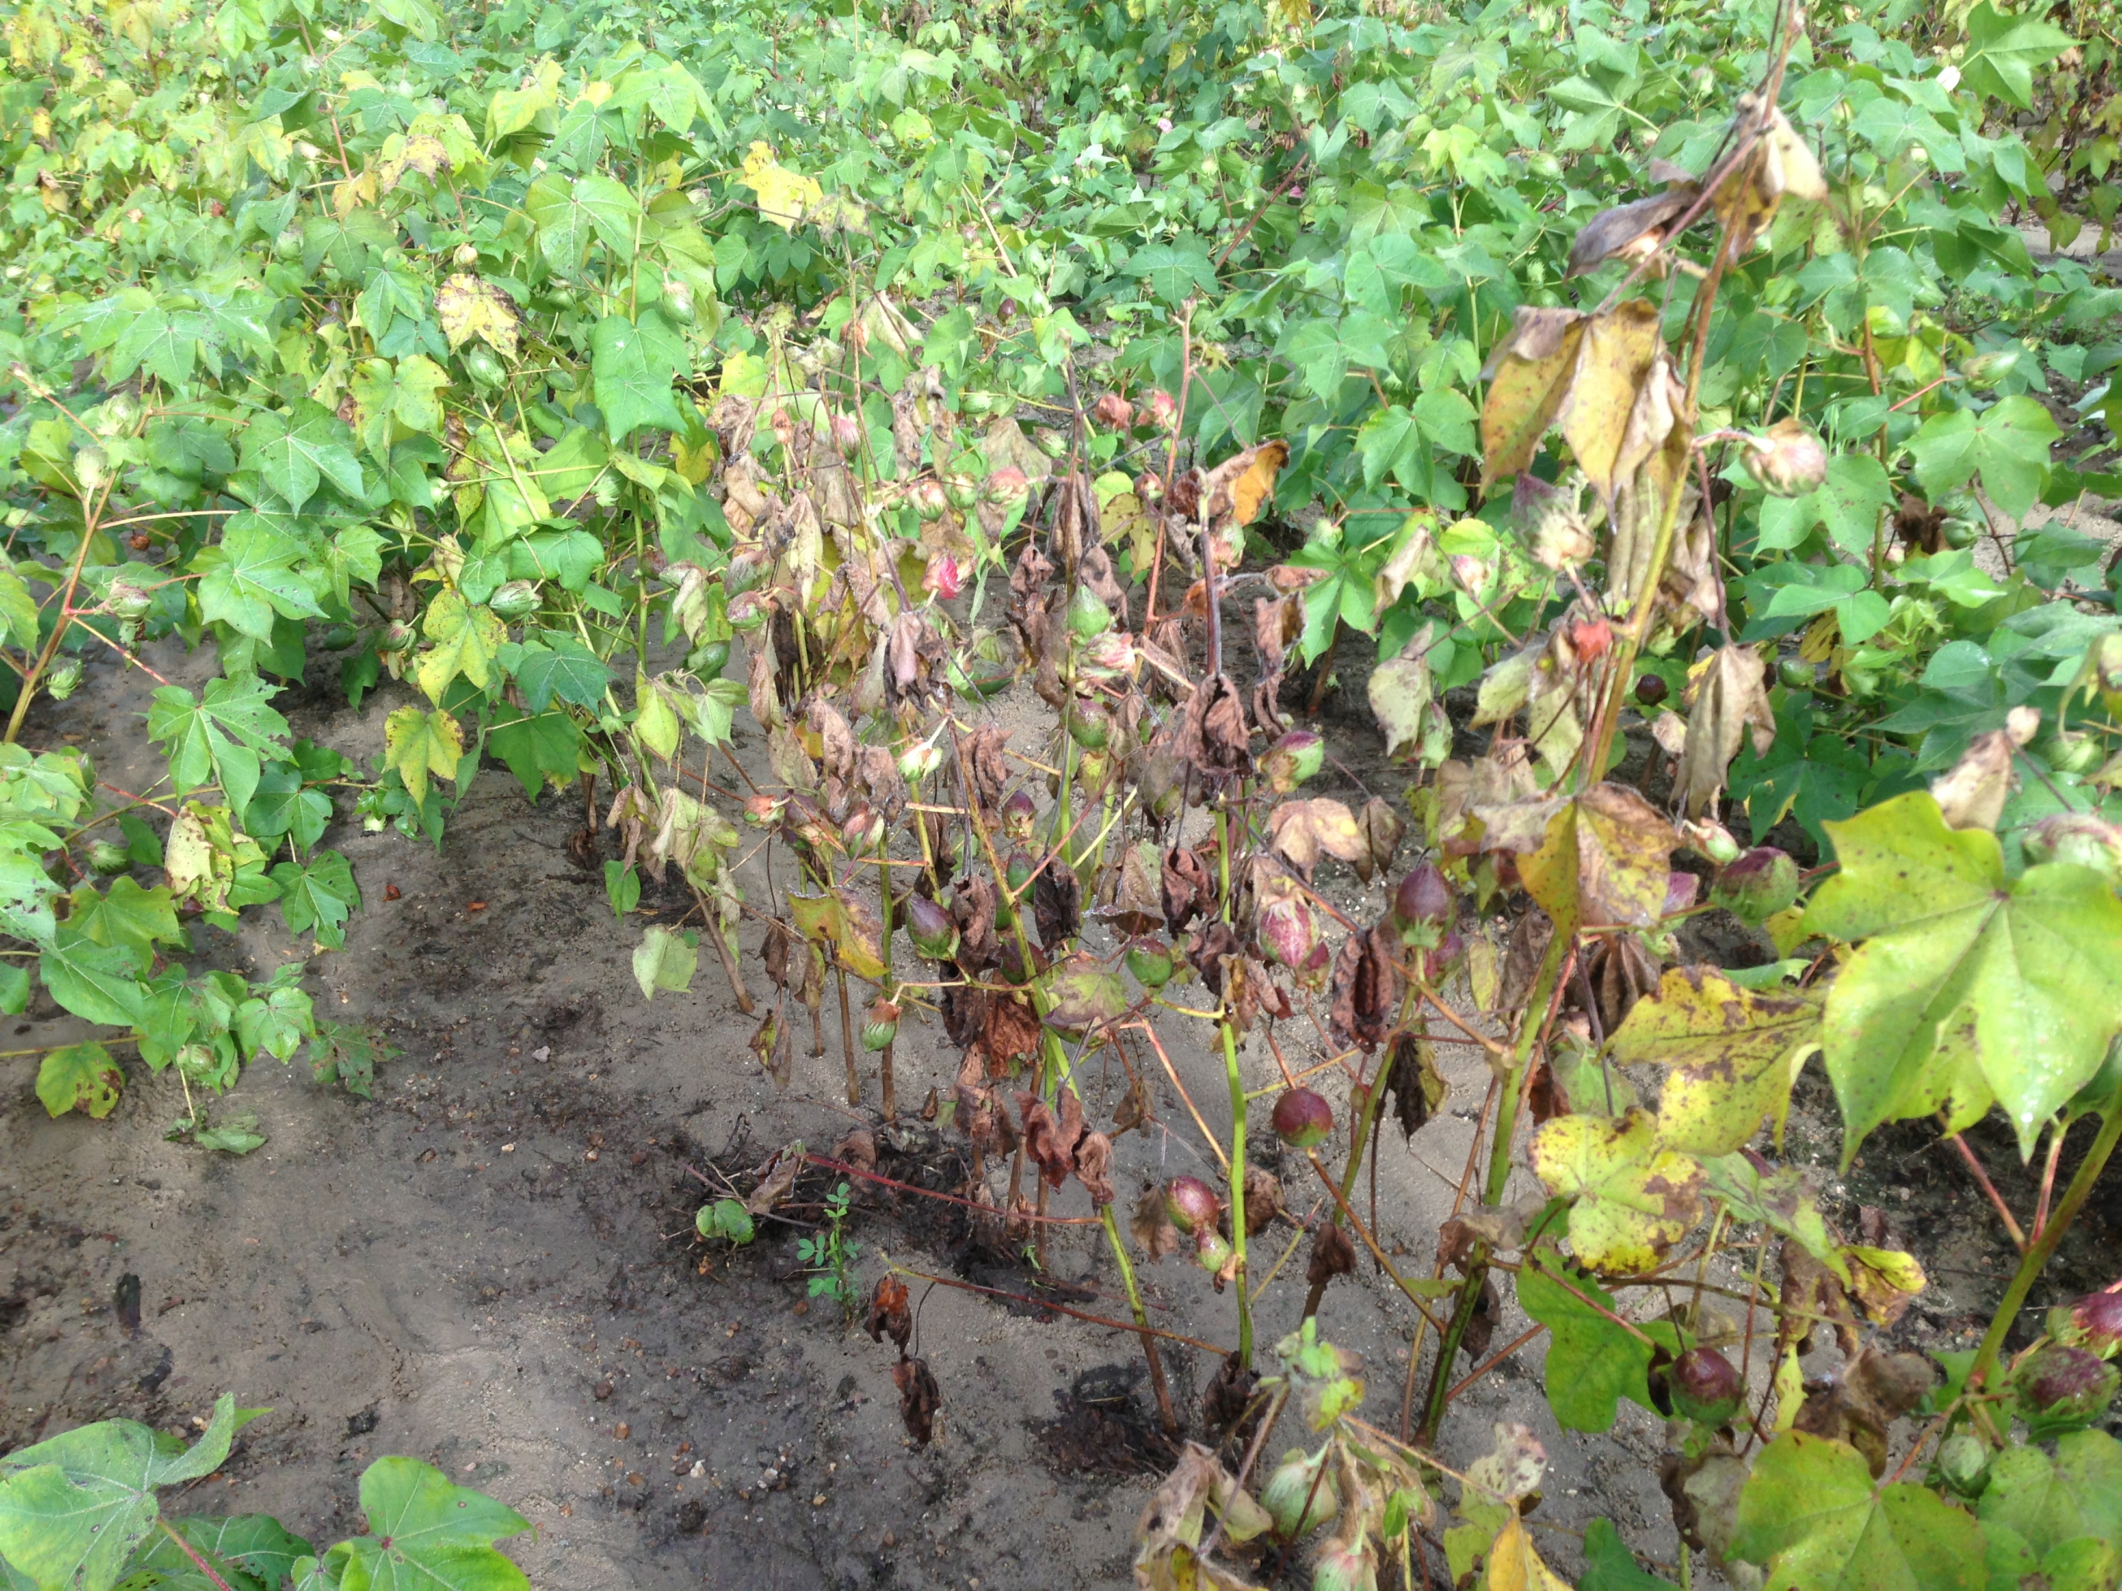
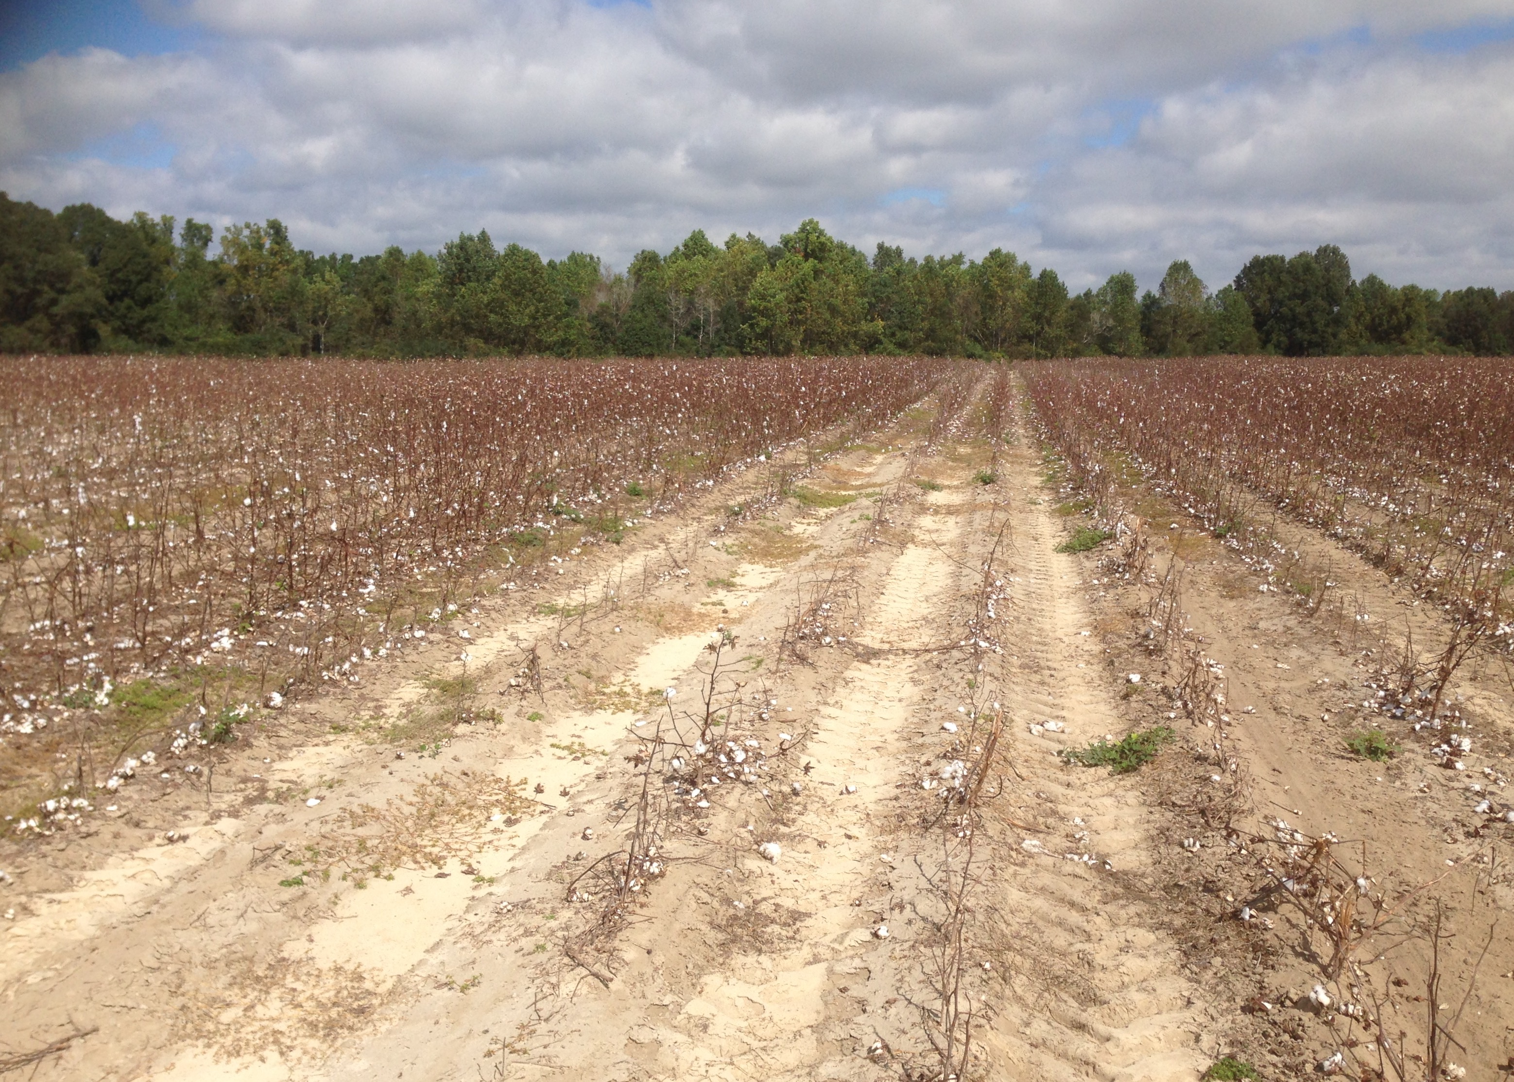
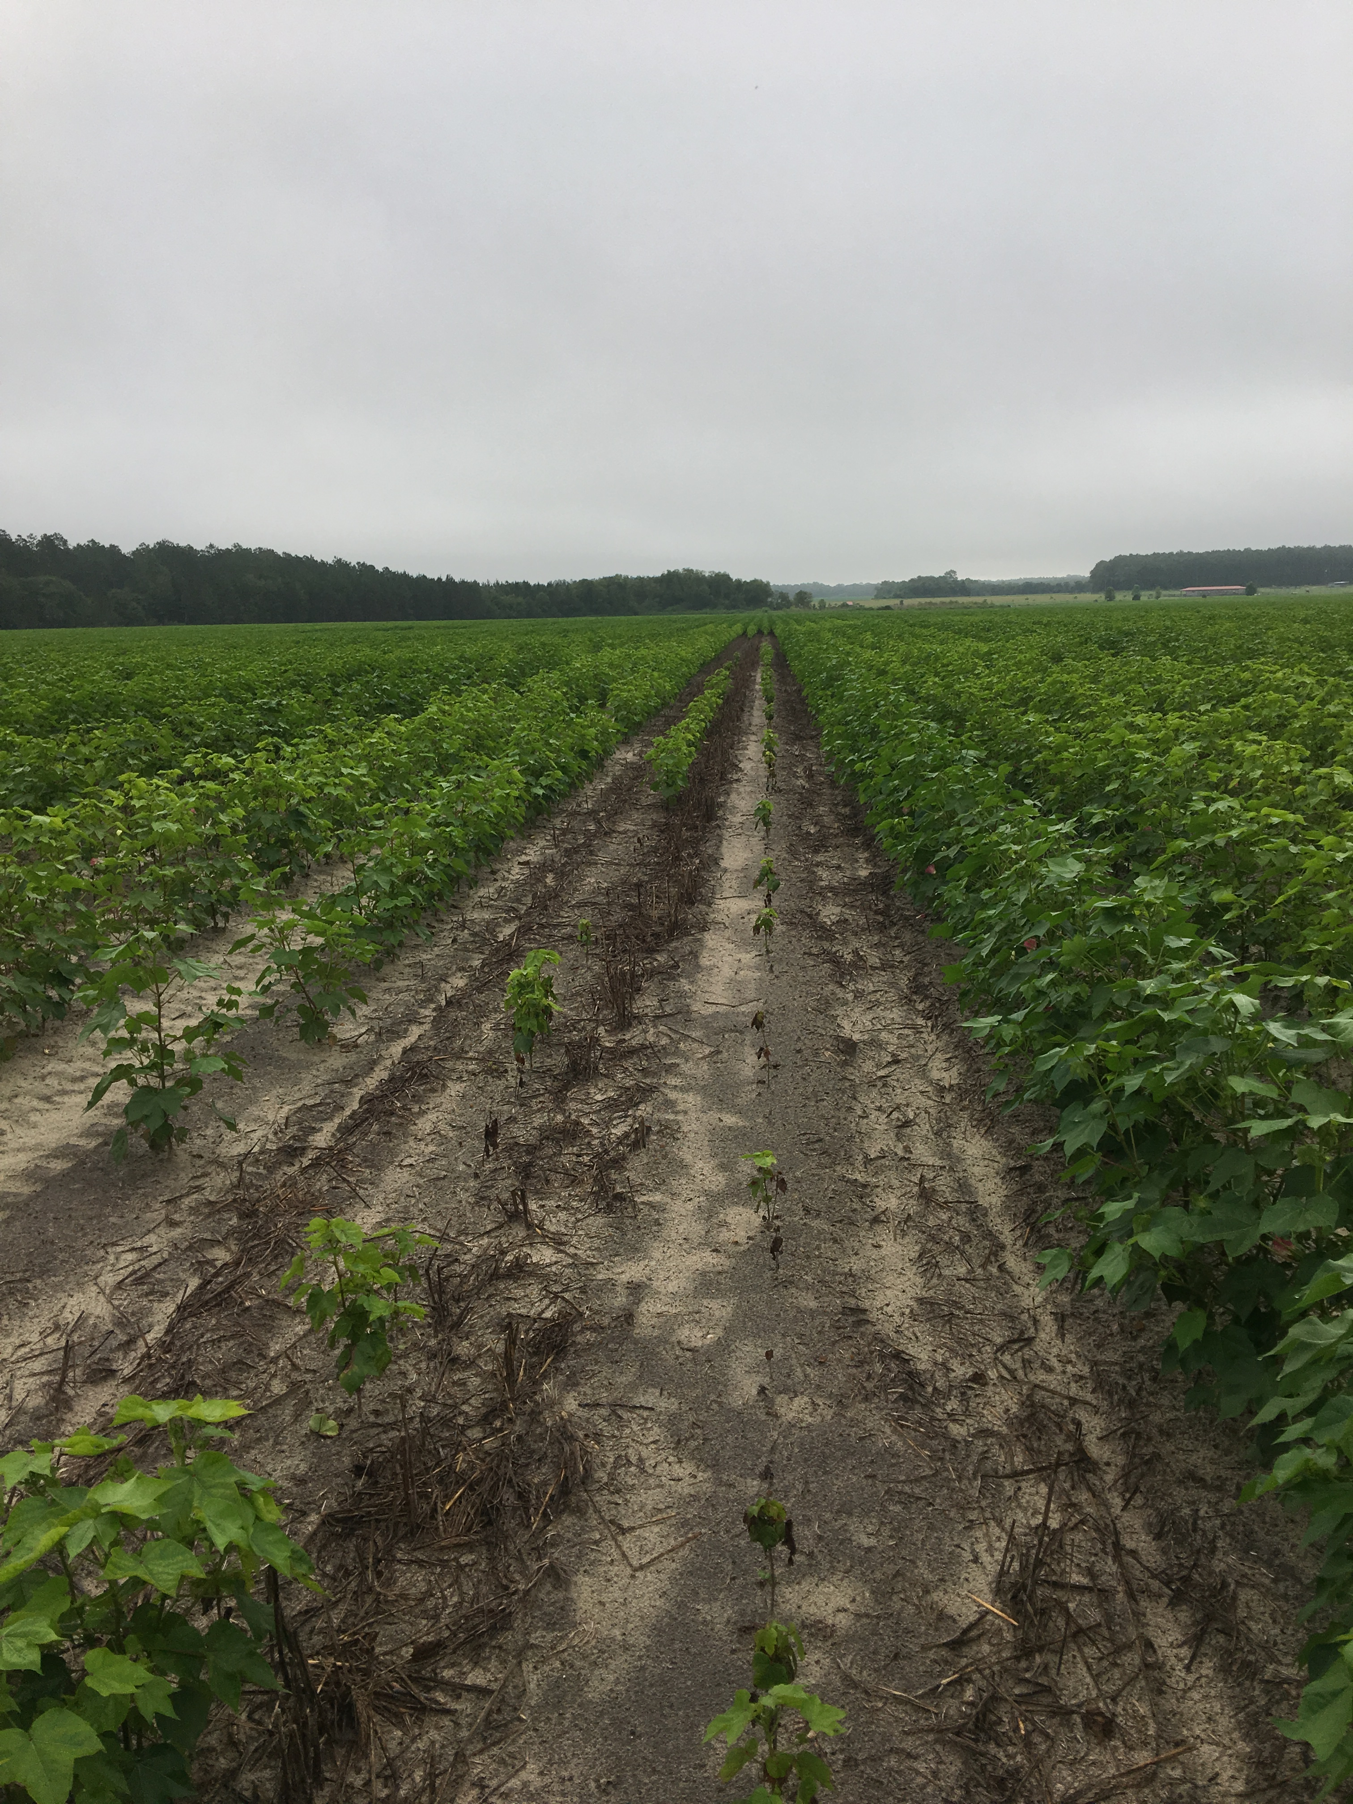
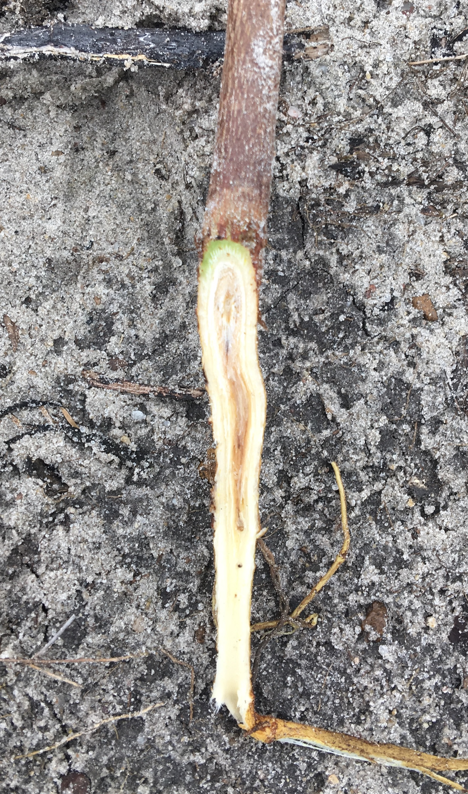
Root-knot Fusarium complex
Notes:
The biggest problem with root-knot nematode is that infected plants are super susceptible to fusarium wilt, a vascular disease caused by fusarium oxysporium.
When you have root-knot and fusarium together, you will see widespread plants wilting. It could affect seedlings as well as mature plants.

Slide 7
Auburn 623 resistance source
Wild Mexican
Jack Jones
Clevewilt 6
Auburn 623 RNR
Auburn 56 (RC)
Auburn 634 RNR
Stonville 213
Auburn 56
Coker 201
Coker 310
Deltapine 16
M-92RNR
M-249RNR
M-272RNR
M-120RNR
M-155RNR
M-725RNR
M-240RNR
M-315RNR
M-331RNR
Source: Robinson 1999
Notes:
Luckily a high levels of resistance germplasm called Auburn 623 was developed in the 70s by crossing two moderately resistant or tolerant lines. An absolete cultivar called Clevewilt6 and a wild cotton plant called wild mexican.
This highly resistant germplasm line has been utilized to developed other more modern germplasm lines in the late 1970s called the M lines

Slide 8
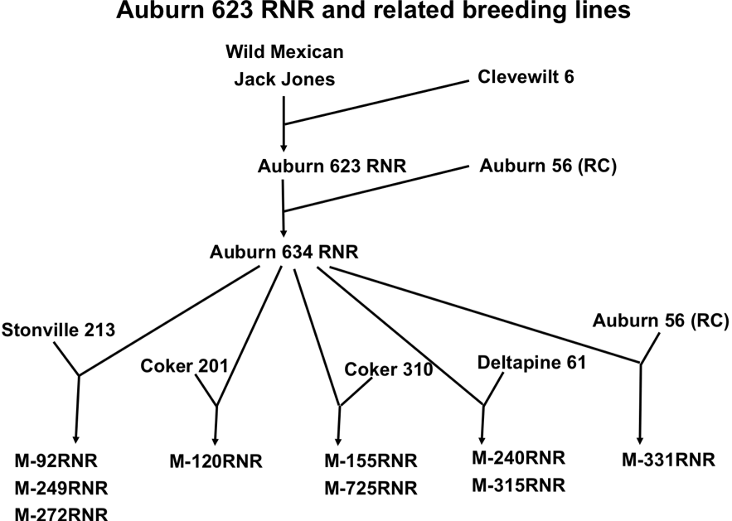
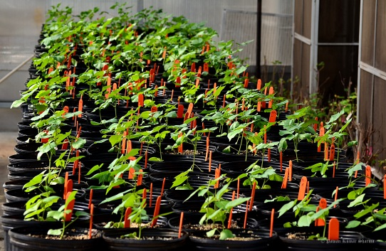
M-120 RNR Genetic mapping population
X
PimaS6
Mapping Population
QTL Mapping/Fine Mapping
Notes:
The inheritance of resistance was somewhat confusing up until the early 2000, some reports suggest that its conferred by 2 genes while other said its qualtitatively inherited.
Some said its dominant or additive but other suggest that its recessive.
So we were interested in understanding the inheritance of the resistance trait in early 2000 by developing a population segregating using the germplasm line M120 and perform QTL mapping on the resistance trait.

Slide 9
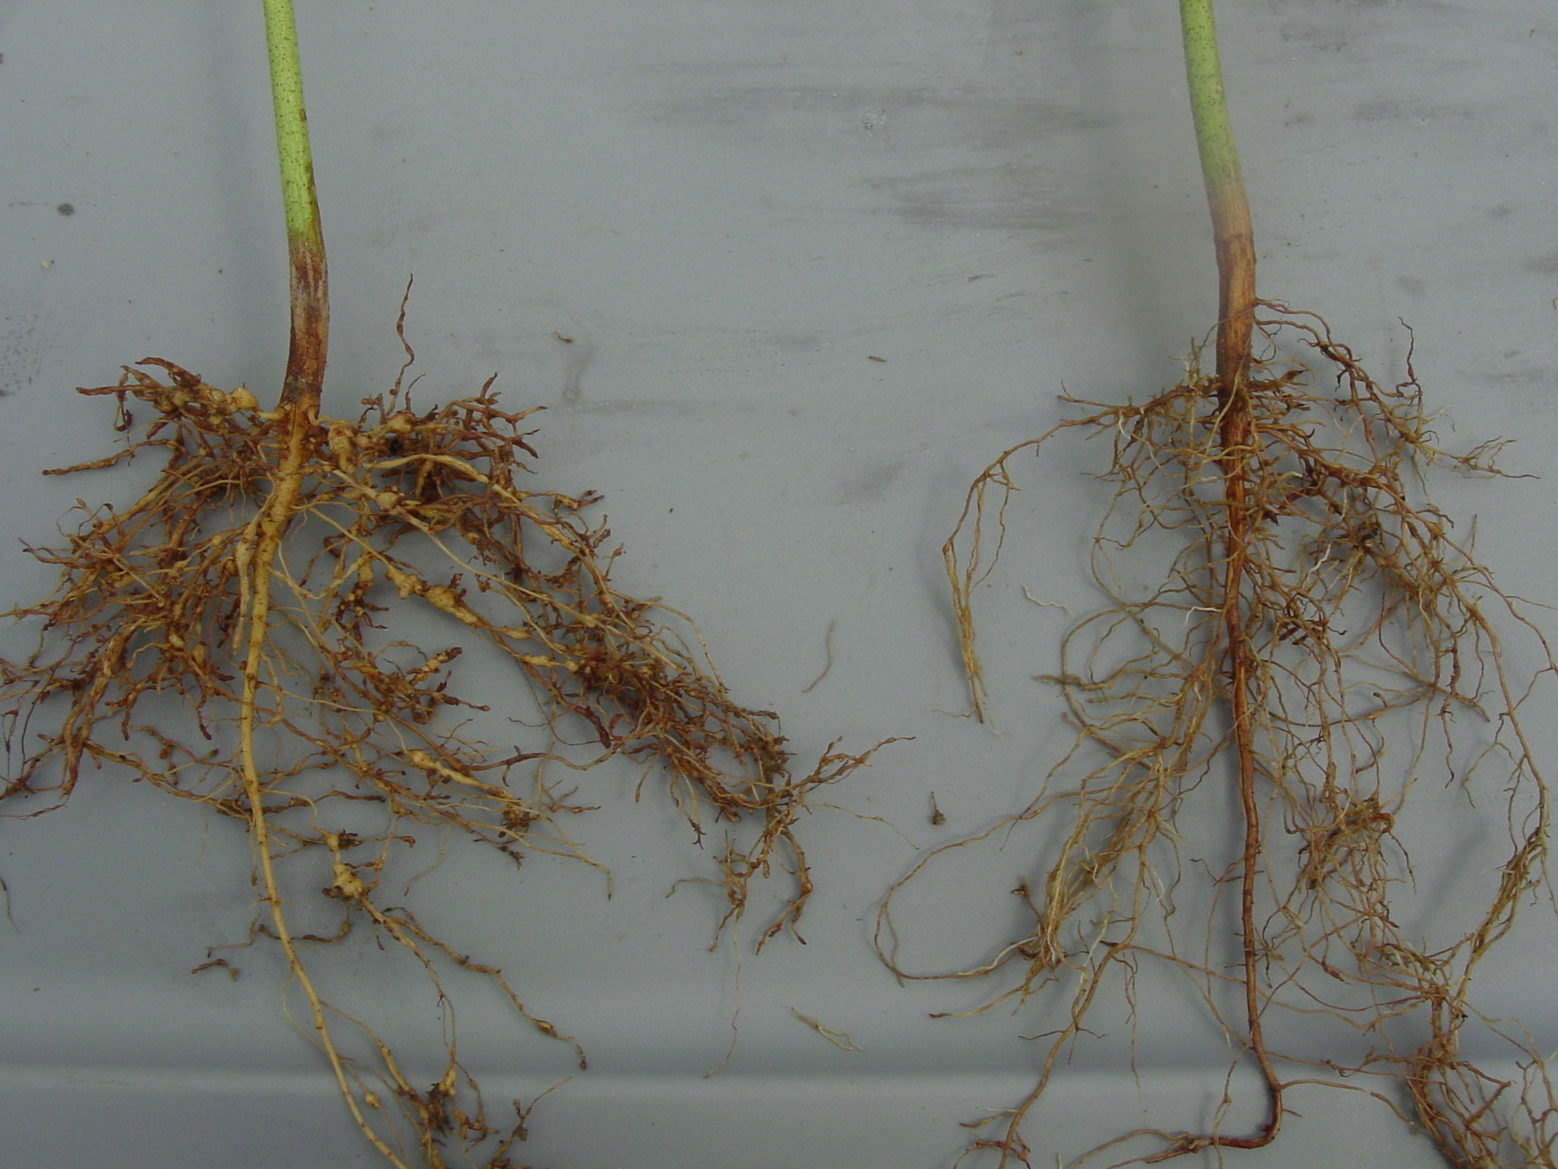
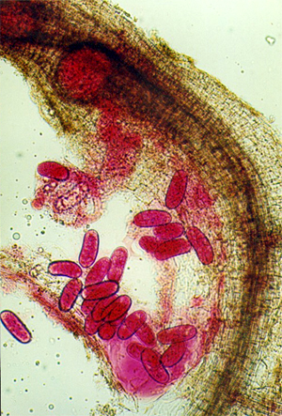
Phenotyping for resistance
# plants
# plants
Gall rating
Eggs/g roots
Notes:
We collaborate with a nematologists with the USDA to measure 2 phenotypes that are related to resistance and susceptibility
We count number of galls in the roots, resistant plant would have less galls compare to the susceptible genotype
We also measure the number of eggs in the roots after 2 life cycle of nematodes

Slide 10
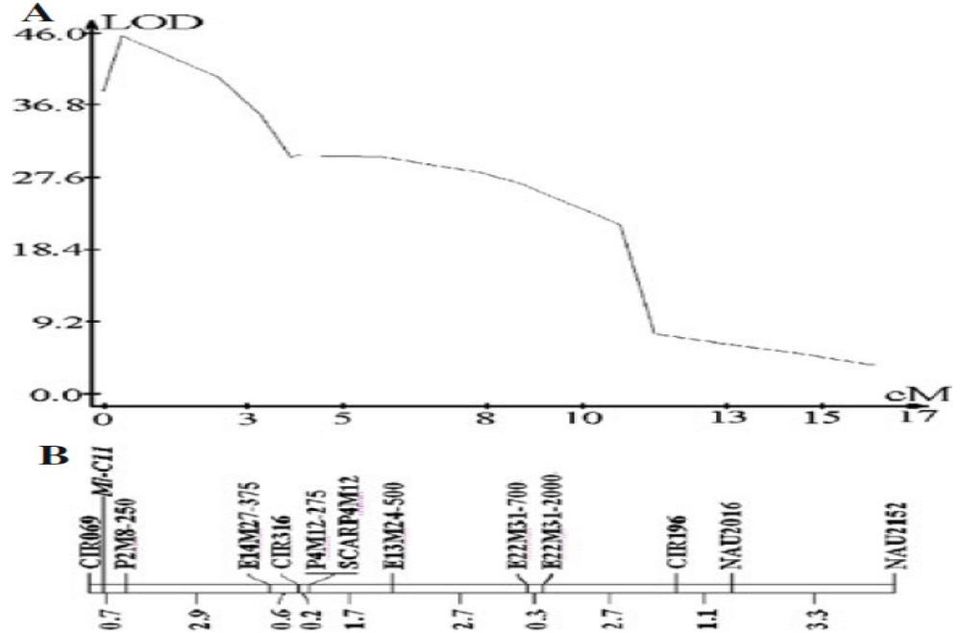
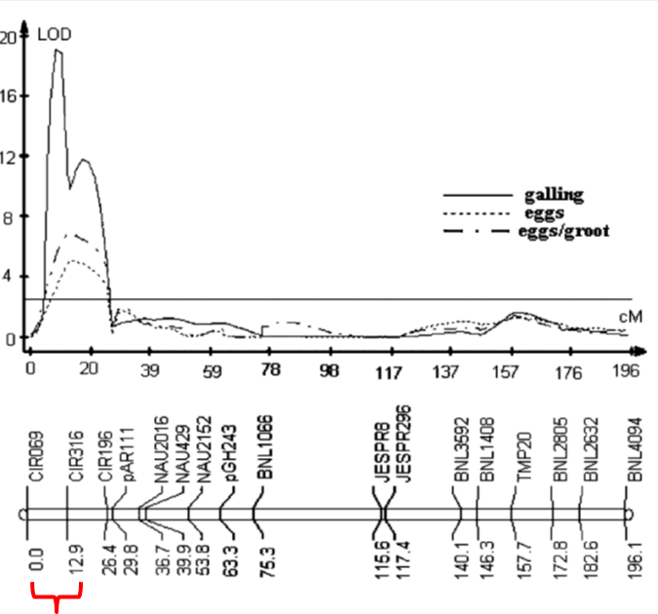
QTL associated with galling – qMi-C11
Shen et. al. TAG (2006)
Shen et. al. TAG (2010)
Notes:
Once we finish genotyping and phenotyping the population, which has around 300 individuals, the QTL analysis was quite straight forward.
we were excited to find a large QTL for galling mapped to CHr 11.
This QTL explained like 60% of the phenotypic variation
I though for sure we the gene.
A few years later we fine mapped this locus from 12 cM to a 3 cM interval

Slide 11
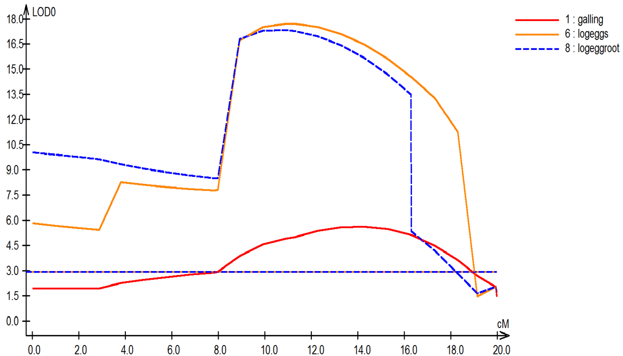
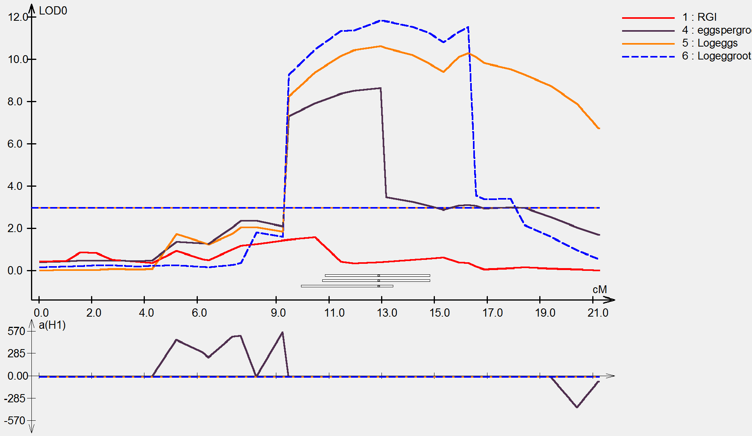
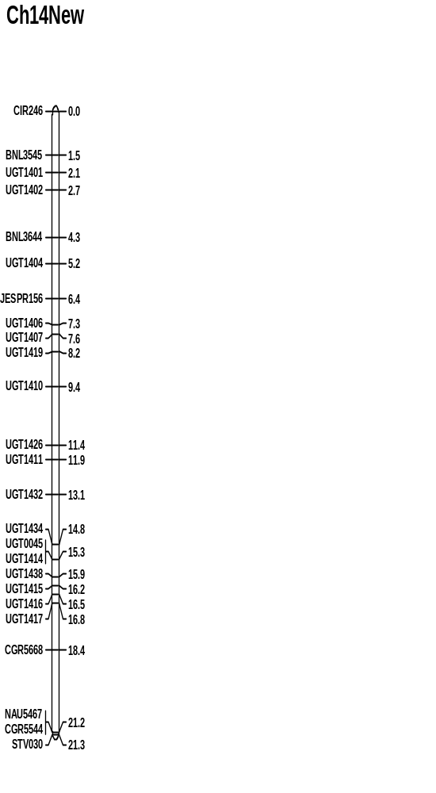
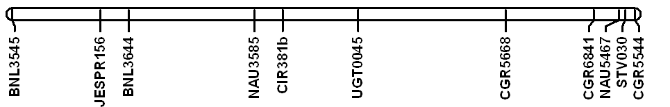
QTL associated with egg counts- Chr. 14
R²=24.5%
R²=21.5%
R²=12.6%
3.9 cM
He et al. TAG (2014)
Kumar et al. BMC (2016)
Notes:
While we were working on fine mapping with a much bigger population, over 1000 individuals, we noticed that the eggs data doesn’t correlate much with galling.
At the same time, another research group working on RKN reported a QTL on Chr14
This prompted us to go back and redo a more through analysis and we were able to detect another QTL on Chr14
Interestingly, this QTL has a strong association with eggs production but not much effect at all on galling.
So apparently, we were so focus on galling that this QTL fell through the crack on our first analysis.
We fine mapped this locus to a 4 cM region

Slide 12
Genetics of resistance
Wild Mexican X Jack Jones
Clevewilt 6
Auburn 623RNR
CH14
CH11
Shen et al. (2006) report a resistance gene on Chromosome 11
Wild Mexican Jack Jones
Clevewilt 6
Gutierrez et al. (2010) report a resistance gene on Chromosome 14
He et al. (2014) report the epistatic effect between the two resistant genes
Notes:
So after 10 years, we finally has a better understanding on the inheritance or resistance. Based on the QTL analysis our current working hypothesis is that there are 2 major resistant genes in the Auburn germplasm
There’s an R gene conferring galling suppression on Chr11
an R gene suppressing eggs production on Chr 14
And there’s data suggesting that the two gene interact epistatically to confer almost immunity to nematodes infection

Slide 13
Development of isogenic lines (NILs)
M-120
Coker 201
X
Homozygous for
qMi-C11 and qMi-C14
Susceptible:
no resistance gene
F1
F2
qMi-C11&
qMi-C14
Neither QTL
qMi-C14
qMi-C11
Notes:
To test this hypothesis we developed isogenic lines with only one QTL to try to understand the mechanism of resistance

Slide 14
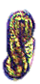
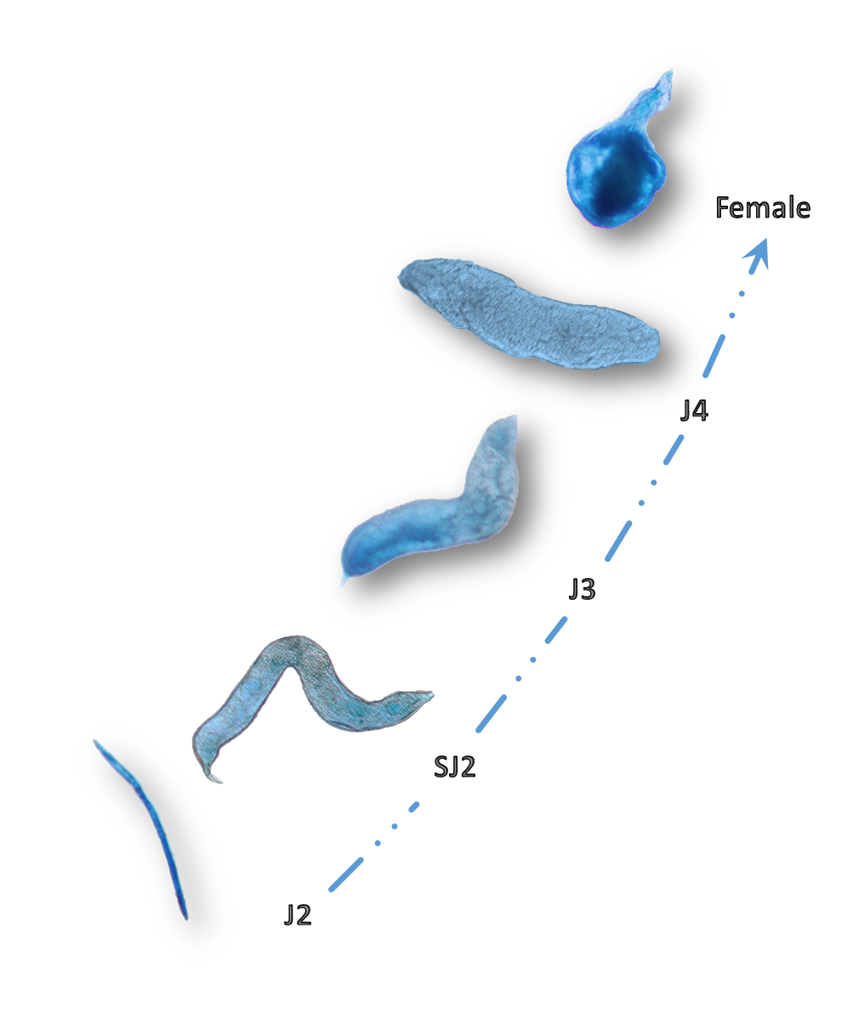
Characterizing M. incognita developmental stages
16 – 25 day
after inoculation
Notes:
Once we developed those isogenic lines, we did histopathology on these lines to see how the nematode react to these genotypes
It takes an average of 16 days for Juvenile nematodes to growing into female and starting to lay eggs.
So, for we have the resistant parent, which represent genotypes with both QTLs and no QTLs, plus the two isogenic lines with only one of the 2 QTLs,
We inoculate cotton seedlings with eggs, let them hatch and count the number of nematodes at different stages of development at every 4 days interval after inoculation.

Slide 15
Gall Numbers
A
A
A
A
Coker
AB
A
CH14
A
AB
AB
CH11
B
B
M120
Silva Batista et al. in Prep
Notes:
This is the gall numbers for the 4 genotypes
As expected the susceptible parent coker has lots of galls and the resistant parent had very few if at all.
The isogenic line with only QTL on CHr 11 is similar to the resistant parent
Also as expected, the isogenic line on CHr14 has lots of galls, in fact just as much galls as the susceptible parent
Although this is what the QTL results say we should expect to see, it did cross my mind that we may have messed up somewhere

Slide 16
Female Numbers
A
A
A
A
Coker
A
A
B
B
CH14
B
B
C
C
B
CH11
B
C
C
M120
Notes:
The total number of females is telling us a similar story
The Chr 11 QTL isogenic line has the same phenotype as the resistant parent
Starting about 12 days after inoculation, you can see a seperation between those with the Chr11 QTL versus those doesn’t
Interestingly, the CHr14 QTL has the same phenotype as the susceptible parent all the way until somewhere between 25 to 30 days. So there’s where the QTL starting to take effect. This data that some where at this point, the females were not able to complete their life cycle and lay eggs.

Slide 17
Eggs Numbers
Coker
Coker | A
CH14 | B
CH11 | B
M120 | C
Coker | A
CH14 | B
CH11 | B
M120 | C
Coker | A
CH14 | AB
CH11 | BC
M120 | C
Coker | A
CH14 | AB
CH11 | AB
M120 | B
CH14
CH11
M120
Notes:
If you look at the eggs data, everything make sense.
The two isogenic lines with each QTL behave like moderately resistant lines
You need both QTLs to get a high level of resistance
Without the QTL like in susceptible parent, you see a tremendous amount of eggs.

Slide 18
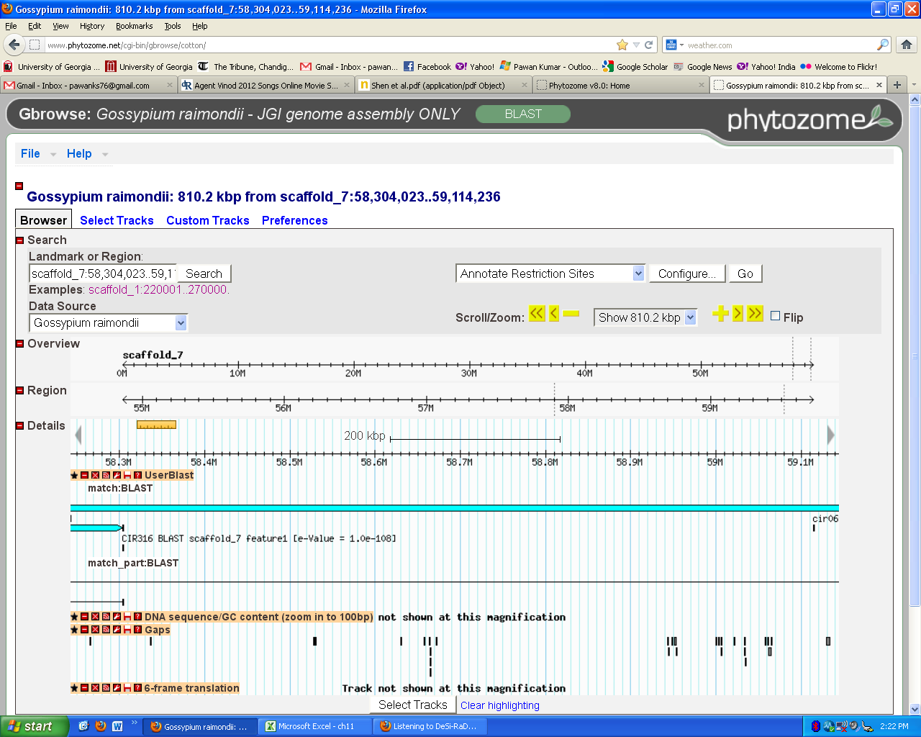
Chr 11 = Scaffold-7 of Gossypium raimondii (59.7Mb)
CIR316
CIR069
810,000 bp
a
Notes:
The first draft genome sequence of cotton, completed in 2013, give us a lot of of tools we didn’t have before.
Imagine, it took us almost 10 years to get to the point of fine mapping the two locus.
But with a click of the mouse, we know that the region for the QTL conferring galling suppression on CHr11 is about 800 Kilobases

Slide 19
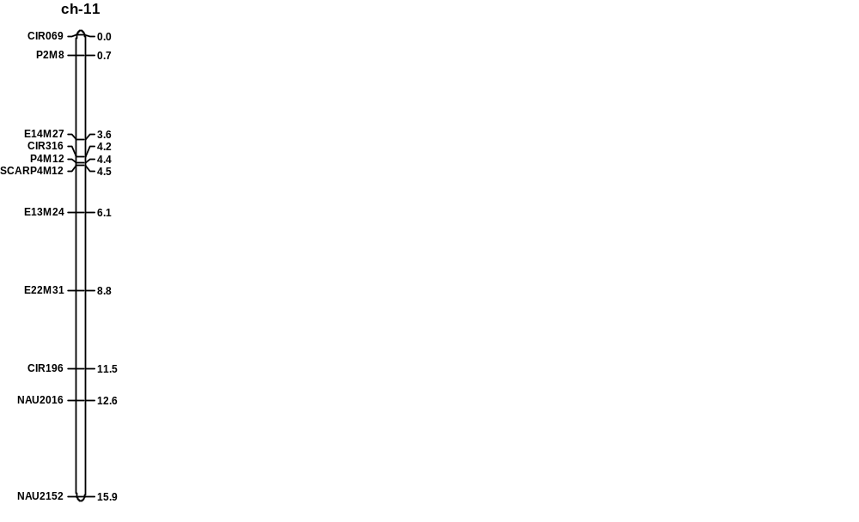
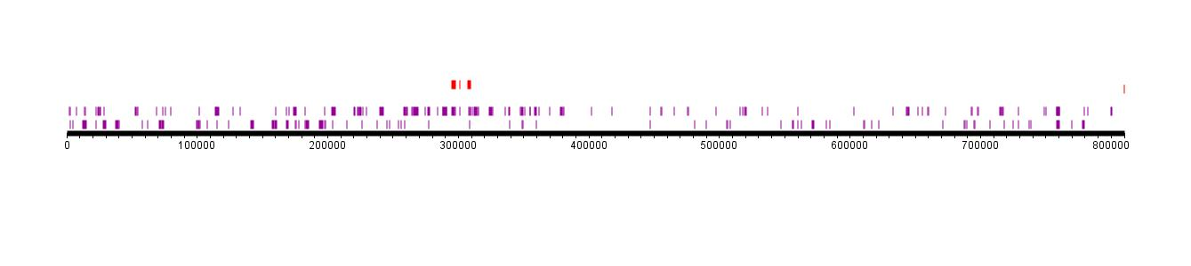
Candidate Genes for qMi-C11
CIR316
E14M27
UGT1116
UGT1117
CIR069
NBS-LRR Genes
810 Kbp
Notes:
It contains 300 coding sequence or genes
15 encodes LLR Lucein rich repeat indicative of disease resistance genes
These genes are scattered across the entire region

Slide 20
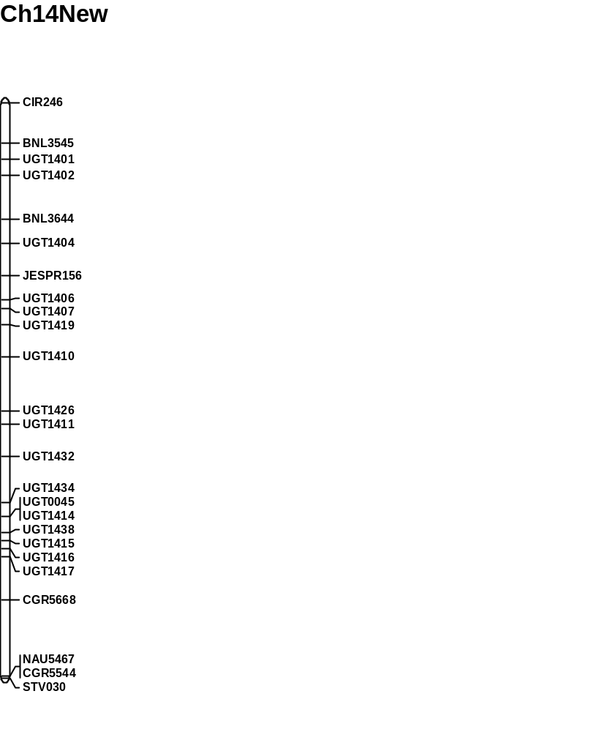
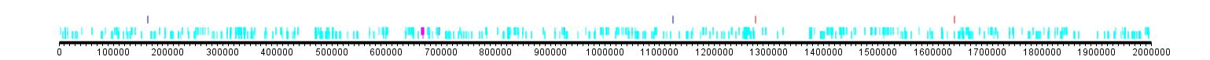
Candidate Genes for qMi-C14
JESPR156
UGT1410
UGT1432
UGT1414
CGR5668
NAU5467
LRR Genes
600 Kbp
Kumar et al. BMC. 2016
Notes:
the QTL region on Chr14, which suppress eggs production, is about a little smaller about 600 kilo bases
There are 60 coding sequences including 20 that have LRR motif
Interestingly these 20 genes are physically located in 3 clusters
and within each cluster, they share a very high homology

Slide 21
cDNA Library for RNASeq analysis
A
Coker
A
A
AB
CH14
AB
A
A
B
B
A
AB
BC
CH11
B
A
BC
C
A
C
B
B
C
M120
C
C
B
cDNA Library 1
cDNA Library 2
cDNA Library 3
Notes:
Based on our histopathology work, we know that the gene for gall suppression likely to express at around 12 day after inoculation
And the gene for eggs suppression likely to express at around 30 day after inoculation
So we developed cDNA libraries from root tissues from these two time point and also from inoculated plants as control

Slide 22
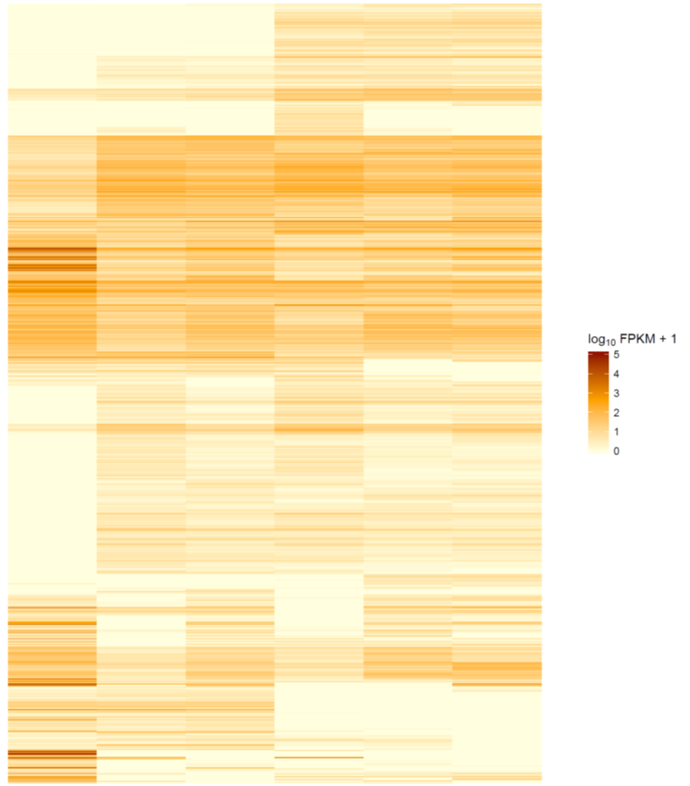
HeatMap of all genes at 0, 12, and 30 DAI in Coker and M120
Illumina NextSeq Sequencing
6 libraries total
2 genotypes: Coker and M120
3 treatments (0, 12, and 30 DAI)
paired-end reads 150 bp
Library | good quality
M120 0 DAI | 18,628,176
M120 12 DAI | 29,061,782
M120 30 DAI | 33,791,327
Coker 0 DAI | 22,033,577
Coker 12 DAI | 22,562,428
Coker 30 DAI | 23,110,355
Coker - 30
Coker - 12
Coker - 0
M120 - 12
M120 - 30
M120 - 0
Notes:
This past spring, we did pilot sequencing completed sequencing of libraries only of the two parents; the susceptible parent coker and resistant parent M120
Again we used tissues from 12 and 30 days after inoculation and also non inoculated plants as control
We obtained anywhere from 18 to 33 millions good reads for M120 and about 22 million reads from Coker the susceptible parents

Slide 23
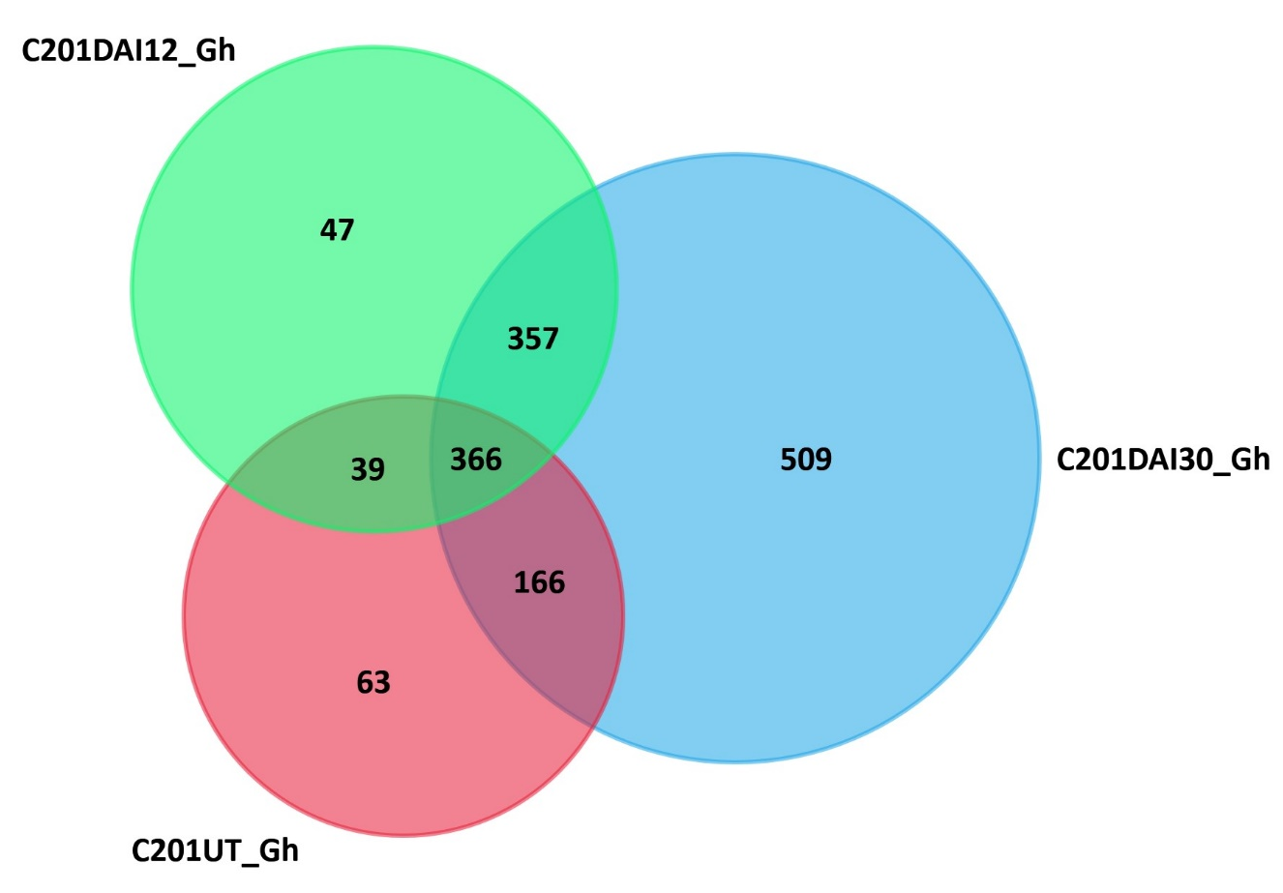
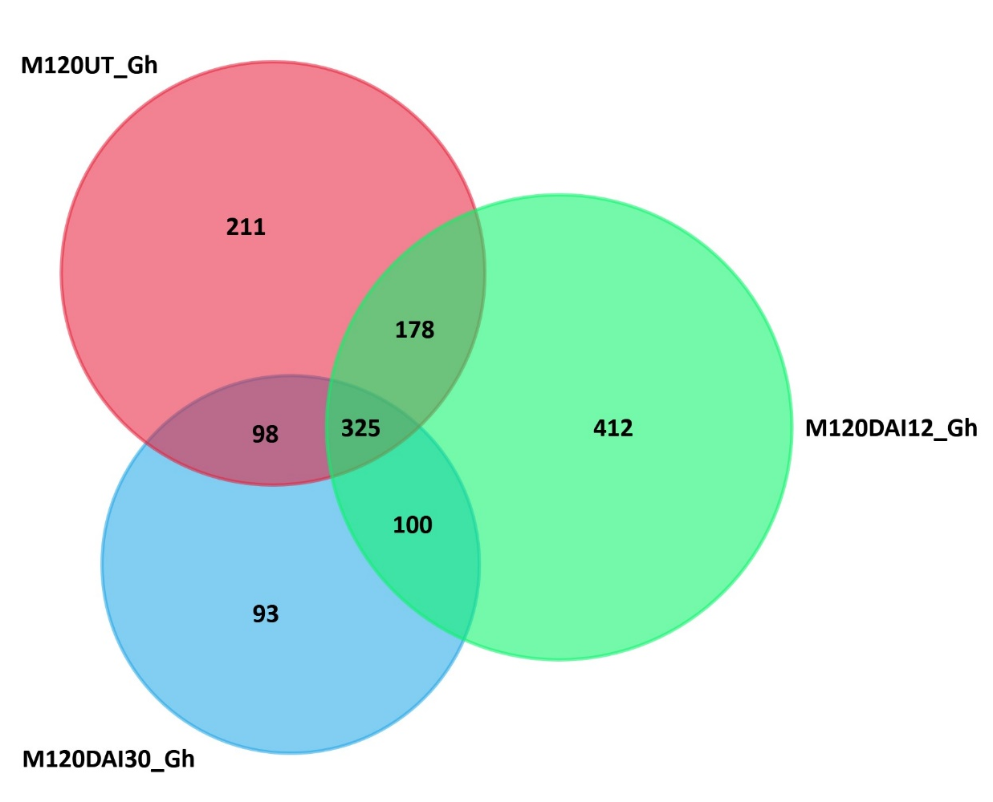
Differentially expressed genes in resistant and susceptible parent
1547 genes
1417 genes
Coker
(Susceptible parent)
M120
(Resistant parent)
Notes:
We are completed that sequencing early this spring so are still working on the analysis
So far we know that there are over 1500 differentially expressed genes in Coker and 1400 in the resistant parent M120

Slide 24
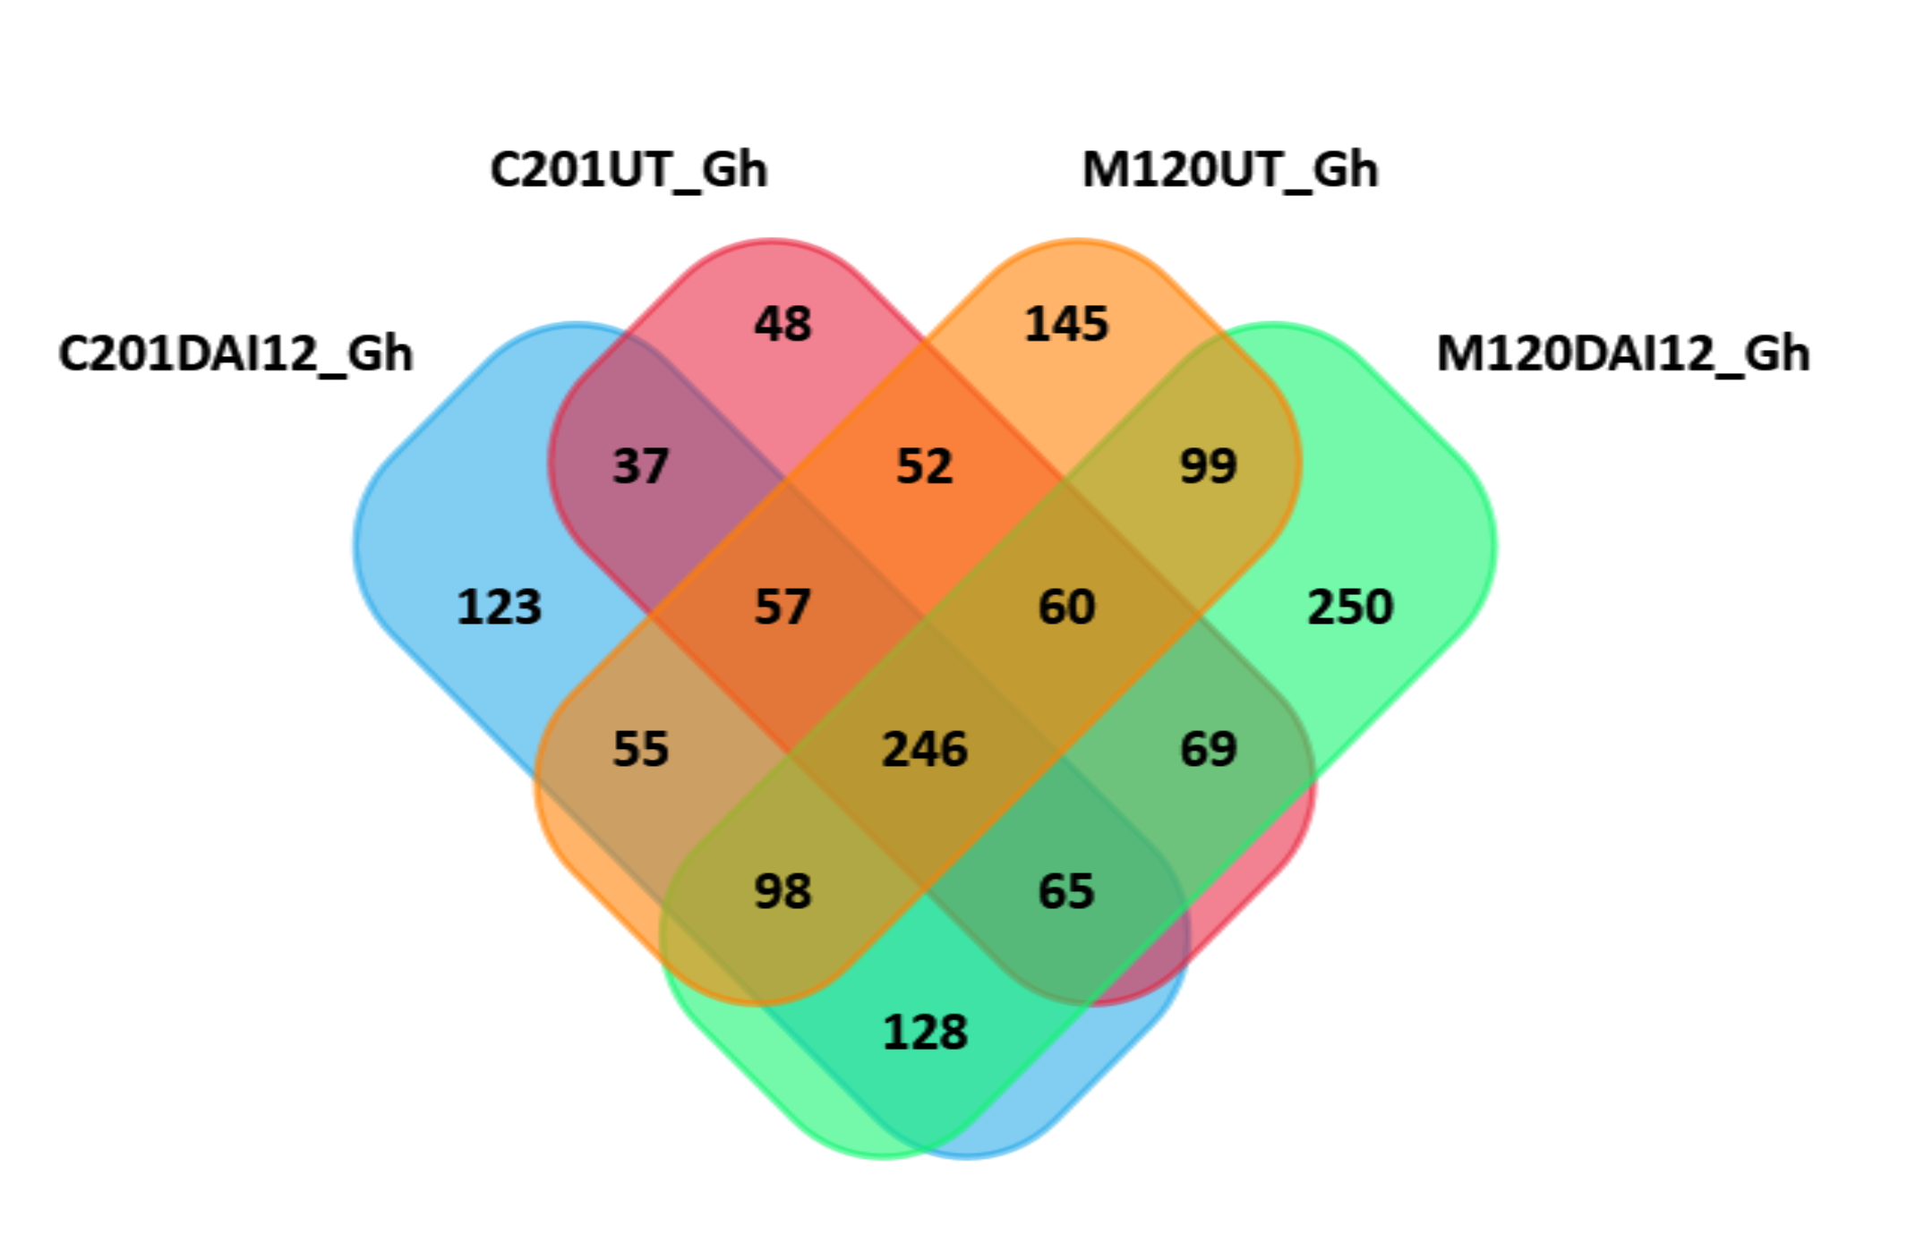
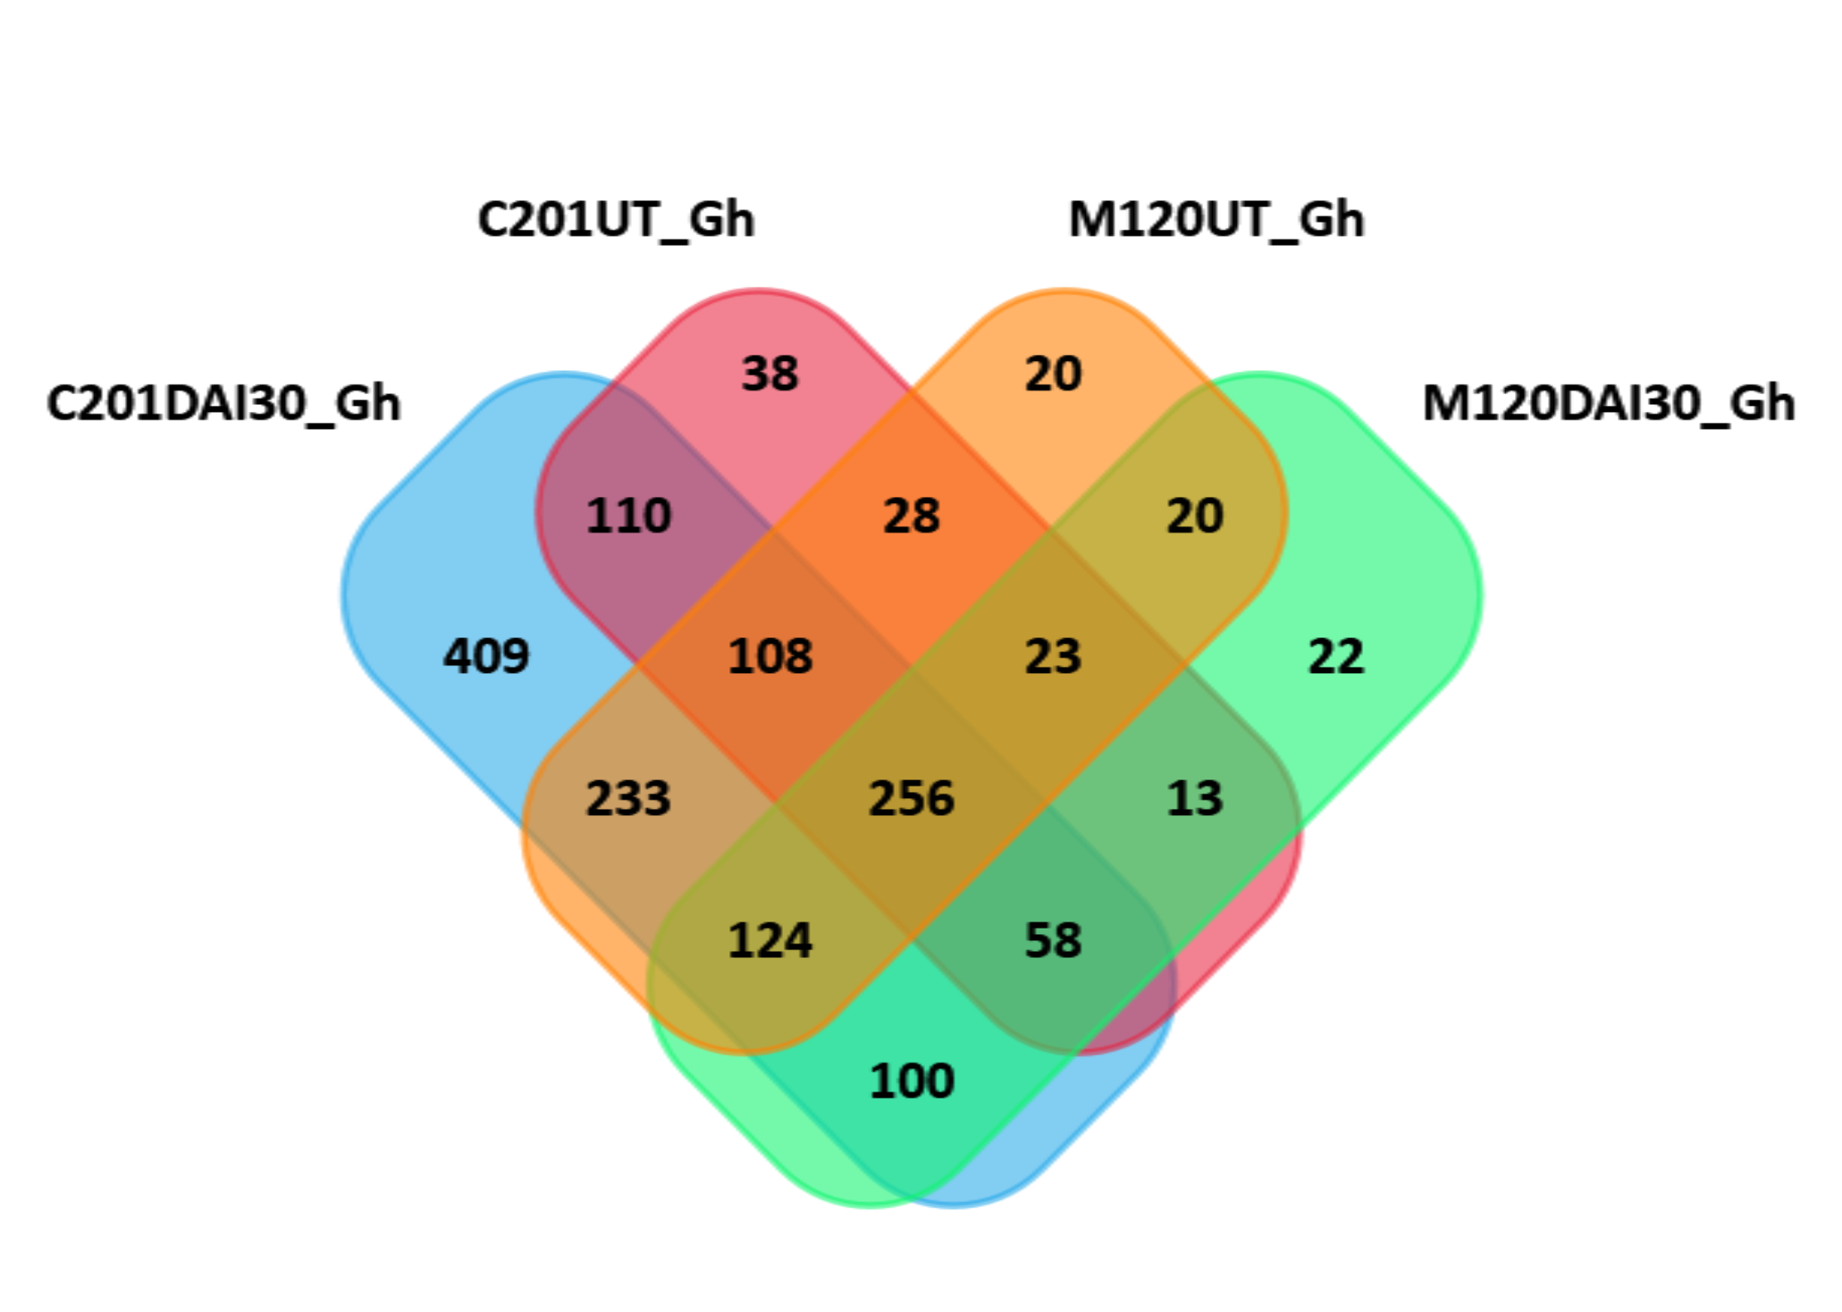
Differentially expressed genes at 12 and 30 DAI in Coker and M120 parent
12 Days after Inoculation
30 Days after Inoculation
Notes:
If we only look at the 12 days after inoculation library
We see two fold differentially expressed gene in the resistant parent 250 compare to the susceptible 123.
But if we look at the 30 days after inoculation, there are only 22 differentially expressed gene in the resistant parent while the susceptible parent has over 400
We do know that the nematode reprogram the root cells to form giant cell so some of these genes may be related to giant cells formation.

Slide 25
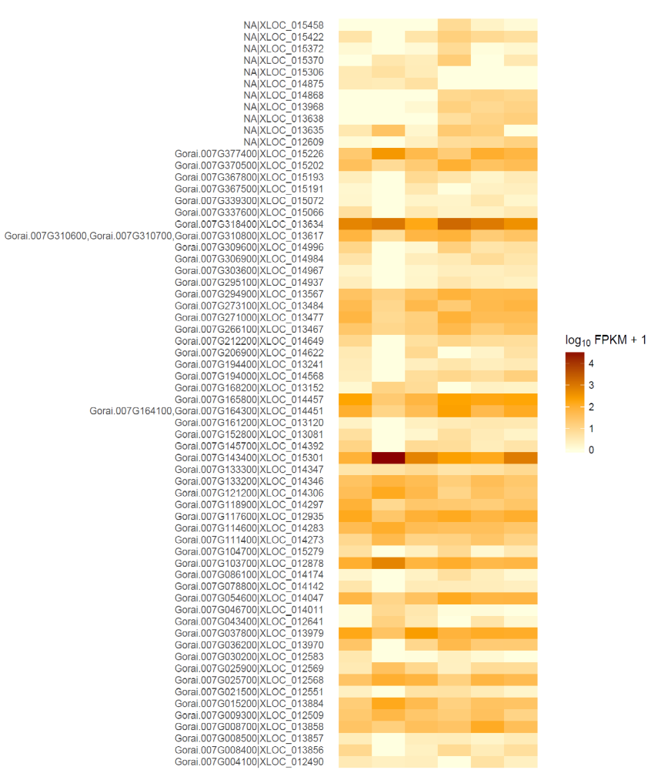
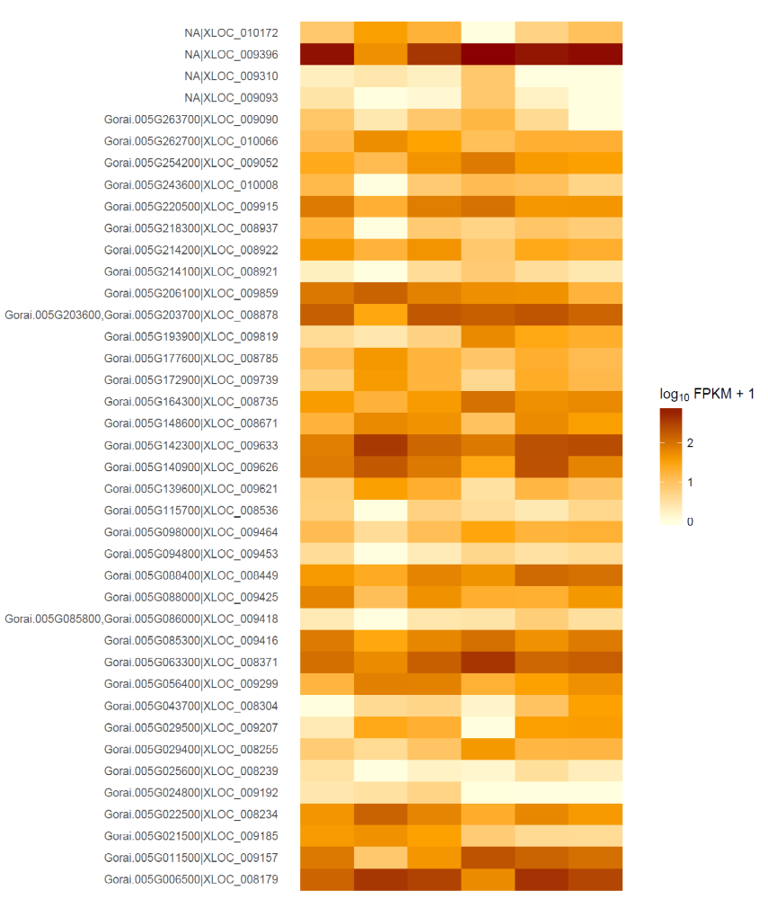
Differentially expressed genes on Chr11
Differentially expressed genes on Chr14
Coker - 0
M120 - 0
Coker 0
M120 - 0
M120 - 12
Coker - 12
M120 - 30
M120 - 12
M120 - 30
Coker - 30
Coker - 12
Coker - 30
Notes:
Of all the differentally expressed genes we found, we are most interested in these 3 genes on CHr 11 and 2 here on CHr 14 because they are located in the QTL regions
These are probably our most likely candidate genes we are looking for.
We are now working on RT PCR to confirm the expression of these genes
Also, we are sequencing the other libraries for the isogenic lines and working on determining if these are the gene conferring resistance.

Slide 26






Acknowledgements
Postdocs/Students
Dr. Guillermo Bacalaere
Mychele da Silva Batista
Nino Brown
Dr. Kedong Da
Aparna Desai
Dr. Yajun He
Dr. Naeem Iqbal
Dr. Pawan Kumar
Dr. Limei Liu
Dr. Edward Lubbers
Jinesh Patel
Dr. Hamidou Sakhanokho
Dr. Xinlian Shen
Dr. Baohua Wang
Technicians
Kippy Lewis
Jennifer McCurdy
Michael Jing
Jumin Zhuang
Stephen Walker
Collaborators
Dr. Richard Davis
Dr. Lloyd May
Dr. Andrew Paterson
Dr. C. Wayne Smith
Dr. Bob Nichols
Dr. Todd Campbell
Dr. Don Jones
Dr. Robert Wright
Funding source:
Notes:
May be I will get invited back next year to give an update.
I want to mention a few names that are involved in this project
We collaborate with Richard Davis on the nematology work and Andrew paterson on the genomic work
My former postdoc Xinlian Shen did most of the initial QTL mapping and fine mapping work on Chr 11
Pawan Kumar, who is also a postdoc, did the fine mapping on Chr 14 and the RNASeq
Mychele Batista is graduate student and she did all the histopathlogy work I presented

Slide 27
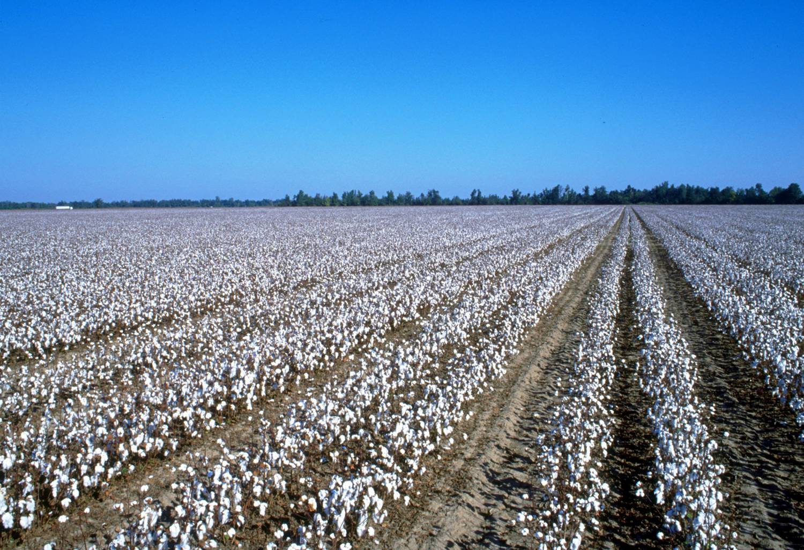
Thank you for your attention

