Slide 1

Applications of UPLC-MS QTOF in Structural Elucidation of Small Molecules
Peng Chen, Ph.D.
Chemic Laboratories, Inc.
Canton, MA 02021, USA

Slide 2
Chemic Laboratories..
provides expertise via 4 business units: CMC Data production; QC monograph testing, Extractables/Leachables assessment, Organic synthesis and drug product production.
Chemic’s clients..
are fortune 100 to virtual companies in the Pharmaceutical, Biotech, Veterinary medicine, and Medical device industries.
Chemic continues to offer quality services..
through continuous recruitment of scientific professionals and acquisition of state of the art equipment allowing us to meet the rigorous needs of our client sponsors.
Chemic measures success..
by successfully completing and reporting contracted programs leading to numerous approved IND, NDA, ANDA, BLA, PMA & 510(k) submissions.

Slide 3
Credo
Quality
We believe quality comes first …All projects can be completed in strict compliance to cGMP or GLP. Every Chemic employee is dedicated to continuous professional development. This policy ensures that Chemic generates only the highest quality data.
Service
We believe service is the definition of technical expertise and quality…Chemic identifies a program leader for each contracted program. Specialized employee positions have been developed allowing program sponsors direct access to data, timelines and program information throughout the life of the program.
Commitment
We believe in value added partnerships… Chemic looks to develop long term strategic alliances with our clients to assist those clients in achieving their goals faster and more efficiently.

Slide 4
FAQ
Established 1998
480 Neponset street, Bldg. 7, Canton MA (15 mi. sw of Boston)
Privately owned, MA, Sub-S corporation
22,500 ft2
45 employees
9 FDA inspections, most recent Dec 2017
> 15 US DEA inspections
On average 20+ client audits annually
GC (FID,TCD,NPD,MS, MS-MS, NCD, Headspace): 10
HPLC (DAD, RI, FL, MS (APCI & ESI), MS-MS, High res MS, RAM): 16
Mass Spectrometers: 17

Slide 5
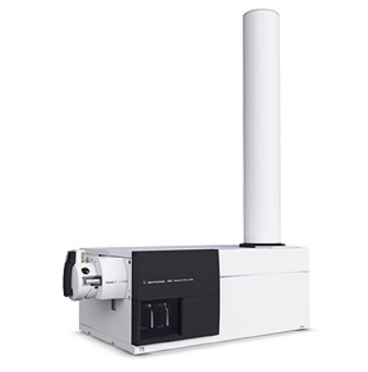
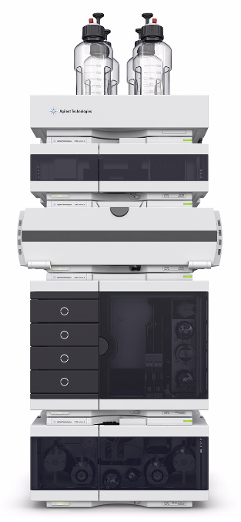
Agilent 1290 Infinity II UPLC System
Agilent 6550 iFunnel Q-TOF LC/MS
Quadrupole Time of Flight LC/MS

Slide 6
Agilent 6550 iFunnel Q-TOF LC/MS
Femtogram-level sensitivity.
Sub-ppm mass accuracy and ~45K resolution.
Wide dynamic range with excellent detection limits and reproducibility.
Powerful MassHunter software for profiling, characterizing, identifying and
quantifying compounds in mixtures via high-definition MS and MS/MS.
All Ions MS/MS technique.
Other assisting software such as Molecular Structure Correlator (MSC).

Slide 7
Instrument Features Utilized for Structural Elucidation
Sufficient chromatographic separation for compounds of interest
Mass accuracy and resolving power to derive a formula list based
on the exact mass, isotopic abundance and isotopic spacing.
MS/MS capability to allow insight into structural details of a molecule.
Pseudo MS³ to probe fragment ions for further structural information.
MSC software to aid in analysis of fragmentation pathways.

Slide 8
Application 1
Analysis of Synthetic Compounds by UPLC-MS QTOF
Assist synthetic chemists in their chemical synthesis.
Determine synthetic routes, product identities, and purities.

Slide 9
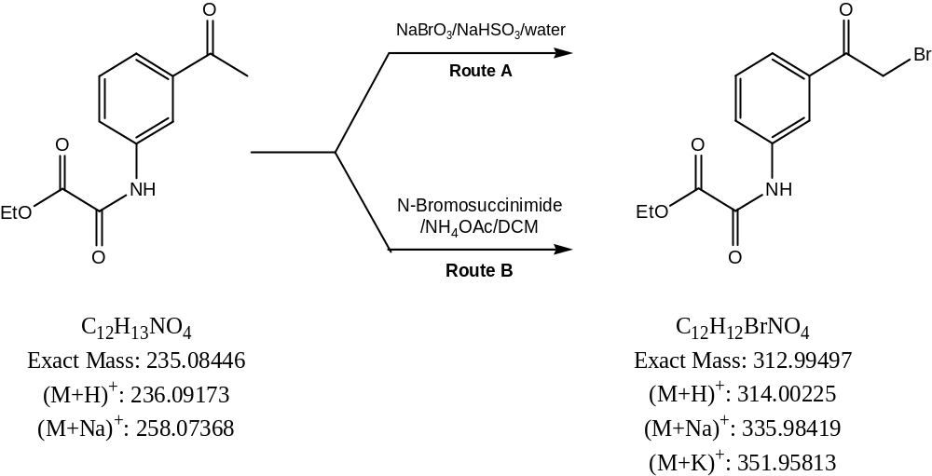
Bromination Reaction

Slide 10
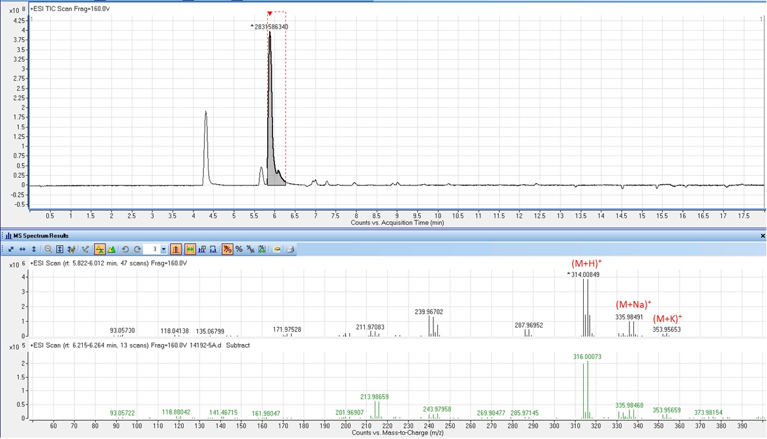
Route A
Product A

Slide 11
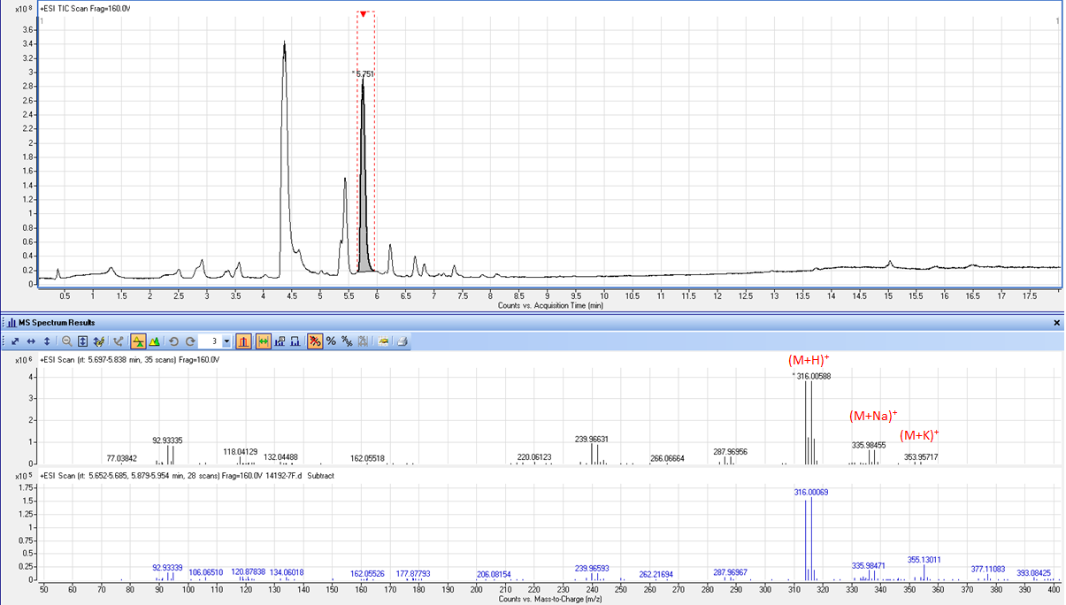
Route B
Product B

Slide 12
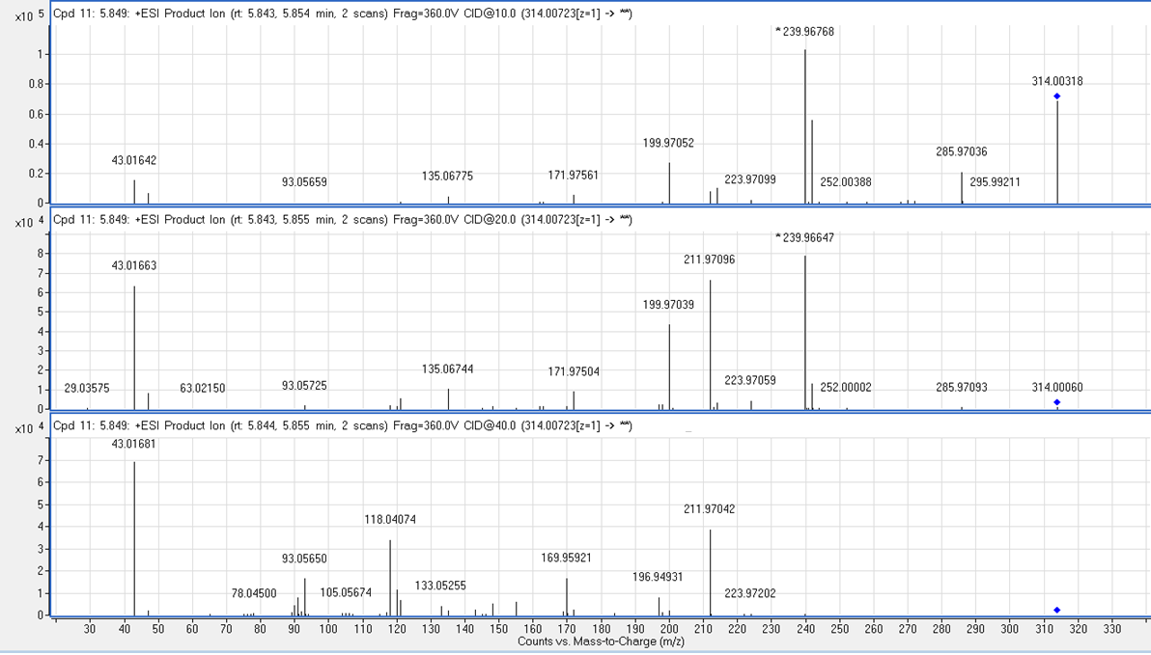
MS/MS Spectra of Route A Product

Slide 13
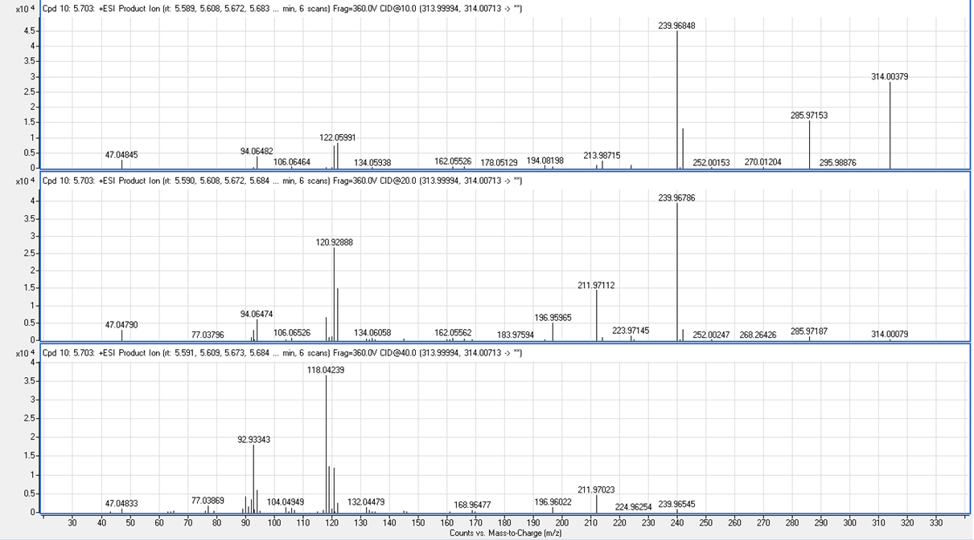
MS/MS Spectra of Route B Product

Slide 14
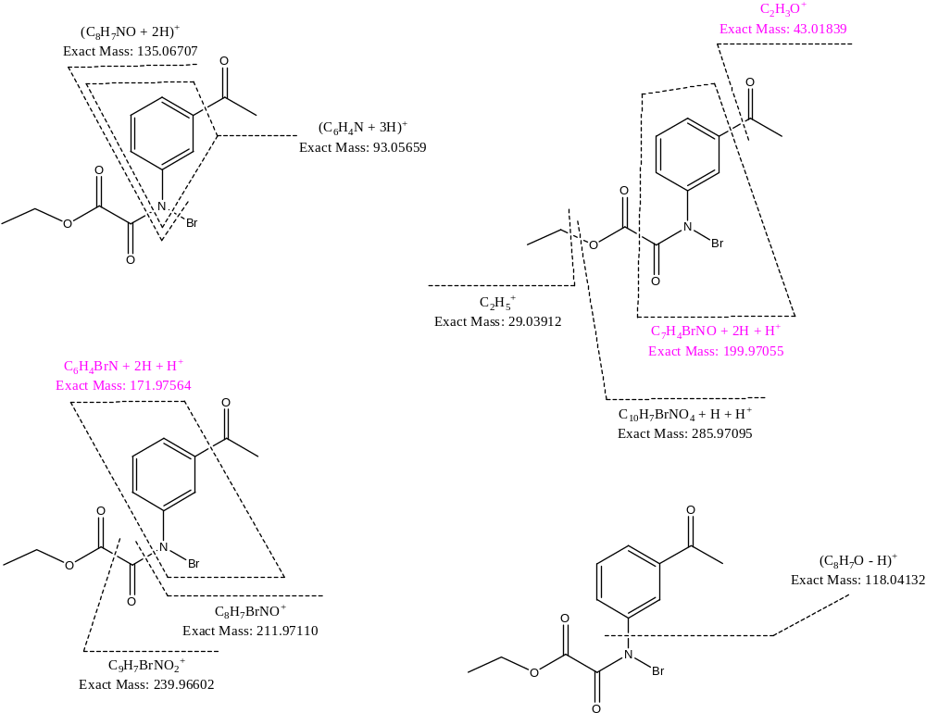
Proposed structure for Route A product and its major MSMS fragments
C₁₂H₁₂BrNO₄
Exact Mass: 312.99497
(M+H)+: 314.00225
(M+Na)+: 335.98419
(M+K)+: 351.95813

Slide 15
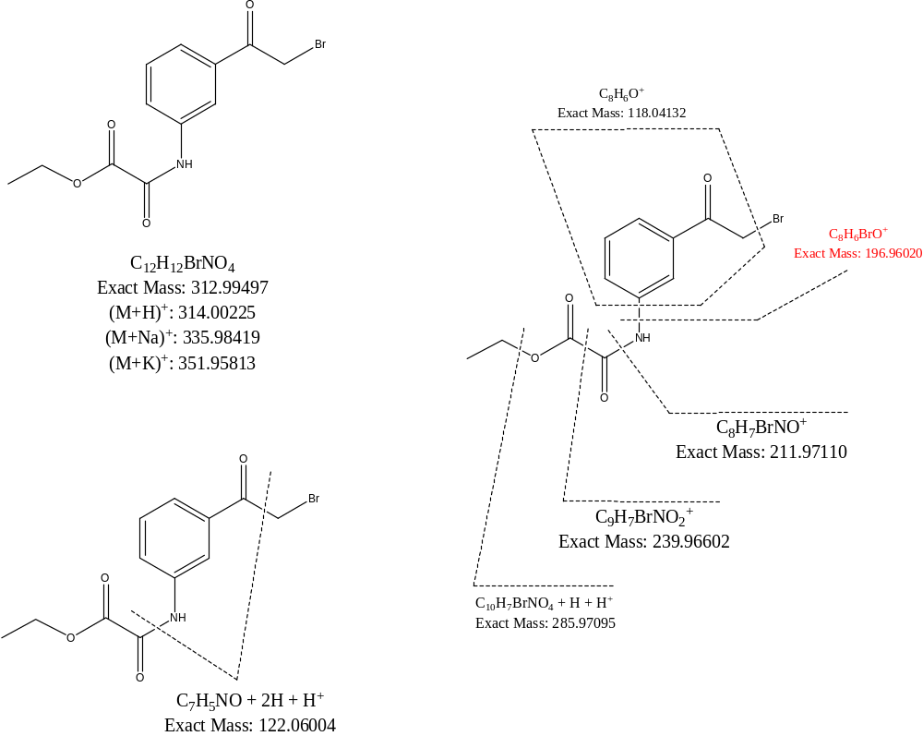
Proposed structure for Route B product and its major MSMS fragments

Slide 16
Application 2
Analysis of Impurities, Additives and Degradation Compounds
Associated with Pharmaceuticals and Medical devices
Impurities in pharmaceuticals.
Additives and degradation compounds.

Slide 17
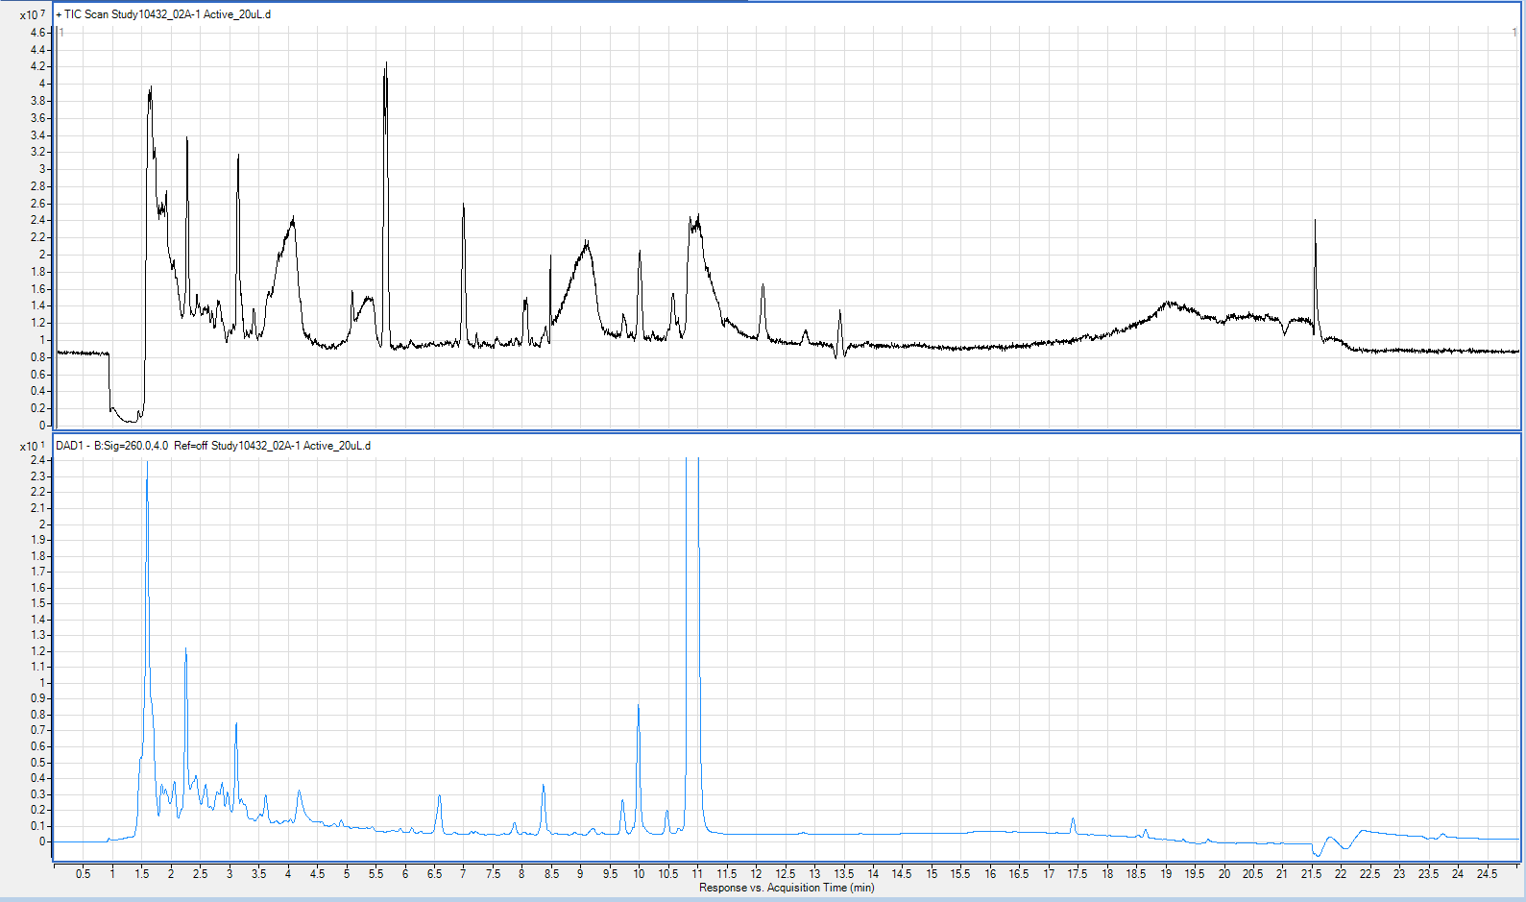
MS TIC of sample
RRT 0.31
DAD @260 nm of sample
API
RRT 0.31

Slide 18
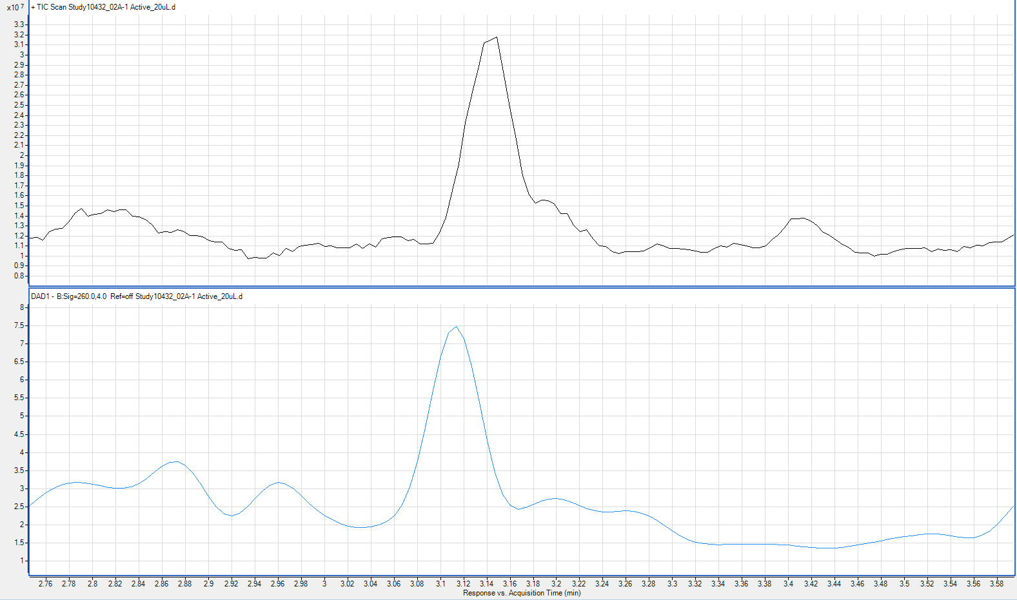
RRT 0.31
MS TIC of Active sample
DAD @260 nm of Active sample

Slide 19
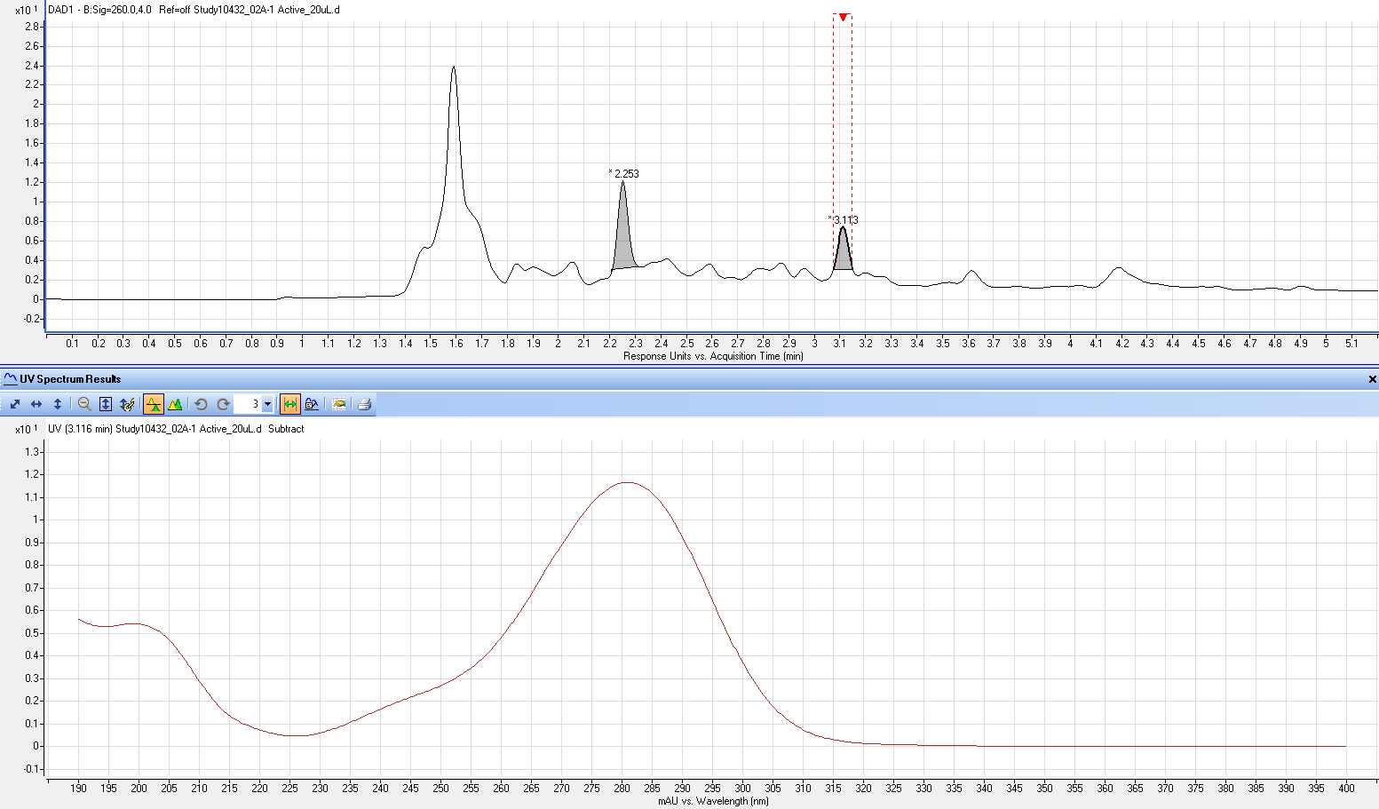
UV chromatogram @260 nm of sample
RRT 0.31
UV spectrum (190-400 nm) of peak apex of RRT 0.31

Slide 20
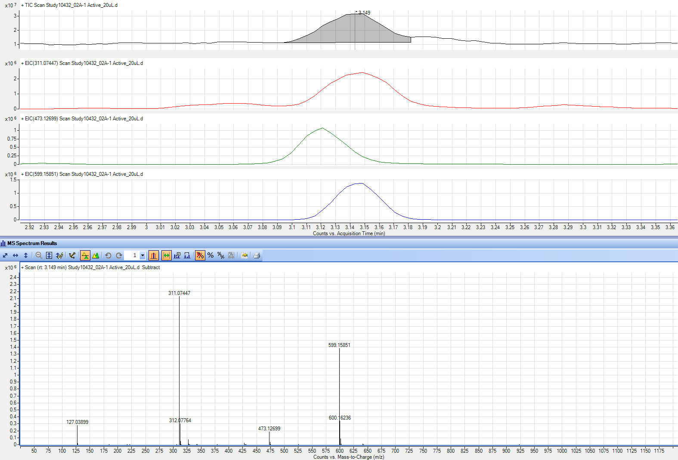
RRT 0.31
(M+Na)⁺
MS spectrum of RRT 0.31
(2M+Na)⁺

Slide 21
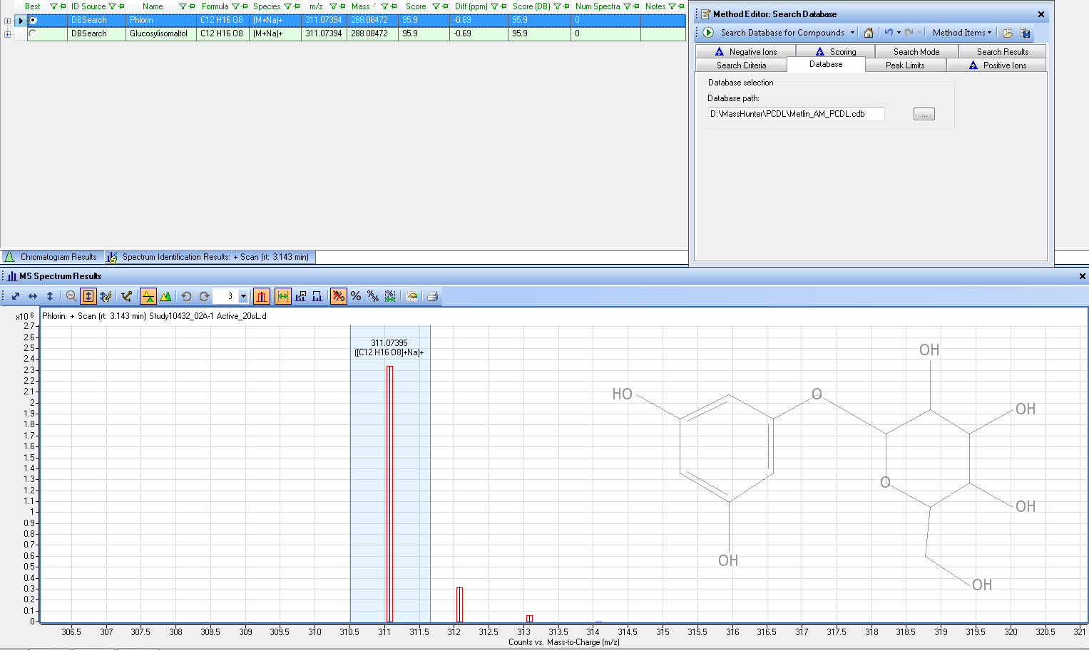
Database search
Candidate 1: Phlorin

Slide 22
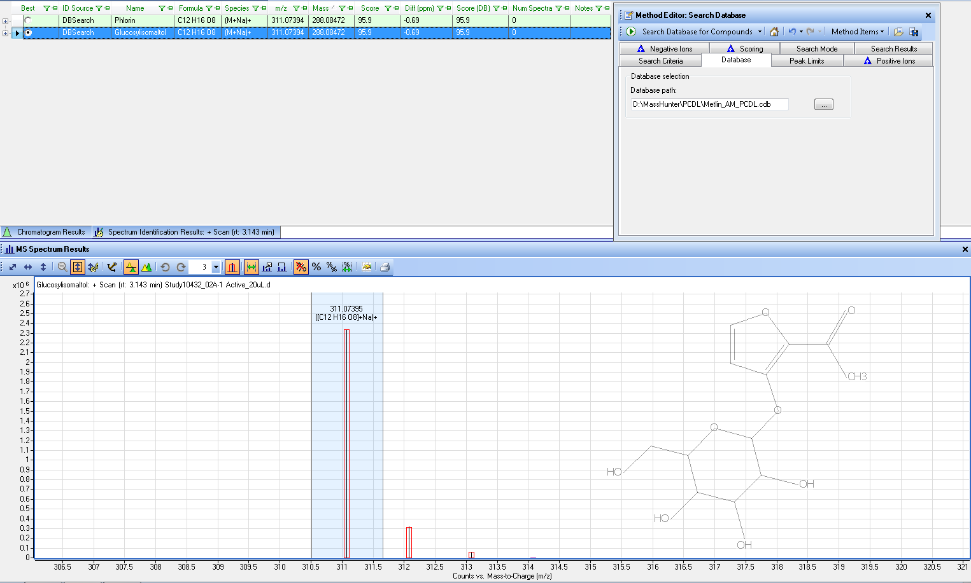
Database search
Candidate 2: Glucosylisomaltol

Slide 23
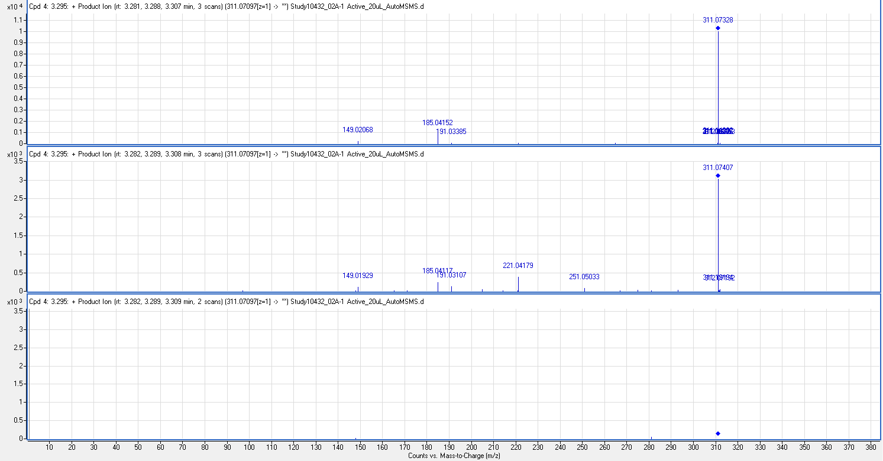
Auto MS/MS spectra of (M+Na)⁺ Ion 311

Slide 24
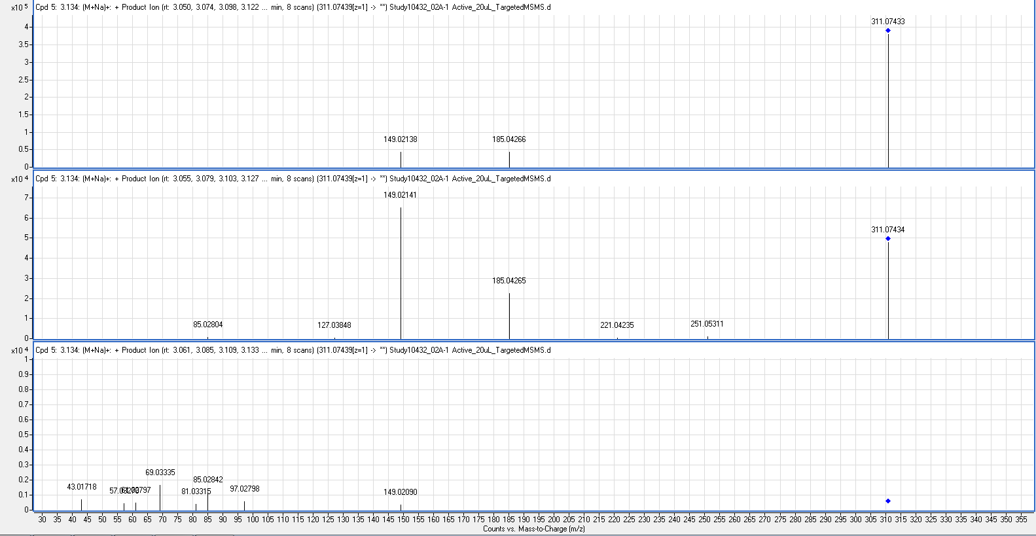
Targeted MS/MS to obtain higher fragment signals for (M+Na)⁺ Ion 311
CID@10V
CID@20V
CID@40V

Slide 25
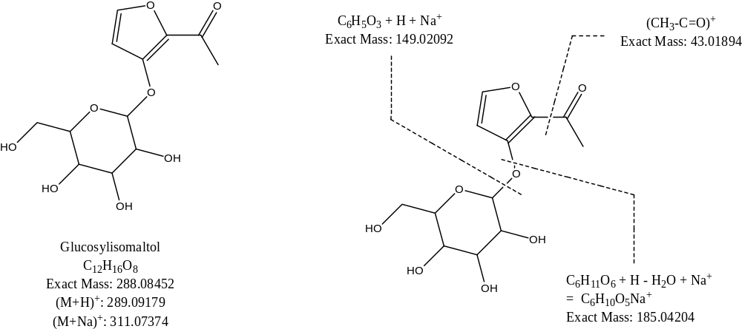
Proposed MS/MS Fragmentation Pathway

Slide 26
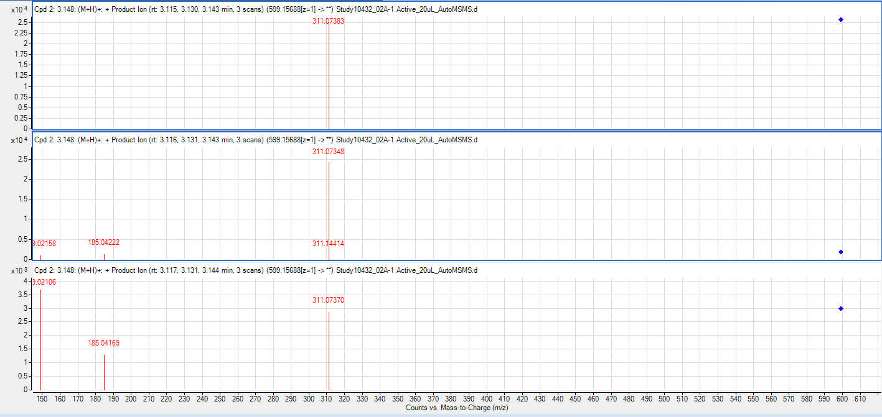
MS/MS of (2M+Na)⁺ Ion 599 to yield (M+Na)⁺ during fragmentation
CID @10V
CID @20V
CID @40V

Slide 27
Confirmation with Glucosylisomaltol reference standard
Glucosylisomaltol
Mfr: HPC Standards GmbH, Germany
Lot No: 779373
CAS#: 85559-61-1

Slide 28
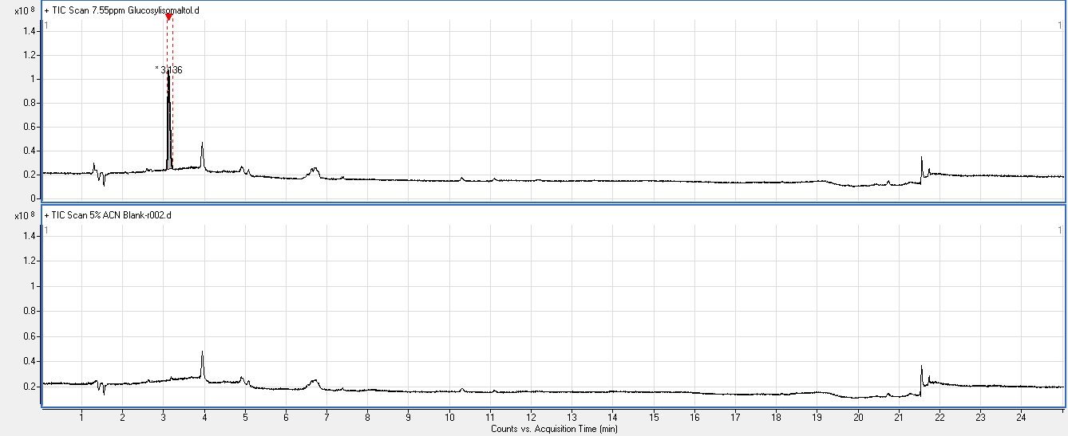
Glucosylisomaltol
TIC of 7.6-ppm Glucosylisomaltol standard
TIC of 5% ACN Blank

Slide 29
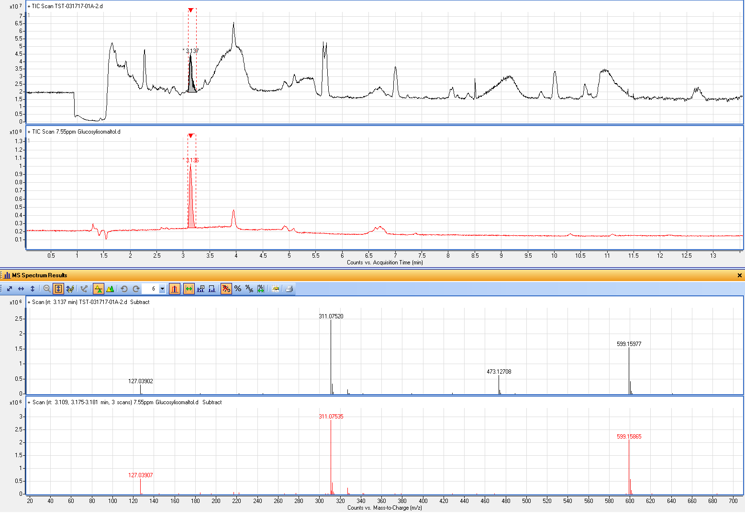
TIC of Sample
TIC of Glucosylisomaltol Standard
(M+Na)⁺
MS Spectrum of Sample
(2M+Na)⁺
Overlapped
interference
(M+Na)⁺
MS Spectrum of Glucosylisomaltol Standard
(2M+Na)⁺

Slide 30
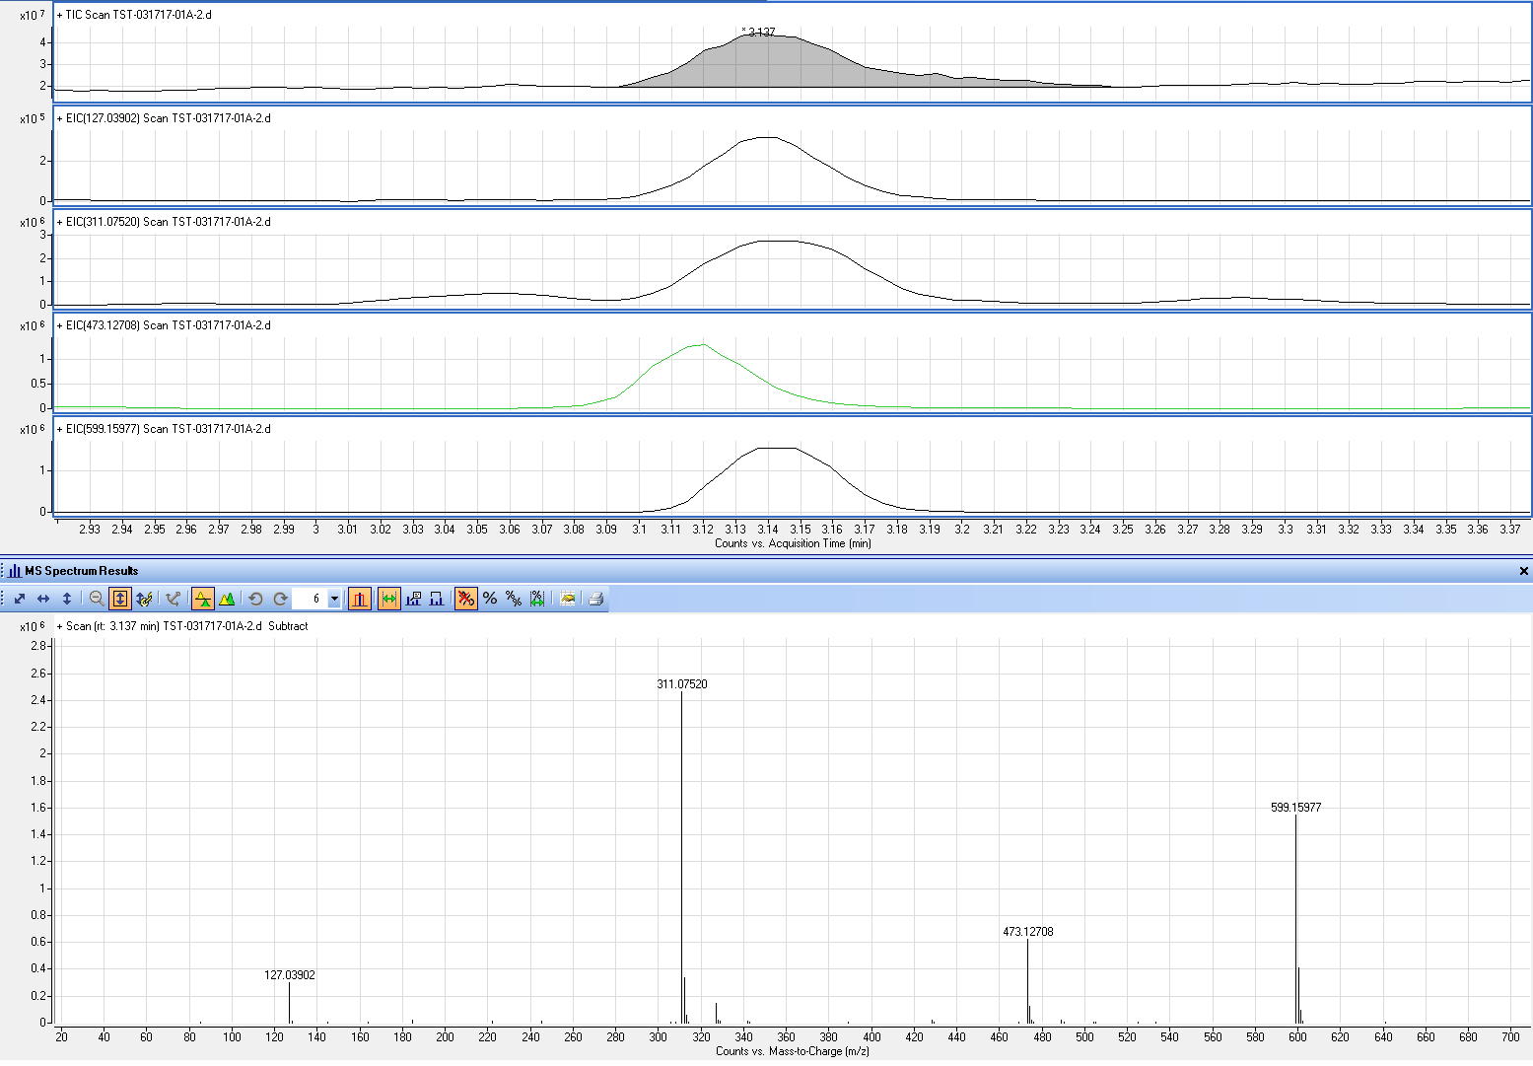
EIC of other overlapped peak
Overlapped
interference

Slide 31
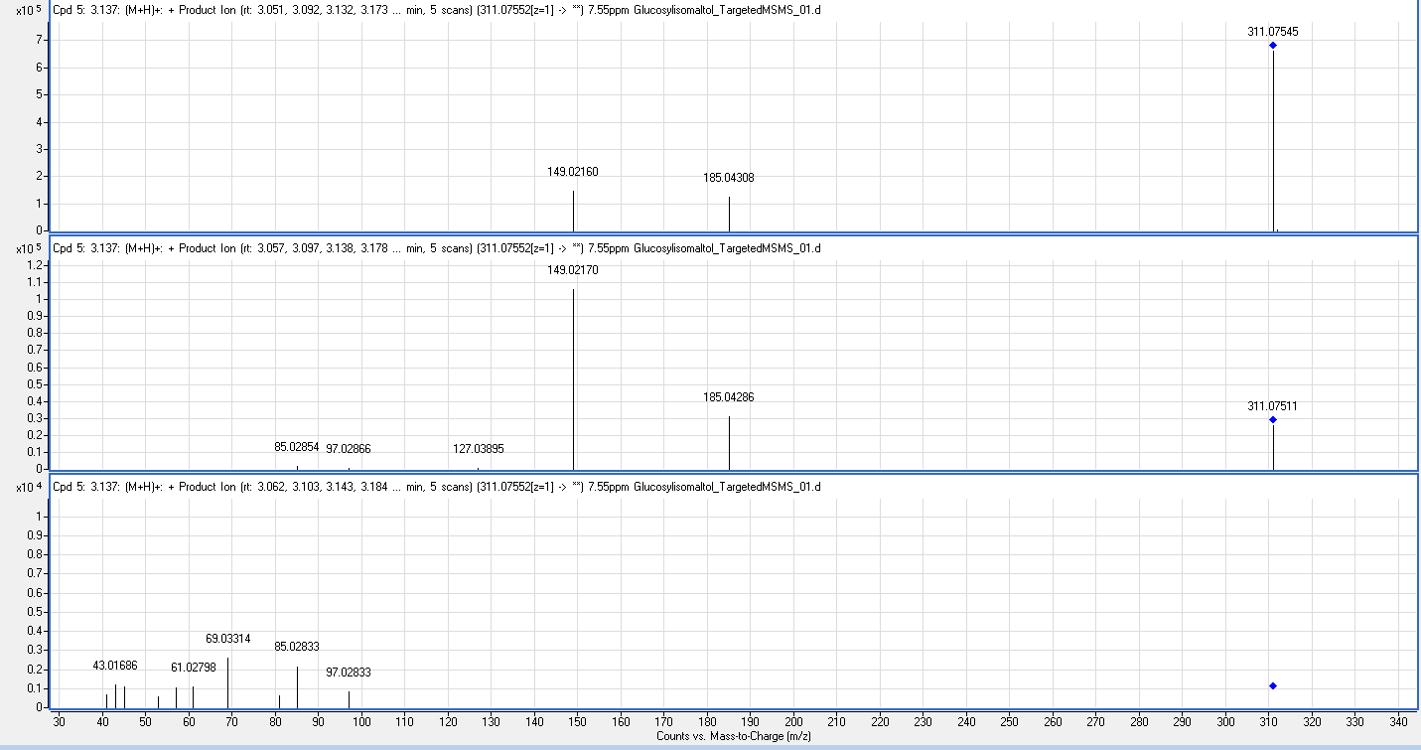
Targeted MS/MS Spectra of (M+Na)⁺ Ion 311 of Glucosylisomaltol Standard
CID@10V
CID@20V
CID@40V

Slide 32
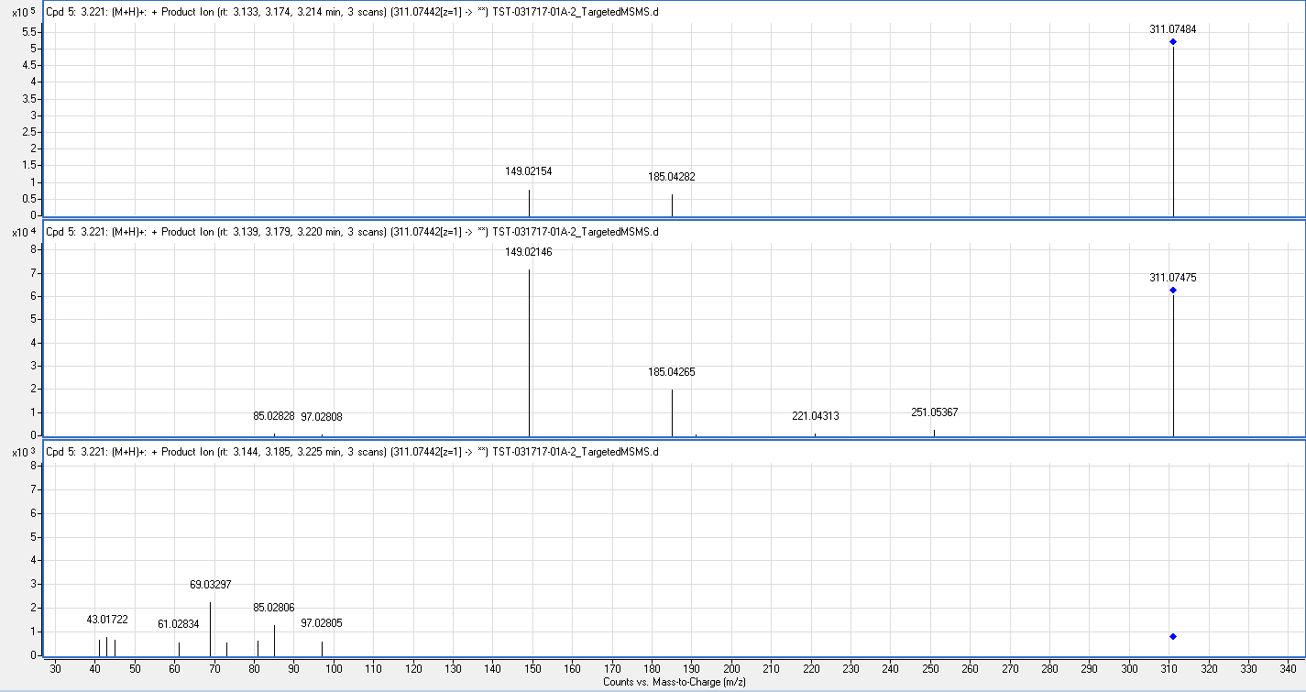
Targeted MS/MS Spectra of (M+Na)⁺ Ion 311 of Sample
CID@10V
CID@20V
CID@40V

Slide 33
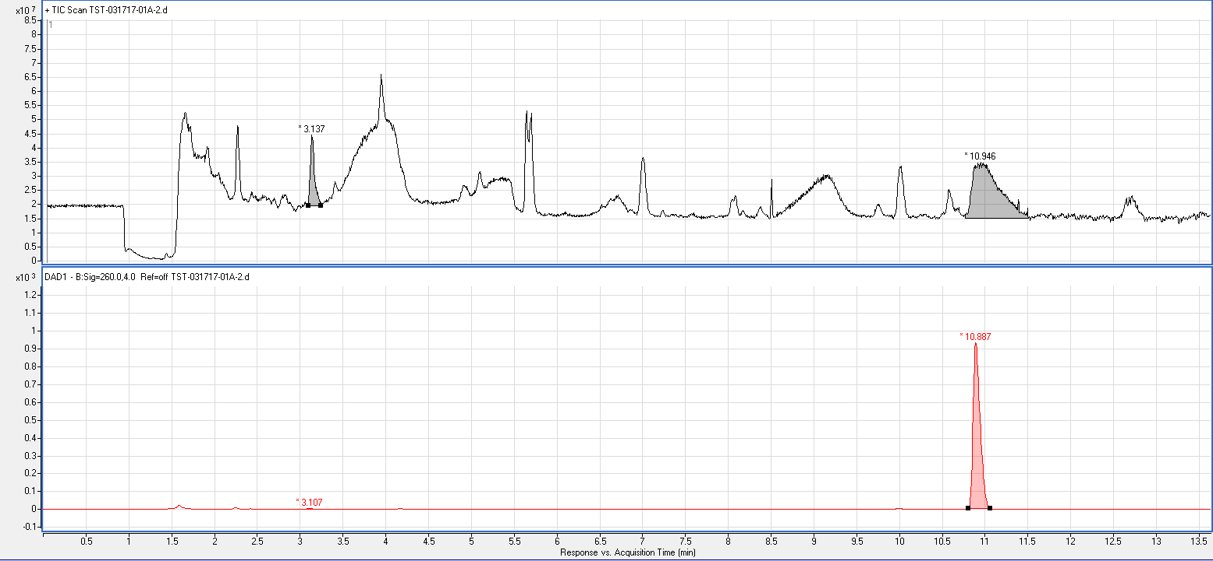
TIC of Sample
3.137 min / 10.946 min = RRT 0.287
Glucosylisomaltol
API
DAD of Sample
3.107 min / 10.887 min = RRT 0.285
API
Glucosylisomaltol

Slide 34
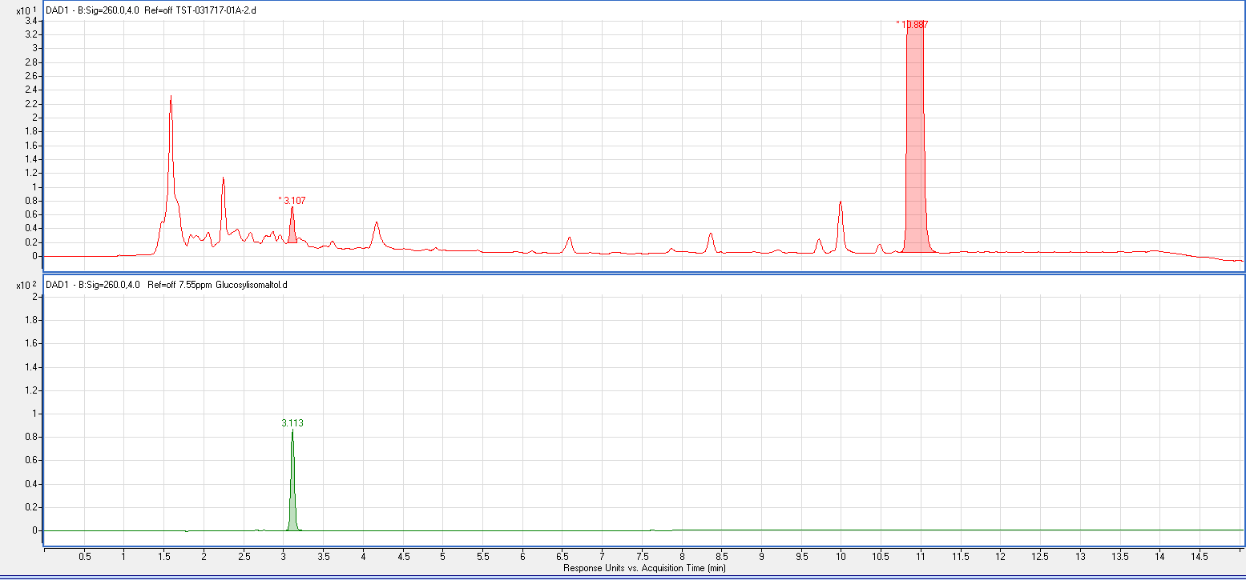
Sample
Sample
API
DAD of Sample
Glucosylisomaltol
3.107 min / 10.887 min = RRT 0.285
DAD of Glucosylisomaltol Standard
Glucosylisomaltol
3.113 min / 10.887 min = RRT 0.286

Slide 35
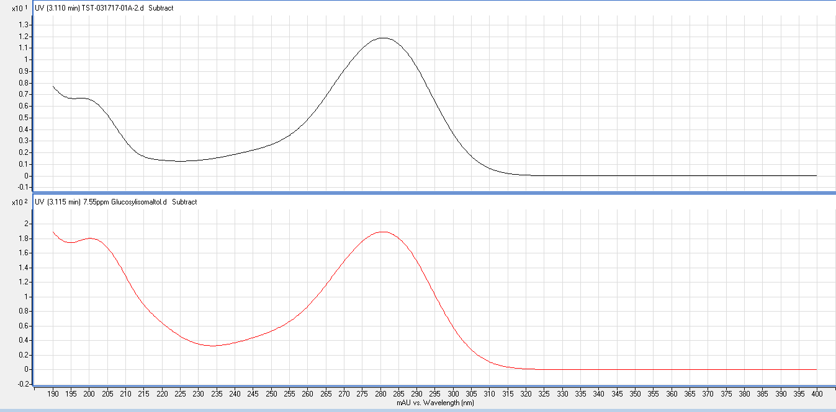
UV spectrum (190-400 nm) of peak apex @RT 3.11min of sample
UV spectrum (190-400 nm) of peak apex of Glucosylisomaltol

Slide 36
Application 3
Identification of an unknown due to reaction
of internal standard in sample environment
via HPLC-MS QToF

Slide 37
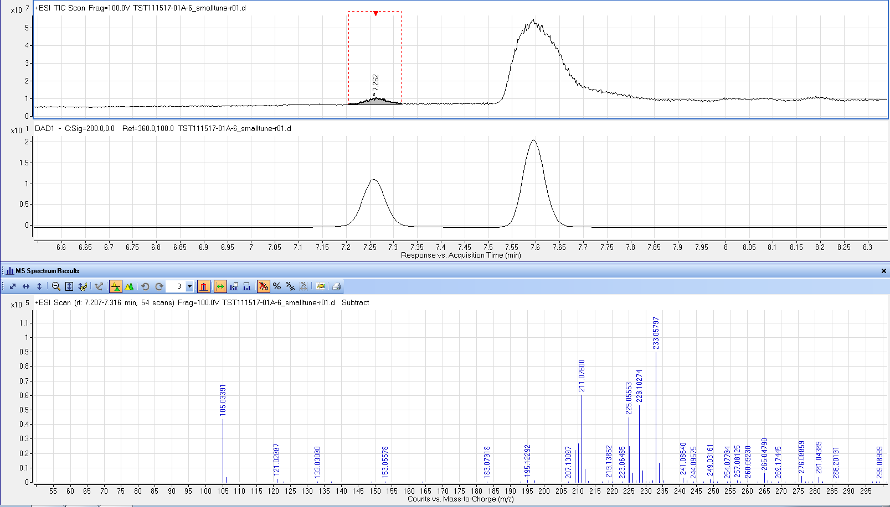
IS
Unknown
(M+Na)⁺
(M+H)⁺
(M+NH₄)⁺

Slide 38
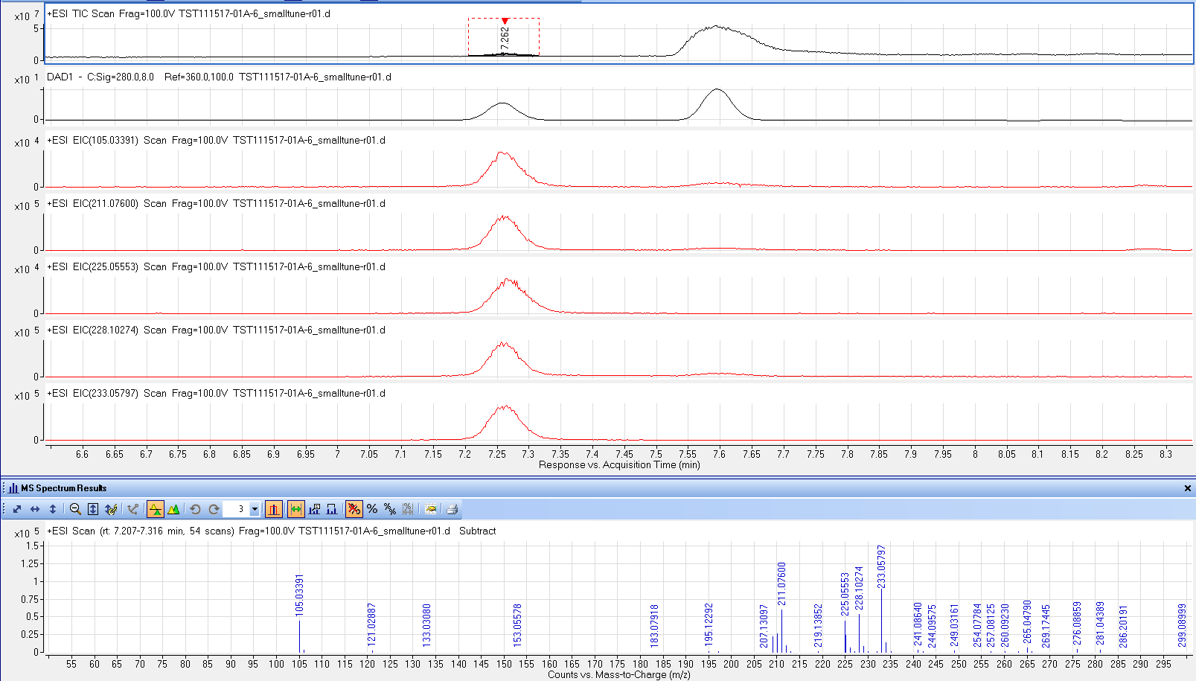
Unknown
IS
(M+Na)⁺⁰
(M+H)⁺
(M+NH₄)⁺

Slide 39
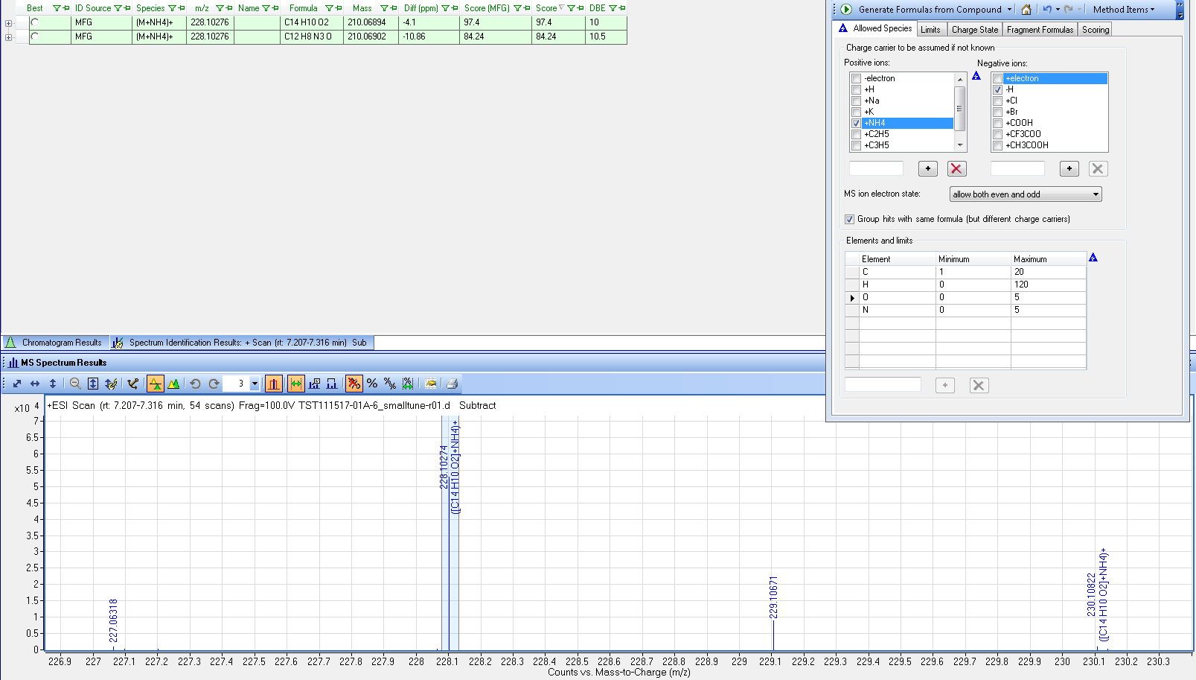

Slide 40
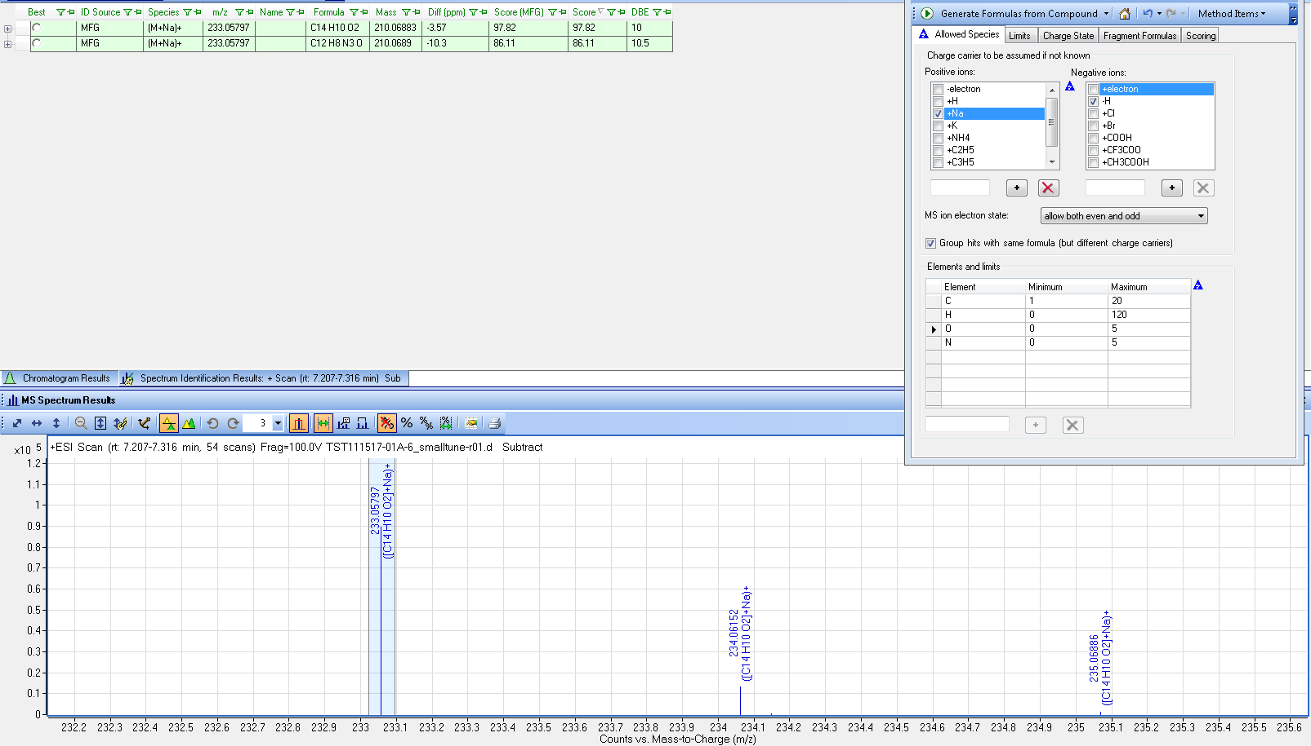

Slide 41
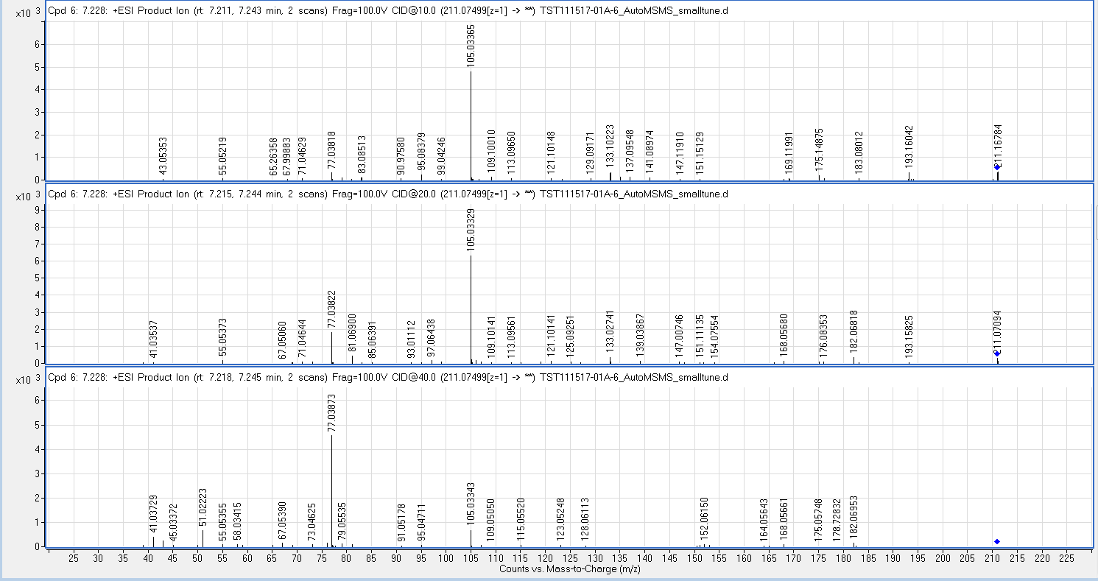
MS/MS spectra of (M+H)⁺ ion 211 of the unknown

Slide 42
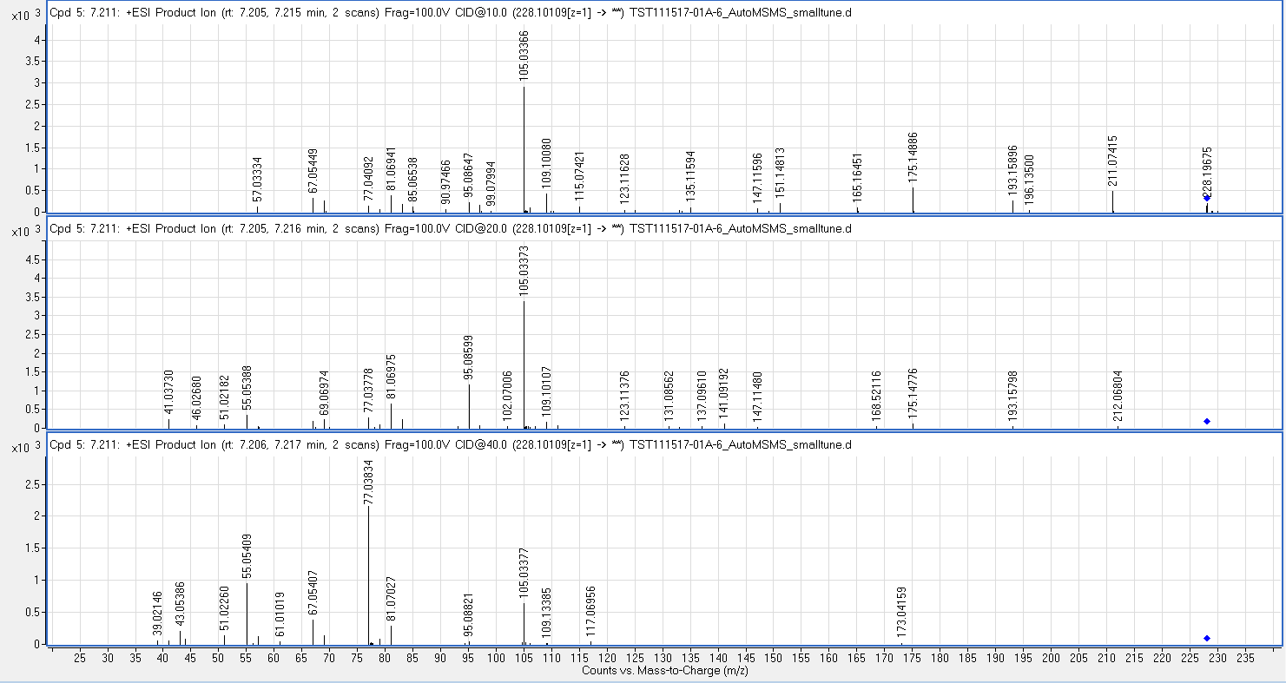
MS/MS spectra of (M+NH₄)⁺ ion 228 of the unknown

Slide 43
ESI(-)

Slide 44
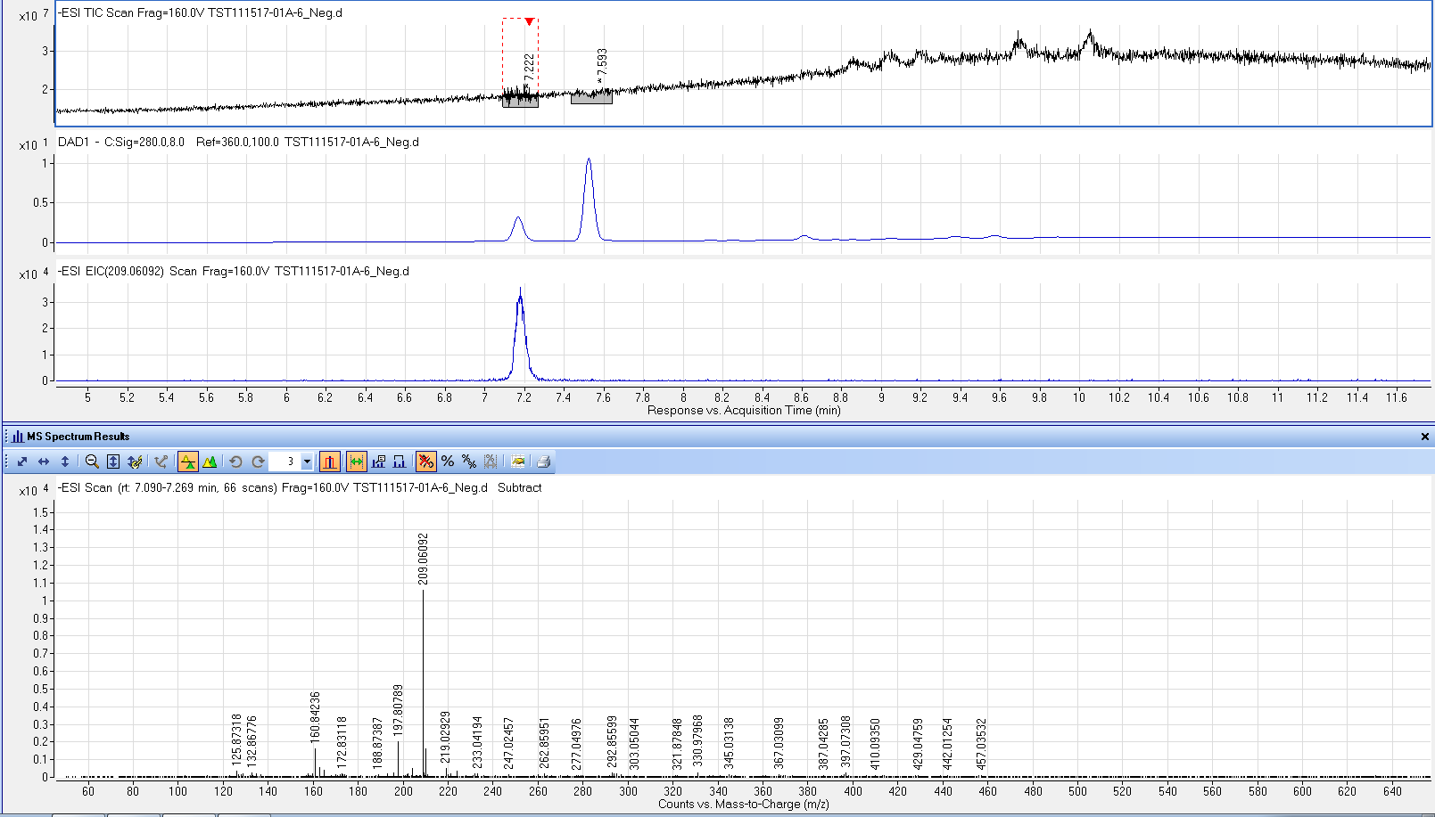
IS
Unknown
EIC of (M-H)⁻
(M-H)⁻

Slide 45
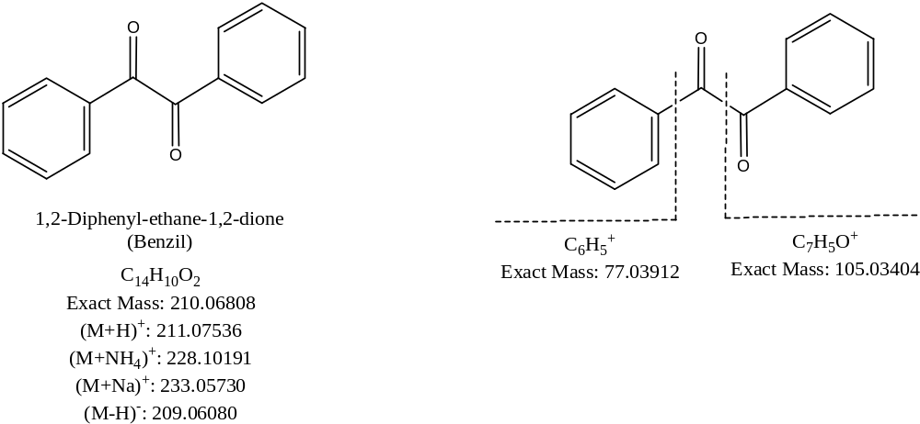
Proposed structure
Assignment of major MSMS fragments

Slide 46
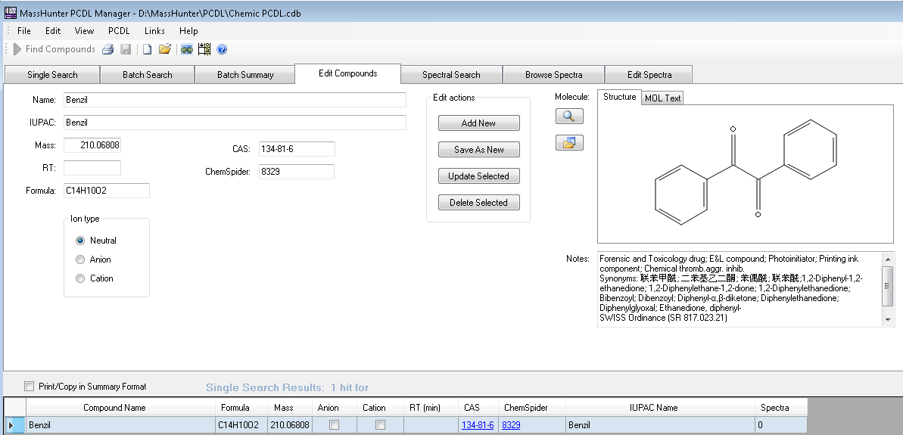
Note: no MS/MS spectra in the library on Benzil

Slide 47
Observation
The unknown peak eluted out before the internal standard (2,2-Dimethoxy-1,2-diphenyl ethanone).
The unknown peak is not present in the samples without IS added, but is present in the samples
with IS added, suggesting that it came from the internal standard addition.
The unknown peak is not present in method control with or without IS addition, suggesting that
chemical conversion from IS to the unknown is only catalyzed in the sample environment.

Slide 48
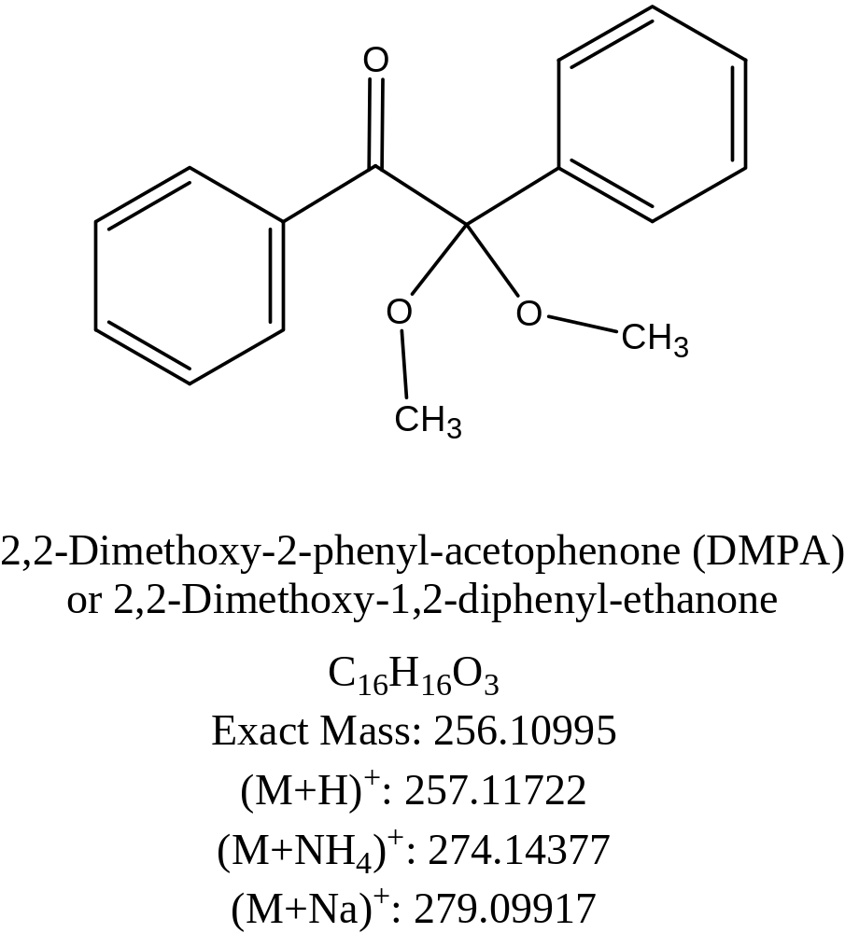

Slide 49
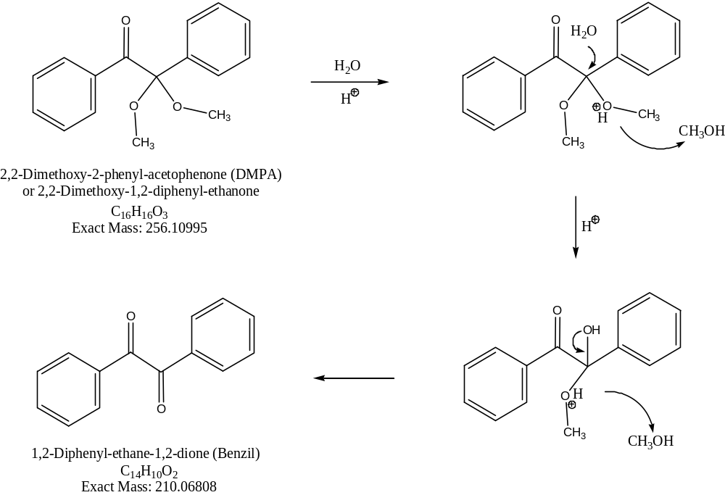
Hydrolysis mechanism of a ketal (DMPA) to a ketone (Benzil)

Slide 50
Acknowledgement
Joseph St. Laurent
Scott Goodrich
Gerald Jones
Scott Walsh
David Bisordi
Chris McGee
Kin Chiu
Chemic Laboratories, Inc.

