Slide 1
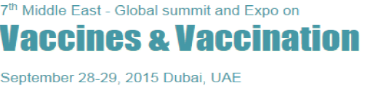
An Immunoinformatics analysis and structure based modeling of potential HLA class II allele binding T cell epitopes for vaccine design of JE
Pawan Sharma
Assistant Professor
Mangalayatan University, India

Slide 2
Japanese encephalitis virus (JEV) is a flavivirus, family Flaviviridea
Causes disease to human beings: Japanese Encephalitis (JE)
Flavivirus genus comprises of 72 other viruses, viz. Dengue virus, Yellow fever virus and West Nile virus.
Mode of transmission: Culex tritaeniorhynchus and C. visnui mosquitoes to human.
JE virus causes membrane inflammation of brain and leads to deleterious effects on Central Nervous System (CNS).

Slide 3
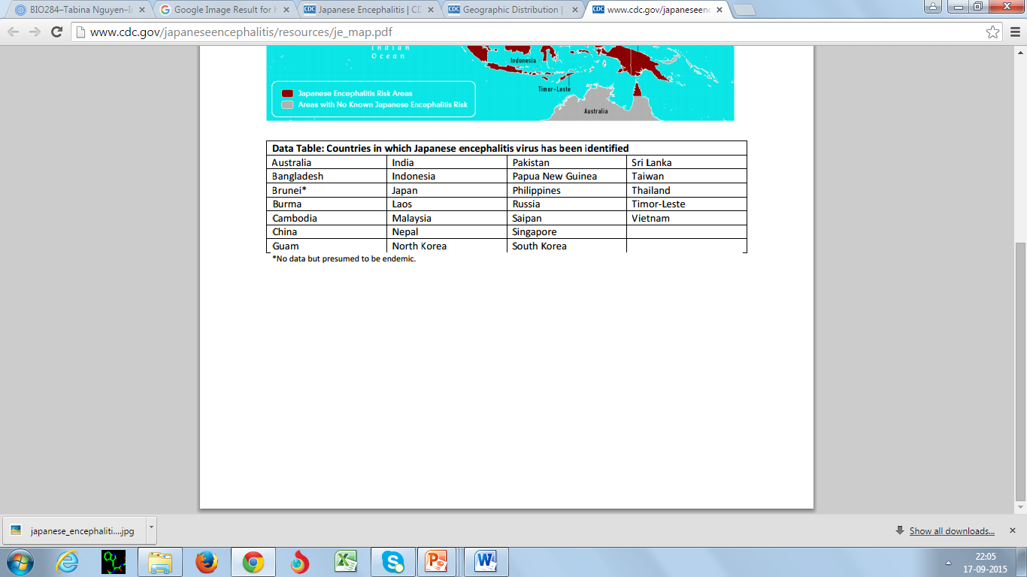
Epidemiology
As reported 67,900 clinical cases of JE occur annually, with approximately 13,600 to 20,400 deaths, in spite of widespread availability of vaccine (WHO 2015).

Slide 4
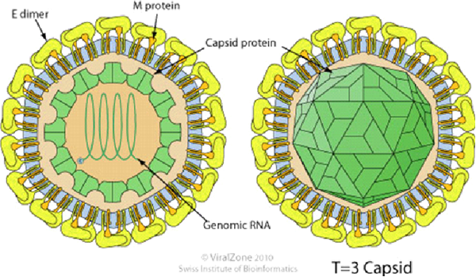
JE virus- ss RNA genome
11,000 nucleotides encoding a single polypeptide of 3432 amino acids.
The virus has seven nonstructural proteins and three structural proteins
Adopted from Swiss Institute of Bioinformatics, 2010

Slide 5
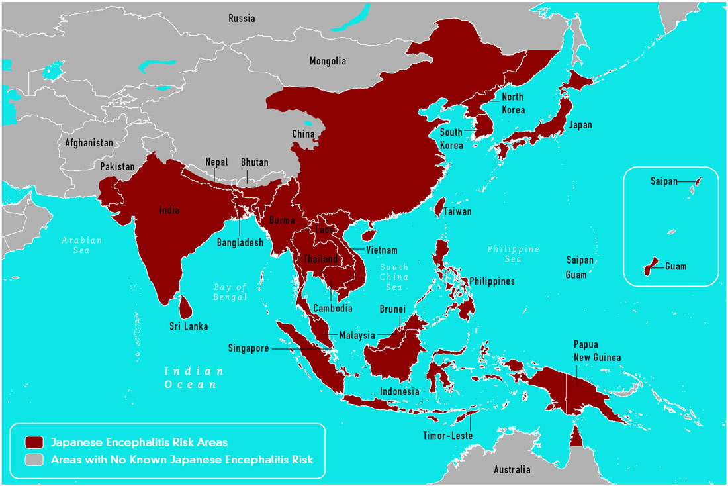
Geographic Distribution of Japanese Encephalitis Virus
Adopted from Centers for Disease Control and Prevention, August 2015

Slide 6
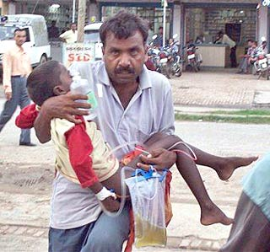
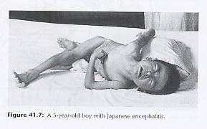
Seen in picture is a man rushing his child to a hospital in Ghorakpur, U.P. , India)

Slide 7
Current status of Vaccine for JE virus
Now-a-days, a number of vaccines have been developed for JE in several countries:
Inactivated mouse brain derived Nakayama strain vaccine is the most commercially used vaccine
Vero cell derived JE vaccine (IXIARO) which can effectively boost the immunity
Drawbacks associated with these vaccines:
High cost,
Vaccine production shortage
Neurological adverse effects
All this leads to the serious requirement to develop more compatible and economically effective vaccines.

Slide 8
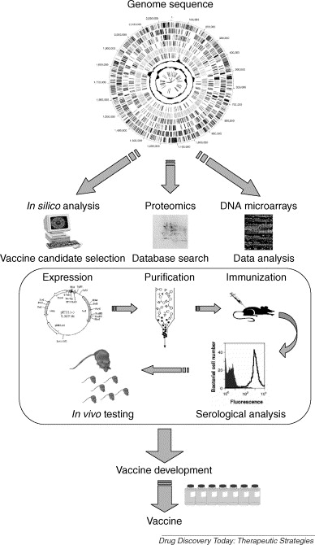
Vaccine development methodologies.
Adopted from Drug Discovery Today, Therapeutic Strategies, June 15, 2002

Slide 9
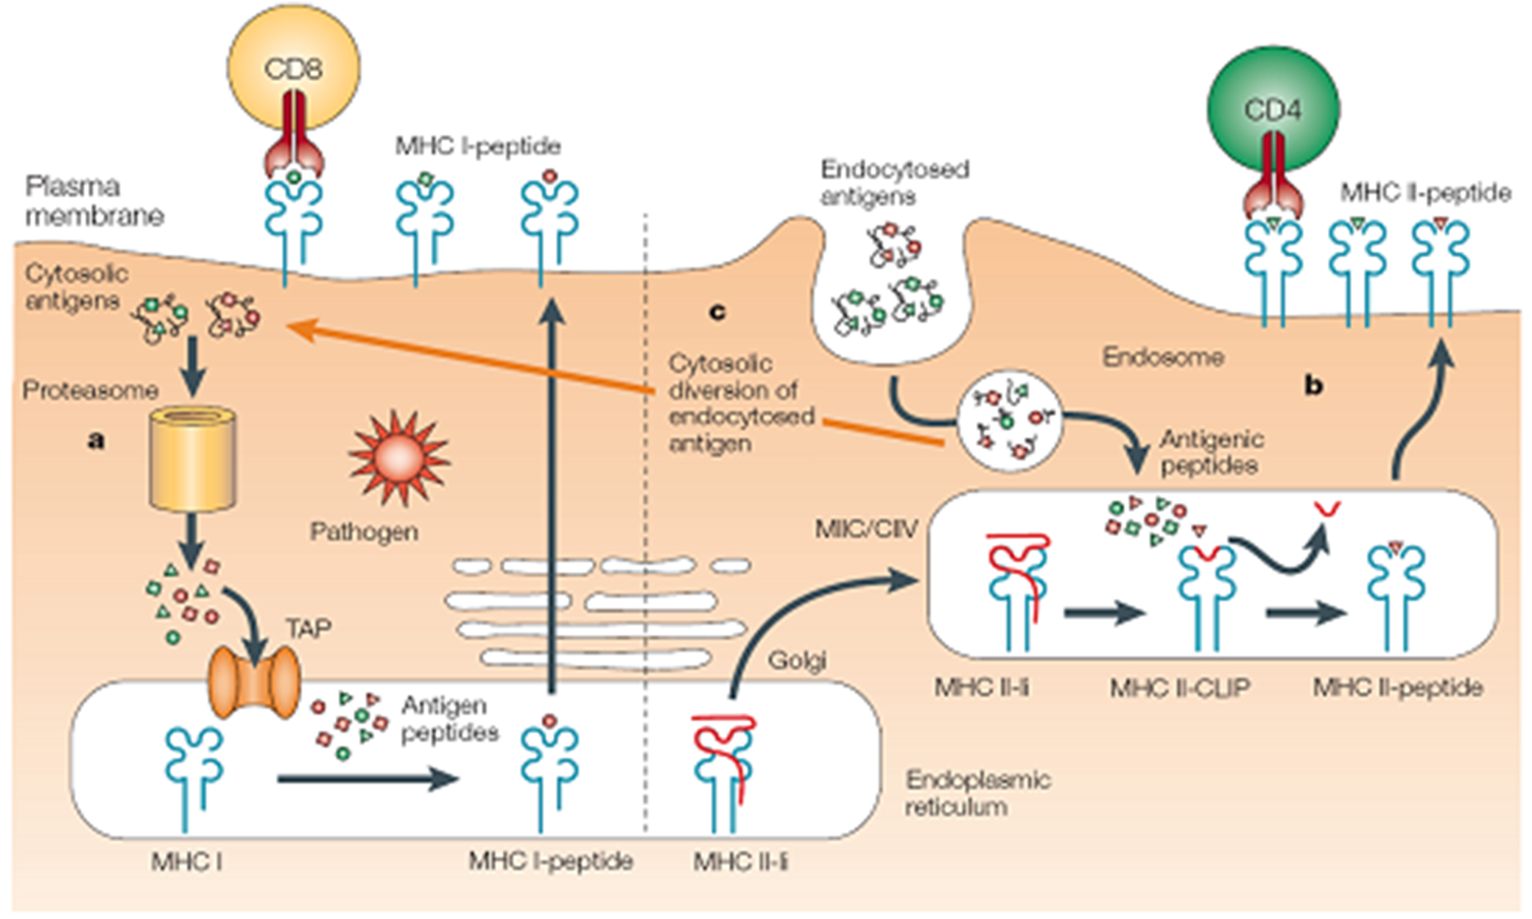
MHC I and MHC II antigen presentation
Sebastian D. Schuck, HU Berlin, Dessertation, March 13, 2009

Slide 10
Advantage of Epitope Vaccine:
More specific immunity
Devoid of side effects in contrast of entire viral proteins vaccines
Ability to deliver high doses of potential immunogen at lower cost
Criteria for best epitope for vaccine development:
World wide conservancy of Epitopes
Stable binding with HLA class I and class II alleles
Smooth passage through TAP for epitopes binding with HLA class I alleles

Slide 11
Work flow
Identification of T cell epitopes and their conservancy study
Tools: . Propred I, Propred, IEDB and MHC pred 2.0
Screening of epitopes forming stable complex with HLA I & HLA II allele.
Molecular modeling of the identified epitopes and HLA I/II allele.
Tools: Pepstr, Swiss Model and Validation by: Errat, ProSA, Pro Q and RAMPAGE
Molecular docking of identified epitopes and HLA I/II allele.
Tools: by Autodock 4.2 and Hex 8.0
Molecular dynamics simulation of identified epitopes and HLA I/II allele.
Tools: NAnoscale Molecular Dynamics (NAMD) and Visual Molecular Dynamics (VMD)
Molecular docking of identified epitopes and human cTAP1.
Tools: by Autodock 4.2 and Hex 8.0

Slide 12
Screening for conserved nanomer peptide.
Molecular modeling
Molecular docking
Molecular dynamic simulation

Slide 13
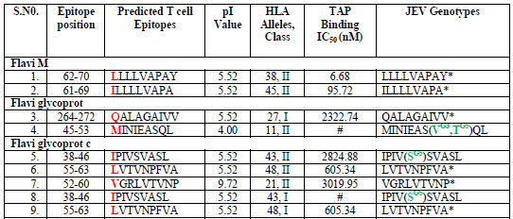

Identification of HLA alleles and TAP binding epitopes and their conservancy study

Slide 14
Identified HLA alleles and TAP binding epitopes of JEV by Propred I, Propred and MHC pred 2.0 respectively.

Slide 15
LVTVNPFVA epitope showed best binding with HLA class I and Class II molecules viz. B5102 and DRB1 0405 HLA alleles.
FRTLFGGMS epitope showed binding with DRB1 0405 HLA II allele.
These two epitopes are also showed HLA binding population coverage

Slide 16
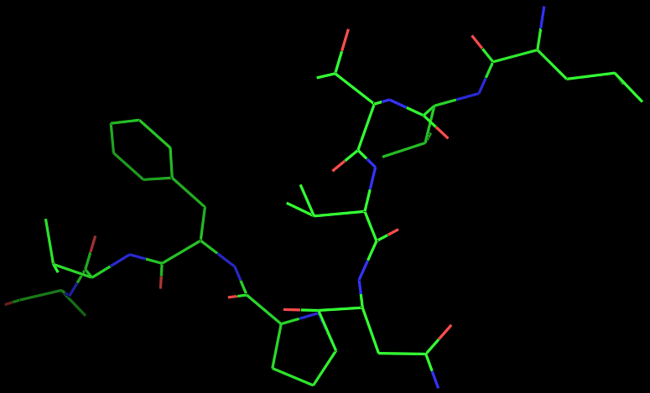
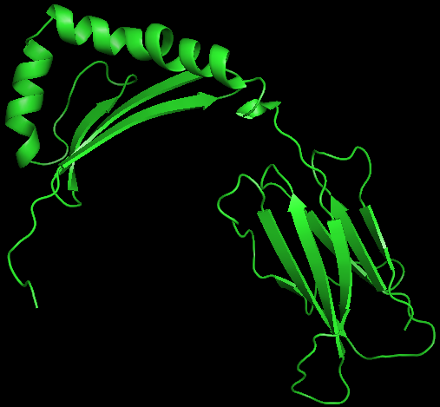
Modeling of identified nanomer peptides
3D conformation prediction of identified conserved LVTVNPFVA epitope nanomer peptide for Japanese Encephalitis. PEPstr, Swiss Model
Epitope LVTVNPFVA Model
HLA Class DRB1 0405 Model

Slide 17
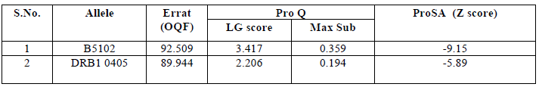
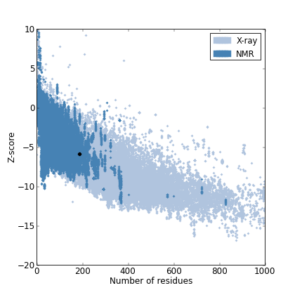
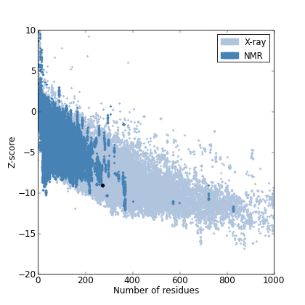
Molecular modeling of the identified epitopes and HLA I/II allele
Calculated Errat, ProQ and Pro SA scores for B5102 and DRB1 0405 HLA alleles
Fig.1: ProSA analysis: (a) Z score plot of DRB1 0405 allele (b) Z score plot of B5102 allele

Slide 18
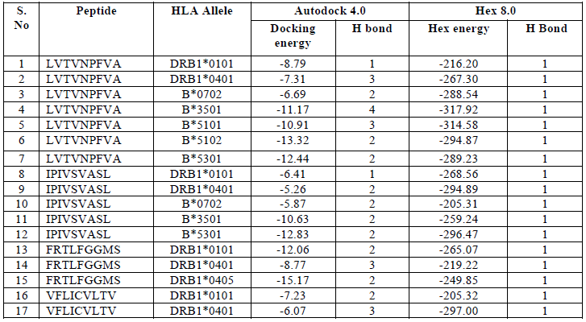
Molecular docking of identified epitopes and HLA I/II allele.

Slide 19
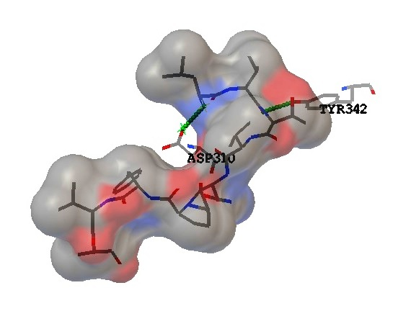
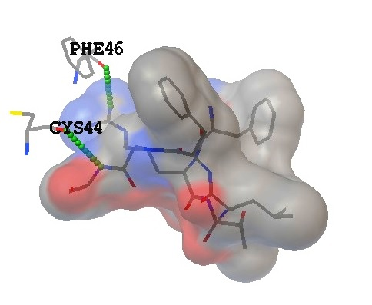
Fig.2: Epitope LVTVNPFVA (sticks) and B*5102 allele (solid spheres) complex obtained by Autodock 4.2, showing two H- bond viz. ASP53:HN1 and SER28:HN1.
Fig.3: Epitope FRTLFGGMS (sticks) and DRB1*0405 allele (solid sphere) complex obtained by Autodock 4.2, showing two H-bond viz. CSY44: HN1 and PHE46: HN1.

Slide 20
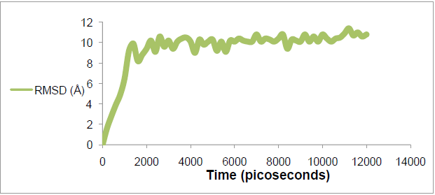
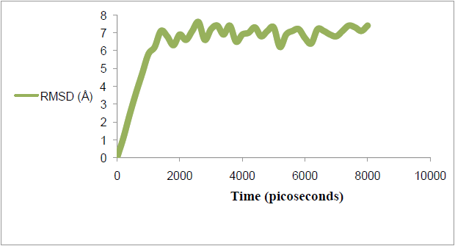
Molecular dynamics simulation of identified epitopes and HLA I/II allele.
A: Graph displaying RMSD in relation to time (picoseconds) for NAMD-VMD simulation of LVTVNPFVA and B 5102 complex, with highest RMSD value of 11.4 Å at 12,000 picoseconds.
B: Graph displaying RMSD in relation to time (picoseconds) for NAMD-VMD simulation of FRTLFGGMS and DRB1 0405 complex, with highest RMSD value of 7.6 Å at 8,000 picoseconds.

Slide 21
Molecular docking of identified epitopes and human cTAP1.
Fig.4: The docking study of identified highly conserved epitope LVTVNPFVA (grey solid spheres) with cTAP1 (white solid spheres) channel cavity facilitating the smooth passage of the epitope from cytoplasm to ER lumen. (a) This docking study shows that the epitope peptide gets hold at the upper part of the cavity by two hydrogen bonds. (b) With very optimal binding energy it is gripped by lower part of the cavity. (c) The Docking study by Autodock 4.2 shows the epitope is forming 2 hydrogen bonds at the upper portion of cTAP1 viz. ARG515: ALA9 and TYR555: THR3, having binding energy of -1.88. If we put these two states of binding in sequence then we may conclude a smooth facilitation for epitope peptide transport from cytoplasm to ER lumen.

Slide 22
Conclusion
The peptides LVTVNPFVA and FRTLFGGMS are completely conserved epitopes with super antigenic property.
Identified epitopes LVTVNPFVA and FRTLFGGMS of envelope protein form stable complex with B5102 and DRB1 0405 HLA alleles respectively.
Also, smooth facilitation of epitopes LVTVNPFVA through cTAP1 shows actual acceptance of the epitope in cytosolic antigen processing for further presentation by HLA class I.
Hence these identified epitopes are most promising as vaccine candidates for JE and can also be useful as diagnostic agents for JE.
Here we look forward to use these results as a platform for further trails for vaccine development against JE.

Slide 23
References
  WHO (2015) Weekly epidemiological record. 90: 69–88.
  Singh A et al. (2015) A Japanese encephalitis vaccine from India induces durable and cross-protective immunity against temporally and spatially wide-ranging global field strains. Journal of Infectious Diseases (2015): jiv023.
  Sharma P, Saxena K, Mishra S, Kumar A (2014) A comprehensive analysis of predicted HLA binding peptides of JE viral proteins specific to north Indian Isolates. Bioinformation 10:334-34.
  Erra EO, Askling HH, Rombo L, Riutta J, Vene S, Yoksan S, Lindquist L, Pakkanen SH, Huhtamo E, Vapalahti O, Kantele A (2012) A single dose of vero cell-derived Japanese encephalitis (JE) vaccine (Ixiaro) effectively boosts immunity in travelers primed with mouse brain-derived JE vaccines. Clin Infect Dis 55:825-34.
  Tang H, Liu XS, Fang YZ, Pan L, Zhang ZW et al (2012) The epitopes of foot and mouth disease. Asian J Anim Vet Adv 7:1261–1265.
  Procko E and Gaudet R (2009) Antigen processing and presentation: TAPping into ABC Transporters. Current Opinion in Immunology 21:84–91.

Slide 24


Slide 25


Slide 26
        Thank you
              (Shokran)

